Slide 1
MICE Spectrometer Solenoid Repair

Slide 2
MICE Spectrometer Solenoids
These magnets have had a long history and I will make NO attempt to review it in any detail here.
Steve and Soren will fill in some of the details
Both magnets met the full specification at the vendor and were fully mapped.
Cryogenic operation was very good. Both magnets had significant cooling headroom (SS2 more than SS1)
SS2 (in upstream position of the beam line – SSU) has reached full operating current at RAL, but full training (soak, solenoid mode) has not been completed.
SS1 (in downstream position – SSD) had a lead failure during training.
What is the optimal path forward?

Slide 3
Reminder: Basic design
5 2-stage CCs
1 single-stage CC
5 Coils
Max current ~300A
High inductance 10-40H
M1
M2
E1
C
E2

Slide 4
Training history

Slide 5
Lead failure
However, upon entering the hall the odor of burnt FR4/G10 was extremely strong. Strongest at He relief valve
After a great deal of analysis, it has now been determined that (see diagram on next slide):
One leg of M1 dead short to ground. This is LTSA lead.
LTSB lead not connected to coil (open), but connected to LTSA with ~ 2.4KOhm resistance.
M2 coil OK.
No damage seen anywhere else.
However, M2 coil has 1.3 KOhm resistance to M1 (& ground)
AC measurements show that QP on M1 not active indicating a break in the internal QP circuit. Most likely point is indicated in the figure on the next slide (x next to diodes) because there is another short to ground on this leg of the circuit.
All other coils OK (including their QP circuit).

Slide 6
M1 circuit after fault
Diagram of the M1 circuit. Resistance (four wire and two wire)
measurements revealed:
i) Lead A has hard short to ground,
ii) LTSB is shorted to LTSA through 2.4 kOhms and LTSB is not connected
to the M1 coil on the Lead B side.

Slide 7
QP data – M1

Slide 8
QP data – M1 Expanded V scale II

Slide 9
Analysis
Quench initiated on ECE and initially proceeded normally
There is no evidence that any LTS leads were involved initially
At ~ 20 sec, the internal QP for coil M1 failed
The voltage on the coil increased rapidly and, it appears that an arc at the LTS power feed through (from vacuum to LHe volume) occurred which burned out the lead and effected M2 (the power leads for M1 and M2 utilize the same 4 pin feed through).
What caused the QP failure?

Slide 10
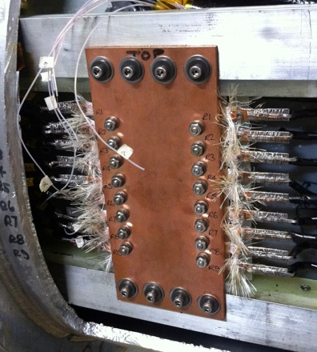
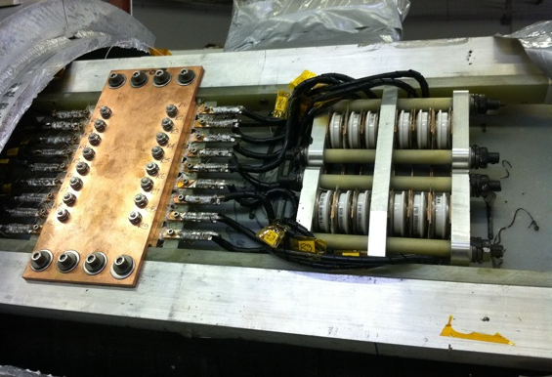
LBNL re-design Picture of final configuration for SS2/SSU
Conductively cooled resistors
Quench protection circuitry

Slide 11
SS1/SSD
This is a photo of the QP pack for SSD/SS1. What is not known at this time is
exactly how the terminations were made. Did Wang follow the procedures used on SSU/SS1?

Slide 12
Normal Quench
These are data from a normal quench
All coils ramping together to their design current
NOTE: In this case, the quench occurred as the currents were ramping down
ECE initiated the quench (QP system detected and sent trigger to open contactors)
M2 followed, then M1
As predicted.

Slide 13
Quench propagation analysis without M2 powered
Case I
Case II
Compared the results with (case I)and without (case II) M2 powered.
Quenches were initiated in E2 in both cases.
The quench current in case I is 265A in all coils.
In case II, the quench currents in ECE and M1 are 260A and 250A, respectively.

Slide 14
Quench delay
Time to Q for M1 increased by ~ 2X
However, overall scale in simulation does not agree with data
There is a qualitative understanding
LHe & gas not modeled exactly
The thermal properties of the mandrel + insulation between coils and the bobbin are not precisely known
The starting location of the quench will affect the heat propagation from the hot spot to the mandrel, this will cause time difference. The model is always set so that the innermost layer initiates the quench.
Given the above, there is qualitative agreement:
The quench delay of M1 increased by ~2X, from 10 seconds to 20+ seconds.

Slide 15
Moving forward
Options to move forward
Disassemble, fix, and rebuild the current SSD.
Build a new cold mass, and insert it into the existing SSD cryostat.
Do no rework on SSD but insert a new (TBD) solenoid coil in the MICE hall, lengthening the overall system from the current plan but meeting the optics needs.
Repair the SSD in place by attempting surgery through the vacuum vessel, shields, MLI, and helium vessel.
Construct a completely new spectrometer solenoid and cryostat.
Best option we feel is to build a new cold mass and cryostat it with the existing SSD vacuum vessel, etc.
Don’t have the funds to do this

Slide 16
MICE Project Board
Recommendations from MICE project Board:
Prepare technical, cost, schedule and risk information to an equivalent level for the Second Spectrometer Solenoid Review (in November or December) such that a preferred path going forward is confirmed.
Develop the preferred option from that review in more detail such that a full project planis available for review in (about) January 2016.
Consider one team for fabrication and test of a new coil assembly at one location (for instance Fermilab), and another team for integration into the cryostat at a second location (for instance Europe).
Action:
Confirm the optics and performance limitations of various options at the Beam Dynamics Review, and keep the collaboration fully informed of these options.

Slide 17
Schedule Review Panel
Recommendations:
The Panel strongly recommends that the DoE offers some formal alleviation to the current hard schedule end-date and 9:6:3 funding profile. While this goes against thegrain for top-level project management, the Panel is convinced that it is now necessary to relax these boundaries/constraints to reduce ongoing risk and maximise the probability of success for the MICE project to achieve its goals and hence maximise return for the funding agencies.
The US Project Director should not undertake a fully resource-loaded schedule for the second Solenoid Review but rather investigate more than one option that provides a ‘good-enough’ solution and subsequently spend time working on the resourceloaded impacts in detail to report to the funding agencies in ~January.
The STFC and DoE need to jointly agree on the future funding for MICE over the next three months – this is the most important recommendation/action from the entire Review.
Actions:
The STFC needs to communicate concerns about potential transferred risks to the US project side prior to the second Solenoid Review
The STFC needs to be made aware of the consequences of the flat-cash funding profile on the schedule of the project (action on the RLSR Chair)

