Slide 1
Far Detector CERN integration meeting

Slide 2
DUNE Engineering Meeting
from Monday, 9 November 2015 at 02:00 to Thursday, 12 November 2015 at 13:00 (US/Eastern)
CERN ( 3179-1-D06 )
385 Route de Meyrin, Point 1 (Atlas site)
https://indico.cern.ch/event/459004/other-view?view=standard
Talks are posted and the web page is public.

Slide 4
CERN Engineering Week Goals
1) Decision on the CPA materials 1/2 day review
2) Decide on placement of Laser alignment and beam window 1/2 day
3) Signal flange interface to the cryostat - Need remote attendance of electronics people.
4) Work on Cathode/rail/cryostat interface
5) Work on APA/rail/cryostat interface
6) Work on cabling and interfaces
7) Work on Field cage/ground plan interfaces to APA and CPA
8) Work on beam window/TPC/Cryostat interfaces
9) Installation planning
TCO Definition.
10) Cryostat loads
11) Plan mockup studies of critical
12) Debug the edms data interface and go over document structure.
13) Plan documents for the review in December
14) Plan the Detector reviews
15) Internal Cryo-Piping
16)Grounding and power
Made substantial progress on most goals

Slide 5
Cathode Material Discussion
Reasons for resistive cathode:
Stored energy in DUNE is sufficient to potentially damage the cryostat membrane
A ground plane could potentially mitigates this.
The voltage swing of the cathode during discharge produces a voltage pulse on the preamps. Simple simulation showed the current in the protection diode is a factor of two less than the diode rating. The resistive cathode reduced this current by orders of magnitude.
Conclusion: Surface resistivity in the 1 to 100 MOhm/square is required.
Planarity within 1 cm.

Slide 6
Investigated materials
Micarta (“bakelite”)
Intrinsic bulk resistivity in the required range (few MOhm/cm)
Density comparable to LAr
G10 vetronite coated with resistive layers:
~ Mohm/square ink print with specific patterns
Glued bulk resistive kapton foil (25 µm, 6-9 MOhm/cm)
Graphite loaded (outer layers) G10

Slide 7
Radiological measurements
sample: NORPLEX, Micarta, NP 315, phenolic laminate with graphite, black
weight: 23.0 g
live time: 328991 s
detector: GePaolo
radionuclide concentrations:
Th-232:
Ra-228: (15.2 +- 0.5) Bq/kg <==> (3.74 +- 0.13) E-6 g/g
Th-228 (15.8 +- 0.5) Bq/kg <==> (3.88 +- 0.13) E-6 g/g
U-238:
Ra-226 (9.1 +- 0.3) Bq/kg <==> (7.4 +- 0.2) E-7 g/g
Pa-234m (6 +- 3) Bq/kg <==> (5 +- 2) E-7 g/g
U-235 < 0.24 Bq/kg <==> < 4.2 E-7 g/g
K-40: (7.6 +- 0.6) Bq/kg <==> (2.5 +- 0.2) E-4 g/g
Cs-137 < 50 mBq/kg
upper limits with k=1.645,
uncertainties are given with k=1 (approx. 68% CL);
Ra-228 from Ac-228;
Th-228 from Pb-212 & Bi-212 & Tl-208;
Ra-226 from Pb-214 & Bi-214;
U-235 from U-235 & Ra-226/Pb-214/Bi-214
sample: Current Inc., C770 ESD (Electro-Static Dissipative material), G10/FR4 (glass/epoxy)
weight: 89.0 g
live time: 830876 s
detector: GePaolo
radionuclide concentrations:
Th-232:
Ra-228: (54 +- 8) mBq/kg <==> (13 +- 2) E-8 g/g
Th-228 (49 +- 6) mBq/kg <==> (12 +- 2) E-8 g/g
U-238:
Ra-226 (47 +- 5) mBq/kg <==> (3.8 +- 0.4) E-9 g/g
Pa-234m < 0.52 Bq/kg <==> < 4.2 E-8 g/g
U-235 < 6.9 mBq/kg <==> < 1.2 E-8 g/g
K-40: (4.9 +- 0.3) Bq/kg <==> (1.6 +- 0.1) E-4 g/g
Cs-137 < 3.7 mBq/kg
upper limits with k=1.645,
uncertainties are given with k=1 (approx. 68% CL);
Ra-228 from Ac-228;
Th-228 from Pb-212 & Bi-212 & Tl-208;
Ra-226 from Pb-214 & Bi-214;
U-235 from U-235 & Ra-226/Pb-214/Bi-214
Measurements taken at Gran Sasso
Micarta is worse than G10 for Uranium/Thorium/Potassium… chains

Slide 8
Material choice for structural frame
G-10 preferred over Micarta for structural elements.
Advantages:
Lower radiological
Denser than LAr (CPA will not float)
Stronger than Micarta
Cheap
Cathode inner frame does not need to be resistive.
Sandwich of thin G10 foils with resistive coating mounted on G10 bar frame:
Total thickness ~1 cm seems feasible.
Coating choice can be defined
Density larger that LAr eases suspension and planarity

Slide 9
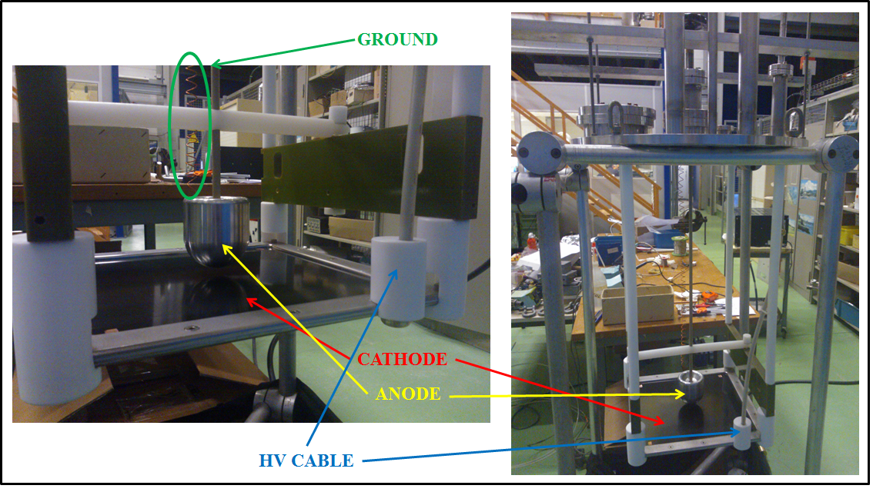
HV Test setup at CERN
Resistive material is kept in position by SS frame. Connection with a small amount of silver paste. Sustaining structure for cathode plate and anode is in plastics (vetronite, teflon, PEEK).

Slide 10
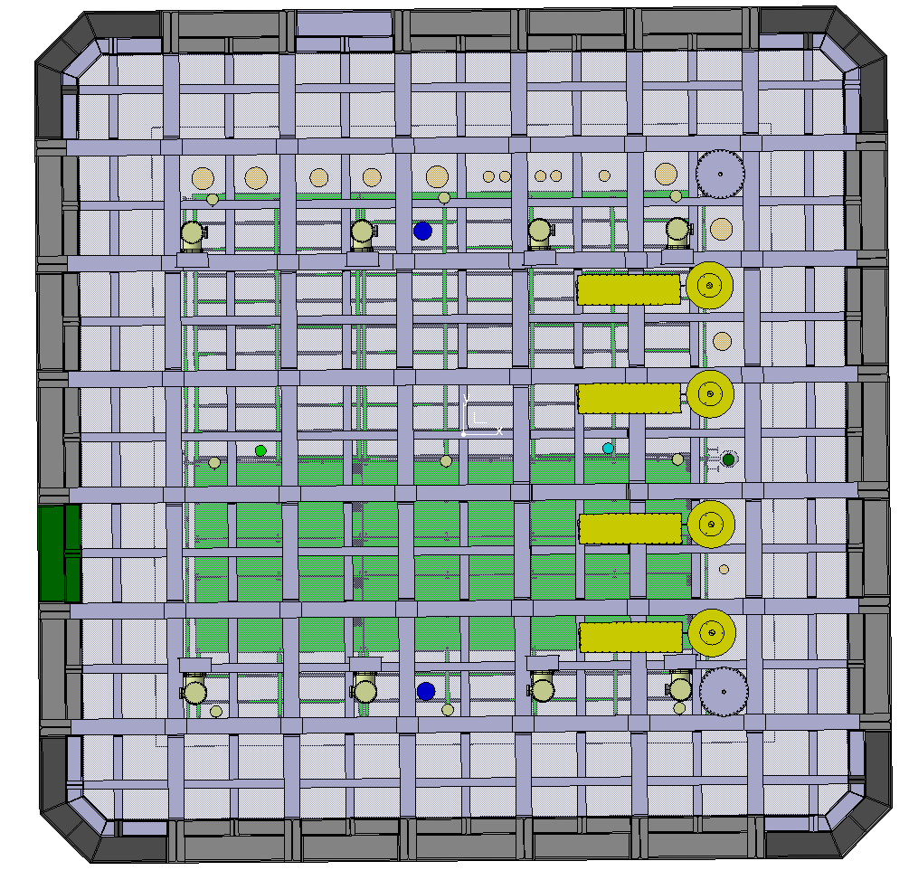
Laser Calibration System
Beam
4 Laser systems
Girders block access on beam end
Placed Laser Calibration using SBND 3D model with modifications from Igor.
Located the cryostat penetrations required.

Slide 11
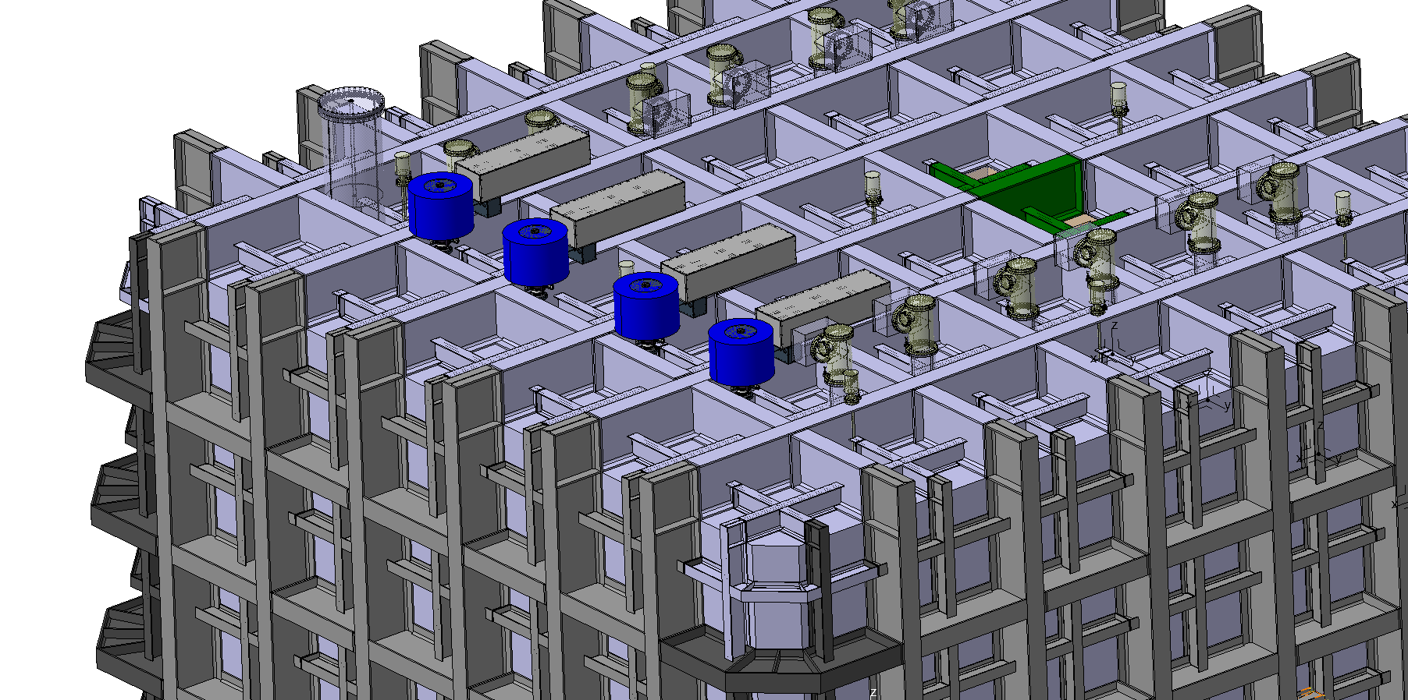
Isometric View
100 mm

Slide 12
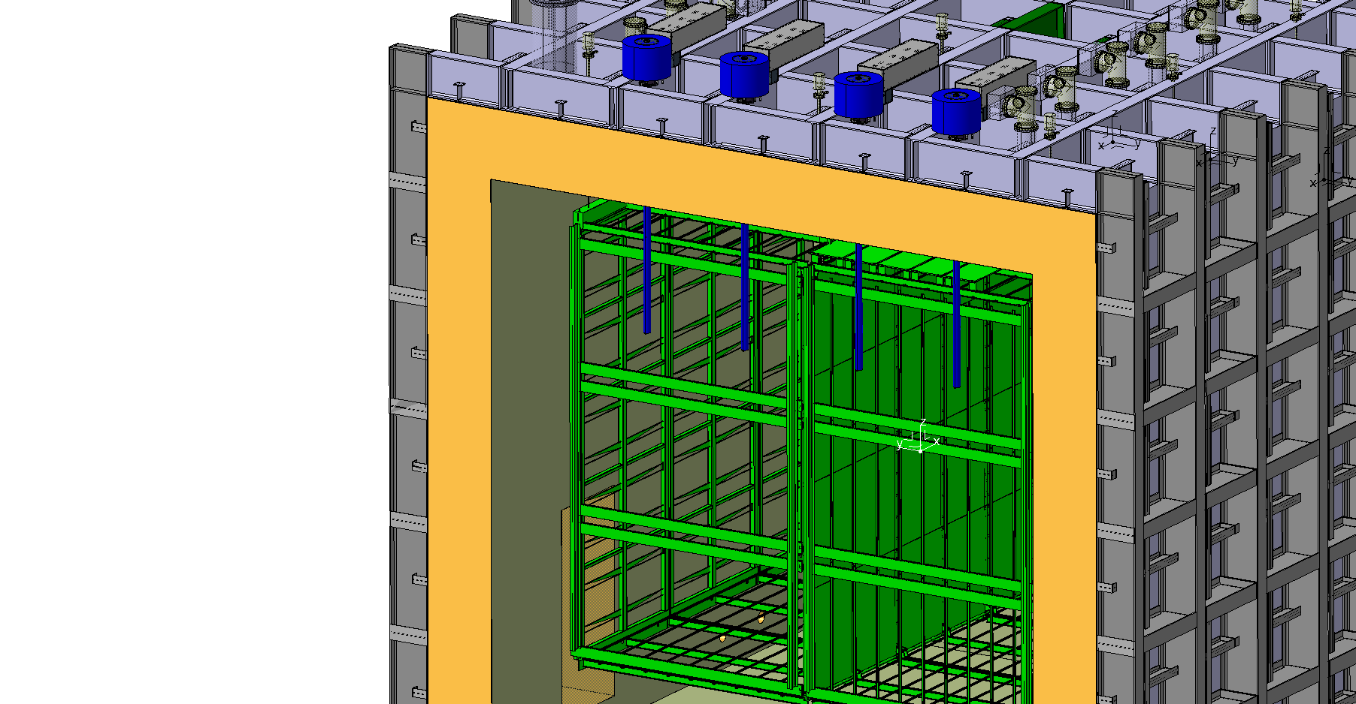
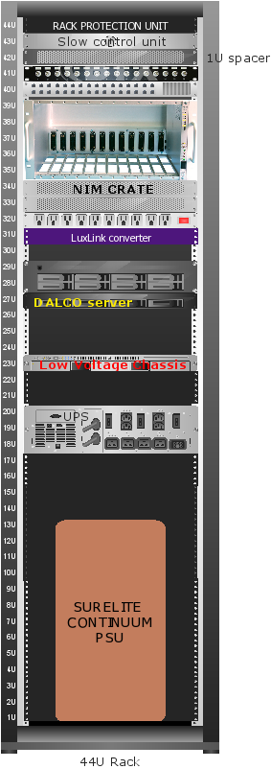
Cut View
LASER Rack

Slide 13
Penetration summary
Penetrations detector:
West TPC translation suspension: N. 3, crossing tube diameter 200 mm
Center TPC translation suspension: N. 3, crossing tube diameter 150 mm
East TPC translation suspension: N. 3, crossing tube diameter 150 mm
Signal cable chimney FTs: N. 8, crossing tube diameter 250 mm
Spare on Signal cable row FTs: N. 2, crossing tube diameter 250 mm
Laser FTs: N. 4, crossing tube diameter 100 mm
Calibration Fiber CPA FT: N. 1, crossing tube diameter 150 mm
Spare on CPA line FTs: N. 2?, crossing tube diameter 150 mm
HV FT: N. 1, crossing tube diameter 156 mm
Manhole: N. 2, crossing tube diameter 609 mm
Angled beam windows – west side N. 3, crossing tube diameter 300 mm
2 Spare over beam window NEED TO CHECK!

Slide 14
TCO
TPC mounting beams
Penetrations:
West TPC translation suspension: N. 3, crossing tube diameter 200 mm
Center TPC translation suspension: N. 3, crossing tube diameter 150 mm
East TPC translation suspension: N. 3, crossing tube diameter 150 mm

Slide 15
Spare Penetrations:
Two along the cathode plane (fibers plus?)
One on each APA feedthru row
Two over the beam windows (not shown)
2 manholes
If needed then one could try to integrate other functionality into the feedthru flanges perhaps using a cross rather than a tee to increase spares effectively

Slide 16
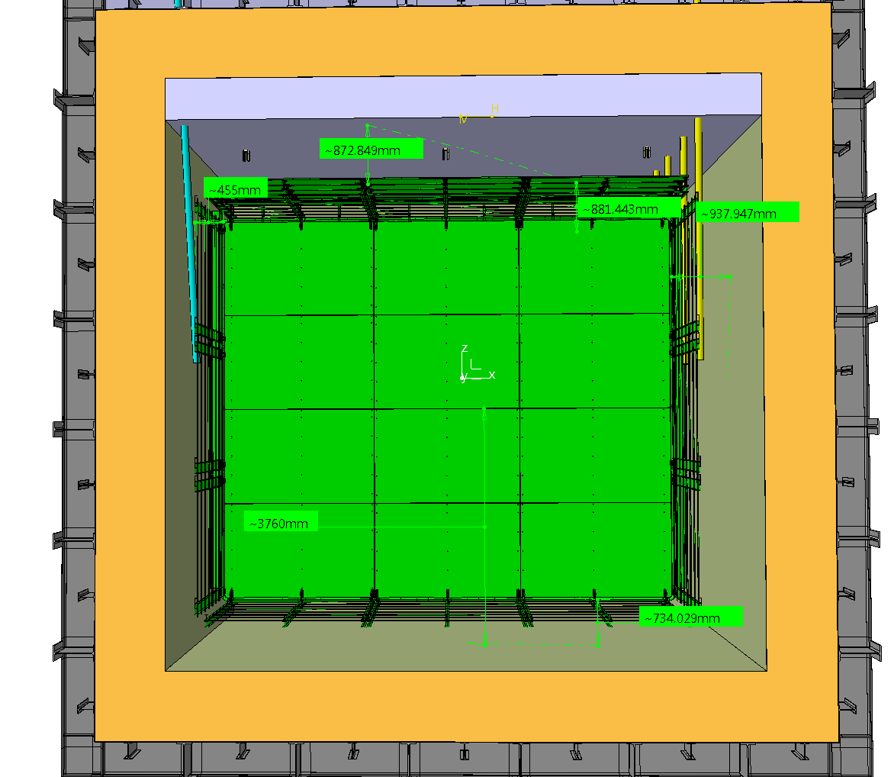
Detector position
The detector was positioned in the cryostat according to the far detector parameters.
The cryostat was shortened by 600mm.
Moves the detector away from muon background
Reduced the needed LAr
Reduces stress in the iron increasing safety factor
Agreed with WA105
Cross rails are foreseen which will allow changing from 3.6 m to 2.5 m if needed.

Slide 17
TPC support structure
“Central and East transverse rail
Installation rail fixed after positioning
Installation rail

Slide 18
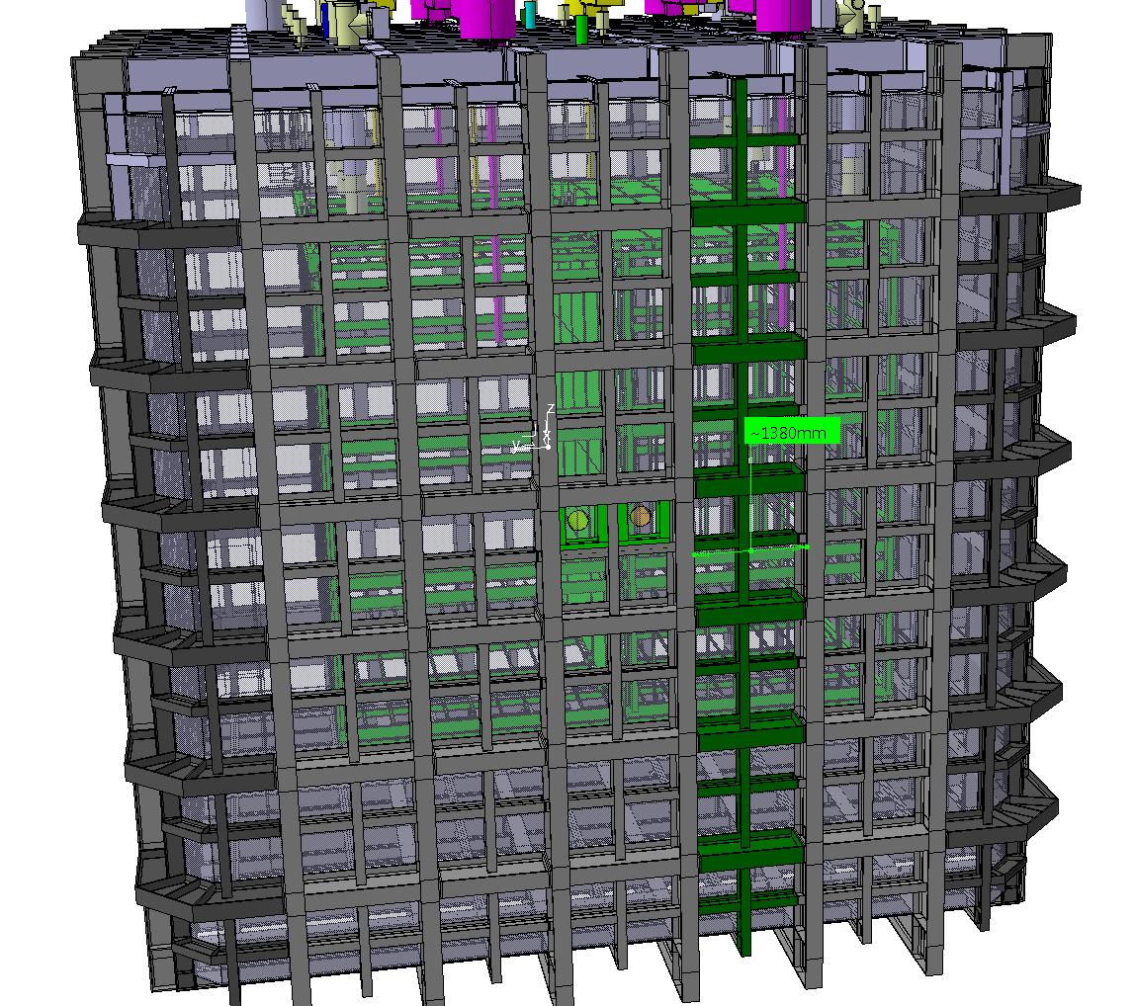
Afternoon session found no show stoppers to installing through a TCO
Temporary Construction Opening

Slide 20
Update from CERN
EHN1 extension making good progress. Expect completion in August 2016.
Outfitting and beam planning are well advanced
CERN hiring experiments interface to the facilities (January)
Some desire within CERN management to merge ProtoDUNE and WA105 under DUNE
Initial planning for a meeting at CERN for European contribution to ProtoDUNE/DUNE in ~Feb.
Schedule development for ProtoDUNE ongoing (2nd ProtoDUNE run?)
Cryostat Review Dec 17-18
detector design reviews in spring-summer
Need plan for ProtoDUNE presence at CERN (offices near EHN1)

Slide 21
Summary
The TPC placement in the cryostat was fixed.
Cathode plane materials were identified.
The proposed cryostat penetrations were defined.
Use of a TCO for installation was confirmed
Potential placement of a laser system was found.
Identified areas for further work on the beam window.
Placement still needs fixed
A great deal of progress was made.
Next meeting ~Feb-Mar 2016

