Slide 1
Mu2e Project & Delivery Ring RF Overview
Steve Werkema – Mu2e Accelerator Systems L2 Manager
Delivery Ring RF Review
November 19, 2015

Slide 2
Outline
The Mu2e Experiment
The Muon Campus
The Mu2e Project Accelerator Systems
Mu2e Longitudinal Phase Space
  Recycler RF Manipulations
  Delivery Ring RF
Construction Progress
Schedule Overview

Slide 3
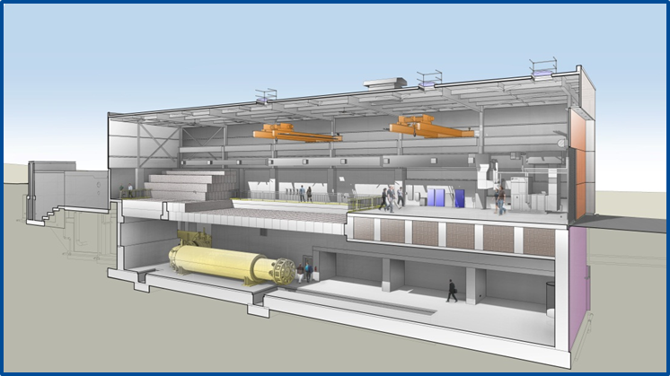
1. The Mu2e Experiment

Slide 4
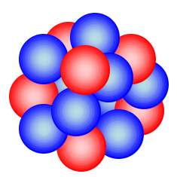


Charged Lepton Flavor Violation
Al
The Mu2e experiment will attempt to detect Charged Lepton Flavor Violation (CLFV)
CLFV is a process involving charged leptons (e±, μ±, τ±) that violates the conservation of the number of leptons of each flavor
e⁻
105 MeV
μ ⁻
μ ⁻ N → e⁻ N
L_{μ}: 1 0 ΔL_{μ} = -1
L_{e}: 0 1 ΔL_{e} = 1
Both L_{μ} and L_{e} are not conserved in this process
Ordinary muon decay is not CLFV
L_{μ}: 1 0 0 1
L_{e}: 0 1 -1 0
If this is observed, it is evidence physics beyond the Standard Model
Notes:
Muon stopping target is Aluminum.
Mu2e is looking for a neutrinoless final state.

Slide 5
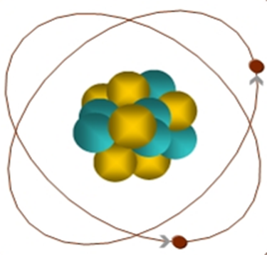
Experimental Signature of μ ⁻ N → e N
When captured by a nucleus, a muon will have an enhanced probability of exchanging a virtual particle with the nucleus.
This reaction recoils against the entire nucleus, producing a mono-energetic electron carrying most of the muon rest energy
μ
~105 MeV e⁻

Slide 6
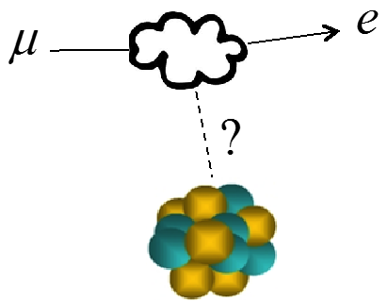
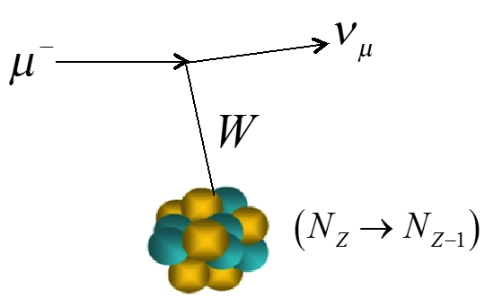
What We (Plan to) Measure
We will measure the rate of
μ to e conversion…
…relative to that of ordinary μ capture
This is quantified in the ratio R_{μe} – which is defined as:
N_{Z}
Rate of CLFV μ → e conversion
μ capture rate

Slide 7
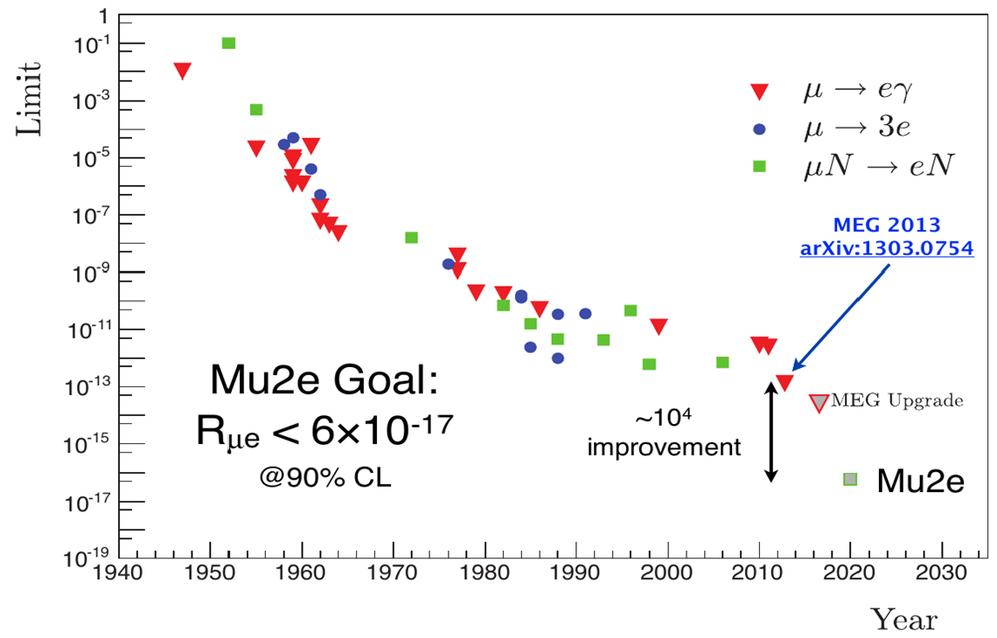
Results of Previous CLFV Searches
90% CL Limit
Mu2e goal for 10¹⁸ stopped muons:
Single event sensitivity = 2.87×10⁻¹⁷ (i.e. one observed event yields R_{μe} = 2.87×10⁻¹⁷)
90% CL R_{μe} Limit < 6.0×10⁻¹⁷

Slide 8
Mu2e Apparatus
The Mu2e apparatus consists of three superconducting solenoids joined together to make a continuous whole
Production Solenoid
Contains proton target
Magnetic mirror – reflects secondaries back toward transport solenoid
Transport Solenoid
Collimation
Momentum and charge selection
Transport to stopping target
Detector Solenoid
Contains stopping target
Tracker (straws)
Calorimeter (BaF₂ crystals)
Proton Beam
Calorimeter
Tracker
105 MeV e ⁻
2.5 T
1 T
4.6 T
1 T
2 T
Al Stopping Target
~ 0.0019 stopped μ⁻/POT
10¹⁰ Hz of stopped muons

Slide 9
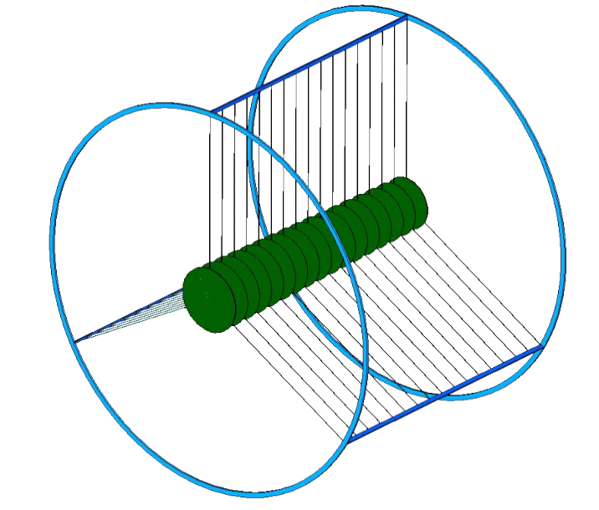
Stopping Muons
Aluminum
Nucleus
μ ⁻
Captured μ ⁻
M_{μ} = 105 MeV/c²
Mu2e muon stopping target
17 Al foil disks (200 μm thick)
Disk radii decrease from 83 mm to 65 mm in downstream direction
A muon that is stopped in the Mu2e target is captured into an atomic orbital state of an aluminum nucleus
The muon quickly (≲ psec) transitions to the 1S state where its wave-function overlaps the nucleus *
*A stopping target monitor measures detects the photons emitted during these atomic transitions – measuring the denominator of R_{μe}
Notes:
The muon stopping target is designed to simultaneously optimize the muon stopping rate will minimizing the amount of material through which a conversion electron must pass.

Slide 10
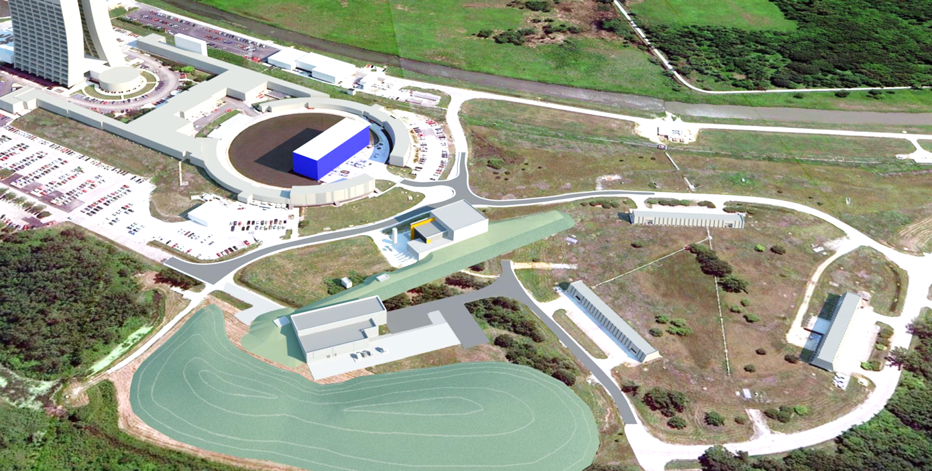
2. The Muon Campus

Slide 11
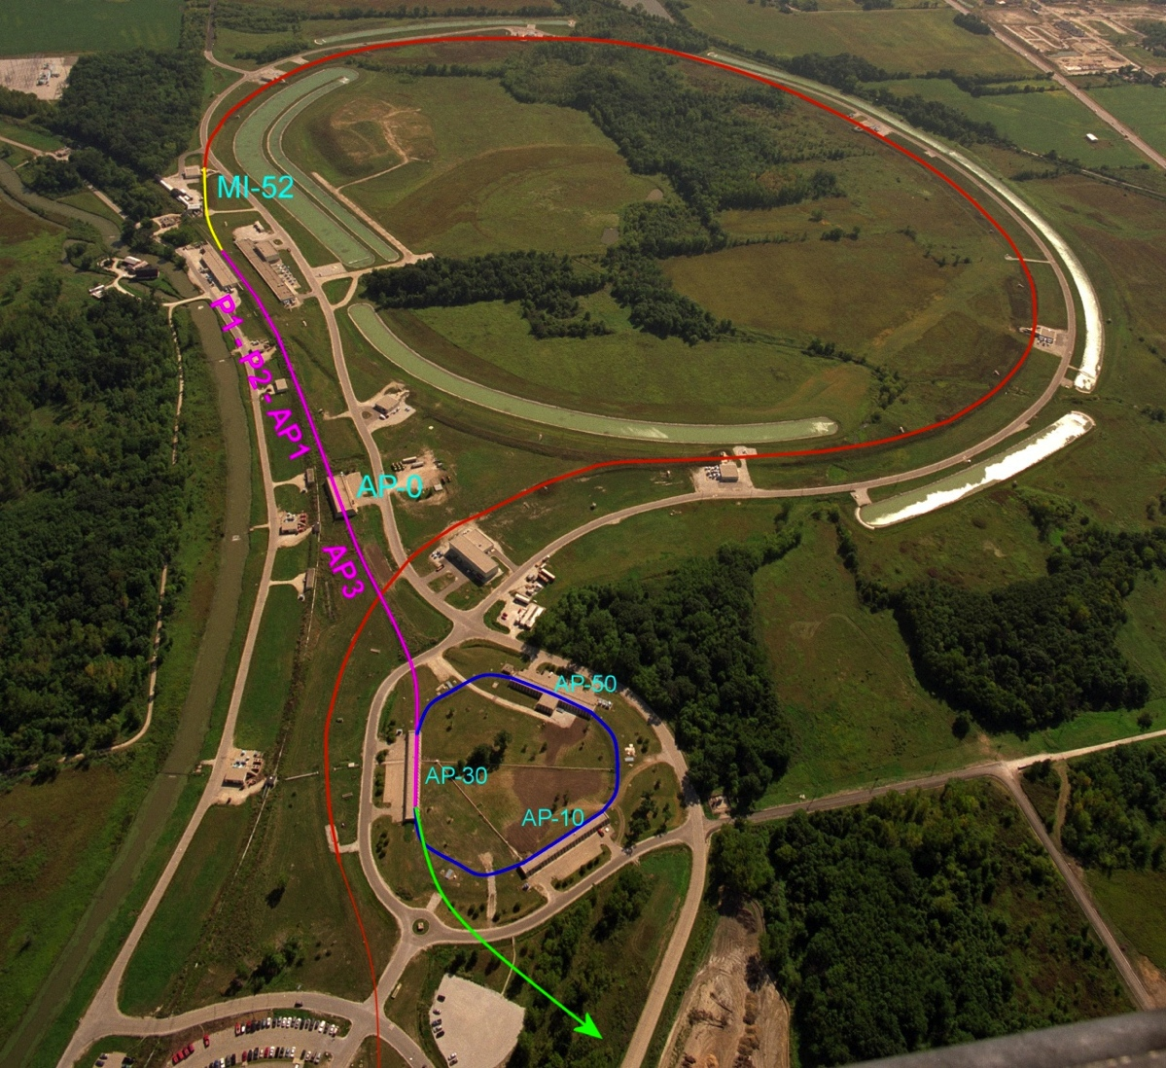
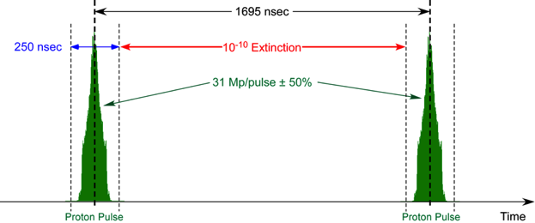
Mu2e Proton Delivery
Two Booster “batches” are injected into the Recycler (8 GeV storage ring). Each batch is:
  4×10¹² protons
  Batch Length = 1.7 μsec
These are re-bunched into 8 bunches of 10¹² protons each
The bunches are extracted one at a time to the Delivery Ring
  DR Period = 1.7 μsec
As the bunch circulates, it is resonantly extracted to produce the desired beam structure.
  Pulses of ~4×10⁷ protons each
  Separated by 1.7 μsec
Recycler Ring
Delivery Ring
Mu2e
Booster
Exactly what we need
Notes:
Animation courtesy of Eric Prebys

Slide 12
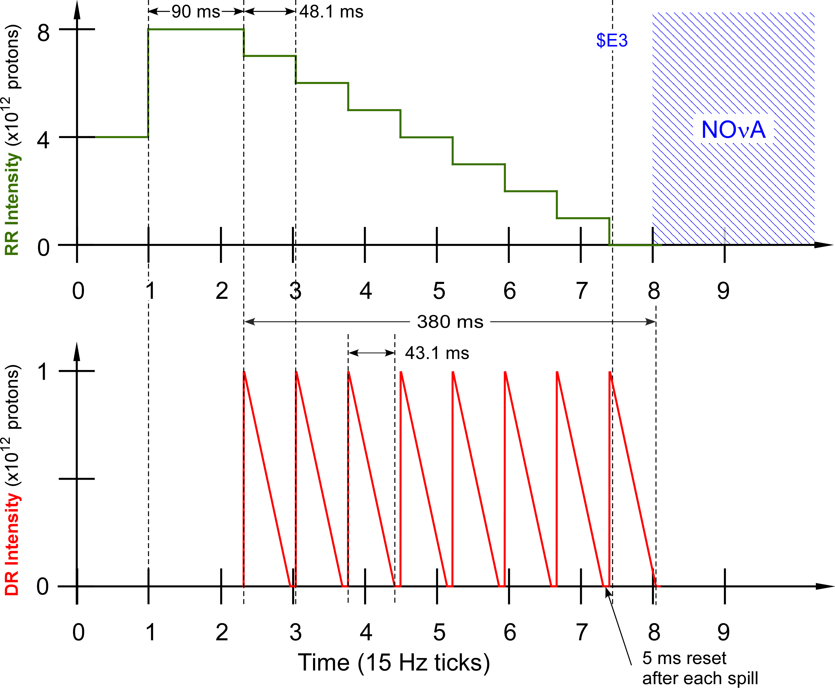
Accelerator Timeline for Mu2e Proton Beam Delivery
Macro Time Structure of the Beam
Spill duration: 43.1 ms
Interval between spills 48.1 ms
Beam on for 380 ms
Beam off for 953 ms
Duty Factor: 28%
(Total Spill Time/Length of Cycle)
Peak Delivery Ring proton intensity: 1.0 ×10¹²
Recycler Ring
Delivery Ring
Notes:
The muons for the Mu2e experiment come from the interaction of a primary proton beam with a tungsten target in the Mu2e experimental hall. The protons that meet the requirements of the experiment are derived thusly:
Two Booster proton batches (4 Tp/batch) of 8 GeV KE are transported to the Recycler Ring via the MI-8 Line. Booster batches are injected into the Recycler at a rate of 15 Hz. Thus, the basic unit of time in the Accelerator Timeline is one 15 Hz cycle = 67 msec ≡1 tick
The protons are rebunched in the Recycler with a 2.5 MHz RF system into 8 narrow 1 Tp bunches that occupy 2/7th of the Recycler circumference.
These bunches are extracted, one-at-a-time, from the Recycler and transported to the Delivery Ring.
The single bunch circulating in the Delivery Ring is resonantly extracted over approximately 43 msec to the Mu2e proton target forming a train of proton pulses spaced in time by 1.695 μs (Delivery Ring T_{rev}).
These proton pulses are transported to the proton target via the M4 Beamline.
During transport from the Delivery Ring to the target the beam pulse passes through an extinction section containing a fast ac dipole magnet that removes the unwanted beam between pulses.
This process is repeated every 1.333 sec MI ramp cycle in the part of the cycle during which NOvA beam is being accelerated in the Main Injector.

Slide 13
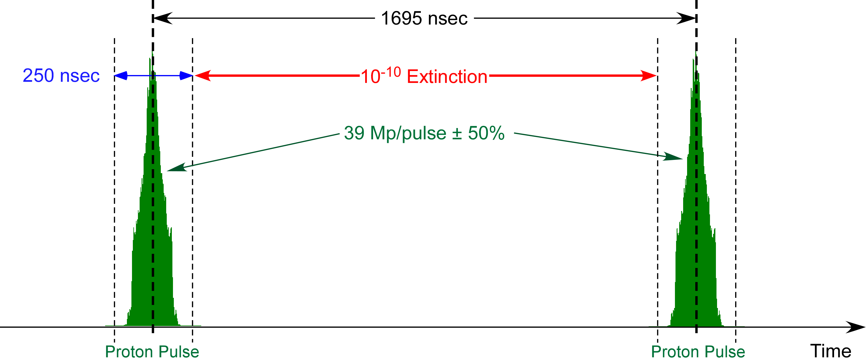
Beam Micro-structure
The proton beam on target consists of a train of ~25,000 narrow pulses separated by 1.695 μsec
Extinction = No. of out-of-time protons / No. of in-time protons
Inter-pulse extinction provides time for prompt backgrounds to decay before the Mu2e detectors go live for events from the current pulse

Slide 14
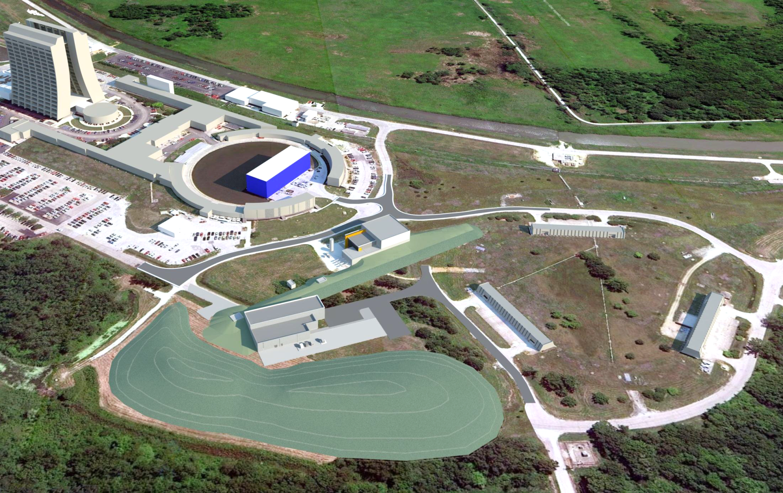
The Muon Campus
+ ^{a new Recycler RF system}
+ ^{Recycler to P1 transfer}
+ ^{Beamline upgrades}
+ ^{Cryo support}
g-2 (MC-1)
M4 Beamline
Picked over remnants of the Antiproton Source
Mu2e
The Muon Campus Program consists of a total of 9 projects
Notes:
Note: the Mu2e and g-2 experiments will not be able to run at the same time.

Slide 15
DOE Projects, AIPs, GPPs
Building the Muon Campus requires the following projects:
DOE Projects
  Muon g-2
  Mu2e
AIPs (Accelerator Improvement Projects)
  Recycler RF
  Beam Transport
  MC Cryo Plant
  Delivery Ring
GPPs (General Plant Projects)
  MC-1 Building
  Beamline Enclosure
  MC Infrastructure Upgrade
Notes:
DOE Projects = Projects for which DOE Order 413.3b applies

Slide 16
Muon Campus Upgrades Required for the Mu2e Experiment but not on the Mu2e Project
Accelerator Upgrade | Project
MI-8 beamline to Recycler Ring Injection | NOvA Project
Recycler Ring 2.5 MHz RF system | Recycler RF AIP
Delivery Ring 2.4 MHz RF Cavities and HL Amps & Cooling | Recycler RF AIP
Single bunch extraction from Recycler Ring | Beam Transport AIP
Beamline aperture upgrades | Beam Transport AIP
AP1, AP2, AP3 to M1, M2, M3 conversion & upgrade | Beam Transport AIP
Beam transport instrumentation & infrastructure | Beam Transport AIP
Beam transport controls | Delivery Ring AIP
Delivery Ring Injection | Delivery Ring AIP
Delivery Ring Abort | Delivery Ring AIP
Delivery Ring infrastructure | Delivery Ring AIP
Delivery Ring Controls and Instrumentation | Delivery Ring AIP
D30 straight section reconfiguration | g-2 Project
Delivery Ring Extraction (except ESS) | g-2 Project
Extraction line (M4) to M5 split | g-2 Project
M4 beamline enclosure | MC Beamline Enclosure GPP

Slide 17
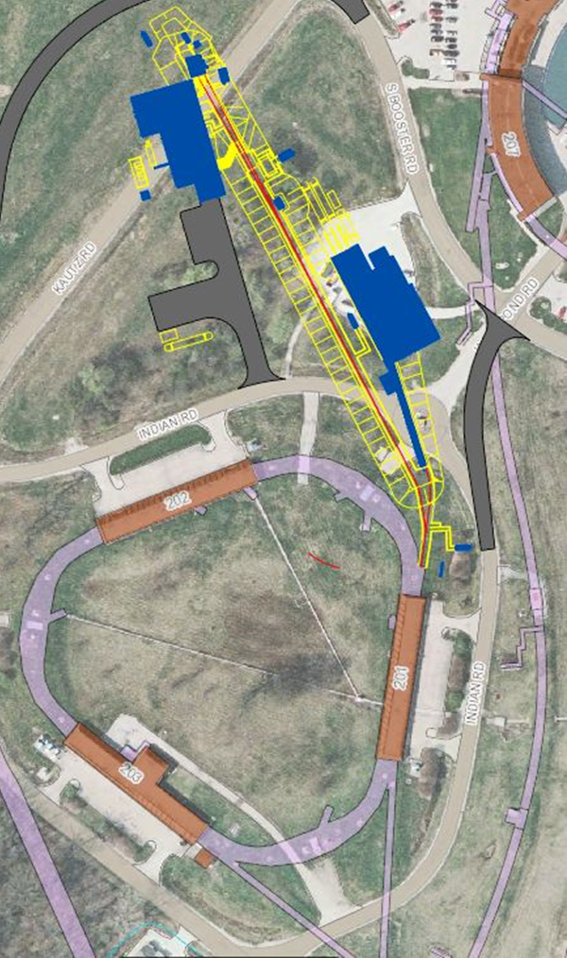
3. The Mu2e Project Accelerator Systems

Slide 18

Mu2e Accelerator Systems Scope Overview
×
475.02.08.03 Extinction Monitor
475.02.09 Target Station
Mu2e
Bldg
475.02.07 External (M4) Beamline
MC-1
Bldg
475.02.08.02 Extinction
475.02.03 Instrumentation & Controls
475.02.04 Radiation Safety
Everywhere
Delivery Ring
475.02.05 Resonant Extraction
475.02.06 Delivery Ring RF
Notes:
Note: Kautz Road will not be routed around the Mu2e building – hence the big red X.

Slide 19
Mu2e Proton Beam Requirements
Parameter | Design Value | Requirement | Unit
Total protons on target | 3.6×10²⁰ | 3.6×10²⁰ | protons
Time between beam pulses | 1695 | > 864 | nsec
Maximum variation in pulse separation | < 1 | 10 | nsec
Spill duration | 43 | > 20 | msec
Beamline Transmission Window | 230 | 250 | nsec
Transmission Window Jitter (rms) | 5 | <10 | nsec
Out-of-time extinction factor | 10⁻¹⁰ | ≤ 10⁻¹⁰
Average proton intensity per pulse | 3.9×10⁷ | < 5.0×10⁷ | protons/ pulse
Maximum Pulse to Pulse intensity variation | 50 | 50 | %
Target rms spot size | 1 | 0.5 – 1.5 | mm
Target rms beam divergence | 0.5 | < 4.0 | mrad
3-4 year run
Time Structure
Intensity
Beam
Size
Notes:
The time structure requirements are generally for the reduction of prompt backgrounds in the Mu2e detector.
The intensity requirements optimize Mu2e detector performance.
The beam size requirements optimize muon yield and preclude excessive energy density in the proton target.

Slide 20
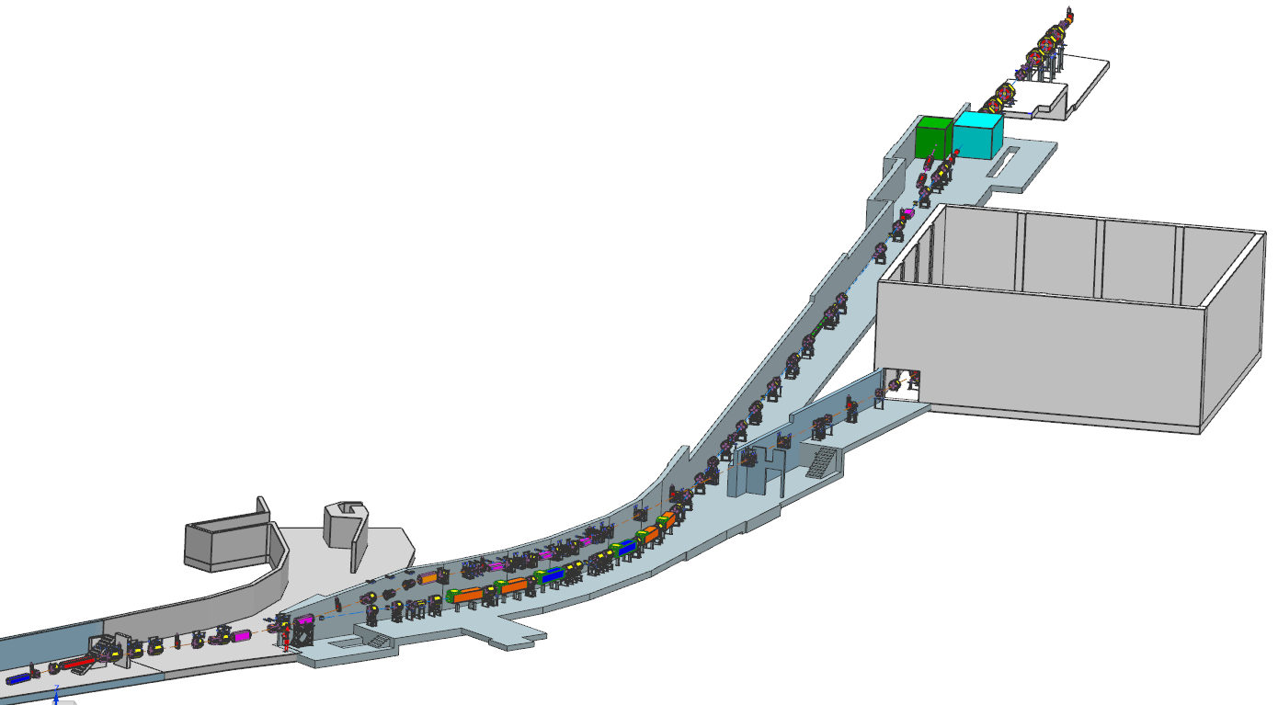
External (M4) Beamline Layout
Mu2e
g-2 project responsible for M4/M5 combined beamline section
Mu2e Project responsible for beamline downstream of V907
Diagnostic Absorber
Final Focus
Temp Shielding
Extinction Dipole Modules
MC-1
g-2
V907
Delivery Ring
M5 Beamline
M4/M5 Combined Beamline

Slide 21
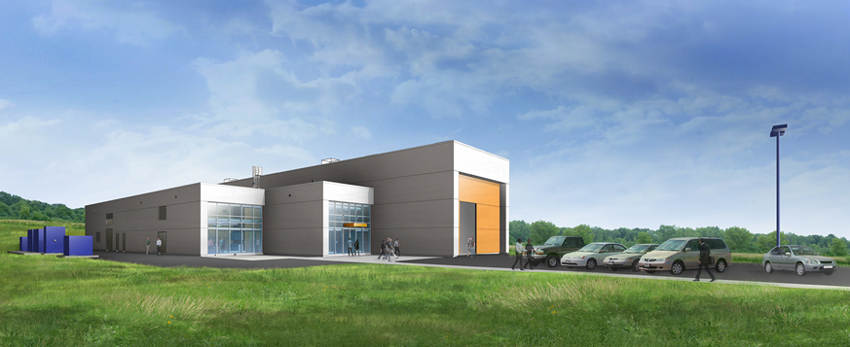
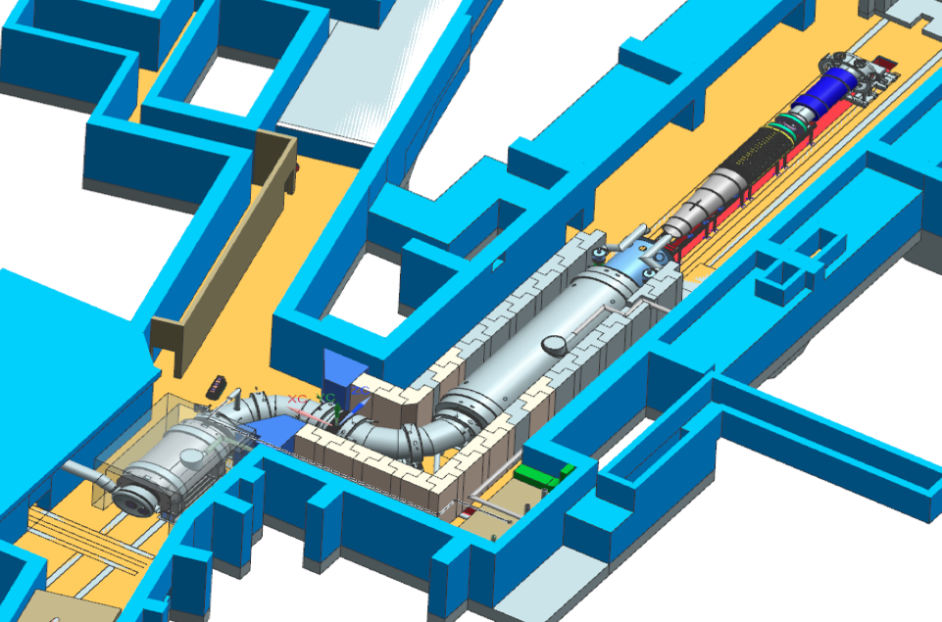
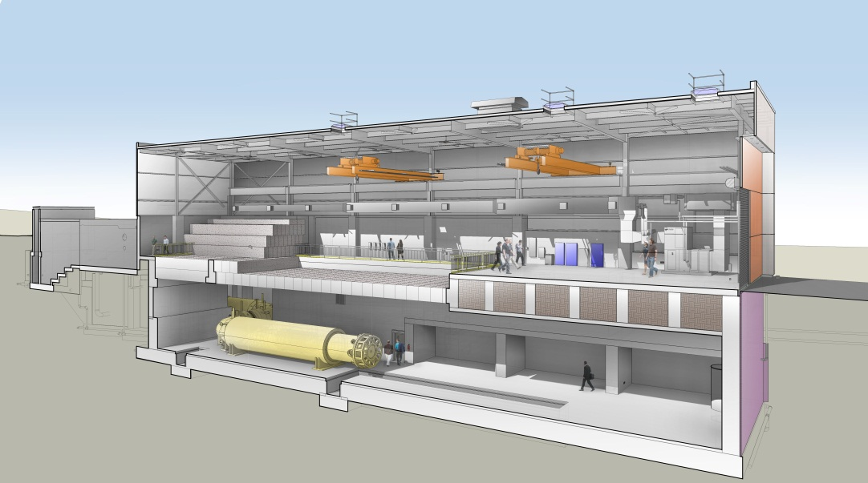
The Mu2e Building
Proton Target
lives here
M4 Beamline

Slide 22
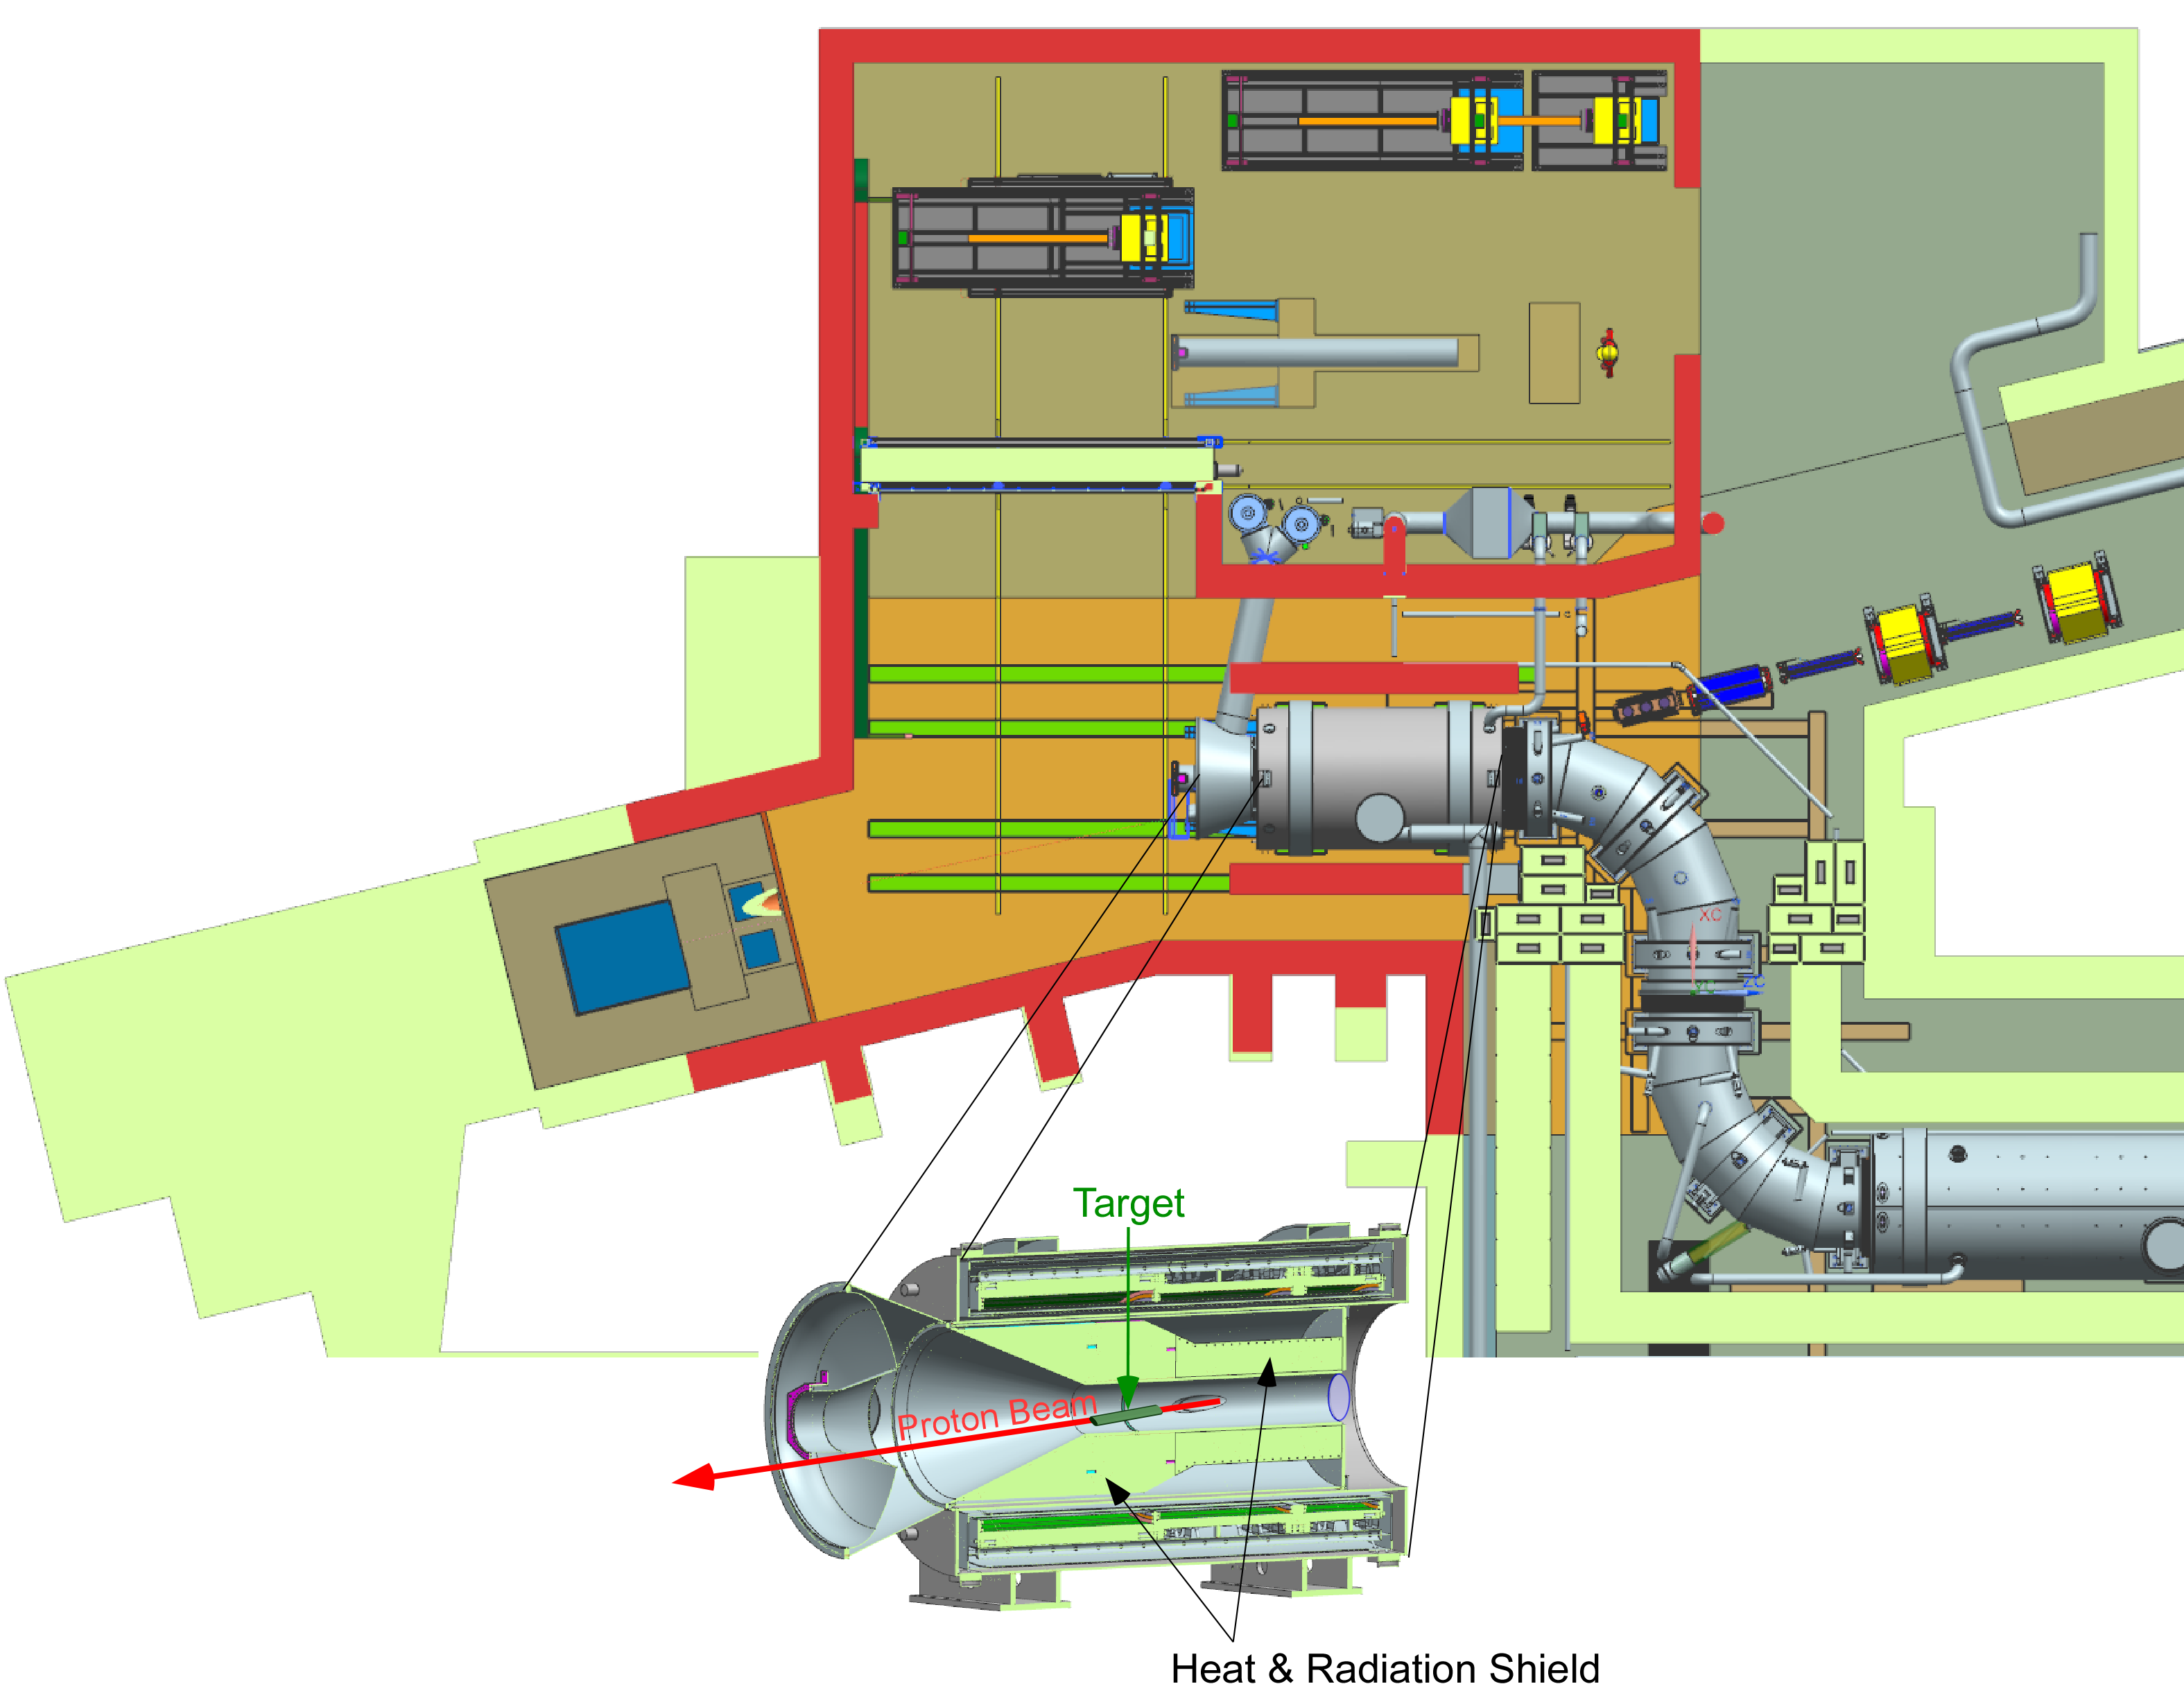
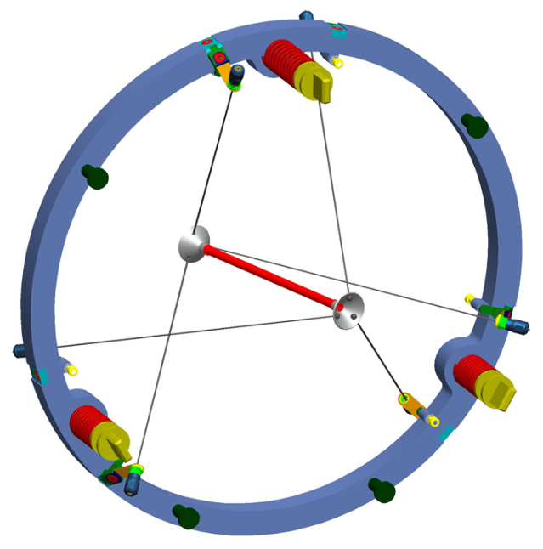
Mu2e Proton Target Station
Target Station Components:
Target – located inside the Production Solenoid (PS)
Heat & Radiation Shield (HRS)
Target Handling
Proton Absorber
Protection Collimator
Remote Handling Room
M4 Beamline
PS
Protection
Collimator
Proton Absorber
Target

Slide 23
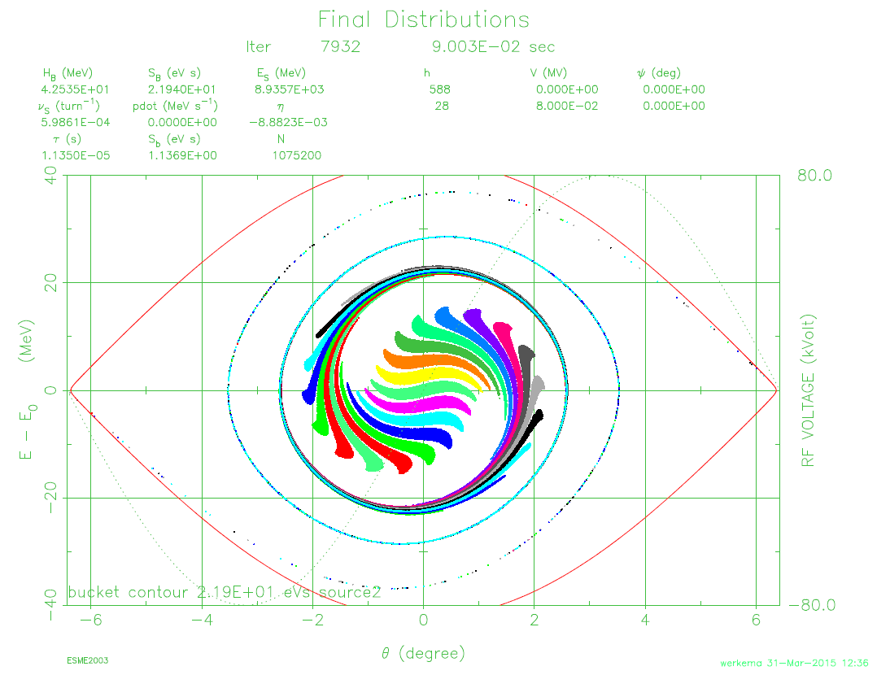
4. Mu2e Longitudinal Phase Space
Recycler RF Manipulations
Delivery Ring RF
Notes:
NOTE: This chart is just a pretty picture – it’s not intended by be read.

Slide 24
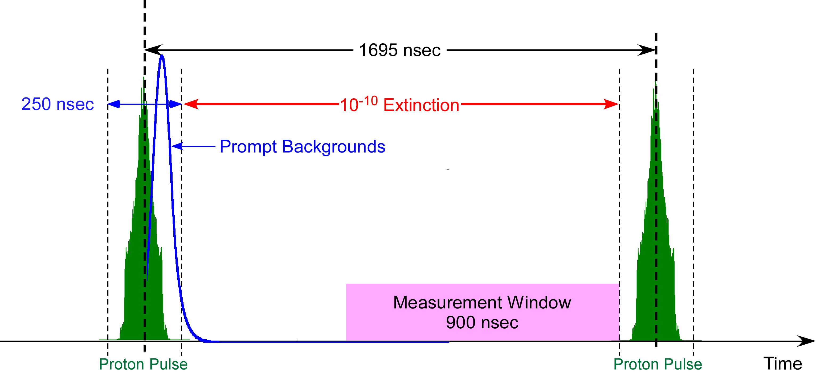
Proton Beam Requirements (Revisited)
The 2.5 MHz RF manipulations in the Recycler and Delivery Ring achieve two goals:
FW bunch length ≤ 250 ns
Extinction of beam extracted from DR < 10⁻⁴
(beamline extinction insert provides additional factor of 10⁻⁷)
The bunch length requirement is primarily accomplished by the Recycler 2.5 MHz RF system.
The function of the Delivery Ring 2.4 MHz RF system is to preserve the narrow bunch width received from the Recycler.
The g-2 experiment uses the same Recycler 2.5 MHz system for their bunch formation.
Since the g-2 requirements are more severe than those of Mu2e, the system will meet the needs of Mu2e.
FW Bunch Length Requirements
Mu2e | g-2
250 nsec | 149 nsec

Slide 25
Recycler and Delivery Ring RF Parameters
Parameter | Value | Units
Recycler Ring 2.5 MHz Bunch Formation RF System
Harmonic Number | 28
Frequency | 2.515 | MHz
Peak Total Voltage | 80 | kV
Number of Cavities | 6
Duty Factor | 33 | %
Bunch Formation time | 90 | msec
Delivery Ring 2.4 MHz RF System
Harmonic Number | 4
Frequency | 2.360 | MHz
Peak Total Voltage | 10 | kV
Number of Cavities | 1
Duty Factor | 27 | %
Both Systems
R/Q | 400 | Ω
Q | 125
Beam loading Comp. feedback gain | 4
Note: the 2.5 MHz Cavities for the Recycler and Delivery Ring are identical

Slide 26
Two Stage ESME Model
Recycler Ring Model
  10,752,000 protons generated in twenty one (21) 53 MHz buckets. This is done in ten separate runs of 1,752,000 proton each.
  Initial longitudinal emittance of each bunch is 0.10 eV-sec
  Tracked using ESME through Recycler RF manipulations until time of extraction
  Final phase coordinate of each proton is converted to Delivery Ring phase
  Resulting energy and phase of each proton written to disk for use as input to the Delivery Ring Model
Delivery Ring Model
  Input = Energy/phase output from Recycler model
  Cavity impedance and space charge effects simulated
  Beam loading compensation simulated by reducing cavity shunt impedance and Q by the beam loading compensation feedback gain (4) and applying an accelerating phase to compensate for energy lost
  Beam is tracked using ESME to various spill times

Slide 27
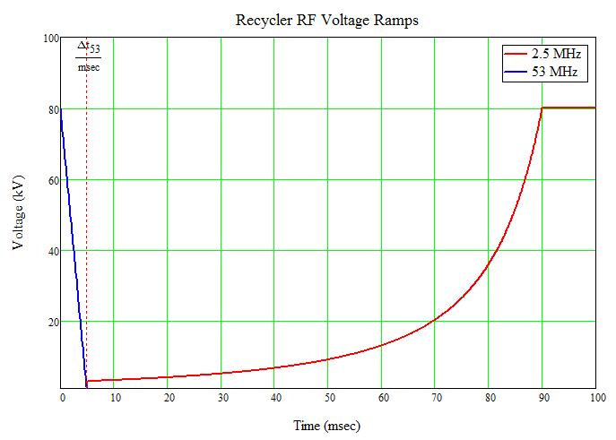
Recycler RF Voltage Ramps
Synchronous transfer from Booster to Recycler into 53 MHz RF buckets at t = 0
53 MHz RF voltage linearly ramped to zero in 5 msec
When 53 MHz is off, the 2.5 MHz voltage is adiabatically ramped to 80 kV in 85 msec
The purpose of the 2.5 MHz re-bunching is to produce narrow (FW < 250 nsec) bunches
Note: Muon g-2 uses this system before Mu2e and requires FW < 150 nsec
53 MHz
2.5 MHz
Each 2.5 MHz bunch is synchronously transferred to the Delivery Ring into a stationary 2.4 MHz bucket

Slide 28
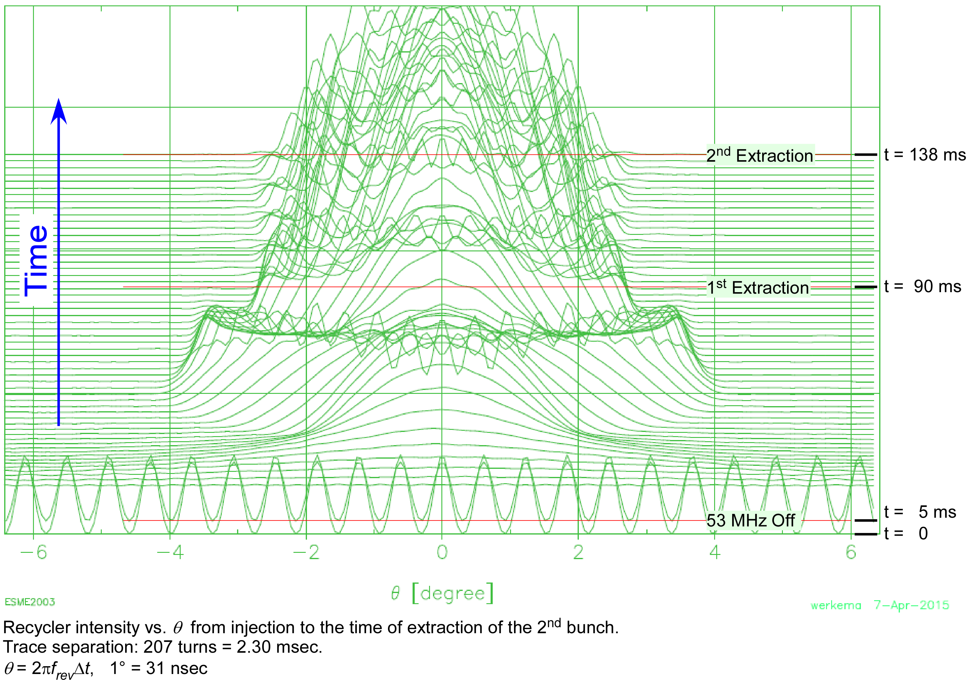
Recycler RF Model – Time Distribution Waterfall during 2.5 MHz Bunch Formation
250 nsec
53 MHz Bunches
The Mu2e beam time window is defined to be the center of the RF bucket ±125 nsec
Notes:
Note: θ = 2𝜋f_{rev}. θ is not the RF phase.

Slide 29
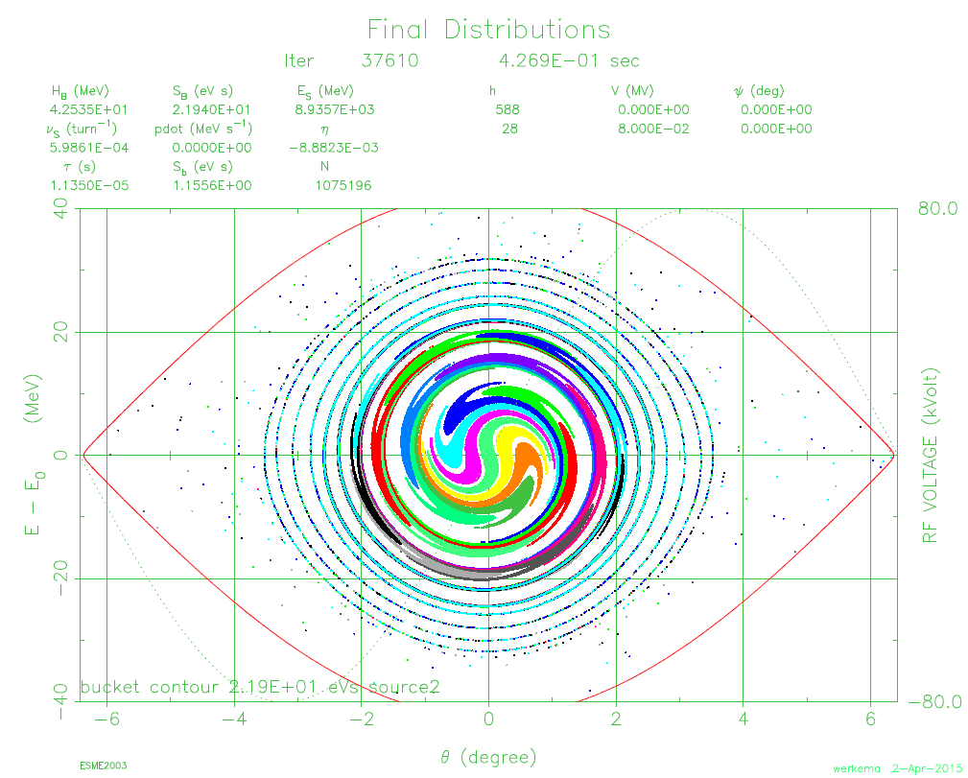
Recycler Longitudinal Phase Space at Extraction Time for Bunch 2
Beam is not matched to the RF bucket.
This distribution is the input to the Delivery Ring stage of the model
Notes:
The protons in each initial 53 MHz bunch were colored differently.
Only one tenth of total protons tracked is shown.

Slide 30
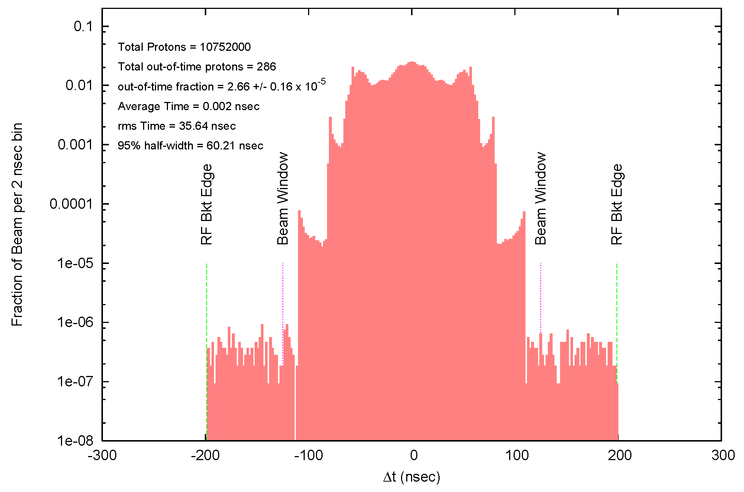

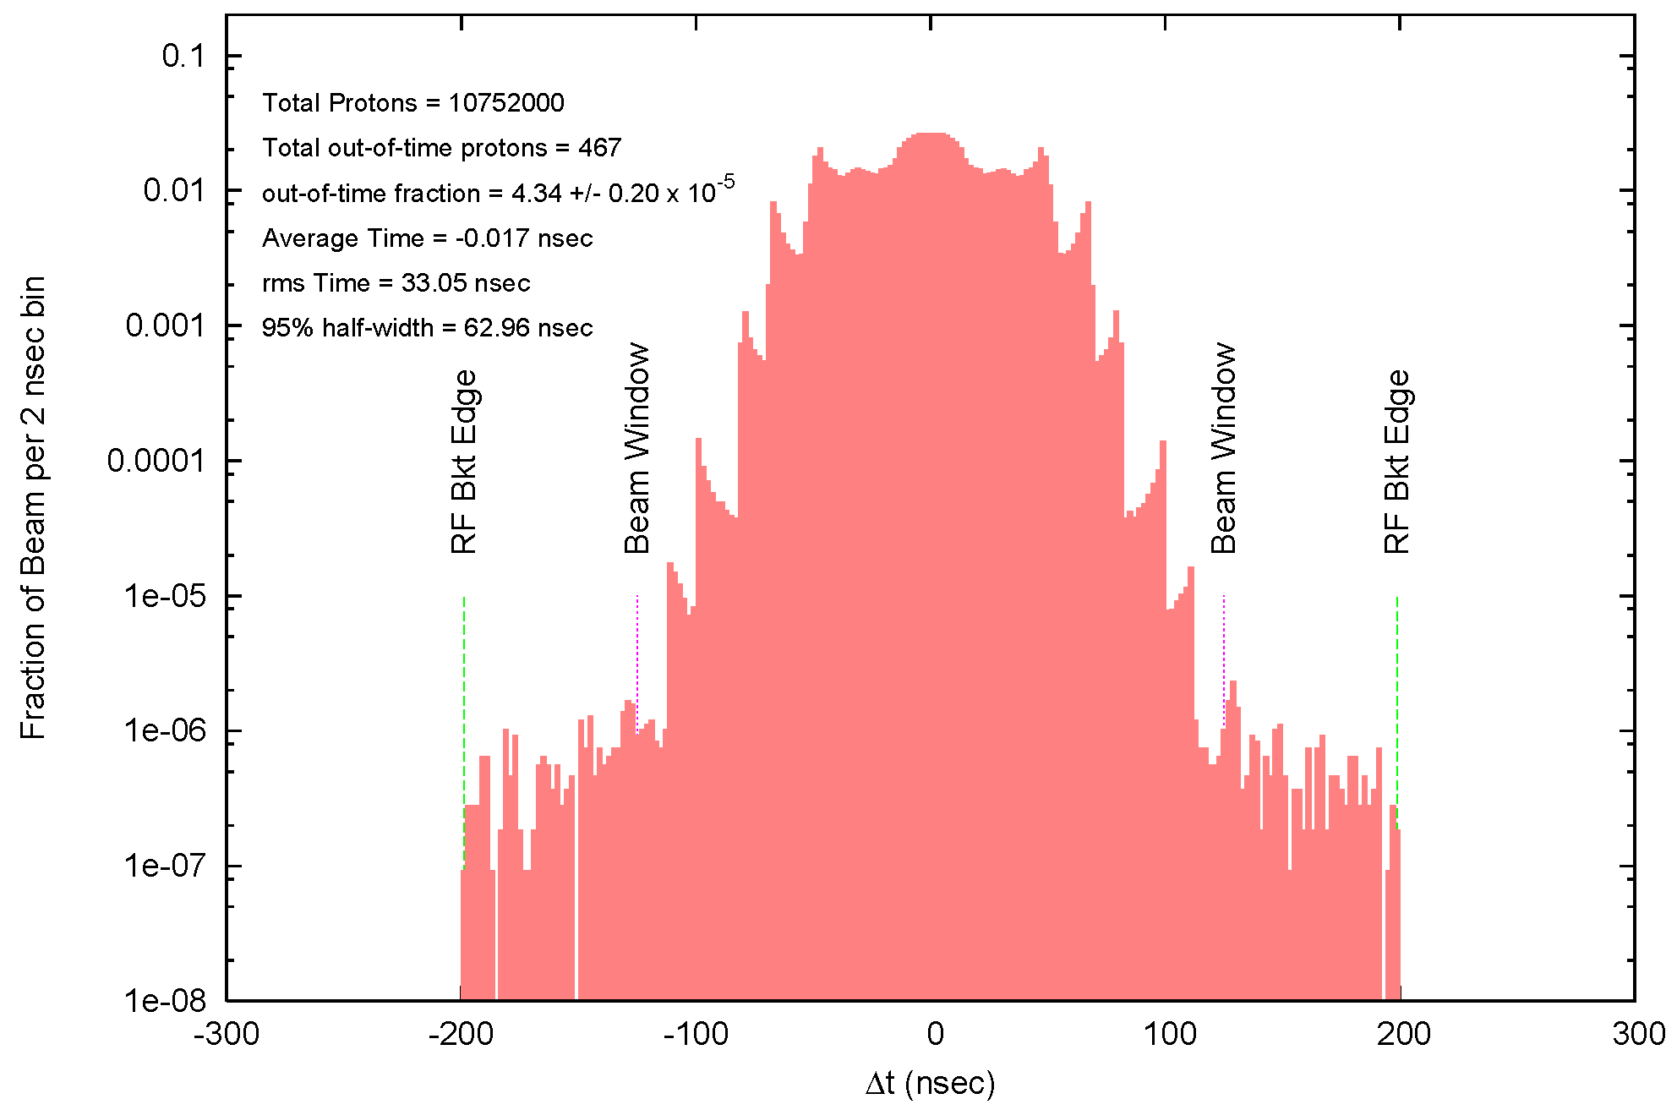



Recycler Proton Time Distributions at Extraction Time
Bunch 1
Bunch 2
Bunch 3
Bunch 4
Bunch 6
Bunch 8
Notes:
Note: this slide is an animation of the proton time distribution at extraction time for six different extractions. The pdf version of these slides will not show this slide properly.
Out-of-Time Fraction = fraction of protons that are outside of the Beam Window = ±125 msec

Slide 31
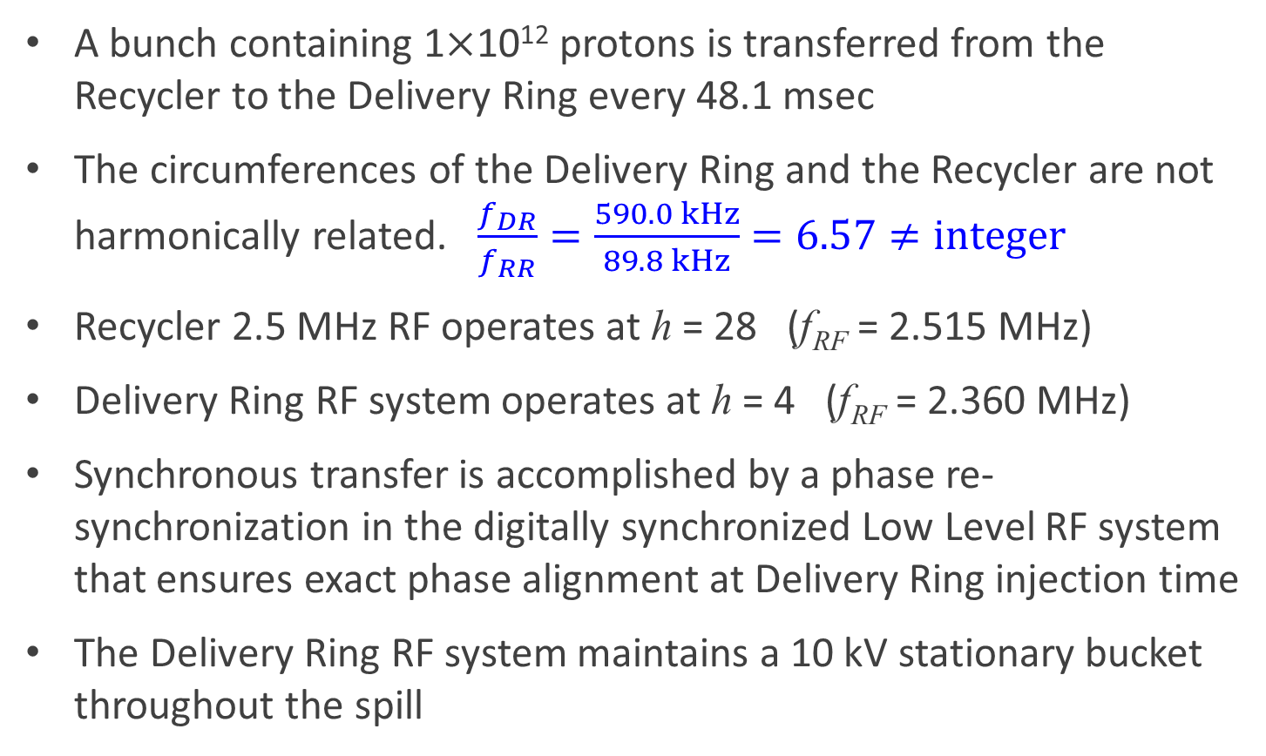
Recycler to Delivery Ring Synchronous Transfers
A bunch containing 1×10¹² protons is transferred from the Recycler to the Delivery Ring every 48.1 msec
The circumferences of the Delivery Ring and the Recycler are not harmonically related. $\frac{f_{DR}}{f_{RR}}=\frac{590.0 kHz}{89.8 kHz}=6.57≠integer$
Recycler 2.5 MHz RF operates at h = 28 (f_{RF} = 2.515 MHz)
Delivery Ring RF system operates at h = 4 (f_{RF} = 2.360 MHz)
Synchronous transfer is accomplished by a phase re-synchronization in the digitally synchronized Low Level RF system that ensures exact phase alignment at Delivery Ring injection time
The Delivery Ring RF system maintains a 10 kV stationary bucket throughout the spill
Notes:
DR = Delivery Ring
RR = Recycler Ring

Slide 32
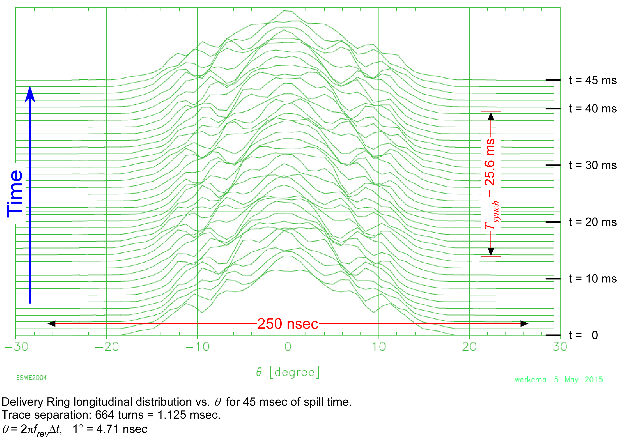
Delivery Ring RF
Delivery Ring RF maintains a stationary 10 kV bucket for the duration of the spill
Notes:
This slide shows the development of the core of the beam distribution with time in the spill – it says very little about the out-of-time tails.
Note: the T_{synch} given here is the small amplitude synchrotron frequency.

Slide 33
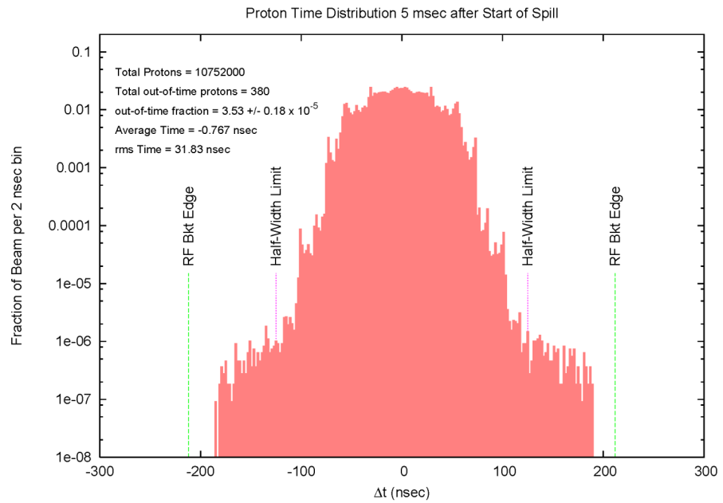
Delivery Ring Proton Time Distribution During Spill Animation
Notes:
Note: this is an animation that probably won’t play properly in the pdf version.
Out-of-Time Fraction = fraction of protons that are outside of the Half-Width Limit= ±125 msec

Slide 34
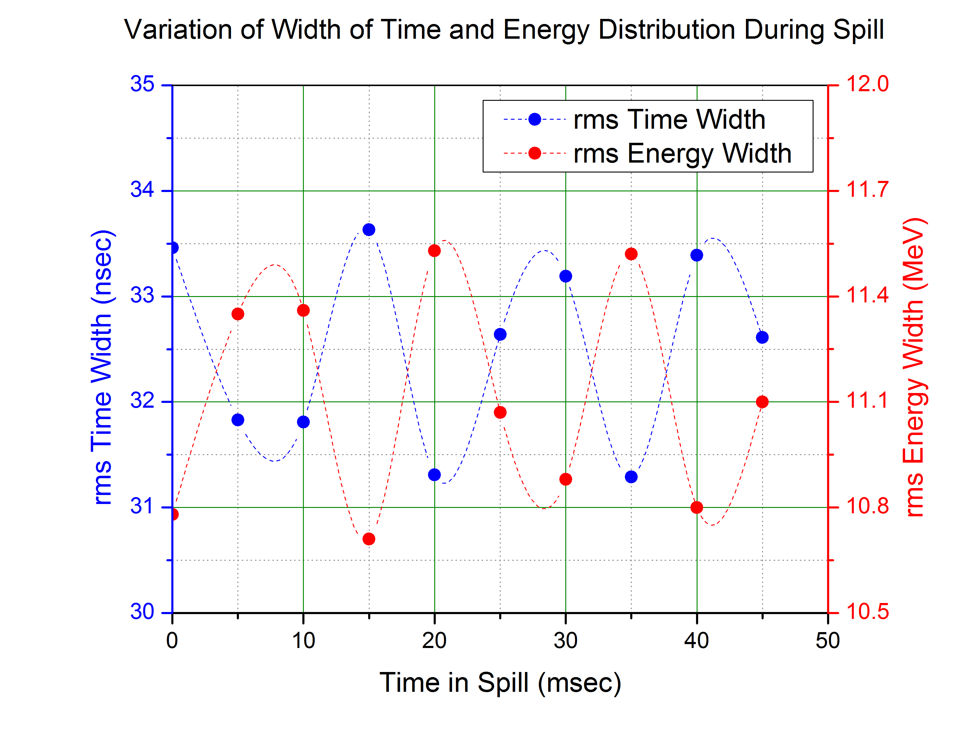
Variation of RMS Energy and Time Width
RMS widths oscillate at twice the synchrotron frequency as expected.
Note: the T_{synch} given here is the small amplitude synchrotron frequency.
T_{synch} = 25.6 msec
Notes:
The period of rms variations is half the synchrotron period, as expected.

Slide 35
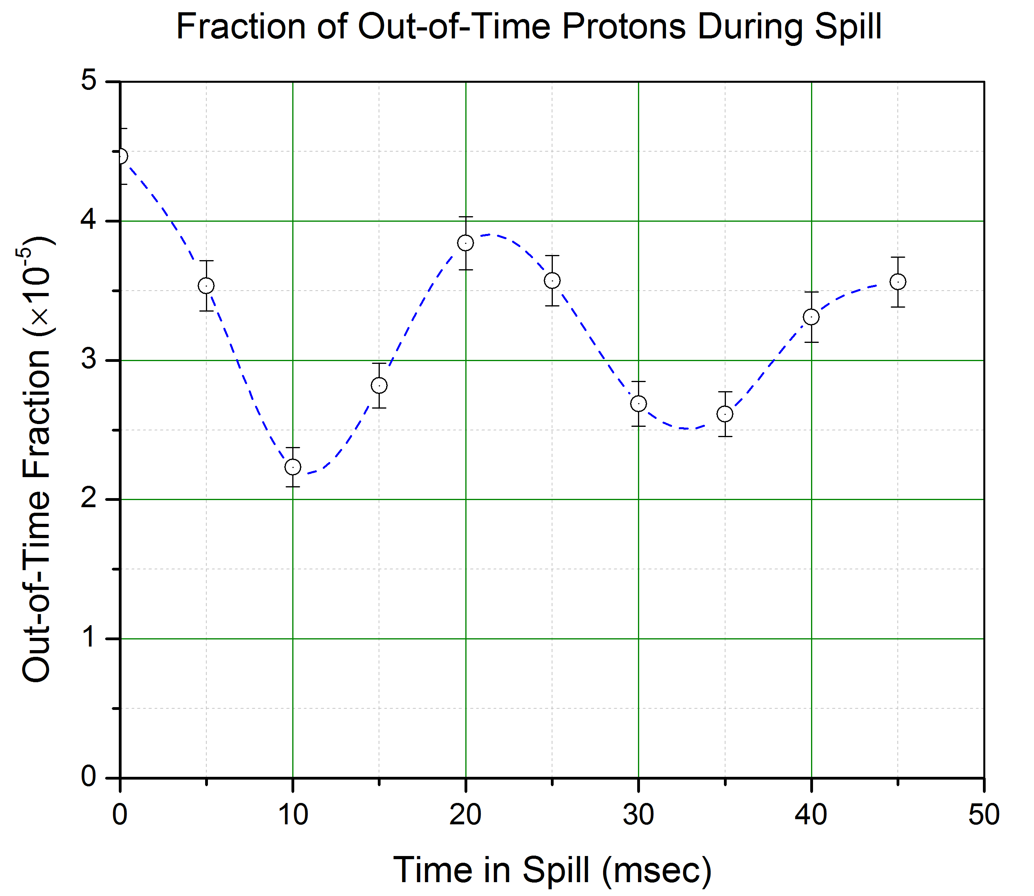
Variation of the Out-of-Time Fraction Over a 45 msec Spill
Not particularly well correlated with synchrotron period.
Note: the T_{synch} shown here is that of a proton 125 nsec from the center of the RF bucket. This is larger than the small amplitude synchrotron period.
T_{synch} = 32.5 msec

Slide 36

The Average Beam Pulse at Extraction from the Delivery Ring – Time
Averages of distributions at 5 msec intervals throughout spill
No beam outside of ±200 nsec at any time during spill
Fraction of beam outside of ±125 nsec is:
3.18 ± 0.54 × 10⁻⁵
Bucket Edge
Bucket Edge

Slide 37
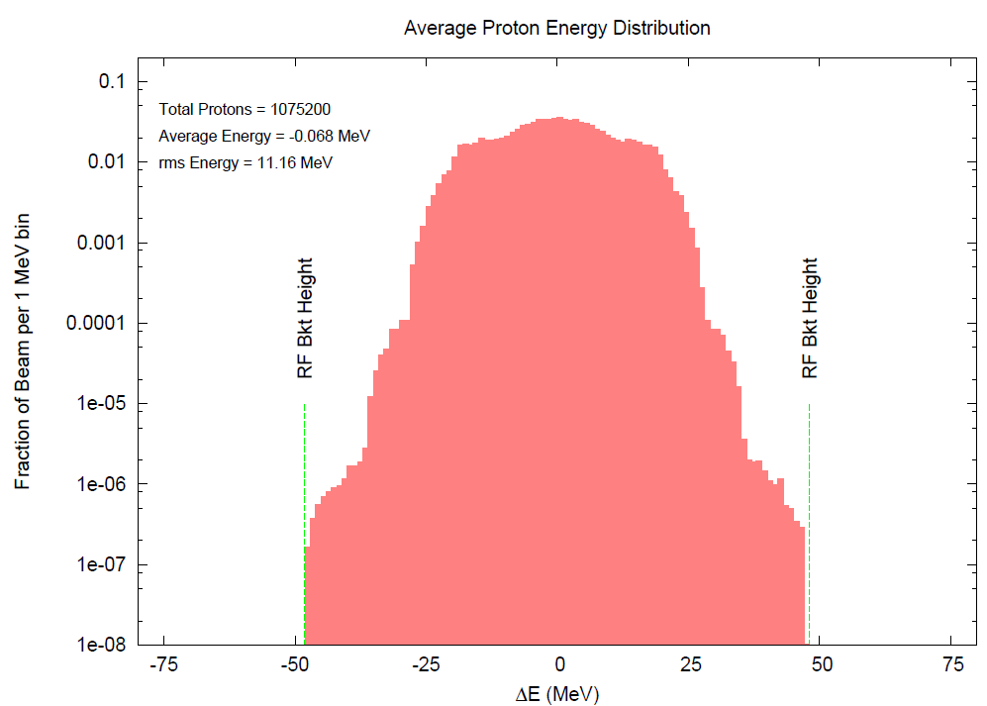
The Average Beam Pulse at Extraction from the Delivery Ring – Energy

Slide 38
Extinction Performance
DR Extraction
Extinction Transmission
Fraction of extracted beam outside of ±125 ns: | 3.2×10⁻⁵
In-time beam transmission: | 99.5%
Beam line extinction: | <5×10⁻⁸
Total extinction: | <1.6×10⁻¹²
Extinction Requirement: | <1.0×10⁻¹⁰
Two order of magnitude margin
Beam on Target
Notes:
TODO: Make a backup slide showing the calculation of the energy kick required to knock the beam out of time at various points between the RR and the target.

Slide 39
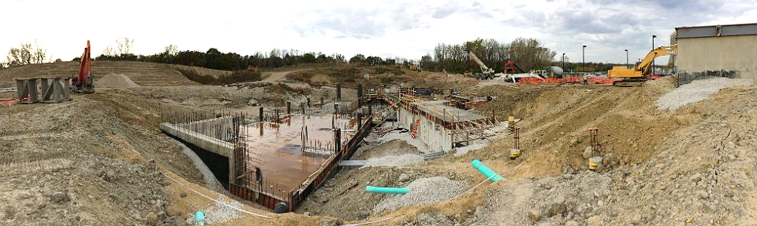
5. Construction Progress

Slide 40
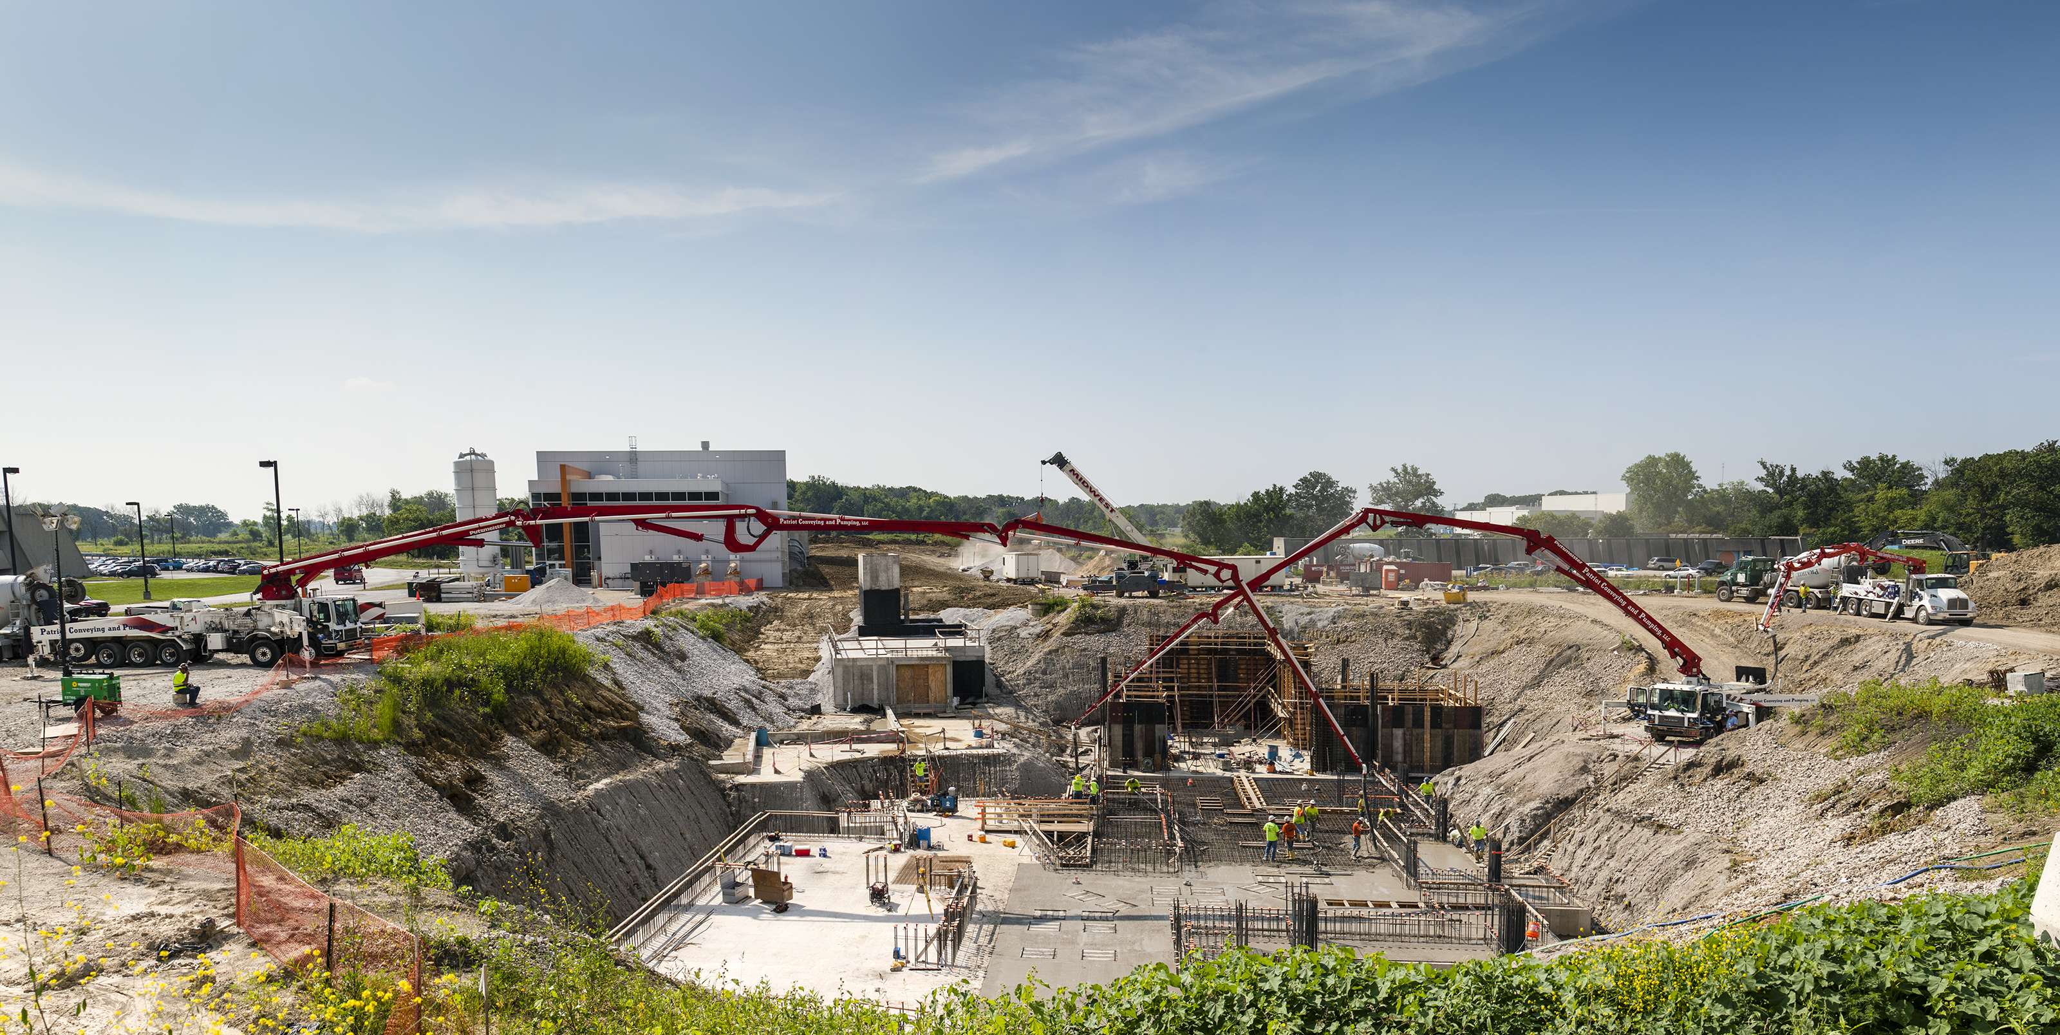
M4 Beam Enclosure
MC-1
Pouring Mu2e building floor slab
Looking east toward g-2 Building

Slide 41
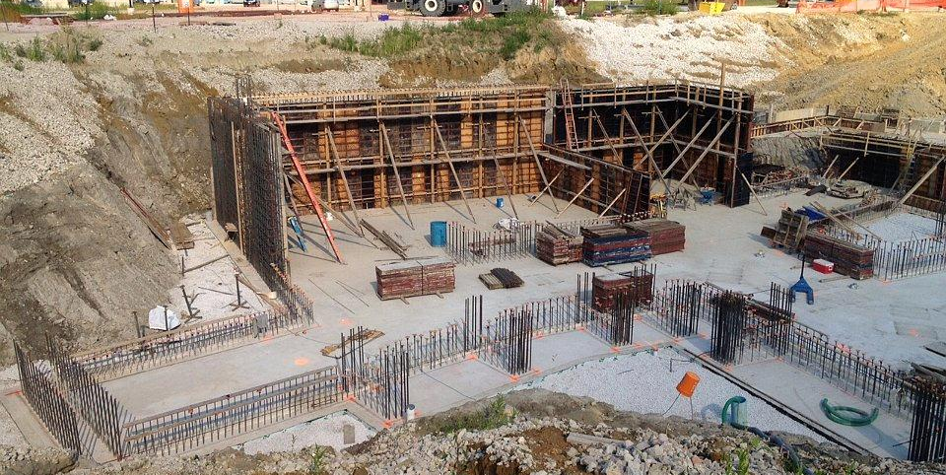
Target Dump floor
Framing the walls in the proton target station area of the Mu2e building

Slide 42
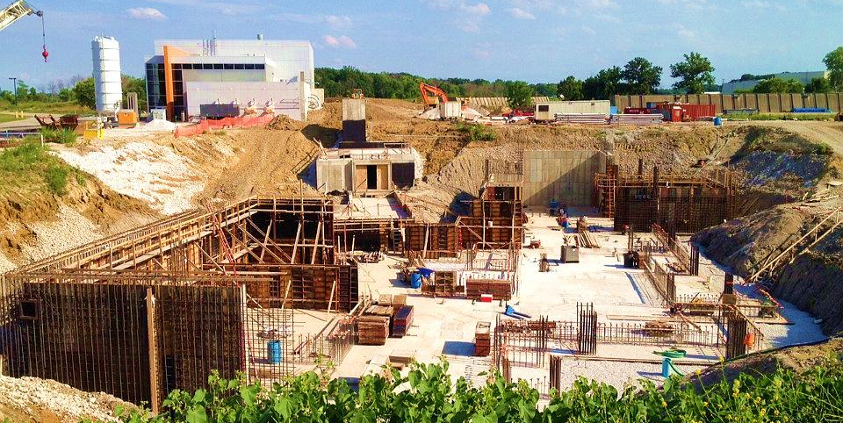
M-4 Enclosure
AP30
AP10
MC-1
Concrete floor complete
Framing and pouring the walls

Slide 43
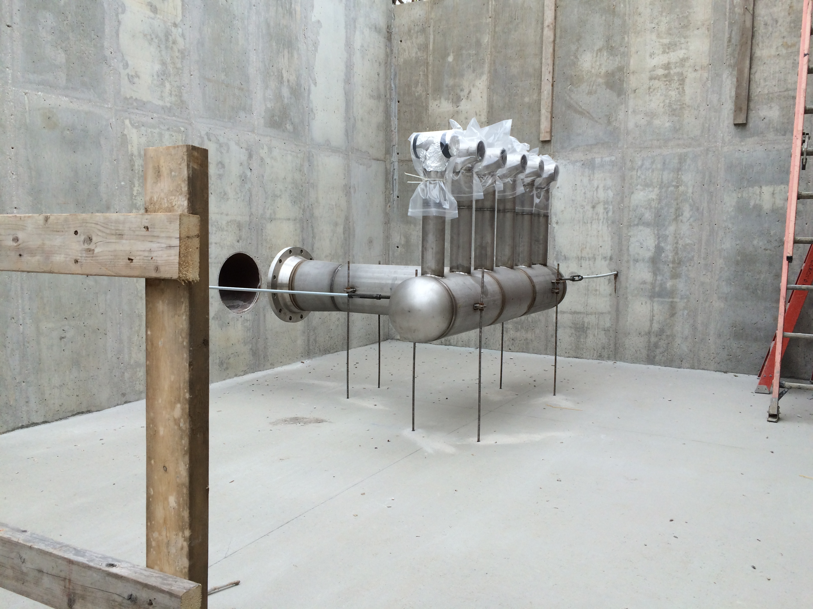
Target Proton Beam Absorber Air Manifold

Slide 44
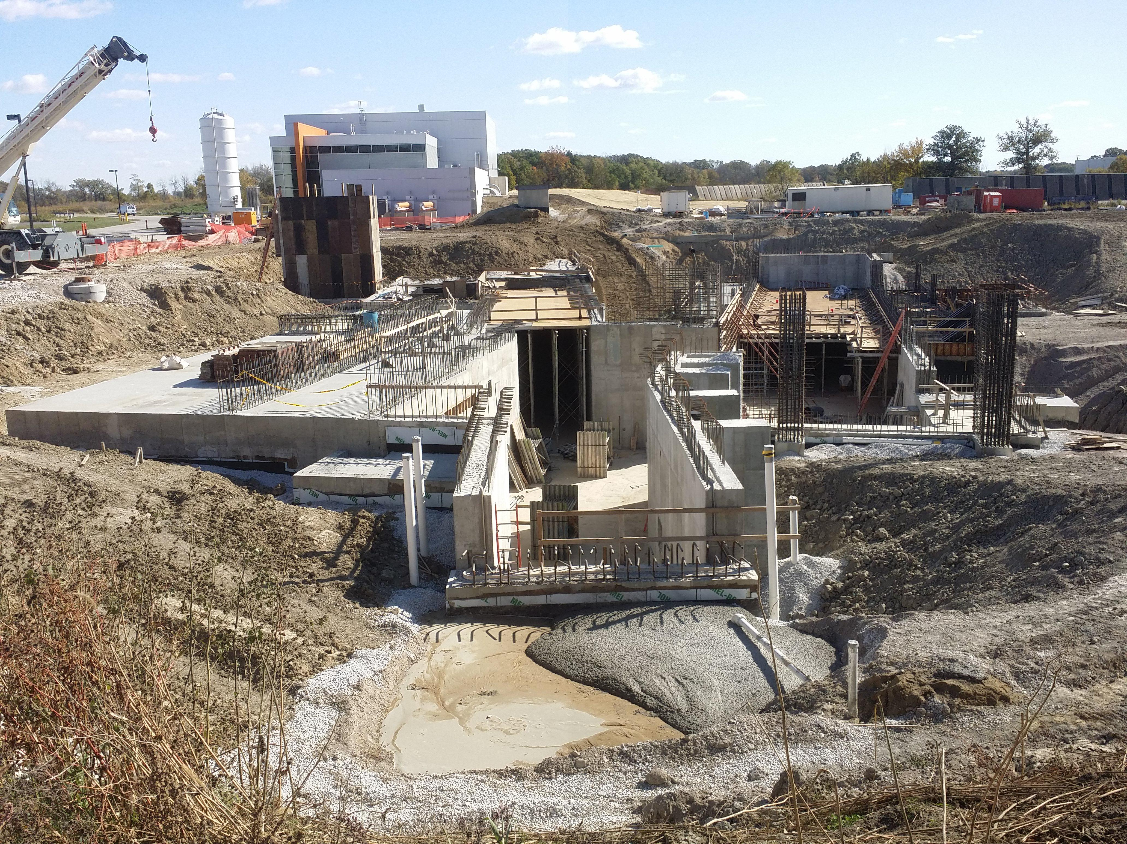
Saturday, 17 October 2015
M-4 Enclosure
MC-1
AP30

Slide 45
Why Start Building Construction before Design is Complete?
Generally, this is a very bad thing to do
  Removes the flexibility to accommodate unforeseen design issues that might be alleviated by building changes
  Once an A&E firm is retained, building design changes are expensive. Once a construction contract is awarded changes become even more costly
  The building becomes a design constraint as soon as concrete is poured
The Muon Campus and Mu2e projects did this because:
  Allows early start on projects necessary for g-2 – early g-2 running simplifies accelerator commissioning for Mu2e
  Construction costs were relatively low and projected to trend up when this decision was made
Notes:
This slide is for those who might think it is very odd that they are being shown construction photographs at a design review.

Slide 46
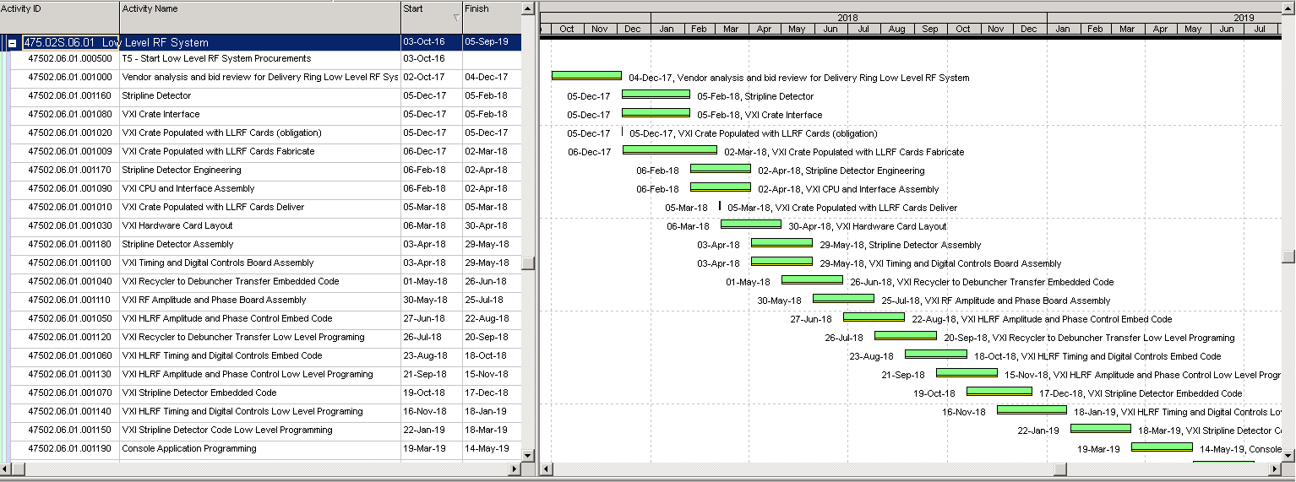
6. Schedule
Notes:
NOTE: This chart is just a pretty picture – it’s not intended by be read.

Slide 47
Mu2e Accelerator Schedule
CD-2/3b
CD-3c
Beam to Diagnostic Absorber
CD-4
M4 Enclosure
BO
Resonant Extraction Design
Fabrication & Installation of Res. Extr. ESS, Magnets, Power Supplies, & Electronics
Install ESS
Commission Res. Extr.
External (M4) Beamline Design
Beamline component and pwr supply procurement and fabrication
Extinction/M4DA
Extinction & M4DA Section Installation
Hbend
Hbend Section Installation
FF
Final Focus Section Installation
Target Station Design
Target Prototype Work
Target Fabr.
RH Prototyping
RH Procure & Assembly
RH
RH Install & Test
HRS Procurement & Assembly
HRS
HRS Assembly & Installation
Extinction Design
AC Dipole, Pwr Supply & Collimator Procurement, Fabrication & Install
Extinction Monitor Procurement, Assembly & Install
Instrumentation & Controls Design
Instrumentation & Controls Implementation
Radiation Safety Design
Radiation Safety Procurements, Fabrication & Installation
Delivery Ring RF Design
Delivery Ring RF Procurements, Fabrication & Installation
Beam Operations:
g-2 Beam Operations
M4 Commissioning with single turn Beam
Q3 | Q4 | Q1 | Q2 | Q3 | Q4 | Q1 | Q2 | Q3 | Q4 | Q1 | Q2 | Q3 | Q4 | Q1 | Q2 | Q3 | Q4 | Q1 | Q2 | Q3 | Q4 | Q1 | Q2 | Q3 | Q4 | Q1 | Q2 | Q3 | Q4 | Q1 | Q2 | Q3 | Q4
FY14 FY15 FY16 FY17 FY18 FY19 FY20 FY21
Notes:
Notes:
No Muon Campus beam between Spring 2014 and Spring 2017
M4DA = M4 Diagnostic Absorber
The ESS replaces a Delivery Ring extraction kicker module. Therefore, ESS installation precludes further single turn extracted beam to the M4 beamline.
HRS installation takes 10 days (box on schedule is over-sized)
Target installation is off-project and estimated to occur later than Dec. 2021.
Beam commissioning activities are not on the Mu2e project

Slide 48
Significant Milestones
Milestone | Date
Diagnostic Absorber Installation Complete | March 2015
M4 Beamline Enclosure Beneficial Occupancy | Nov 2015
DOE CD-3c Approval | July 2016
2.5 MHz RF Cavity Installed in Delivery Ring | Sep 2016
Start of Muon g-2 Run | May 2017
Delivery Ring RF System Complete | Dec 2019
Ready to run beam to diagnostic absorber | June 2020
DOE CD-4 Approval | May 2021

Slide 49
Muon Campus Program Cost
Project | Total Project Cost ($M) | Accelerator Costs ($M)
Muon g-2 Project | 46.4 | 22.2
Mu2e Project | 271.0 | 50.2
Recycler RF AIP | 9.7 | 9.7
Beam Transport AIP | 6.2 | 6.2
Delivery Ring AIP | 9.3 | 9.3
Cryo AIP | 9.7 | 9.7
MC-1 Building GPP | 9.0
Beam Enclosure GPP | 9.7
MC Infrastructure GPP | 1.0 | 1.0
Total | 372.0 | 108.3
Delivery Ring RF total cost: ~$2.2M
∼4% of Mu2e Accelerator
All costs are base cost + estimate uncertainty (contingency)
(These costs compiled November 2014)
Notes:
This cost estimate was compiled in November 2014

Slide 50

Almost
6. Conclusions

Slide 51
Conclusion
Thank you for your helping us by participating in this review
The Mu2e project is in the final stages of completing its final design
  We expect to begin our CD-3c reviews in ~March of next year
We would very much appreciate your advice on how we should best focus our attention in preparation for these reviews

Slide 52
Backup Slides

Slide 53
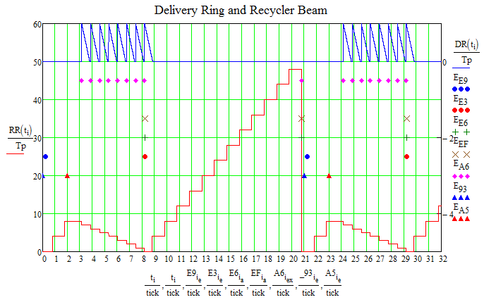
Mu2e / NOvA Accelerator Timeline Model
DR Beam ⇒
RR Beam ⇒
Notes:
Horizontal axis is time in units of Booster 15 Hz ticks. 1 tick = 1/15 Hz = 67 msec

Slide 54
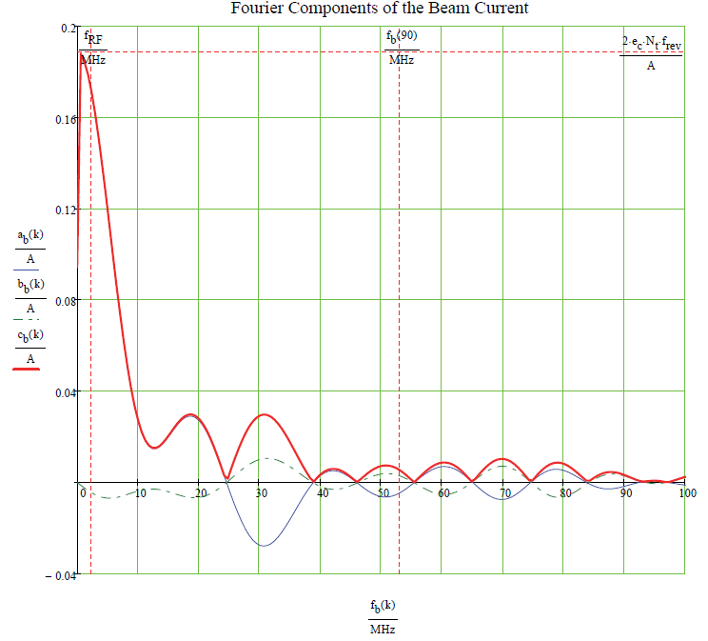
Fourier Components of Delivery Ring Beam at Injection
1×10¹² protons
Single Bunch
ESME Simulation
a_{b}(k) = cosine amplitudes
b_{b}(k) = sine amplitudes
c_{b}(k) = overall magnitude
Amps

Slide 55
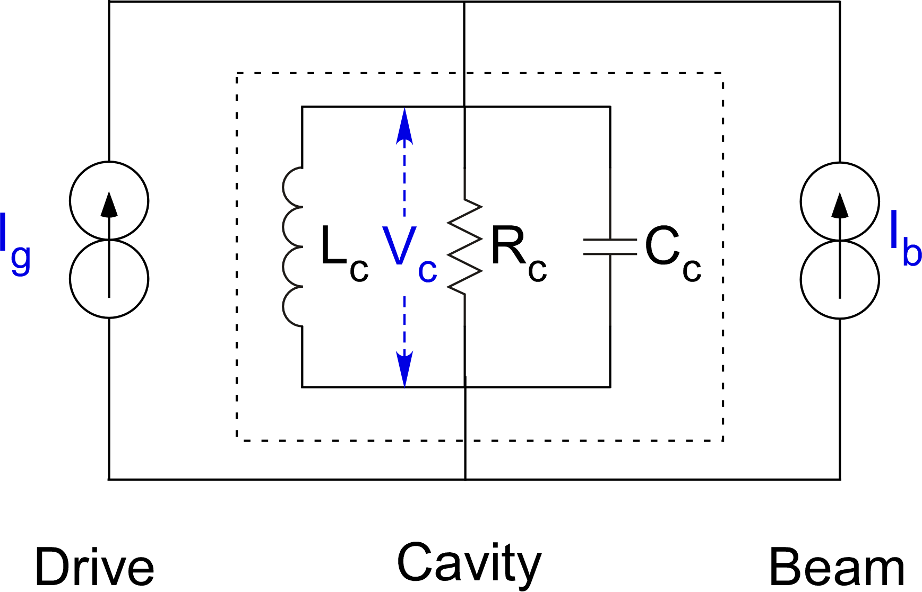
Beam Loading Compensation
Detect and feed back the beam current into the cavity drive
G
-
I_{g}
+
Feedback gain (G) is 4.
75% of beam current is applied to the drive
NOTE: direct feedback effectively reduces the impedance and Q of the cavity by a factor of G.
Notes:
This is a cartoon – don’t take this representation of an RF system too seriously.

Slide 56
Application of Beam Loading Compensation
I_{b}
Result is:
The required voltage (10 kV) is applied to the cavity
There is a small accelerating phase (which is compensated in the actual RF system by phase feedback)
Beam Current
I_{T} = I_{b} + I_{blc} + I₀
I_{T}
Resultant Current through Cavity
small accelerating phase
V_{c}
Cavity Voltage
I₀
No beam (unloaded)
current
Modeling this is done by the following:
Cavity impedance and Q is reduced by the feedback gain (4×) – (already in model)
Introduce a phase ramp to keep the energy constant
I_{blc}
Beam loading compensation current
Notes:
I gave little effort to properly scaling these vectors.

Slide 57
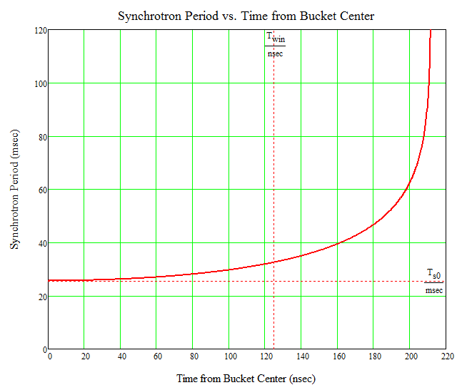
Delivery Ring Synchrotron Period as a Function of Δt
Bucket
Center
Half-width Limit

