Slide 1
Delivery Ring LLRF system for the Mu2e Project
P. Varghese
Delivery Ring LLRF system
19 Nov 2015

Slide 2
Location of RF components and Delivery Ring LLRF system

Slide 3
8 Booster cycles in MI cycle used for Mu2e

Slide 4
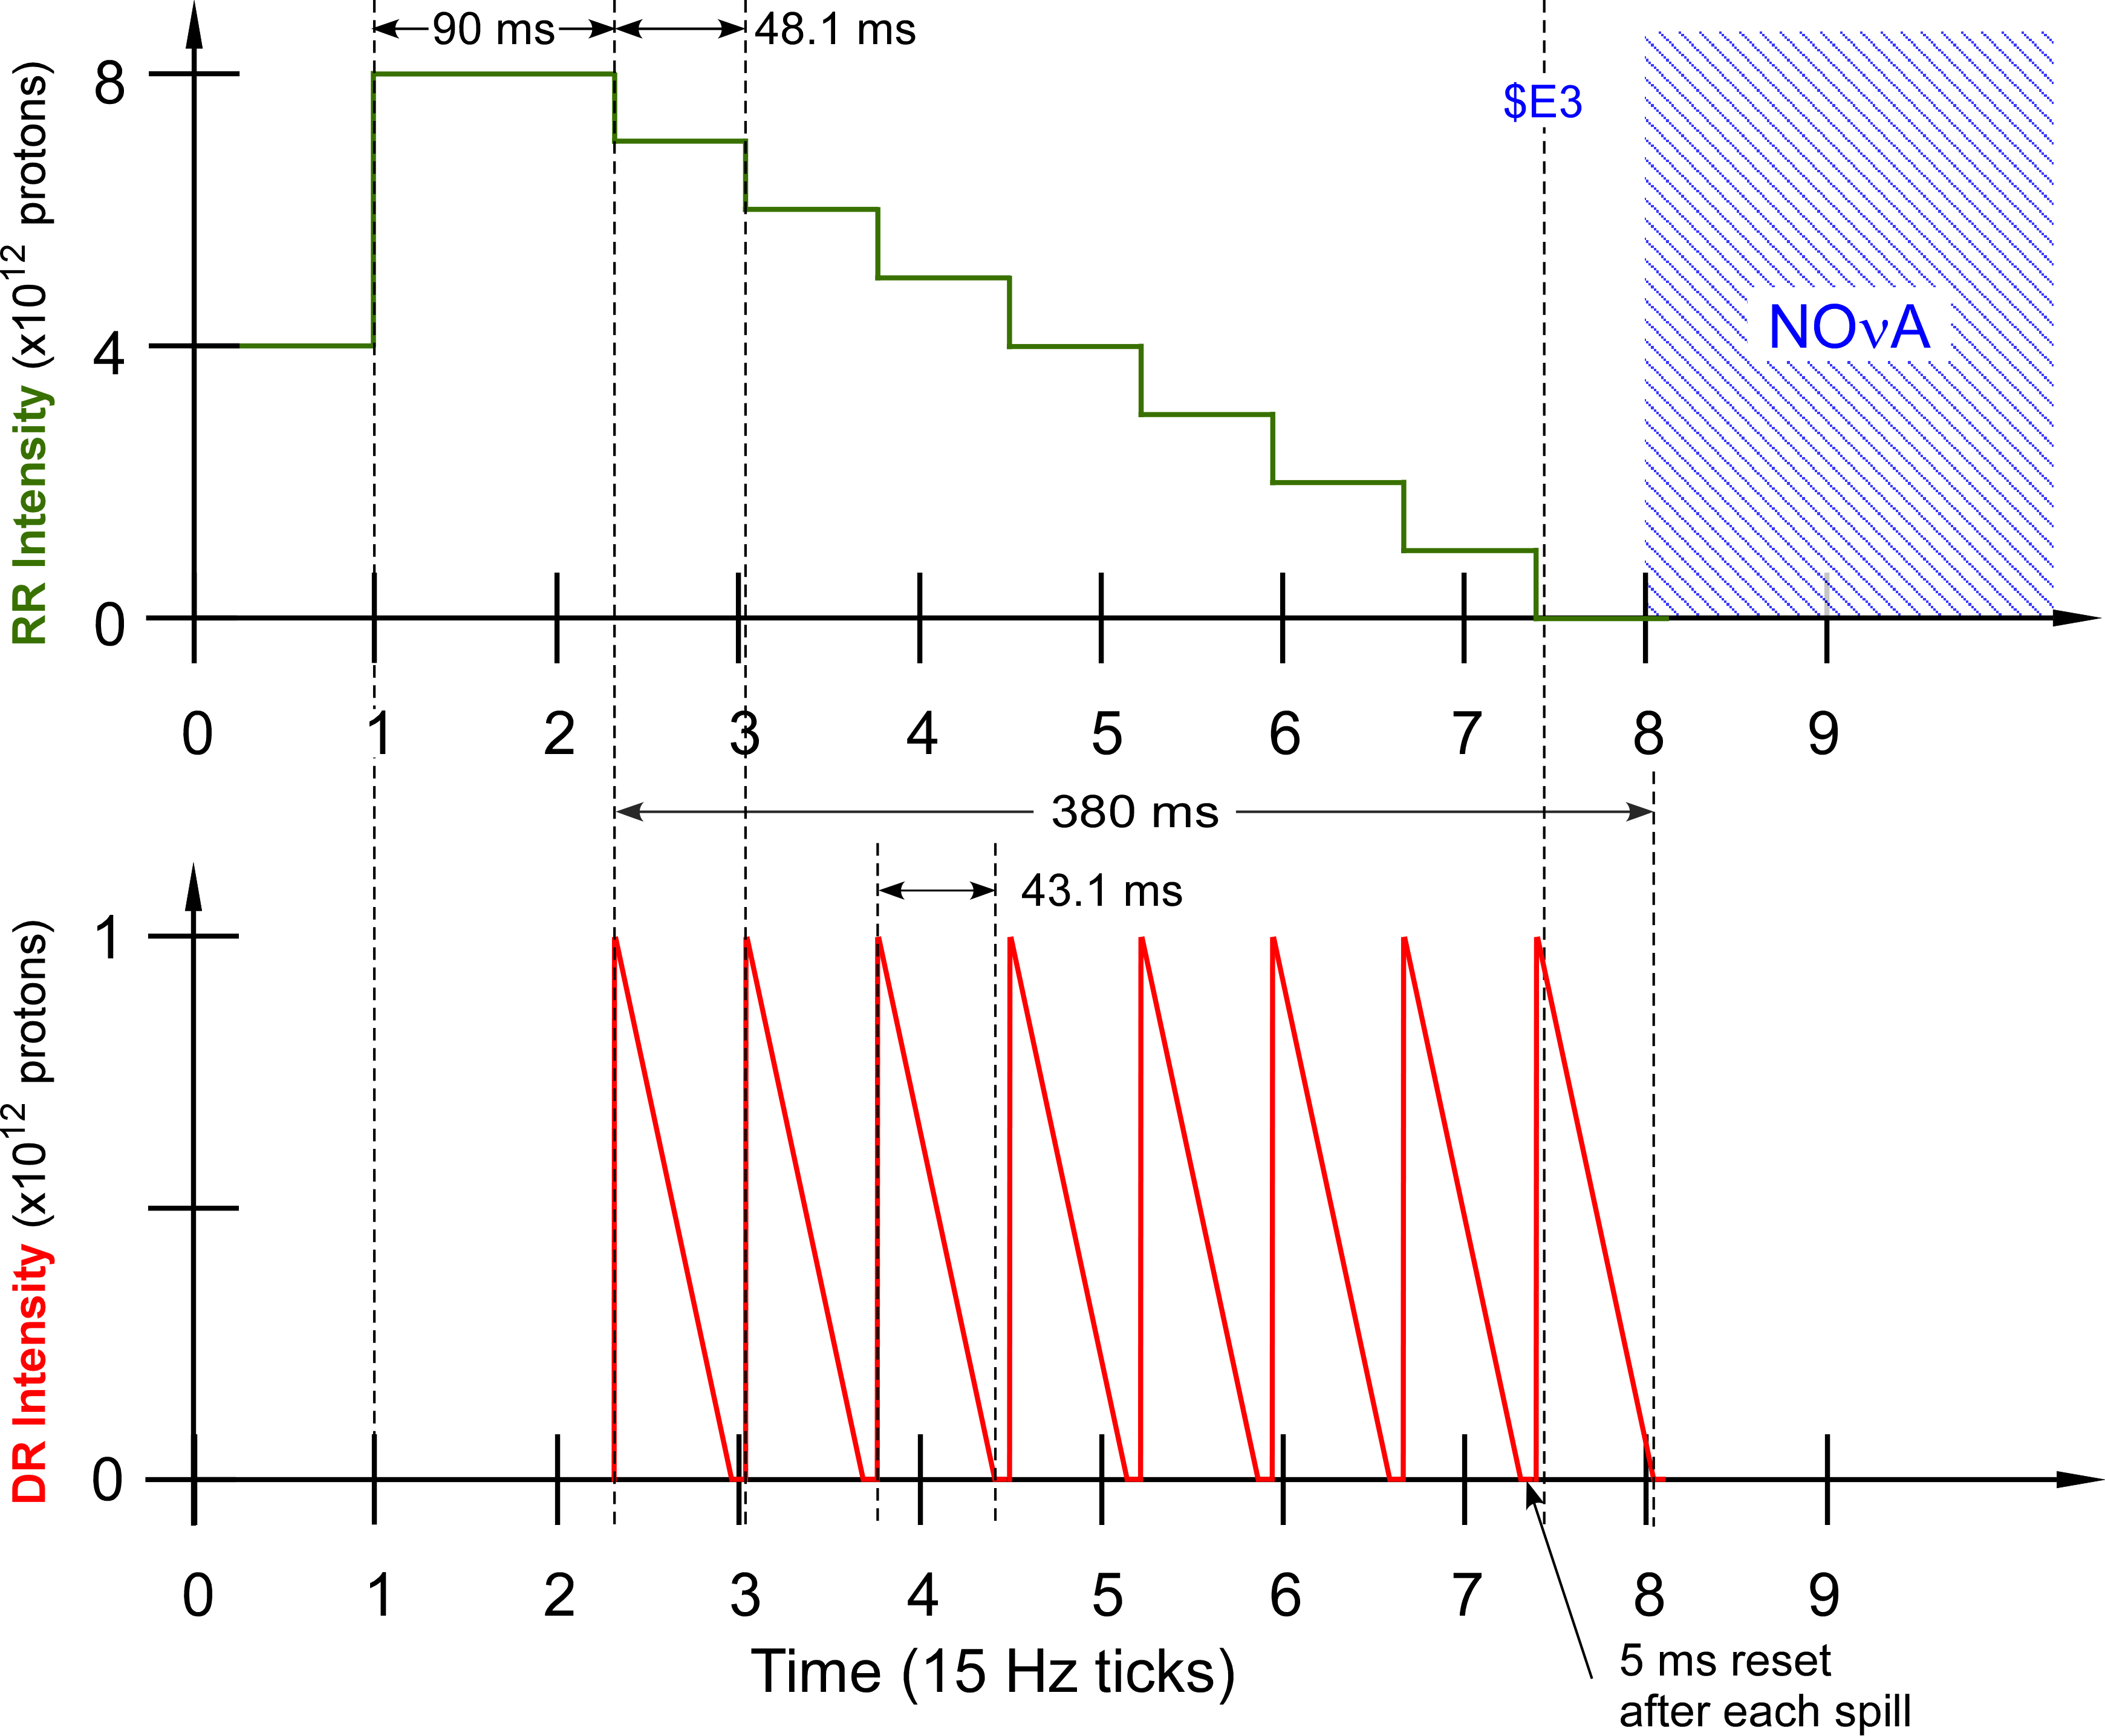
Modified Operating Scenario

Slide 5
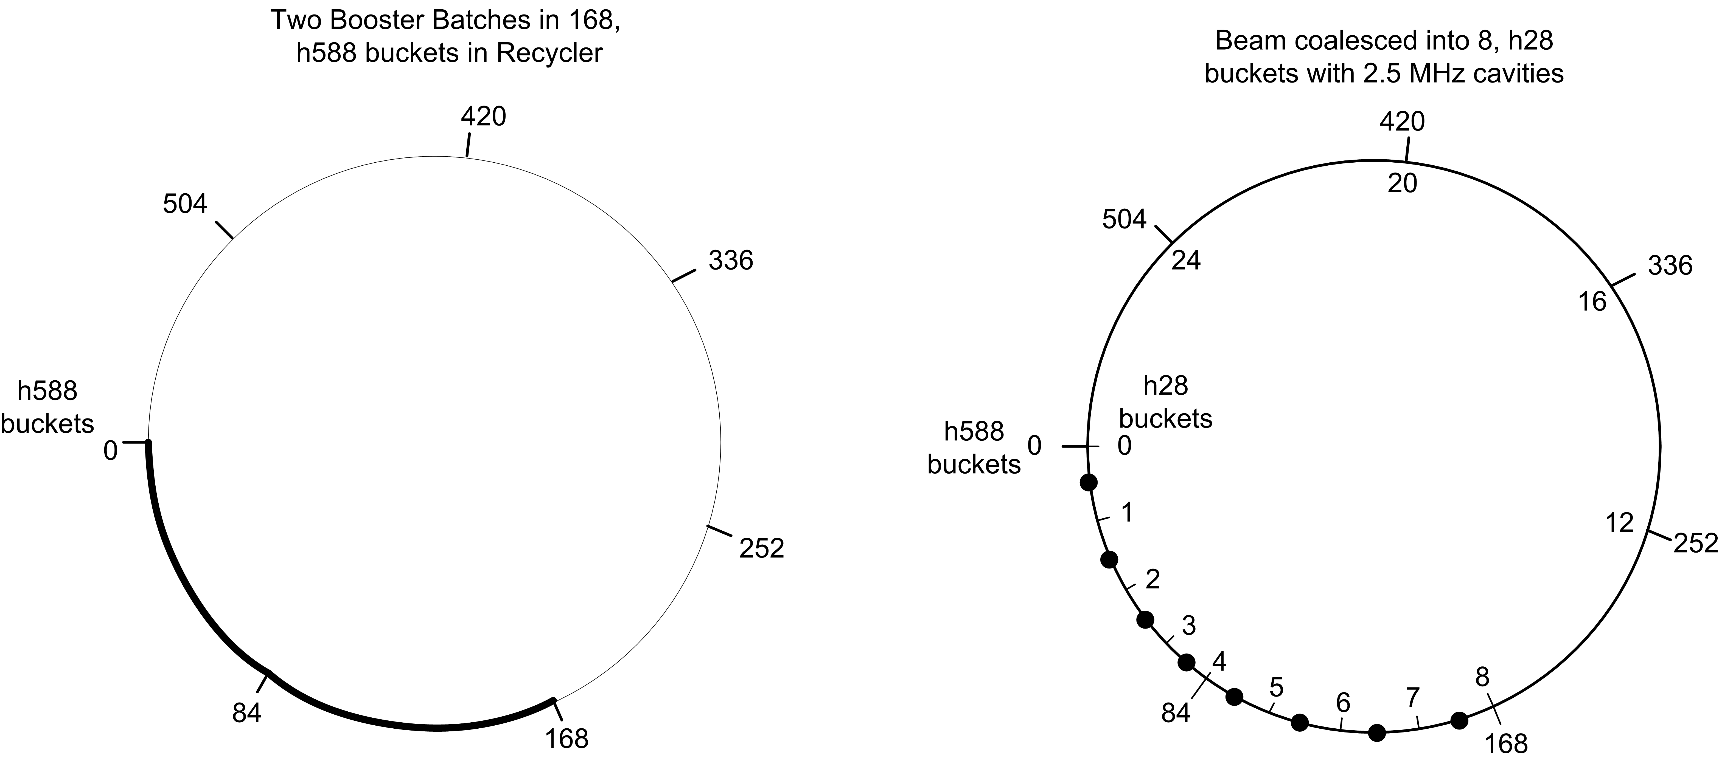
Recycler Beam Manipulation for Mu2e
2.5 Mhz and 53 Mhz buckets are aligned

Slide 6
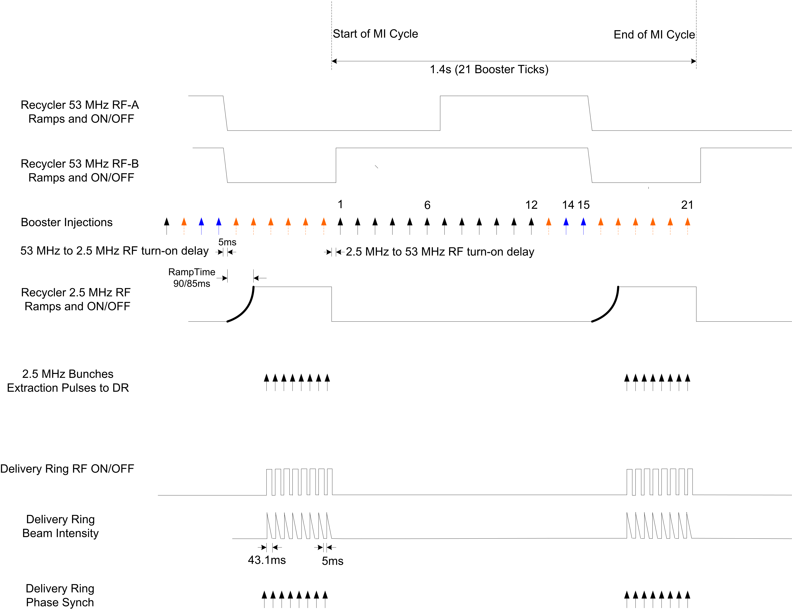
Nova/Mu2e Timeline

Slide 7
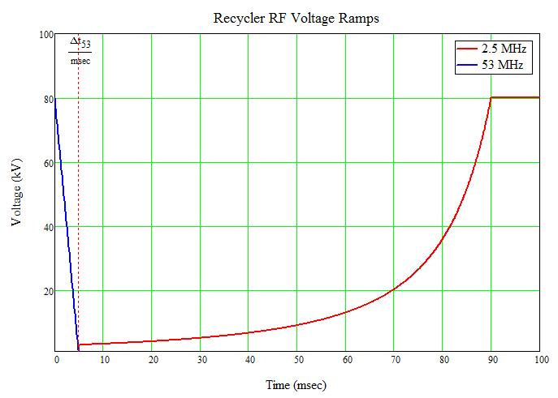
Recycler RF Voltage Ramps for Beam Manipulation
53 Mhz RF linearly ramped down over 5 ms interval
2.5 Mhz RF adiabatically ramped from 3 – 80 kV over
an interval of 90 ms for coalescing

Slide 8
Requirements for Mu2e Delivery Ring LLRF
8 booster cycles in MI cycle used to provide beam to
the Delivery Ring
Two batches are captured in 53 MHz buckets. 53 MHz RF is
ramped off and 2.5 MHz RF is ramped to 80 kV over 90ms
8, 2.5 Mhz bunches are transferred - one bunch at a time to
the Delivery Ring
Extraction synch pulses provided for each bunch
Delivery Ring frequency of 2.36MHz is non-harmonically
related to the RR 2.5 MHz.
The frequency drop must be handled by the LLRF system
while providing phase alignment at transfer

Slide 9
Recycler 2.5 MHz Cavity Parameters
Parameter | Value | Units
Harmonic Number | 28
Frequency | 2.515 | MHz
Peak Voltage | 80 | kV
Number of Cavities | 6
R/Q | 400 | Ω
Q | 125
Bandwidth | 18.8 | kHz
Time Constant τ | 16.9 | μs
90% Rise Time w DRF FB | 7.3 | μs
Cavity Power Loss | 1.0 | kW
SS Amplifier Output | 6x5.0 | kW
5000 ft , ½ ” Heliax LDF4-58 cable from MI-60 to cavity
Cable attenuation 5.1 dB

Slide 10
Delivery Ring Cavity Parameters
Parameter | Value | Units
Harmonic Number | 4
Frequency | 2.360 | MHz
Peak Voltage | 10 | kV
Number of Cavities | 1
R/Q | 400 | Ω
Q | 125
Bandwidth | 18.8 | kHz
Time Constant τ | 16.9 | μs
90% Rise Time w DRF FB | 7.3 | μs
Cavity Power Loss | 1.0 | kW
SS Amplifier Output | 8.0 | kW
2000 ft , ½ ” Heliax LDF4-58 cable from MI-60 to cavity
Cable attenuation 2 dB

Slide 11
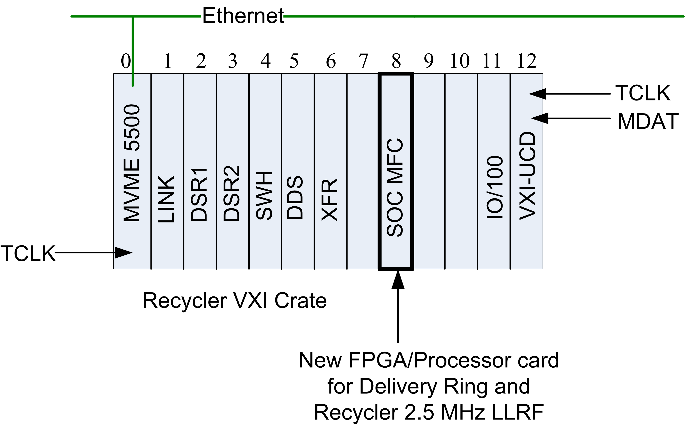
Recycler Nova/Mu2e LLRF system
Nova Recycler LLRF system

Slide 12
Integration of DR LLRF Card into the Recycler VXI Crate
Backplane access to the ACNET control system for parameter settings and data acquisition
One crate permits tight co-ordination of RR-DR LLRF timing
Trigger Lines in backplane for timing signals
Mu2e specific sequence table messages in R6 PA

Slide 13
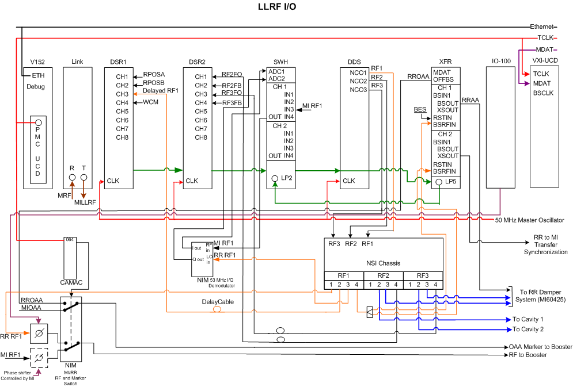
Nova Recycler VXI LLRF system

Slide 14
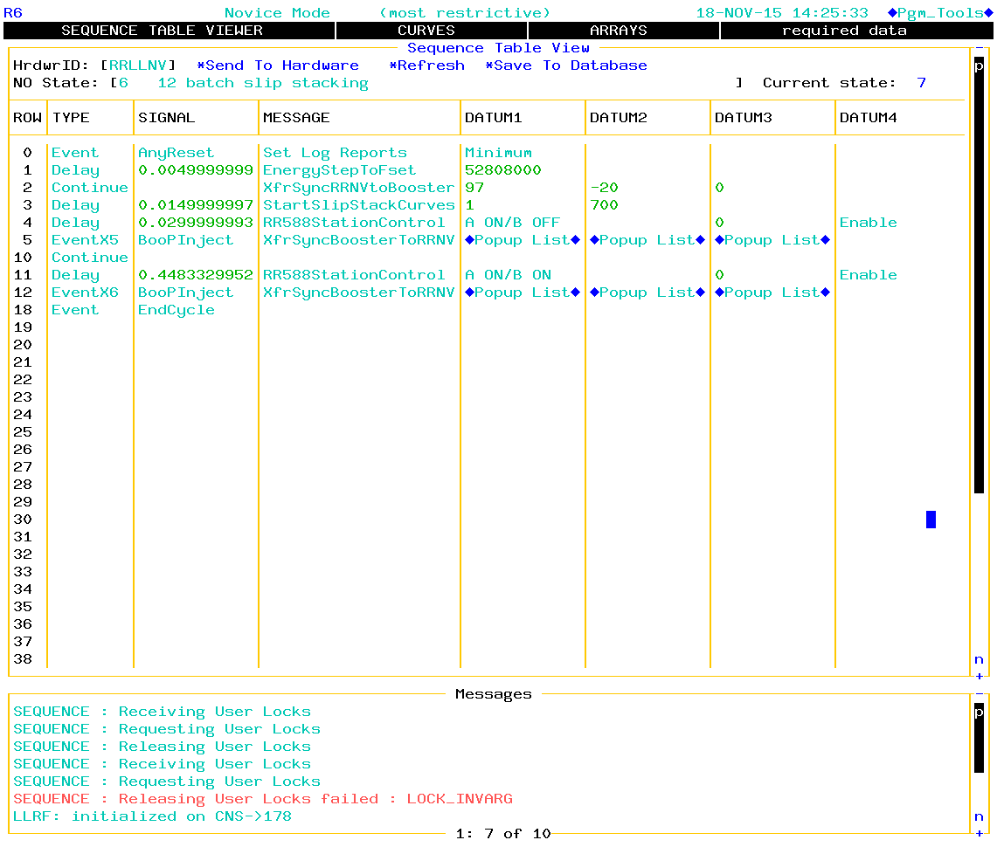
R6 User Interface for Various Operational Sequences

Slide 15
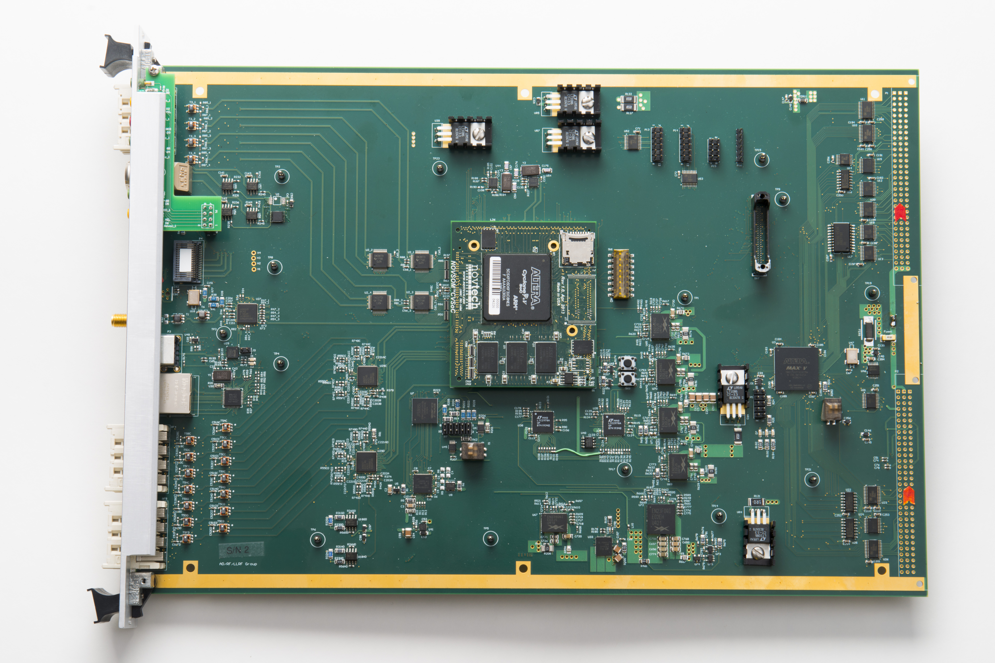
SOC MFC VXI FPGA Board

Slide 16
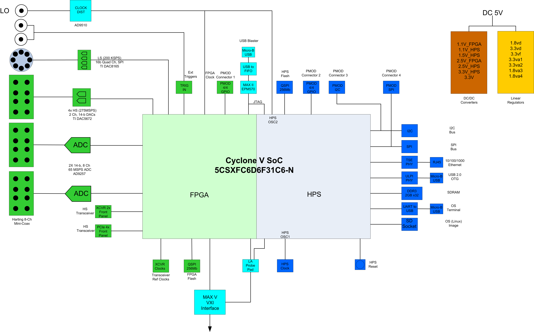
SOC MFC – LLRF card based on SOC FPGA

Slide 17
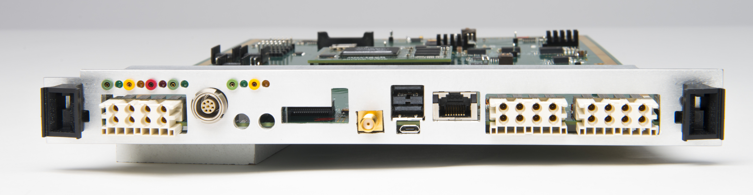
SOC MFC Front Panel Connectors
Board can be used in a VXI crate with a slot0 controller for
network access
Can also be used as a stand-alone NAD (network attached
device)
8x DAC
4x DAC(diff)
Triggers
PCIe 4x
HS xvrs
LO Clock
3x USB
Ethernet
8x ADC/IO
8x ADC

Slide 18
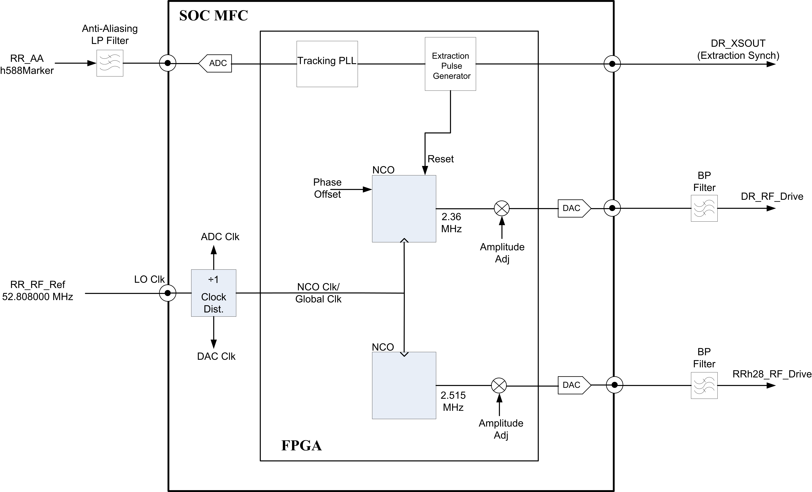
Mu2e LLRF System Conceptual Design

Slide 19
FPGA NCO Functional Block Diagram

Slide 20
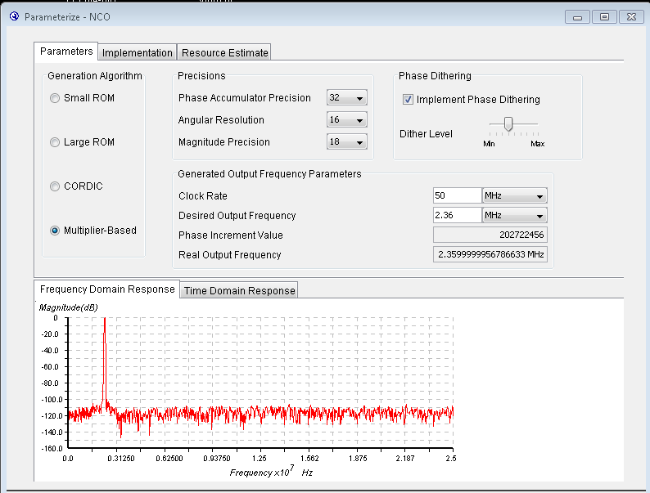
NCO Parameters and Output Frequency Response

Slide 21
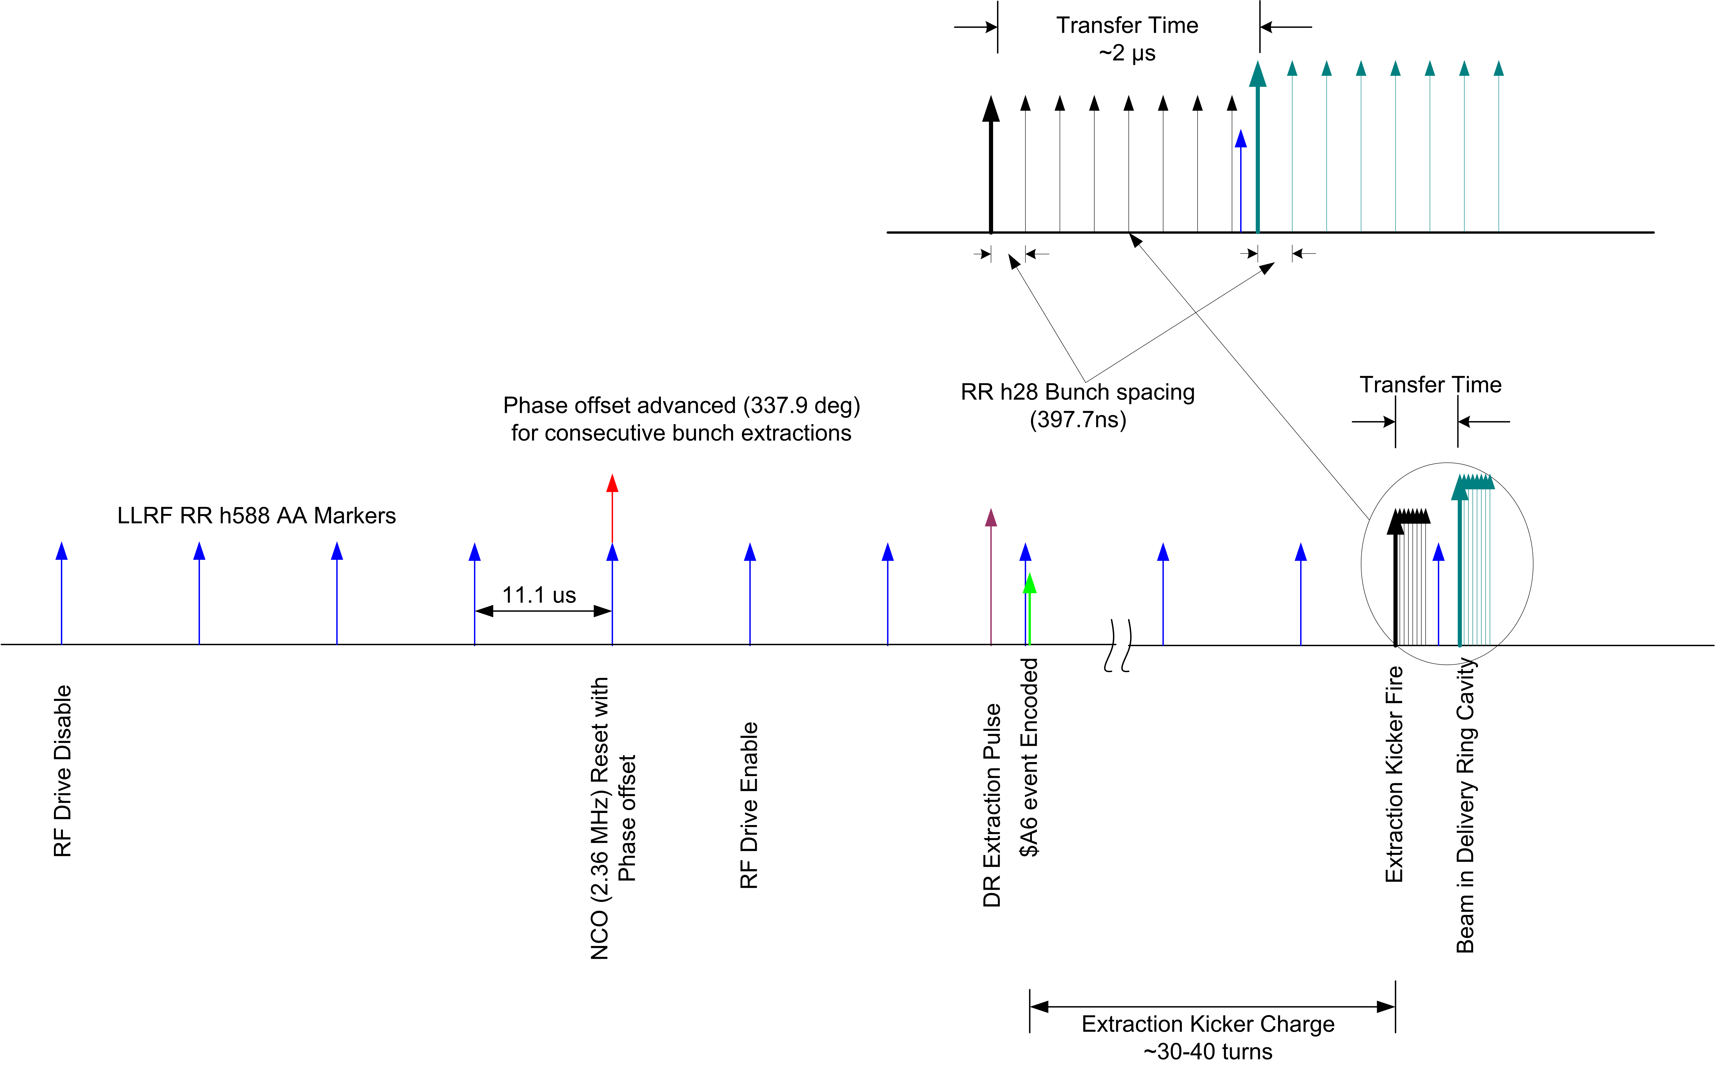
Beam Transfer Timing with Phase Alignment

Slide 22
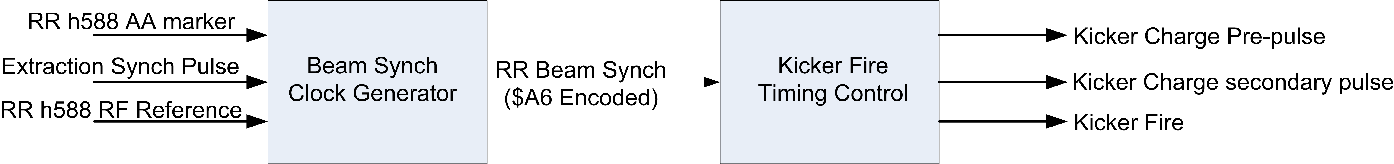
Kicker Fire Sequence
$A6 Beam extraction event encoded in the beam synch
clock at the next AA marker following the extraction pulse
Kicker fire timing control adjusts timing for the bunch
spacing of 397ns between 2.5 Mhz bunches

Slide 23
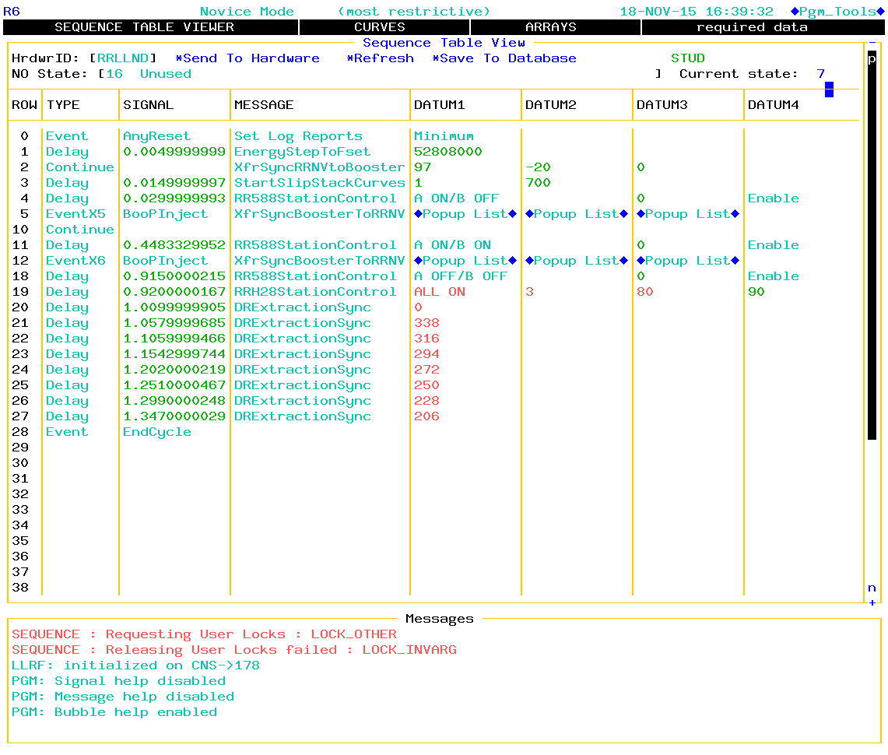
Example Recycler State for 8 bunch extraction to DR

Slide 24
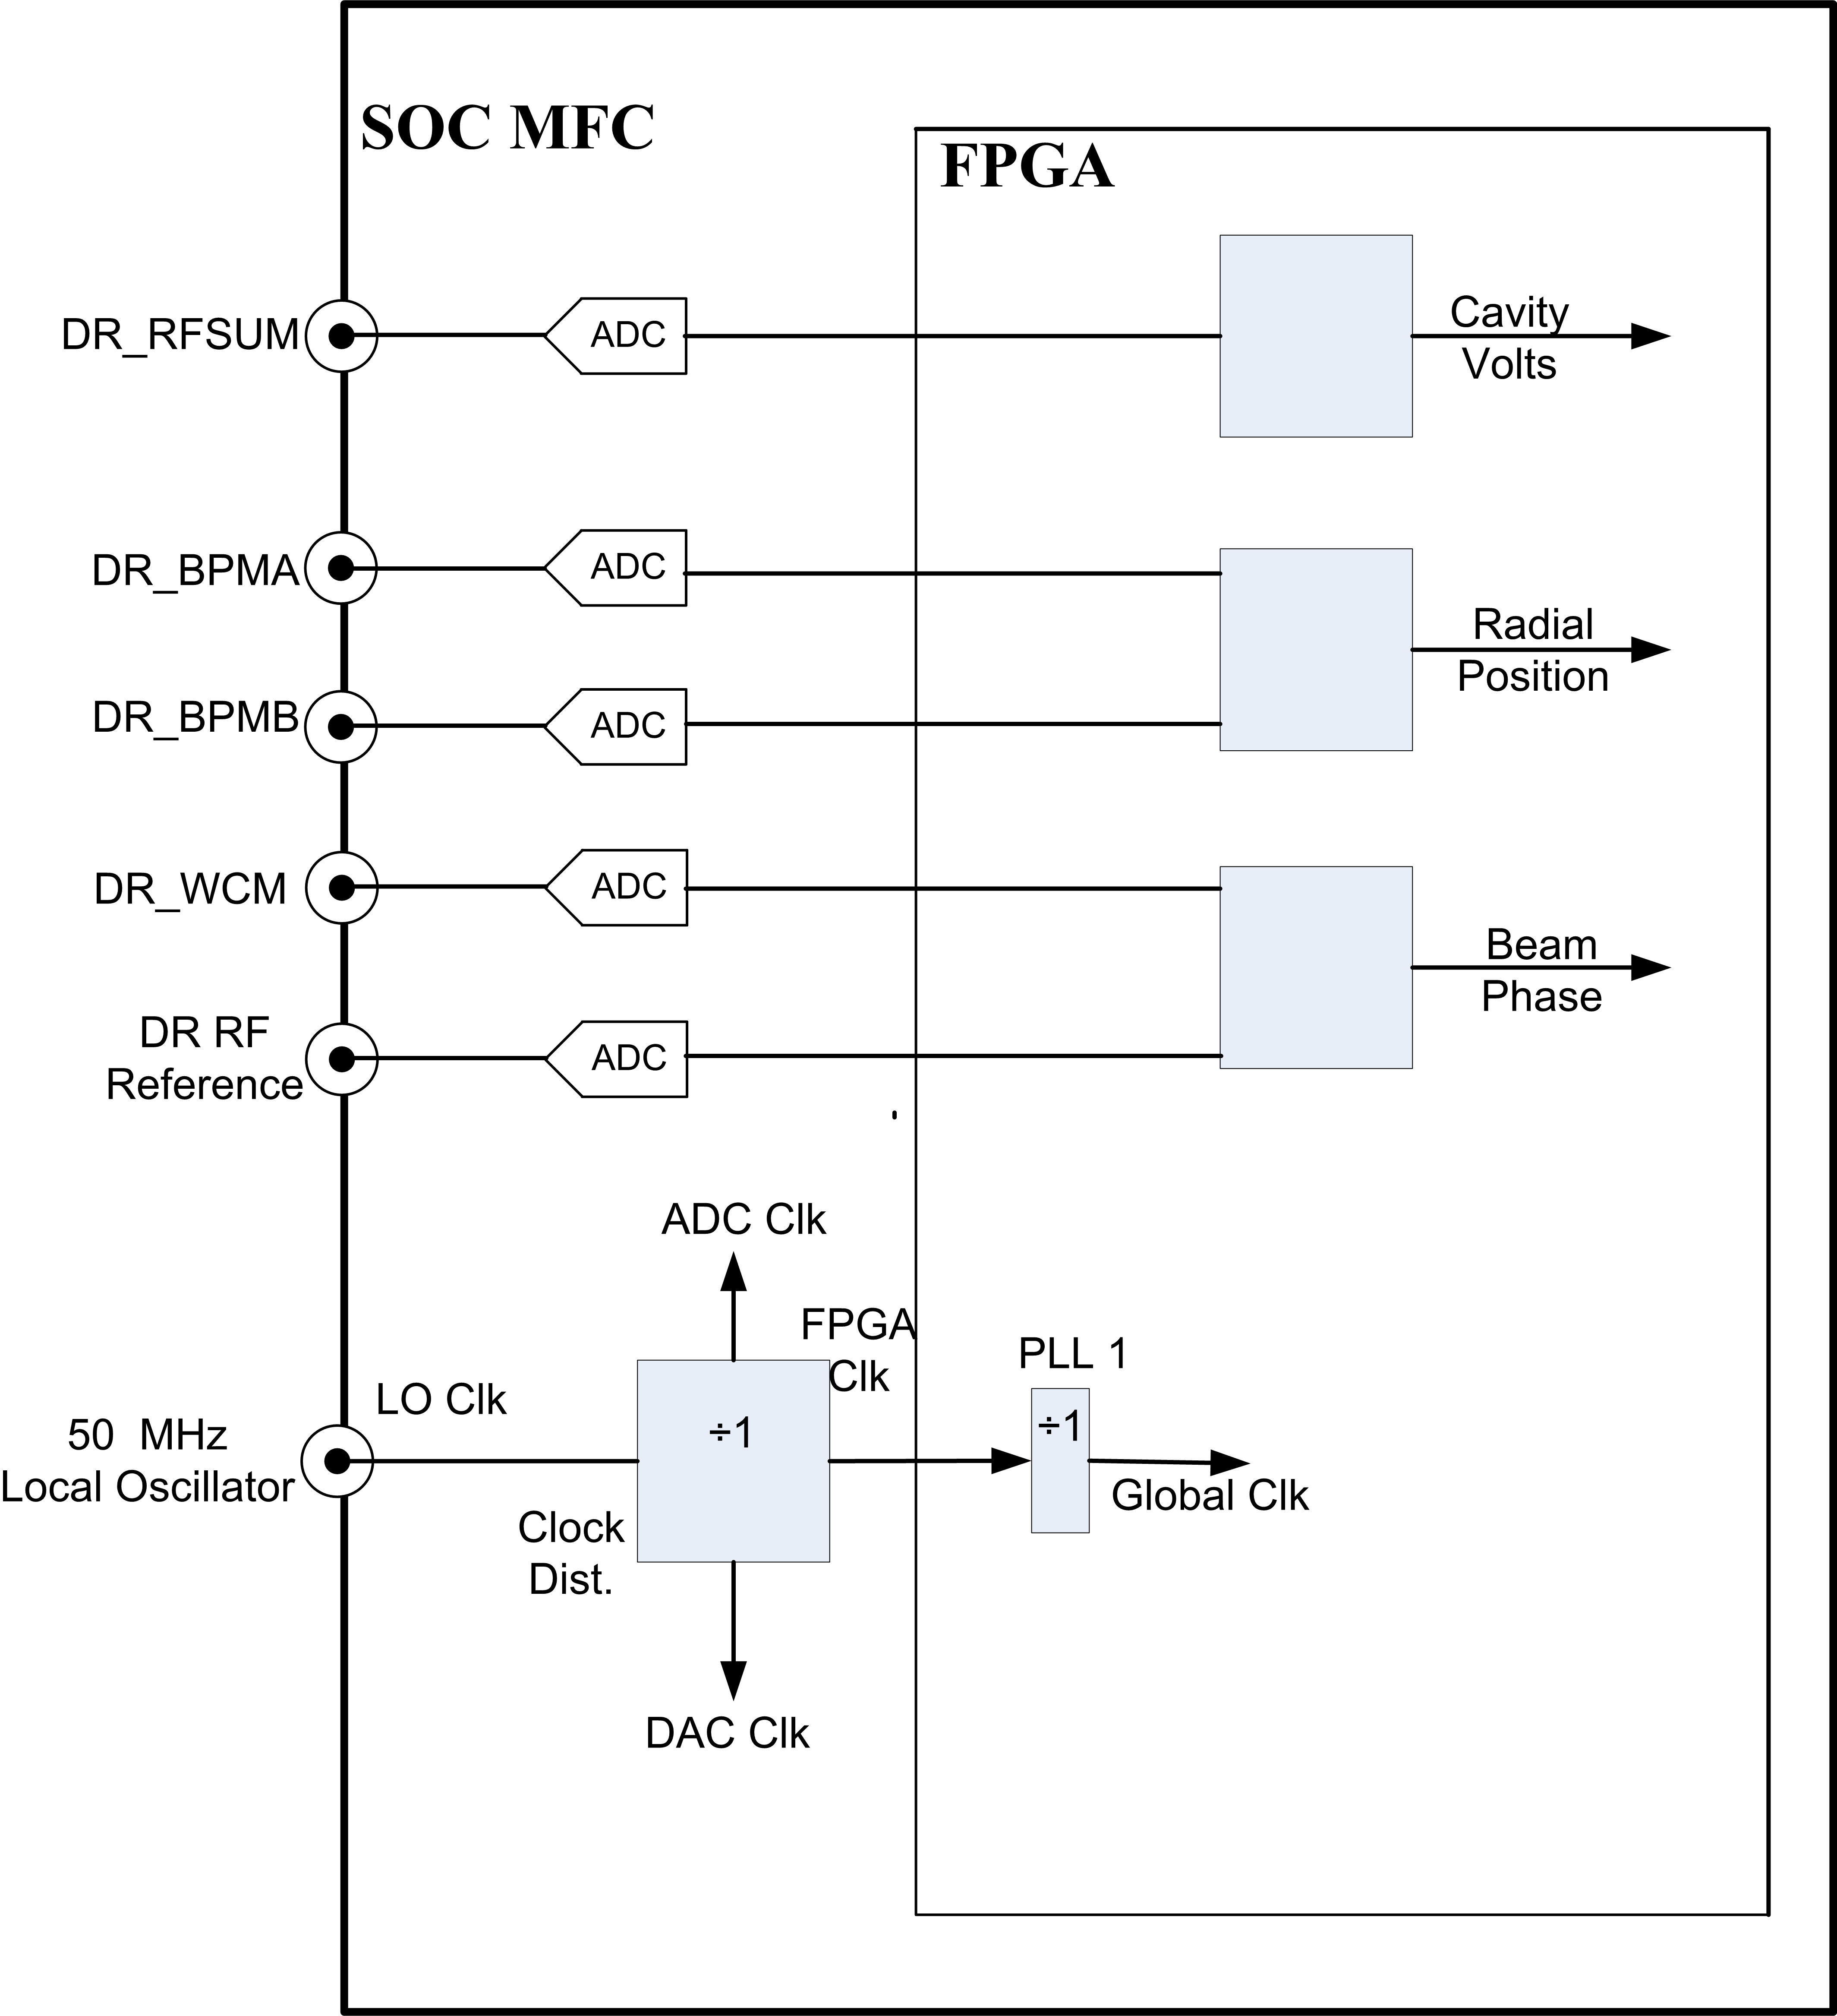
Beam Phase and Radial Position Measurement

Slide 25
Beam Phase and Radial Position Measurement Hardware

Slide 26
Summary
Delivery Ring LLRF and the Recycler 2.5 MHz LLRF systems are implemented in one VXI card located in the
same crate as the Recycler 53MHz LLRF system
The Recycler 53MHz, Recycler 2.5 MHz and Delivery Ring LLRF systems are tightly integrated allowing for various operational sequences to be supported.
The existing ACNET primary application page R6 will include new messages to support machine sequences involving the three LLRF systems

