Slide 1
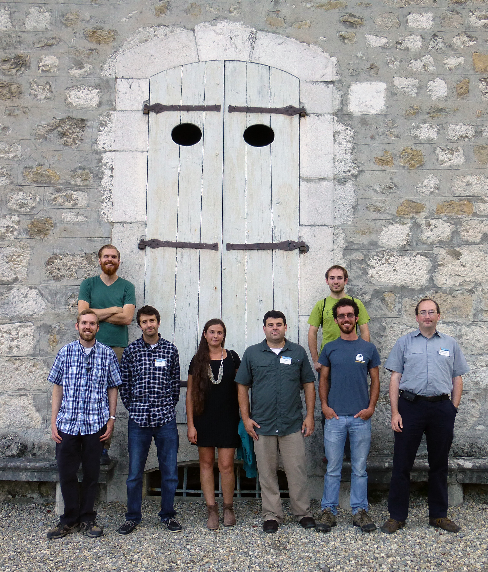




Microwave Kinetic Inductance Detectors for Dark Energy
Ben Mazin, November 2015
The UVOIR MKID Team:
UCSB: Ben Mazin, Seth Meeker, Matt Strader, Paul Szypryt, Gerhard Ulbricht, Alex Walter, Clint Bocksteigel, Giulia Collura, Neelay Fruitwala
JPL/IPAC: Bruce Bumble, Julian van Eyken
Oxford: Kieran O’Brien, Rupert Dodkins
Fermilab: Chris Stoughton, Juan Estrada, Gustavo Cancelo
Mazin Lab @

Slide 2
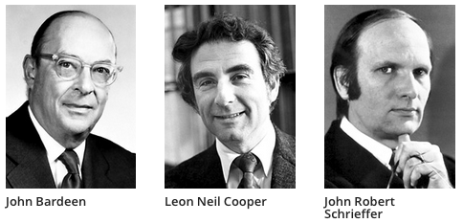
Superconductors
A superconductor is a material where all DC resistance disappears at a “critical temperature”. 9 K for Nb, 1.2 K for Al, 0.8 for our TiN
This is caused by electrons pairing up to form “Cooper Pairs”
  Nobel Prize to BCS in 1972
Like a semiconductor, there is a “gap” in a superconductor, but it is 1000-10000x lower than in Si
So instead of one electron per photon in a semiconductor, you get ~5000 electrons per photon in a superconductor – much easier to measure (no noise and energy determination)! We call these excitations quasiparticles.
However, superconductors don’t support electric fields (perfect conductors!) so CCD tricks of shuffling charge around don’t work
Excitations are short lived, lifetimes of ~50 microseconds

Slide 3
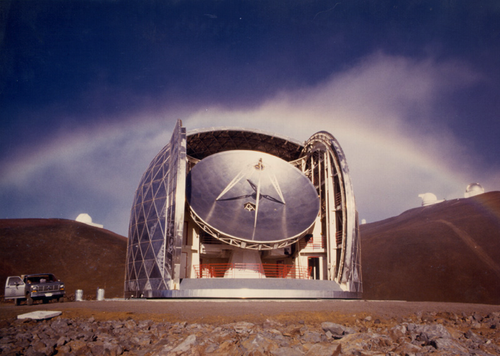
We can’t let the submm guys have all the fun!
The “submillimeter” approach to Astronomy:
  Build your own detectors
  Don’t be afraid of low temperatures
  Put them in an instrument
  Do science
Can this approach be productive in the UV/optical/near-IR where excellent commercially available detectors exist? Yes! Semiconductor detectors are powerful, but:
    Usually poor time resolution
    No intrinsic energy resolution
    Read Noise, Dark Current, Cosmic Rays
    Dispersion can lead to packing problems/inefficient use of array real estate and potentially being read noise limited

Slide 4
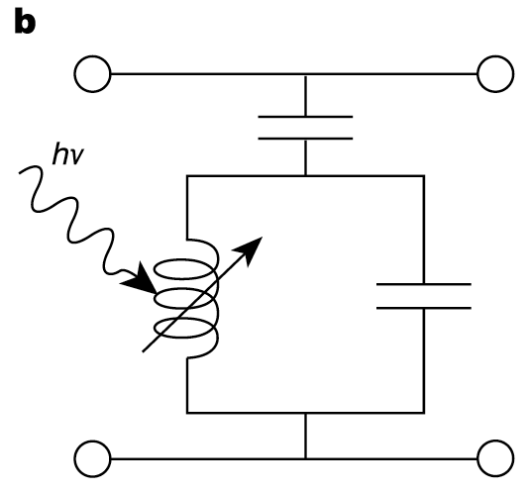
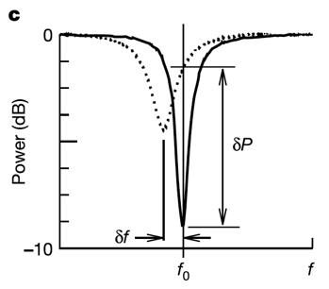
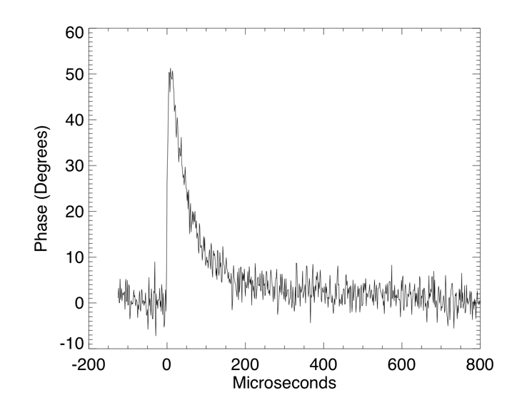
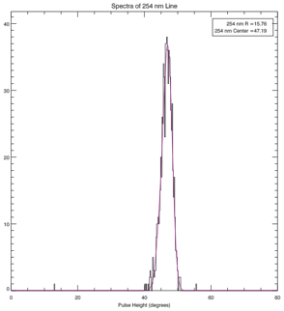
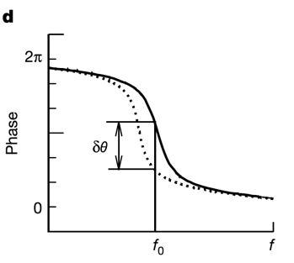
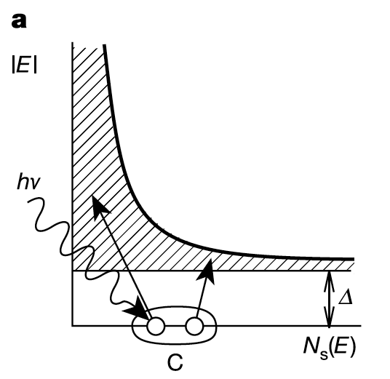

MKIDs
MKID Equivalent Circuit
Typical Single Photon Event
Inductor is a
Superconductor!
Energy Gap
Silicon – 1.10000 eV
Aluminum – 0.00018 eV
Energy resolution:
Cooper Pair

Slide 5
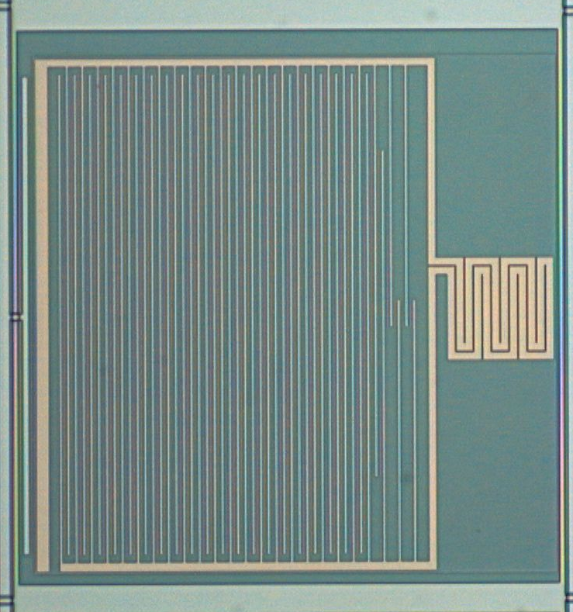
What is a Kinetic Inductance Detector ?
We use a square microlens array to improve effective fill factor to ~92%

Slide 6
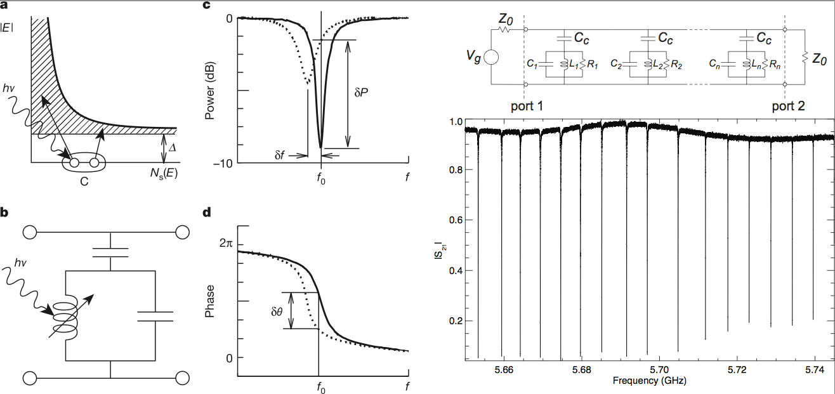
Frequency Domain Multiplexing
Each resonator (pixel) has a unique resonant frequency in the GHz range
A comb of sine waves is generated and sent through the device
Thousands of resonators can be read out on a single microwave transmission line (FDM)

Slide 7
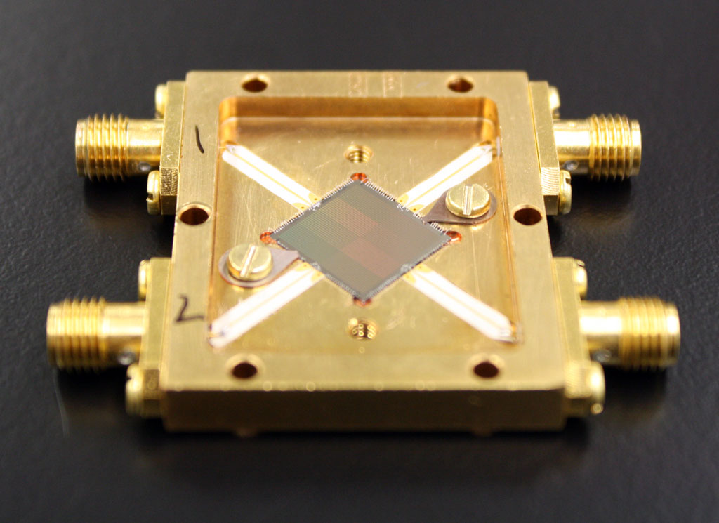
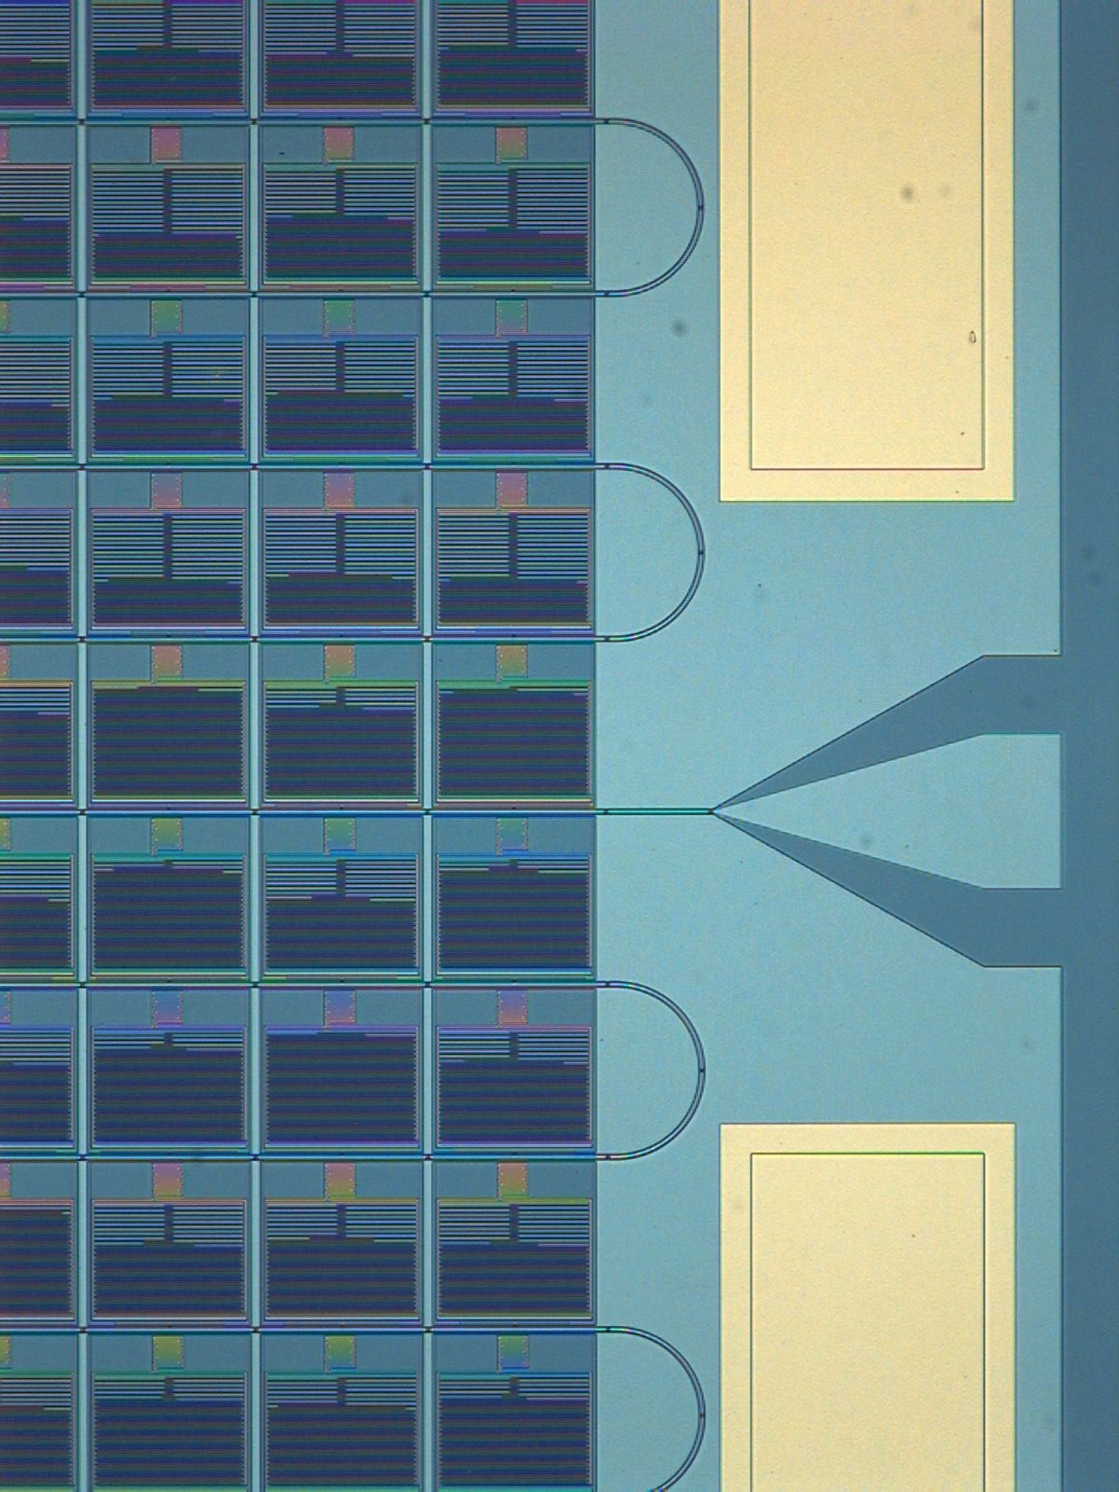
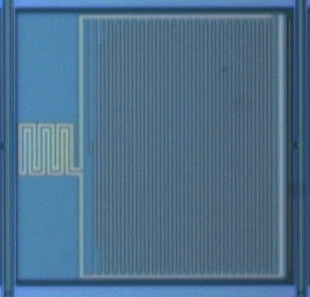
UVOIR MKIDs
Notes:
Note: Present a non-proprietary technical presentation on the technology selected to be of interest by the audience (Heliophysics and Astrophysics). Keep in mind your total presentation should be no more than 20 minutes allowing an additional 10 minutes for Q&A.
Suggested talking points:
Understanding of alignment with NASA mission(s)
Commercialization or government infusion plans/goals
Compare your technology to others in the marketplace or currently under development
Business alliances/partnerships and/or synergy with NASA, Industry, academia, and other government agencies.

Slide 8

UVOIR MKIDs
Current State-of-the-Art
2024 (44x46) pixel array
222 micron pixel pitch
2 feedlines
2 MHz resonator spacing
~92% resonator yield
~70% “good” pixel yield
  Frequency collisions dominate yield!
  More uniform TiN (multilayer, ALD, new materials) should significantly improve yield
110 mK operating temp.
Mazin et al. 2012, Optics Express, 20, 2

Slide 9
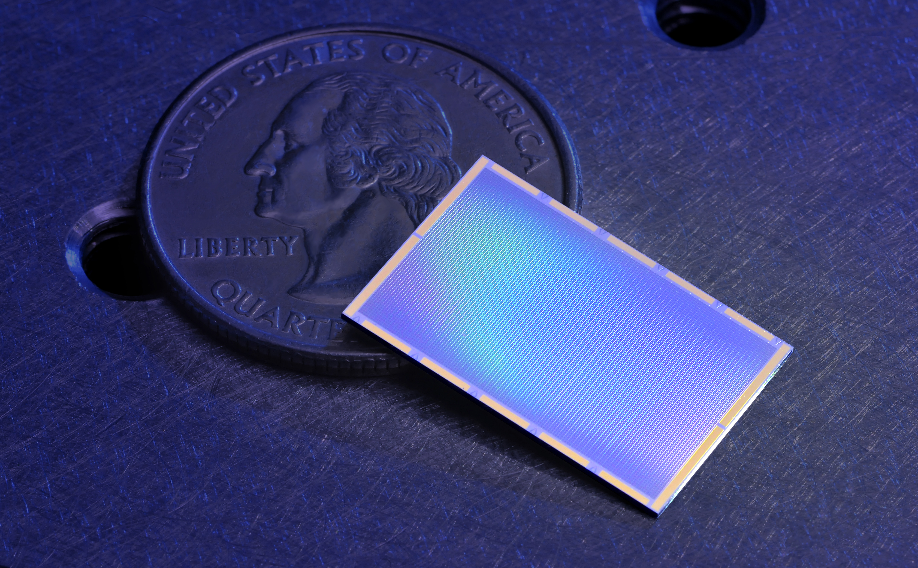
10 kpix DARKNESS Array
Funded to build 3 10-20 kpix instruments
DARKNESS for Palomar (NSF): 2016A
MEC for Subaru (Japan): 2016B
PICTURE-C Balloon (NASA): 2019

Slide 10
Digital MKID Readout
Software Defined Radio (SDR) Overview
  Leverages massive industry investment in ADCs/FPGAs
  Generate frequency comb and upconvert to frequency of interest
  Pass through MKID and amplify
  Downconvert and Digitize
  “Channelize” signals in a powerful FPGA
  Process pulses (optical/UV/X-ray) or just output time stream (submm)

Slide 11
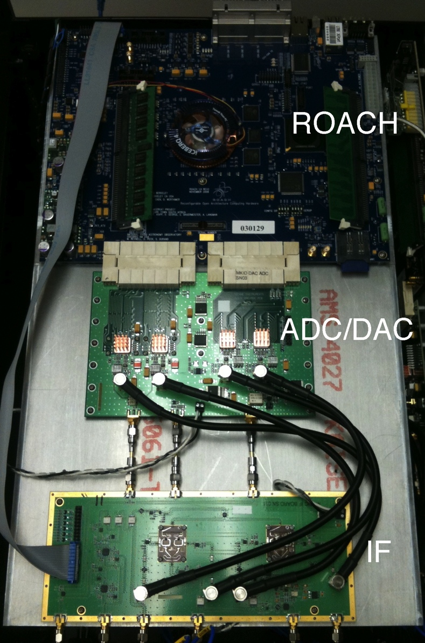
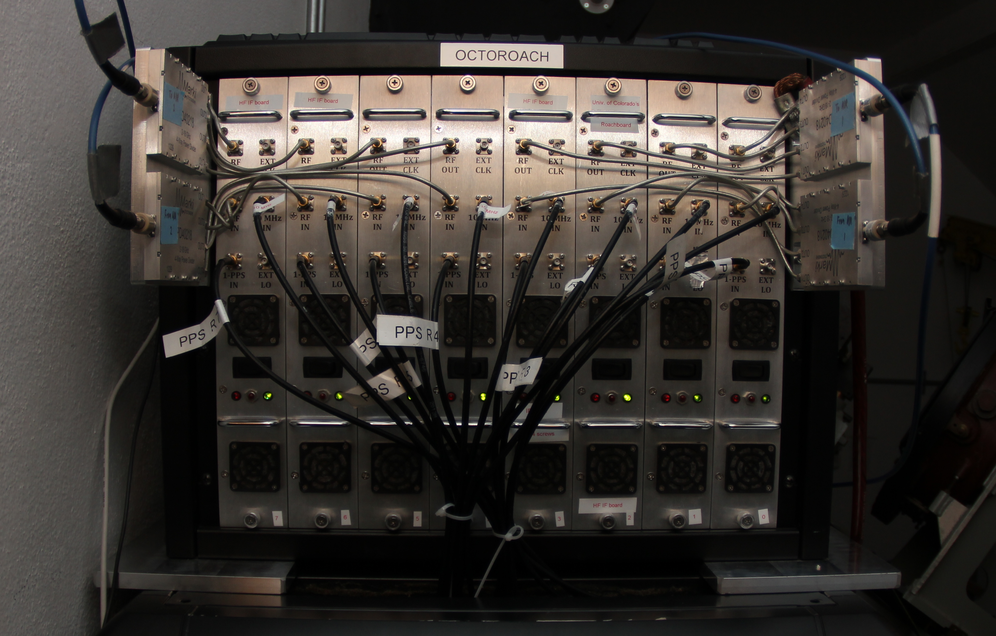
Current Readout System (Gen 1)
Dual 1 GSPS 16-bit DACs
Dual 550 MSPS 12-bit ADCs
ROACH with Virtex 5 SX95T
Complete readout for 256 resonators in 550 MHz of bandwidth
8 ROACH boards read out 2048 pix
~$25/pixel (Gen2 - $5/pixel)

Slide 12
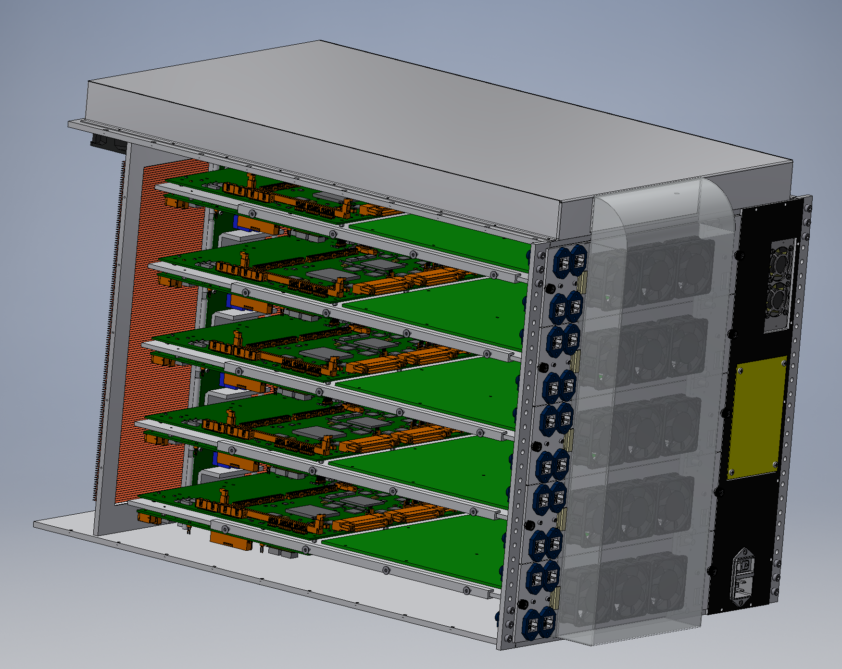
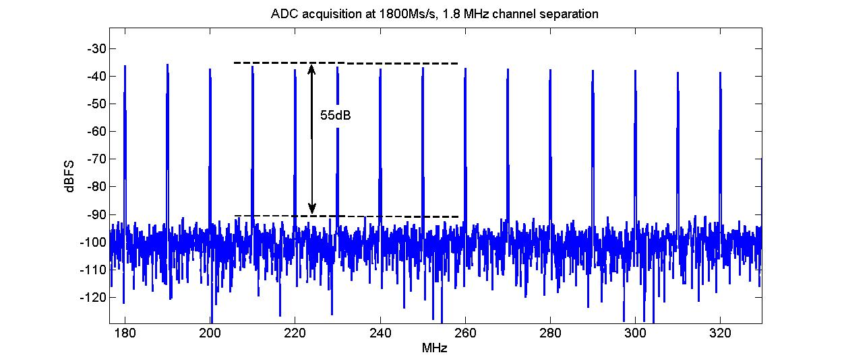
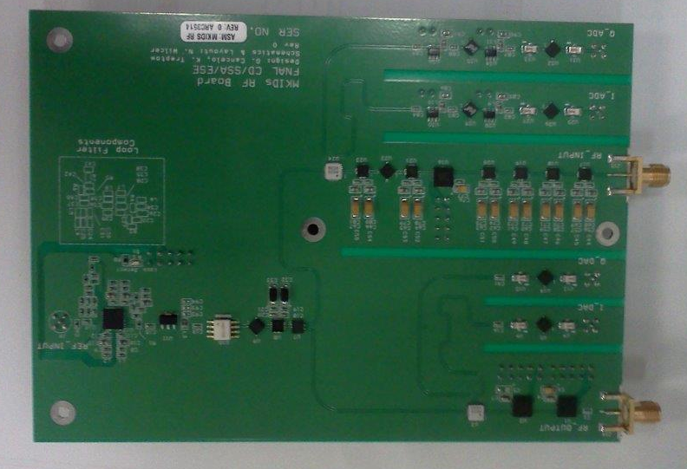
Gen 2 Readout
Designed in collaboration with Fermilab
Based on Casper ROACH2 (Virtex 6)
Uses dual 2 GSPS 12 bit ADC
Will read out 1024 resonators in 2 GHz
2 boards per feedline in 4-8.5 GHz band
  scalable to 30+ kpix
Incorporates many lessons from Gen1!
Prototypes by November
Cost Goal: ~$5-10/pixel, excluding HEMT and FPGA

Slide 13
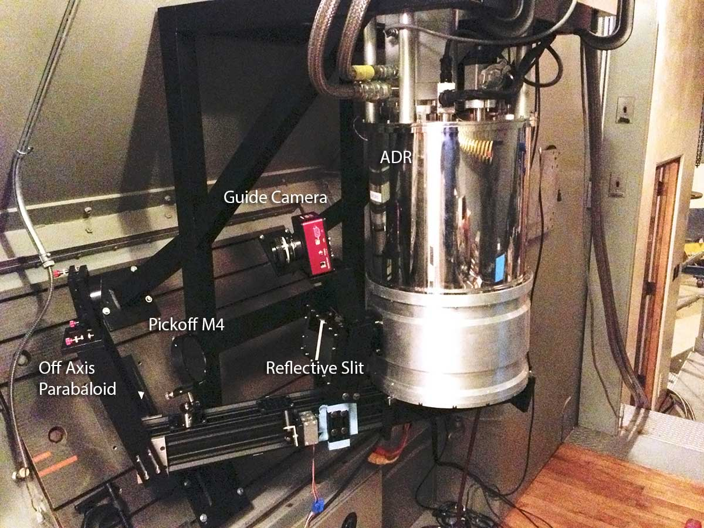
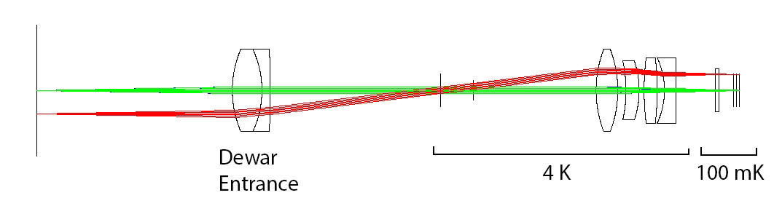
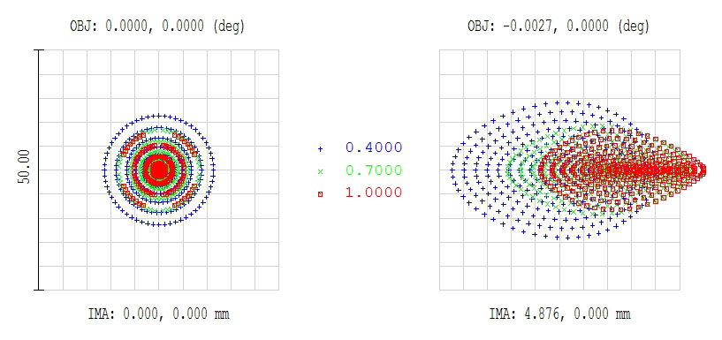
Proven at the Telescope with ARCONS
Array Camera for Optical to Near-IR Spectrophotometery (ARCONS)
First Light: July 28, 2011, Palomar 200” Coudé
Now 35 observing nights (Palomar+Lick)
Lens coupled 2024 (44x46) pixel array in cryogen-free ADR
0.4” pixels yields 20”x20” FOV
380 nm to 1150 nm simultaneous bandwidth with maximum count rate of ~2000 cts/pixel/sec
Energy resolution R~8 at 400 nm
Mazin et al. 2013, PASP

Slide 14
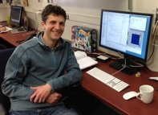
Data Pipeline
Man man-years already invested, many more to go…
Complex!
Data format is HDF5, with each photon stored as a 64-bit packet
van Eyken et al., ApJS 219, 14 (2015)
Open source, available at github.com/bmazin/ARCONS-pipeline

Slide 15
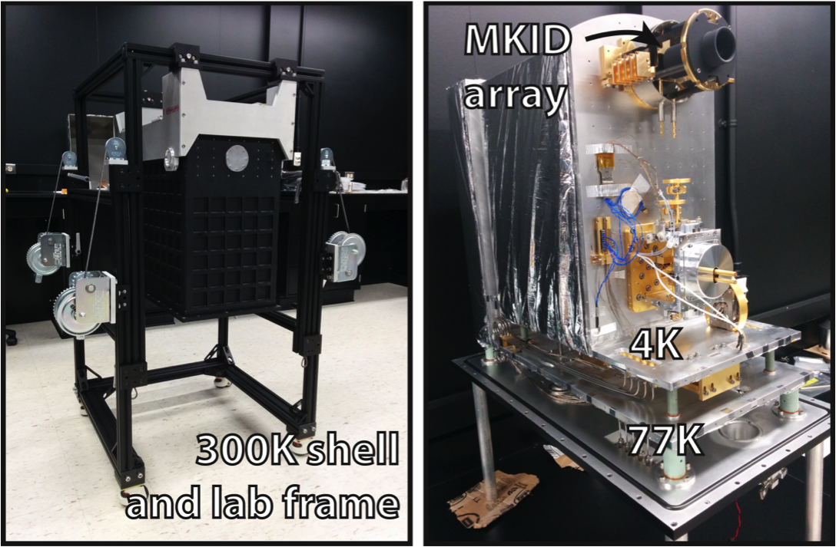
DARKNESS

Slide 16
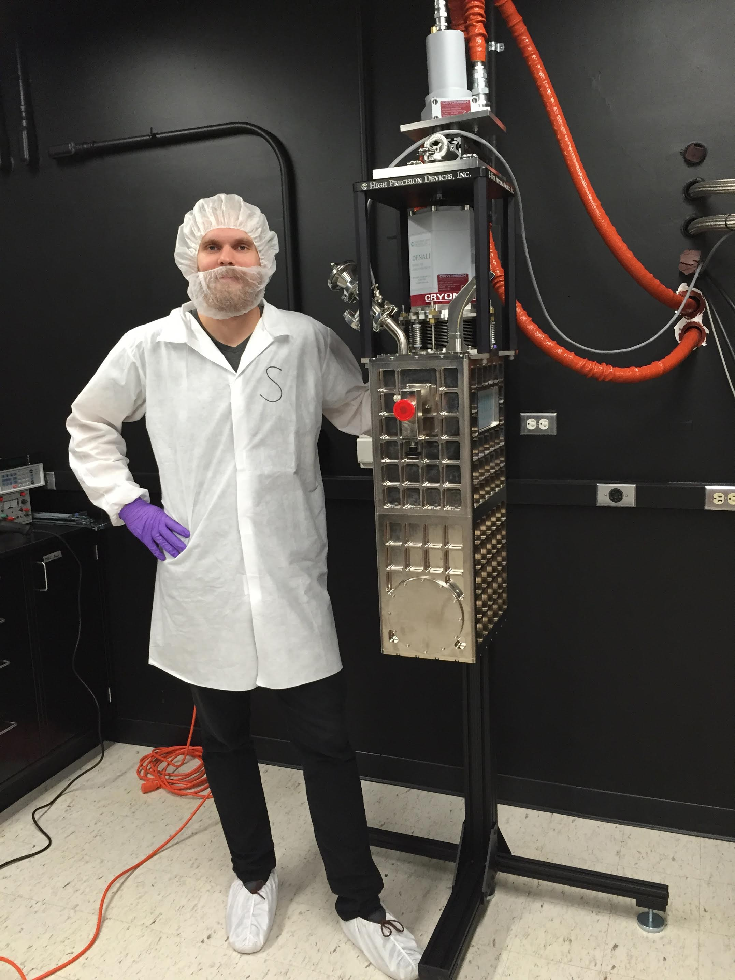
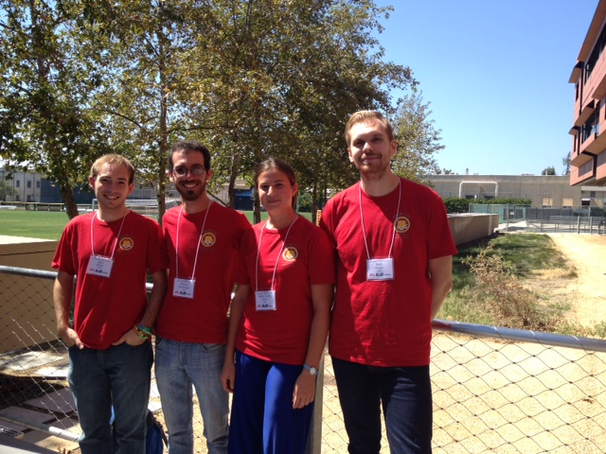
MEC
MEC is a 20 kpix version of DARKNESS for Subaru SCExAO
MKID Exoplanet Camera
MKID IFU
SCExAO at Subaru Observatory
  PIAA/Vector Coronagraph
Observe cold gas giants in reflected light ~2017
We have T-shirts

Slide 17
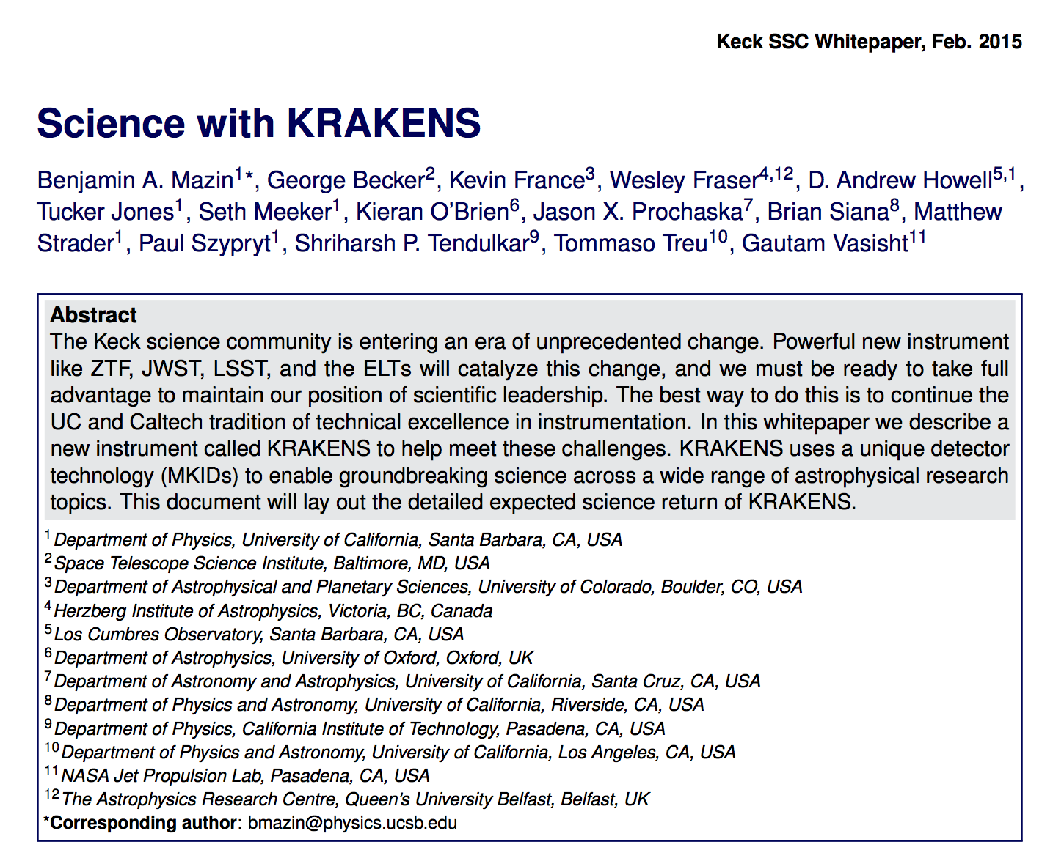
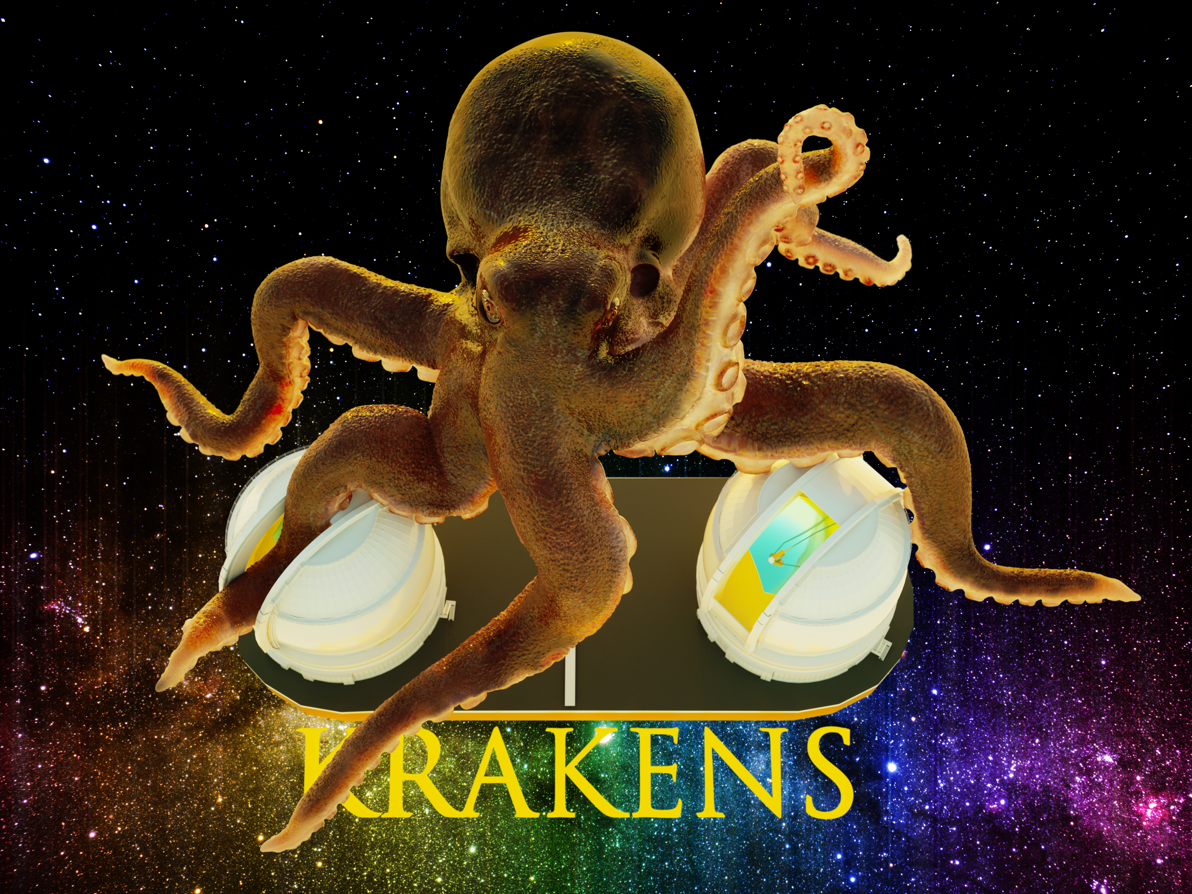
Other MKID Instruments
KRAKENS: A 1 square arcmin MKID imager for KECK
Giga-z: A 100,000 Object, 0.35-1.35 μm MKID MOS
  Marsden et al. 2013. ApJS, 208, 8

Slide 18
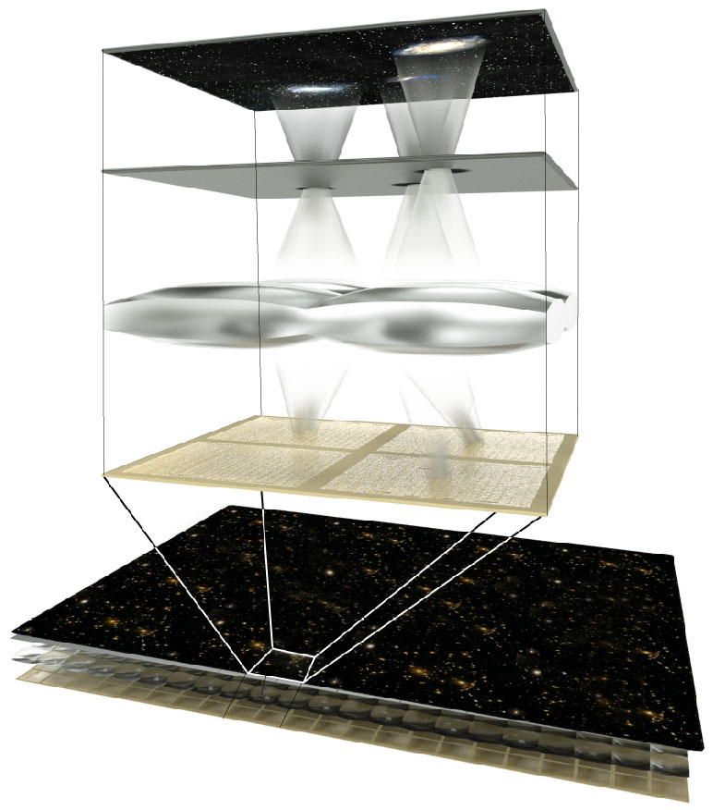
SuperMOS
SuperMOS: A Superconducting Multi-Object Spectrograph
Uses newly developed Microwave Kinetic Inductance Detectors (MKIDs)
A focal plane mask allows selection of sources
No dispersive optics – MKIDs provide the spectral resolution of R~50, 0.3-1.35 micron band
Scales to much larger number of simultaneous objects than fiber-fed solutions

Slide 19
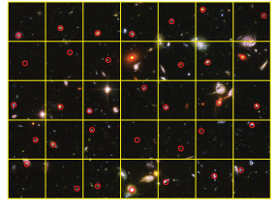
SuperMOS
Pre-existing imaging is used to select one galaxy per “macropixel”
A ~1” hole is drilled/burned in a metal mask (or shutter is opened, or DMM is actuated) at this location, allowing only light from a desired source through the mask
A reimaging system or microlens array takes the light from a hole anywhere in the macropixel and focuses it onto a single MKID
Uniquely maps 1 source to 1 MKID
Some fraction empty to sample sky for background subtraction

Slide 20
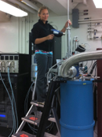
Giga-z Simulated Galaxy Spectra
Full Giga-z paper:
Marsden et al. 2013
ApJS, 208, 8
arXiv:1307.5066

Slide 21
Redshift Determination
Simulations show:
  σ_{z}/1+z ~ 0.01 for field galaxies
  σ_{z}/1+z ~ 0.005 for LRGs
LSST
Giga-z
3x better than LSST alone, with a much lower catastrophic failure rate

Slide 22
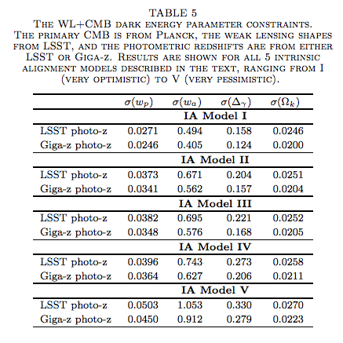
Weak Lensing with Giga-z
With weak lensing, adding Giga-z to LSST is equivalent to doing the 10-yr LSST survey again in the northern hemisphere.

Slide 23
What is KRAKENS
KRAKENS, the Keck Radiometer Array using KID ENergy Sensors, is a proposed Keck I Instrument
It is an 45”x45” (1’x1’) integral field spectrometer (IFS) with 32,000 (57,600) pixels
  0.25”/pixel to take advantage of good seeing
Each pixel is a photon counting, energy resolving MKID detector without read noise or dark current
0.38-1.2 (0.32-1.35) micron bandwidth
R~20 (40) at 0.4 micron, goes down linearly with λ
Mounted at bent Cass, with tight integration with K1DM3
Matches Keck Cass plate scale, uses only flat optics for very high throughput
Fore Modules can enable polarimeter, GRISM (bright objects!), exoplanet, and other modes
Significant time domain potential
Science case has been developed, available at arXiv:1506.03458

Slide 24
Science with KRAKENS
Compact Binaries
Exoplanet Transits
Lensing Clusters
Gravitational Wave Counterparts
Galaxies in the Epoch of Reionization
Kuiper Belt Objects
Strong Lensing
X-ray Binaries
Magnetars
Optical Pulsars
Protostars
Blind Surveys for High-z Galaxies
Supernovae
The Unknown

Slide 25
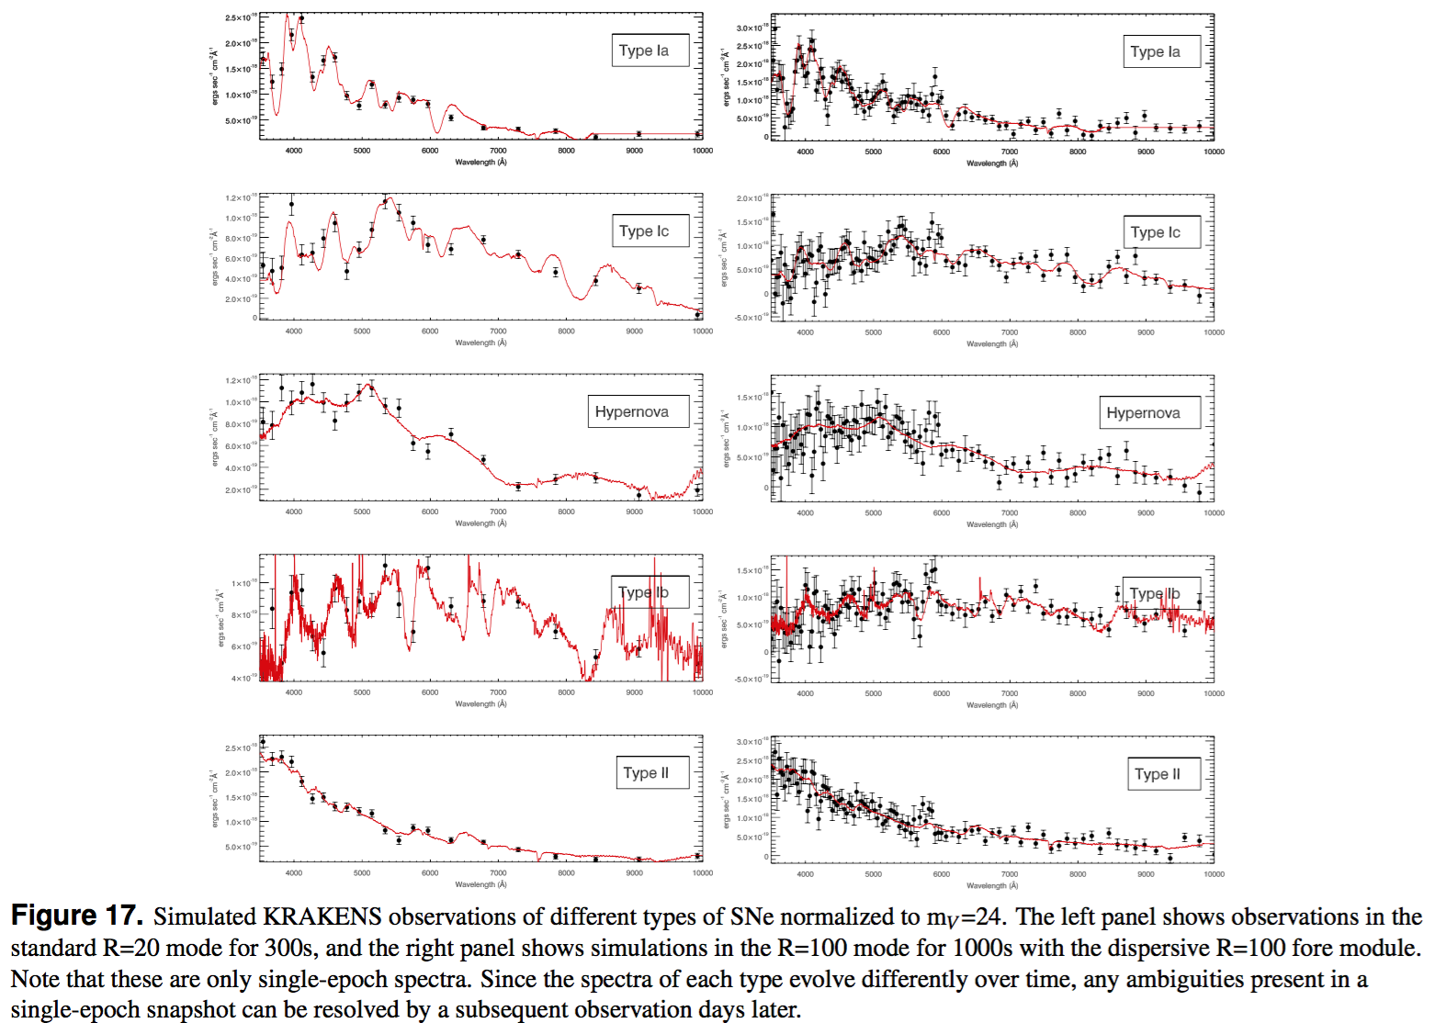
Supernova
“Only a few hundred SNe have been observed spectroscopically at z >0.5 ... A few night Keck run with KRAKENS would eclipse all previous studies done over several decades.”

Slide 26
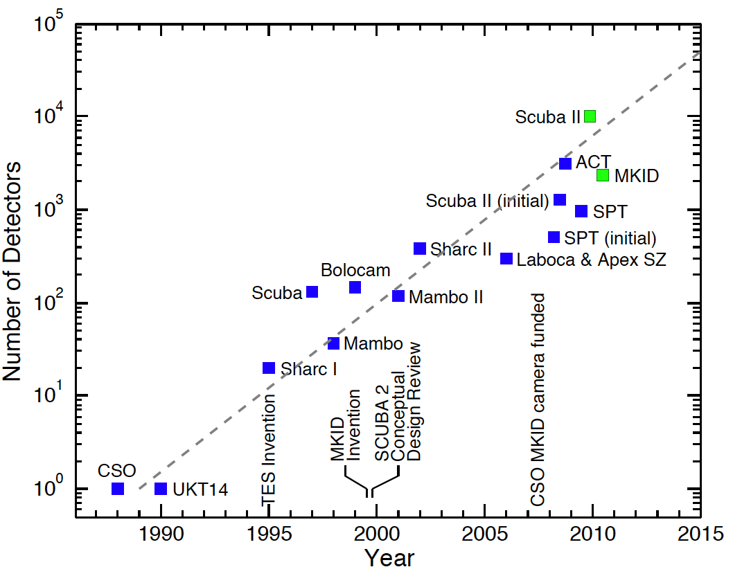
MKID Scaling
MEC
DARKNESS
NIKA2
ARCONS
Plot from J. Zmuidzinas
Original plot from J. Zmuidzinas

Slide 27
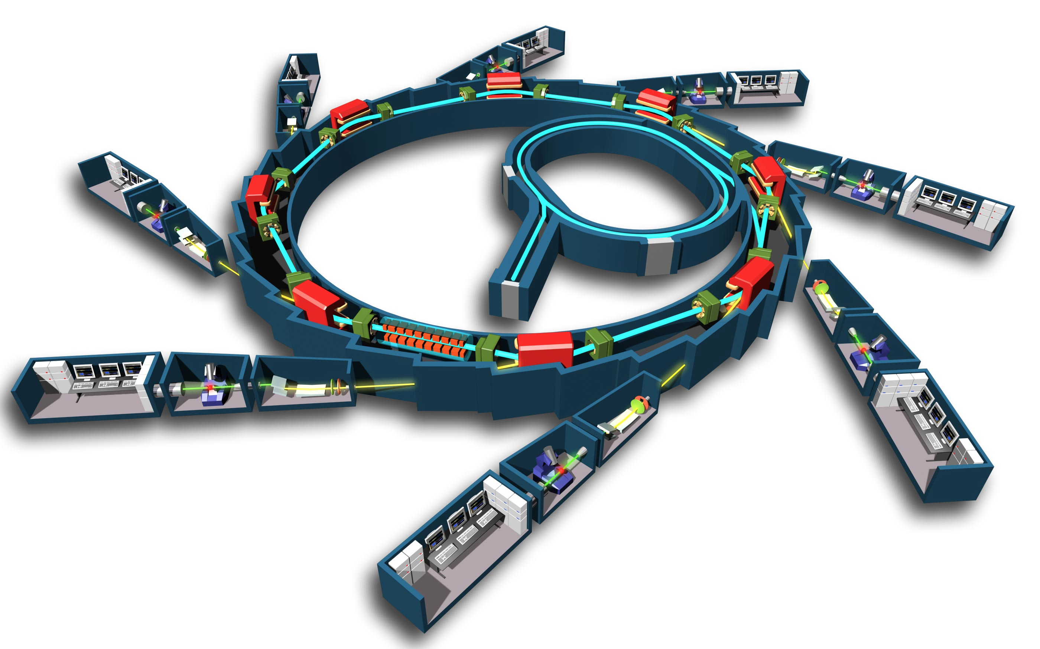
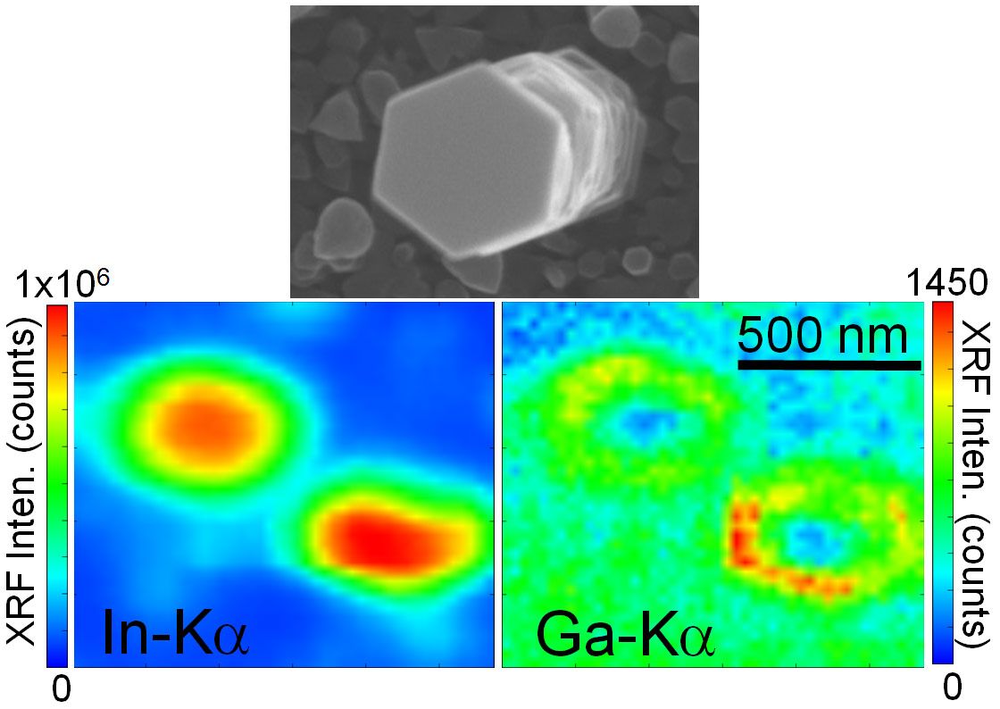
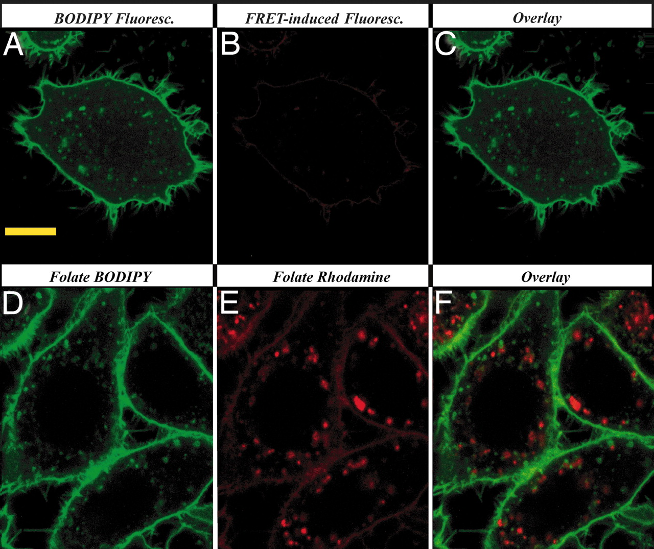
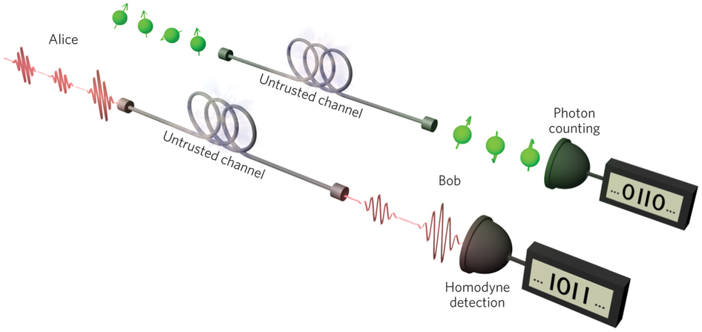
Other Applications
There are a significant number of other potential applications:
  Satellite-based Reconnaissance
  X-ray beam line studies
  Semiconductor process debugging (XRF)
  Laser communications
  Quantum Key Distribution
  Biological Imaging (FRET, etc.)

Slide 28
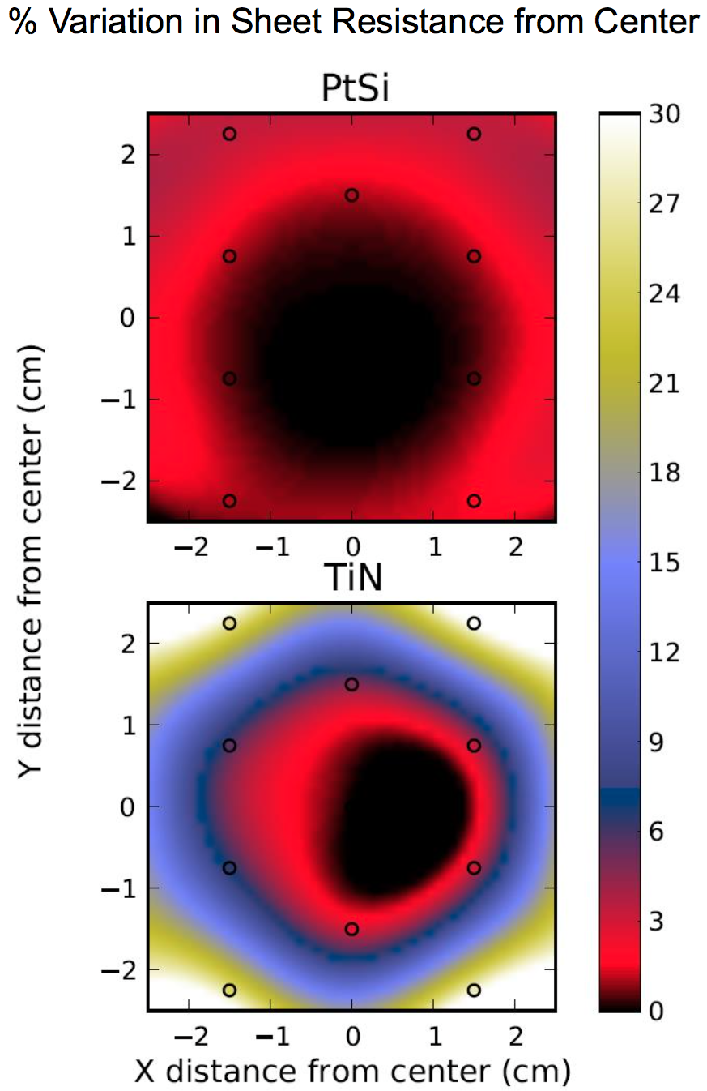
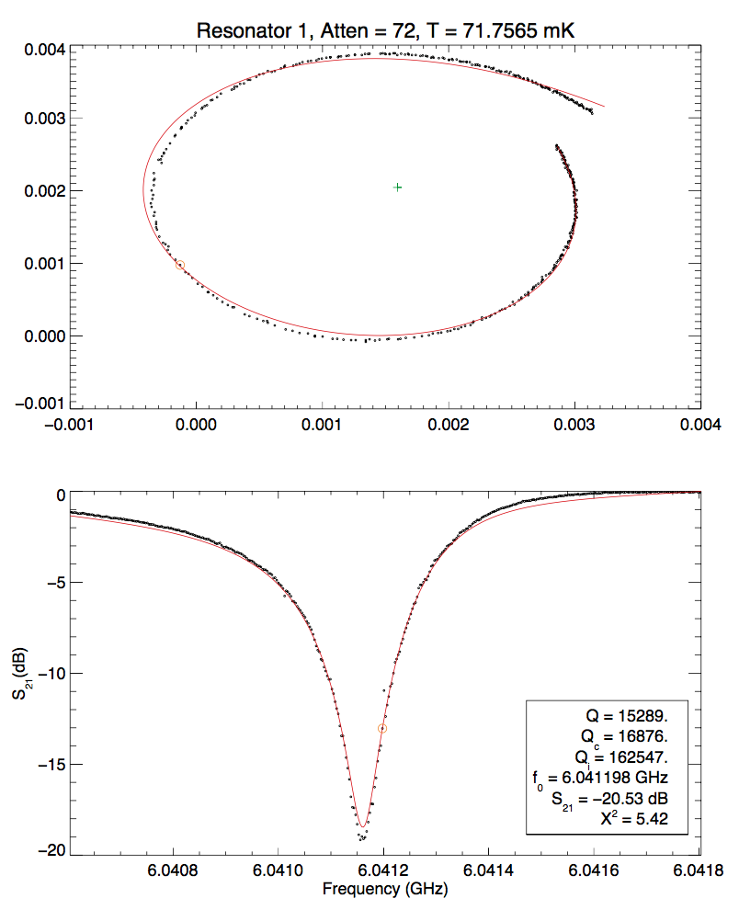
Yield
PtSi on sapphire
  Very uniform
    1% without trying hard
  Q_{i}>150K
  20 microsecond qp lifetimes
  R>8 already achieved

Slide 29
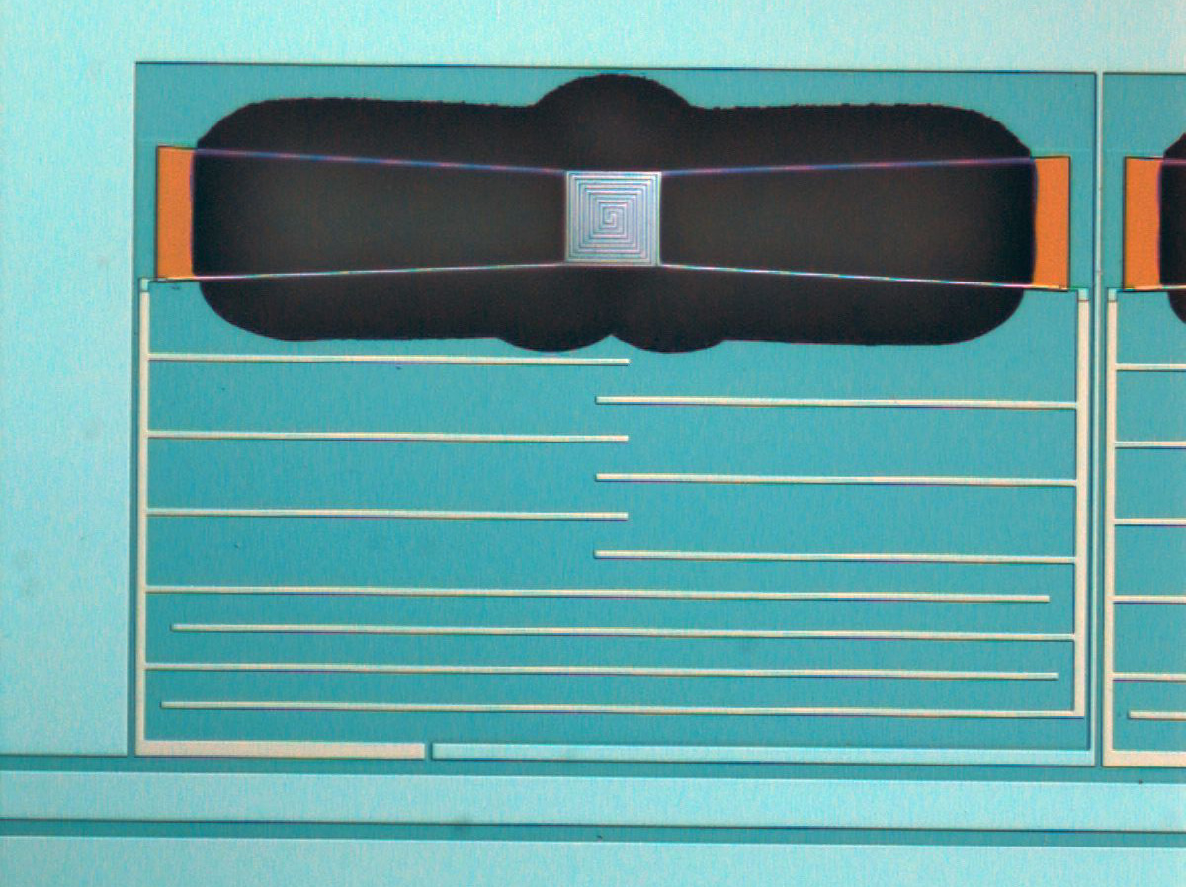
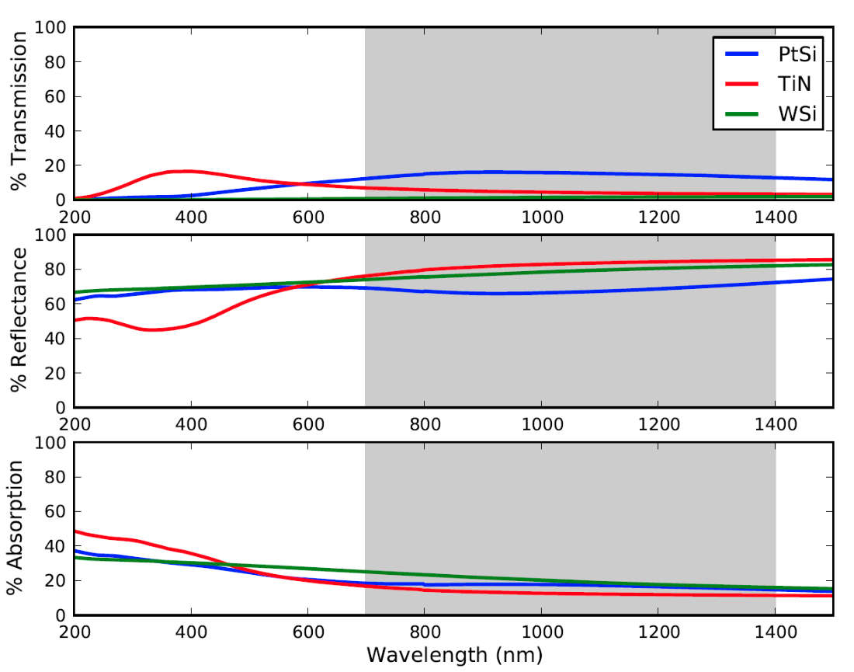
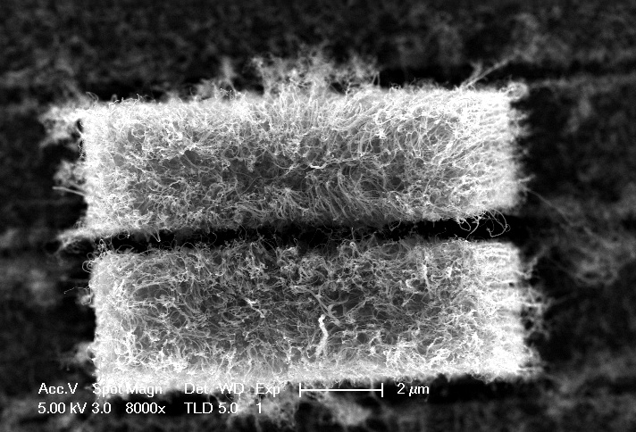
Quantum Efficiency
We need to improve QE for some applications

Slide 30
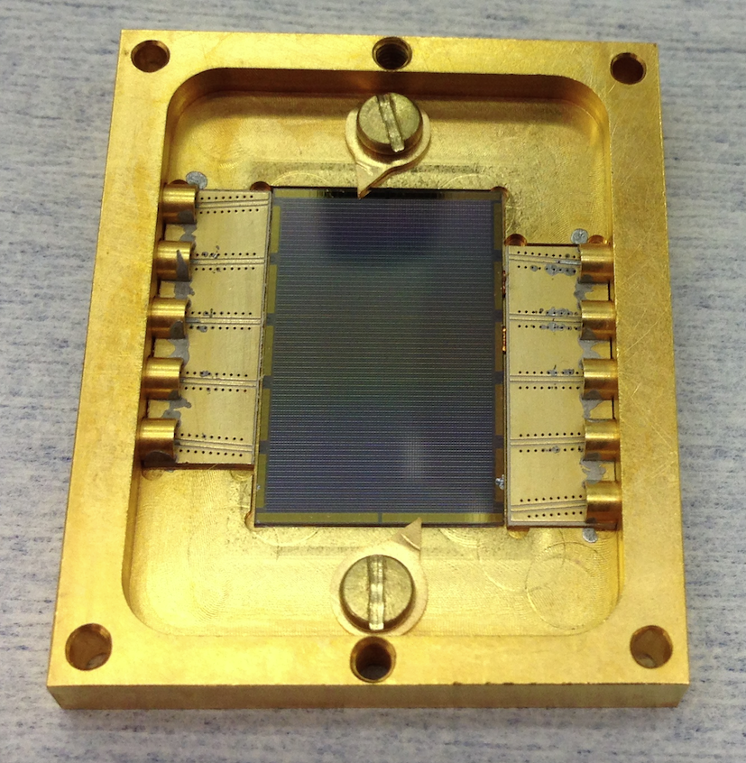
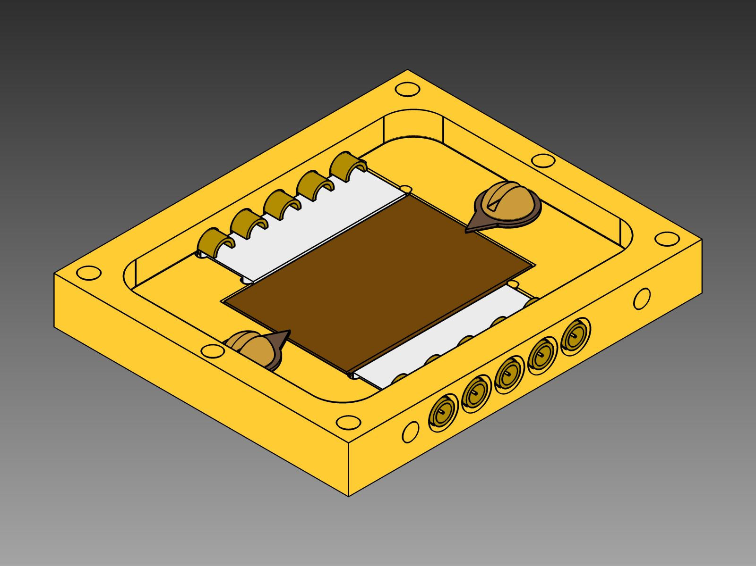
New Device Box
Moving to TINY G3PO connectors (this box ix 1.25” x 1.5” x 0.2”)

Slide 31
Photometric Stability for mV~15

Slide 32
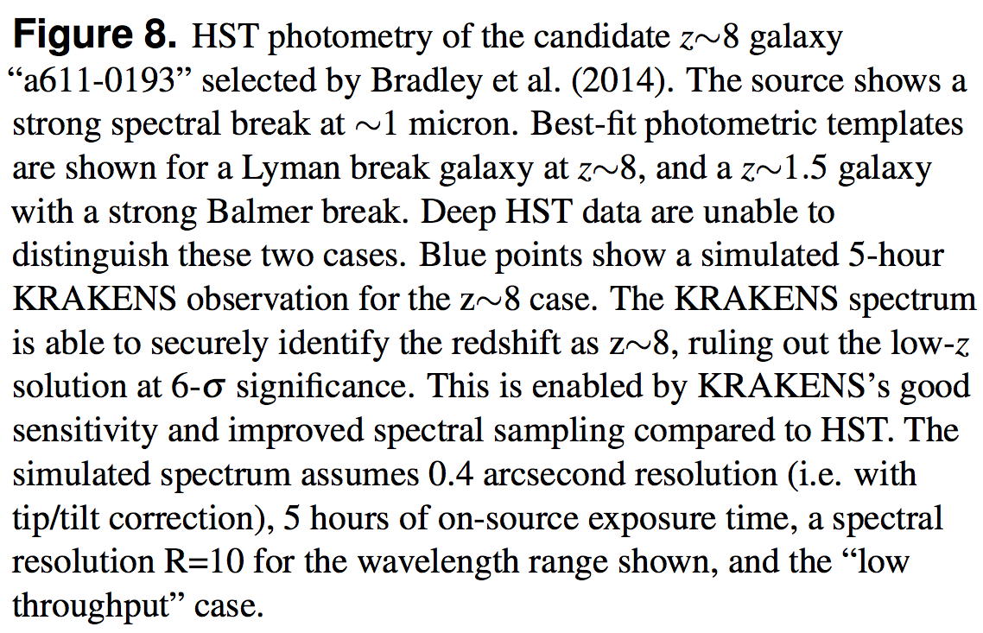
Science Case Highlights
Cluster science
  “This means KRAKENS can obtain obtain accurate redshifts from continuum spectra for hundreds of cluster members in 1/6th the time that VLT/MUSE would require. Alternatively, in the same amount of time, KRAKENS can measure continuum photometric redshifts for galaxies one magnitude fainter than VLT/MUSE. ”
High-z Galaxies
  “It will therefore enable higher fidelity surveys of the galaxy population at redshifts up to z > 8.”

Slide 33
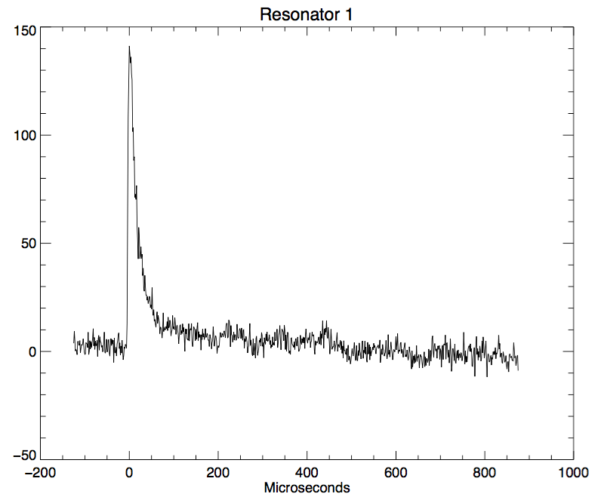
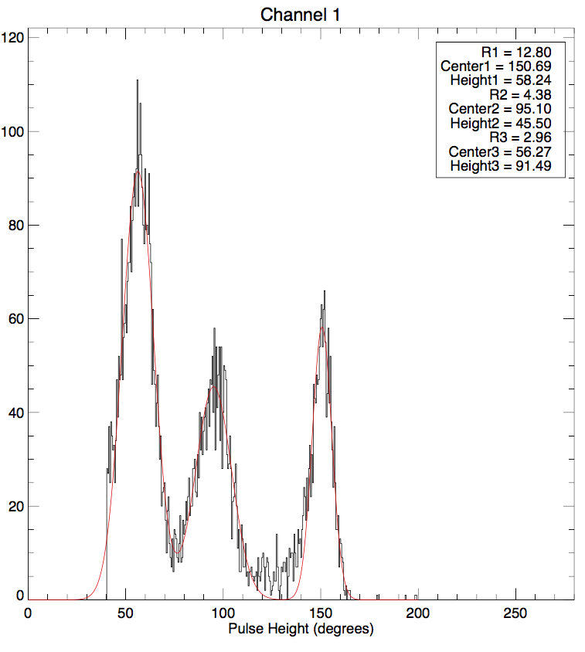
Energy Resolution
Our best detectors have R=12.5 at 400 nm, but their noise and pulse shape indicate they should have R~25
Possible explanations:
  Geometry effects
    Sims show OK to R>50
  Non-uniform TiN on microns scales
    Some STM evidence for this
  Hot phonon escape
    Calculations show OK to R>30
    (A. Kozorezov, private com.)
  Non-stationary noise/non-optimal
  analysis
    Certainly present, we have yet to
    quantify its effects

