Slide 1
3.9 GHz Cryomodule Design
Preliminary Design Review
Tom Peterson, Yun He, Matt Kramp
20 November 2015

Slide 2
Outline
Introduction, configuration and layout
Documentation list
Design overview
Summary
Additional information

Slide 3
LCLS-II Linac
Physics Requirements Document: “SCRF 1.3 GHz Cryomodule,”
LCLSII-4.1-PR-0146.
Thirty-five 1.3 GHz 8-cavity cryomodules
Two 3.9 GHz 8-cavity cryomodules
Four cold segments (L0, L1, L2 and L3) which are separated by warm beamline sections.

Slide 4
LCLS-II cryomodules: top level parameters
Cryomodule (CM) Parameters | Symbol | nom.value | Units
Cavity operating temperature | T­_{cryo} | 2 | K
# 9-cell cavities per cryomodule (1.3 GHz) | N_{cav} | 8 | -
# installed cryomodules (1.3 GHz) | N_{CM} | 35 | -
# 3.9-GHz cavities per 3.9 GHz CM | - | 8 | -
# 3.9 installed GHz cryomodules | - | 2 | -
# installed 1.3 GHz cryomodules in L0 | N_{CM0} | 1 | -
# installed 1.3 GHz cryomodules in L1 | N_{CM1} | 2 | -
# installed 3.9-GHz cryomodules as linearizer | N_{CMLH} | 2 | -
# installed cryomodules in L2 | N_{CM2} | 12 | -
# installed cryomodules in L3 | N_{CM3} | 20 | -
Physics Requirements Document: “SCRF 1.3 GHz Cryomodule,”
LCLSII-4.1-PR-0146.
Notes:
Magnet:
Conductively-cooled, split magnet prototypes have been tested
LCLS-II will include a quad/corrector dipoles / BPM package
Detailed magnetic design(s) will be made specific for LCLS-II

Slide 5
Documentation: Physics & Gen’l CM requirements
Document Reference Number | Document Title
 | Physics requirements
LCLSII-1.1-PR-0133 | LCLS-II Parameters
LCLSII-4.1-PR-0146 | 1.3 GHz Cryomodule
LCLSII-4.1-PR-0097 | SCRF 3.9 GHz Cryomodule
LCLSII-PR-2.4-0496 | Magnet Alignment Tolerances
LCLSII-2.4-PR-0081-R0 | Magnets
LCLSII-2.4-PR-0136 | Beam Position Monitor
 | General cryomodule requirements
LCLSII-2.5-FR-0053 | Functional Requirements Specification, "1.3 GHz Cryomodule"
LCLSII-4.5-ES-0356 | Engineering Specifications Document, “1.3 GHz Cryomodule Technical Description”
LCLSII-4.5-EN-0179 | Engineering Note, “Cryomodule Heat Load”
LCLS-II-4.5-EN-0186 | Engineering Note, “Cryogenic System – Cryomodule Design Methodology”
LCLSII-2.5-IC-0056 | Interface Control Document, “Accelerator Systems to Cryogenic Systems”
LCLSII-4.5-IC-0372 | Interface Control Document, "LCLS-II Cryomodule External Interfaces" (ED-0002307)
SLAC-I-720-0A24E-001 | Seismic Design Specification for Buildings, Structures, Equipment and Systems: 2014
LCLSII-4.5-EN-0226 | Engineering Note, “Cryomodule Seismic Design Criteria”
LCLSII-4.9-IC-0058 | Interface Control Document, "Cryogenic Distribution System"
LCLSII-4.5-EN-0214 | Cryomodule Design Heat Flux for Vacuum Failures
LCLSII-4.1-FR-0096-R0 | Functional Requirements Specification, “3.9 GHz Superconducting RF Cryomodule”

Slide 6
Documentation: CM components
Document Reference Number | Document Title
 | About cryomodule components
LCLSII-4.5-ES-0411 | Fermilab Engineering Specification, "LCLS-II Cryomodule Vacuum Vessel"
LCLSII-4.5-ES-0412 | Fermilab Engineering Specification, "LCLS-II Cryomodule HGRP"
LCLSII-4.5-ES-0055 | Engineering Specifications Document, “Fundamental Power Coupler"
LCLSII-4.5-IC-0237 | Interface Control Document, “Fundamental Power Coupler”
LCLSII-4.5-EN-0221 | Engineering Note, “Tuner electro-mechanical design”
LCLSII-4.5-ES-0385 | Cryomodule SRF Cavity Tuner
LCLSII-4.5-EN-0222 | Magnetic Shielding: Requirements and Possible Solutions
LCLS-II-4.5-EN-0310 | Engineering Note, “A Study of Magnetic Shielding Performance of a Fermilab International Linear Collider Superconducting RF Cavity Cryomodule”
LCLSII-4.5-ES-0413 | Fermilab Engineering Specification, "LCLS-II Prototype Cavity Magnetic Shield Specification"
LCLSII-4.5-ES-0355 | Engineering Specifications Document, "Cryomodule Magnet"
LCLSII-EN-0286 | Engineering Note, “Vacuum System Safety Plan”
LCLSII-4.5-IC-0237 | Interface Control Document, “Fundamental Power Coupler”
LCLSII-4.5-ES-0414 | Engineering Specifications Document, “CM Coaxial Cable and Connectors Specification"
LCLSII-4.5-ES-0415 | Engineering Specifications Document, “Prototype Cryomodule Sensors Specification"
LCLSII-4.5-ES-0416 | Engineering Specifications Document, “Multi-pin Connectors"
LCLSII-4.5-ES-0417 | Engineering Specifications Document, “Prototype Cryomodule Sensor Wiring"
LCLSII-4.5-ES-0418 | LCLS-II 1.3 GHz Cryomodule Stand Design
LCLSII-4.5-ES-0419 | LCLS-II 1.3 GHz Cryomodule Transport System
Fermilab document | LCLS-II Magnet Package Design, Fabrication, and tests, May 6, 2014
LCLSII-4.5-ES-0403 | Cold Button Beam Position Monitor
F10023160 | LCLS-II Cold BPM Assembly Drawing

Slide 7
Documentation: CM details, analyses, compliance
Document Reference Number | Document Title
 | Cryomodule engineering details, analyses, and compliance documents
F10009945 | Assembly, 1.3GHz Cryomodule LCLS-II (model)
F10022915 | LCLS-II Prototype Cryomodule P&ID (drawing)
ED0001152 | Master Spreadsheet 1.3GHz CM-LCLS-II (cryomodule dimensional details)
ED0001995 | LCLS-II CDS Relief System Analysis
ED0002339 | Fermilab Engineering Note, LCLS-II Cryomodule Vacuum Vessel (FESHM conformance)
ED0002337 | Fermilab Engineering Note LCLS-II Vacuum Vessel FEA Structural Analysis
ED0002396 | Cryomodule vacuum vessel venting calculation
ED0002383 | Procedure for Support Post Traction Test (Draft)
ED0002112 | Fermilab Engineering Specification, LCLS-II Cryomodule Beam Pipe Copper Plating
ED0002026 | Assembly Procedure for LCLS-II Support Post (Draft)
ED0002454 | LCLS-II 1.3GHz Prototype Cryomodule Instrumentation List
ED0002638 | P&ID (instrumentation) tag name list
ED0002593 | Inter-connect assembly procedures
ED0002453 | JT valve sizing and flow calculation
ED0002406 | Cool-down valve sizing and flow calculation
ED0002405 | Cryomodule two phase pipe pressure, vapor velocity, and venting calculation
ED0002404 | Cryomodule cooldown line pressure, flow, and venting calculation
ED0002962 | Cryomodule cavity helium circuits
ED0002403 | Cryomodule two phase pipe valve sizing calculation
ED0002340 | LCLS-II Inter-module bellows unit specification
EN0001803 | Cryomodule piping engineering note (FESHM piping standard)
Fermilab draft document | Electric heater sizing, design, implementation engineering note
ANL/Fermilab document | Thermal intercept analyses (ANL effort)
LCLSII-4.5-EN-0430 | Stress Analysis of LCLS II Cryomodule for Seismic Load
LCLSII-4.9-EN-0253 | CDS/Cryomodule What-If Analysis
LCLSII-4.9-EN-0255 | CDS/Cryomodule Failure Mode and Effects Analysis
EN01774 | Dressed cavity helium vessel engineering note (cavity AES035, FESHM conformance)
EN01748 | Dressed cavity helium vessel engineering note (cavity AES027, FESHM conformance)
ED0003252 | Fermilab Engineering Specification, "LCLS-II Cryomodule Cold Mass Upper Sub-assembly"

Slide 8
Documentation: CM other references docs & pubs
Document Reference Number | Document Title
 | Other reference documents and publications
TESLA report #94-18 (June, 1994). | “Notes about the Limits of Heat Transport from a TESLA Helium Vessel with a Nearly Closed Saturated Bath of Helium II”, by Tom Peterson, Fermilab
REVIEW OF SCIENTIFIC INSTRUMENTS 81, 074701 (2010). | O. Kugeler, A. Neumann, W. Anders, and J. Knobloch, Helmholtz-Zentrum-Berlin (HZB), 12489 Berlin, Germany, “Adapting TESLA technology for future cw light sources using HoBiCaT”
Advances in Cryogenic Engineering, Vol 43B, pp. 1441 - 1448 | "Latest Developments on He II Co-current Two-phase Flow Studies," by B. Rousset, A. Gauthier, L. Grimaud, and R. van Weelderen, in Advances in Cryogenic Engineering, Vol 43B (1997 Cryogenic Engineering Conference).

Slide 10
“First Light”, 1 cryoplant with 2 cryomodule strings
CP-1
Early
“First Light”
CP-2
Normal Beam
Operations
U-tube TL Jumper Connections

Slide 11
Normal beam operations 2 cryogenic plants with 2 cryomodule strings
CP-1
Normal Beam Operations
CP-2
Normal Beam
Operations
U-tube Jumper Connections removed

Slide 12
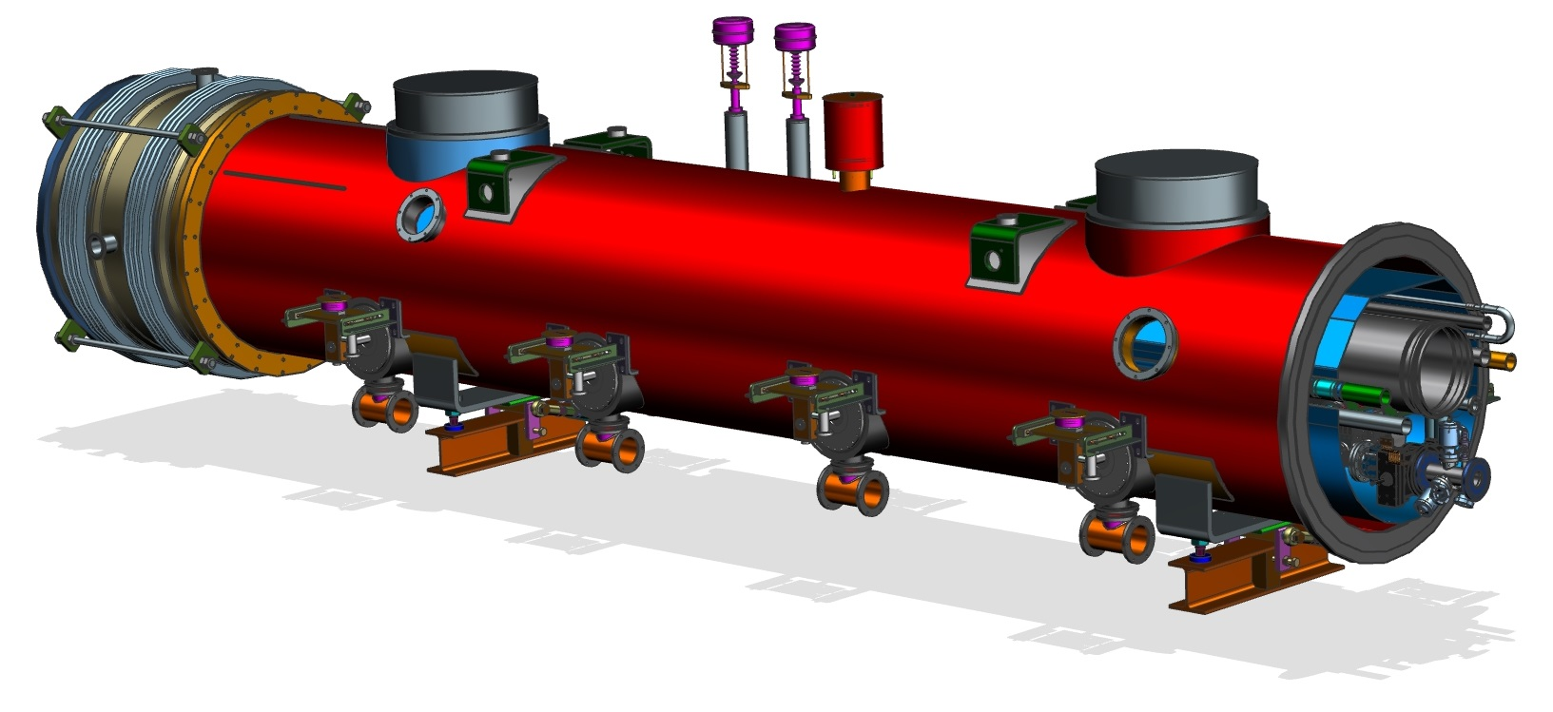
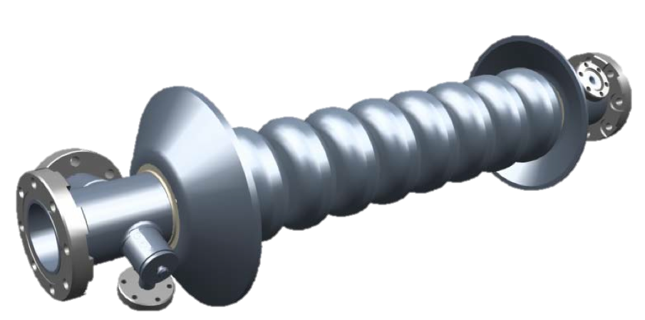
3.9 GHz cryomodule (two needed)

Slide 13
Design strategy
Build on successful implementation now in operation at FLASH
Many lessons learned and subsequently applied
XFEL experience
LASA, Milano has adapted our design and used us as a resource including test verification
reciprocal collaboration in progress
Apply LCLS-II 1.3 GHz CM as much as possible
lower risk, but sequential (series) design process
will supplement plans for Design Verification
Common procurements e.g. instrumentation
Common transport fixture
CMTS can accommodate both types of CM’s
Primary design issues
Tuner (modification to add piezos to existing blade tuner design)
RF Power Input Coupler for CW operation
Cavity dynamic heat – larger diameter 2-phase chimney
Reduce trapped modes – minor change to ends, but not cavity

Slide 14
3.9 GHz cryomodule flow scheme

Slide 15
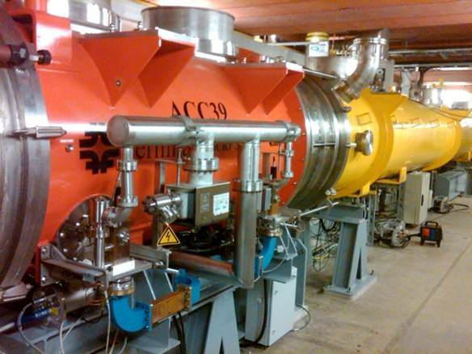
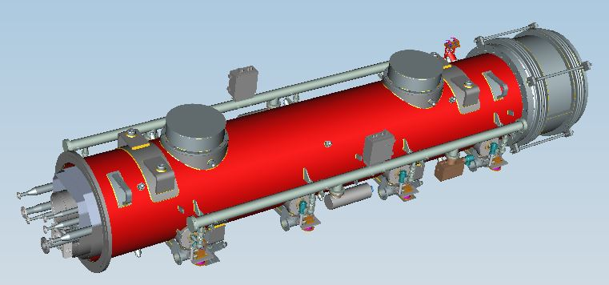
3.9 GHz cryomodules – prior experience
4-cavity 3.9 GHz cryomodule designed
and built at Fermilab for FLASH at DESY,
in operation. Shown here in the linac.
3.9 GHz cryomodule for XFEL design by INFN

Slide 16
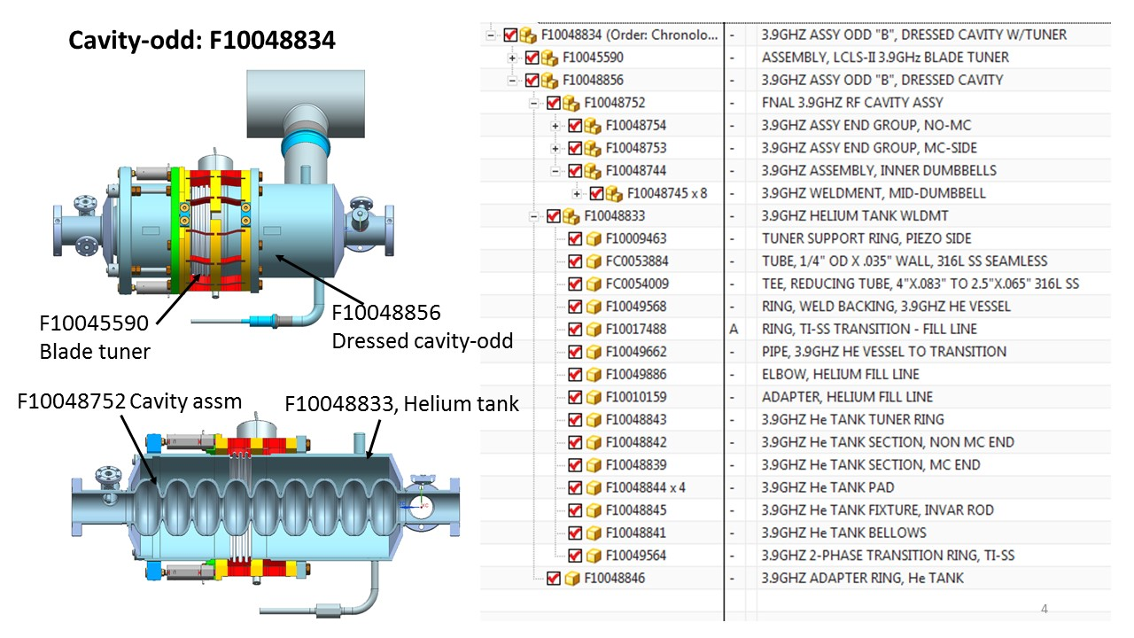
3.9 GHz RF dressed cavity model

Slide 17
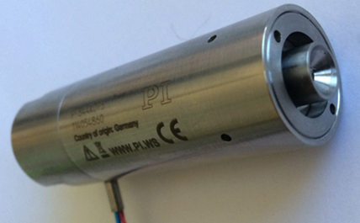
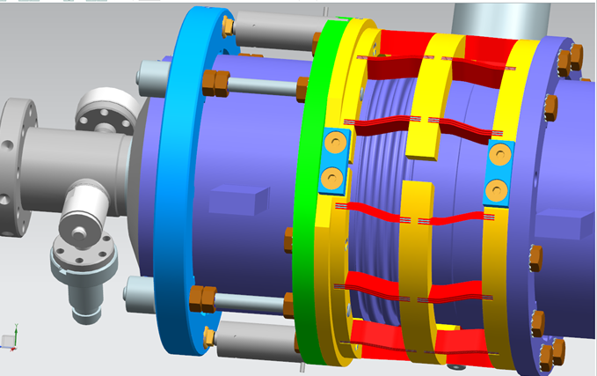
Tuner - design
‘Slim’ blade tuner design is preferred to minimize significant re-engineering of the dressed cavity/helium vessel while providing room for a larger 2-phase chimney
Designed and built by LASA/INFN, Milano for the 3.9 GHz cavities fabricated for the XFEL project
Modified to allow fast tuning by means of piezo tuners
Encapsulated piezo designed for the LCLS-II 1.3 GHz cavities will well fit for this task
Experienced LLRF & microphonics team at Fermilab
Encapsulated piezo stack for Fast tuner
Modification of the LASA/INFN tuner by adding 2 encapsulated piezo stacks

Slide 18
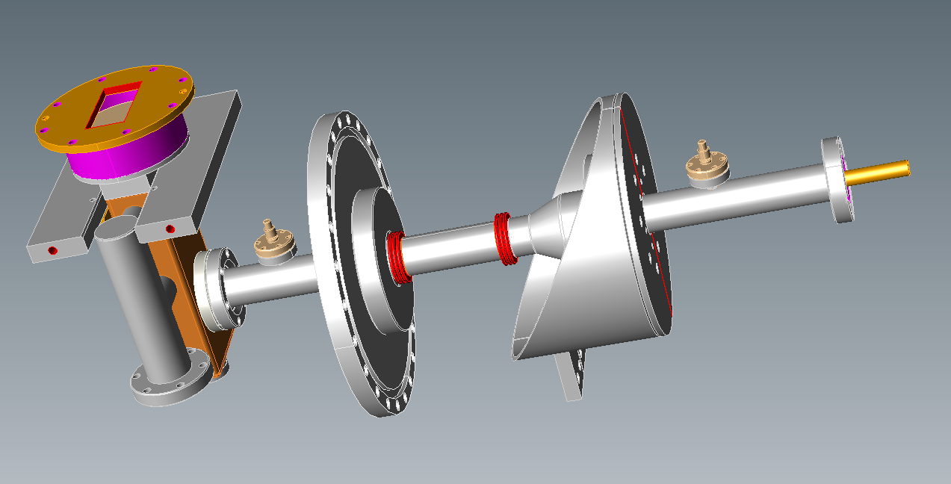
3rd harmonic cavity Power Coupler
For LCLS-II three modifications of existing design will provide safe margin for operation at 2kW cw power:
Shortening antenna to provide Qext~2.5e7
Decrease length of two SS bellows in inner conductor (warm part) from 20 convolutions to 10 convolutions
150 microns Cu plating of inner conductor (instead of 30 microns in current design)
Also considering other options for copper
Q:\TD_SCRF\LCLS-II\3rd_Harmonic\Coupler\ MAIN-COUPLER_ASSEMBLY_3-9GHZ.sat

Slide 19
3.9 GHz cryomodule support system
Fixed support post
Slide-able support post
Invar rod fixed to HGRP
at the location under fixed support post
Cavity support system
Cavity helium tank anchored to Invar rod

Slide 20
Constraints in increasing the chimney size
Tuner ring at edge of helium tank
3 mm for tack welding
14 mm between welds
Support hanger between chimney and tuner
Need to shift cavity string during cold mass assembling
Needle bearing clamps

Slide 21
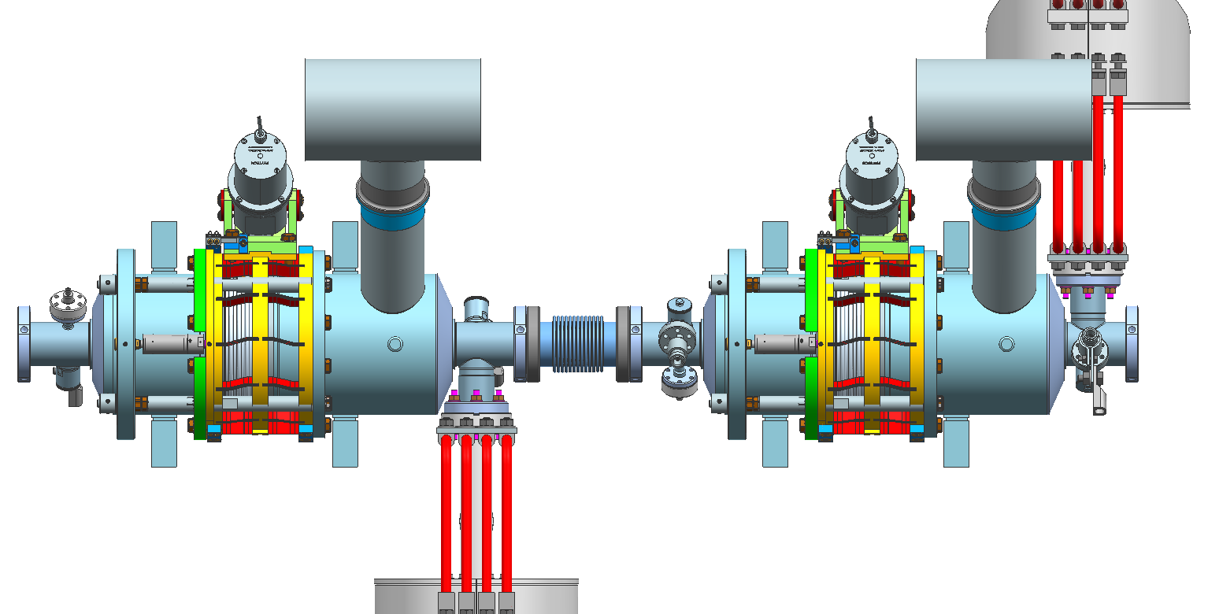
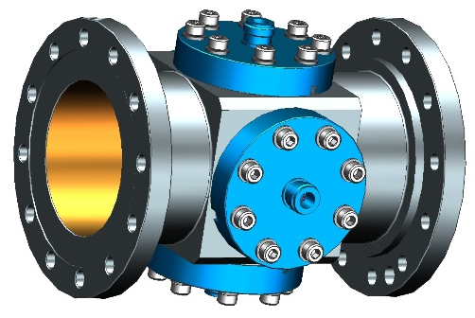
3.9 GHz cryomodule cavity string (note alternating input coupler positions)
Cavity-even: F10048832
Chimney: ID 60.198 mm, OD 63.5 mm
2-phase pipe: ID 97.3836 mm, OD 101.6 mm
Cavity-odd: F10048834
Cavity rotated by 180°wrt helium tank
BPM spool
F10023168
Flange Reducer
F10002532
Φ38 mm to Φ78 mm, 18 mm THK
607.92 mm
Chimney tee to HGRP
cavity string
F10014812

Slide 22
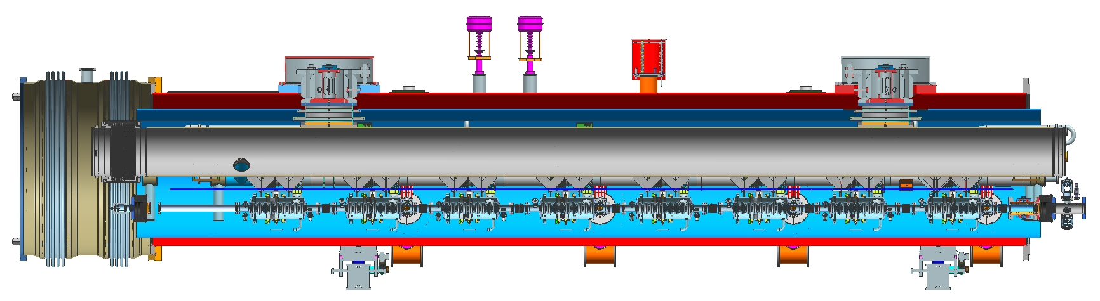
3.9 GHz cryomodule assembly
Less Instrumentation flanges (no magnets)
Identical inter-module bellows
Identical piping
Beams
6.1219 m

Slide 23
3.9 GHz cryomodule external physical interfaces
Port for roughing pump & gauge
Fixed support post
Pressure relief
Sliding support post
2 Instrumentation ports
Insulating vac pump-out port
4 couplers on both sides of module
8 pairs of instrumentation ports
Module pickup bushing hoist rings
Pre-cool valve
Survey fiducials
On both sides of 2 post ports
JT Valve
2 LHe level instrumentation ports
Access to cryogenic valve welds to piping lines
2 support feet

Slide 24
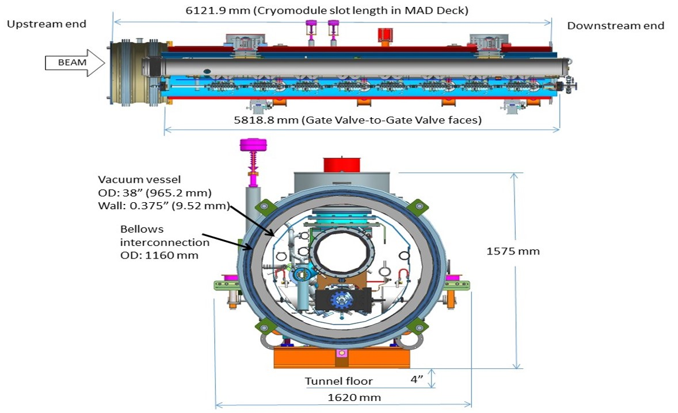
3.9 GHz cryomodule overall dimensions

Slide 25
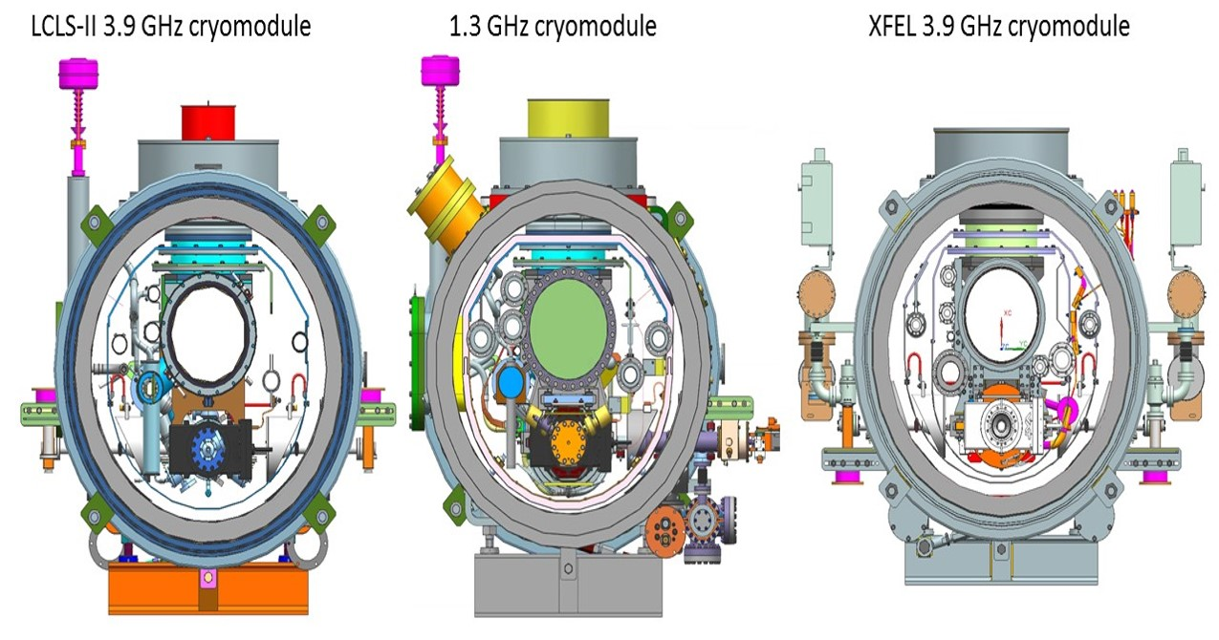
Cryomodule cross sections

Slide 26
Liquid helium levels in the 2-phase pipe with LCLS-II tunnel slope ~0.5%
Upstream end
Beam
Downstream end
5250 mm
Shorter cryomodule results in less impact of slope
on liquid helium elevation issue in the 2-phase pipe.

Slide 27
2 K heat in first few cryomodules
From LCLScryoHeat-18Sep2015.xlsx
3.9 GHz cryomodule heat load is incorporated into Cryogenic Heat Load, LCLSII-4.5-EN-0179
A small revision is required for 3.9 GHz: 14 cavities operating at 13.4 MV/m

Slide 28
3.9 GHz cryomodule summary
LCLS-II 3.9 GHz Harmonic Linearizer consists of two 8-cavity cryomodules
Parameter set determined
Design issues identified and being addressed
Design work begun & accelerating some work
1.3 GHz design & commonalities
collaborations – XFEL, ANL, etc.
Schedule in place
Driven by Project decisions (after 1.3 GHz)
1.3 GHz effort now focusing on procurements

Slide 29
Acknowledgments
This presentation includes information from many people at Fermilab, Jlab, and SLAC involved in cryomodule design, cryogenic distribution design, and overall cryogenic system design.
Special thanks to Camille Ginsburg, Chuck Grimm, Elvin Harms, Yuriy Orlov, and Yuriy Pischalnikov who provided information and slides for this presentation.

Slide 30
Backup slides, additional information

