Slide 1
3.9 GHz components design
Speaker:
Nikolay Solyak (from behalf of LCLS-II design team)
Dressed cavity Review, FNAL, Nov. 20, 2015

Slide 2
Outline
3.9 GHz system functionality
Requirements (Elvin)
Cavity design
HOM heating issues and cables
Wakefields
Coupler design
BPM; Gat Valve; HOM absorber
Conclusion

Slide 3
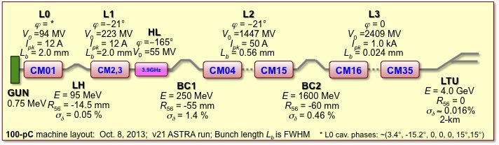
Overview, why?
Space charge effects limit the maximum obtainable charge density from the photocathode and thus the minimum bunch length.
300 pC bunch has a length of approximately 1 mm at the exit on the injector. Sinusoidal variation in the RF voltage over this distance leads to a correlated energy variation, or “chirp,” in the uncompressed bunch and, after bunch compression, to an asymmetric bunch profile
Applying a voltage at a harmonic ω₁=3ω₀ of the fundamental RF frequency ω₀ results in an integrated voltage that is approximately linear over the bunch length, removing the curvature of the beam distribution in longitudinal phase space, and facilitating more efficient bunch compression and controlled bunch charge distribution
3.9 GHz cryomodules are installed just before the first bunch compressor BC1

Slide 4
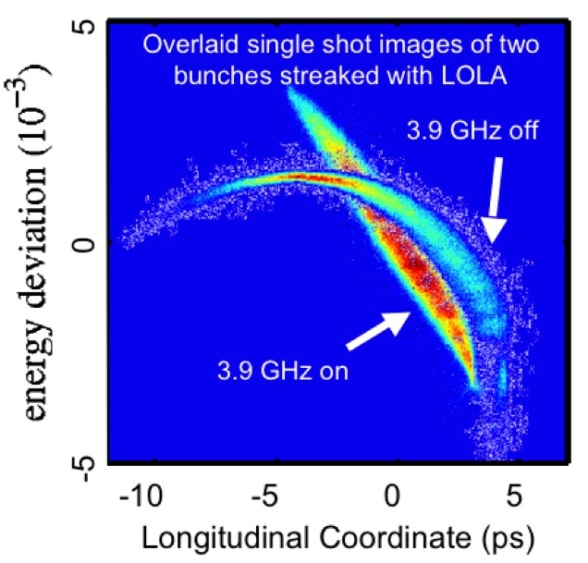
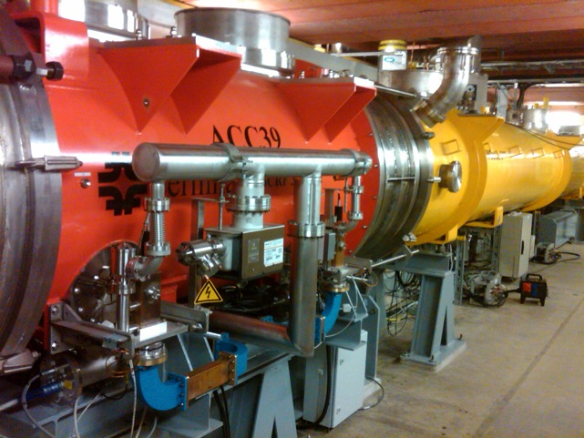
FLASH - ACC39 performance
ACC39 routinely operates at 18.9 to 19.7 MV/m
  Capable of operation at 22 MV/m
    - Limitation set by thermal interlocks – concern about compromising HOM’s on cavities 3 & 5 (trimmed 2-post style)
Amplitude stability ≤ 2x10⁻⁵ pulse-to-pulse
Phase stability ≤ 0.003° pulse-to-pulse
4

Slide 5
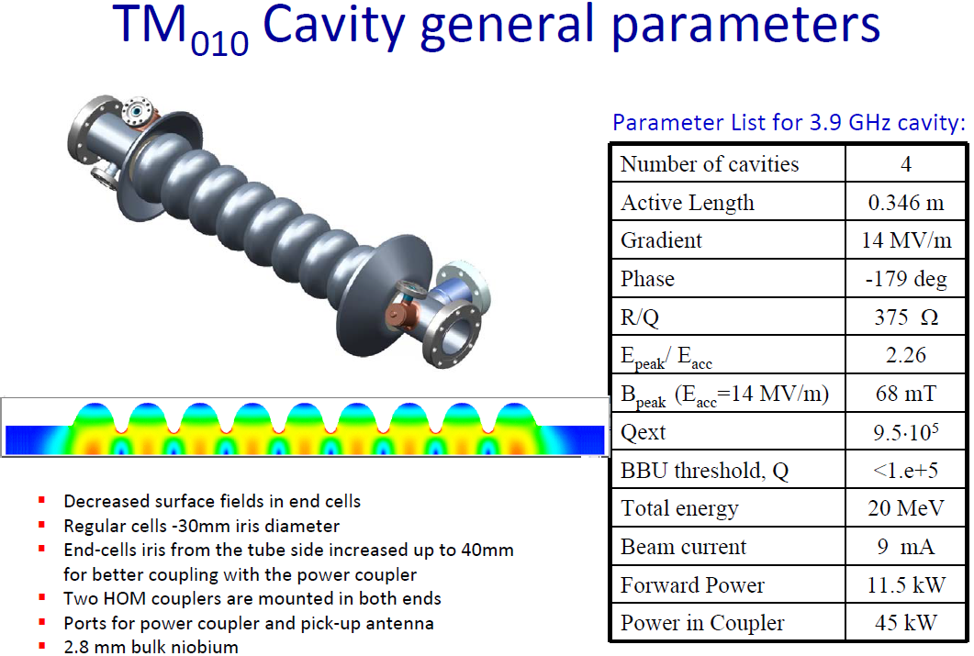
4.8
FLASH
750
Iris Aperture: 30mm vs. 70mm (ratio 2.34)
E_{p}/E_{acc} ; 2.26 vs. 2.0 (13% higher)
H_{p}/E_{acc}(mT/MV/m) 4.86 vs. 4.26 (14% higher)
R/Q (Ohm) 750 vs. 1000
BCS resistance ratio (f²) (9 times higher)
Comparison
3.9 GHz vs. 1.3 GHz:

Slide 6
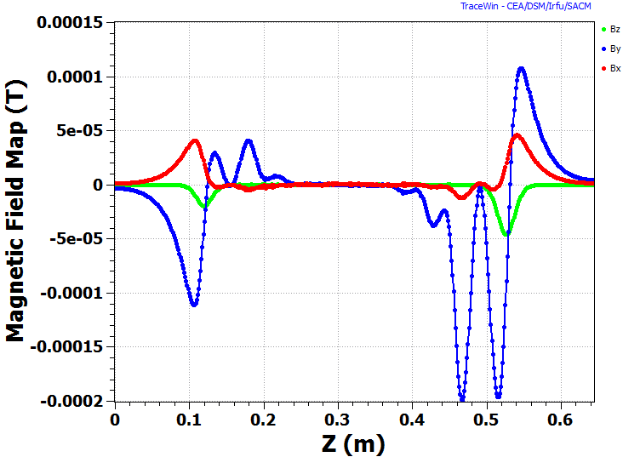
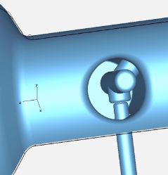
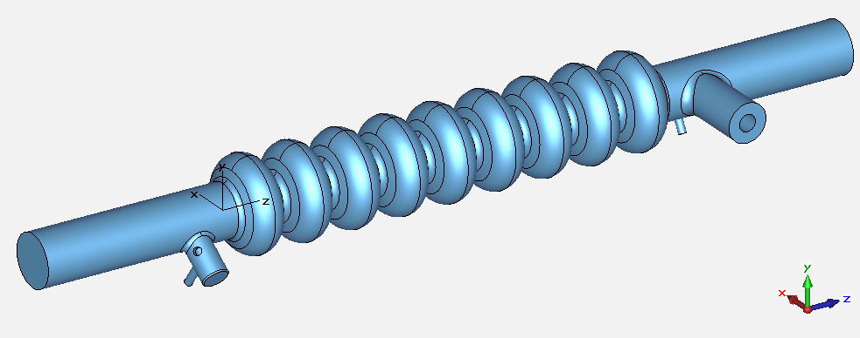
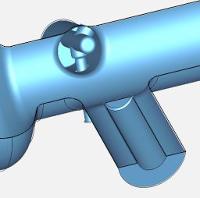
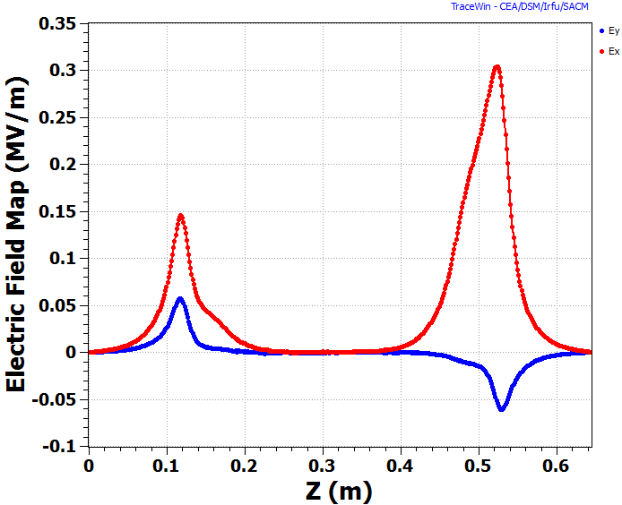
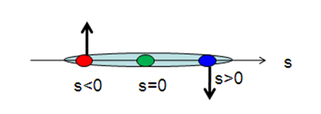
Field asymmetry and RF Analysis for 3.9GHz cavity
Magnetic Fields
3.9 GHz Accelerating Structure
Transverse Electric Fields
Upstream HOM Coupler
Downstream HOM Coupler
 | 10⁶ V_{x}/V_{z} |  | 10⁶ V_{y}/V_{z}
 | Direct | P/W | Direct | P/W
Upstream | -73.8 + 250i | - | -19.4 + 147i | -
Downstream | -609 – 25.9i | - | 25.1 + 136i | -
Full | -682 + 227i | -683 + 230i | 5.5 + 282i | 5.6 + 281i

Slide 7
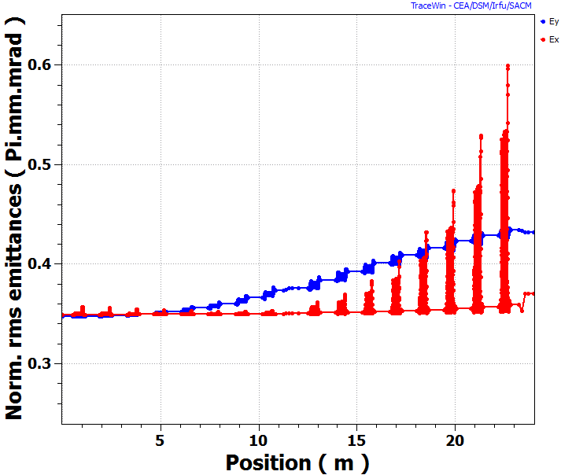
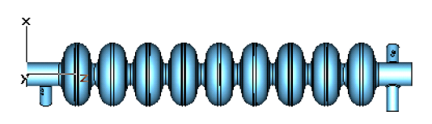
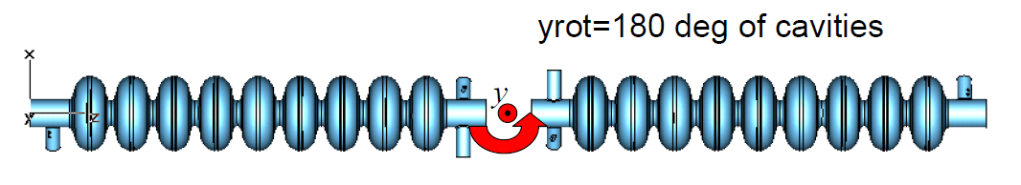
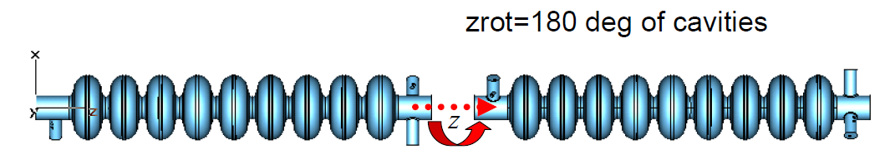
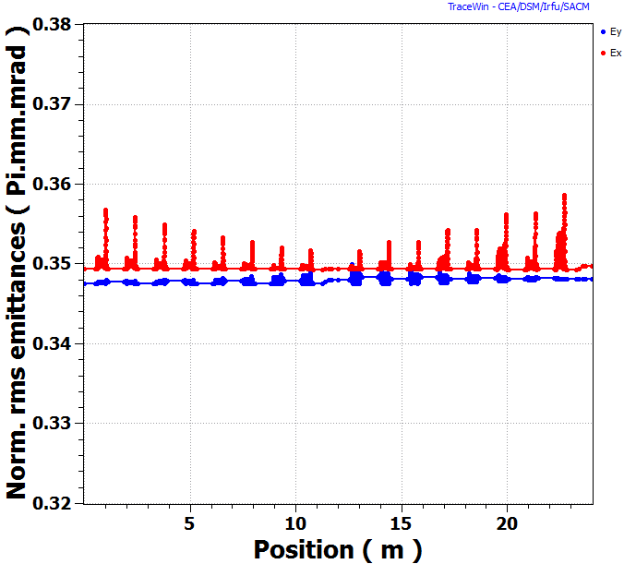
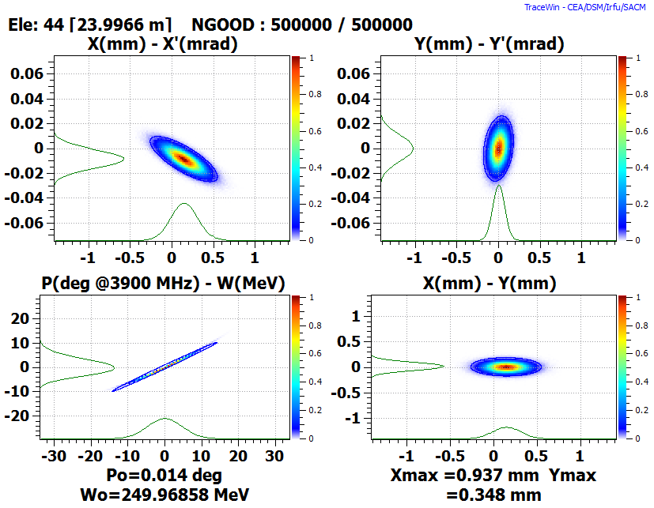
3.9 GHz Cryomodule Options
Δε_{x} (%) ~ 6.0 %
ε_{y}
Δε_{y} (%) ~ 24.0 %
ε_{x}
1.3GHz like Cryomodule Layout:
FLASH-like Cryomodule Layout:
XFEL/LCLS2 Cryomodule Layout:
 | 1.3GHz-like | XFEL
Δε_{x} (%) | 6 .0 | 0.09
Δε_{y} (%) | 24.4 | 0.15

Slide 8
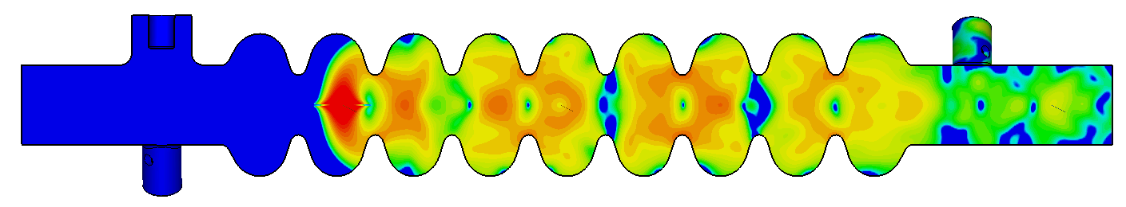

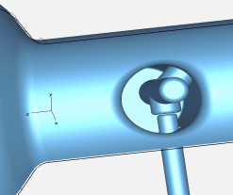
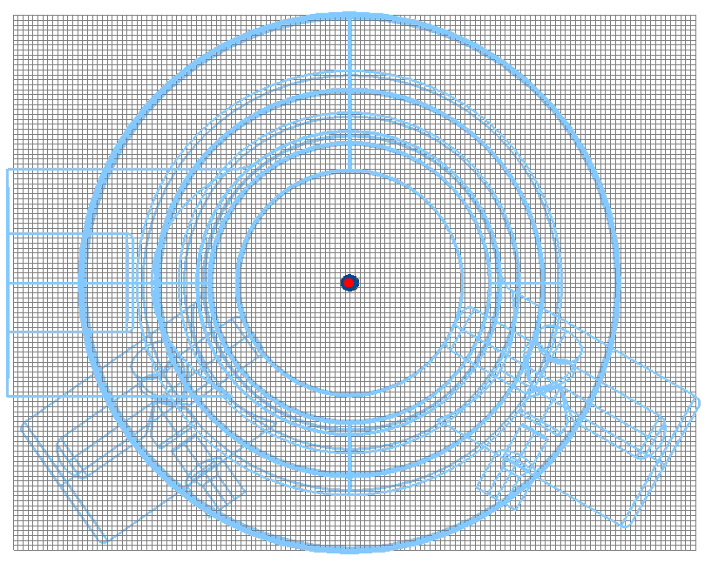
Wake development in the 3.9GHz cavity
Electric field snap-shot of 2mm rms bunch
Q_{ext} ~ 1e7
Wake potential convergence
Cubic mesh (σ/h = 6)
A.Lunin/T.Khabiboulline

Slide 9
Wake Potentials in the 3.9GHz cavity
dx= 0mm; dy= 0mm
dx= 0mm; dy= 0mm
dx= 0mm; dy= 0mm
dx= 0mm; dy= 1mm

Slide 10
Wake Loss and Kick Factors in the 3.9GHz cavity
Couplers wake Kick
Structure Kick, dx= 0mm, dy = 1mm
Conclusions
Transverse wake kicks produced by couplers in the 3.9GHz cavity is about 0.02 V/pC and weakly depends on a bunch length.
Couplers wake kick is comparable with kick produced by the structure itself for beam shifted by 0.1mm of axis.

Slide 11
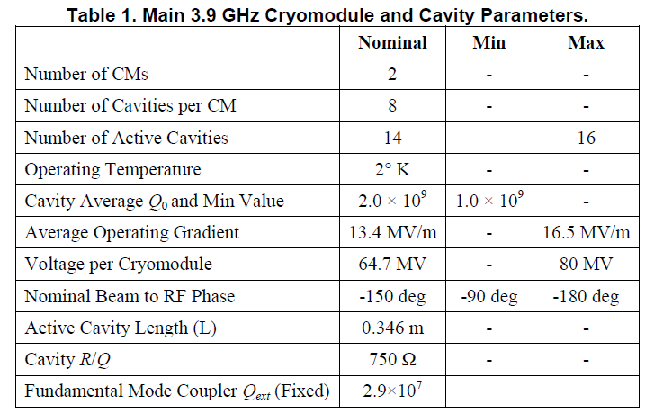
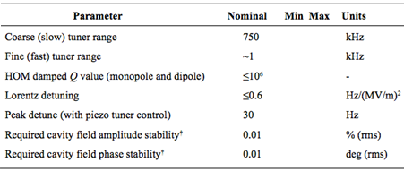
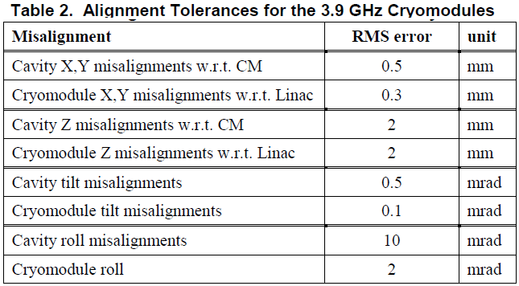
LCLS-II requirements: (PRD and FRD)
Table 3. Tuning/stability requirements
Two CMs; 8 cavity / each
Coupler orientation as per XFEL
Electropolishing instead of BCP
~150 W heat load/cryomodule (2K)
BPM at downstream end (1.3GHz type)
No magnet

Slide 12
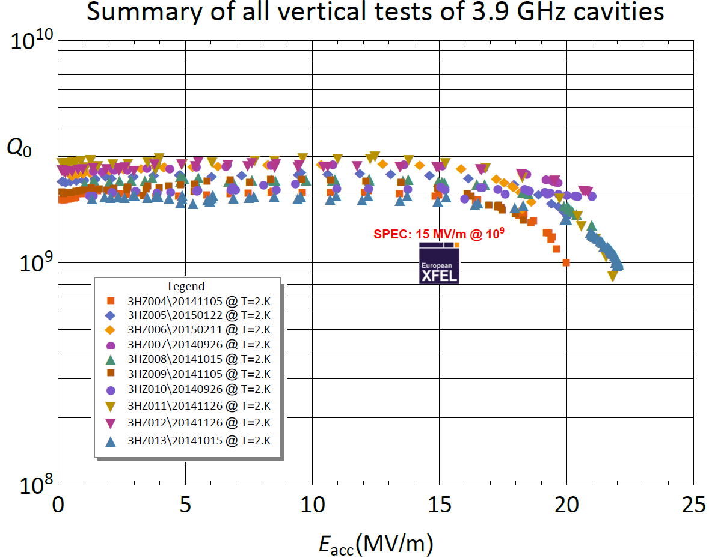
Cavity gradient and Q0 requirements
(recent data from XFEL cavity production)
P.Perini, INFN
Recent XFEL production cavities (INFN-Zenon);
At 2K the all cavities have Qo in range ~(2-3)·10⁹
No field slope up-to ~17 MV/m; Quench at 20-23 MV/m, VTS
No Q degradation after welding to HV
Risk: LCLS-II cavity (cw) requirements more stringent than XFEL (pulse) !!!
➔ Require Prototyping and Testing

Slide 13
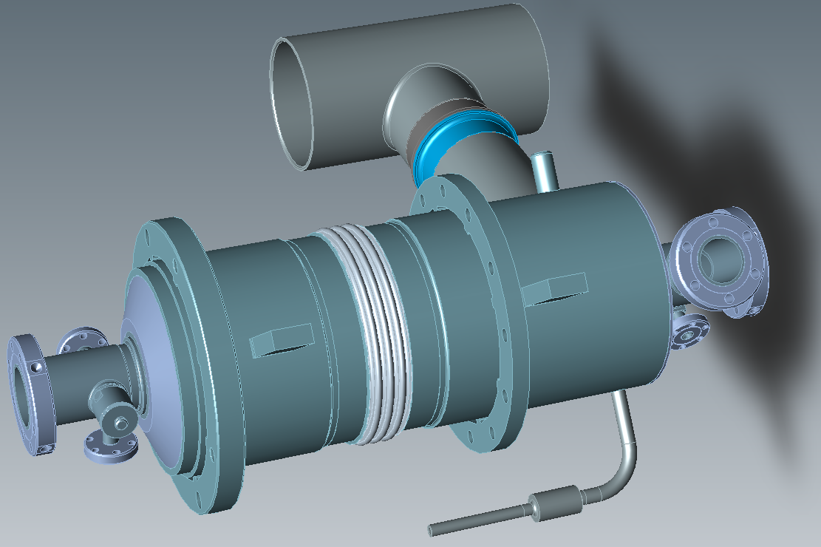

Chimney Power Limit
$$P=\frac{{(E_{acc}∙L)}^{2}}{(R/{Q)∙Q_{0}}}$$
Cryoload at 2K
LCLS2-1.3 GHz
 | Nominal parameters | Max or Min | VTS/HTS param
E_{acc} (MV/m) | 13.4 | 16.5 | 18
Q0 | 2.e9 | 2.e9 | 2.e9
P/cav (W) | 17.4 | 21.7 | 25.9
LCLS2-3.9 GHz

Slide 14
Cavity design issues and proposed modifications for LCLS-II CW operation
Cavity
HOM coupler
Main Power Coupler
Blade-Tuner with piezo (Y.Pischalnikov talk)

Slide 15
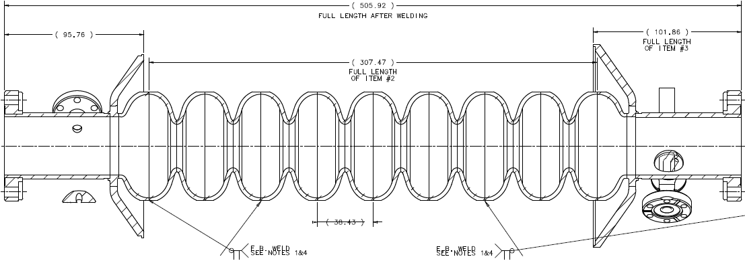
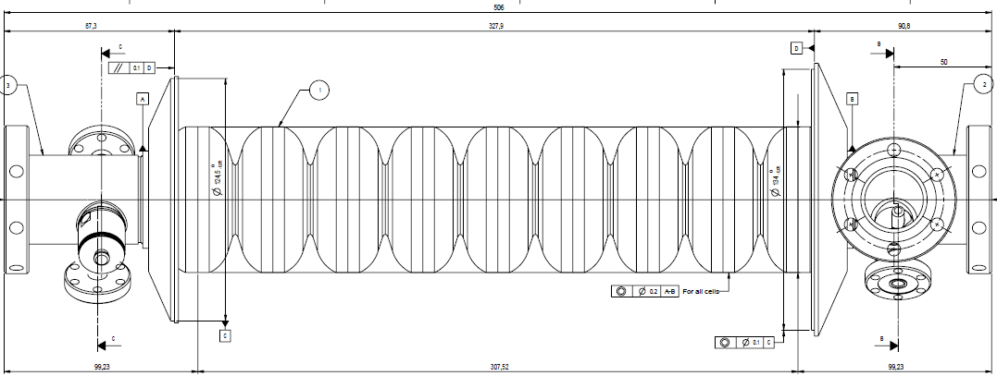
Cavity drawings: LCLS-II vs. XFEL and FLASH
FNAL/FLASH
design
INFN
modification
(adopted for LCLS2 as a starting point)
Additional modifications are needed to meet LCLS2 reqs.

Slide 16
LCLS-II 3.9 GHz cavity design
INFN modified FNAL design of the cavity for XFEL project. Mostly modifications done to simplify/improve production (Zenon) and tuning. Drawings and 3D models are available (thanks INFN team)
CW operation in LCLS-II is more severe regime for the cavity. Some minor modifications are needed to reduce risks and eliminate tuning and heating problems.
Proposed modifications in cavity RF design.
Issue #1: Frequency of lowest dipole mode trapped in coupler end of the cavity is too close to operating mode frequency, 3.9 GHz. As a result the tuning of notch frequency is difficult and 3.9 GHz frequency power leak is significant.
    Solution: Move away frequency of this mode. Few options:
        Reduce radius of pullouts for main and HOM couplers.
        Reduce beam pipe and bellow diameter from 40 to 38mm.
Issue #2 : Overheating of the HOM antenna (quench ~20MV/m at cw/VTS)
  Solution: HOM F-part modification possibilities in order to reduce heating
    Reduce penetration to beam pipe
    Increase length of bump

Slide 17
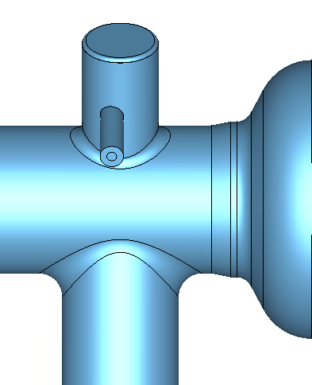
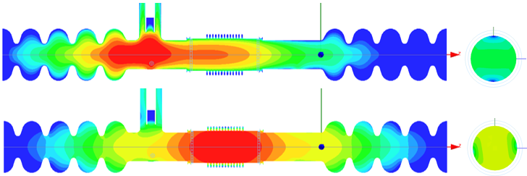
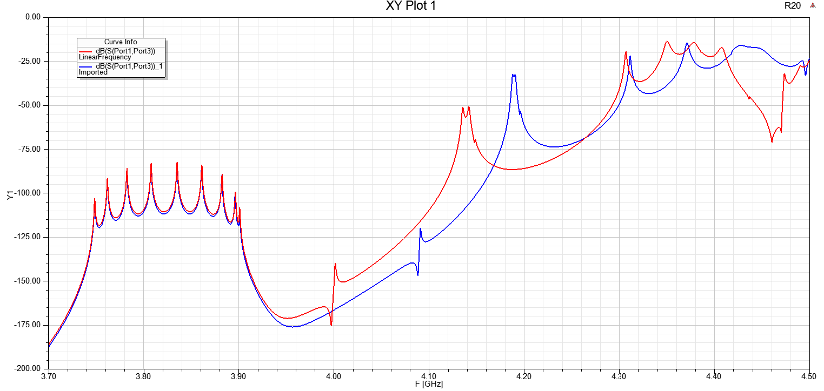
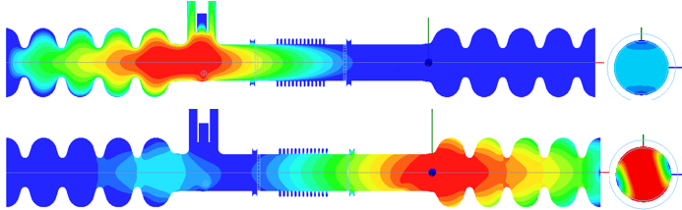
Reduce beam pipe diameter from 40mm to 38mm.
No modification of cavity cells.
Add small conical transition between beam pipe and end cell.
5mm
FLASH: Lowest Dipole HOMs. Beam Pipe Ø 40 mm and Bellows Ø 42 mm.
F = 3.992 GHz, Q_{E} = 3.6e4
Ø38 mm
F = 4.047 GHz, Q_{E} = 8.0e4
  A. Lunin/T.Khabiboulline
LCLS2: Lowest Dipole HOMs. Beam Pipe Ø 38 mm and Bellows Ø 38 mm.
F = 4.092 GHz, Q_{E} = 2.7e4
F = 4.188 GHz, Q_{E} = 7.4e3
Lowest dipole mode frequency shifted by 100 MHz up away from operating mode frequency.

Slide 18
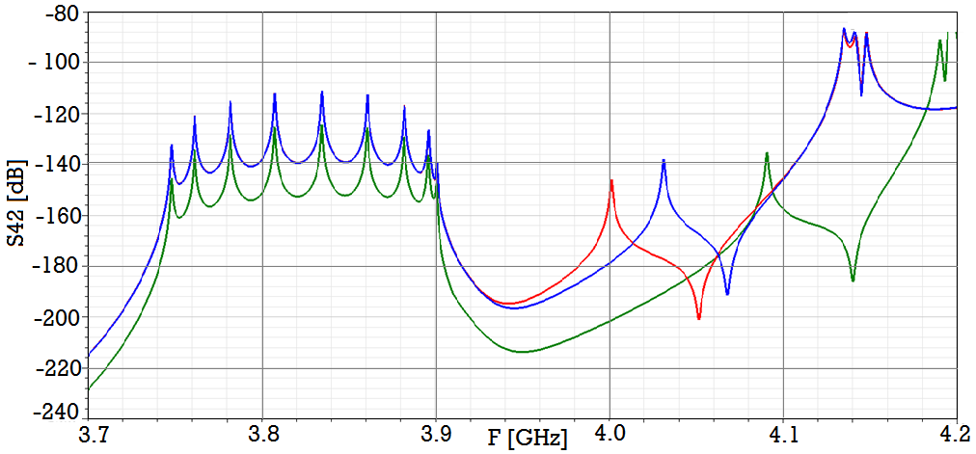
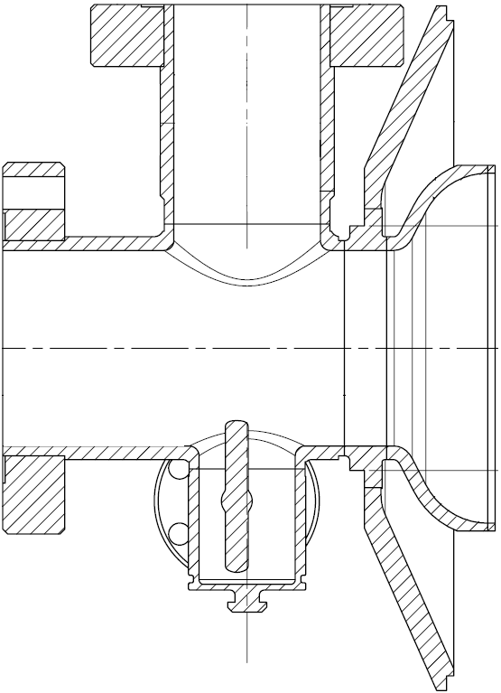
Effect of pullouts radius change (main coupler).
FLASH design
Coupler Pullouts R=3mm
Beam pipe Ø38mm
R=6
lowest dipole modes
Ø40
In current design lowest mode are closer (min ~10-20 MHz vs. 100MHz in simul.)
The FPC pull out radius of 3mm shifts the nearest HOM by 25 MHz, changing the beam pipe aperture to 38 mm allows to detune the HOM by ~ 100 MHz up.

Slide 19
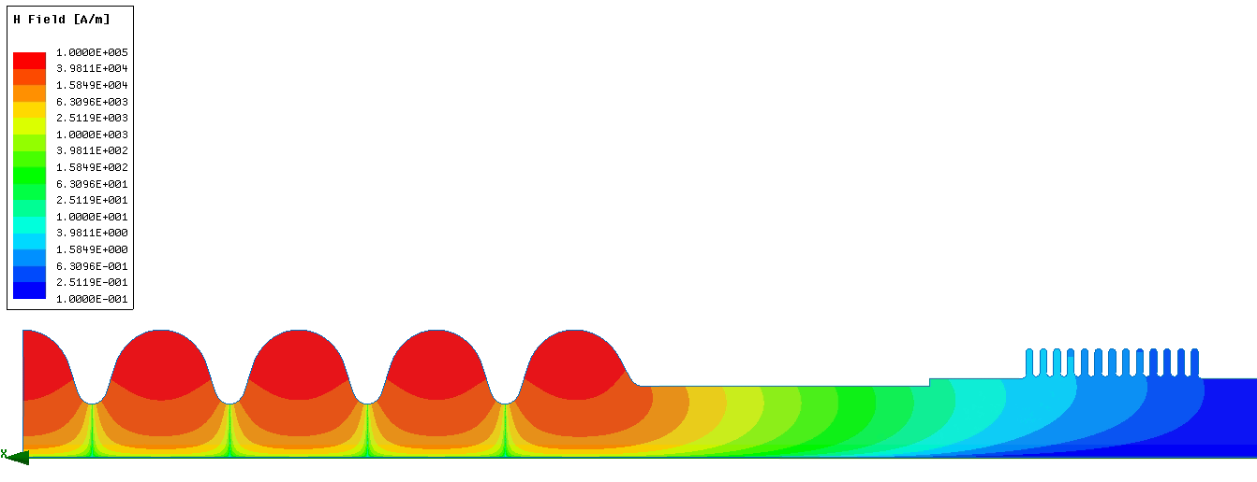
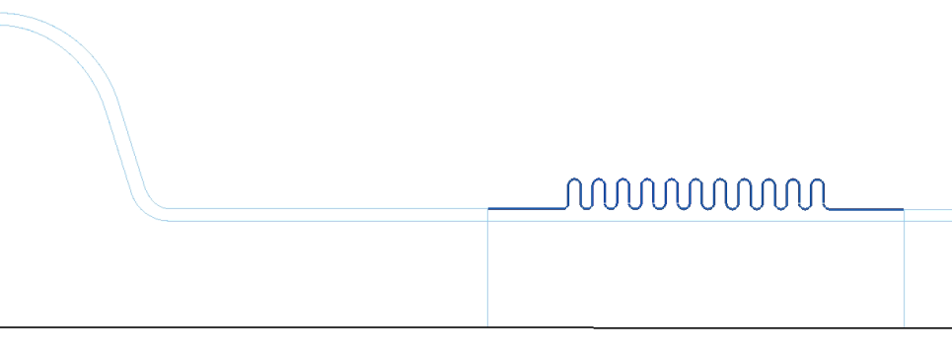
RF Losses in the Bellow due to the Operating Mode Fringing Field
Accelerating gradient: 15.5 MV/m
Stored energy: 1.57 J
Q_{bellow_Cu} : 3.3e12
Copper at RT (σ_{Cu} = 5.8e7 s/m)
Magnetic Field
80 mm
105 mm
Conservative approach: Copper RRR = 15
P_{bellow_Cu_RT} = 2*ω*W/Q_{bellow_Cu} = 2*6.28*3.9e9*1.57/3.3E12 ≈ 0.023 W
P_{bellow_Cu_5K} ≈ 0.006 W
Smaller for 38mm pipe

Slide 20
Modification of HOM coupler
Reduce penetration of antenna inside HOM to reduce heating → F-part modification
Increase wall thickness on the top of HOM can to prevent cracks and vacuum leak
To modify length of HOM feedthrough
(choice of feedthrough design: Fermilab vs. XFEL)

Slide 21
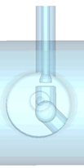
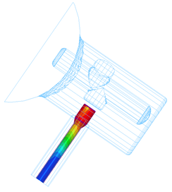
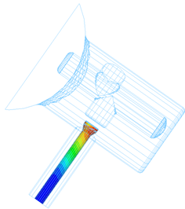
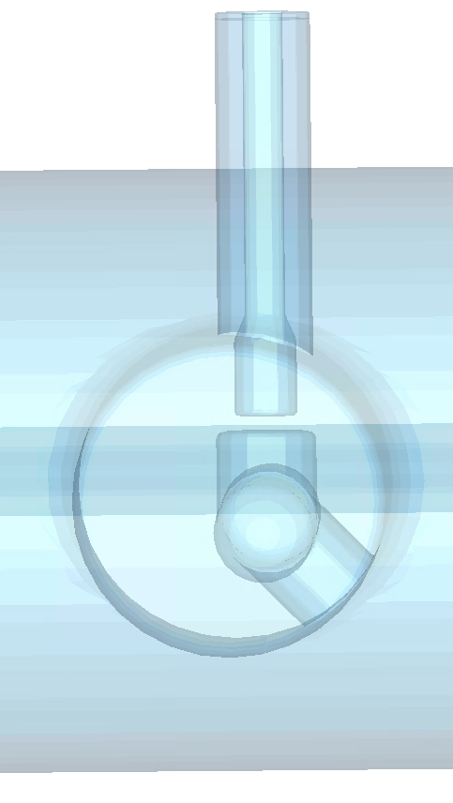
HOM F-part modification to reduce antenna heating
Reduce penetration to beam pipe. Increase length of bump in F-part
Current design
Modified design
G = 3.2e8 Ω
G = 1.74e9 Ω
  A. Lunin/khabiboulline
  Current design HOM antenna quenches at ~20 MV/m in VTS. Expected that quench limit will even lower in CW regime at HTS and CM.
RF power dissipation on HOM antenna reduced by factor of 5.4 after modification

Slide 22
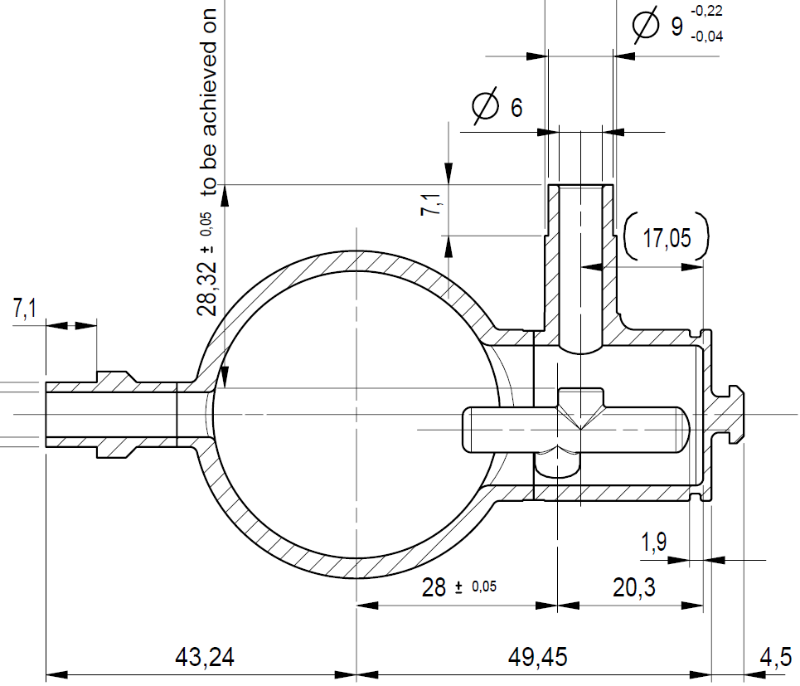
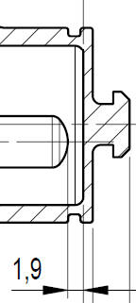
HOM can thickness increase from 1.0 mm to 1.3 mm.
  Thickness of hat is a concern. Was broken when h=1mm.
  XFEL design already has thickness of 1.15 mm → one prototype cavity has a leak. Proposal to have 1.3mm.
1.15mm

Slide 23
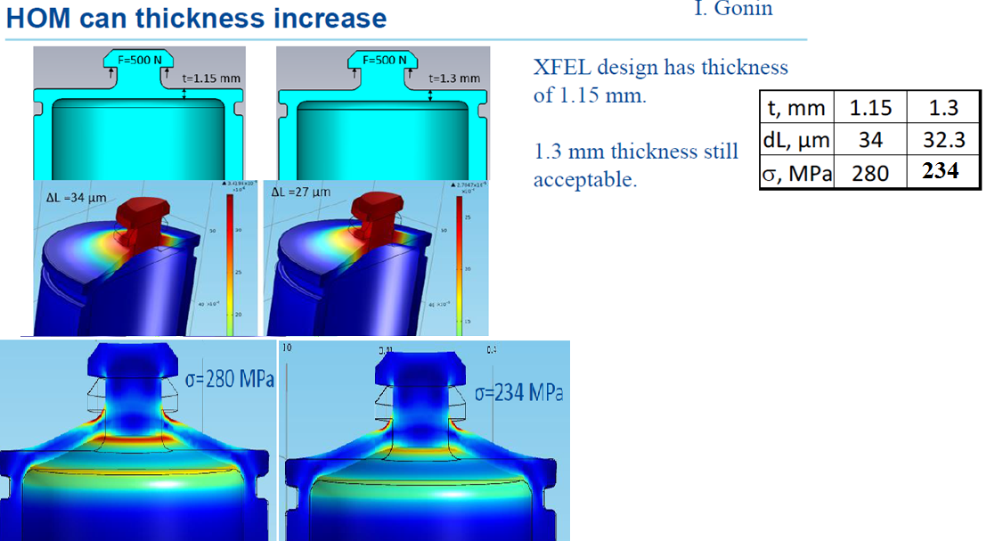
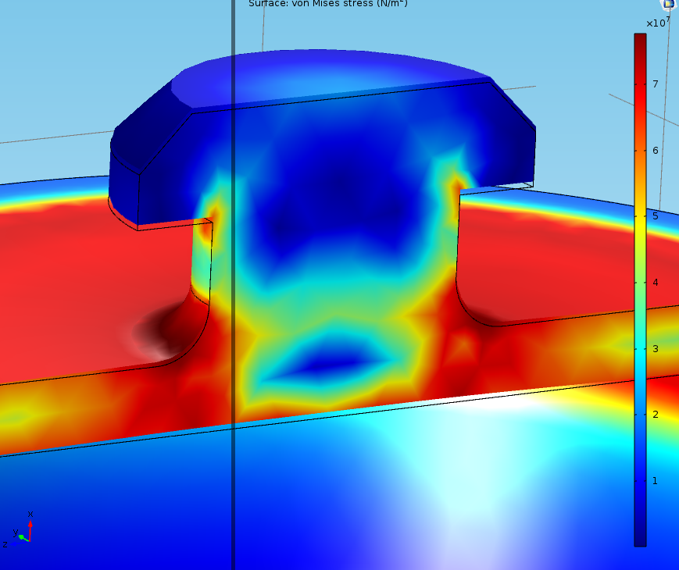
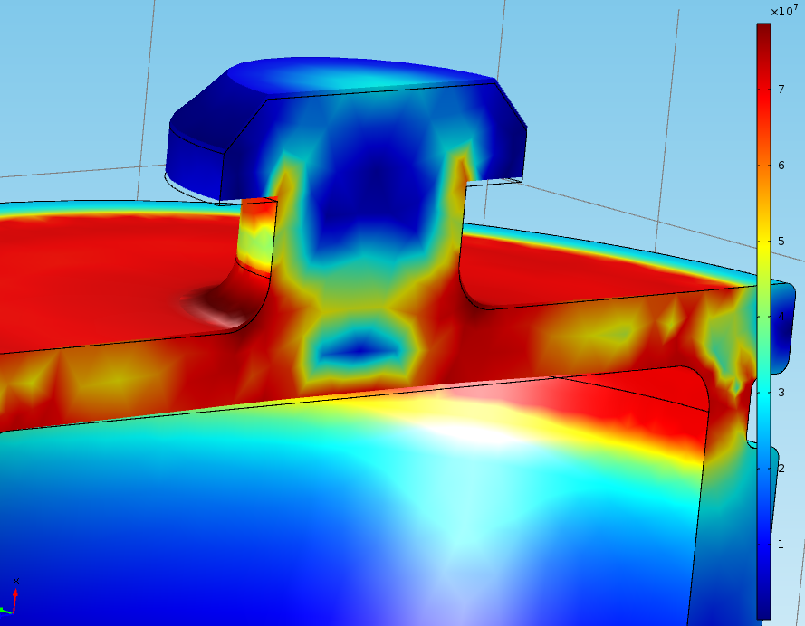
/ T.Khabiboulline
Knob pulled up by 0.1 mm
Wall=1.3 mm
Von Misses stresses distribution of HOM cup at yield level (non-linear analysis)
1.3 mm vs. 1.5 mm wall thickness
Conclusion: 1.3mm is acceptable thickness of can wall
Wall=1.5 mm

Slide 24
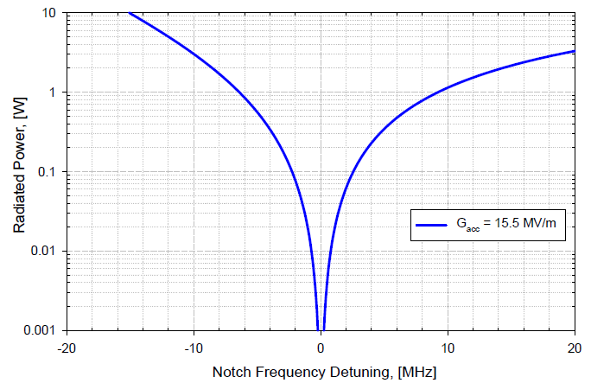
Notch filter tuning requirements
Tuning accuracy ±2MHz ➔ P < 0.1 W
For 1.3 GHz HOM accuracy for notch filter frequency ~0.5MHz

Slide 25
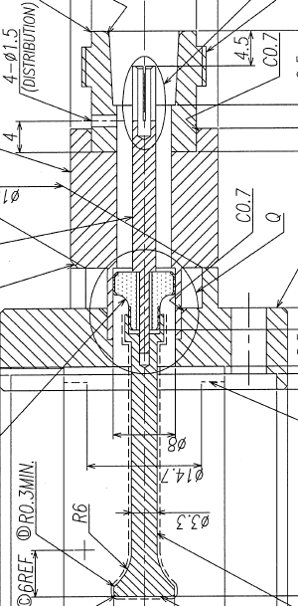
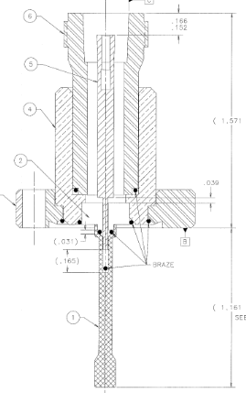
HOM feedthrough:
XFEL design (used for 1.3GHz and 3.9 GHz)
FNAL design for 3.9 GHz (FLASH)
T.Khabiboulline design
Antenna modified for 3.9GHz
XFEL design: no resonances up to 3.5GHz, no data for 3.5-10GHz range (test under preparation)
FNAL design: good up to 10GHz (goal of design)

Slide 26
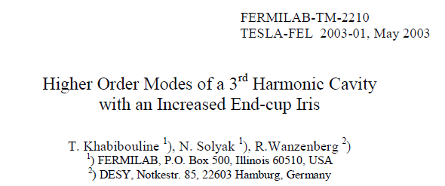
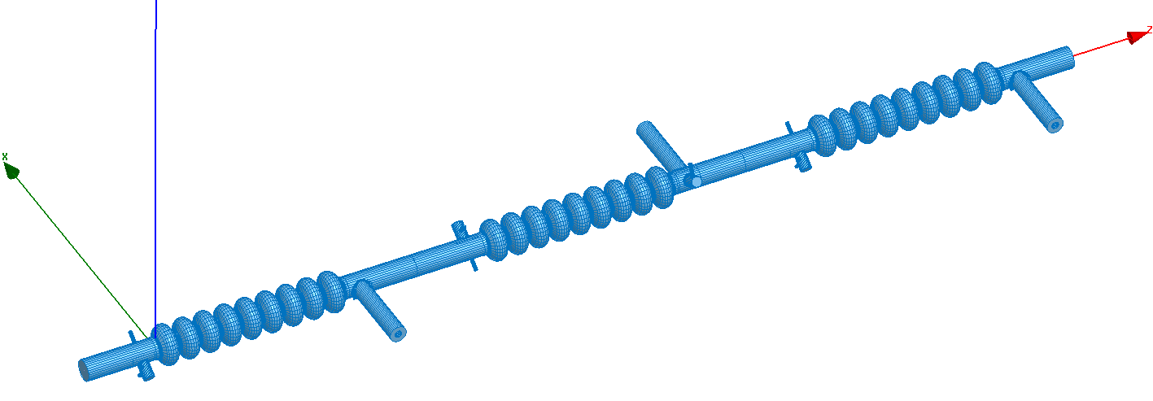
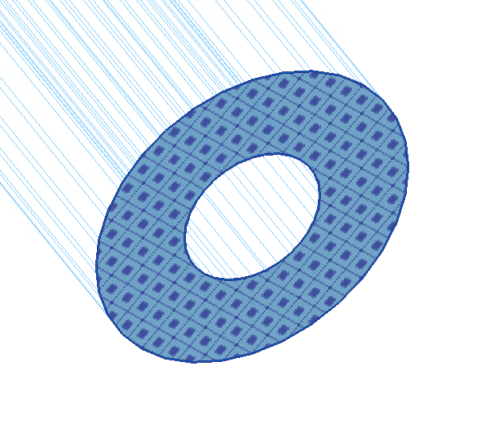

Analysis of HOM Spectrum in the 3.9GHz LCLS-II cavity
Recent HOM modeling in modified cavity
Modified cavities with random mechanical errors (± 0.1mm). Compare with INFN.
All cavities tuned to frequency and flatness (>90%)
Copper plated bellows in between cavities
Statistics: 10…20 cavities
> 1000 modes in 4- 10 GHz frequency band
Matched TEM Impedance Boundary
Matched Dipole HOMs
Impedance Boundary
A.Lunin/T.Khabiboulline

Slide 27
HOMs Resonant Losses in the 3.9GHz LCLS-II cavity (run #1)

Slide 28
HOMs Transverse Kick (1mm offset) in the 3.9GHz LCLS-II cavity (Ø38mm)

Slide 29


3.9 GHz: Power removed by HOM coupler
A. Sukhanov
R/Q of monopole modes in cavity chain
Simulation model includes copper plated bellows between cavities
HOM frequencies have random distribution ~ 1MHz rms
Max values of R/Q for each mode is used (vs. cavity to cavity distance)
Q_{HOM} < 10⁶ for most dangerous modes

Slide 30
HOM antenna heating issues
Expected maximum power flux to HOM coupler up to 4W:
~0.5 W – leakage from operation mode
Part of this will be dissipated in cable (0.6dB/m) and will heat HOM antenna
Heat removal from feedthrough (2K) and from the cable intercepts (5K and 50K) is essential part of design.
Choice of cable and specs is part of current activity

Slide 31






Thermal simulation for HOM cable (TFlex401)
P_{antenna}= 9uW (140mT with modified design, 63 mT with original design)
Narrow cooling leads
(45mm x 2.5x2.5 mm²)
Wide cooling leads
(45mm x 2.5x10 mm²)
M.Hasan/T.Khabiboulline
zoom
Cable is OK up to 9 W input power flow
(80°C cable limit).

Slide 32
Lead Intercepted Power (3.9 GHz)
Narrow Leads
Wide Leads
Power Flow [W] | 2K | 5K | 50K | 300K
0 | 6.30 | 189.88 | 287.86 | -484.04
1 | 18.06 | 217.86 | 358.44 | -394.68
2 | 29.84 | 246.19 | 435.51 | -298.46
3 | 41.63 | 274.95 | 520.27 | -194.23
4 | 53.49 | 304.20 | 614.21 | -80.58
5 | 65.44 | 334.01 | 719.21 | 44.26
6 | 77.43 | 364.58 | 837.66 | 182.56
7 | 89.46 | 396.08 | 972.68 | 337.22
8 | 101.50 | 428.79 | 1128.35 | 512.10
9 | 113.61 | 462.98 | 1310.21 | 712.38
10 | 125.80 | 499.07 | 1525.91 | 945.19
Power Flow[W] | 2K [mW] | 5K [mW] | 50K [mW] | 300K [mw]
0 | 9.27 | 164.76 | 242.83 | -416.87
1 | 21.91 | 193.01 | 313.60 | -326.02
2 | 34.61 | 221.87 | 393.03 | -226.41
3 | 47.43 | 251.44 | 483.14 | -116.22
4 | 60.39 | 281.94 | 586.51 | 6.86
5 | 73.47 | 313.74 | 706.51 | 145.86
6 | 86.67 | 347.22 | 847.86 | 304.90
7 | 100.05 | 383.02 | 1017.10 | 489.75
8 | 113.67 | 422.00 | 1223.63 | 708.57
9 | 127.78 | 465.89 | 1481.52 | 973.22
10 | 142.70 | 517.64 | 1812.94 | 1301.92

Slide 33
Vendor | Times Microwave |  |  | Huber+Suhner |  |  |  | Gore Type 42
Cable Type | TFlex-401 | TFlex-401t | SFT-304 | 32022 | 32039 | SF229 | 3288LM (SF329) | Gore Type 42
Inner Cond OD [in] | 0.0641 | 0.062 | 0.062 | 0.0359 | 0.06 | ? | ? | 0.089
Outer Cond ID [in] | 0.208 | 0.185 | 0.185 | 0.106 | 0.191 | ? | ? | 0.196
Outer Cond OD [in] | 0.249 | 0.227 | 0.227 | 0.109 | 0.20 | ? | ? | 0.225
Cable OD [in] | 0.27 | 0.250 | 0.250 | 0.144 | 0.250 | 0.20 | 0.20 | 0.29
Material of Conductor | CuAg | CuAg | CuAg | CuAg | CuAg | CuAg | AlCuAg | CuAg
Dielectric | PTFE (ε_{r}=2.04) | ePTFE | ePTFE | Microporous PTFE | Extruded TFE | Low density PTFE | Microporous PTFE | ePTFE (ε_{r}=1.4)
Velocity % | 69.5 | 69.5 | 76 | 76.3 | 70.3 | 82 | 82
Attenuation [dB/m] at 1 GHz | 0.26 | 0.22 | 0.22 | 17dB/100ft at 2GHz | 12dB/100ft at 2GHz | 0.18 | 0.18 | 0.3
Outer Braid | CuAg | CuAg | CuAg+ Polymide/Al+CuAg | CuAg+ Polymide/Al+SS | CuAg+ Polymide/Al+SS | Polymide/Al+CuAg | Polymide/Al+AlCuAg | CuAg+ Mechanical Shield
Jacket Material | FEP | TEFZEL 750 | FEP | FEP | FEP | FEP | ECTFE | TEFZEL
Temperature Rating [C] | -65 to +125 | -55 to +200 | -55 to +200 | -55 to +200 | -55 to +200 | -55 to +125 | -65 to +165 | -100 to 150
Shielding | >100 dB | >100 dB | >110 dB | >110 dB | >110 dB | >90 dB | >90 dB | >110 dB
Radiation Resistance [Rad] | 1e5 | 3e7 | 1e5 | 1e5 | 1e5 | 1e5 | 2e8 | 1e8
Material of Connectors | Brass | Brass | Brass | Brass | Brass | Brass | Brass | Be Cu
Price of 3m long assemblies(min is 250) | $147 | $175 | $157 | $146 | $192 | $266 | $341 | $756

Slide 34


TFlex 401 cable after 500 MRad γ-radiation in Sandia (7 days)
Modification: FEP→Tefzel for outer conductor
Conclusion
New antenna design has better thermal performance
Preliminary analysis shows that the TFlex-401t/Huber-SF329 cable used for the 1.3GHz cryo-module will work for up to 8W power flow out of the HOM ports for the 3.9GHz cryo-module
Wide Leads are critically needed
Y.Pischalnikov/T.Khabiboulline/M.Hasan

Slide 35
Proposed modification of 3.9 GHz power coupler for LCLS-II CW operation
Coupler was designed for pulse operation (P=50kW, DF=2%).
LCLS-II requirements: P_{max}=2kW cw; quasi – TW regime:
    Without modification coupler inner conductor of warm part will be overheated up to ~1000 K.
Proposed modifications:
    Shorter antenna (QL~2.5e7 vs. 1.5e6)
    Increase thickness of copper plating in inner conductor from 30 microns to 150 microns
    Reduce length of 2 inner bellows in inner conductor from 20 convolutions to 10-15 convolutions.
    Increase thickness of ceramics in cold window to move parasitic mode away.
    Look alternatives

Slide 36

Solid Model of Power Coupler of 3rd harmonic cavity
Fix coupling; Q=2.5e7 (2.9e7)
Cylindrical cold window (same as 1.3GHz)
Waveguide warm window

Slide 37



Main Coupler Design
Cold part
Input Coupler Modifications
Cold part (upper picture)
Dimensions of ceramic window
Length of antenna (cut at the last stage of production)
Warm outer part (middle in picture)
  No changes
In inner conductor of warm section (bottom picture)
  Cu plating increased from 30 to 150 um.
  Alternative solutions:
    reduce number convolution in both inner conductor bellows (15 vs 20)
    Replace SS tube to solid copper
Warm part (outer conductor)
Warm part (inner conductor) and Waveguide with warm window

Slide 38


Thermal simulations (COMSOL)
RF Power=2kW TW
I.Gonin
  FLASH/XFEL coupler with 20 convolution (inner) 30 µm Cu plating. Max. T ~658-1000 K

Slide 39

SS inner conductor and bellows, all copper plated
T=320K
T=150K
T=10K
SS Inner Conductor + bellows plating | T max, K | Losses, 80K | Losses, 4K
30 microns plating | ~1000 | 9.2 | 0.8
100 microns plating | 507 | 9.3 | 0.8
150 microns plating | 427 | 9.4 | 0.8
Pin=2kW TW,
10μm on outer,
RRR=50; ASE,
10% roughness
ε=9.8, tan=3e-4,

Slide 40

Alternatives: Copper inner conductor; SS bellows (30,50,100 um Cu plated)
Pin=2kW TW,
10μm on outer,
RRR=50; ASE,
10% roughness
ε=9.8, tan=3e-4,
Dynamic losses ( boundaries: 10K/150K/320K)
Static losses ( boundaries: 10K/50K/320K)
Cu inner conductor + bellows plating | T max, K | Losses 50K | Losses 5K
30 µm | 591 | 7.75 | 0.8
50 µm | 461 | 7.65 | 0.8
60 µm | 403 | 7.7 | 0.8
100 µm | 346 | 8.0 | 0.8
Cu inner conductor + bellows plating | T max, K | Losses 50K | Losses 5K
30 µm | 591 | 2.08 | 0.465
50 µm | 461 | 2.4 | 0.47
100 µm | 346 | 3.45 | 0.485

Slide 41


150 μm 20 convolutions of SS bellow Cu plated
0.275mm
0.58mm
150 mm plating
Positive experience with 1.3GHz coupler at CPI
Concern: smaller size of bellow OD=12mm vs. 25mm (see picture)
→ need prototyping and coupler tests (DV program)

Slide 42


Main coupler antenna configuration
Beam Pipe Ø40 mm
 | Q_{ext} | Ant. depth [mm]
Original coupler, 40 mm | 2.5E7 | 11
Modified coupler, 38 mm | 2.5E7 | 9.5
Beam PipeØ38 mm
  A. Lunin
Beam Pipe Ø38 mm
Beam Pipe Ø40 mm
11 mm
9.5 mm
Coupler tip length should be longer by 1.5 mm

Slide 43



Measurements of WESGO ceramic samples (CPI)
Geometry
Dipole mode
TE 110
Computer simulations:
#1: ε = 10, F = 3.1062 GHz,
#2: ε = 10, F = 3.0860 GHz
Cu tube: ID = 50.16 mm
Length ~ 600 mm
Measurements:
#1: F₁/F₂F_{av} = 3.09956 / 3.10782 / 3.1037 GHz
#2: F₁/F₂F_{av} = 3.07873 / 3.086977 /3.0829 GHz
Preliminary results
Sample #1:
ID = 35.03 mm; OD = 46.99 mm
L = 23.09 mm – 23.85 mm
ε ≈ 10.0; tanδ≈ 1.03E-3 (@4 GHz)
Monopole mode TM010
Sample #2:
ID = 35.00 mm; OD = 46.99 mm
L = 24.99 mm – 25.4 mm
ε ≈ 10.0; tanδ≈ 1.03E-3 (@4 GHz)
Computer simulations:
#1: ε= 10; F = 4.07725 GHz
#2: ε= 10; F = 4.02229 GHz
Measurements at 1.3 GHz ongoing
Cross-check with independent measurements
Measurements:
#1: F = 4.07875 GHz, Q = 2585
#2: F = 4.02507 GHz, Q = 2387
S. Kazakov

Slide 44


BPM and HOM absorber
Concept: Use 1.3GHz beam line components (ID=78mm) in transition between cavity string:
BPM,
Spool piece,
Gate-valve,
Beamline HOM absorber
Optimize length and shape of transition from ø38mm to ø78mm for minimum wakefield.
Short ~25mm in flange (XFEL)
Long >300mm in spool-piece (upstream)

Slide 45
Conclusion
General Design and Technology exist (based on XFEL/INFN)
To meet LCLS-II requirements cavity, coupler, HV, tuner designs should be modified to reduce risks and improve performance at cw operation.
Simulations and studies for the dressed cavity are done to prove proposed modifications and predict performance in LCLS-II cryostat.
Auxiliary components (Tuner, main coupler, magnetic shielding, feedthroughs,…) require more work and prototyping before major procurement starts.
Some work require for understanding 3.9GHz cryomodule (wakefields, HOM absorber performance, heating and heat removal issues/design, ….). All these questions will be addressed in the followings reviews.

Slide 46
Thanks:
T.Khabiboulline, I.Gonin, A.Lunin, S.Kazakov, R.Stanek, C.Ginzburg, E.Harms, H.Edwards, C.Grimm, M.Foley, Y.Pischalnikov, T.Arkan, A.Rowe, A.Grassellino, G.Wu, O.Prokofiev, J.Ozelis, A.Saini, J.Kaluzny, S.Yakovlev, M.Hasan, T.Peterson, Y.Orlov, Y.He, E. Borissov, …

Slide 47
Back-up slides

Slide 48



Transverse deformations, for original (upper) and modified (lower) couplers
Longitudinal deformations, for original (upper) and modified (lower) couplers
Stresses, MPa/mm | 20 conv. | 10 conv.
Inner conductor, transverse | 26 | 45
Outer conductor, transverse | 44 | 44
Inner conductor, longitudinal | 150 | 290
Outer conductor, longitudinal | 96 | 96

Slide 49


LCLS-II 3.9GHz Cryomodule, (F10014857 in Team Center)
8 - 3.9GHz cavities
Power couplers from both sides
2-coldmass supports
Interconnection sliding bellow
38” OD vacuum vessel pipe
One thermo shields:50K
5K intercept
XFEL cavity orientation (z-rotation:180 deg)

Slide 50



LCLS-II. 3.9GHz Cavity String (F10014812)
Blade tuner
Spool piece
Spool piece
and BPM
3.9 cavity Style-B
3.9 cavity Style-A
Gate Valve

