Slide 1
LCLS-II 3rd Harmonic Dressed Cavity Design Review
Chuck Grimm
November 20, 2015

Slide 2
LCLS-II 3rd Harmonic Dressed Cavity Design Review
Outline:
Review Bare Cavity Design
Differences between XFEL and LCLS-II Designs
Reduced Beam Tube Diameter
Change to HOM F-Part
Evaluate Helium Vessel Design
Differences between XFEL and LCLS-II Designs
Helium Vessel – Bellow - Spanner Rods
Bi-Metallic Transitions – Elimination of Titanium 2-Phase Pipe
Dressed Cavity Design
Weld Joint Descriptions
Dressing Procedure
FESHM 5031.6

Slide 3
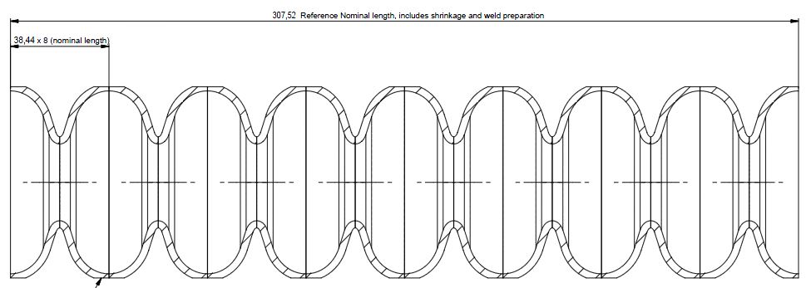
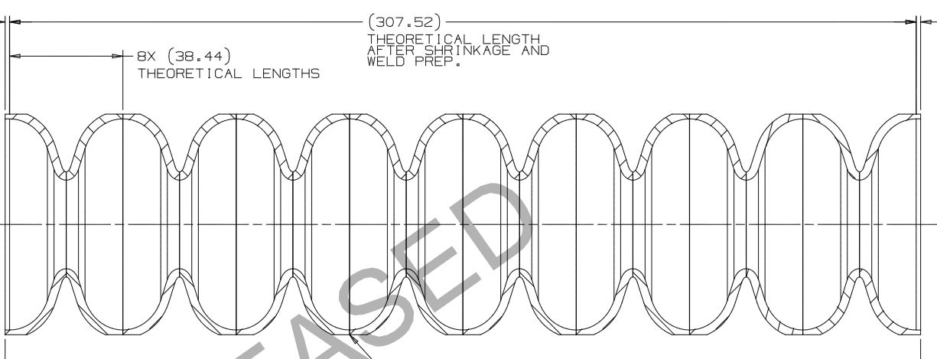
Review Bare Cavity Design
XFEL Cavity Dumbbell and LCLS-II Cavity Dumbbell Assemblies are Identical
Mid-Cells and End Half-Cells are the Same Geometry (XFEL – Top / FNAL Bottom)

Slide 4
Review Bare Cavity Design
CW operation in LCLS-II is more severe regime for the cavity. Some minor modifications are needed to reduce risks and eliminate tuning and heating problems.
Proposed modifications in cavity RF design.
Issue #1: Frequency of lowest dipole mode trapped in coupler end of the cavity is too close to operating mode frequency, 3.9 GHz. As a result the tuning of notch frequency is difficult and 3.9 GHz frequency power leak is significant.
Solution: Move away frequency of this mode. Few options:
Reduce radius of pullouts for main and HOM couplers.
Reduce beam pipe and bellow diameter 40 to 38mm.
Slide Presented by Nikolay Solyak FAC Review, SLAC, Oct. 13-15, 2015

Slide 5
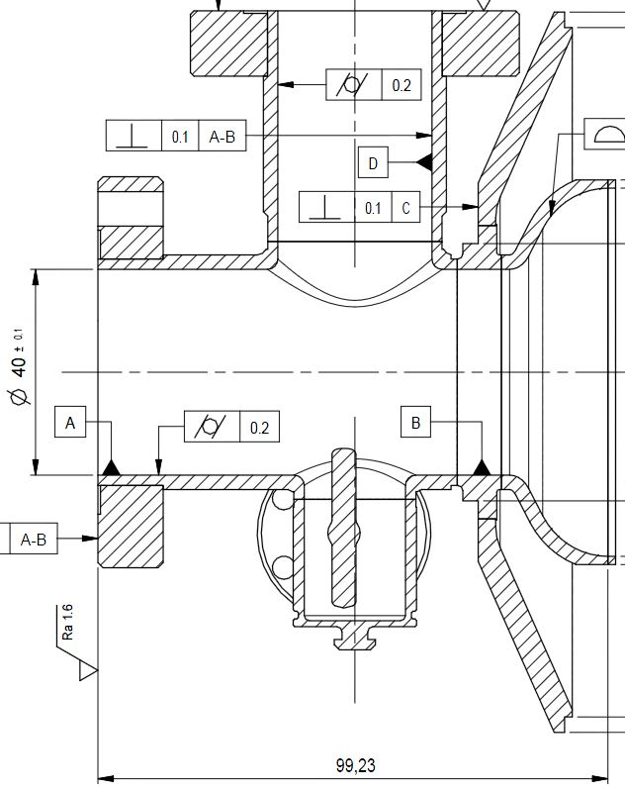
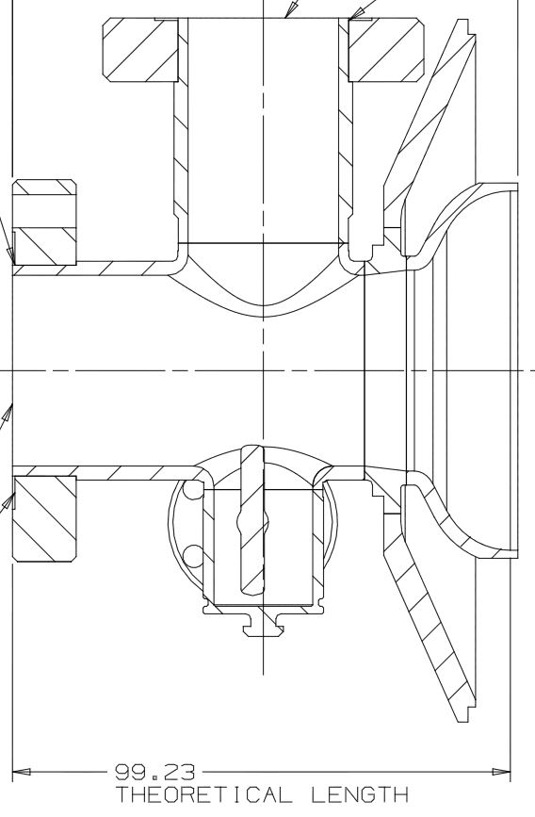
Review Bare Cavity Design
XFEL Bare Cavity MC Endgroup Design – Left – 40mm Beam Tube
LCLS-II Bare Cavity MC Endgroup Design – Right – 38mm Beam Tube
Dia = 38
Reducing
Spool

Slide 6
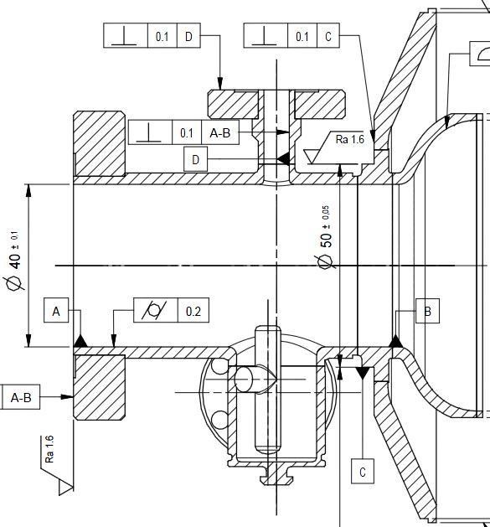
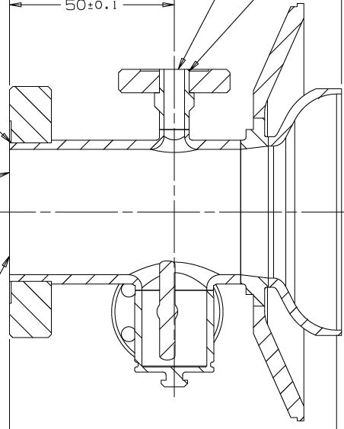
Review Bare Cavity Design
XFEL Bare Cavity FP Endgroup Design – Left – 40mm Beam Tube
LCLS-II Bare Cavity FP Endgroup Design – Right – 38mm Beam Tube
Dia = 38
Reducing
Spool

Slide 7
Review Bare Cavity Design
CW operation in LCLS-II is more severe regime for the cavity. Some minor modifications are needed to reduce risks and eliminate tuning and heating problems.
Proposed modifications in cavity RF design.
Issue #1:
Issue #2 : Overheating of the HOM antenna (quench ~20MV/m at cw)
Solution: HOM F-part modification possibilities in order to reduce heating
Reduce penetration to beam pipe
Increase length of bump
Slide Presented by Nikolay Solyak FAC Review, SLAC, Oct. 13-15, 2015

Slide 8
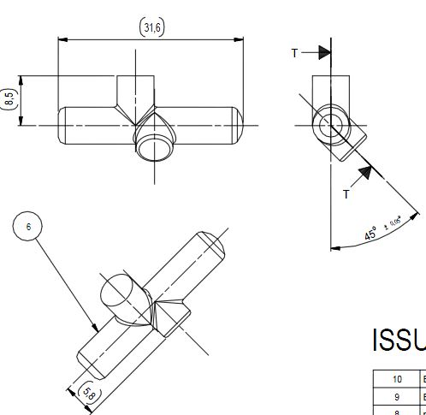
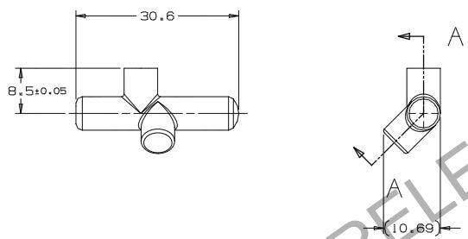
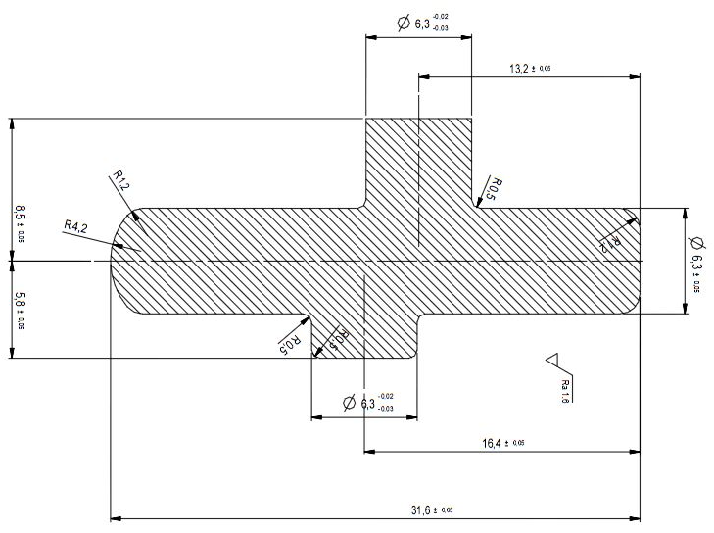
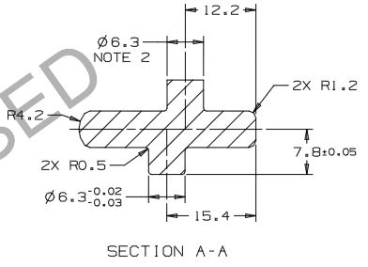
Review Bare Cavity Design
XFEL HOM F-Part Design – Left – 31.6mm Long
LCLS-II HOM F-Part Design – Right – 30.6mm long
F-Part Overall Length 1mm Shorter,
Antenna Bump 2mm Longer

Slide 9
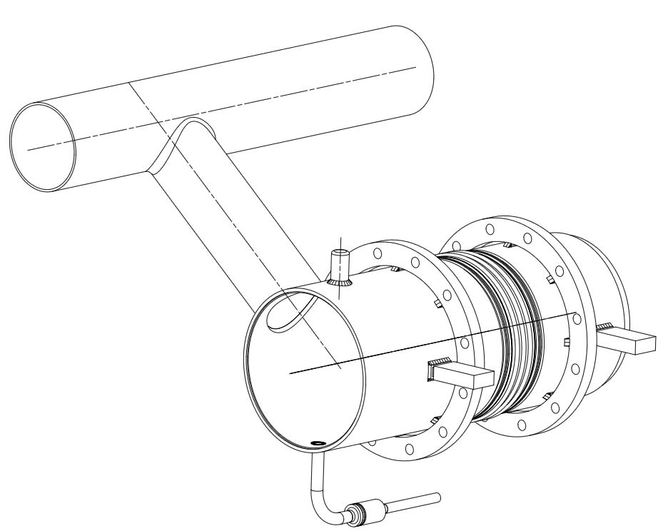
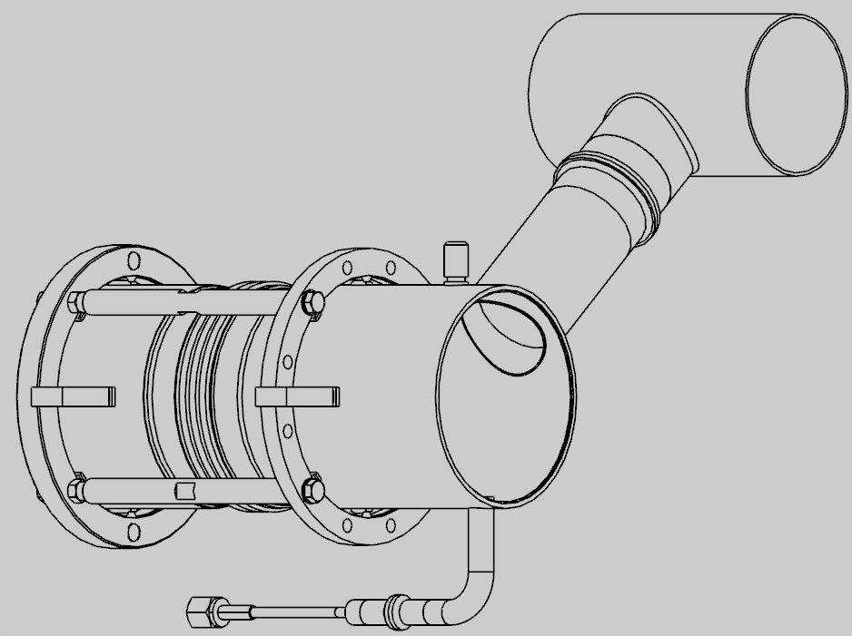
Evaluate Helium Vessel Design
XFEL Helium Vessel Design - Left
LCLS-II Helium Vessel Design - Right
Stainless Steel
2-Phase
Pipe
Titanium
2-Phase
Pipe
Tuner Rings Spread Apart
to Accommodate Piezos

Slide 10
Evaluate Helium Vessel Design
XFEL Helium Vessel Design - Left
LCLS-II Helium Vessel Design - Right
Bellows
Spanner
Rods
Bi-Metal Transitions Same
As 1.3 GHz LCLS-II He Vessel

Slide 11
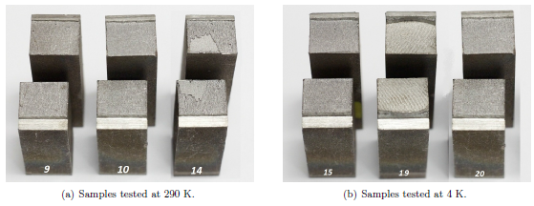
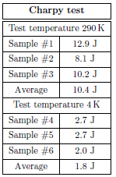
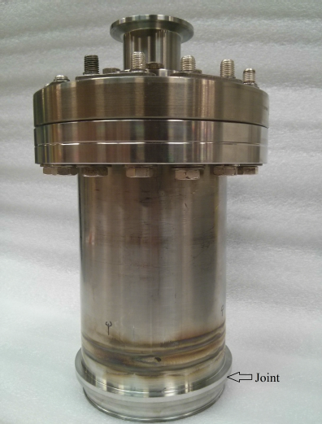
Evaluate Helium Vessel Design
Bi-Metallic Transition Qualification
Cold shock test sample
Bi-Metallic Transition Qualification
Charpy impact test
2.5
Test Results Courtesy of Donato Passarelli

Slide 12
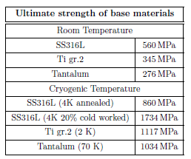
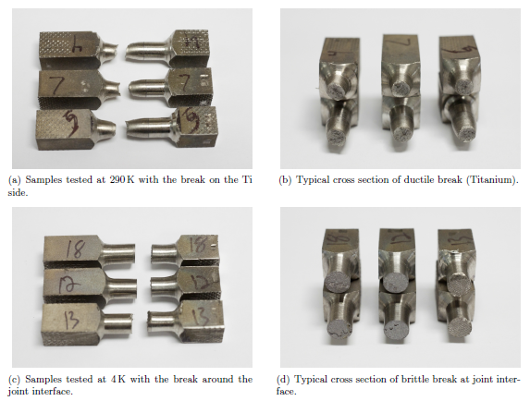
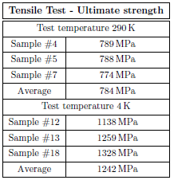
Evaluate Helium Vessel Design
Bi-Metallic Transition Qualification
Tensile test
Test Results Courtesy of Donato Passarelli

Slide 13
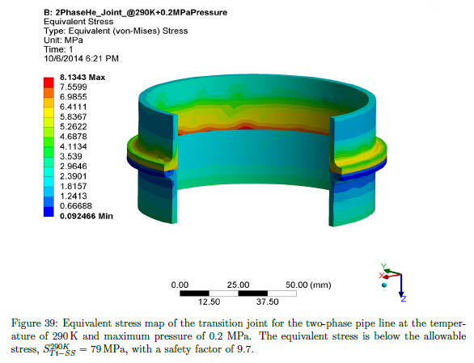
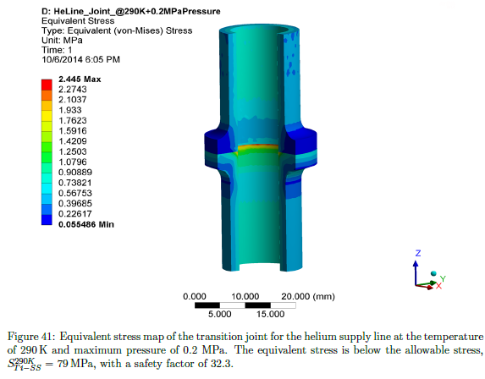
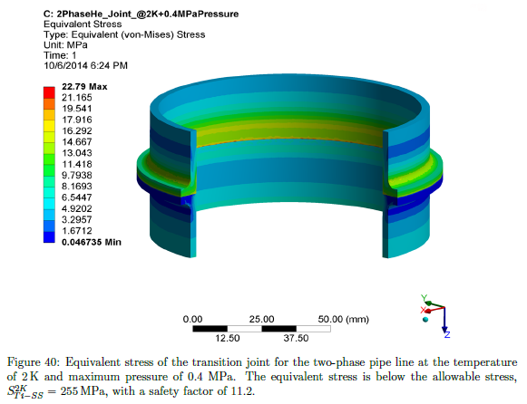
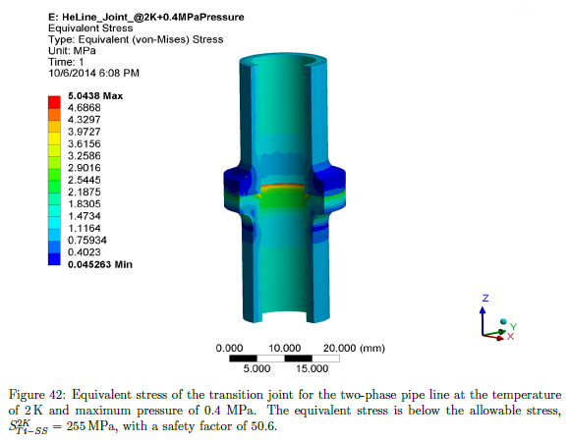
Evaluate Helium Vessel Design
Bi-Metallic Transition Qualification
FEA analysis – Large transition joint
Bi-Metallic Transition Qualification
FEA analysis – Small transition joint
Test Results Courtesy of Donato Passarelli

Slide 14
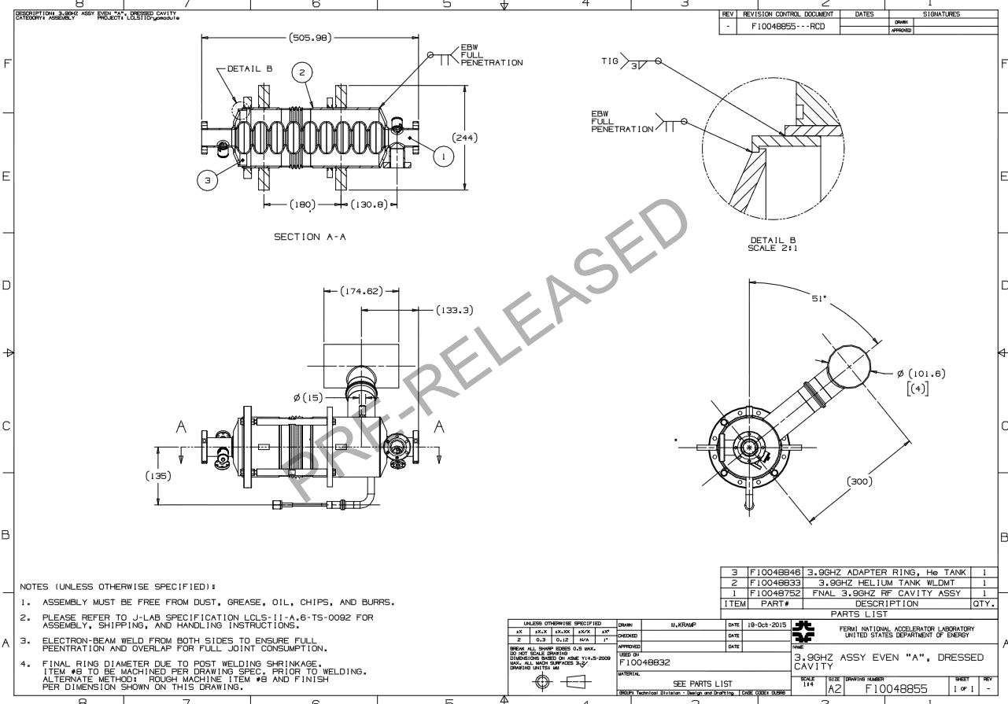
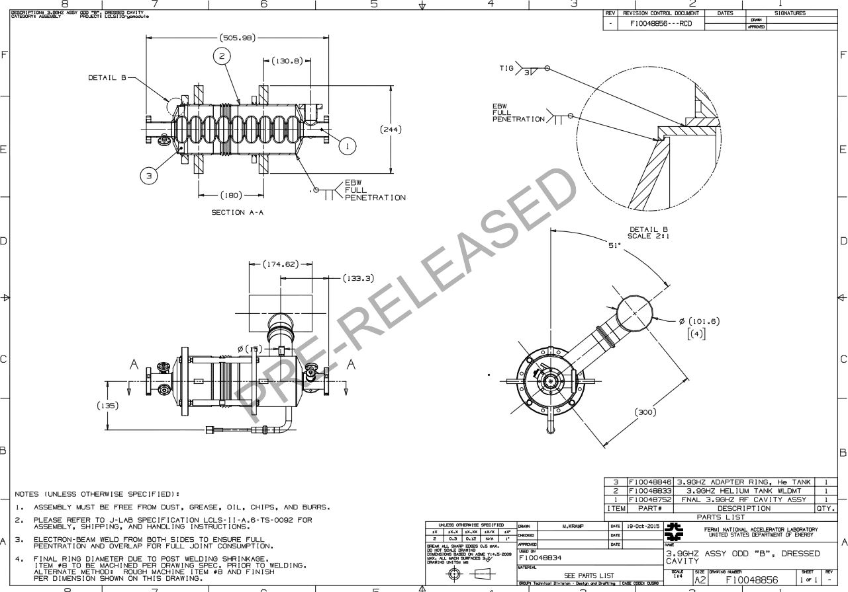
Dressed Cavity Design
LCLS-II Helium Vessel Dressed Even “A” - Left
LCLS-II Helium Vessel Dressed Odd “B” - Right
Cavities are welded in the helium so that the coupler ports are 180° apart. This is due to couplers alternating sides in the cryomodule.

Slide 15
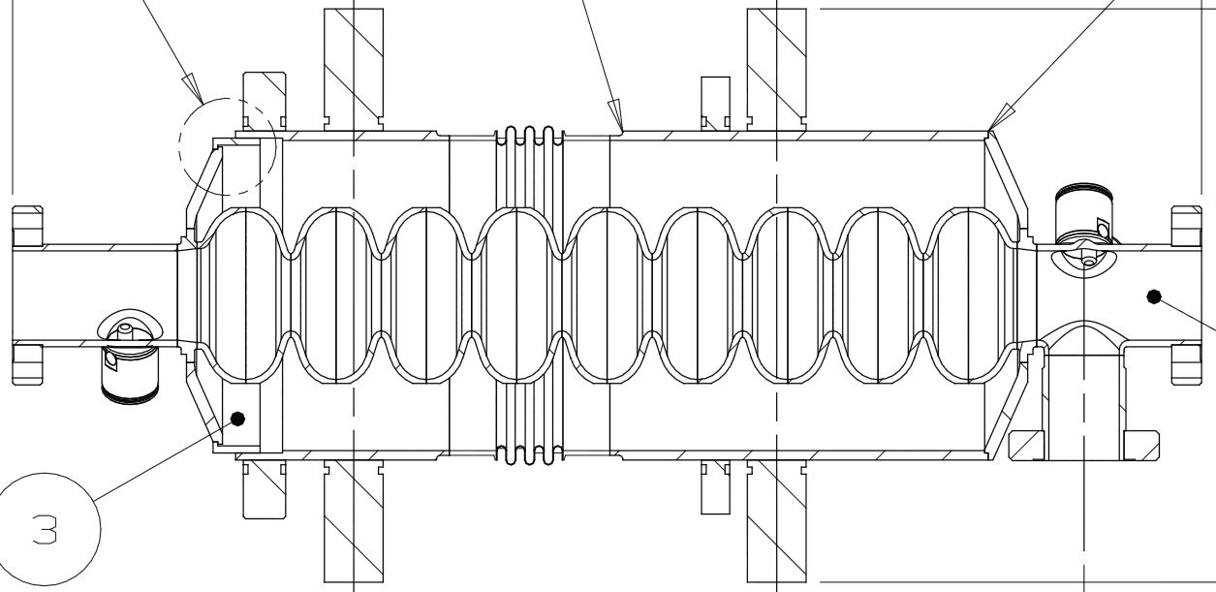
Dressed Cavity Design
Example of Welds for Dressed Even “A” Cavity
Same for Dressed Odd “B” Cavity
Electron-Beam Weld
TIG Weld
Electron-Beam Weld

Slide 16
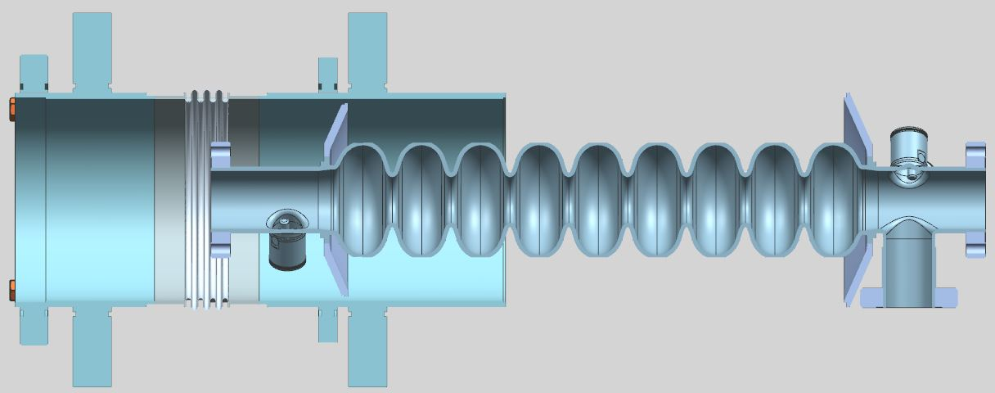
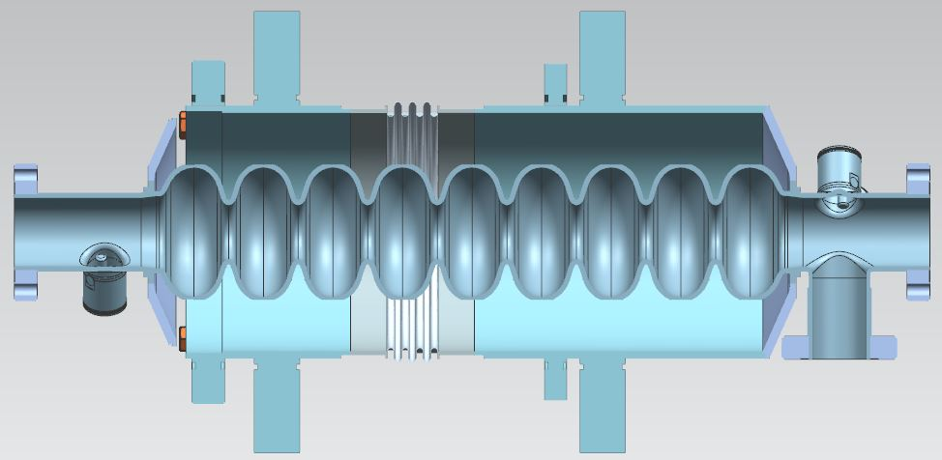
Dressed Cavity Design
Example of Weld Sequence for Dressed Even “A” Cavity
Same for Dressed Odd “B” Cavity
Weld Joint is Nb55Ti Disk on Cavity to the Titanium Helium Vessel
Electron-Beam Weld

Slide 17
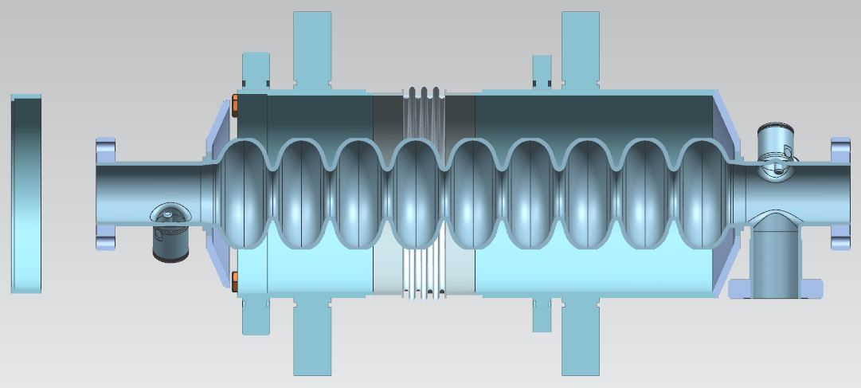
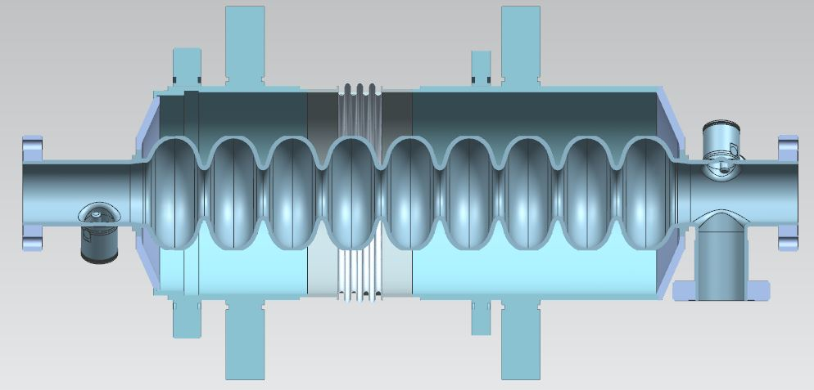
Dressed Cavity Design
Example of Weld Sequence for Dressed Even “A” Cavity
Same for Dressed Odd “B” Cavity
Titanium Adapter
Ring
Electron-Beam Weld
Weld Joint is Nb55Ti Disk on Cavity to the Titanium Adapter Ring

Slide 18
Dressed Cavity Design
Example of Weld Sequence for Dressed Even “A” Cavity
Same for Dressed Odd “B” Cavity
Final TIG Weld
Weld Joint is Titanium Adapter Ring to the Titanium Helium Vessel

Slide 19
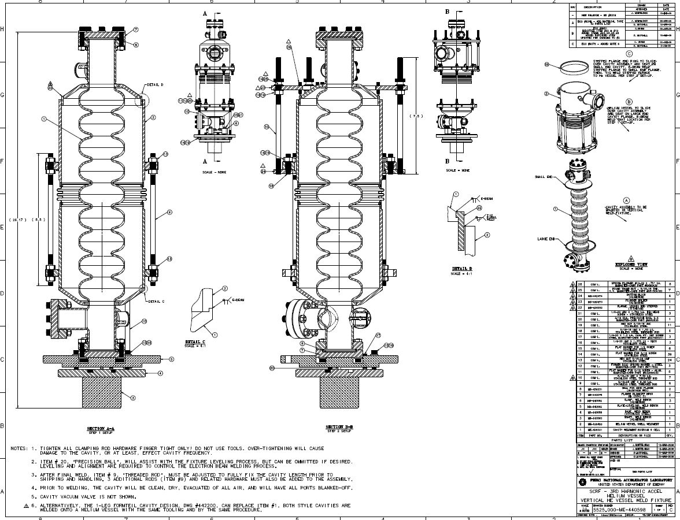
Dressed Cavity Design

Slide 20
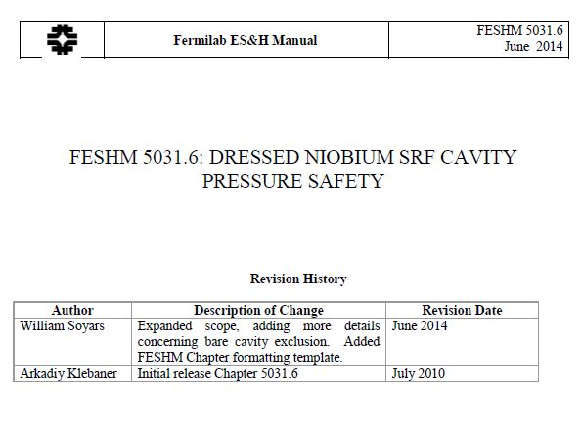
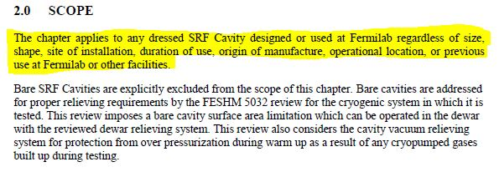
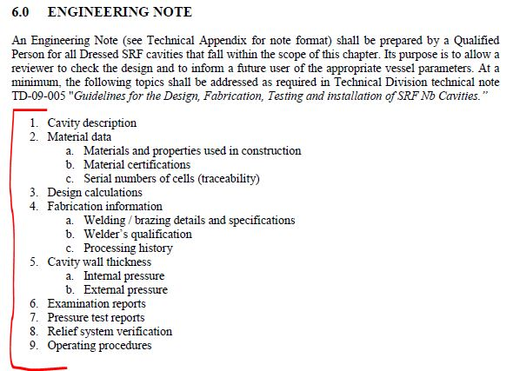
Dressed Cavity Design
Follow Pressure Vessel Guidelines as Specified in Fermilab’s ES&H Manual:
FESHM 5031.6: Dressed Niobium SRF Cavity Pressure Safety
TD-09-005: Guidelines for the Design, Fabrication, Testing and Installation of SRF Nb Cavities

Slide 21
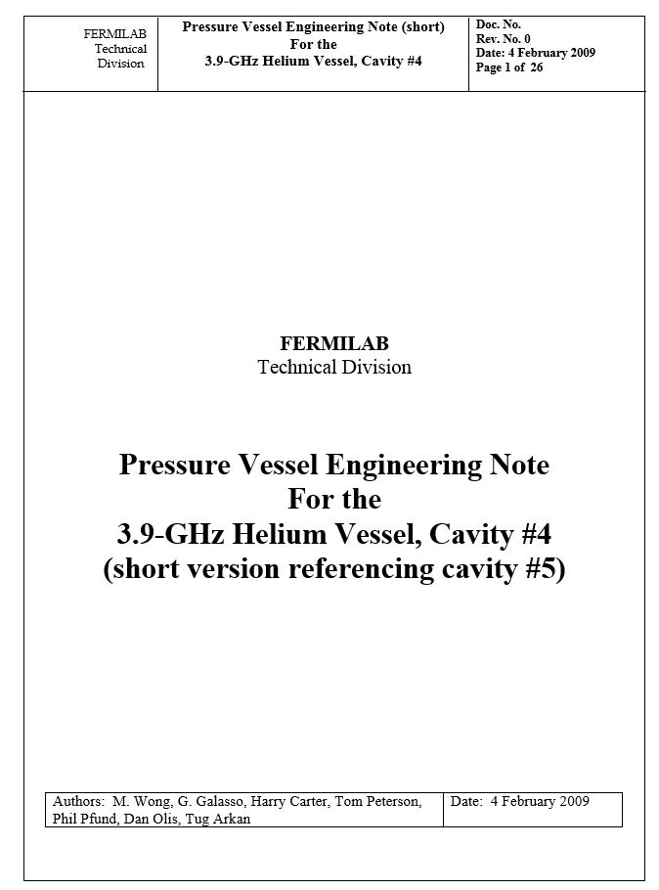
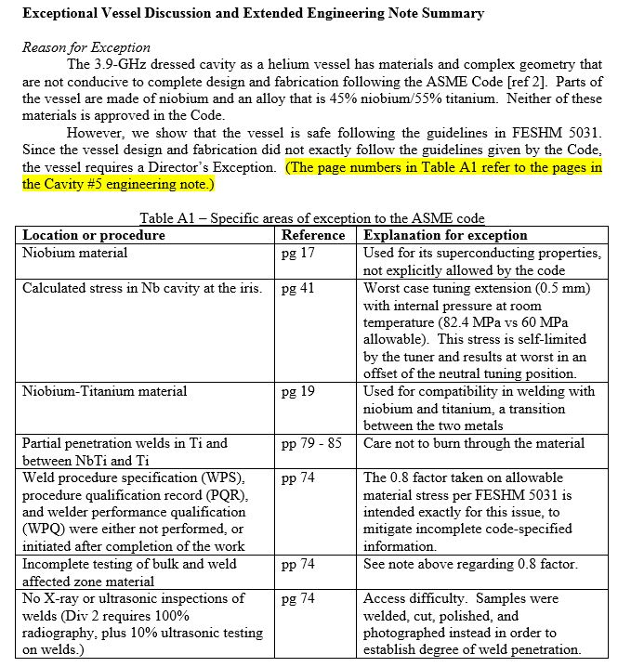
Dressed Cavity Design
Follow Pressure Vessel Guidelines as Specified in Fermilab’s ES&H Manual:

Slide 22
LCLS-II Helium Vessel Production CM FDR
Summary:
Bare cavity drawings are complete – Pre-released state
Helium vessel drawings are complete – Pre-released state
Dressed cavity assembly drawings are complete – Pre-released state
Explanation on differences between the XFEL and LCLS-II designs
Bi-metal transition qualification work was completed as required for the 1.3 GHz dressed cavities for LCLS-II
Pressure Vessel Note is not complete, work in progress
FESHM 5031.6 will be used as a guideline for Vessel Note

Slide 23
LCLS-II Helium Vessel Production CM FDR
Thank You!

Slide 24
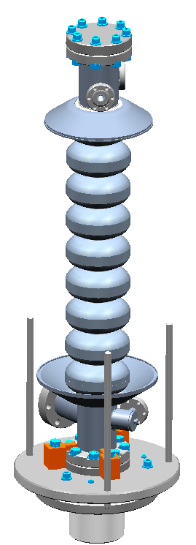
Vertical Welding Fixture Assembly Procedure
Place 9-cell niobium cavity with
main coupler end down and large end-group clamped to “Leveling Plate” on fixture.
Add helium vessel support threaded rods.
Small End-Group Flange
(Ni/Ti)
Support Rods
Large End-Group Flange
(Ni/Ti)
Clamp Block
Leveling Plate
Back-up Slides

Slide 25
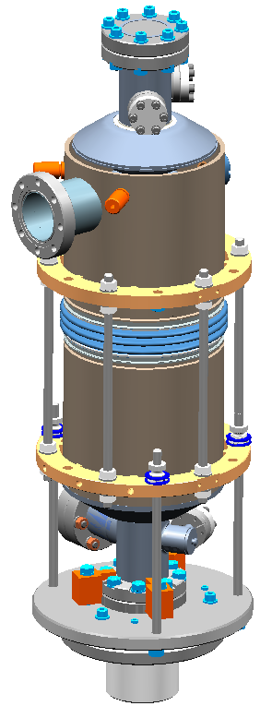
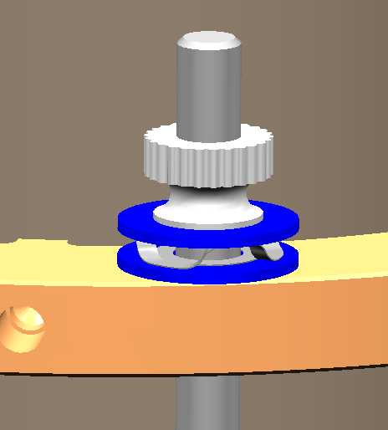
Helium Vessel Placement
Lower vessel and align vessel step to cavity end-group step. Secure with spring washers and thumb nuts.
Hand tighten thumb nuts only!!
Insure proper clocking of the helium vessel with respect to the cavity.
Thumb Nut
Flat Washers
Spring
Washer
Back-up Slides

Slide 26
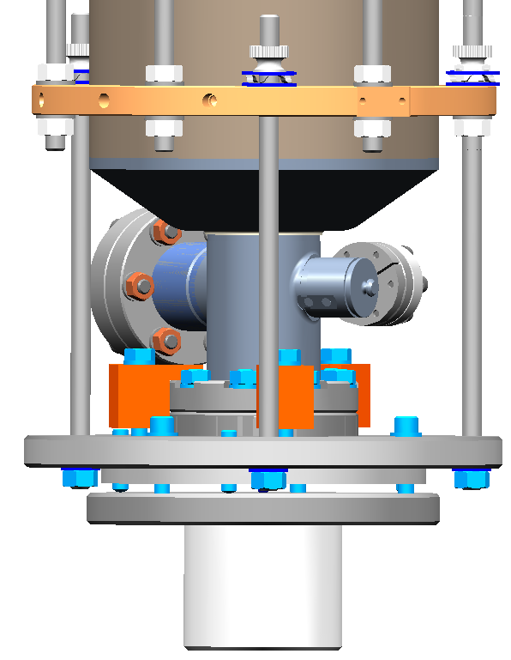
First Electron Beam Weld
Perform electron beam tack weld on large end-group flange. Beam to have a slight “upward” angle.
Location and angle
of electron beam
weld. Tack in (3)
places equally
around flange.
Back-up Slides

Slide 27
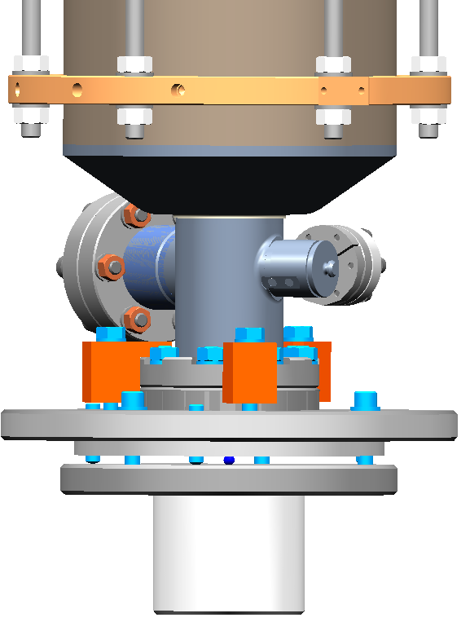
First Electron Beam Weld Continued
Perform electron beam weld on large end-group flange.
Beam to have a slight “upward” angle.
Spring
Washer
Remove support rods
and perform 360 degree
continuous weld.
Back-up Slides

Slide 28
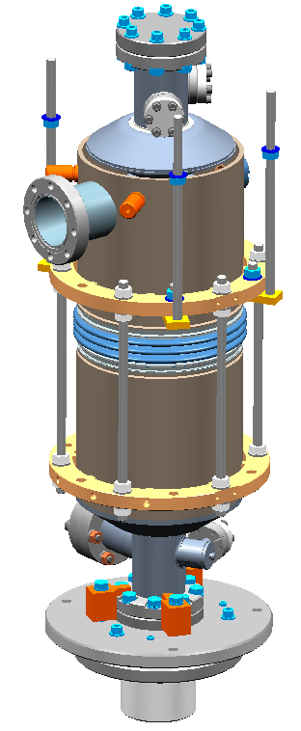
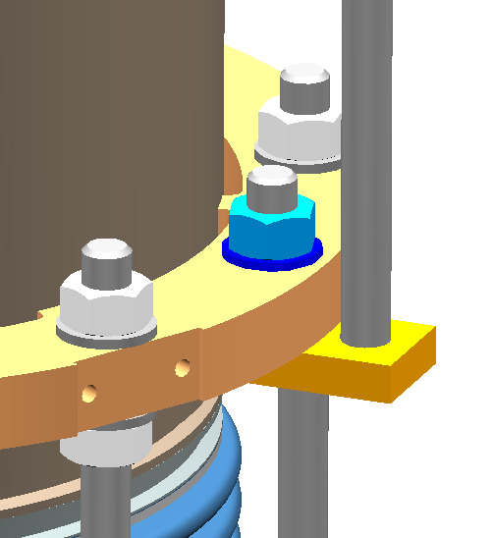
Fixture Setup for 2nd Electron Beam Weld
Threaded Rod
Flat Washer
Hex Nut
Add threaded rods and “Bottom Block” assembly.
Bottom Block
Back-up Slides

Slide 29
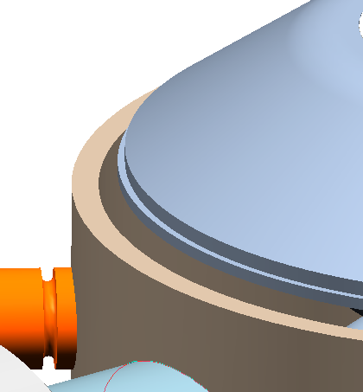
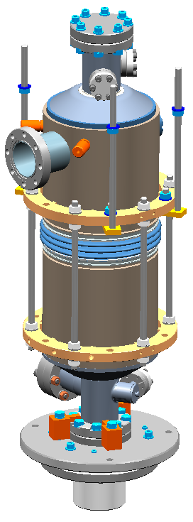
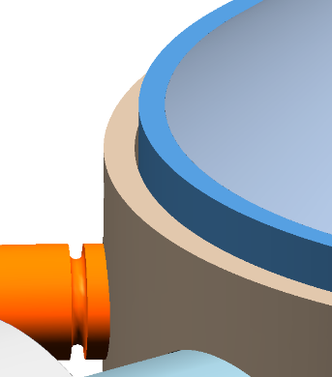
Fixture Setup for 2nd Electron Beam Weld Continued
Lower stepped flange end ring and seat on small end-
group flange.
Small end group-
flange before
installation of
stepped flange
end ring
View after stepped
flange end ring
installation (Titanium)
Back-up Slides

Slide 30
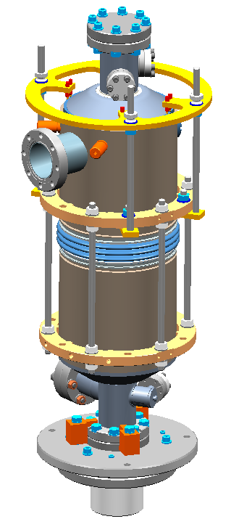
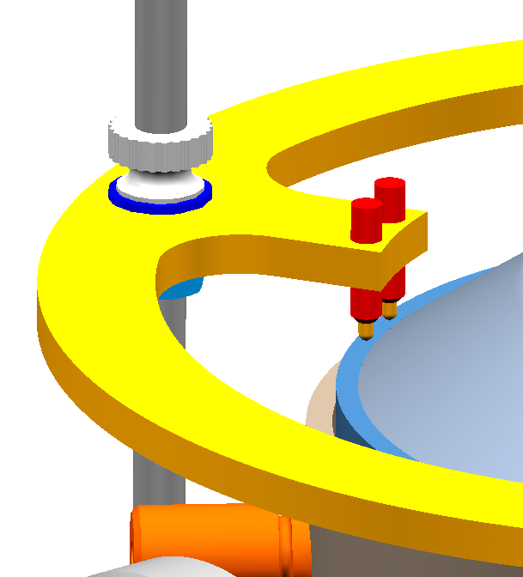
Fixture Setup for 2nd Electron Beam Weld Continued
Add “Plunger Holder” and “Spring Plungers” to add pressure to stepped flange
end ring to maintain proper
fit and alignment during tack
welding.
Plunger Holder
Spring Plungers.
Each plunger provides
1.3 – 2.7 lbs. of down force.
This is not enough load to
de-tune the cavity.
Back-up Slides

Slide 31
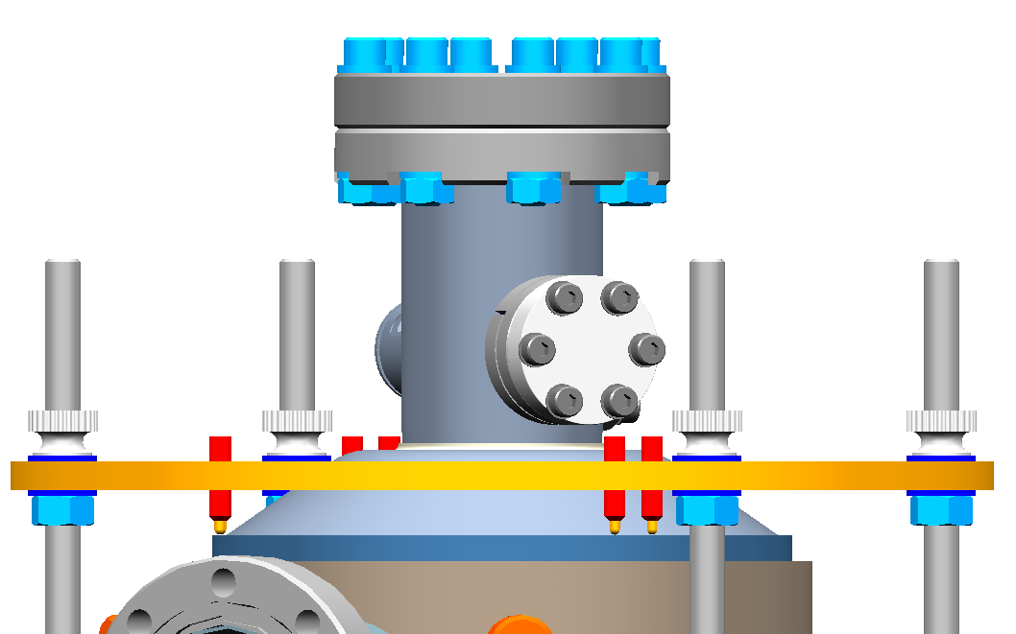
Second Electron Beam Weld
Perform electron beam tack weld on small end-group flange. Beam to have a slight angle.
Location and angle
of electron beam
weld. Tack in (4)
places around flange
between spring plungers
Back-up Slides

Slide 32
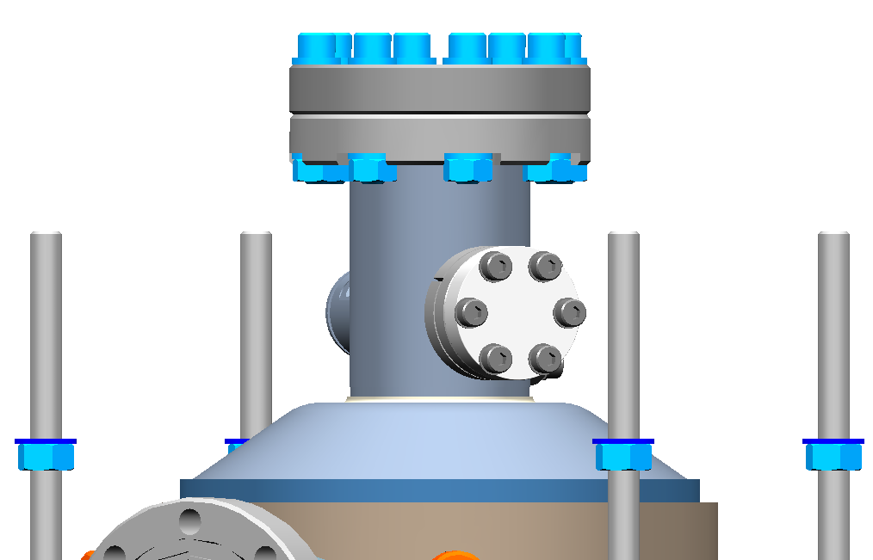
Second Electron Beam Weld Continued
Perform electron beam weld on small end-group flange.
Beam to have a slight angle.
Remove “Plunger Holder”
and perform a 360 degree
continuous weld.
Back-up Slides

Slide 33
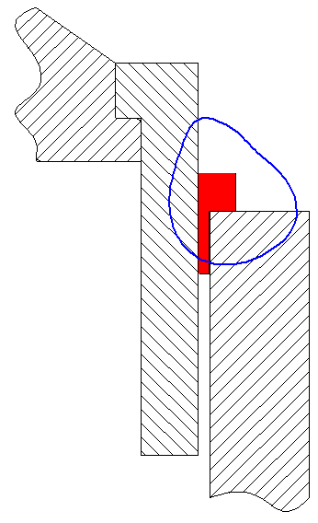
Final TIG Weld
Stepped Flange
End Ring
(Titanium)
Move to an argon purged glove box and perform final TIG weld of titanium stepped ring to titanium helium vessel. Weld to be performed in a “free” state.
A filler ring is added to fill the gap between the stepped ring and the helium vessel. The filler ring helps with alignment and supplies filler material to complete the weld
360 degree
continuous
TIG weld.
Small End- Group Flange
(Ni/Ti)
Filler Ring
(Titanium)
Helium Vessel
(Titanium)
Back-up Slides

