Slide 1
Default zero suppression in simulation
DUNE 35-ton simulation, reconstruction and analysis
David Adams
BNL
November 18, 2015
Updated 15:50 EST

Slide 2
Introduction
I have been working on zero suppression (ZS)
  Have simulation of the ZS planned for 35-ton running
    See description of this and current simulation default at
    https://cdcvs.fnal.gov/redmine/projects/35ton/wiki/Data_compression_and_zero_suppression
  Working on new DetSim module that can use the new ZS sim
    Will allow user to plug in different services for ZS
      And for multi-channel ZS and compression
    Also developing modules to reproduce current behavior
  For more info, see my talk at Monday’s DAQ meeting:
    https://indico.fnal.gov/conferenceDisplay.py?confId=10621
I have been validating the new code
  Found the current default ZS does not have much effect
    With our current noise model
    Subject of this talk—see following slides

Slide 3
DetSim configuration (1)
I use the fcl at right
  I believe this is our current default for simulation
  Resulting fcl parameters for DetSim are on the following page
#include "services_dune.fcl"
#include "singles_dune.fcl"
#include "largeantmodules_dune.fcl"
#include "detsimmodules_dune.fcl"
process_name: SinglesGen
services:
{
# Load the service that manages root files for histograms.
TFileService: { fileName: "mu35t_hist.root" }
TimeTracker: {}
RandomNumberGenerator: {} #ART native random number generator
user: @local::dune35t_simulation_services
}
#Start each new event with an empty event.
source:
{
module_type: EmptyEvent
timestampPlugin: { plugin_type: "GeneratedEventTimestamp" }
maxEvents: 1 # Number of events to create
firstRun: 1 # Run number to use for this file
firstEvent: 1 # number of first event in the file
}
# Define and configure some modules to do work on each event.
# First modules are defined; they are scheduled later.
# Modules are grouped by type.
physics: {
producers: {
generator: @local::dune35t_singlep
largeant: @local::dune35t_largeant
daq: @local::dune35t_simwire
rns: { module_type: "RandomNumberSaver" }
}
#define the producer and filter modules for this path, order matters,
#filters reject all following items. see lines starting physics.producers below
simulate: [generator, largeant, daq, rns]

Slide 4
DetSim configuration (2)
daq: {
CollectionPed: 500
CollectionPedRMS: 0.01
CompressionType: "ZeroSuppression"
DriftEModuleLabel: "largeant"
FractHorizGapUCollect: 0.1
FractHorizGapUMiss: 0.8
FractHorizGapVCollect: 0.1
FractHorizGapVMiss: 0.8
FractHorizGapZMiss: 0.8
FractUUCollect: 0.5
FractUUMiss: 0.2
FractUVCollect: 0.1
FractUVMiss: 0.2
FractVUCollect: 0.5
FractVUMiss: 0.2
FractVVCollect: 0.1
FractVVMiss: 0.2
FractVertGapUCollect: 0.1
FractVertGapUMiss: 0.8
FractVertGapVCollect: 0.1
FractVertGapVMiss: 0.8
FractVertGapZMiss: 0.8
FractZUMiss: 0.2
FractZVMiss: 0.2
InductionPed: 1800
InductionPedRMS: 0.01
LowCutoffU: 7.5
LowCutoffV: 7.5
LowCutoffZ: 7.5
NearestNeighbor: 25
NeighboringChannels: 3
NoiseArrayPoints: 1000
NoiseFactU: 0.332
NoiseFactV: 0.332
NoiseFactZ: 0.332
NoiseModel: 1
NoiseOn: 1
NoiseWidthU: 62.4
NoiseWidthV: 62.4
NoiseWidthZ: 62.4
PedestalOn: "false"
SaveEmptyChannel: "true"
SimCombs: "false"
SimStuckBits: "false"
StuckBitsOverflowProbHistoName: "pCorrFracOverflowVsInputLsbCell"
StuckBitsProbabilitiesFname: "ADCStuckCodeProbabilities35t/output_produceDcScanSummaryPlots_20150827_coldTest_0p1to1p4_step0p0010.root"
StuckBitsUnderflowProbHistoName: "pCorrFracUnderflowVsInputLsbCell"
ZeroThreshold: 5
module_type: "SimWireDUNE35t"
}

Slide 5
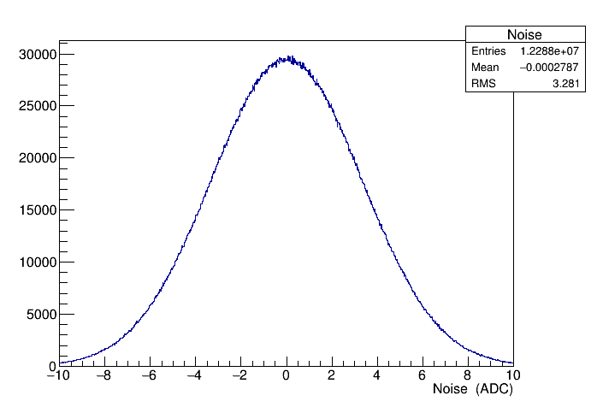
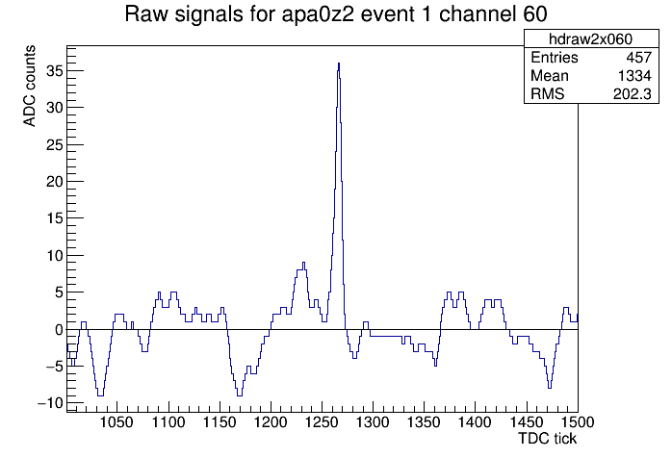
Noise
Histograms show noise
  Top is noise histogram from DetSim module
  Bottom is part of ADC spectrum from one wire
Comment
  Signal is evident on wire
  Noise clearly has time correlations
  Noise often dips above or below threshold of 5
  No ZS is evident
    Presumably because of ZS channel window

Slide 6
Zero suppression
Following slides show 2D ADC spectrum for one plane
  Channel number vs. TDC tick
  Four plots:
    No ZS
    Default channel window sizes (NeighboringChannels) Nch = 3
    Nch = 1 (only keep adjacent channels)
    Nch = 0 (no neighboring channels)
  Note distortion for small channel numbers when ZS is applied
    Defect in ZS or unpacking code?

Slide 7
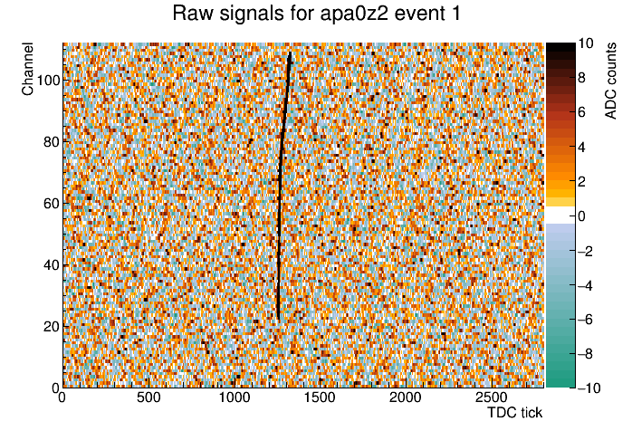
ADC spectrum without ZS

Slide 8

ADC spectrum for ZS channel window of 3

Slide 9
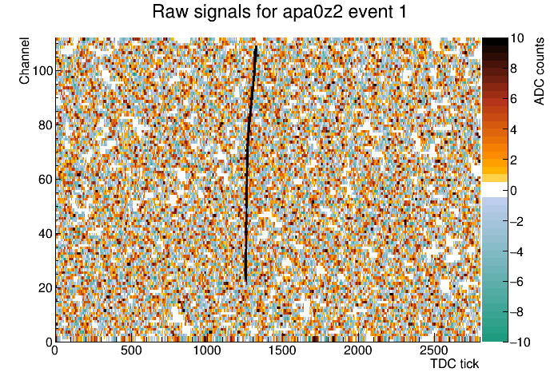
ADC spectrum for ZS channel window of 1

Slide 10
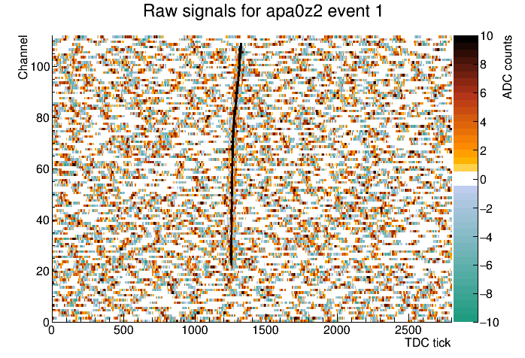
ADC spectrum for ZS channel window of 0

Slide 11
Zero suppression comments
Comments
  Current default suppresses almost nothing
  Ignoring neighbors entirely only suppresses about half
  For this signal/noise simulation, we should
    Use one or better zero neighboring channels
      There is no plan for more than zero for 35 to DAQ
    Decrease tick window: maybe 25 → 10
    Raise threshold: 5 (1.5σ) → 10 (3σ) or more
    See next two plots for the effect of these parameters
  Or don’t bother to include ZS in simulation
  Or switch to simulation of ZS being developed for the DAQ
    Available soon

Slide 12
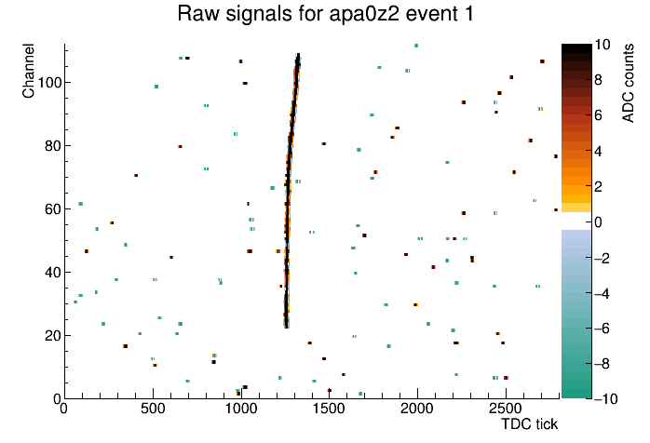
ADC spectrum for ZS Nch=0, Ntick=10, th=10

Slide 13
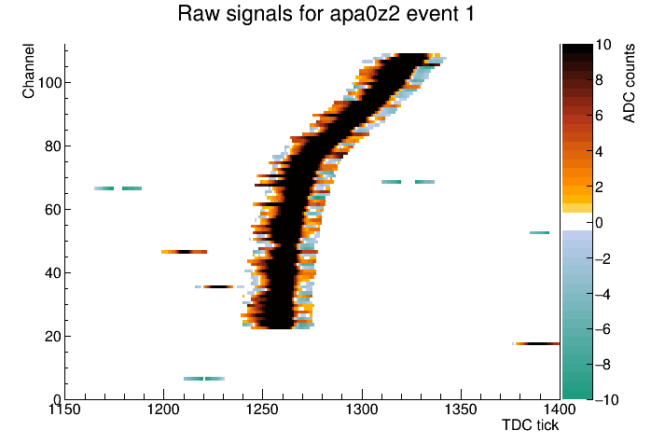
ADC spectrum for ZS Nch=3, Ntick=10, th=10

Slide 14
Current status of ZS development
New code is in github:
  https://github.com/dladams/dunezs
This package includes
  Interface for ZS
  ZS implementations for legacy (window) and 35 ton online sim
  Service wrappers for ZS interface and implementations
  Compression which replaces suppressed values with zero
    Plan to add interface and implementation with current block packing
  New SimWire module: SimWireDUNE
    Copied from SimWireDune35t
    ZS/compression section replaced with call to ZS and compression services
Validation
  I ran 5 events and compared current and new implementations
    With my preferred values for ZS
  17/80 planes, 21/29M bins differ.
    I am investigating. One example is on the following page.

Slide 15
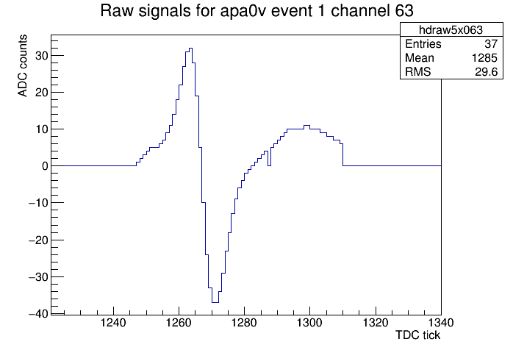
ZS development discrepancy
Plot at right shows discrepancy
  Plot is the new code
  Original does not have hole at channel 1287
  But it is 11 channels away from the nearest bins with <-10 and >10 and so should be suppressed. No?
  Or I don’t understand the intent of the current algorithm
Suppressed signal

