Slide 1
Preliminary Schedule & Cost Summary for MICE ds Spectrometer Solenoid Magnet Repair
DRAFT Thursday 2 PM needs corrected & more #s
Peter H. Garbincius,
Mark Palmer, Alan Bross, Rich Krull
Fermilab
December 3, 2015

Slide 2
Balance Sheet from Oct 15 RLS Review at RAL
Mark said this $ 100 K carryover from FY15 => FY16 is LBNL
actual = 1,431 need to update subsequent #’s final = 1,932
does include all probability weighted risks, but
does NOT include estimate for repair of ds Spectrometer Solenoid

Slide 3
Estimates and Basis (page 1)
Warm-up, De-Install: $ 0 needed anyway, Step IV => Final Cooling
Transport RAL => ? Site – not included, small
Remove Cold Mass from Cryostat $ 65 K LBNL estimate based on Wang experience adjust to FNAL Rates + 40% contingency
Fabricate New Cold Mass $ 1,679 K Fermilab TD estimate + 40% contingency
Re-Assemble $ 188 K LBNL est => Fermilab Rates + 40% cont

Slide 4
Estimates & Basis (page 2)
Transport: ? Site => RAL not included, small
Install, Pump, Cool, Train $ 0 needed anyway Step IV => Final Cooling
Total Estimate = $ 1.932 M
Available Contingency = $ 1.932 M planned to be used for MICE Exp Ops
Estimated Shortfall = $ 0 M
what a coincidence!
Does NOT include estimated for additional Power Supplies or Quench Protection mods

Slide 5
Personnel Needs ~ 4.93 person-yrs

Slide 6
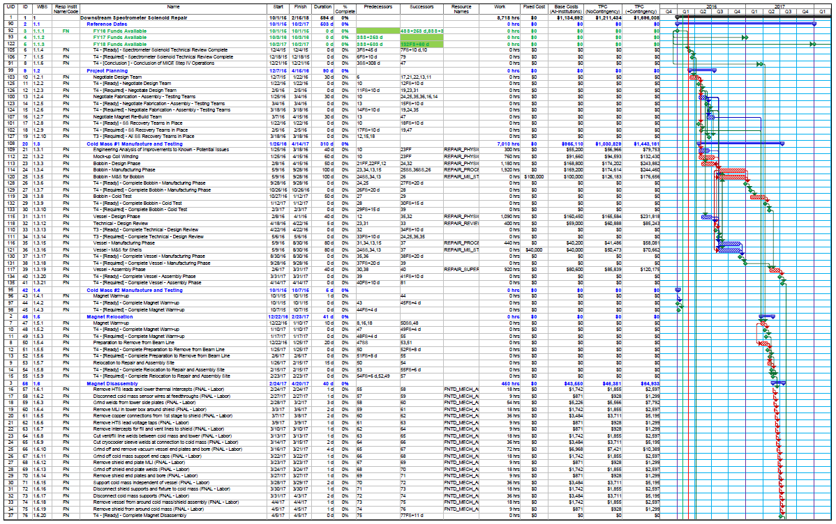
RLS – 15-11-30-MAP-SS-Repair2-Cont
- need to updated - page 1 of 2

Slide 7
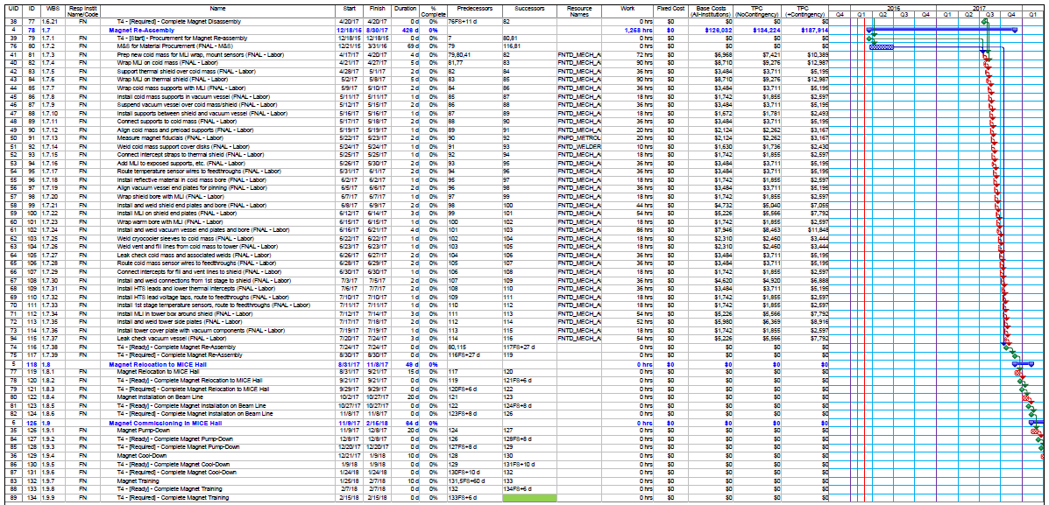
RLS – 15-11-30-MAP-SS-Repair2-Cont
- need to update - page 2 of 2

Slide 8
Preliminary Timeline Summary
Color code, add details, key dates
duration estimate
time uncertainty, typically 40%

Slide 9
The End
Questions?
Back-up slides

Slide 10
R&D Risk Register

Slide 11
R&D Risk Register – 1 new Risk
Highlights since April 2015 Review:
  Retired Three RISKs: RF Couplers in Magnetic Field (no additional cost) Step IV PRY Shielding Integration (no additional cost) Cooling Demo PRY Design changes ($ 32 K + 5 weeks)
  Updated the Target Retirement Dates
  6 R&D RISKs remain active: weighted est & work days
  RF Modules Assembly & Integration $ 151 K & 36 days
  Cooling Demo Magnetic Shielding $ 117 K & 125 days
  Commission Spectrometer Solenoids $ 262 K & 40 days
  New: RF Install & Commission at RAL $ 168 K & 56 days
  Total Weighted Risks & Durations $ 698 K & 257 days
  Total Unweighted => $ 1,208 K & 750 work days
  Does NOT include est for repair of ds Spectrometer Solenoid

