Slide 1

Status of DQW cavity and auxiliary systems production
Marco Garlaschè
On behalf of EN-MME & Crab Cavity Manufacturing Collaboration
Joint LARP CM26/Hi-Lumi Meeting – SLAC – May 2016

Slide 2
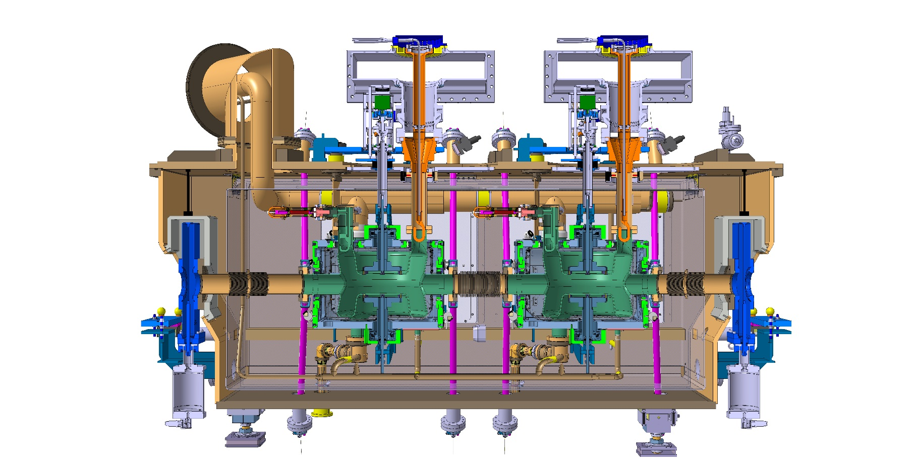
Overview
An update of production inside out..
HOM
Cavity
Pick-up
Feedthrough
Cold Magnetic Shield
Tank
Tuner

Slide 3
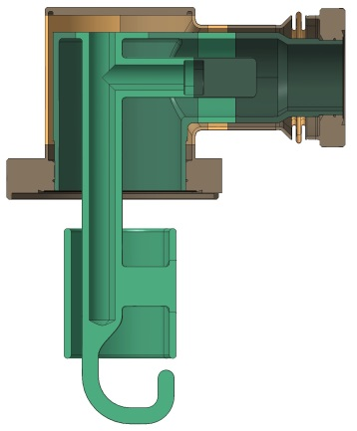
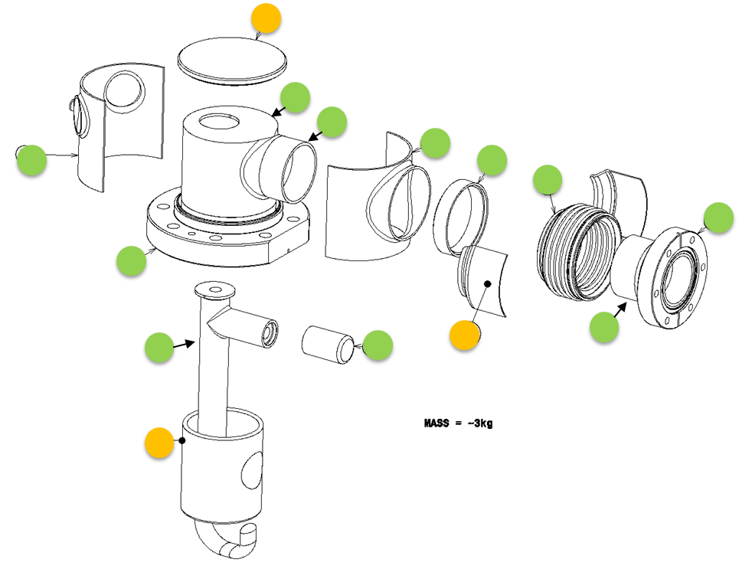
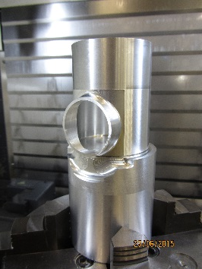
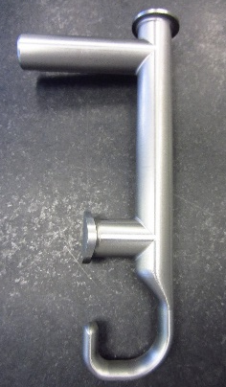
HOM : Production Status
Machining
~ all Nb parts have been produced
steel parts and tools (EB, brazing) ready
Prototype assembly for EB test ready
Cleaning
Bulk BCP_{60um} done
Light preparation for brazing done
Joining
Brazing of flanged extremities ongoing (by end May)
EB: see next slide
6x in Stby
Notes:
8+(1 test soudage)

Slide 4
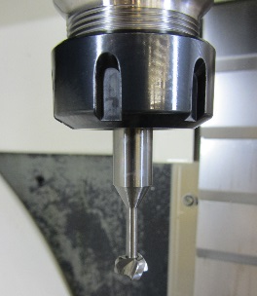
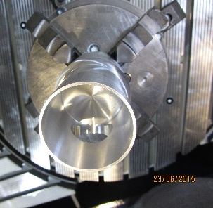
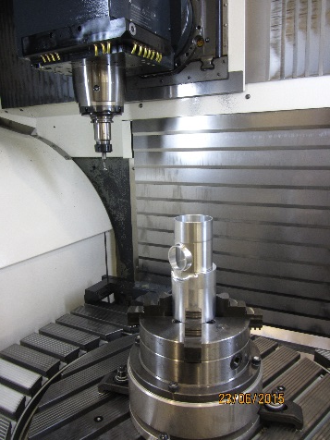
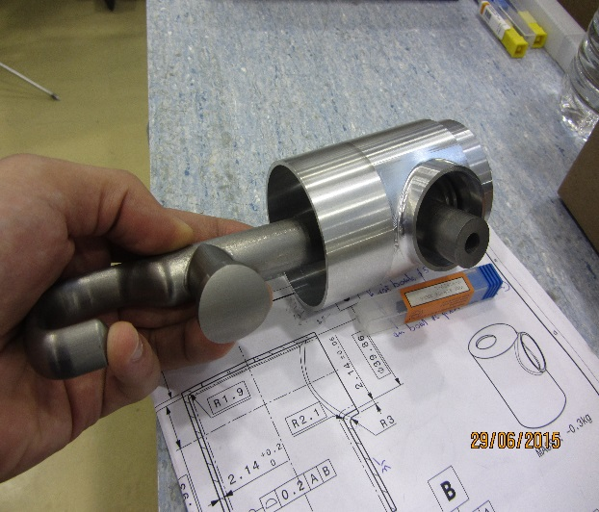
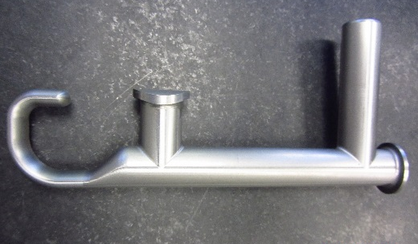
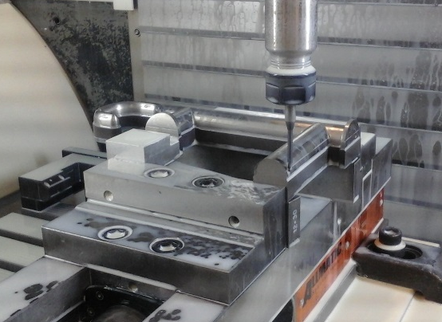
HOM: Challenging parts for machining
Machining performed on 5x-axis milling center
Machining via custom-made tools and clamping systems
Procedure qualification via Aluminum prototypes

Slide 5
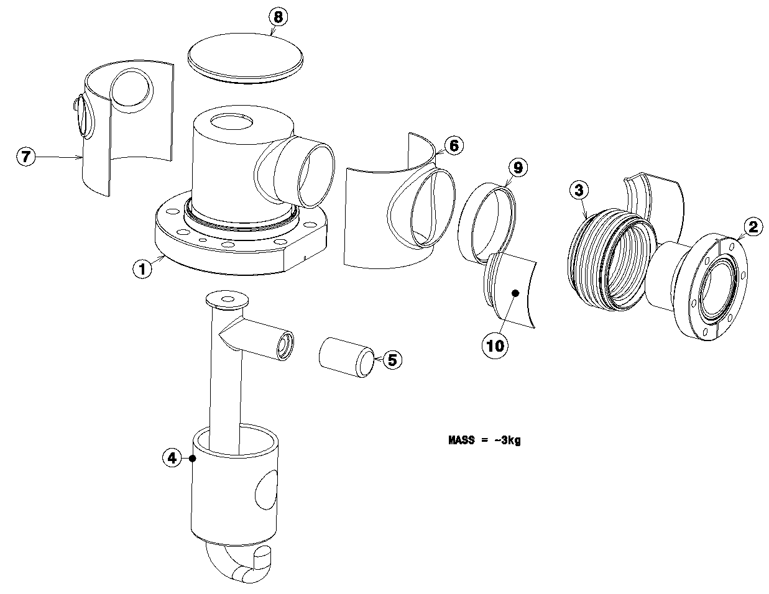
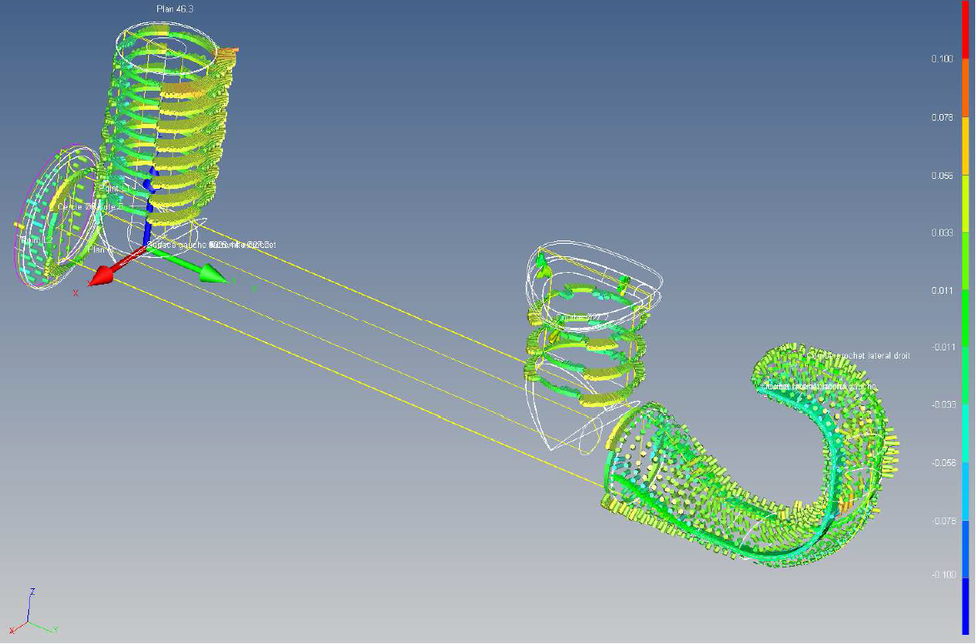
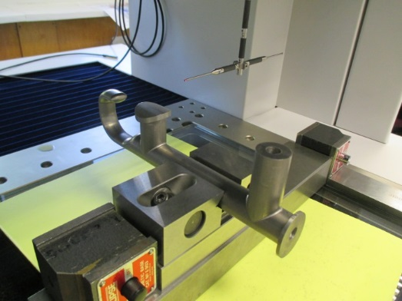
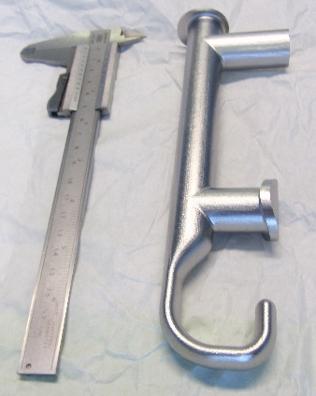
HOM: BCP Results & Metrology
All pieces conform to dimensional requirements
0.1
EDMS 1507831
Hooks: profile tolerances below ±0.15mm
(spec.: 0.3mm profile band on hook)
-0.1
= metrology
= BCP Test
BCP
Initial tests: 20um / 30um / 60um
→ variability among BCP: = ± few um
Production : 60um
→variability among pieces = ±10um

Slide 6
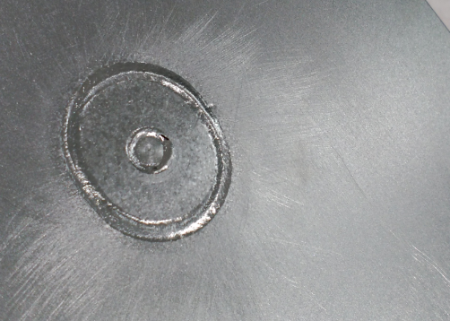
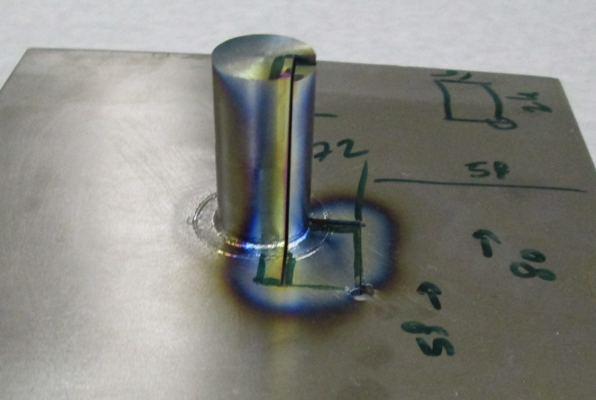
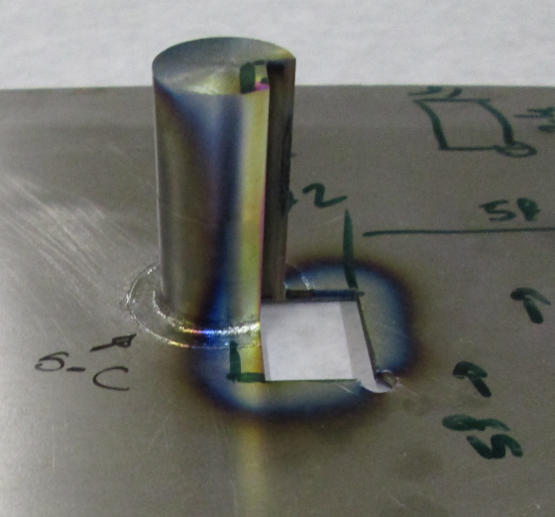
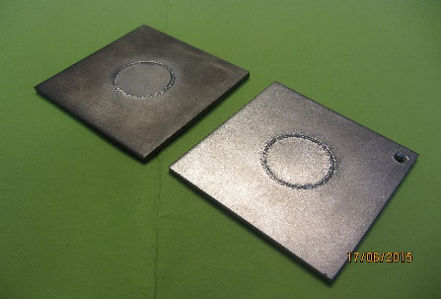
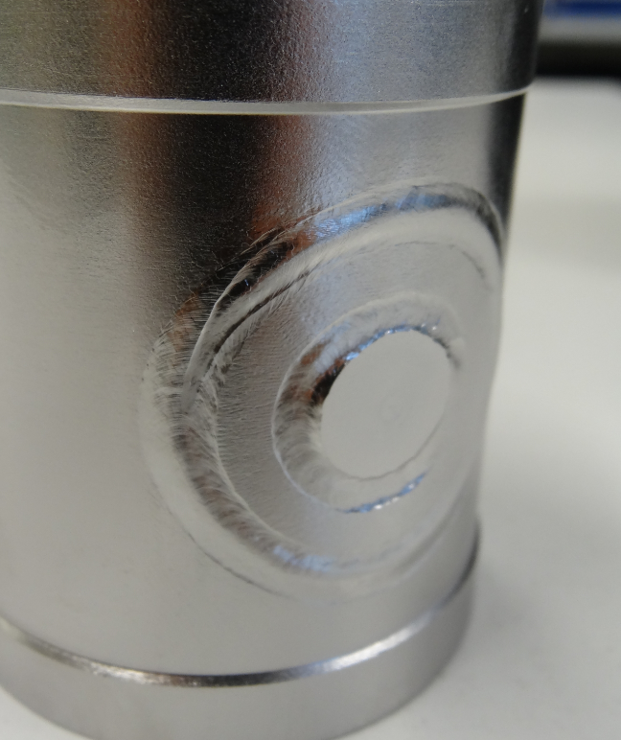
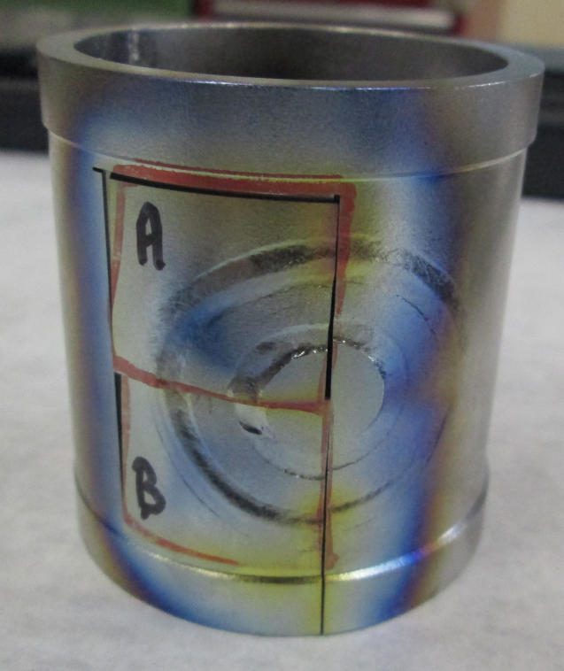
HOM: Welds
W050
Samples for parameters & qualif. of critical welds DONE
THE WELDING PARAMETERS FOR BOTH WELDS: OK
VISUAL INSPECTION ACCORDING TO ISO 13919-2 LEVEL B : OK
QUALIFICATION according to EN-15613: Metallographic and Hardness Test ONGOING
- W050: Niobium thickness 2mm. Welding from external side
W010
Internal Side
Sample
External side
- W010: Niobium thickness 3.6 & 4.2mm. Welding from external side
Brazing
EB welding
Before BCP
Samples
After BCP
External Side

Slide 7
HOM: Conclusions
Machining:
all critical parts produced
pieces compliant with specified tolerances
BCP:
variability on 60um in the order of ±10um
no issue for RF performance
accounted for on dimensions of coupled elements (e.g. flanges)
Joining:
brazing by end May
weld test of most difficult joints being finalized
Next Steps:
mid June: finalize qualifications + Proto Welding + Welding

Slide 8
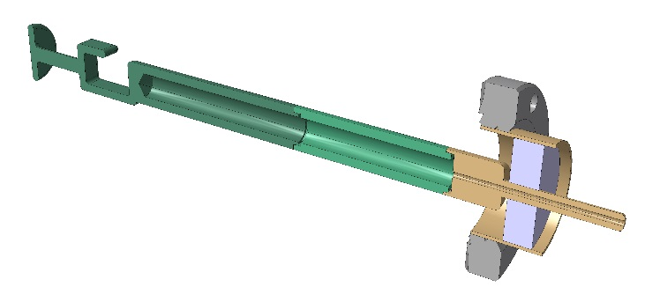
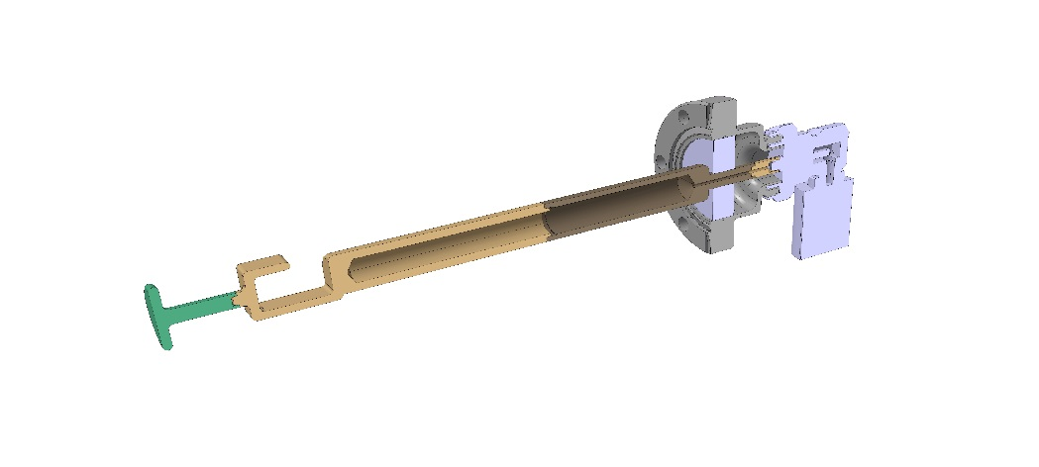
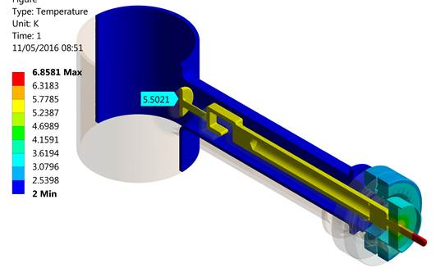
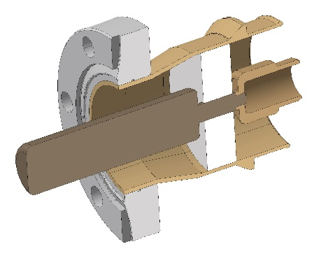
Pick –up / HOM Feedthrough
Pick-Up:
Cu-Nb weld already performed at CERN; parameters tbd once interface design finalized
Ongoing minimisation of Nb Part
RF/Thermal calcs → not critical
  Reduced Nb Volume
  Challenging machining on Copper part
HOM Feedthrough:
Deadline November
Long lead materials ordered
No issues foreseen

Slide 9
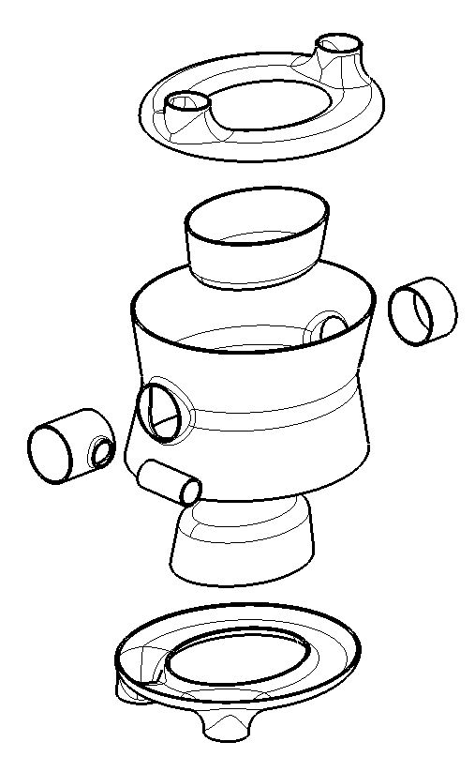
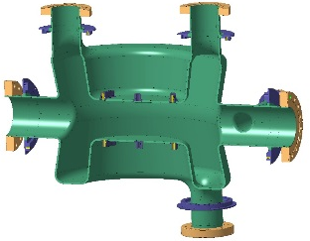
Cavity
2
Manufacturing Strategy
TESTS:
  Explore different option in parallel
  Annealed Cu→ Nb
3
Circ. TEST /
Straight TEST
Ellipt. TEST
Final Design
Ready for Prod.
1
5
Circular Tests:
Cheaper & easier production for quicker understanding & ruling out of non-viable options
20x Tools potentially. Big effort for all stakeholders
4
1
Main Body
2
Cap
3
Bowl

Slide 10
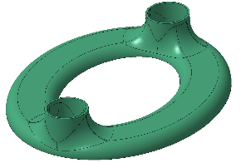
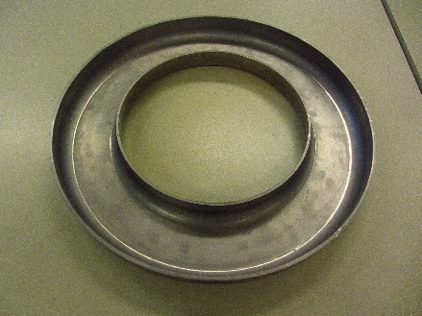
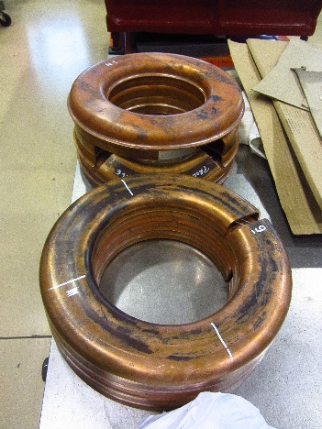
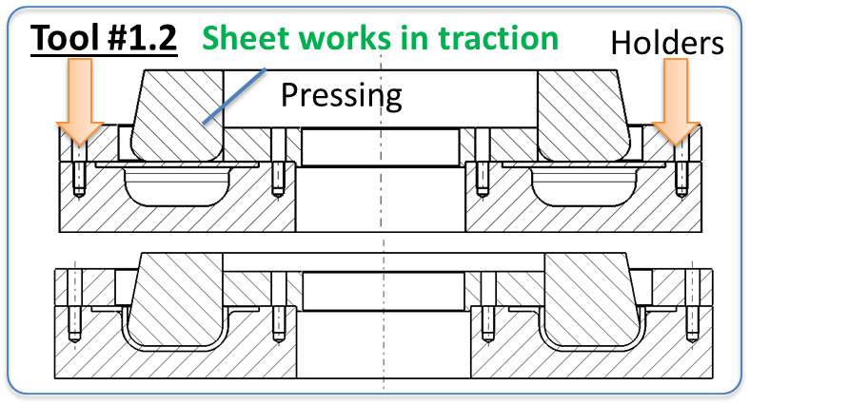
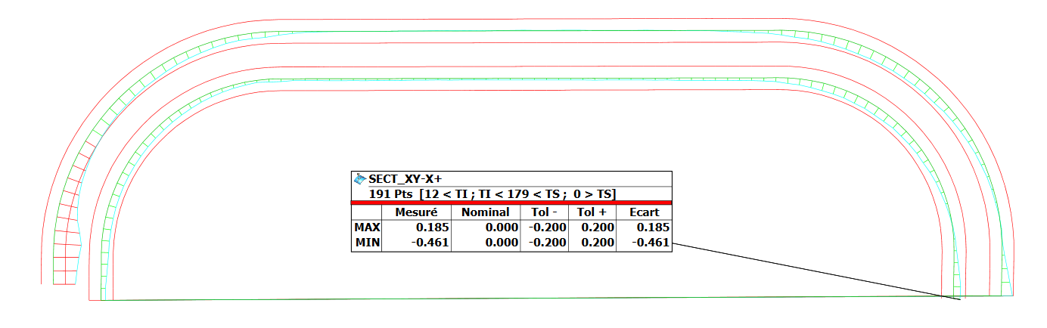
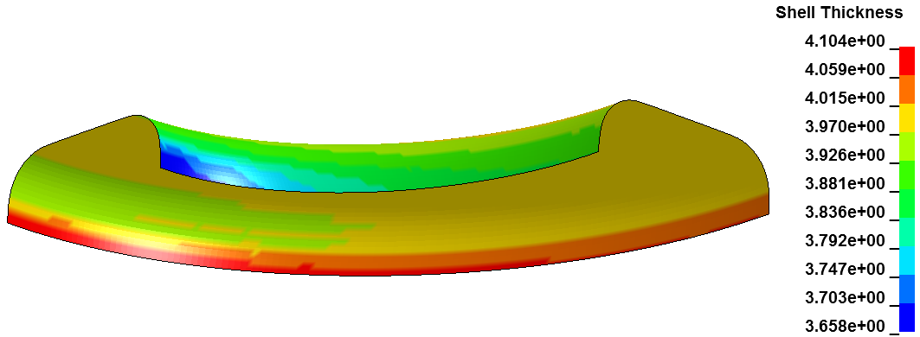
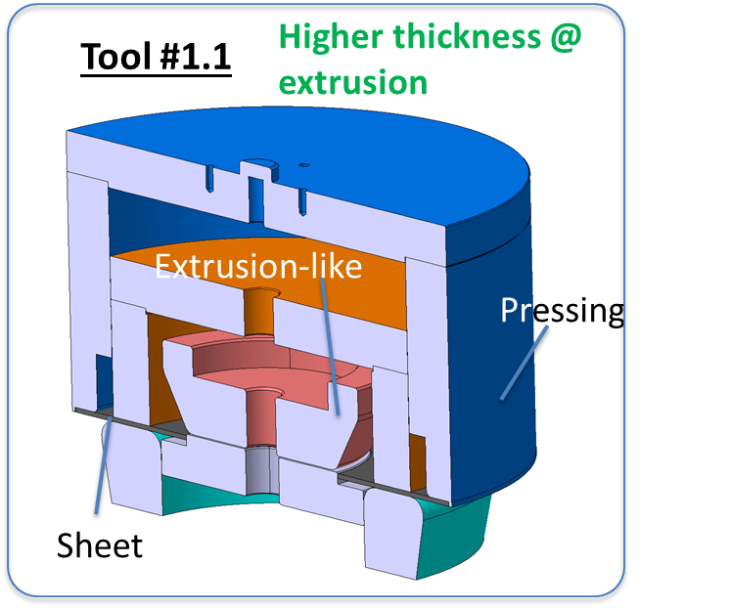
Cap
Profile Tolerance inner surface | 0.6 [mm]
Deep-Drawing Tool
Shaping + Punching | [mm]
Planarity of flat surfaces | 0.04
Profile error inner surface | 0.4
Cilindricity | 0.13
thickness | ~3.6
Vs.
Shape precision
Sheet thickness
LS-Dyna: Nb sheet thickness [mm]
Sheet-Bending Tool
3.6
Metrology: EDMS1571689, n.470
4.1
Metrology + Thickness Analysis + FE Calcs
→ Thickness evaluation for elliptical shape
Elliptical Tool in production, expected beg June

Slide 11
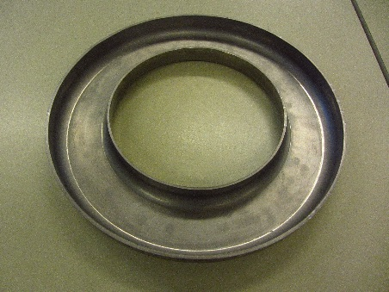
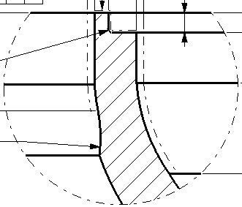
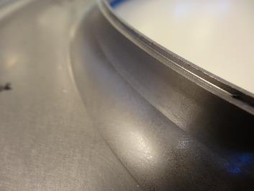
Cap: Machining Test
Test on:
Inner & outer edges
Welding lip, butt weld, transition to RF surface
Results:
Shape accuracy in the order of few hundredths of mm
  (ATTENTION: does not correct for planarity/position error after forming)
Smooth continuous transition (no burrs)
Trimming
Welding lip
Thickness + curvature

Slide 12
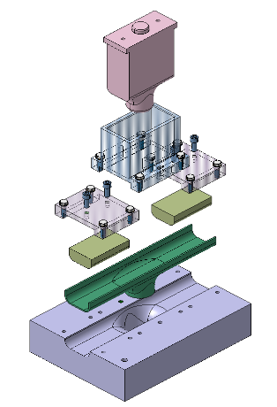
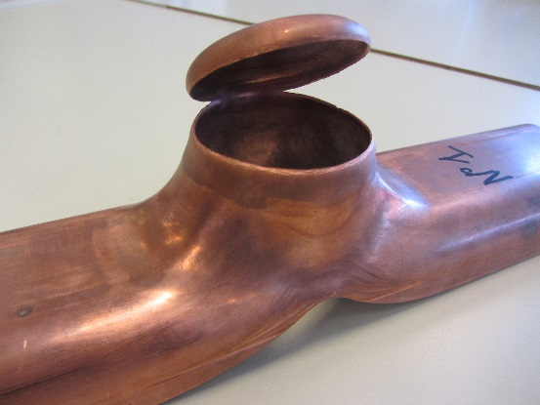
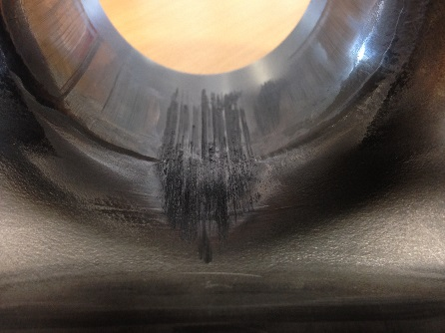
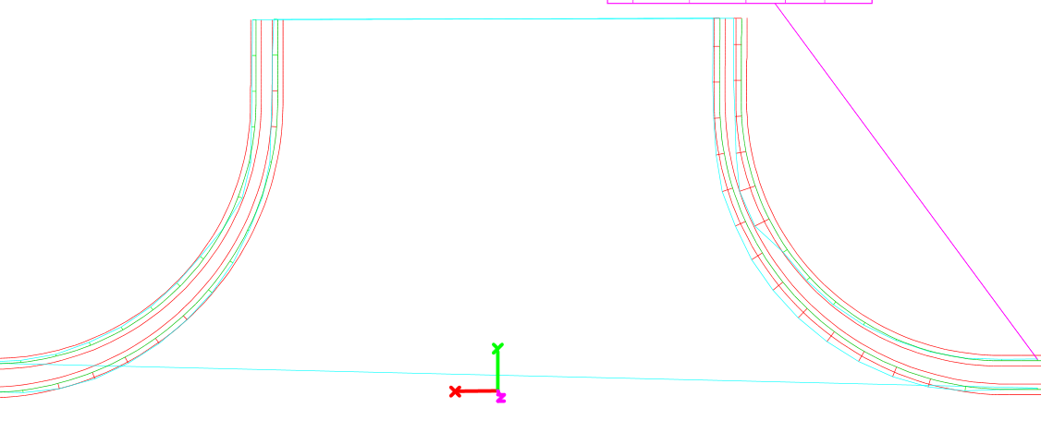
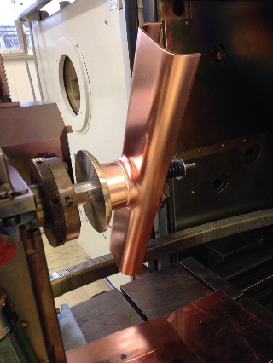
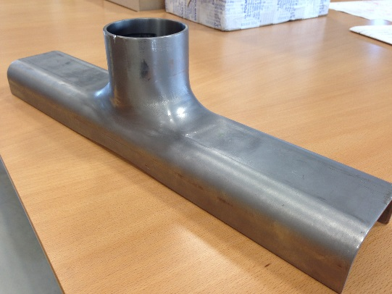
Cap Extrusion
Punching Tool
Rupture
Profile Tolerance inner surface | 0.6 [mm]
Shaping + Punching | [mm]
Profile error inner surface | <0.6*
thickness | ~3.0
Extreme Thickness Reduction
Material Loss
*Except local area due to tool nonconformity
‘Extrusion + Punching’ Tool
Welding of intermediate collar
Friction on Nb during last phase of shaping → CuSn12 & Steel 1.2343 for tools sliding on Nb
Thickness may be ameliorated via collar dimensions
STATUS: Elliptical tool in production, expected beg. June

Slide 13
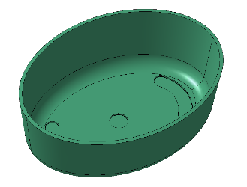
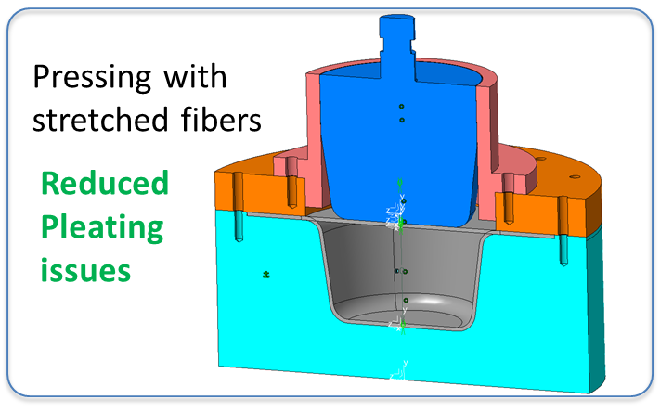
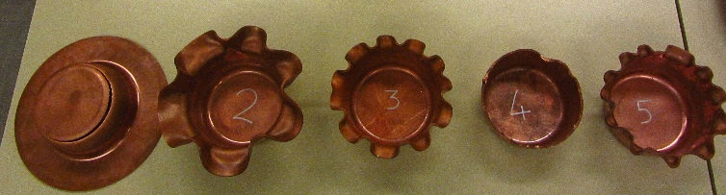
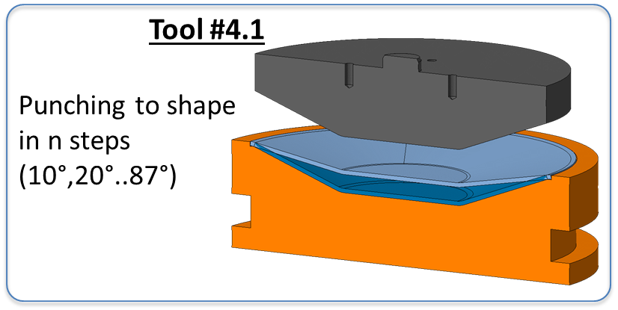
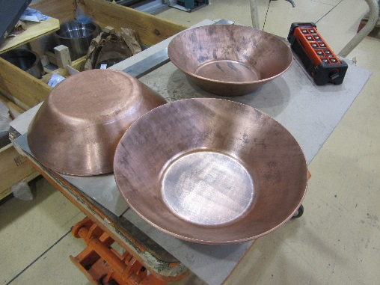
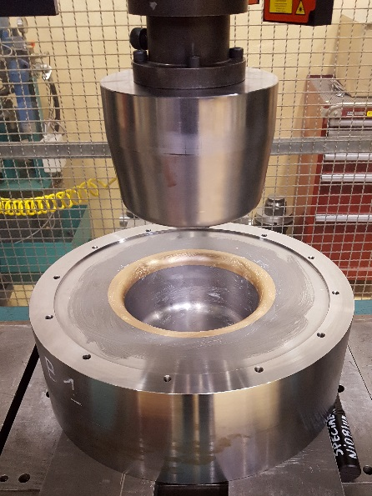
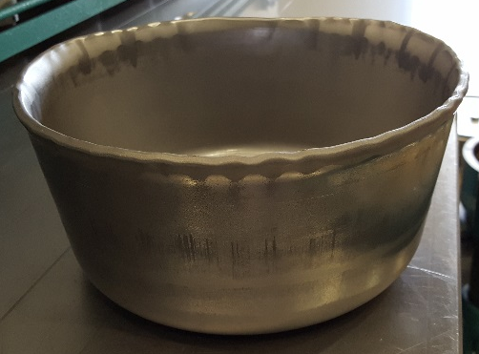

Bowl:
Deep Drawing Tool
Punching Tool
Cu Tests: many parameters permutations (press-pads) for optimal result
scratches
No pleating | More tools
no friction | Longer process
Higher thickness w.r.t. tool 2 | Intermediate cutting of external edges..
Bronze collar to reduce friction
Rougness @ scratches : Ra1.9 , Rt15

Slide 14


Bowl
A2
A1
B1
B2
0.4mm
B2
B1
A2
A1
Profile Toler. RF surface | 0.6 [mm]
High non-axisymmetric results on Nb w.r.t. Cu test → friction
Punching step being performed this week:
Shall reduce plate flatness (as for Cu test)
To what extent shall it reduce conical error?
Lower-friction design for elliptical tool
Planarity lower RF surface | 0.3 [mm]
Only shaping | [mm]
Planarity of flat surface | 0.3
Profile error inner surface | Up to ~1mm
Thickness | 3.6 @radius

Slide 15






Diabolo
Design Change 2x longitudinal welds
STATUS: All components @ CERN, Cu tests by next week
Polymer Shapes
Extremities
BCP-ed
HOM Collars
STATUS: production ongoing, ready for welding by mid July
Al₂O₃
Alumina particles (<=25um) found on sheets by supplier
Effects of BCP and targeted removal being investigated
Baseline: material from 2nd supplier for all upcoming tests/parts
BCP on already-produced parts (i.e. extremities)

Slide 16



Numerical Modelling all main shaping processes (also springback, trimming)
Outputs:
Process feasibility (rupture, buckling) and parameters (expected loads)
Process efficiency →tool design
Thickness
Needed Inputs:
Material properties
→ Characterization of : Nb, polymers
F.E Analyses
Elliptical Cap

Slide 17




F.E Analyses: Cap Results
Sheet metal forming (thickness)
0.05
Thickness Error [mm]: sim VS. reality
-0.1

Slide 18





F.E: Main Body & Bowl
Notes:
We want to re-use the elastomers for the tests we will perform in the workshop.

Slide 19


Niobium Properties
Properties of Niobium
Tensile tests of Niobium by MME-MM
Swift law approximation
for the stress strain curve
Future improvements on the material model
Tensile tests at 0⁰, 45 ⁰ and 90 ⁰ for anisotropy;
Cyclic tension-compression tests for Kinematic hardening model;

Slide 20


Weld Sequence
W. Extr
W. #7.1
W. #8
W. #7.2
W. #5
W. Extr
W. #3
W. #2
Critical Welds:
W #1
Extremities on Cap (#6)
  [thck=3mm]
W. #4
Elliptical Cap & Bowl on Diabolo (#8-9)
  [thck=3mm]
Half-Moons: Nb/NbTi (#7)
  [thck=2mm]
W. #6
W. #9

Slide 21







Cavity - Extremities
Welds #6
Staggered weld sequence, with dedicated tooling
Design modification to facilitate weld of Extremities to Cap
Welds #7.1 & 7.2
Both Nb and NbTi Half Moons to be tested
Currently developing of a program to follow the shape
Nb
NbTi
Notes:
All tools ready. Pieces being formed and cut

Slide 22





Cavity - Extremities
Welds #8 & #9
Dedicated circular and elliptical tests
Baseline: beam parameters w. large acceptance
Options: transversal movement, change of focus
Finalizing test equipment now
E. Beam
Cavity
Linear weld tests performed
Two configurations: Key (Clé) and Butt Weld (Bords droits)
BOTH CONFIGURATIONS WITH SATISFACTORY RESULTS
NO VOLUMETRIC DEFECTS FOUND
WELDING IMPERFECTIONS COMPLIANT WITH ISO 13919-2 LEVEL B
INTERNAL SIDE - RF
INTERNAL SIDE - RF

Slide 24





Other Ongoing
Production Main Body Extrusion
Design Of weld Tools
Production of Machining Tools
Extremities:
Testing of Nb / NbTi interface (1side 4mm weld)
Qualification specimens ready

Slide 25
Cavity: Conclusion
Initial ‘circular’ phase concluded (Copper & Nb)
  Very good results for cap and extrusion
  Watch out for Main Body & Cap (friction)
Main parts Production in line with schedule (caveat: no major showstoppers during elliptical phase)
Planning Milestones:
  Extremities ready for EB @ mid/end July
  Cavity parts shaped by summer
  …
  Beg. 10/2016 : main parts welded for RF
  End 11/2016: 1st cavity ready
  Beg 01/2017: 2nd cavity ready
Al₂O₃ issue being addressed

Slide 26


Helium TANK

Slide 27




Tank: Weld Test
TIG Welding of Titanium tank under protective atmosphere
Iterative weld + metrology steps
Maxima deformations: 0.3mm along cavity beam axis
Tank after assembly (screws tightening)
Vertical (i.e. along z) welds
Welds around the top plate
Welds around the bottom plate
Longitudinal covers
Circular covers on interfaces on cavity beam axis
Circular covers on top and bottom faces
Second beam tube
Pressure test
Thermal test

Slide 28





Weld Results
Highest deformation (0.3mm):
@ Beam Axis after top/bottom plates’ weld;
cavity may still not be joined to tank
Feedback for minor redesign of weld joints: better accessibility, lower deformations
Stress @ weld (study ongoing):
Ti near to yield @ 2.5mm, well below yield @ 10mm
Notes:
Accessibility, thus less weld time. How much time in the end?

Slide 29


Pressure Test
Test @ p=2.6 bar
Load increment on screws not critical
Validation of F.E. model for assembly and weld/screw behaviour
Defined preload sufficient to avoid failure of weld (no leaks / hysteresis effects on geometry)
@ Bunker
LVDT
LVDT

Slide 30




Cold Test
5 cycles, LN2 bath
Vacuum inside the tank
Validation of analytical model for screw preload and its evolution during Cooldown
Defined preload sufficient to avoid ‘opening’ of interfaces during cool-down
No hysteresis effects (i.e. yield) on geometry (especially @ Cavity interfaces)
Vacuum tight after all welds and cold + pressure test

Slide 31



Magnetic Shields
Courtesy STFC Daresbury

Slide 32


Cold Magnetic Shield
1 mm Cryophy, annealed
Shield currently @ CERN
Dimensional controls (+ magnetic measurements) foreseen
DQW
RFD
FE simulation
Notes:
3.5 uT max on hom pickup

Slide 33





Comparison of Data and Simulations
Coherent values between requirements, measurement and FE data
Reduction factor ~65
Nominal input:
Earth field ($∼42 μT$) along beam axis

Slide 34



Tuner
Tests & characterization of linear motor performed
Test @ SM18: → ppt by A. Castilla

Slide 35




Structural assessment
The frequency range provided by the pre-tuner is currently limited (~200 kHz)
        New procedure explored, that would allow a larger range: pre-tuning load released before cool-down (i.e. before p_{HE}=1.8 bar)
Calcs: F.E. plus analytical (weld). Also considering Nb hardening due to deep drawing process
Deformation [mm]
Plastic strain
Δ>0.4
Localized yield
Notes:
Fine tuning 1.6mm = unchanged

Slide 36

Structural assessment
The frequency range provided by the pre-tuner is currently limited (~200 kHz)
        A procedure that would allow a larger pre-tuning is Pre-tuning load released before cool-down (i.e. pHE=1.8 bar)
F.E. plus analytical (weld) calcs. Also considering Nb hardening due to deep drawing process
New procedure would allow more than twice the tuning range
Limiting factors are the stress in the NbTi tab and in the weld

Slide 37
General Conclusions
CAVITY
Initial ‘circular’ phase concluded (Copper & Nb)
Main parts Production in line with schedule (caveat: no major showstoppers during elliptical phase)
Planning Milestones:
  End 11/2016: 1st cavity ready
  Beg 01/2017: 2nd cavity ready
Al₂O₃ issue being addressed
HOM
Machining:
all critical parts machined
pieces compliant with specified tolerances
Next Steps:
mid June: finalize qualifications + Proto Welding + Welding
TANK
No plasticization + Vacuum tight = design and process validated
Info for numerical modelling of tank joints + weld optimization

Slide 38
Thanks!!

Slide 39


Tank Deformations : Relative

Slide 40

SUMMARY OF WELDING STEPS & DIMENSIONAL CONTROLS:
1- Vertical welds (x4)
DIMENSIONAL CONTROL
2- Welds around the top plate (x4)
DIMENSIONAL CONTROL
3- Welds around the bottom plate (x4)
DIMENSIONAL CONTROL
4- Longitudinal Covers (x12)
DIMENSIONAL CONTROL
5- Circular Covers beam axis (x2)
DIMENSIONAL CONTROL
6- Circular Covers TOP & BOTTOM
plate (x4)
DIMENSIONAL CONTROL
7- Beam Pipe (x2)
DIMENSIONAL CONTROL
2
6
7
1
4
5
3
All Welding Information collected on EDMS:
https://edms.cern.ch/document/1562825/1

Slide 41
Hidden slide on positions measured at metrology (i.e. TP1, TP2 etc)
Measured positions:
Circles around flanges
Transversal lines on plates

Slide 42



WELDS FROM VERTICAL CORNERS, TOP AND BOTTOM PLATE:
RESULTS GIVE DEFORMATIONS ∼0.2mm
Suggestion: Local reduction of the thickness
LONGITUDINALS COVERS:
The maximum deformations were found after welding the longitudinal covers (∼ 0.4mm)
- Groove longitudinal close to the covers

Slide 43




CIRCULAR COVERS BEAM AXIS, TOP and BOTOM PLATES:
Upgrade for the operative weldability:
Increase the distance between the weld joint and the flange on the TOP circular covers as well as the distance of the beam axis cover
TOP
BEAM AXIS
INCREASE
Distance OK
BEAM PIPE
The best option (avec gorge):
Groove all around

Slide 44
CONCLUSIONS:
Changes to include (if possible):
Reduction locally of the thickness in Vertical, Top & Bottom welds joints
Increase the distance between the weld joint to the flange in the top circular covers
Change the Beam Pipe configuration: Increase the length and include a groove
Upgrades:
  Operative weldability
  Quality of the weld
  Welding Procedure
  Less deformations

Slide 45


Brief Introduction to Hole Drilling Method
COURTESY
Material Removal
Travelling Microscope
Stepper motor
Redistribution of stresses
Determination of deformation
High Speed Turbine
Back Calculation
Notes:
Methods
Many methods exist for the measurement of residual stresses in engineering applications.
Most of them measurements works on the principle of removing material from the
component to release stresses
after this operation the stress equilibrium is modified and one or more strain gages, placed in the measurement area, acquire the strain values needed for the new equilibrium of the workpiece.
the strain data acquired by the strain gage sensor are used for the back calculation of residual stresses.
Within this methods there exist:
semi-destructive methods remove just a small quantity of material closer to a strain gage rosette placed in the measurement area, leaving its overall structural integrity intact for other testing or use
the destructive methods need a higher removal of material (cuts and milling process) that completely destroy the testing workpieces.
The hole drilling method: Introduction
drilling method allows accurate experimental stress analyses at moderate costs. It consists in drilling a small hole (typically 1.8 2.0 mm) which changes the initial deformation allowing redistribution of the residual stresses locked in a material.
The strains that are released in this way can be measured by a specially configured three-element strain gage rosette and then used in special calculation system to determine the residual stresses that exist in a material.

Slide 46


Hole Drilling Technique: Analysis
COURTESY
System of equations
Vector of principal stresses and directions
+
Acquired Strains
Calibration Coefficients
Methods
ASTM E837-13
  uniform stress field
  non-uniform stress field
Integral method
Kockelmann method
HDM method
Notes:
Through hole uniform stresses
the simpler case of a hole drilled completely through a thin plate in which the residual stress is uniformly distributed through the plate thickness. Because of this, the theoretical basis for the hole-drilling method will first be developed for the through-hole geometry, and subsequently extended for application to blind holes.
Blind holes
Unfortunately, the blind-hole geometry is sufficiently complex that no closed-form solution is available from the theory of elasticity for direct calculation of the residual stresses from the measured strains — except by the introduction of empirical coefficients.
ASTM E837-13
Uniform
This is the method described in standard ASTM E837-13, based on the assumption that stresses do not vary with distance from the surface of the workpiece.
This method has to be used when preliminary calculation results demonstrate that the stress field is uniform with depth or if you need a preliminary indication of the amplitude of residual stress.
For this reason, the method does not consider spatial resolution. Nevertheless, when measured residual stresses are in fact uniform, this is the method to choose, because it is the least sensitive to the effects of test errors.
Not Uniform
This calculation method is described in standard ASTM E837-13, based on the assumption that stresses vary with distance from the surface of the workpiece.
This method has to be selected in the case of a non-uniform stress field in hole depth and the output of the calculation is a plot of residual stresses in the hole depth.
The numerical coefficients established by ASTM E837-13 are used for the calculation. The maximum depth that the method can be used for is 1.00 mm (using a strain gage rosette of approximately 5.13 mm of strain diameter): in this case the ASTM E837-13 standard establishes 20 acquisition depth steps, each one of 0.05 mm. The number and the distribution of the calculation steps are fixed by the ASTM E837-13 standard.
The experimental errors in the calculation are minimized using the Tikhonov regularization algorithms.

Slide 47

Screws load
Max change (excluding outlier): -1.15 kN
One screw changes load slightly positively (0.15 kN)
µ_{Δload}: -0.64 kN
σ _{Δload}: 0.44 kN

Slide 48



Screws load: comments
According to VDI 2230-1 the preload change is:
result of change in Young's modulus
result of different CTEs
 | Preload [N]
Increase in E |  | 2000 | 2500 | 3000
 | 5% | -250 | -275 | -300
 | 7.5% | -303 | -341 | -378
 | 10% | -357 | -407 | -457
$$∆P=P_{0}\left(1−\frac{δ_{b}+δ_{p}}{δ_{b}\frac{E_{bRT}}{E_{b77K}}+δ_{p}\frac{E_{pRT}}{E_{p77K}}}\right)+\frac{l_{b}∆T\left(α_{b}−α_{p}\right)}{δ_{b}\frac{E_{bRT}}{E_{b77K}}+δ_{p}\frac{E_{pRT}}{E_{p77K}}}$$
$P_{0}$ = 3000 [N] – initial preload
𝛿_{b} = 1.304·10⁻⁵ [mm/N] – bolt resilience
𝛿_{p} = 8.867·10⁻⁷ [mm/N] – clamped plates resilience
$E_{bRT}$ = 110 [GPa] – bolt Young’s modulus at RT¹
$E_{b77K}$ = 121 [GPa] – bolt Young’s modulus at 77 K²
$E_{pRT}$ = 102 [GPa] – plates Young’s modulus at RT¹
$E_{p77K}$ = 112 [GPa] – plates Young’s modulus at 77 K²
$l_{b}$ = 10 [mm] – clamping length
$∆T$ = -215 [K] – temperature difference
$α_{b}$ = 7.546·10⁻⁶ [1/K] – integrated CTE for the bolt¹
$α_{p}$ = 6.620·10⁻⁶ [1/K] – integrated CTE for the plates¹
For the given values the loss of preload is:
$$∆P≈−500 N$$
Calculated ΔP is close to the average value of the bolt preload.
¹ L. Dassa, Crab cavity – material properties for mechanical analysis, EDMS 1530740.
² Assuming 10% increase in Young’s modulus.

Slide 49










PICS

Slide 50

CRAB HOMs
TIG
Turning
Brazing
Forming & Extrusion
5-axis
EBW
BCP
TOL @ work condition=
0.5mm
5-axis

Slide 51





Materials
DQW
H-HOM (RFD)
V-HOM (RFD)
St. steel*
Ceramic*
St. steel*
Niobium*
Copper*
St. steel*
Niobium*
*All materials used to manufacture HOMs
shall be compliant with CERN specification n°1389669

Slide 52



DQW
Cavity (RT , no PCB) with He vessel + pretuning device
Input force 2.5 kN
Displacement z 0.53/0.6 mm
Maximum eq. Stress 225 MPa
Corresponds to about 0.21 MHz (0.42 MHz pp) *
For 400 MPa/1.2= 333 MPa -> 0.31 MHz (0.62 MHz) range (linear), 3.7 kN, ±1.6 mm
Force/tuner stroke 2.2 kN/mm
199 MPa/mm
At RT for 50 MPa , 0.25 mm maximum tuner stroke for 0.5 kN

Slide 53


Pre tuning DQW
At warm
Bellows are outside of the helium vessel
3 M6 screws (pull) and studs (push)
Pitch 1 mm
Bellows (Ti) will be probably edge welded
Sensitivity 0.8023 MHz/mm (distance between plates) (Binping Xiao)

Slide 54



Deformation
Top : 0.21 mm screw motion
-> 0.11 mm plate deformation
Bottom: 0.23 mm screw
-> 0.16 mm centre plate def.
Force: about 3 kN /screw M6x1
σ_{i} screw = 178 MPa (0.3 friction)
Flexibility gives the resolution
0.8023 MHz/ mm

Slide 55
Goal
The frequency range provided by the pre-tuner is currently limited (~200 kHz)
The current limit comes from the combined effect of pre-tuning and pressure
A procedure that would allow a larger pre-tuning is:
        End of fabrication
        He tank welding
        Pre-tuning -> permanent deformation
        Pre-tuning load released
        Cool-down (pressure: 1.8 bar)
big assumption

Slide 56

Model and BC
No tank
Cavity fixed at NbTi rings extremities
Pre-tuner tabs are of course in NbTi (baseline)

Slide 57

Example of results: push 1 mm

Slide 58

Example of results: push 1 mm

Slide 59
Summary of results
Applied δ | Residual δ + | Residual δ - | Max plastic ε* | Max elastic σ**
-5 mm | -4.6 mm | -3.8 / -4.1 mm | ~7 % | 690 Mpa
- 2 mm | -1.4 mm | -1 / 1.29 mm | ~3.5 % | 560 MPa
-1 mm | -0.49 mm | -0.23 / -0.29 mm | ~0.9 % | 460 MPa
-0.7 mm | -0.22 mm | -6e-2 / -8e-2 mm | ~0.4 % | 395 MPa
0.7 mm | 0.21 mm | 6e-2 / 8e-2 mm | ~0.4 % | 400 MPa
1 mm | 0.45 mm | 0.22 / 0.29 mm | ~0.85 % | 480 MPa
2 mm | 1.43 mm | 1 / 1.36 mm | ~ 3 % | 550 MPa
5 mm | 4.35 mm | 3.5 / 4.9 mm | ~9 % | 650 MPa
* far from weld
** in the NbTi tab, peak stress, limit: 480 MPa

Slide 60
Conclusions
The plastic strain in the cavity due to plastical pre-tuning is very limited
Limiting factors are the stress in the NbTi tab and in the weld
Assumption: it’s possible to release the pre-tuner load at the level used for the strength assessment so far (0.1 mm elastic)

Slide 61






Slide 62


Further Forming Tools

Slide 63


Extremities: Critical points
#2) Size & Thickness of interface to cavity
WHY? addressable only after feedback from shaping
+0.5mm
+~0.5mm
+>0.5mm
Planned in prod. Sequence
OK w.r.t. material available
ACTIONS:
Launch rough components
Overthickness on Nb plate (& sheet)
Only Collar launched following forming
CASE Smaller extrusion
CASE Bigger extrusion
Ref. LHCACFCA0001

