Slide 1
ALIGNEMENT SPECIFICATIONS FOR THE TRIPLET
SLAC, 18th May 2016
LARP Hi Lumi collaboration meeting
E. Todesco, H. Prin
CERN, Geneva Switzerland

Slide 2
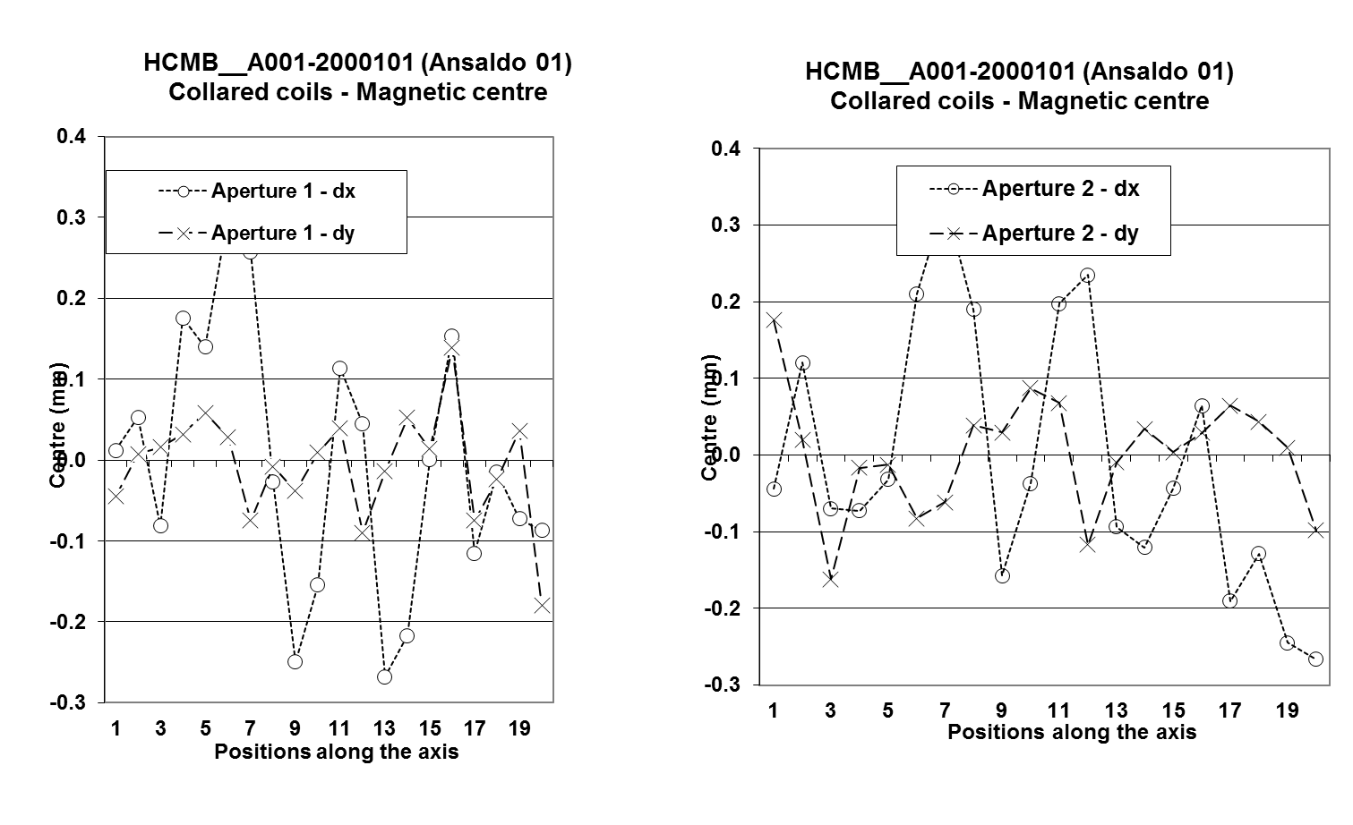
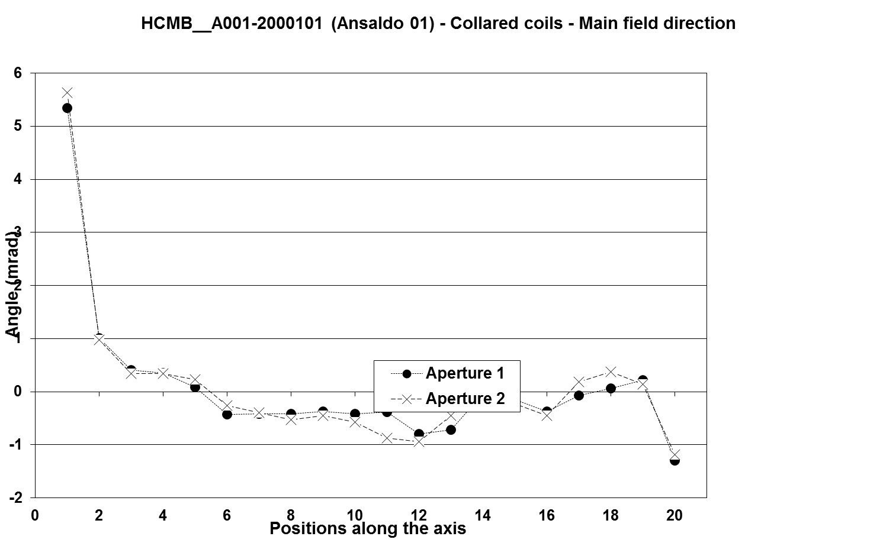
VARIATION ALONG THE AXIS
One needs to specify the length of the measuring mole (integral) to specify the waviness of the
centre of the quadrupole
direction of field
In the LHC production we had measuring moles of 750 mm
We should use the length of the probes we are going to use (500?)

Slide 3
VARIATION ALONG THE AXIS
Waviness (not specified for LHC)
I would set a target on the peak to peak (better than on the sigma)
±0.5 mm for the centre
±2 mrad for the axis direction
This corresponds on a position of the midplane within ±0.11 mm

Slide 4
COLD MASS FOR Q1/Q3
Case of Q1 /Q3: two magnets split in two
One needs a alignement requirement for the two magnets in the cold mass
Today there is a draft under discussion giving
Offset: +/- 0.2 mm
Roll: +/- 0.5 mrad
Pitch: +/- 1 mrad
Yaw: +/- 0.5 mrad
I see some problems with this specification
There is no consideration of the fact that the longitudinal direction is different from horizontal and vertical
With a 4 m long magnet, a longitudinal (along the axis, not in the transverse plane) angle of 0.5 mrad (yaw) can bring the end of the magnet out of 2 mm !
I would rather give the axis within a cilynder

Slide 5
COLD MASS FOR Q1/Q3
Proposal:
The two axis of Q1a and Q1b with respect to the common axis are
±0.5 mm for the centre
±2 mrad for the axis direction (corresponds to ±0.5 mm in the outer part of the cold mass)

Slide 6
COLD MASS FOR Q2
Case of Q2a and Q2b
The average axis is well defined and can be measured with a stretched wire
The magnet average axis will be aligned with respect to the beam with the precision ensured by the geometry colleagues
So for Q2a and Q2b the precision is given by the alignement not by manifacturing
Q2a and Q2b also have orbit correctors
Alignment of the correctors dominated by assembly aspects
We propose correctors aligned within ±1 mm, ±4 mrad w.r.t. the Q2a /Q2b axis

