Slide 1
MQXFS1 Magnetic Measurements Analysis and Evaluation of the Impact of the Beam Screen on Field Quality
LARP CM26/Hi-Lumi Collaboration Meeting
18th May 2016, SLAC
Susana Izquierdo Bermudez,
with contributions from
Giorgio Ambrosio, Joe Di Marco, Per Hagen, Trey Holik, Paolo Ferracin, Gianluca Sabbi, Ezio Todesco, Giorgio Vallone, Xiaorong Wang.

Slide 2
Contents
  MQXFS1 Magnetic Measurements Analysis
    Iron saturation effect
    3D Geometric Field Quality Analysis
  Update on magnetic shimming capabilities
  Evaluation of the impact of the beam screen on field quality.

Slide 3
Contents
  MQXFS1 Magnetic Measurements Analysis
    Iron saturation effect
    3D Geometric Field Quality Analysis
  Update on magnetic shimming capabilities
  Evaluation of the impact of the beam screen on field quality.

Slide 4
Iron Saturation Effect - Transfer Function
Saturation well captured by ROXIE model
100 units discrepancy in the absolute value.
  Cross-check of the measuring system on-going to discard calibration error.
At room temperature, better agreement in between measured and calculated values. (20-30 units discrepancy using nominal ID)

Slide 5
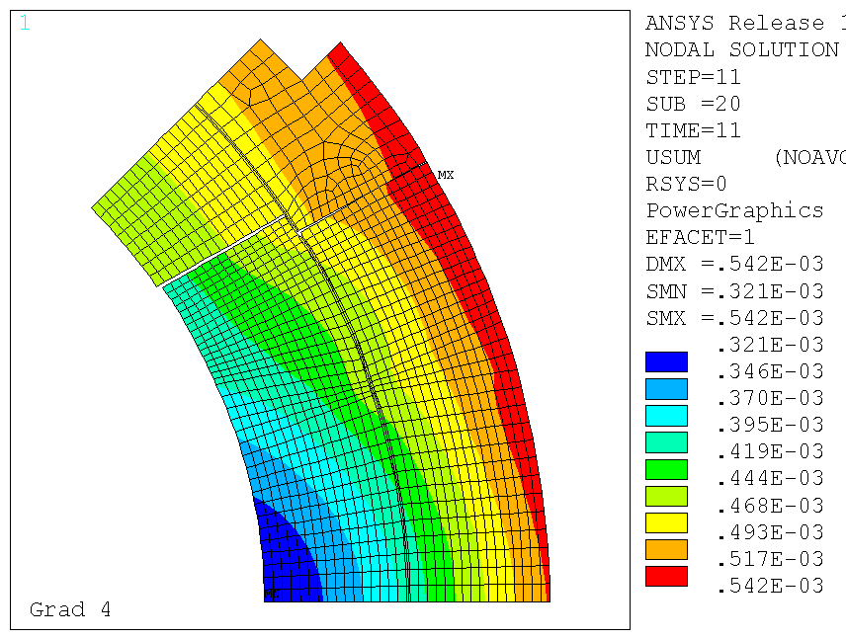
Iron Saturation Effect - b₆
The effect of the iron saturation effect on b6 is close to ROXIE prediction.
The impact of saturation on the rest of the harmonics is negligible (as expected).
The impact of the coil deformation during powering due to the electromagnetic forces is small. The main geometric contribution is coming from the cool down (+0.9/+1.6 units, depending on the assumed elastic modulus and thermal contraction of the coil)

Slide 6
3D Geometric Field Quality Analysis
Longitudinal scan measurements in MQXFS1 are compared to the 3D ROXIE magnetic model.
General definitions:
  z = 0 is defined both in the measurements and in the model as the magnetic centre
  Harmonics are normalized with respect to B₂ in z = 0 (measurements normalized to measured B2, model normalized to computed B₂)
(MQXF V1)
(MQXF V1)
REF: Coil End Optimization of the Nb3Sn Quadrupole for the High Luminosity LHC
IEEE TRANSACTIONS ON APPLIED SUPERCONDUCTIVITY, VOL. 25, NO. 3, JUNE 2015

Slide 7
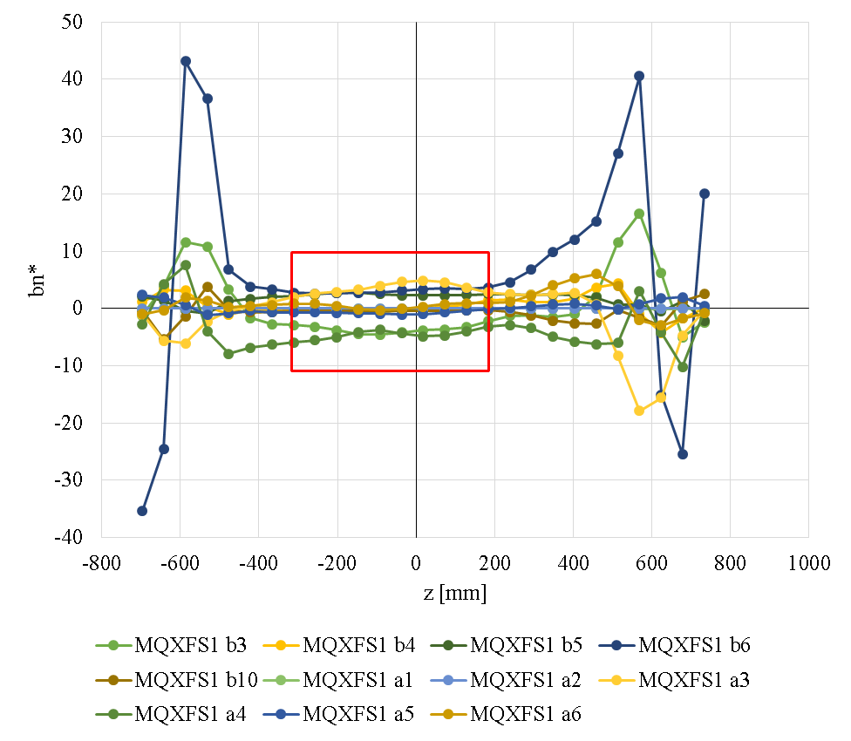
Straight section and waviness
According to the model, the “good field quality region” should be z = [-300,200]
In the straight part (z=[-300,200] mm), the longitudinal variation of the main field is within 8 units.
If we consider only z = [-150,150] mm, the longitudinal variation of the main field is 4 units.
The standard deviation of the harmonics on the straight section corresponds to a random displacement of the coil blocks of 50 um.
 | RT (10 A) |  | 6 kA |  | 16.5 kA
bn | av | std | av | std | av | std
2 |  | 2.51 |  | 7.25 |  | 7.17
3 | -3.24 | 1.20 | -3.77 | 1.13 | -4.21 | 1.14
4 | 0.30 | 0.79 | 0.07 | 1.01 | 0.32 | 1.10
5 | 2.47 | 0.18 | 2.67 | 0.16 | 2.76 | 0.19
6 | 3.57 | 1.21 | -0.26 | 0.90 | 0.95 | 0.95
7 | 0.13 | 0.20 | 0.18 | 0.17 | 0.18 | 0.19
8 | 0.23 | 0.08 | 0.24 | 0.07 | 0.25 | 0.07
9 | 0.15 | 0.10 | 0.21 | 0.12 | 0.22 | 0.12
10 | -0.49 | 0.26 | -0.26 | 0.19 | -0.51 | 0.19
an | RT (10 A) |  | 6 kA |  | 16.5 kA
 | av | std | av | std | av | std
2 | 0.00 | 0.00 | -0.01 | 0.00 | -0.01 | 0.00
3 | 3.46 | 0.91 | 3.06 | 1.37 | 3.29 | 1.37
4 | -4.18 | 0.83 | -5.74 | 0.96 | -6.49 | 0.96
5 | -0.55 | 0.47 | -0.85 | 0.45 | -0.87 | 0.50
6 | 0.65 | 0.73 | 0.56 | 0.66 | 0.52 | 0.68
7 | 0.27 | 0.20 | 0.29 | 0.19 | 0.32 | 0.20
8 | -0.25 | 0.13 | -0.65 | 0.14 | -0.65 | 0.15
9 | 0.31 | 0.07 | 0.31 | 0.08 | 0.33 | 0.09
10 | 0.12 | 0.07 | 0.16 | 0.08 | 0.16 | 0.07

Slide 8
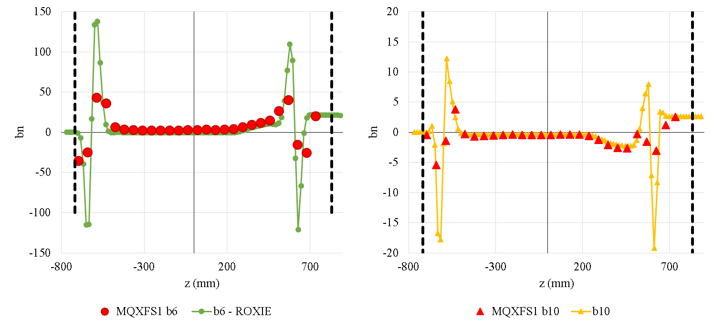
Allowed harmonics b_{n}
Return end, magnetic length 205 mm
 | MEASURED |  | ROXIE 3D
n | b | a | b | a
6 | 8.18 | 0.69 | 11.96 | 0.00
10 | -1.18 | 0.00 | -0.89 | 0.00
Except b₆, return end, the allowed harmonics are well captured by the 3D magnetic model (i.e., we have similar level of discrepancy to what we have in the straight part)
Lead end, magnetic length 388 mm
 | MEASURED |  | ROXIE 3D
n | b | a | b | a
6 | 13.59 | 2.13 | 14.09 | 1.88
10 | -1.47 | 0.00 | -1.03 | 0.00

Slide 9
Contents
  MQXFS1 Magnetic Measurements Analysis
    Iron saturation effect
    3D Geometric Field Quality Analysis
  Update on magnetic shimming capabilities
  Evaluation of the impact of the beam screen on field quality.

Slide 10
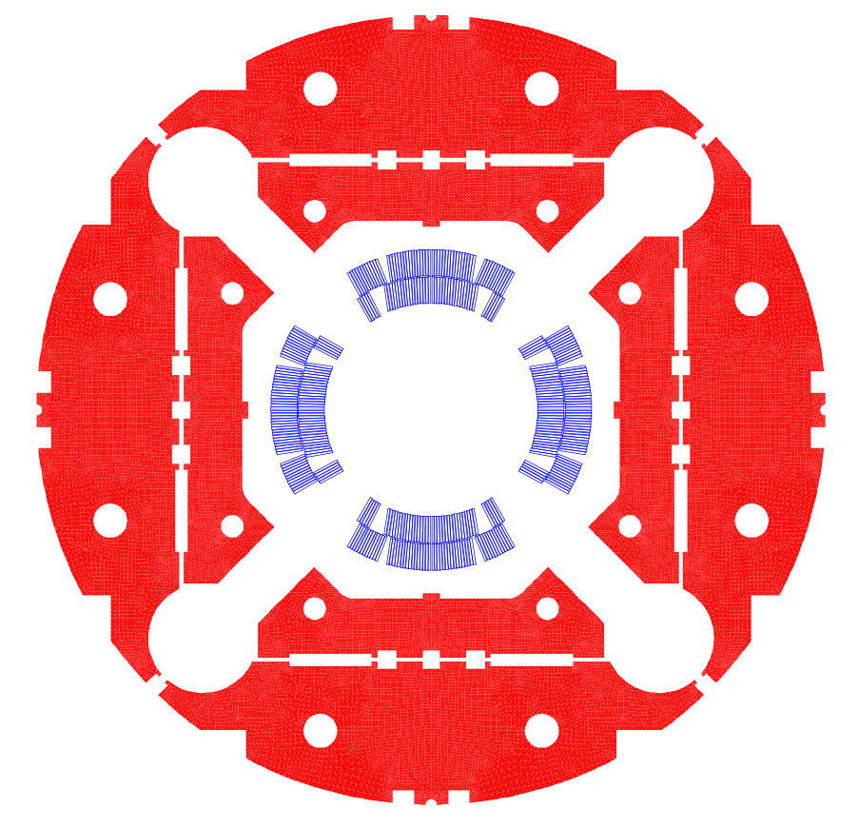
Magnetic Shimming Capabilities
In order to correct the non allowed multipoles (a₃, b₃, a₄, b₄), different families of shims have been explored:
Rods in the collars. Not interesting because the iron strongly saturates, they are transparent.
Shims in the bladder slots, very interesting.
Shims in the yoke slots. They are too far from the coil to act. Additional rods in the yoke for magnetic shimming were studied, but they have small impact compared to the bladders shims.
Shims in the collars-pad. They can efficiently correct non-allowed harmonics at high field, but they have a large contribution at intermediate-low current levels.

Slide 11
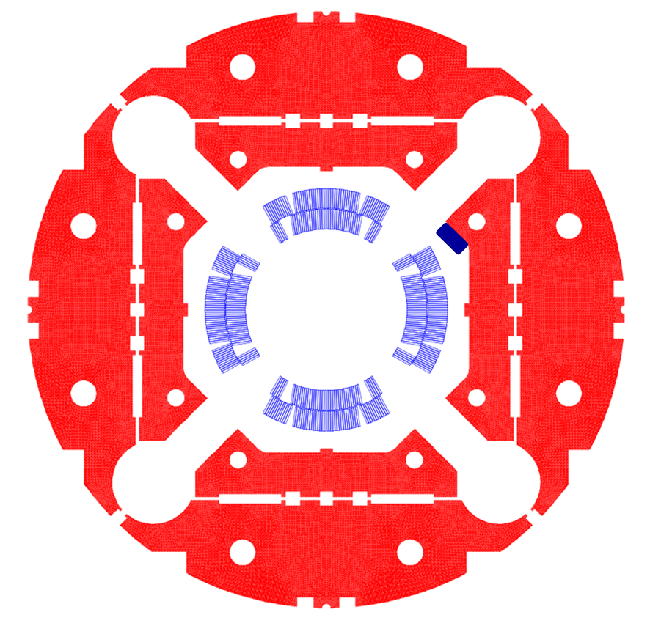
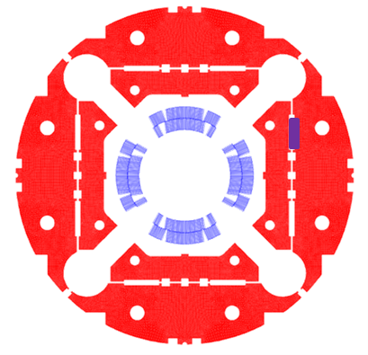
Magnetic Shimming Capabilities
P. Hagen
Δ shim collar-pad
Order | bn | an
3 | 2.90 | -1.00
4 | 0.90 | -1.30
5 | 0.05 | -0.70
6 | -0.14 | -0.30
Δ shim bladder
Order | bn | an
2 |  | 3.66
3 | 2.10 | 0.49
4 | 0.73 | -0.21
5 | 0.19 | -0.10
6 | 0.05 | -0.03
Show-stopper for collar shims: very large contribution at low-intermediate currents

Slide 12
Magnetic Shimming Capabilities
P. Hagen
9x58 mm shim in the bladder slot | Multipoles | Value (units) @ 16471 A
S 1,2,3,8 | +b3 (+b5) | +3.2 (+0.2)
S 4,5,6,7 | -b3 (-b5) | -3.2 (-0.2)
S 1,2,4,7 | +b3 +b5 | +5.2 +0.6
S 3,5,6,8 | -b3 -b5 | -5.2 -0.6
S 1,2,5,6 | +b4 | +2.8
S 3,4,7,8 | -b4 | -2.8
S 1,3,4,6 | +a3 -a5 | +5.2 -0.6
S 2,5,7,8 | -a3 +a5 | -5.2 +0.6
S 1,4,5,8 | -a4 | -0.8
S 2,3,6,7 | +a4 | +0.8
S 1,6,7,8 | -a3 (+a5) | -3.1 (+0.2)
S 2,3,4,5 | +a3 (-a5) | +3.1 (-0.2)
Different shim configuration in the bladders slots (baseline geometry, 9 x 58 mm) allow us to correct up to:
    ±5 units of b₃ and a₃
    ±3 units of b₄
    ±1 units of a₄
The effect can be doubled by increasing the size of the bladder slots (18x58 mm). The impact on the mechanics have been verified an it is acceptable.
Larger correction capabilities in b5/a5 using collar/pad shims, with the drawback of large contribution to the harmonics at low-intermediate currents.
Fine tuning is possible:
  Changing the size of the shim
  Varying the permeability of the shims along the Z-axis
10x25 mm shim in the collar-pad | Multipoles | Value (units) @ 16471 A
SX 1,2,3,8 | +b3 (-b5 -b6) | +8.0 (-1.3 -0.6)
SX 4,5,6,7 | -b3 (+b5 -b6) | -8.0 (+1.3 -0.6)
SX 1,2,4,7 | +b3 (+b5 -b6) | +3.8 +1.5 (-0.6)
SX 3,5,6,8 | -b3 (-b5 -b6) | -3.8 -1.5 (-0.6)
SX 1,2,5,6 | +b4 (-b6) | +3.6 (-0.6)
SX 3,4,7,8 | -b4 (-b6) | -3.6 (-0.6)
SX 1,3,4,6 | +a3 -a5 (-b6) | +3.8 -1.5 (-0.6)
SX 2,5,7,8 | -a3 +a5 (-b6) | -3.8 +1.5 (+0.6)
SX 1,4,5,8 | -a4 (-b6) | -5.2 (-0.6)
SX 2,3,6,7 | +a4 (-b6) | +5.2 (-0.6)
SX 1,6,7,8 | -a3 (-a5 -b6) | -8.0 (-1.3 -0.6)
SX 2,3,4,5 | +a3 (+a5 -b6) | +8.0 (+1.3 -0.6)

Slide 13
Contents
  MQXFS1 Magnetic Measurements Analysis
    Iron saturation effect
    3D Geometric Field Quality Analysis
  Update on magnetic shimming capabilities
  Evaluation of the impact of the beam screen on field quality.

Slide 14
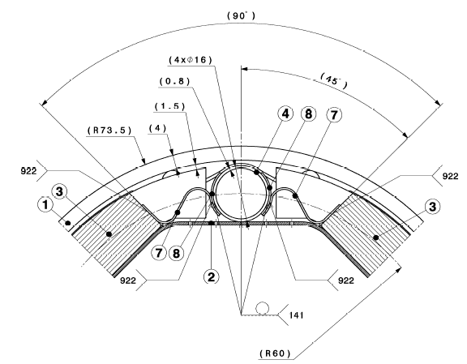
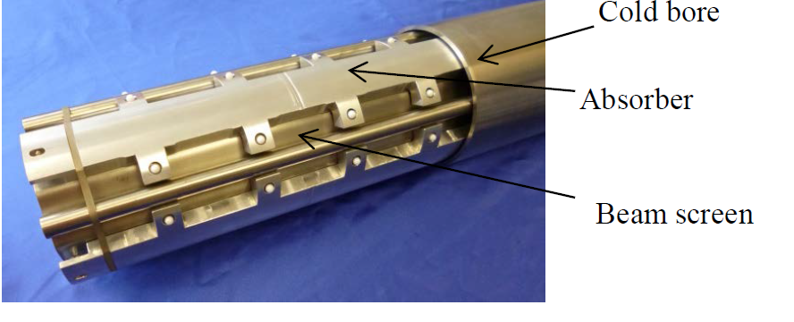
Beam Screen: Geometry & Materials
Geometry from lhcvsmpa0009-B
Materials:
Beam screen and cooling channels: High-Mn Austenitic Steel (Developed for the LHC beam screen working at 10-20K, must stay non-magnetic down to very low temperatures)
  Magnetic permeability ~ 1.0025
Absorber: Tungsten
  Magnetic permeability ~ 10 times lower than the High-Mn Austenitic Steel
Cold bore: Austenitic Steel 316 LN
  Magnetic permeability ~ 1.01
REF: Material characterisation and preliminary mechanical design for the HL-LHC shielded beam screens operating at cryogenic temperatures.
C. Garion, L. Dufay-Chanat, T. Koettig, W. Machiocha, M. Morrone

Slide 15
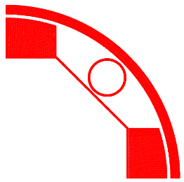
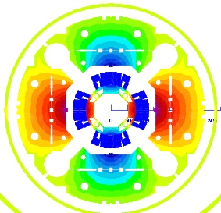

Impact on field quality
 | Impact of Beam Screen in Q1 Field harmonics at 6.5 TeV
 | Without | With | Δ
b6 | -1.53 | -2.18 | -0.65
b10 | -0.11 | 0.27 | 0.37
b14 | -0.87 | -0.95 | -0.09
b18 | -0.26 | -0.16 | 0.10
LHCVSMPA0009-0
 | Impact of Beam Screen in Q2/Q3 Field harmonics at 6.5 TeV
 | Without | With | Δ
b6 | -1.53 | -1.94 | -0.40
b10 | -0.11 | 0.07 | 0.18
b14 | -0.87 | -0.93 | -0.06
b18 | -0.26 | -0.18 | 0.08
LHCVSMPA0029-0A

Slide 16
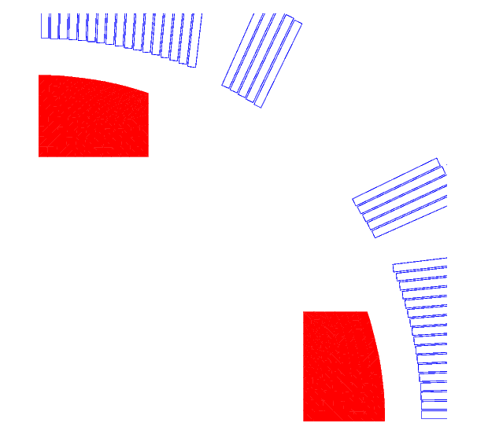
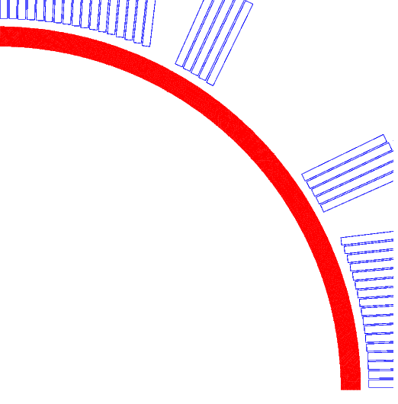
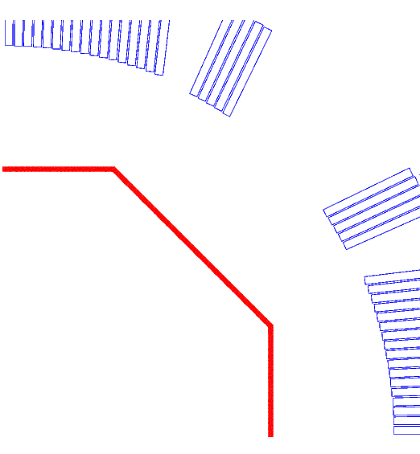
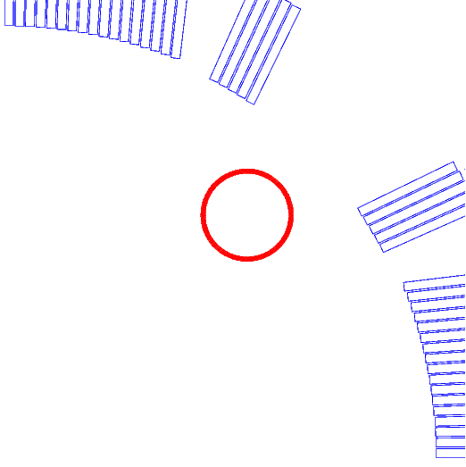
Impact on field quality
 | Impact of the shielding at 6.5 TeV (beam screen + cooling channels+ absorber + cold bore)
 | Without | With | Δ
b6 | -1.53 | -2.18 | -0.65
b10 | -0.11 | 0.27 | 0.37
b14 | -0.87 | -0.95 | -0.09
b18 | -0.26 | -0.16 | 0.10
Impact of each component:
 | Absorber | Cold Bore | Beam Screen | Cooling Channels
Δb6 | -0.07 | 0.00 | -0.14 | -0.44
Δb10 | 0.05 | 0.00 | 0.00 | 0.32
Δb14 | 0.02 | 0.00 | 0.09 | -0.20
Δb18 | -0.01 | 0.00 | 0.00 | 0.11

Slide 17
Summary
Iron saturation effect is well captured by ROXIE model.
Geometric field errors coming from the coil ends are in agreement with expectations.
Magnetic shims are not enough to correct the field errors measured in MQXFS1 (only measured b3 or a3 can be compensated):
  Better positioning of the coil turns is expected on the second generation coil design.
  If needed, larger shims in the bladder slots could be used to enlarge the magnetic shimming capabilities.
The impact of the beam screen on field quality has been evaluated. Cooling channels are the main contributor to the field errors.

