Slide 1

MQXFS1
Strain Gauge Data Analysis
G. Vallone, P. Ferracin, C. Fichera, M. Guinchard, P. Grosclaude, D. Cheng, H. Pan, T. Strauss, G. Chlachidze
Joint LARP / HL-LHC Annual Meeting 2016, SLAC, 19/05/2016

Slide 2
Acknowledgments
CERN
  A. Ballarino, H. Bajas, M. Bajko, B. Bordini, J.C. Perez, S. Izquierdo Bermudez, P. Fessia, M. Juchno, F. Lackner, L. Oberli, H. Prin, J. Rysti, E. Rochepault, S. Sequeira Tavares, E. Todesco
BNL
  M. Anerella, A. Ghosh, J. Schmalzle, P. Wanderer
FNAL
  G. Ambrosio, R. Bossert, L. Cooley, E. Holik, S. Krave, F. Nobrega, M. Yu
LBNL
  D.R. Dietderich, H. Felice, R. Hafalia, M. Marchevsky, G. Sabbi, X. Wang
LASA
  V. Marinozzi, M. Sorbi
Tampere Univerisity of Technology
  T. Salmi

Slide 3
Outline
Strain Gauges overview
Pre-stress measurement and FEM comparison
Coil elastic properties
Strain/Stress during excitation

Slide 4
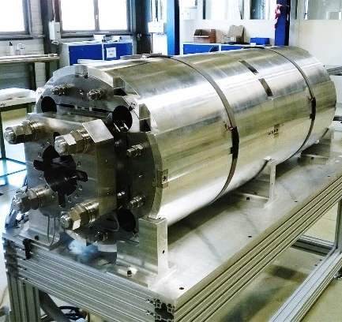
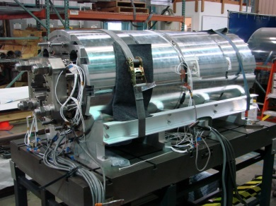
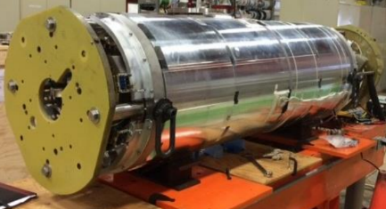
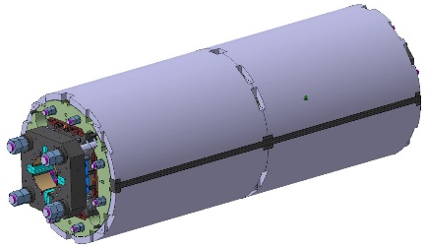
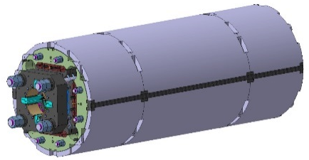
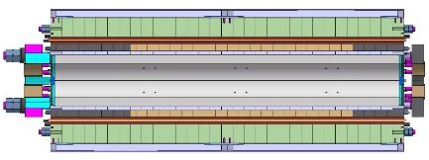
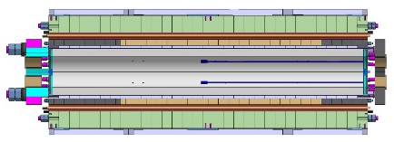
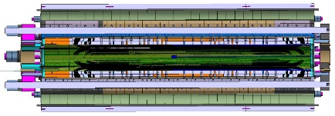
Short models strain gauge data overview
(total of 120 strain gauges)
MQXFSD0
44 gauges
  CERN-type
MQXFSD1
52 gauges
  CERN-type, LARP type
MQXFSD2
36 gauges
  CERN-type
MQXFS1
36 gauges
  CERN-type, LARP type

Slide 5
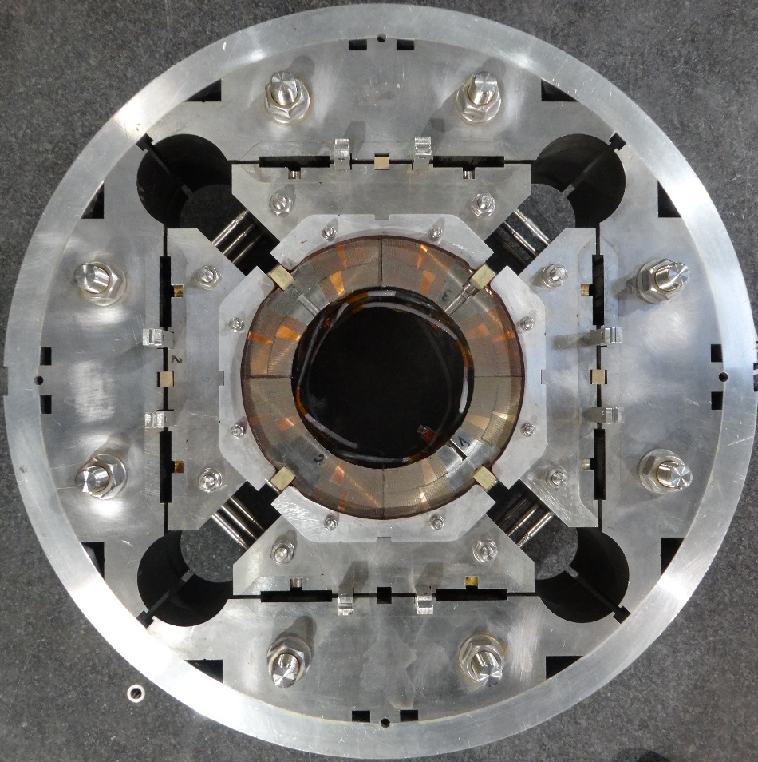
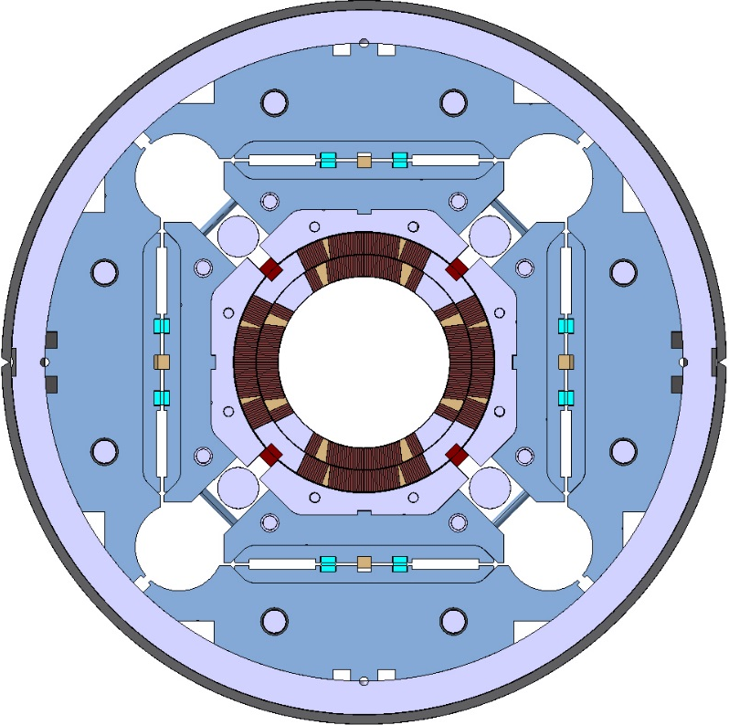
Strain gauge locations in real coils
Shell
Pole

Slide 6
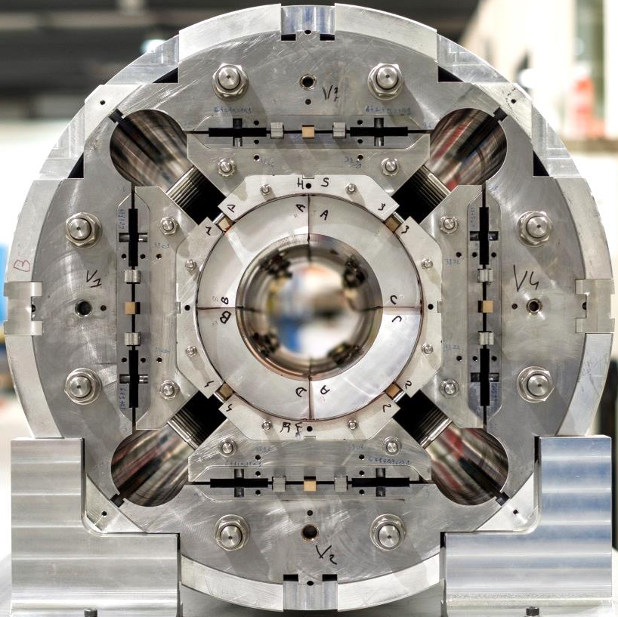
Strain gauge locations in dummy coils
Shell
Pole

Slide 7
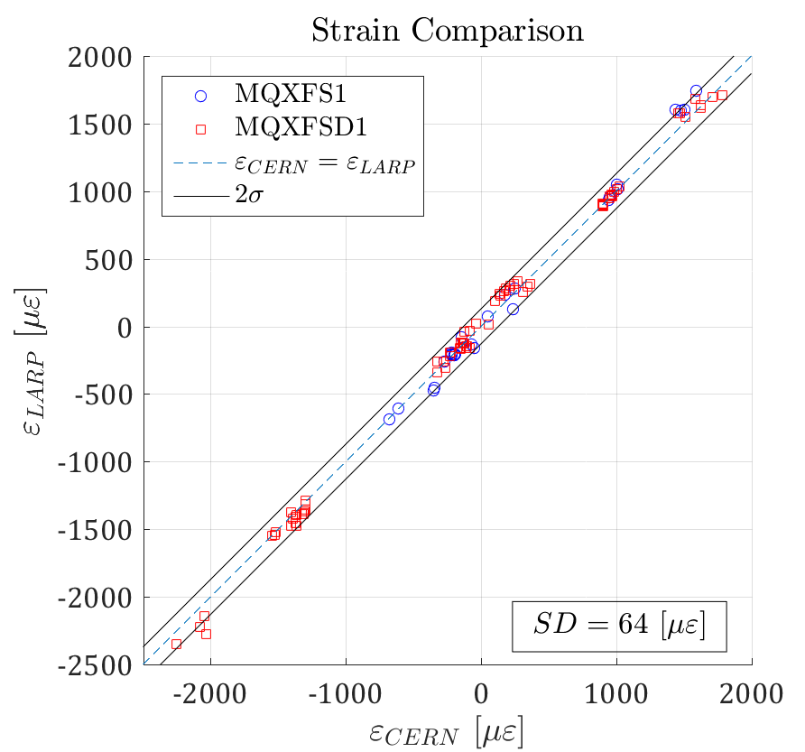
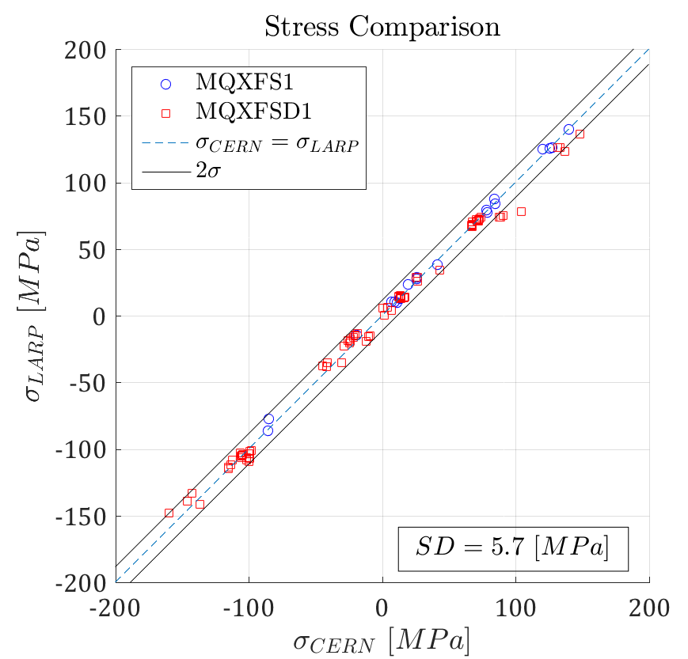
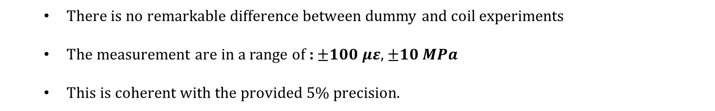
Measurement Differences of LARP and CERN systems
  There is no remarkable difference between dummy and coil experiments
  The measurement are in a range of : $±100 με$, $±10 MPa$
  This is coherent with the provided 5% precision.

Slide 8
MQXFS1
Pre-stress Analysis

Slide 9
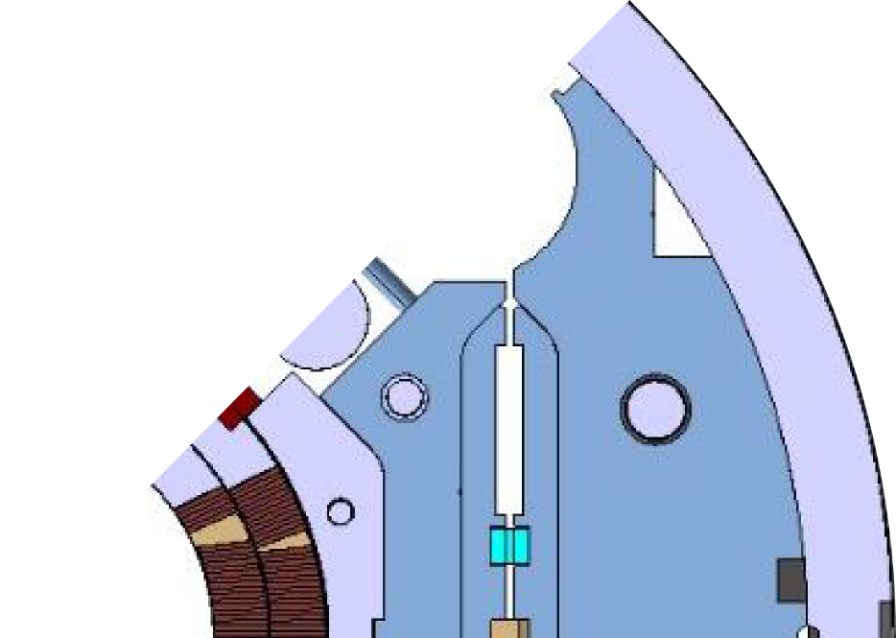

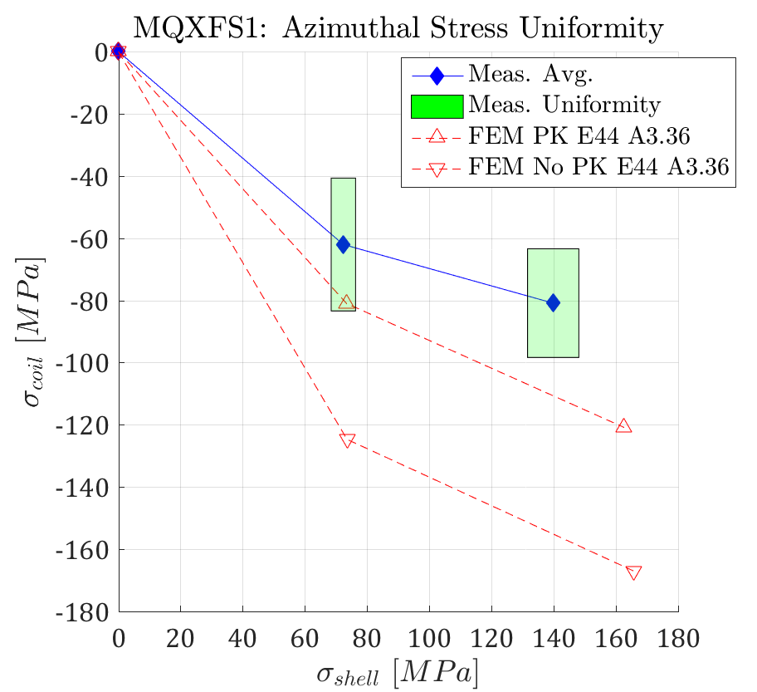
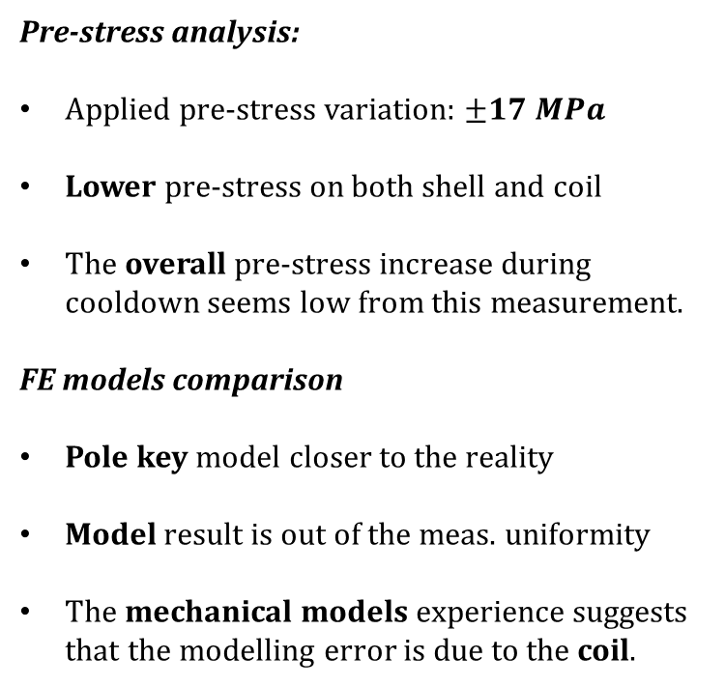
Azimuthal Pre-stress - MQXFS1
Shell
Pole
  Pre-stress analysis:
  Applied pre-stress variation: $±17 MPa$
Lower pre-stress on both shell and coil
The overall pre-stress increase during cooldown seems low from this measurement.
FE models comparison
Pole key model closer to the reality
Model result is out of the meas. uniformity
The mechanical models experience suggests that the modelling error is due to the coil.
Loading
Cool-Down

Slide 10
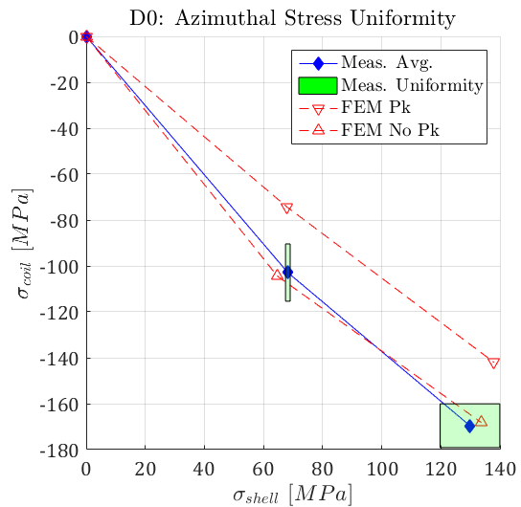
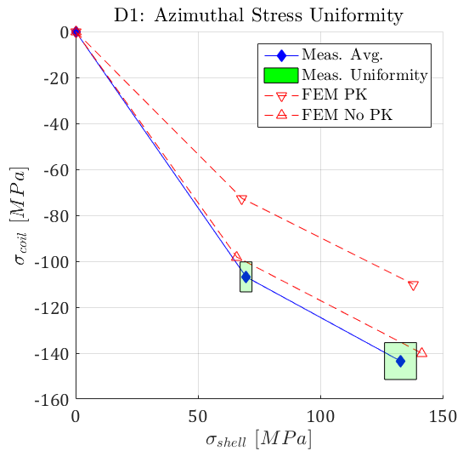
Azimuthal Pre-stress - Dummy

Slide 11
Real Coil:
Mechanical Properties

Slide 12
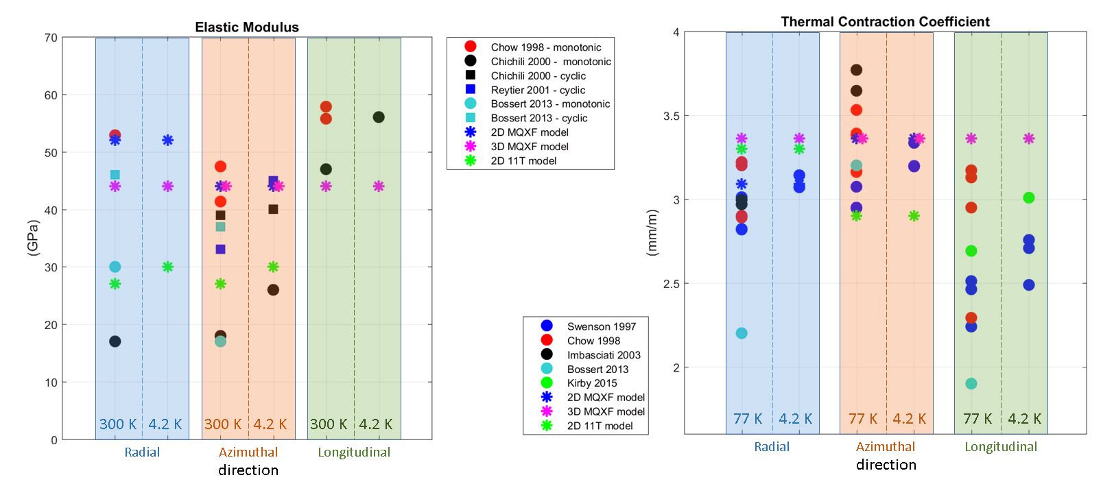
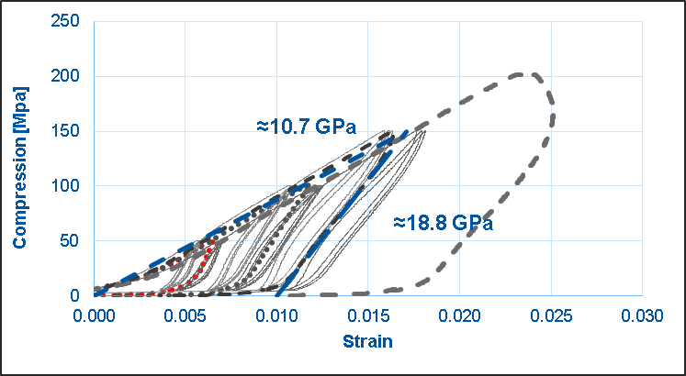
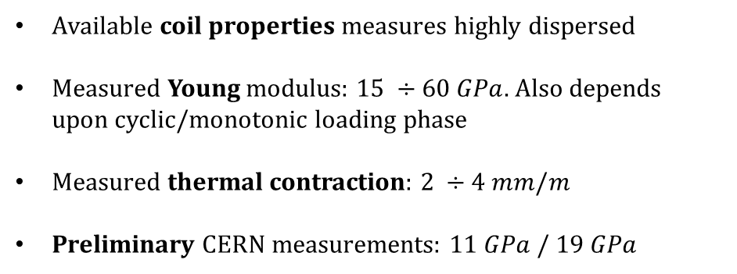
Coil Properties – Available Data
Y – azimuthal
Z – longitudinal
X – radial
Available coil properties measures highly dispersed
Measured Young modulus: $15 ÷60 GPa$. Also depends upon cyclic/monotonic loading phase
Measured thermal contraction: $2 ÷4 mm/m$
Preliminary CERN measurements: $11 GPa / 19 GPa$

Slide 13
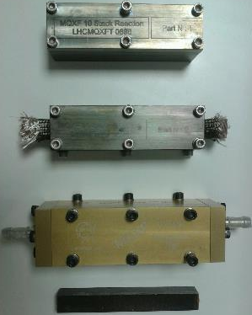
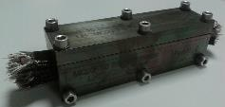
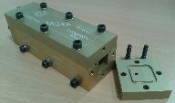
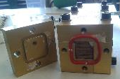
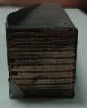
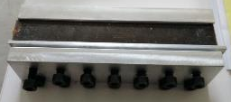
Coil Properties - Experimental campaign
Experimental Test | Sample | Temperature | Loading Direction | Measurements
Free Compression | PIT 10-stack Reacted + Impregnated | 300 K | Azimuthal | E_{yy}, ε_{yy}, ν_{yx}, ν_{yz}
 |  |  | Radial | E_{xx}, ε_{xx}, ν_{xy}, ν_{xz}
 |  |  | Longitudinal | E_{zz}, ε_{zz}, ν_{zx}, ν_{zy}
 |  | 77 K | Azimuthal | E_{yy}, ε_{yy}, ν_{yx}, ν_{yz}
 |  |  | Radial | E_{xx}, ε_{xx}, ν_{xy}, ν_{xz}
 |  |  | Longitudinal | E_{zz}, ε_{zz}, ν_{zx}, ν_{zy}
 | RRP 10-stack Reacted + Impregnated | 300 K | Azimuthal | E_{yy}, ε_{yy}, ν_{yx}, ν_{yz}
 |  |  | Radial | E_{xx}, ε_{xx}, ν_{xy}, ν_{xz}
 |  |  | Longitudinal | E_{zz}, ε_{zz}, ν_{zx}, ν_{zy}
 |  | 77 K | Azimuthal | E_{yy}, ε_{yy}, ν_{yx}, ν_{yz}
 |  |  | Radial | E_{xx}, ε_{xx}, ν_{xy}, ν_{xz}
 |  |  | Longitudinal | E_{zz}, ε_{zz}, ν_{zx}, ν_{zy}
Reaction Mould
Impregnation Mould
10-stack
Cutting tool

Slide 14
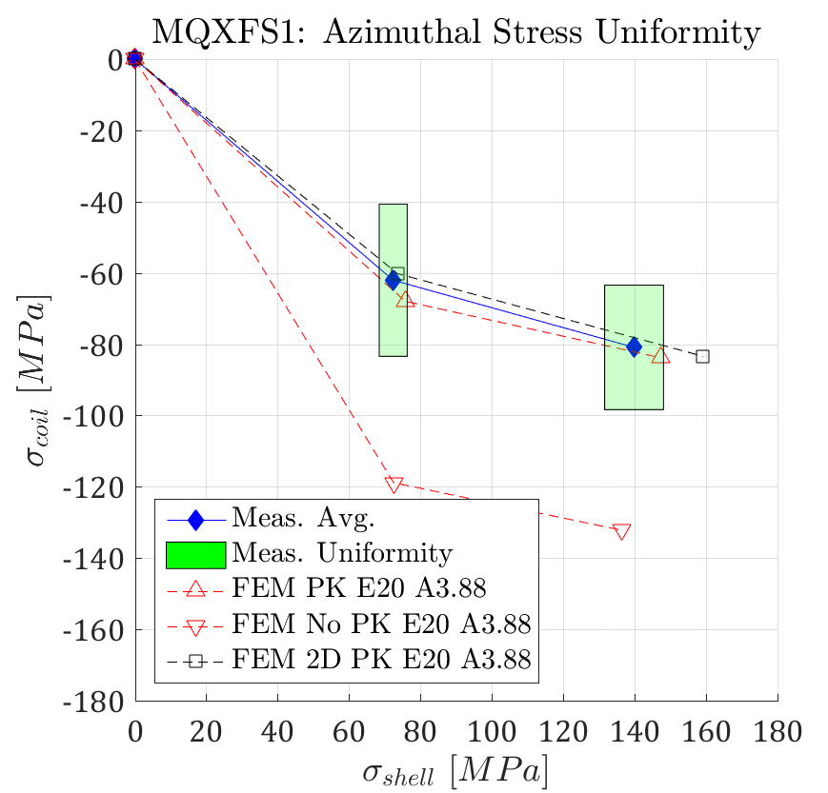
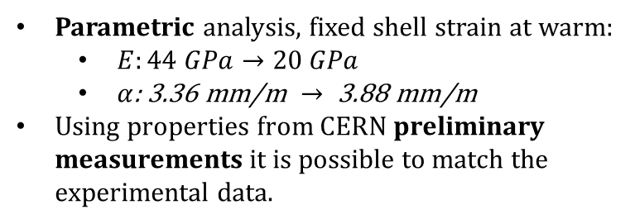
Azimuthal Pre-stress
Parametric analysis, fixed shell strain at warm:
  $E:44 GPa→20 GPa$
  $α\text{: }\text{3.3}\text{6} \text{mm}\text{/}\text{m} →\text{ 3.88 }\text{mm}\text{/}\text{m}$
Using properties from CERN preliminary measurements it is possible to match the experimental data.
Shell
Pole

Slide 15
MQXFS1:
Strain Gauge Data During Excitation

Slide 16
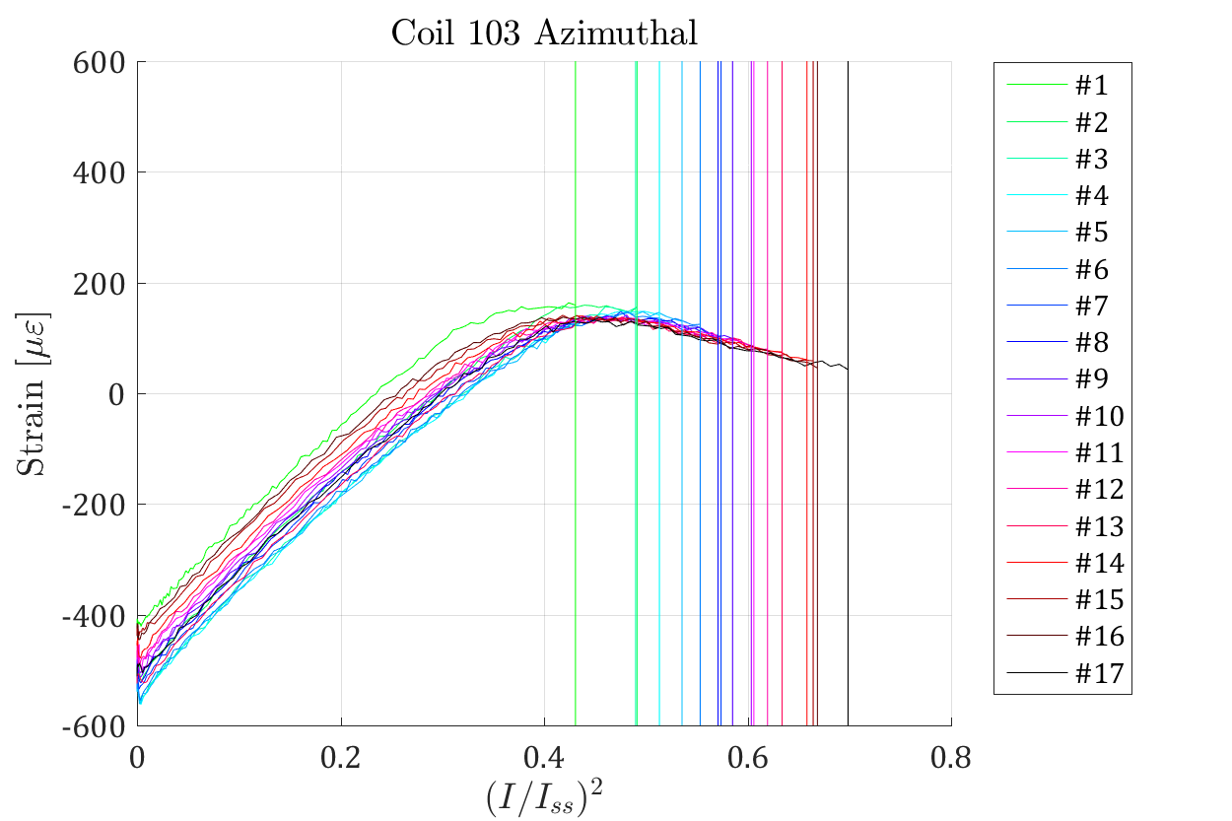
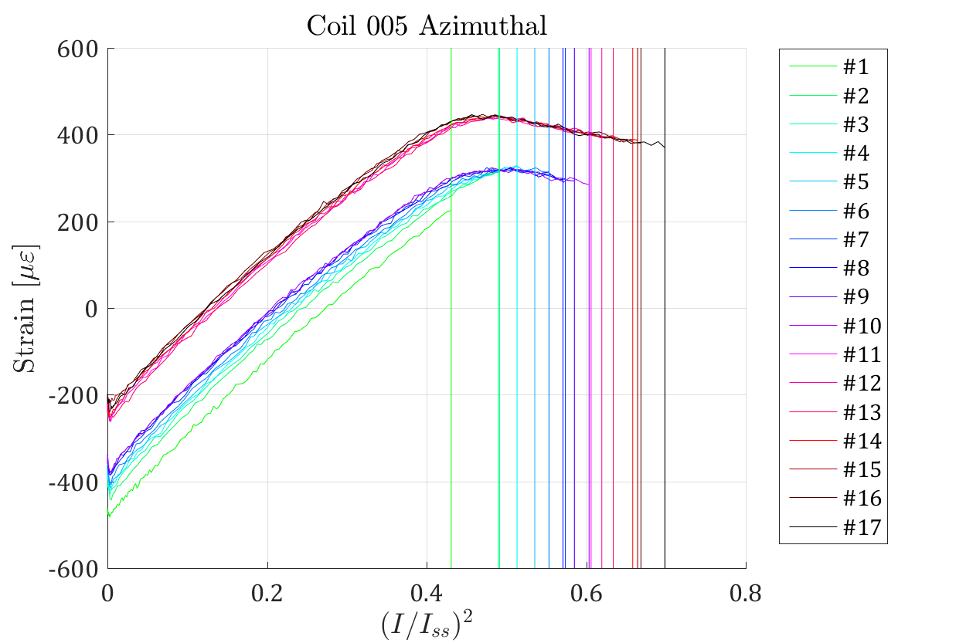
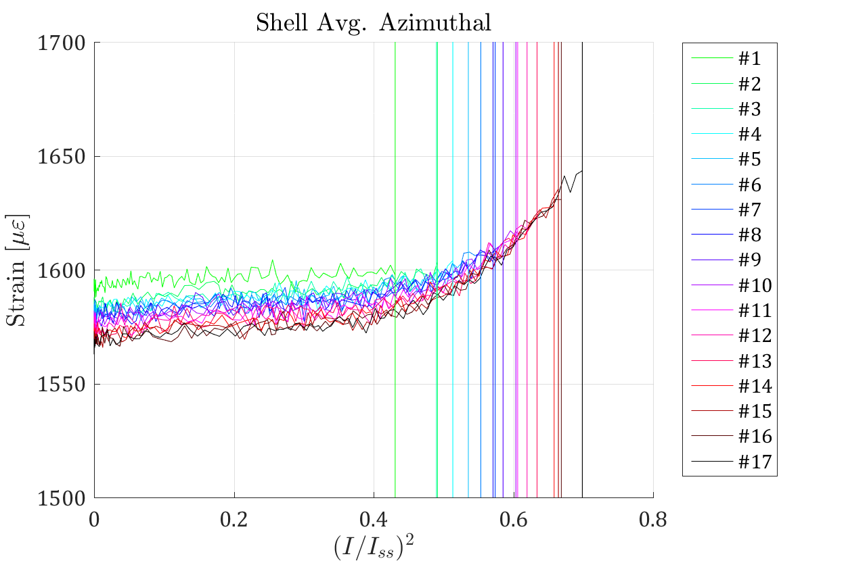
Azimuthal Strain
Quench Current
Flattening of the coil strain signal usually considered as indication of detachment/low pre-stress
Coil 103/005 pre-stress re-sets during the training
Detachment appears first on the Coil 103. This is coherent with the lower preload measured
Zone I
Zone II

Slide 17
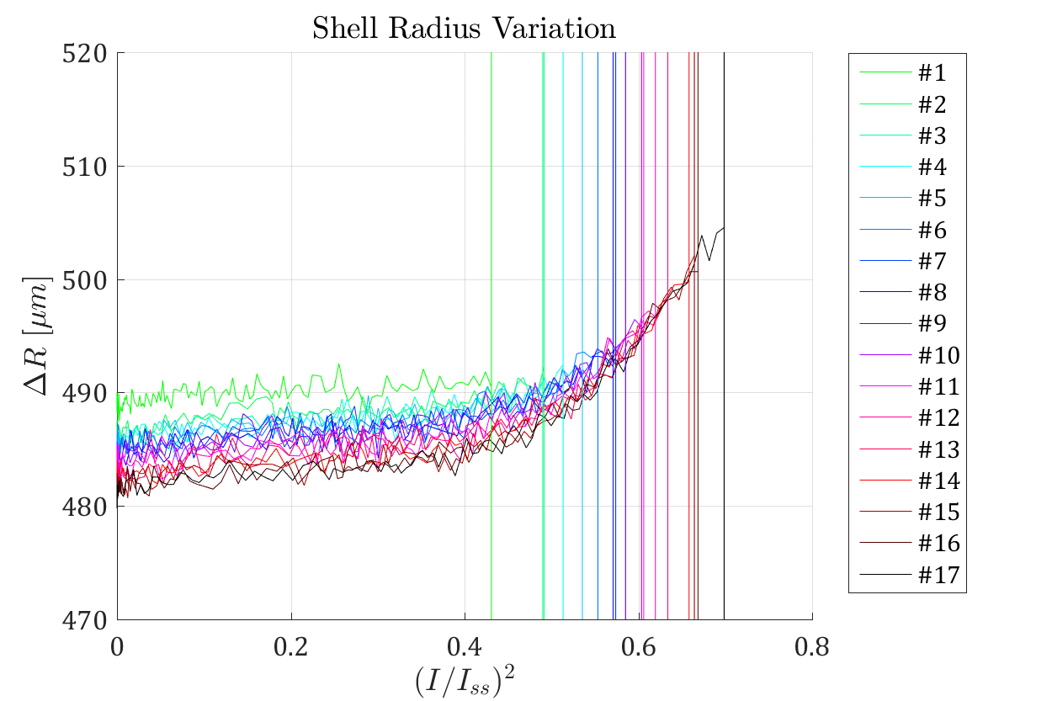
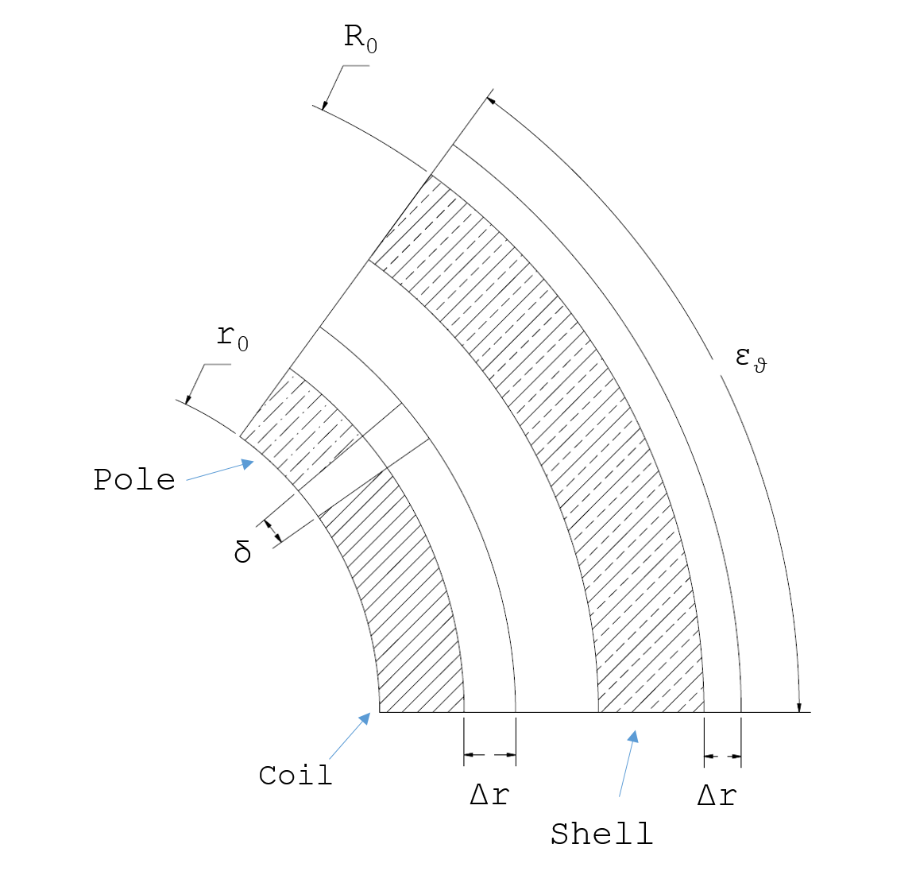
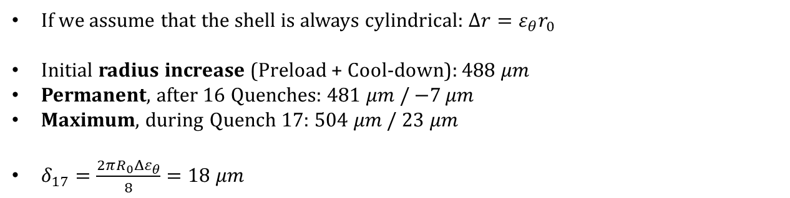
Pole/Coil Gap
If we assume that the shell is always cylindrical: $Δr=ε_{θ}r_{0}$
Initial radius increase (Preload + Cool-down): $488 μm$
Permanent, after 16 Quenches: $481 μm$ / $−7 μm$
Maximum, during Quench 17: $504 μm$ / $23 μm$
$δ_{17}=\frac{2πR_{0}{Δε}_{θ}}{8}=18 μm$

Slide 18
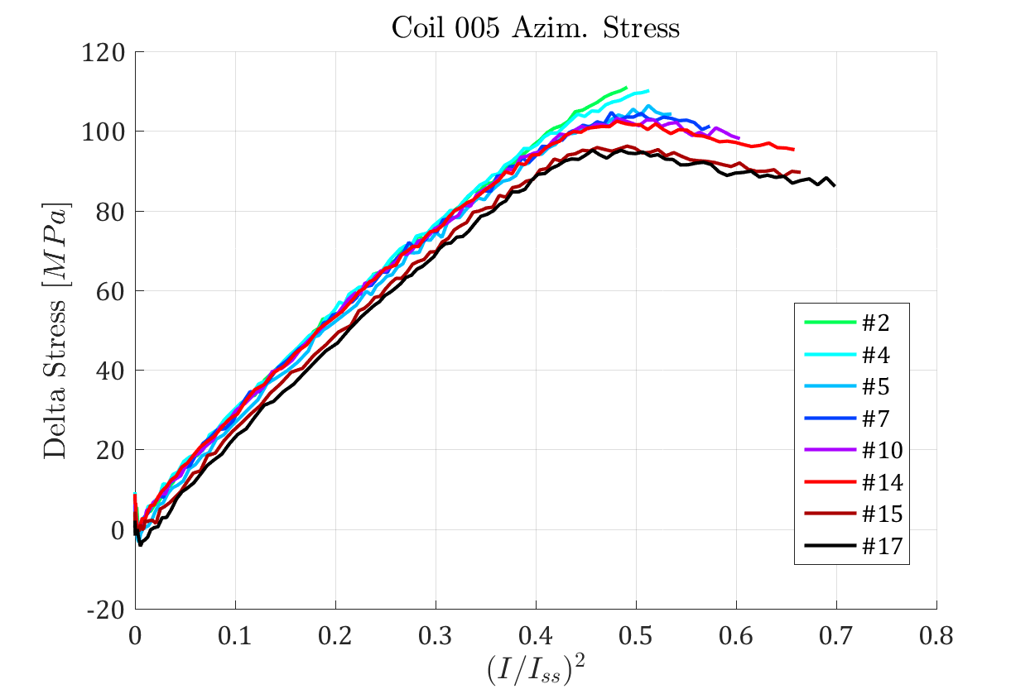
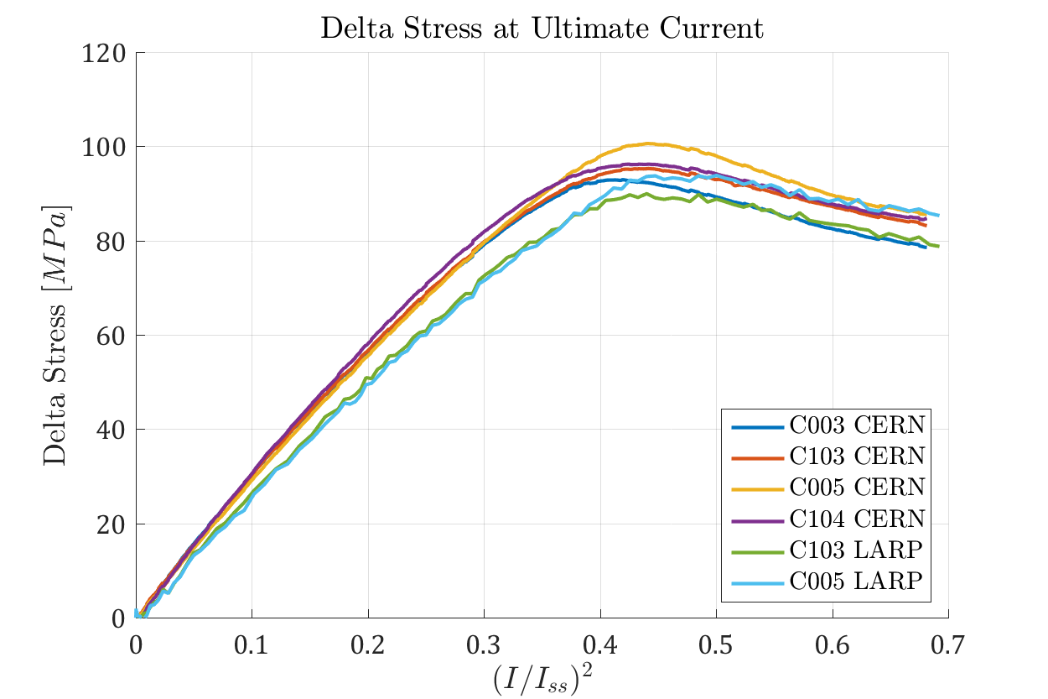
Coil Azimuthal Delta Stress
The pole stress gradually changes during training:
  The slope of the linear part is not affected by the loading cycles
  The maximum stress gradually decrease in the first cycles
  The following cycles gradually increase the zone II length
When the training is completed the four coils behave in a very similar manner:
  The pre-stress is very uniform on the four quadrants
  The results from the two SG systems are consistent

Slide 19
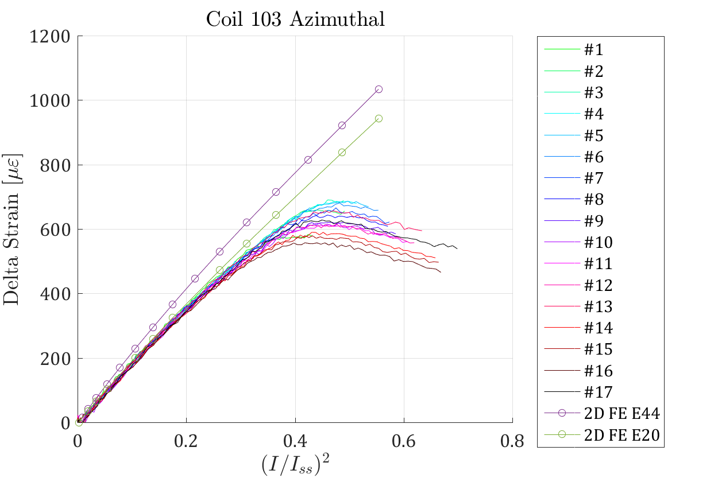
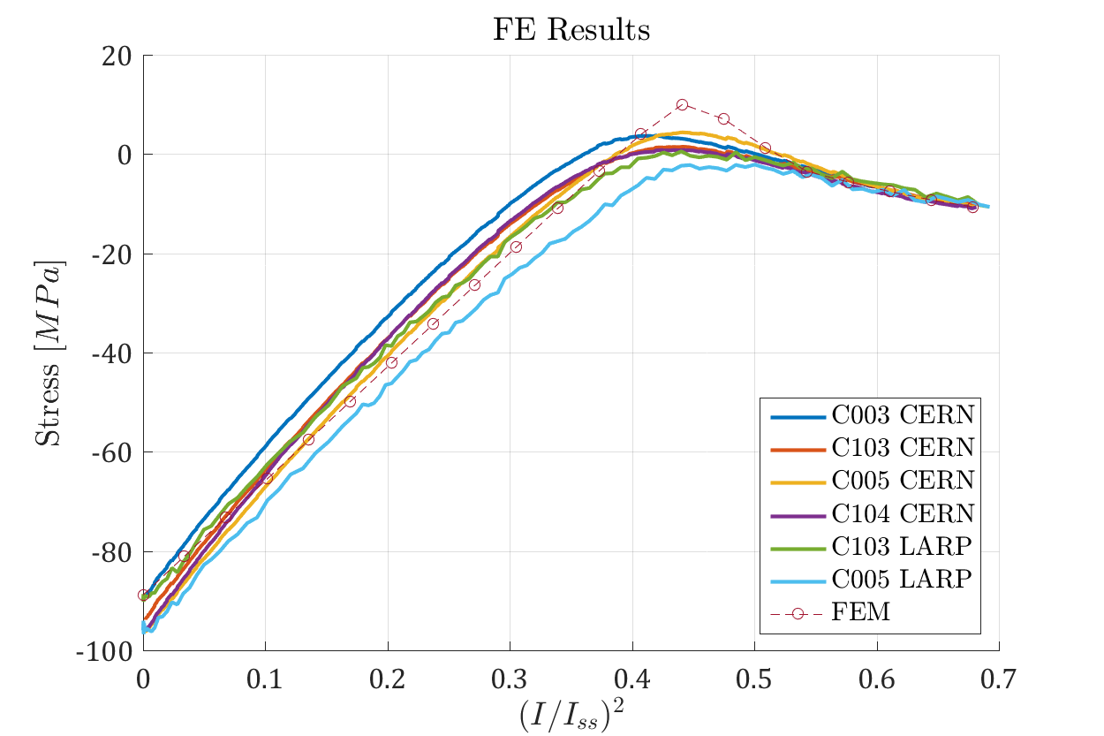
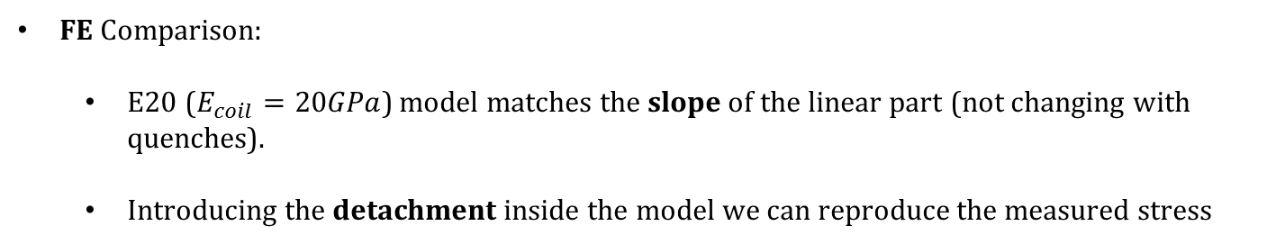
Coil Azimuthal Delta Strain – FEM Comparison
FE Comparison:
  E20 ($E_{coil}=20GPa$) model matches the slope of the linear part (not changing with quenches).
  Introducing the detachment inside the model we can reproduce the measured stress

Slide 20
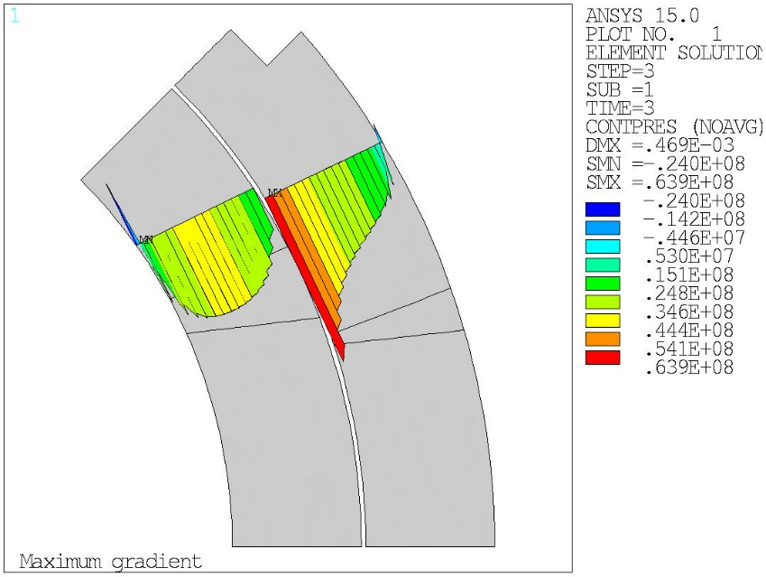
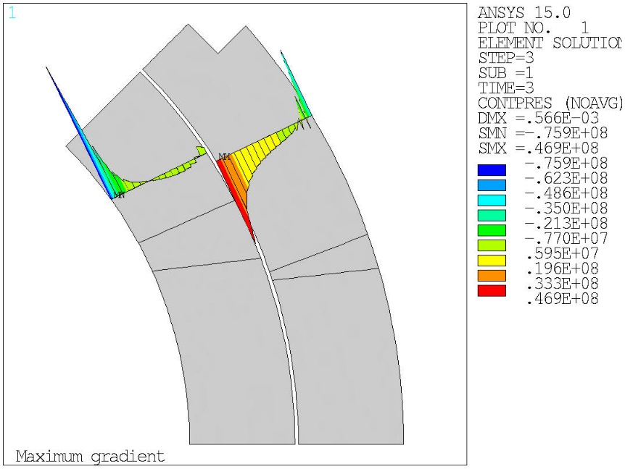
Pressure/Tension at the Interface
G = 132.6
Nom. Coil Properties
550 um Interference
G = 132.6
New Coil Properties
550 um Interference
Nominal Gradient:
  We did not expect any tension on the pole/coil interface
  With the new properties we see that most of the inner layer would be in tension

Slide 21
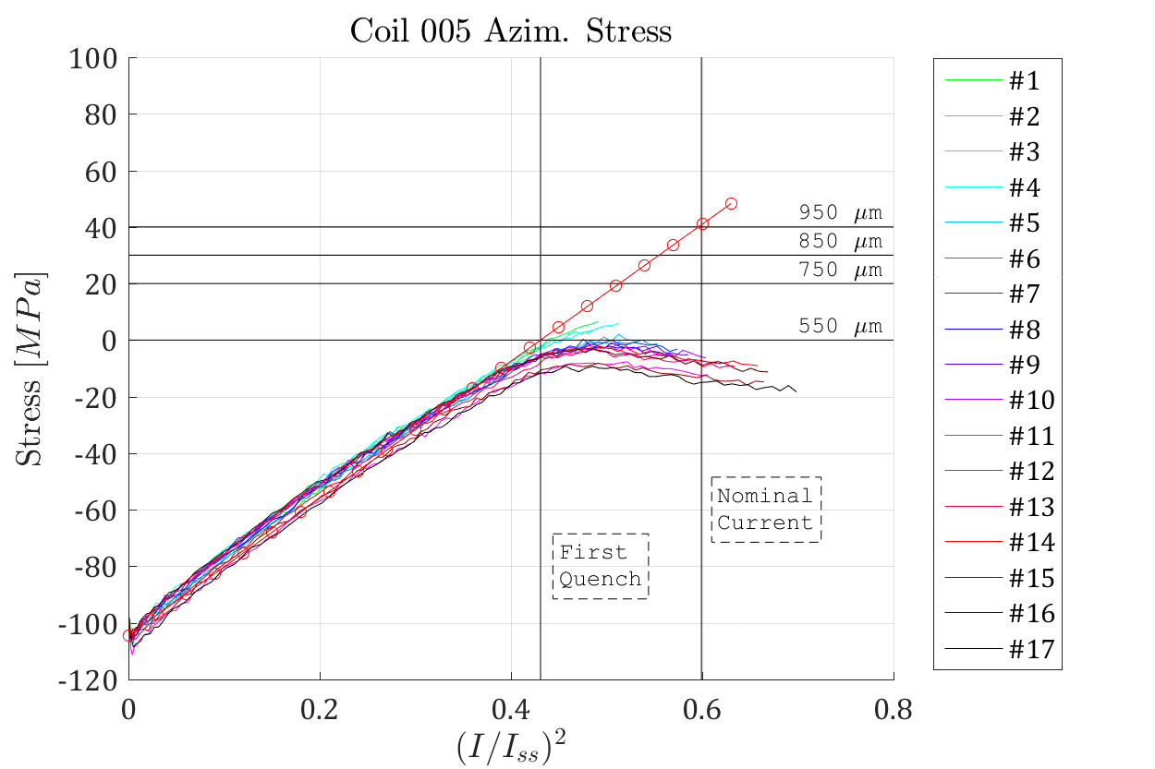
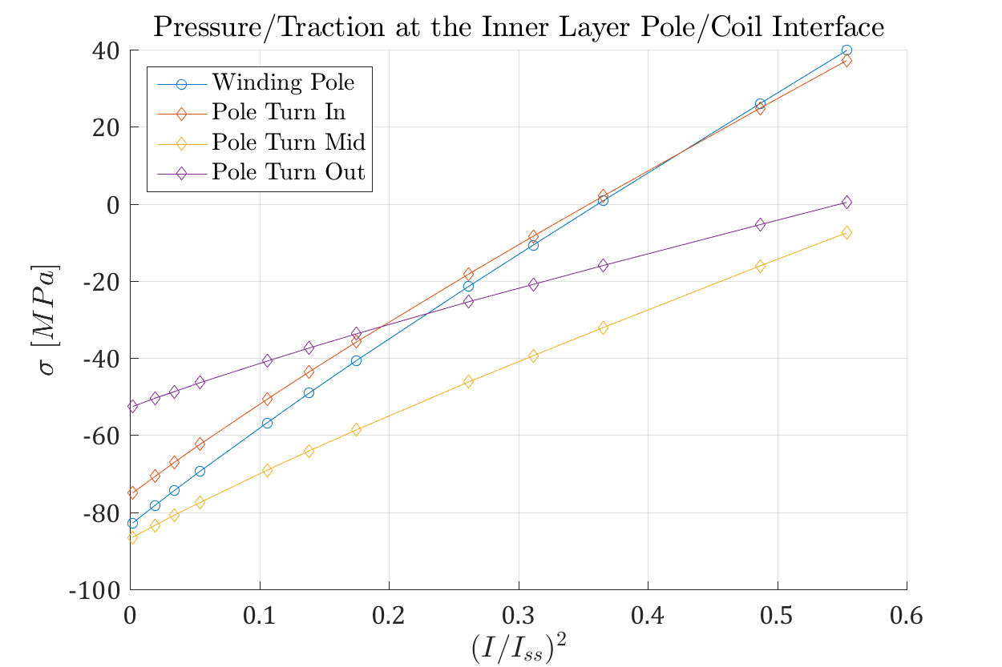




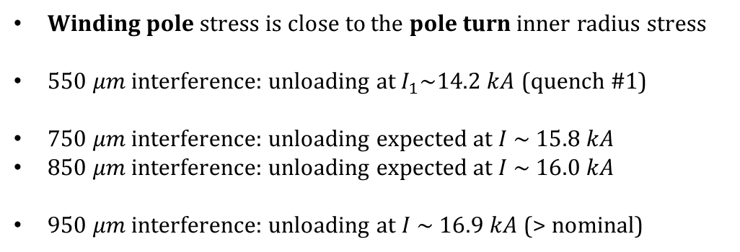
Pole Stress at Nominal Current
Winding pole stress is close to the pole turn inner radius stress
$550 μm$ interference: unloading a$t I_{1}\sim 14.2 kA$ (quench #1)
$750 μm$ interference: unloading expected at $I \sim 15.8 kA$
$850 μm$ interference: unloading expected at $I \sim 16.0 kA$
$950 μm$ interference: unloading at $I \sim 16.9 kA$ (> nominal)
Winding
Pole
Pole
Turn

Slide 22
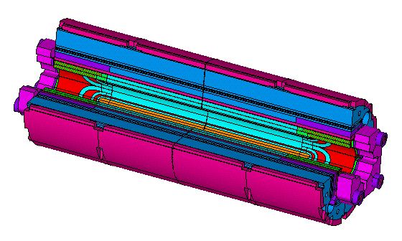
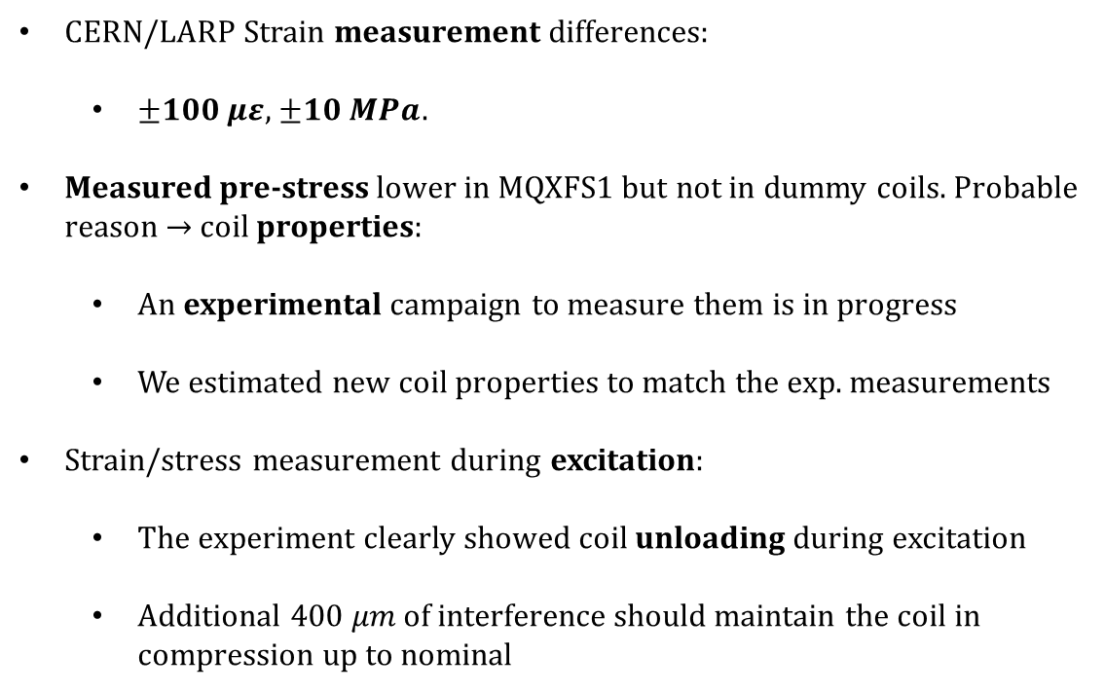
Conclusion
CERN/LARP Strain measurement differences:
  $±100 με$, $±10 MPa$.
Measured pre-stress lower in MQXFS1 but not in dummy coils. Probable reason $→$ coil properties:
  An experimental campaign to measure them is in progress
  We estimated new coil properties to match the exp. measurements
Strain/stress measurement during excitation:
  The experiment clearly showed coil unloading during excitation
  Additional $400 μm$ of interference should maintain the coil in compression up to nominal

Slide 23
Thanks for your attention!

Slide 24
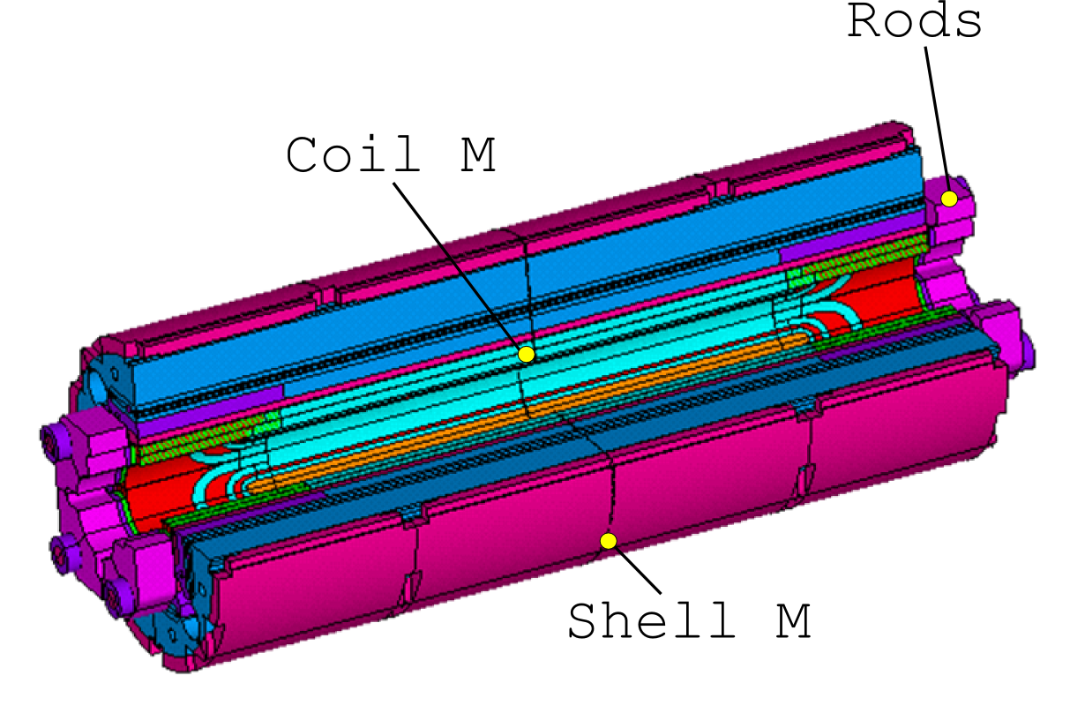
Measurement Differences
Index:
  Measurement differences;
  Stress uniformity;
  Model inaccuracies / errors.
Strain Gauges on Poles and on the Shell with two different systems:
  LBNL SG instrumentation
  Vishay Gauges
  DC current powered
  k factor variation not characterized on Vishay SG
  CERN SG instrumentation
  HBM Gauges
  AC voltage powered
  SG characterized at cold => k factor variation by 8 % at 4.2 K
 |  | LARP |  | CERN
Component | Position | Azim. | Z | Azim. | Z
Shell | TOP | V | V | V | V
 | BOTTOM | V | V | V | V
 | LEFT | V | V | V | V
 | RIGHT | V | V | V | V
Coil | C003 | VX | V | V | V
 | C005 | V | V | V | V
 | C103 | V | X | V | V
 | C104 | X | V | V | V

Slide 25
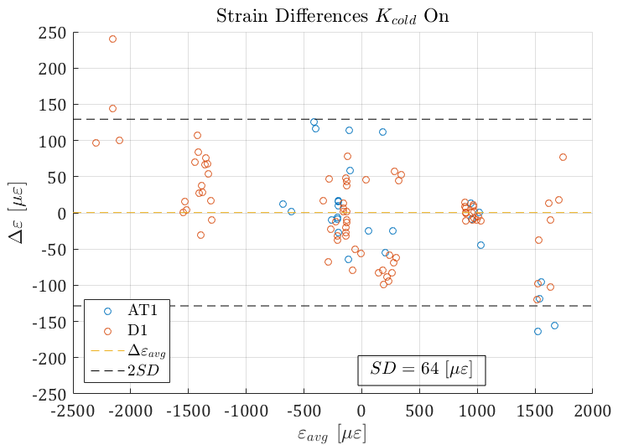

Measurement Differences

Slide 26

Azimuthal Stresses – 2D
Shell
Pole
Also the 2D model with the new parameters set is representative of the overall behaviour
An interference of 550 um is used in the 2D model to match the experimental strain at warm
We try to compare the current vs pressure/traction at the pole/coil interface
This can be then compared with the epoxy strength (Rs ~= 20 MPa)

Slide 27


Rods Strain / Longitudinal Stiffness
Coil Elongation: $ΔL=ε_{z}L_{0}$
Initial elongation (Preload + Cool-down): $3.193 mm$
Permanent elongation after 16 Quenches: $3.228 mm$ / $35 μm$
Maximum elongation (during Quench 17): $3.324 mm$ / $96 μm$

Slide 28





Azimuthal Stress – Design
(H. Felice)
Max Stress 85MPa
Max Stress = 164 MPa
Max Stress = 134 MPa
Parameters:
  E = 44 GPa
  550 um interference
  Nominal Current
Max tension at the interface: 25 MPa
Coil stresses uniformity: ±20 MPa
Target strain on shell: $−1119 με$
Target strain on coil: $−646 με$

Slide 29





Azimuthal Stress – 550 um
Max Stress 70 MPa
Max Stress = 143 MPa
Max Stress = 111 MPa
Parameters:
  E = 20 GPa
  550 um interference
  Nominal Current
Max tension at the interface: 73 MPa
Target strain on shell: $−1053 με$
Target strain on coil: $−477 με$

Slide 30





Azimuthal Stress – 750 um
Max Stress 96 MPa
Max Stress = 164 MPa
Max Stress = 126 MPa
Parameters:
  E = 20 GPa
  750 um interference
  Nominal Current
Max tension at the interface: 49 MPa
Bladder pressure of about 40/50 MPa
Target strain on shell: $−1436 με$
Target strain on coil: $−649 με$

Slide 31





Azimuthal Stress – 850 um
Max Stress 109 MPa
Max Stress = 174 MPa
Max Stress = 137 MPa
Parameters:
  E = 20 GPa
  850 um interference
  Nominal Current
Max tension at the interface: 37 MPa
Bladder pressure of about 45/55 MPa
Target strain on shell: $−1627 με$
Target strain on coil: $−734 με$

Slide 32





Azimuthal Stress – 950 um
Max Stress 122 MPa
Max Stress = 184 MPa
Max Stress = 147 MPa
Parameters:
  E = 20 GPa
  950 um interference
  Nominal Current
Max tension at the interface: 35 MPa
Bladder pressure of about 50/60 MPa
Target strain on shell: $−1819 με$
Target strain on coil: $−819 με$

Slide 33
Long Coil:
Fabrication Status

Slide 34
Long Coil Fabrication Status
Inner layer of coil wound
  Smaller changes in winding machine setup
  Additional clamps
Curing
  Shells mounted
  Forming hood assembled
  Trials for sectorization of press (main dipoles) ongoing
  Lifting tool not delivered
Interlayer
  Trial start 2x 4m pieces
  8m piece

Slide 35


Long Coil Fabrication Status (1)
Coil Winding
Inner Layer Copper Insulated

Slide 36


Long Coil Fabrication Status (2)
Preparation coil curing
Mandrel and shell assembly inner layer

Slide 37


Long Coil Fabrication Status (3)
Preparation coil curing
Forming hood

Slide 38

CD I: 1570-984~+580 ueps
CD II: 1523-826~+700 ueps
During CD II we recovered some of the pre-stress lost
CD III: The shell strain was 100 ueps lower at cold, 200 after warm-up
We should consider 1570-1478~100 ueps as pre-stress lost
We should anyway compute the increase of pre-stress from the 1478 value

Slide 39

CD I: 134-72 = +62 MPa
CD II: 131-59~+72 MPa
During CD II we recovered some of the pre-stress lost
CD III: The shell stress was 8 MPa lower at cold, 20 MPa after warm-up
We should consider 8 MPa as pre-stress lost
We should anyway compute the increase of pre-stress from the 8 MPa value

