Slide 1
Conductor procurement and QC from CERN
B. Bordini, A. Ballarino, M. Macchini, D. Richter
Joint LARP CM26/Hi-Lumi Meeting at SLAC – 18th– 21st May 2016

Slide 2
Outline
Wire Technical Specs
Main Parameters
Magnet Margin
Received 108/127 RRP Wire
Data From OST
First Verification Measurements by CERN
The bundle-barrier PIT
Status of the wire Procurement
Conclusions

Slide 3
Wire Technical Specs Main Parameters
 | MQXF Quadrupole
Wire diameter Φ | 0.850 ± 0.003 mm
Nominal sub-element diameter | < 55 µm
Copper to non-copper ratio | 1.2 ± 0.1
Wire twist pitch | 19 ± 3 mm
Wire twist direction | Right-handed screw
Minimum critical current @ 4.22K, 12T | 632 A
Minimum critical current @ 4.22K, 15T | 331 A
RRR (after full heat treatment) | > 150
n-value @ 4.22K, 12T | > 30
J_{c}(4.22 K, 12 T)≈2450 A/mm²
J_{c}(4.22 K, 15 T)≈1280 A/mm²

Slide 4
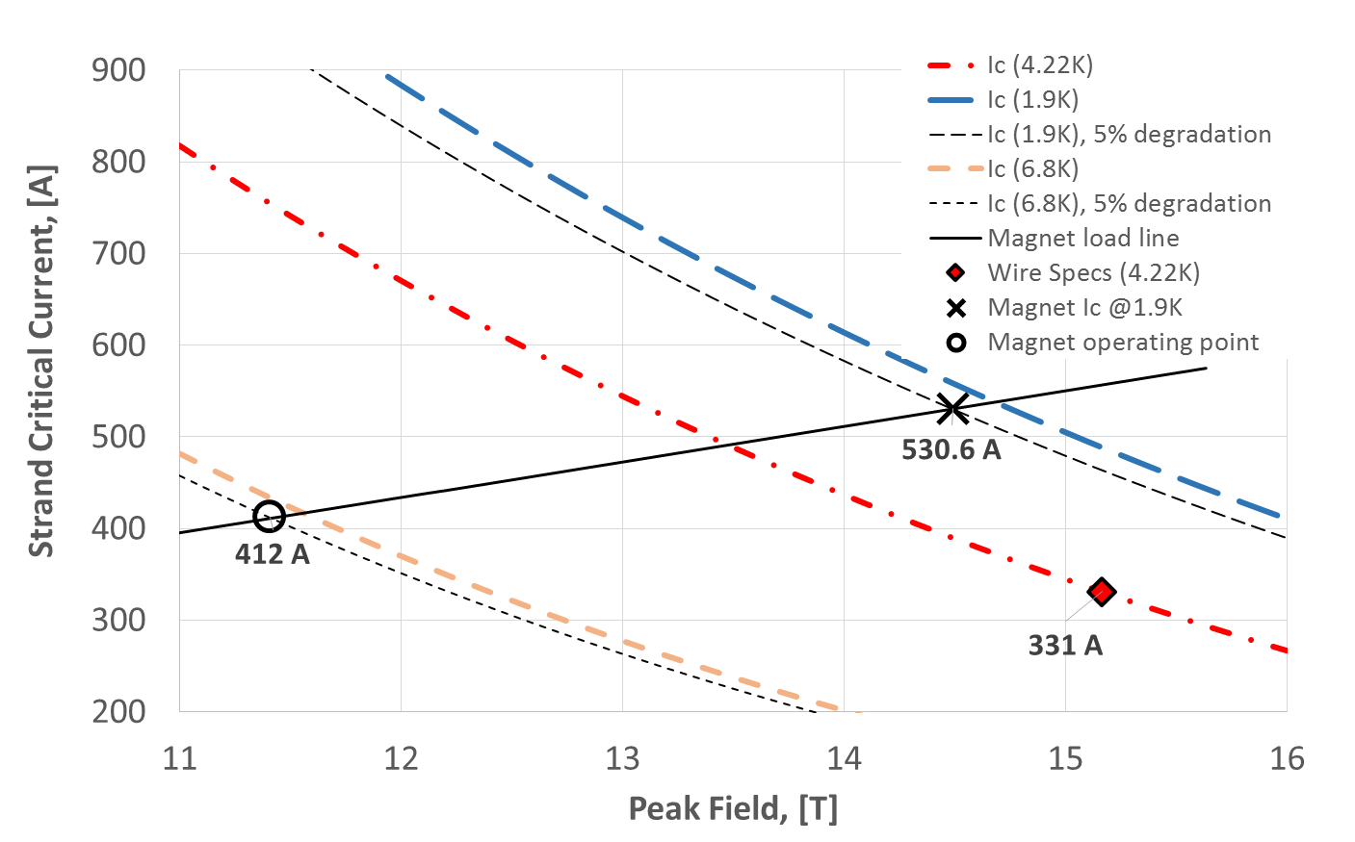
Wire Technical Specs Magnet Margin
4.9 K Temperature Margin and 22.3% Margin on the Load-Line

Slide 5
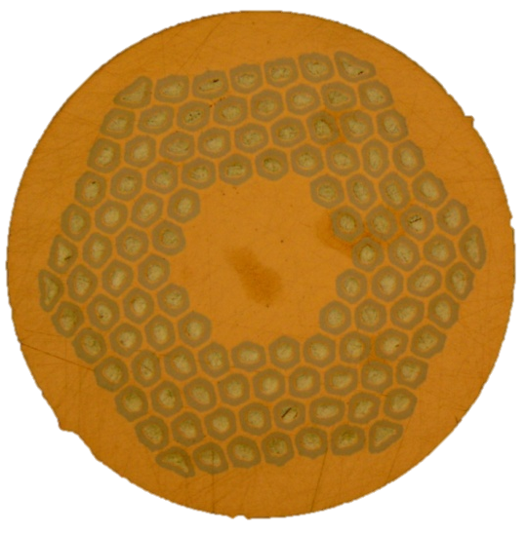
Received 108/127 RRP Wire I_{C} @ 12 T, 4.22 K & RRR – OST Data 1/2
0.85 mm RRP | Value
Quantity [km] | 73.83
n° billets | 9
Layout | 108
Average I_{c} , RMS [A] | 720.1, 22.4
I_{c} spec [A] | 632
Average RRR, RMS | 290, 51.4
RRR spec | 150
Average J_{c}, RMS [A/mm²] | 2760, 85.0
Average B_{c2}, RMS [T] | 25.6, 0.45
For the RRP Prototypes and the series magnets the 108/127 layout will be used
The average I_{c} value is about 14% larger than specification; the RMS value is 3% of the average value
The average RRR value is almost two times the spec value; the RMS value is 18% of the average value

Slide 6
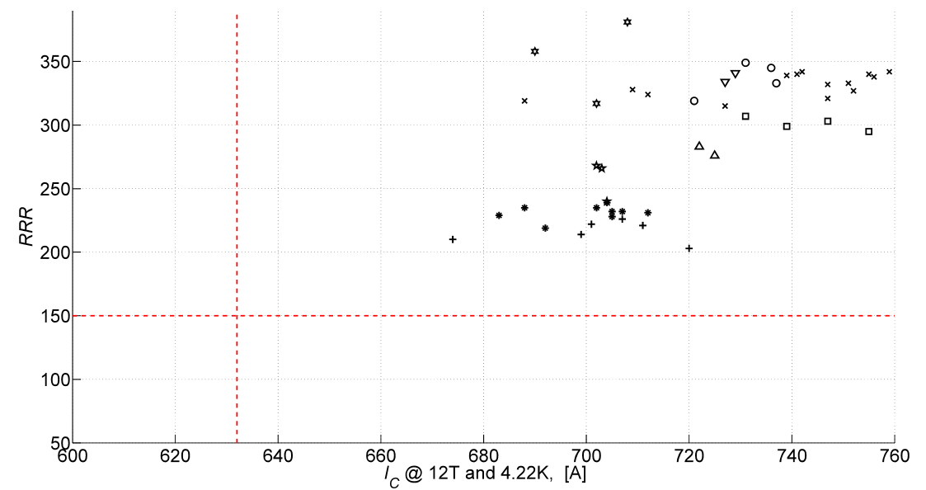
Received 108/127 RRP Wire I_{C} @ 12 T, 4.22 K & RRR – OST Data 2/2
Different Markers
Different Billets
632 A
The lowest measured I_{c} value is more than 6% larger than spec
The lowest measured RRR is larger than 200

Slide 7
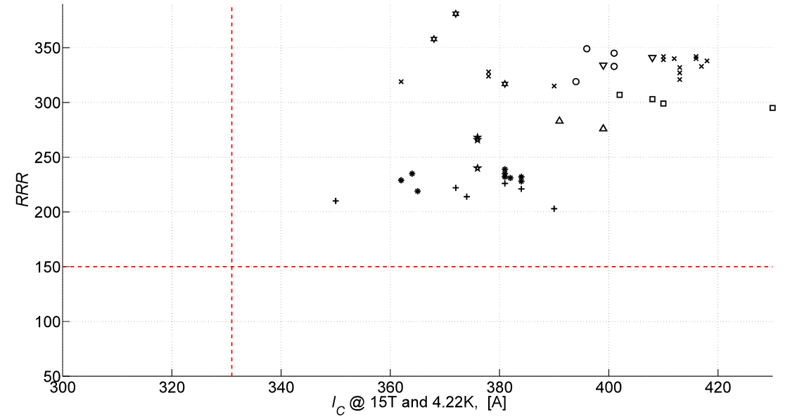
Received 108/127 RRP Wire I_{C} @ 15 T, 4.22 K & RRR – OST Data
Different Markers
Different Billets
331 A
At 15 T the average I_{c} value is about 391 A, 18% larger than specification; the RMS value is 5% of the average value
The lowest measured I_{c} value is more than 5% larger than spec
lso at 15 TThe lowest measured I_{c} value is more than 6% larger than spec

Slide 8
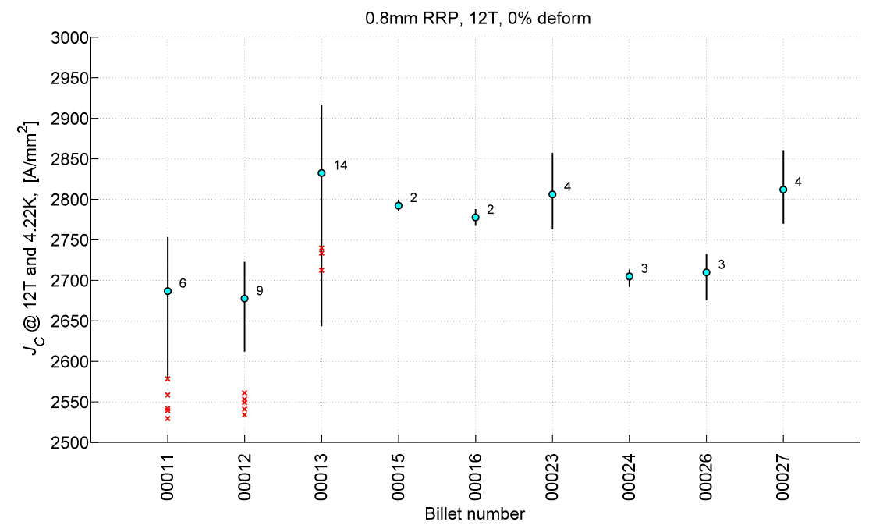
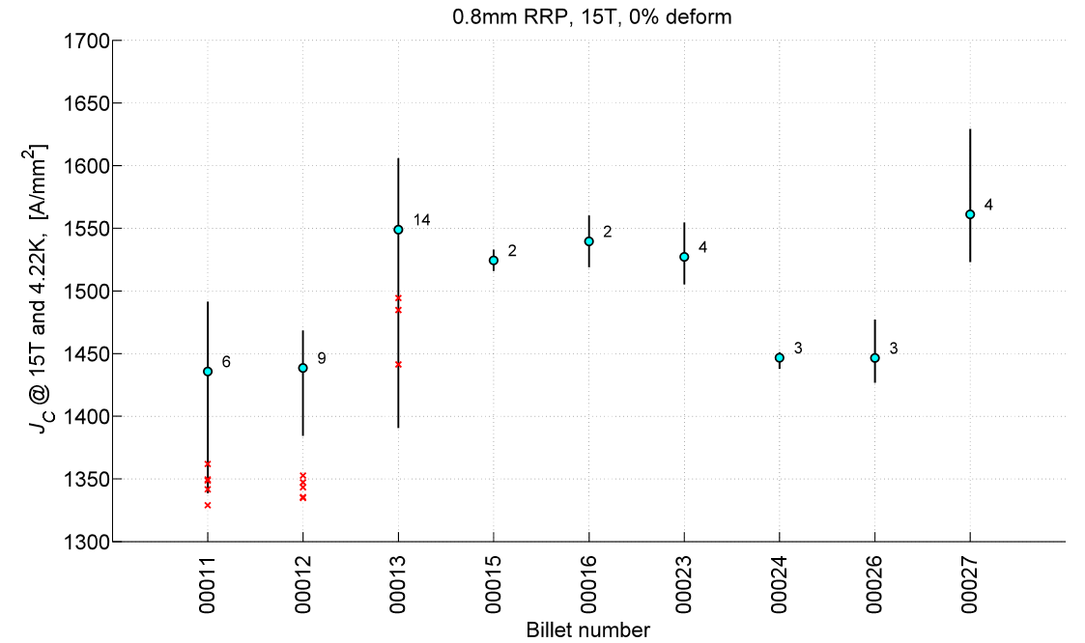
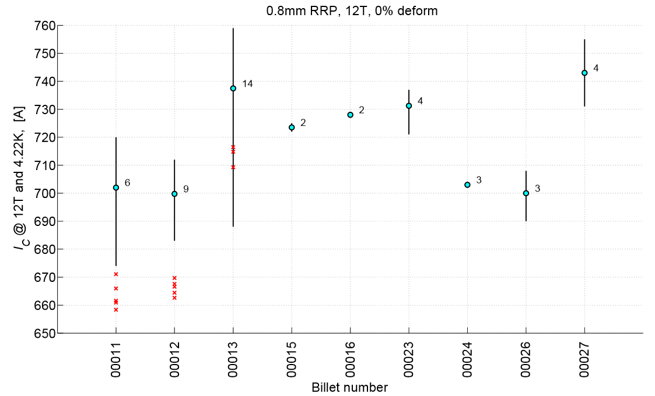
Received 108/127 RRP Wire I_{C} @ 12 T, 4.22 K – OST vs CERN data
Max value
Number of OST measurements per Billet
Average value
Min value
In Red CERN measurements
CERN measurements about 5% lower – in any case full in spec

Slide 9
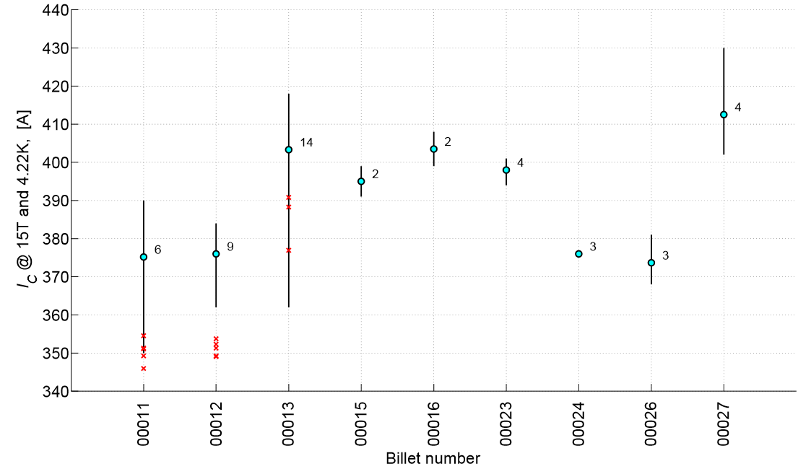
Received 108/127 RRP Wire I_{C} @ 15 T, 4.22 K – OST vs CERN data
Max value
Number of OST measurements per Billet
Average value
Min value
In Red CERN measurements
CERN measurements about 7% lower – in any case full in spec

Slide 10
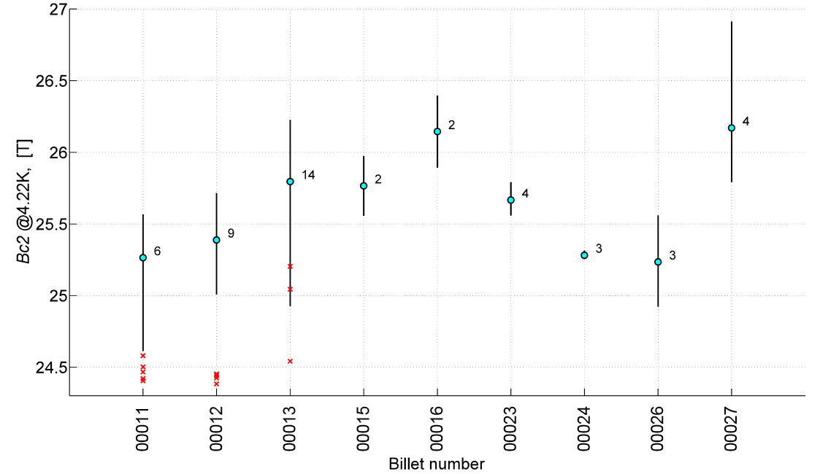
Received 108/127 RRP Wire B_{C2} @ 4.22 K – OST vs CERN data
Number of OST measurements per Billet
Max value
Average value
Min value
In Red CERN measurements
Lower B_{c2} measured by CERN suggests that difference between OST and CERN is due to different strain on the superconductor

Slide 11
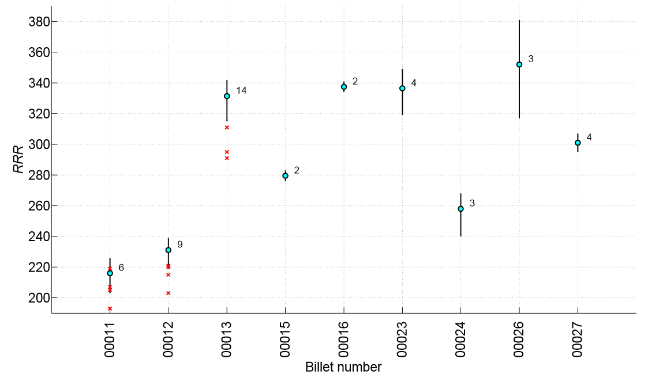
Received 108/127 RRP Wire RRR – OST vs CERN data
Number of OST measurements per Billet
Max value
Average value
Min value
In Red CERN measurements
The RRR value measured by CERN is about 10% lower; in any case full in spec

Slide 12
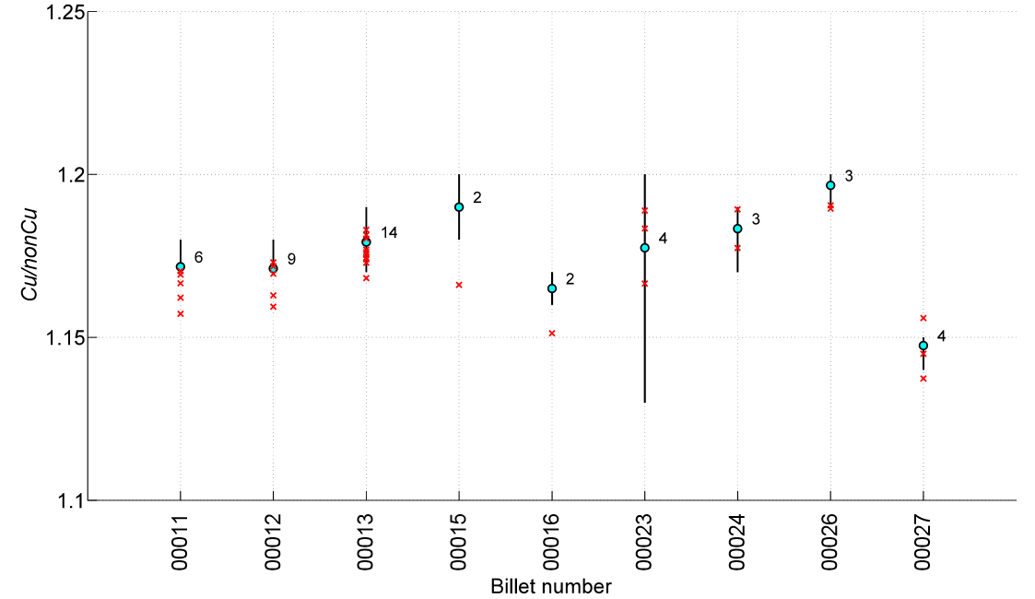
Received 108/127 RRP Wire Cu to non-Cu – OST vs CERN data
Max value
Number of OST measurements per Billet
Average value
Min value
In Red CERN measurements
Good agreement between CERN and OST data

Slide 13
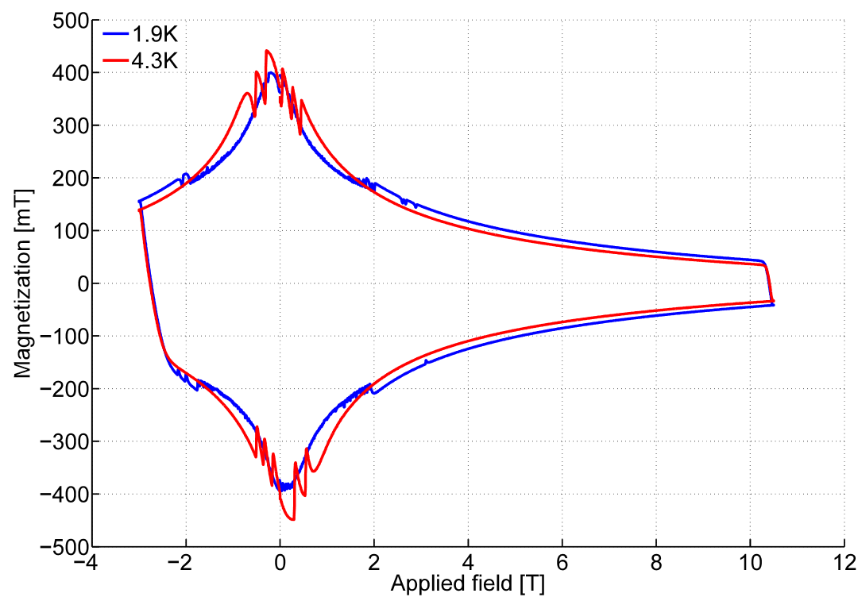
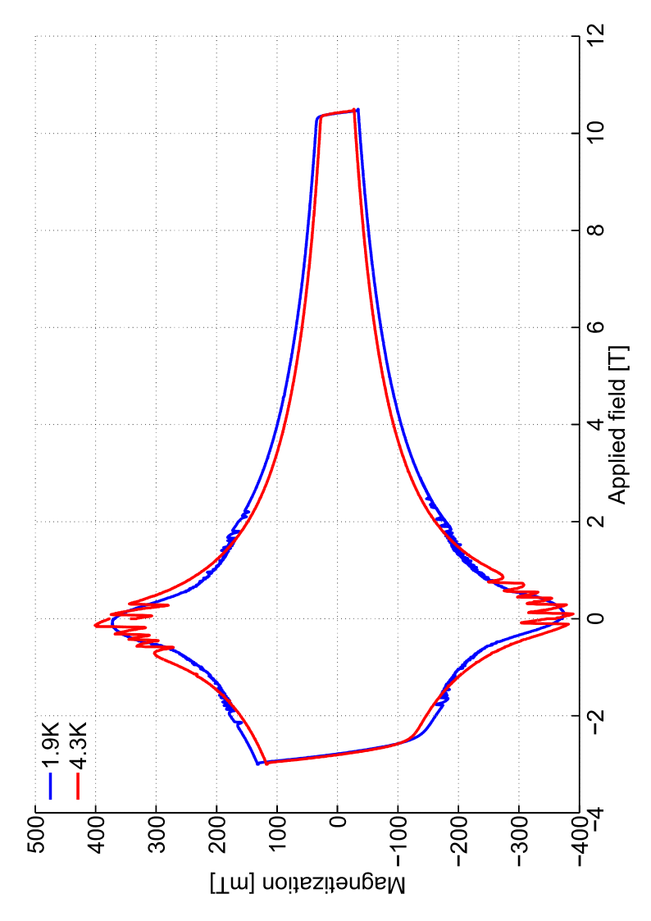
Magnetization of the 127 RRP Wire
Billet 00012 (A03)
Billet | DM (3 T, 1.9 K)
11 | 303
12 | 300
13 | 297
15 | 303
16 | 304
Magnetization Measurements are carried out only at CERN
The first 5 billets shipped to CERN were measured and, as expected, they showed a good reproducibility of the measured values

Slide 14
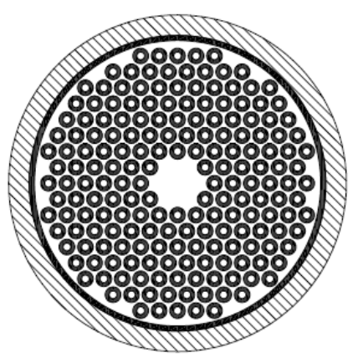
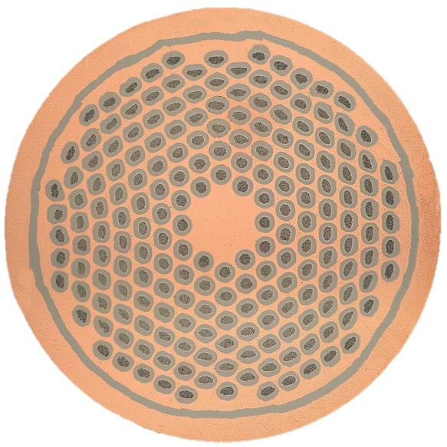
The Bundle-Barrier PIT wire
Additional Nb barrier around the filaments’ bundle
Drastically reduced the effect on the Residual Resistivity Ratio (RRR) of:
mechanical deformations
The Heat Treatment (HT) cycle
Already a slightly larger critical current with respect to the previous generation of PIT wire; potential to further improve.
CERN/Bruker-EAS Collaboration for HL-LHC

Slide 15
Status of the RRP wire Procurement 1/2
Received 73.660 km out of the 360 km ordered:
64.68 km – in pieces of 840 m → 77 piece lengths
3.85 km – in pieces of 550 m → 7 piece lengths
5.130 km – in pieces of 190 m → 27 piece lengths
Procurement limited in 2016 because of problems on the Nb raw material procured by OST for the sub-element diffusion barrier
NbB particles that produce small tears in the barrier (low RRR)
This problem never occurred in the past
Most likely a new Nb ore source
Established a polishing procedure that allows identifying particles in samples taken during processing of the ingot (and at final stage); OST is trying to replicate the technique so they may independently verify if necessary

Slide 16
Status of the RRP wire Procurement 2/2
Recovery Plan (Best Guess by Mike Field OST):
Received 100.8 km of wire for 3 dummy coils
good I_{c} , low RRR
Series Wire: Financial Committee December 2016

Slide 17
Status of the PIT wire Procurement
Produced 65 km of bundle-barrier PIT wire for models
Long piece lengths: 96 % above 840 m (CERN unit length) and 86 % above 1680 m (two times CERN unit length)
Ordering 220 km (march 2016 Financial Committee) of wire for prototypes (production already started)
Series Wire: Financial Committee December 2016

Slide 18
Conclusions
For the RRP prototype and series magnets the 108/127 layout will be used
CERN has received 73.660 km of the 108/127 RRP out of the 360 km ordered (fulfil RRP prototype needs)
Good wire performance
OST experienced a problem in the procurement of the raw material for the diffusion barrier of the sub-element; that will limit the wire procurement in 2016
The problem was identified and a recovery plan established, the foreseen delay will not have an impact on the cabling schedule
In collaboration with CERN, Bruker-EAS has developed a new PIT conductor that has solved the problem of RRR degradation due to: 1) mechanical deformation; 2) overreacting the superconductor
The bundle barrier PIT will be used for the PIT prototype;
produced 65 km that will be used for models (long piece lengths)
Finalizing a contract for 220 km (production already started)
Series Wire (RRP & PIT) : Financial Committee December 2016

Slide 19
Thank You For Your Attention !
For the RRP prototype and series magnets the 108/127 layout will be used
CERN has received 73.660 km of the 108/127 RRP out of the 360 km ordered (fulfil RRP prototype needs)
Good wire performance
OST experienced a problem in the procurement of the raw material for the diffusion barrier of the sub-element; that will limit the wire procurement in 2016
The problem was identified and a recovery plan established, the foreseen delay will not have an impact on the cabling schedule
In collaboration with CERN, Bruker-EAS has developed a new PIT conductor that has solved the problem of RRR degradation due to: 1) mechanical deformation; 2) overreacting the superconductor
The bundle barrier PIT will be used for the PIT prototype;
produced 65 km that will be used for models (long piece lengths)
Finalizing a contract for 220 km (production already started)
Series Wire (RRP & PIT) : Financial Committee December 2016

