Slide 1
LARP in HL-LHC AUP Times
G. Apollinari
Fermilab

Slide 2
LARP during HL-LHC AUP
Two phases:
Transition phase FY18-FY19
Transition to production mid-year in FY18
Support needed to complete and test Cold Mass prototype and CC Pre-Series Production within LARP (FY18-FY19)
Asymptotic phase FY19-FY24
After “spin-off” of HL-LAUP, LARP reverses from “Risk Reduction” Program to original “LHC R&D” mandate

Slide 3
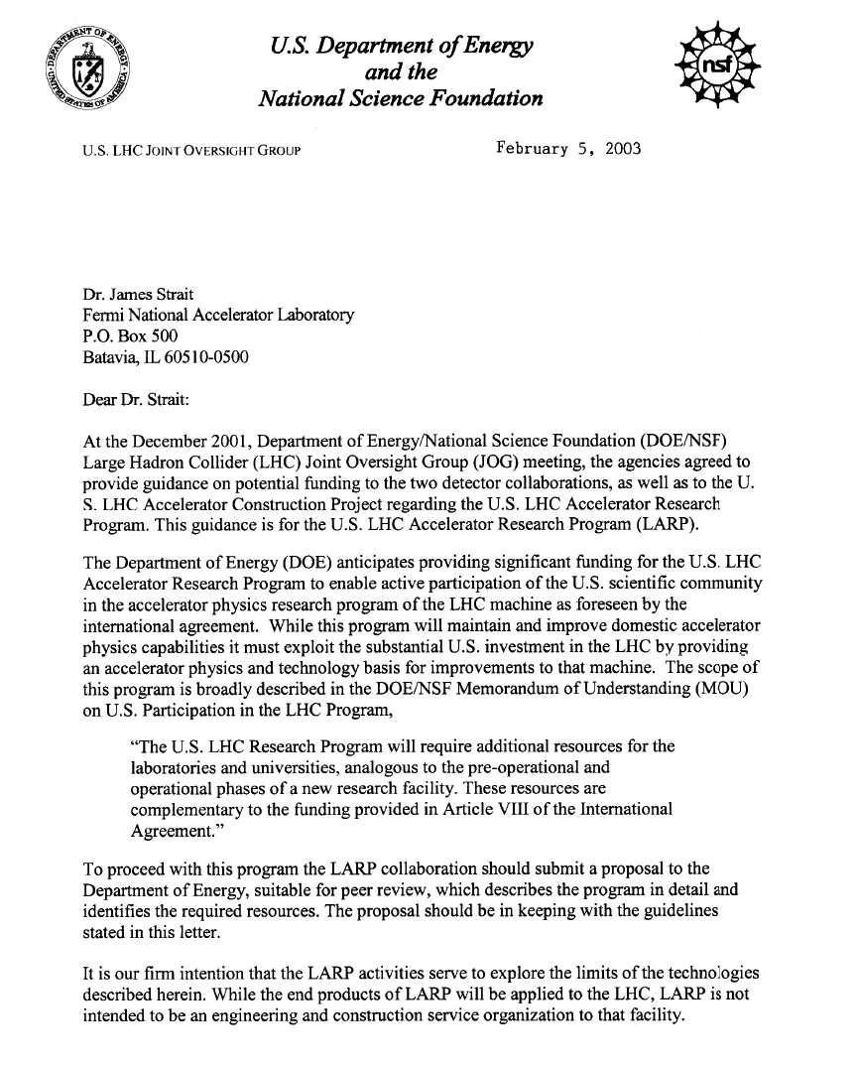
Origins of LARP (2003)
DOE guidance for LARP received on February, 2003
NSF/DOE supported
Follow in the foot-prints of HEP Experimental Physics endeavors:
Enable US scientists to maintain and expand world-wide technological leadership in accelerator physics and superconducting magnets
LARP goal to increase physics productivity by:
Commissioning of Triplets
Advanced beam Diagnostic
Simulation Studies

Slide 4
LARP Seeds for the Future (2003)
Need for R&D Program on elements of National Leadership acknowledged from the get-go.
LARP not replacing existing Base R&D Programs at various Laboratories.
Specific R&D Programs aimed at enhancing machine capabilities beyond baseline deemed appropriate
but not the conversion of these programs into “deliverables”
These seeds are still pertinent for R&D within the LARP framework for HL-LHC and HE-LHC !

Slide 5
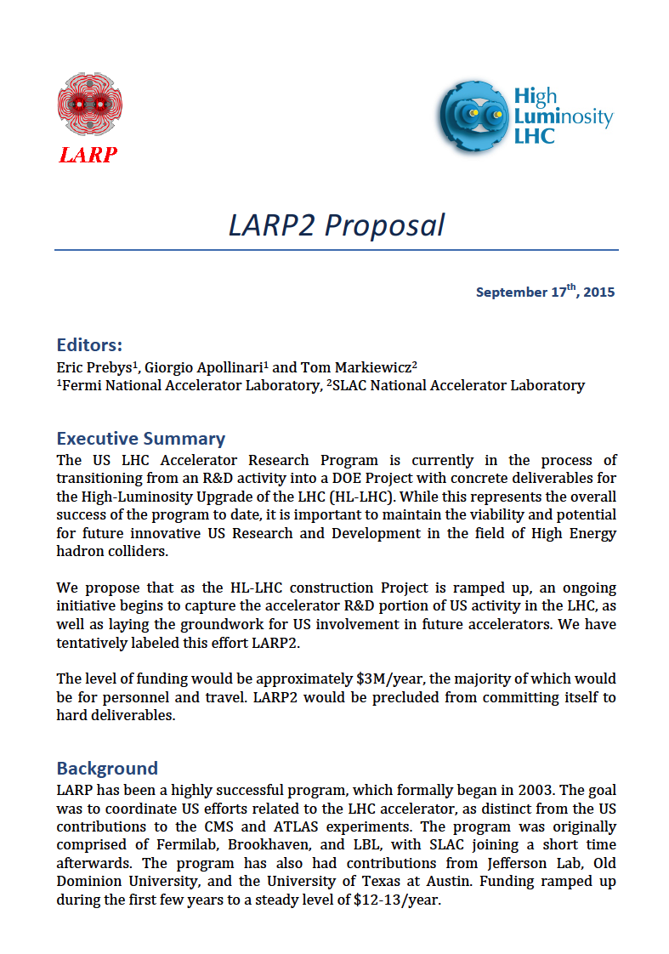
LARP in 2019 and beyond
Basic Idea
Initiative to capture US Acc. R&D at the LHC toward the end of HL-LHC AUP.
Focus on intellectual contributions and test at LHC
Support of Conference/CM Attendance, Toohig Fellows, LTV, R&D@HL-LHC
Plan
Satellite ½ workshop at next HiLumi/LARP@SLAC (May ‘16).
Program driven by US interests, but will solicit feedback and support from CERN

Slide 6
Basic Guidance and “Hoped-for” Outcome
Ground Rules:
Each proposal should be presented with few motivational arguments for execution in FY19-onward at the HL-LHC
Proposal should entertain 3 levels of funding (low-medium-high, roughly sized at 100k$/y-250k$/y and 500k$/y) in general terms (FTEs, small M&S items, travel) keeping in mind that if indeed this program happens at all, overall funding is likely to be rather limited.
Each proposal should be kept to ~15 10 min, to allow at least a similar amount of time for discussion.
Outcome
Document with ~single page description of different activities discussed this afternoon and a table of funding requests.
Ready by mid-June, for “formal” presentation in short talk at July DOE Review of LARP.
Get on the “FY19 and beyond” funding cycle in time.

