Slide 1
E-beams for LRBB Compensation and Advanced Halo Control in LHC upgrades
M. Fitterer, G. Stancari, A. Valishev
Joint LARP CM26/Hi-Lumi Meeting

Slide 2
Research Topics
Long-range beam-beam (LRBB) compensation
Hollow e-beam for halo control
E-lens
Topic 1:
Topic 2:
Topic 3:
Development of LRBB scenarios for LHC upgrades
Development of e-lens for LRBB compensation
Research on hollow electron beam collimation

Slide 3
Collaborations and Expertise
Expertise in high current e-lenses, beam-beam effects and halo control
Expertise in PIC code development for e-beams and numerical simulations
Expertise in high current e-lenses and magnetized beams
Synergy with halo monitoring, essential for all proposals
Notes:
LBL: Jean-Luc Vay

Slide 4
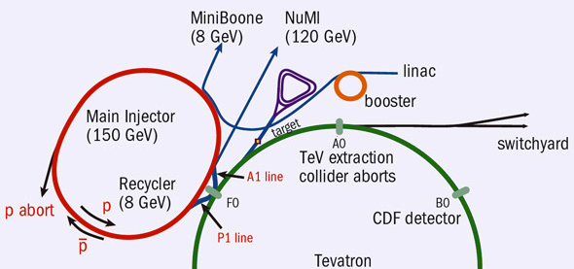
Overlap with US projects
e-lens to generate non-linear field:
new concept of non-linear integrable optics could allow for a further increase in beam intensity
to be tested in IOTA and, if successful, to be applied to a new RCS to replace current Booster (LBNF)
electron cooling:
research of electron-cooling for high energy beams (e-RHIC @ BNL and MEIC @ Jefferson LAB) could as well profit from proposed e-lens studies
Neutrinos
Neutrinos
LBNF
(120 GeV)
LBNF
(120 GeV)
Courtesy E. Prebys
Courtesy E. Prebys
Booster

Slide 5
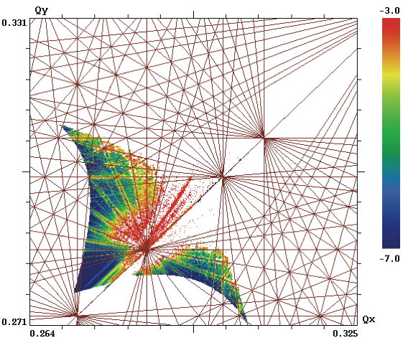
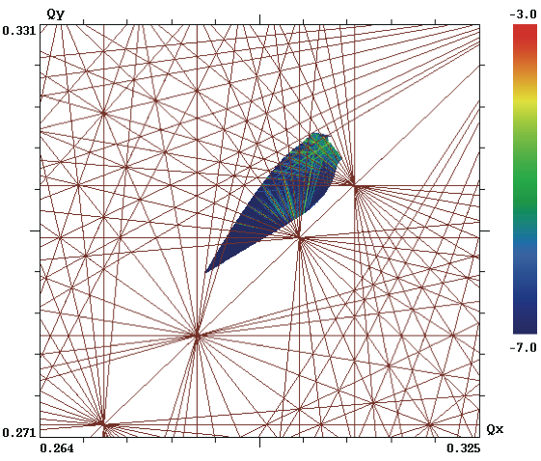
Research Topic 1 Development of LRBB scenarios for LHC upgrades
Baseline HL-LHC scenario (N_{b}=2.2x10¹¹,β*=15/15cm,Θ_{x,full}=450 µrad) without (left) and with (right) LRBB compensation [*]
[*] S. Fartoukh, A. Valishev, Y. Papaphillippou., D. Shatilov, PRSTAB 18,121001
Notes:
message: bblr compensatino is essential in order to reduce the crossing angle

Slide 6
Research Topic 1: Development of LRBB scenarios for LHC upgrade
Motivation: Recover luminosity performance of HL-LHC without relying on full crab cavity performance with e.g.:
flat beam operation (RLIUP plan B, [1])
reduction of crossing angle in order to relax crab cavity parameters (e.g. staged crab cavity installation) [2]
[1] S. Fartoukh, 5th HL-LHC coordination meeting (2013)
[2] R. Tomas, HL-LHC alternatives, 4th Joint HiLumi LHC-LARP Annual Meeting (2014)
Notes:
without crab cavities: 7% performance loss
wire would only improve peak pile-up from 1.8s/mm to 1.6/mm

Slide 7
Research Topic 1: Development of LRBB scenarios for LHC upgrade
Activities:
support demonstration experiment with wires in 2018 [3] (numerical simulations + data analysis):
scientific effort: 0.3 FTE + travel
develop scenarios for LHC upgrades (numerical simulations)
scientific effort: 0.3 FTE + travel
[3] Y. Papaphilippou, Proposal for the experimental scenario, Workshop on Measurements of Long Range Beam-Beam Effects in the LHC, Lyon, France

Slide 8
Research Topic 2 Development of e-lenses for LRBB compensation
14 σ
6σ
WIRE
ELECTRON BEAM
3σ
PROTON BEAM
16.0 mm
5.8 mm
0.8
0.4
2.2
2.2
0.2
Notes:
message: e-beam can be placed close to the p-beam, beta*=15/15, beta_wire=1605

Slide 9
Research Topic 2: Development of E-lenses for LRBB compensation
Motivation: enable LRBB schemes for high-power and high-energy beams [4]
LRBB can be compensated with wires installed in the high luminosity experiment IRs
for an effective compensation, the wires have to be installed close to the beam -> due to machine protection and impedance effects, this is mostly not feasible for high-power or high-energy beams
wires are ideally pulsed in order to compensate PACMAN bunches
E-lens can fulfill all the above requirements, however further R&D needed to reach required parameters!
[4] A. Valishev et al.,Electron Lens as Beam-Beam Wire Compensator in HL-LHC, FERMILAB-TM-2571-APC

Slide 10
Research Topic 2: Development of E-lenses for LRBB compensation
Activities:
study conceptual design and current limitations [5]:
scientific effort: 0.3 FTE
extend electron gun current range and test new materials:
scientific effort: 0.1 FTE
technical effort: 0.3 FTE
materials & supplies: 50 k$
contribute to CERN test stand:
scientific effort: 0.1 FTE + travel
technical effort: 0.1 FTE + travel
[5] G. Stancari, Status of technical design report on BBLR compensation with e-lenses, Workshop on Measurements of Long Range Beam-Beam Effects in the LHC, Lyon, France

Slide 11
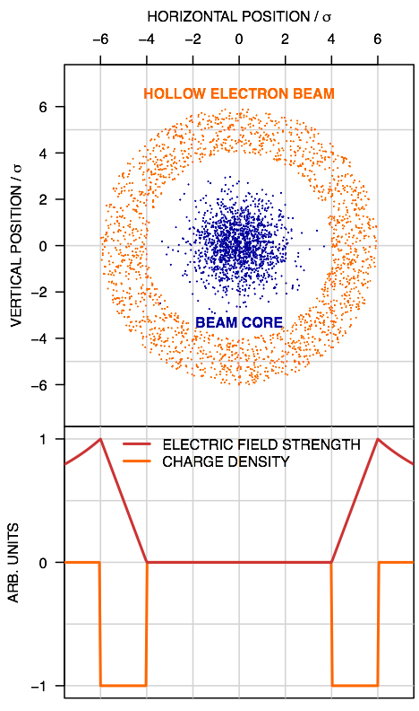
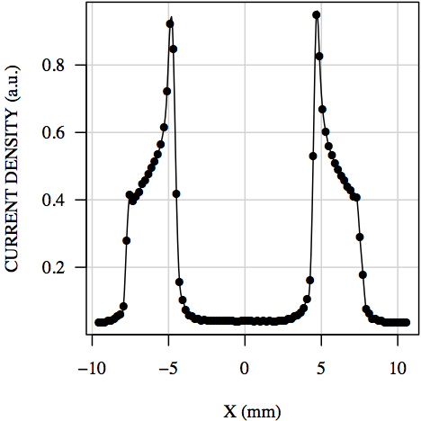
Research Topic 3 Hollow e-beam collimation
Notes:
message: if project, then we want to get from an already good profile with good current to an even better profile with higher current in order to scrape faster and to apply it to higher energies

Slide 12
Research Topic 3: Hollow electron beam collimation
Motivation: extend halo control capabilities to higher intensities and energies
concept has been proven experimentally (Tevatron [6]) and in simulations ([7,8,9])
for an application at higher intensities and energies, research is still needed in direction of higher e-beam currents and further optimization of the beam profile
overlap with research of e-beams for LRBB compensation
[6] G. Stancari et al. ,Phys. Rev. Lett. 107, 084802 (2011)
[7] G. Stancari et al. , FERMILAB-TM-2572-APC
[8] V. Previtali, FERMILAB-TM-2560-APC;
[9] A. Valishev, FERMILAB-TM-2584-APC

Slide 13
Research Topic 3: Hollow electron beam collimation
Activities:
higher current guns for faster scraping or operation at higher energies:
scientific effort: 0.1 FTE
technical effort: 0.3 FTE
materials & supplies: 50 k$
dynamics of high-intensity magnetized hollow beams for precise control of beam profile and e-lens bends:
scientific effort: 0.3 FTE
investigate axially symmetric configuration:
scientific effort: 0.1 FTE
Note: If e-lens not in HL-LHC baseline, support CERN design with scientific and technical effort (1 FTE)

Slide 14
Summary
E-lens
LRBB compensation
halo control
1
2
3
LRBB scenarios for LHC upgrades
e-beams for LRBB compensation
e-beams for halo control
Activities:
conceptual design, current limitations
e-guns, new materials
CERN e-lens test stand
Resources:
scientific: 0.5 FTE + travel
technical: 0.4 FTE + travel
M&S: 50 k$
Collaborations:
LBNL, BNL
Activities:
high current e-guns
dynamics of high-intensity hollow e-beams
axial symmetric configuration
Resources:
scientific: 0.5 FTE
technical: 0.3 FTE
M&S: 50 k$
Collaborations:
LBNL, BNL
Activities:
2018 LRBB experiments
LRBB LHC upgrade scenarios
Resources:
scientific: 0.6 FTE + travel
$ 200 k/year
$ 350 k/year
$ 290 k/year

Slide 15
Thank you for your attention!

Slide 16
Hollow e-lens studies if e-lens not part of the US-HiLumi project
support CERN with scientific and technical effort:
numerical and experimental studies of collimation system performance with hollow e-beams:
scientific effort: 0.3 FTE + travel
numerical studies of magnetized hollow e-beams:
scientific effort: 0.3 FTE
contribution to CERN test stand and e-lens design:
scientific effort: 0.1 FTE
technical effort: 0.3 FTE

Slide 17
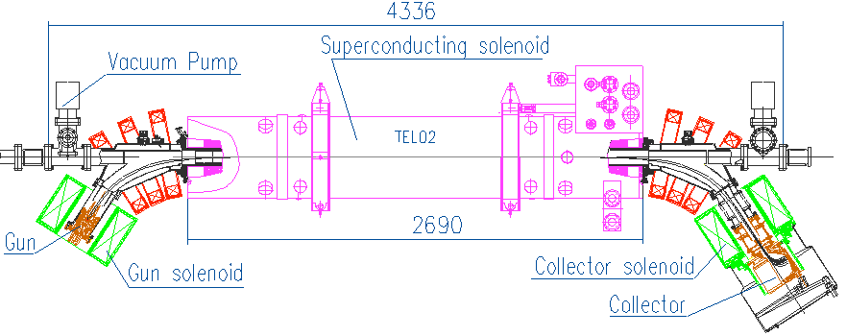
E-lens – what’s an e-lens
Example: Tevatron electron lens
main solenoid
circulating beam
electrons
overlap region
collector
5-kV, 1-A electron gun,
200-ns rise time
gun solenoid
collector solenoid
pulsed, magnetically confined, low-energy electron beam
Circulating beam affected by electromagnetic fields generated by electrons
Current-density profile shaped by cathode and electrode geometry
Stability provided by strong axial magnetic fields

Slide 18
Halo control for collimation
Why is halo control important for future colliders?
LHC, HL-LHC and HE-LHC (High Energy) represent large increase in stored beam energy + indication for overpopulated tails
very good performance of collimator system so far, but …
about 40 fills lost in 2012 due to instabilities
minimum design HL-LHC lifetimes are close to plastic deformation of collimators
reduction of losses in case of earthquakes or human activities leading to vibrations (Geothermie 2020, FCC construction?)
quench limits, magnet damage, or even collimator deformation will be reached in case of fast crab cavity failure
=> controlled removal of halo is required for safe beam operation
 | Tevatron | LHC nominal | HL-LHC
stored beam energy | 2 MJ | 362 MJ | 692 MJ

Slide 19
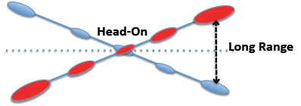
LRBB compensation
HL-LHC challenges:
LRBB encounters every 25 ns (around 30 encounters/IP)
control of non-linearities induced by LRBB require a minimum crossing angle of >12 σ
=> loss in instantaneous luminosity and requirement of large aperture IT
=> current solution: large crossing angle + crab cavities to compensate luminosity loss due to crossing angle + large aperture IT

