Slide 1
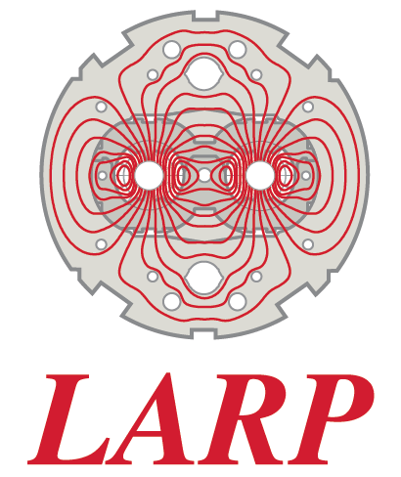
HOM Impedance Update for RFD and DQW Crab Cavities
Zenghai Li
for UK, BNL, ODU, SLAC Crab Cavity Teams
LARP CM26/Hi-Lumi SLAC May 19, 2016

Slide 2
Content
HOM impedance overview
  RFD
  DQW
  What further improvement is needed for LHC ?
  On operating voltage stability
  cavity failure model for beam dynamics study?
  RF-Mechanical mode coupling, transfer function of external excitation to RF mode

Slide 3
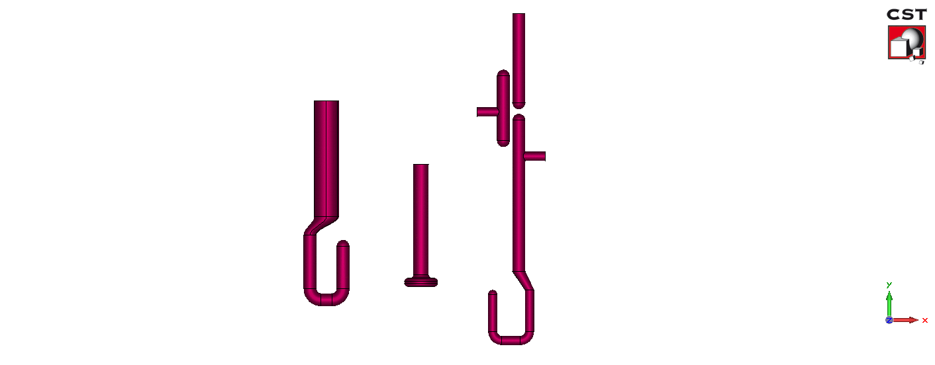
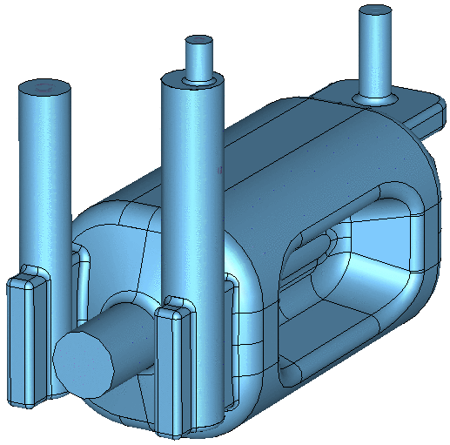
RFD Cavity
FPC
Outer diameter – 62 mm
Inner diameter – 27 mm
Interface to LHC main coupler design
Q_{L} = 5.0×10⁵
Hook shaped coupler reduced RF heating → 69 W
FPC
Coupling Hook
V-HOM Coupler
V_HOM
Doesn’t couple to fundamental mode
  No filter necessary
Damps vertical dipole modes and some accelerating modes
H-HOM Coupler
H-HOM High Pass Filter
H_HOM
Horizontal HOM high pass filter to cut off fundamental mode
Couples to horizontal dipole modes and accelerating modes
Both options damp adequately to meet impedance requirements

Slide 4
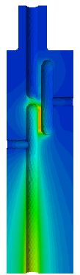
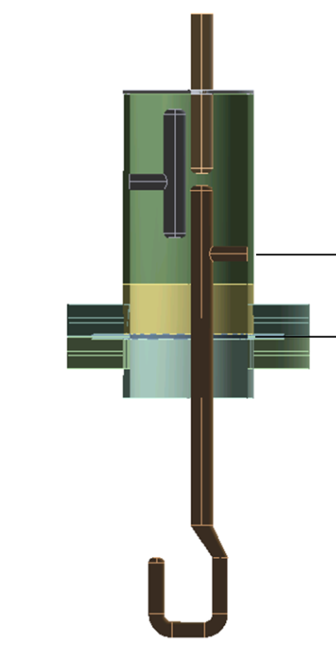
RFD Cavity H-HOM – High Pass Filter
50 Ω probe (Cu)
High pass filter
  Damps horizontal deflecting and accelerating modes
  Demountable
  Low fields in the filter
Rejection of operating mode
T (Nb)
Hook (Nb)
Dimensions
  Center rod diameter: 14 mm
  Larger cylinder diameter: 74 mm
  50 ohm port: 14mm/32.2mm
High pass filter transmission
S₂₁ [dB]
Frequency [GHz]

Slide 5
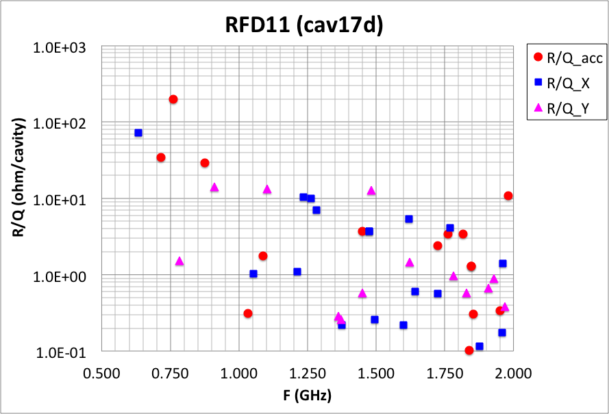
RFD Cavity HOM R/Q
Shunt Impedance:
Transverse Impedance:

Slide 6
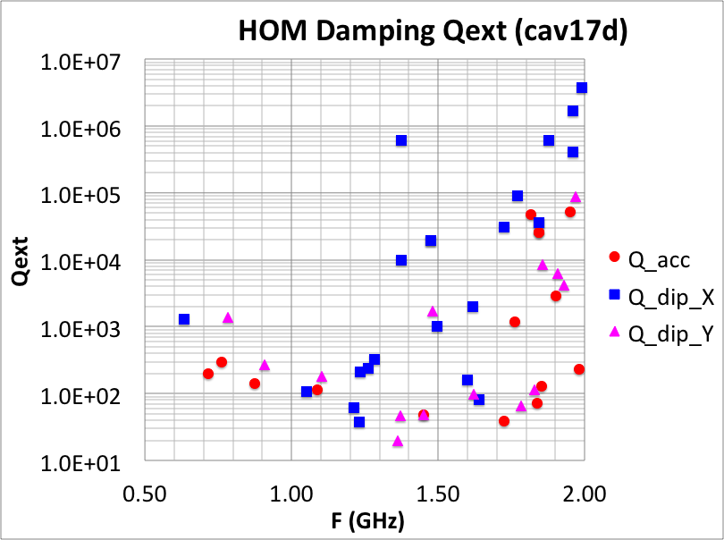
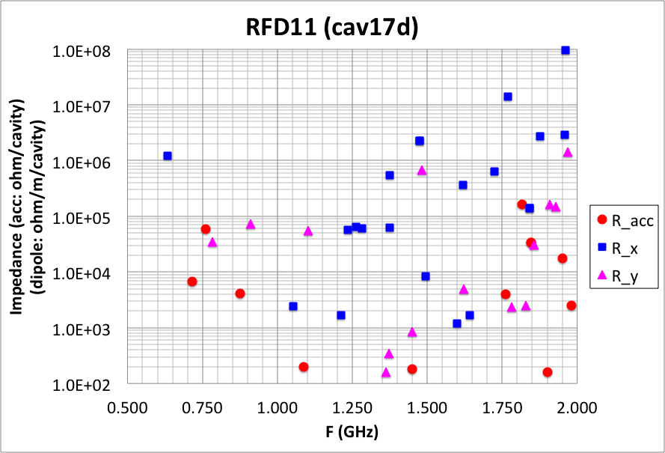
Q Reduction of High Impedance Modes
(as of Feb 2015 Engineering Review)
Modified H-HOM hook and V-HOM probe
  → Reduced impedance by 1-2 orders of magnitude

Slide 7
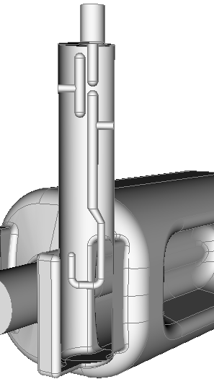
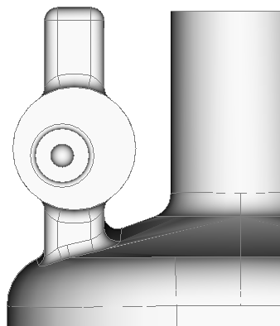
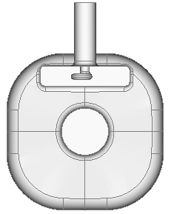
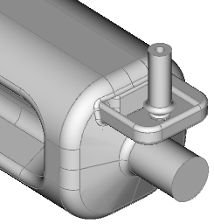
Improved HOM Damping
Horizontal HOM Coupler
Coupling hook optimized
30 degree hook orientation
No change in filter elements
30deg
Vertical HOM Coupler
7 mm offset incorporated into the pickup tip to enhance coupling to the dipole modes at around 2GHz
Small RF power leakage through the coupler, ~1.5W, due to asymmetry

Slide 8
RFD Cavity HOM Damping and Impedance SPS prototype cavity
Solid lines are the impedance budget for dipole HOMs (blue) and accelerating HOMs (red) respectively
Damping scheme meets the impedance requirement (2011)

Slide 9
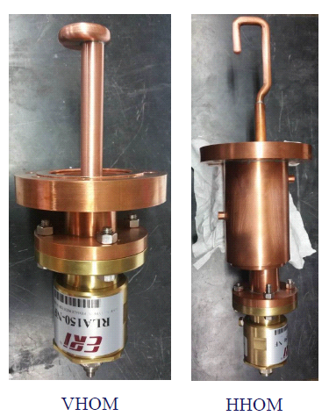
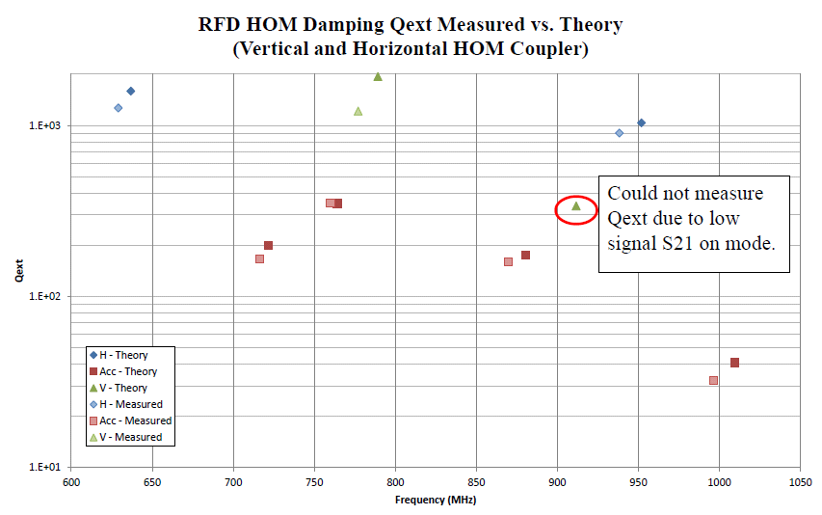
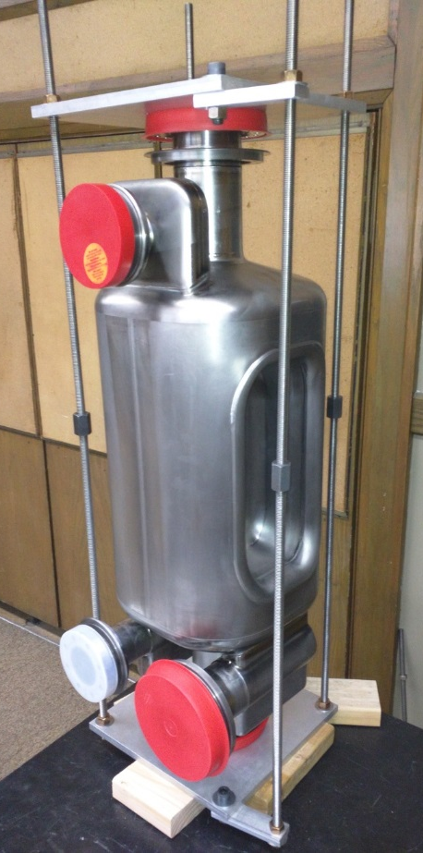
RFD Cavity HOM Coupler Measurements
Courtesy: Adam Rogacki – Niowave Inc.
HOM measurements obtained up to 1 GHz from the stacked RFD cavity
Both frequency and Q_{ext} were lower
  Possibly due to longer center body
Future work:
  Further measurements up to 2 GHz
  Nb couplers and measurements with a test box
Cu
Prototypes of HOM Couplers

Slide 10
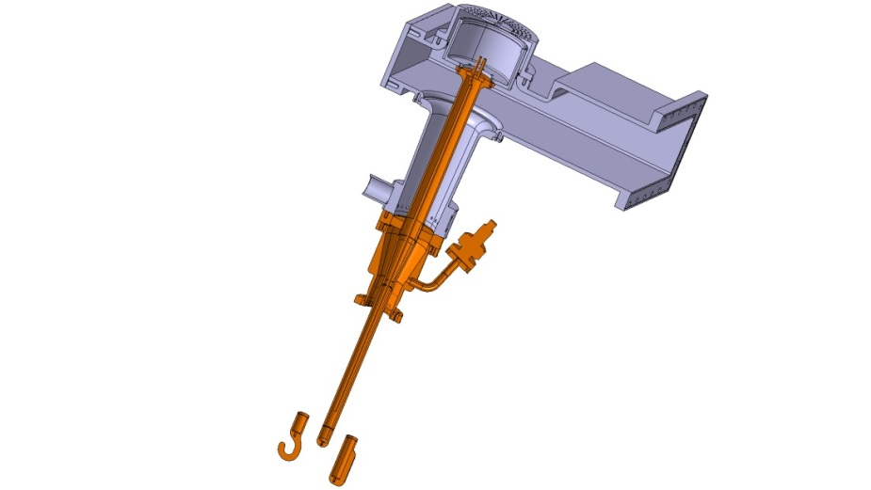
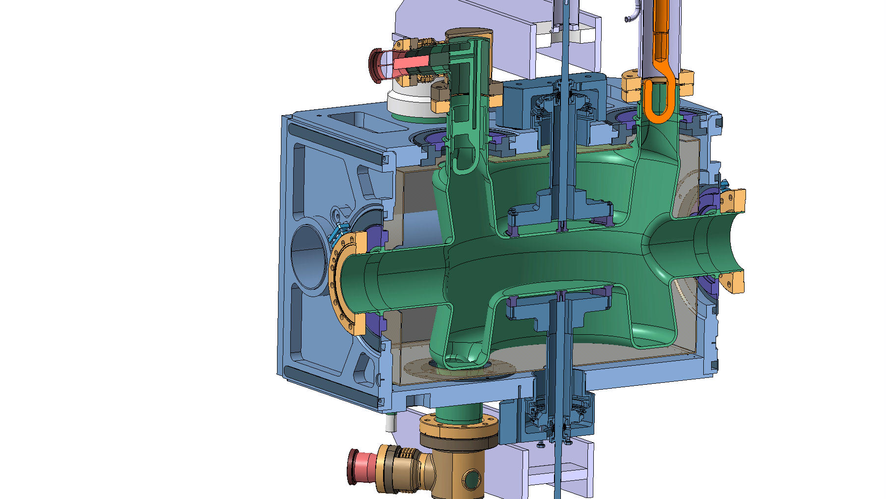
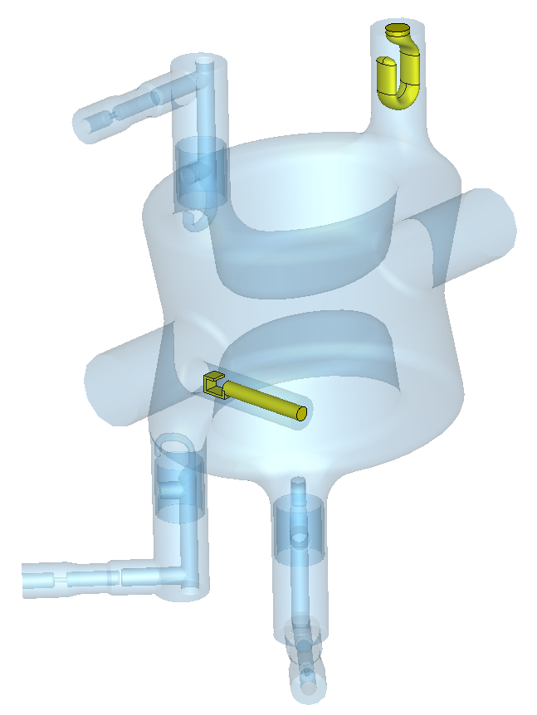
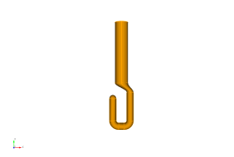
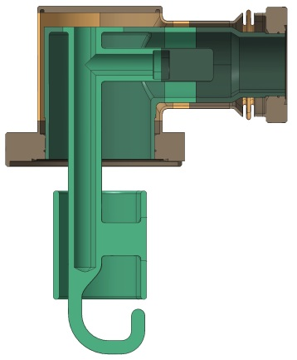
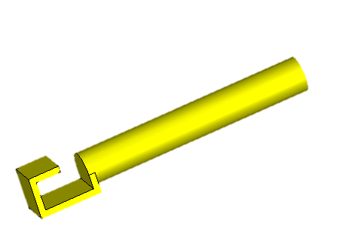
SPS DQW Cavity
Hook-type antennae for well coupling with magnetic field.
Detachable from cavity to ease installation.
Active cooling for FPC and HOM down to hook bending.
FPC antenna (Cu):
Qext ^{f(0)} is 5.3x10⁵, 40kW enough to feed cavity. Optimized design to reduce P_{diss} on hook tip.
HOM
FPC
PU
HOM
HOM coupler with high pass filter (Nb)
HOM
Pick-up antenna (Cu):
Qext ^{f(0)} is 1.6x10¹⁰, extracts about 1.5W of fundamental mode.
Notes:
Limited He → limited heat load budget: special attention paid to thermal loads
Located on port opened on beam pipe to avoid breaking cavity symmetry.
Thermal losses in RF-seal Cu gaskets considered to determine port length.
40 kW power supply is enough to feed the cavity

Slide 11
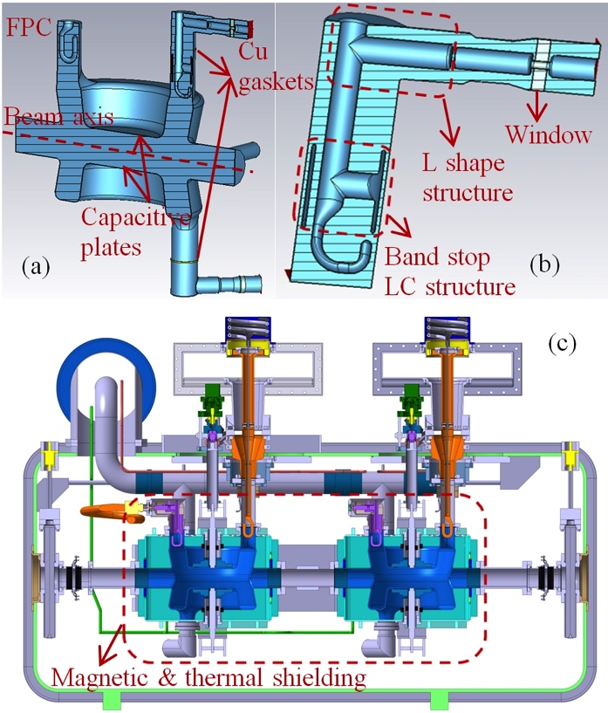
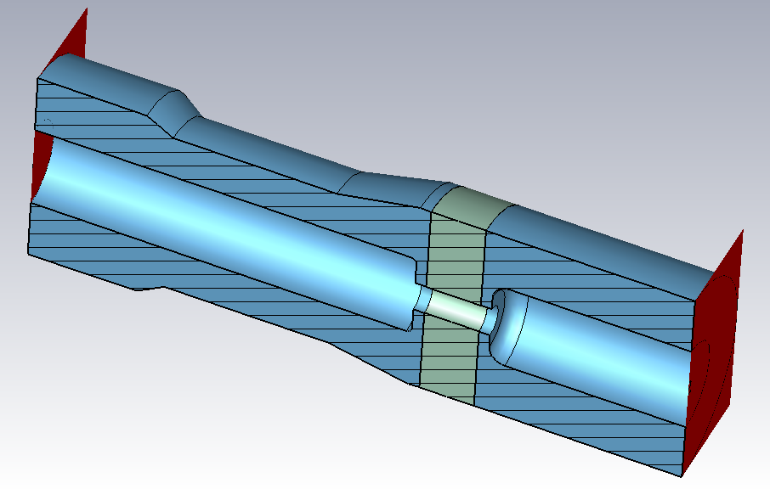
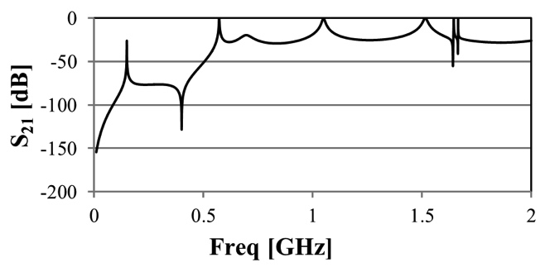
DQW Cavity HOM Filter Design
HOM window

Slide 12
DQW Cavity – Impedance with original PU antenna
(as of May 2015 HOM Review)
high impedance
Pick up antenna (5/2015)
modified to lower Qext of 1.75 GHz mode
(next page)

Slide 13
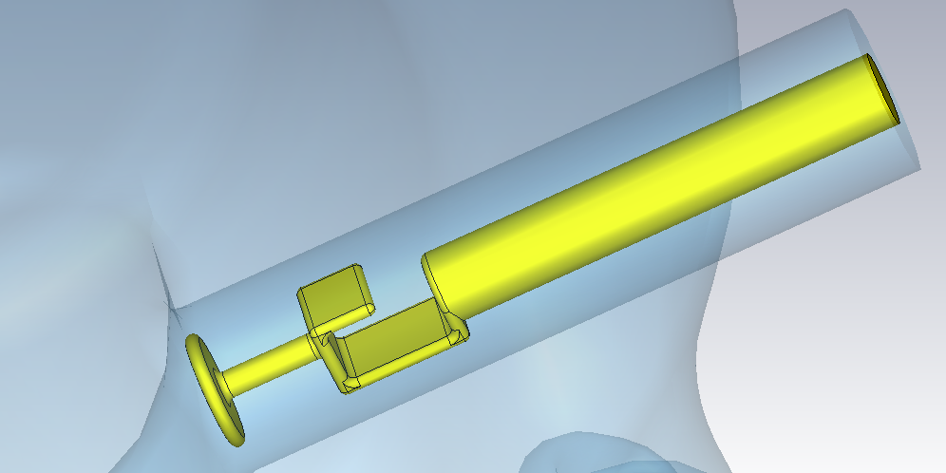
DQW Cavity New PU design
Mitigation of High Qext Mode at 1.75 GHz
Add a “T” on top of the original PU coupler
To reduce Qext of mode at 1.75 GHz

Slide 14
DQW Cavity
HOM impedance with Modified Pick Up Antenna

Slide 15
DQW Cavity
RF properties with Modified Pick Up Antenna
 | Modified PU | Original PU
Qext @ 1.75 GHz (from PU and HOM couplers) | 9616 | 7.27e6
Horizontal shunt impedance (Ω/m/cavity, in circuit definition) | 8.39e5 | 6.34e8
Qext @ 400 MHz (from PU coupler) | 1.6e10 | 1.6e10
Pickup power at 3.34MV (W) | 1.57 | 1.57
Power dissipation at PU at 400MHz (for 20nΩ Nb PU) | 26.5µW
With only the added “T” to be Nb | 10mW

Slide 16
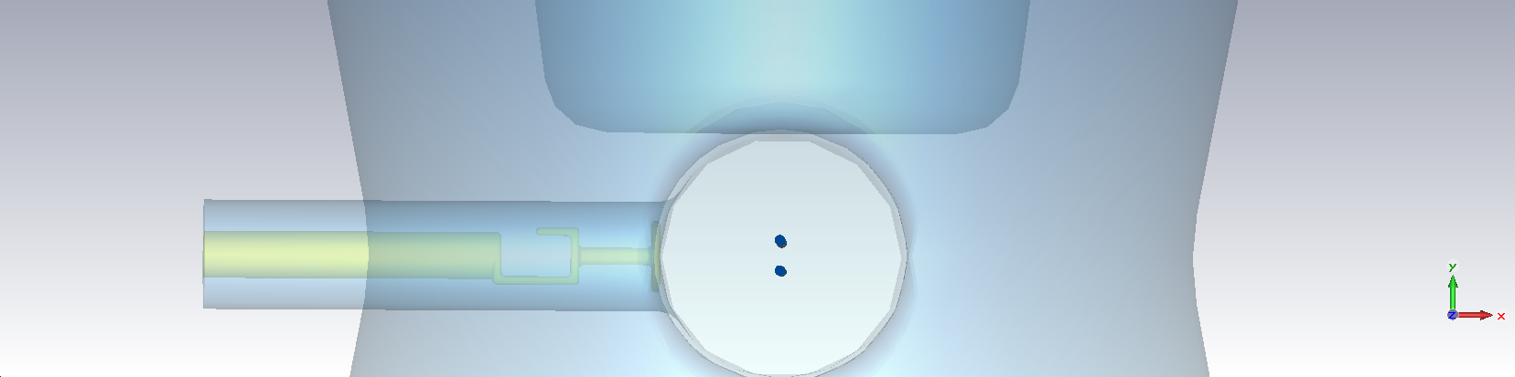
CST Impedance Calculations
(Graeme Burt)
As some of the modes have high Q, it is unlikely that we will have a long enough wakelength to resolve all the modes.
Use different wakelengths as a check of convergence.
Currently working on if the variation in impedance with wakelength can be used fit to a curve to get final impedance.
Also looking into pole fitting.
Use two beams to separate dipole components

Slide 17
RFD, DQW Cavity Impedance on Beam Dynamics
See N. Biancacci’s talk at HL-LHC TC, 05-11-2015 for details
Next two slides are from N. Biancacci’s talk

Slide 18
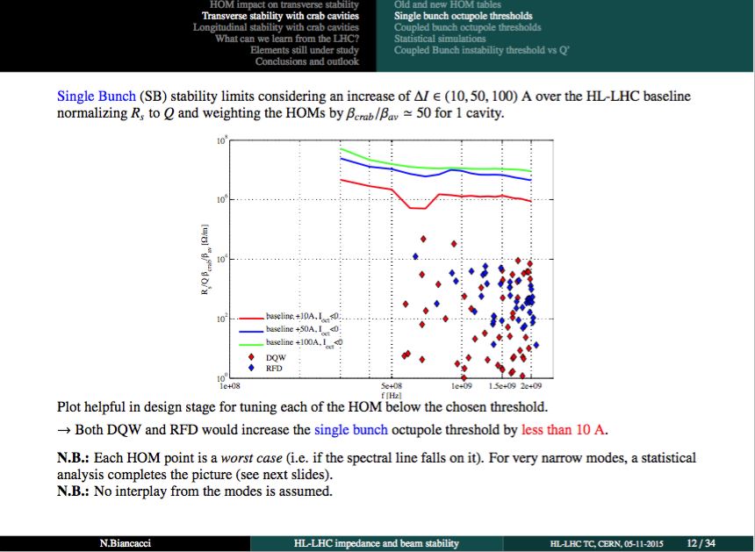
Single Bunch (CS) stability limits
N. Biancacci
HL-LHC TC, 05-11-2015

Slide 19
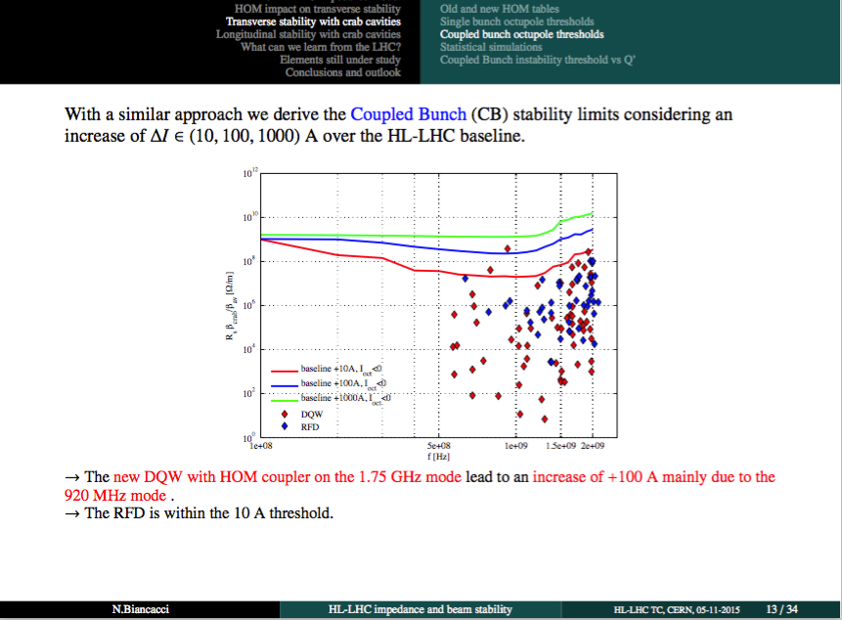
Coupled Bunch (CB) stability limits
N. Biancacci
HL-LHC TC, 05-11-2015

Slide 20
Operating Mode Voltage Stability ?
Voltage stability modeling
Failure mode modeling
Microphonics driven frequency and phase jitter
Resonance coupling of mechanical mode (noise) to RF mode
Modeling external excitation
Multi-physics solvers developed in ACE3P to model ME-RF coupled system
Cavity quench
  response time?
  amplitude?
  phase?
Quench model?

Slide 21
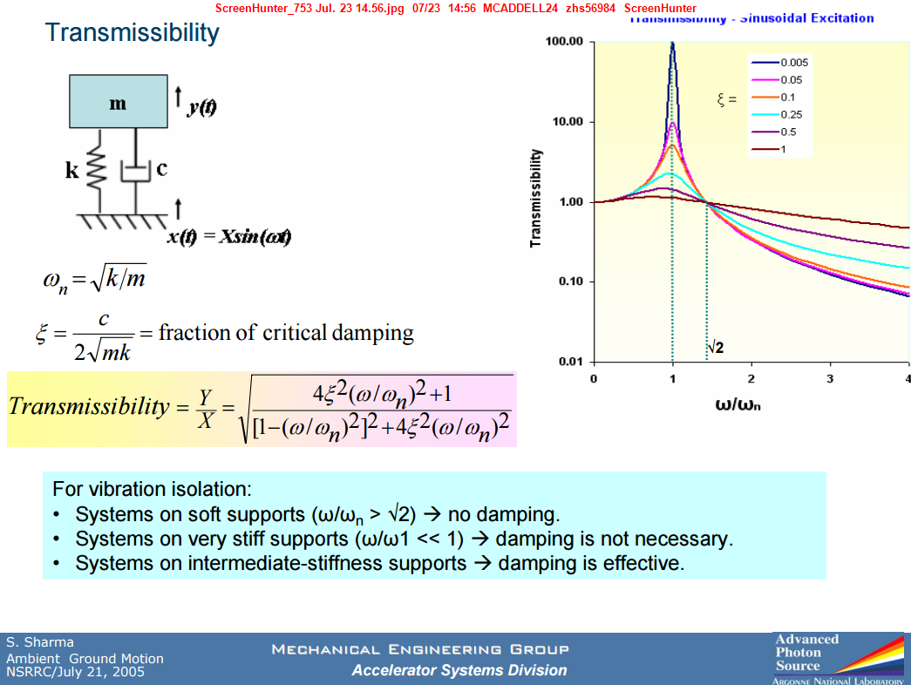
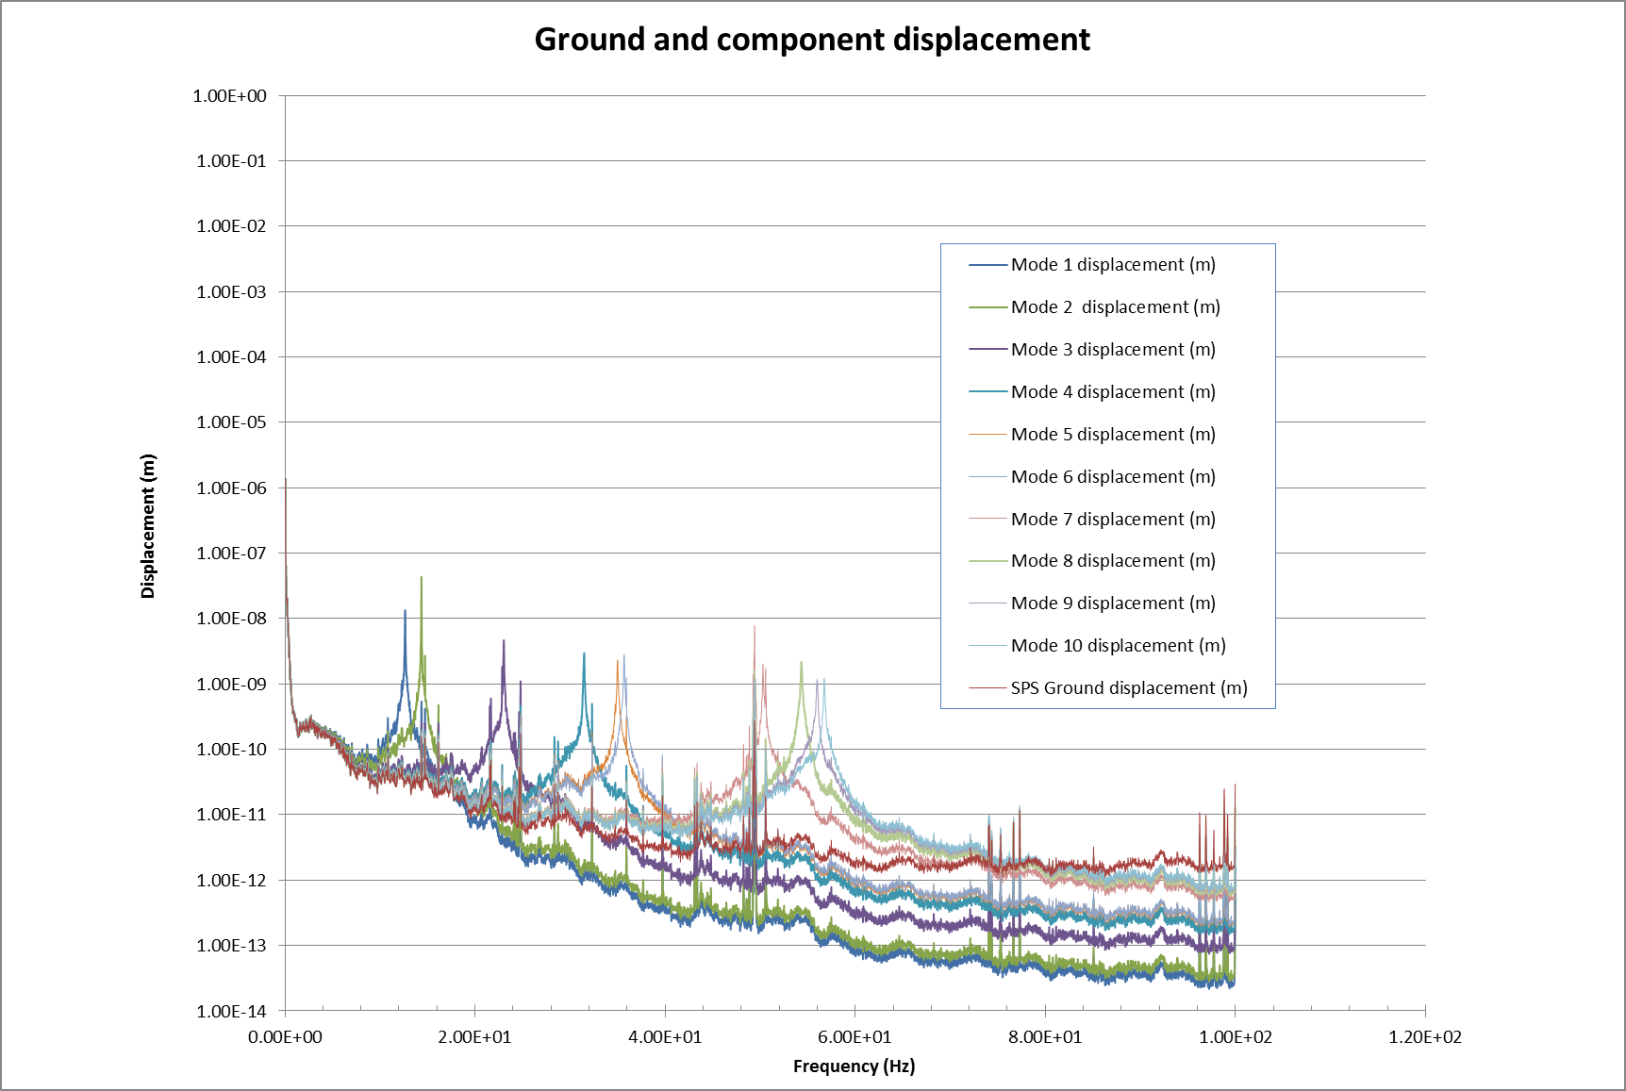
Response spectrum - SPS
Thomas Jones 10/11/15
Crab Cavity support system
Ground amplitudes are larger at lower frequencies, therefore we aim to increase the values of fundamental modes.
SPS has spike at 49.4Hz, close to the 50.3Hz mode of the tuner. There is some amplification but below 10Nm. This is at extremities of the tuner, actual cavity deflection is <1Nm.
This data is for the relatively quiet SPS area which was measured with Cryo OFF.
The next slide shows the results for using the Diamond PSD data, which can in this instance be taken as a worst case. Although, Diamond is still a relatively quiet site.
21

Slide 22
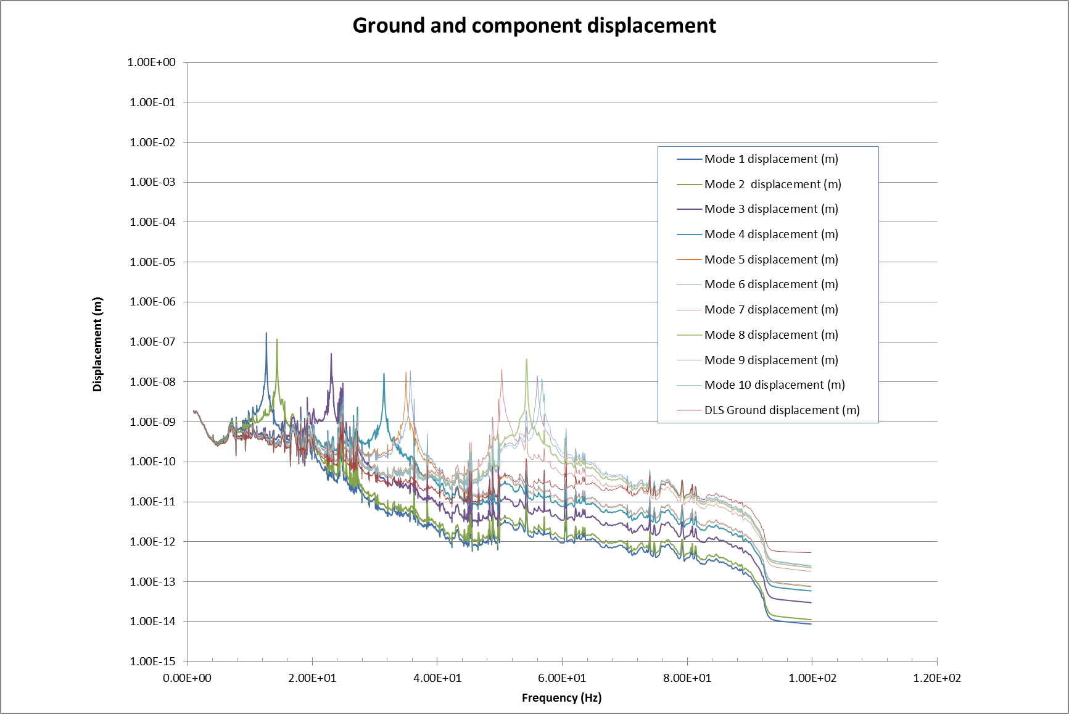
Response spectrum - DLS
Thomas Jones 10/11/15
Crab Cavity support system
Vibration amplitudes now as high as 170nm.
This highest amplitude will be at the extreme edges of the helium vessel/tuner.
At this mode there is no deformation of the cavity, it acts as one rigid body. Therefore detuning will be <1Hz.
22

Slide 23
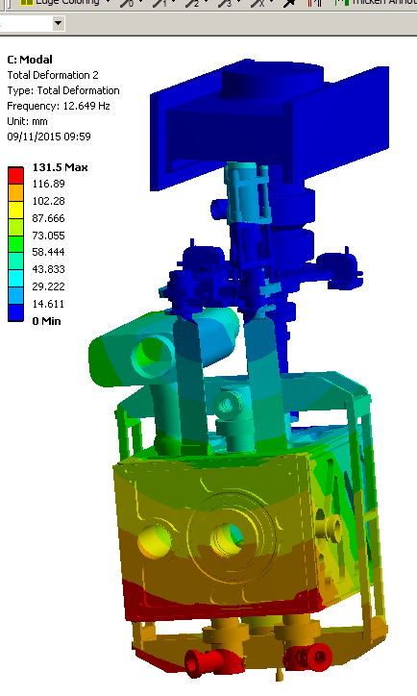
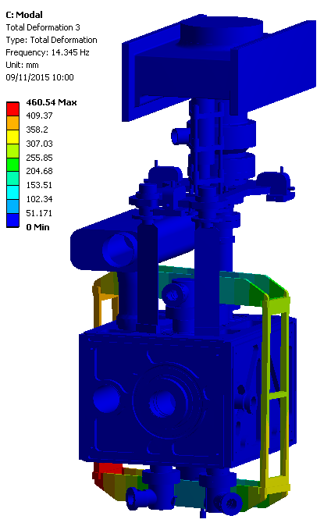
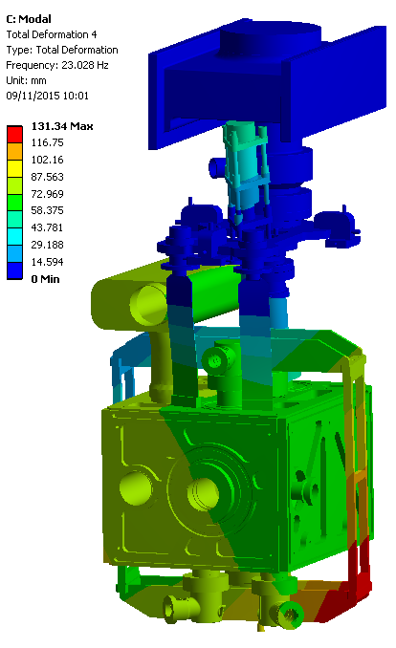
Modal result
Thomas Jones 10/11/15
Crab Cavity support system
Mode 1
Mode 2
Mode 3
23

Slide 24
Crab Cavity Multi-physics Analysis Using ACE3P
Have started modeling RFD dressed cavity
  Mode decomposition of LFD
  Transfer function of external mechanical vibration to RF mode (noise and tuner mode …)
Plan to apply analysis to DQW cavity/module
See Oleksiy’s talk next

Slide 25
Acknowledgements:
ODU – Subashini De Silva, HyeKyoung Park, Rocio Olave, Jean Delayen
CERN – Rama Calaga, Ofelia Capatina, Teddy Capelli, and the team
Alex Ratti - LBNL
Tom Nicol - Fermilab
STFC/UK – Graeme Burt, Tom Jones, Nik Templeton and the team

