Slide 1

Update of the stability limits including the effect of electron cloud, implications for machine and HW parameters (e.g. ramp rates)
Elias Métral for the instability team (and BE-ABP-HSC section)
Joint LARP CM26/Hi-Lumi Meeting, SLAC, 19/05/2016

Slide 2
Contents
Introduction
Beam stability from impedance model
Effect of beam-beam and ramp rates
Effect of noise
Effect of e-cloud
Effect of linear coupling
Conclusion

Slide 3
Introduction
Transverse instabilities are a concern based on the experience of the LHC Run 1 (2012 with 50 ns) and beginning of Run 2 (2015 with 25 ns)
2 questions since 2012 => Why do we need (at high energy) to use
  High chromaticities (~ +15 units)? A known/predicted mechanism is e-cloud at injection...
  ~ Max current in the Landau octupoles (max = 550 A), i.e. much more (factor ~ 5) than predicted from impedance only?
We have identified 3 possible mechanisms (so far) which could explain a factor ~ 5 increase in the required current of the Landau octupoles
  Noise => Already predicted by simulations but not measured yet. 1st BTF measurements and related Stability Diagram (SD) at injection made in 2015
  E-cloud => Already measured in MD but simulations still to come
  Linear coupling between the transverse planes => Already predicted from simulations and measured in MD

Slide 4
Introduction
In a machine like the LHC (and HL-LHC), not only all the mechanisms have to be understood separately, but (ALL) the possible interplays between the different phenomena need to be analyzed in detail, including the
  Beam-coupling impedance (with in particular all the necessary collimators to protect the machine but also new equipment such as crab cavities at large β-function)
  Linear and nonlinear chromaticity
  Landau octupoles (and other intrinsic nonlinearities)
  Transverse damper
  Space charge
  Beam-beam: BBLR (Long-Range) and BBHO (Head-On)
  Electron cloud
  Linear coupling strength
  Tune separation between the transverse planes (bunch by bunch)
  Tune split between the two beams (bunch by bunch)
  Transverse beam separation between the two beams
  Noise
  Etc.

Slide 5
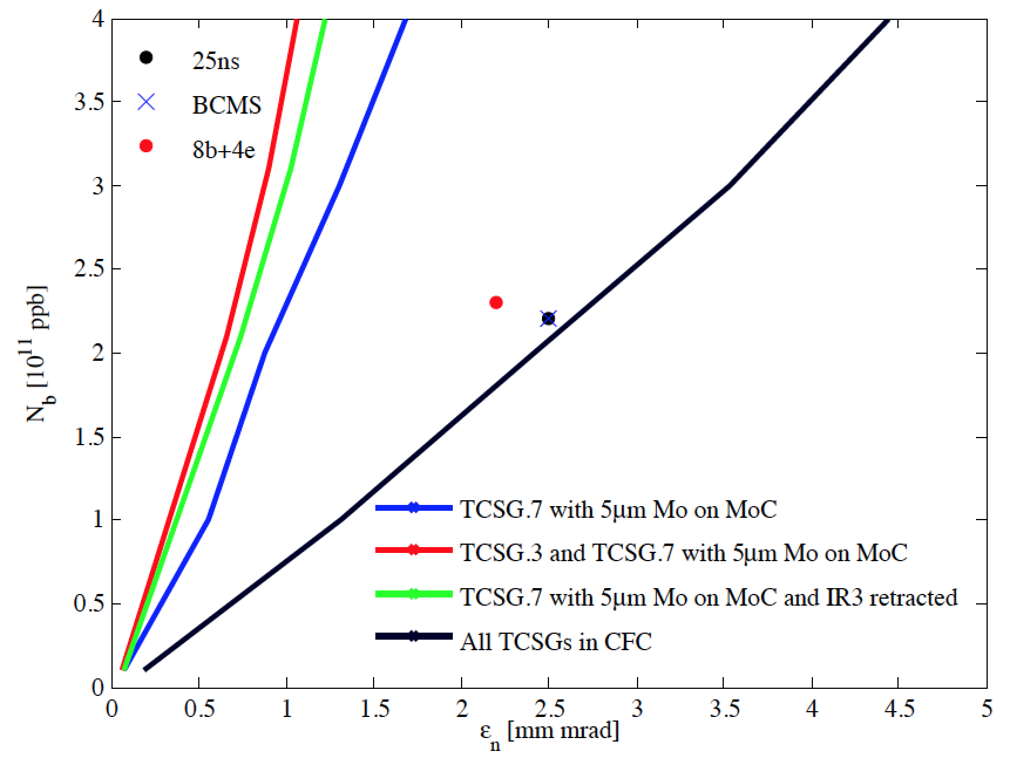
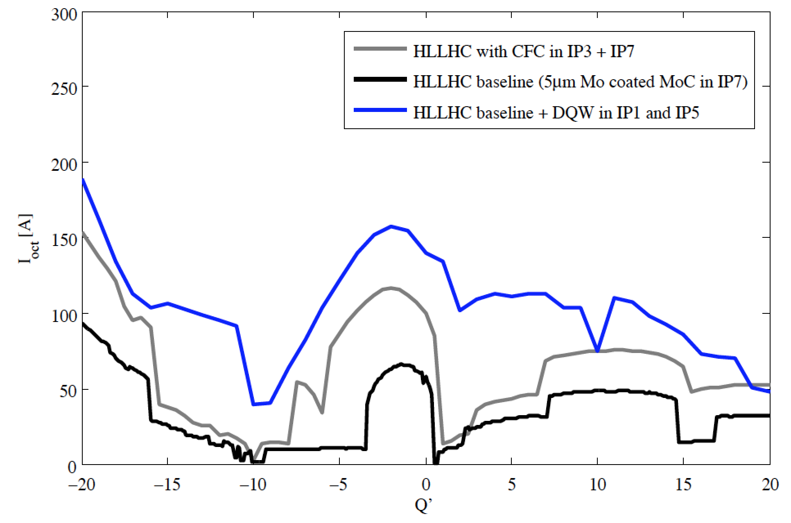
Beam stability from impedance model
Curves scaled w.r.t. 2012 instabilities (assumed impedance-induced) w/o CC
Curves NOT scaled w.r.t. 2012 instabilities, w/o & w CC, (2.2E11 p/b, 2.5 μm and 8.1 cm)
Courtesy of
N. Biancacci
Courtesy of L.R. Carver

Slide 6
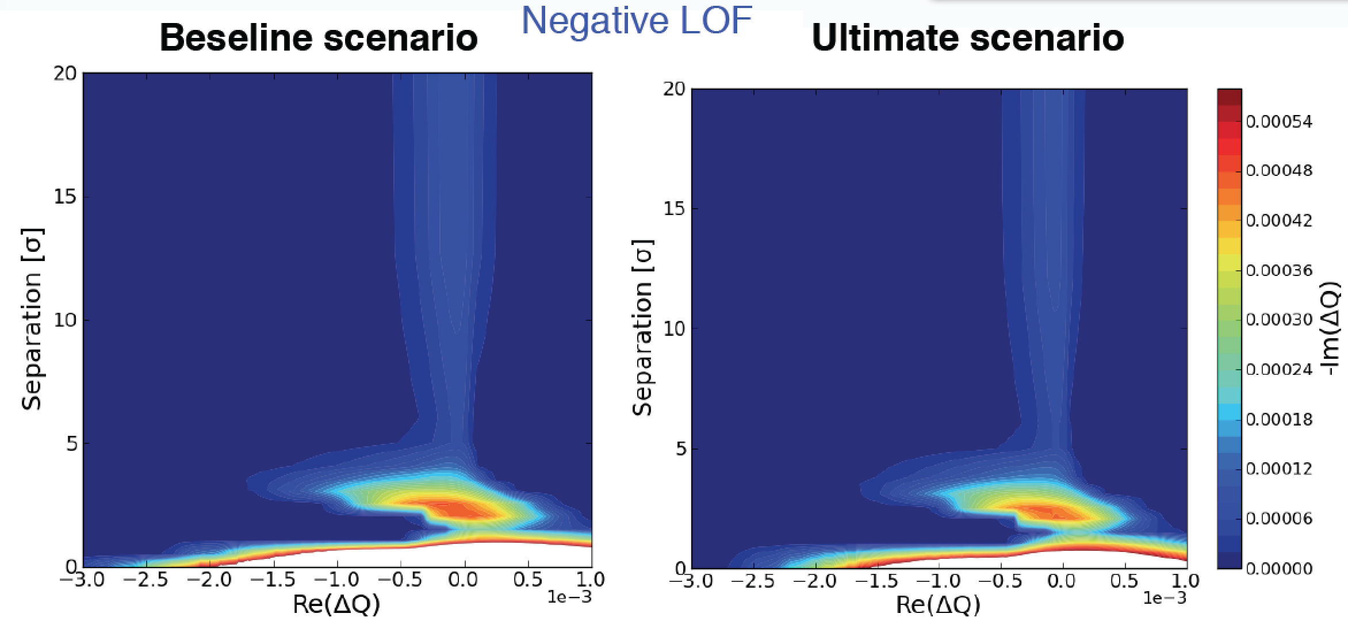
Effect of beam-beam and ramp rates
Evolution of the SD during collapse of separation (crab crossing OFF), from BBLR + BBHO in IP1&5
Courtesy of
C. Tambasco
LOF = - 570 A
2 reductions of SD:
~ 6 σ and ~ 1.5 σ

Slide 7
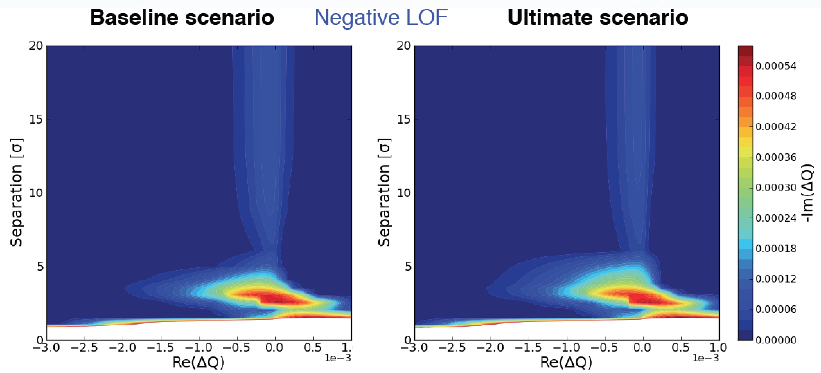
Effect of beam-beam and ramp rates
Evolution of the SD during collapse of separation (crab crossing ON), from BBLR + BBHO in IP1&5
Courtesy of
C. Tambasco
LOF = - 570 A
2 reductions of SD:
~ 6 σ and ~ 1.5 σ

Slide 8
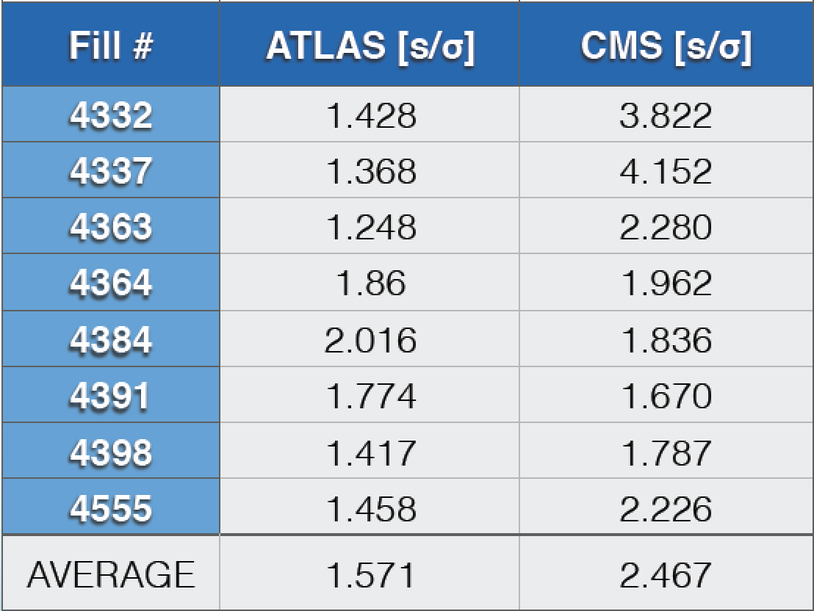
Effect of beam-beam and ramp rates
LHC 2015 separation bump speed from 2σ to 1σ
Courtesy of
C. Tambasco

Slide 9
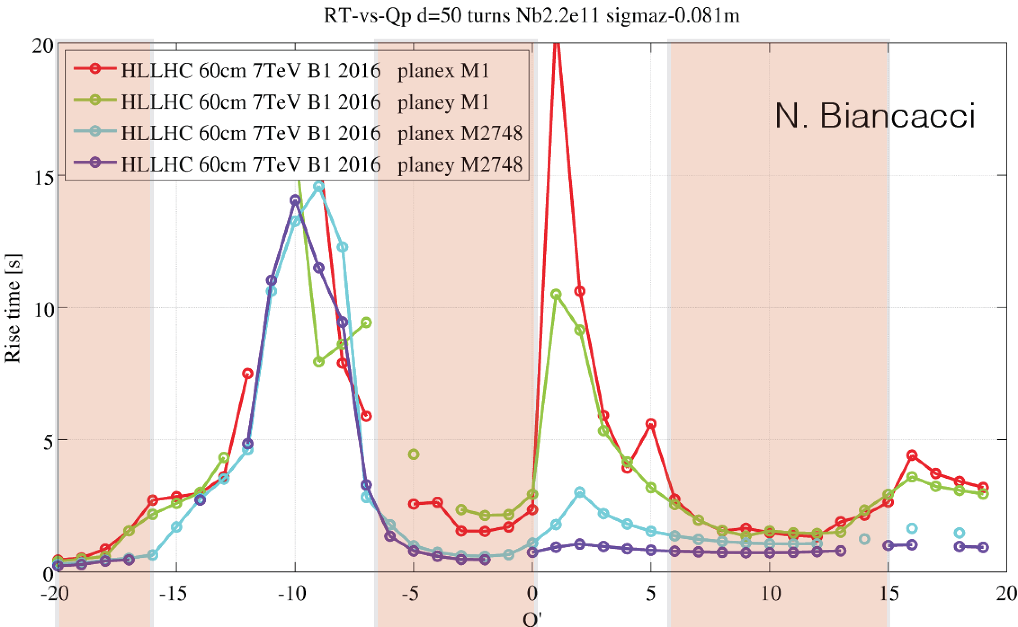
Effect of beam-beam and ramp rates
HL-LHC instability rise-times for the baseline scenario

Slide 10
Effect of beam-beam and ramp rates
Summary
  2 reductions of SD: ~ 6 σ and ~ 1.5 σ
  No observations of instabilities at the minimum of SD during the regular operational fills
  The minimum of SD at 1.5 σ occurs at the deceleration part of the correctors: increasing the ramp rate will not help
  Going faster will have also bad impact on beam loss lifetimes
  The LHC speed (from 2 σ to 1 σ) is ~ 1.6 s (ATLAS) and ~ 2.5 s (CMS) comparable with the HL-LHC rise times
  => Recommendation to go from 2 σ to 1 σ in less than 1 s
  MDs are planned to explore fast instability at the minimum of SD

Slide 11
Effect of noise
Possible mechanism which can lead to a loss of Landau damping (deforming / drilling holes in the SD)

Slide 12
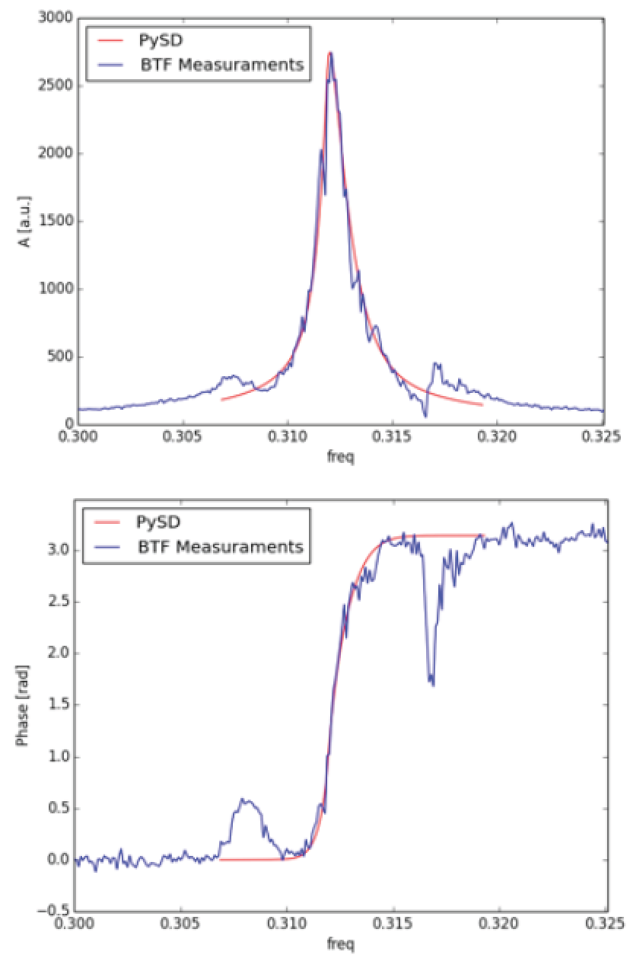
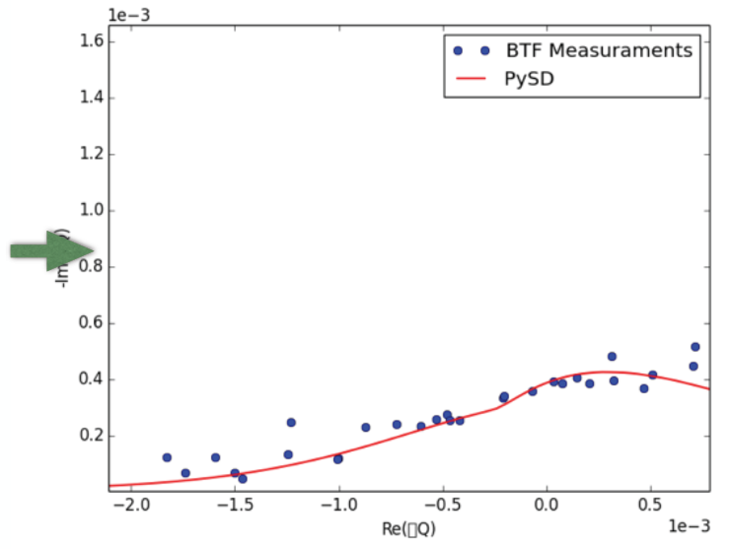
Effect of noise
1st (preliminary) results from BTF measurements in the LHC in 2015 and 1st measured SD at injection => To be continued…
Courtesy of
C. Tambasco
Calibration factor
still needed

Slide 13
Effect of e-cloud
Optimization of working point at injection
Courtesy of
A. Romano
Courtesy of
G. Iadarola

Slide 14
Effect of e-cloud
Instabilities observed at injection when Laslett tune shifts not corrected => Believed to be due to linear coupling (see later)
Courtesy of
L.R. Carver

Slide 15
Effect of e-cloud
Instabilities observed at high energy with a train of 72 b

Slide 16
Effect of e-cloud
Courtesy of
L.R. Carver

Slide 17
Effect of e-cloud
To be further studied (from both simulations and measurements)
  What will happen with many batches / full beam?
  Will we succeed to remove all the e⁻ from dipoles? Effect on beam stability?
  What about the remaining e⁻ in the quads (effect on tune footprint, beam stability, etc.)?

Slide 18
Effect of linear coupling
Linear coupling can be beneficial or detrimental
Why could linear coupling be a problem for beam stability?
=> Because the coherent tunes are shifted by linear coupling differently compared to the incoherent tunes (providing the Landau damping) due to the nonlinear fields (from octupoles to create the tune spread). Therefore in some cases a too strong coupling can be detrimental, leading to instabilities due to a loss of transverse Landau damping

Slide 19
Effect of linear coupling

Slide 20
Effect of linear coupling
Closest tune approach
Courtesy of L.R. Carver

Slide 21
Effect of linear coupling
pyHEADTAIL simulations with an octupole as detuner
MADX with the real octupoles
LOF > 0
Courtesy of L.R. Carver

Slide 22
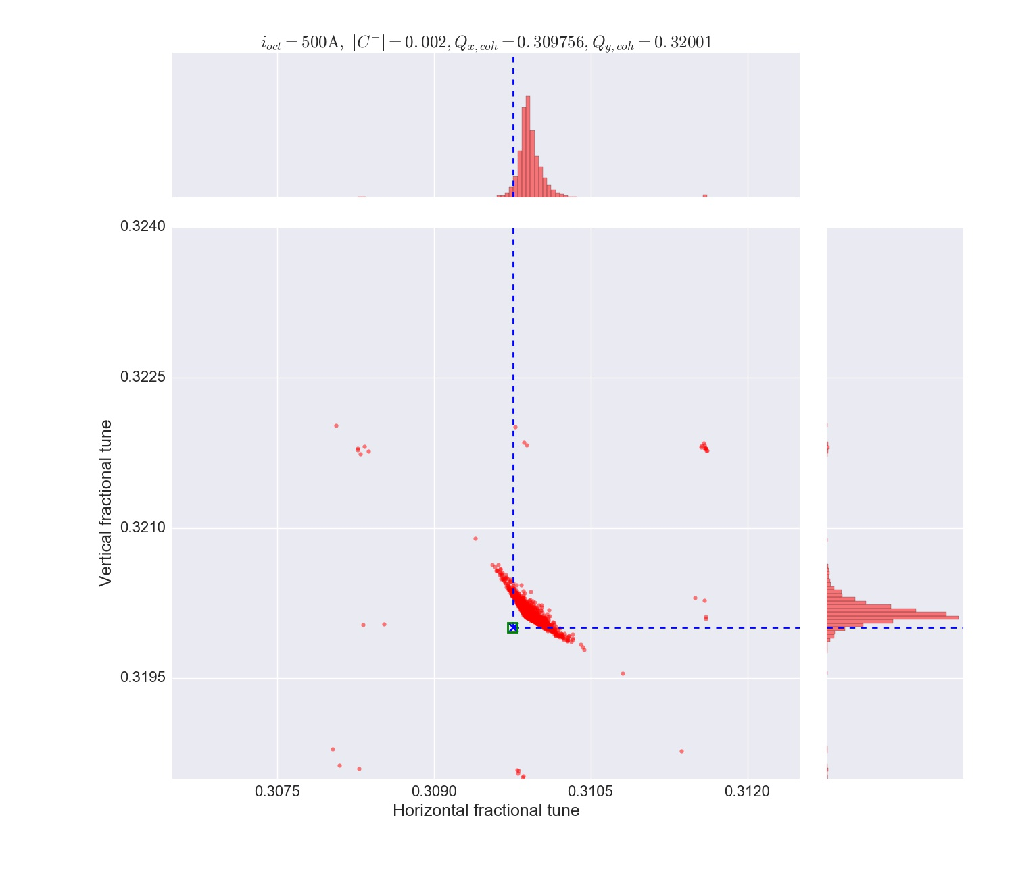
Effect of linear coupling
pyHEADTAIL simulations with an octupole as detuner
MADX with the real octupoles
LOF > 0
Courtesy of L.R. Carver

Slide 23
Effect of linear coupling
pyHEADTAIL simulations with an octupole as detuner
MADX with the real octupoles
LOF > 0
Courtesy of L.R. Carver

Slide 24
Effect of linear coupling
pyHEADTAIL simulations with an octupole as detuner
MADX with the real octupoles
LOF > 0
Courtesy of L.R. Carver

Slide 25
Effect of linear coupling
pyHEADTAIL simulations with an octupole as detuner
MADX with the real octupoles
LOF > 0
Courtesy of L.R. Carver

Slide 26
Effect of linear coupling
pyHEADTAIL simulations with an octupole as detuner
MADX with the real octupoles
LOF > 0
Courtesy of L.R. Carver

Slide 27
Effect of linear coupling
pyHEADTAIL simulations with an octupole as detuner (LOF < 0)
MADX with the real octupoles (LOF > 0, swapped tunes)
Courtesy of L.R. Carver

Slide 28
Effect of linear coupling
pyHEADTAIL simulations with an octupole as detuner (LOF < 0)
MADX with the real octupoles (LOF > 0, swapped tunes)
Courtesy of L.R. Carver

Slide 29
Effect of linear coupling
pyHEADTAIL simulations with an octupole as detuner (LOF < 0)
MADX with the real octupoles (LOF > 0, swapped tunes)
Courtesy of L.R. Carver

Slide 30
Effect of linear coupling
pyHEADTAIL simulations with an octupole as detuner (LOF < 0)
MADX with the real octupoles (LOF > 0, swapped tunes)
Courtesy of L.R. Carver

Slide 31
Effect of linear coupling
pyHEADTAIL simulations with an octupole as detuner (LOF < 0)
MADX with the real octupoles (LOF > 0, swapped tunes)
Courtesy of L.R. Carver

Slide 32
Effect of linear coupling
pyHEADTAIL simulations with an octupole as detuner (LOF < 0)
MADX with the real octupoles (LOF > 0, swapped tunes)
Courtesy of L.R. Carver

Slide 33
Effect of linear coupling
Physical mechanism => Simple model?

Slide 34
Effect of linear coupling

Slide 35
Effect of linear coupling

Slide 36
Effect of linear coupling
Similar (but much smaller) behaviour seen
Another ingredient is needed => Amplitude-dependent C⁻
  Example found empirically:

Slide 37
Effect of linear coupling
Another ingredient is needed => Amplitude-dependent C⁻
  Example found empirically:

Slide 38
Effect of linear coupling

Slide 39
Effect of linear coupling

Slide 40
Effect of linear coupling
See also R. Tomas et al., “Amplitude dependent closest tune approach” (submitted to PRAB) => However, the amplitude-dependent C⁻ discussed before is not the same as the one in the paper and has been deduced empirically => To be continued…

Slide 41
Effect of linear coupling
Dedicated instability measurements in the LHC on 16/04/2016
  1) During the betatron squeeze
  2) At top energy (before the betatron squeeze)

Slide 42
Effect of linear coupling
  1) During the betatron squeeze: ADT on, Q’ ~ 9 and LOF = + 285 A
  |C⁻| ~ 0.008
  Q₁/Q₂ kept at 0.31/0.32 (tune feedback) => Q_{x} ~ 0.312 and Q_{y} ~ 0.318 => Q_{y} – Q_{x} ~ 0.006 (i.e. tune feedback is amplifying the coupling effect!)
  Instability observed with LOF = + 285 A, i.e. ~ 4 times higher octupole current than uncoupled threshold

Slide 43
Effect of linear coupling
  2) At top energy (before the betatron squeeze)
  |C⁻| ~ 0.001 and Q_{sep} = 0.03:
  => Stability for LOF = + 71 A
  |C⁻| ~ 0.01 and LOF = + 310 A
  => Instability for Q_{sep} ~ 0.018
Courtesy of L.R. Carver

Slide 44
Effect of linear coupling
  =>This gives a factor 310 / 71 = 4.4 increase in Landau octupoles current compared to the uncoupled case
Courtesy of L.R. Carver

Slide 45
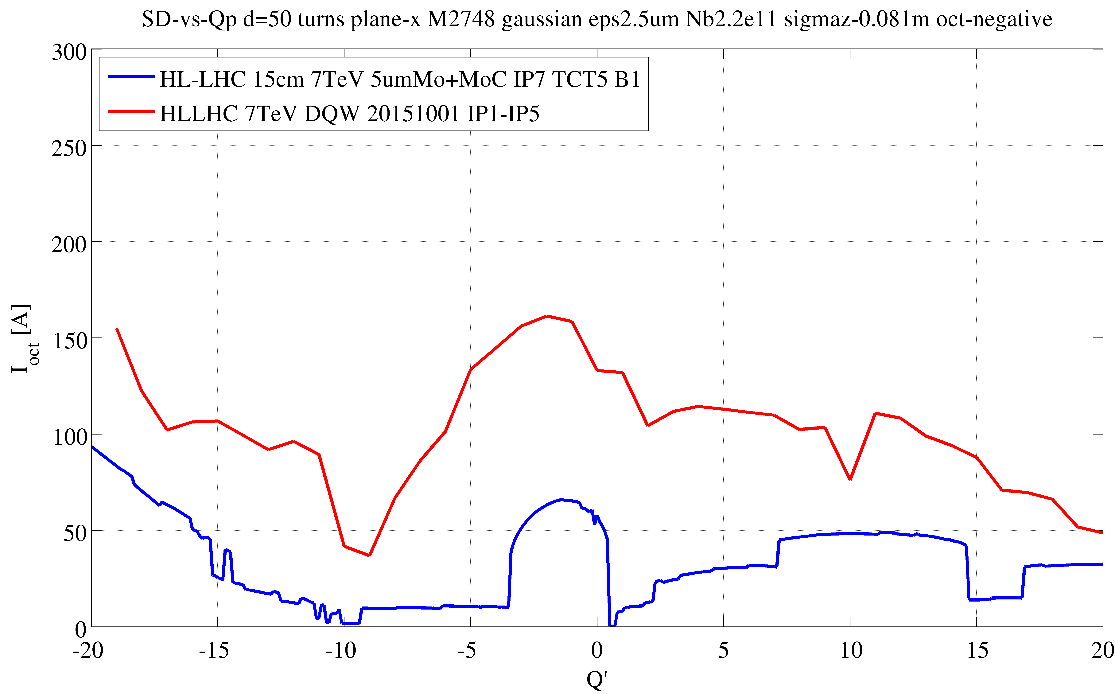
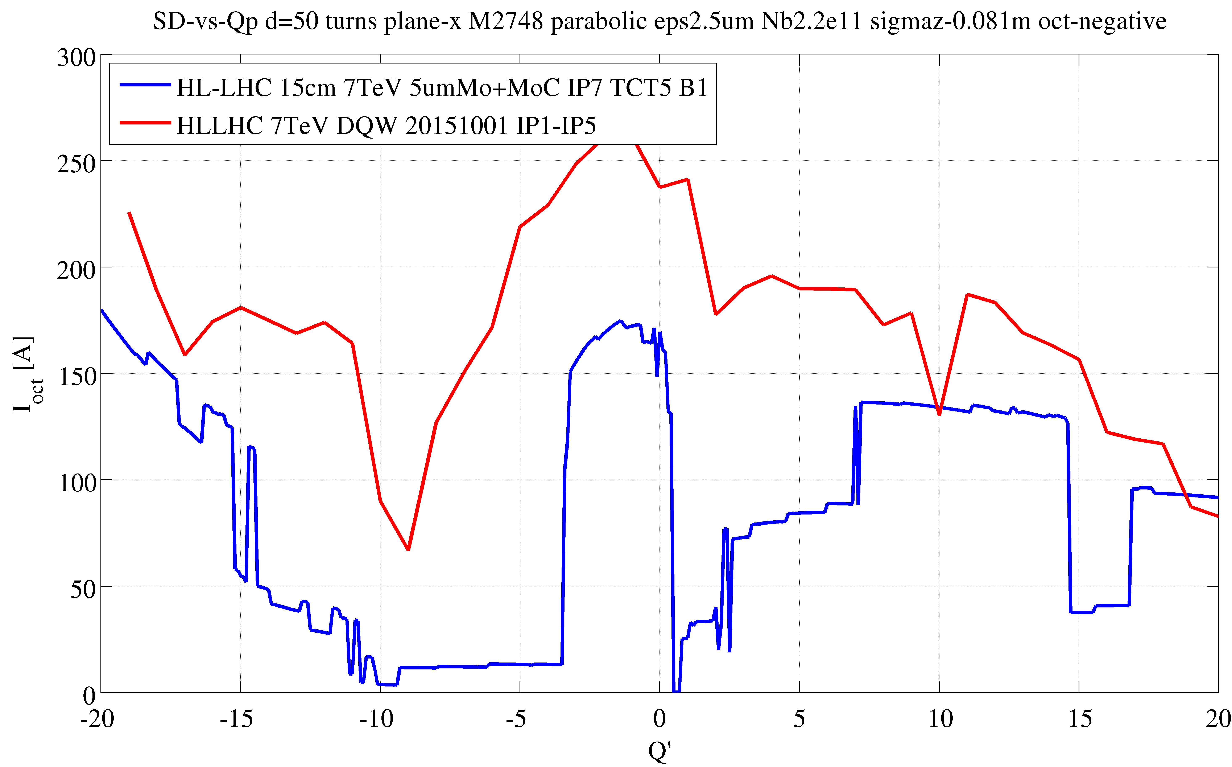
Conclusion
Beam stability predictions were based so far on a scaling from instabilities observed in 2012
  The limit from impedance only is believed to be (much) higher (at least for Q’ > ~ 2, from meas. in LHC => See talk on impedance)
e.g. from e-lens
Gaussian
transverse profile
Quasi-parabolic
(~ 3.2 σ)
transverse profile
Baseline w CC
Baseline w/o CC
Courtesy of
N. Biancacci

Slide 46
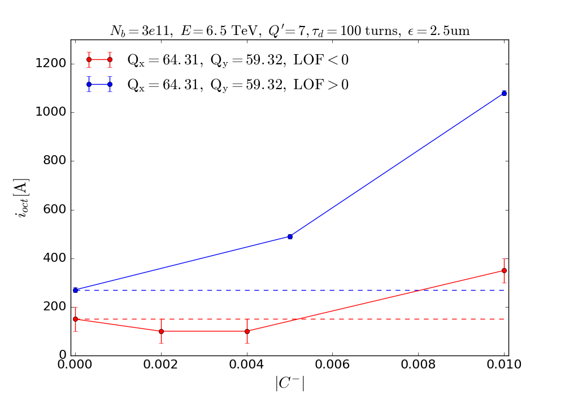
Conclusion
  Should work more now on the other mechanisms
Recommendations
  Linear coupling
    For LOF > 0 (as LHC in 2016) => For each bunch:
    For LOF < 0 (as for HL-LHC) => Bit less critical:
Courtesy of L.R. Carver

Slide 47
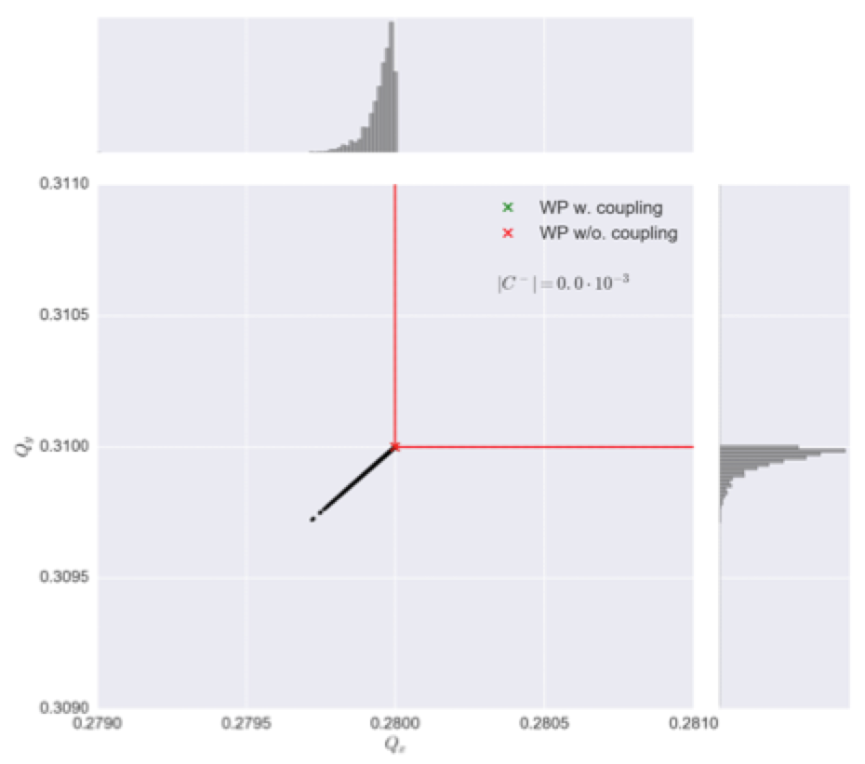
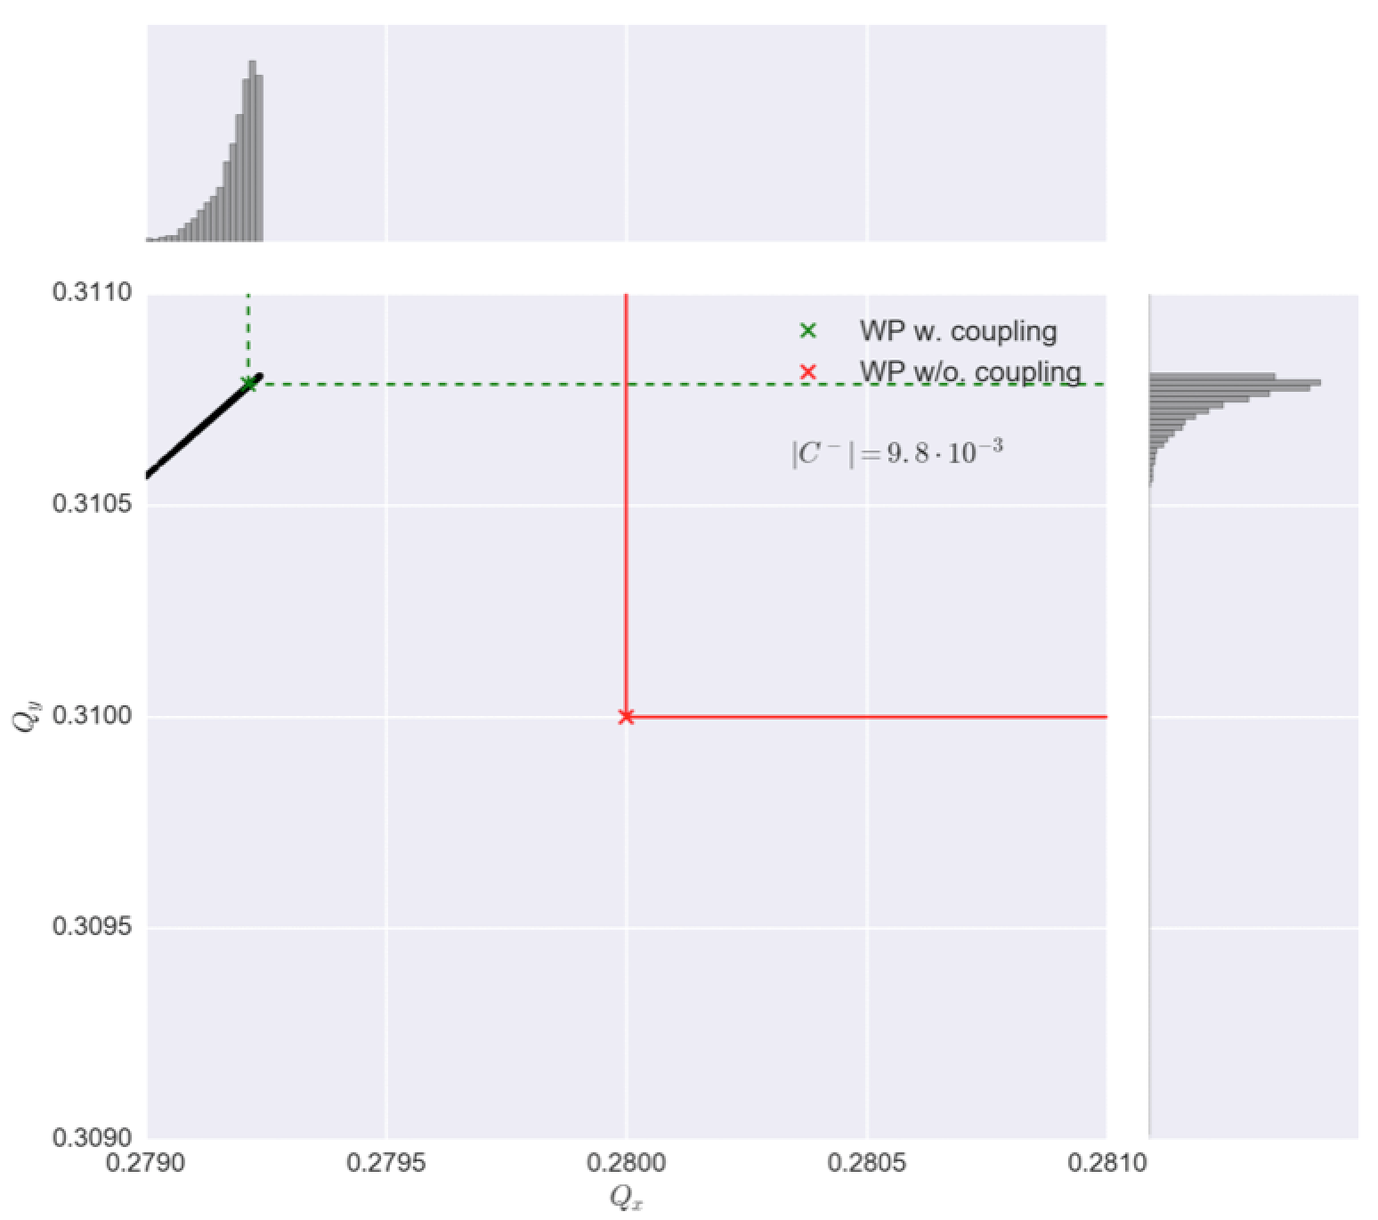
Conclusion
    Note that using Q” or an RFQ (for longitudinal-to-transverse Landau damping), linear coupling should not be detrimental for beam stability!
Q”
Courtesy of M. Schenk

Slide 48
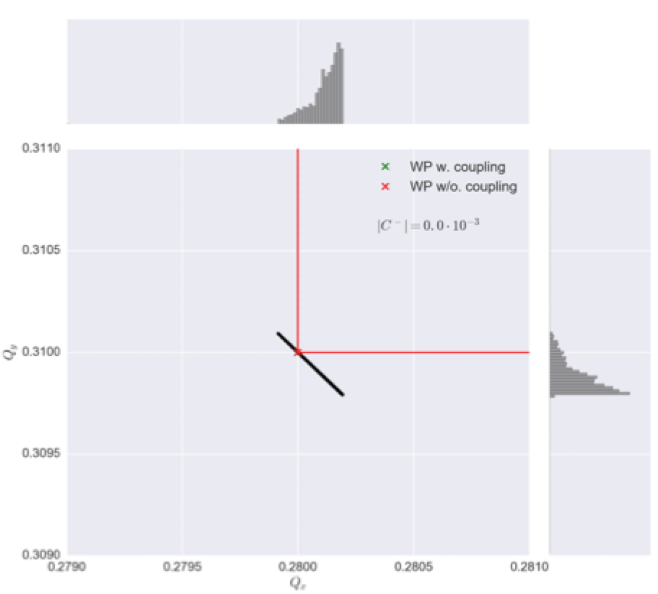
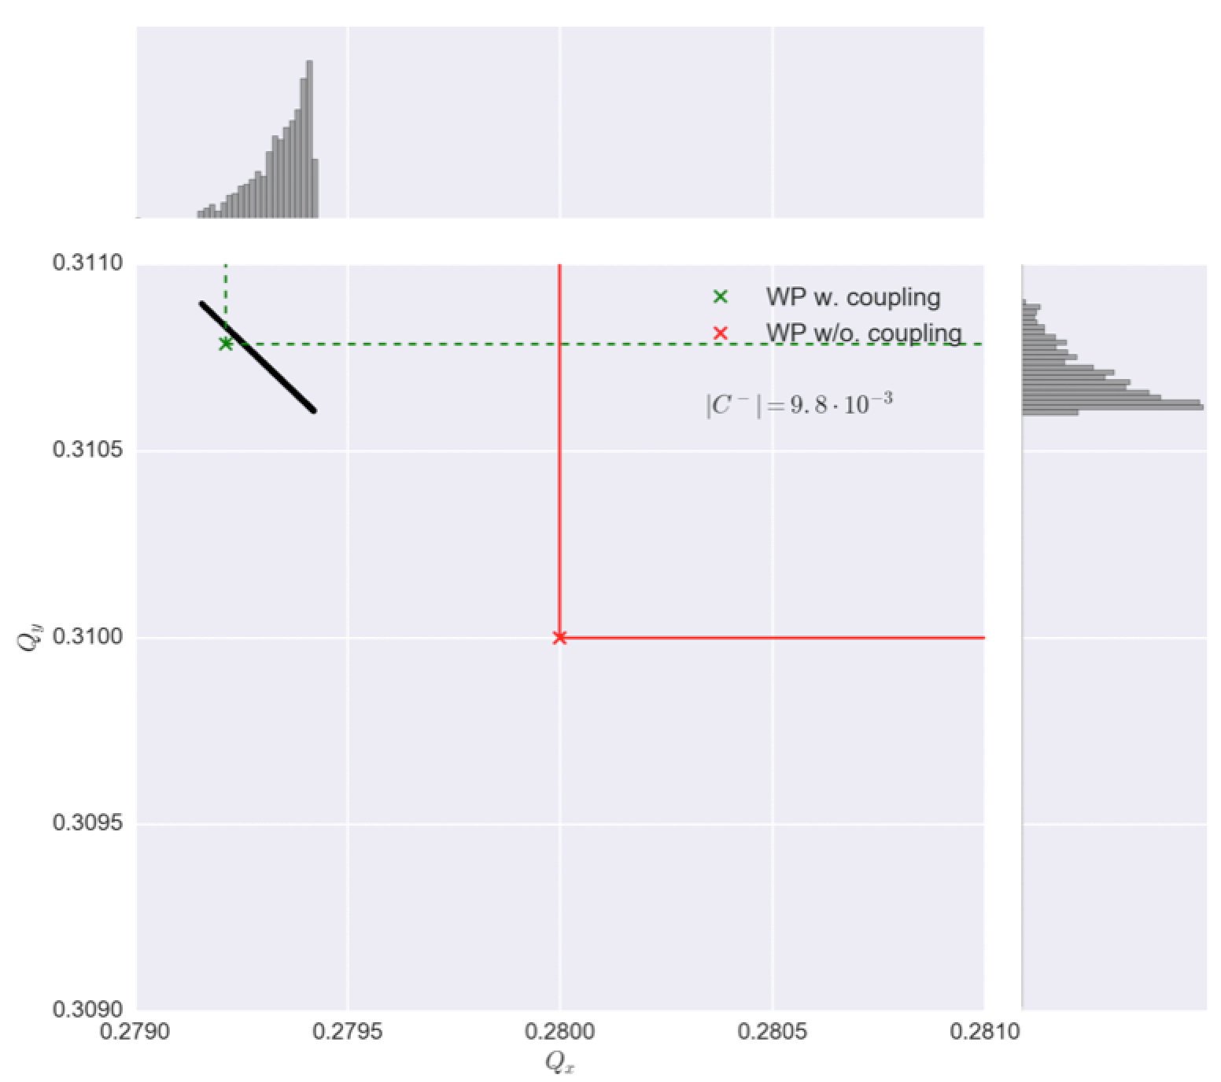
Conclusion
RF quadrupole
Courtesy of M. Schenk

Slide 49
Conclusion
  E-cloud => Coating (low SEY) + scrubbing + further studies needed (ongoing)
  Noise
    1st SD measured at injection (BTF)
    Evolution of SD still to be measured at high energy
    The 12 non-colliding bunches (in the witness region and with ADT in bunch-by-bunch) unstable in stable beams on 13/05/2016 after few hours => Effect of noise? => To be continued…
  Working point at injection
    Same as 2016? => 0.27/0.295 instead of nominal 0.28/0.31
    Compensation of Laslett tune shifts (otherwise possible issues with linear coupling)

Slide 50
Conclusion
  Going into collision
    Recommendation to go from 2 σ to 1 σ in less than 1 s
    MDs are planned to explore fast instability at the minimum of SD

Slide 51
Thank you for your attention!

