Slide 1


Long QXF Mirror Fabrication
(MQXFPM1)
Rodger Bossert
HiLumi-LARP Collaboration Meeting
May 18-20, 2016
SLAC

Slide 2
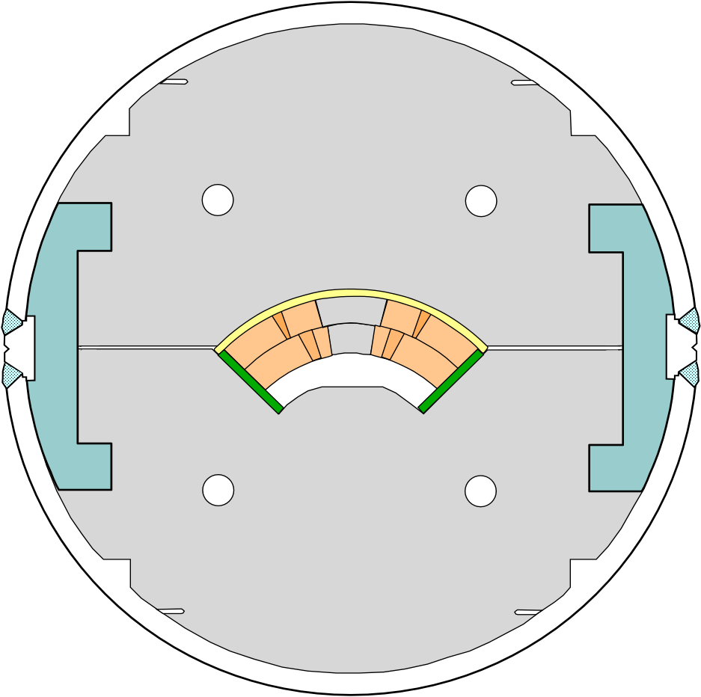

QXF Mirror Design
Tests single LQXF coil in traditional Fermilab yoke with stainless steel weld-on skin.
Coil Protective Shell
Yoke (EDM’d blocks)
Bolt on skin
Aluminum Side Clamp
Longitudinal side weld
Coil midplane shim

Slide 3
LQXF Mirror Design is derived from previous Mirrors built at Fermlab.
HFM Dipole Mirror
TQ mirror
HQ mirror
SQXF Mirror
LQXF Mirror

Slide 4
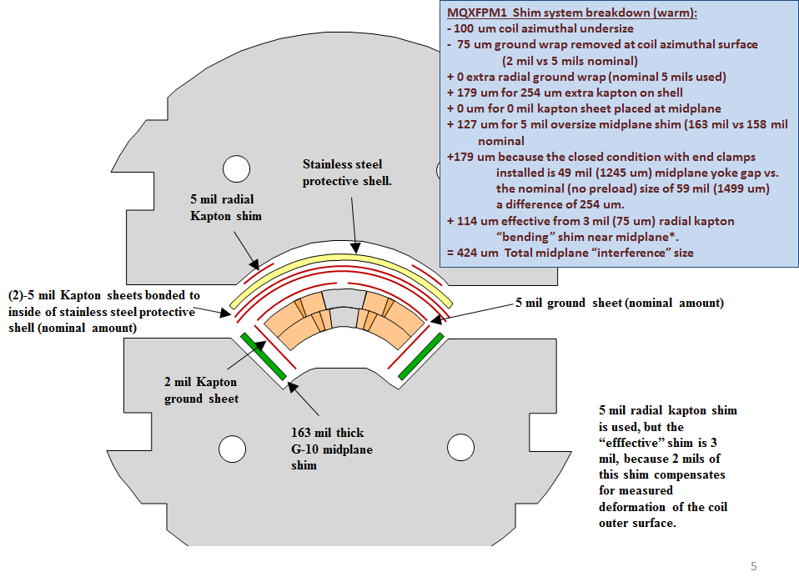
Preload is adjusted by altering shims within the cross section.

Slide 5
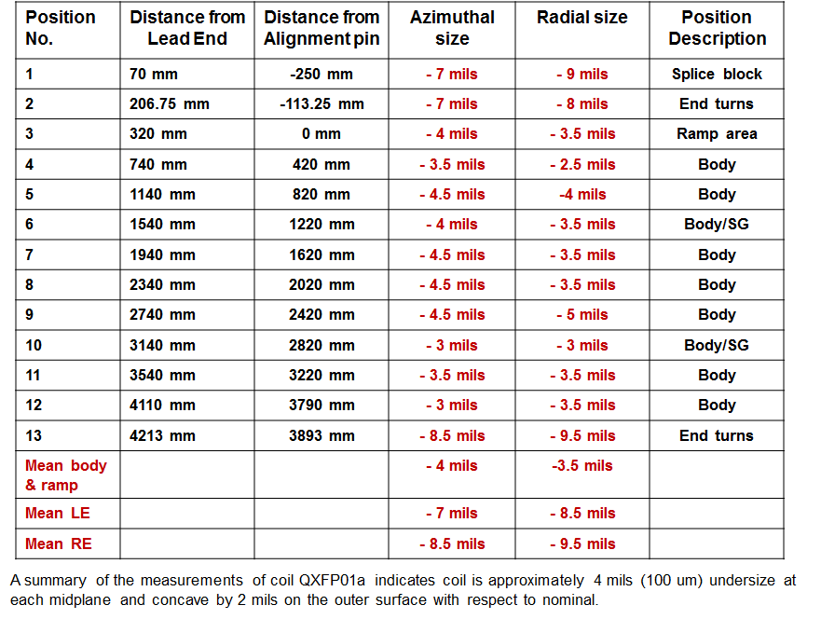
CMM Measurements Summary – Coil QXFP01a

Slide 6
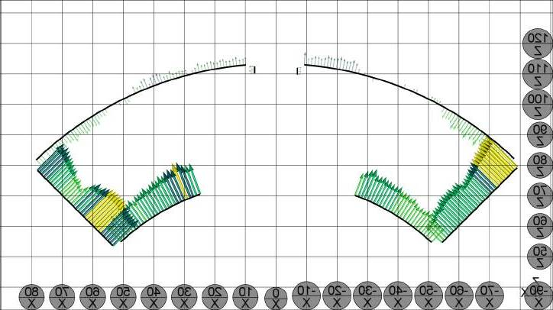
CMM measurements – Typical cross section
Average azimuthal size = -4 mils
Average radial size = -3.5 mils
One square =
100 um (4 mils)

Slide 7
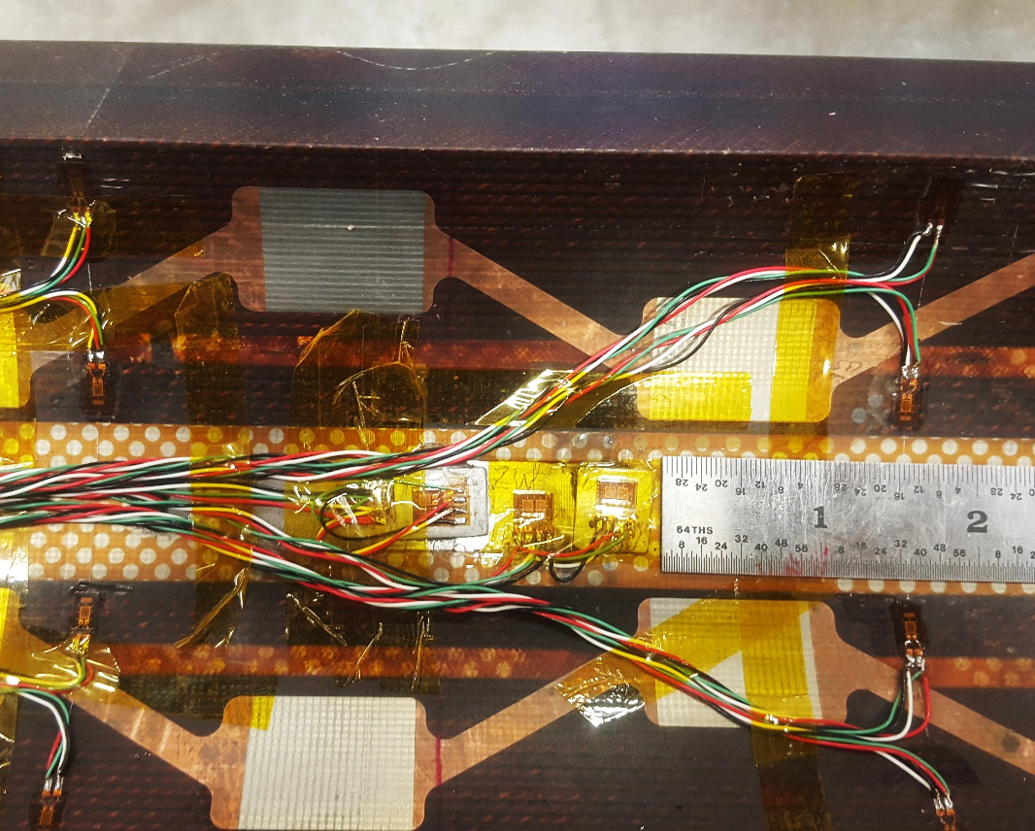
Coil Strain Gauges
Strain gauge system, standard for long mirror. There are two “stations”, located at approximately one third of the way from each end of the coil. Each station contains:
1 set of full bridges on inner titanium pole, one azimuthal bridge, one longitudinal bridge.
4 quarter bridges bonded to inside surface of inner coil, used during construction only.
Gauges bonded to coil

Slide 8
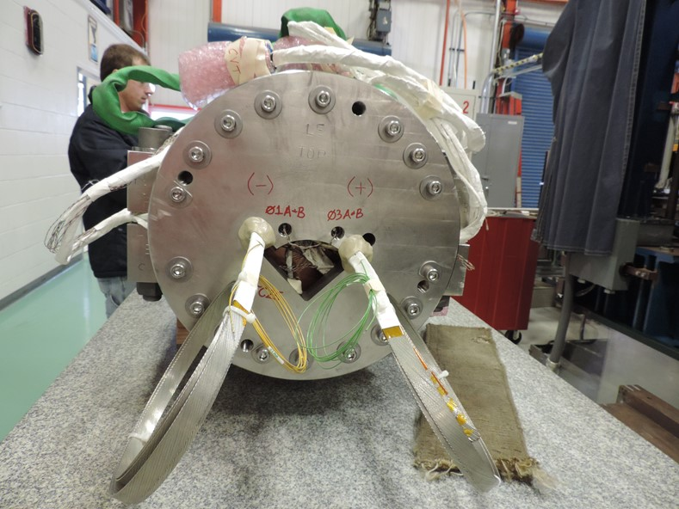
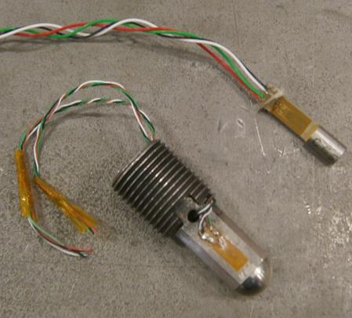
End Preload Bolt Strain Gauges
Location of temperature compensator
Location of end preload bolts
Temperature Compensator
Short QXF mirror shown
End load the same as the short mirror. 2 preload bolts on each end, each applying 7 kN (1600 pounds) of force from the 50 mm thick end plate, for a total of 14 kN (3200 pounds) at each end.
Strain gauges bonded to end preload bolts.

Slide 9
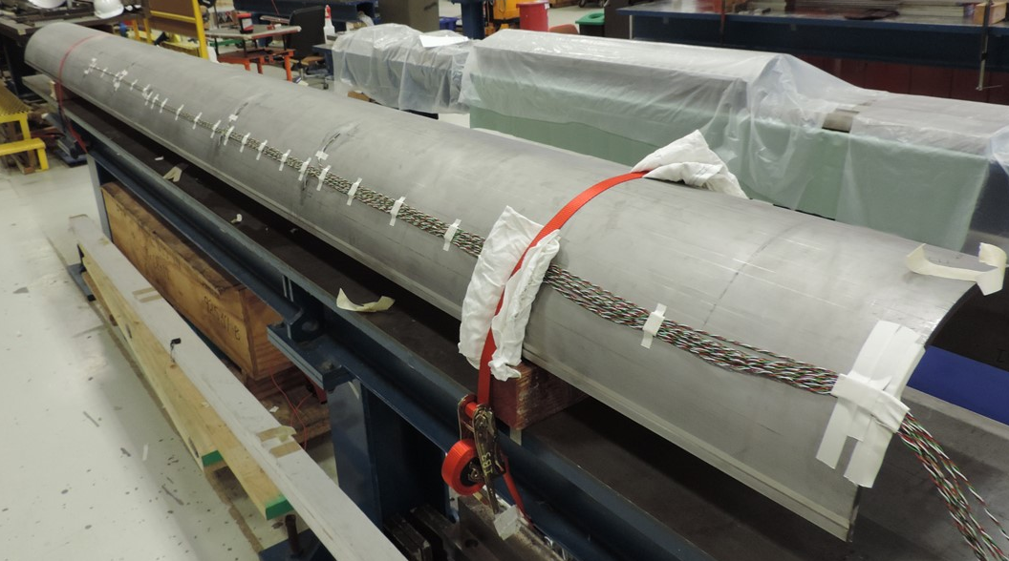
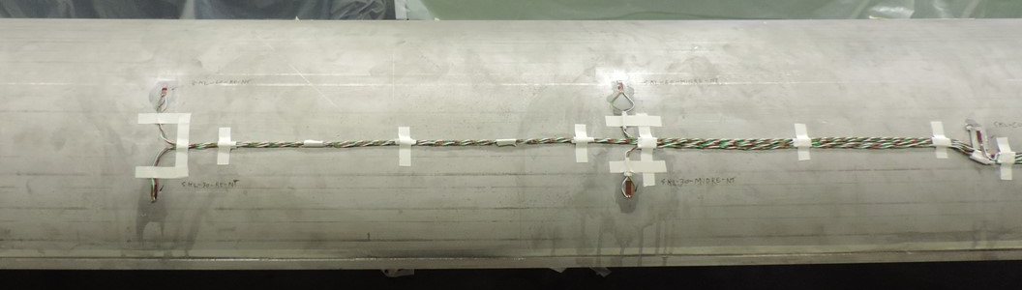
Shell (Skin) Strain Gauges
An array of gauges on the shell at 30 and 60 degrees from the midplane. One set of four gauges in each quadrant at each station.
Gauge at 60 degrees
Temperature Compensator
Gauge at 30 degrees

Slide 10
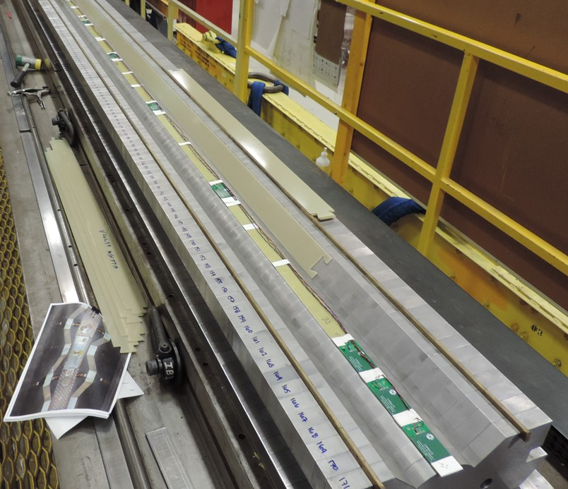
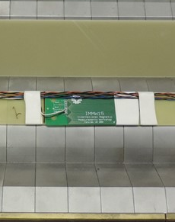
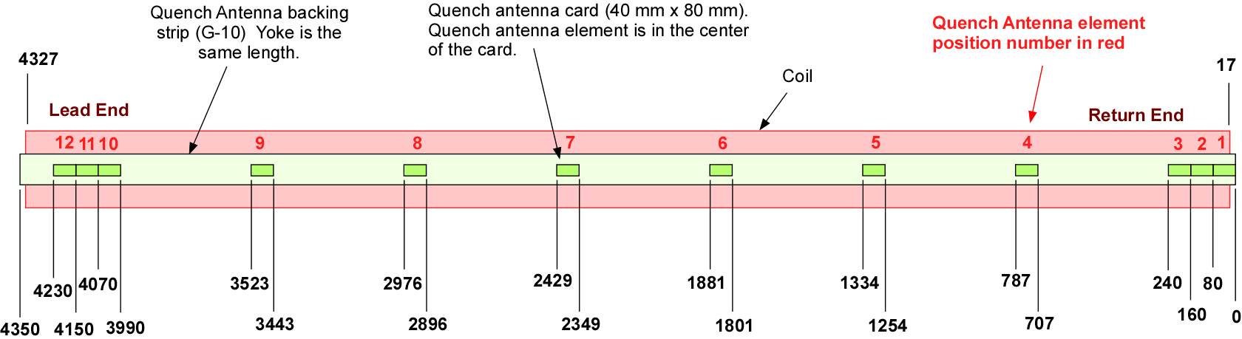
Quench Antenna

Slide 11
Assembly Steps – Planned and Actual
Plan was to replicate the preload of the short QXF mirror.
Press to 80 Mpa azimuthal stress in press without skin or clamps.
Actual – -74 MPa azimuthal
+171 µS longitudinal
Drive in side clamps, increasing azimuthal preload to 90 Mpa
Actual – -86 MPa
+170 µS longitudinal

Slide 12
Assembly Steps – Planned and Actual
3. Remove press pressure, clamps deflect, azimuthal preload is 66 MPa.
Actual – -66 MPa azimuthal
+186 µS longitudinal
Install skin, return to press, press to azimuthal preload of 70 MPa.
Actual – -60 MPa azimuthal
+184 µS longitudinal
Weld skin and release press. Final average azimuthal coil preload of 80 MPa.
Actual – -98 MPa azimuthal
-98 µS longitudinal

Slide 13
Coil Strain Gauge Summary
(Station 1 is nearer the lead end and station 2 is nearer the return end. )
Operation | Pole Azimuthal |  | Pole Axial |  |  | Coil gauges near pole |  | Coil gauges near midplane
Units | MPa |  | µS |  |  | MPa |  | MPa
Station | 1 | 2 | 1 |  | 2 | 1 | 2 | 1 | 2
After Clamping | -61 | -70 | +255 | +116 |  | -50 | -44 | -70 | -52
After Welding | -90 | -106 | -98 | -99 |  | -87 | -83 | -129 | -116
Note: Axial strain on MQXFPM1 is continually positive (tension) until after the welding is complete, and becomes negative after the press pressure is removed. This is typical of long mirrors. For example, the long LHQ mirror (LHQM01) axial strain readings averaged +208 uS during welding, but -125uS after releasing pressure.

Slide 14
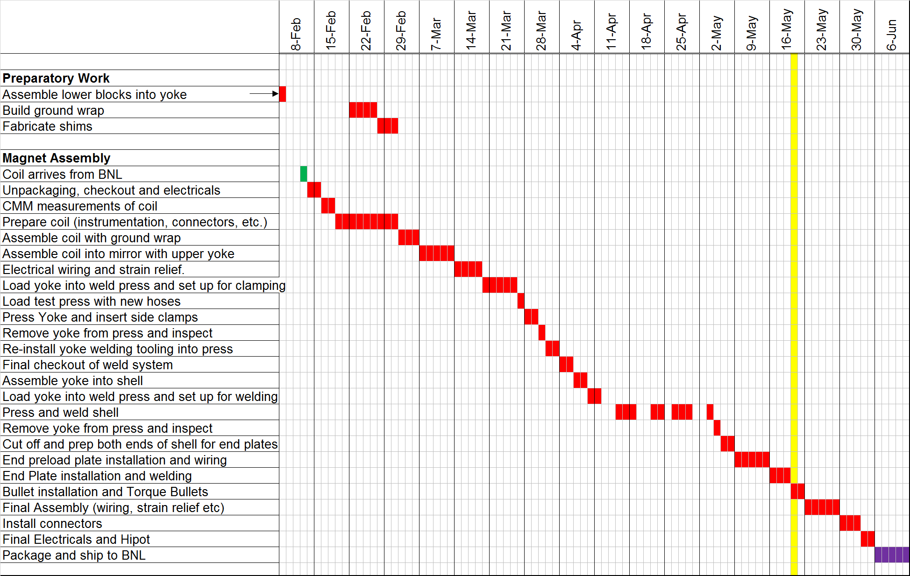
MQXFPM1 Fabrication Schedule

Slide 15
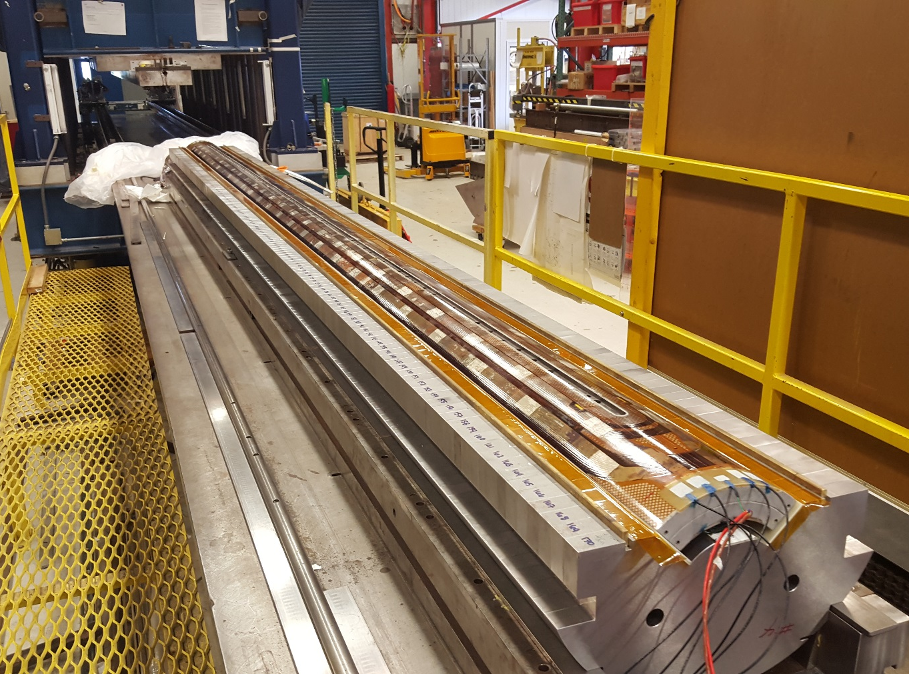
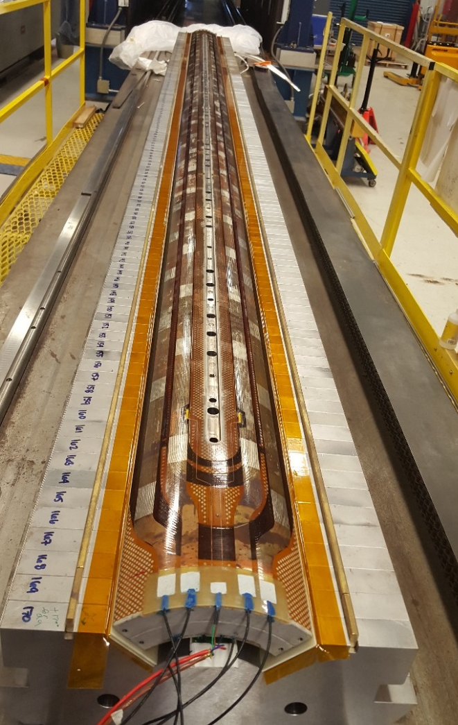
MQXFPM1 Construction Pictures
Coil placed in lower yoke before end clamps

Slide 16
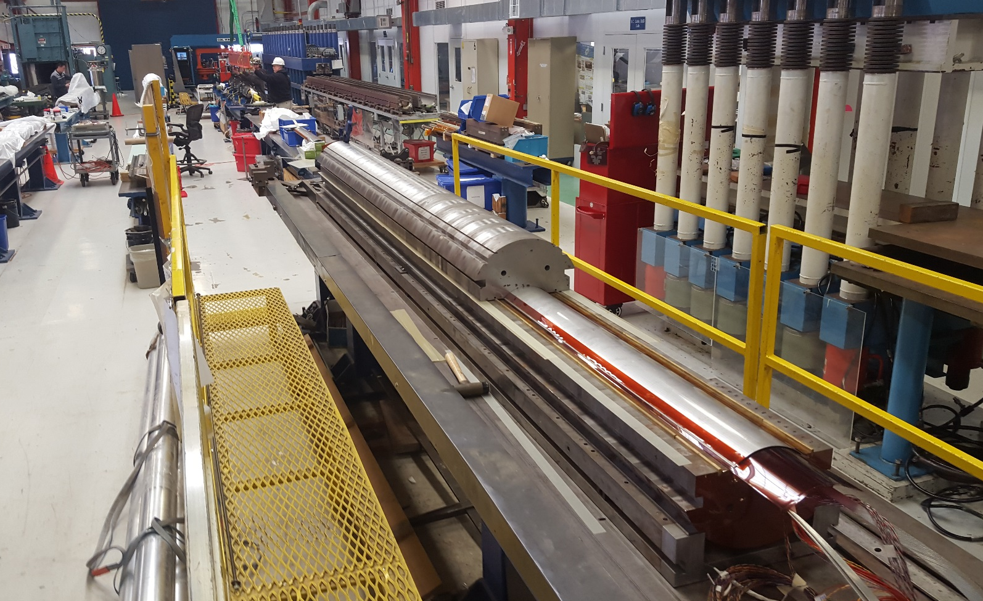
MQXFPM1 Construction Pictures
During installation of upper yoke

Slide 17
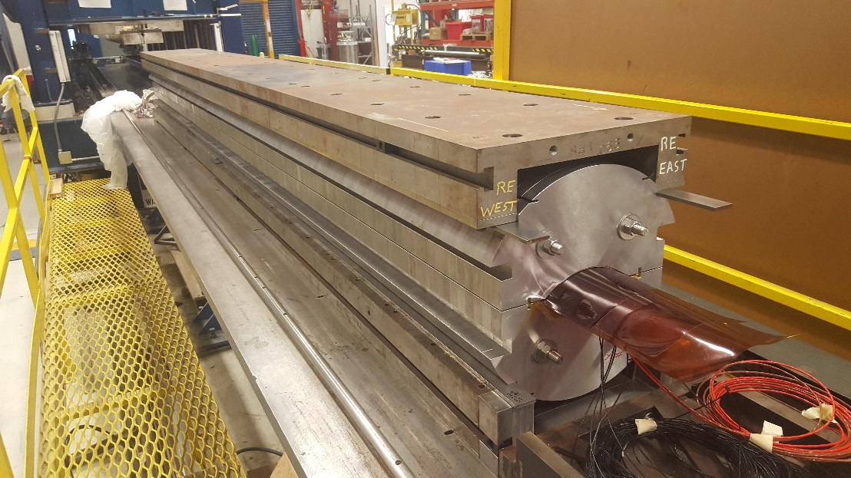
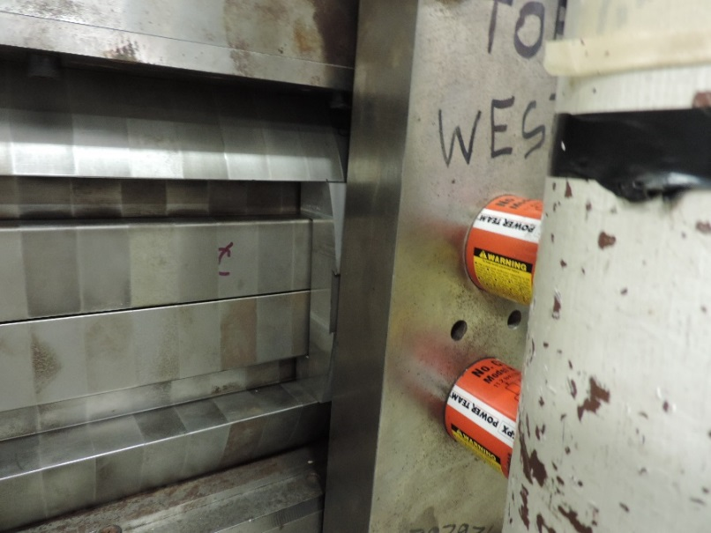
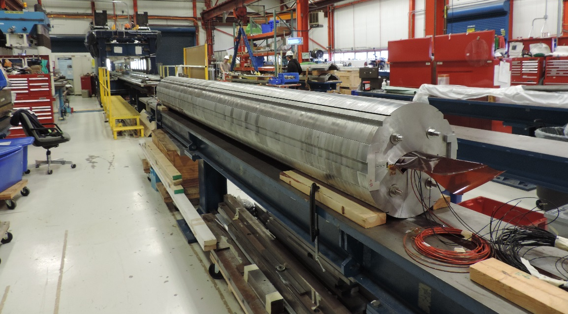
MQXFPM1 Construction Pictures
Ready to install side clamps
Side clamps installed
Side clamp installation

Slide 18
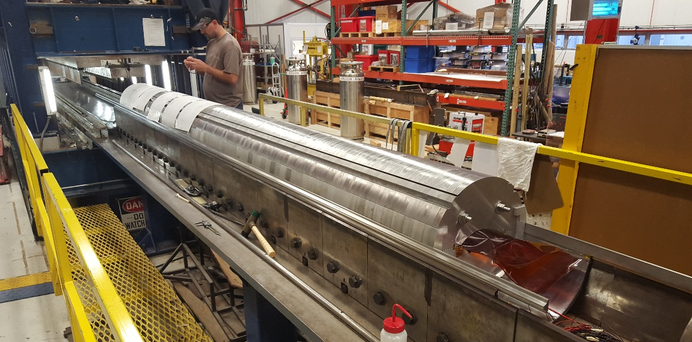
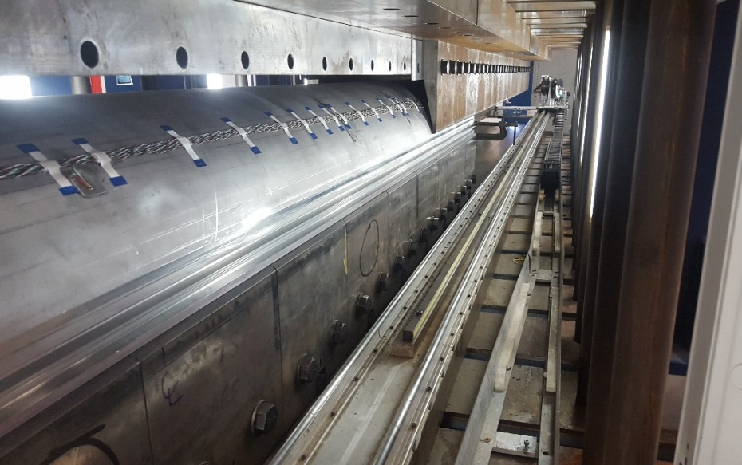
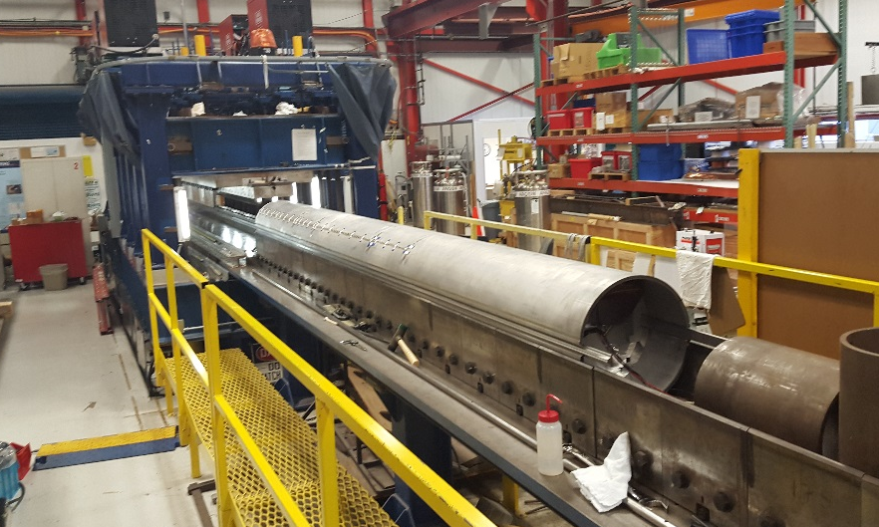
MQXFPM1 Construction Pictures
Preparing to weld yoke

Slide 19
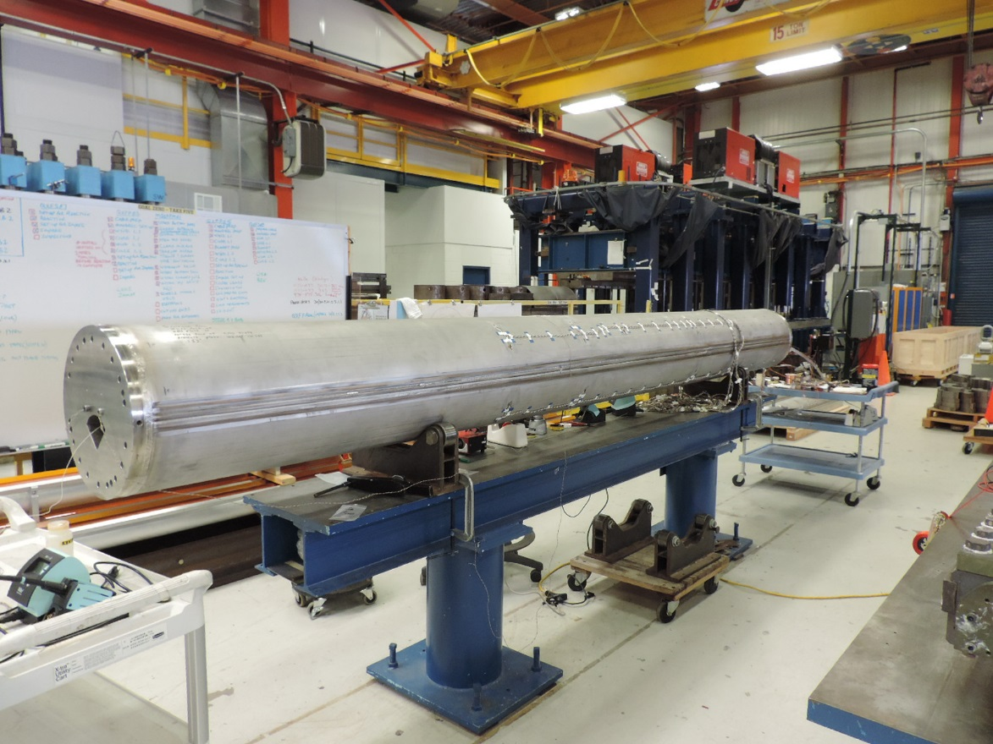
MQXFPM1 Construction Pictures
End Plates welded, and installing End Preload Bolts

Slide 20
Summary
Long mirror design is based on previous quadrupole and dipole mirrors.
MQXFPM1 is nearly complete, and should be shipped to BNL for testing in early June.
No significant manufacturing problems occurred.
Preload average at pole is 98 MPa, higher than the short QXF mirror.

Slide 21
Backup Slides

Slide 22
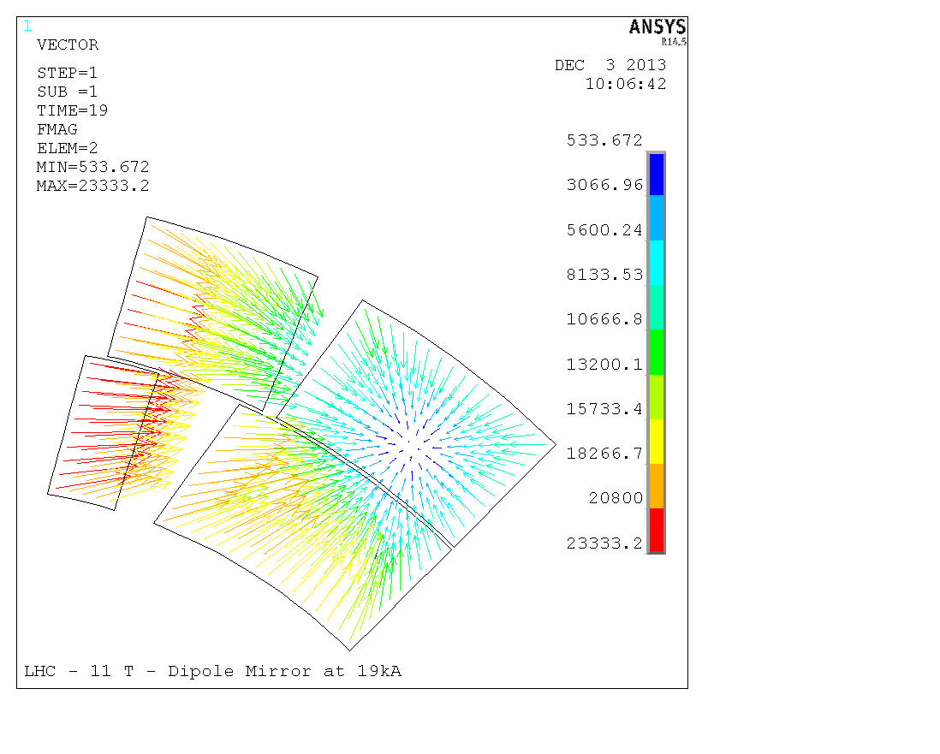
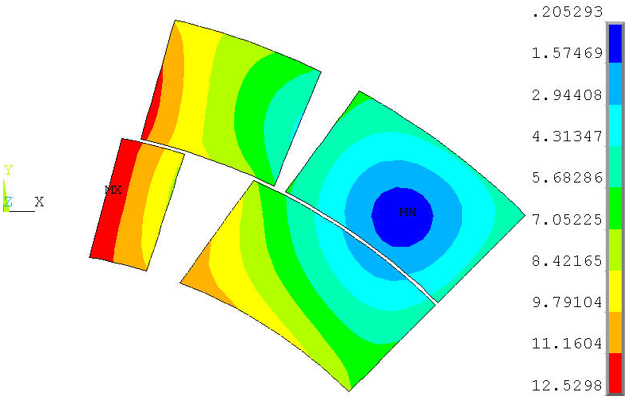
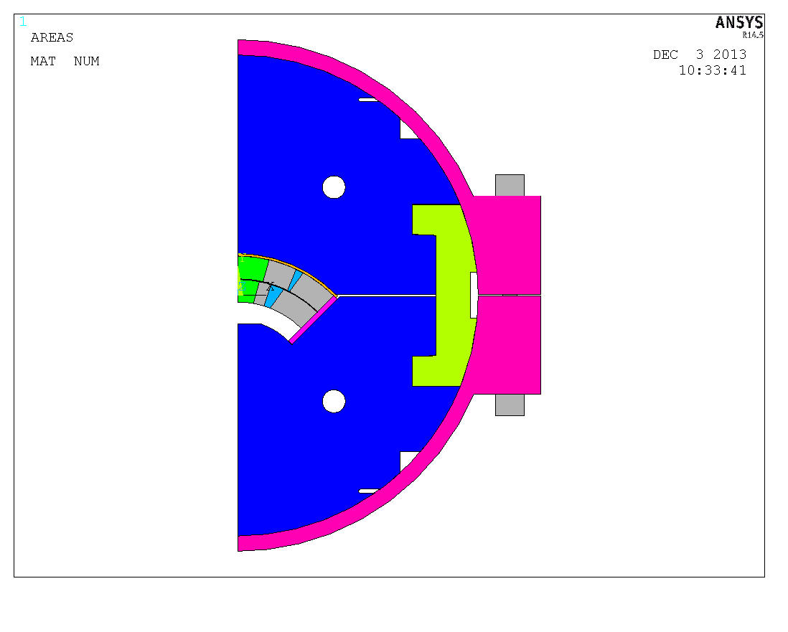
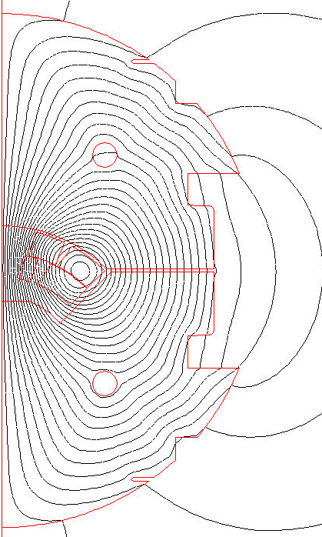
LQXF Mirror Magnetic Field at 19 kA

Slide 23
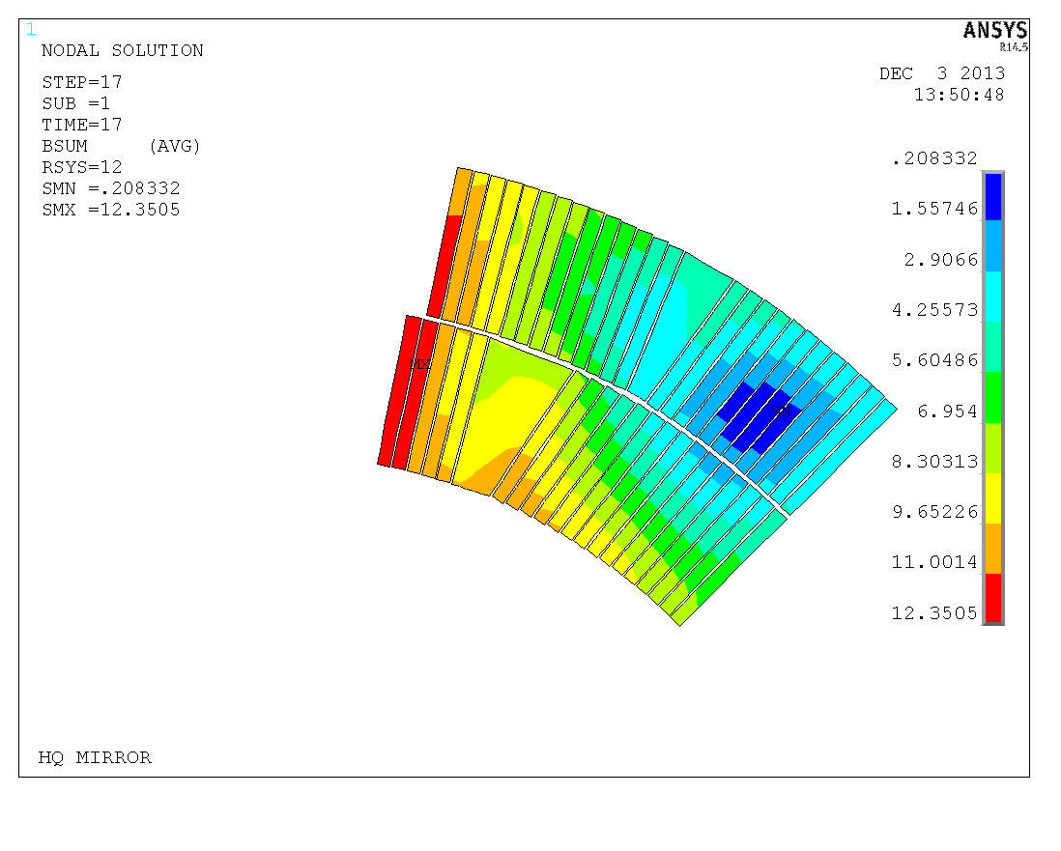
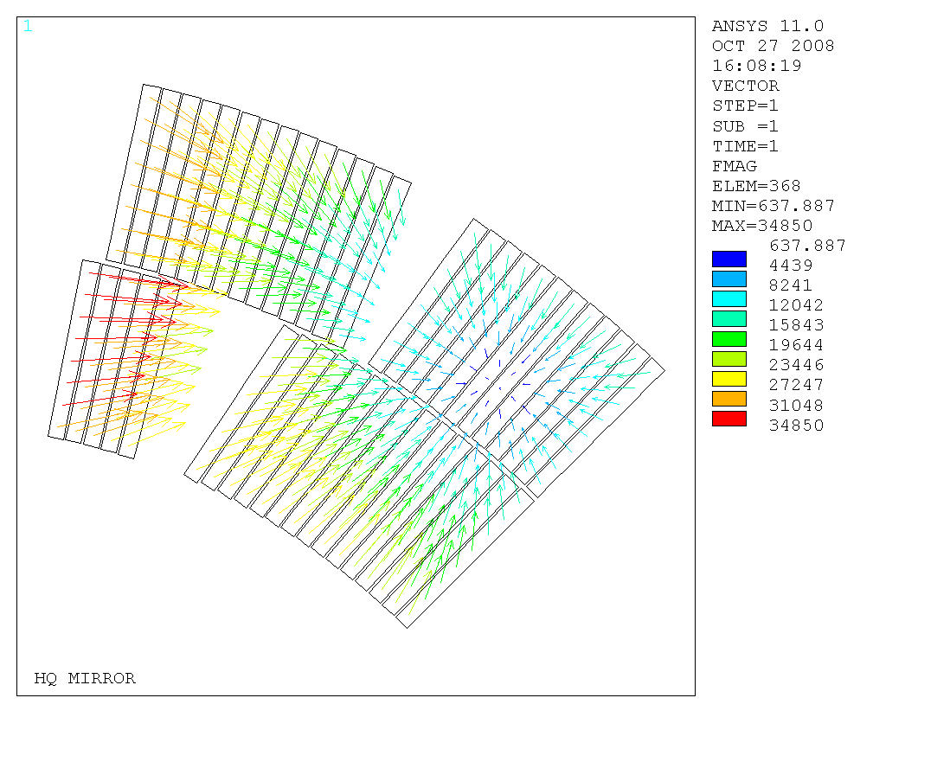
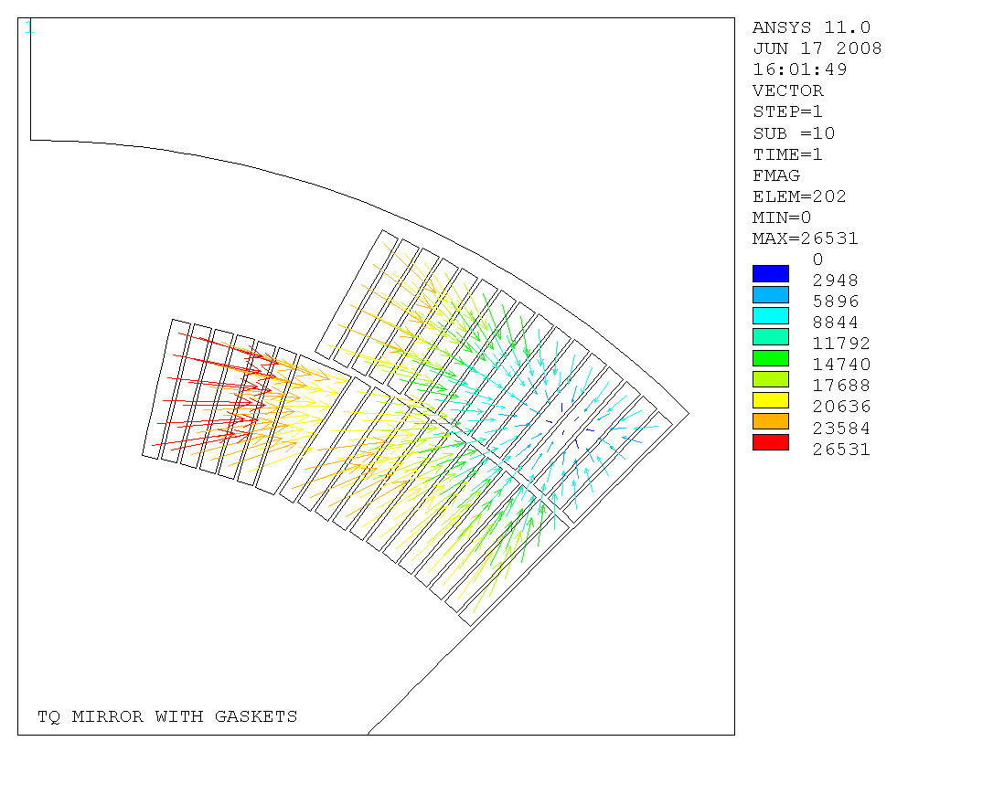
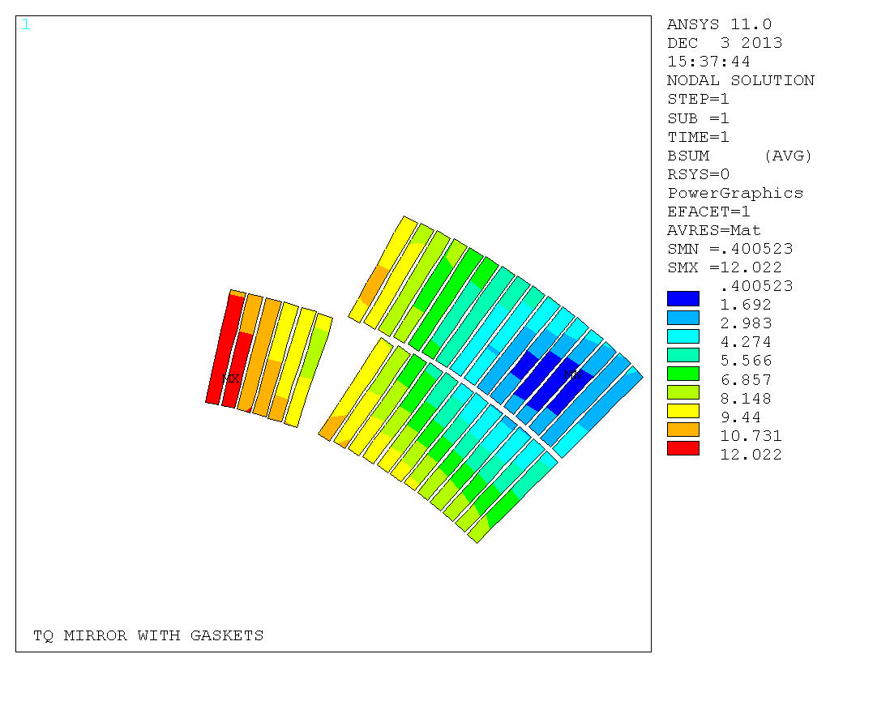
HQ and TQ Mirror Magnetic Field (for reference)
HQM at 17 kA
TQM at 14 kA

Slide 24
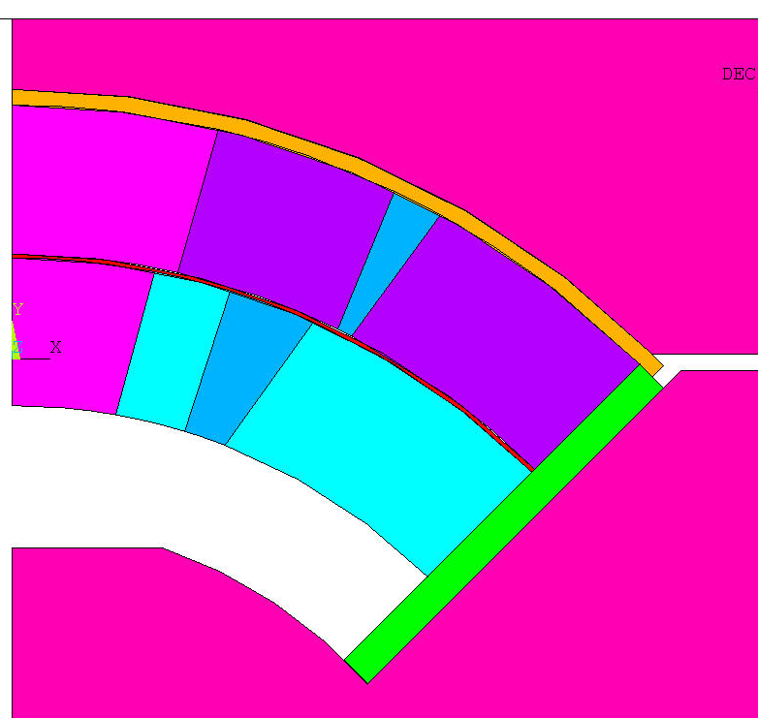
FEA Structural Model
Steel
E(293K) = 213 GPa
E(4.2K) = 224 GPa
α= 1.97/(1000*293)
Titanium alloy
E(293K) = 130 GPa
E(4.2K) = 130 GPa
α= 1.74/(1000*293)
St. Steel
E(293K) = 193 GPa
E(4.2K) = 210 GPa
α= 2.84/(1000*293)
St. Steel
E(293K) = 193 GPa
E(4.2K) = 210 GPa
α= 2.84/(1000*293)
Insulation
E(293K) = 30 GPa (x)/30 GPa (y)
E(4.2K) = 30 GPa (x)/30 GPa (y)
αx= 7.06/(1000*293)
αy= 7.06/(1000*293)
AL Bronze
E(293K) = 110 GPa
E(4.2K) = 120 GPa
α= 3.12/(1000*293)
Steel
E(293K) = 213 GPa
E(4.2K) = 224 GPa
α= 1.97/(1000*293)
Cable Composite
E(293K) = 52 GPa (r)/44 GPa (θ)
E(4.2K) = 52 GPa (r)/44 GPa (θ)
αr= 3.08/(1000*293)
αθ= 3.36/(1000*293)

Slide 25
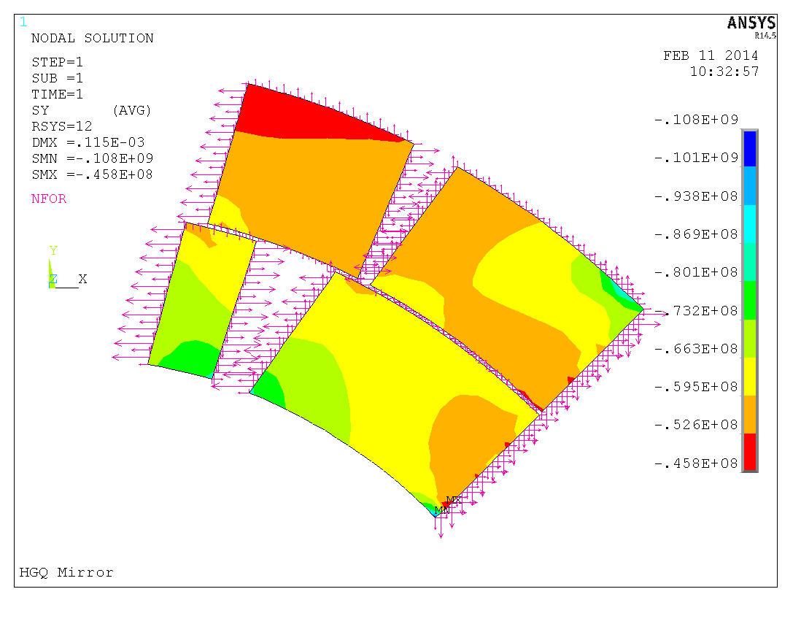
300K
Saz, Pa
Radial Shim=0.1mm

Slide 26
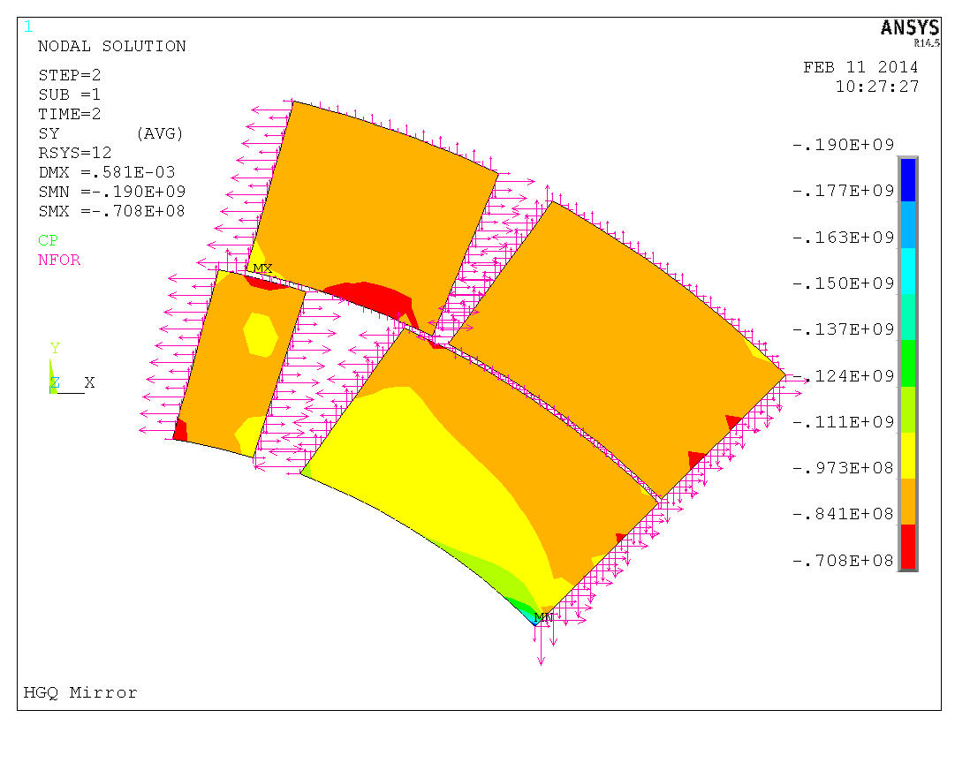
4K
Saz, Pa
At quench current the azimuthal Lorentz force in the mirror is ~30% lower than in the quadrupole model => lower coil prestress needed.

Slide 27
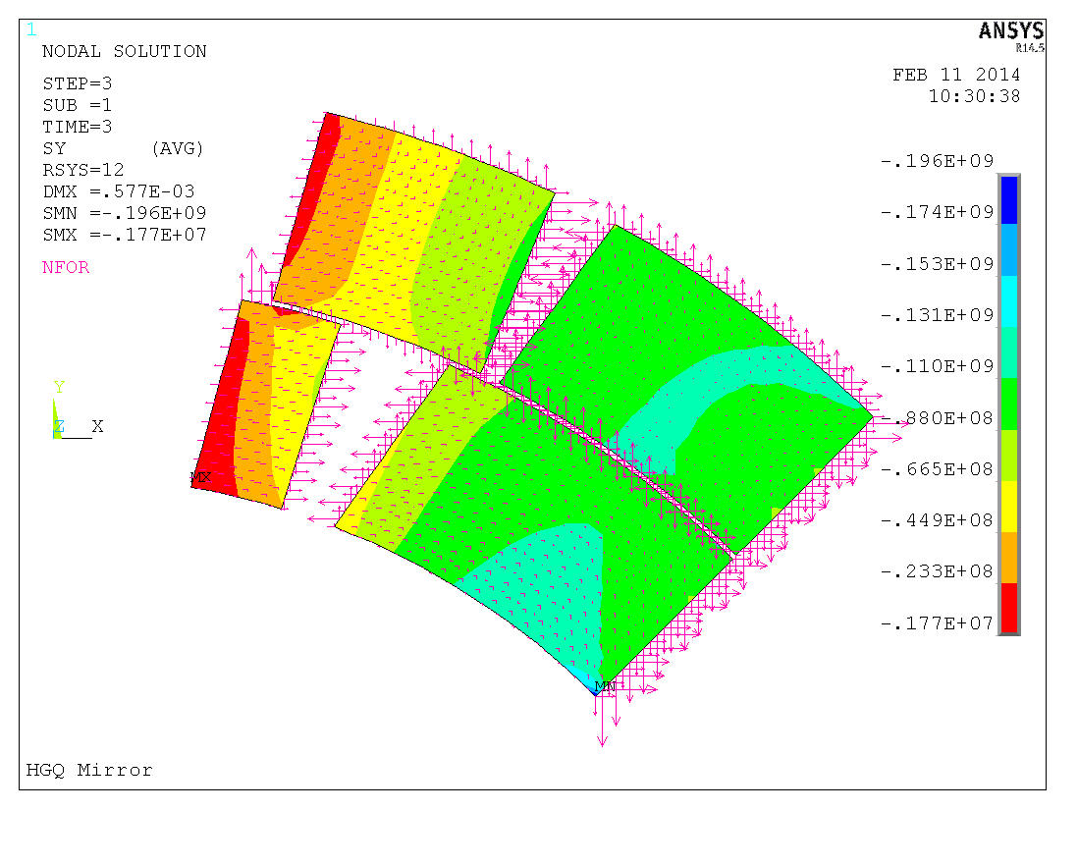
4K 11.9T 18kA
Saz, Pa
Radial Shim=0.1mm

Slide 28
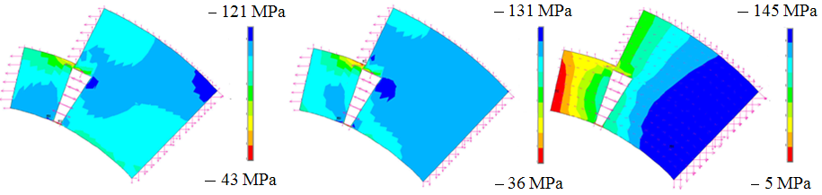
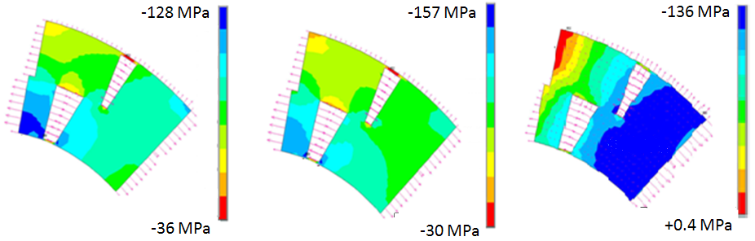
Coil Stress in TQ and HQ mirrors (for reference)
300 K
4 K
4 K, 14 kA, 17 kA
90 mm
28
120 mm

