Slide 1
SBND Cryostat
Dimitar MLADENOV
Director’s Progress Review of SBN
15-17 December 2015

Slide 2
Who Am I and Where Have I Been?
Leading engineer of CERN Neutrino platform.
Member of the SBND Collaboration.
Experience includes 15 years as project engineer on structures for large scale physics detectors, from its conceptual stage to the final commissioning.
Large experience on design, manufacturing, underground installation, assembly and logistics.
Education as Mechanical Engineer (PhD).

Slide 3
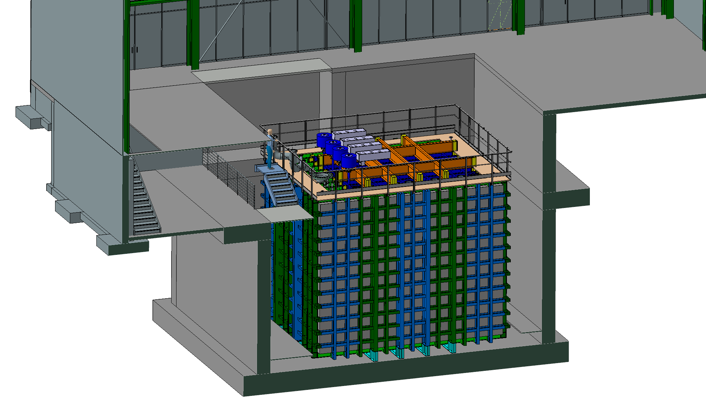
System Scope
To design and manufacture a cryostat, based on the GTT membrane technology
The cryostat will be installed at Fermilab

Slide 4
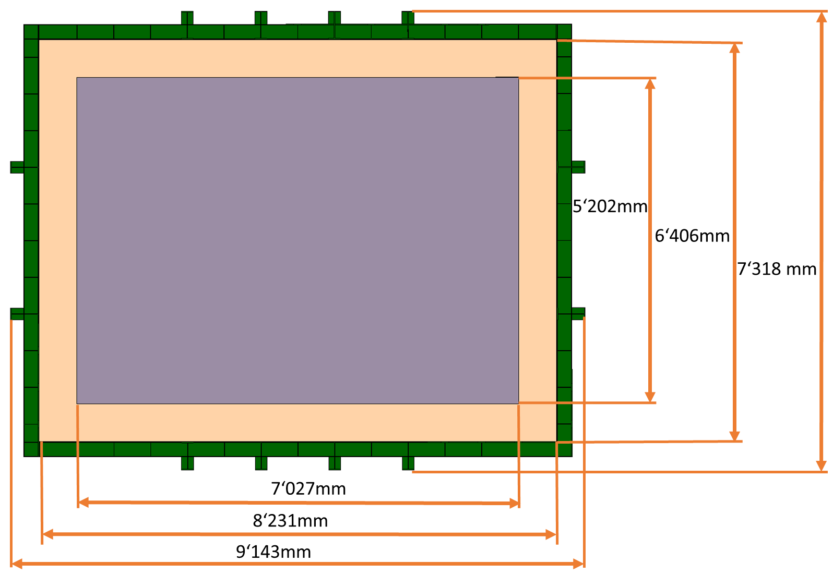
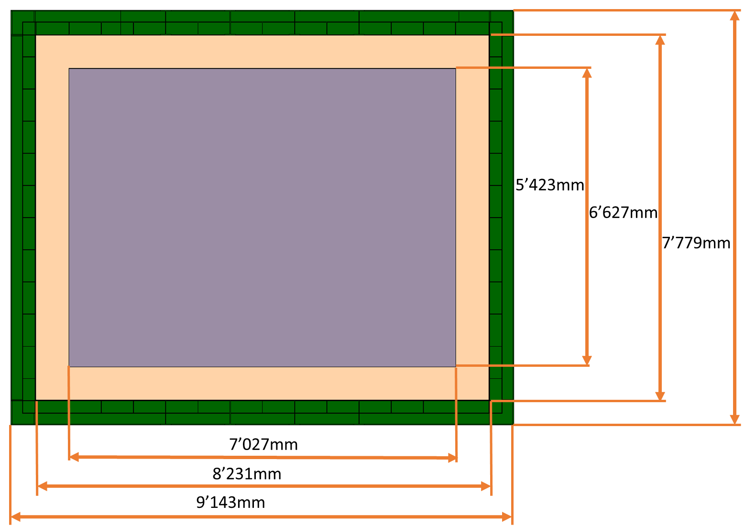
Cryostat Size
SBND Cryostat – Dimensions
Cryostat external dimensions:
  Width: 7’318mm
  Length: 9’143mm
  Height: 7’779mm
Cryostat internal dimensions:
  Width: 5’202mm
  Length: 7’027mm
  Height: 5’423mm
Internal volume:
  198m³
Insulation Thickness:
  600mm
  Heat Leak: <15W/m² side and <20W/m² top

Slide 5
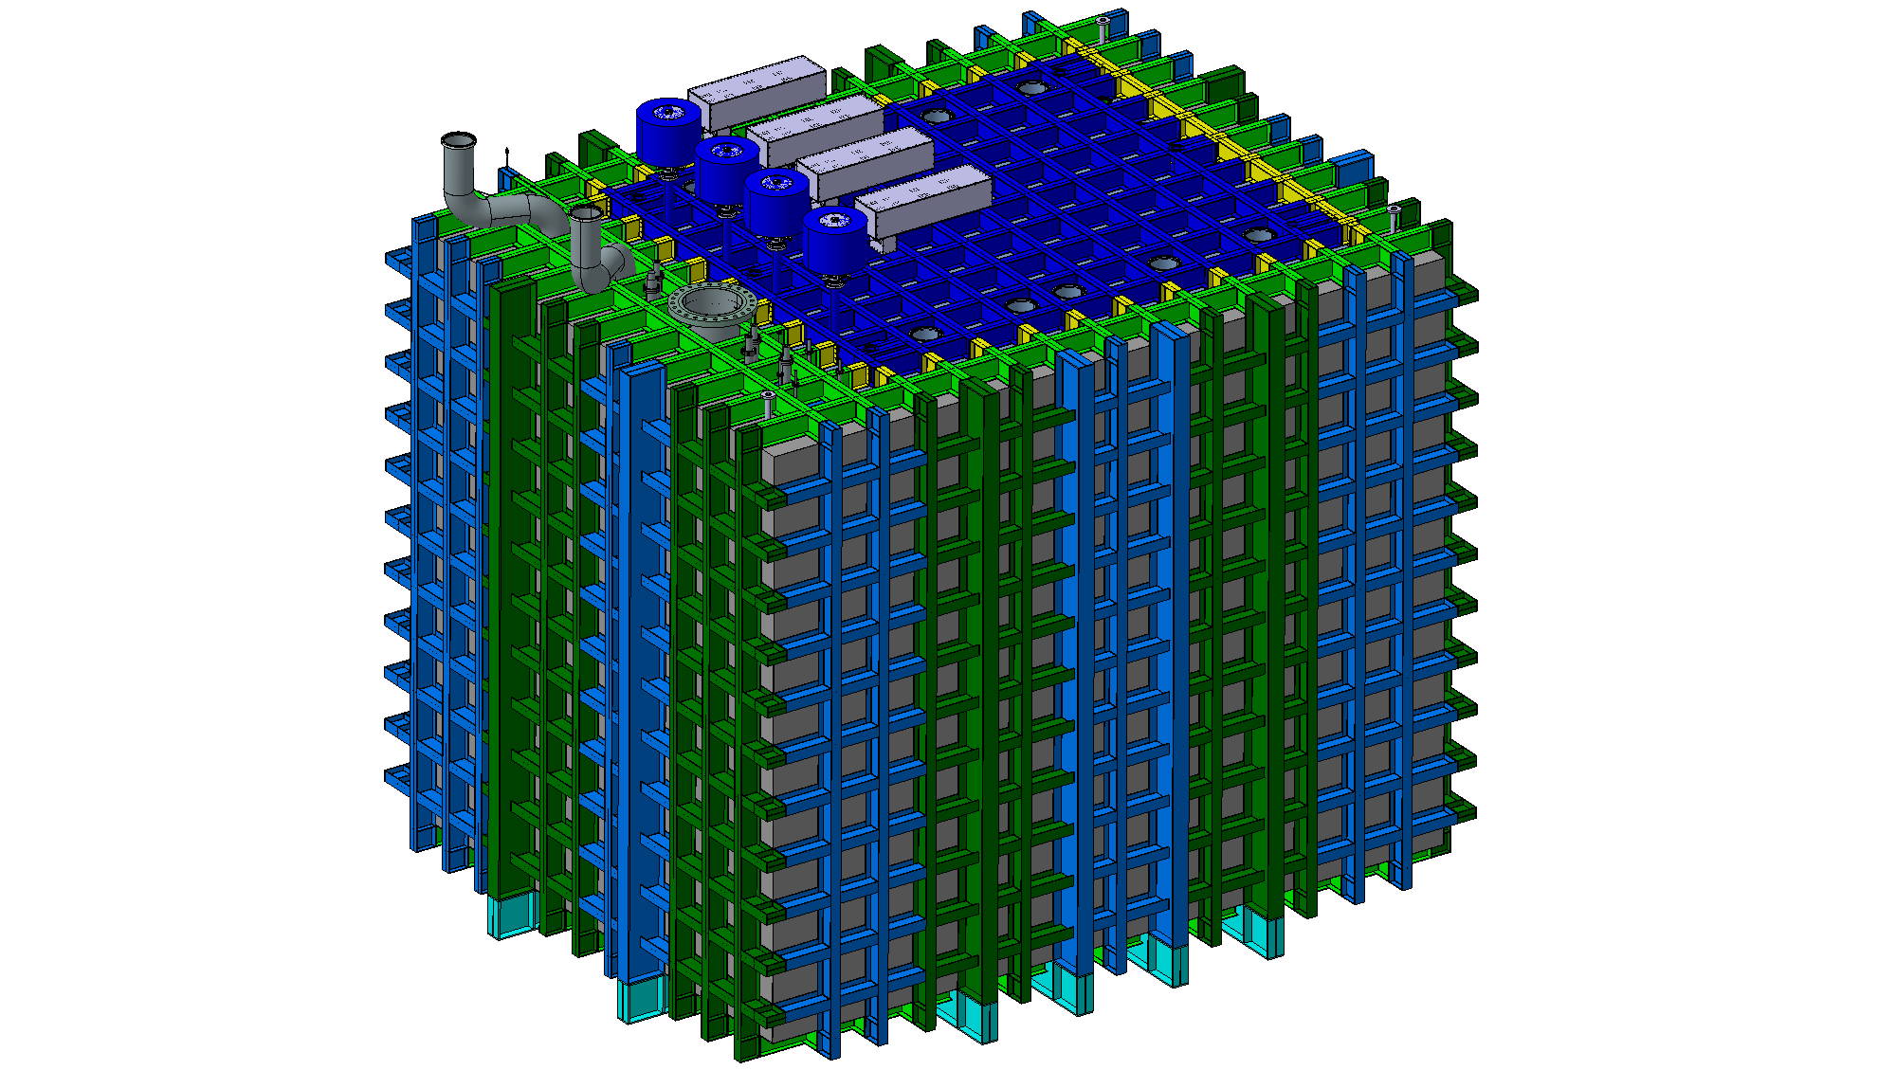
Status of Design
Roof
Penetrations
6mm stainless steel plate
Steel structure from I-Profiles
  IPE240
  IPE450
Material
  S460ML
Outer skin
  Stainless steel 304L plate – 6mm
IPE240
IPE450
SBND Cryostat – Outer Structure

Slide 6
Logistics (weights & transportation)
Main beams: IPE450 – 77.6 kg/m
Web interlinks: IPE240 – 30.7 kg/m
Total Steel profiles: 40 T
The 6 mm SS plates: 48 kg/m²
Total SS plate: 14 T
Insulation (600mm) including the primary membrane: 83 kg/m²
Total insulation and membrane: 18 T
Total Steel Structure: 72 T (this includes: Steel profiles, Stainless steel plate, insulation and membrane)
LAr weight: 266 T
Transported in sub-assemblies (29 pieces)
  Sizes around 2’000mm x 7’500mm
  Weight between 2 T and 3 T

Slide 7
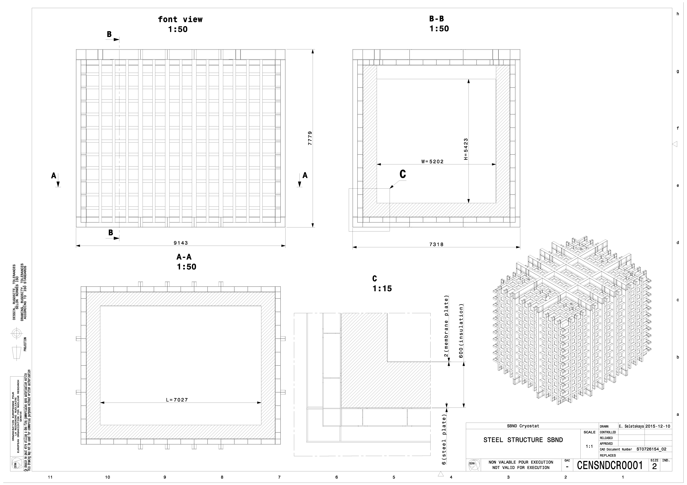
Drawings (Cryostat)
SBND Cryostat - Layout Drawing

Slide 8
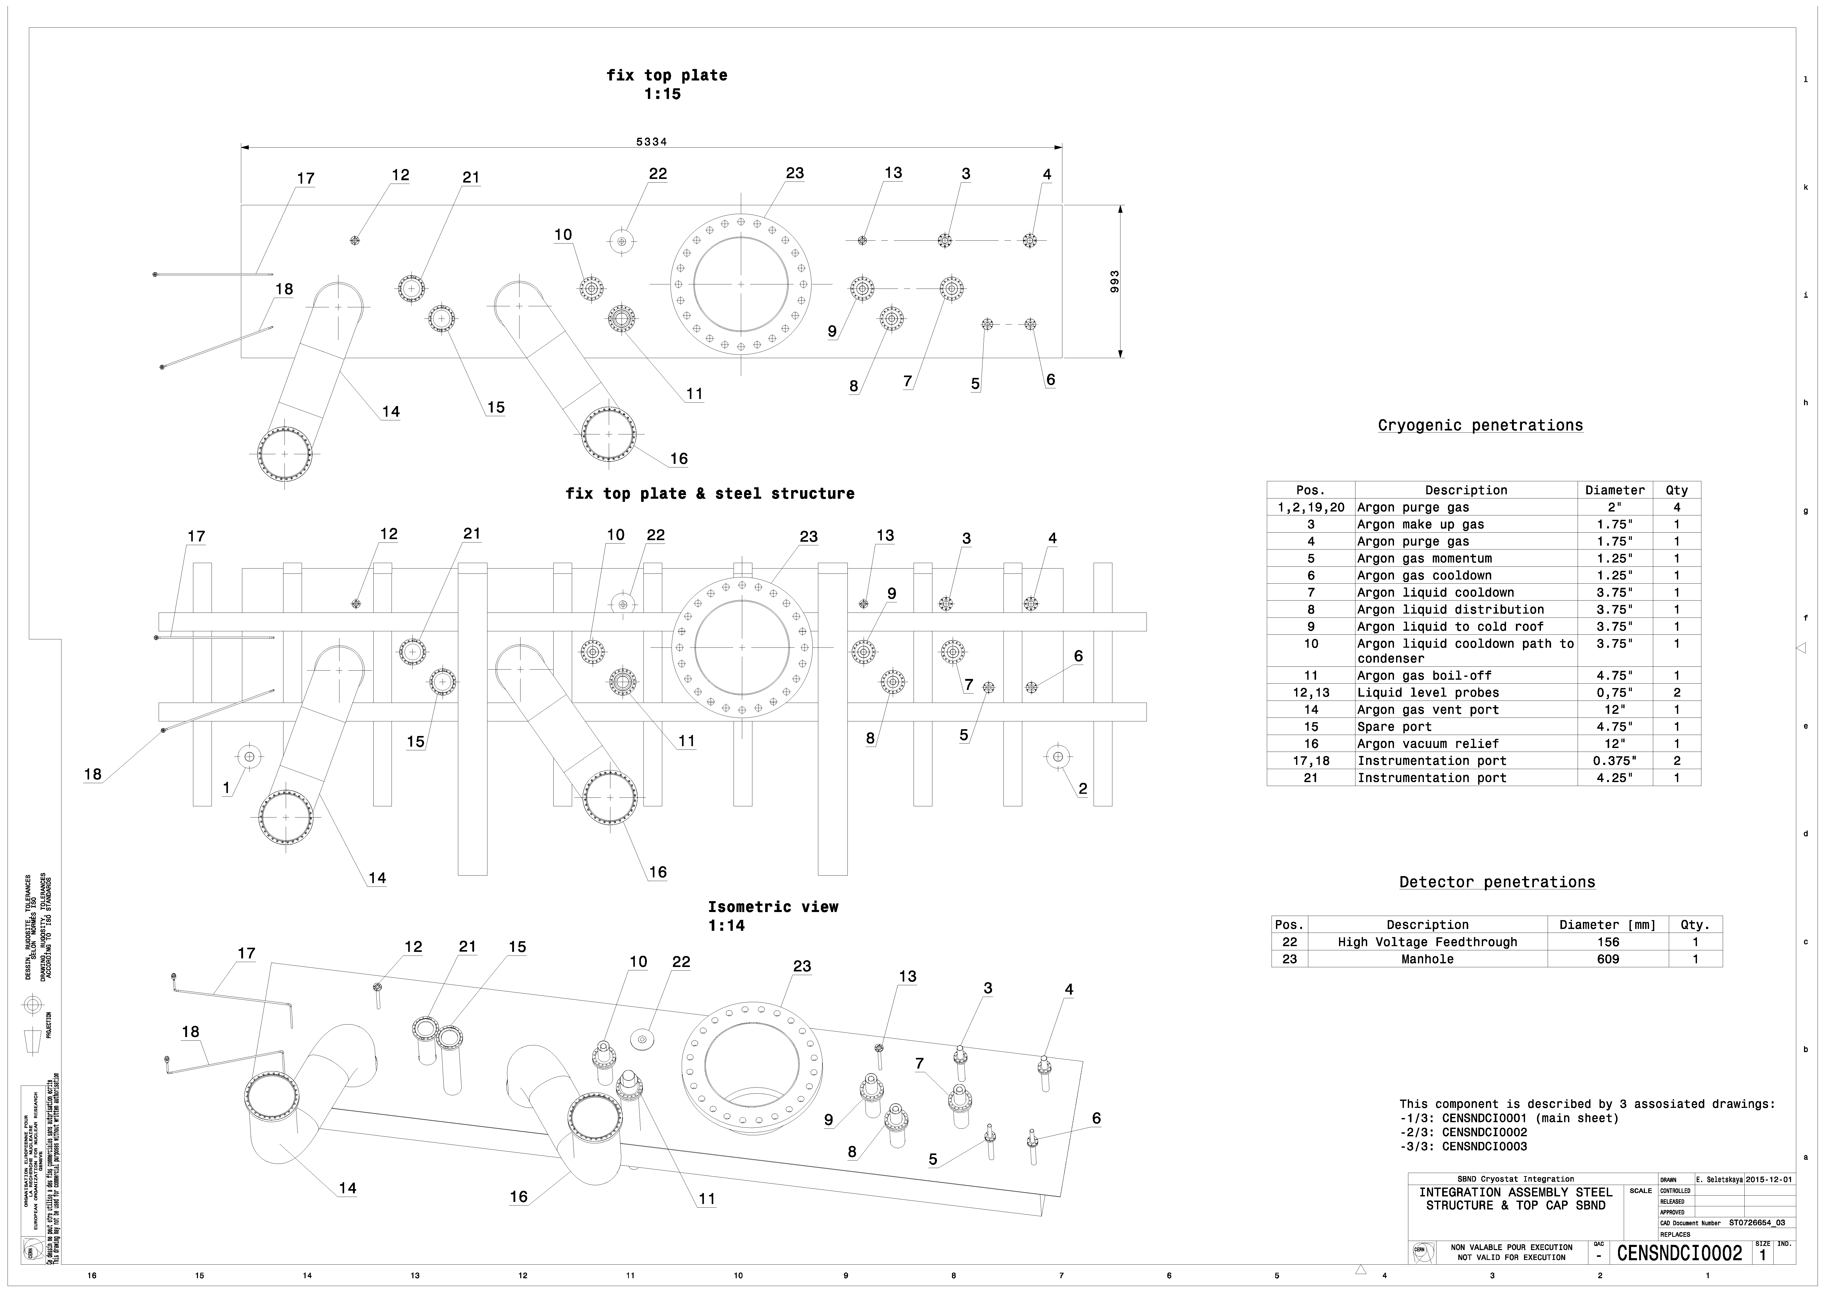
Drawings (Cryogenic Penetrations)
SBND Cryostat – Roof penetrations – Cryogenics

Slide 9
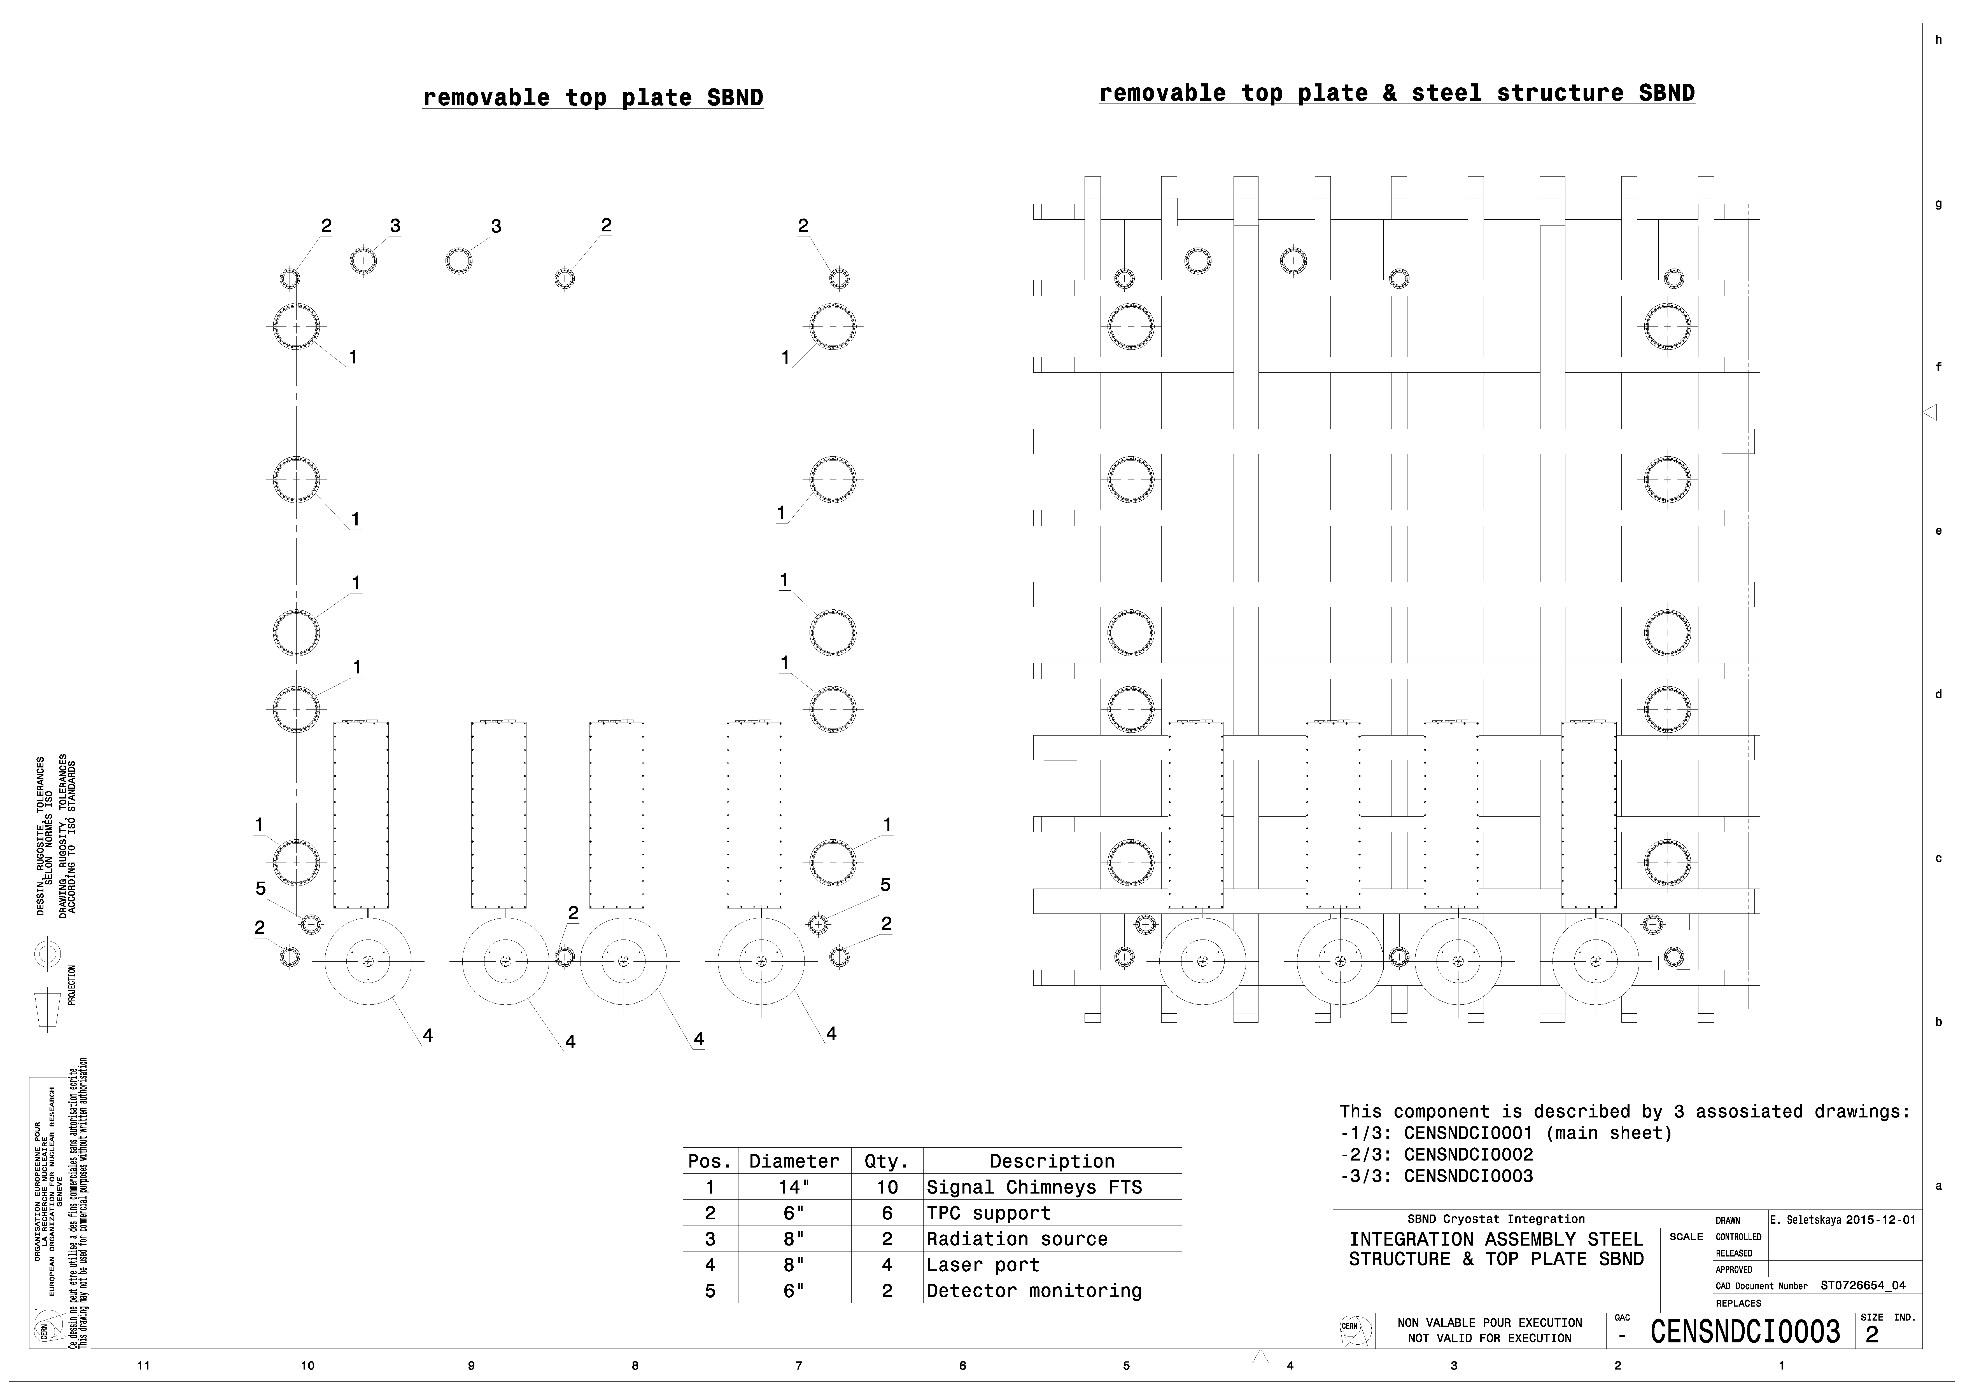
Drawings (Detector Penetrations)
SBND Cryostat – Roof penetrations – Detector

Slide 10
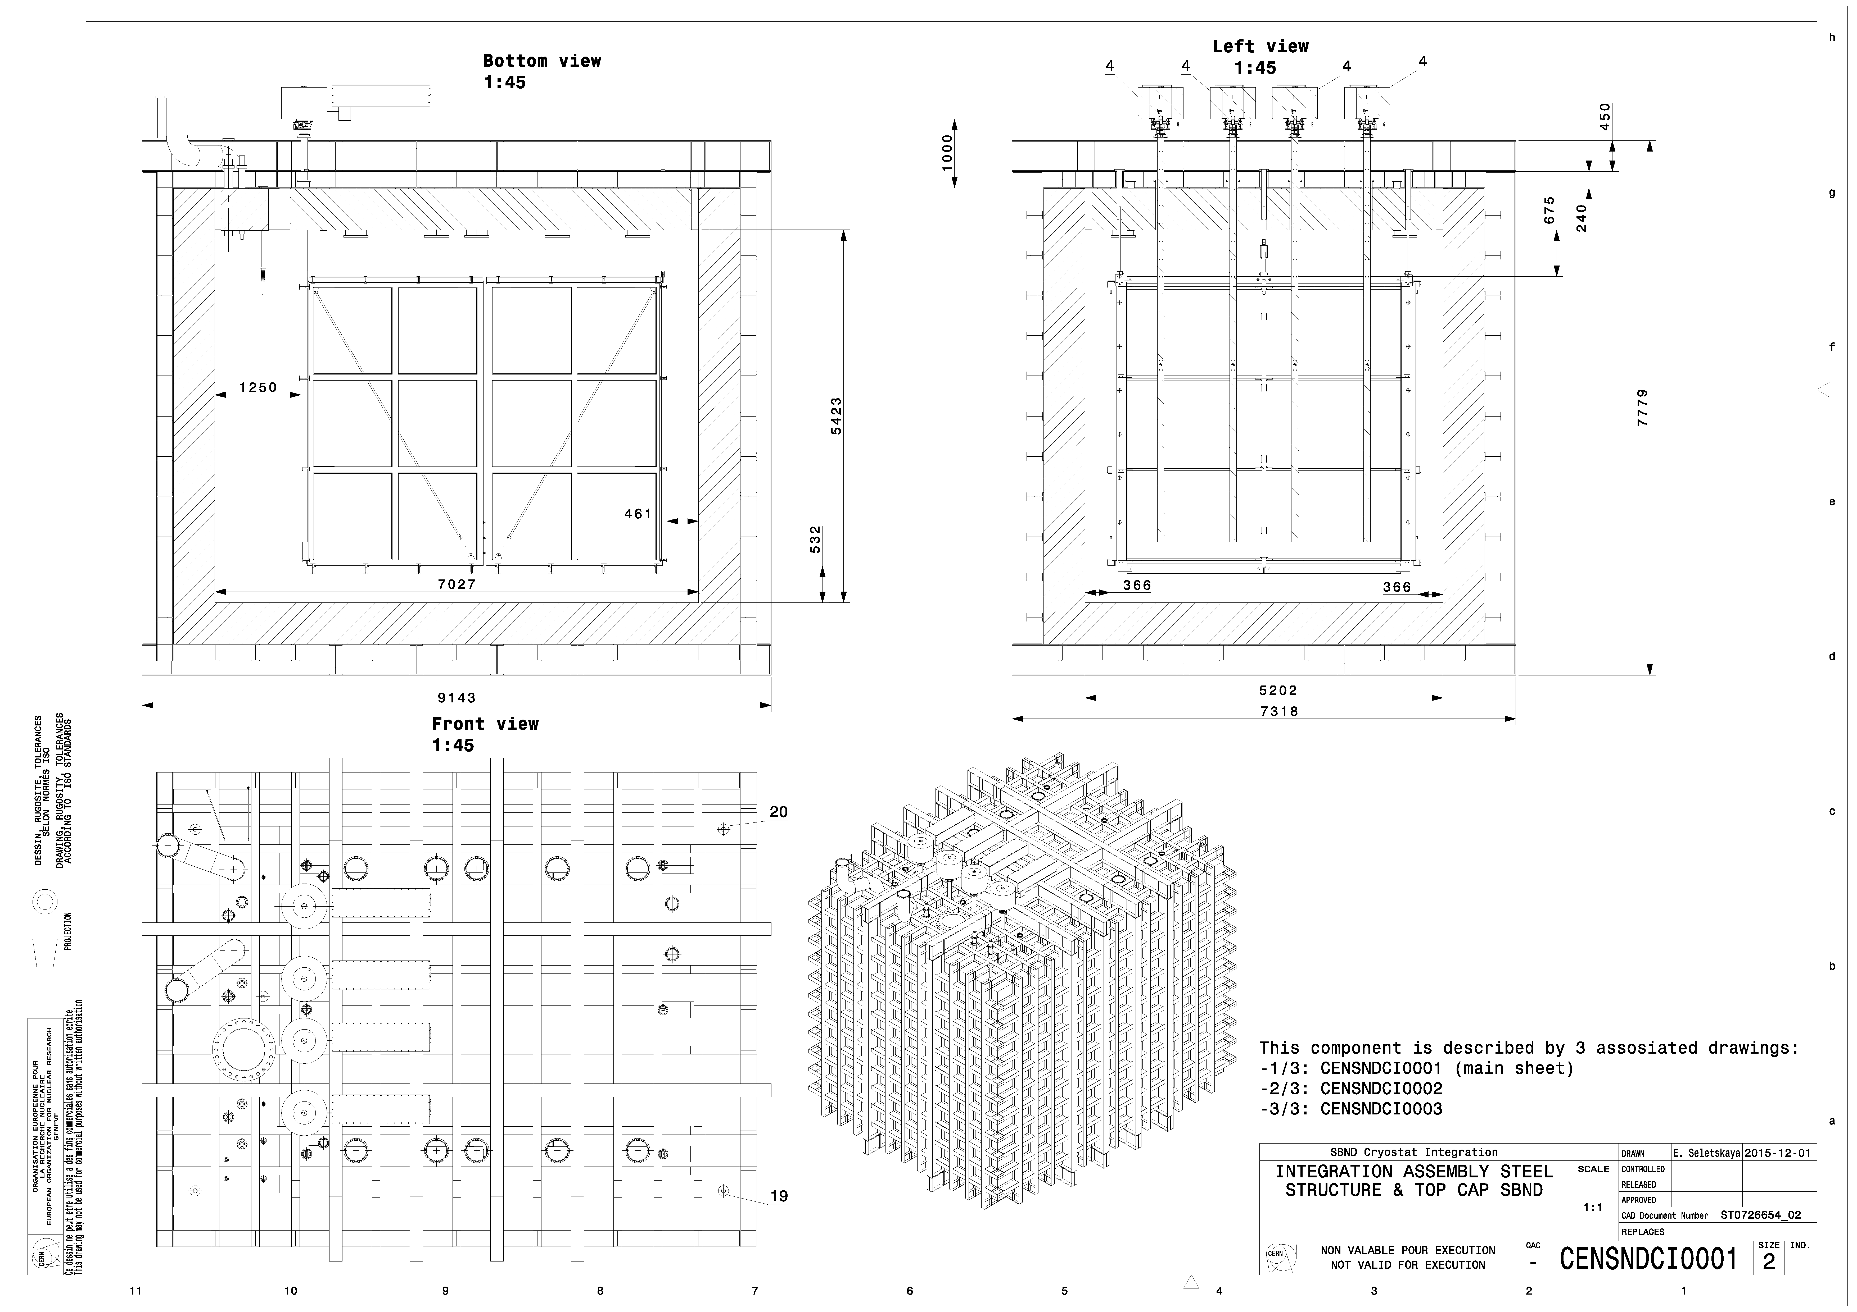
Drawings (Integration)
SBND Cryostat – Detector Integration

Slide 11
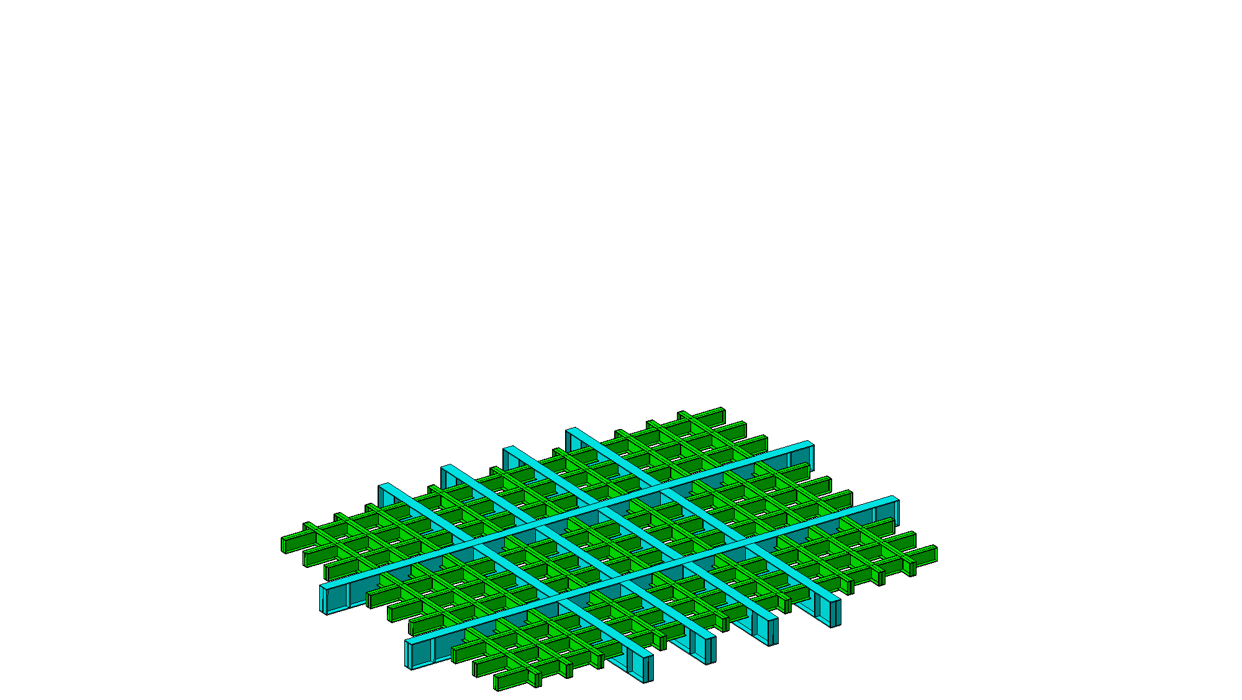
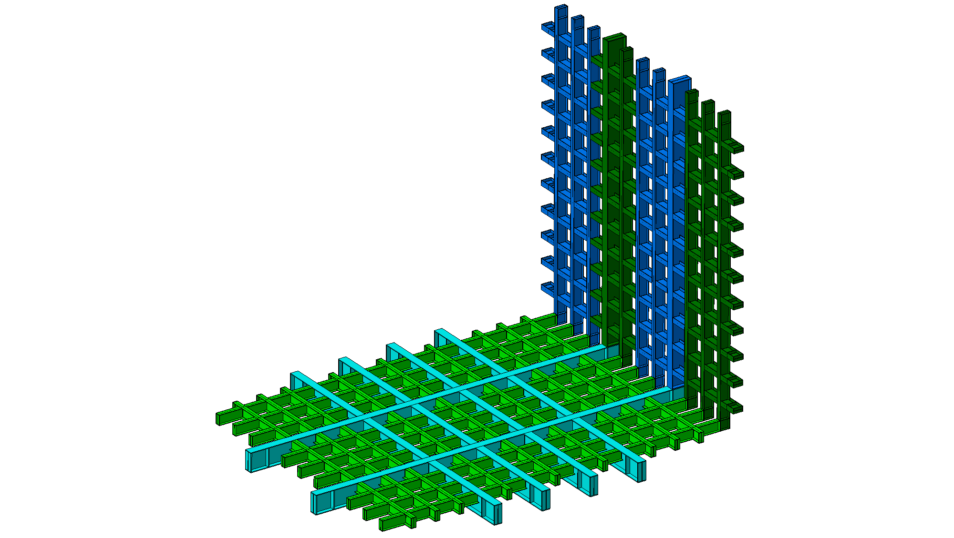
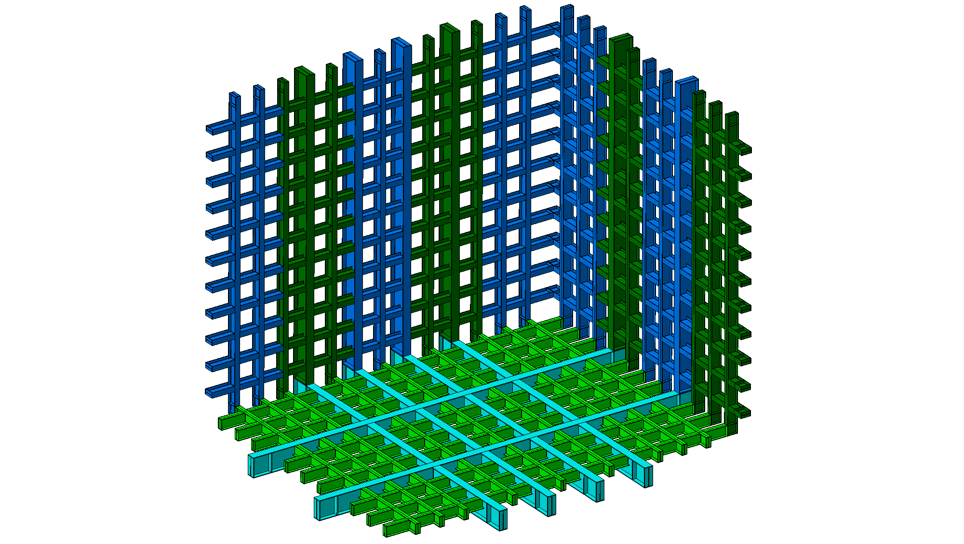
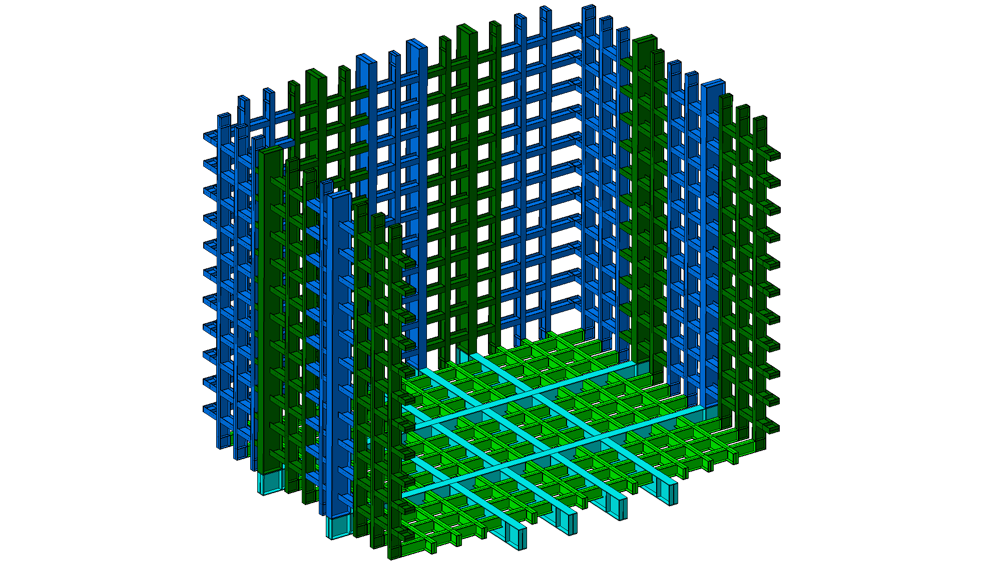
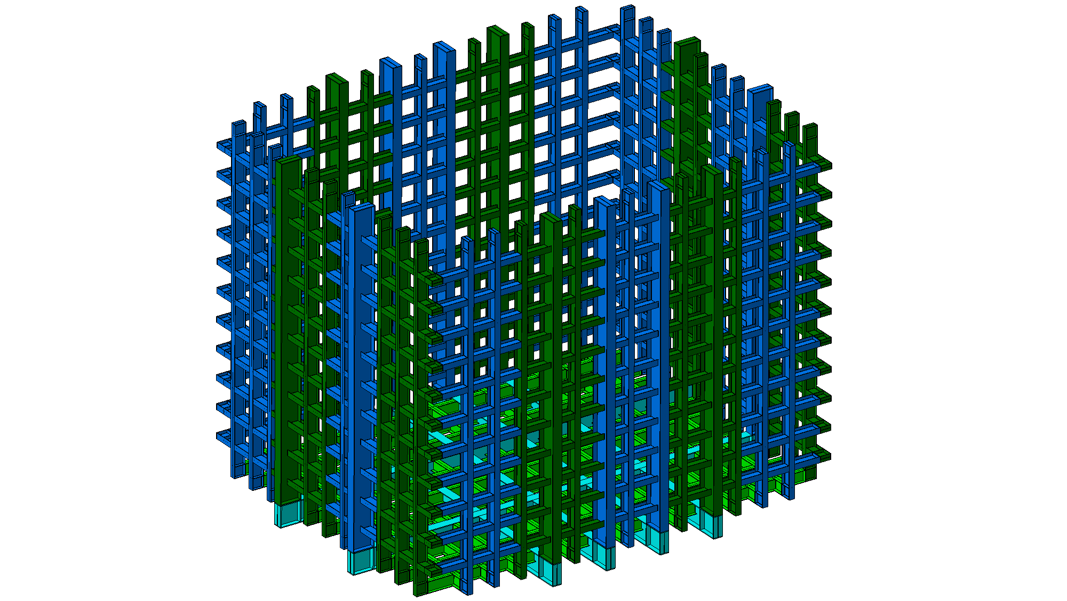
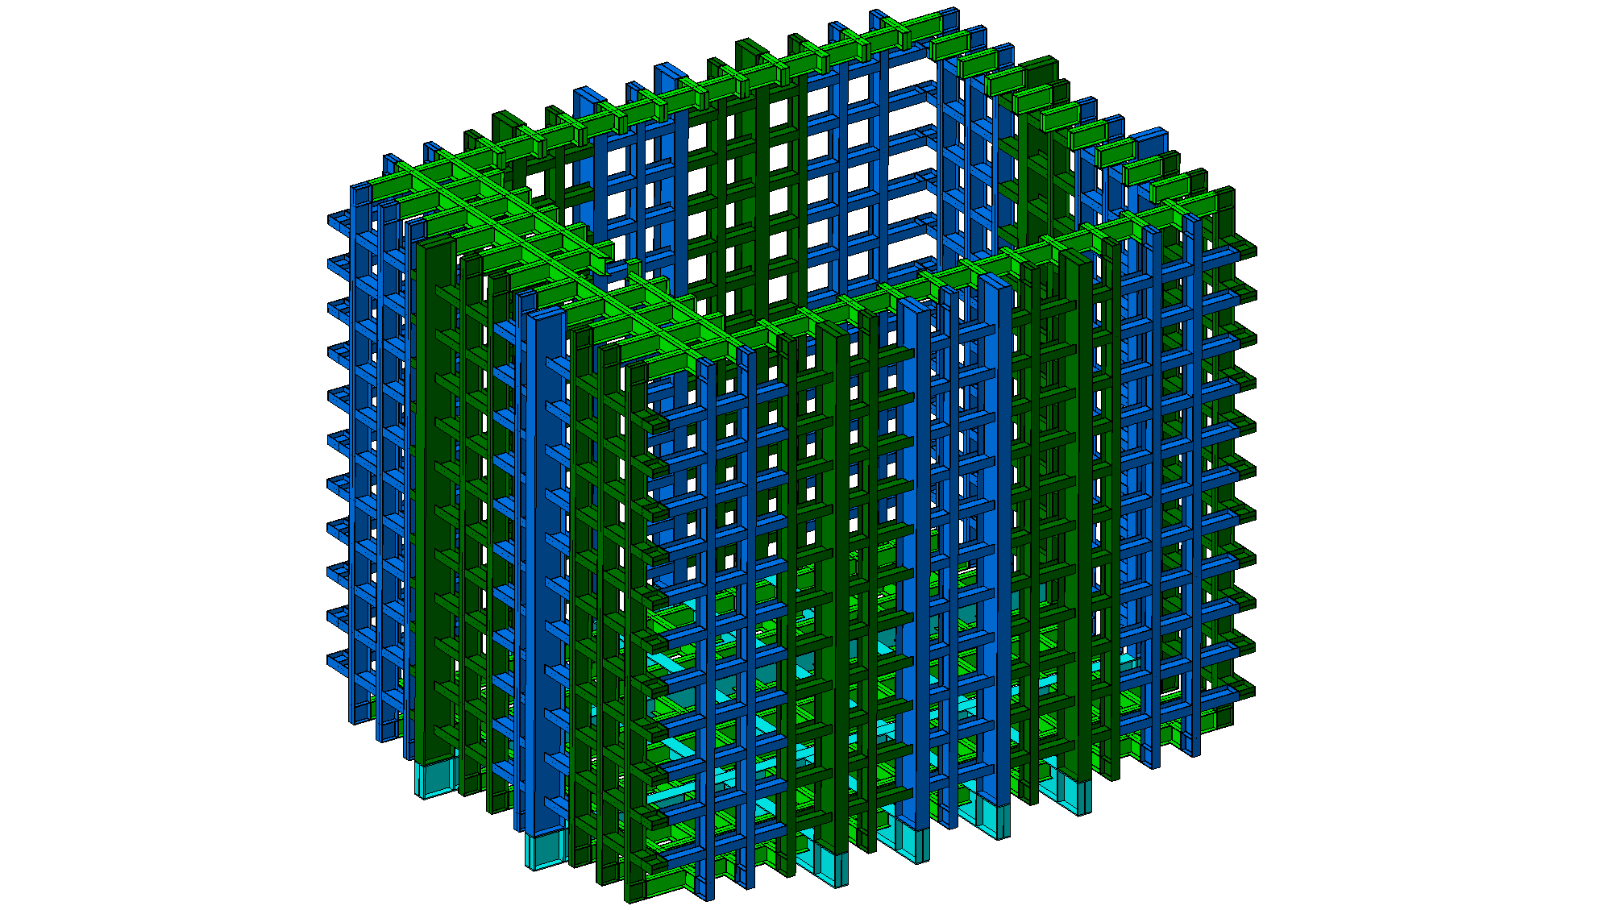
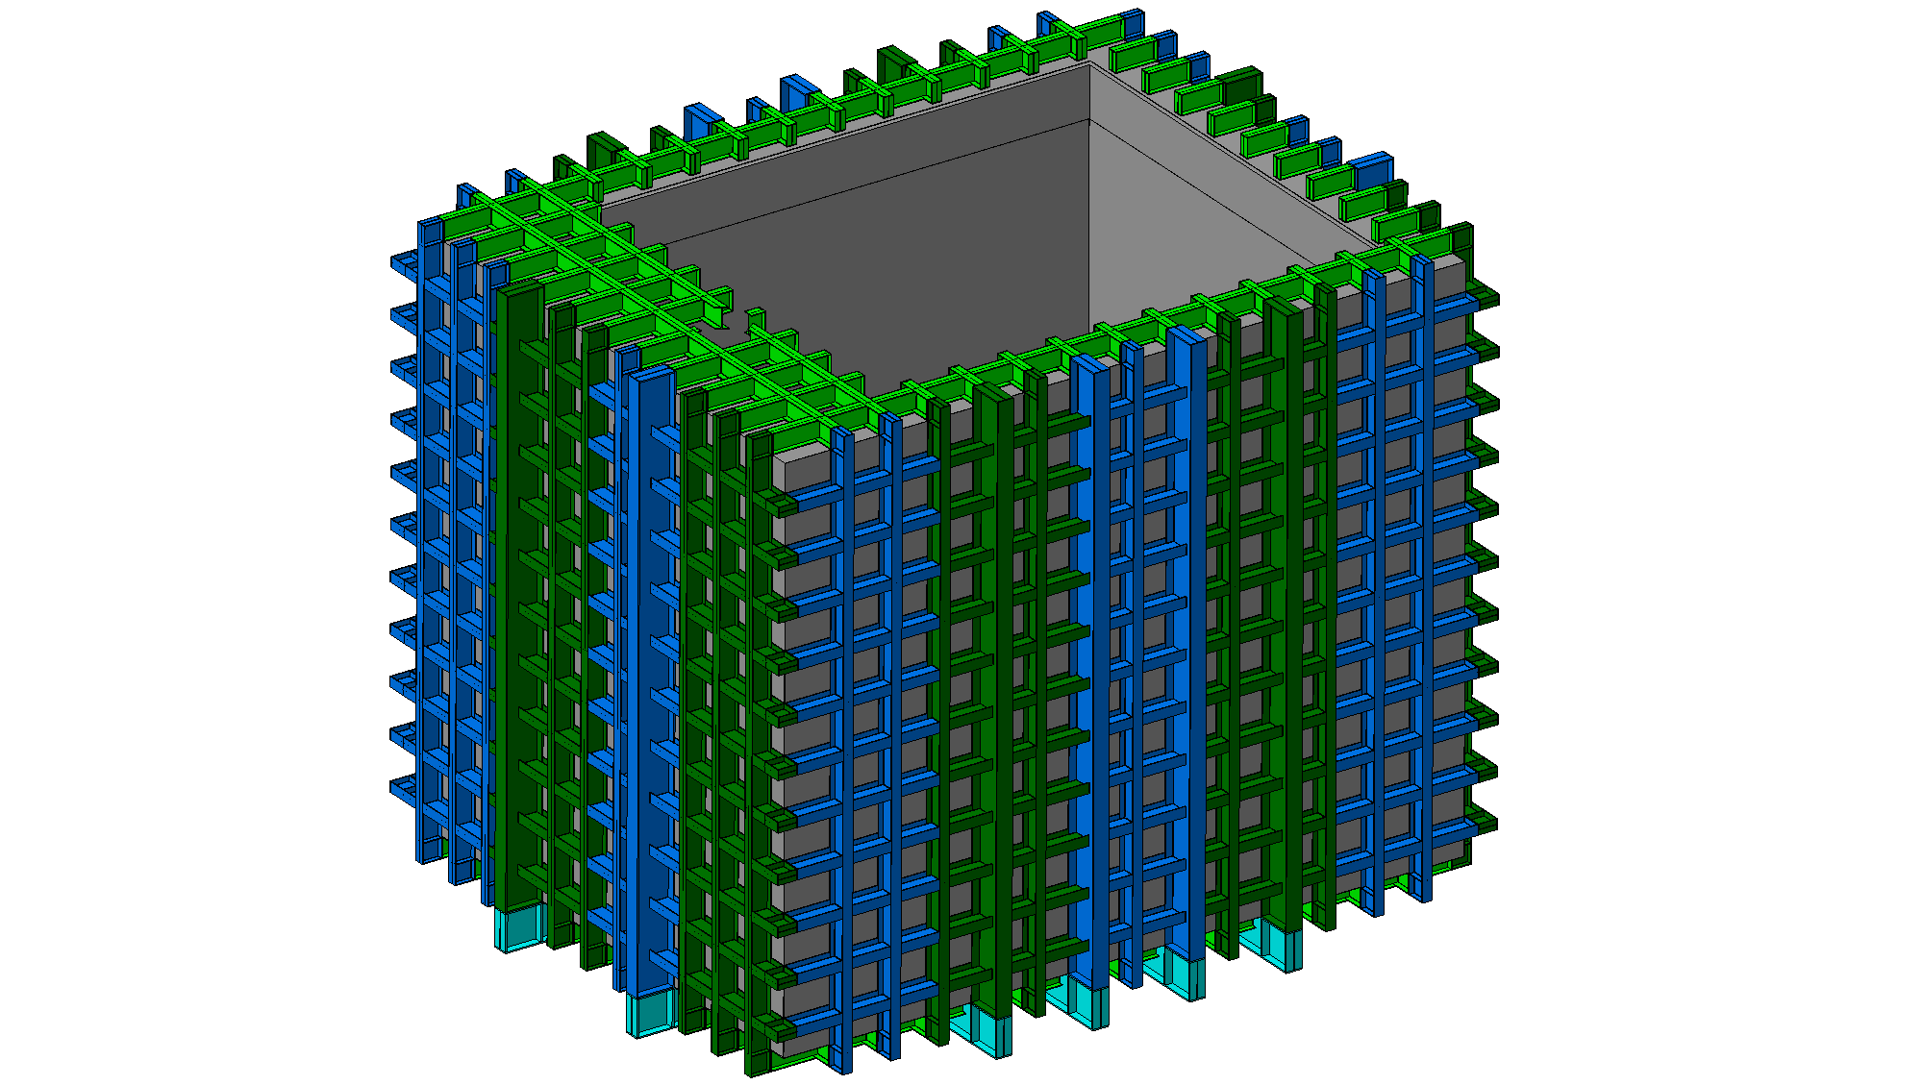
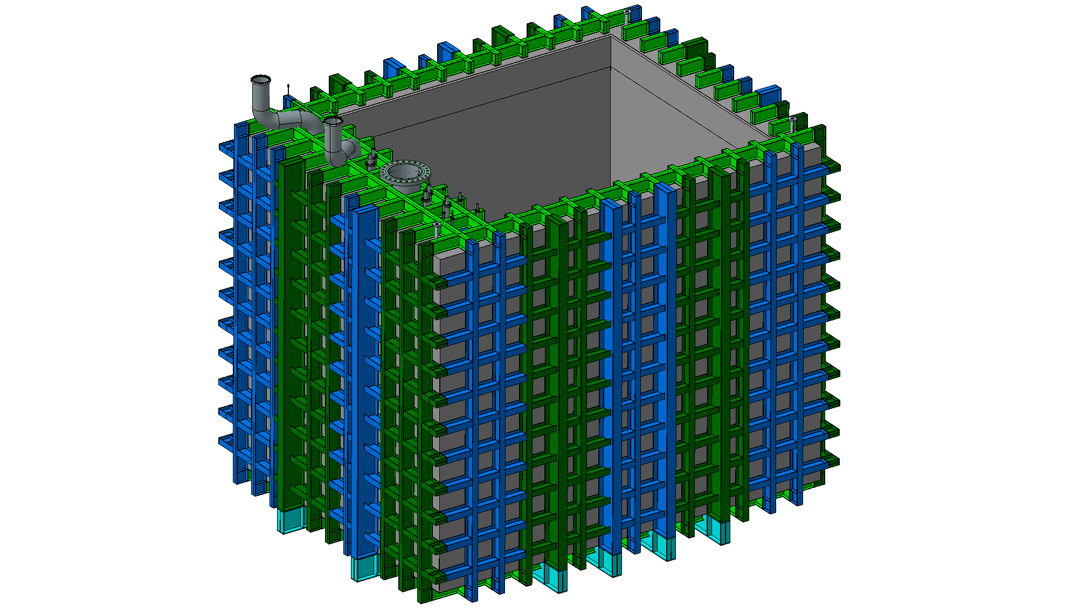
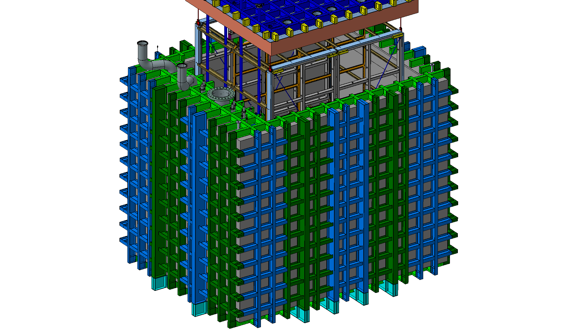
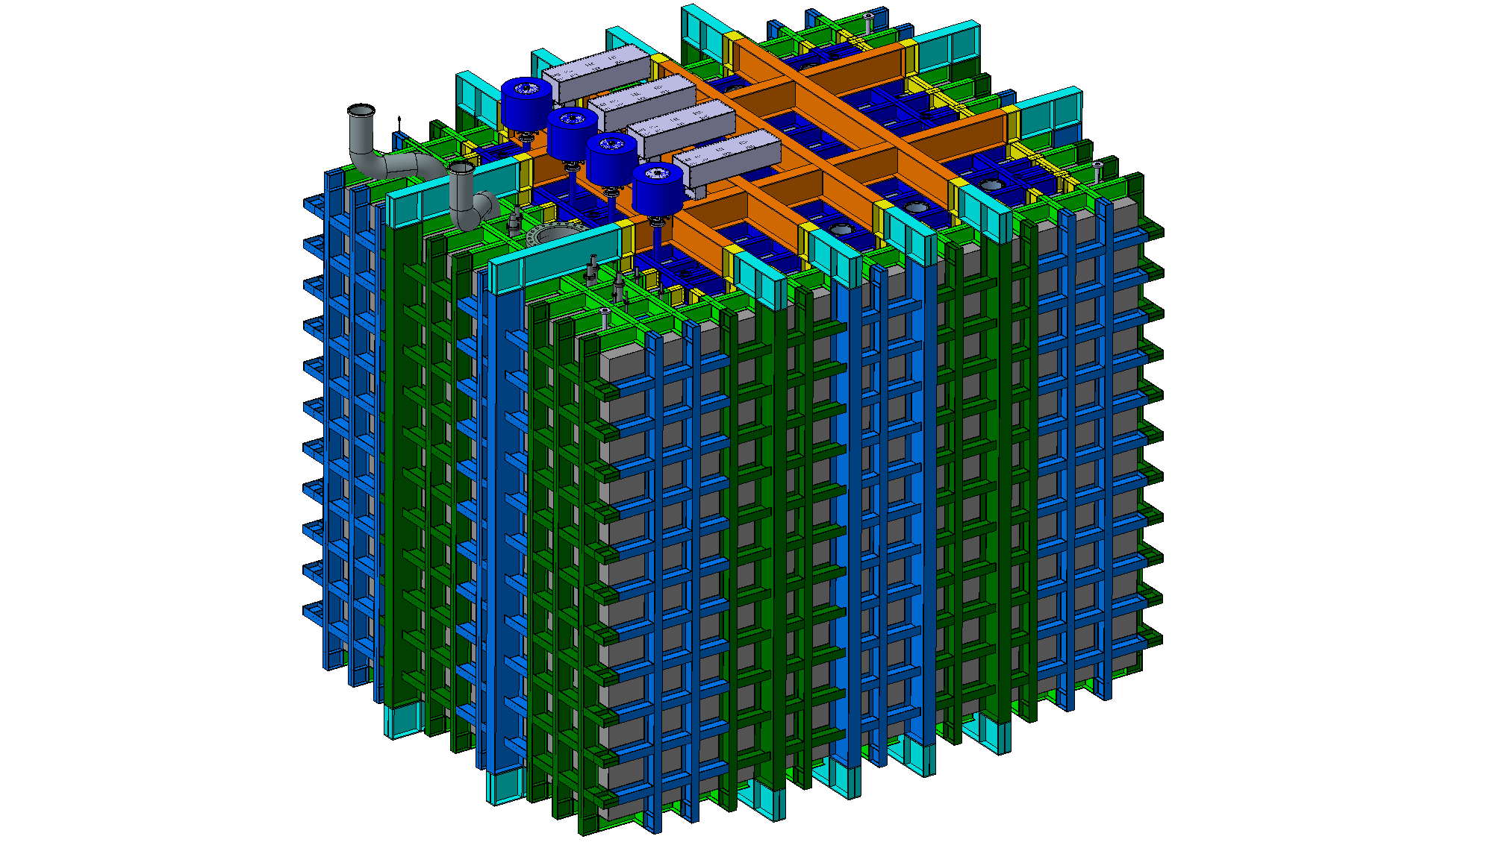
Cryostat Assembly

Slide 12
SBND – Detector Building integration
What has been done
What reviews have been completed or are planned for near future

Slide 13
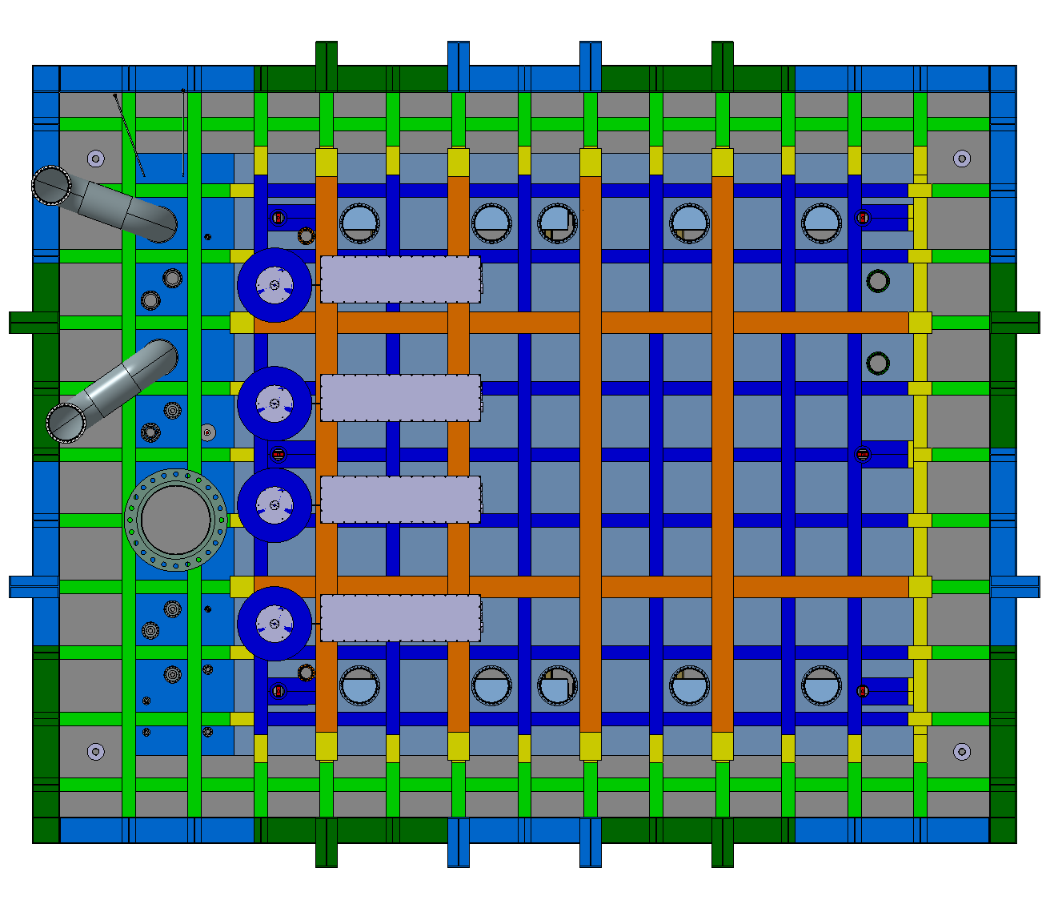
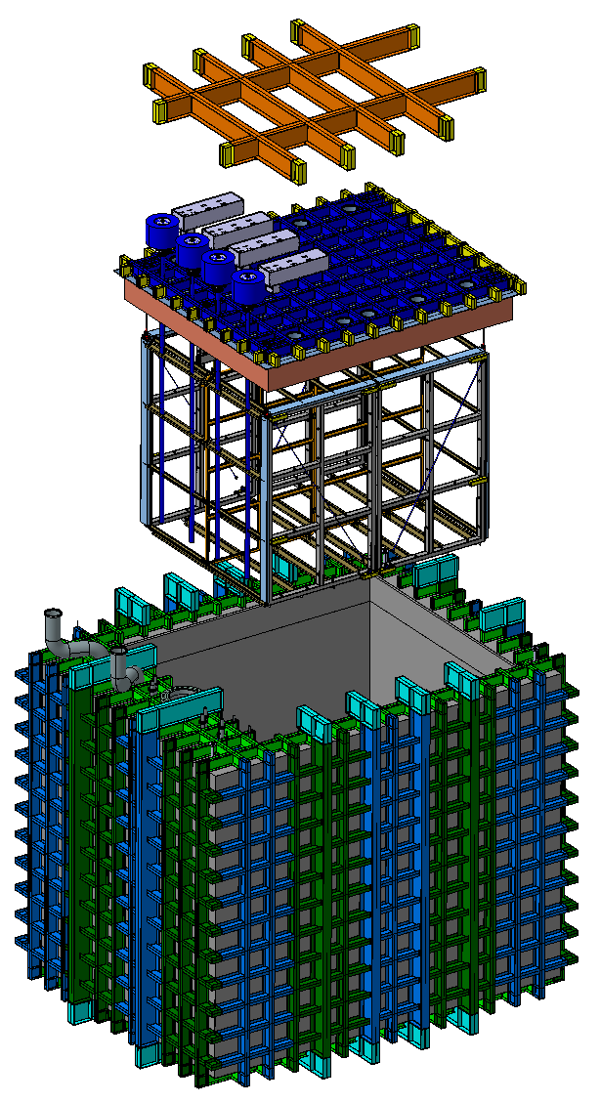
Integration & Assembly Studies

Slide 14
Lasers Integration

Slide 15
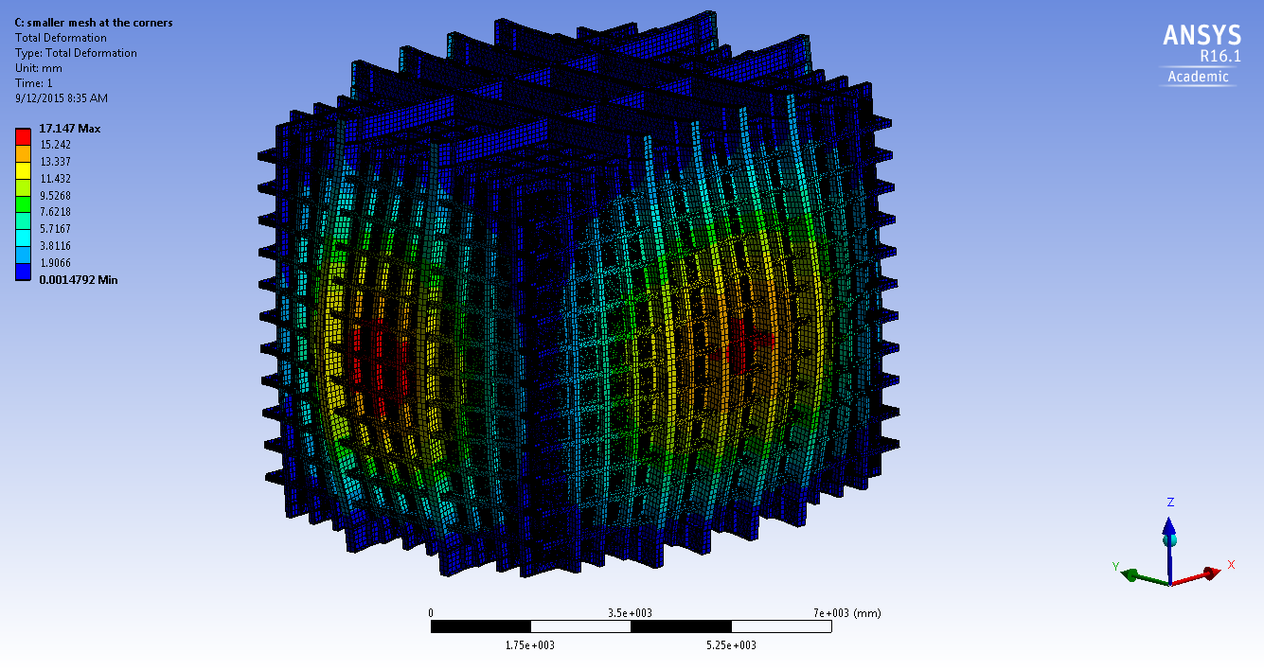
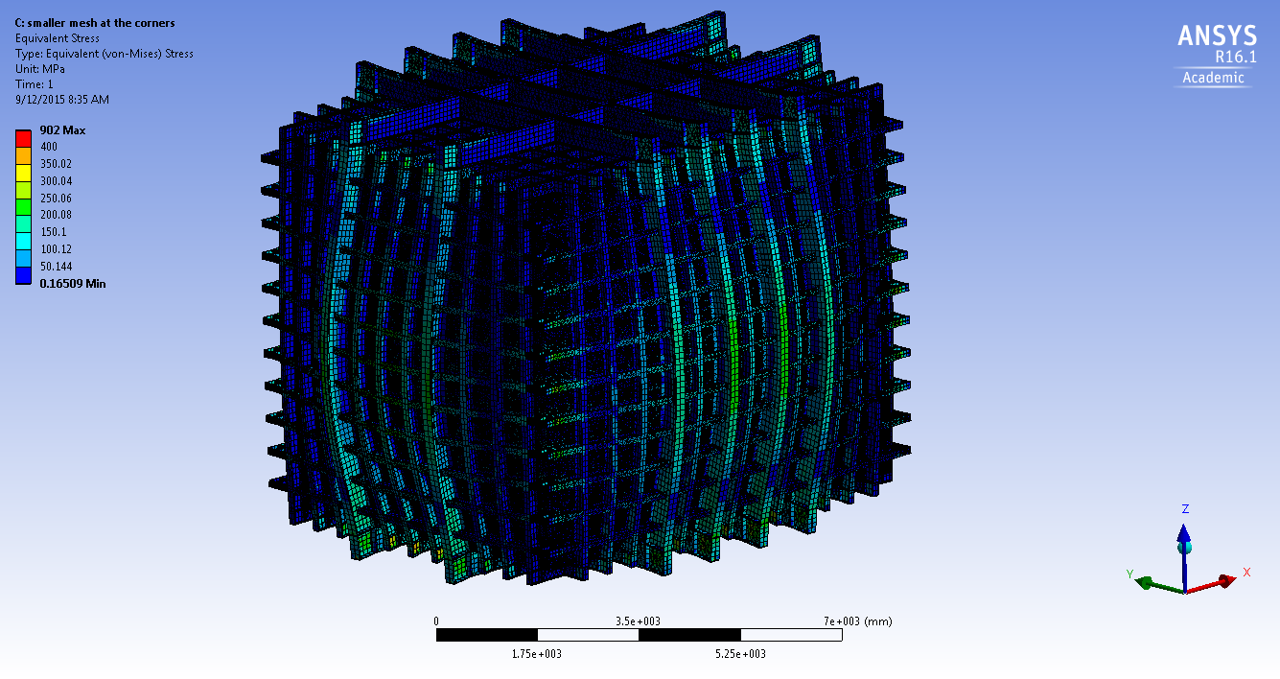
Calculations
Designing code:
  Eurocode 3 / ANSI/AISC 360
Structural analysis done, but report not yet finalized
Deformations [mm]
Stresses [MPa]
MOU between Fermilab and CERN on Design, Fabrication, Installation and Testing of Membrane Cryostats is, or will be, closely followed

Slide 16
Documents
SBND - Warm cryostat functional requirements
https://edms.cern.ch/document/1531611
SBND - Cryostat structure drawings
https://edms.cern.ch/document/1531612
SBND - Cold cryostat technical requirements
https://edms.cern.ch/document/1553294
SBND - Cryostat penetrations drawings
https://edms.cern.ch/document/1553295
SBND - Cryostat floor loading
https://edms.cern.ch/document/1531615
SBND - Cryostat roof deformations
https://edms.cern.ch/document/1531616
SBND - Cryostat warm structure analysis
https://edms.cern.ch/document/1531617
SBND - Cryostat specific drawings and models
https://edms.cern.ch/document/1568176

Slide 17
Summary
Design close to final
Penetrations understood and agreed by both sides
Current height of the structure compatible with FNAL requirements
Activities proceeding as planned

Slide 18
Thank you!

