Slide 1
Status of ICARUS
C. Montanari – CERN / INFN-PV

Slide 2
Foreword
In 2013 ICARUS concluded a very successful, long duration run with the T600 detector at the LNGS underground laboratory taking data both with the CNGS neutrino beam and with cosmic rays. Several relevant physics and technical results were achieved.
It is mainly thanks to the continuing efforts of the ICARUS Collaboration and to the support of INFN, that the LAr TPC technology has been taken to full maturity. The T600, with about 500 ton of sensitive mass, is the largest LAr TPC ever constructed.
The T600 detector is now at CERN for a significant overhauling in view of the short baseline neutrino experiment on the FNAL Booster and NUMI beams.
The experiment is expected to start data taking by end 2017.

Slide 3
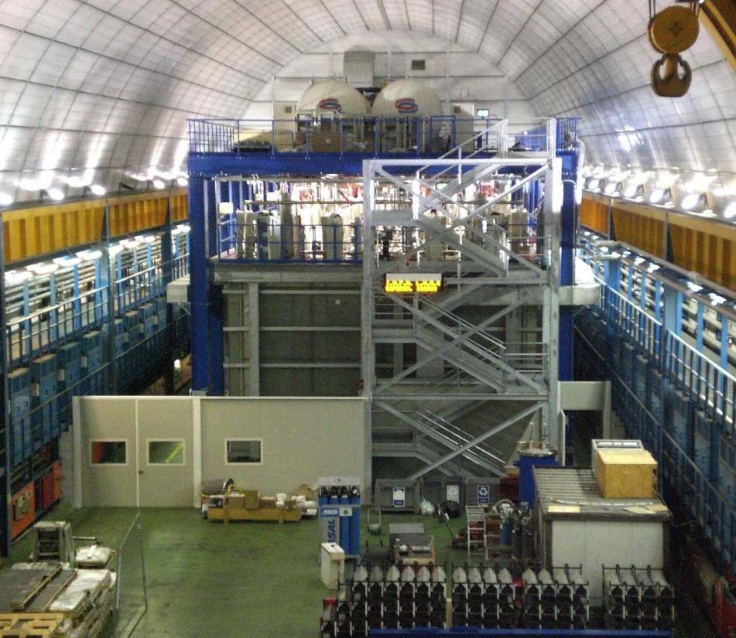
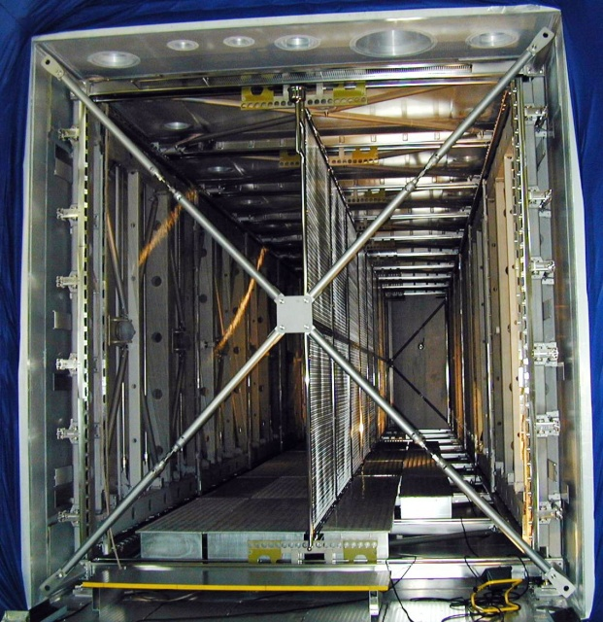
ICARUS-T600 detector at LNGS
cathode
LN₂ vessels
1.5m
cryogenics
(behind)
readout electronics
T300
T300
E
E
readout wire arrays
Two identical modules (T300)
  3.6x3.9x19.6 = 275 m³ each
  Liquid Ar active mass: ~476 t
  Drift length = 1.5 m (1 ms)
  HV = -75 kV; E = 0.5 kV/cm
  drift velocity = 1.55 mm/μs
  Sampling time 0.4 μs (sub-mm resolution in drift direction)
4 wire chambers
  2 chambers per module
  3 “non-distructive” readout wire planes per chamber wires at 0, ±60° (ind1, ind2, coll view)
  ~ 54000 wires, 3 mm pitch and plane spacing
  Charge measurement on collection plane
20+54 8” PMTs for scintillation light detection
  VUV sensitive (128nm) with TPB wave shifter

Slide 4
T600 overhauling activities in progress
  The following main activities are being developed to setup the ICARUS T600 detector for the SBN run at Fermilab:
    New PMTs system deployment;
    Cathode substitution/”planarization”;
    Detector re-cabling;
    New readout electronics;
    New cold vessels construction;
    New thermal insulation;
    Maintenance and partial replacement of cryogenics and purification systems;
    Construction of the Cosmic Rays Tagger.

Slide 5
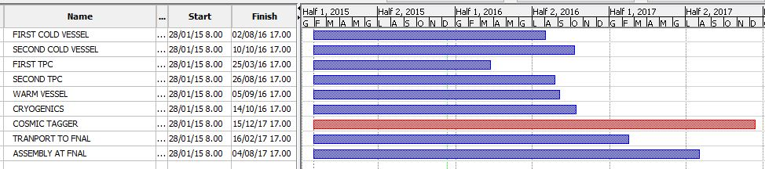
General schedule
NOW

Slide 6
New PMTs system deployment
    The mechanical design of the new scintillation light collection system has been completed for the chosen configuration. All the components have been delivered to CERN.
    The PMTs are being produced by Hamamatsu. The 20 pre-series samples arrived at CERN at the end of September. All units have been tested and certified both at room temperature and in LAr.
    The first production batch of 80 PMTs has been delivered and is presently under test (room temperature and LAr). The second production batch of 100 PMTs is being delivered.
    Design of a second version of new bases has been completed. The full production has been ordered and a pre-series has been delivered.
    The setup for testing and pre-assembling of the PMTs is operational: two locations, B182 for cold tests and Ideasquare for warm tests and pre-assembly.
    The TPB evaporator is installed in B169. Evaporation protocol was established after several tests. Production is ongoing (4 evaporations/day).
    See G.L. Raselli presentation in the breakuot session for additional details.

Slide 7
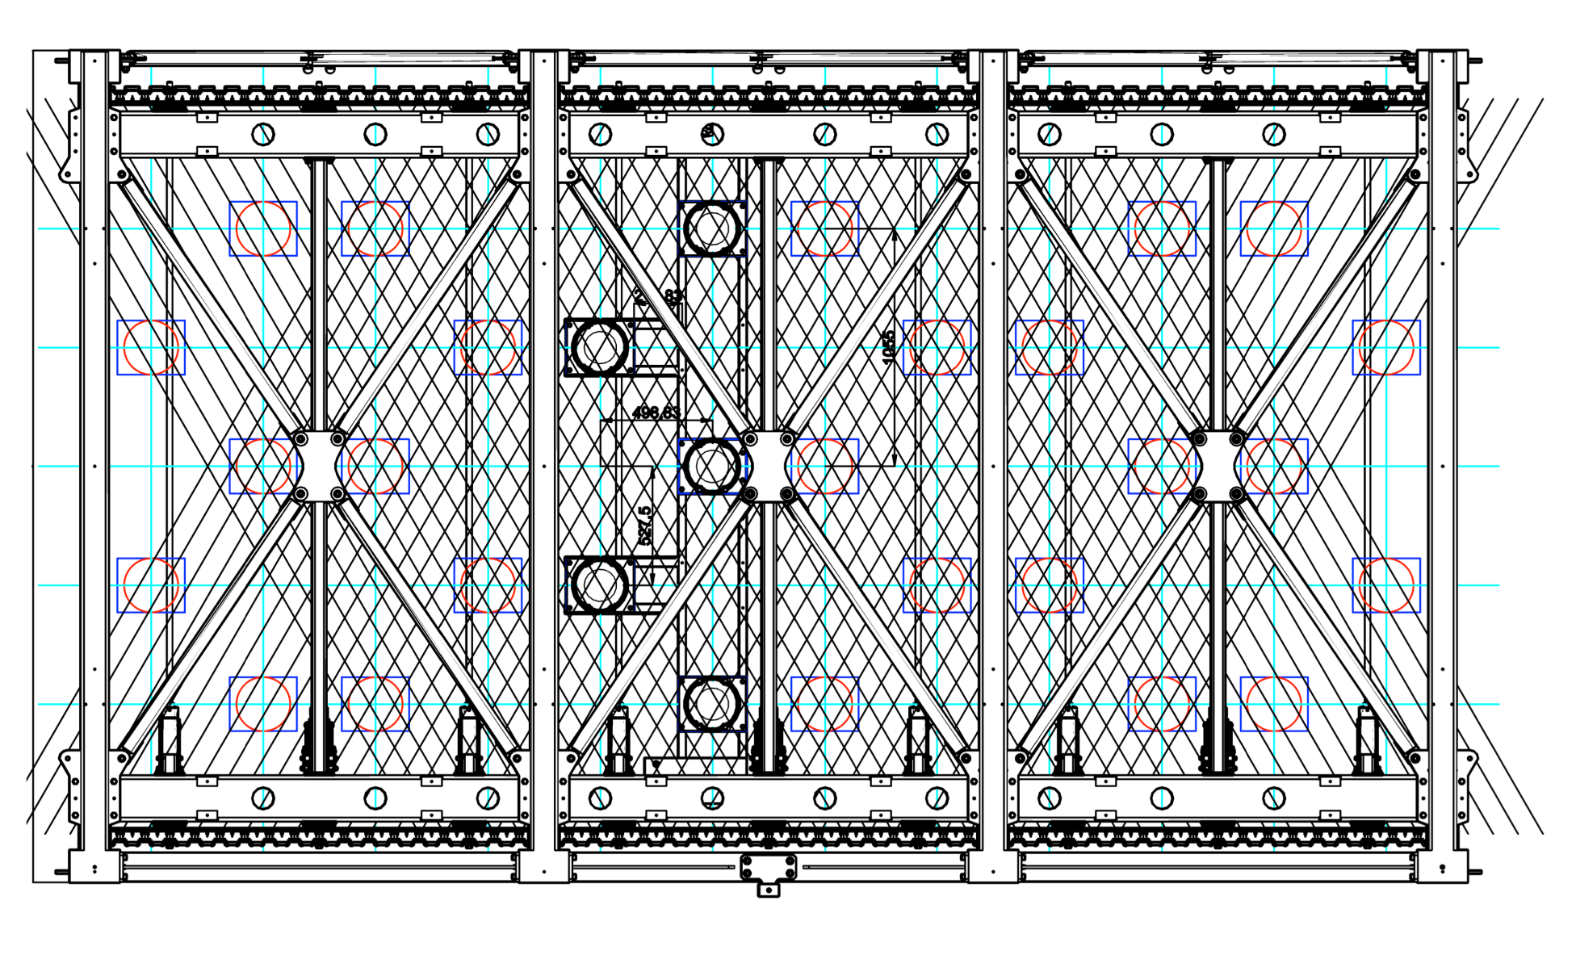
New PMTs system deployment and mechanics
90 PMTs per wires chamber – 360 PMTs in total

Slide 8
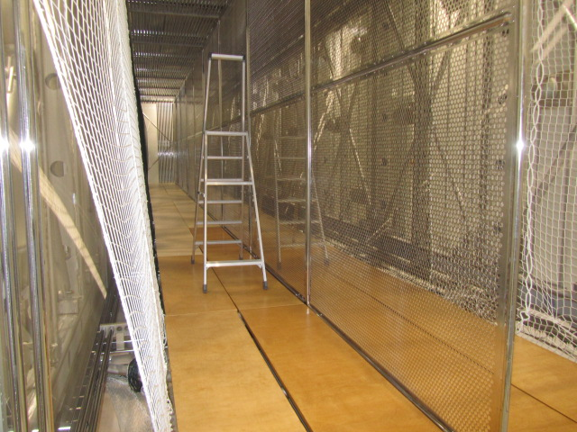
Cathode substitution/”planarization”
    The intervention on the cathode panels of the first T300 module by personnel of the CERN Main Workshop was successful: the residual non-planarity is within few mm.
    The “flattening” operation was completed at the end of September. The panels were taken to an external company for cleaning and electro-polishing. All the pales have been re-installed in the first T300 module. Survey of the present planarity is ongoing.
Cathode panels after flattening and electro-polishing

Slide 9
    Detector re-cabling
The design of the decoupling boards is complete and the components selection for the biasing chain is also complete.
Prototypes have been installed in the TPC to check for mechanical interferences and to fix the details of the mechanical supports.
Pre-series have been delivered; a second batch was also produced and delivered.
New cables have been selected and tested in LAr. Order for the cables procurement and assembly was done. Production of the cable bundles is ongoing.
V1
V2
V3

Slide 10
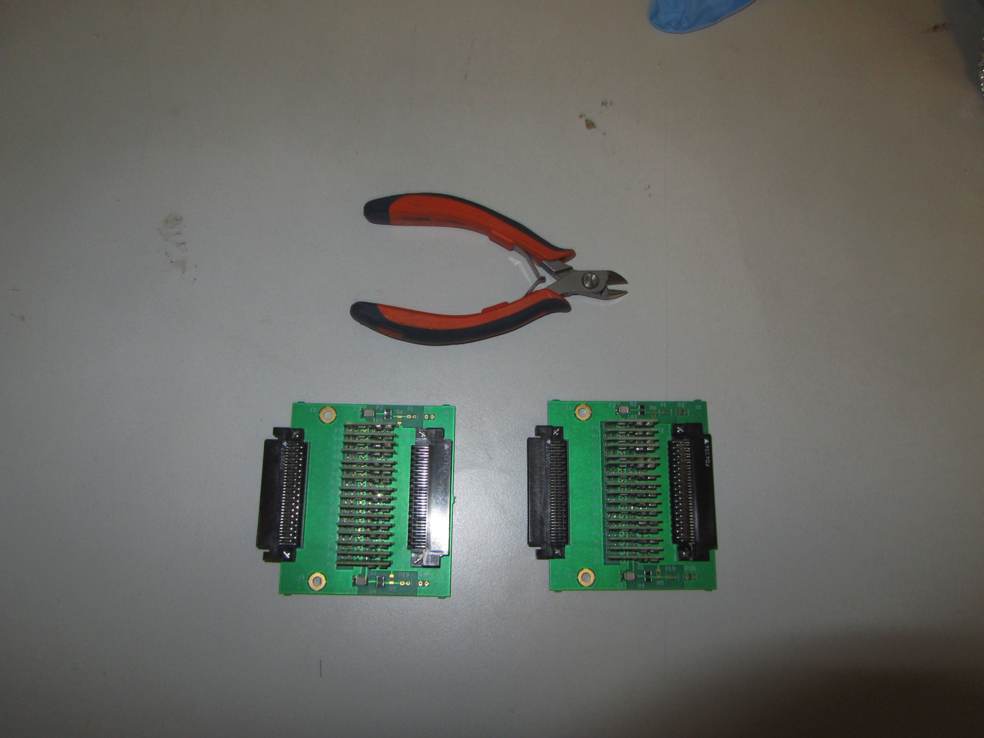
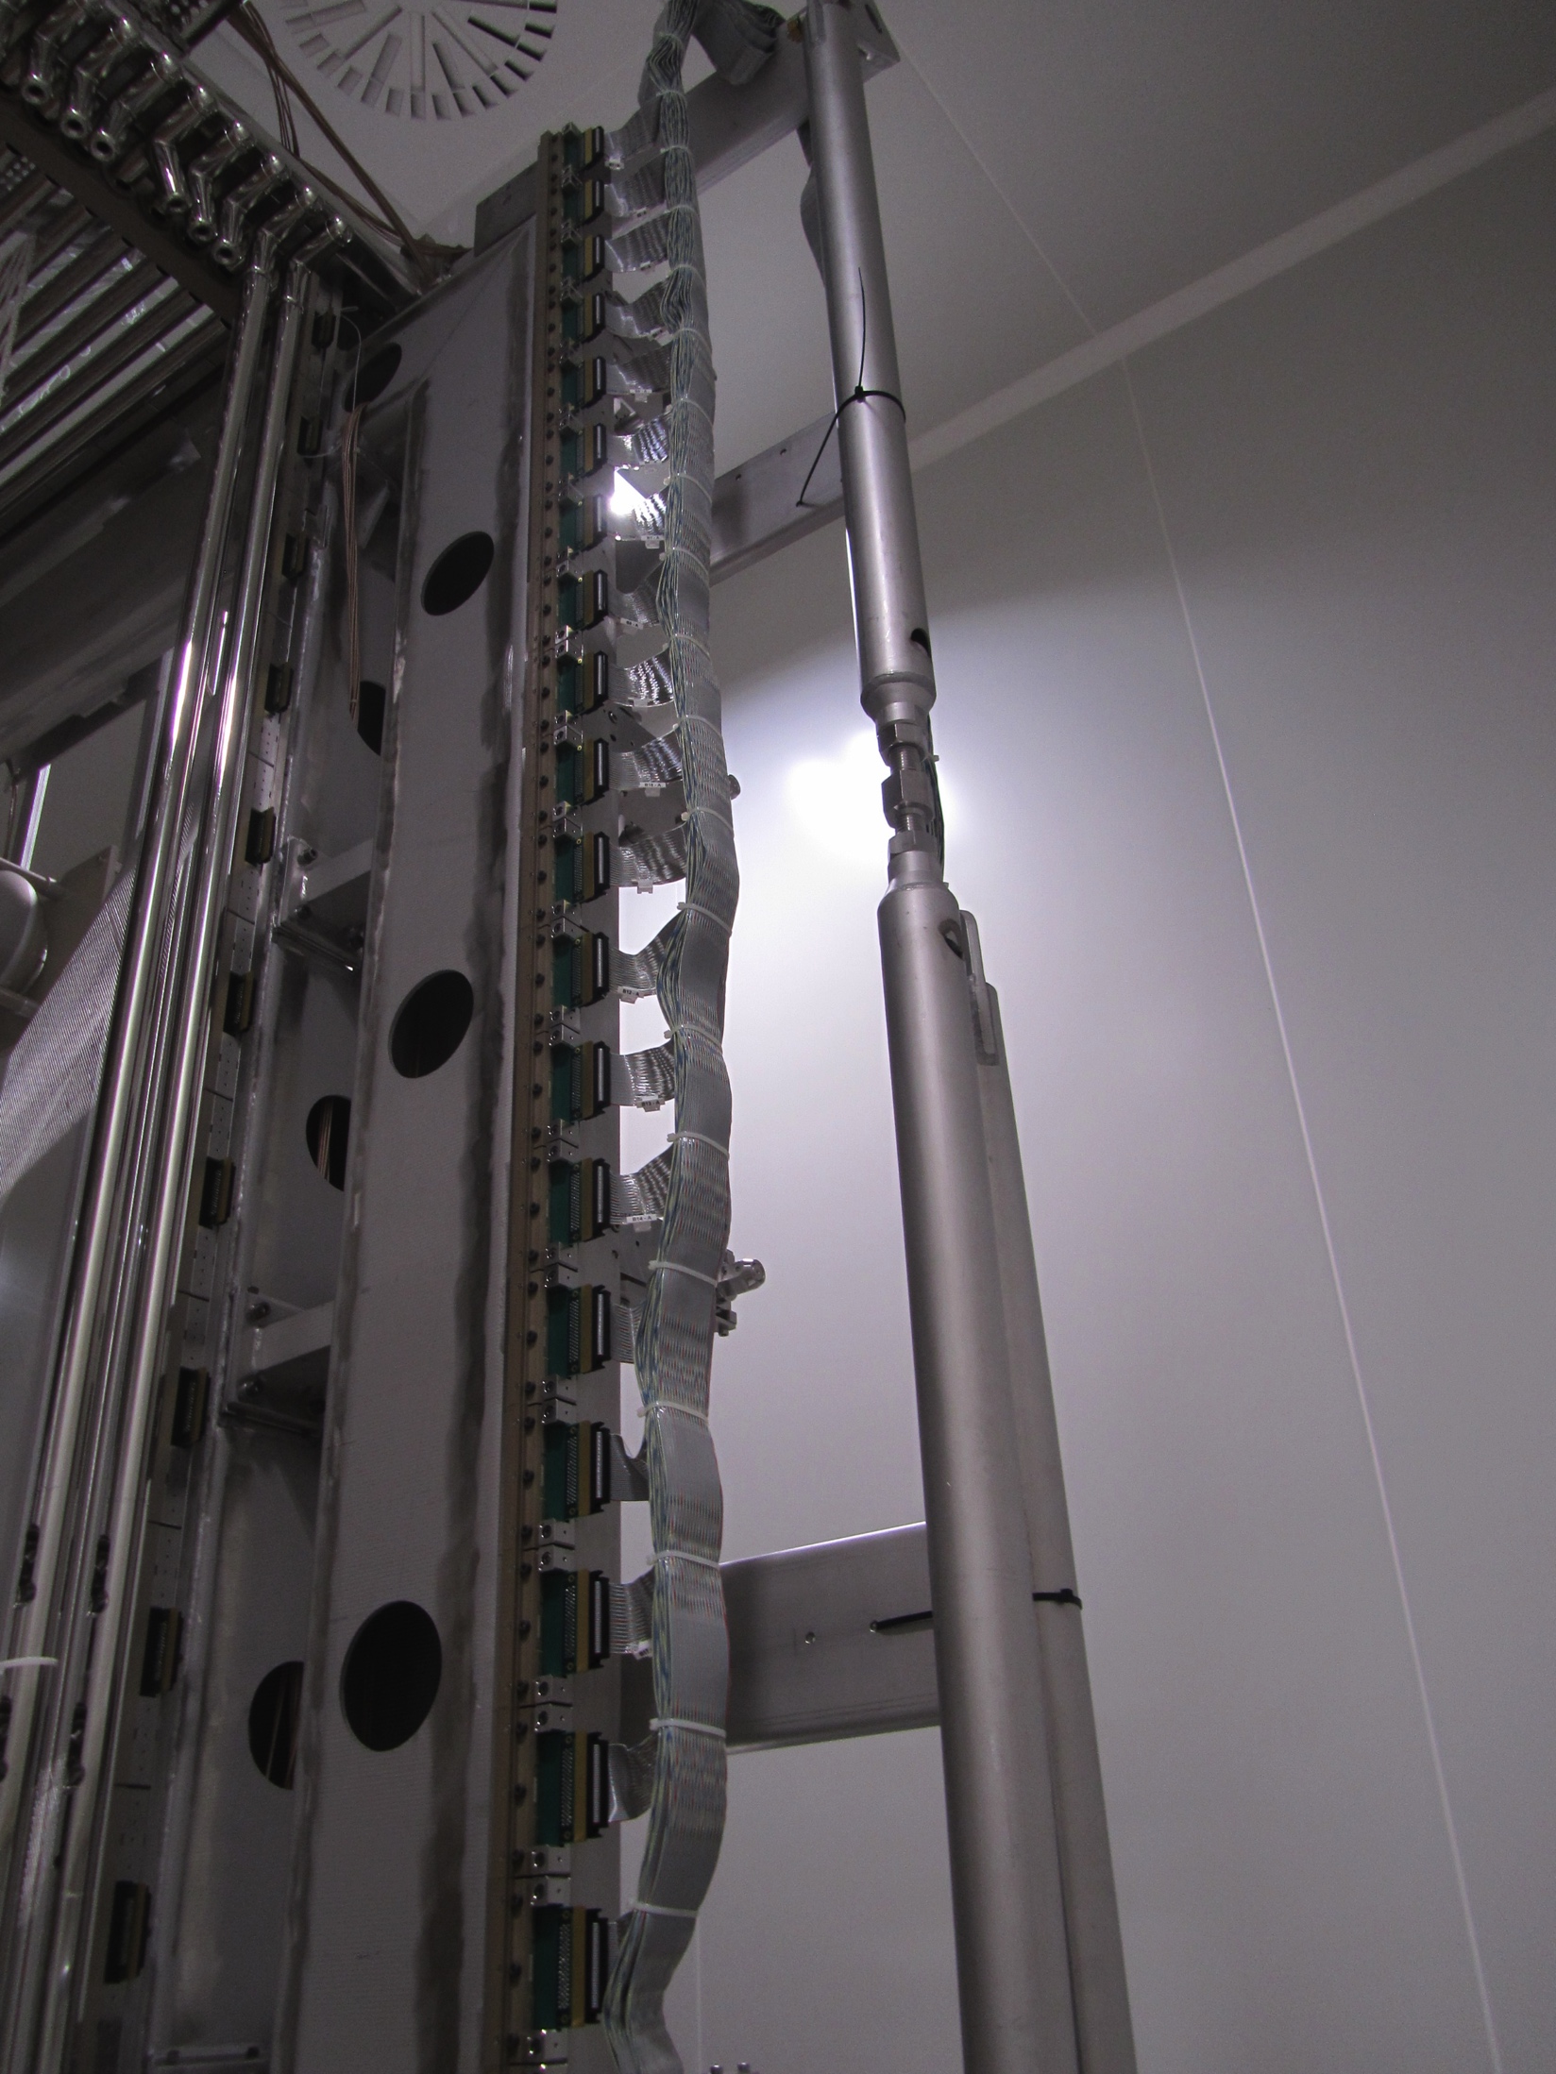
    Detector re-cabling
First cables bundle
Decoupling boards (pre-series)

Slide 11
The need for an electronics upgrade
ICARUS-T600 electronics consists of analogue boards (VME-like) with 32 low noise amplifiers, and a tree of 8 analog multiplexers, 4 10-bit ADCs, 2 digital multiplexers, resulting in a 2.5 MHz AD conversion (400ns sampling). Each analogue board is connected (serial link) to a digital VME module that provides storage, data compression, read-out through VME bus.
Limitations of ICARUS-T600 electronics is due to the technology available when electronics was first conceived (1998). Spare part are difficult to find.
Improvements concern:
  adoption of serial synchronous ADCs, one per channel;
  housing and integration of electronics on detector flanges;
  adoption of a modern serial bus architecture with optical links for faster transmission rate (Gbit/s) to sustain higher data rates.
The procurement of the new electronics (≈ 55000 channels) has been granted by INFN. For fiscal year 2016 INFN has granted 530k€. The total cost is about 1930k€.
The readout electronics for the PMTs is not yet fully defined, although it is budgeted within the existing CERN – INFN MoU.
See S. Centro presentation for details.

Slide 12
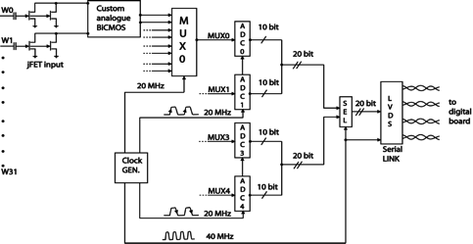
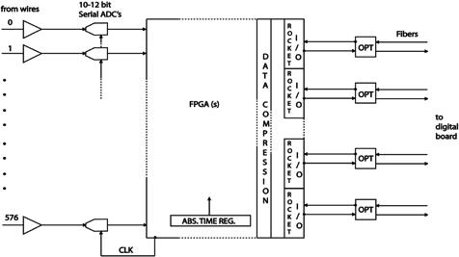
New simplified analogue/digital integration
Block diagram of the classical old Icarus multiplexed ADC architecture, compared with the new parallel serial ADC feeding directly the digital part housed in a single high performance FPGA.
Upgraded scheme integrating Analogue and Digital board into one single board
Present ICARUS Analogue board

Slide 13
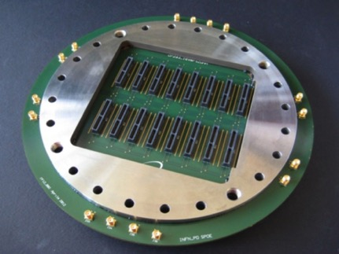
The flange as electronics backplane
A new flange, that uses the same INFN proprietary design, used for T600, has been developed.
The connectors on the external side allow for direct insertion of 9 electronics boards where both analogue and digital electronics are housed.
The design will allow for reusing the original T600 cabling modularity and same number of signal feed-through.

Slide 14
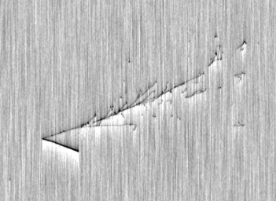
Some examples at FNAL (MC) – ev.150 (0.7GeV)
Old Ind: >~20 MIP wires
New Ind (filtered signal). Hits are resolved even very close to the vertex

Slide 15
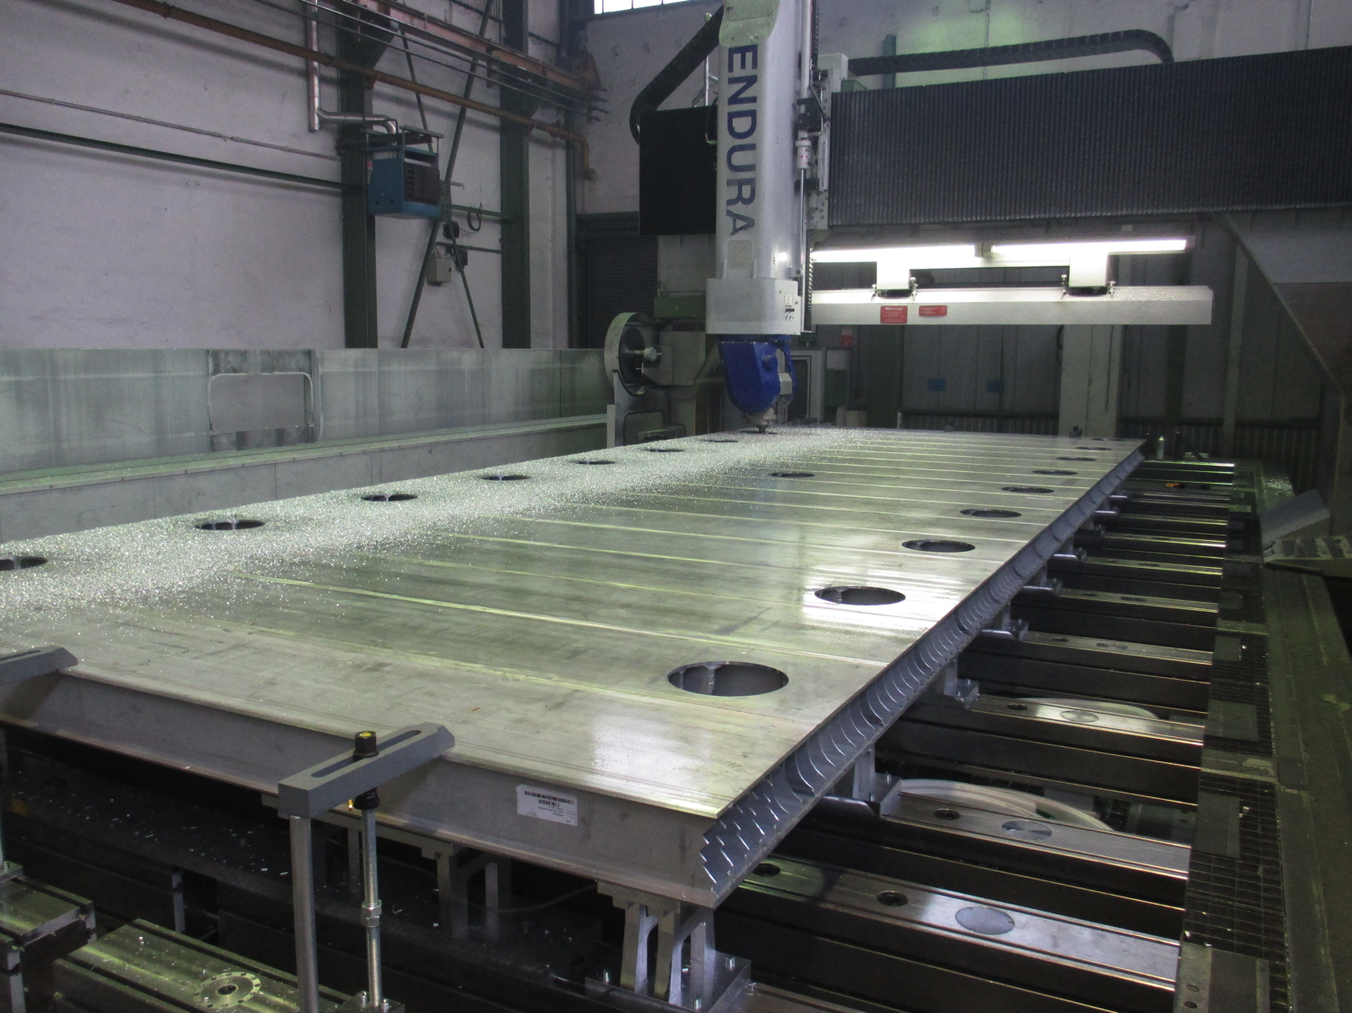
    New cold vessels construction
  First extrusions produced and delivered to CERN for first tests on welding.
  Order for the panels pre-assemblies was sent out to the company, first delivery before end of 2015 (the roof pre-assemblies)
  Order for end-caps also done.
  The final assembly strategy has been defined; the required tools have been delivered.
  CERN Main Workshop is proceeding with
  the assembly of the stiffening frames.
  All the angular profiles of the stiffening
  frames have been delivered at CERN, as
  well as 10 “I” profiles.
  Welding procedures have been defined
  according to maximum quality (level B of
  Eurocodes).
  See M. Nessi presentation in the
  breakout session for additional details.

Slide 16
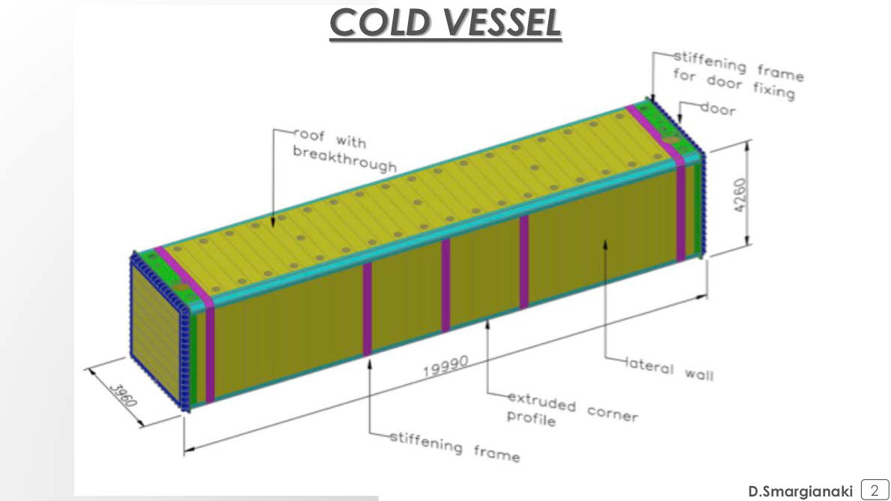
New cold vessels

Slide 17
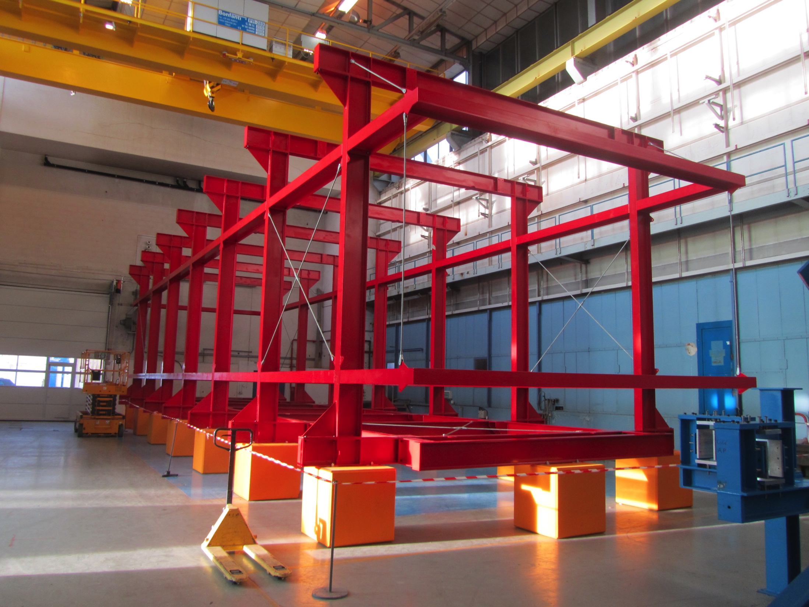
Assembly Tool in B156

Slide 18
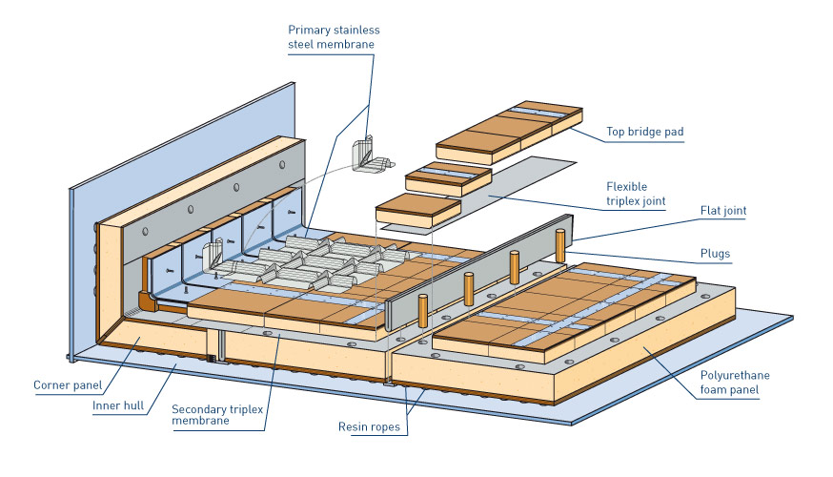
New Thermal Insulation
Purely passive insulation chosen for the installation at CERN, coupled to our standard cooling shield with boiling Nitrogen.
Technique developed for 50 years and widely used for large industrial storage vessels and ships for liquefied natural gas.
Expected heat loss through the insulation:
T600 ≈ 6.6 kW
Preliminary design done by GTT in Jan 2013
No internal membrane is required for our case
Slide 18

Slide 19
    Cryogenics and purification systems
    Maintenance of cryogenic pumps and valves from the Gran Sasso installation was started.
    Tests of the new cold shield have been done. Measurements confirm the numerical model. A complete report is being elaborated.
    Tests of the new copper filters are under way at B182 with the 50 liters prototype. First results, with purification in the gas phase, show that the purity limit is compatible with our needs (> 10 ms, above the sensitivity of the 50 lt chamber). Results on the adsorption capacity are somehow contradictory. Further tests are ongoing. Tests of purification in the liquid phase are being prepared in collaboration with WA105 Collaboration.

Slide 20
T600 Warm Vessel
Preliminary design is complete
Procurement and production in 2016

Slide 21
Far Detector Building at FNAL – July 24, 2015
Dear Carlo and Sandro,
On Wednesday July 22nd, Fermilab issued the formal notice to the construction contractor for the SBN far detector building that they may begin work on the project. We expect that the contractor will start on site within the next couple of weeks.
Included in the notice are the construction milestones agreed to by Fermilab and the contractor. Below is a summary of some key dates. As you can see we are on target for being ready for the T600 installation start.
We will make sure to keep you informed regularly as the construction proceeds.
Regards, Peter
SBN Far Detetor Building Milestones
0 Calendar Days - Notice to Proceed Issued (22JUL15)
183 Calendar Days – Concrete Work Complete (21JAN16)
319 Calendar Days – Building Envelope Work Complete (05JUN16)
440 Calendar Days – Substantial Completion (04OCT16)
-----
Peter Wilson - Short Baseline Neutrino Program

Slide 22
Understanding the Cosmic Rays induced backgrounds
  The planned activities at FNAL to settle the LSND / MiniBooNE / reactors hints for the possible existence of a new sterile neutrino pose several challenges.
  The unambiguous identification of CC electron neutrino events to within the overwhelming background from cosmic rays, neutral currents and CC muon neutrinos is a must for the successful completion of such an ambitious program.
  Although the superior characteristics of the LAr TPC technology allow us to identify and reject most of the backgrounds, we are all well aware that additional tools are needed to cope with the ones coming from cosmic rays.
  The intrinsic complexity of the cosmic rays induced events, makes Montecarlo estimates largely uncertain.

Slide 23
Understanding the Cosmic Rays induced backgrounds
  A direct measurement of cosmic rays induced background before the start of operation on the Booster neutrino beam, in our view, can and must be done in order to assess:
    the correct thickness of the overburden;
    the correct performance of the Cosmic Rays Tagger;
    the validity of the reconstruction and event selection algorithms.
  This measurement can be performed, at CERN, using already existing cryogenic and purification equipment. The existing equipment has to be complemented with a TPC (≈10 m³ active volume), an adequate shielding using existing concrete blocks and and Cosmic Rays Tagger.
  The direct availability of data from other detectors like MicroBooNE, MiniBooNE, ... is also crucial for a correct comparison of data and Montecarlos.

Slide 24
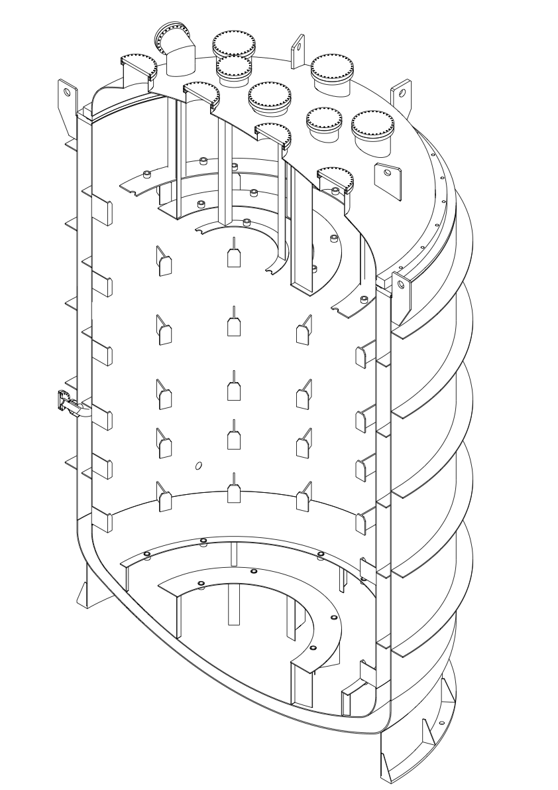
Former WArP Cryostat
Internal vessel diameter | 2900 mm
External vessel diameter | 3200 mm
Max ext vessel diameter | 3440 mm
Internal vessel thickness | 6/7 mm
External vessel thickness | 6/10 mm
Max internal height | 4996 mm
Max external height | 5090 mm
Cylindrical useful part height | 3755 mm
Cooling worm-pipe diameter | 22x1.5 mm
LAr recirculation flange from cap flange 170 mm dim. | 2630 mm
Internal vessel volume | 29 m³
Vacuum insulation volume | 6 m³
Cryostat mass (empty) | 8800 kg
LAr level from cap flange | 500 mm
Max LAr level from bottom | 3693 mm
LAr volume | 22.8 m³
LAr mass | 32000 kg

Slide 25
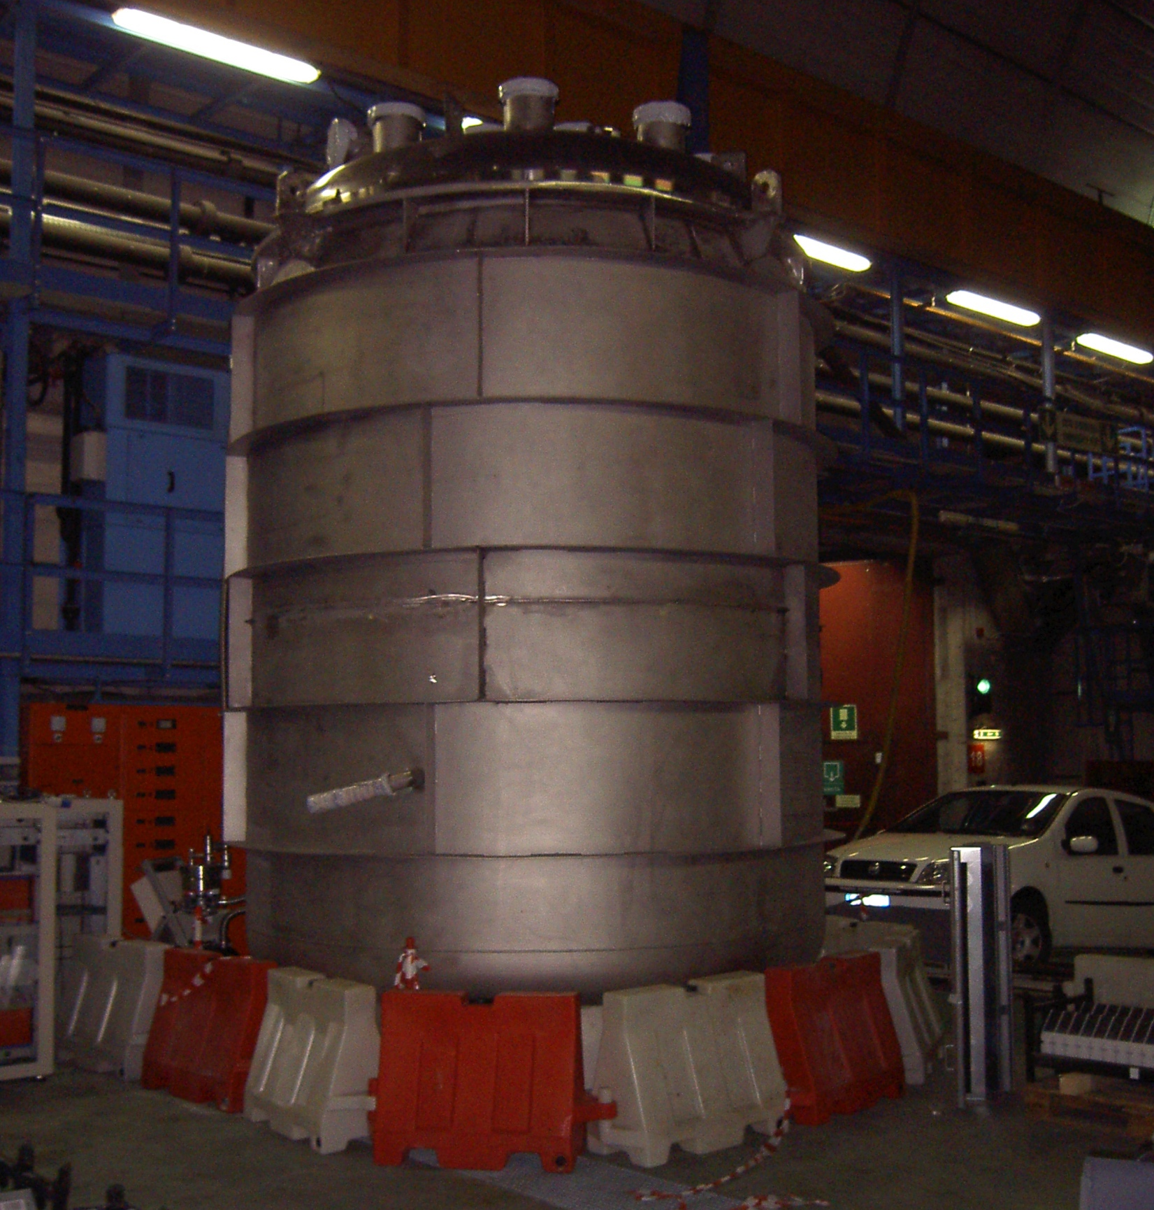
Former WArP Cryostat
Internal vessel diameter | 2900 mm
External vessel diameter | 3200 mm
Max ext vessel diameter | 3440 mm
Internal vessel thickness | 6/7 mm
External vessel thickness | 6/10 mm
Max internal height | 4996 mm
Max external height | 5090 mm
Cylindrical useful part height | 3755 mm
Cooling worm-pipe diameter | 22x1.5 mm
LAr recirculation flange from cap flange 170 mm dim. | 2630 mm
Internal vessel volume | 29 m³
Vacuum insulation volume | 6 m³
Cryostat mass (empty) | 8800 kg
LAr level from cap flange | 500 mm
Max LAr level from bottom | 3693 mm
LAr volume | 22.8 m³
LAr mass | 32000 kg

Slide 26
Cosmic Rays Tagger – Conceptual design
Largest possible coverage (> 98%)
Timing to recognize particles coming from outside the detector from those coming from the
inside.
14
Total surface
≈ 1250 m²
13
15
9
12
8
Access to the detector
10
11
7
6
Scintillator + WLF fiber + SiPMs
Two configurations considered
  X-T – single layer
  X-Y double layer
Physics performance vs. cost
More details in breakout session
1
2
3
4
5

Slide 27
Conclusions
    The overhauling of the T600 is proceeding according to schedule and in line with the budget, with the only exception of the Cosmic Rays Tagger.
    The first T300 module will be ready in the first months of 2016. The second one will take advantage of all the preparatory work of the first one and will require only six months to be completed. Both modules will be ready for transport in second half 2016.
    Aim of the Collaboration is to start data taking with the BNB during 2017.
    Preparation for installation and run at FNAL requires some actions:
      Formal agreements between INFN and FNAL and between CERN and FNAL;
      Exact definition of the onsite work to be done by the Collaboration prior to transportation;
      Identification of the missing resources.
      The active involvement of US teams is essential.

Slide 28
Schedules and future activities
ICARUS Referee Meeting, September 15, 2015
28

Slide 29
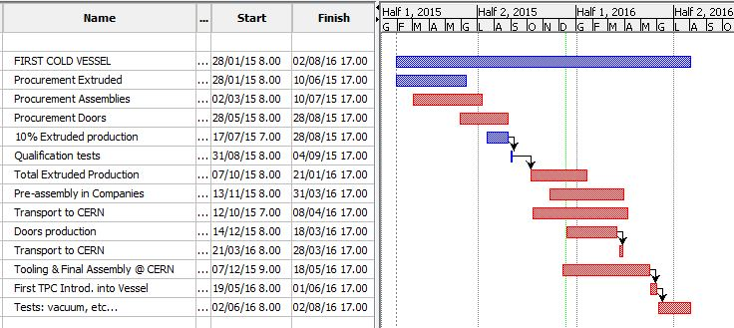
First Cold Vessel
NOW

Slide 30
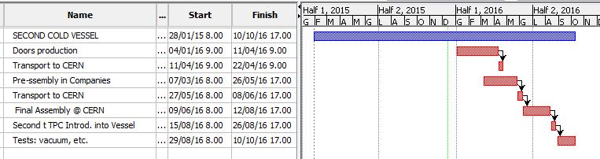
Second Cold Vessel
NOW

Slide 31
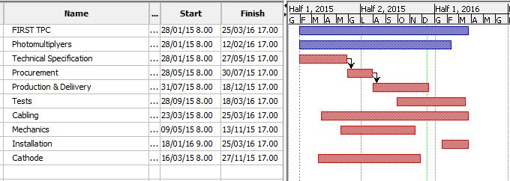
First TPC
NOW

Slide 32
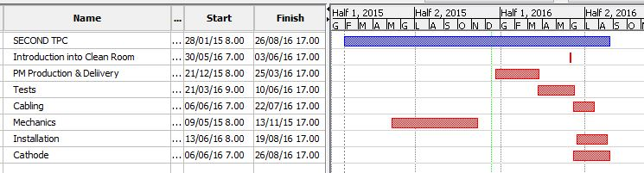
Second TPC
NOW

Slide 33
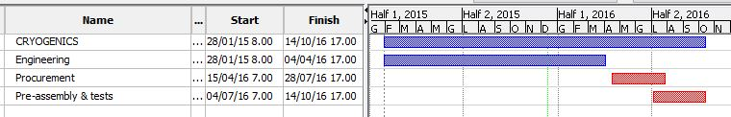
Cryogenics
NOW

Slide 34
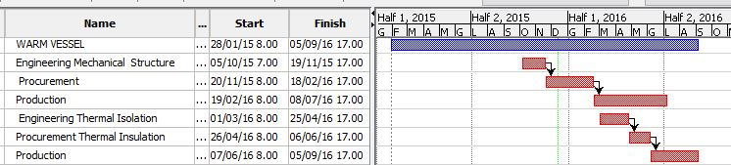
Warm Vessel
NOW

Slide 35
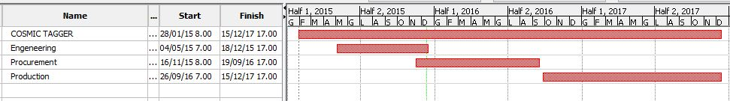
Cosmic Tagger
NOW

Slide 36
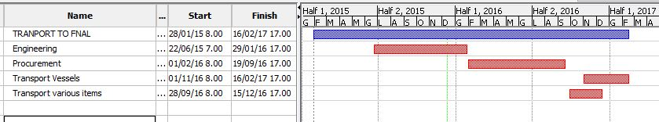
Transport to FNAL
NOW

Slide 37
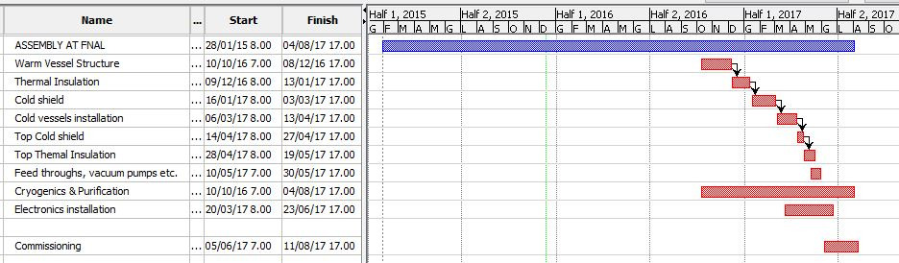
Assembly at FNAL & Commissioning
NOW

Slide 38
All in One
NOW

Slide 39
BACKUP SLIDES

Slide 40
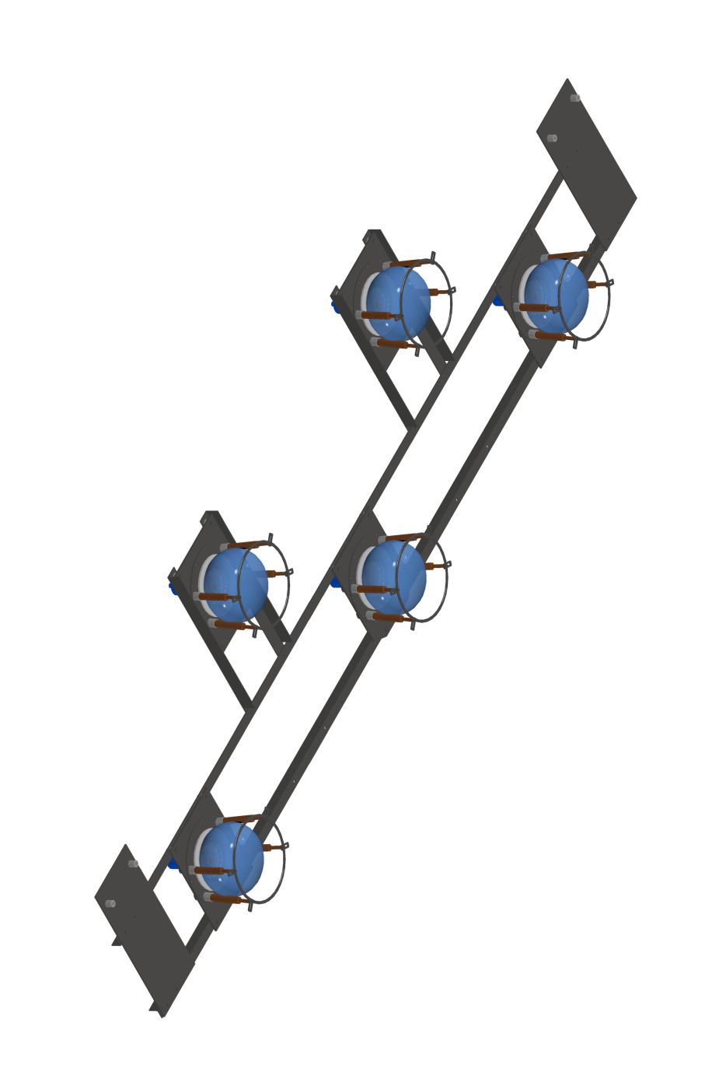
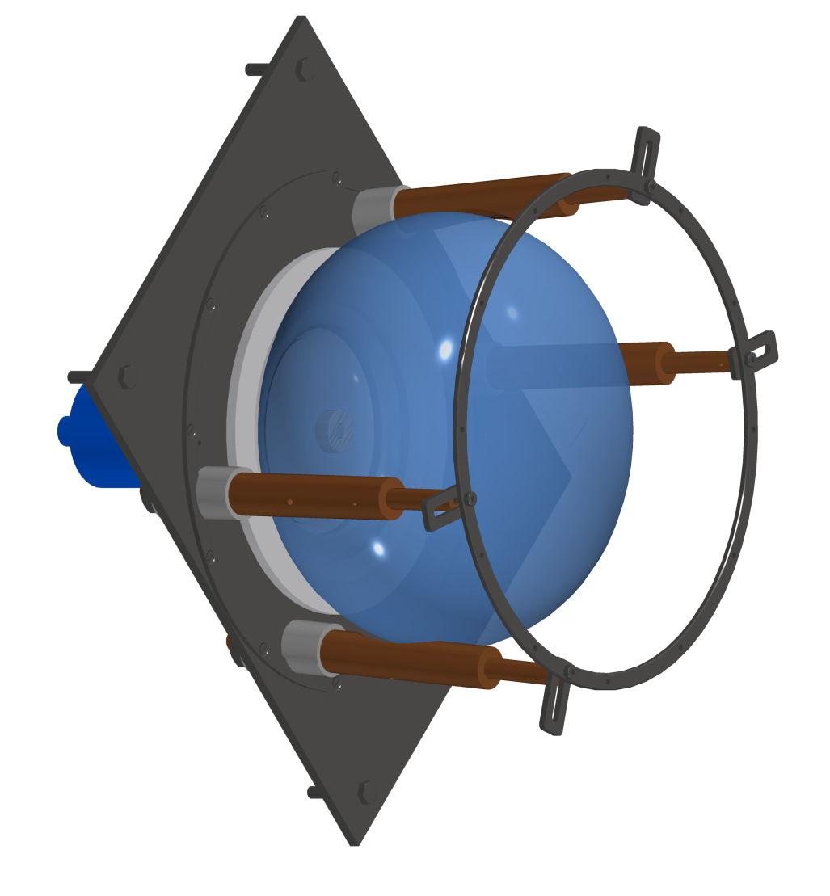
PMTs mechanics
Basic Unit
(36 / T300 module)
Shielding grid

Slide 41
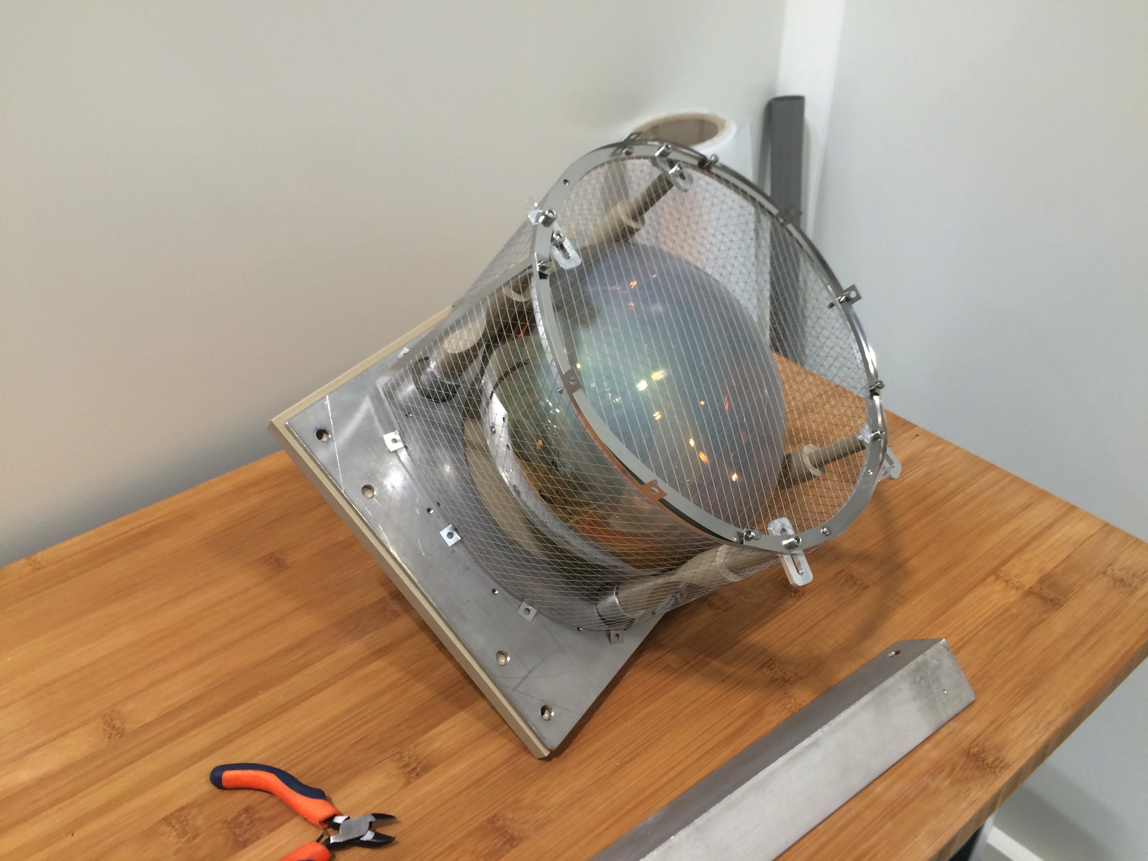
PMTs mechanics
Shielding grid

Slide 42
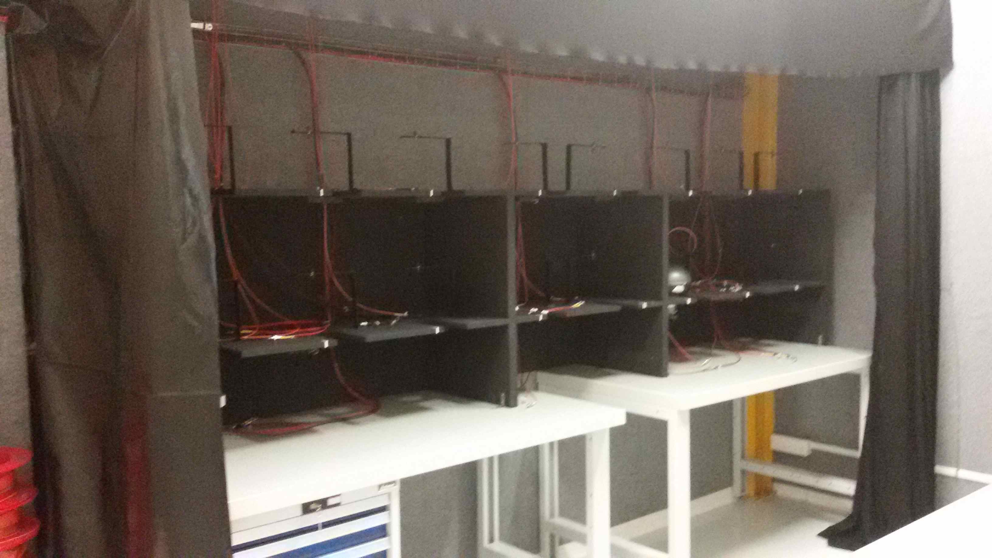
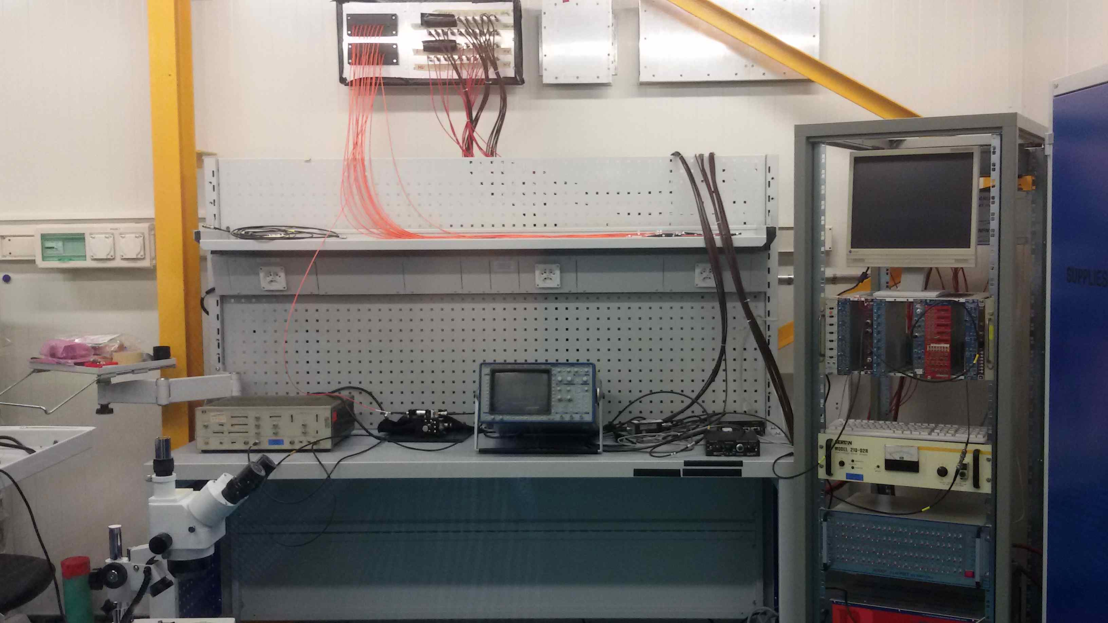
Preparation of the dark room for PMT testing (I)
Test Area
Dark room
Dark room
Control Area
Electronics Lab
Electronics Lab
Ideasquare Lab

Slide 43
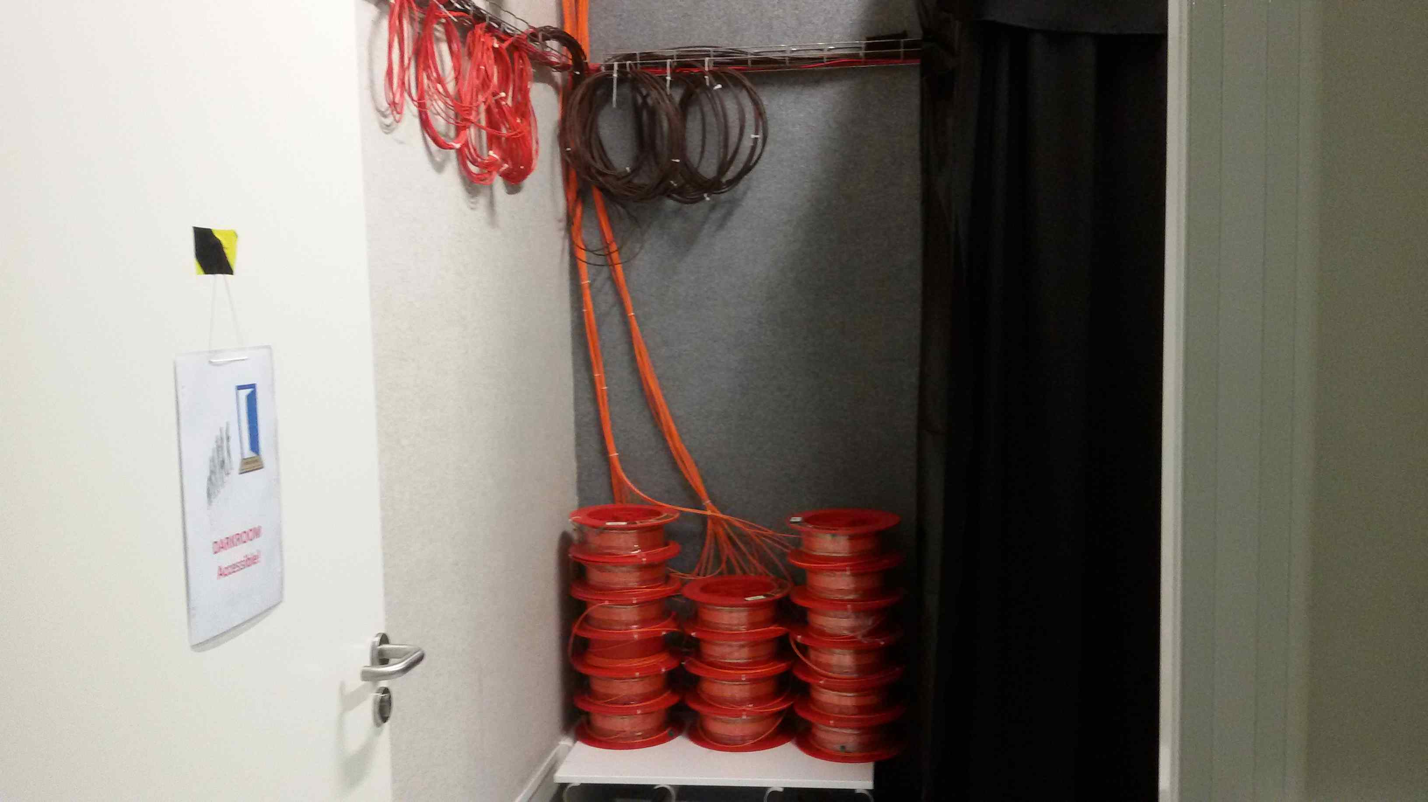
Preparation of the dark room for PMT testing (II)
Equipped for simultaneous testing of 16 PMTs
items | status
Furniture | Installed
Cabling | Installed
Feedthroughs electronics lab to dark room | Installed
Access and environmental monitoring | Being implemented

Slide 44
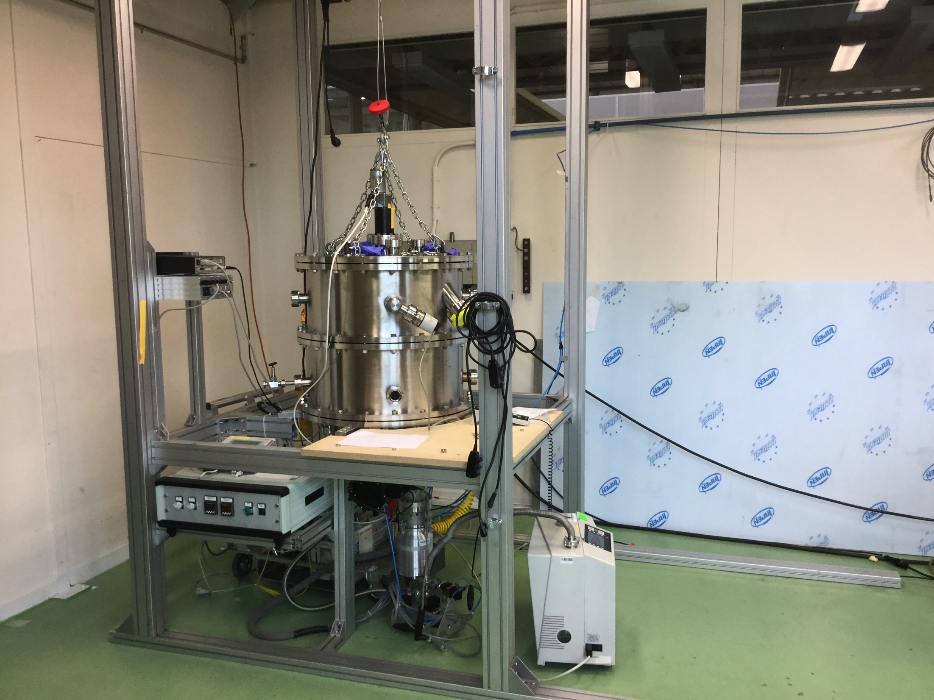
TPB Evaporation – B169
The evaporator is installed in B169.
Protocols for PMTs cleaning and evaporation have been established after several tests.
Production is ongoing.

Slide 45
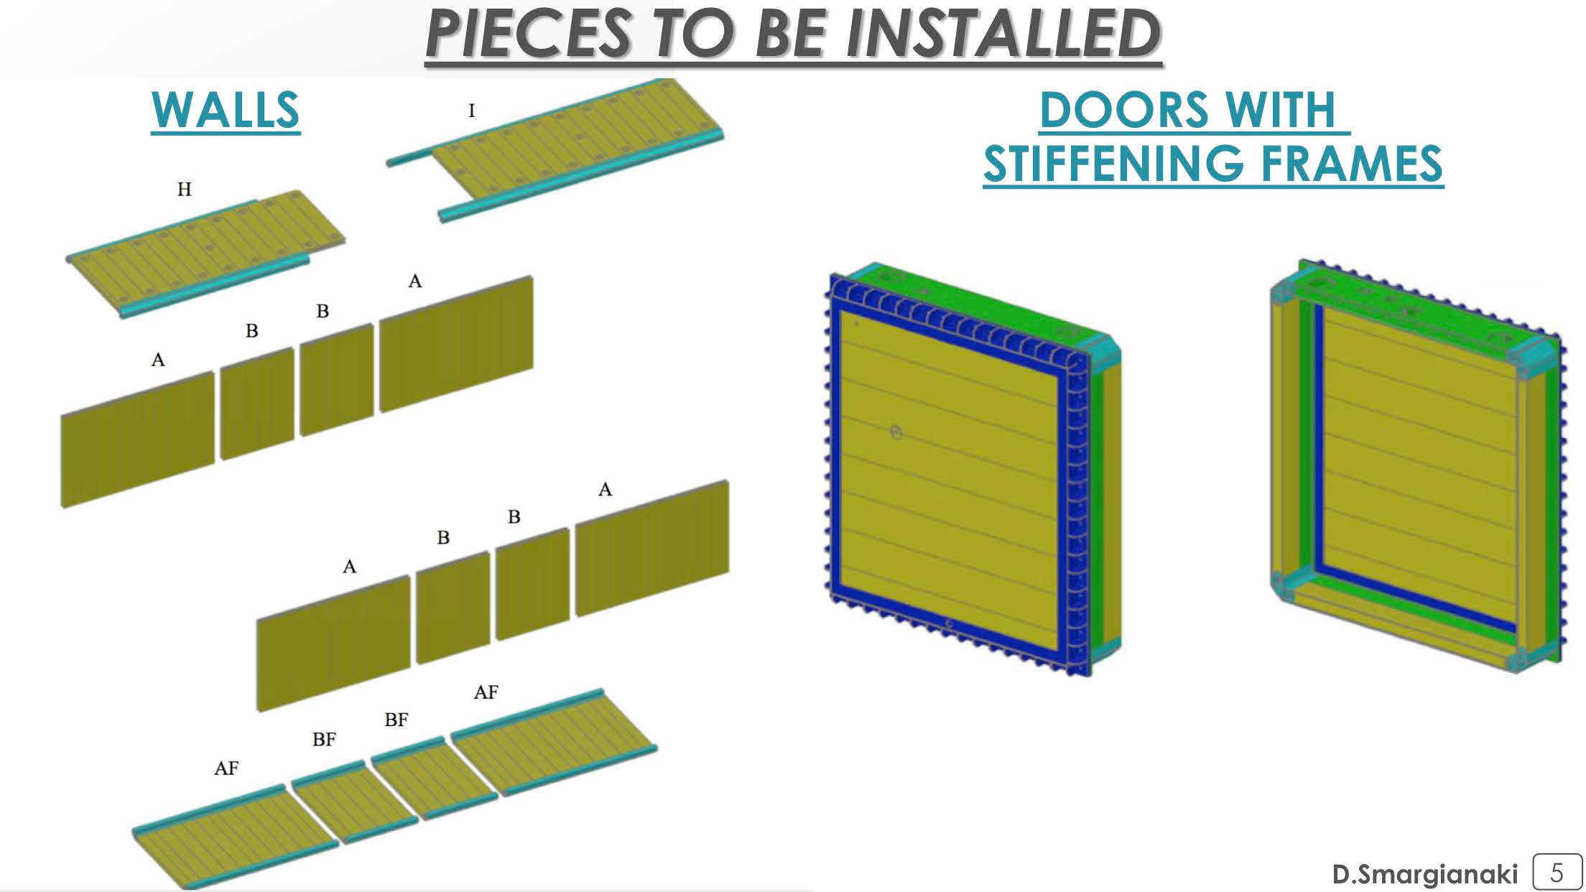
New cold vessels construction – Materials I

Slide 46
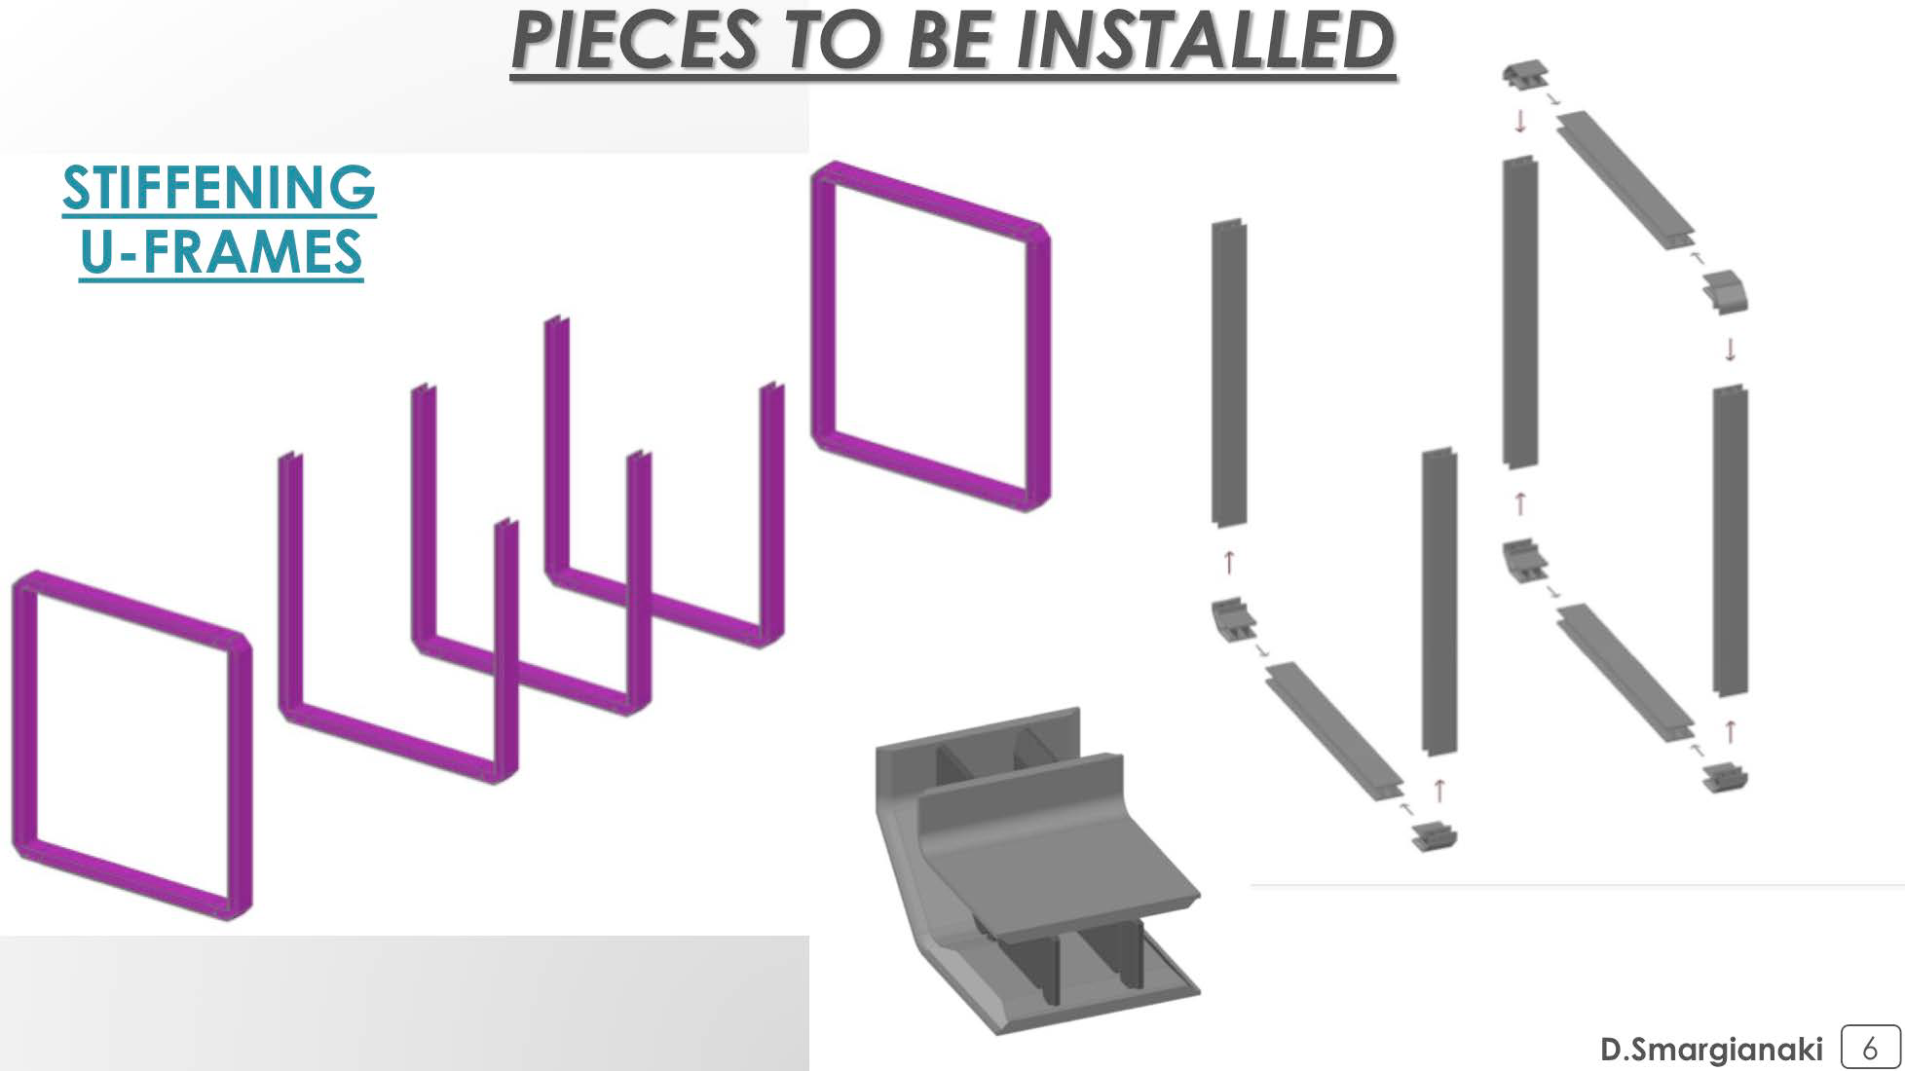
New cold vessels construction – Materials II

Slide 47
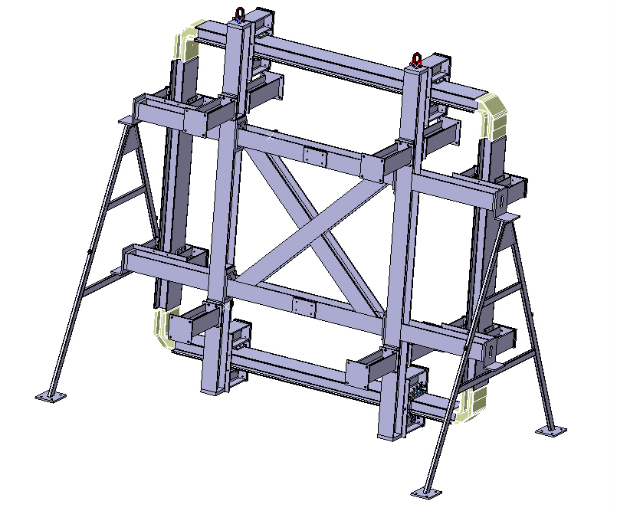
U-frames
Assembly tooling
Design of a specific tooling
  To ensure an appropriate positioning and clamping of the parts in order to achieve the thigh tolerances required
  To allow the welding in flat position which is mandatory to achieve the quality level required
Delivered: end October

Slide 48
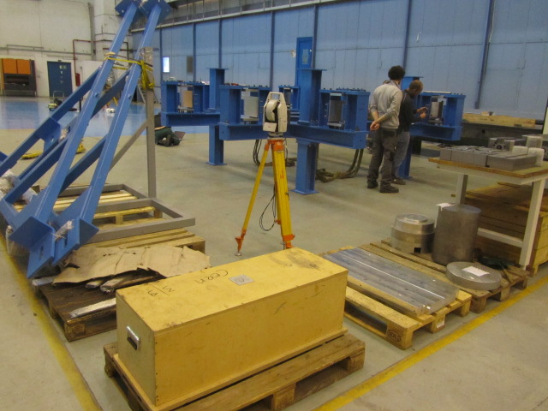
U-frames - Assembly tooling
Assembled and aligned in B156

Slide 49
Assembly strategy - 1

Slide 50
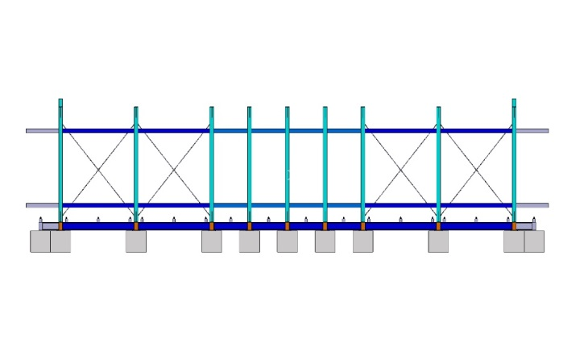
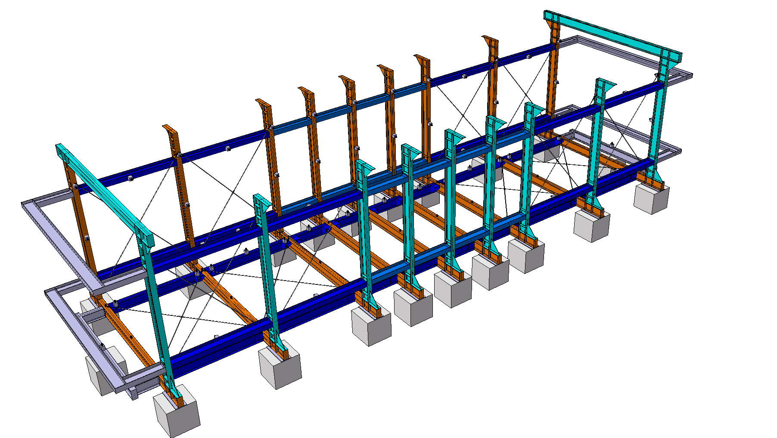
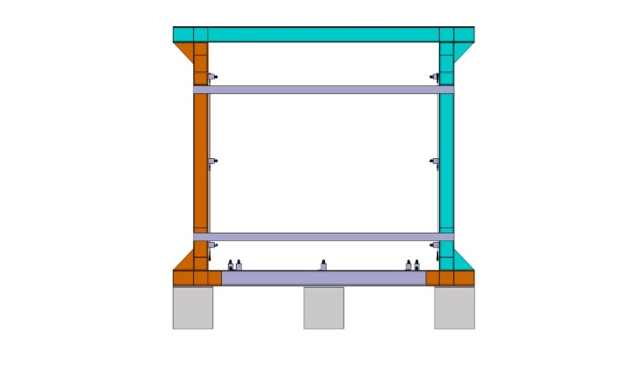
Assembly strategy - 2

Slide 51
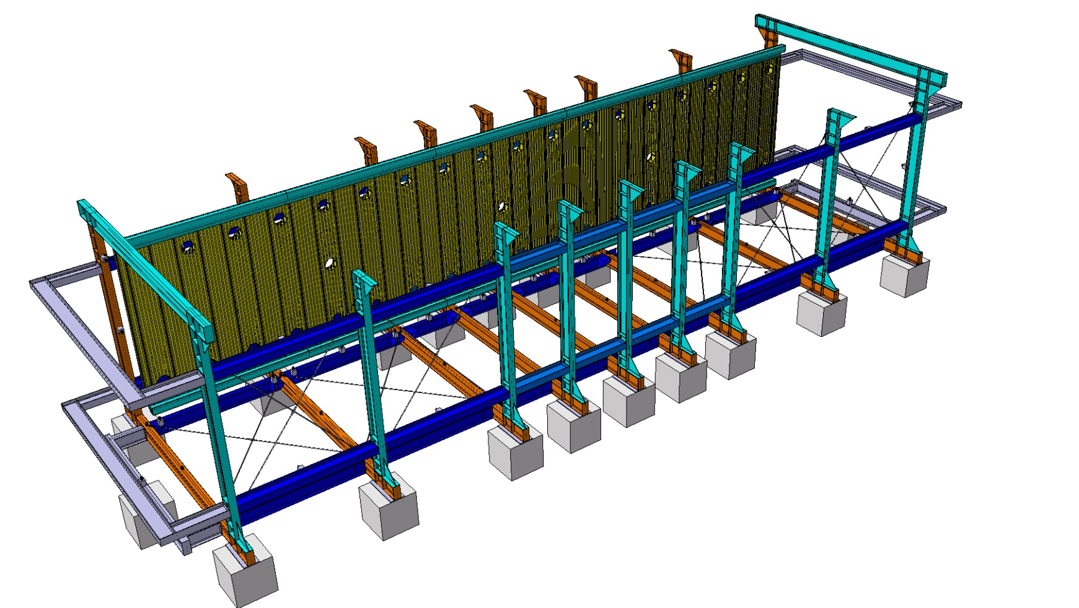
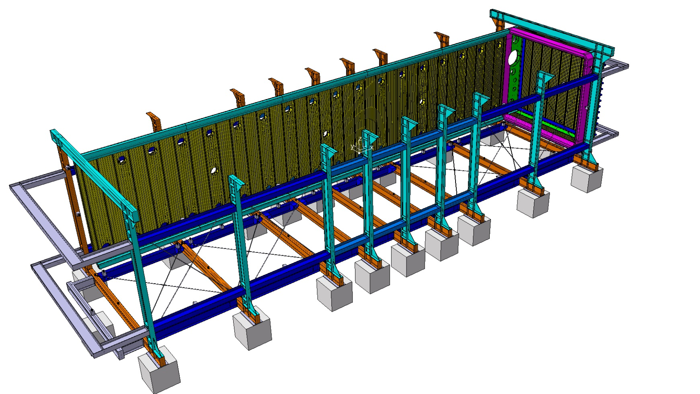
Assembly strategy - 3
Start from the roof
Vessel assembled “on a side”
1
2
Rotation of the whole vessel, in the end, to complete welding.
As many final welds during installation as possible.

Slide 52
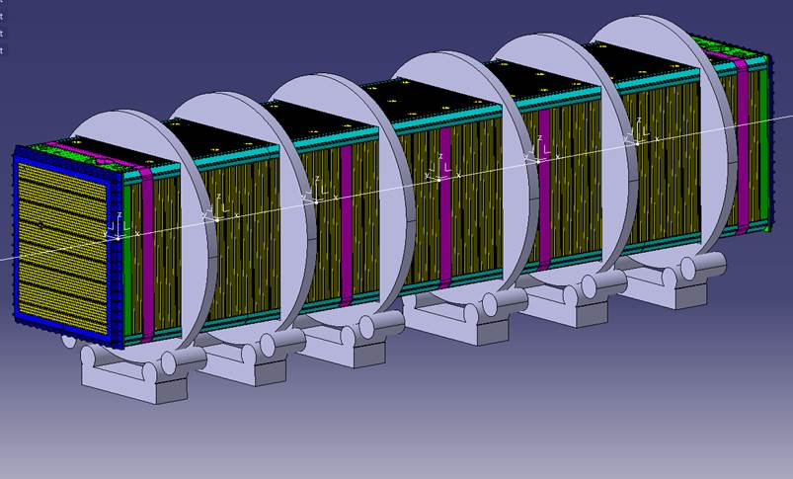
Assembly strategy – Tool for cold vessels rotation

Slide 53
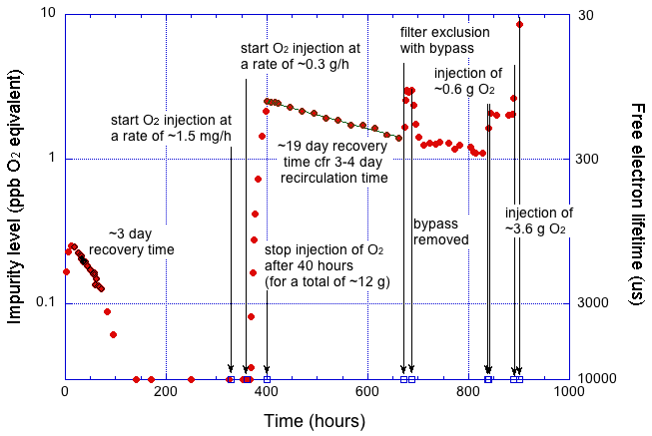
Test of copper-based filter

Slide 54
Drawing to be replaced with the new design by D. Smargianaki and D. Warner

Slide 58
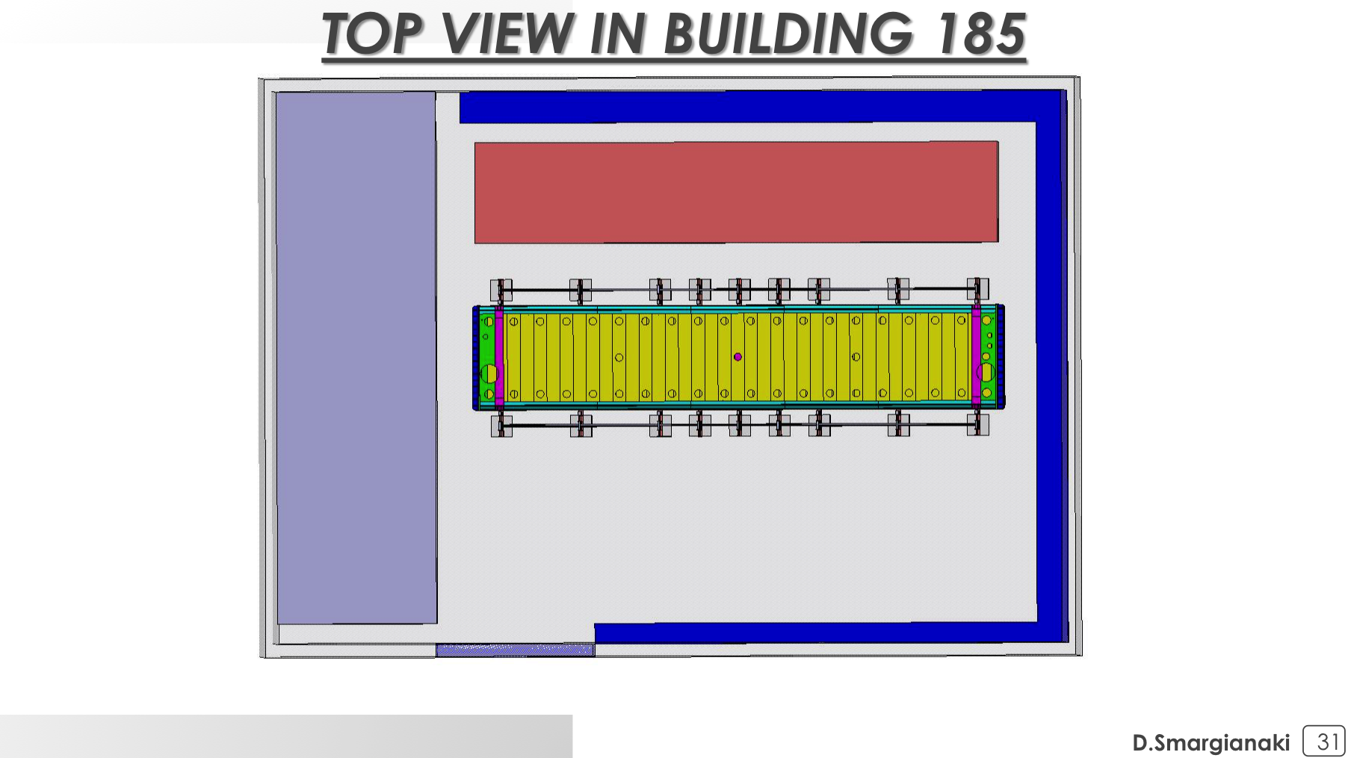
    Installation area
Second T300 module in transport vessel.
Clean room with first T300 module
First cold vessel assembled in B156. Second cold vessel assembled in B185. This allows to recover about 2 months in the construction procedure.

Slide 59
T600 Warm Vessel and Cryogenics envelope
Longitudinal view
Drawing to be replaced with the new design by D. Smargianaki
Cryo
and purification
Warm Vessel

Slide 60
T600 Warm Vessel and Cryogenics envelope
Drawing to be replaced with the new design by D. Smargianaki
Detector supports (I beams)

Slide 61
Existing cryogenic plant
Main purifier
GAr Fiters
GAr re-condenser
LAr recirculation pump

Slide 62
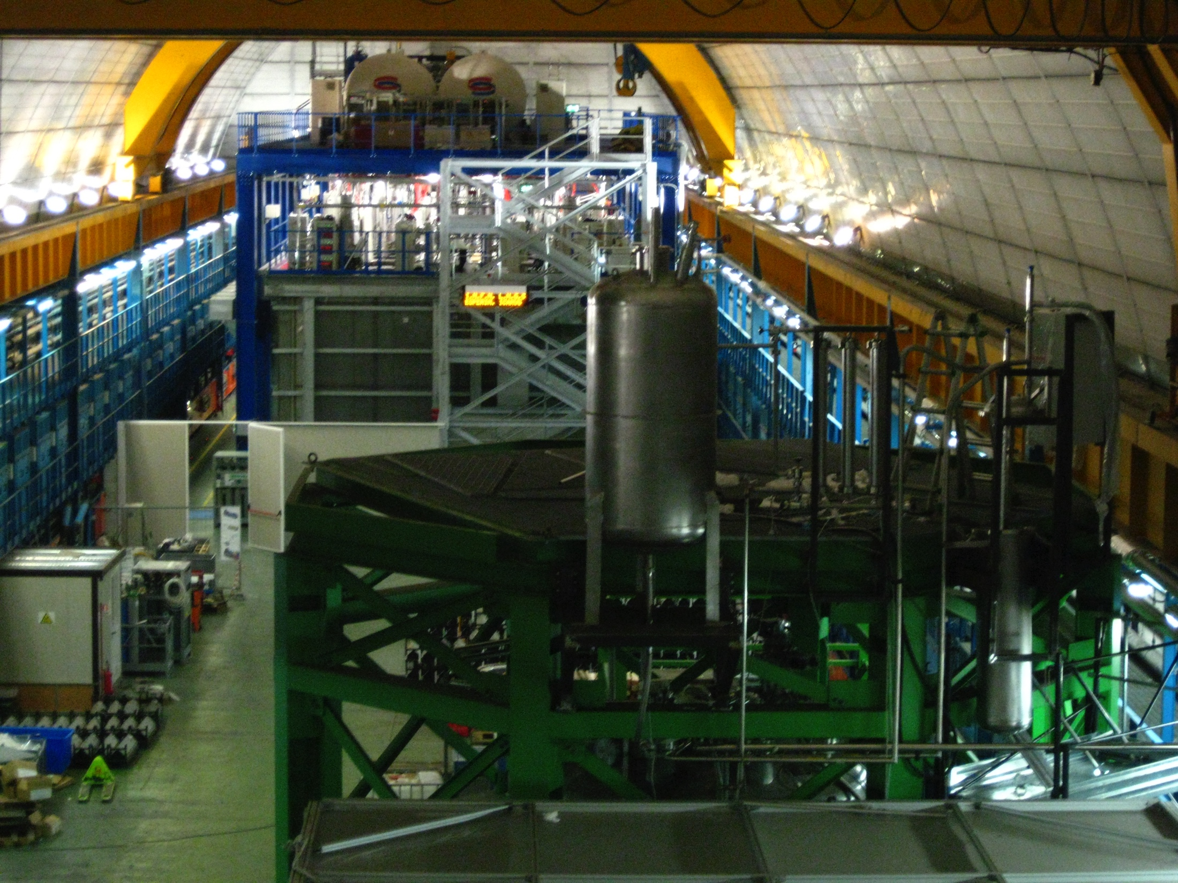
Existing cryogenic plant (Top part)

Slide 63
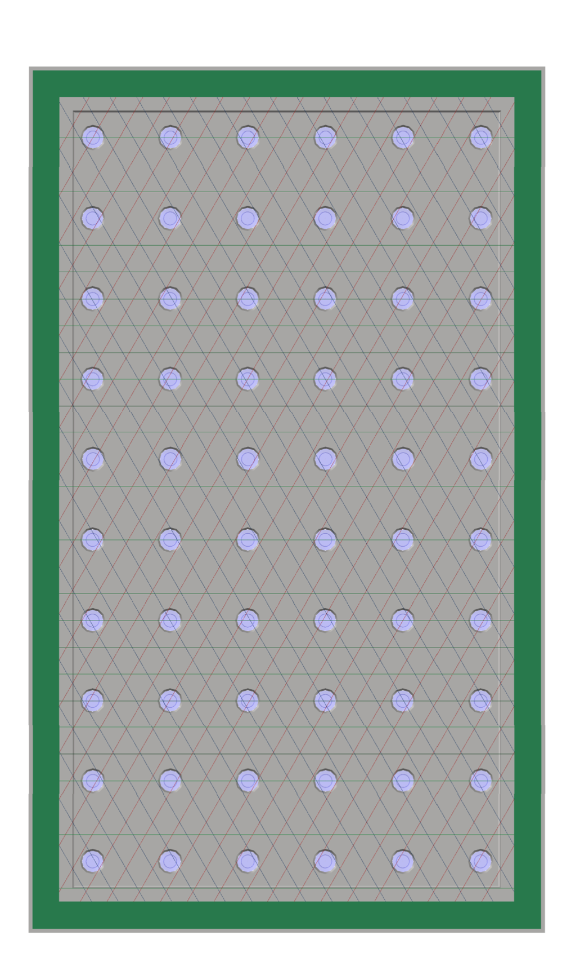
Detector conceptual layout
≈ 10 m3 active volume
Central cathode plane
Wire Chambers (3 planes 0, ± 60°)
3.2 m
≈1 m drift
≈2m
≈1 m drift
Cryogenic 3” PMTs (existing)

Slide 64
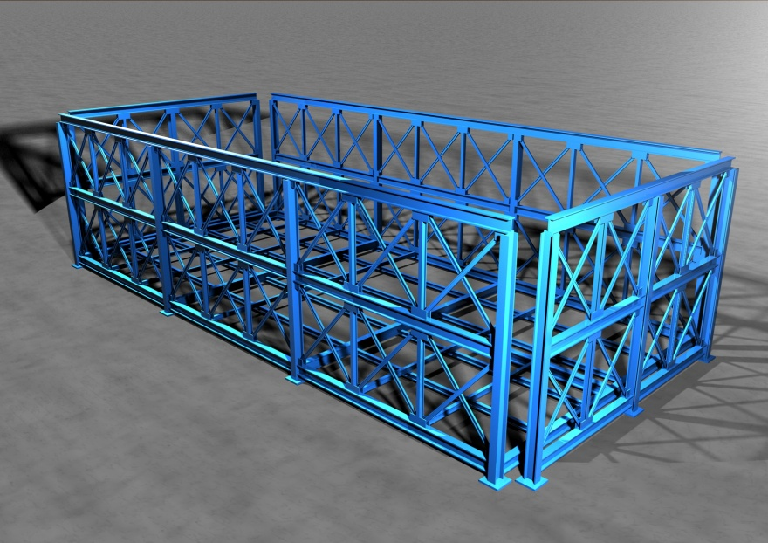
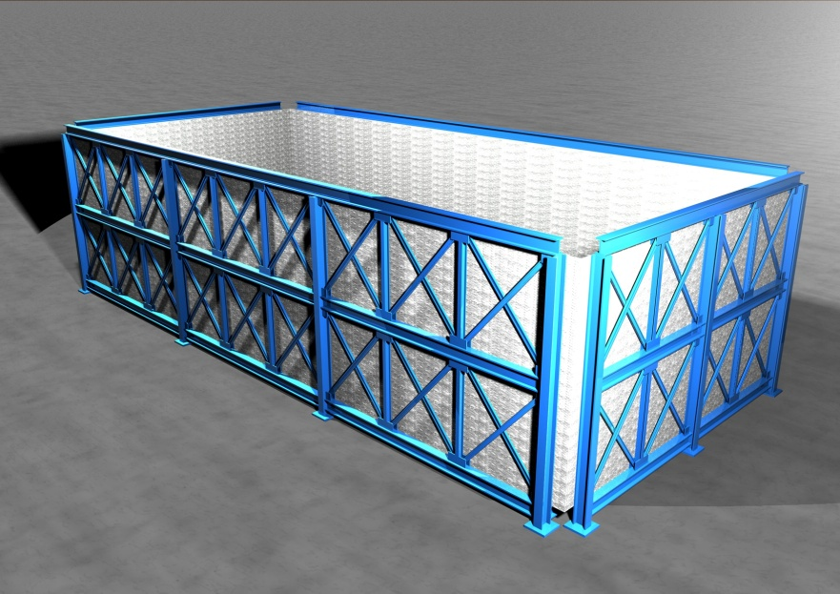
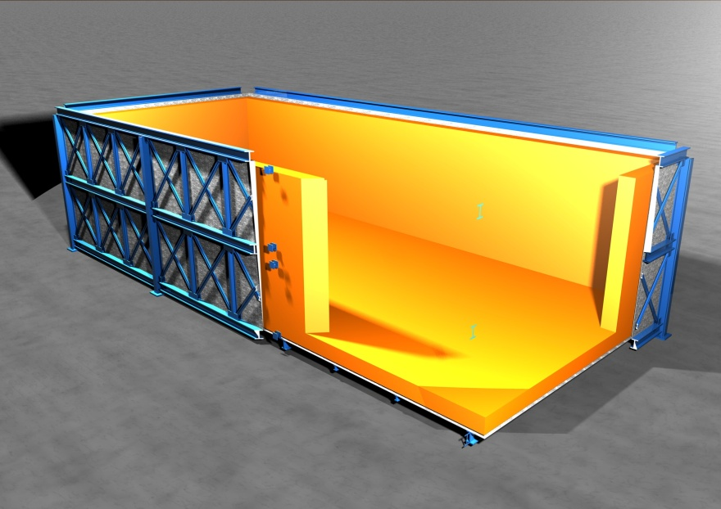

New T600 layout
Warm vessel cage
External skin
Insulation panels
T600 modules

Slide 65


New T600 layout
Insulation top
Top flanges (final layout)

Slide 66
Cosmic Rays Tagger – US contribution
See Bob Wilson presentation in the breakout session for additional details

