Slide 1
SBND TPC Status
Kostas Mavrokoridis -TPC Manager (k.mavrokoridis@liverpool.ac.uk )
Directors’ Progress Review of SBN
15-17 Dec 2015, Fermilab

Slide 2
Outline -Key TPC Components
APA
  APA frames
  Geometry boards, mounting platforms
  Wire mesh, wire support, E-diverter
  APA assembly procedure and tooling
  Interface to electronics; faraday cage
  APA winding
CPA
  CPA frames & panels
  HV Cup
  CPA suspension features
Field Cage
  Field cage panels
  Roll-formed metallic profiles
  Resistor divider board
  Supporting beams
HV Feedthrough
TPC Integration
  APA Interconnect and alignment
  TPC suspension features
  TPC assembly procedure and tooling
Preliminary Design Report (docdb ID 613)
Review was held Sept 2015
http://sbn-docdb.fnal.gov:8080/cgi-bin/RetrieveFile?docid=613&filename=sbnd-tpc-PDR-review.pdf&version=1

Slide 3
The SBND TPC Working Group
Collaboration between UK and USA Institutions,
funded by NSF and STFC
Deliverables | Institution
Four APA Frames (2UK&2US) | University of Sheffield
Winding two APAs | University of Manchester
Winding two APAs | Chicago, Syracuse and Yale
CPAs | University of Liverpool
HV Feedthrough | UCL and Yale
Field Cage | BNL and Yale
QA/APA cold tests | Lancaster University
Integration, Assembly, and Installation | Chicago, BNL and Fermilab

Slide 4
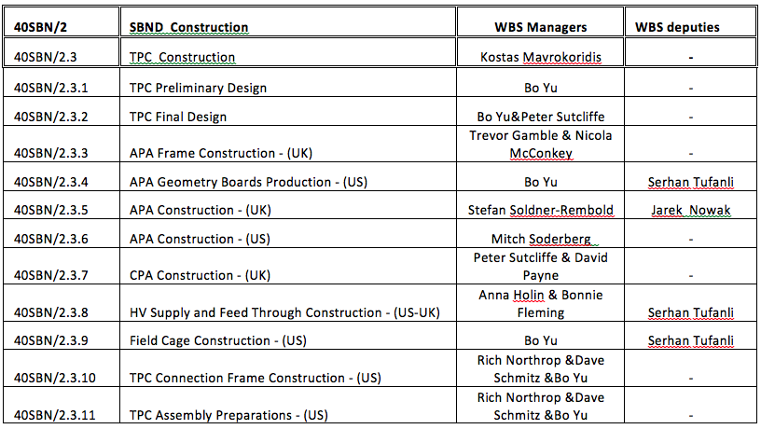
The SBND TPC Working Group
The WBS Managers
funded by NSF and STFC

Slide 5
TPC Requirements
The TPC volume is large enough to achieve the physics goals of the experiment.
The 3 mm wire pitch is chosen, as in the MicroBooNE and ICARUS detectors, to enable electron/photon separation to be achieved with identical efficiency.
Limit variation in the wire sag to < 0.5 mm such that it does not significantly impact the position and energy resolution of the detector.
The APAs are constructed in a manner that guarantees no wires will break during the operational life of the experiment.
The electric field must not exceed 30 kV/cm inside the liquid, and not exceed 5 kV/cm in the argon gas to prevent HV breakdown.
Minimize dead space in the active volume: place the cathode in the center of the TPC.
The wire plane and HV cathode designs must be compatible with the photon detection system designs being considered for the experiment.
Use only materials that are compatible with high-purity liquid argon.

Slide 6
TPC Parameters

Slide 7
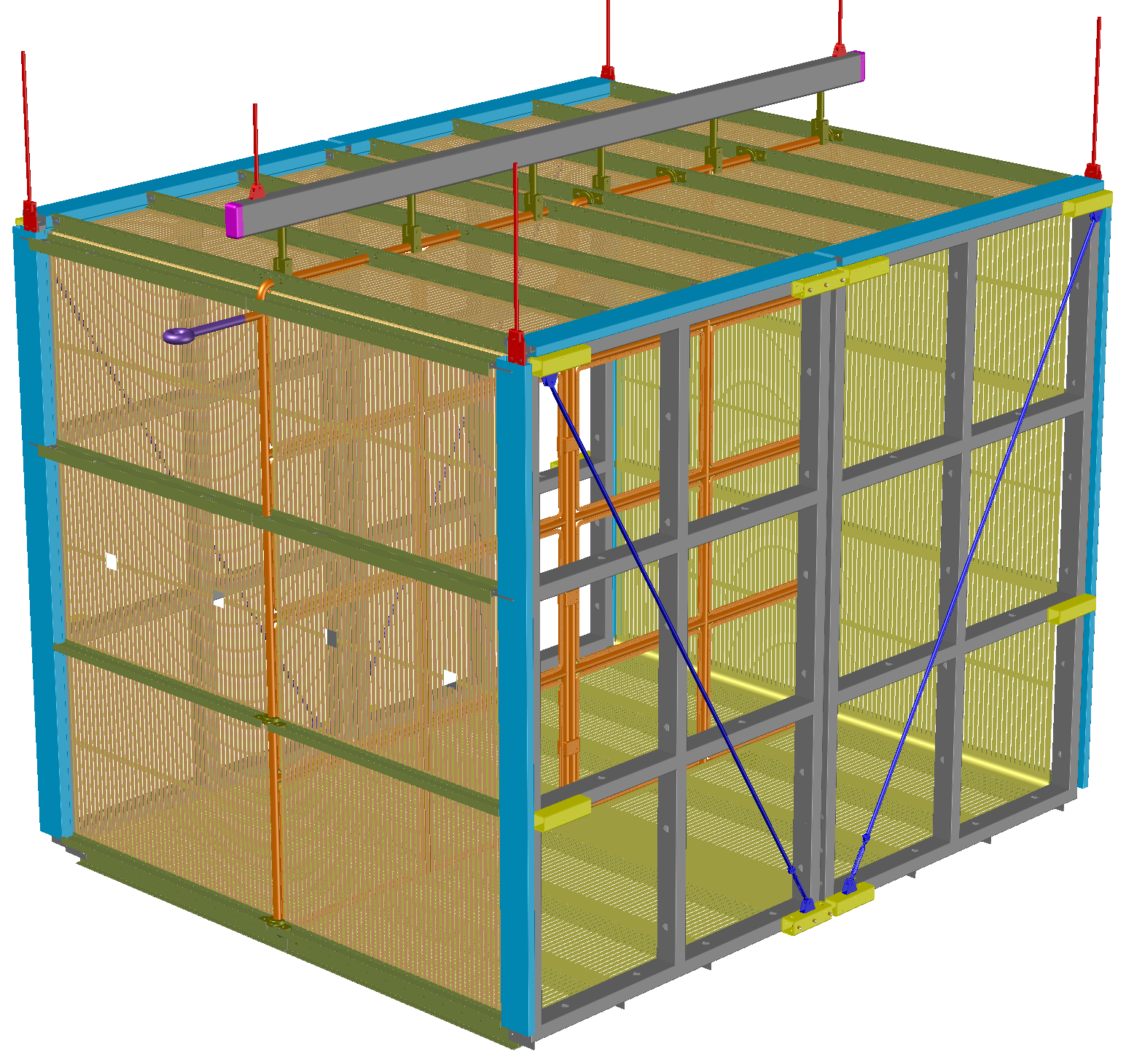
SBND TPC Layout
6 connection points to cryostat lid
HV cup
Field Cage
on 4 sides
4 m
Field Cage
support beams
E
E
2 cathode frames down the center
5 m
2 APA frames per side
4 m

Slide 8
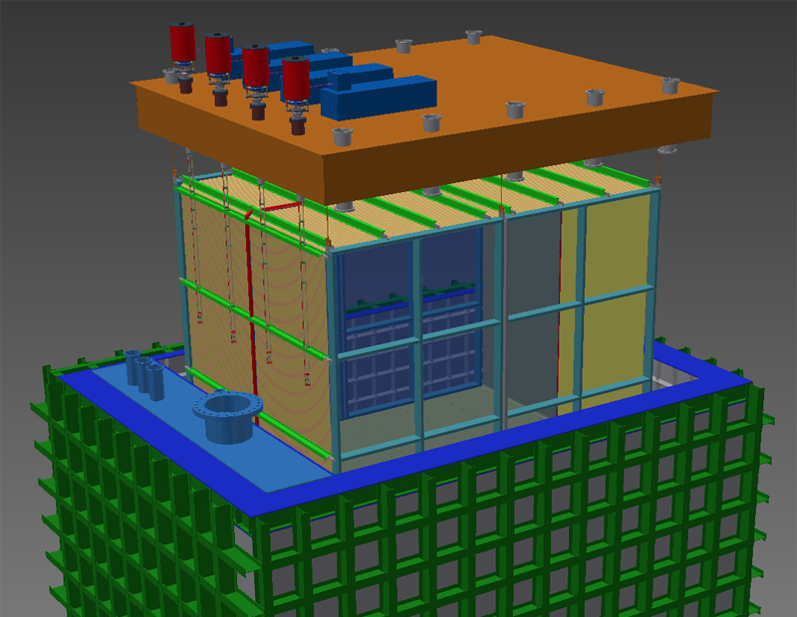

“mobile” cryostat lid plate
60 cm insulation
“fixed” cryostat lid plate
Outer mechanical support. Membrane cryostat built inside.

Slide 9
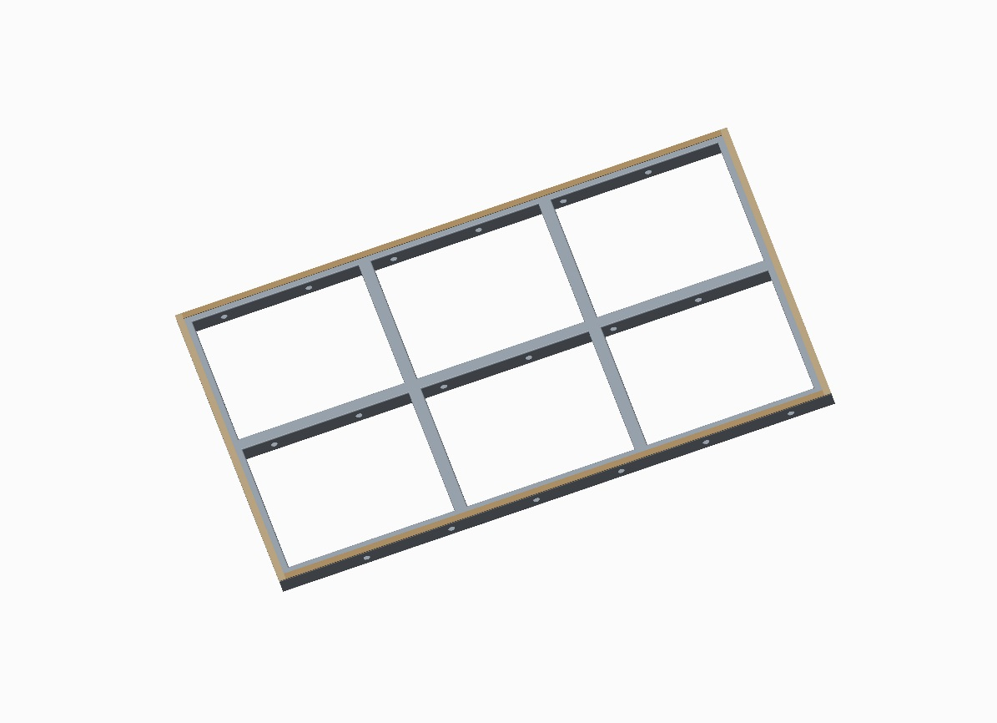
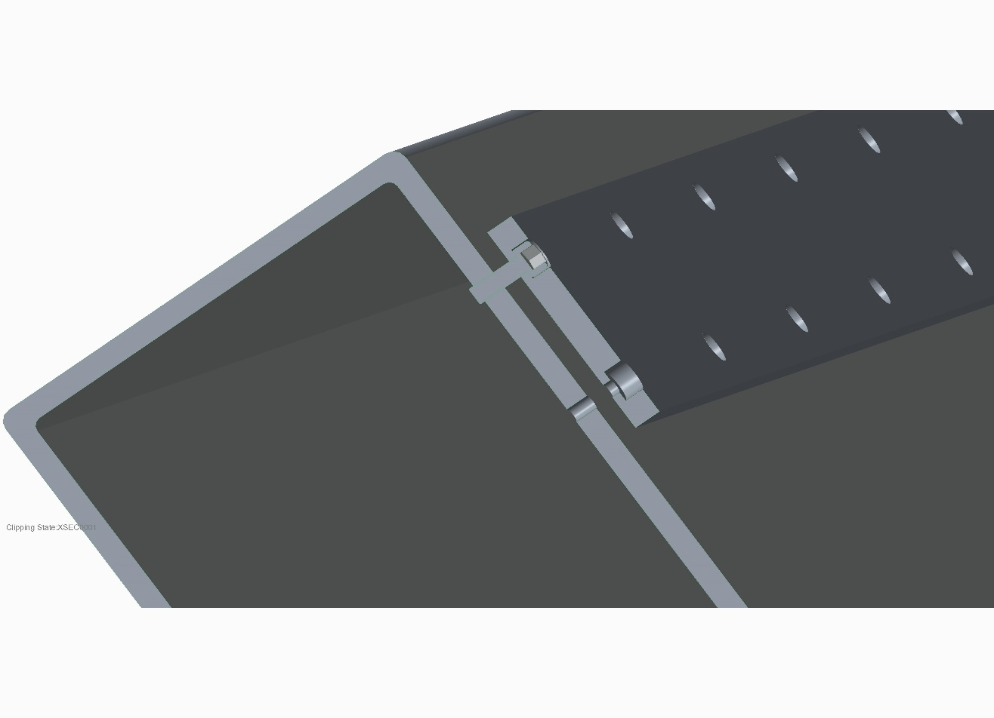
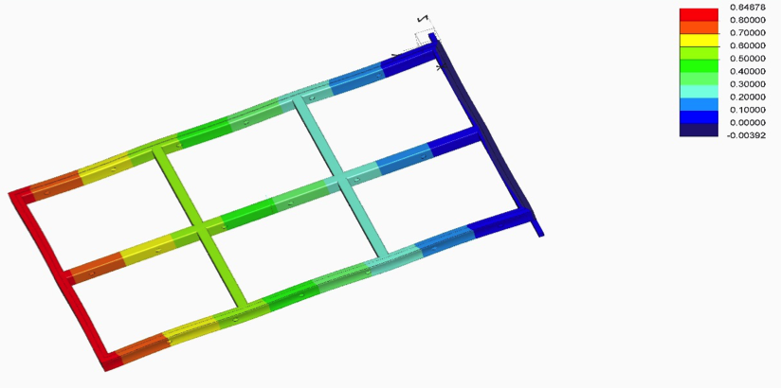
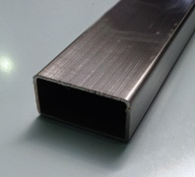
APA Frame
University of Sheffield & Chicago
Leveling plate
For 3 mm wire plane separation need better than ± 2 mm flatness, plate adjustable to ± 0.5 mm
Fabricated from 150 x 100 x 5mm 304 Stainless Steel rectangular hollow sections (RHS)
Bare frame weight = 480 kg
FEA: Max X displacement 0.85 mm
± 2 mm flat welded frame

Slide 10
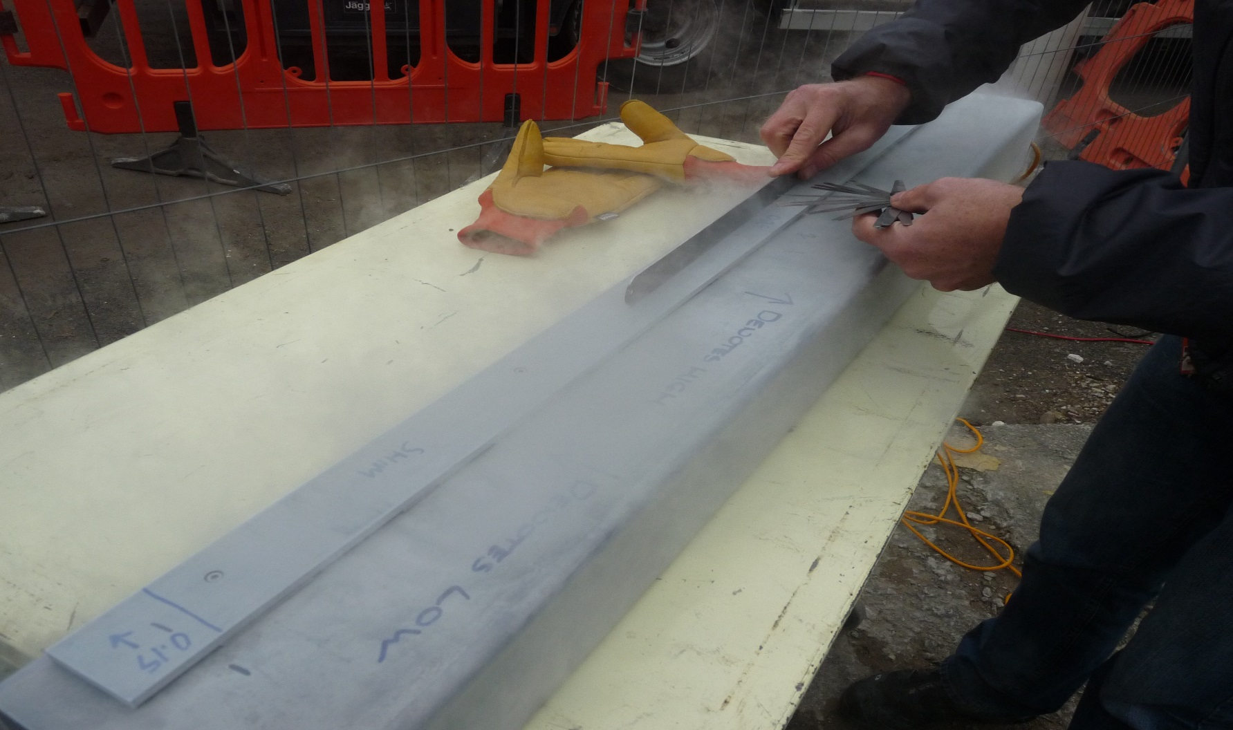
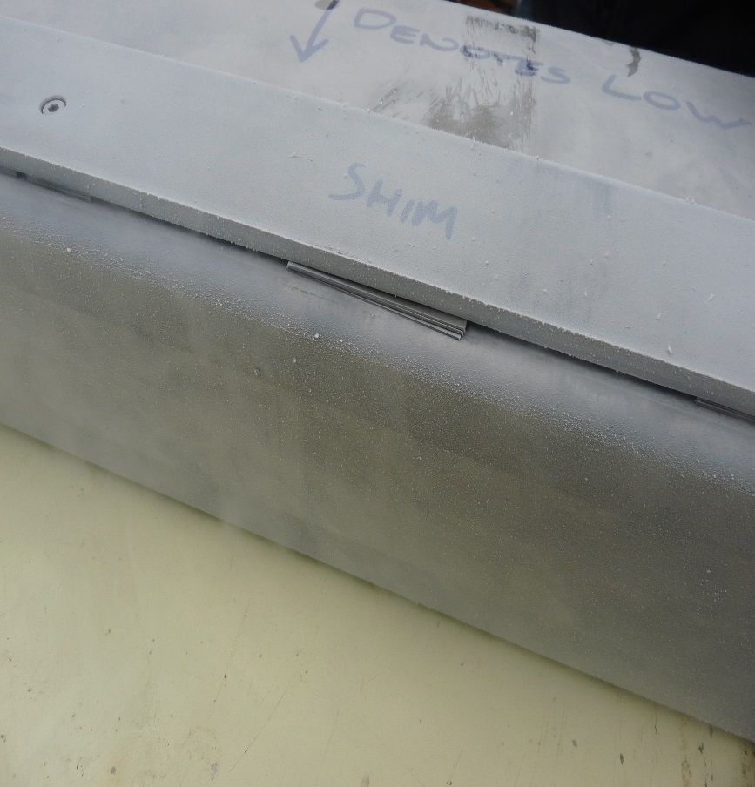
APA Frame
Prototyping levelling plates -deformation check at Sheffield
Shims

Slide 11
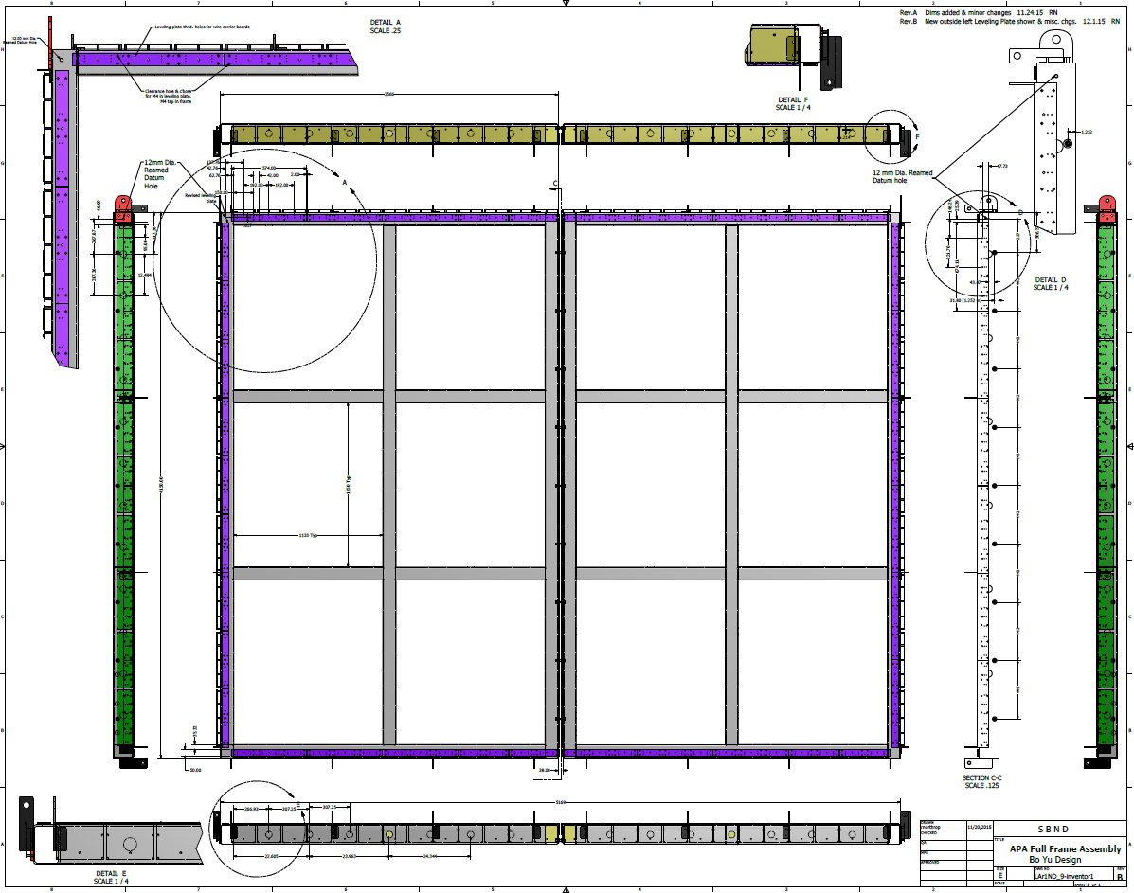
APA Frame
University of Sheffield & Chicago

Slide 12
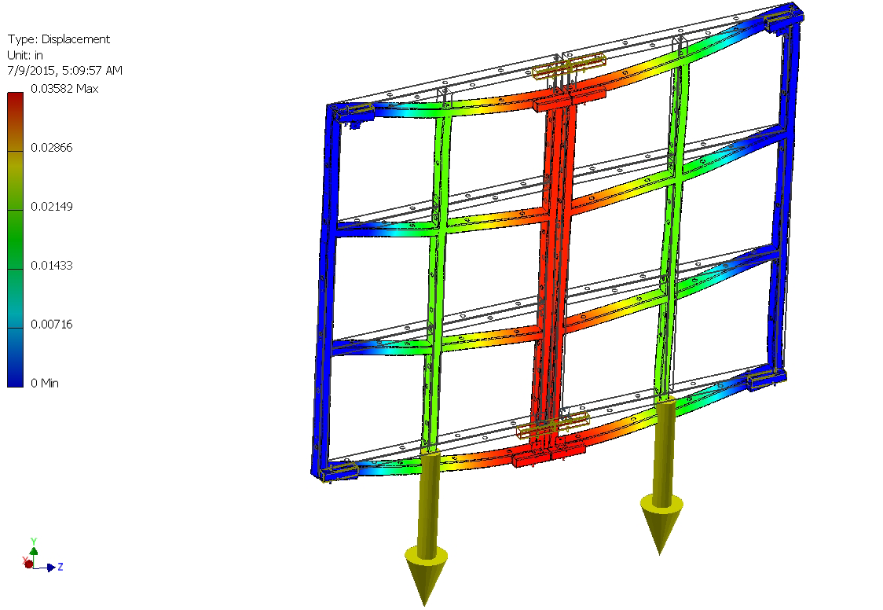
APA Frame
Full Assembly Deflection
Top & Bottom inserts plus 9 12mm bolts

Slide 13
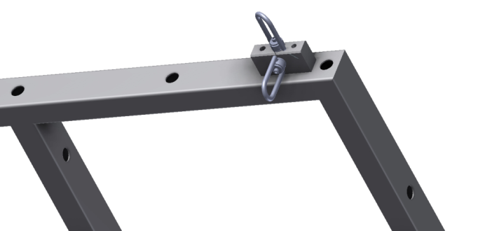
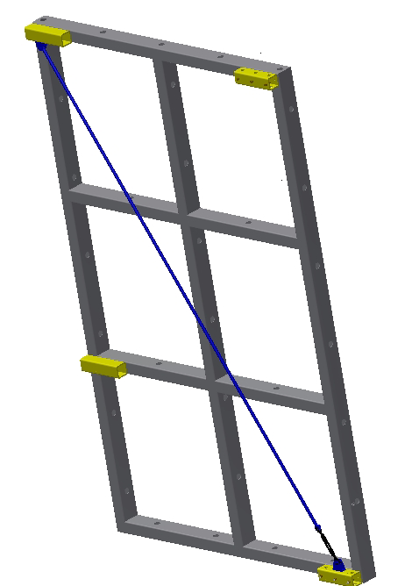
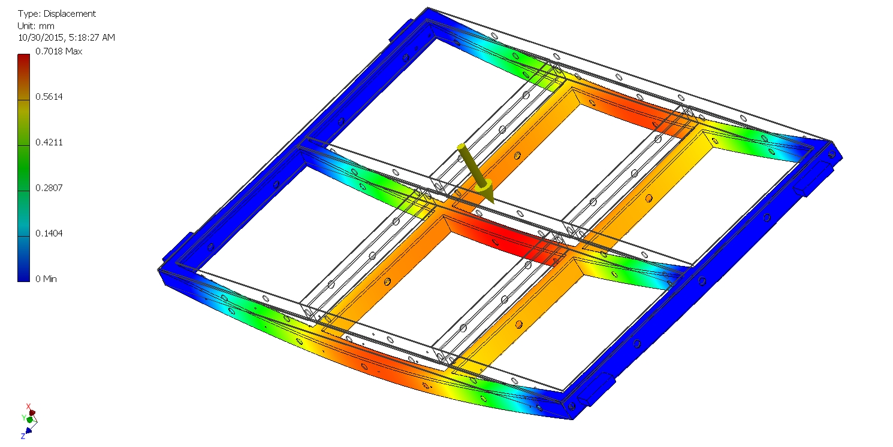
APA Frame
Lifting fixture
Screw mounted attachment - 8 M6 screws
Tack welded
Tube attachments
Deformation while lifting at horizontal position 0.7 mm

Slide 14
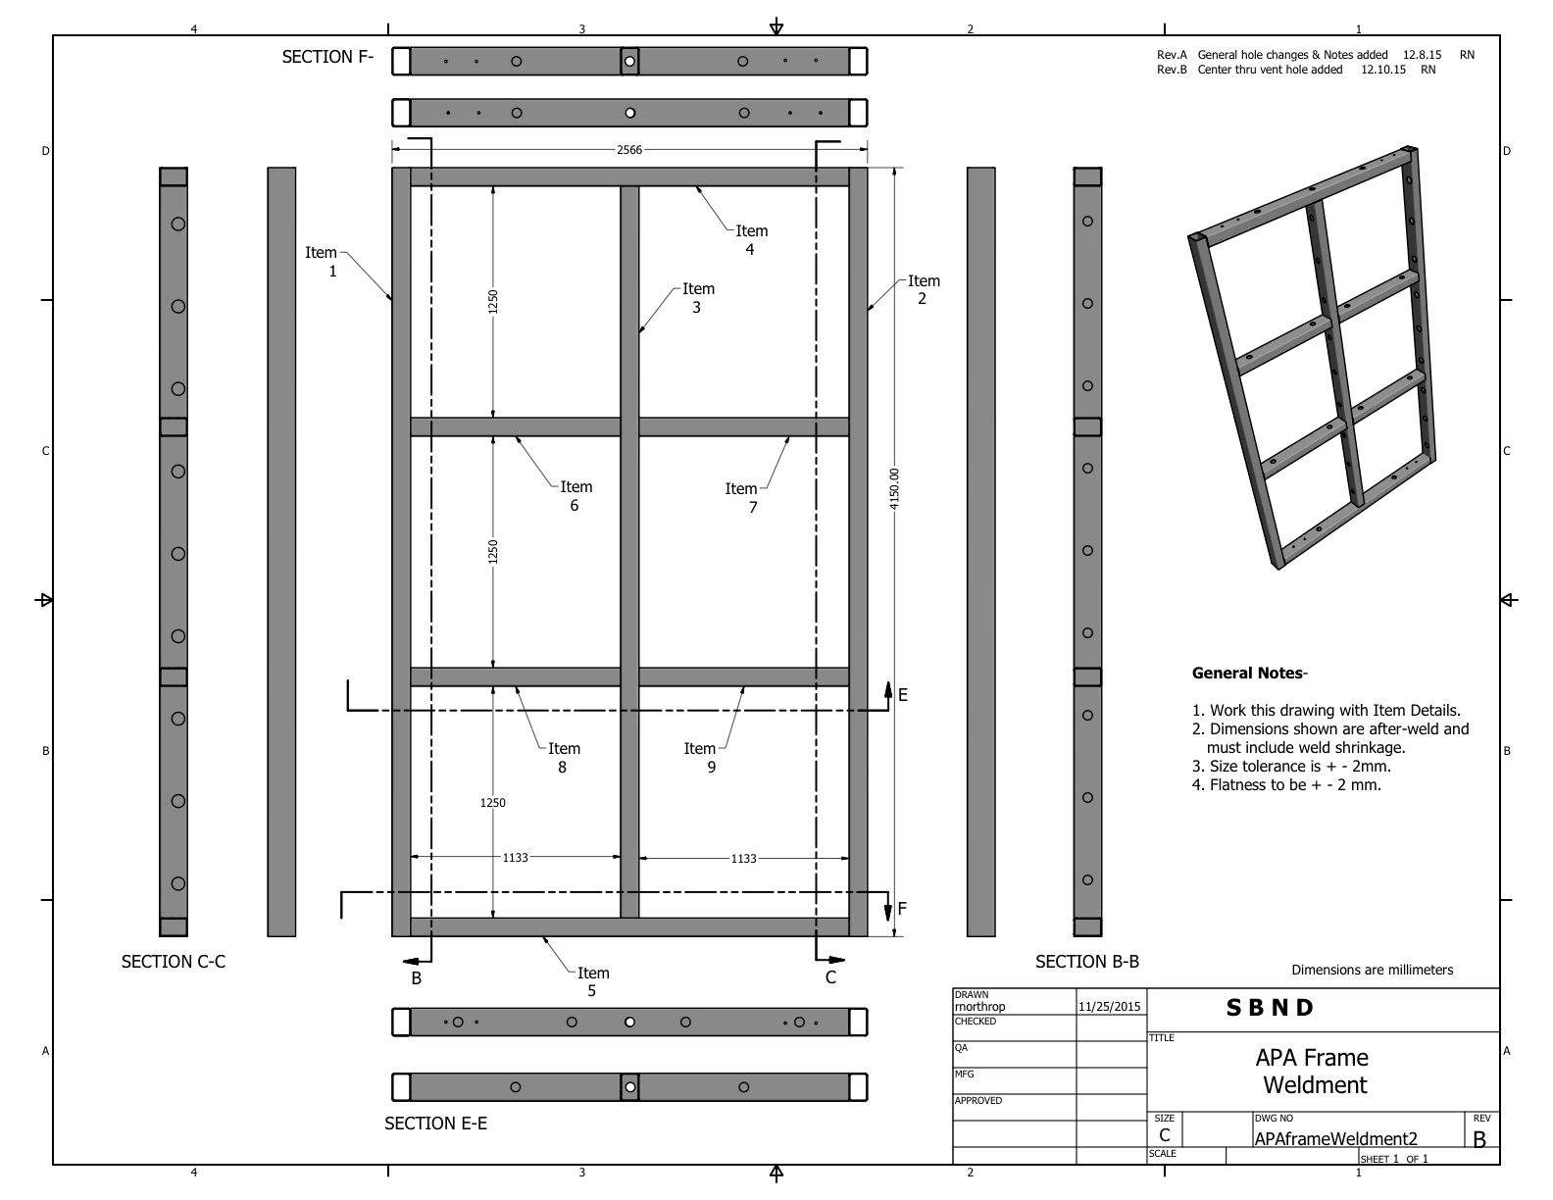
APA Frame
Final bare frame design
APA bare frame and jig review on Dec 17th
Almost ready to place an order
Quote from Portobello:
4 APAs and Jig 129k GBP
Levelling bars and laser surveys 43k GBP

Slide 15
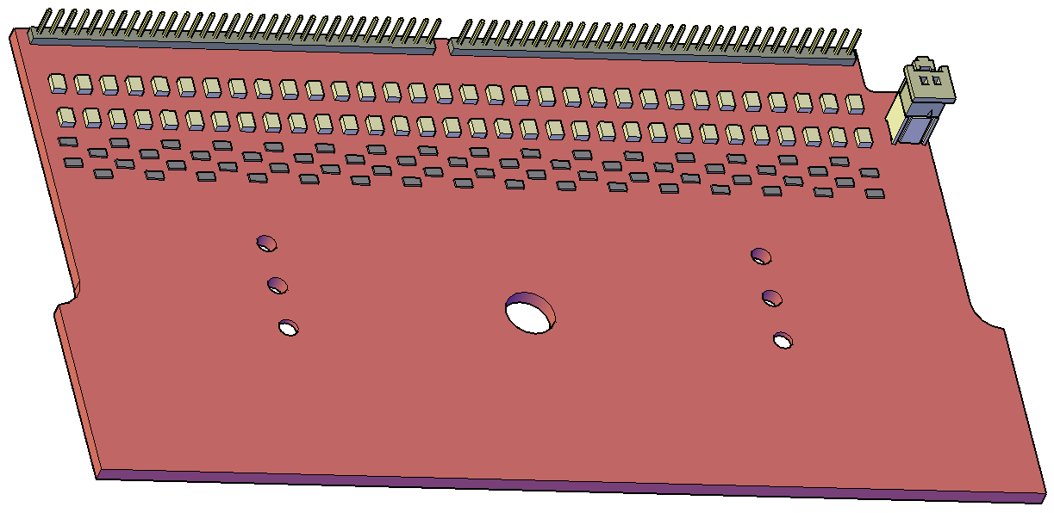
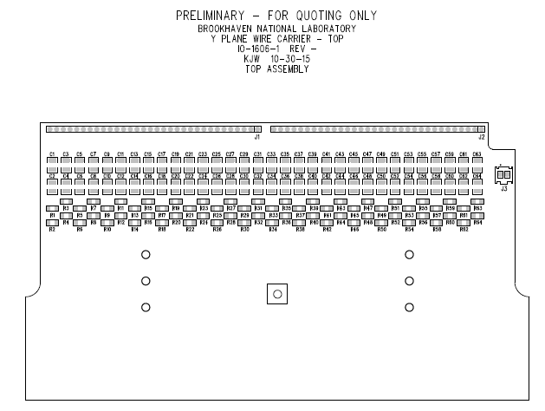
APA Construction
All geometry boards are modeled in 3D
Layout of the Y_top Geometry Board Complete
APA leveling plates to achieve flat surface for the geometry boards (± 0.5 mm adjustment)
Three layers of the Geometry Boards
Total Estimate for all boards: ~80k$

Slide 16
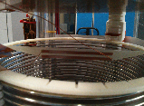
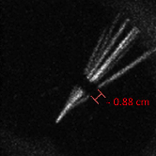
APA Construction –Electron Deflector
To be tested in 35t
Preliminary studies with the Liverpool camera readout TPC
in gas
Alpha tracks 1s exposure
Electron deflector to recover the “dead” region (15mm) between the two interconnected APAs

Slide 17
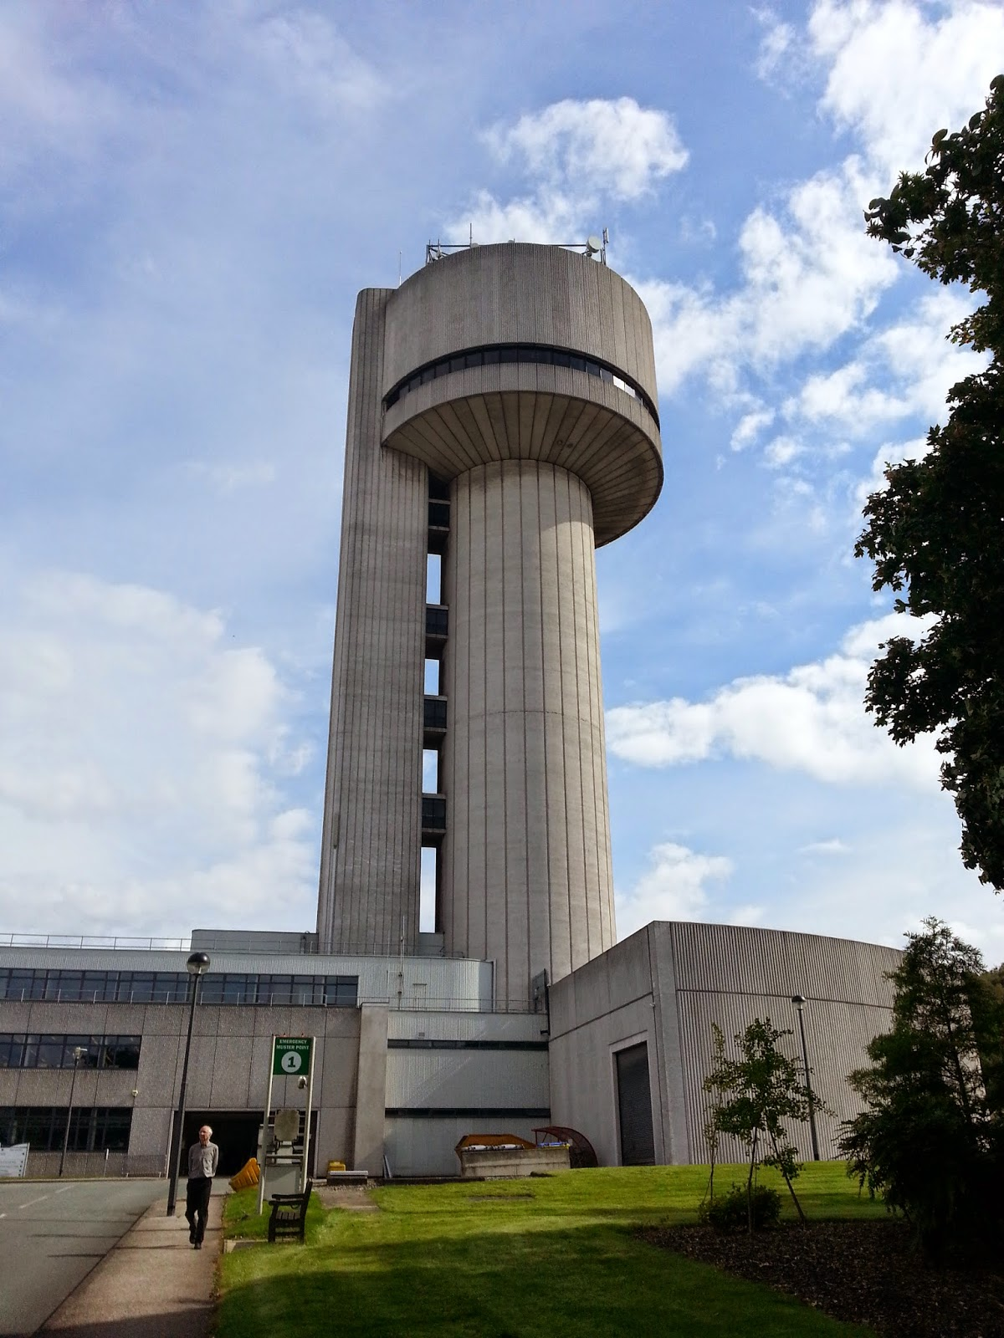
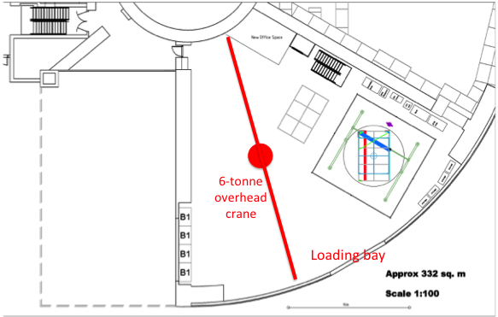
APA Winding
Daresbury, UK (Manchester group)
Two winding Facilities
Yale, USA (Syracuse group)
UK Daresbury Space

Slide 18
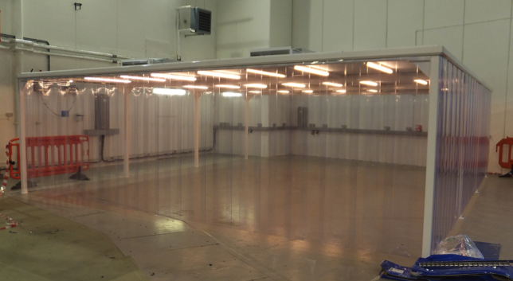
APA Winding
UK Daresbury space ready to be used

Slide 19


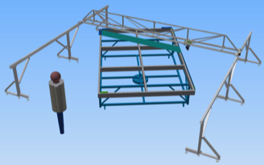
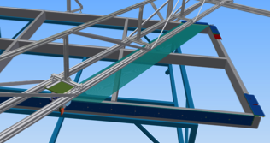
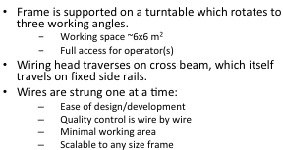

APA Winding
Winding Procedure UK: Semi automated
Turntable framework and bridge design is complete

Slide 20

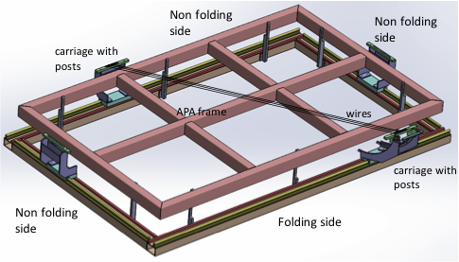
APA Winding
The New Wright Laboratory
Facilities
85,200 sf of lab and office space include
- PI laboratories
- Specialized laboratories
- Prototyping, teaching, fabrication shops
space for SBND assembly

Slide 21
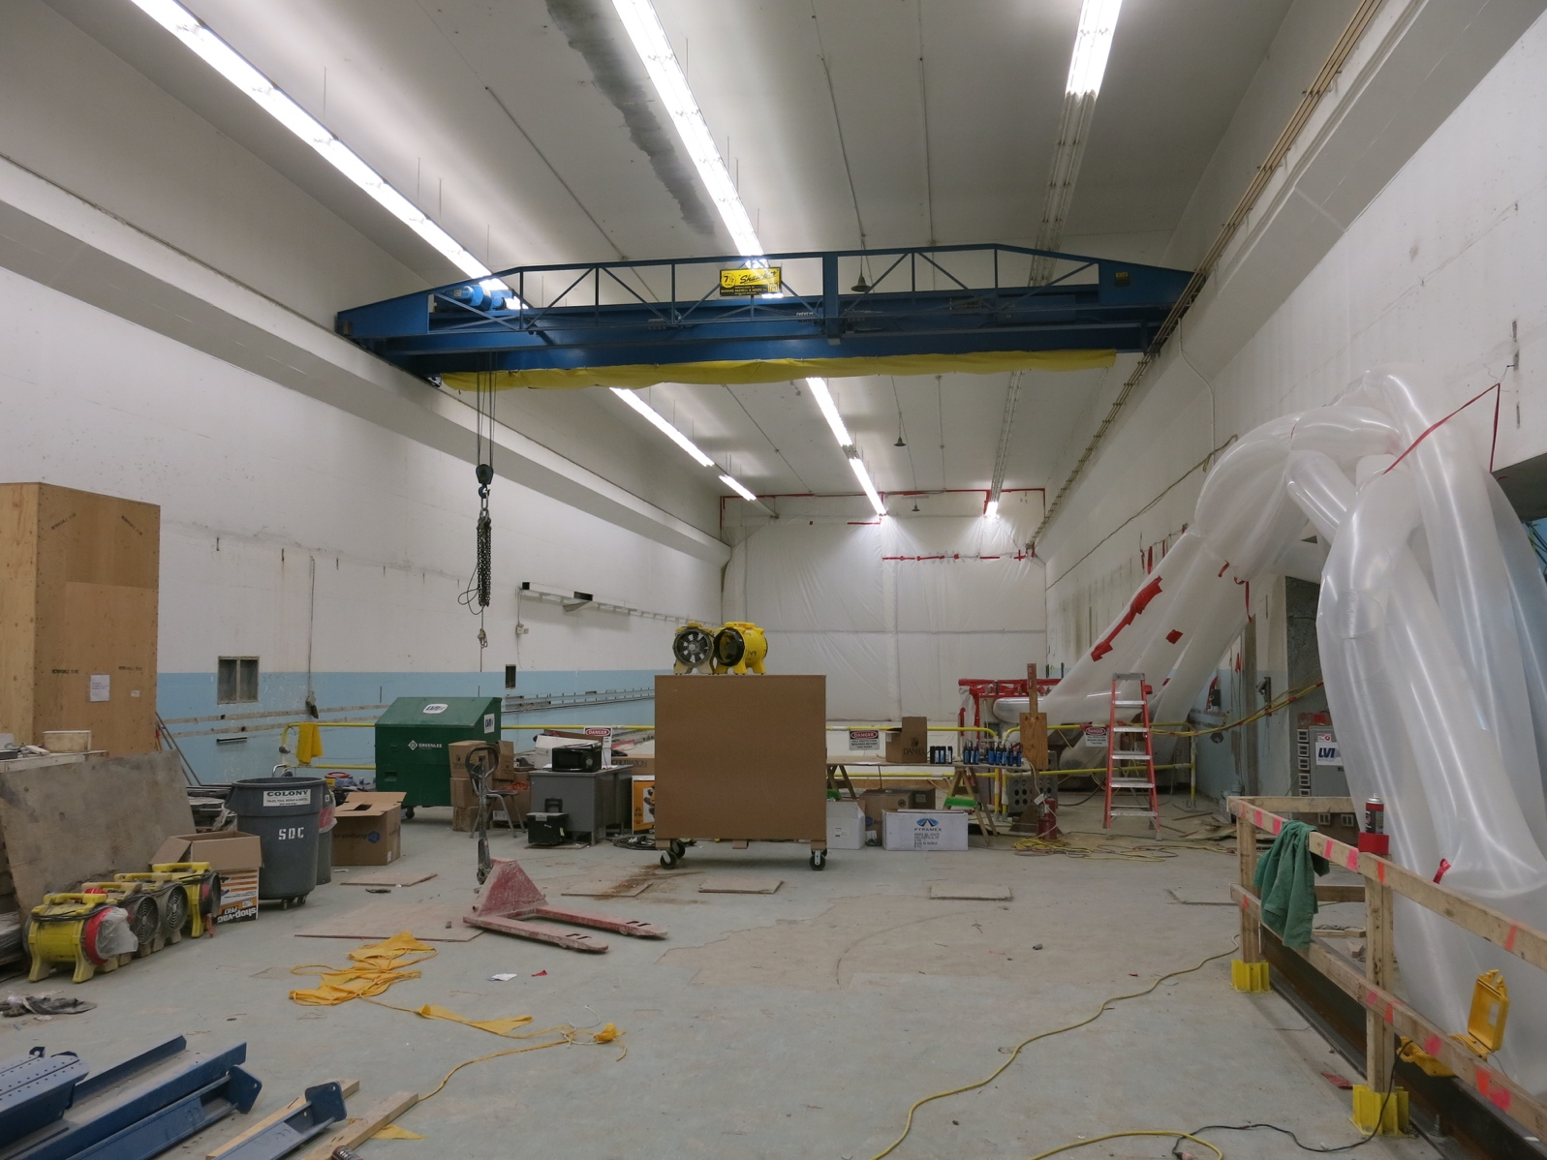
APA Winding
The New Wright Laboratory
Winding Procedure US: Manual
Detector assembly and staging areas.
Currently undergoing renovations.
Available in summer 2016
Syracuse group works
with PSL

Slide 22
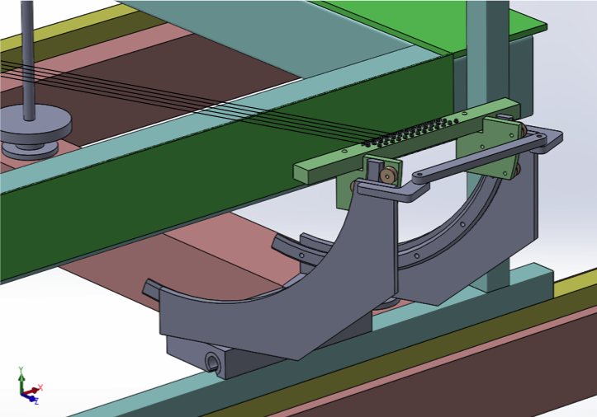
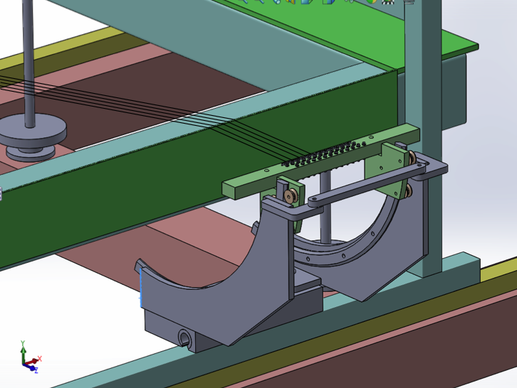
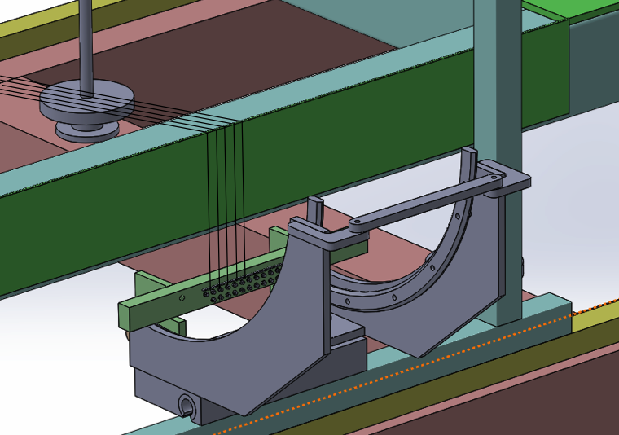
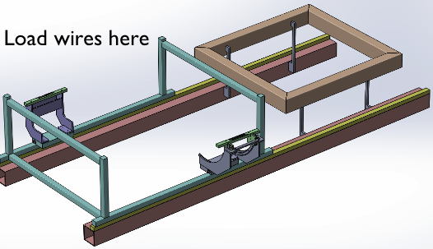
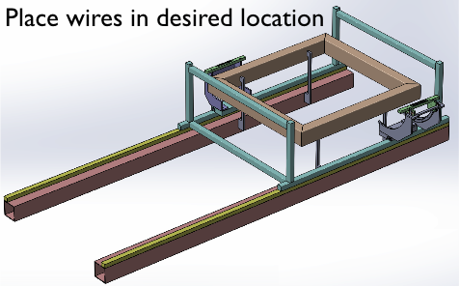
APA Winding
Winding Procedure US: Manual
Prototype expected delivery February 2016
Cost prototype ~40k USD
Cost for full machine ~50k USD
Procedure for wires to be placed over the edge:
2. The 1st fold brings the wire outside the APA perpendicular to the side
3. The 2nd fold brings the wires down along the edge geometry boards where they are then soldered
1. Starting position

Slide 23
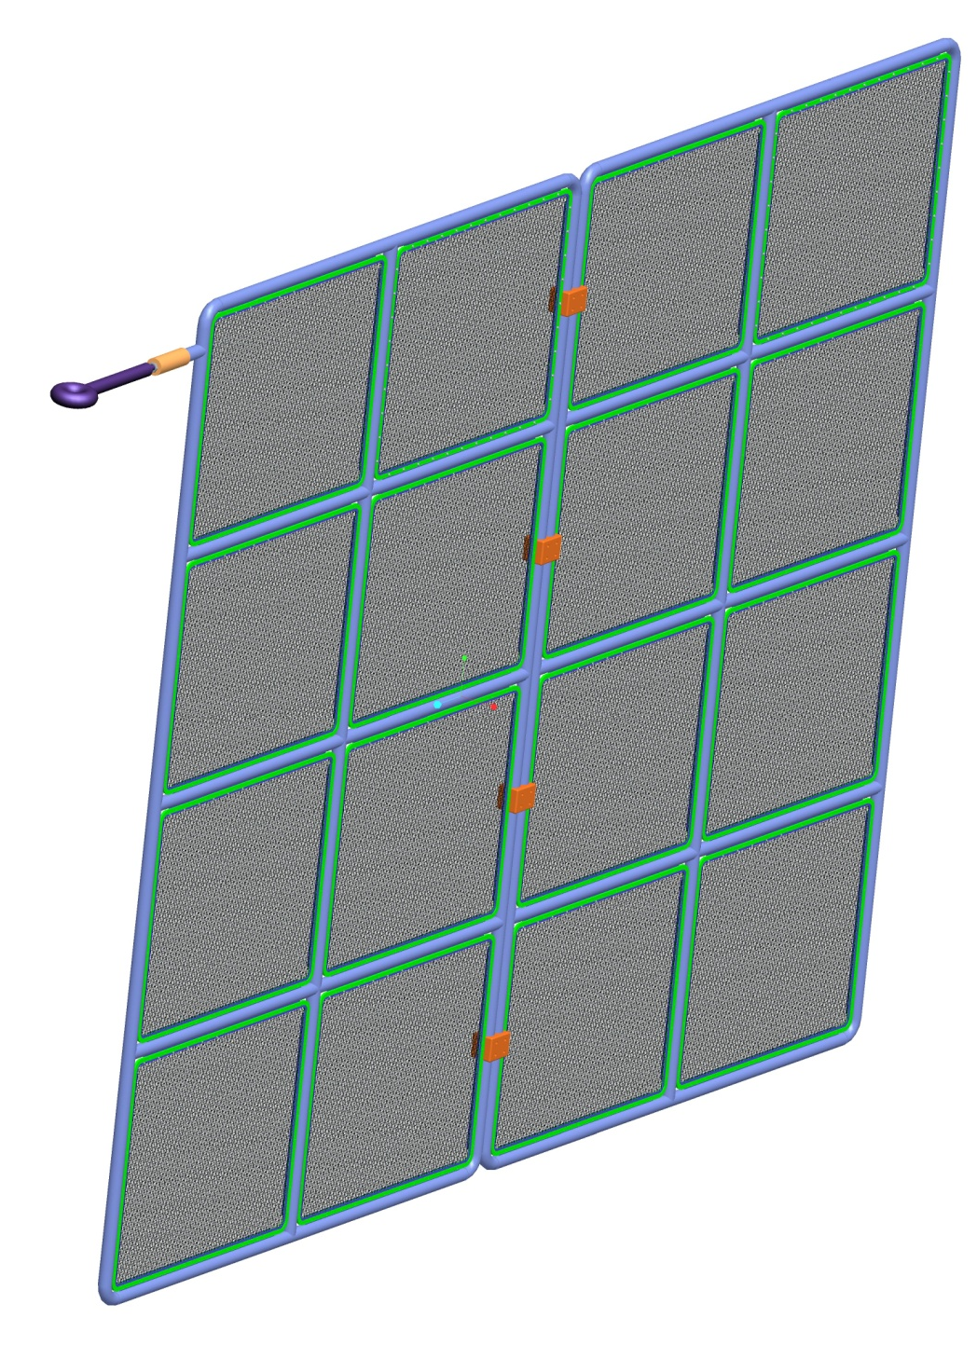
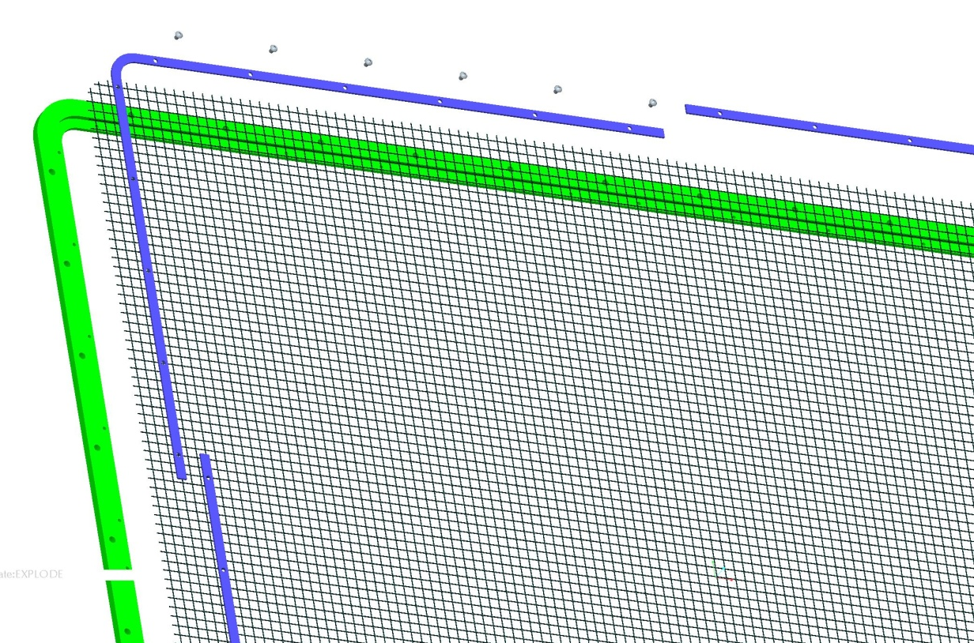
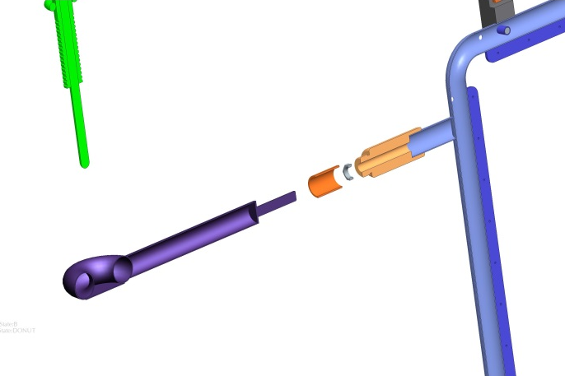
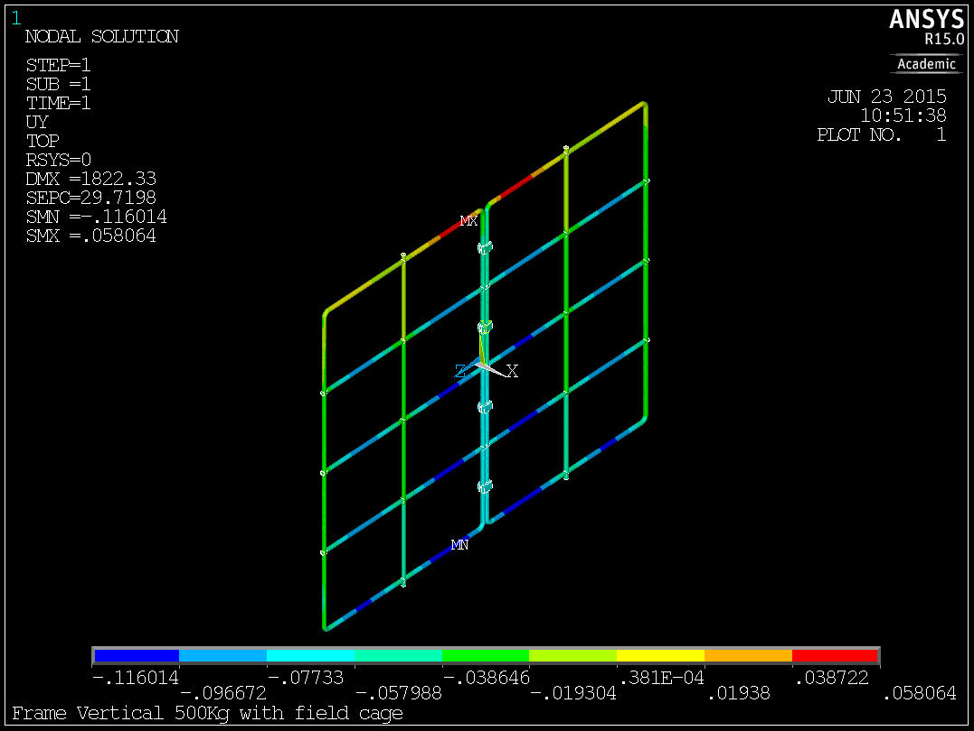
CPA
Construction University of Liverpool
Cost 39k GBP
HV Cup
5 mm aperture
1 mm wire ID
70% transparency
Baseline design transparent mesh
Weight:
  half CPA Frame 130Kg
  each Mesh Panel 8.5Kg
  Total for 2 CPAs around 440Kg
CPA Made up of a Stainless steel frame and 8 stainless steel wire mesh smaller frames.
FEA: Deflection 0.116 mm

Slide 24
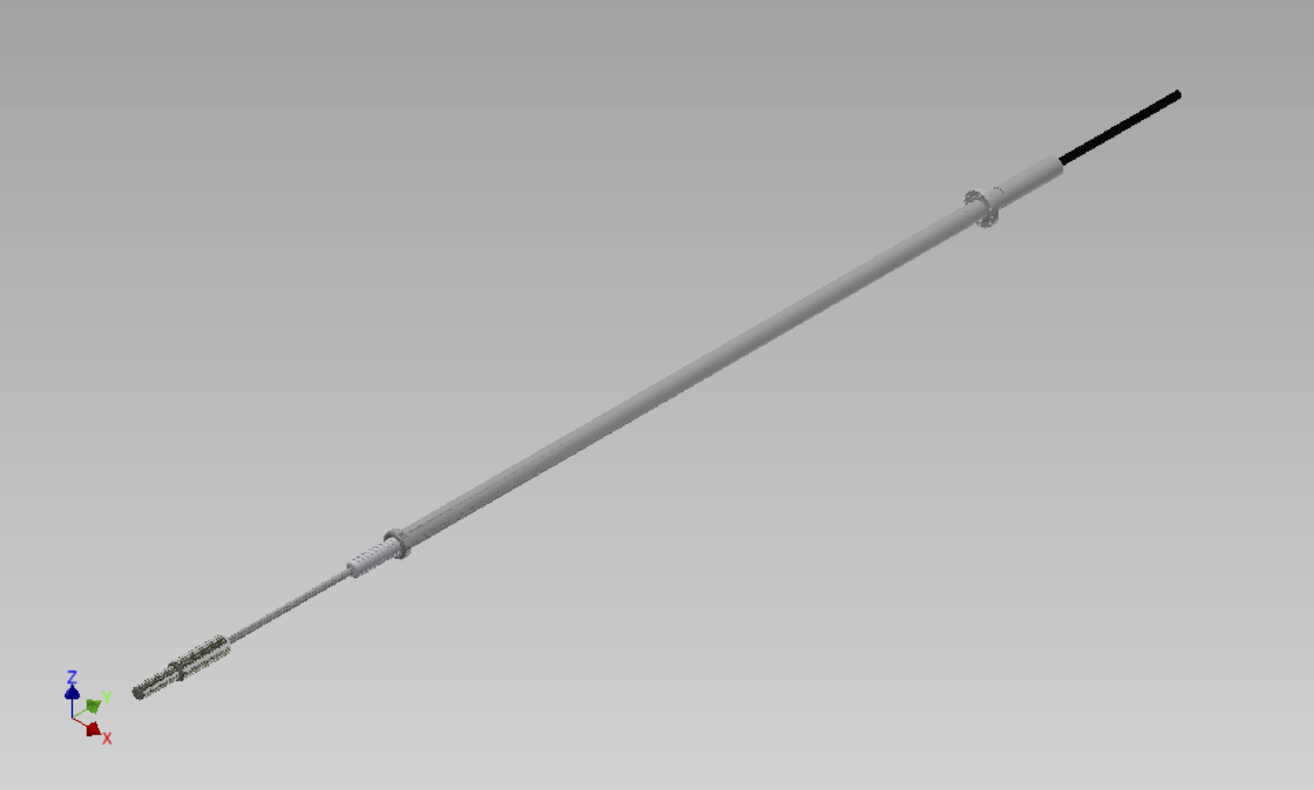
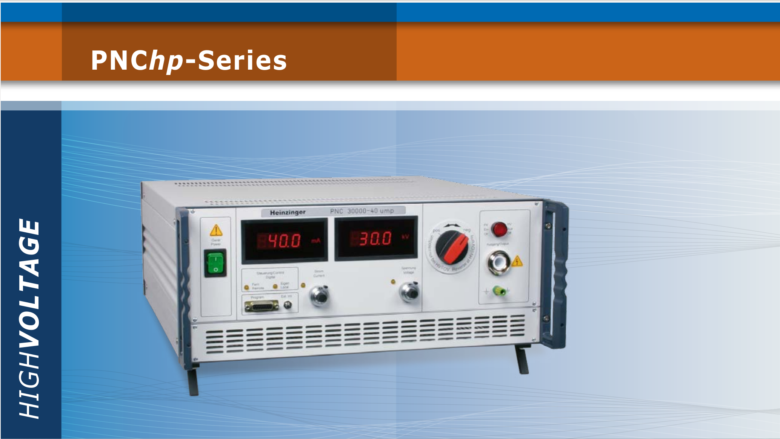
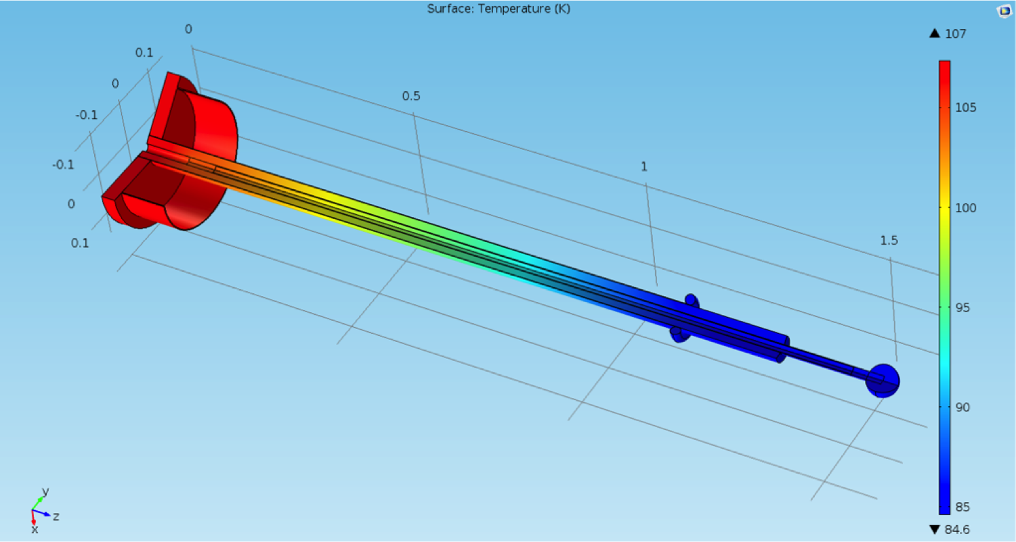
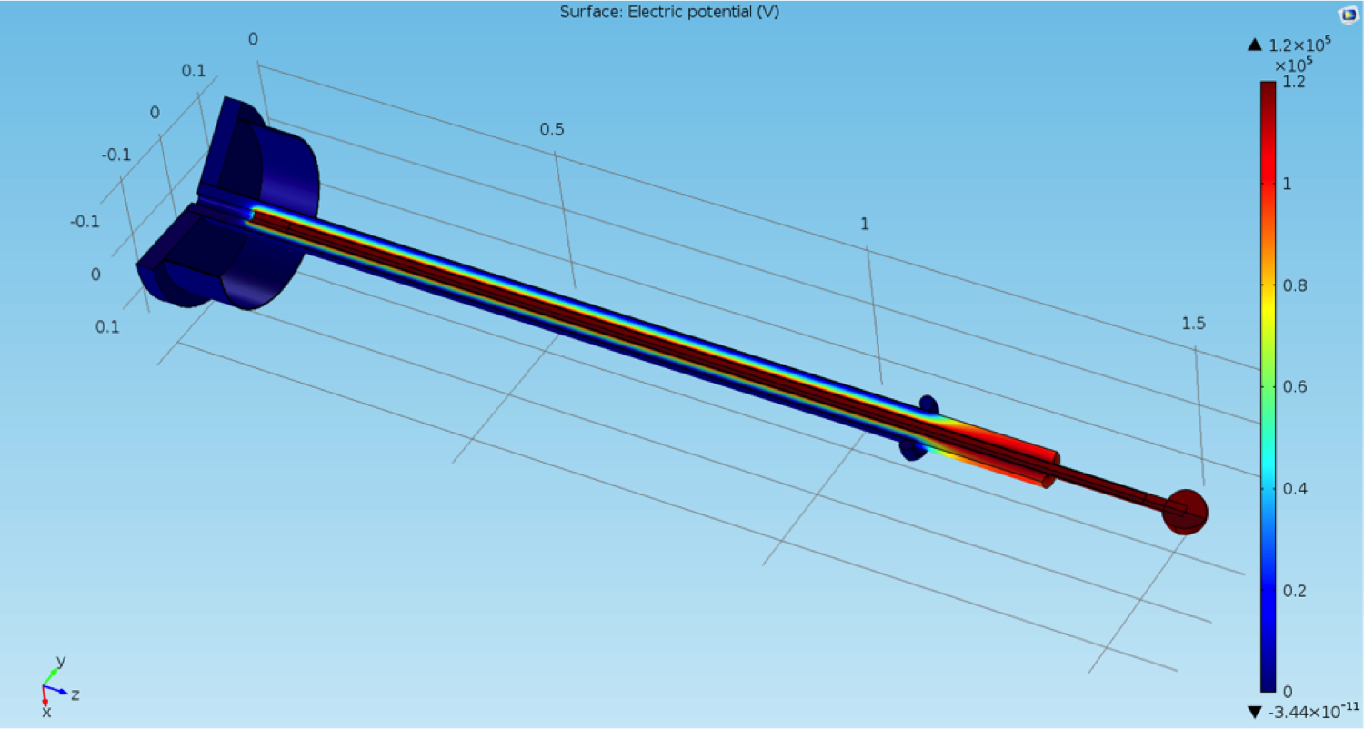
HV supply & Feedthrough
Yale and UCL groups
100 kV FT, Spring loaded tip based on 35ton design
Heinzinger PNChp 150000 – 1 neg
High Precision – HighVoltage – Power Supply
Material cost is 67k $
Simulations:
  electric field
  thermal

Slide 25
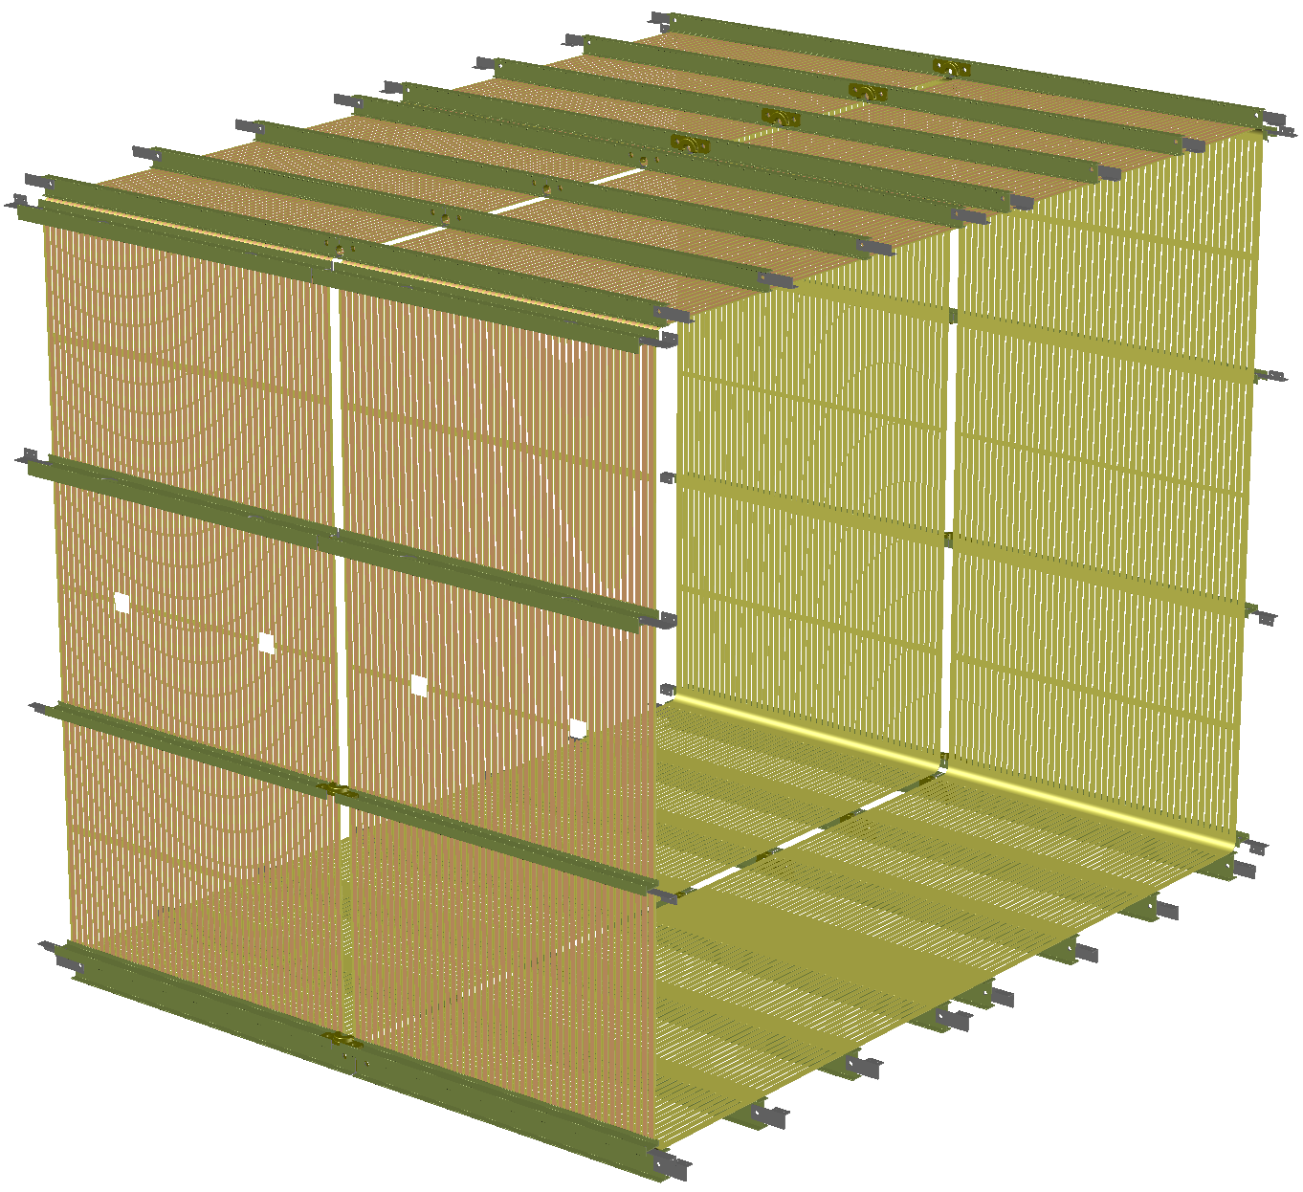
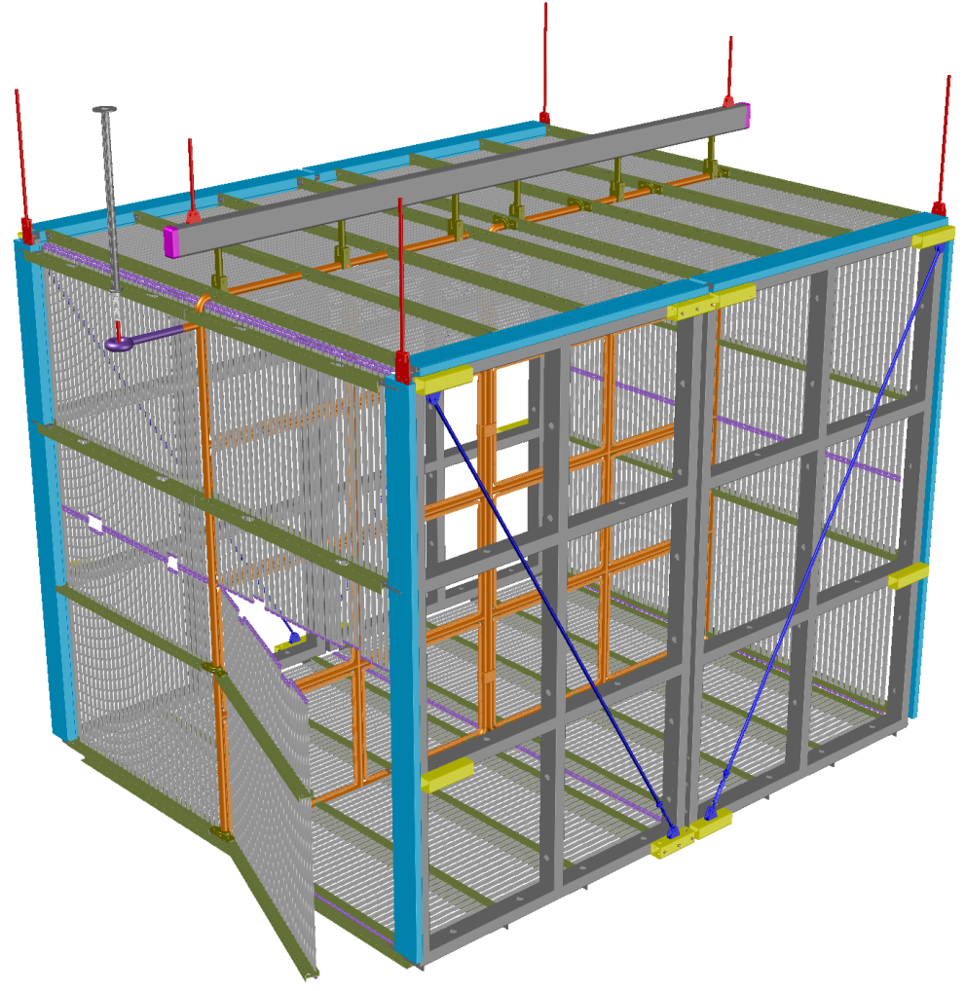
Field Cage
Work led by BNL and Yale
5m
Roll-formed metallic profiles
Field cage Design
4m
4m
PCB based design

Slide 26
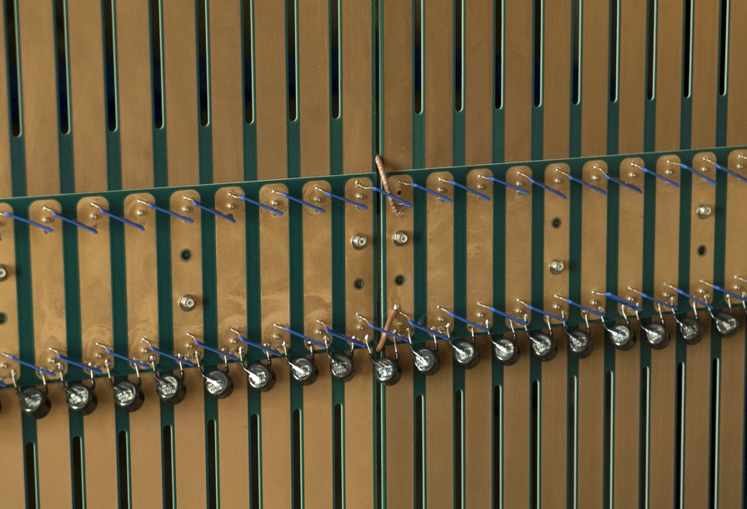
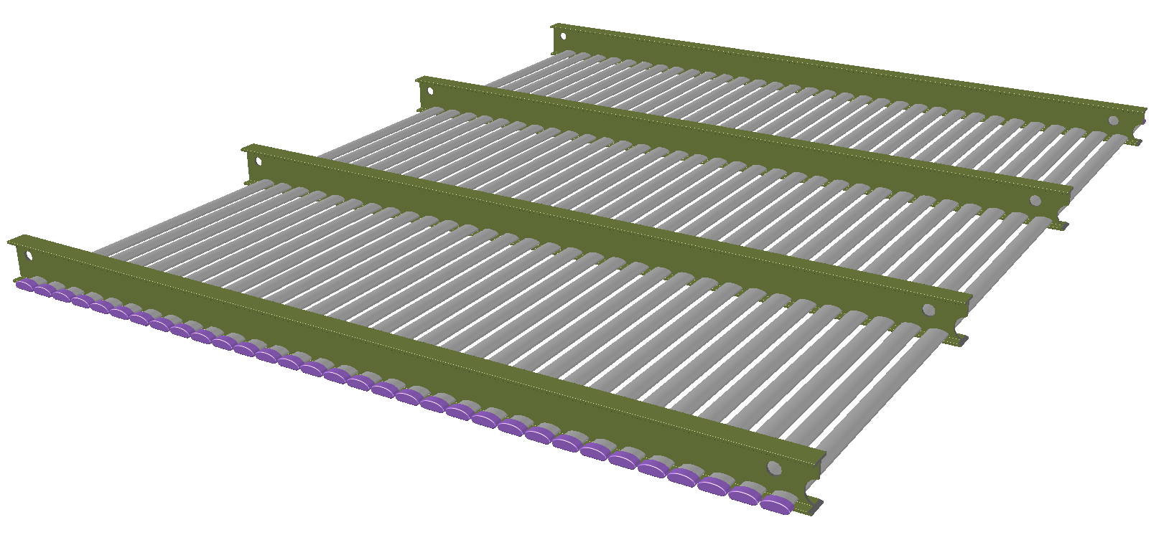
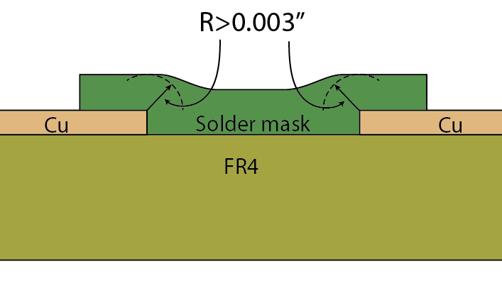
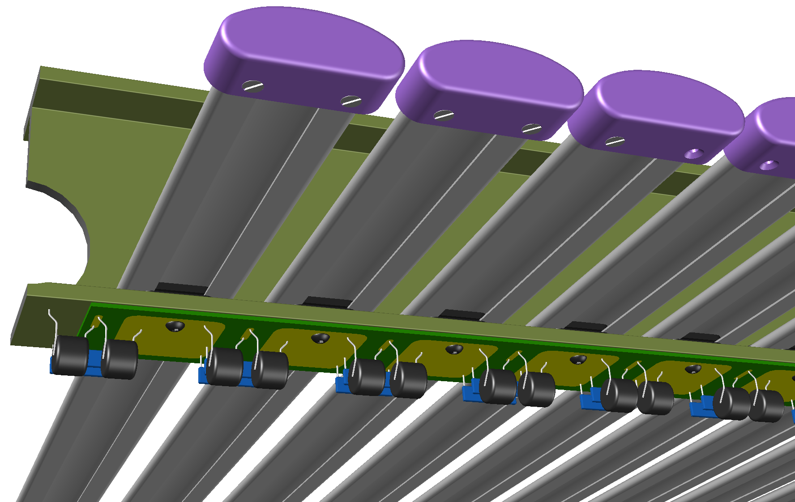
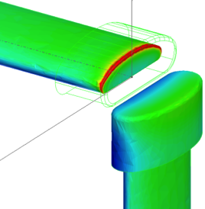
Field Cage
Roll-formed metallic profiles design
PCB design based on 35t
A pre-assembled module:
32 bars @ 6cm pitch to cover 2m drift.
There is no electrical connection between adjacent field cage modules. Each module has its own
resistive divider chain.
Profile and cap locking scheme
Resistive divider and surge suppressor chain
Cost ~250k USD
Cost ~67k USD
Awaiting performance of 35t and Roll-formed field cage prototype test at CERN

Slide 27
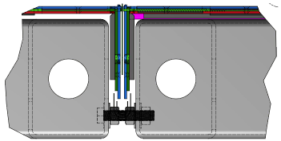
TPC Integration & Installation
Work led by Chicago, BNL and Fermilab
APA sub-assembly scheme
M12 bolt connecting the frames
Connected using two custom connection fixtures, allowing uniform gap and ensure alignment of U/V wires across two frames

Slide 28
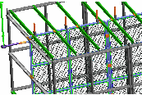
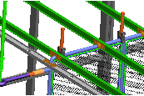
TPC Integration & Installation
CPA Integration
^{G10 connecting brackets}
^{G10 hanging brackets}

Slide 29



TPC Integration & Installation
TPC assembly in the DAB tent
Work led by Chicago, BNL and Fermilab
(See Joe Howell’s talk for more details)
^{Tent dimensions:} 5.8 m (19 ft) high × 7.9 m (26 ft) wide × 15.2 m (50 ft) deep
Model of SBND assembly

Slide 30

TPC Schedule
Finished
Expected Feb 16
1st UK frame 4/16
1st US frame 7/16
All TPC components to be delivered to Fermilab by March 2017

