Slide 1
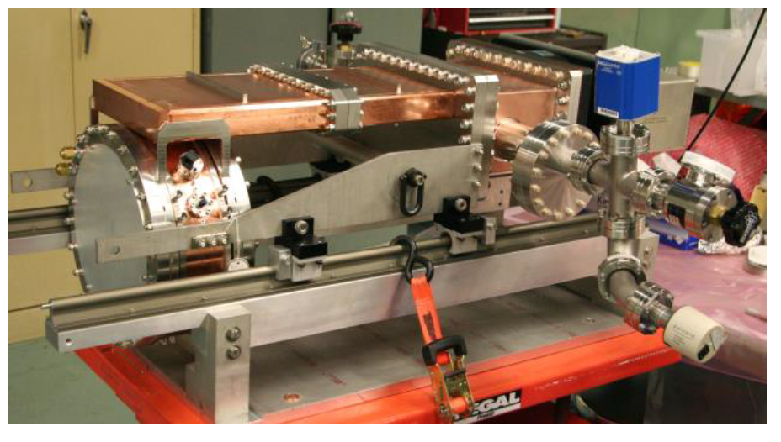
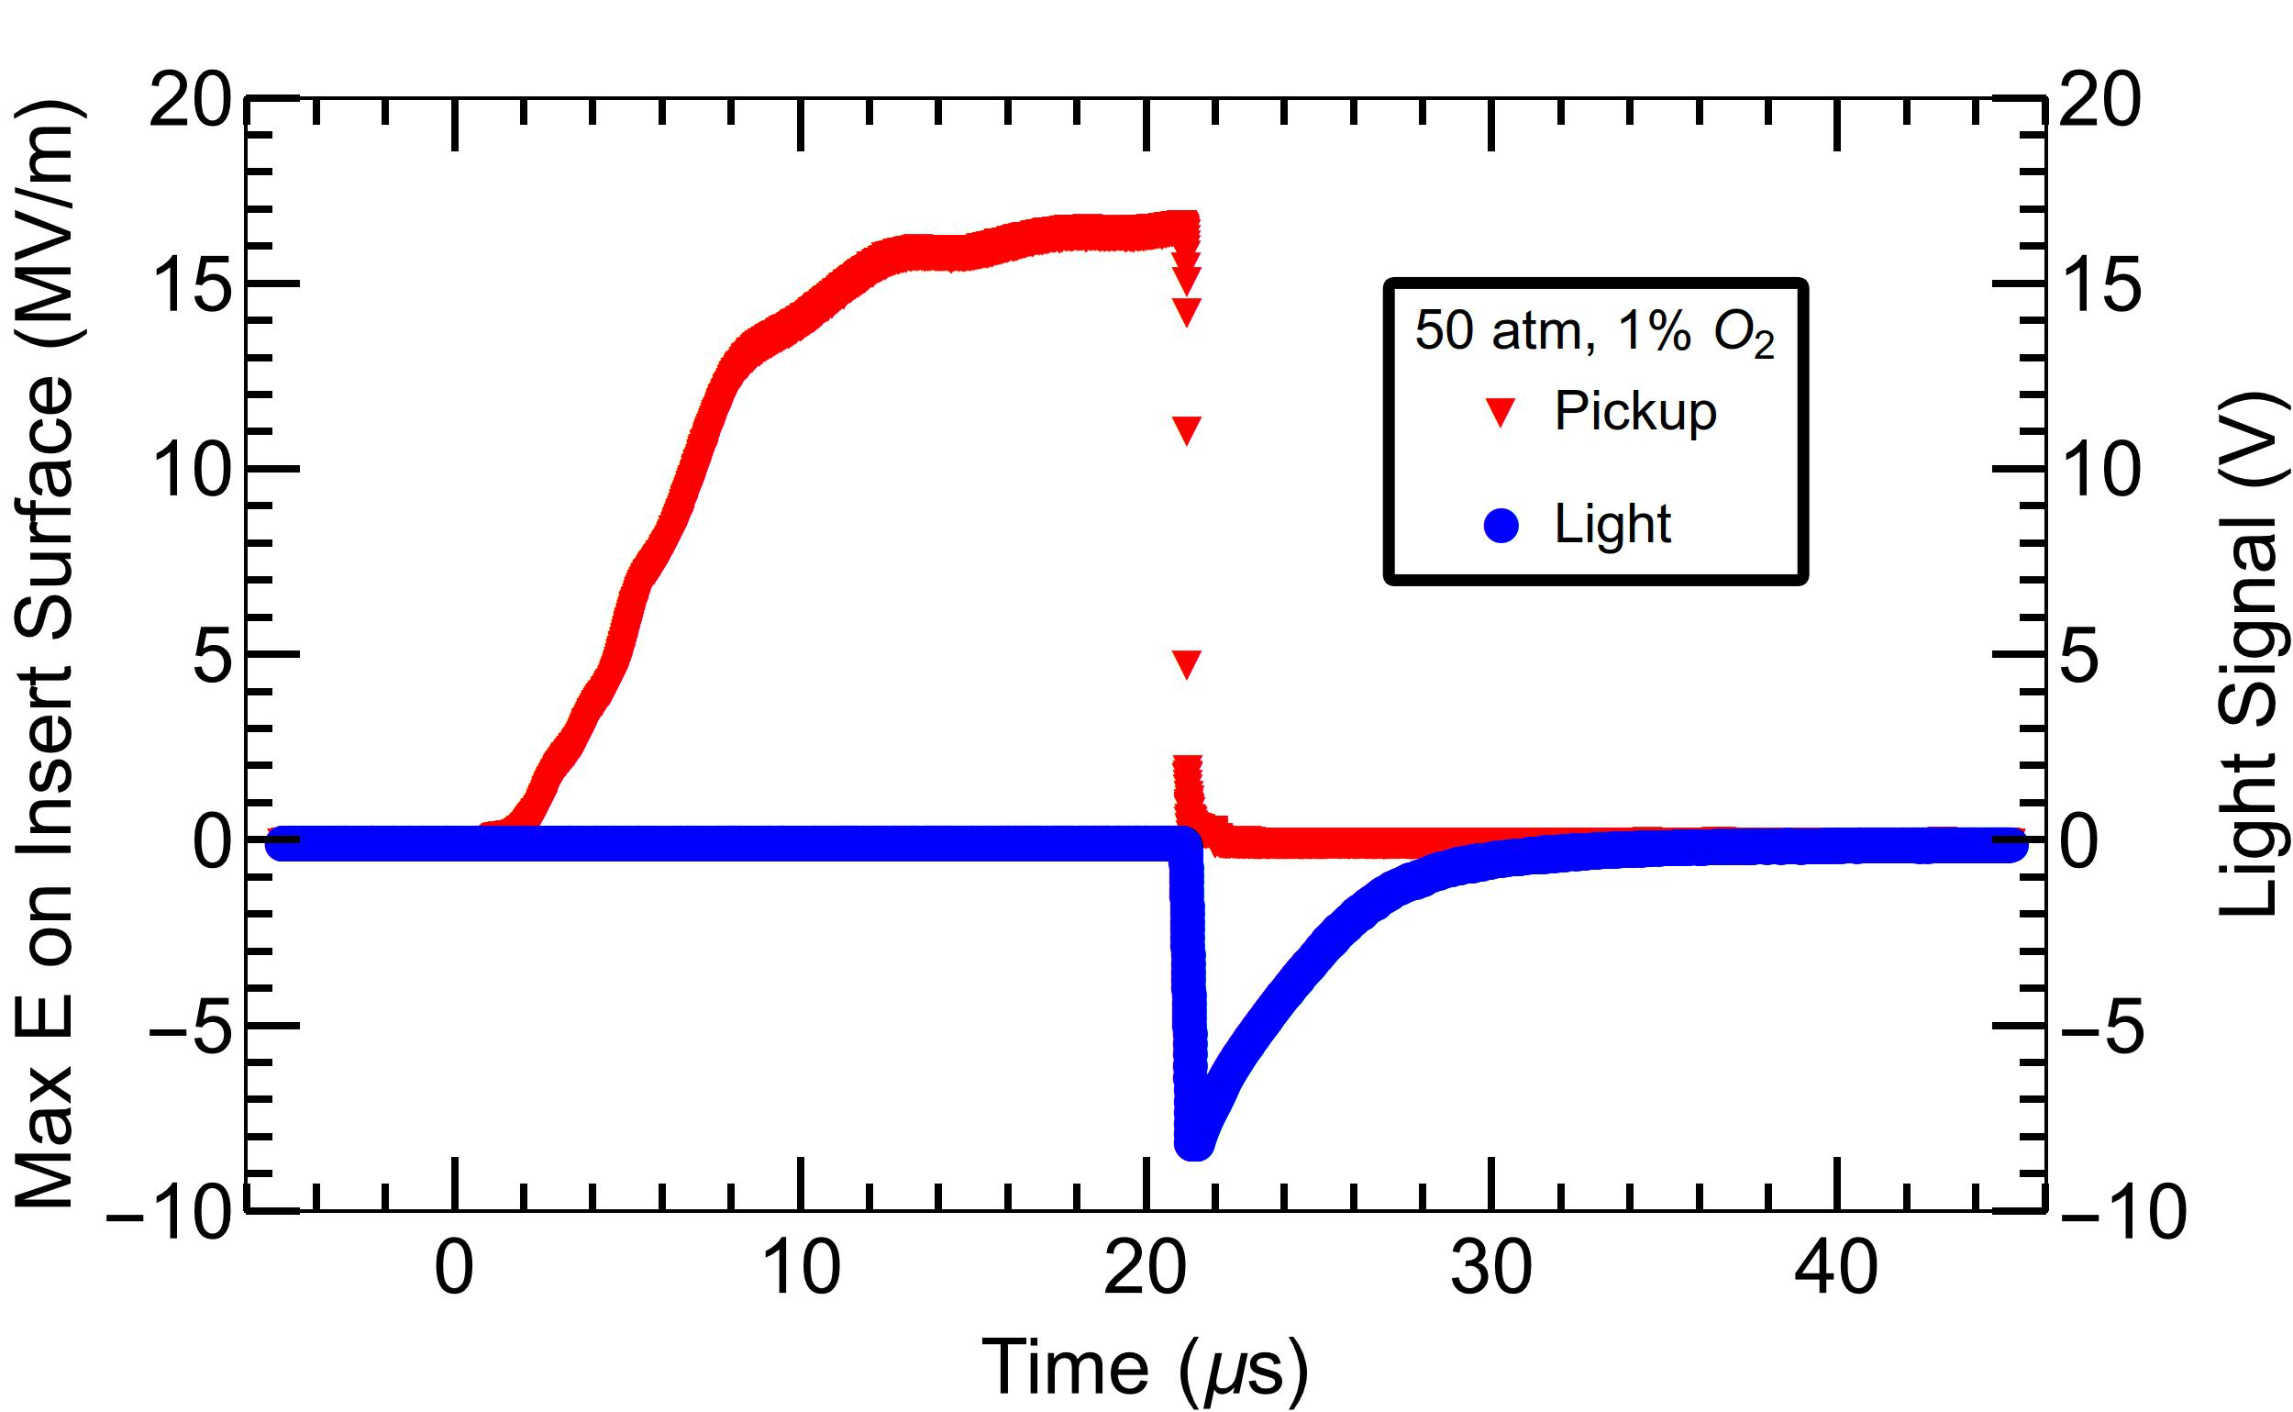
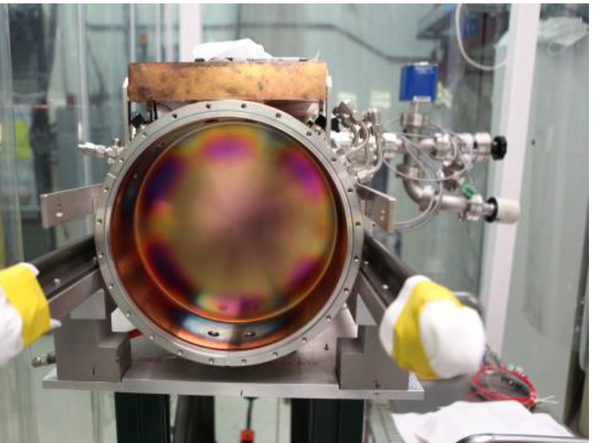
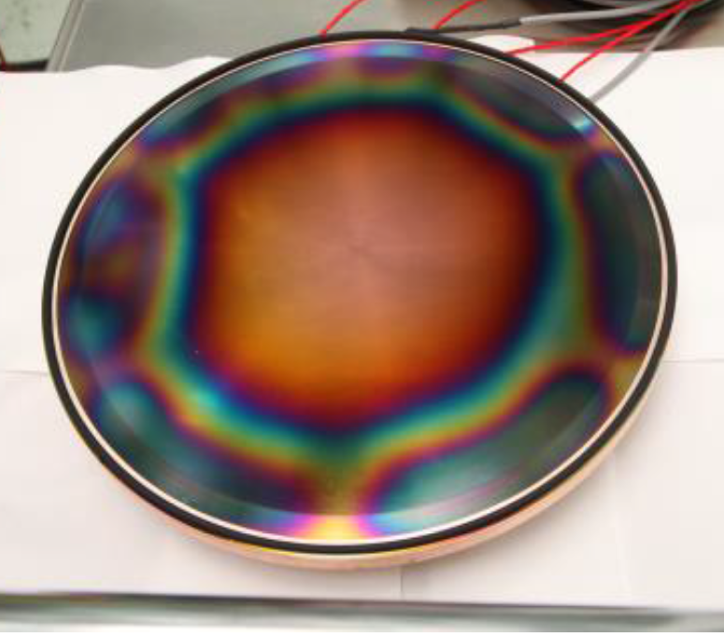
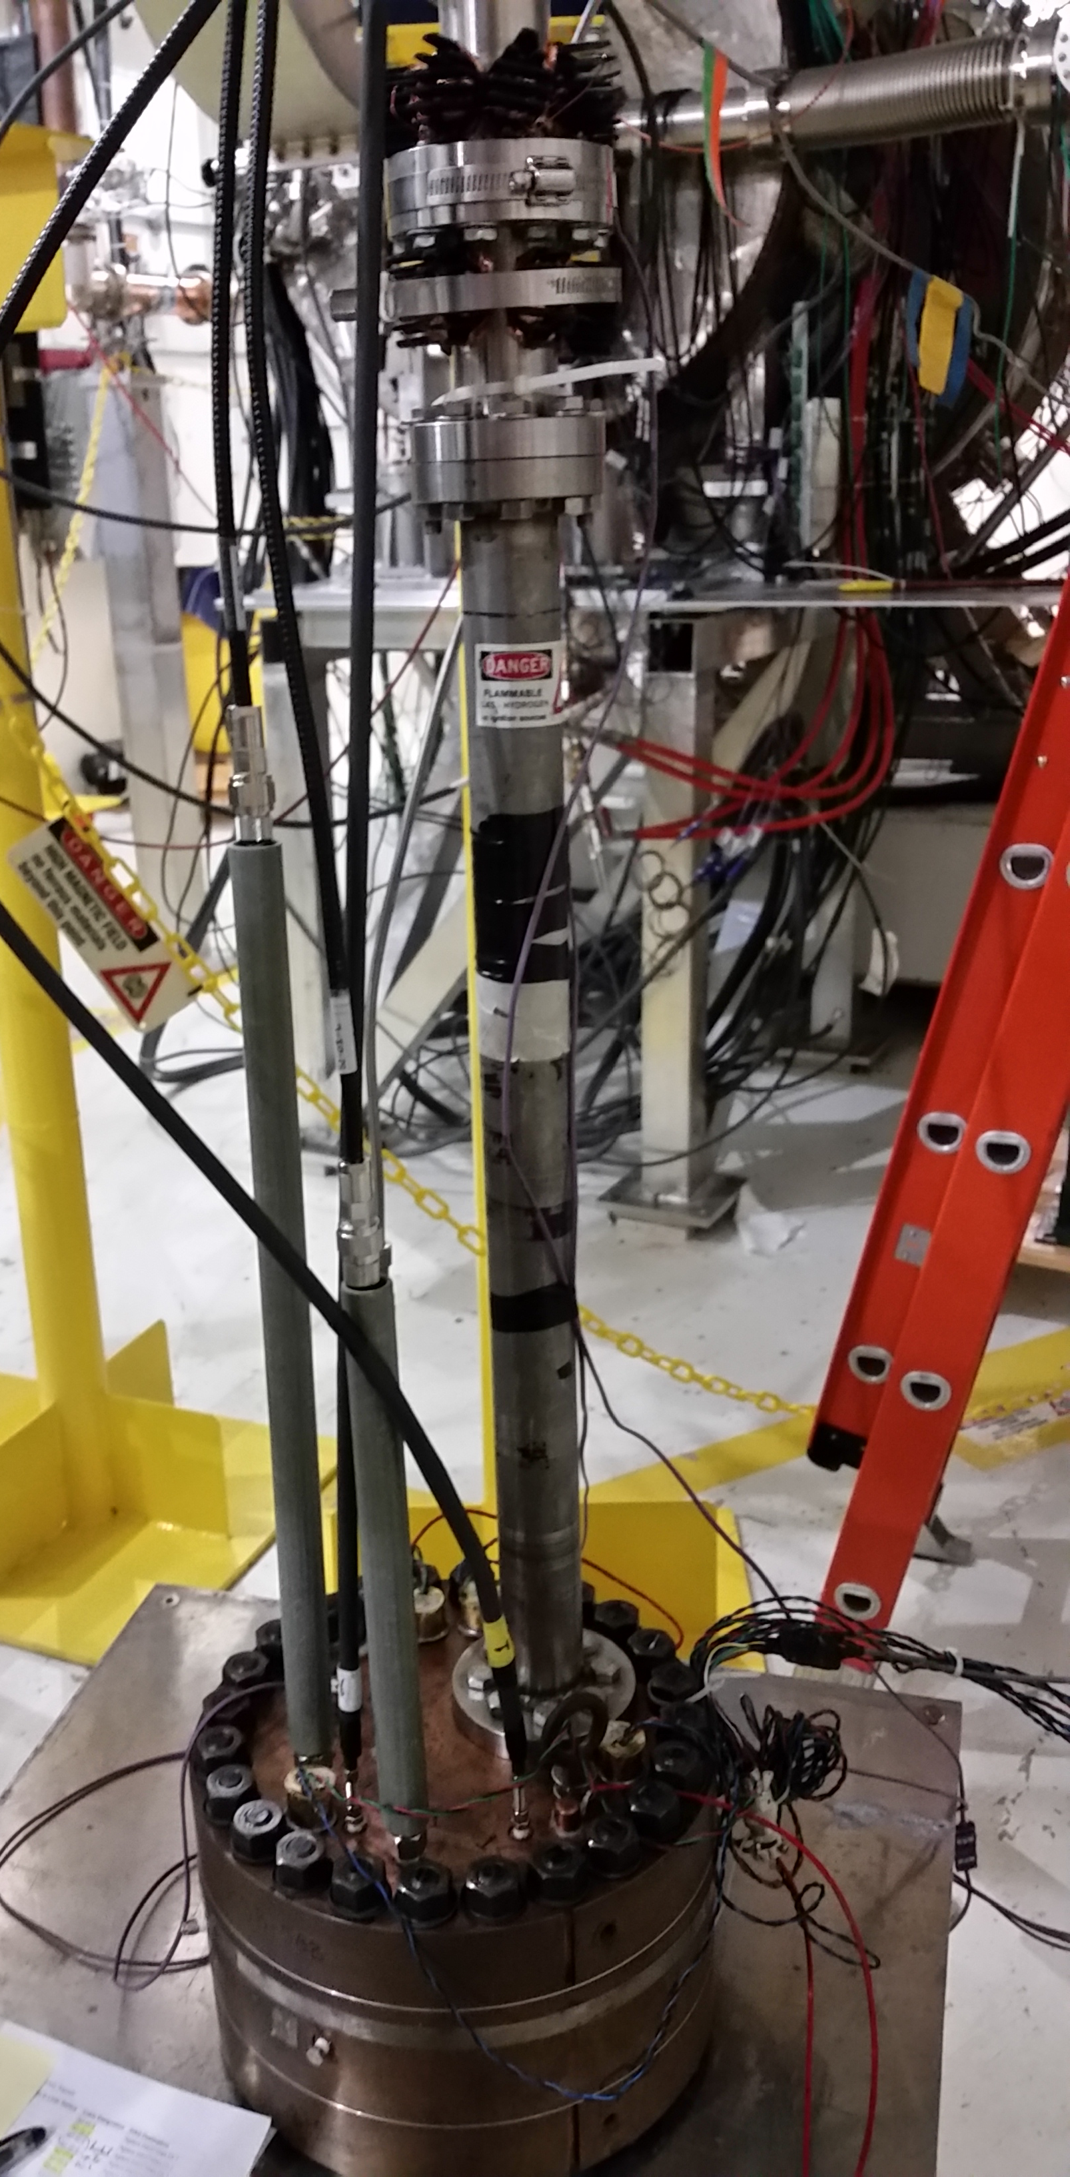
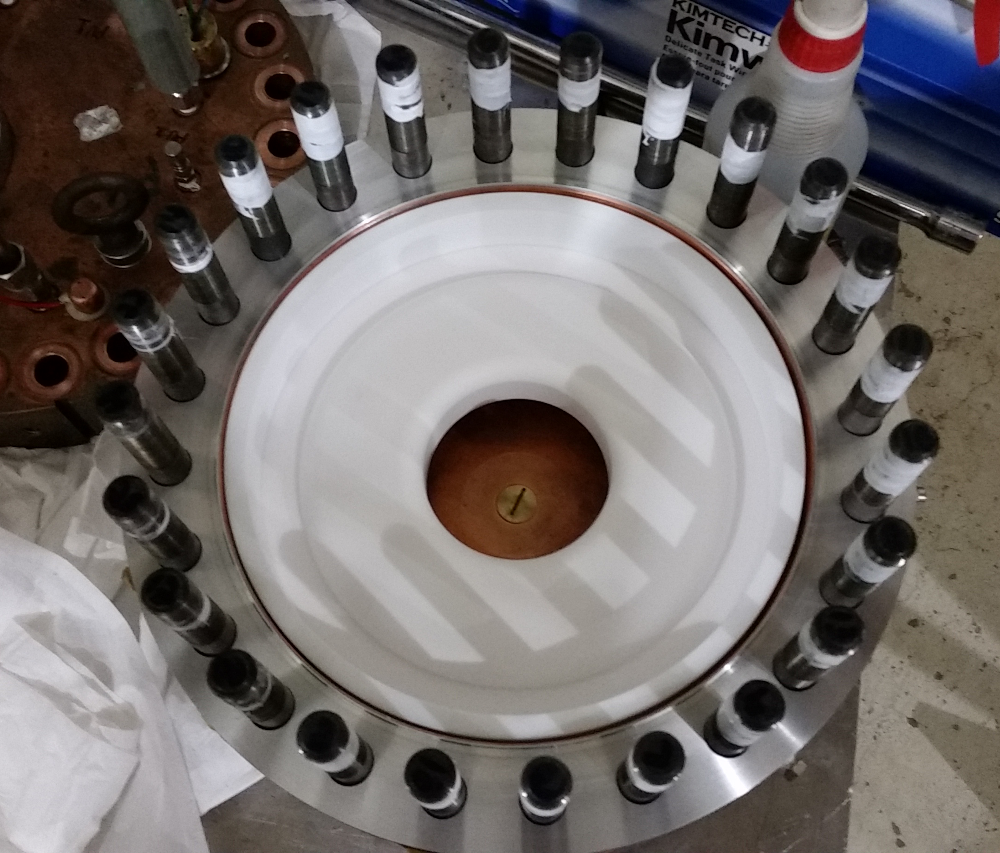
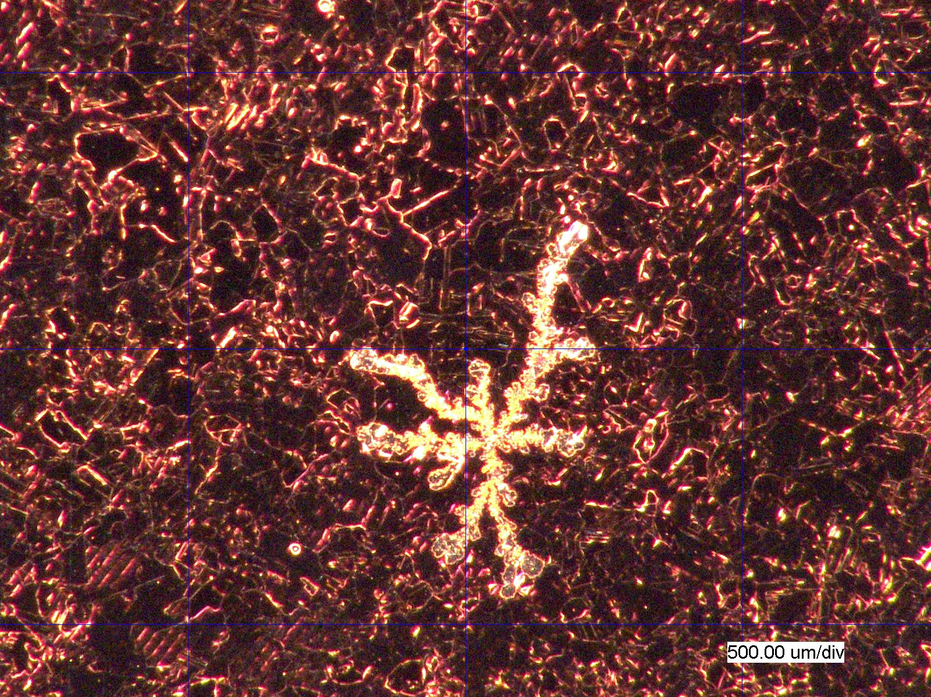
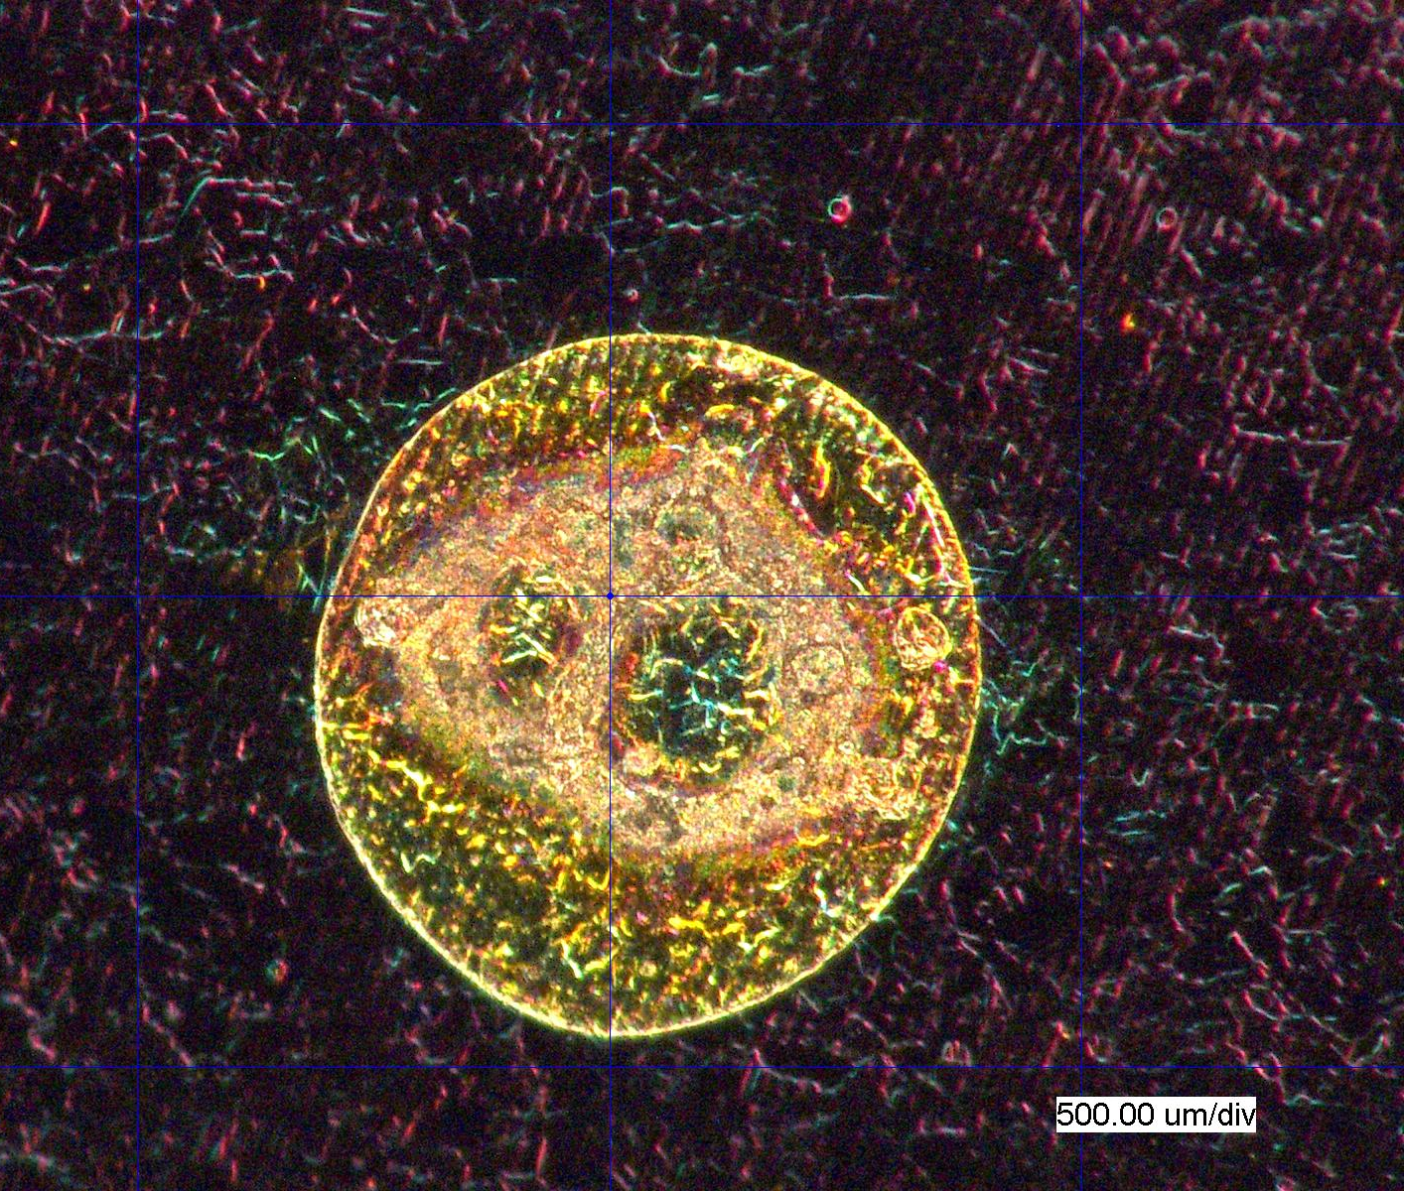
MuCool Test Area
High-Pressure RF Cavities
Characterization of dielectric-loaded cavity materials
Evaluation of plasma loading in “hybrid” cooling channel
Complete results from the HPRF beam test was submitted to PRST-AB
Characterization of “Modular” Vacuum RF Cavity
Max. safe operating gradient 45 MV/m
Completed study of breakdowns with B=0 a minimal surface damage
Studies in B = 3T now underway

Slide 2
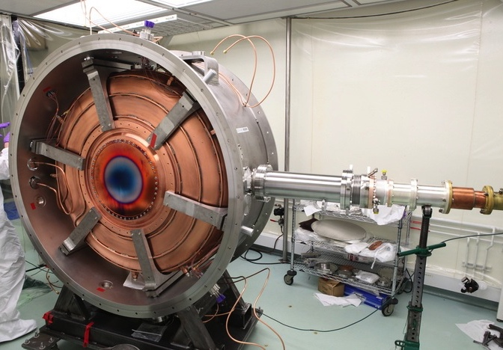
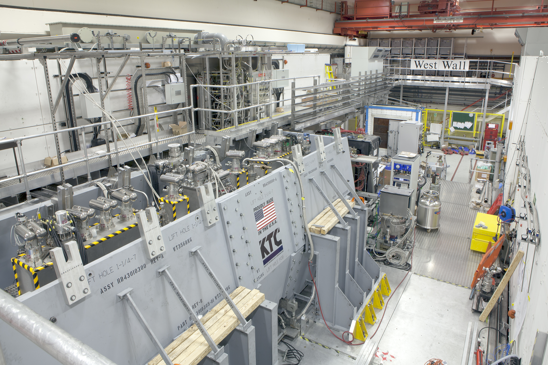
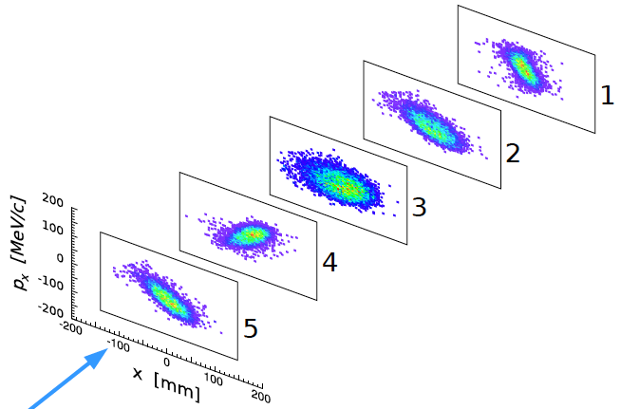
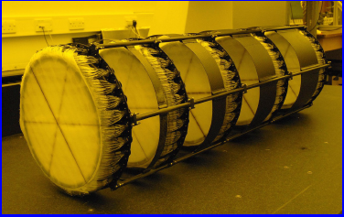
MICE Experiment
MICE 201 MHz RF Module –
MTA Acceptance Test in B-field Complete
11MV/m in Fringe of 5T Lab-G Solenoid
<4×10⁻⁷ Spark Rate (0 observed)
Support for
MICE Step IV
Commissioning
Emittance Evolution in
Upstream Spectrometer
Solenoid SciFi Tracker
Courtesy C. Hunt
& V. Blackmore

Slide 3
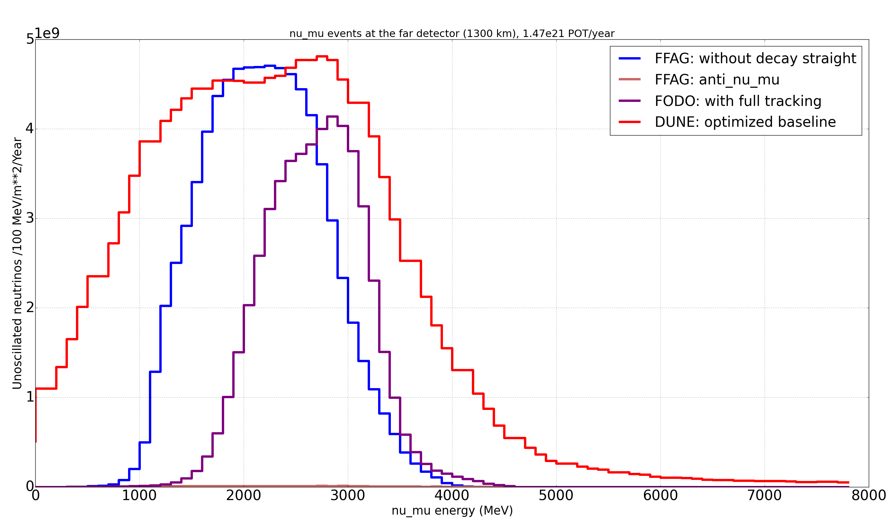
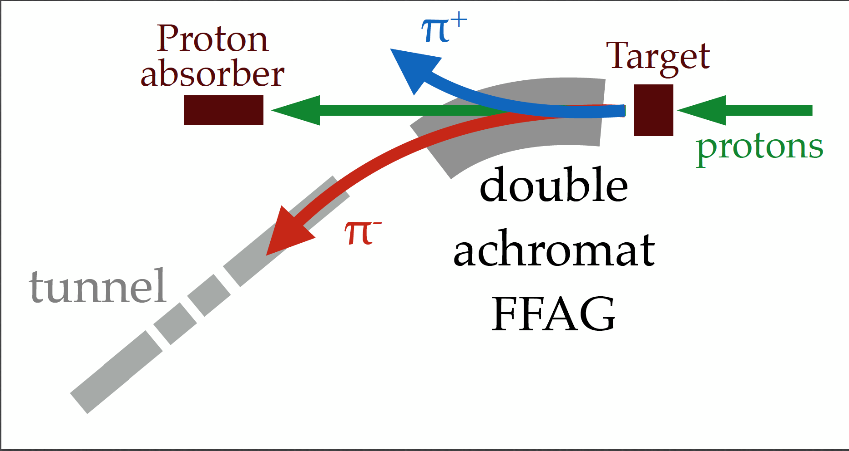

Accelerator Design
Jean-Baptiste
Lagrange
ICL/FNAL
Momentum acceptance ~ ± 50%
6D Muon Ionization Cooling Designs Approaching Final Specifications for NF and Collider Applications

