Slide 1


The National Spherical Torus Experiment Upgrade
First Year Operating Results and Experiences
Al vonHalle
DOE Accelerator Safety Workshop
Fermi National Accelerator Laboratory
September 21, 2016

Slide 2
Outline
NSTX-U intends to advance the spherical tokamak (ST) concept as a complement to larger aspect ratio devices:
Reminder: Key features of the Upgrade
Summary of NSTX-U experimental operations
Engineering Operations
Operations Experiences

Slide 3
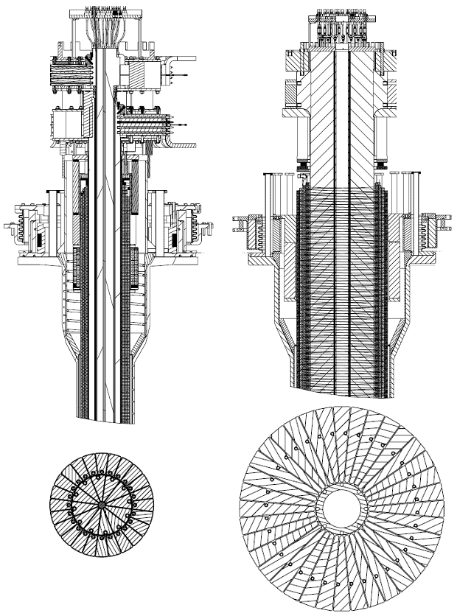
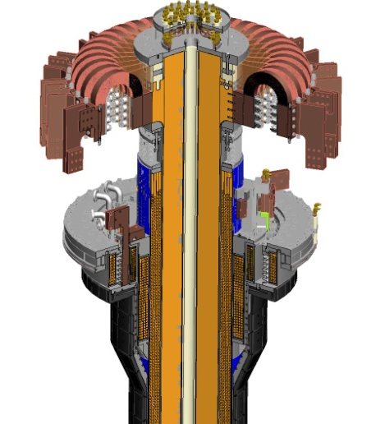
Major Upgrade #1:New CS Provides Enhanced Capabilities, But Modifies the Discharge Programming
TF cooling lines
TF flex-bus
New
center-stack
Previous
center-stack
TF OD = 40cm
TF OD = 20cm
TF Coil
New CS allows twice higher fields and plasma current
Larger radius and different geometry required that the breakdown & current ramp scenario be redeveloped
New divertor coils required a redevelopment of the plasma shapes.
PF Coil 1c
PF Coil 1b
PF Coil 1a
OH Coil

Slide 4
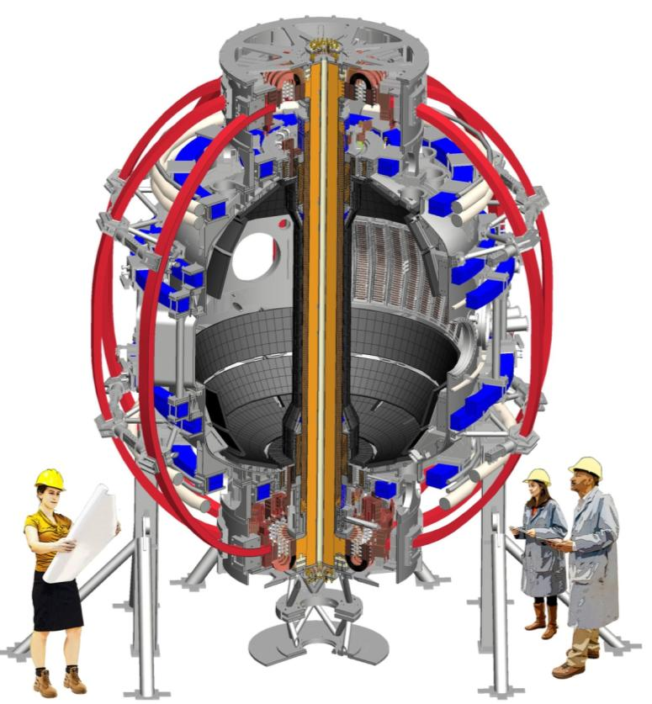
Overall NSTX-U Machine Geometry
The “outer” machine geometry (Toroidal field coils in red, Poloidal in Blue) remain the same with additional supports for higher fields
Aspect ratio (R/a) increased to 1.7. (Tokamak at ~2.7)

Slide 5
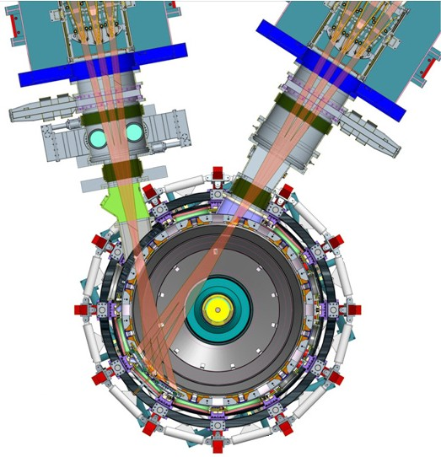
Major Upgrade #2: Additional Beamline Provides Additional Power and Critical Off-Axis Current Drive
Doubled power from 6 to 12 MW (at V_{accel}=90kV)
More tangential injection on NB#2 triples the NBI plasma current drive and increases current profile control capability.
Introduced many additional power supplies into the NB systems.
Significant updates to the NB control hardware and software.
NB #2
NB #1

Slide 6
Comprehensive Modifications/Improvements Made to Many Subsystems
New rectifier control hardware and software
New PLCs for the rectifiers, water system
New realtime data links for rectifier control, realtime digitizers
New Digital Coil Protection System (DCPS)
    In addition to over-current and I²T, provides 400 real-time force and stress calculations using coil and plasma currents
New plasma control computers
Rewrote and/or updated all plasma control system code
New boronization system
Major changes to operations diagnostics such as Thomson Scattering and the Magnetics

Slide 7
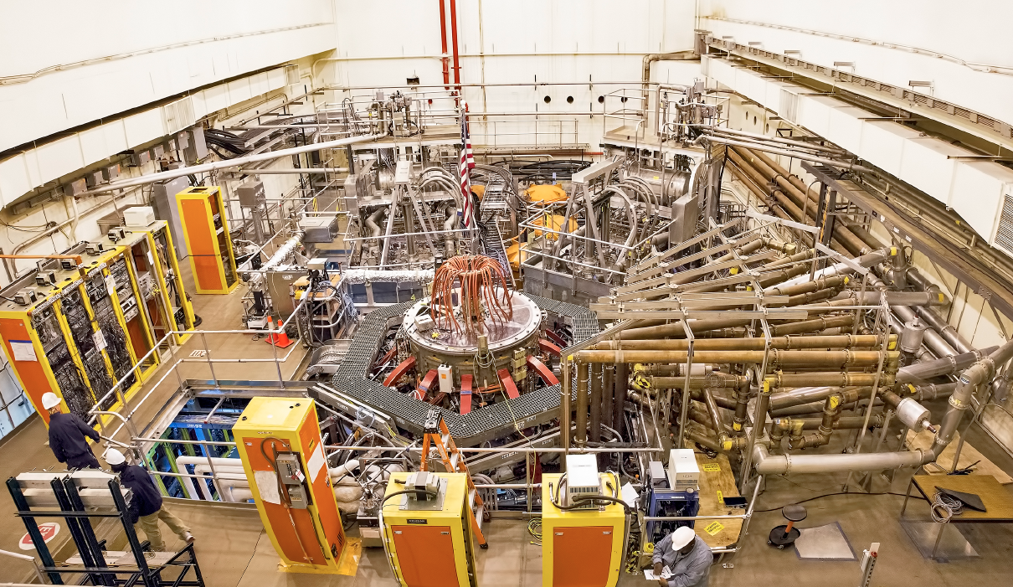
NSTX-U is now a Research Facility
2nd NBI
1st NBI
NSTX-U
All six NBI sources are now operational, and have supported experiments

Slide 8
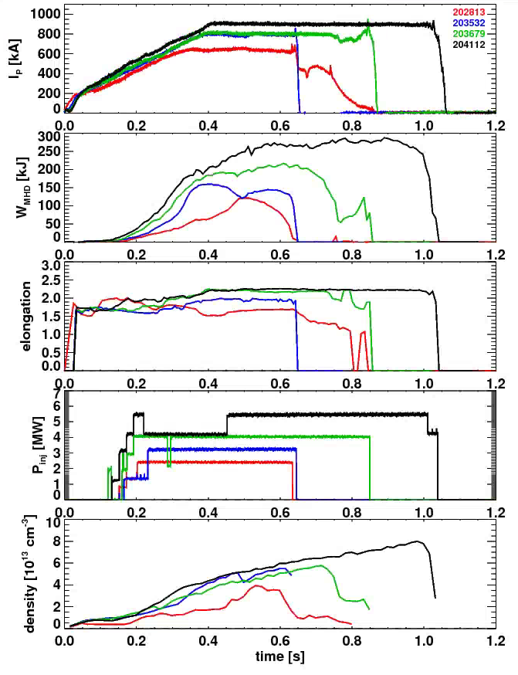
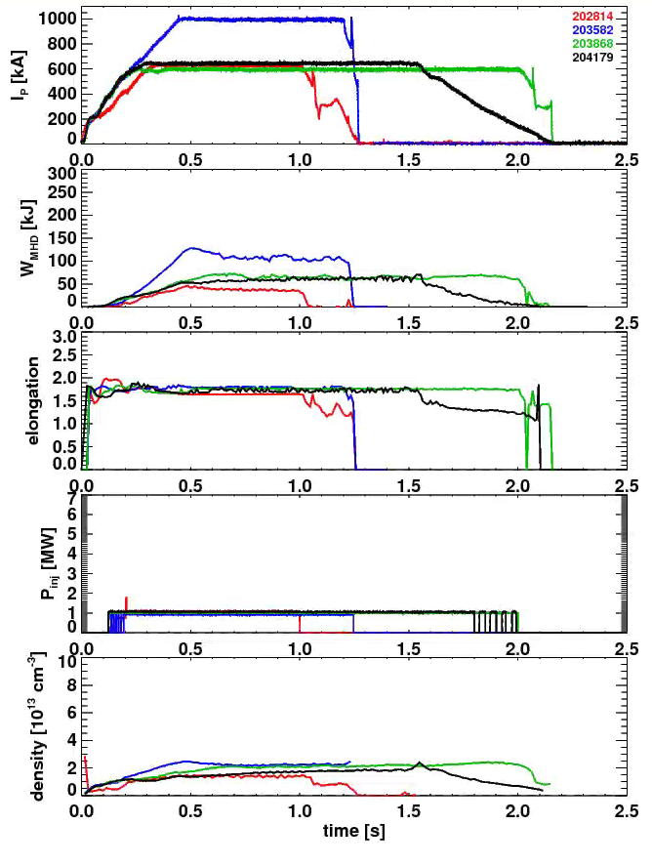
Substantial Progress in Developing L- and H-Mode Scenarios
H-Mode Development
L-Mode Development
First H-Mode
“Best” Shots From
January
February
March
April
NSTX Longest Shot

Slide 9
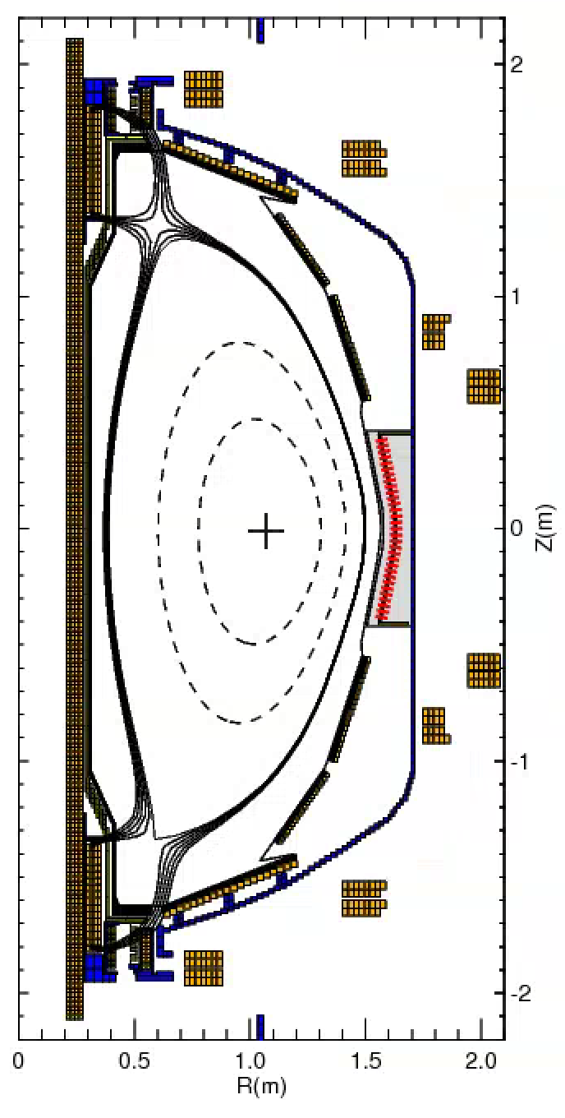
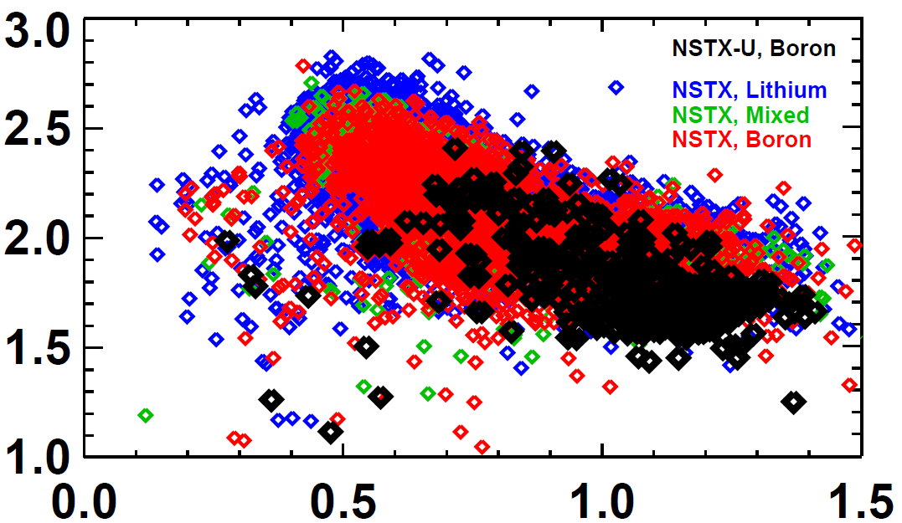
Shape and Vertical Position Control Are In Good Position to Support the Future Experiments
rtEFIT/ISOFLUX control established for the plasma radius, vertical position, X-points.
  NSTX didn’t routinely do closed loop X-point control.
  Now testing multi-threaded rtEFIT with greater capabilities
New vertical control sensors & algorithms -> matching the NSTX elongation for the same l_{i}, but at higher A.
NSTX-U, Boronized
NSTX, Lithium
NSTX, Mixed
NSTX, Boronized
Elongation
Internal Inductance

Slide 10
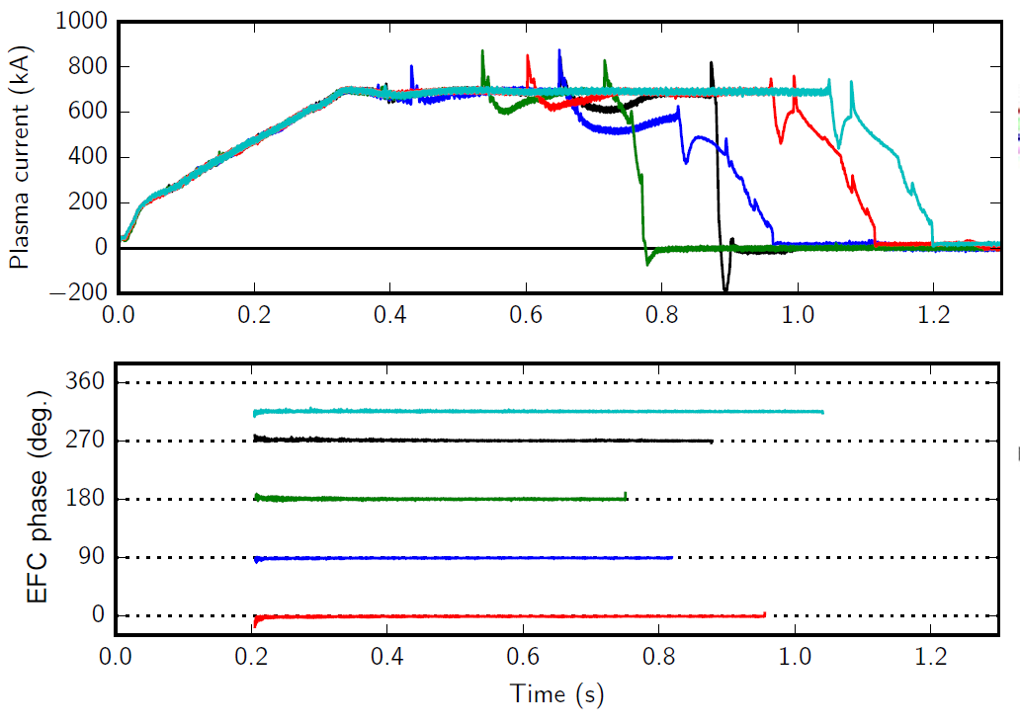
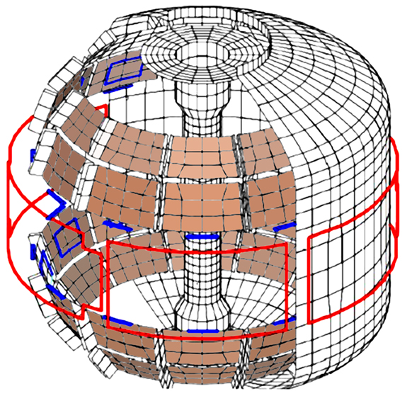
Discharge Development Aided by Error Field Correction
Dominant error-field source: vertical field coils
Long-pulse L-modes used to identify optimal correction amplitude, phase
Copper passive
conductor plates
SS Vacuum
Vessel
Use this EFC on every shot now
Preparing to deploy feedback-based error field correction
internal sensors
6 ex-vessel midplane control coils powered by Switching Power amplifiers for 6kA-turn at 1kHz

Slide 11
NSTX-U Experiments are Using a Significantly Expanded Plasma Shutdown Scheme
NSTX PCS: No means of detecting a disruption, or ramping down the plasma current based on events.
NSTX-U PCS: State machine orchestrates the shutdown.
SS=0:
Ramp-Up & Flat-Top
“SS” = “Shutdown State”
Disruption Indicators
Locked Modes,
I_{P} Error
Vertical Motion
Disruption Imminent
SS=1:
Slow I_{P} Rampdown
Disruption Imminent
SS=2:
Fast I_{P} Rampdown
SS=3:
I_{OH} Loss of Control
SS=4: Insufficient I_{P}

Slide 12
NSTX-U Experiments are Using a Significantly Expanded Plasma Shutdown Scheme
NSTX PCS: No means of detecting a disruption, or ramping down the plasma current based on events.
NSTX-U PCS: State machine orchestrates the shutdown.
L-mode Rampdowns Triggered By a Single Switch
I_{P} [MA]
P_{inj} [MW]
Beam power ramped down
W_{MHD} [kJ]
κ
204179
204163
204155
Rampdown Development and Disruption Detection/Avoidance are Key Parts of our Joint FES & ITER Support Contributions
n_{e} [10¹³ cm⁻³]

Slide 13
Summary of Experimental Operations
Routinely running with plasma control tools that were rare or non-existent on NSTX.
  Assists in continued progress in scenario development
L-mode development has opened up a space of physics studies that was not available on NSTX.
  We are developing experiments to exploit this capability.
Access to H-mode found to be routine.
  We are continuing the development of high-performance H-mode scenarios.
Studying fast-ion physics associated with the new beamline.
  Tangential injection suppresses fast ion instabilities, and is a significant tool for improving energy confinement.

Slide 14
Additional Systems were commissioned during the run
Lithium Evaporators
Massive Gas Injector
Impurity Granule Injector
High Harmonic Fast Wave Heating & Current Drive
  Major upgrade to the antenna during the outage
  Sources 1-4 are vacuum conditioning, 5 & 6 are ready
TF Coil Bending Stress Instrumentation
CHI Instrumentation & Gas Feeds
Diagnostics
  Langmuir Probe Electronics
  Infrared Video Bolometer
  Divertor SPRED
  Fusion Products Detector
  FIReTIP

Slide 15
Notable Processes in Place to Ensure Proper Engineering Practices and Con-Ops
Work Control Center (WCC) continues to manage all test cell activities.
  Committee, lead by the head of NSTX-U construction, involving coil engineer, electrical construction manager, lead machine tech, weld engineer, head of research operations, lead diagnostic engineer.
  Meet weekly to coordinate & prioritize all test cell activities, ensure that all tasks have proper procedures and engineering pedigree.
The Chief Operating Engineers (COEs) invoke the new procedure OP-G-NSTX-176 when responding to any protection system trip.
  Removes all ambiguity about the response to a trip.
Activity Certification Committee (ACC) continues to actively meet to monitor new systems, including assessing any impact on the safety certificate & SAD
  PPPL and DoE membership ensures good communications on ACC related issues.

Slide 16
NSTX-U Operating Experience:
Neutral Beams
NB1A Ion Source Failure
  Installed a spare source on beamline within 4 working days & started conditioning
NB2B Autotransformer Failure
  Replaced with a spare autotransformer
NB Cryosystem Helium Leak
  Vented cold box, found & repaired the leaks + preemptive replacements of similar parts
Neutral beam transmission line high voltage limits
  Opened lines, repaired arc damage and damaged spacer elements, repositioned lines
All six neutral beam ion sources operating at 90kV
  Including reliable operation during beam modulation

Slide 17
NSTX-U Operating Experience:
Torus Systems
2 of 72 TF water fitting assemblies developed cracks
  Replaced fittings per improved procedure
High voltage failures of the gas injection system (GIS)
  Traced to ceramic break being pumped out as gas entered NSTX-U, fixed by reverting to NSTX configuration
Realtime data glitches aborting the shot
  Traced to noise from failing HV supply & jittery trigger on realtime digitizer
Field Coil Power Conversion (FCPC, basically the rectifiers) Troubleshooting
  Hoses & rectifier modules replaced, now building system to better instrument rectifiers
NTC water leak
  Flow switch body cracked, 1 day cleanup + replacement of flow switches of similar age
Failed BES Shutter Cover
  Extracted pieces with vacuum friendly “suction extractor”, recovered operations quickly

Slide 18
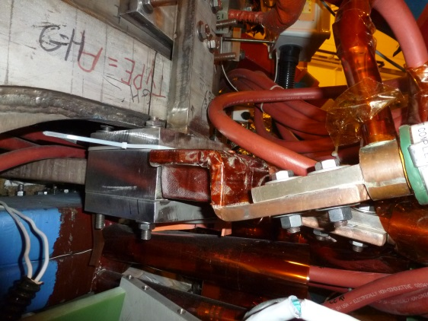
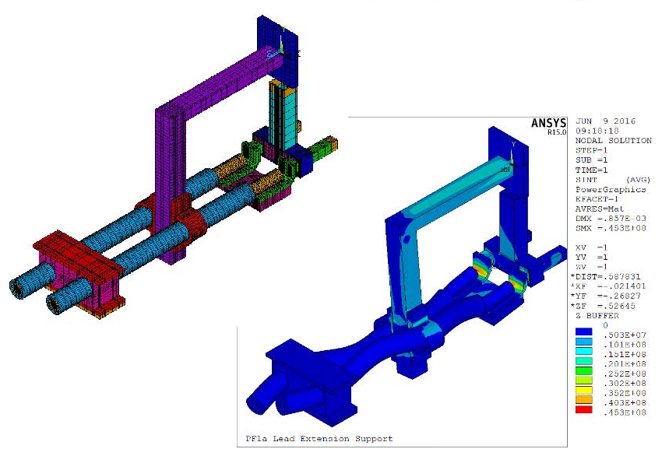
NSTX-U Operating Experience:
Magnet Systems - Flexible Bus
Cable/hose motion observed on test cell video
  PF1a flexible bus cables were disturbed
  Hard Bus flags connected to the coil leads were bent
  The PF1a hard bus leads were undisturbed
  Same condition on both PF1aU & L
Original design called for longer PF1a hard bus leads
  Flex bus out of high-field area
  Shortened/reviewed for diagnostic access
New supports for water cooled flex bus added
  Supports were mocked up and analyzed using ANSYS
  All unsupported flex bus strapped together.
  Structural support added to the hard bus flags
New Support
Clamps

Slide 19
NSTX-U Operating Experience:
Magnet Systems – PF1aU Failure
TF cooling lines
TF flex-bus
The PF1aU coil tripped-off on a low water flow interlock
  Flushing the coil released a melted copper slug, presumably from the coil
  Coil remained partially blocked, and water path was no longer leak tight
Failure is consistent with a shorted PF1aU turn
  PF1aU has only run at a fraction of its designed rating
  PF1aU flux loop measurements indicate a circulating current when induced by the adjacent PF2U coil
  Coil Flux analysis does show a very slow, small change in PF1aU coil inductance
PF1aU has been removed and forensic analysis in progress
  Radiography has revealed a possible problem at a coil layer to layer transition
  Borescope views and a full dissection are next
PF1aL does NOT show similar trends but both coils will be redesigned/replaced
TF Coil
PF Coil 1c
PF Coil 1b
PF Coil 1a
OH Coil

Slide 20
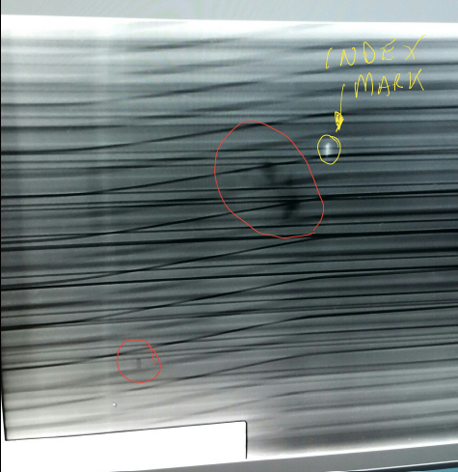
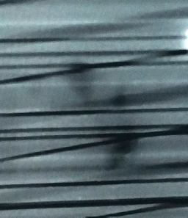
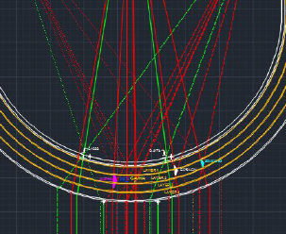
PF-1aU Coil Radiography/Forensics
• Preliminary images showed potential copper voids near the layer to layer “joggle” transitions.
• Additional coil radiography for the void area has been completed to determine radial locations, and the coil is back at the lab.
• Radiography results are under review, and will be used in developing a dissection and borescope inspection plan.

Slide 21
PF-1aU Fabrication Plans
• Four design improvements have been identified:
Eliminate joggles (ease winding and reduce stresses during cool down )
Double insulation thickness (increase insulation margin)
Use softer copper and control hardness (ease winding)
Use continuous conductor, eliminate in-line joints (avoid potential leaks)
• New coil mandrels are being fabricated.
• New copper conductor is on order.
• A coil shop is being set up at PPPL where the NSTX-U TF and OH coils were fabricated.

Slide 22
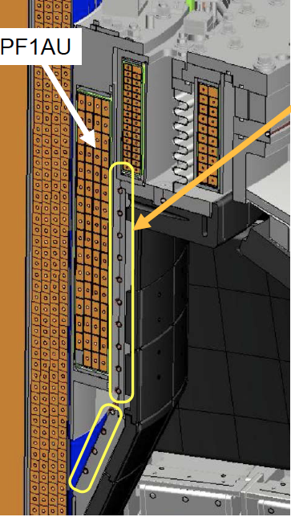
Center Stack Divertor Cooling Tube Issues
• NSTX-U has spiral cooling tubes installed for a possible future need to avoid thermal ratcheting.
    This cooling capability has not yet been used.
• Inspections upon the PF1aU removal revealed damage to the Cu tubing from induced currents.
• Analysis of this failure is in progress, and a redesign using stainless tubing is in progress.
• Similar tubing on bottom of CS casing near PF1AL coil.

Slide 23
Summary
The Upgrade involved two major components (CS and NB2), but also major changes at every other level of the facility.
Research has been making steady progress on scenarios and control for the physics mission, while beginning the scientific exploration.
While there are operations issues/failures to resolve, they are being handled properly.

Slide 24
Backup

Slide 25
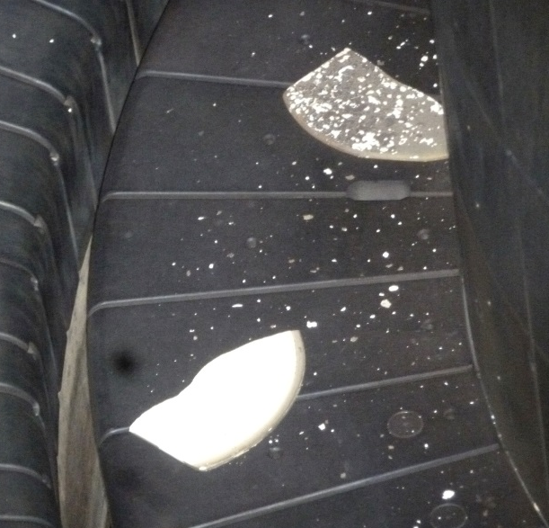
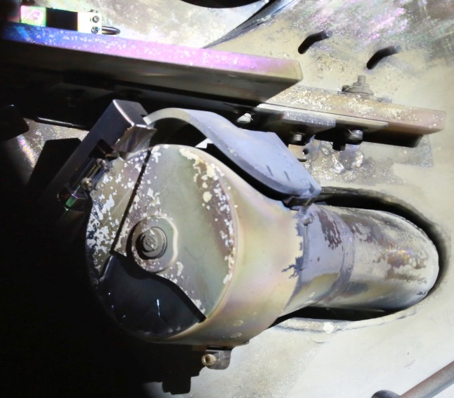
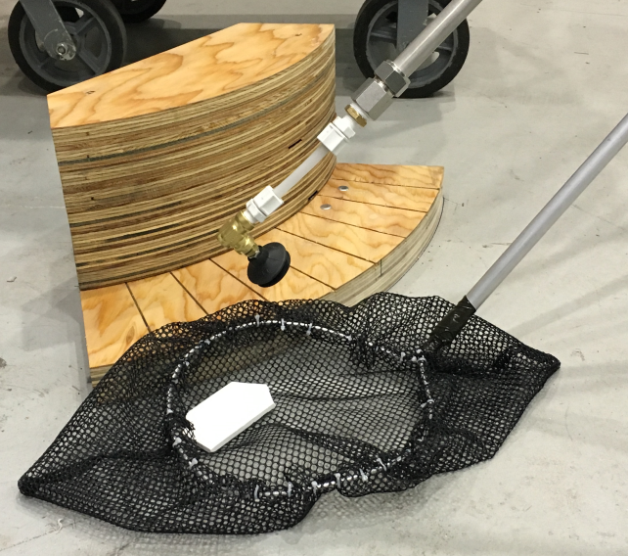
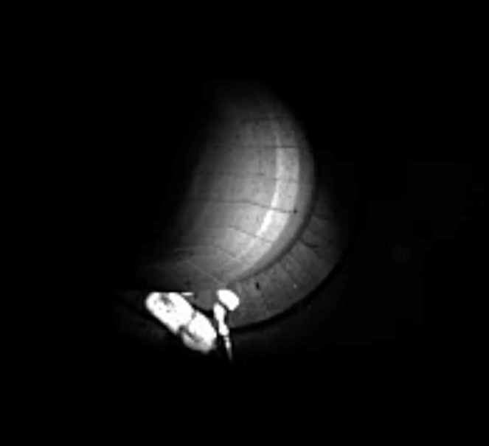
BN Fragments From BES Shutter Were Removed With Minimal Impact on Operations
Noted by diagnostician on 2/9/2016
  quickly identified as broken parts of the BES shutter.
Competing teams formed to develop vacuum friendly extraction methods.
Settled on a vacuum tool that place the fragments in a net.
Practiced using a full-scale model of the port used for extraction.
Extracted on 3/11/2016 with ~4.5 minutes of machine open (with an Ar atmosphere).
Recovered operations with minimal set-back on 3/21/2016.
Broken by improper air line connections/pressures
  Now have procedure to properly set pressures on BES shutter actuator.
BES functionality was restored.

Slide 26
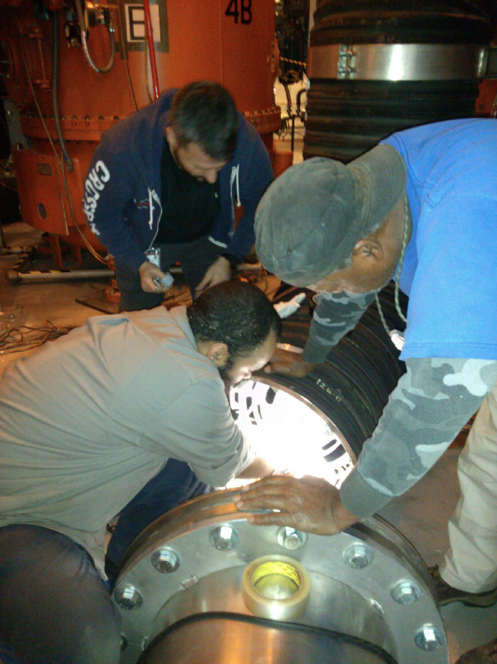
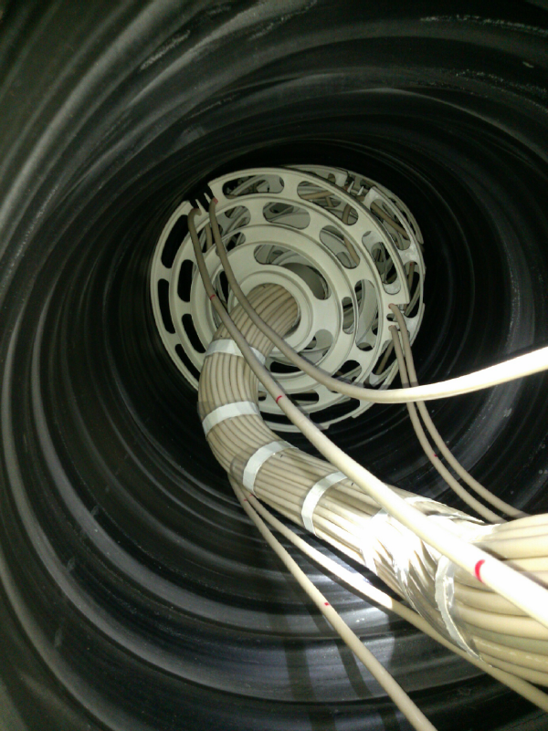
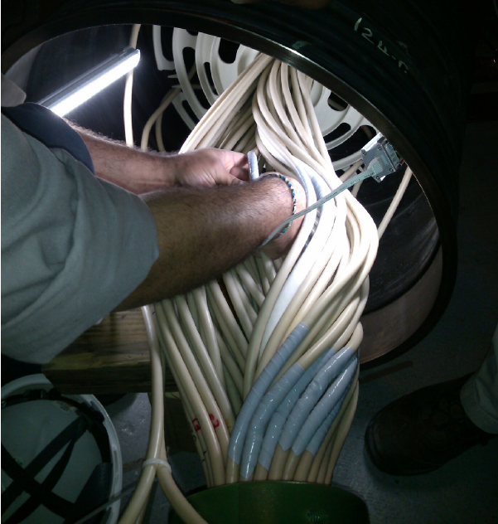
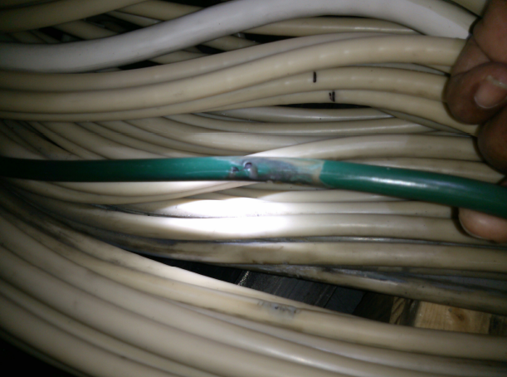
NBI 2 Transmission Line Repairs Have Been Completed
Transmission lines designed for TFTR beam geometry
Bends required for NSTX-U installation have proved problematic…internal damage limited the achieved voltage.
Maintenance period used to replace broken rib structures, repair electrical damage, improve positioning…service ceilings have been increased.
Notes:
Key Point: Problem was Quickly Addressed

Slide 27
List of DCPS Algorithms
Overcurrent
I²t integrals
T_{TF}-T_{OH}
  Must limit this due to aquapour.
Vertical and radial forces on coils
Combinations of vertical forces
Local stresses in OH, PF-4, PF-5
Torsional Shear Stress
TF outer leg moments
Including the heating after a suppress and bypass
Including calculations of the forces following a disruption with a simple model for the post-disruption currents.

Slide 28
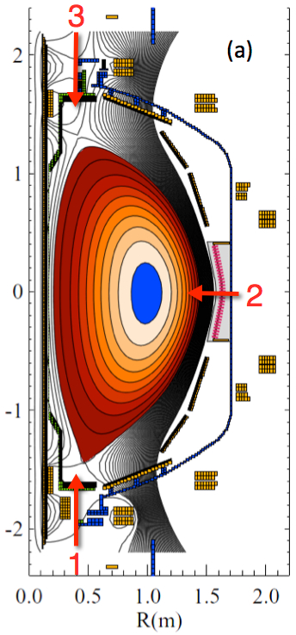
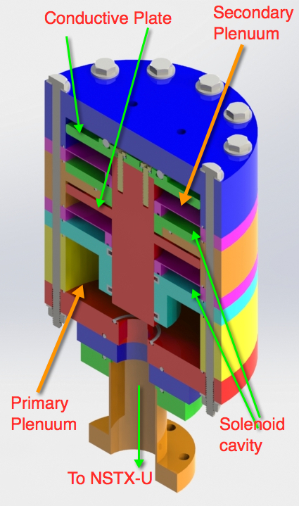
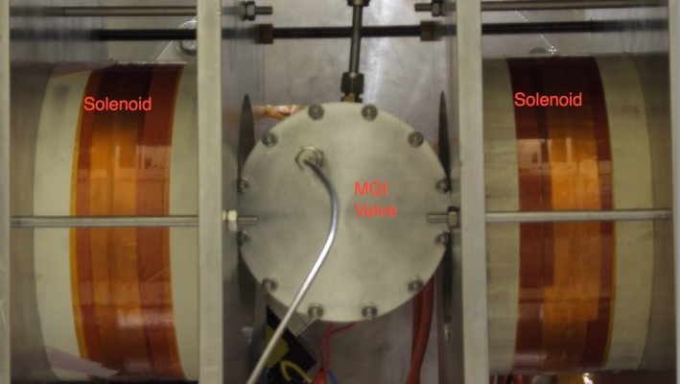
Disruption Mitigation System for NSTX-U
Massive gas injection system at multiple poloidal positions
NSTX-U MGI Valve
  - Massive gas injector system at multi
  poloidal location with identical injection set-up
  - Compact power supply proto-type tested at UW
  - A new double solenoid MGI design (zero net J x B
  torque) based on the ORNL ITER MGI design
  MGI also tested on the U. Washington test stand with magnetic field
Magnets
Magnets
MGI
Valve
U. Washington
• Successful final Design Review of MGI system was held on February 18, 2016.
• All the MGI components including MGI valves were delivered to PPPL from U. Washington and installed on NSTX-U.
• Preliminary MGI testing with the initial gas pulses into NSTX-U completed.

Slide 29
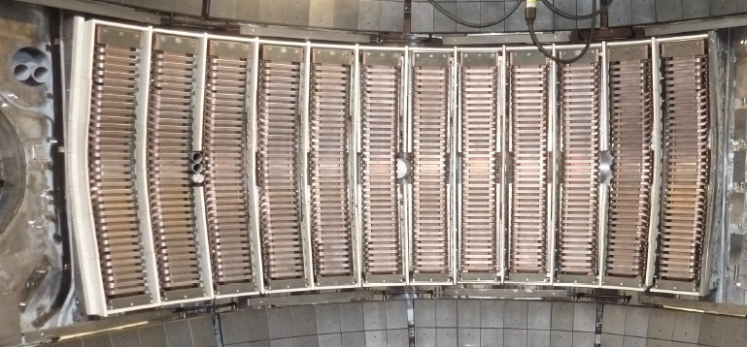
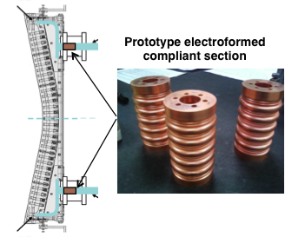
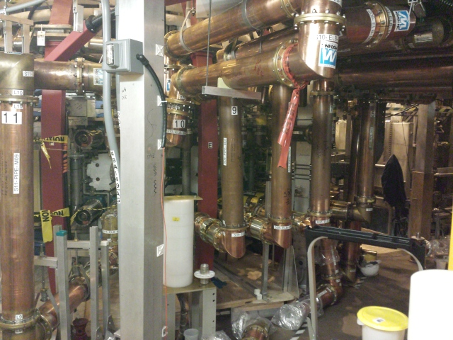
HHFW systems have been vacuum conditioned
Antennas are ready for plasma conditioning
New Compliant Antenna Feeds
Allow HHFW antenna feedthroughs to tolerate 2 MA disruptions
Antennas were re-installed with the new feeds and back-plate grounding
Transmission lines installed & tuned.
Additional ground installed
- Prototype compliant feeds tested to 46 kV in the RF test-stand. Benefit of back-plate grounding for arc prevention found.
- RF diagnostics also installed.
• Four sources used for antenna vacuum conditioning.

Slide 30
NSTX-U device performance progression
FY 2016: Limit forces to ½ way between NSTX and NSTX-U, and ½ of the design-point heating of any coil
  Operated at B_{T} ~ 0.65T for ~ 2 sec for over 1000 shots. All joints came out clean and nominal.
FY 2017 goal: Implement repair/enhancements needed to achieve full capability
  - Replace TF joint lead extension pieces
  Replace poloidal CHERs passive plates and enhance passive plates as needed
  PF-1C to be available and in-board divertor tiles will be thermally insulated for bake-out
  Install and test instrumentation to monitor coils and passive plates to full capability
FY 2018 goal: Full capability
Parameter | NSTX (Max.) | FY 2016 NSTX-U Operations Achieved | FY 2017 NSTX-U Preparation for | Year 3 NSTX-U Operations | NSTX-U Ultimate Goal
I_{P} [MA] | 1.2 | ~1.1 | 2.0 | 2.0 | 2.0
B_{T} [T] | 0.55 | ~0.65 | 1.0 | 1.0 | 1.0
Allowed TF I²t [MA²s] | 7.3 | 80 | 160 | 160 | 160

