Slide 1
Jefferson Lab’s ATLis (Accelerator Task List)
Accelerator Safety Workshop
September 21, 2016
Steve Suhring
Accelerator Manager
Notes:
Budget constraints prevented me from attending in person.

Slide 2
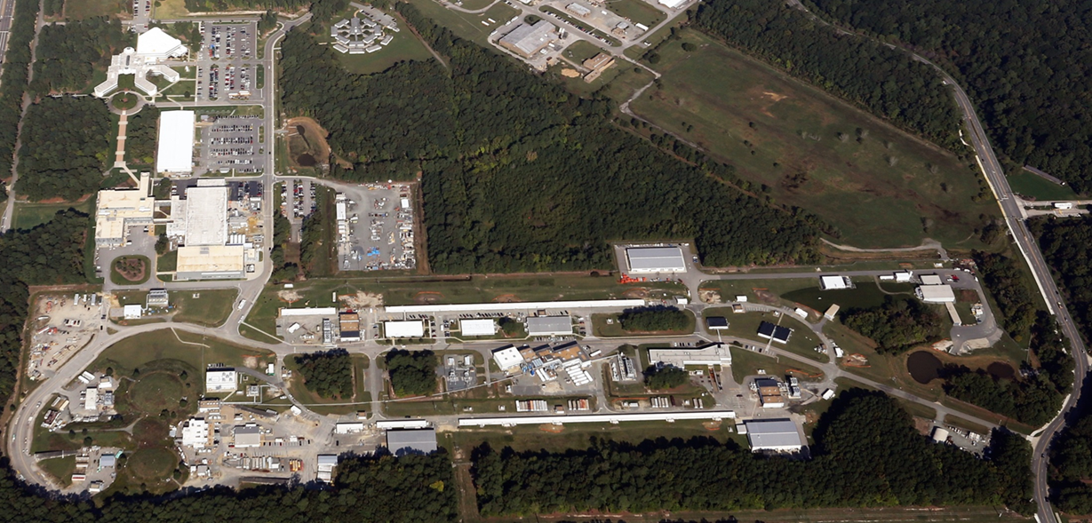
JLab’s Main Machine
CEBAF:
Continuous Electron Beam Accelerator Facility
First large scale application of Superconducting
Radio Frequency Technology (1990’s)
e- Injector
Linear Accelerators
Central Helium Liquefier
D
A
B
C
~1 mile around
Notes:
Recent doubling of the machine energy went very well.
Much work was done interspersed with running the ‘old machine’.
Allowed for a broad platform for communication.
We have started conducting experiments with the newly rebuilt machine.

Slide 3
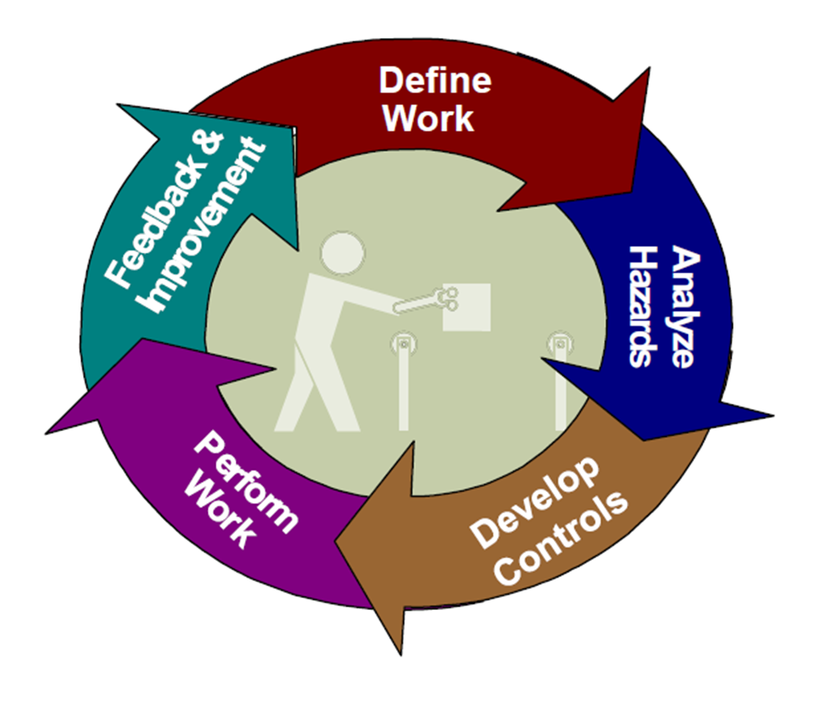
ISM Core Functions
Notes:
DOE graphic that will be referenced throughout the talk.

Slide 4
ATLis: Accelerator Task List
Developed by JLab for work planning
Oversight by an informal user group.
Migrated from Accelerator Division to
Engineering, Software Application Group,
Accelerator Physics (Beam Tests),
Experimental Physics and Facilities
Promotes interdepartmental/interdivisional
communication
How does this tool address work planning?
Notes:
Work planning.
Hazard analysis and mitigation plan.
Documentation.
Communication.

Slide 5
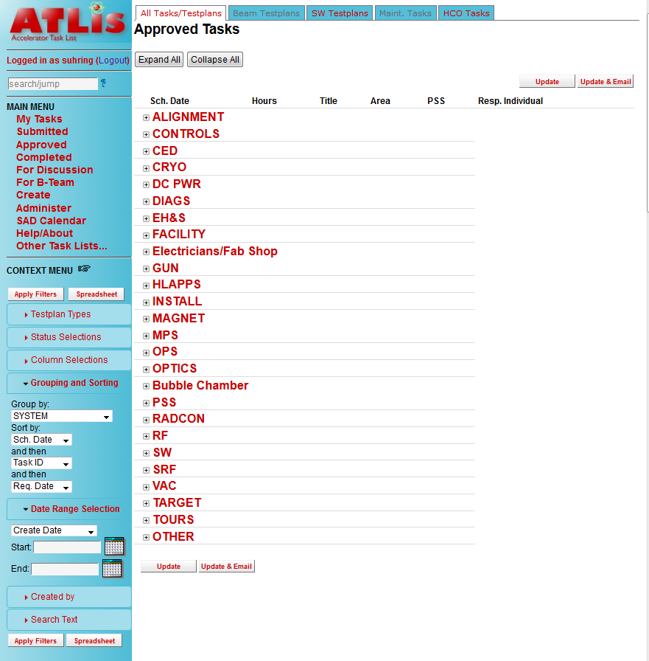
ATLis front page
Easy to access and use
Group training provided
Addresses DOE Work Planning
Accepted and working well
ATLis Link (internal)
Notes:
Developed to address the ASO Guidance for work planning and control and provide a useful tool to plan, document, and review work. Password protected both on and off site.
In use since 2003. About 16,000 tasks (repairs, installations, software and beam tests) since the beginning. About 6 per day.

Slide 6
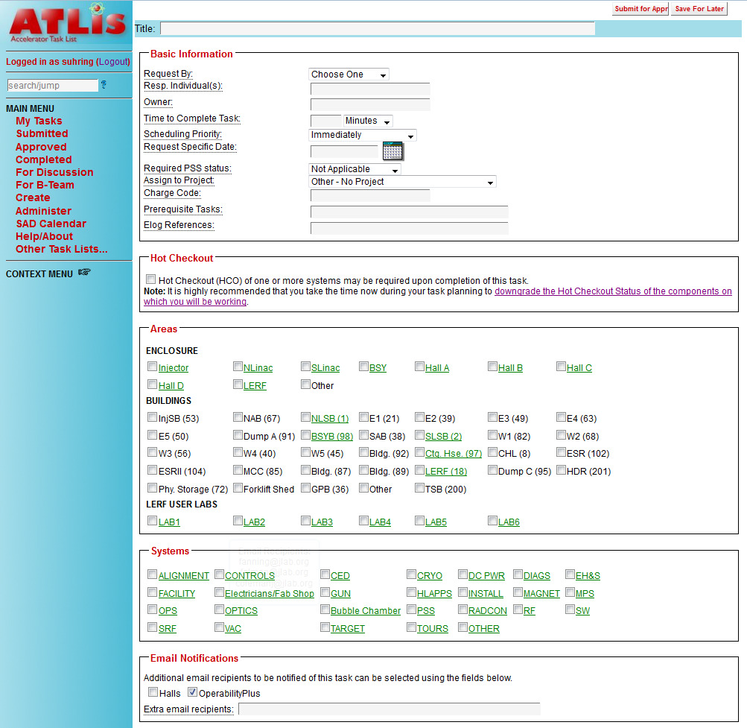
ATLis Create Task I
Basic Information: Task Title
Responsible Individual
Location
Affected Systems
Additional Notification
All Systems and Enclosures
have auto-email distribution
ATLis Link (internal)
Notes:
Anyone can write an ATLis task. Most are written by the people doing the work. They own the process for their work. Automatic email list managed by Operability Group Leader. They are the person responsible for all work done on and to the machine. C’est moi.

Slide 7
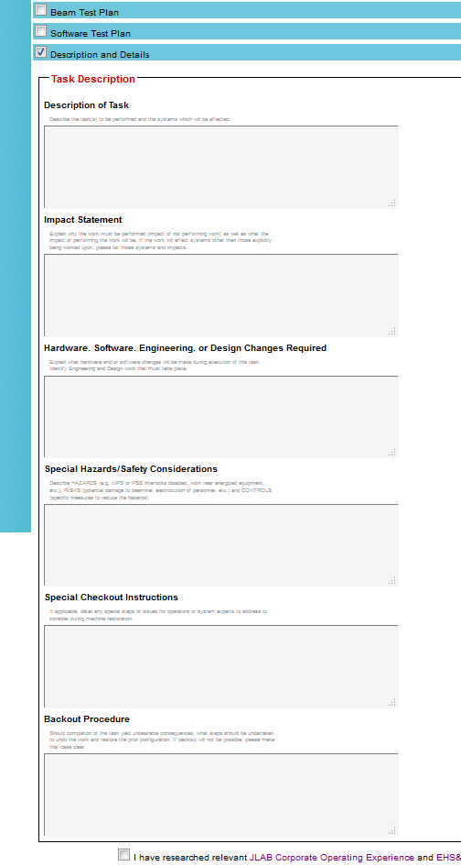
ATLis Create Task II
Additional Information:
Description
Impact Statement
Changes
Special Hazards/Safety
Special Checkout
Backout Procedures
Information stored in an
Oracle database
ATLis Link (internal)
Notes:
Alpha Numeric entries allow for more complete descriptions than simple check boxes.
ATLis is used for planned work AND immediate repairs. It takes about 10 minutes to write an ATLis task. This allows the work to be thought through before starting.

Slide 8
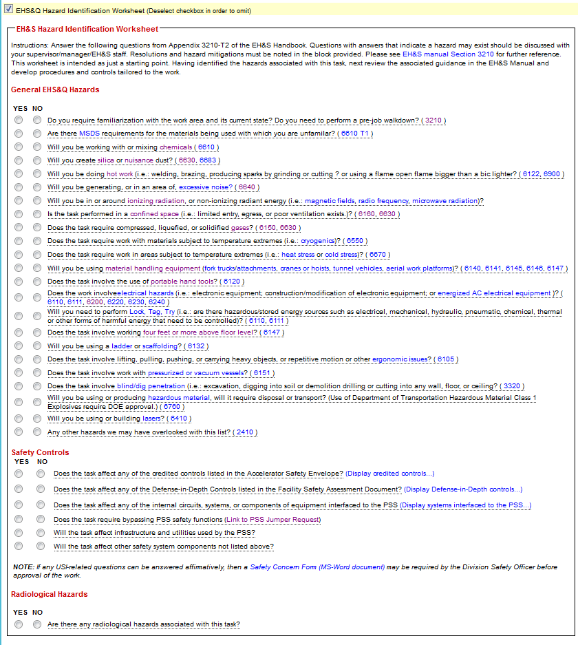
ATLis Create Task III
ESH Hazard ID Worksheet:
Developed from the JLab ESH Manual
Hyperlinks to ESHQ guidance resources
Comments fields for addressing Hazards
Safety Controls Section
Credited Controls and Defense in Depth
Automatically pings Safety Systems Group
Link to Safety Concern Form
Radcon Hazards called out
ATLis Link (internal)
Notes:
Hazard ID augments work plan from a safety point of view. Space is provided to document hazard mitigation plans. Stand alone section on Credited Controls and Radiologic hazards.

Slide 9
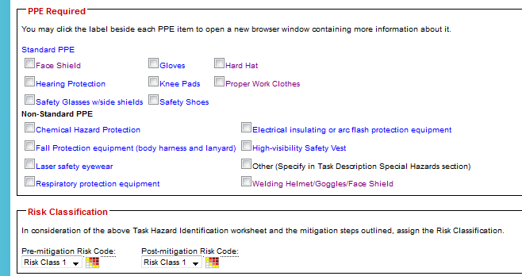
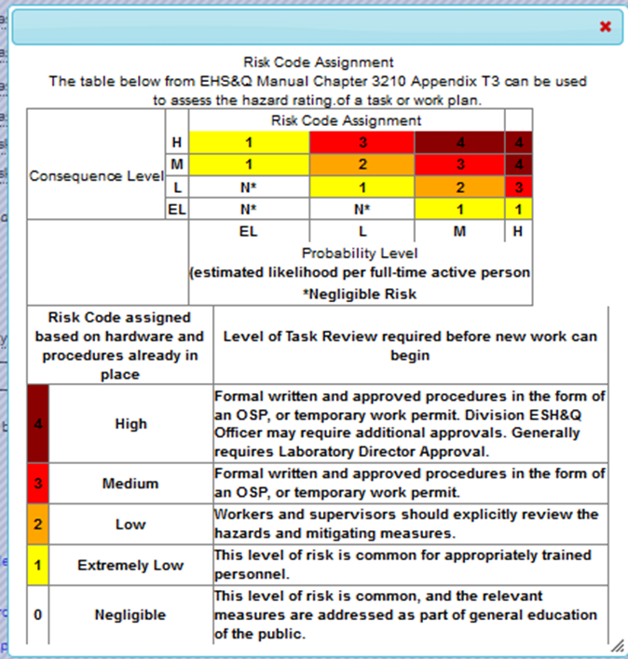
ATLis Create Task IV
PPE Checklist with additional
info links
Risk Classification Guidance
WPC Documentation Triggers
ATLis Link (internal)
Notes:
Risk Classification may be somewhat subjective, but it calls attention to more complex or hazardous tasks. WPC Work Planning and Control. All JLab workers trained on this.

Slide 10
ATLis Task Review I
Initial Hazard Analysis by Owner
This includes a comments field
for Owner to outline controls
Controls can also be added
through the ESH Review
All participants can provide
guidance or comments
ATLis Link (internal)
Notes:
Comments Fields used to document progress, problems, guidance. Anyone can add a Comment. In this instance, Operability, ESHQ, Industrial Safety, Owner.
Comments are distributed to a wide audience and can generate additional conversation across groups.

Slide 11
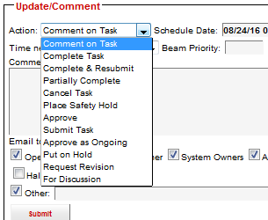
ATLis Task Review II
Comments / Controls
Anyone with access to ATLis: co-workers, ESH,
supervisor, management, designers, field staff
Information can be posted to the e-logbook
Email Distribution:
By System, Location and Interest
Every ATLis is sent to ESH for review
Approval
Accelerator Manager/Deputy or Crew Chief
NOTE: Work Authorization by Line Supervisor
ATLis Link (internal)
Notes:
Work Approval goes through Accelerator Operations. Authorization is a term that refers to Supervisor-Field Worker OK.
NOTE: Place Safety Hold can be instigated by anyone.

Slide 12
ATLis Task Execution
Work process governed by ESH Manual and
specific work plan for each ATLis task
Files, photos, formal work control
documents, etc. can be added / attached
Logbook postings and email distribution
increases awareness of comments,
concerns, questions, changes, progress. . .
ATLis Link (internal)
Notes:
The ability to attach drawings, files, pictures, etc. makes each task self sufficient in documenting work.

Slide 13
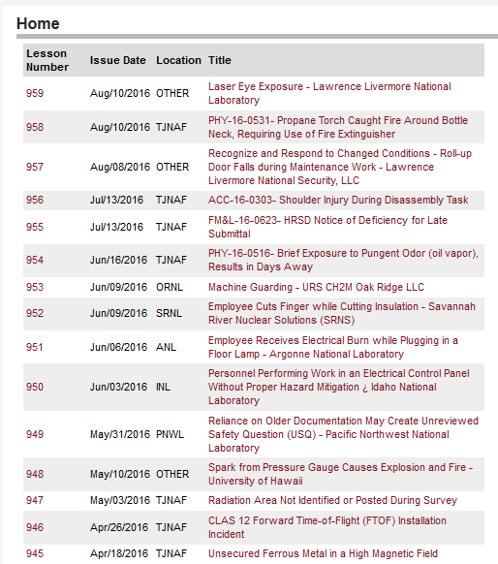
ATLis Task Completion
Upon completion, Owner or technician
closes ATLis task with final comments
Repeat tasks can be cloned and edited. This
avoids reinventing the wheel
Hyperlink to Lessons Learned on the ATLis
‘Create’ page for reference as new tasks
are developed
Lessons Learned Coordinator within ESHQ
ATLis Link (internal)
Notes:
Feedback / Continuous Improvement important for repetitive tasks, both from a quality and an ergonomic point of view.
Tasks can be cloned to ease re-write, but can be edited. Each is assigned a new unique ATLis tracking number. >80% of the tasks are written from scratch. We encourage this so that the worker re-assesses the work and work controls.

Slide 14
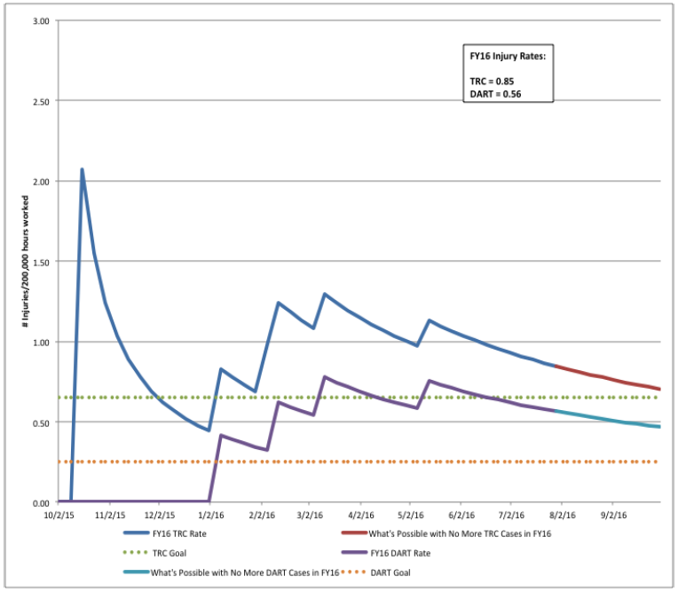
Summer’16 Shutdown
JLab TRC & DART
ATLis is an accepted part of the work process
at Jefferson Lab
It is a tool that helps address ISM
Safety and communication can be improved
through the use of ATLis-like tools
Summer’16 Shutdown:
No TRC events on the Accelerator Site
ATLis Link (internal)
Notes:
Jefferson Lab’s Accelerator Task List may not be the only reason the safety record is good, but it contributes to the overall safety culture.
It is hard to know, we feel that >90% of all work goes through ATLis. It is used because it benefits multiple groups: workers, supervisors, operations, ESH, Radcon, etc.

Slide 15
ATLis / ISM Overview
5 Core Functions
1.) Define the Scope of Work YES
2.) Analyze the Hazards YES
3.) Develop and Implement Hazard Controls YES
4.) Perform Work within Controls YES
5.) Provide Feedback and Continuous Improvement YES
7 Guiding Principals
1.) Line Management Responsibility for Safety
2.) Clear Roles and Responsibilities
3.) Competence Commensurate with Responsibilities
4.) Balance Priorities YES
5.) Identification of Safety Standards and Requirements YES
6.) Hazard Controls Tailored to Work Being Performed YES
7.) Operations Authorization Conditional YES.
Operations approves the work,
authorization is a line management responsibility
Notes:
The focus of this presentation has been on Jefferson Lab’s ATLis and the ISM 5 Core Functions. Most of the Guiding Principals are also addressed when using ATLis.
Those Guiding Principles that are NOT addressed are covered either at a higher level or by the immediate supervisor of the workers.

Slide 16
Contact Information
Steve Suhring
Jefferson Lab
Accelerator Operations
suhring@jlab.org
757-269-7670
Notes:
Questions?

