Slide 1
DOE-STD-6004-2016 “Clearance and Release of Personal Property from Accelerator Facilities”
Sayed Rokni (SLAC) for Technical Standard Working Group
DOE Accelerator Safety Workshop, FNAL, September 19-21, 2016

Slide 2
Topics to discuss
Your thoughts on the Standard,
Why it is significant,
What will be different under the new standard
Any improvements you would like to see going forward

Slide 3
Clearance
Removal of items that contain or may contain residual radioactive material from radiological control is a restrictive process in many countries due to:
Lack of approved clearance criteria
Lack of rigorous and approved processes to demonstrate compliance with the clearance criteria
Policies that further restrict clearance of materials due to public concerns, or inadequate practices
(DOE) Secretarial Memoranda
US DOE Policy (January 2000): Prohibits the release of volumetrically contaminated metals into commerce
US DOE Policy (July 2000): Suspends the unrestricted release for recycling of scrap metals from Radiological Areas
Notes:
clearance relates to the release of materials from regulatory control; exemption relates to practices which do not need to be reported
Clearance is the removal of items or materials that may contain residual levels of radioactive materials within authorized practices from any further control of any kind.
Clearance implies that the subject materials or objects were under regulatory control—exclusion and exemption do not.
Exclusion is the designation by a regulatory authority that the magnitude or likelihood of an exposure is essentially unamenable to control through requirements of a standard and such exposures are outside the scope of standards, e.g., exposure from 40K in the body, from cosmic radiation at the surface of the earth and from unmodified concentrations of radionuclides in most raw materials.
Exemption is the designation by a regulatory authority that specified uses of radioactive materials or sources of radiation are not subject to regulatory control because the radiation risks to individuals and the collective radiological impact are sufficiently low. [Sources: International Atomic Energy Agency(IAEA), Vienna; Principles for the Exemption of Radiation Sources and Practices from Regulatory Control, Safety Series No. 89 (IAEA 1988); and International Basic Safety for Protections against Ionizing Radiation and for the Safety of Radiation Sources, Safety Series No.
115 (IAEA 1996a).]
Screening Level: Activity concentrations (for either surface or volumetric
contamination) that are designed to determine compliance with the primary dose
criterion through comparison with radiation survey results

Slide 4
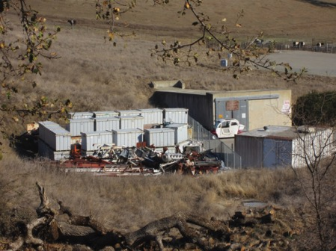
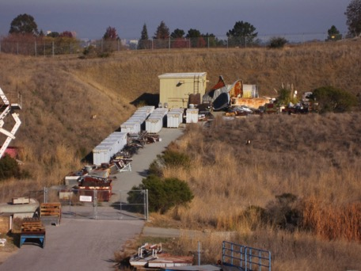
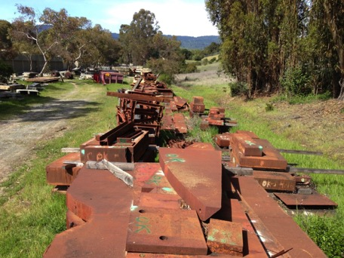
Excess Metal in DOE Facilities(before)
Notes:
Steel/iron , concrete (with attached metal), aluminum, copper , wire, electronics
Covered-storage capacity for larger objects is exhausted. The excess items are being stored outdoors

Slide 5
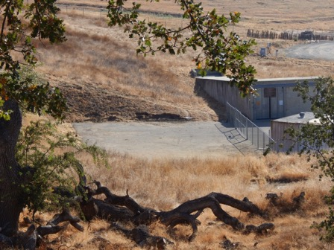
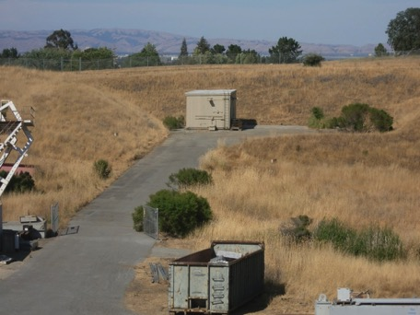
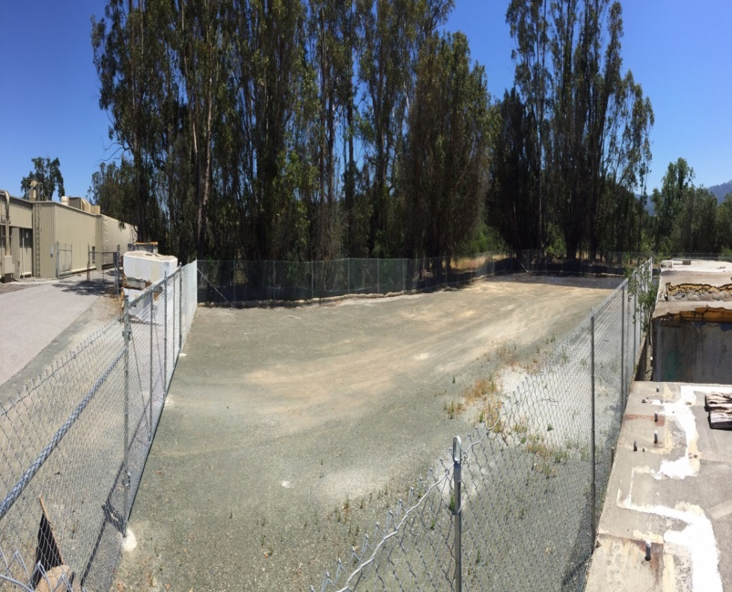
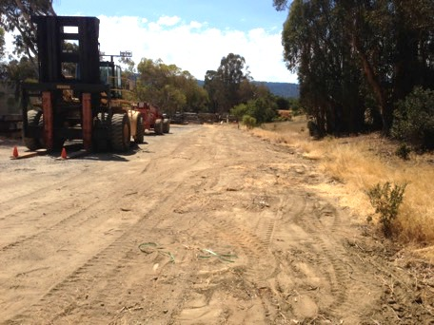
Excess Metal in DOE Facilities (after)
Notes:
Steel/iron , concrete (with attached metal), aluminum, copper , wire, electronics
Covered-storage capacity for larger objects is exhausted. The excess items are being stored outdoors
3528 tons , $1,479,318 loads

Slide 6
SLAC Clearance Program

Slide 7
Roadmap: Clearance of Metals from Accelerators
SLAC (Fasso, Liu, Volaire, Allan, Ligeti, Subarov, Rokni) developed protocols and processes for recycling of accelerator materials, 2006-2009
DOE and Contractors Efforts
DOE review of accelerator facilities starting at SLAC, 2009
SC/NNSA Joint Working Group 2009-2010
Property Clearance Workshop, Las Vegas, NV, 2010
DOE Accelerator Safety Workshop, 2010-2015
DOE/SSO authorization of Clearance operations, 2011
DOE Technical Standard for “Clearance and Release of Personal Property from Accelerator Facilities” starting in 2012
DOE Order 458.1 “Radiation Protection of the Public and the Environment”, Feb. 2011 (chg 3, January 2013)
ANSI N13.12 “Surface and Volume Radioactivity Standards for Clearance”, May 2013
Notes:
DOE O 458.1, Clearance

Slide 8
DOE-STD-6004 Technical Standard Working Groups
Contractor Writing Team
DOE Review Team
SLAC National Accelerator Laboratory: Sayed Rokni (Chair)
Ryan Ford James Liu Thomas Jefferson National Accelerator Facility:
Keith Welch
Sandia National Laboratory:
Elaine Marshall
Oak Ridge National Laboratory:
Scott Schwahn
Office of Science: Scott Davis (Lead and POC) John Blaikie
National Nuclear Security Administration:
Tim Cooper
Steve Wallace
Office of the Environment, Health and Security (AU):
Colleen Ostrowski
Gus Vazquez
Stevel Zobel

Slide 9
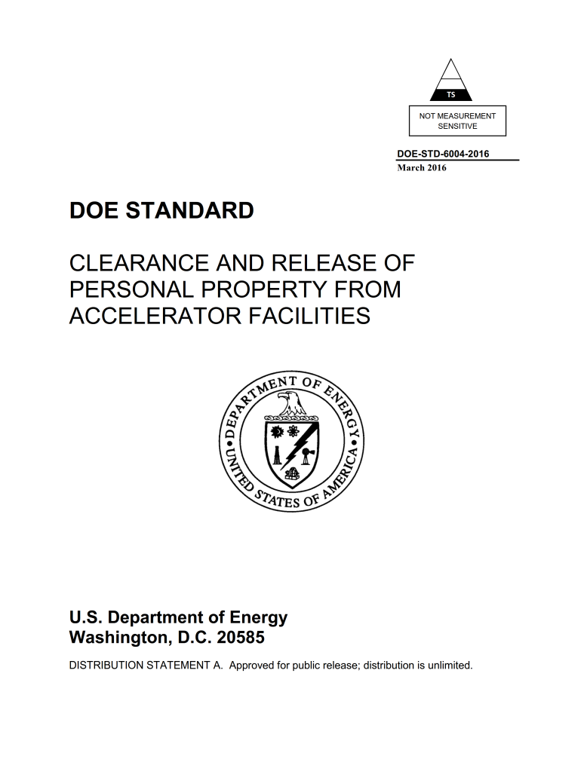
DOE-STD-6004 (2016): 7 Chapters
Purpose and Scope
Introduction
Material Clearance Protocols
Documentation and Reporting Requirements
DOE Independent Verification, Stakeholder Communication
References
Common Acronyms and Definitions
Notes:
RevCom in May 2015
70 pages cover to cover ; 64 pages

Slide 10
Technical Standard: 5 Appendices
Rationale for Endorsement of ANSI N13.12-2013 SLs as DOE Pre-Approved Authorized Limits
Process Knowledge for Volumetric Activation in Accelerator Facilities
Technical Basis for Volumetric Activation at Electron Accelerator Facilities
Technical Basis for Volumetric Activation at Proton Accelerator Facilities
Technical Basis for Measurement Methods of Volumetric Radioactivity and Determination of Detection Capabilities

Slide 11
Purpose of Technical Standard
11
Provides criteria and guidance for DOE accelerator facilities to develop site-specific material clearance program (including management, technical, and operational aspects) that are in compliance with DOE Order 458.1
Serves as acceptable approach for technical basis document and implementation guide for clearance of personal property under O458.1 for accelerator facilities
Where a program deviates from this Standard, equivalent assurance of compliance with O458.1 shall be approved by DOE

Slide 12
Induced Radioactivity in Electron Accelerators
No alpha emitters are produced
No surface contamination in metals and other solid materials due to beam operations
For material recycling purposes, in general, most abundant radioisotopes are those with a half-life of the order of the irradiation time (about 1 to 10 years)
Induced activity in an object is volumetric and presents its maximum at the surface that faces beam loss points
This supports surface measurements
Radioisotopes that are difficult to detect are generally accompanied by “proxy” radioisotopes that can be clearly measured
This supports measurements for proxy radioisotopes, instead of measurements for all potential radioisotopes that can be produced
12

Slide 13
Values of the Technical Standard
13
Facilitate the implementation of personal property clearance requirements in DOE Order 458.1 “Radiation Protection of the Public and the Environment” (Feb. 2011; chg 3, January 2013)
Provides a uniform approach for clearance of metals with potential of volumetric radioactivity (that is also consistent with current practice in most accelerator facilities)
3-tiered clearance criteria
Adopt the Volume and Surface Screening Levels in ANSI N13.12 “Surface and Volume Radioactivity Standards for Clearance” (May 2013), which is based on community consensus
Technical basis
Address Secretarial Moratorium (January 2000)
Prohibits release of volumetrically contaminated metals …into commerce
Address Secretarial Suspension (July 2000, modified January 2001)
Suspends unrestricted release for recycling of scrap metals from Radiation Areas within DOE facilities
Notes:
Show some photos from SLAC

Slide 14
Use of the Technical Standard
14
DOE EHSS Operating Experience Level 3, OE-3 2016-06, (Aug. 22, 2016)
The applicability of the standard should be recorded in the documentation describing the site’s environmental radiological protection program and approved by the responsible DOE Field Element Manager.
Three tiered criteria and approach:
Tier 1 (preferred): uses process knowledge to demonstrate property is not radiologically impacted and MARSAME-based measurements to confirm radioactivity levels are indistinguishable from background (IFB), thus no need for radiological control.
Tier 2: Screening Levels from ANSI N13.12-2013 and meets the DOE O 458.1 conditions (e.g., 1 mrem/y dose criterion) for pre-approved authorized limits. Use of Tier 2 may be approved directly by the DOE Field Element Manager.
Tier 3: alternative approach for release of property that may not be cleared under Tier 1 or Tier 2. It is mainly for designated end use. It follows O 458.1 process for specific authorized limits and requires coordination with the DOE program elements and consultation with AU.

Slide 15
Extension: Clearance Protocol for Lead
15
Radionuclides that can be induced in lead needs to be characterized:
Study results show that dominant radionuclide can be Tl-204 (a pure beta emitter with a ANSI SL of 30 pCi/g) and there are no proxy radionuclides
Measurement methods with sufficient detection limits need to be developed.

Slide 16
Thank You

Slide 17
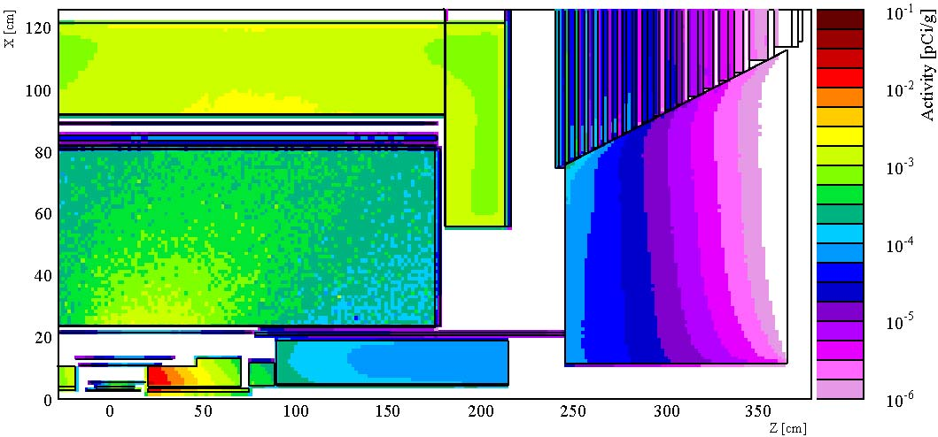
Volumetric Activation
3-D specific activity profile in BaBar detector
Maximum activity of a component is near the surface of the side that faces the radiation source
FLUKA Simulations

Slide 18
Proxy Radionuclides
Radioisotopes that are “hard-to-measure (e.g. ⁵⁵Fe)” are generally accompanied by “proxy” radioisotopes (e.g. ²²Na, ⁵⁴Mn, ⁶⁰Co) which emit high-energy and high-intensity gamma rays
Material | Radionuclide | Half-life
Carbon steel (Fe, C) Cast iron (Fe, C, Si, Mn) | ⁵⁵Fe (5.9 keV x-ray) | 2.73 y
 | ²²Na (proxy) | 2.6 y
 | ⁵⁴Mn (proxy) | 312 d
 | ⁵⁷Co | 272 d
Aluminum | ²²Na (proxy) | 2.6 y
Copper | ⁵⁵Fe (5.9 keV x-ray) | 2.73 y
 | ⁵⁷Co | 272 d
 | ⁶⁰Co (proxy) | 5.26 y

Slide 19
Site’s Clearance Program
Clearance Protocol:
Clearance criteria: 3-tiered approach for materials with potential volumetric radioactivity
Process knowledge: evaluation of potential volumetric activation and surface contamination for materials to be released
Measurement methods: sufficient detection capabilities for the radionuclides of interest and selected clearance criterion
Technical Basis (adopts Standard’s appendices)

Slide 20
Clearance Criteria in Technical Standard
20
Volumetric radioactivity: 3-tiered criteria related to ANSI N13.12-2013 volume Screening Levels (SLs in pCi/g):
Indistinguishable from Background (IFB)
Material has no detectable radioactivity other than ambient background
A level lower than the SLs
Meet O458.1 4.k(3)(a) and is preferred
> IFB and ≤ SLs
Satisfy dose criterion of 1 mrem per year and 4.k(3)(b) of O458.1
> SLs (mainly for restricted release)
Surface contamination: criterion approved in O458.1 (e.g., 10 CFR 835 surface contamination guideline until ANSI N13.12 surface SLs (in dpm /100 cm²) are approved by DOE

Slide 21
IFB Clearance Criterion for Volumetric Radioactivity
21
Basis, Requirements, Usage | DOE Approval
DTs < SLs Measurements are IFB (material has no detectable radioactivity other than background) IFB releases satisfy paragraph 4.k(3)(a) of O458.1 IFB is the preferred clearance criterion No radiological control is warranted and is already ALARA | Approval for releases is not needed if the releases are covered by the scope of the site’s material clearance program
DT: Detection Threshold

Slide 22
ANSI SL Clearance Criterion
22
Basis, Requirements, Usage | DOE Approval
DLs < SLs Measurements meet SLs (derived based on the ANSI dose criterion of 1 mrem/y) ALARA analysis is required because materials with detectable radioactivity may be released Non-IFB release can satisfy paragraph 4.k(3)(b) of O458.1 under certain conditions | SLs are subject to DOE pre-approved AL process (satisfy O458.1 dose constraint of 1 mrem/y) DOE Field Element approval of each release plan, which includes a qualitative ALARA analysis
DL: Detection Limit

Slide 23
Clearance Criterion Higher Than ANSI SL
23
Basis, Requirements, Usage | DOE Approval
Follow DOE AL process to obtain approval for release under a site-specific Authorized Limits. Mainly for restricted release. | DOE approval of the clearance criterion as AL. DOE Field Element approval of each release plan, which includes a quantitative ALARA analysis and notification of DOE program elements and EHSS consistent with O458.1

Slide 24
ANSI N13.12-2013 Screening Levels (SLs)
24
Radionuclide Group | Surface SL (dpm / 100 cm²) | Volume SL (pCi/g)
Group 1: High-energy gamma, radium, thorium, transuranics, and mobile beta-gamma emitters (e.g., ²²Na, ⁴⁶Sc, ⁵⁴Mn, ⁵⁶Co, ⁶⁰Co, ⁶⁵Zn, ¹²⁵Sb, ¹³⁴Cs, ¹⁵²Eu, ¹⁵⁴Eu) | 600 | 3
Group 2: uranium and selected beta-gamma emitters (e.g., ⁵⁷Co, ⁵⁸Co, ⁵⁹Fe, ¹¹³Sn, ¹²⁴Sb) | 6,000 | 30
Group 3: General beta-gamma emitters (e.g., ⁷Be) | 60,000 | 300
Group 4: Low-energy beta-gamma Emitters (e.g., ³H, ⁴⁵Ca, ⁶³Ni) | 600,000 | 3,000
Group 5: Low-energy beta emitters (e.g., ⁵⁵Fe) | 600,000 | 30,000

Slide 25
Clearance Criteria for Surface Contamination
25
Radionuclide | DOE Order 5400.5 Figure IV-1 Allowable Total Residual Surface Contamination (dpm / 100 cm²)
 | Average | Maximum | Removable
Beta-gamma emitters, except ⁹⁰Sr and others noted in Figure IV-1 | 5,000 | 15,000 | 1,000
 | 10 CFR Part 835 Removal Surface Contamination (dpm / 100 cm²)
Tritium | 10,000

Slide 26
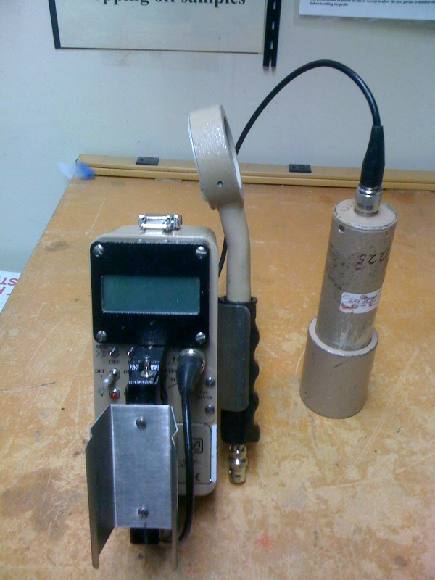
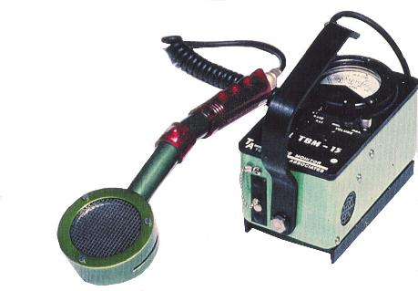
Field Surface Survey Instruments
Ludlum Model 18 with 44-2 detector
Ludlum Model 2241 with both a 44-2 detector (1”x 1” NaI) and a GM pancake
TBM P15
26

Slide 27
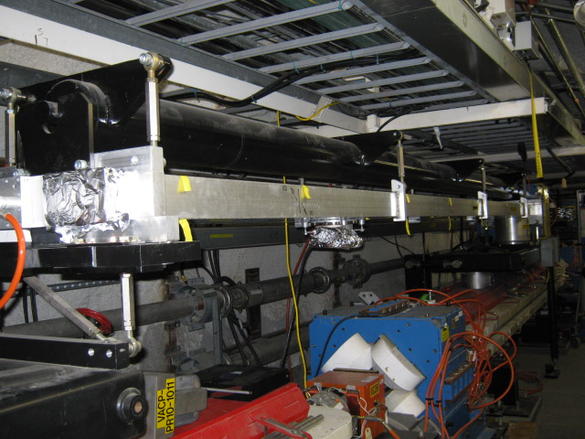
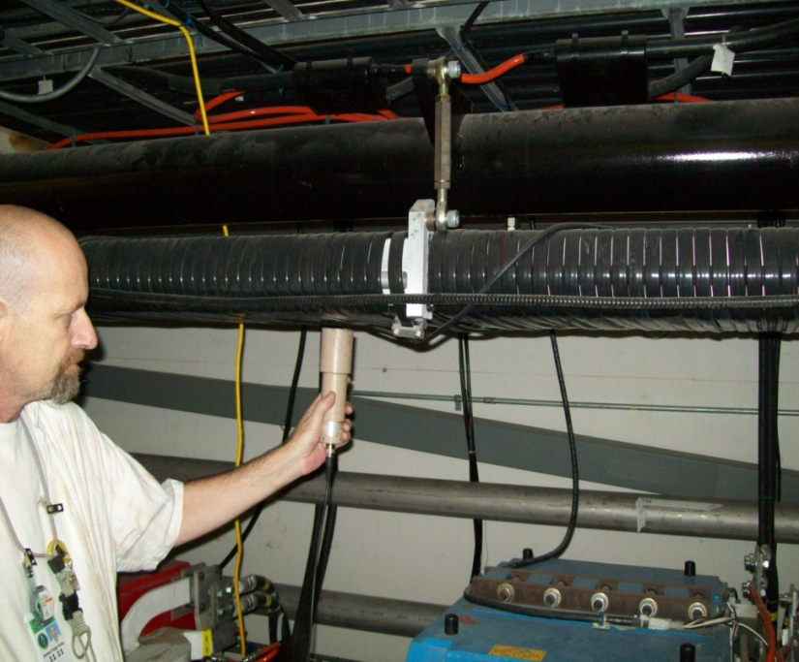
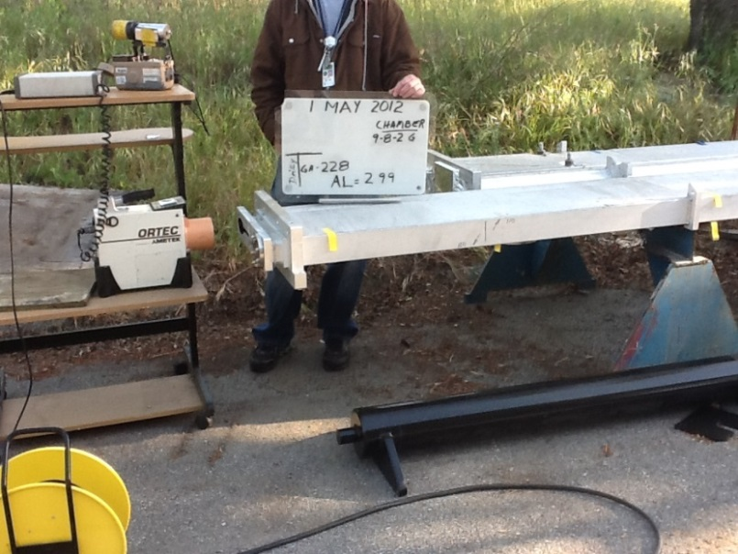
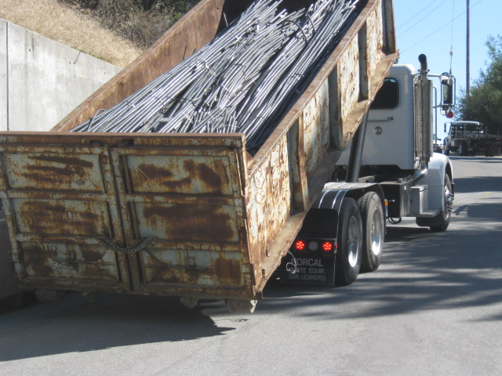
Material Removal, Survey

Slide 28
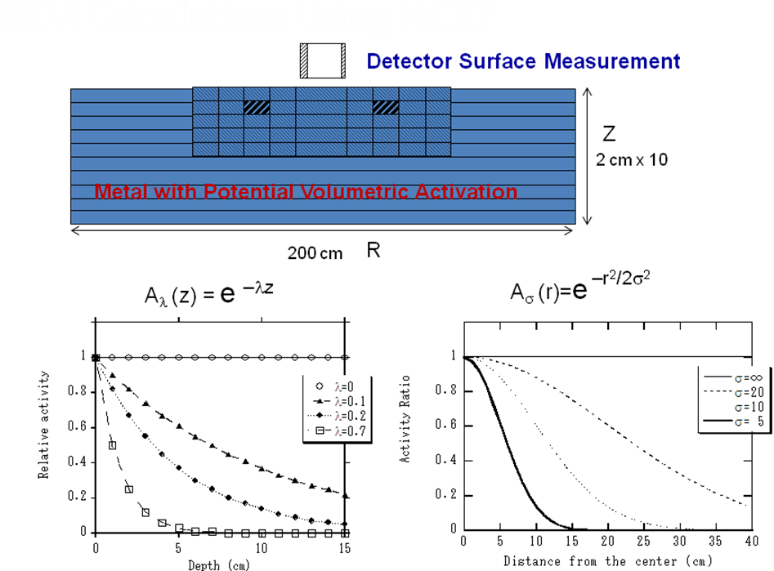
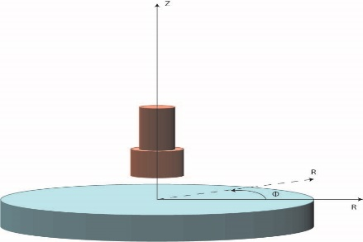
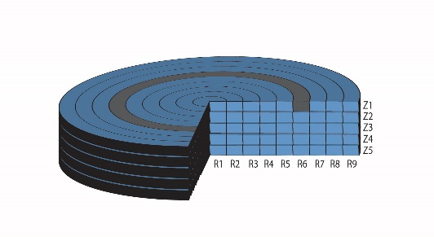
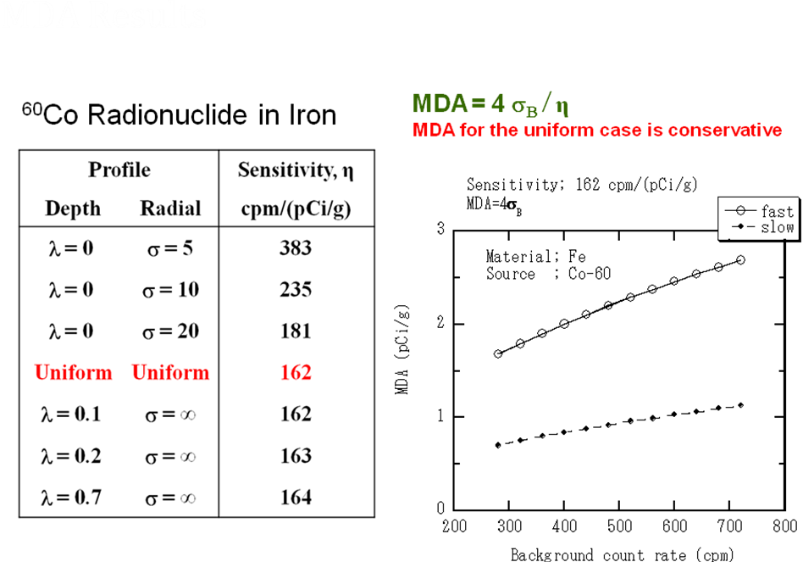
DT Calculations for 1”x1” NaI Survey Instrument
28
“MDA MCNP Calculations”
Hirokuni Yamanishi, et al.,
SLAC RPD-008, June 2011

Slide 29
Thank You

Slide 30
Key Terms
30
Clearance: Removal of personal property that contains or may contain residual radioactive material from DOE radiological control.
Release: Process that material has gone through the clearance process and is released off-site or on-site from radiological control
Detection Limit (DL): The smallest amount of radioactivity (in pCi/g for volumetric radioactivity measurements, or dpm / 100 cm² for surface contamination) that can be detected and quantified by a measurement method.
Detection Threshold (DT): The instrument signal level (in cpm, μR/h, etc.) associated with a determination that a measurement is different than background
Indistinguishable from Background (IFB): The absence of detectable radioactivity, as determined by measurement methods.
Process Knowledge: A collective, objective description of the physical, operational, administrative, and radiological conditions associated with material being considered for clearance such that a reasonable and defendable decision can be made regarding whether the material could or could not have become activated or contaminated.
Notes:
Clearance: Removal of personal property that contains or may contain residual radioactive material from DOE radiological control.
Release: Transfer of control or ownership of property from DOE to a non-DOE party.

Slide 31
Key Differences between ANSI N13.12-2013 and Technical Standard
31
N13.12 provides volume and surface SLs. Technical Standard endorses the volume SLs as Pre-Approved Authorized Limits but retain the DOE 5400.5 surface activity guideline until the ANSI N13.12 is approved by DOE.
N13.12 gives SLs as single clearance criterion. Technical Standard adopts a three-tiered set of clearance criteria for volumetric activity: IFB, SLs and > SL.
To minimize public perception risk, IFB is recommended as the preferred one.
N13.12 provide general process knowledge. Technical Standard provides specific process knowledge to support clearance of common metals at accelerator facilities:
Section 3.2 gives details for the use of process knowledge.
Appendices B to D provides general process knowledge and technical basis that allow the evaluation of induced radioactivity and its characteristics in accelerator facilities.

Slide 32
Key Differences between ANSI N13.12-2013 and Technical Standard
32
N13.12 provides general measurement methods and requirements. Technical Standard Appendix E provides technical basis to support appropriate selection and use of measurement methods and the estimation of associated detection capabilities. In addition to survey measurements, confirmatory measurements (e.g., gamma spectrometry or portal gate monitor) are recommended to be used as warranted.
N13.12 provides technical requirements. Technical Standard provides also programmatic requirements such as program, documentation and reporting, as well as DOE approval and independent verification.
There are no contradictions between ANSI N13.12 – 2013
and the DOE Technical Standard

Slide 35
SLAC Clearance Program

