Slide 1
ASW 2016: Unreviewed Safety Issues (USI) Questionnaire
Wednesday, September 21, 2016

Slide 2
22
Total Responses Across 9 Facilities
Date Submitted: Monday, September 12, 2016

Slide 3
Q1: What Department of Energy (DOE) Government Owned/Contractor Operated site do you represent and/or are associated with?
Ames Laboratory
Argonne National Laboratory
Brookhaven National Laboratory
Lawrence Berkley Laboratory
Los Alamos National Laboratory
Oakridge National Laboratory
Sandia National Laboratory
SLAC National Accelerator Facility
Thomas Jefferson National Accelerator Facility

Slide 4
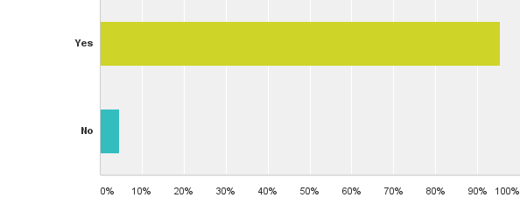
Q2: Does your DOE site implement a form of USI for compliance with DOE Order 420.2C?
Answered: 22 Skipped: 0

Slide 5
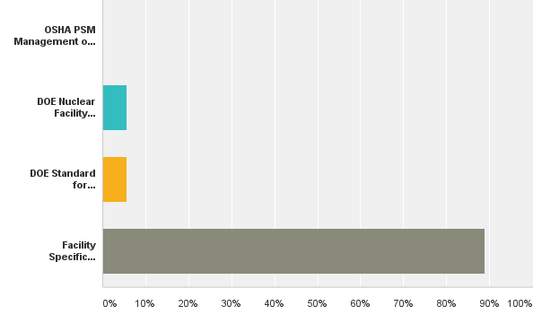
Q3: Does your site USI process follow one or more of the below types of processes?
Answered: 18 Skipped: 4

Slide 6
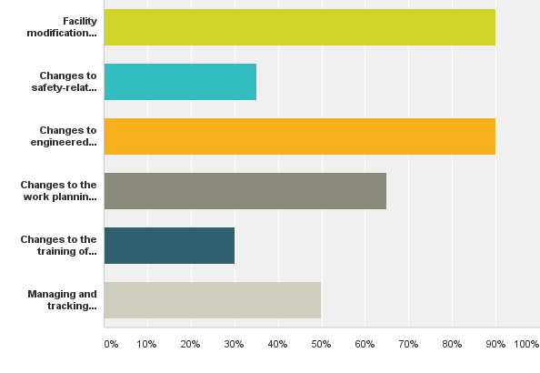
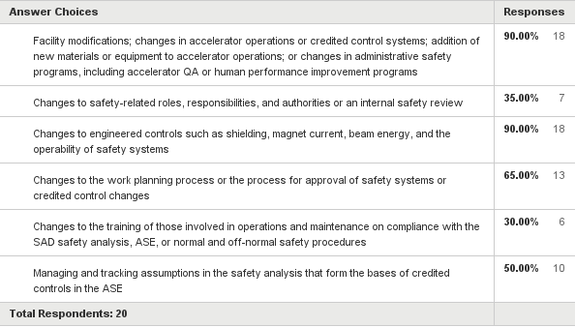
Q4: Does your site USI process identify the following items listed in the accelerator guide?
Answered: 20 Skipped: 2

Slide 7
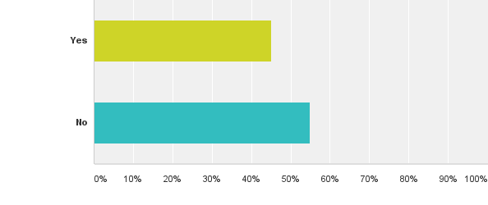
Q5: Is your site USI process part of the site configuration management process?
Answered: 20 Skipped: 2

Slide 8
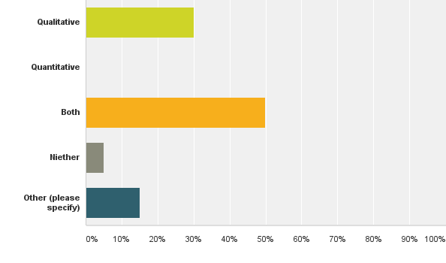
Q6: Does your site USI process evaluate a significant increase in the probability of or consequences using qualitative or quantitative evaluations?
Answered: 20 Skipped: 2

Slide 9
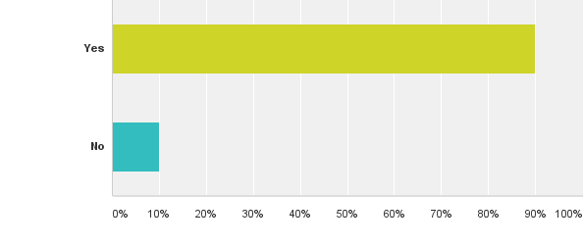
Q7: Are you and/or others from your DOE site interested in participating in the USI discussion on the final day of the 2016 ASW?
Answered: 20 Skipped: 2

Slide 10
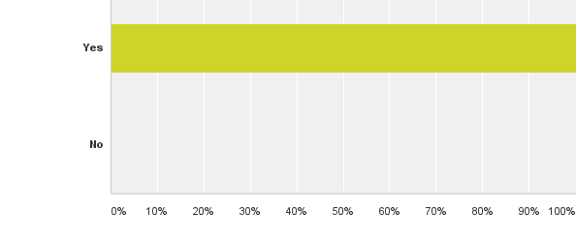
Q8: Would you and/or others from you DOE site participate in a working group to identify "best practices" for implementation of the USI process?
Answered: 21 Skipped: 1

Slide 11
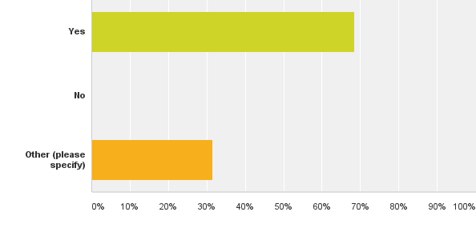
Q9: Are you willing to share your site USI process documentation and/or procedure? If yes, please forward a copy to tsstirr@sandia.gov.
Answered: 19 Skipped: 3

Slide 12
Follow Up Discussion – Seed Questions
What does everyone mean by “facility specific” procedure? Site specific and/or facility specific on single site?
Is process a form based process? Hard copy vs online?
How many questions ?
Who authors, reviews, and approves USI?
How address the aspects outlined in guide – specifically or generally?
Can we create a working group to share ideas? Provide examples? Cross train?

