Slide 1
Search for Charged Lepton Flavor Violation at CMS
Daniel Troendle
On behalf of the CMS Collaboration
University of Hamburg
22.06.2016, CLFV2016, Charlottesville

Slide 2
Motivation: CFLV at LHC (CMS)
Lepton Flavor Number (L) is not conserved →Neutrino Oscillation!
Charged-Lepton-Flavor violation (CLFV): no SM contribution, hence clear signature for New Physics!
Example: μ→eγ
γ
?
New Physics!
μ
e

Slide 3
Motivation: CFLV at LHC (CMS)
Example: μ→eγ
γ
W
Lepton Flavor Number (L) is not conserved →Neutrino Oscillation!
Charged-Lepton-Flavor violation (CLFV): no SM contribution, hence clear signature for New Physics!
μ
e
BR~O(10⁻⁵⁴)

Slide 4
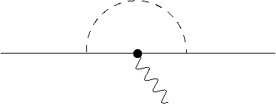
Motivation: CFLV at LHC (CMS)
γ
Example: μ→eγ
γ
W
Lepton Flavor Number (L) is not conserved →Neutrino Oscillation!
Charged-Lepton-Flavor violation (CLFV): no SM contribution, hence clear signature for New Physics (NP)!
Examples for NP contribution: Higgs
μ
e
H
μ
μ
μ
e
γ

Slide 5
Motivation: CFLV at LHC (CMS)
Example: μ→eγ
γ
W
Lepton Flavor Number (L) is not conserved →Neutrino Oscillation!
Charged-Lepton-Flavor violation (CLFV): no SM contribution, hence clear signature for New Physics (NP)!
Examples for NP contribution: Higgs , SUSY,
μ
e
H
μ
μ
μ
e
γ
γ
SUSY
μ
e

Slide 6
Motivation: CFLV at LHC (CMS)
Example: μ→eγ
γ
W
Lepton Flavor Number (L) is not conserved →Neutrino Oscillation!
Charged-Lepton-Flavor violation (CLFV): no SM contribution, hence clear signature for New Physics (NP)!
Examples for NP contribution: Higgs , SUSY, Heavy Neutrinos, Leptoquarks, Z’, ...
μ
e
H
μ
μ
μ
e
γ
γ
SUSY
μ
e

Slide 7
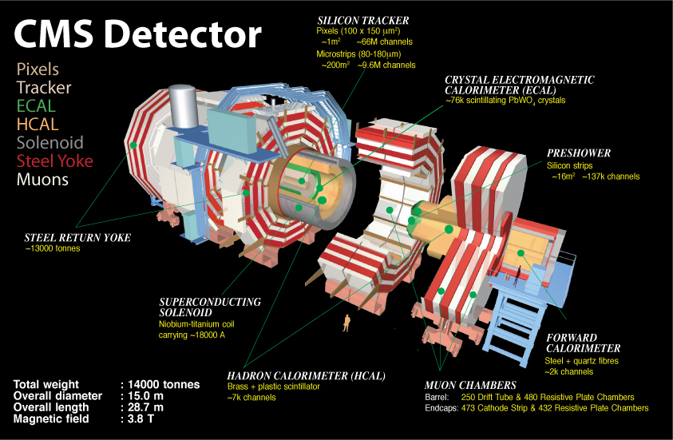

Slide 8
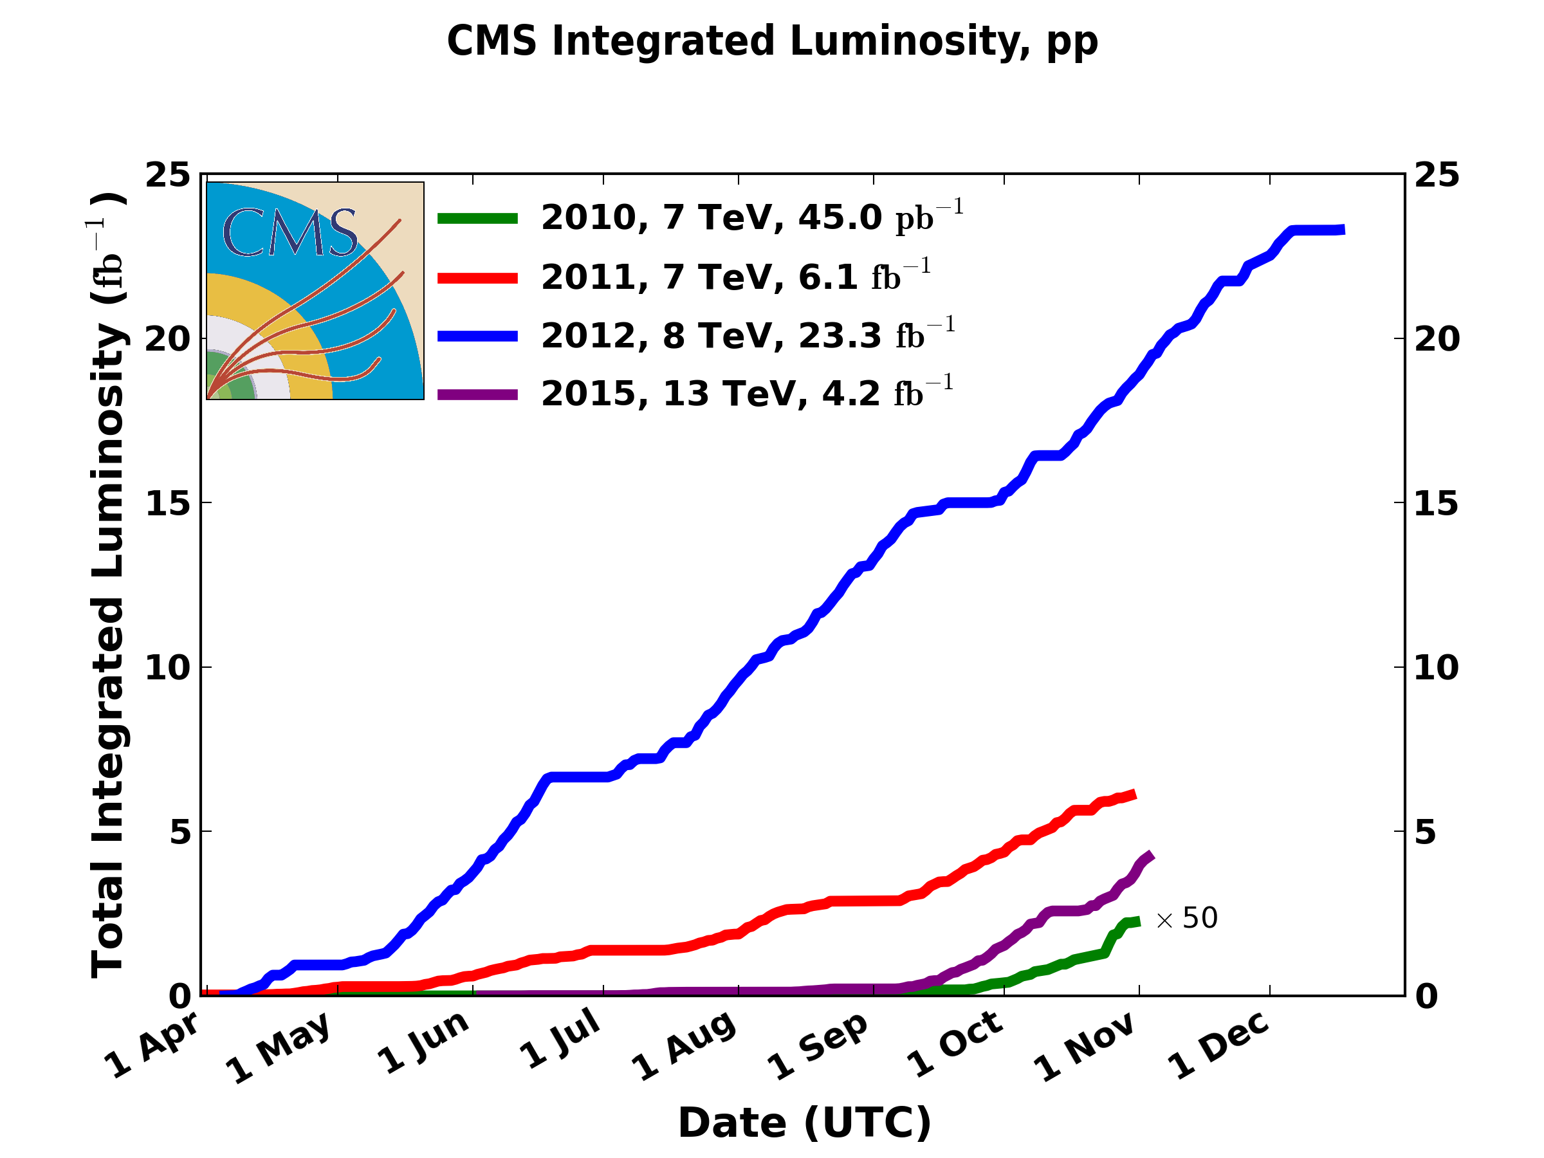
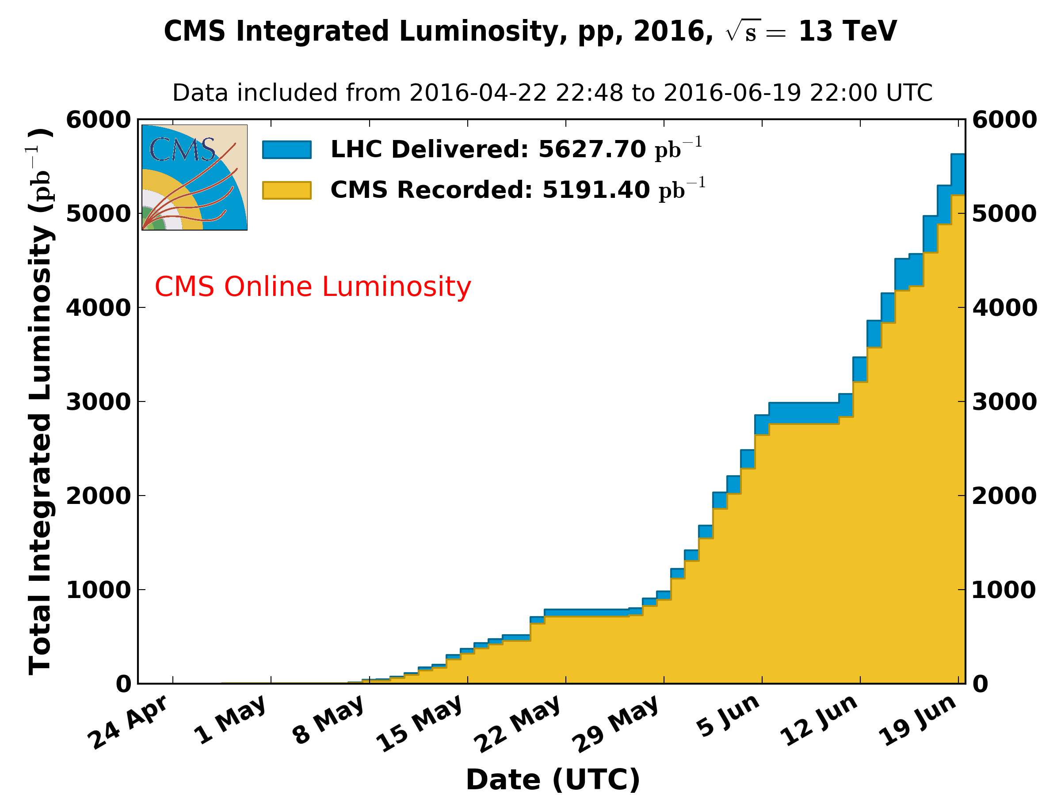
Recorded Data
Results shown in the following are based on the data taking at
7, 8 and 13 TeV center-of-mass energy!

Slide 9
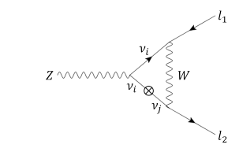
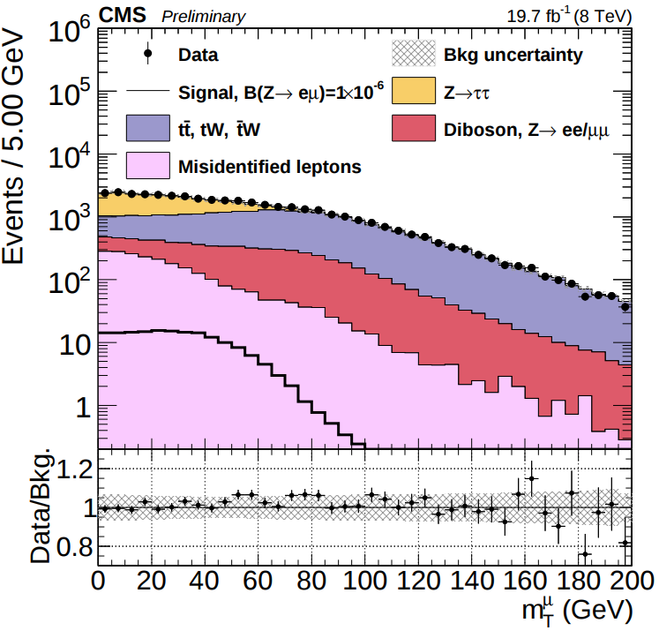
Search for Z→μe decays
Event Selection:
Two tight leptons (e,μ) with opposite sign
Jet-Veto: suppresses ttbar
Low transverse Mass: suppresses WW
Misidentified leptons estimated from data
CMS-PAS-EXO-13-005

Slide 10
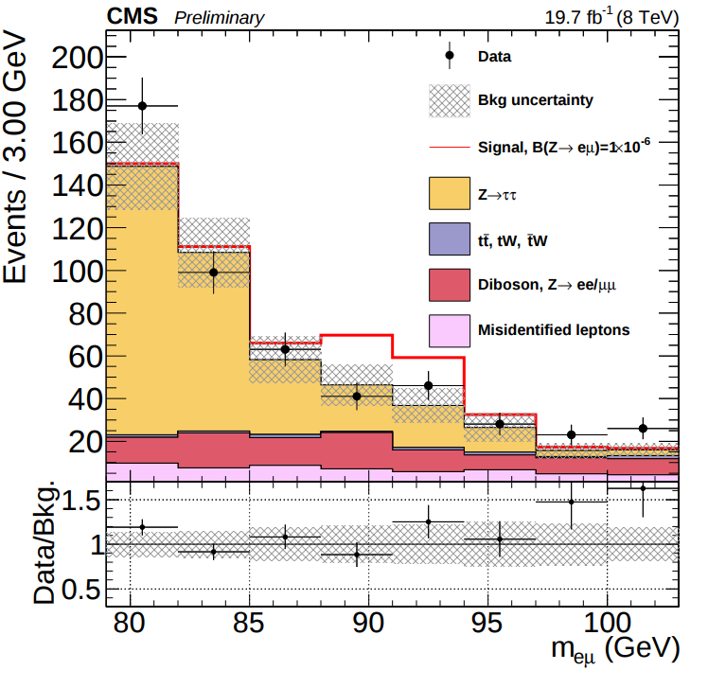
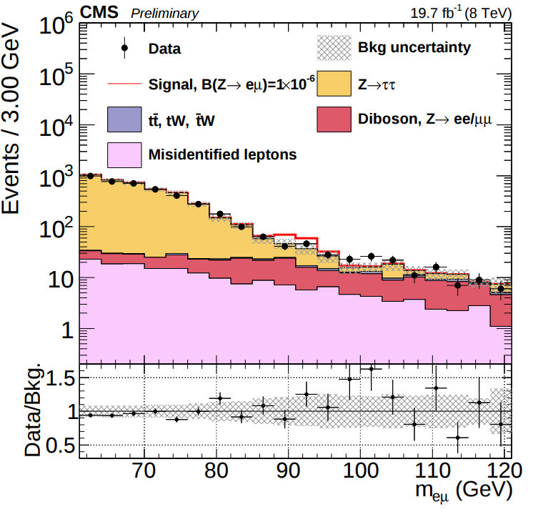
Z→μe: Results
No significant excess has been observed.
Limit:
Expected: B(Z→μe) < 6.7⋅10⁻⁷
Observed: B(Z→μe) < 7.3⋅10⁻⁷
LEP: B(Z→μe) < 7.5⋅10⁻⁷
CMS-PAS-EXO-13-005

Slide 11
Z→μe: Results
Search for Z→μτ/eτ?
ATLAS result: B(Z → µτ) < 1.69 × 10⁻⁵
(arXiv:1604.07730)
LEP: B(Z → µτ) < 1.2 × 10⁻⁵
Good prospects to improve existing limits with the upcoming data taking!
No significant excess has been observed.
Limit:
Expected: B(Z→μe) < 6.7⋅10⁻⁷
Observed: B(Z→μe) < 7.3⋅10⁻⁷
LEP: B(Z→μe) < 7.5⋅10⁻⁷
CMS-PAS-EXO-13-005

Slide 12
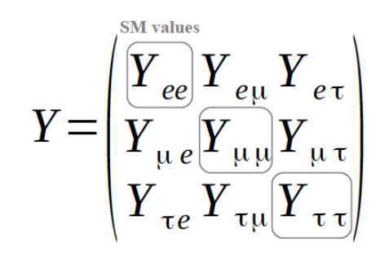
Search for CLFV Higgs decays
In general two Higgs-Doublet models (2HDMs):
CFLV Higgs coupling are possible!
Typically one need to introduce an additional symmetry to suppress flavor changing neutral currents (FCNC)...
LHC-RunII: exploit the full yukawa-matrix, not “only” the diagonal entries!

Slide 13
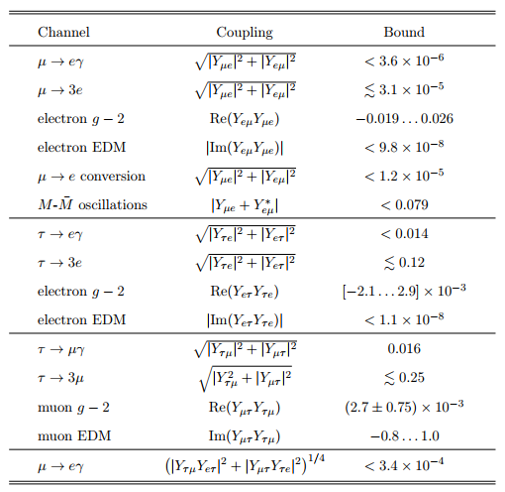
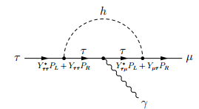
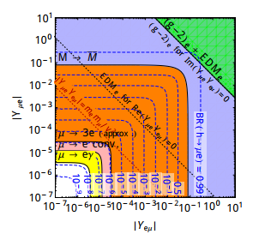
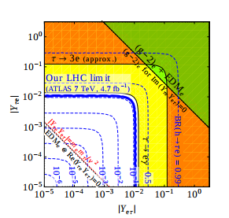
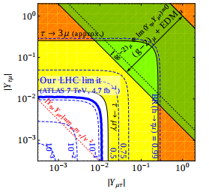
Search for CLFV Higgs decays
Harnik, Kopp, Zupan, arXiv:1209.1397
Pre-LHC constraints: B(H→μτ/eτ)~O(10%) are still allowed!
Pre-LFC bounds on LFV Higgs couplings

Slide 14
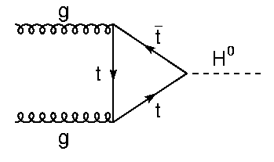
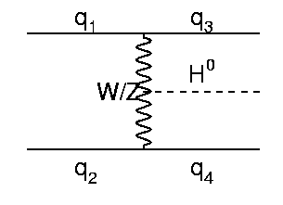
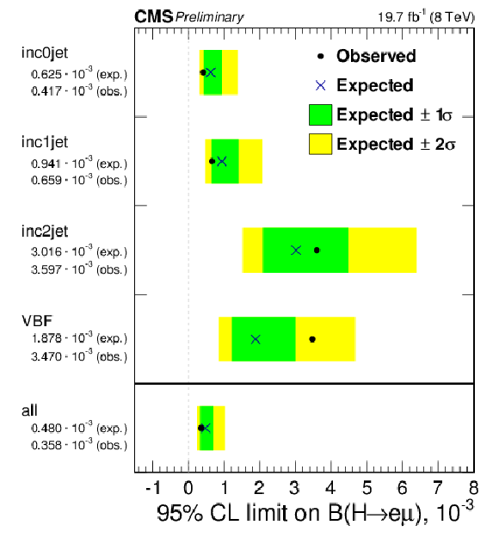
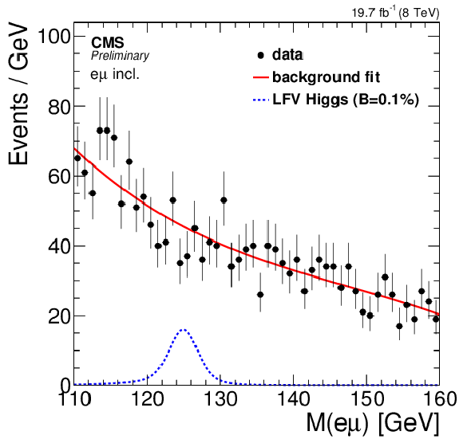
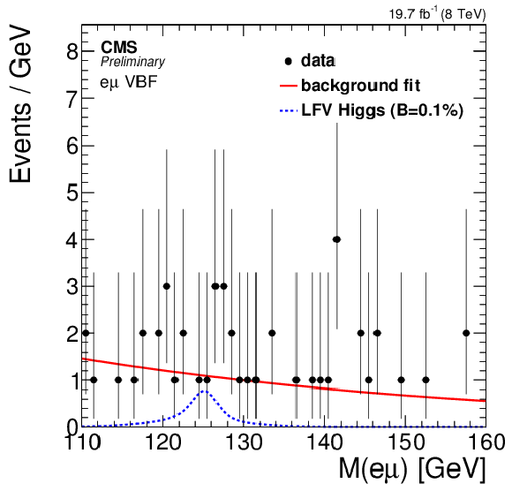
Search for H→eμ
GGF
VBF
Dilepton: e+μ with opposite sign
GGF and VBF production: 0,1 and 2 Jet category
Low MET in the events is required
Background: ‘simple’ fit of the dilepton invariant mass distribution m_{eμ}=[110,160]
CMS-PAS-HIG-14-040

Slide 15
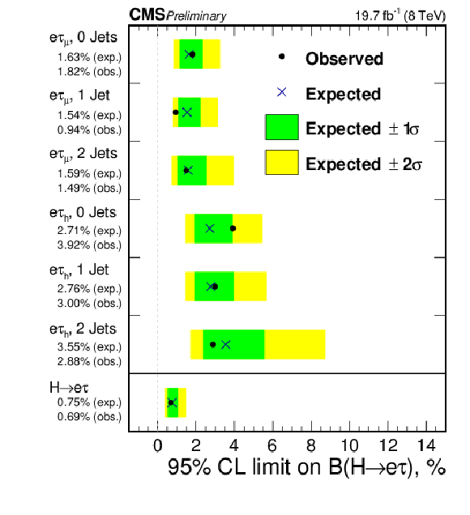
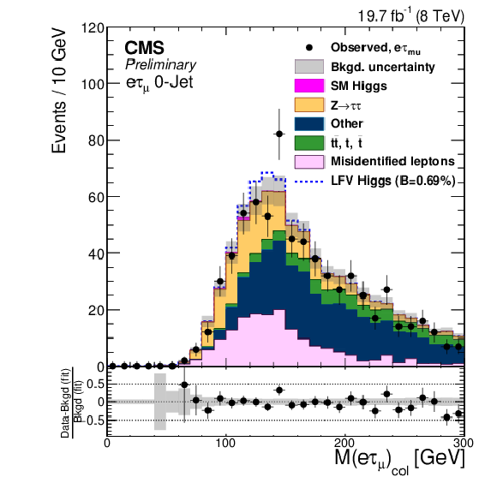
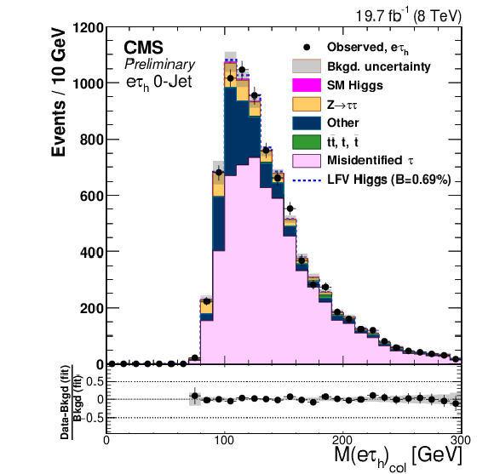
Search for H→eτ
2 channels: leptonic tau (μ) and hadronic tau decays
GGF and VBF production channels: 0, 1 and 2-Jet categories
Kinematic cuts to enhance S/B ratio
CMS-PAS-HIG-14-040

Slide 16
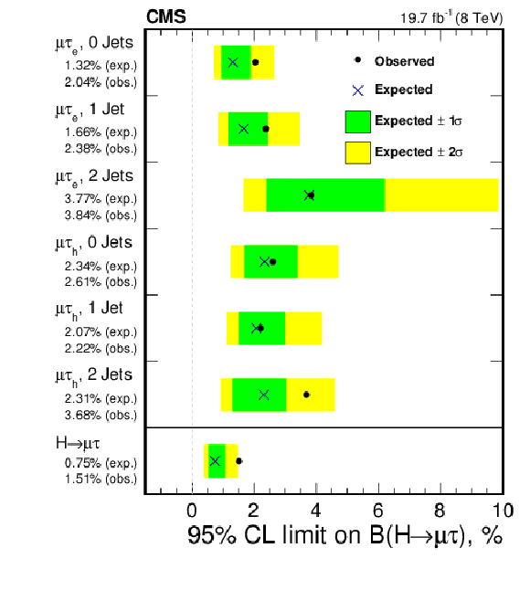
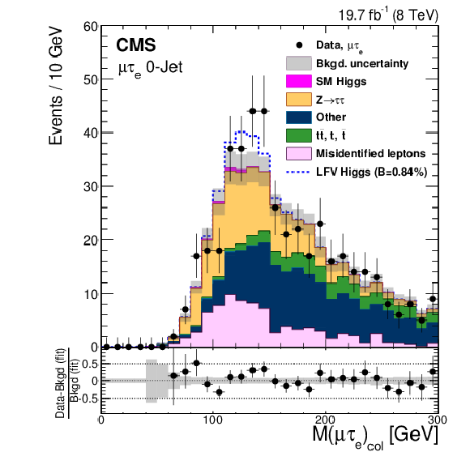
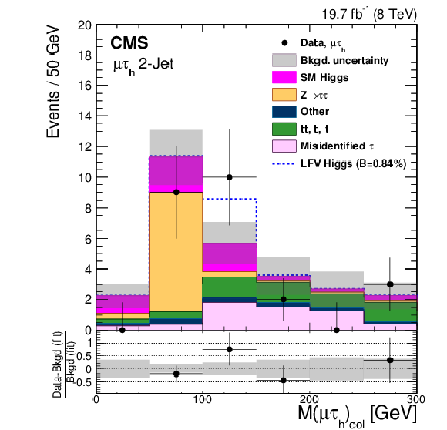
Search for H→μτ
2 channels: leptonic tau (e) and hadronic tau decays
GGF and VBF production considered: 0,1 and 2-Jet categories
Kinematic cuts to enhance S/B ratio
Phys. Lett. B 749 (2015) 337

Slide 17
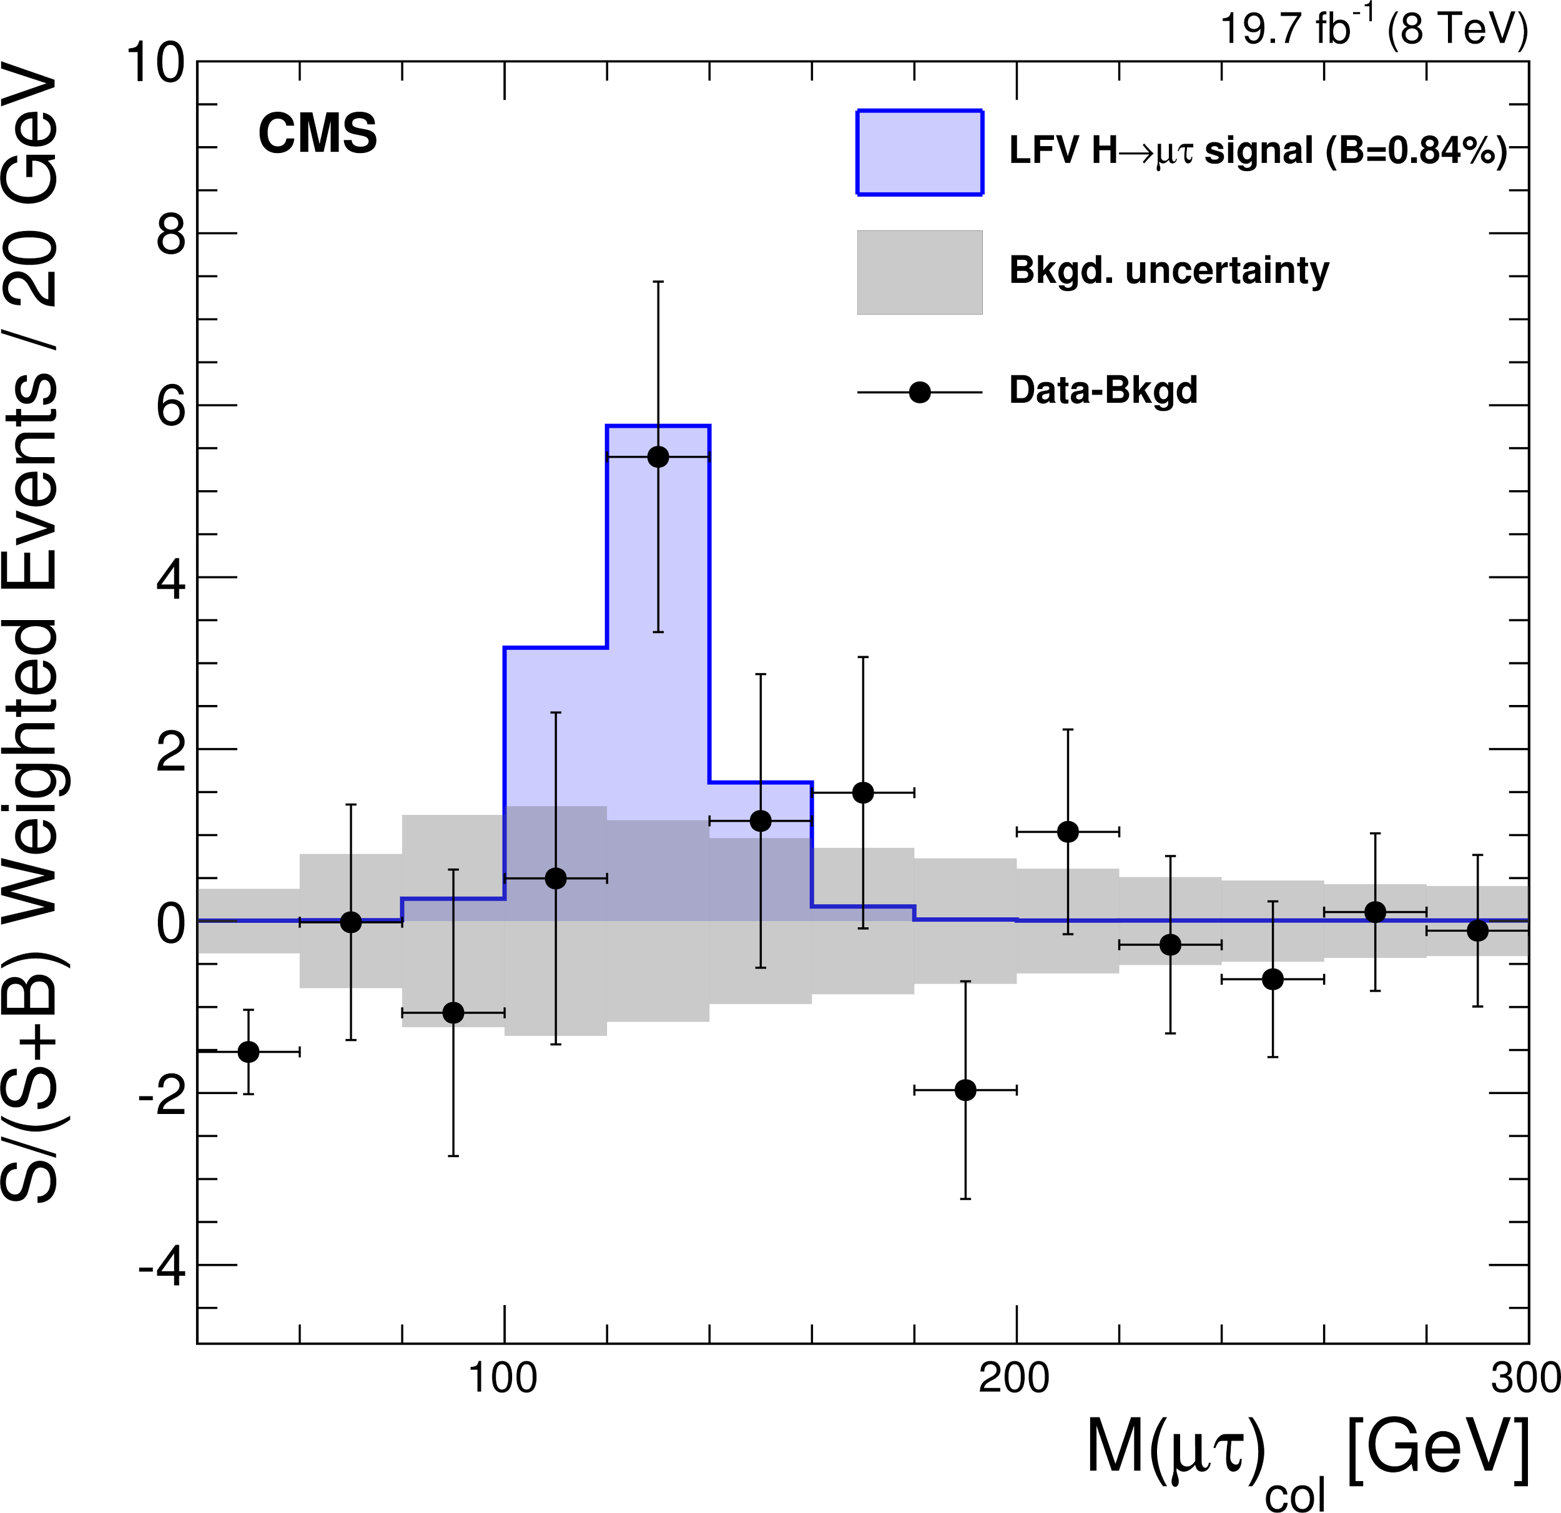
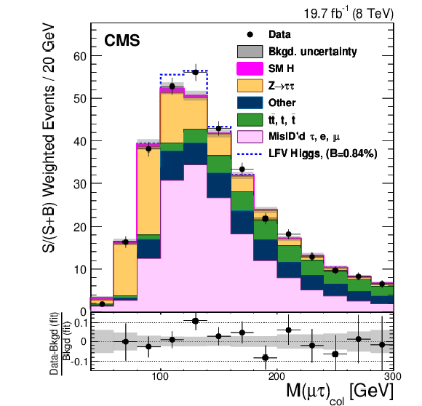
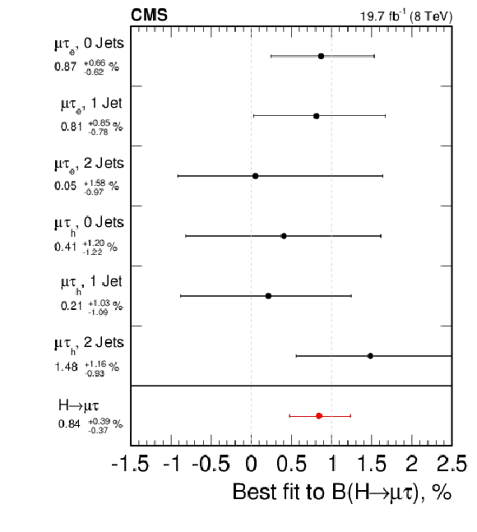
Search for H→μτ
Excess: ~2.4σ excess
Best Fit B(H→μτ)=0.84±0.39%
Phys. Lett. B 749 (2015) 337

Slide 18
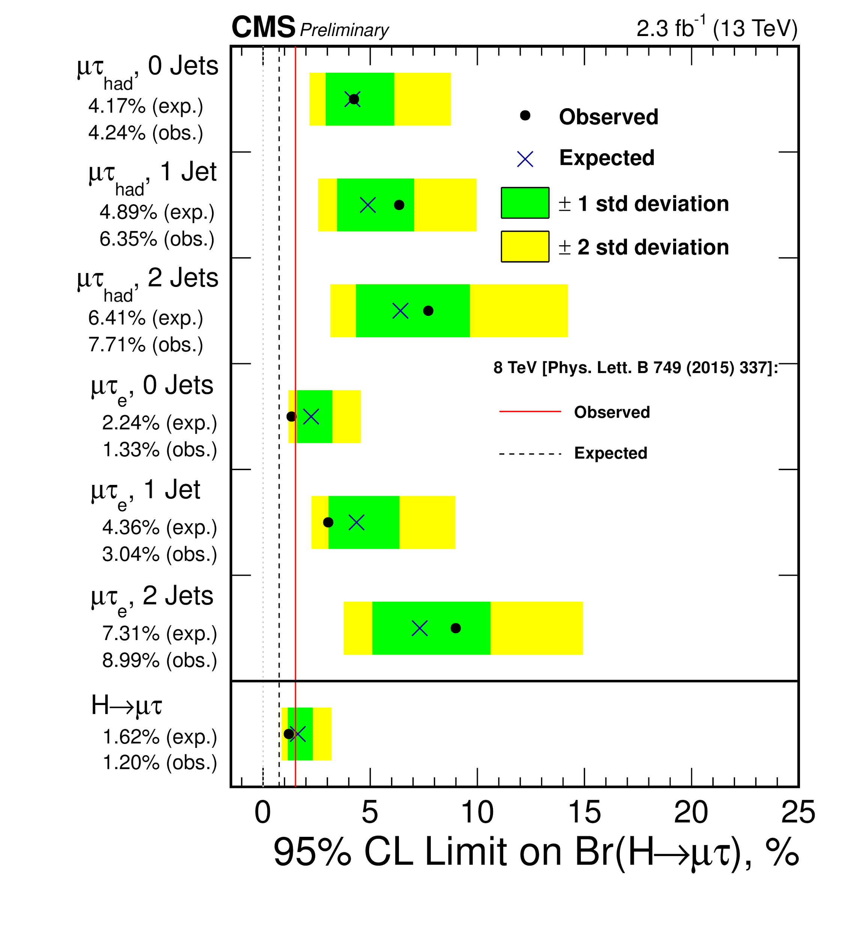
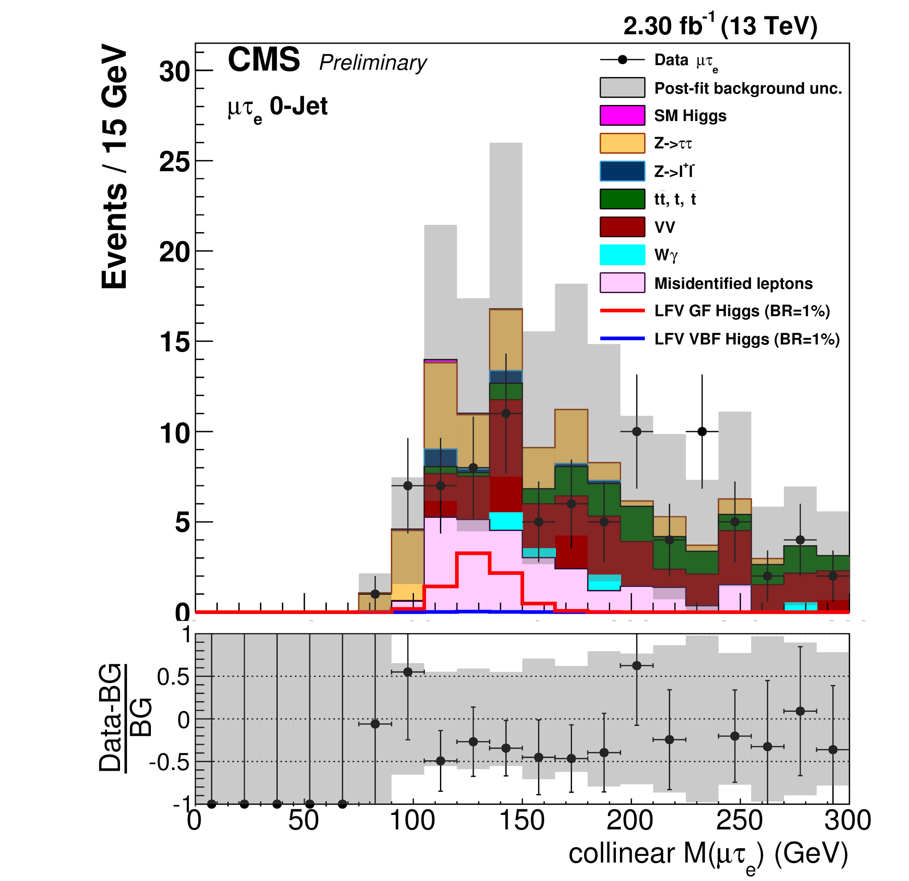
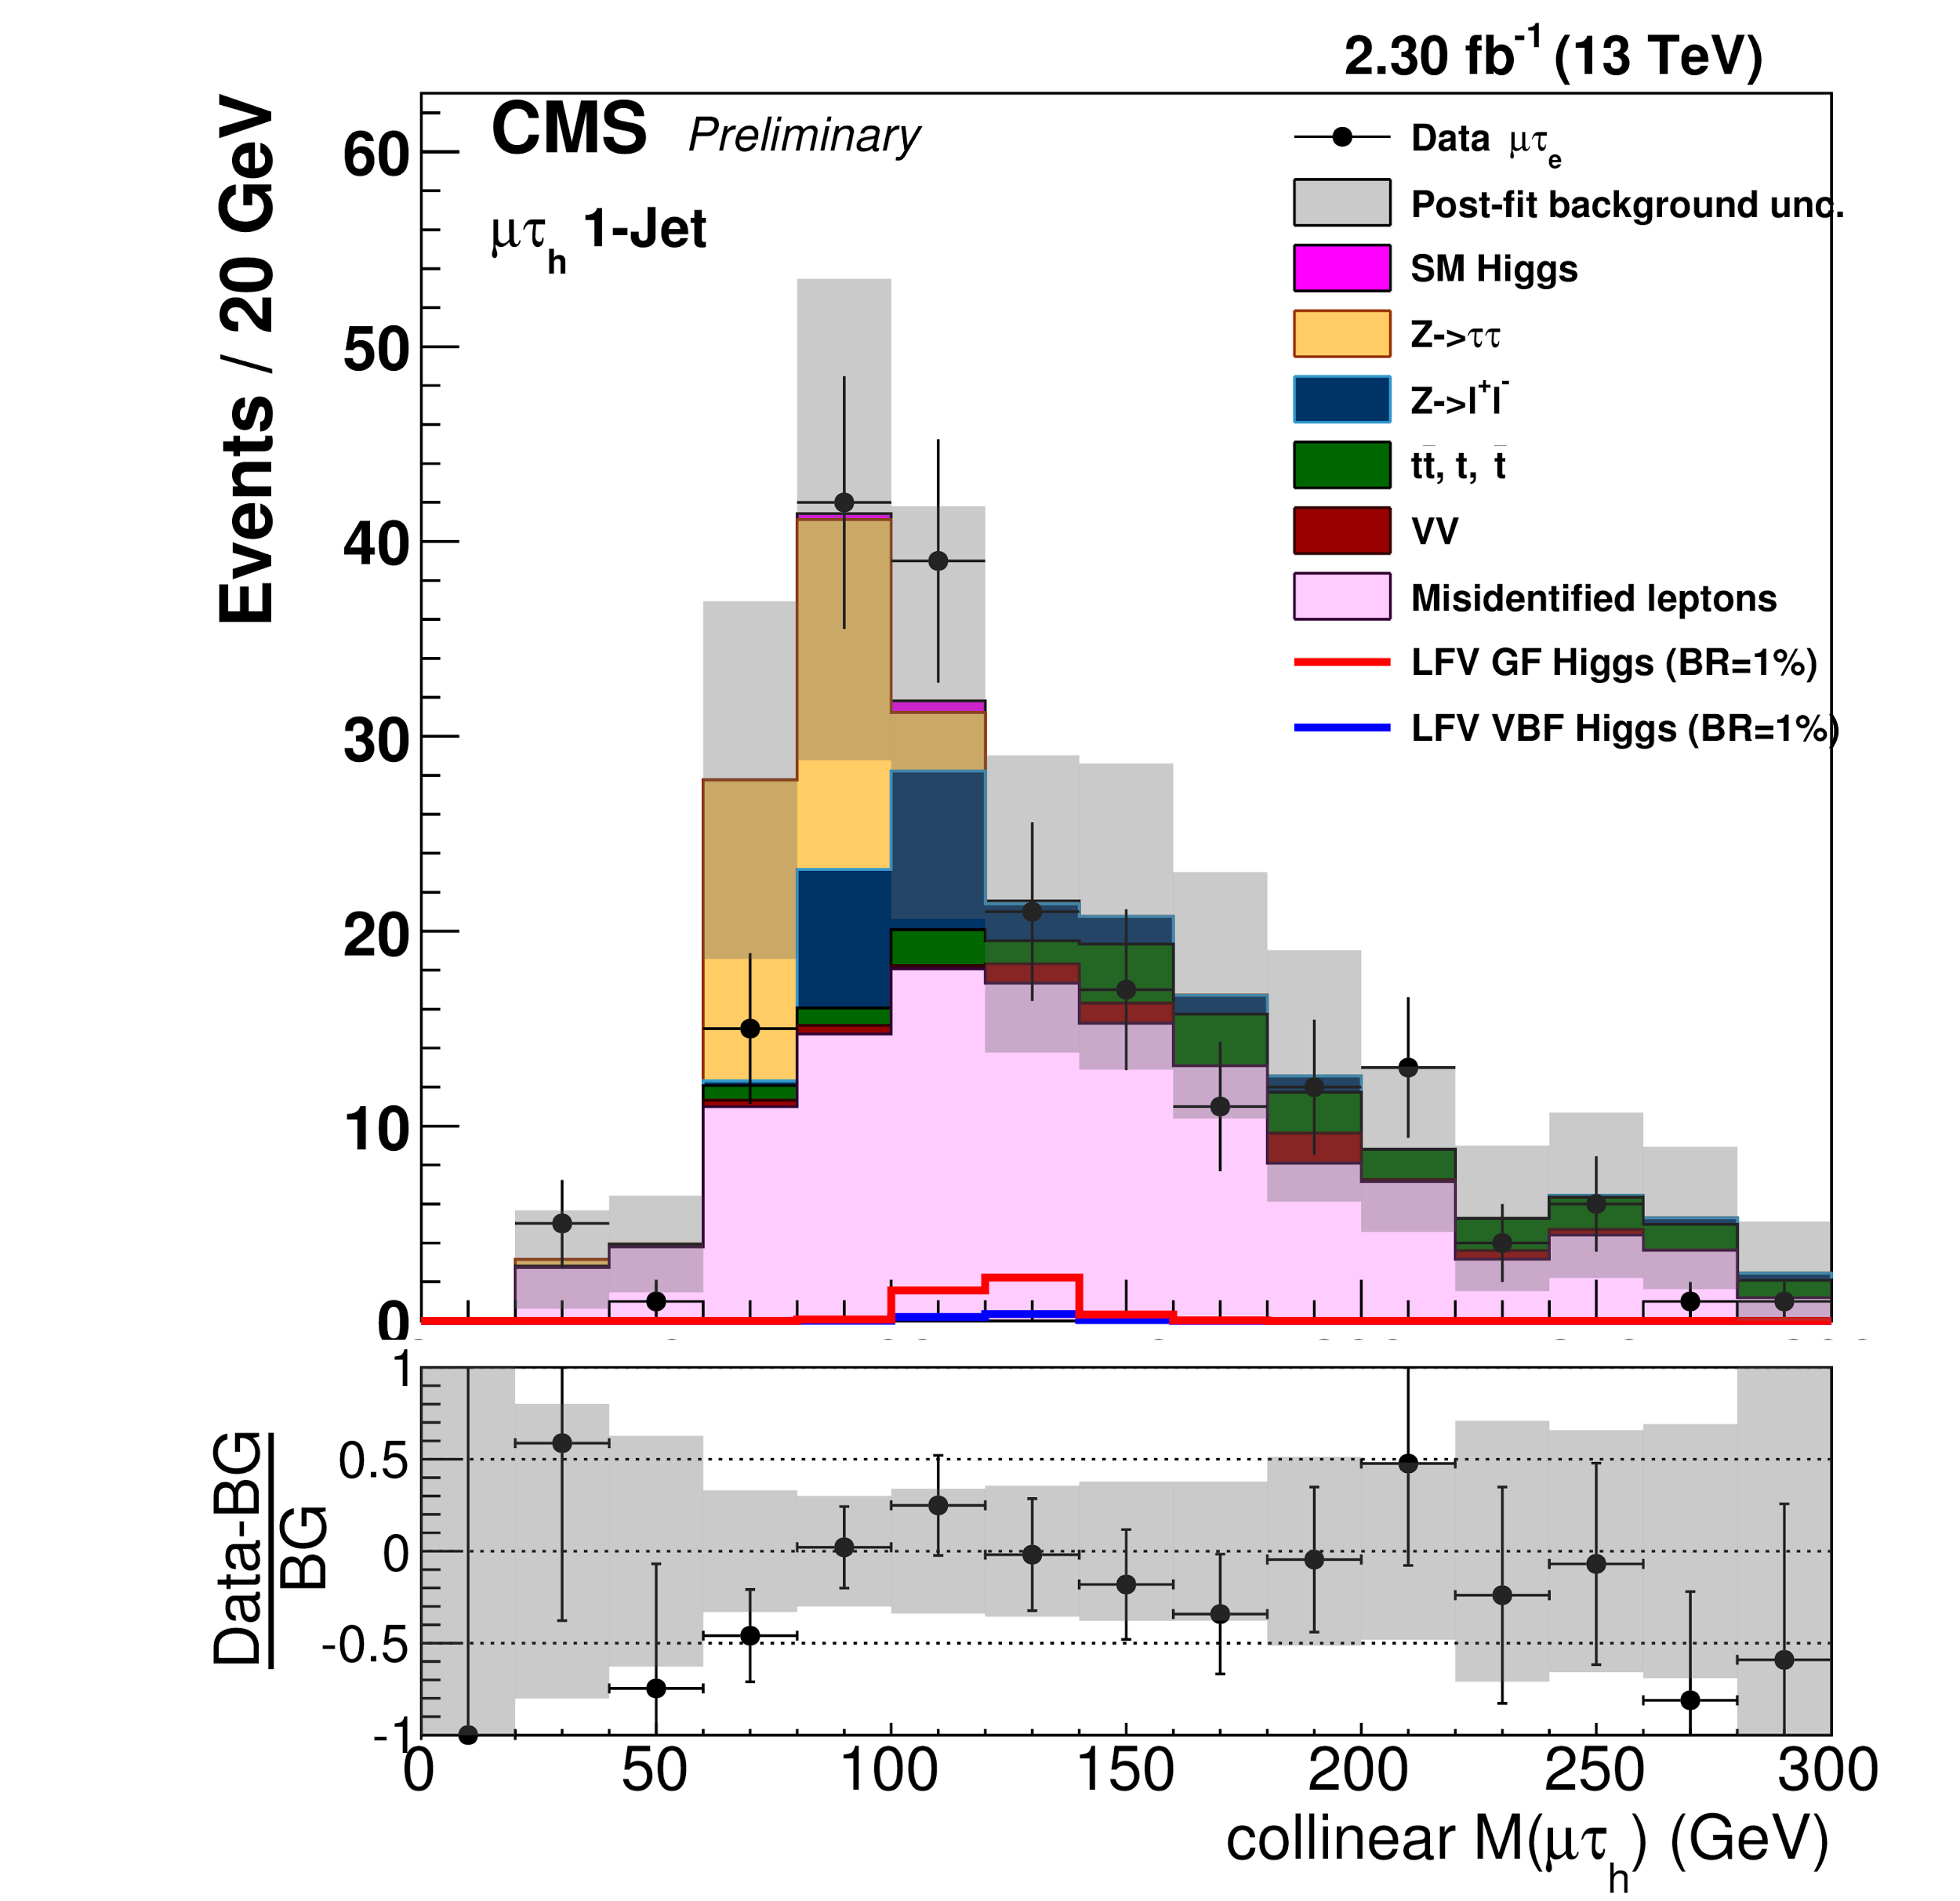
Search for H→μτ @ 13TeV!
Repetition of 8TeV H→μτ analysis: no change of strategy and kinematic cuts
Slight excess of 8TeV analysis could not be confirmed so far, but also not excluded!
Updated B(H→μτ) Limit: B(H→μτ)<1.2% observed (1.62% expected)
CMS-PAS-HIG-16-005

Slide 19
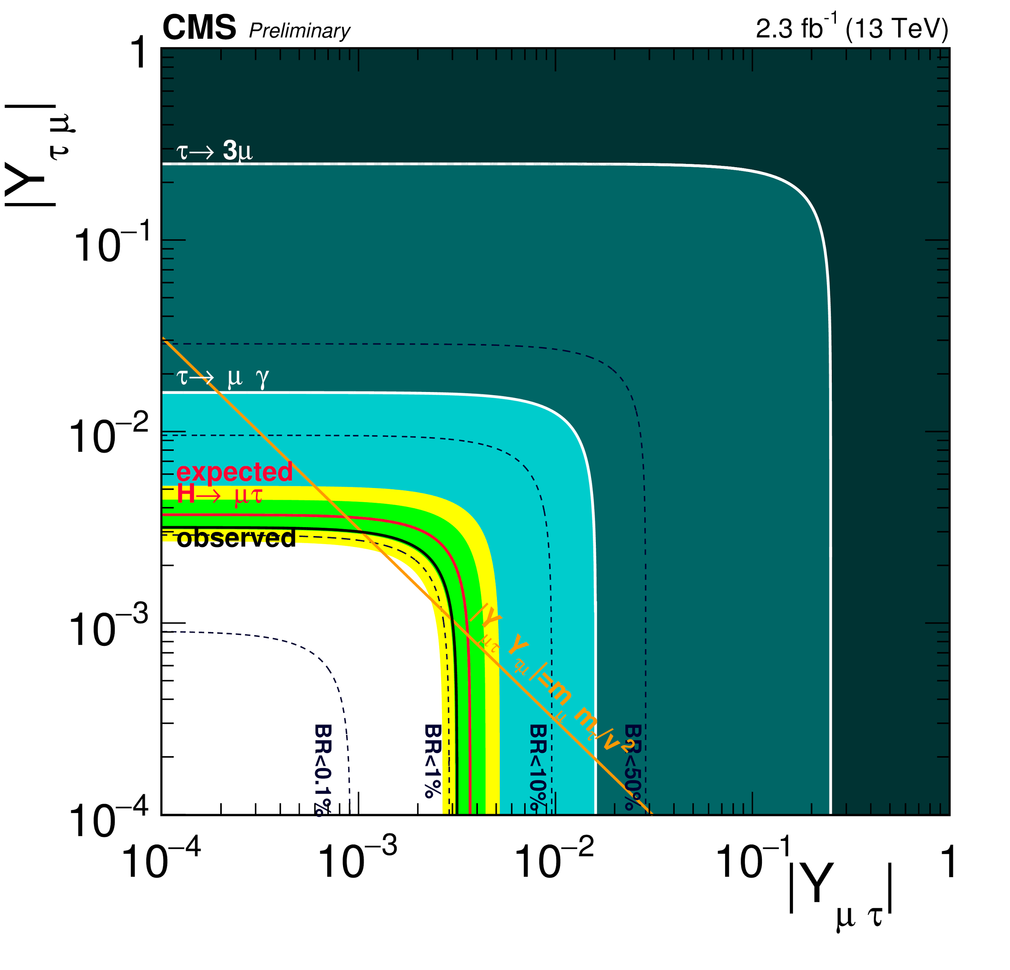
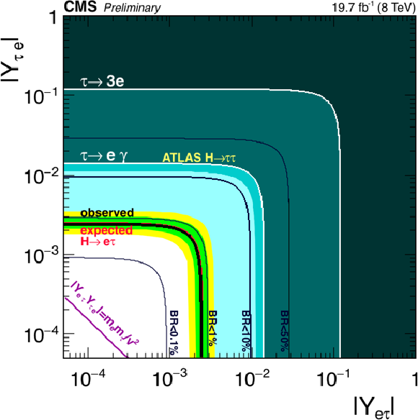
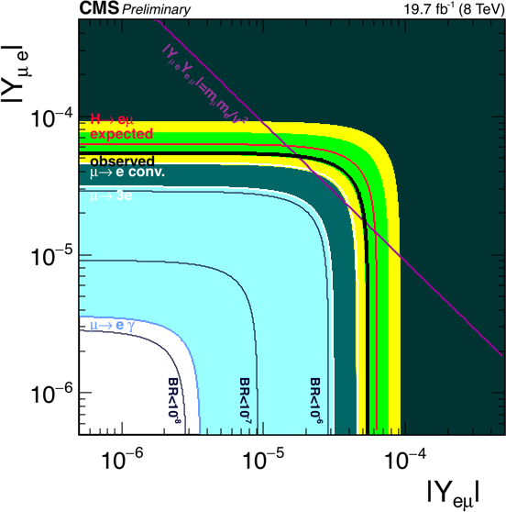
LFV Higgs Summary
Expect major update by end of the year!
Extension to higher masses (H,A→μτ,eτ) is on the list to do!

Slide 20
(L)RPV-SUSY
Heavy Resonances, Heavy neutrinos,...

Slide 21
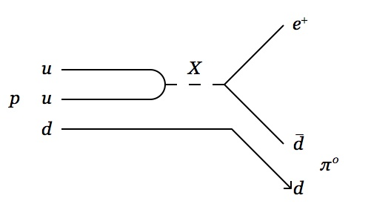
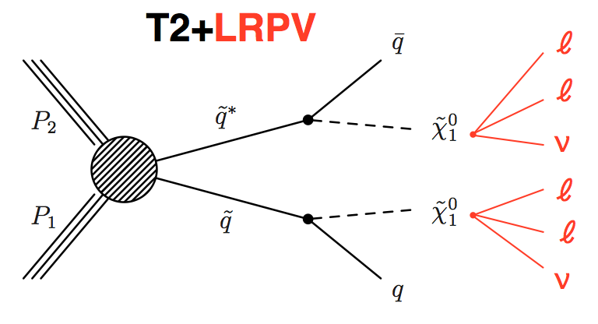
R Parity Violating (RPV) SUSY
R-Parity:
Conversation of R-Parity:
R_{SM}=+1 and R_{SUSY}=-1
Proton stable
Lightest SUSY Particle is stable
...

Slide 22
Search for RPV SUSY
R-Parity:
Baryon-Number (B) and Lepton-Number (L) are violated!
If only L or B is violated, then the proton would be still stable!
Conversation of R-Parity:
R_{SM}=+1 and R_{SUSY}=-1
Proton stable!
Lightest SUSY Particle is stable
....
Main difference to R-parity conserving SUSY: lower MET expectation!
Focus on L-RPV in the following:. For others, please check http://cms-results.web.cern.ch/cms-results/public-results/

Slide 23
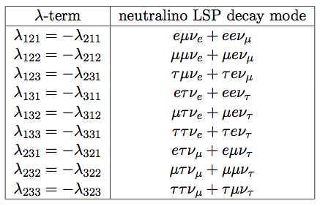
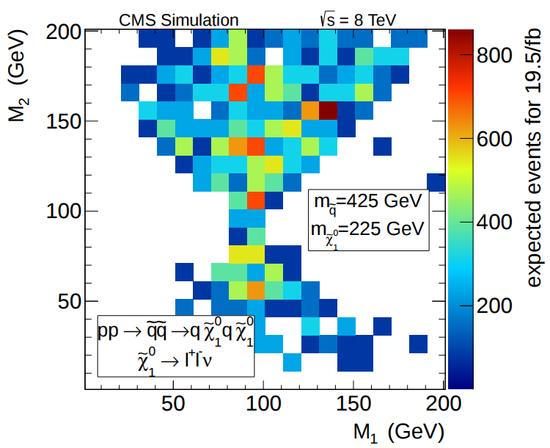
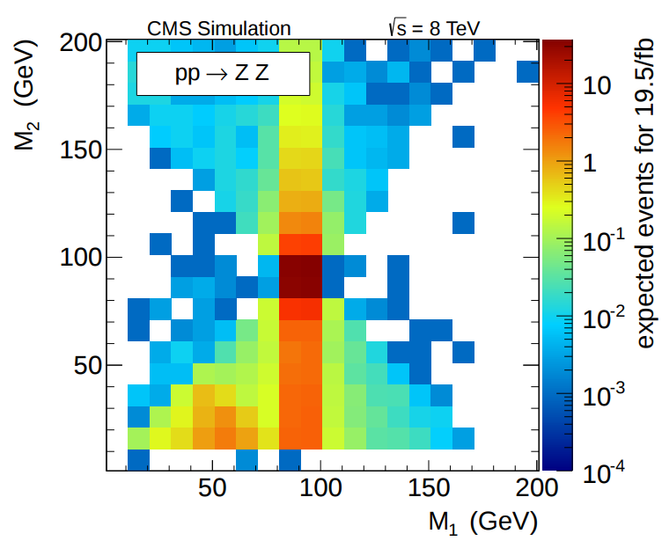
Search for RPV SUSY in 4l final state
Search Strategy:
4 tight leptons (e,μ)
Split M₁ and M₂ in on-Z and off-Z regions
(M₁₍₂₎: invariant mass of first(second) opposite sign same flavor pair )
CMS-PAS-SUS-13-010

Slide 24
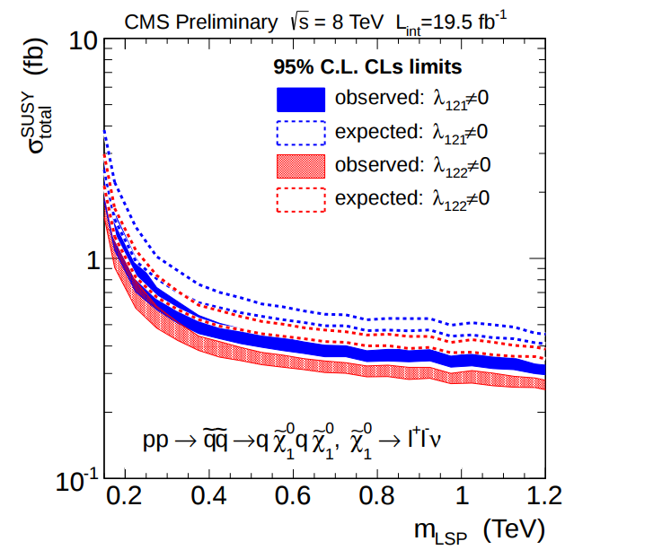
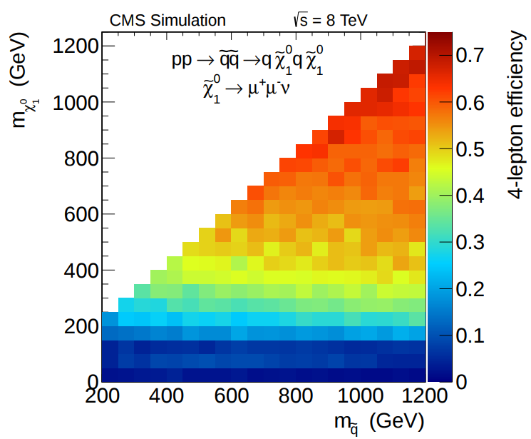
Search for RPV SUSY in 4l final state
Generic search: various SUSY production modes can be extended for 4 lepton RPV final states. Check the documentation for other interpretations!
CMS-PAS-SUS-13-010

Slide 25
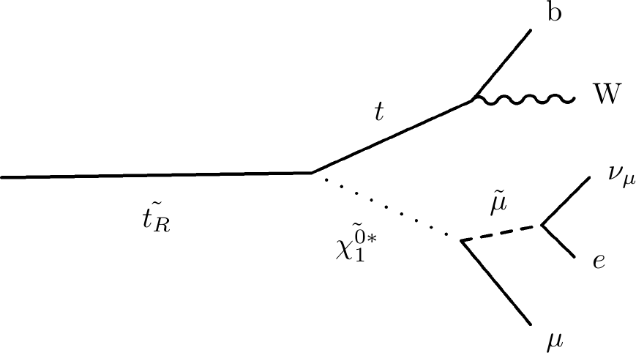
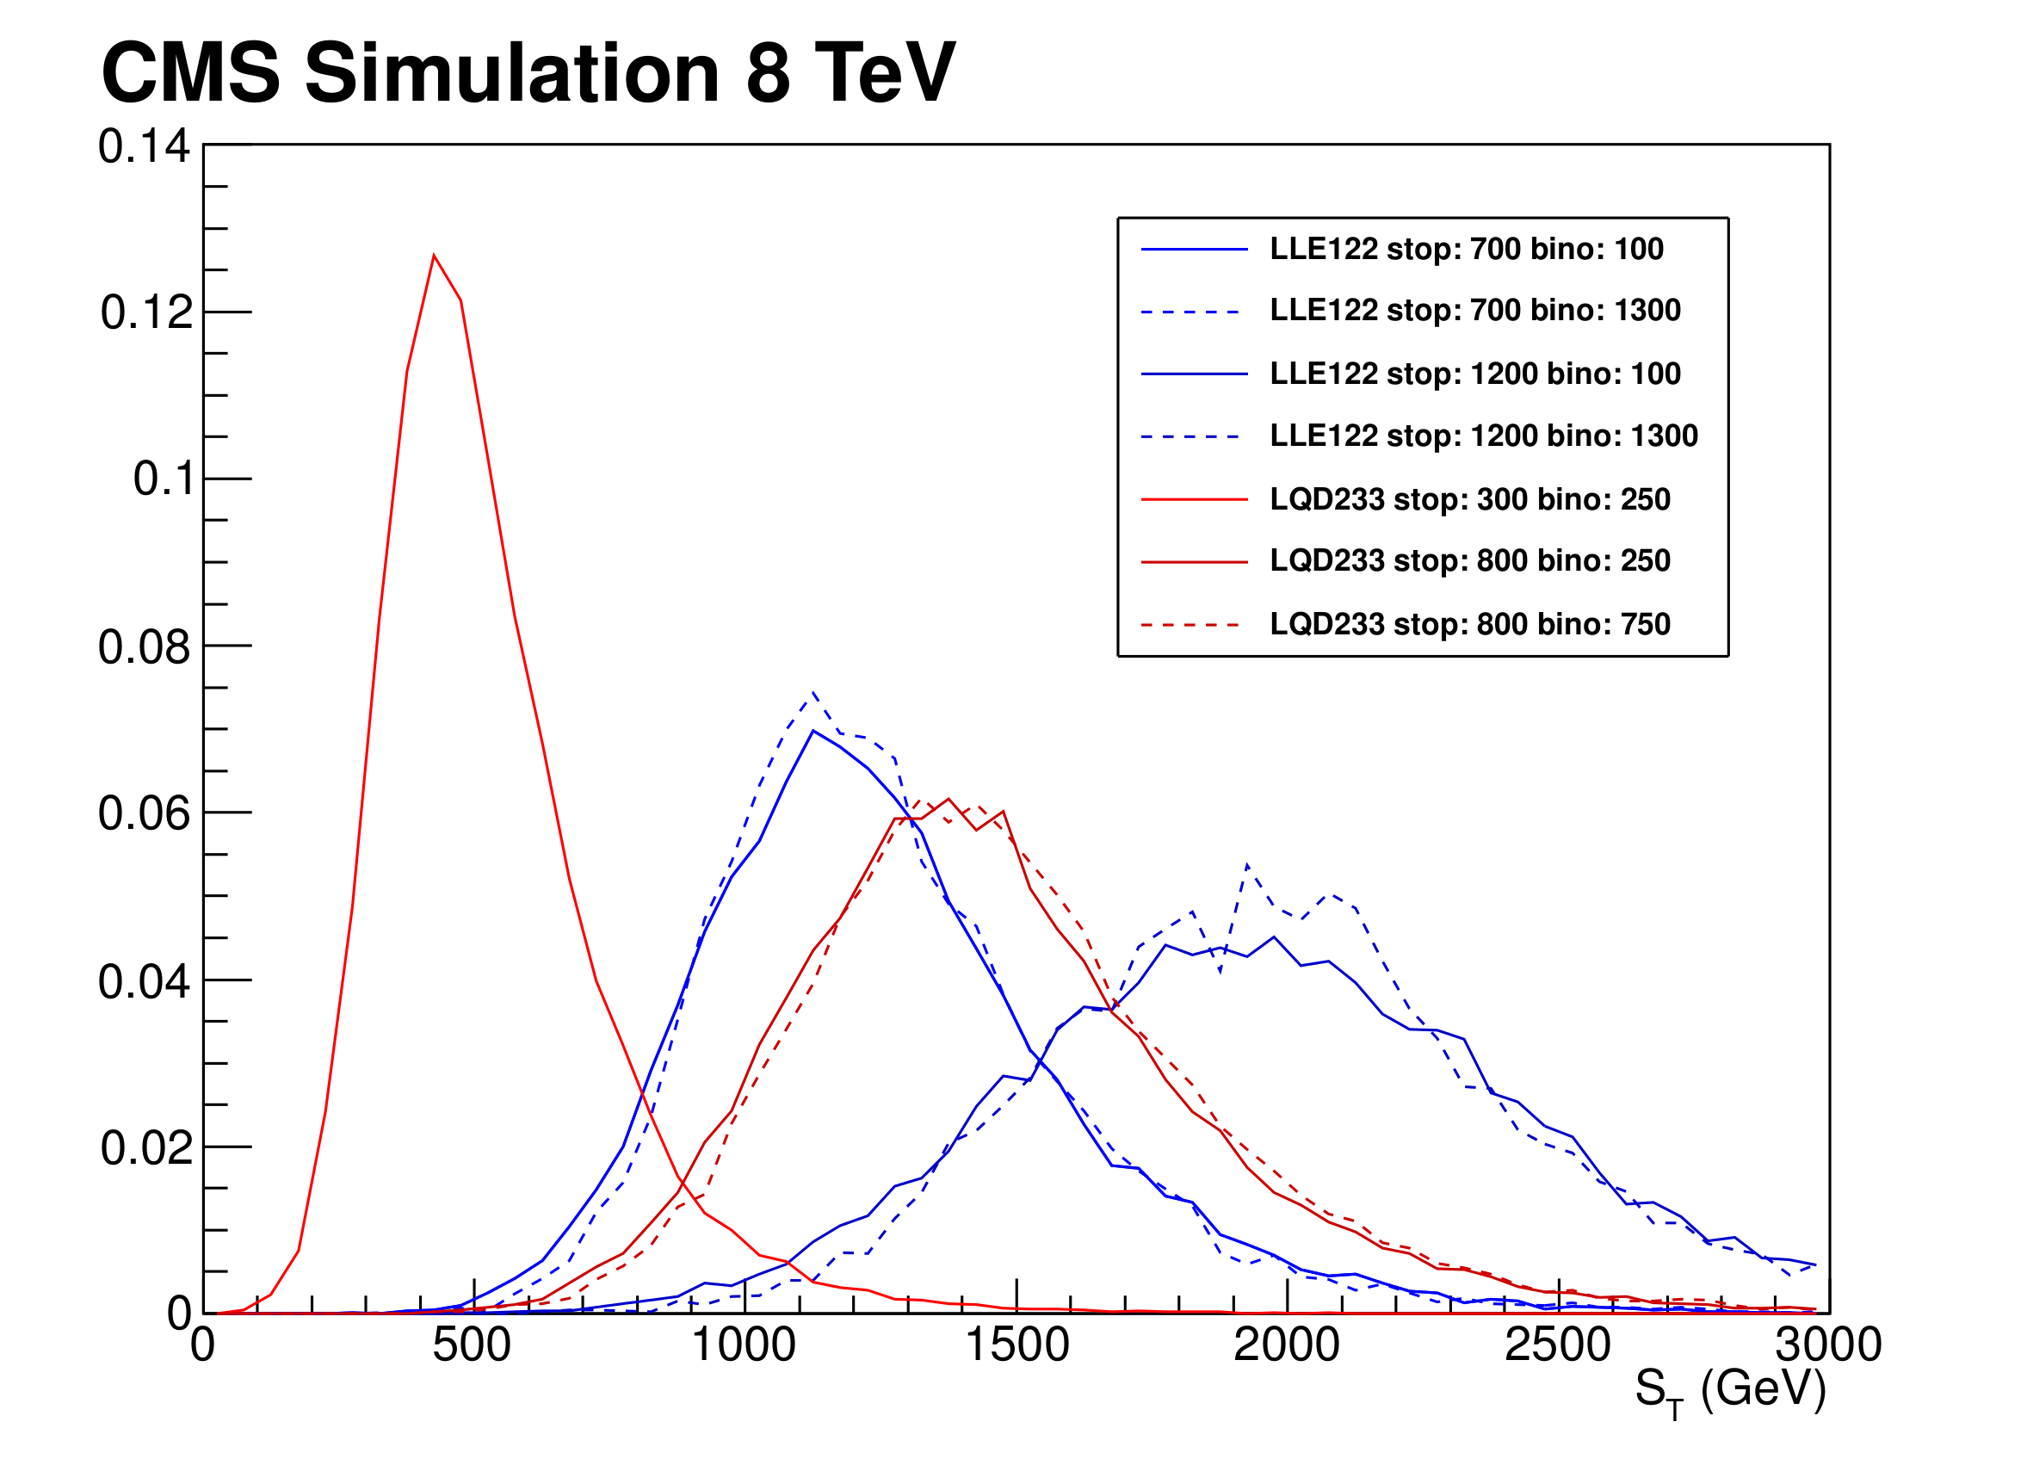
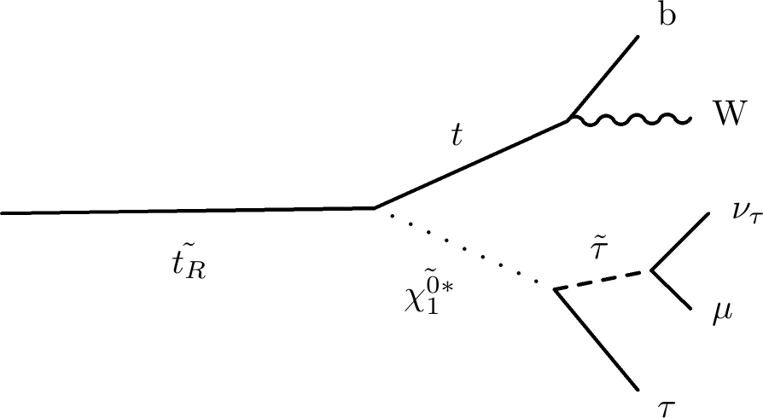
Search for RPV stop quarks
Search Strategy:
3+ tight leptons (e,μ,τ_{had})
S_{T}:scalar sum of all transverse momenta
Signal regions 1-4:at least one b-tagged jets and no Z-candidate
Signal regions 5-8: a Z-Candidate or no b-tagged jet
Phys. Rev. Lett. 111 (2013) 221801

Slide 26
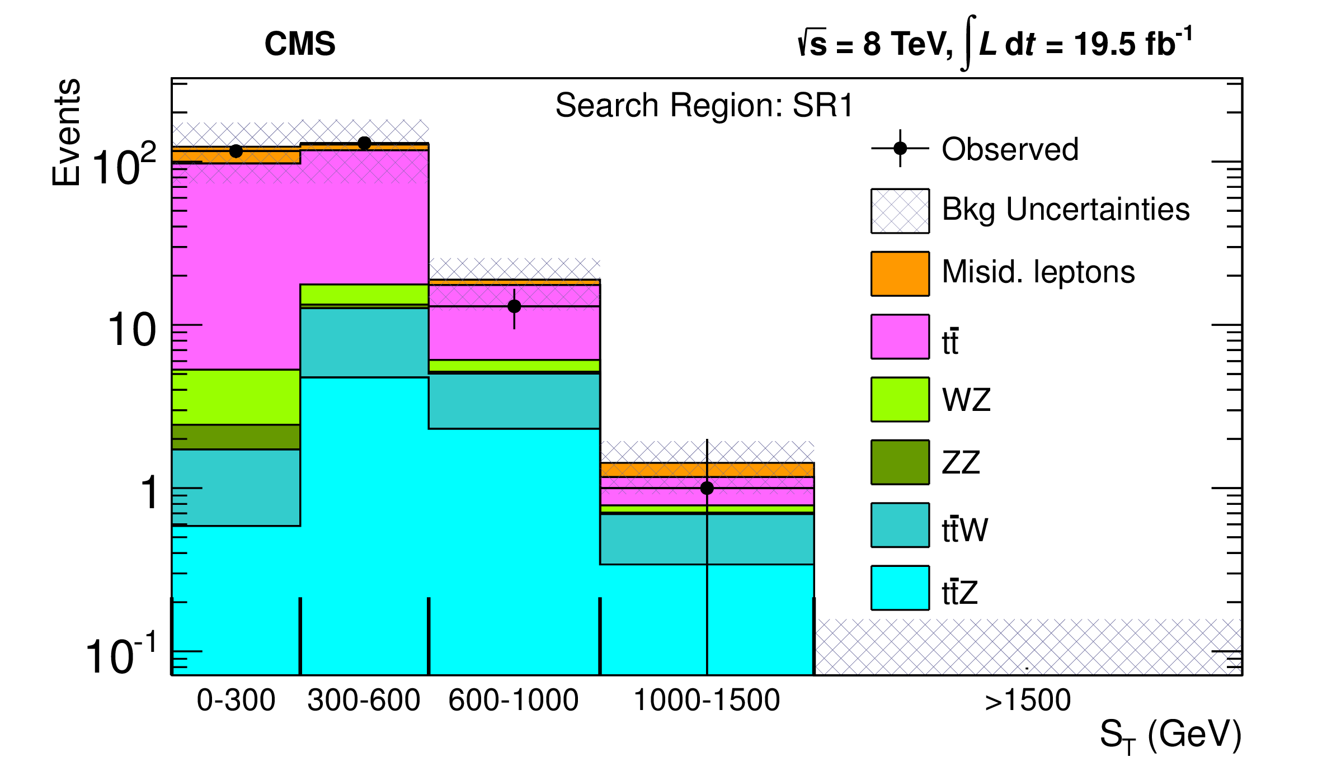
Search for RPV stop quarks
Phys. Rev. Lett. 111 (2013) 221801

Slide 27
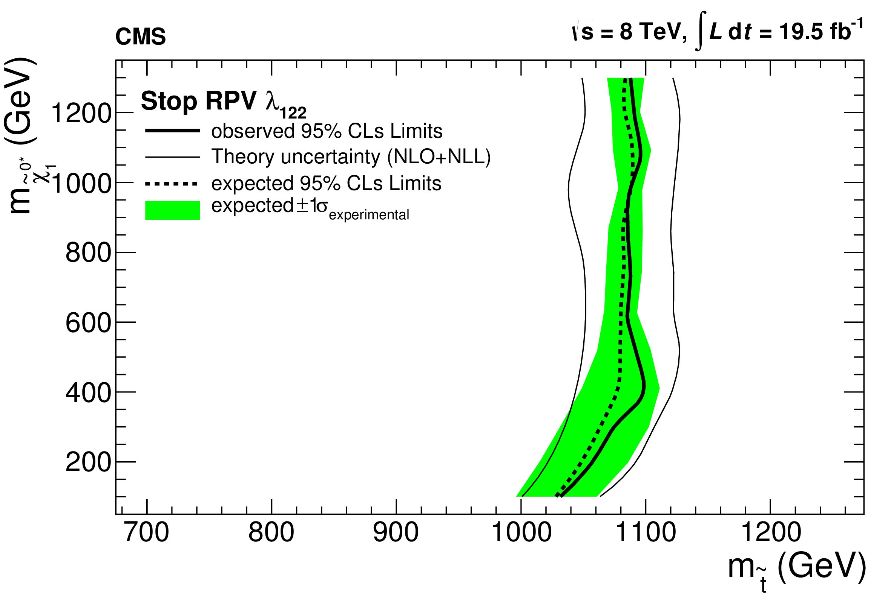
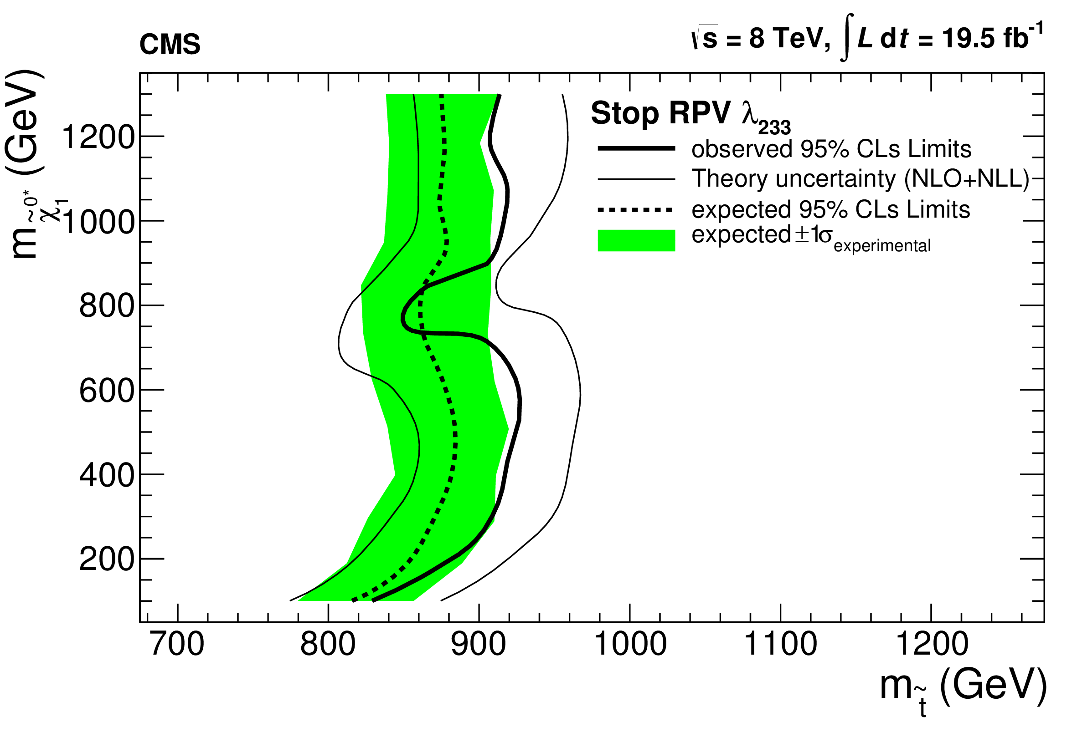
Search for RPV stop quarks
No significant excess observed…
Limits on various RPV couplings, e.g.:
λ₁₂₂ and M_{Bino}=200GeV:
M_{stop} < 1020 GeV excluded
λ₂₃₃ and M_{Bino}=200GeV:
M_{stop}< 820 GeV excluded
Phys. Rev. Lett. 111 (2013) 221801

Slide 28
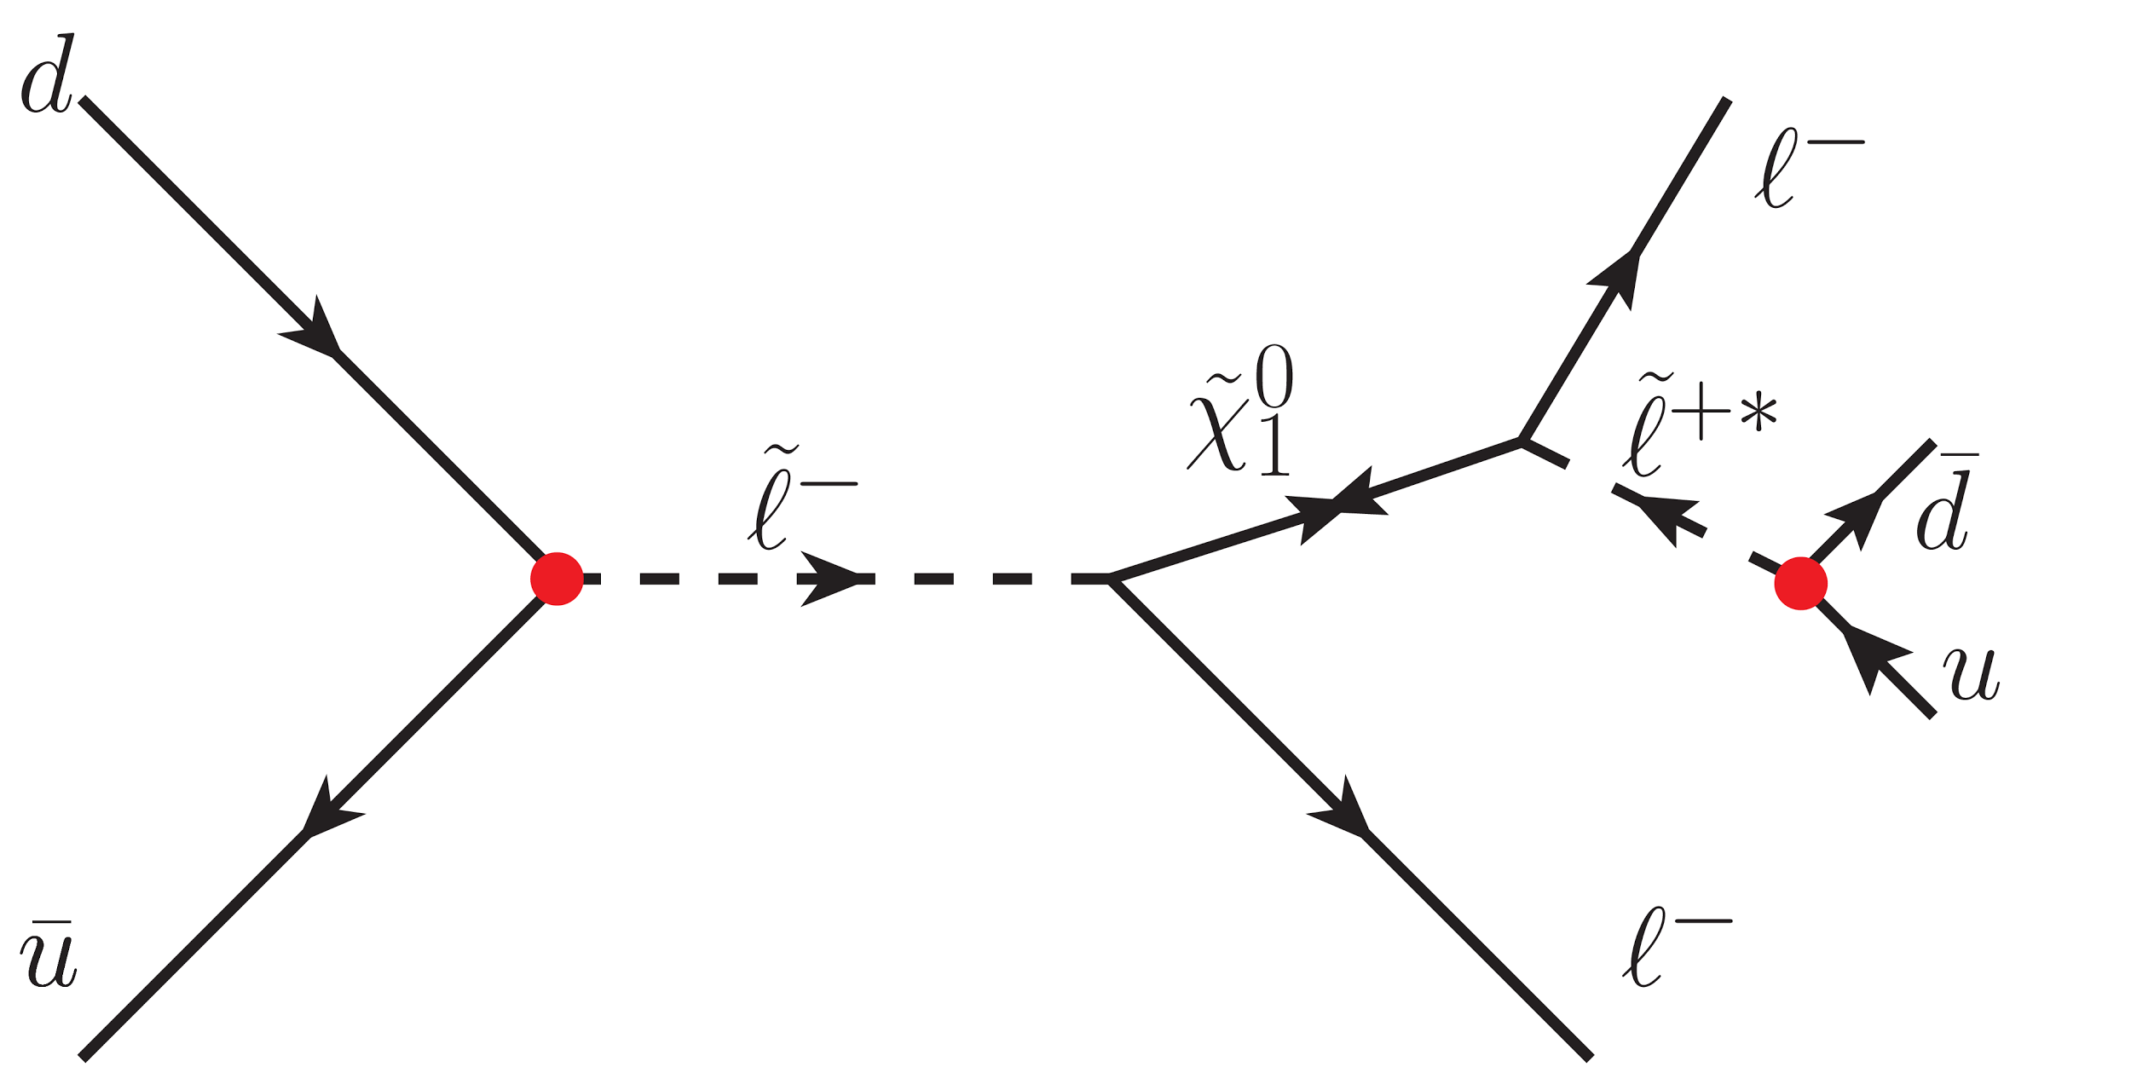
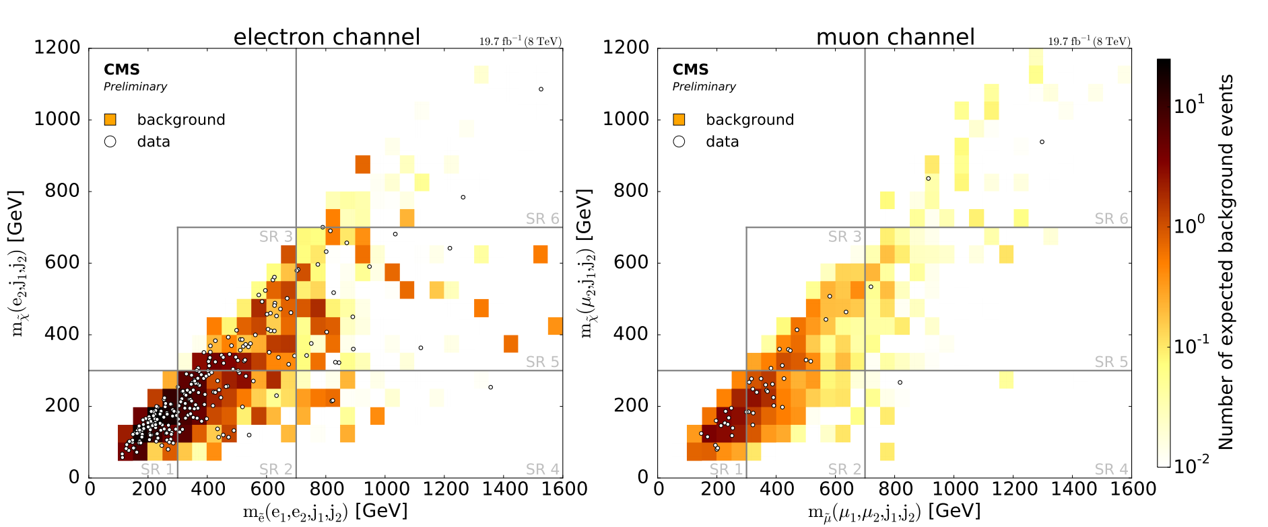
Search for RPV SUSY in dilepton channels
Search Strategy:
2 tight leptons (e,μ)
2 Jets (not b-tagged)
Split event according to M_{slepton}(lljj) and M_{neutralino}(ljj)
CMS-PAS-SUS-14-018

Slide 29
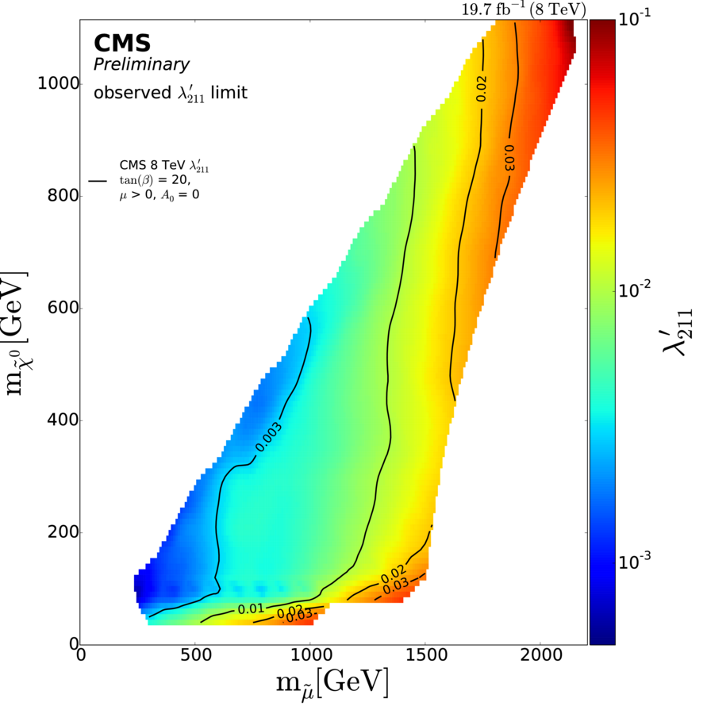
Search for RPV SUSY in dilepton channels
No significant excess observed...
CMS-PAS-SUS-14-018

Slide 30
Search for high mass resonances in the eμ final states at 13 TeV
Resonant sneutrino decays (RPV-SUSY) or non-resonant Quantum-Black-Holes (QBH) could decay into eμ pairs (+others models).
CMS-PAS-EXO-16-001

Slide 31
Highest Mass e-μ pair: M=1635 GeV (13TeV)

Slide 32
Search for high mass resonances in the eμ final states at 13 TeV
CMS-PAS-EXO-16-001

Slide 33
Search for Heavy Majorana Neutrinos
Search Strategy:
Two tight leptons with same sign(e±e±,μ±μ±,e±μ±)
Mass dependent cust:
Low mass m_{N} < 90 GeV: MET<30 GeV , m(lljj)<200 GeV, m(jj)<120 GeV
High mass m_{N}> 90 GeV: MET<35 GeV, m(jj)=m_{W} ± 30 GeV
JHEP 04 (2016) 169
Phys. Lett. B 748 (2015) 144

Slide 34
Search for Heavy Majorana Neutrinos
JHEP 04 (2016) 169
Phys. Lett. B 748 (2015) 144

Slide 35
Conclusion
Strong portfolio of CLFV searches in CMS
New Physics models on CLFV tested up to multi-TeV scale already
LHC Run-II: expect more interesting updates by the end of the year!
http://cms-results.web.cern.ch/cms-results/public-results/publications/

