Slide 1
Search for Lepton Flavor Violation with ATLAS
Craig Blocker
Brandeis University
for the ATLAS Collaboration
CLFV2016

Slide 2
Outline
Introduction
LHC and the ATLAS detector
Searches for LFV decays of Standard Model particles
Beyond the Standard Model LFV searches
Summary

Slide 3
Introduction
Lepton Number and Flavor are not related to a gauge symmetry.
⇒ Might not be conserved.
Neutrino oscillations indeed show this.
Important question is whether charged leptons violate lepton flavor conservation.
Neutrino-induced lepton flavor violation
for charged leptons is expected to be
very small [e.g., BR(μ → eγ) ∼ 10⁻⁵⁰].
(Small but not as small for some τ decays.)
Might manifest itself in
decays of Standard Model particles (e.g. Z → eμ).
decays of Beyond the Standard Model particles (e.g. Z’ → eμ).
Quantum Black Holes (e.g., QBH→ eμ).
other interactions.

Slide 4
RPV SUSY
SUSY allows superpotential term of the form
$$W=\frac{1}{2}λ_{ijk}L_{i}L_{j}E_{k}+{λ_{ijk}^{′}L}_{i}Q_{j}{\overline{D}}_{k}+{\frac{1}{2}λ}_{ijk}^{′′}{\overline{U}}_{i}{\overline{D}}_{j}{\overline{D}}_{k}+ε_{i}L_{i}H_{2}$$
Multiplets:
L and Q are lepton and quark doublets.
E, U, and D are charged lepton, up-like quark, and down-like quark singlets.
H is Higgs doublet (the one coupling to up-like quarks).
i, j, and k are summed over generations.
These terms violate R-parity, R = (-1)^{3(B-L)+2S}.
λ and λ’ terms violate lepton number and flavor; λ’’ terms violate baryon number.
Limits on proton decay mean either λ and λ’ = 0 or λ’’ = 0.
Usually require R-parity conversation, but this is not necessary.

Slide 5
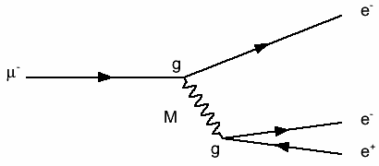
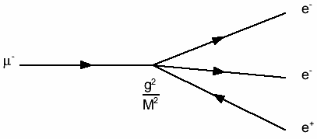
Low Energy Constraints
Low energy results (e.g., μ → eγ, μ → eee, μ-e conversion, τ decays, etc.) provide constraints (but there are often assumptions).
In general, limits on e-μ processes are more stringent.
Often limits are given in terms of an effective energy scale, which is a combination of mass/energy scales and coupling constants. For example, if μ → eee proceeds through a massive, LFV particle with mass M and coupling g, the Feynman diagram essentially becomes a 4-point interaction proportional to g²/M².
At the LHC, if the true mass scale is above a few TeV, then we are not sensitive. But if the effective scale is large because the mass scale is in the TeV range but the couplings are small, we may be able to see it. Also, LHC is almost as sensitive to eτ and μτ modes as to eμ modes.

Slide 6
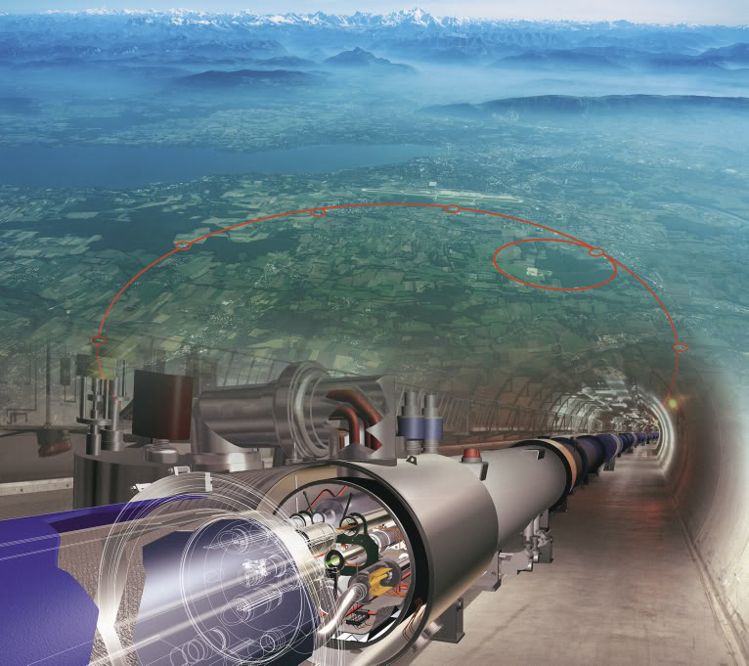
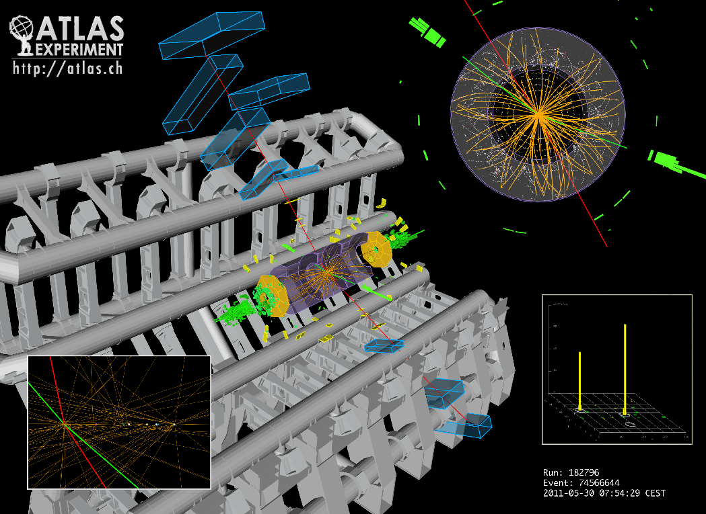
LHC and ATLAS
Large Hadron Collider (LHC) collides
protons or heavy ions at high energy.
27 km ring near Geneva, Switzerland.
4 major detectors: ATLAS, CMS, LHCb,
and ALICE
Results here from 8-TeV pp data taken
in 2012 (~20 fb⁻¹) and 13-TeV pp data taken in 2015 (~3 fb⁻¹) .
Concentrate on leptons: e, μ, and τ, using both hadronic and leptonic τ decays

Slide 7
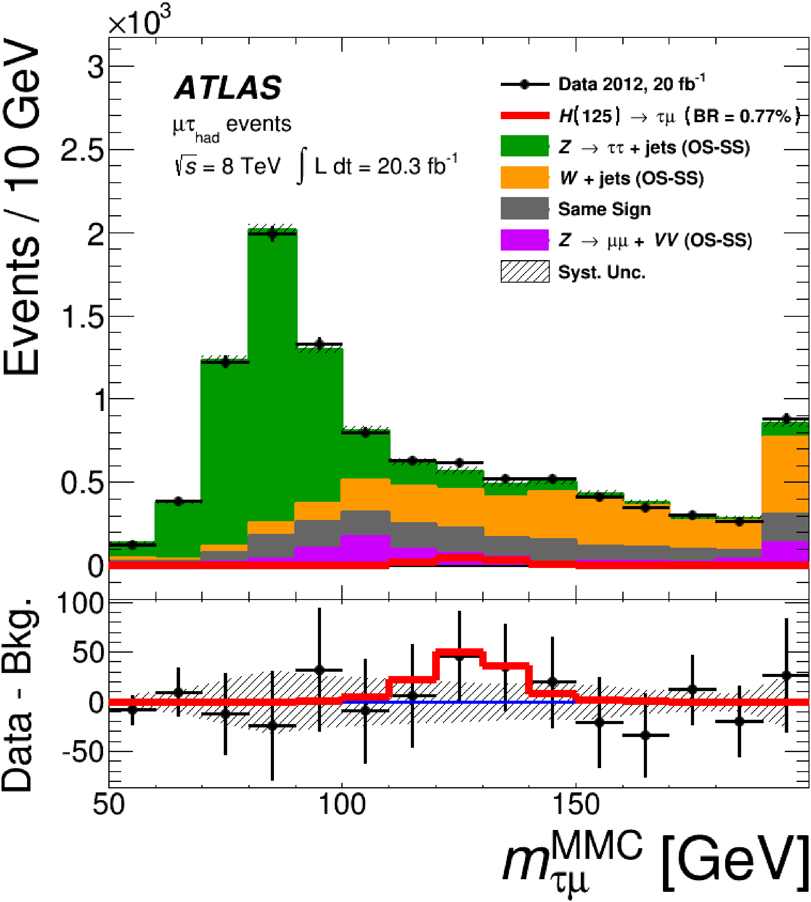
Higgs → μτ
JHEP 11 (2015) 211
arXiv: 1508.03372 and
Submitted to EPJC
arXiv: 1604.07730
Events with μ and τ decaying hadronically or leptonically.
Use τ kinematics and missing E_{T} vector to correct for undetected ν using Missing Mass Calculator (MMC).
Combined, post fit
Two signal regions: one dominated by Z/γ∗ → ττ at lower μτ mass and one dominated by W + jets at higher mass.
Require moderate missing E_{T} to suppress Z/γ∗ → μμ.
BR (H→μτ) < 1.43% (95% CL)
Theory: BR < ~10% from
τ → μγ and (g-2)_{e, μ}

Slide 8
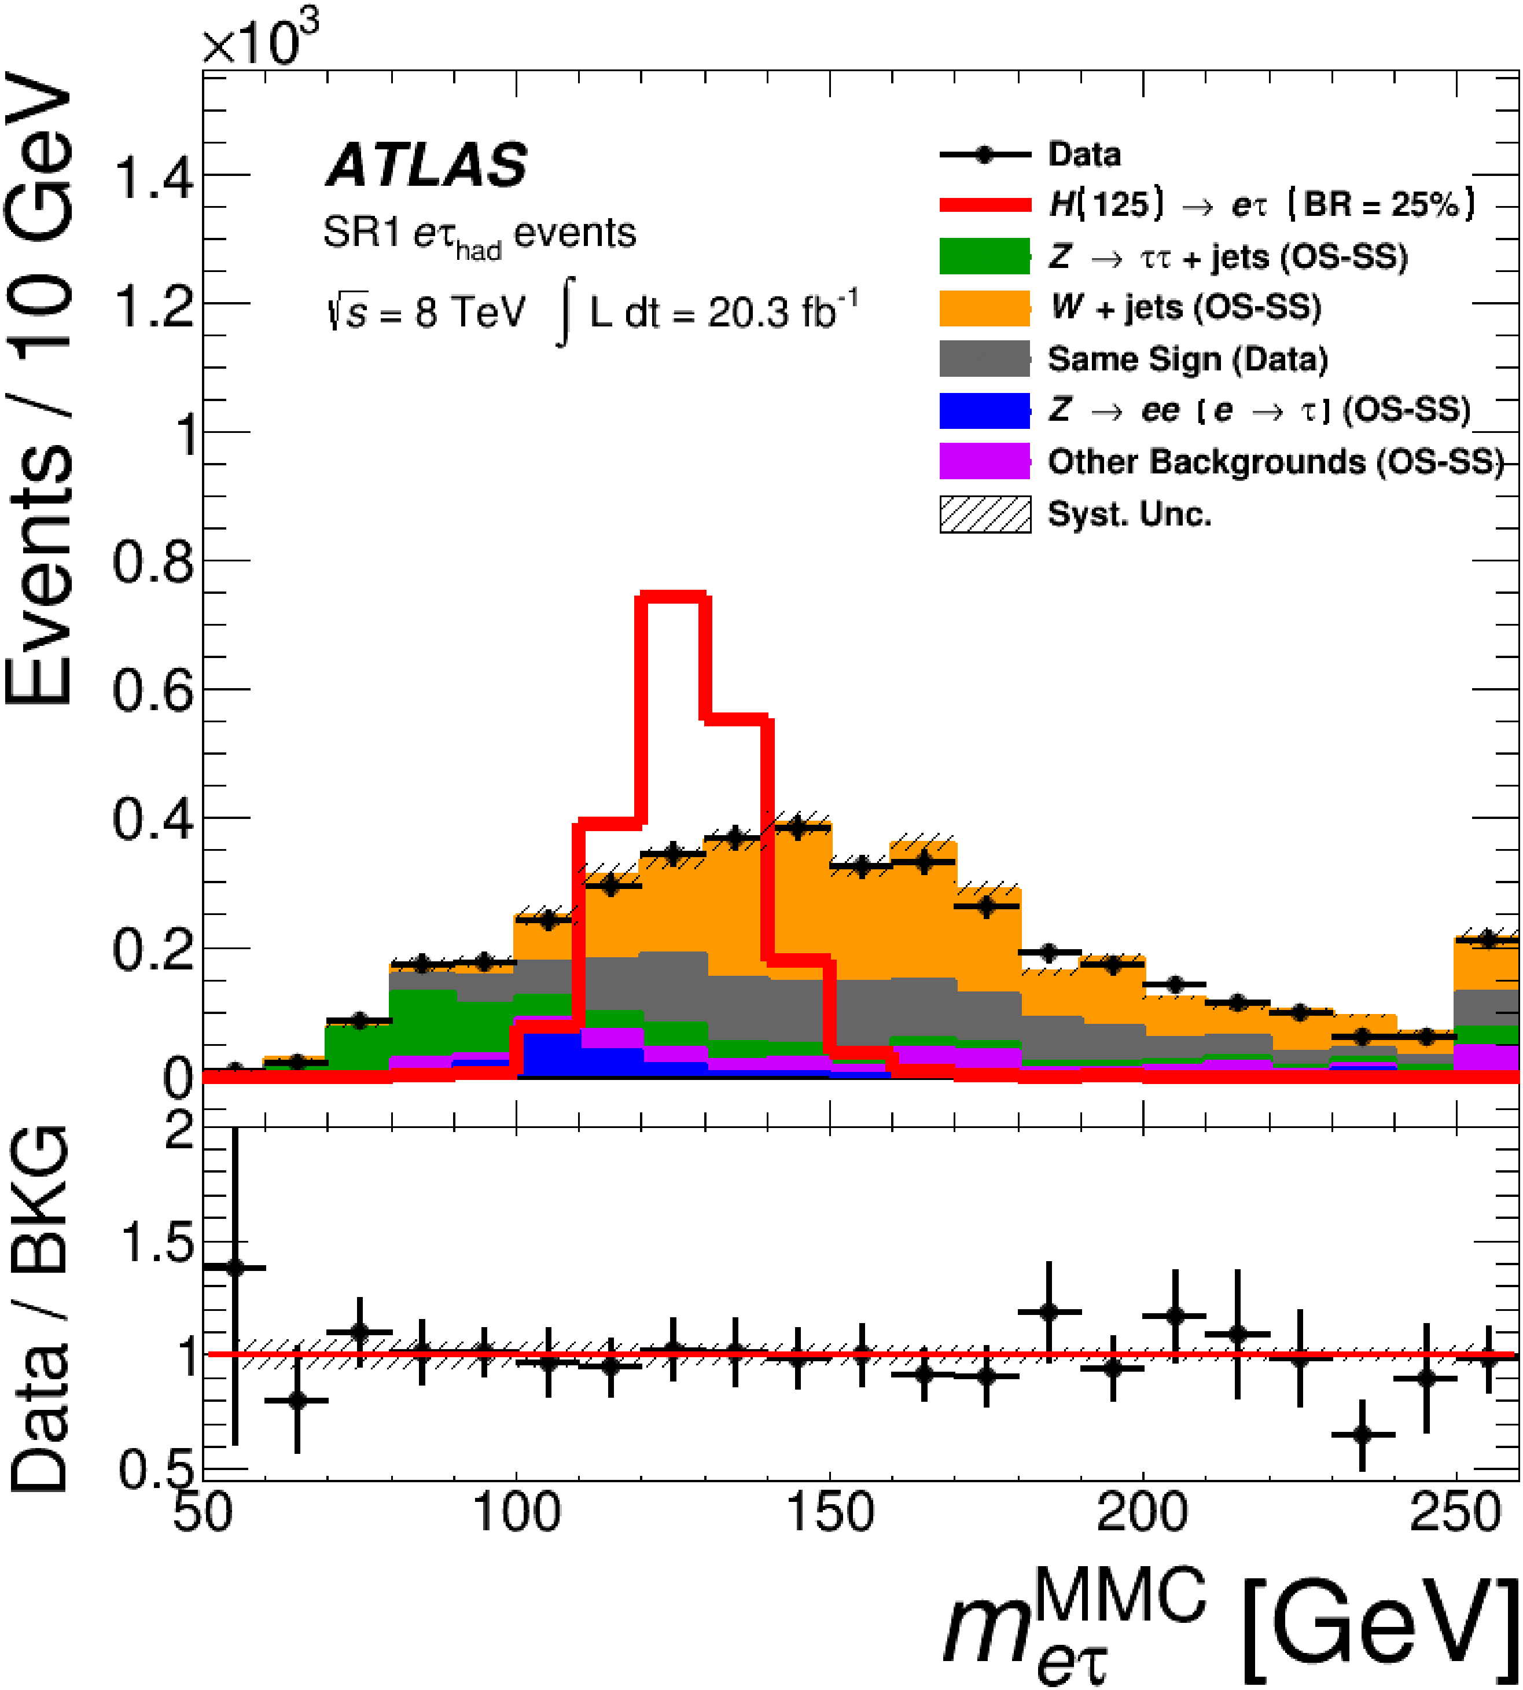
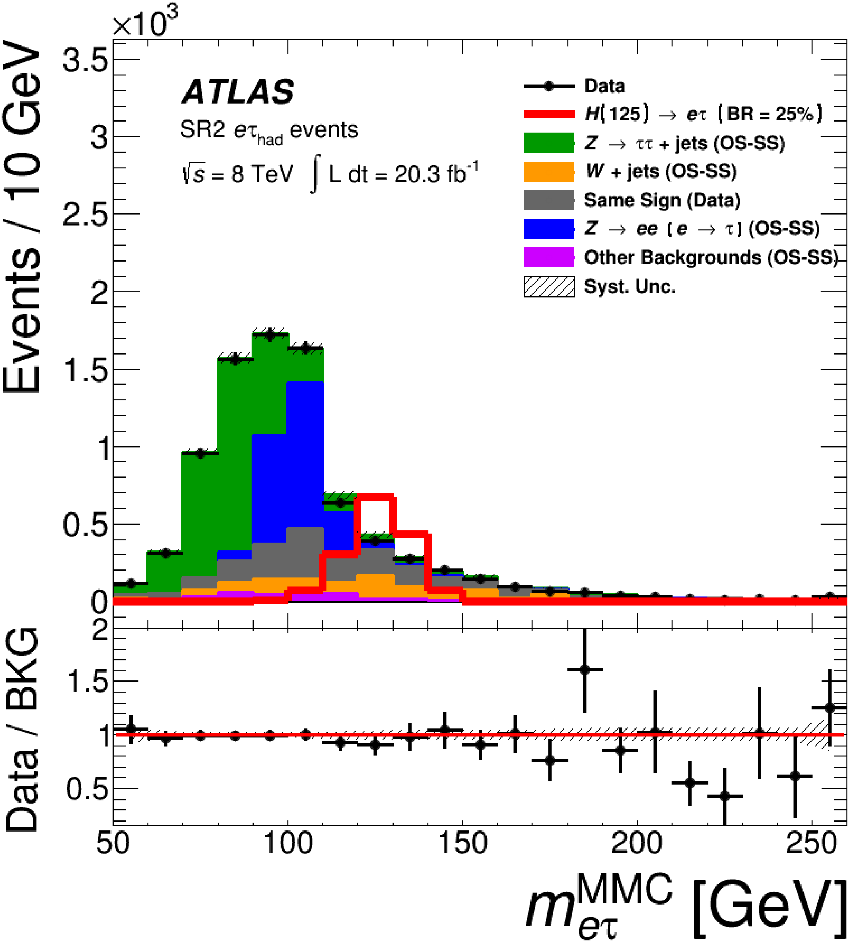
Higgs → eτ
Submitted to EPJC
arXiv: 1604.07730
Similar to μτ analysis, except μ → e.
BR (H→eτ) < 1.04% (95% CL)

Slide 9
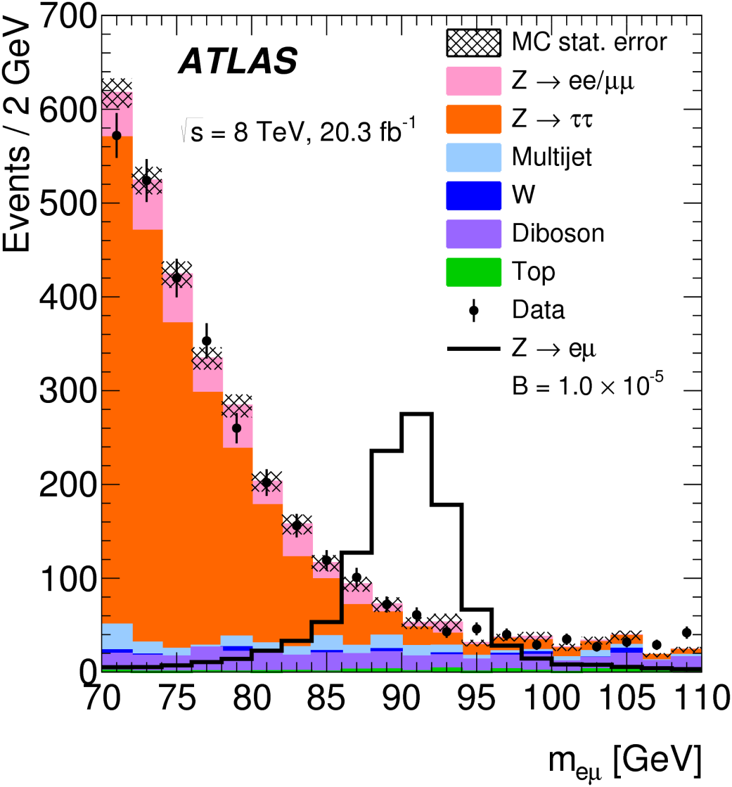
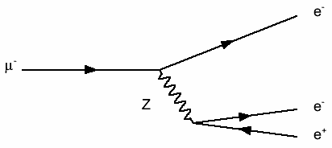
Z → eμ
PRD 90, 072010 (2014)
arXiv: 1408.5774
Fit to background + signal.
BR (Z → eμ) < 7.5 × 10⁻⁷ (95% CL)
LEP: BR < 1.7 × 10⁻⁶ (95% CL)
Limit inferred from
μ → eee: BR < 10⁻¹²

Slide 10
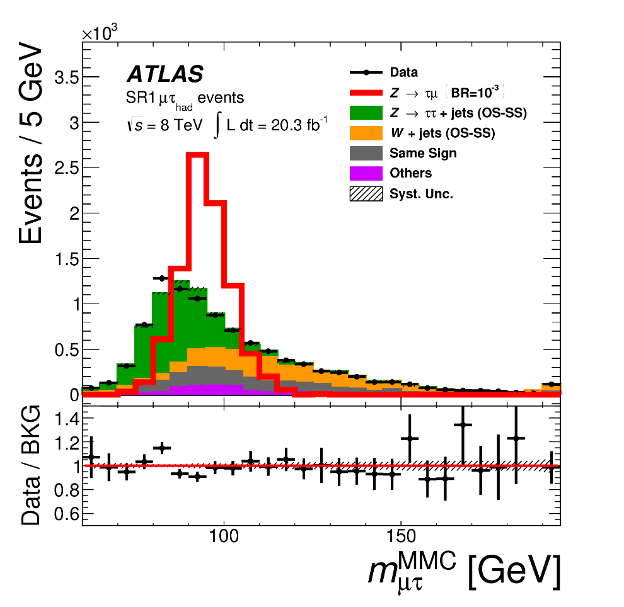
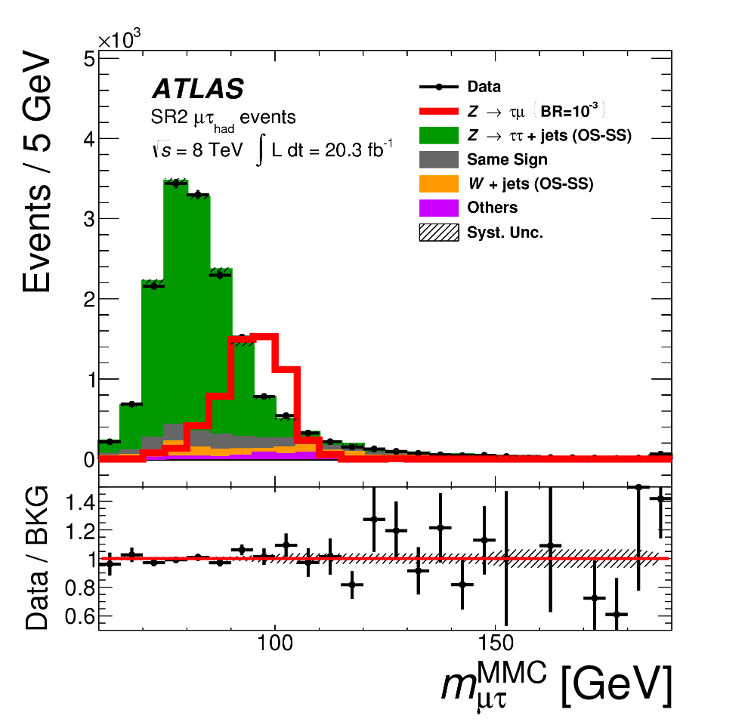
Z → μτ
Submitted to EPJC
arXiv: 1604.07730
Use hadronic τ decays (similar analysis to H → μτ_{had}).
Use τ kinematics and missing E_{T} to correct for undetected ν.
BR (Z → μτ) < 1.7 × 10⁻⁵ (95% CL)
LEP: BR < 1.2 × 10⁻⁵ (95% CL)

Slide 11
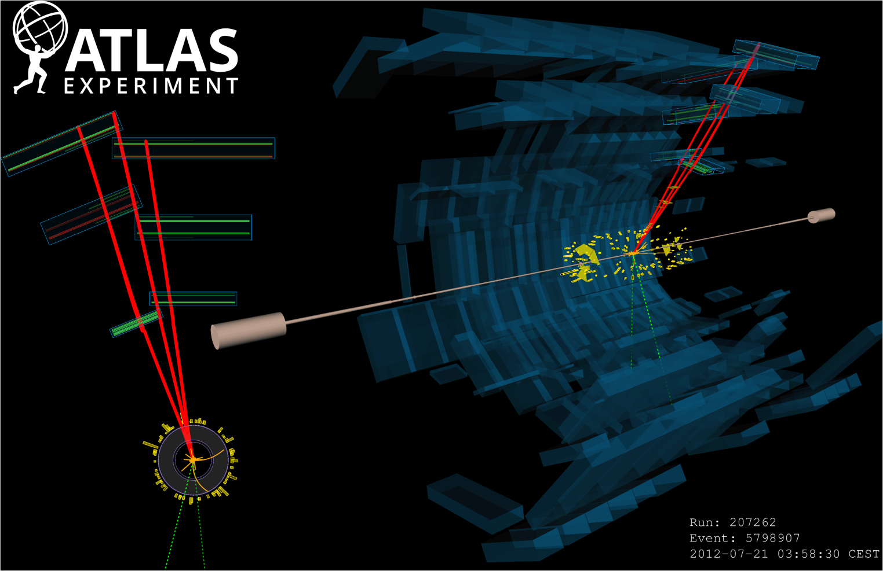
τ → μμμ
EPJC (2016) 76
arXiv: 1601.03567
pp → W → τ ν → (μμμ) ν
Use Boosted Decision Tree based on E_{T}^{miss} , muon momenta, track and vertex quality, W kinematics, etc.

Slide 12
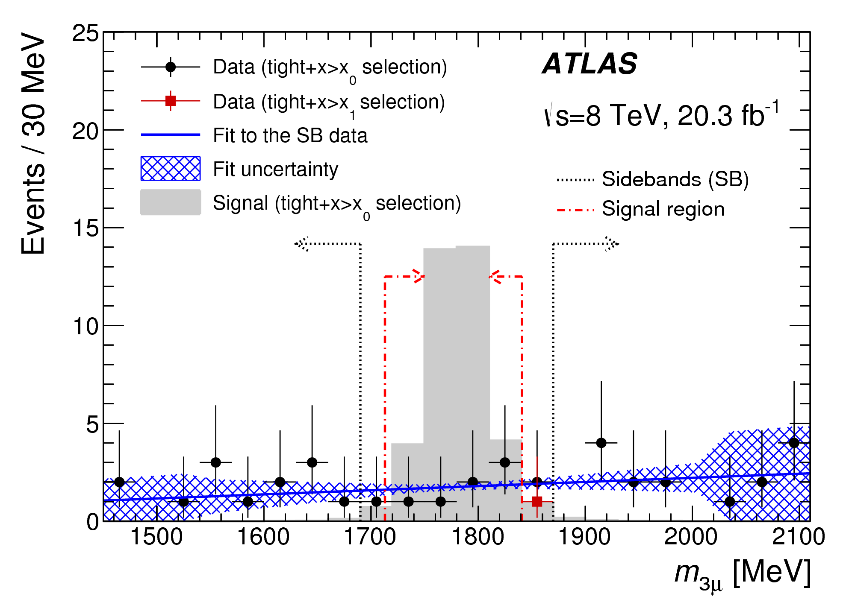
τ → μμμ
EPJC (2016) 76
arXiv: 1601.03567
BR (τ → μμμ) < 3.8 × 10⁻⁷ (95% CL)
PDG: BR < 2.1 × 10⁻⁸ (90% CL) (primarily Belle)

Slide 13
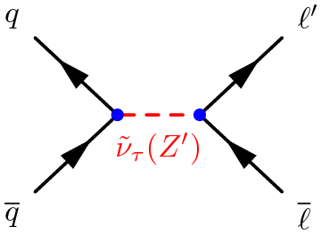
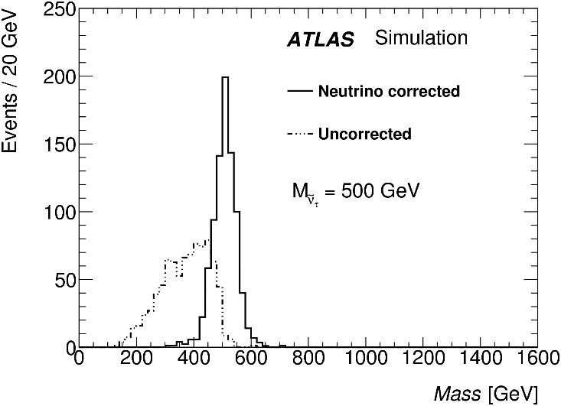
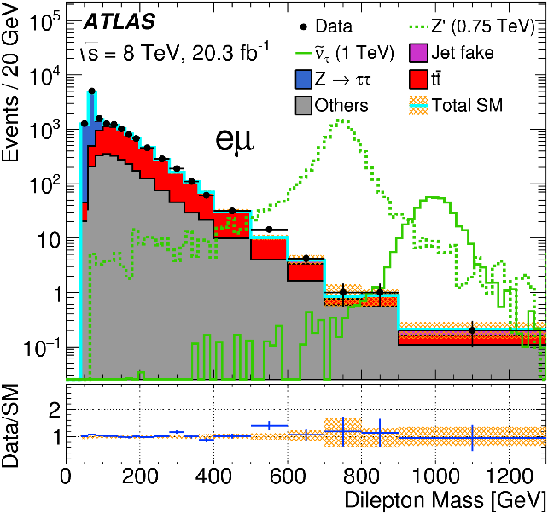
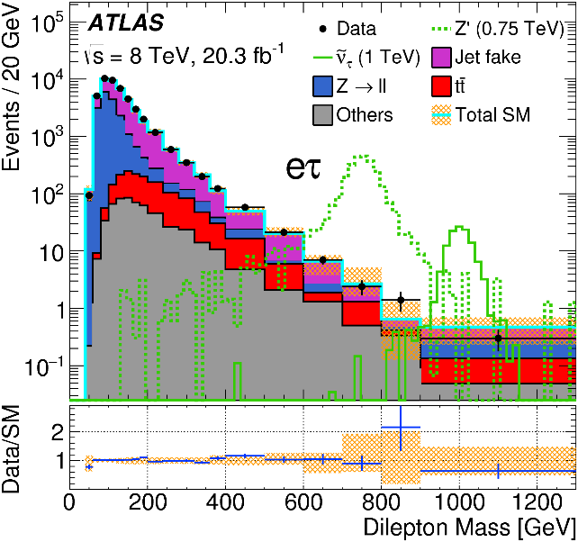
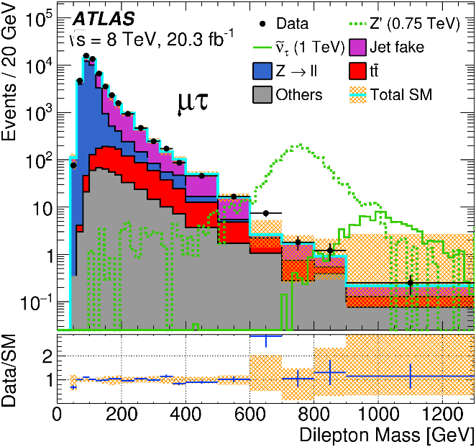
Z’ or ν → eμ, eτ, or μτ
~
PRL 115, 031801 (2015), arXiv: 1503.04430
High Pt, back-to-back, opposite sign, different flavor.
Assume neutrino in same direction as τ.

Slide 14
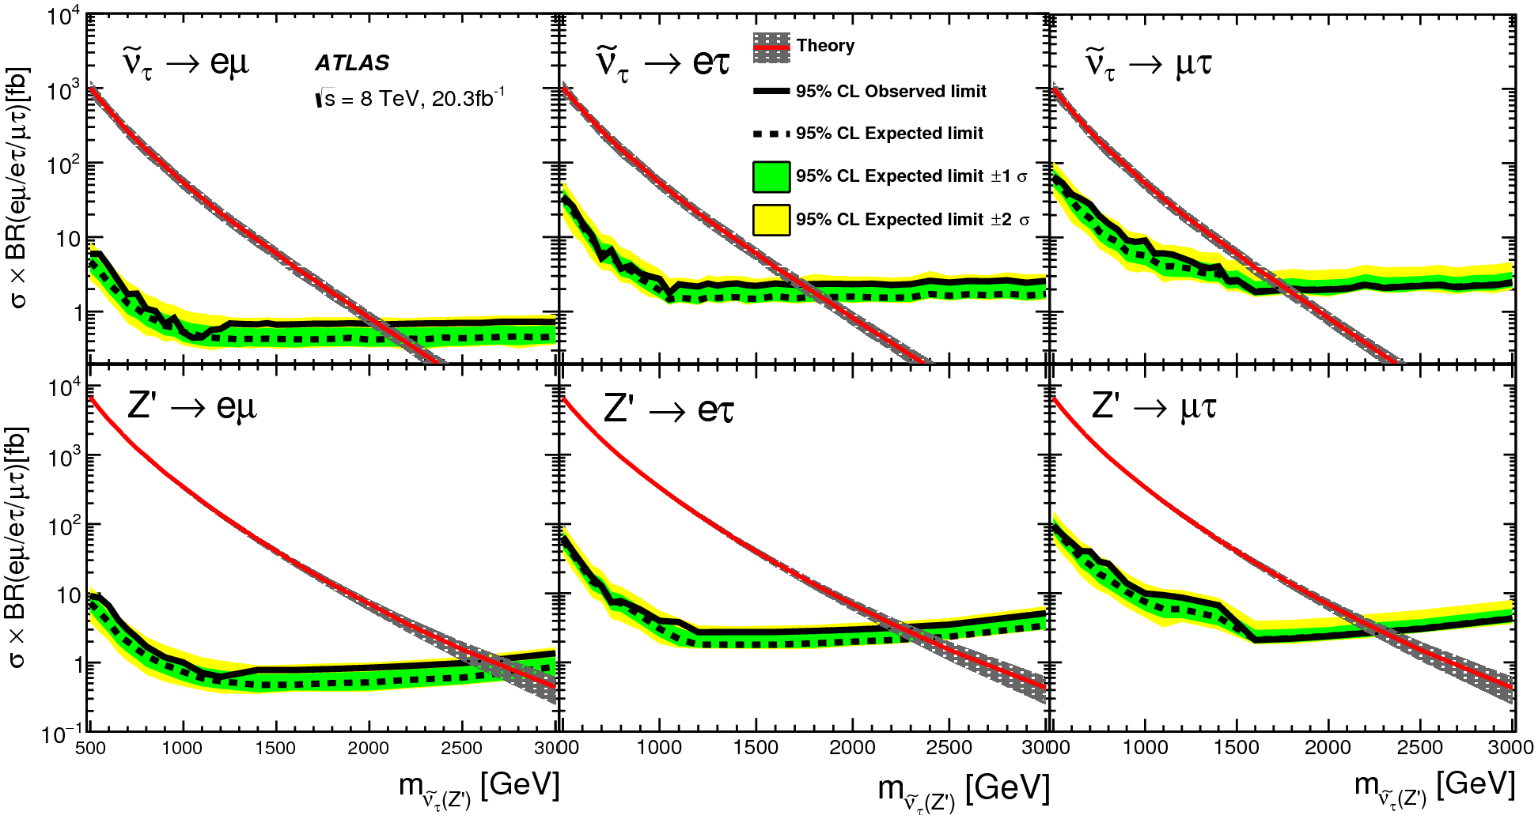
Z’ or ν → eμ, eτ, or μτ
~
Limits on cross sections times branching ratio (95% CL).
Sneutrino coupling limits better or comparable to low energy limits for τ modes and$s\overline{s} → eμ.$ Within order of magnitude for $d\overline{d},d\overline{s}, or s\overline{d}→ eμ.$
.

Slide 15
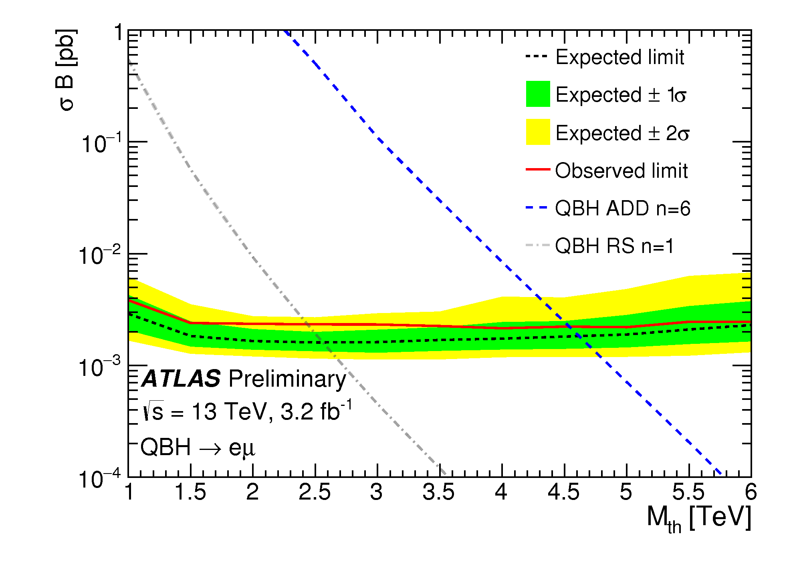
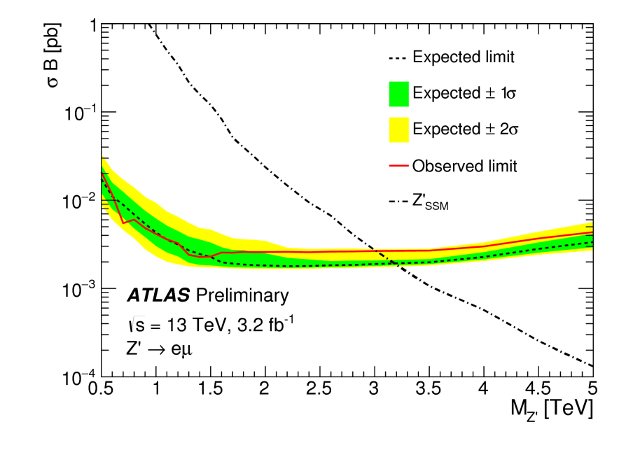
Z’ or QBH → eμ
ATLAS-CONF-2015-072 cds.cern.ch/record/214844
13-TeV analysis. Similar to 8-TeV eμ search.
Look for high p_{T} e and μ of opposite sign.
Quantum Black Holes (QBH) might be produced in theories with large extra dimensions and are expected to not conserve lepton flavor.

Slide 16
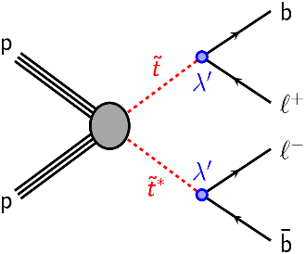
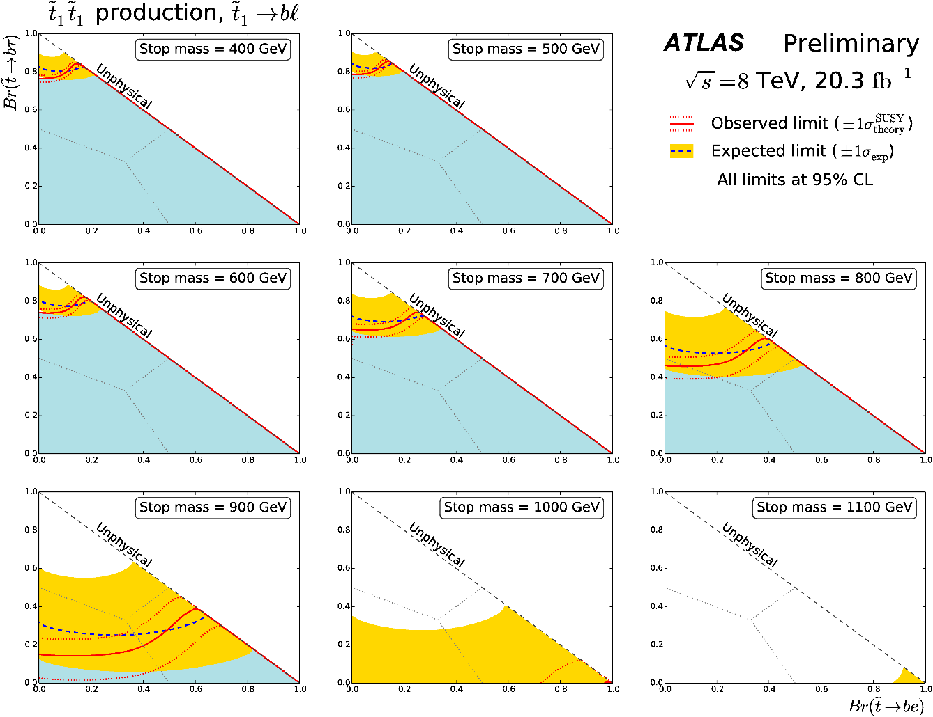
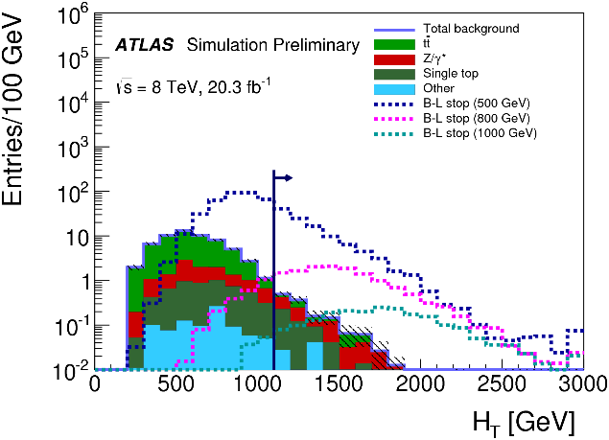
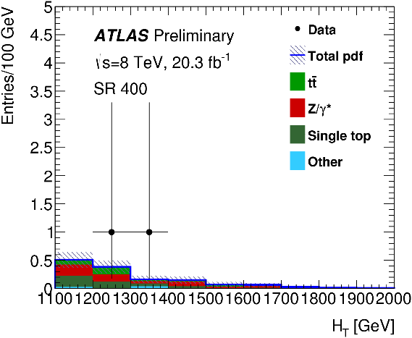
B-L top squark
cds.cern.ch/record/2002885
RPV SUSY with extra U(1) symmetry.
Search for eeb$\overline{\text{b}}$, μμb$\overline{\text{b}}$, and eμb$\overline{\text{b}}$ (b-tag jets).
Discriminate on bl mass, bl mass difference, H_{T} (scalar sum p_{T}).

Slide 17
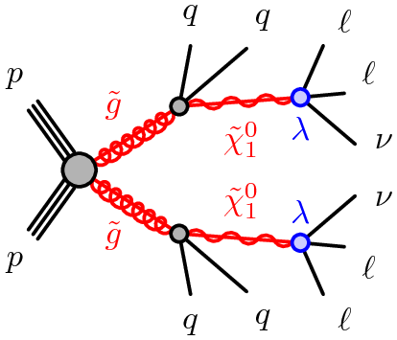
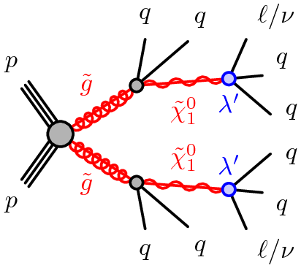
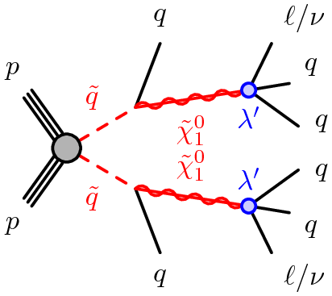
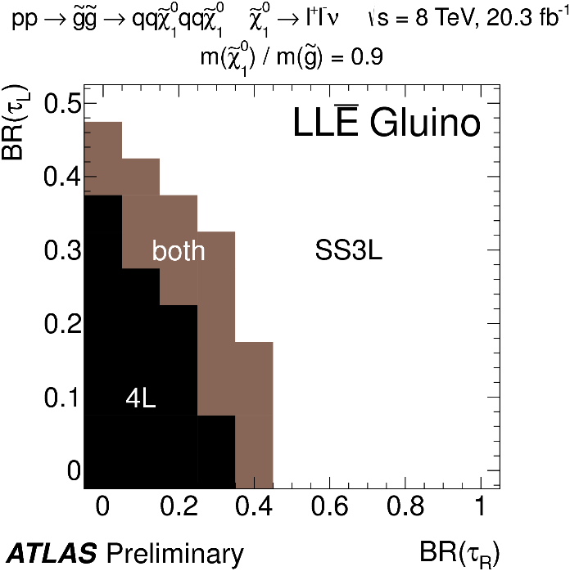
Multileptons in RPV SUSY
cds.cern.ch/record/2017303
ATLAS has reinterpreted SUSY searches in terms of RPV SUSY with an unstable
lowest supersymmetric particle (LSP).
Define 2 types of signal regions:
4L: 4l, 3lτ, or 2l2τ, where l is e or μ.
SS/3L: l±l± or lll.
Include requirements on number of jets and
reject Z → ll, llγ, and llll.
Expect 1.4 to 3 events in various categories.
Observe compatible numbers.

Slide 18
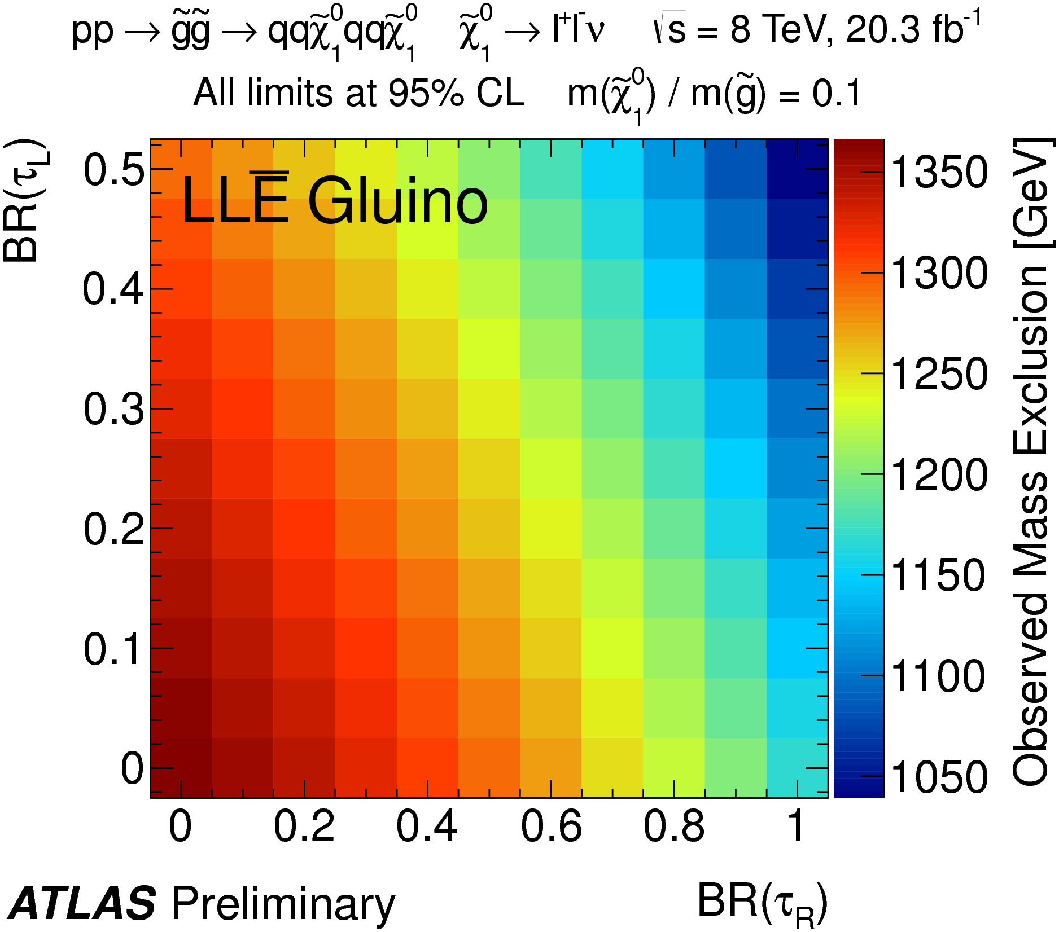
Multileptons in RPV SUSY
Limits depend on many parameters, including SUSY masses and which mode.
Example limit plot shown here.

Slide 19
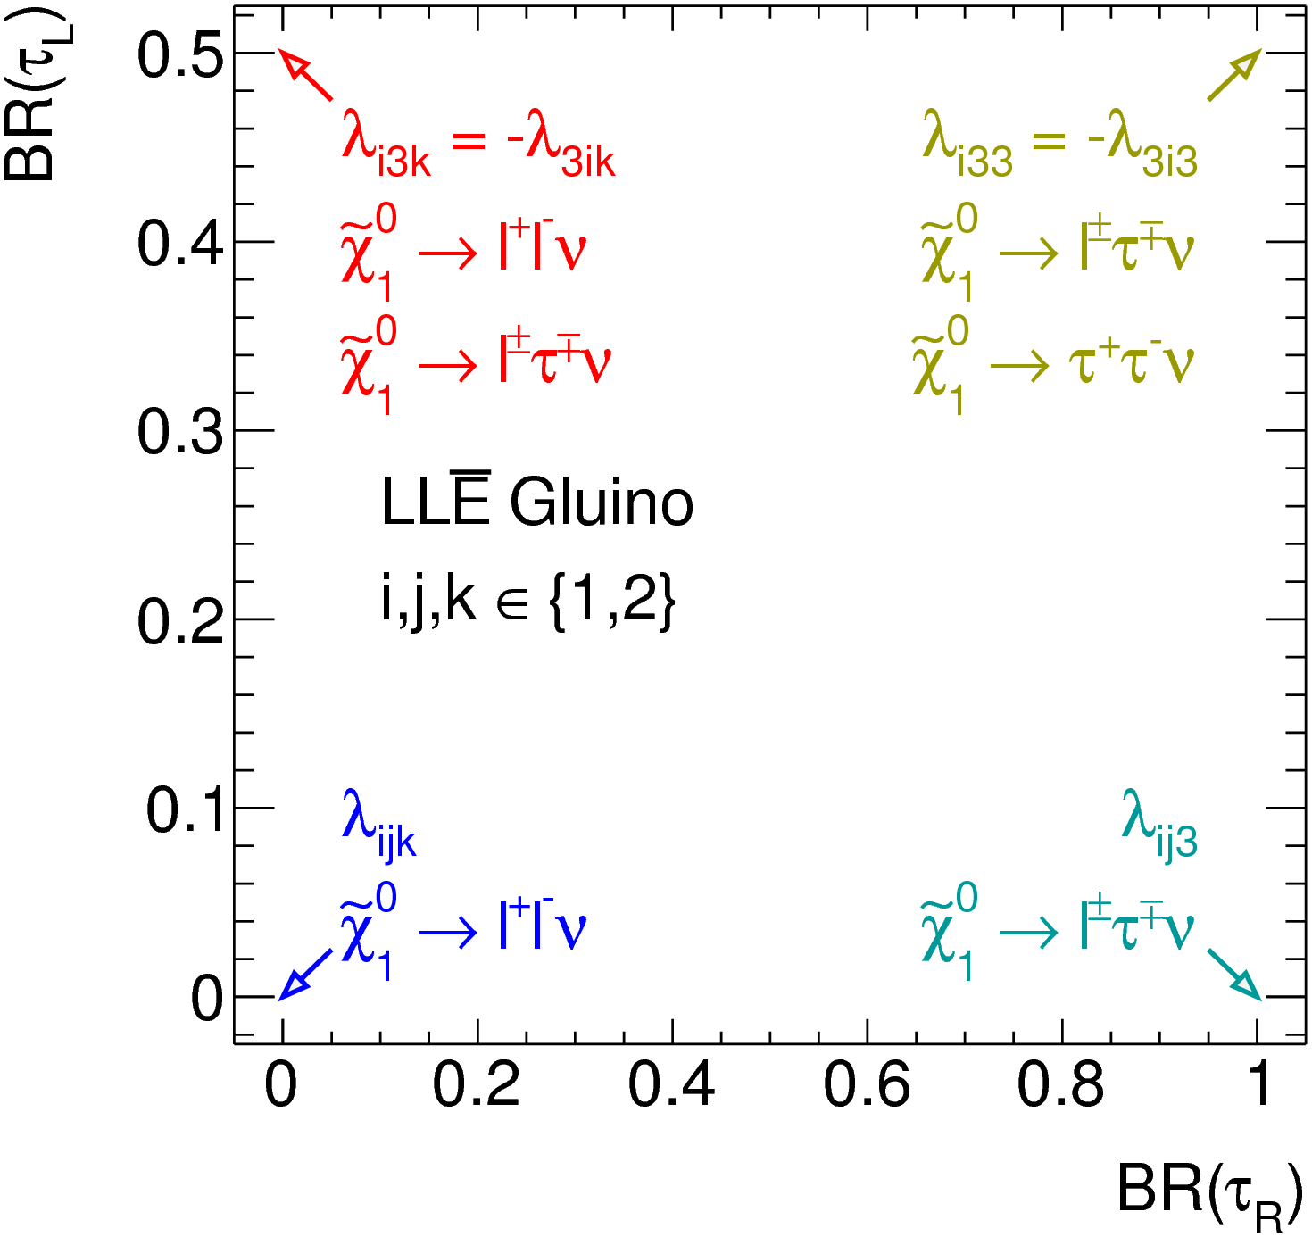
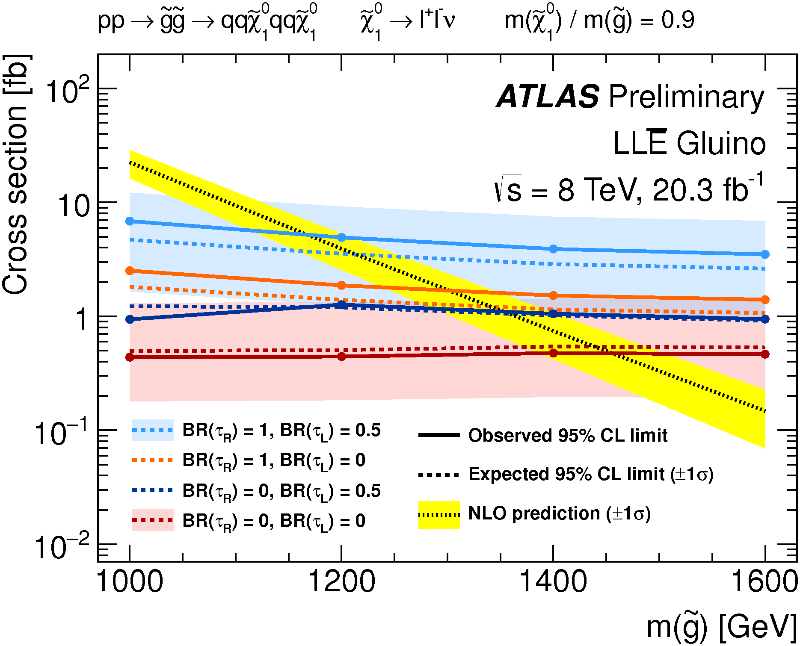
Multileptons in RPV SUSY

Slide 20
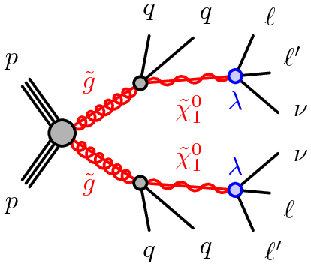
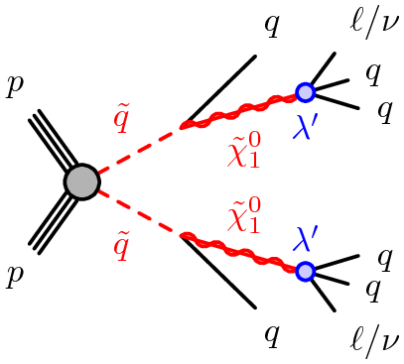
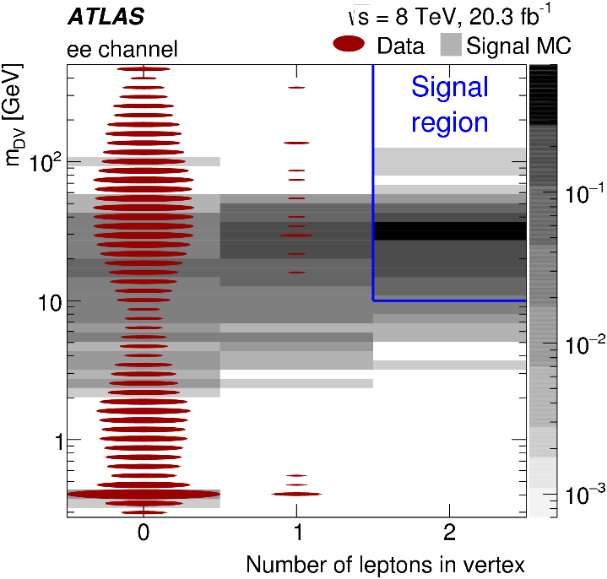
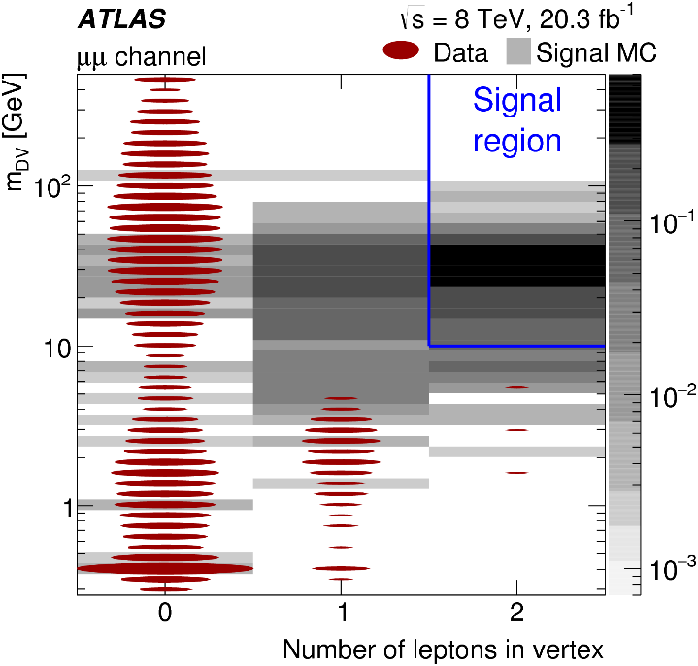
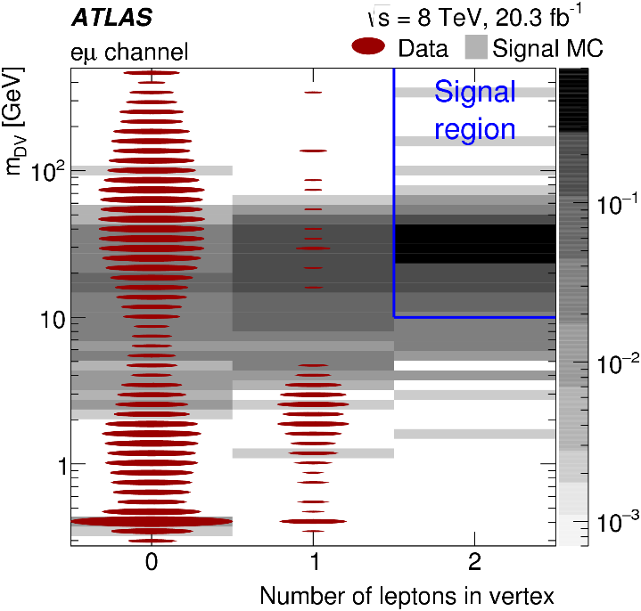
Displaced Vertices in RPV SUSY
PRD 92 (2015) 072004, arXiv: 1504.05162
In RPV SUSY, lowest supersymmetric particle (LSP) is not stable.
If couplings are small, the LSP may give a displaced vertex.
Look for displaced vertices with 1l (e or μ) or 2 leptons (ee, eμ, or μμ).

Slide 21
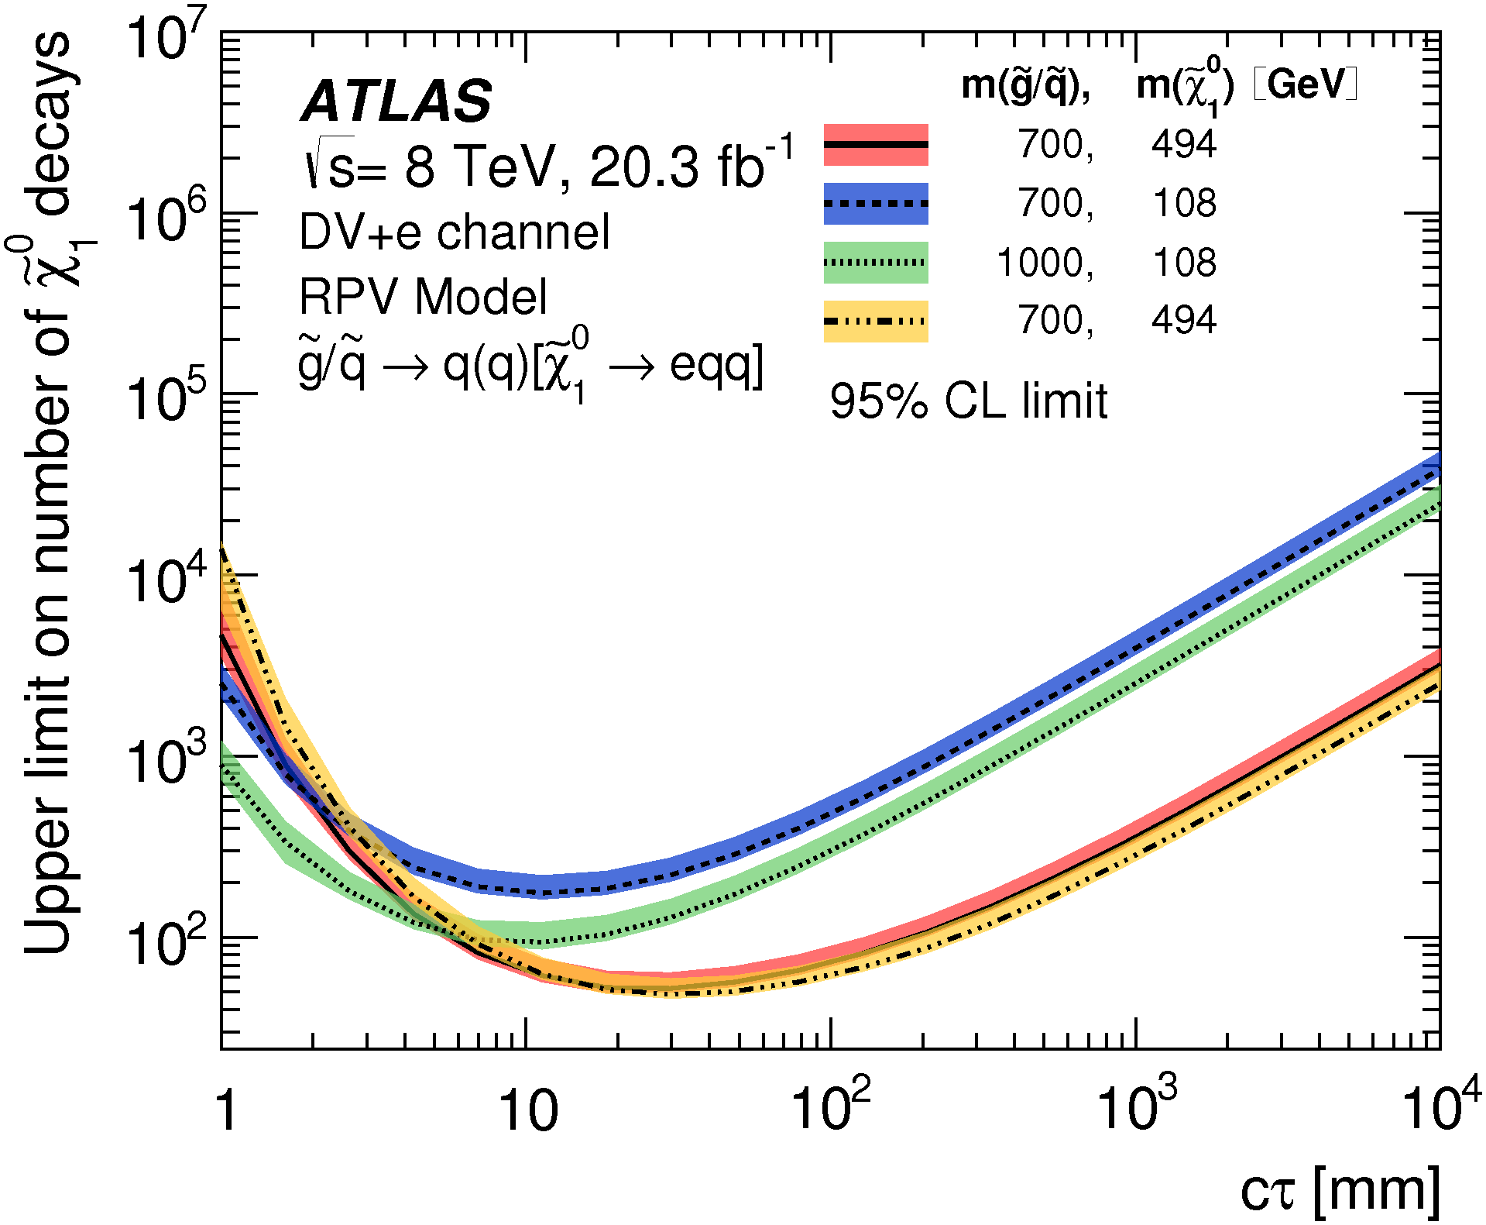
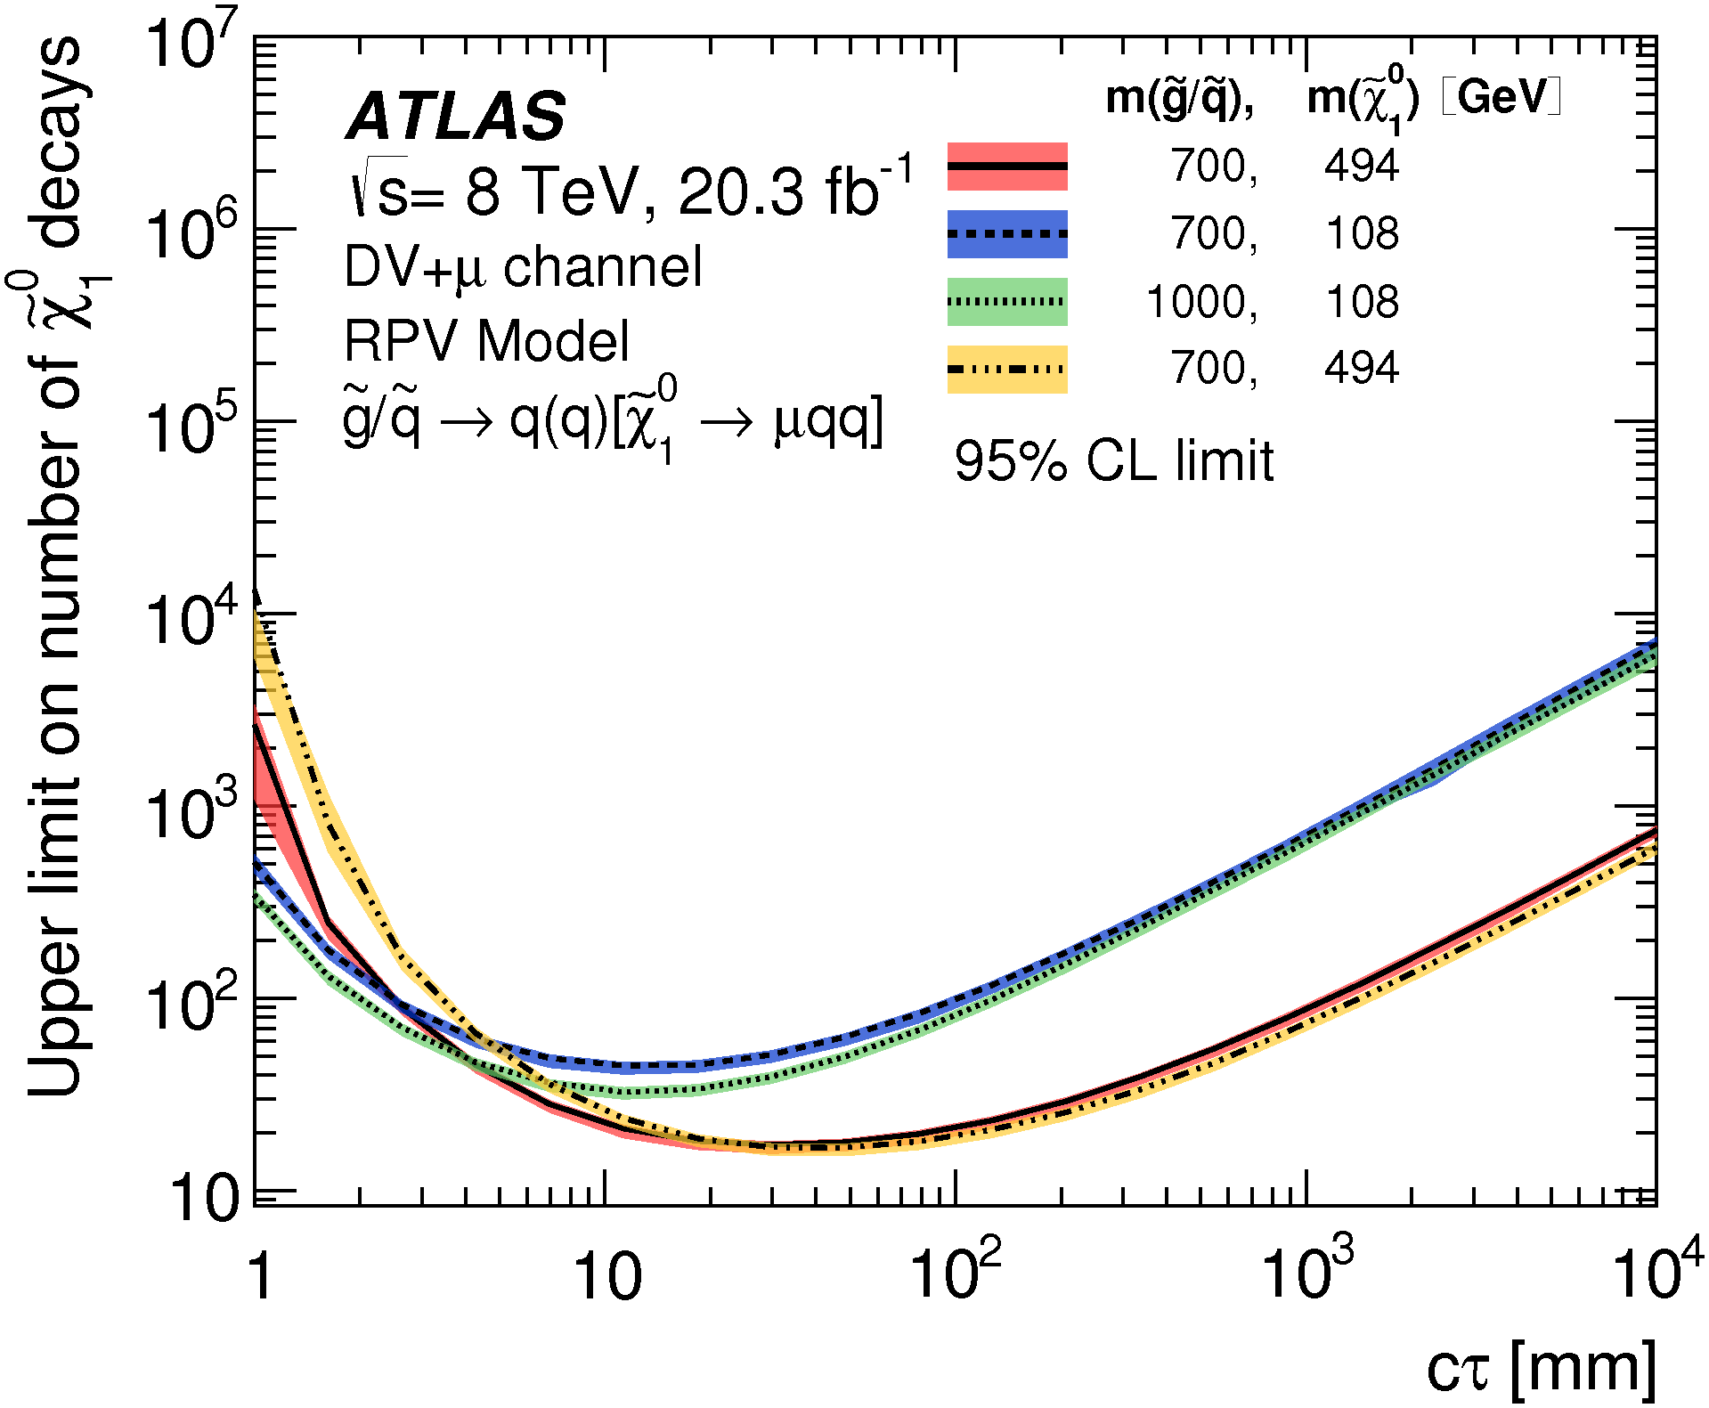
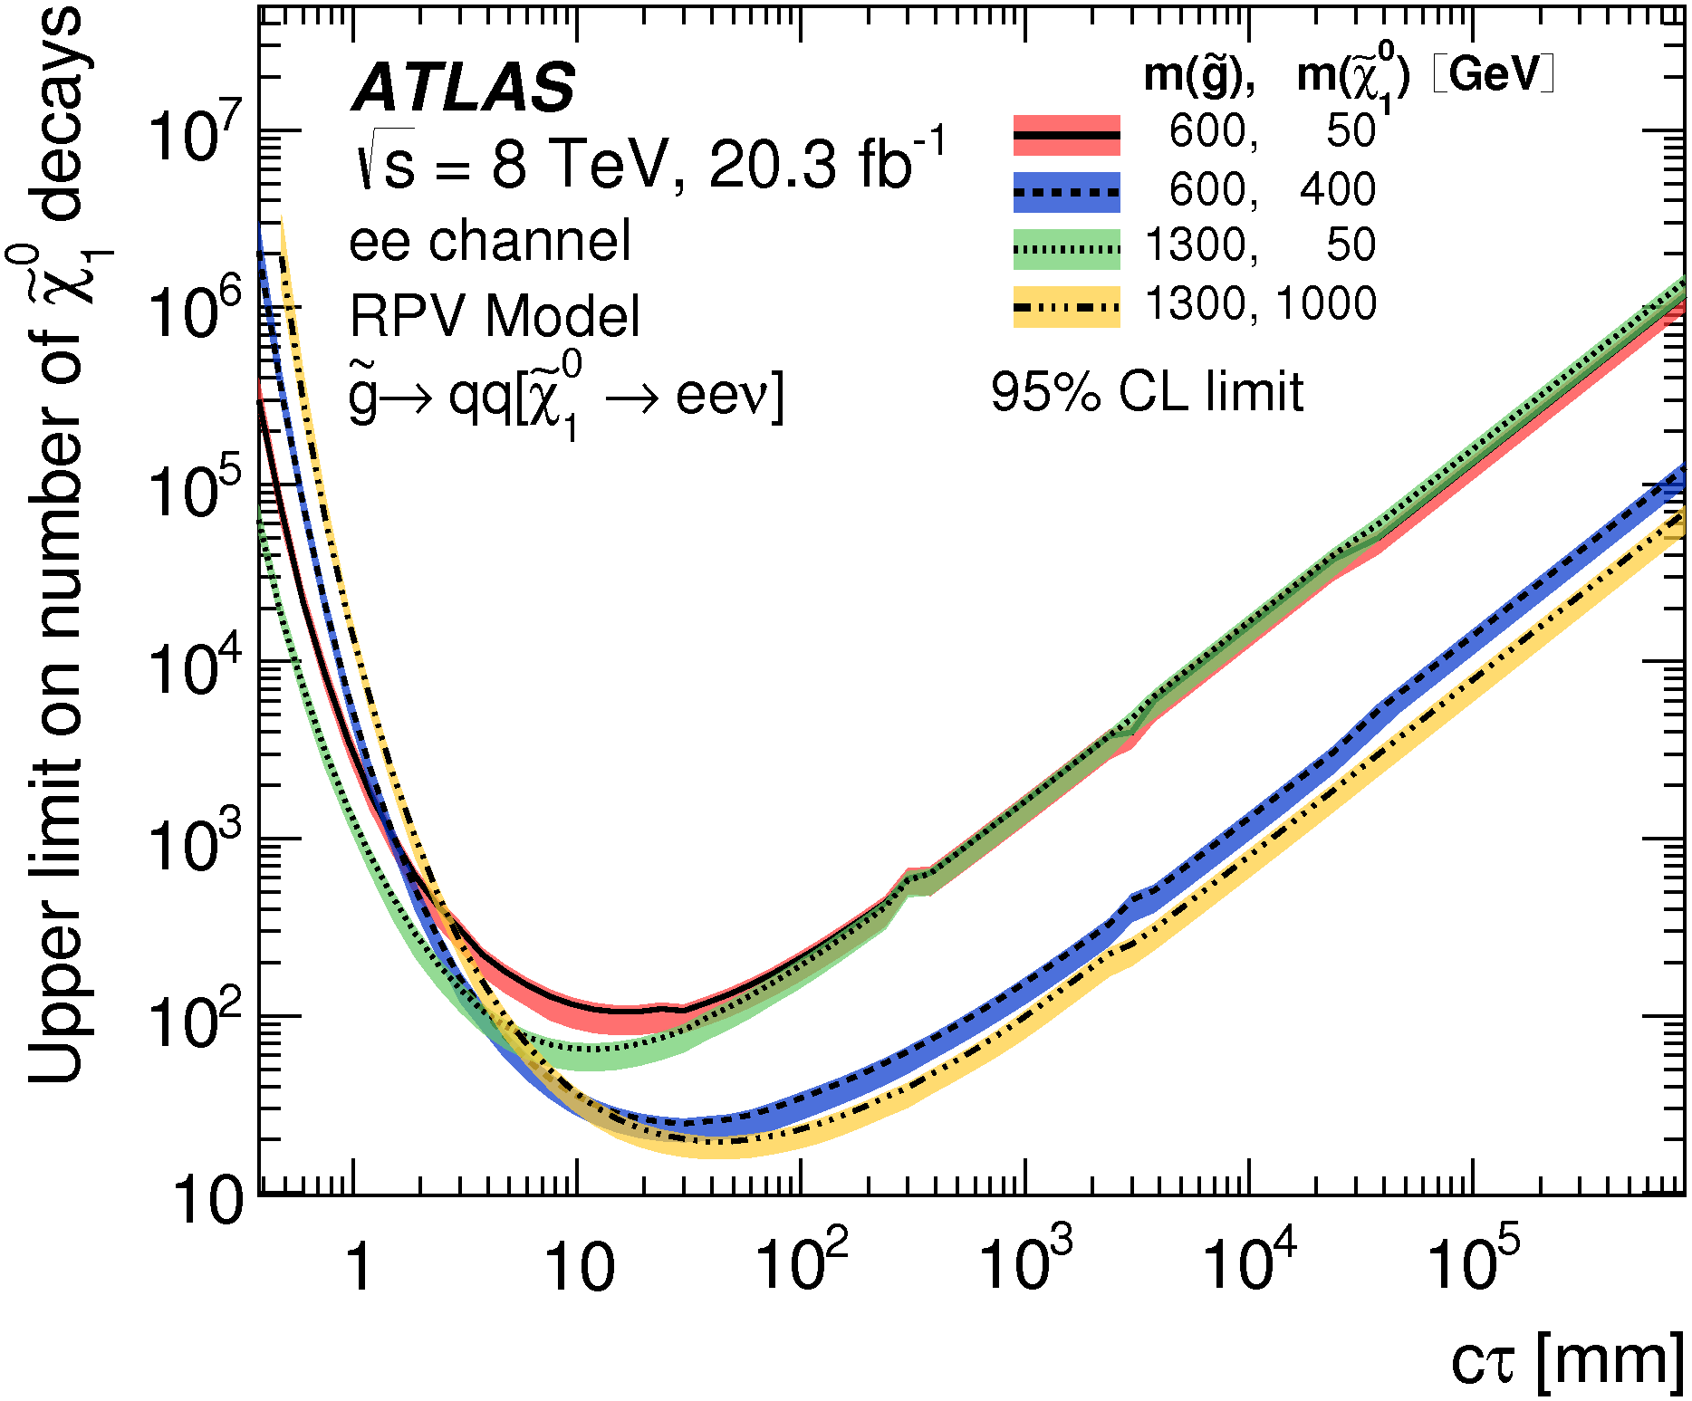
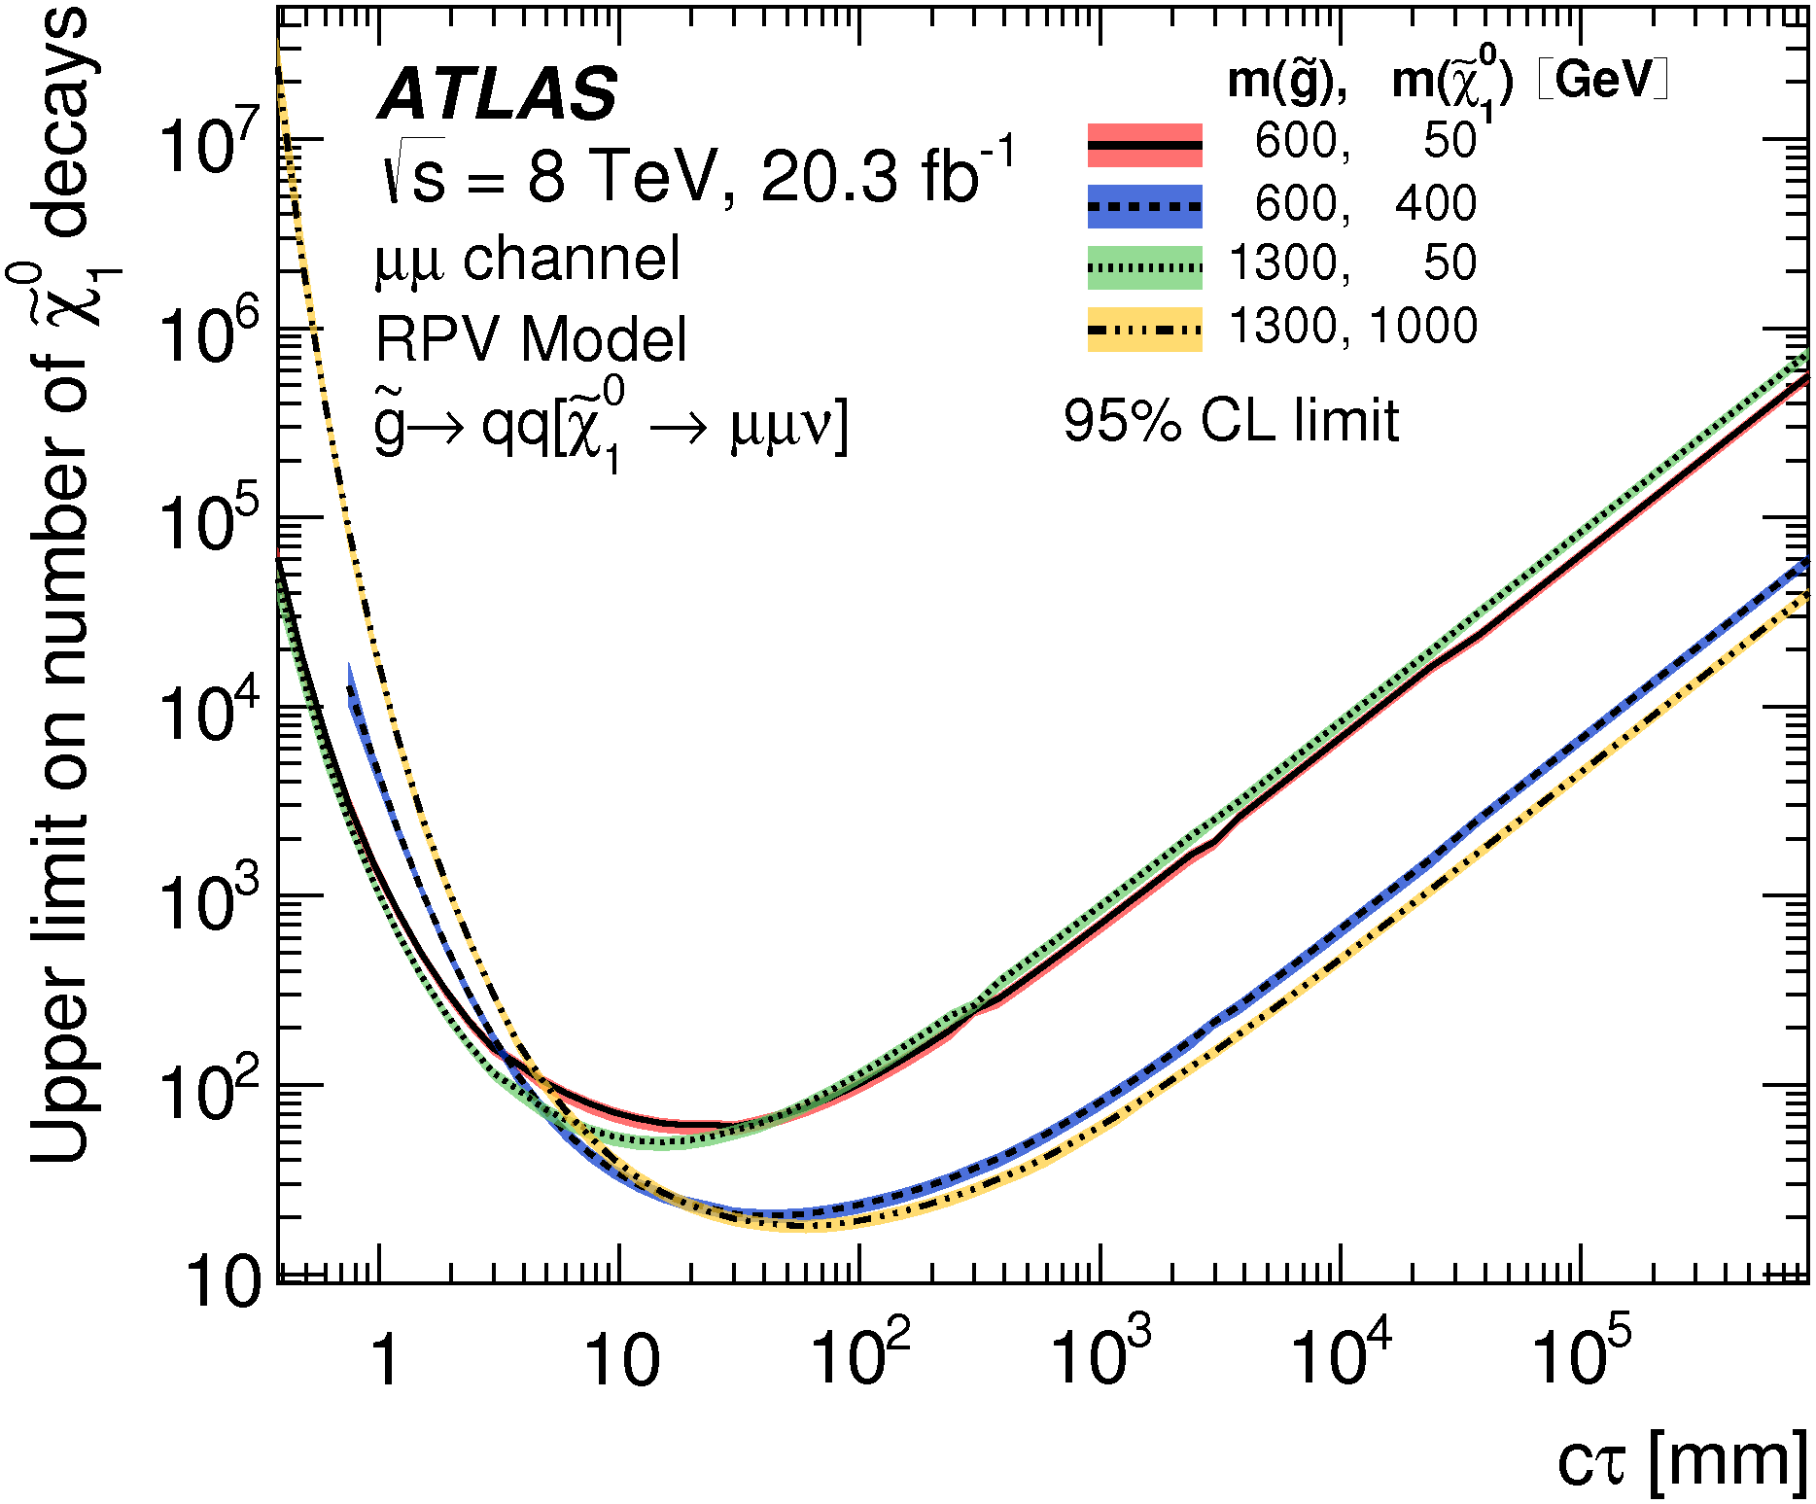
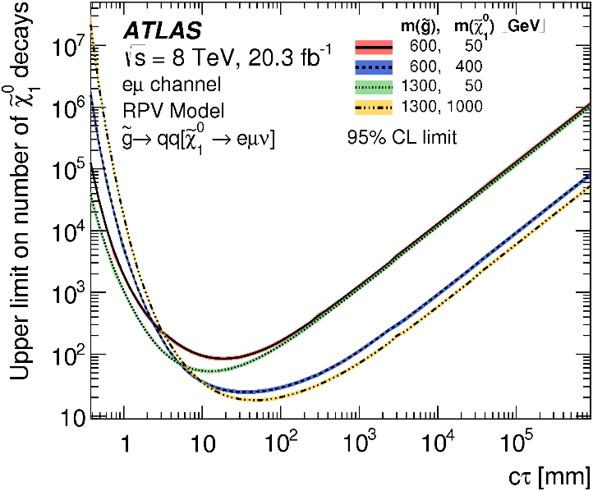
Displaced Vertices in RPV SUSY
DV + 1l
Limits on number vs cτ are most model-independent
e
μ
DV + 2l
ee
μμ
eμ

Slide 22
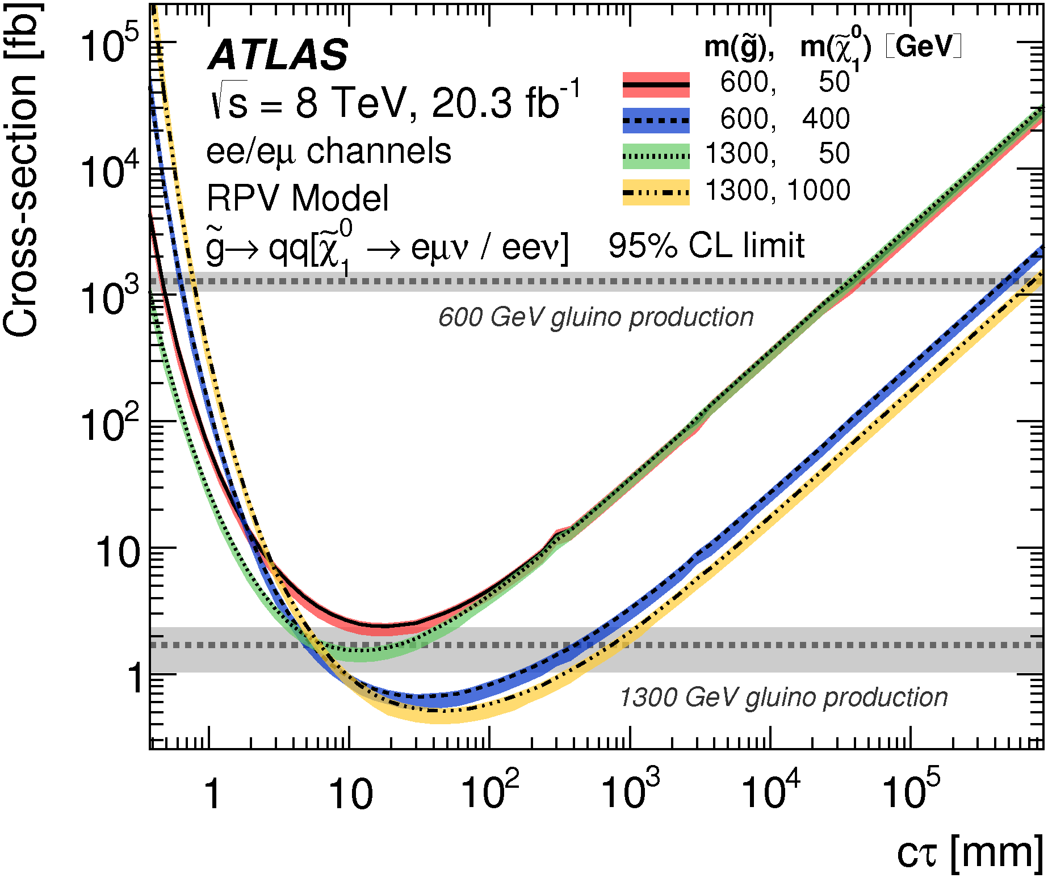
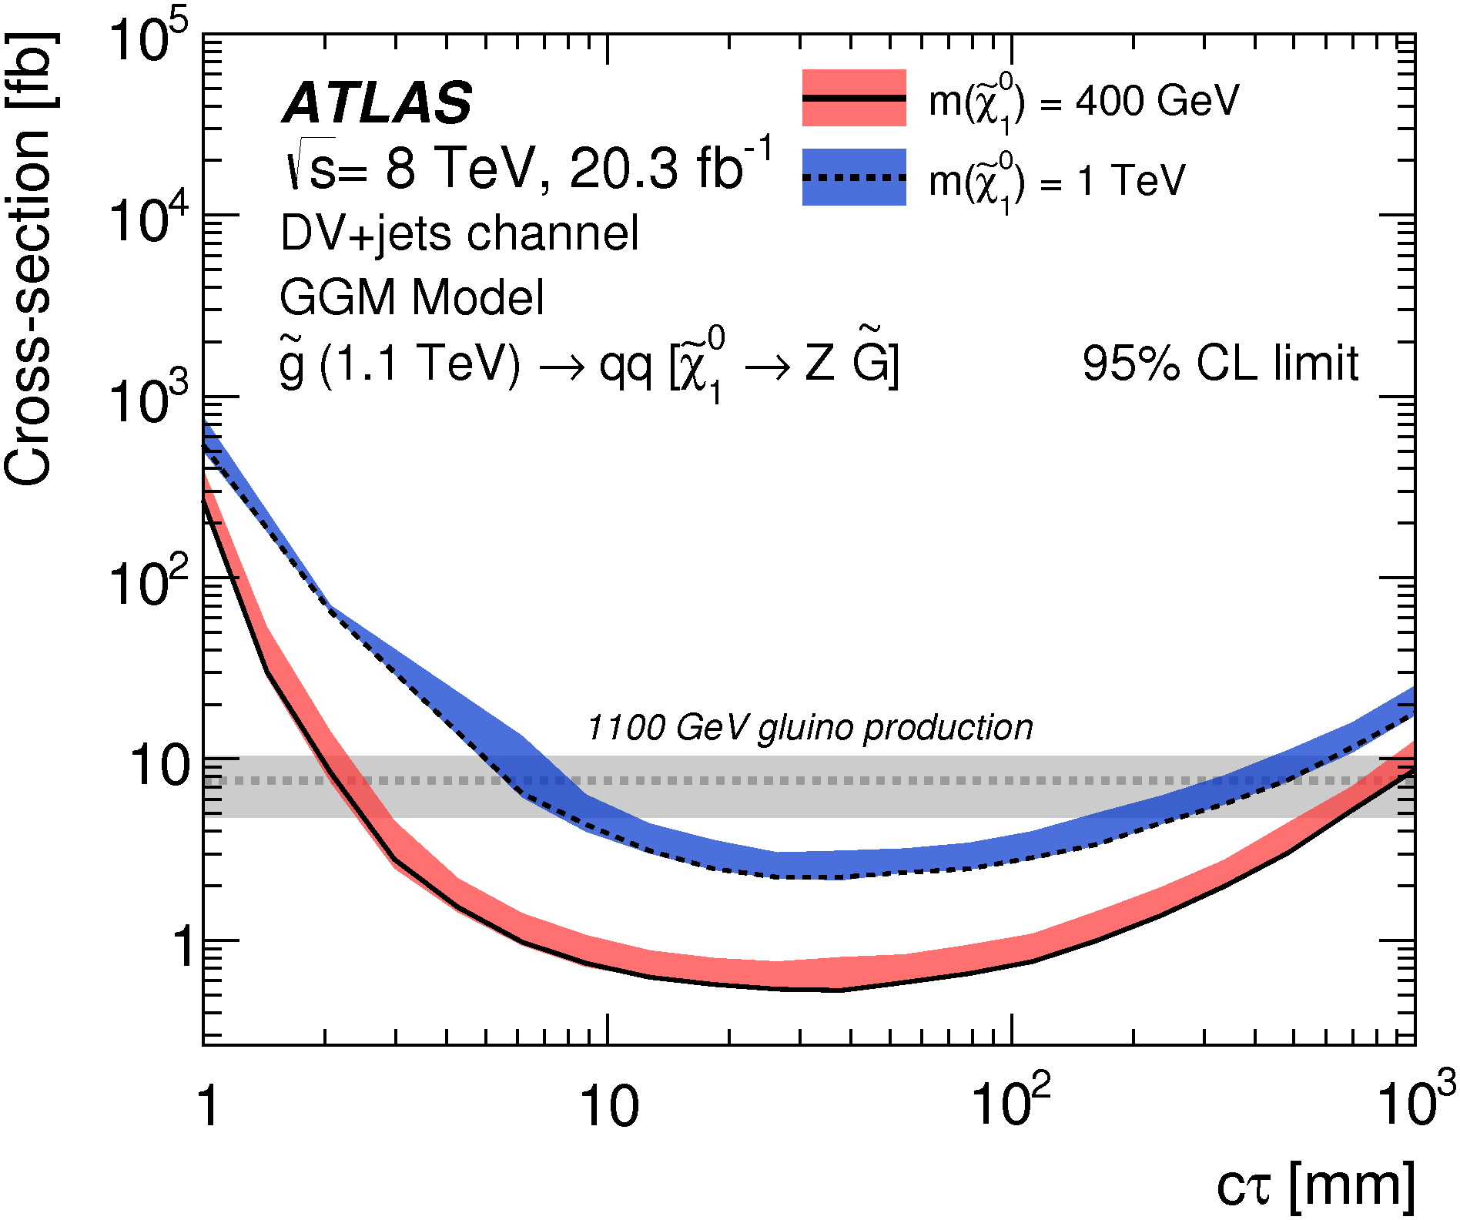
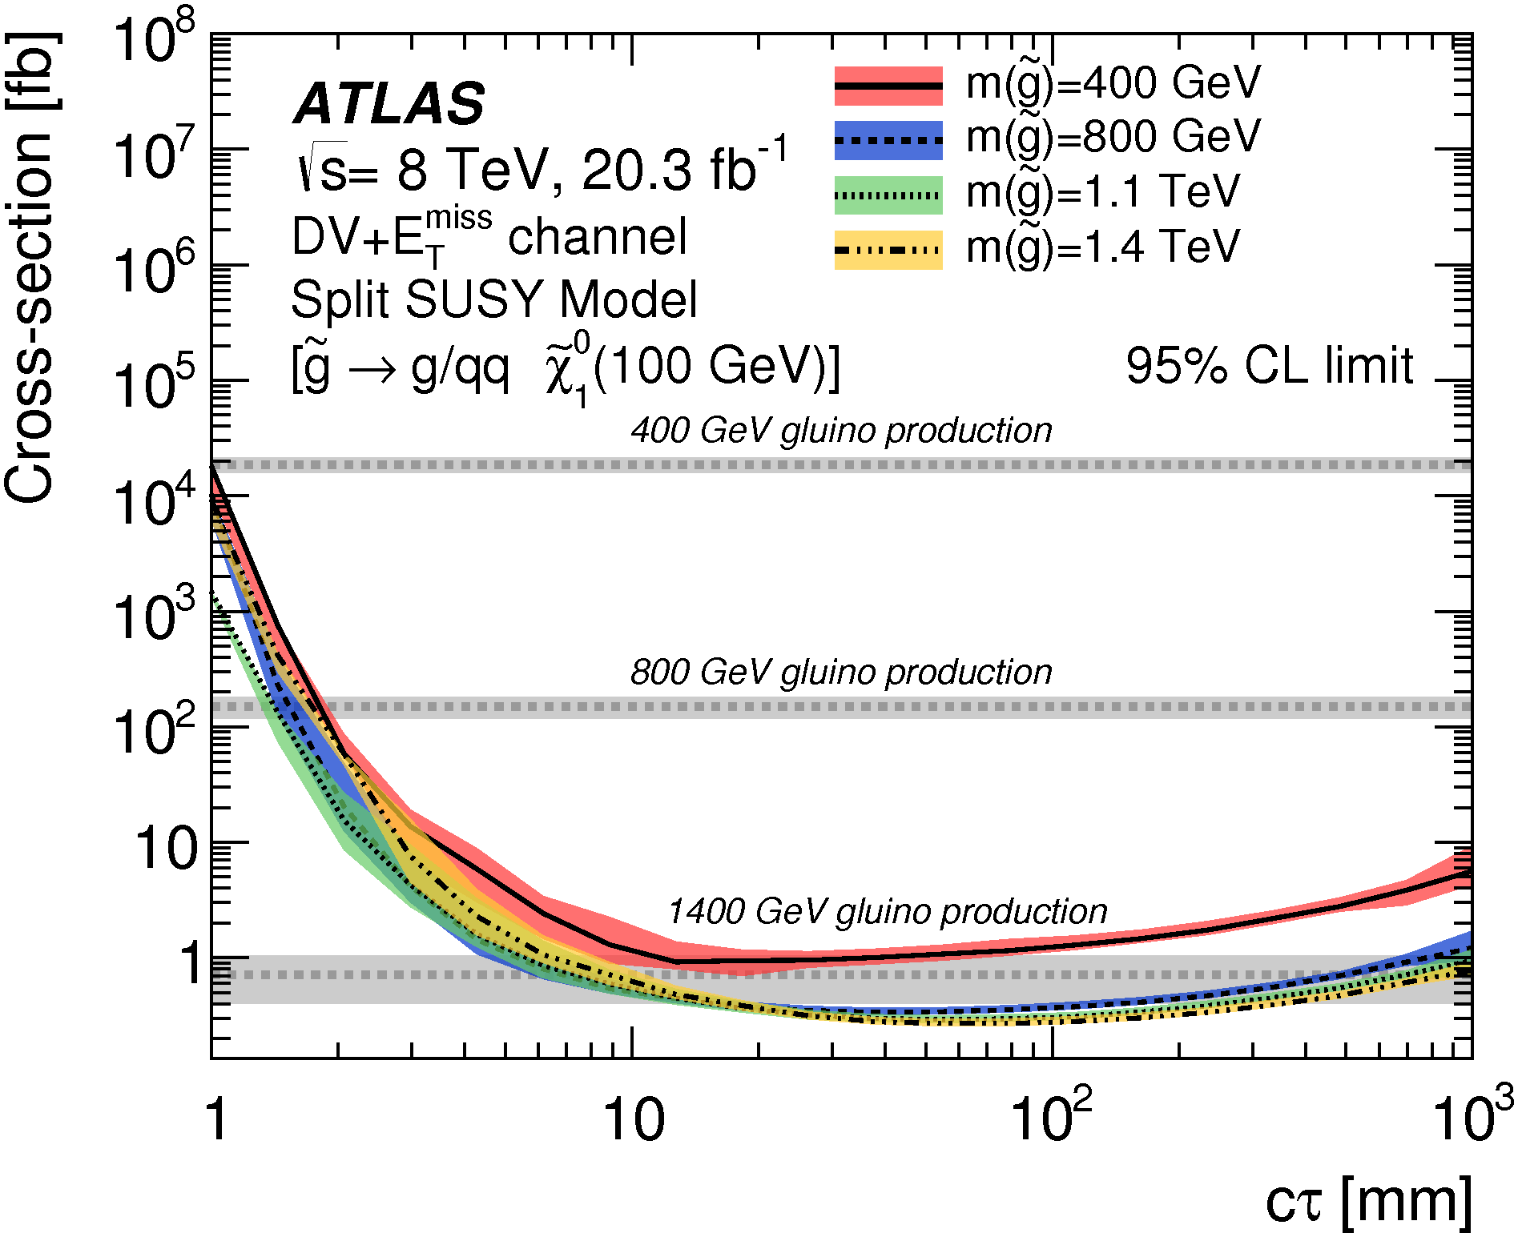
Displaced Vertices in RPV SUSY
Can convert to cross section and mass limits in various models.
Here is a small sample of the available plots.

Slide 23
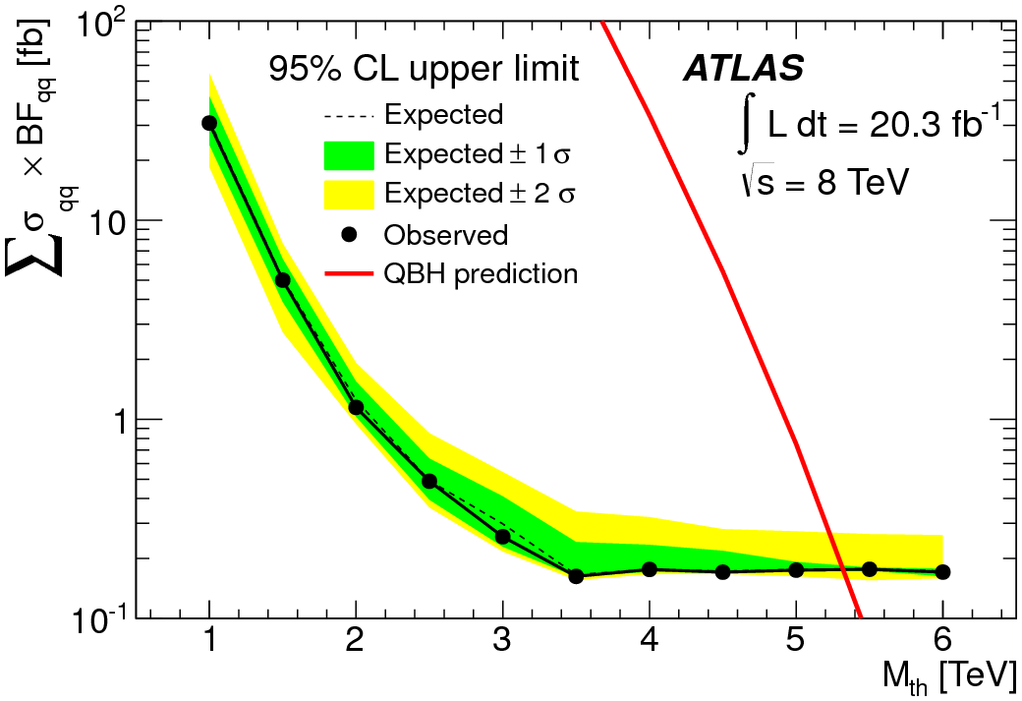
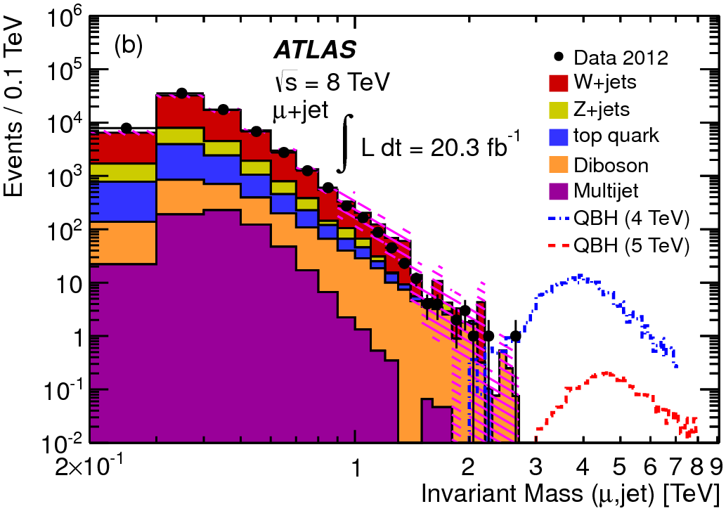
Black Hole → lepton + jet
PRL 112, 091804 (2014)
Quantum black holes predicted in low-scale
gravity theories.
Expected to conserve angular momentum,
charge, color but not other SM quantities.
Search for BH → l + jet.

Slide 24
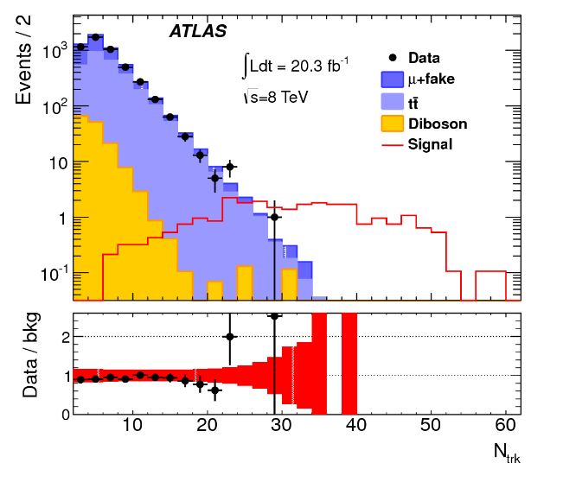
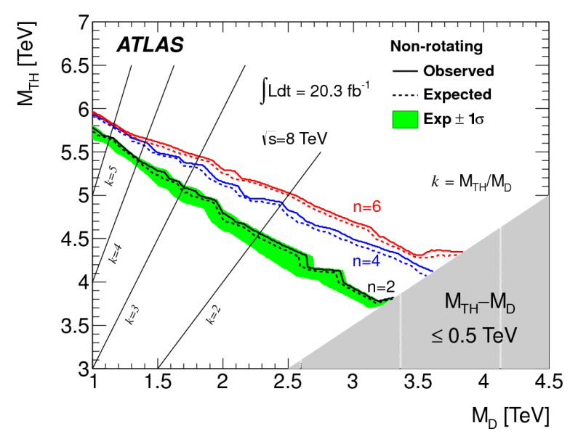
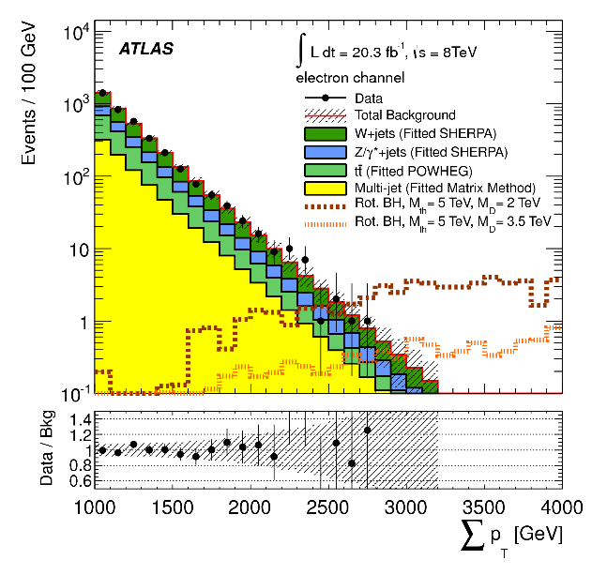
Other Black Hole Modes
PRD 88 (2013) 072001, arXiv:1308.4075
JHEP08 (2014) 103, arXiv:1405.4254
Black holes are expected to violate lepton flavor.
These modes have LFV but do not explicitly show it.
Black hole -> μ± μ± + tracks
Black hole -> ≥ 3 high-p_{T} objects (at least 1 lepton)

Slide 25
Majorana Neutrinos
JHEP07 (2015) 162
arXiv:1506.06020
Theories with heavy neutrinos (such as Seesaw models and left-right symmetric models) may have lepton flavor and number violation.
Search for events with like-sign dileptons (e±e± or μ±μ±) and at least two jets.
No excess seen.

Slide 26
Summary
ATLAS has searched for lepton flavor violation in the 8-TeV and 13-TeV data via
decays of Standard-Model particles (Z, H)
decays of possible new particles ($\tilde{ν}$, Z’, $\tilde{χ}$)
decays of Quantum Black Holes.
No excess over the Standard Model expectations is seen.
Limits are placed on various production and decay mechanisms.
LHC is running at 13 TeV, and we look forward to studying the increased data sets.

Slide 27
Backup Slides

Slide 28
Higgs → μτ
SR1
SR2

Slide 29
Z → eμ

Slide 30
Z → eμ

Slide 31
Z’ or ν → eμ, eτ, or μτ
~

Slide 32
Z’ or ν → eμ, eτ, or μτ
~

Slide 33
B-L top squark

Slide 34
Multileptons in RPV SUSY

Slide 35
Multileptons in RPV SUSY

Slide 36
Displaced Vertices in RPV SUSY
Displaced vertices with less than 5 tracks.
These regions are excluded from the signal search.

Slide 37
Displaced Vertices in RPV SUSY

Slide 38
Black Hole → lepton + jet

Slide 39
Majorana Neutrinos

Slide 40
Majorana Neutrinos

