Slide 1
Muon Department Meeting
Jerry Annala
Staged Commissioning of Muon Campus
17 December 2015

Slide 2
Announcements
Late welcome Diktys Stratakis
Muon Campus lunch next Tuesday in Penthouse
Since we did not plan a holiday lunch for our department, I suggest going to lunch tomorrow
Beneficial occupancy of new tunnel (what it means)
Mu2e technical review update
Other updates
Cable mitigation update
This week’s FTL due right after this meeting

Slide 3
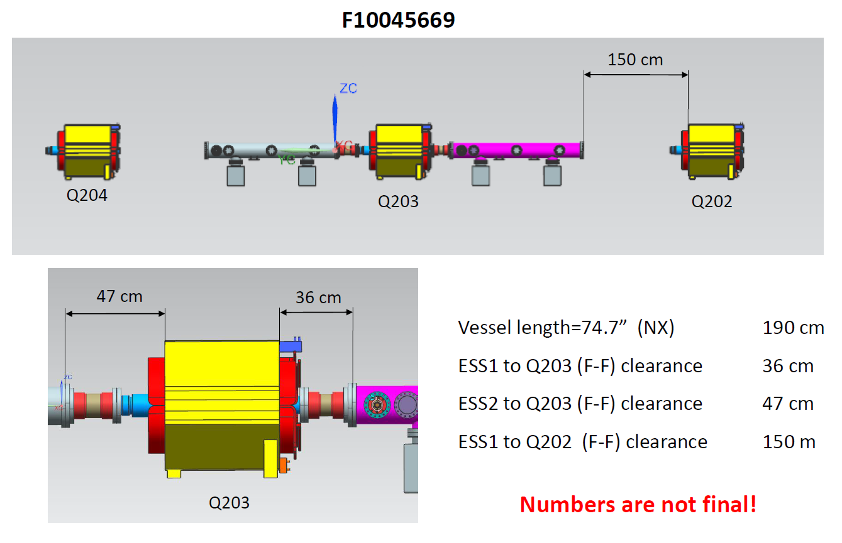
Electrostatic septa drawing

Slide 4
Cable Mitigation update
Pretarget/Prevault
  99% done
Transport
  95% done
Accumulator
  85% to 90% done in the tunnel. Still need to pull cables up through the penetrations
  Mostly load cable left
Debuncher
  60% to 70% done? This is a moving target as we identify more systems that can be removed. BPM test signal cables? Loss monitor HV cables?
  Been concentrating on the 50 straight section recently

Slide 5
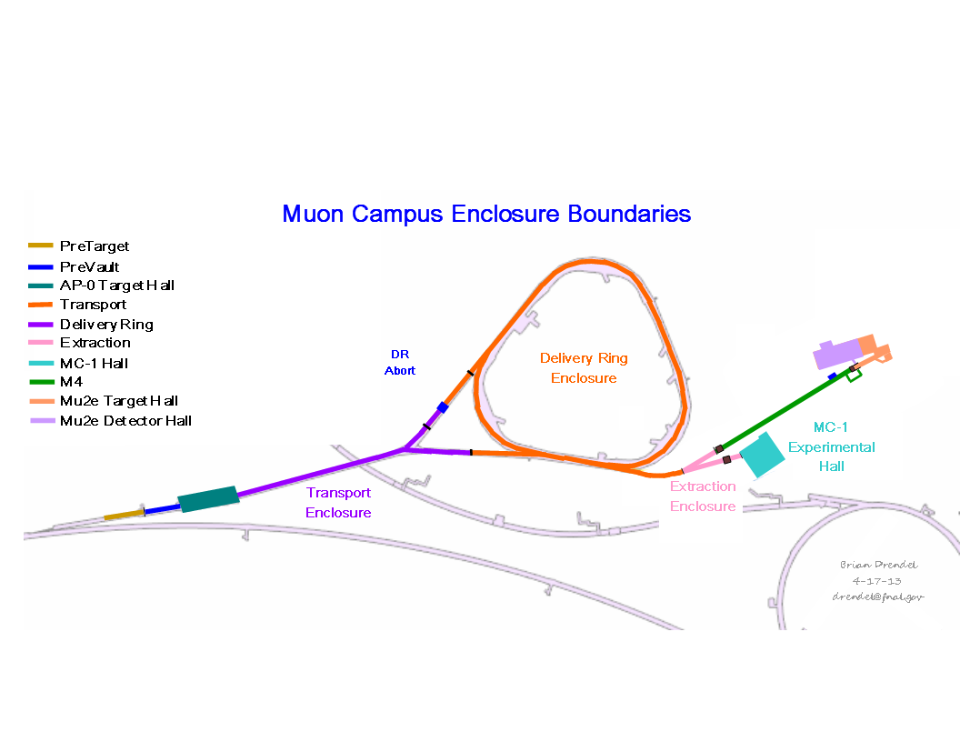
Enclosure diagram
Tony has created a new diagram depicting beam scenarios
Gates installed for this shutdown will likely become permanent

Slide 6
Modification of Transport enclosure
Boundaries of the transport enclosure will be about where they always were in Collider operation.
There will be a short section that is interlocked and tied to the MI-8 radiation permit.
This will allow us to access transport (outside of new gates) to troubleshoot without turning off the Neutrino program.
This will force us to:
  Cut down the number of available transport keys.
  Take two keys with us to go throughout the transport enclosure
  Do extra work to search and secure enclosure if MI-8 line is up
  Consider a coasting beam valve in RR
  Etc.

Slide 7
Commissioning Plan
Jim Morgan has presented a fairly comprehensive plan in the October 2014 beam line review
Complete presentation in g-2 docDB #2215
This plan made assumptions about parts of the accelerator chain being ready and then an ideal schedule was presented.
If the entire complex became ready at the same time, we could follow Jim’s plan exactly.

Slide 8
Advertised commissioning activities with durations
Activity | Duration (weeks) | Beam Power (watts)
Recycler has been commissioned
Commission RR extraction and P1 stub | ? | 10
Commission P1-P2 line at 8 GeV | .5 | 10
Commission M1 line to AP0 target | 1 | 10
Commission M3 line bypass to DR | 2 | 10
Commission DR at 8 GeV | 4 | 10
Extract 8 GeV protons into upstream M4 line | 2 | 10
Begin Commissioning with 3.1 GeV secondary beam
Commission M2/M3 line | 3 | 170
Pass 3.1 GeV through to M4/M5 line | 3 | 170
Circulate in DR and tune up | 3 | 170
Tune up machine toward full intensity | 4 | 170

Slide 9
Staged Commissioning Plan
What limits us from turning running beam part way through the campus early?
  Construction in enclosures including downstream enclosures
  Systems not ready for operation:
    Power Supplies
    Instrumentation
    Infrastructure (Power, Water, Safety system, etc.)
    Controls
  Cable mitigation
  Administrative details:
    Shielding assessments
    Operational readiness reviews
    LOTO lists
    Operator training, etc.

Slide 10
Where does it make sense to commission in stages?
Beam to the AP-0 target (or M2/M3 line beam stop)
  The AP-0 dump is scheduled to be complete in June
  The RR extraction kicker is scheduled to be ready in June
  M3 line construction to DR will be complete by June
Allow circulating beam in the Delivery Ring.
  The 30 straight section can be complete in March 28, 2017
  The tunnel portion of the shared M4/M5 line can be complete through the extraction enclosure by March 28, 2017
  The Accumulator magnets going into the M4 line can be removed from the DR enclosure by March 28, 2017
  The DR modifications can be done by ????
  Cable mitigation in the DR should be done by October 1, 2016
  Injection kicker power supply done by November 2015
Allow beam g-2 storage ring
  The shield wall labyrinth at the M4 line split will need to be in place.

Slide 11
Actual schedule to prepare
Even though some of the project work is not scheduled to be done until end of March 2017, I would like to shoot for all of the non-project work to be ready to run:
  Beam to AP-0 target from RR by June 2016
  Beam through Transport into DR enclosure by February 2017.
    Check out all instrumentation in M2/M3 line all the way through Acnet programs
  Beam to g-2 by April 1, 2017

Slide 12
Preparing to meet proposed schedule
By February 2016
  TLG modules playing (Stan)
  Database entries complete through target (Stan)
  References set to all devices up to target (Morgan)
  Camac timers operational to all kickers (Stan)
  Beam permit system in place (?)
By May 2016
  Transport enclosure in final configuration (Leveling)
  LOTO lists and interlocks completed through transport enclosure. (Morgan, Budlong)
  M3 polarity checks, thermal scans, etc. complete (Morgan)
  Instrumentation check outs complete (Drendel)
  Permission to operate to the target (Leveling)

Slide 13
Installation issues
Will all installation through Transport be complete by May 1, 2016 so that enclosure gates can be re-cored for check out? (Cons)
Will target station be in shape to run beam to dump by June 1, 2016? (Still)
Will software be ready in time for check out?
  Utilities (Vander Meulen, Budlong)
  Instrumentation (Drendel)
  Tuning (Morgan)
  Target Station monitoring (Still)
We will address issues needed to run down the M3 line at a later time. This will get us moving.

Slide 14
Get your FTL done

Slide 17
Allocation of time toward operations next year
 | Fraction of time allocated to operations
Jerry Annala | 23%
Jim Budlong | 32%
Brian Drendel | 8%
Tony Leveling | 35%
Jim Morgan | 31%
Vladimir Nagaslaev | 20%
Al Sondgeroth | 80%
Dean Still | 18%
Dave Vander Meulen | 33%
Steve Werkema | 27%

Slide 18
Non Project activities
Controls
  Application software
  Database entries
  Alarm lists
  Datalogger lists
Call in lists
Reviews and approvals
  ORC
  SAAD
  Shielding Assessment

Slide 19
Non Project activities
Departmental Procedures
Commissioning Plans and Documentation
Labeling of hardware
  Magnets
  Power Supplies
  Transformers
  LOTO points
  Etc.
Interlock lists
Lockout lists
Other safety (getting chipmunks, gates, lock cores etc. back to normal configuration).

Slide 20
Non Project activities
Timer (required hardware, triggers, settings, etc.)
  Reference Drawings
  Magnet circuits
  Utility drawings
Conventions
  Polarity
  Naming/numbering
  Beam Accounting
Cable mitigation

