Slide 1
Superconducting coils heat treatment utilizing Joule heating
TD R&D retreat
Luciano Elementi
26 January 2016

Slide 2
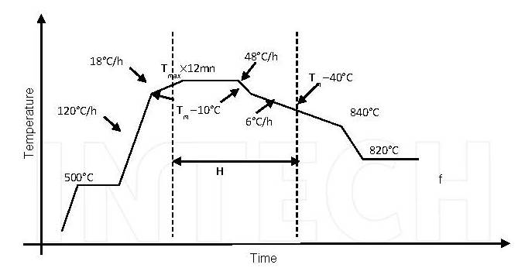
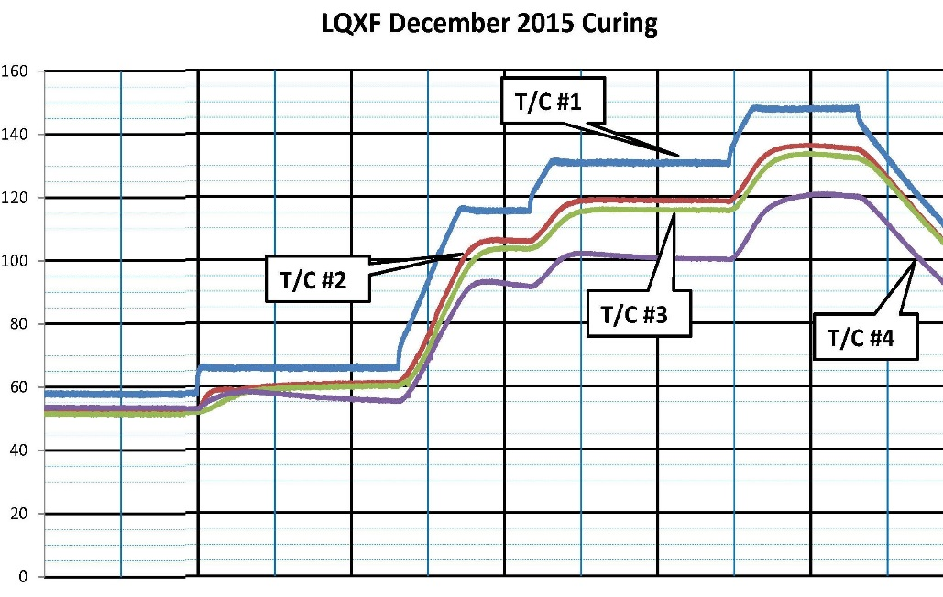
Advanced Superconductors Characteristics:
Virtually all High Current and/or High Temperature Superconductor require Heat Treatment
E.g. Ag/Bi-2212 is being developed for accelerator magnets, post coil fabrication (typically brittle)

Slide 3
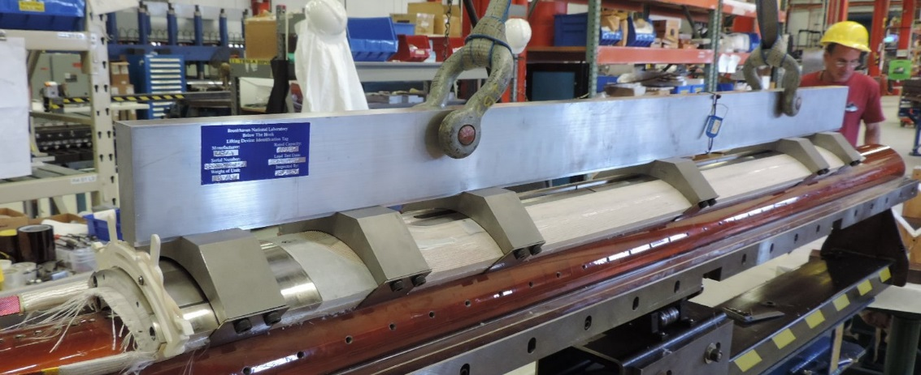
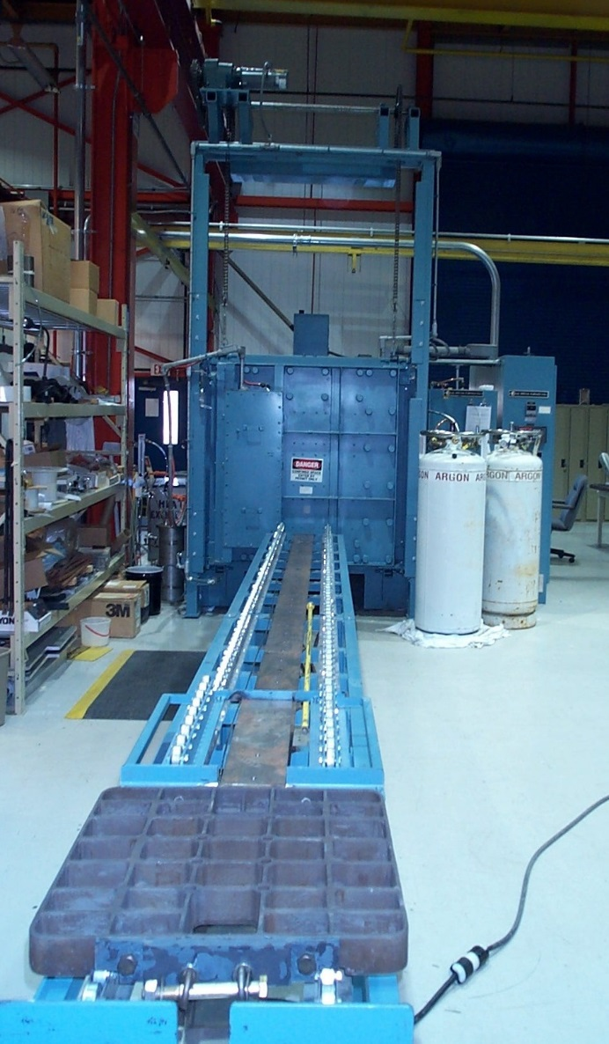
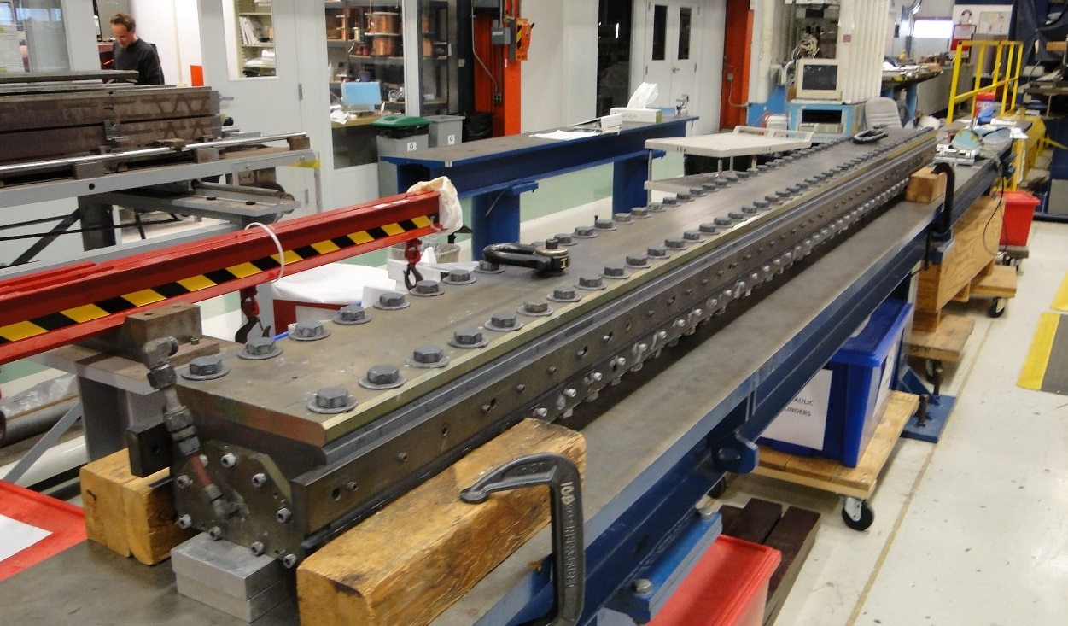
Usually Large:

Slide 4
External vs. Internal Heating:
τ
ΔT is limited (along).
is several minutes (across).

Slide 5
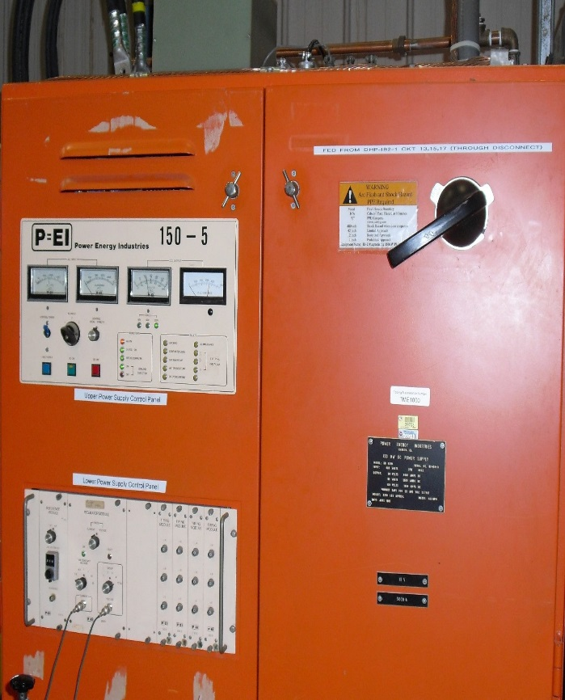
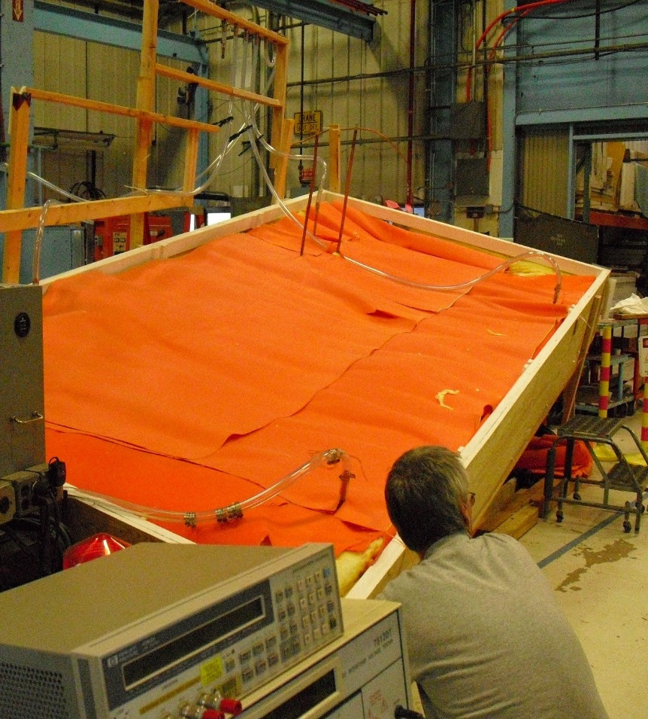
Joule-Heating Experiences:

Slide 6
Advantages and possible improvements:
Follows readily temperature profiles (heating)
Possibility of achieving uniformity inside the whole coils independently of its location.
Possibly save energy because heat is concentrated and deposited where it needs to be.
Reduced dimension of the hardware.

Slide 7
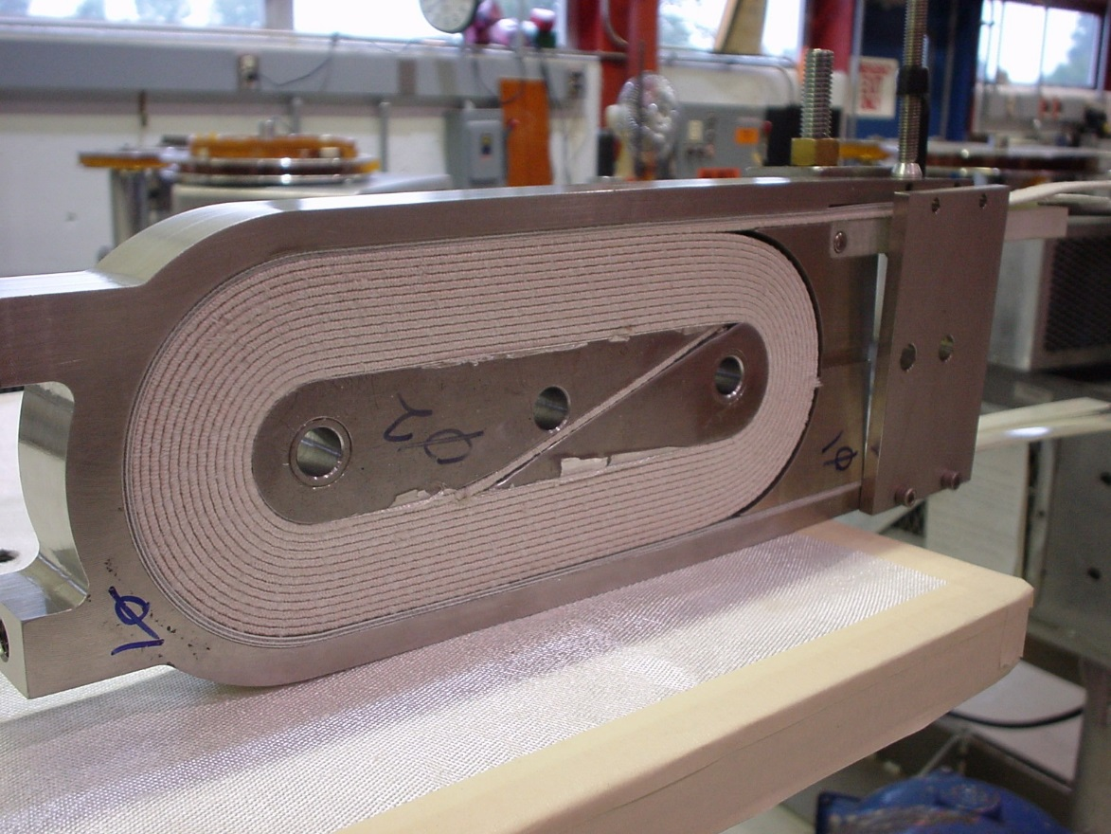
Proposal:
Design and build a viable coil utilizing Nb₃Sn that can be built and tested without too much expenditures. E.g. Small race track:
Tooling is available
Limited Technician help for winding, impregnation and test.
Some modeling

Slide 8
Proposal Cont’d
Compare results with baseline
Resolve problematics that we may encounter along the way.
Repeat the experience with advanced superconductor (e.g. Ag/Bi-2212)
Measure / Publish
Longer coil

Slide 9
Possibility, needs, limitations:
+
Overcome temperature rate limitation
Simpler and more precise control
Possible Cost saving in both infrastructures and electricity.
Temperature uniformity
o
Two technicians four weeks (tooling and winding)
Two technicians two weeks (Curing / Impregnation)
Two technicians two weeks (Testing)
-
May not perform as expected (e.g. scaling)
Uniformity, modeling and measurement
External strategically placed external heater may still be required.

Slide 10
Questions:
Questions / Critiques?

Slide 11
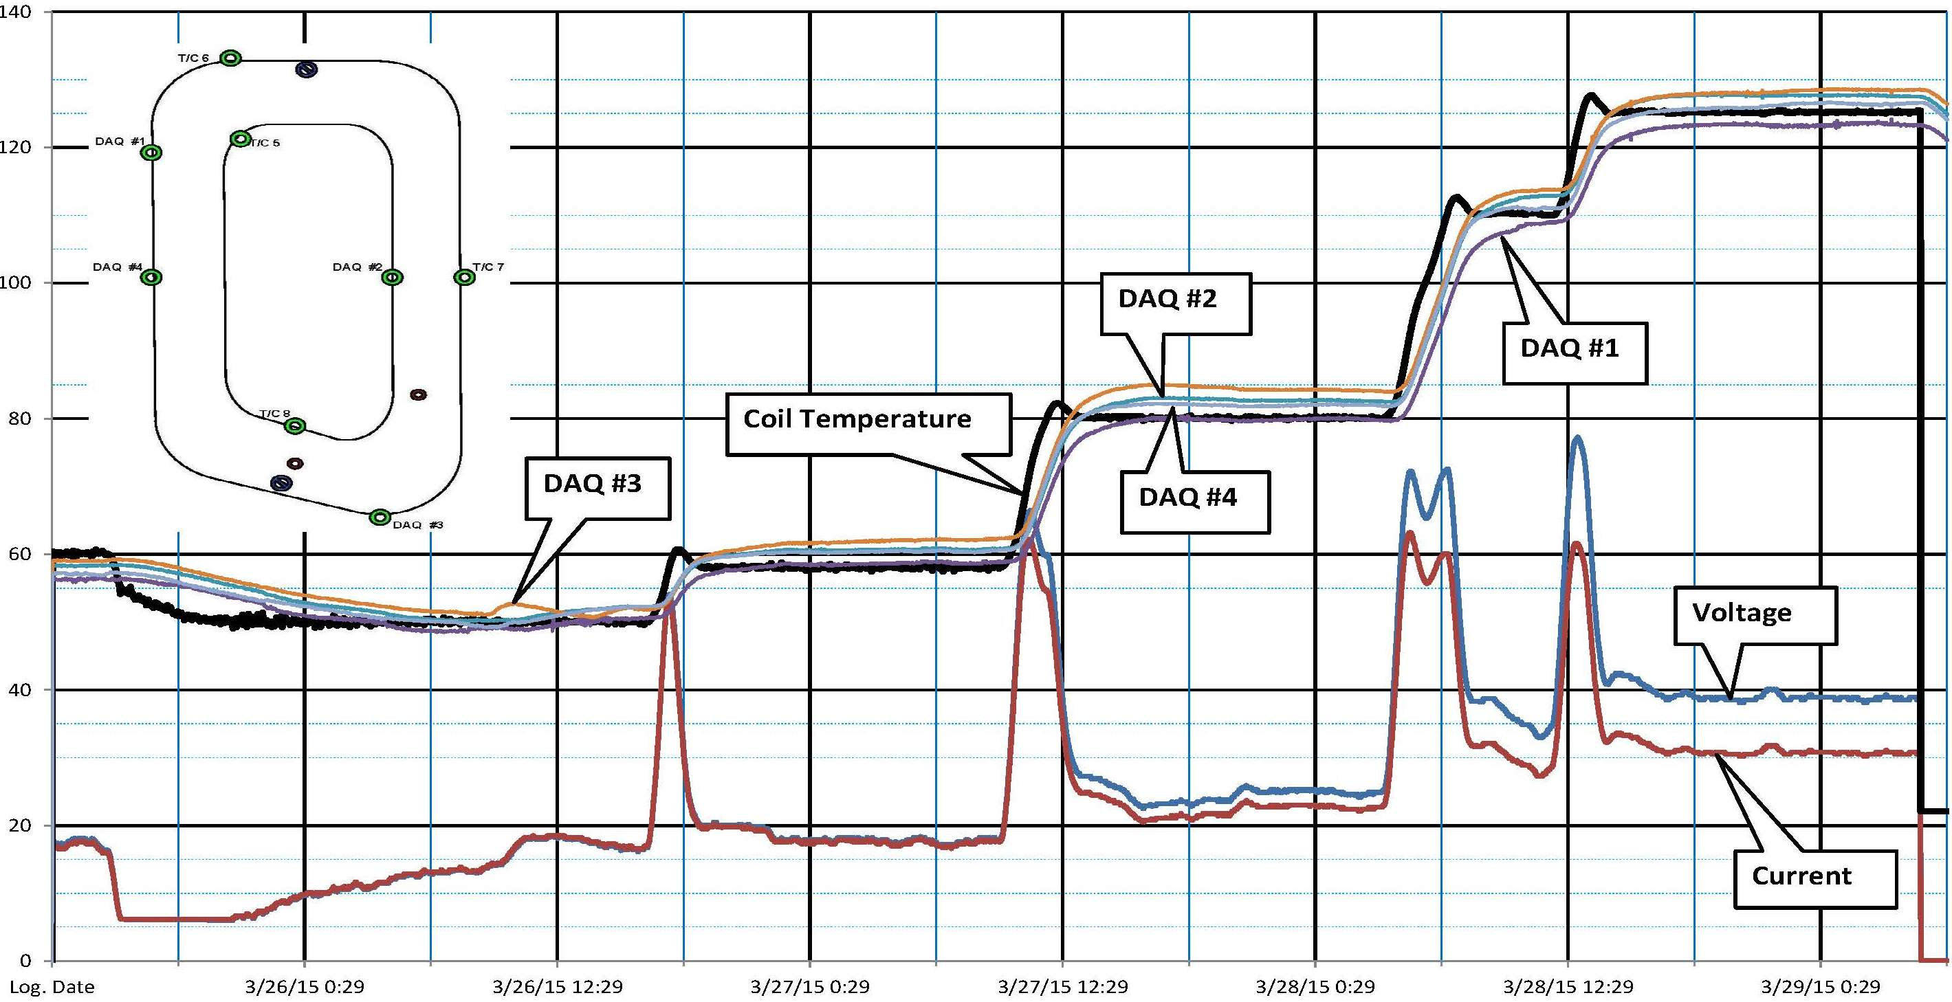
Back-up:

Slide 12
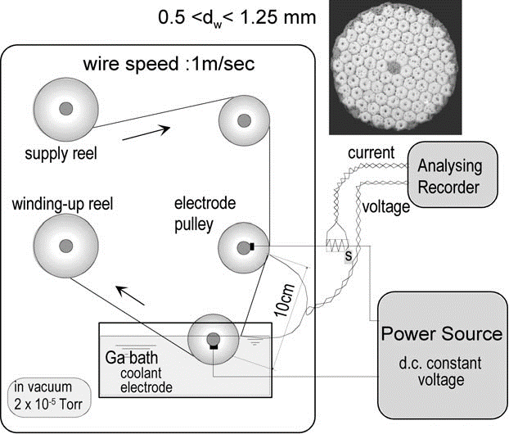
Back-up:
Takao Takeuchi:
Reel-to-reel ohmic-heating and rapid-quenching apparatus to form RHQT Nb3Al multifilamentary conductors

