Slide 1
Fermilab Nb₃Sn SRF R&D Program
Sam Posen
TD R&D Retreat
26 January 2016

Slide 2

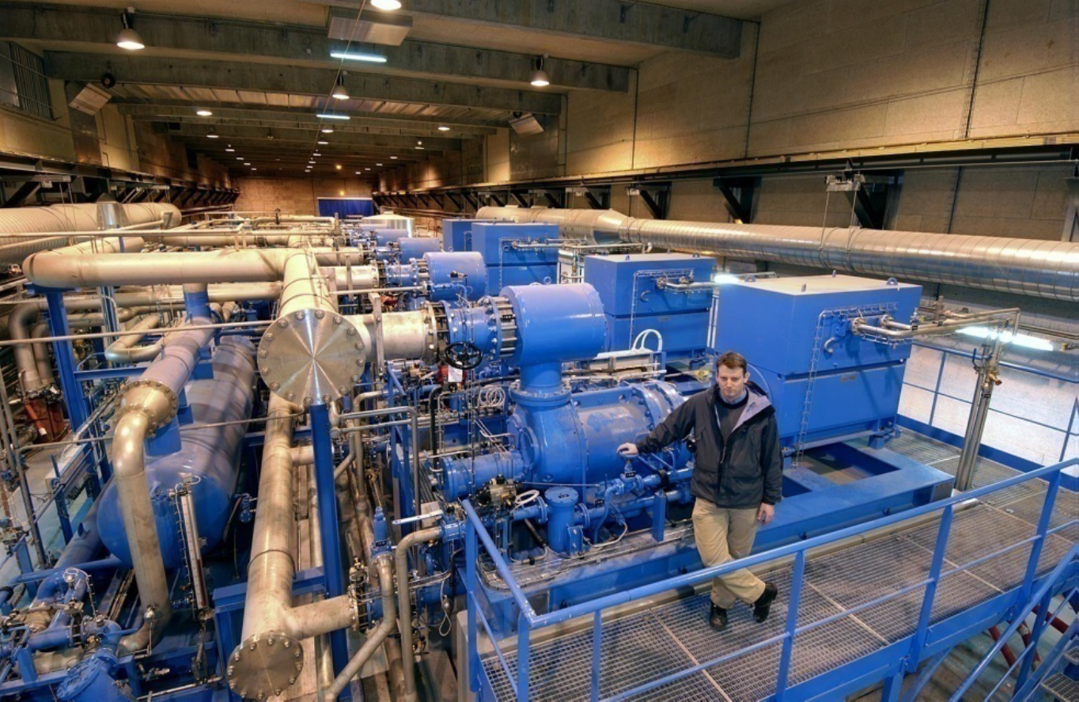
Increasing Reach of SRF Accelerators
Consider these two regimes of SRF accelerators:
Low duty factor, high energy
High duty factor / CW
Gradient in state of the art Nb cavities limited by H_{sh} (quench near ultimate limit)
Large dynamic load
Cost optimum gradient is relatively low: P_{diss} ~ E_{acc}²/Q₀
Image from Rei Hori, linearcollider.org
Image from D. Delikaris, Cryogenics at CERN, 2010
  Cryoplants for large linacs cost ~$100 million and require MW of power
  ILC: 16,000 cavities in 31 km linac
An alternative SRF material with higher H_{sh} and higher Q₀ than niobium could offer dramatic cost savings, increasing reach of SRF accelerators of these types and others
Notes:
LDF1000

Slide 3
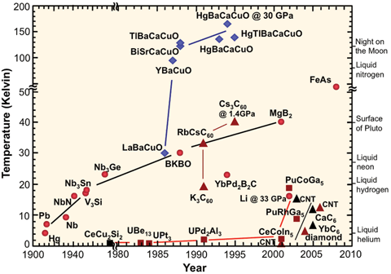
Alternative SRF Materials
Image from Wikipedia
There are many superconductors
Need high Q₀ (large T_{c}), high H_{sh}
Many other important factors to consider
  Fabrication over large, complex geometry
  Easy to clean (e.g. no reaction with water)
  ξ not too small (more on this later)
Nb₃Sn meets these criteria well

Slide 4

Accelerator R&D Subpanel Report
Recommendation 4. Direct appropriate investment in superconducting RF R&D in order to inform the selection of the acceleration technology for the multi-MW proton beam at Fermilab.
Recommendation 6. Increase funding for development of superconducting RF (SRF) technology with the goal to significantly reduce the cost of a ~1 TeV energy upgrade of the ILC. Strive to achieve 80 MV/m accelerating gradients with new SRF materials on the 10-year timescale.

Slide 5
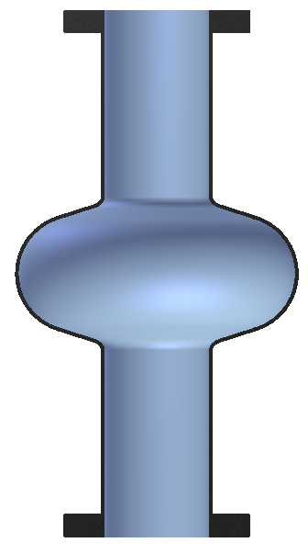
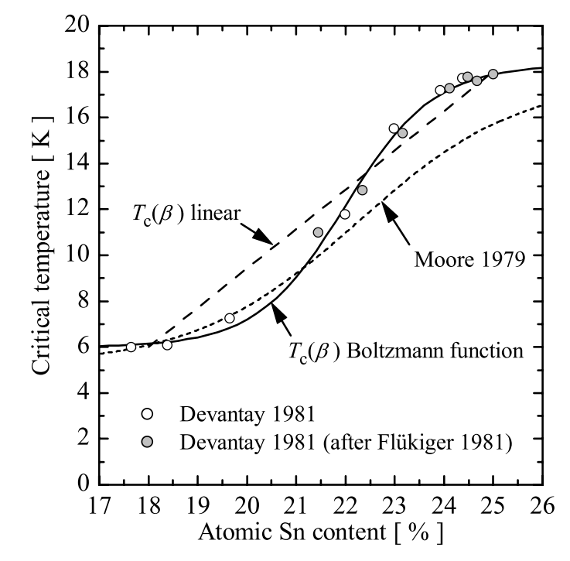
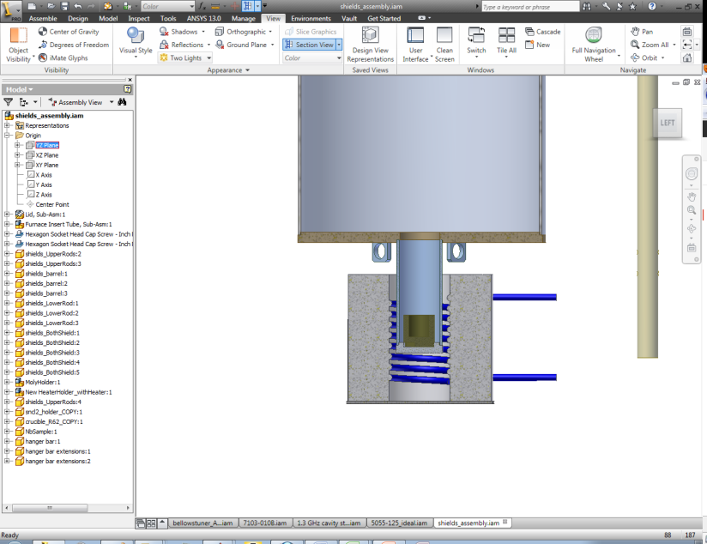
Coating Mechanism: Vapor Diffusion
Sn vapor arrives at surface
Coating chamber in UHV furnace
Nb cavity substrate
Nb
Sn diffusion
Sn
Nb₃Sn
Sn Vapor
T_{f} = furnace temperature
=~1100 C
T_{s} = Sn source temperature
=~1200 C
Heater
By independently controlling Sn vapor abundance, it can balanced with Sn diffusion rate to achieve desired stoichiometry

Slide 6
University of Wuppertal Nb₃Sn Furnaces

Slide 7
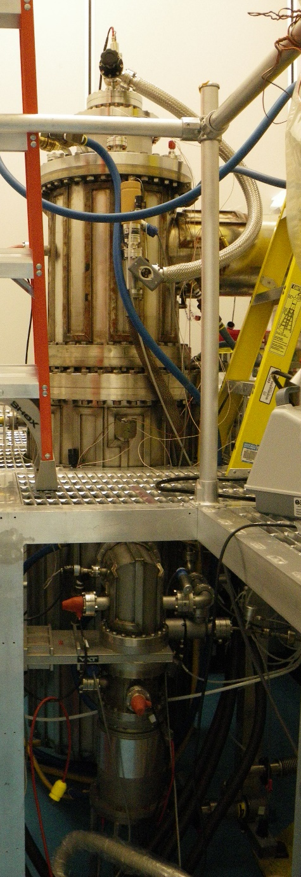
Cornell Nb₃Sn Furnace

Slide 8
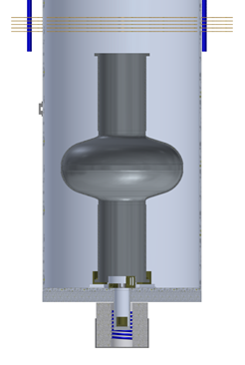
Cornell Nb₃Sn Furnace
Inner heat shields
Tungsten feet
Witness samples
Tin crucible
Tin source heater

Slide 9
Nb₃Sn Q₀(T)
Large T_{c} ~ 18 K
  Very small R_{BCS}(T) – R_{BCS}(T) ~ e^{-1.76Tc /T}
  High Q₀ even at relatively high T
Higher temperature operation
  Simpler cryogenic plant
  Higher efficiency
Possibility of cryocooler operation!

Slide 10
Single Cell 1.3 GHz cavities at Cornell – 4.2 K
N-doped Nb
Approx.
H_{pk} = H_{c1}
of Nb₃Sn
R_{s} 10x smaller
T = 4.2 K

Slide 11
Improved Cooldown – Flat Q₀ !
2x10¹⁰ at 18 MV/m, 4.2 K!

Slide 12
Cryogenic Power Requirements, 1 cell at 1.3 GHz
E_{acc} = 16 MV/m
With Continued R&D

Slide 13
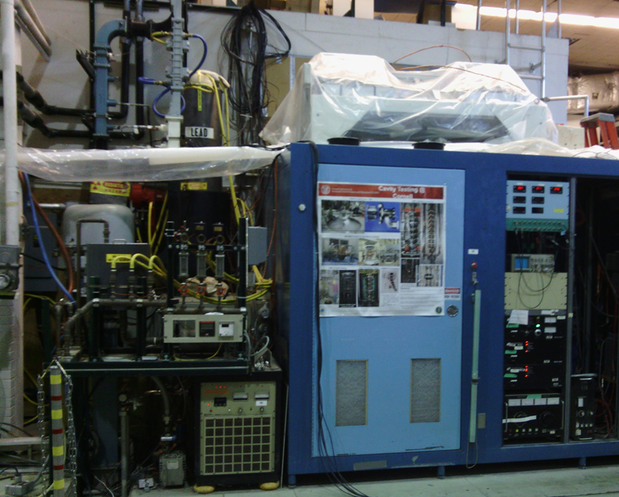
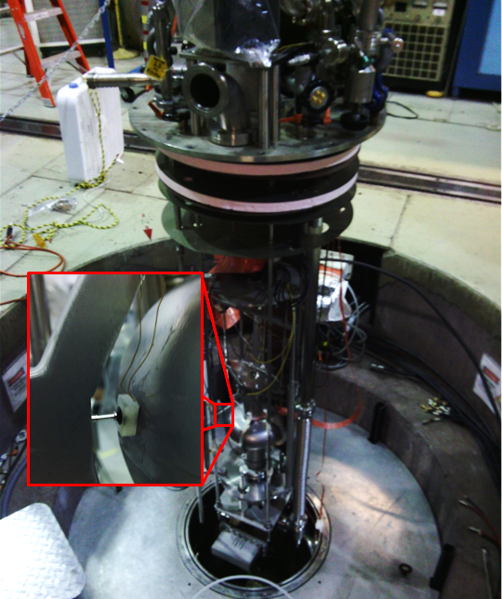
Pulsed Quench Field
Used high power RF (MW) from klystron with short pulses
Measure quench field as a function of temperature
Compare to predicted ultimate magnetic field limit H_{sh}(T)

Slide 14
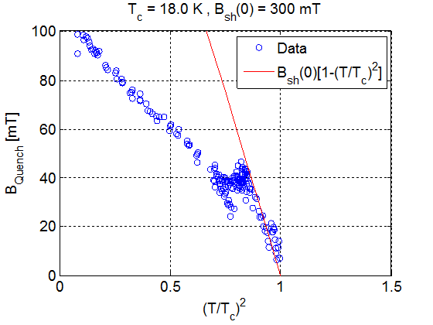
High Gradients – Klystron Measurements
With Continued R&D
Demonstrated close to T_{c} Nb₃Sn follows the expected superheating field of the 18K superconductor.
When extrapolated to 2K this leads to surface magnetic fields of 300 mT
  Nb superheating field 200 mT.
These results suggest that a well prepared Nb₃Sn cavity with optimal shape can reach 80-90 MV/m
Heating at defect/or second phase behavior takes over
Superheaing field
Posen, Valles, Liepe, Phys. Rev. Lett. 115, 047001 (2015)

Slide 15
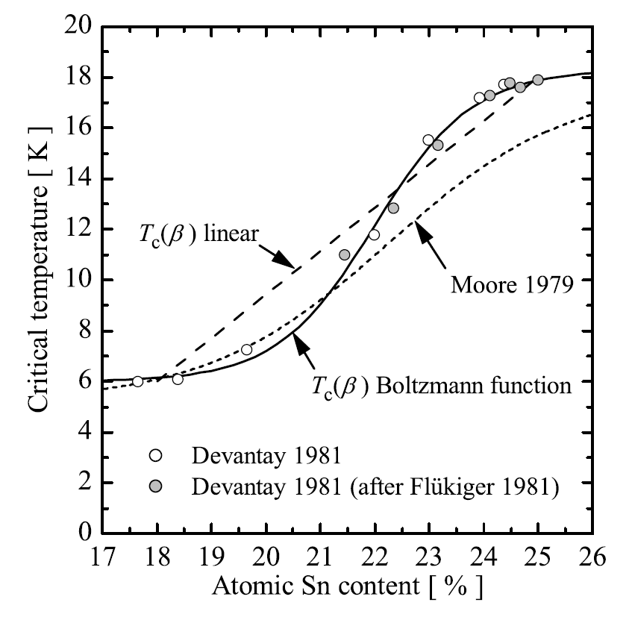
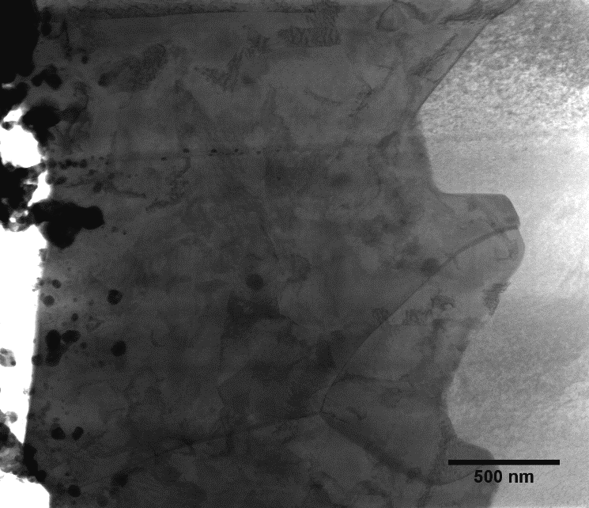
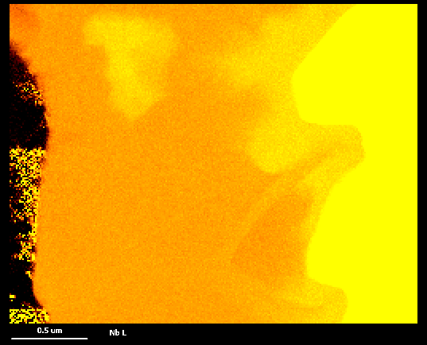
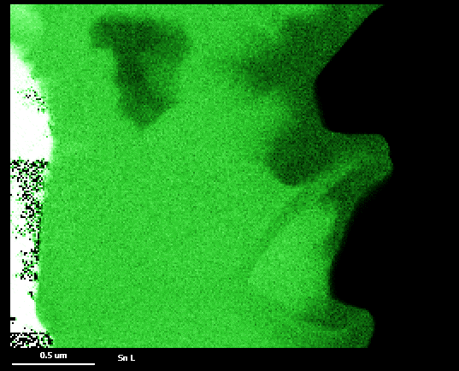
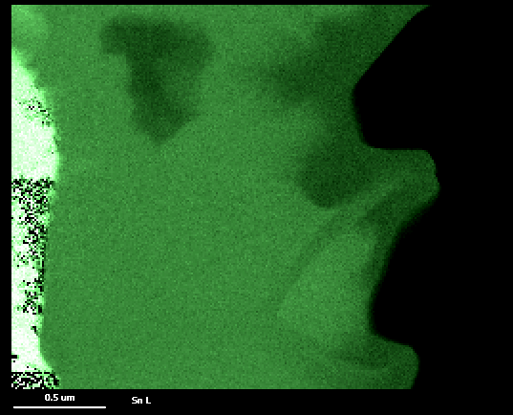
Low Tin Content Regions
A. Godeke, Supercond. Sci. Tech, 2006
Transition?
Nb₃Sn
2
2
Nb
1
1
C. Becker et al., App. Phys. Lett., 106, 082602 (2015).
0.5 μm
Nb L
0.5 μm
Sn L

Slide 16
Nb₃Sn SRF R&D at Fermilab
Increase accelerating gradients E_{acc}
  Optimize coating process to eliminate low tin content regions
  Study fundamental field limits of Nb₃Sn with high power RF
  Study influence of surface roughness
Increase quality factors Q₀
  Study origins of residual surface resistance
  Reduce influence of thermocurrents
  Retain high Q₀ to high fields
Parameters for new recipe
Coat 9-cell sample cavity, measure uniformity
Coat multi-cell cavities, RF test
Coat samples then measure SEM/EDX, PPMS
Coat 1-cell cavities, RF test w/ T-map
Feedback for coating parameters: T_{c}, microstructure, composition, uniformity, R_{s}, quench field….

Slide 17
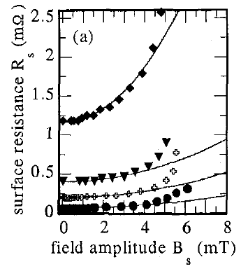
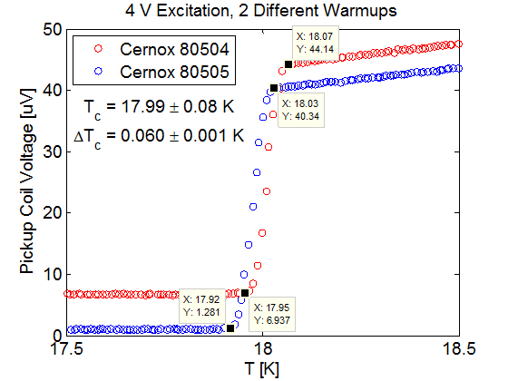
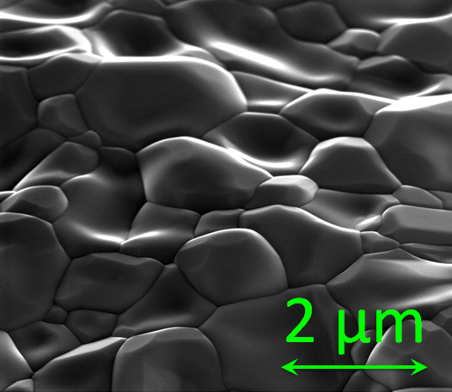

Nb₃Sn SRF R&D at Fermilab
Why vapor diffusion?
  Proven high quality SRF results
  Micron-sized grains
  Favorable phase diagram
  Quite smooth surfaces
Coating chamber in UHV furnace
Nb cavity substrate
S. Posen et al., Cornell U.
Sn Vapor
M. Hein et al.
Wuppertal University
20 GHz Samples on Sapphire with grain size ~450 nm
Heater

Slide 18
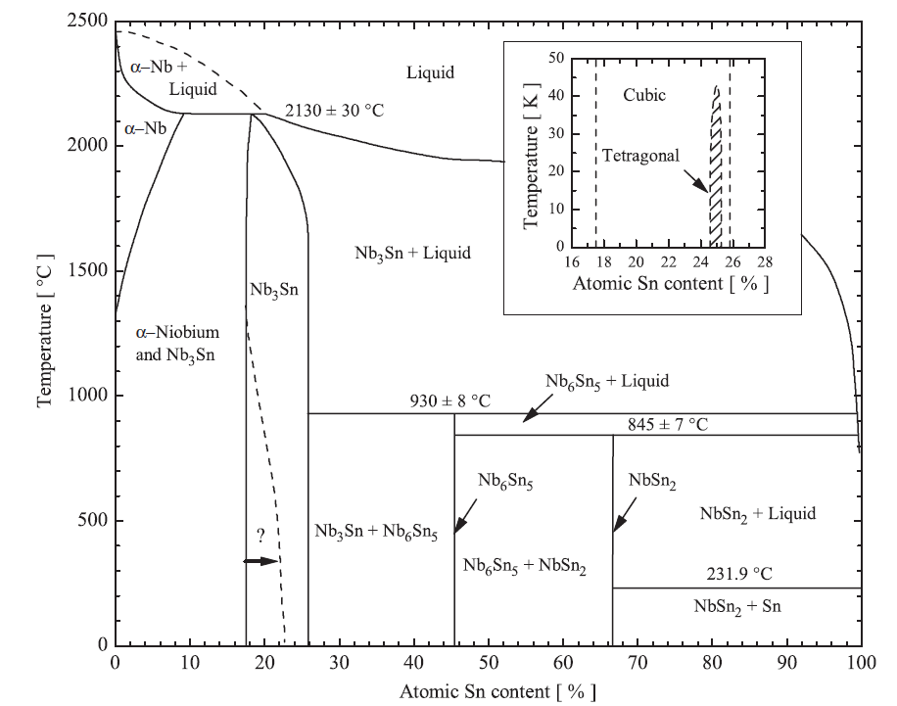
Nb₃Sn SRF R&D at Fermilab
Why vapor diffusion?
  Proven high quality SRF results
  Micron-sized grains
  Favorable phase diagram
  Quite smooth surfaces
Coating chamber in UHV furnace
Nb cavity substrate
S. Posen et al., Cornell U.
Sn Vapor
M. Hein et al.
Wuppertal University
20 GHz Samples on Sapphire with grain size ~450 nm
Heater

Slide 19
Nb₃Sn SRF R&D at Fermilab
Why vapor diffusion?
  Proven high quality SRF results
  Micron-sized grains
  Favorable phase diagram
  Quite smooth surfaces
Coating chamber in UHV furnace
Nb cavity substrate
S. Posen et al., Cornell U.
Sn Vapor
M. Hein et al.
Wuppertal University
20 GHz Samples on Sapphire with grain size ~450 nm
Heater

Slide 20
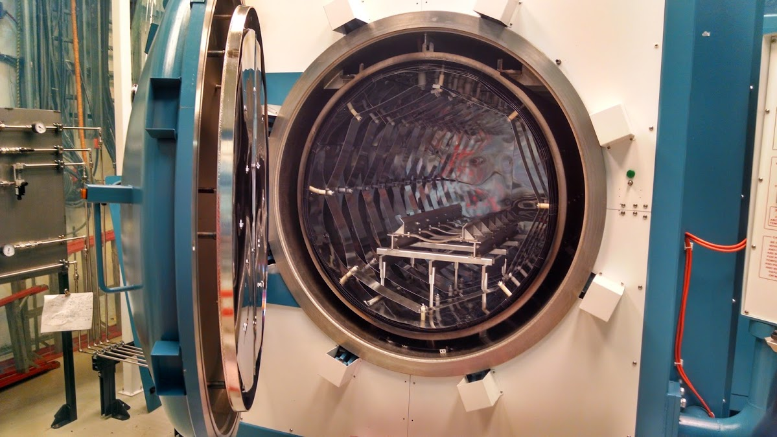
Fermilab Furnace

Slide 21
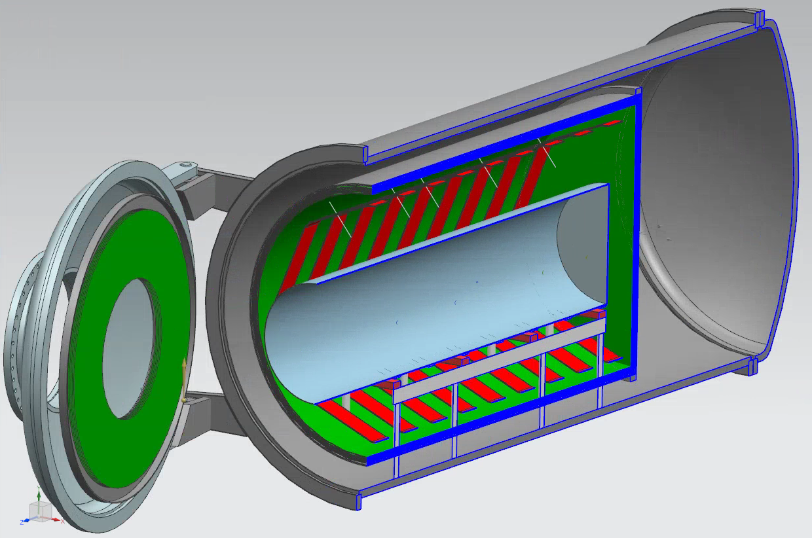
Coating chamber (Nb)
Modified door

Slide 22
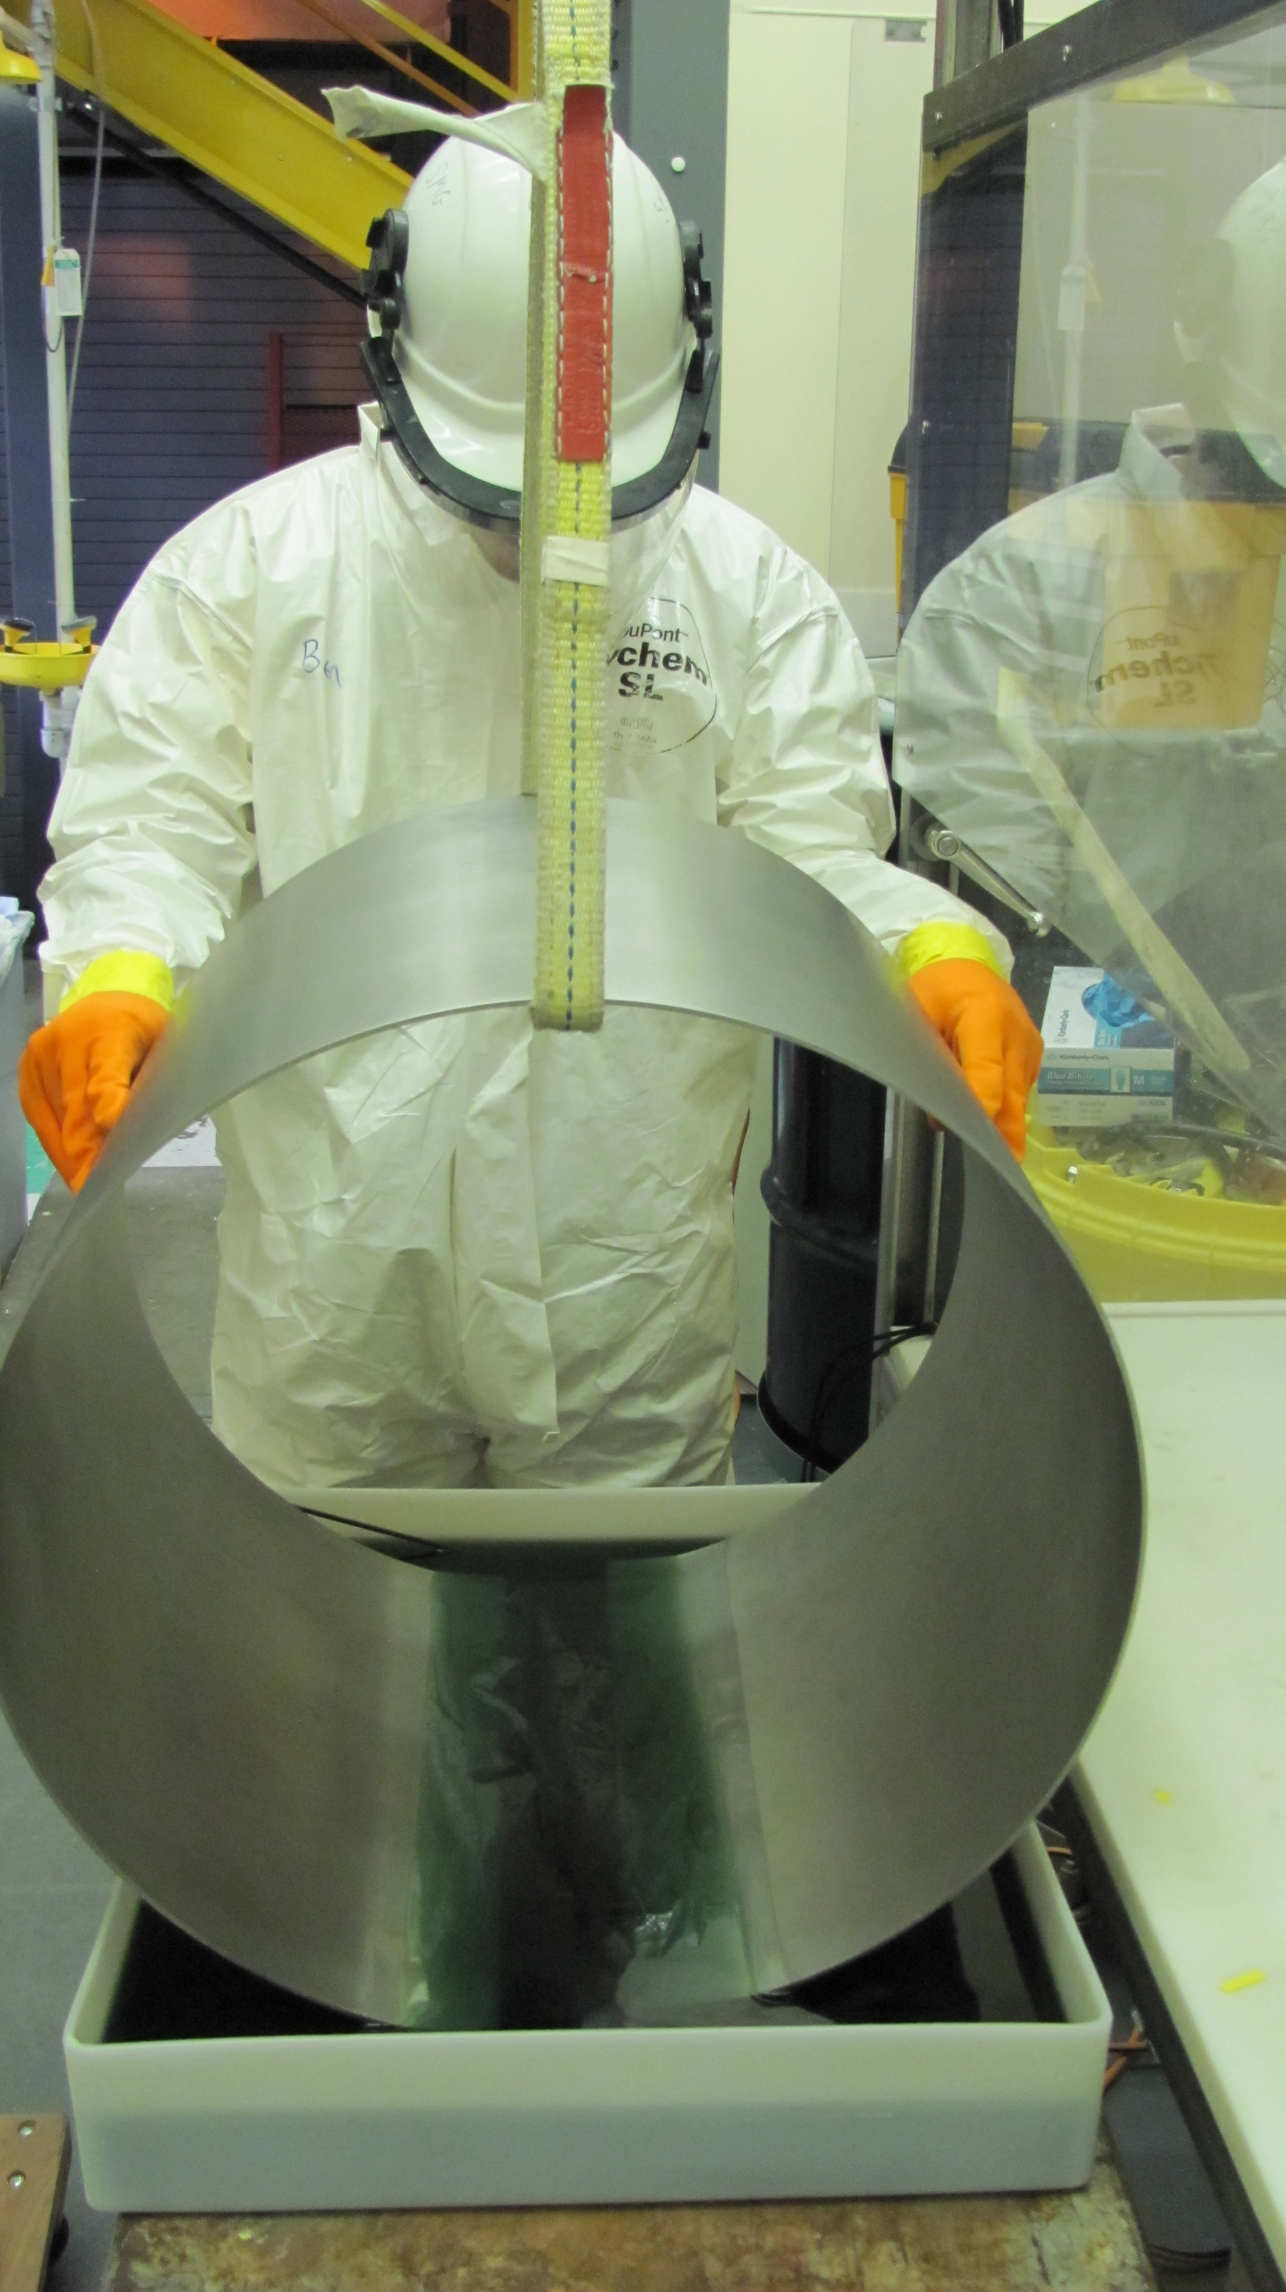
Coating chamber (Nb)
Modified door

Slide 23
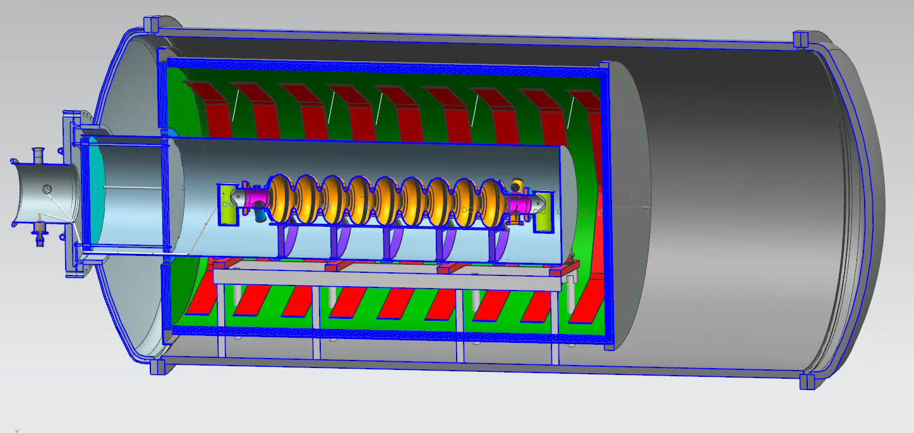
1.3 GHz 9-cell
Inner heat shields
Coating chamber (Nb)
Modified door
Chamber support
Cavity support (Nb)
Tin Source

Slide 24
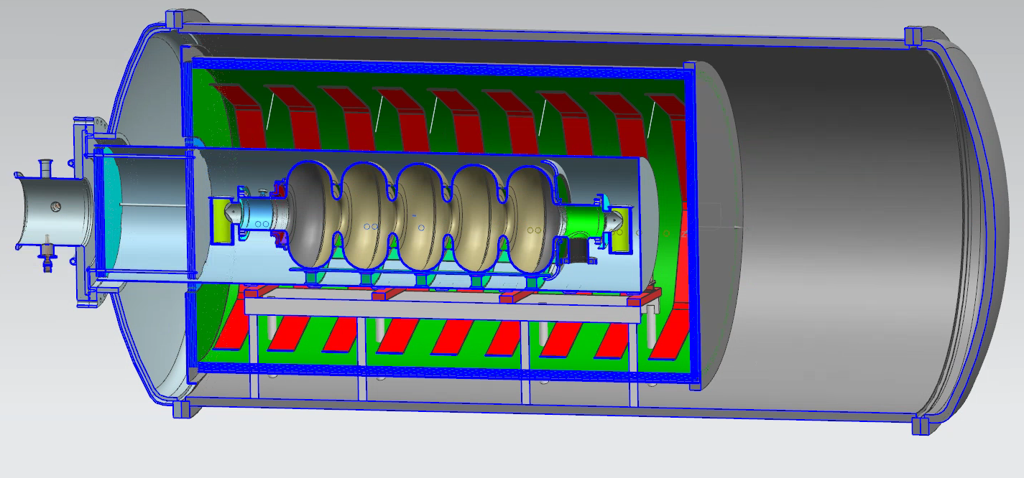
650 MHz 5-cell

Slide 25
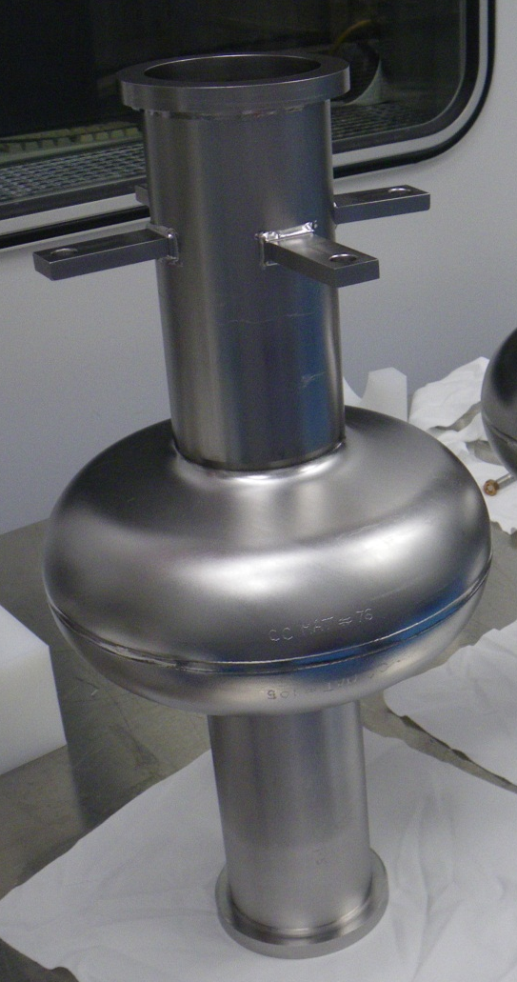
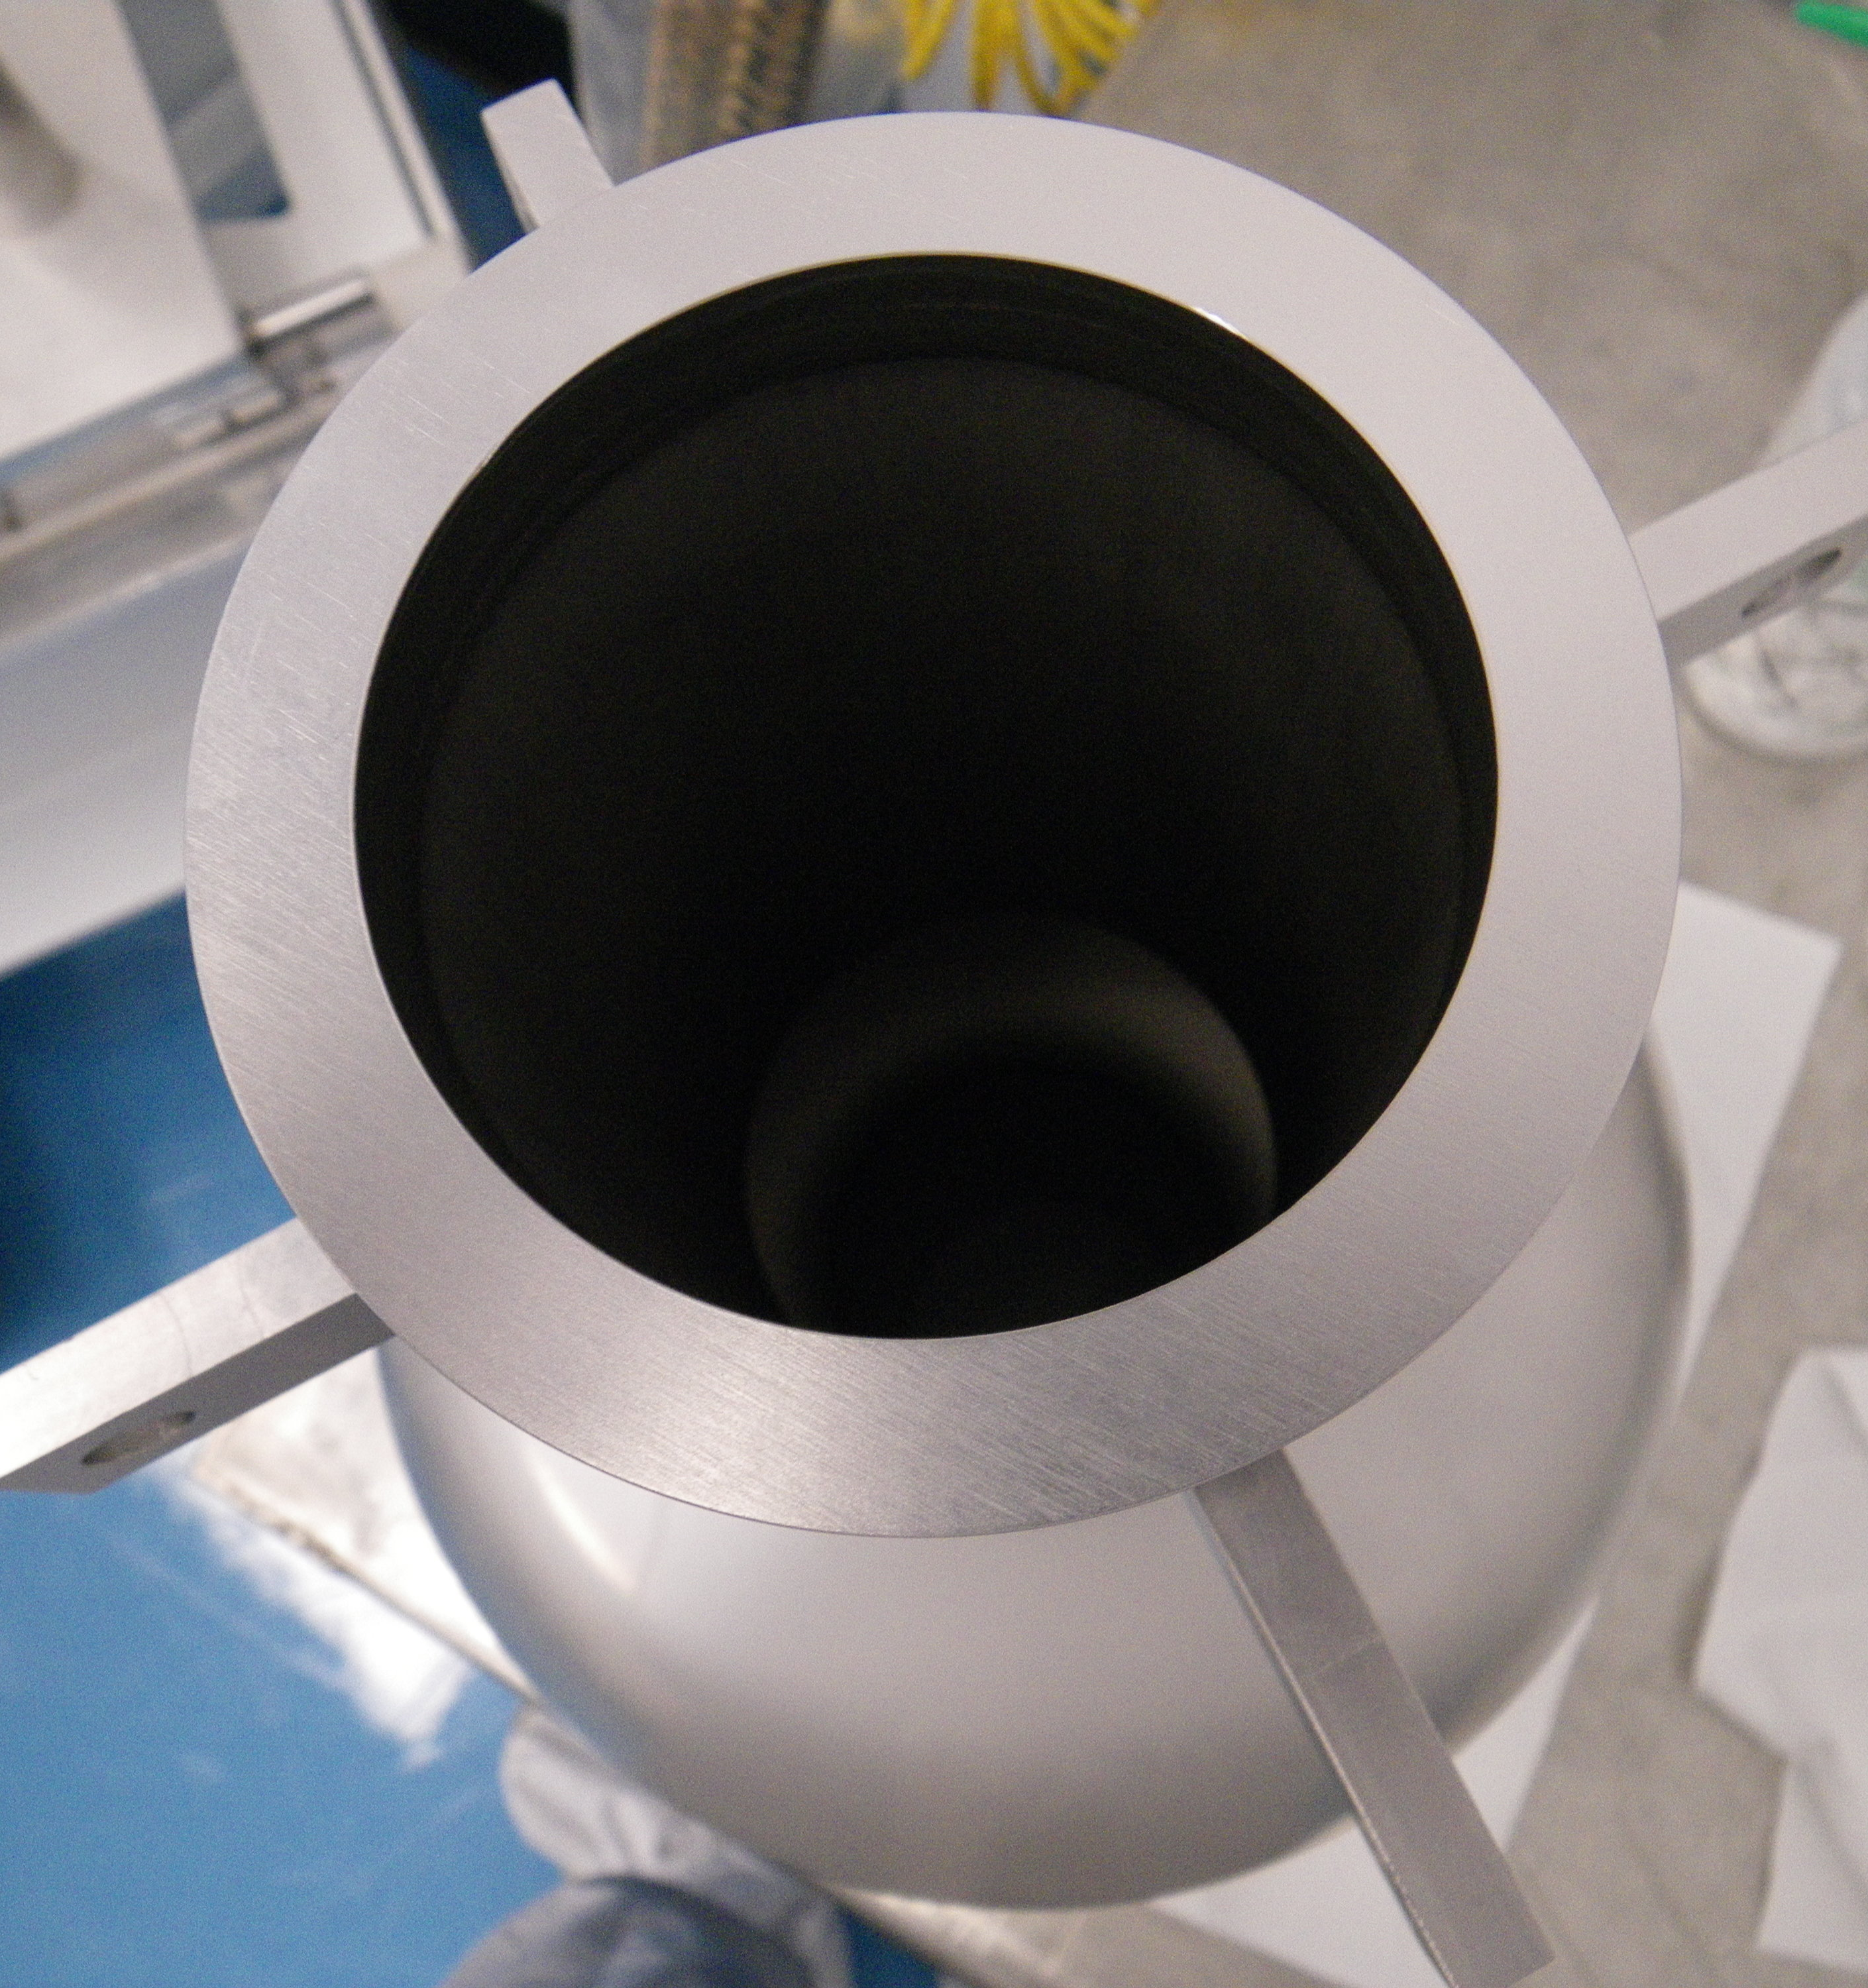
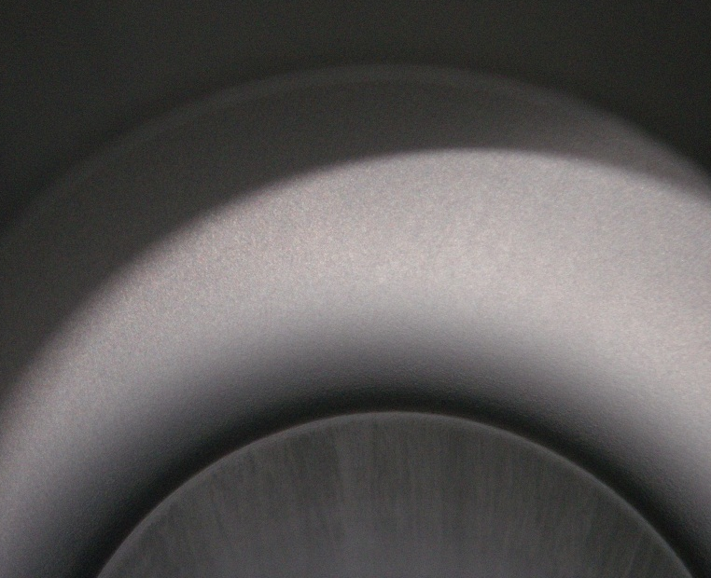
Summary
Nb₃Sn extremely promising alternative material for SRF
  High Q₀ even at high temperatures (++cryogenic efficiency)
  Predicted ultimate gradient limit twice as high as Nb
R&D initiative supported by LDRD
  Advance state of the art, both E_{acc} and Q₀
  Scale up to coating production-style 9-cell 1.3 GHz and 5-cell 650 MHz cavities for the first time

