Slide 1
Simulations update: Injection into DR and multi-turn
Diktys Stratakis
Muon campus beam dynamics meeting
January 06, 2016

Slide 2
Recent progress
What is done so far:
G4BL model for Target-M2-M3
G4BL model for DR
G4BL model for M4-M5
Injection model into DR
What is not done, yet:
Realistic aperture model for injection
Multi-turn studies
Extraction model from DR
Tracking for M4-M5
Fix iron thickness for dipoles

Slide 3
Model for M2-M3 beamlines
Target
Li lens
Collimator
PMAG
Q812
H812
Q706
Q726
H726
Q727
Q728
Q729
H729
Q730
Q752
Q751
V750
Q750
Q749

Slide 4
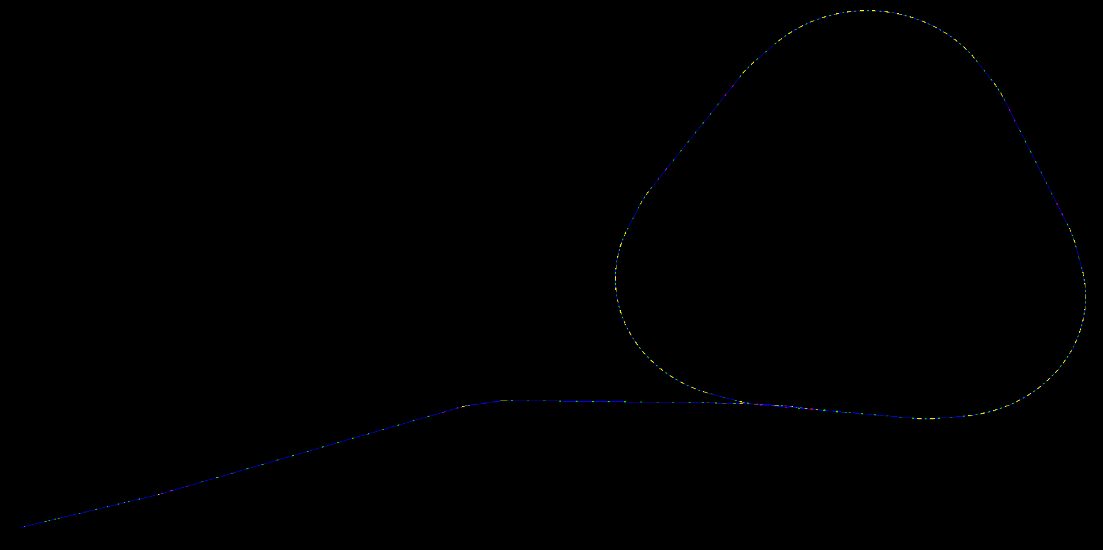
Model for M2-M3-DR
Target
lens
Collimator
PMAG

Slide 5
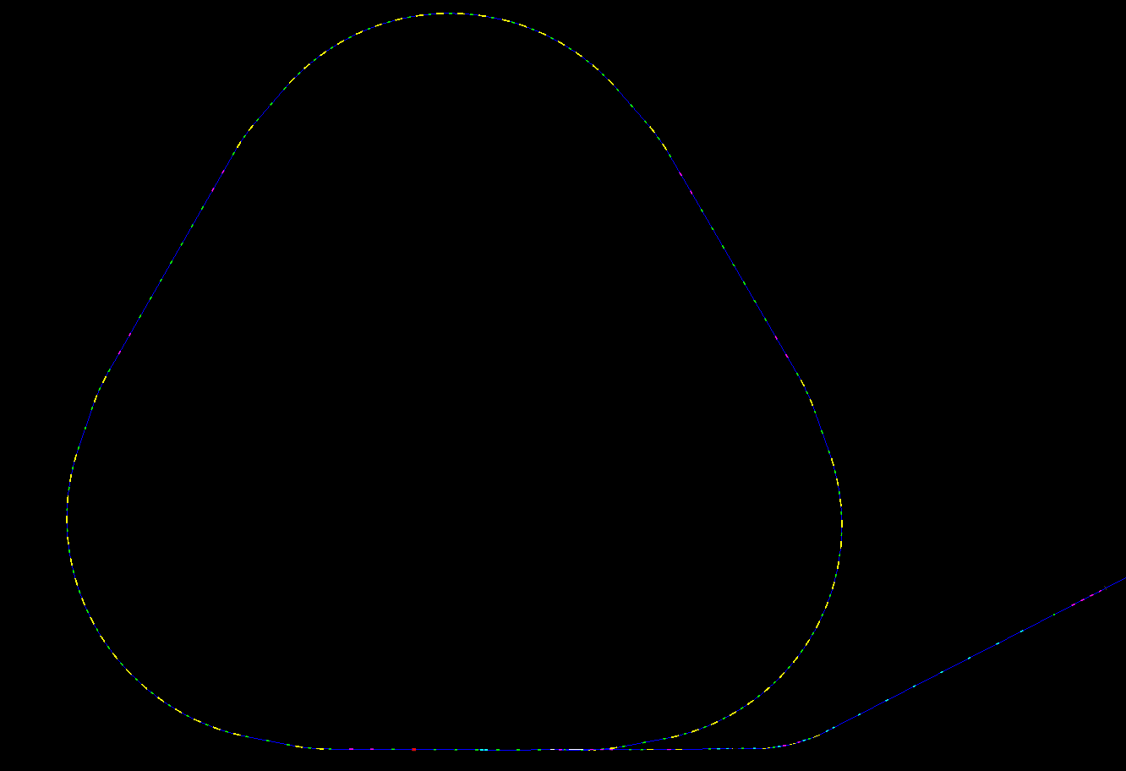
Model for DR-M4-M5
To ring

Slide 6
Injection to DR
116 mm
58 mm
14 mm
29.94 mrad
-14.15 mrad
3.67 mrad
The biggest improvement in the current model is that now G4Beamline can handle “off-axis” trajectories in quadrupoles.
This is crucial for injection and extraction
But note: Q303, Q302, Q301 apertures are unrealistically huge. This will be revised in the next model update

Slide 7
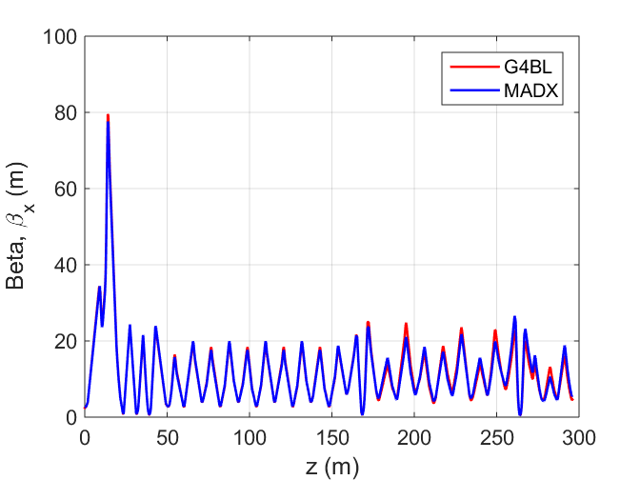
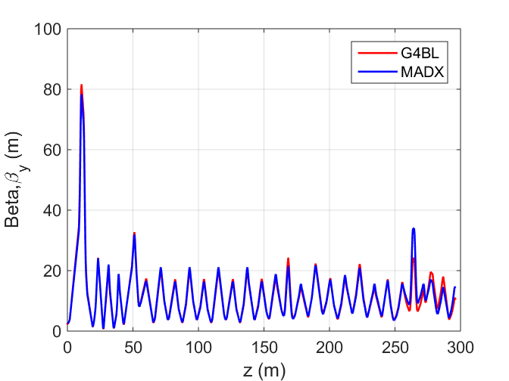
Optics model cross-check
MAD8 model available: g2-doc-700-v13
A comparison of the lattice functions between MAD8 and G4BL shows satisfactory agreement

Slide 8
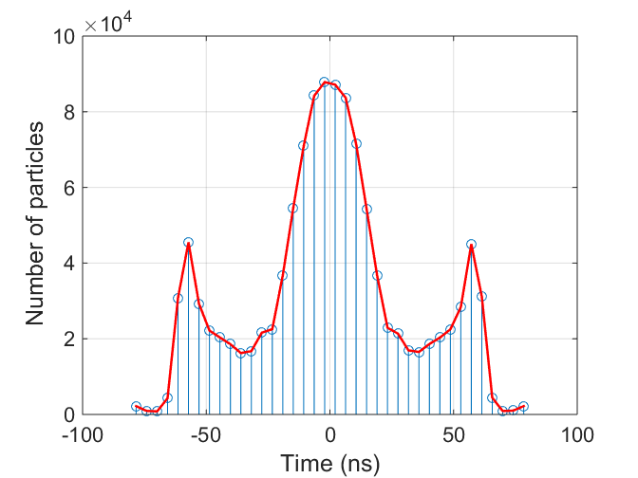
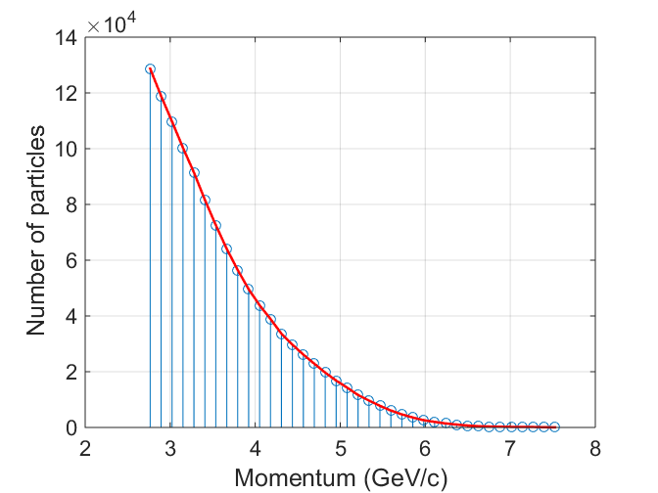
Beam distribution after target
Use distribution published at: g2-doc-3277
Is the result of 8 GeV 10⁹ POT

Slide 9
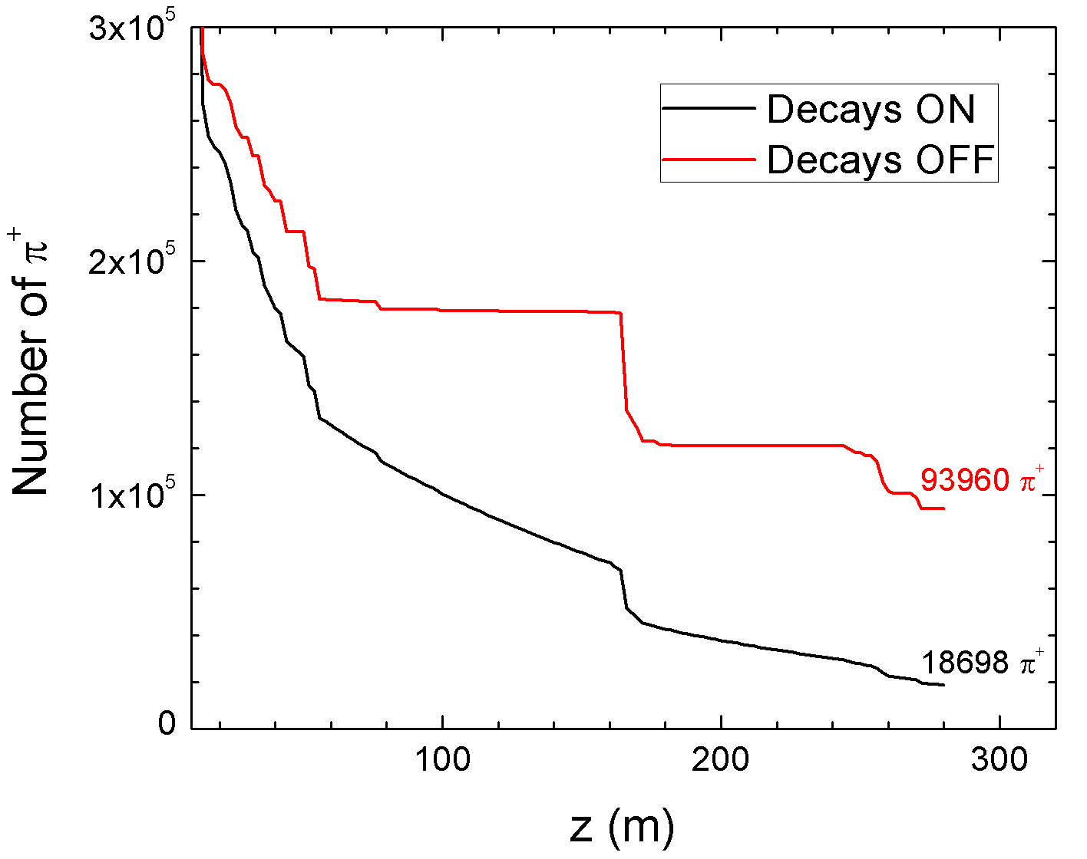
Pion transport on M2-M3
CMAG
G4BL cross-check at CMAG:
9.2x10⁻⁵ pions per proton - no decays (Diktys)
9.3x10⁻⁵ pions per proton - no decays (Volodya g2-doc-1668)

Slide 10
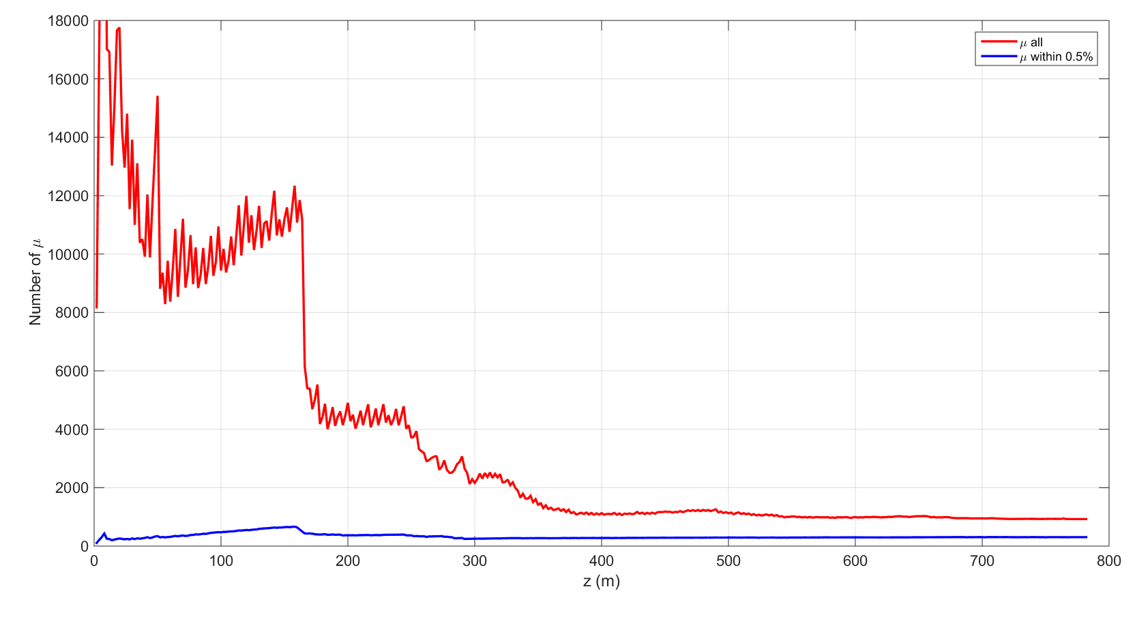
Performance after one turn
1000 all
350 in 0.5%
G4BL cross-check :
0.30x10⁻⁶ muons per proton in 0.5% (Diktys)
0.25x10⁻⁶ muons per proton in 0.5% (Volodya g2-doc-1668)

Slide 11
Next steps
My numbers are close to Volodya’s
It would be interesting to cross-check with Maxim, too
Next steps will be:
Complete multi-turn operation
Model extraction
Tracking through M4-M5
Fix apertures & steel: dipoles, Q303, Q302, ….
Improve statistics
Goal is to complete this effort by the next g-2 collaboration meeting

Slide 12
Agenda for next phone meetings
Jan 20:
Update on BMAD (Maxim)
Feb 3:
Status of storage ring simulations (Nathan?)

