Slide 1
MICE RF Module Update
Andrew Lambert
01/08/2016

Slide 2
Items
Vacuum vessels
1st shipment from Keller on 02/01/2016
Actuator production
RF coupler production
Clean room preparation
Assembly preparation

Slide 3
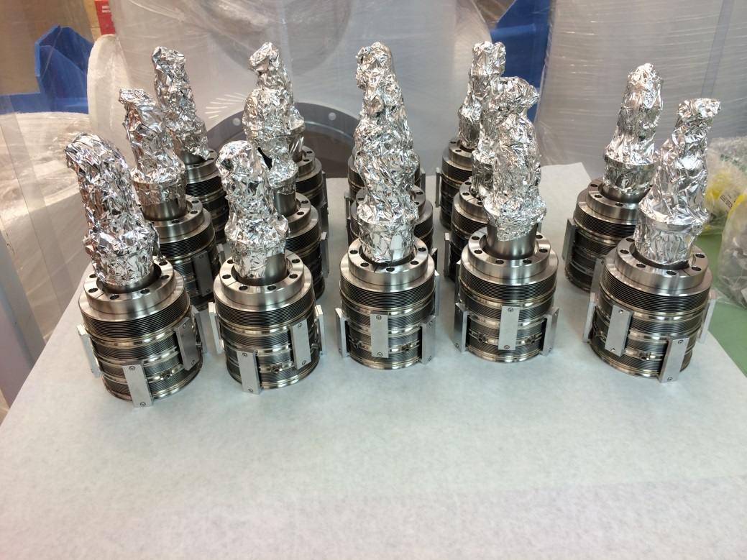
Actuators
14 actuators are completed
Vacuum tight
Leak tight
12 required for operation
2 working spares
2 additional spares that need repair
Low priority
Will fix once other welding tasks are completed (couplers, water feedthrough lines)

Slide 4
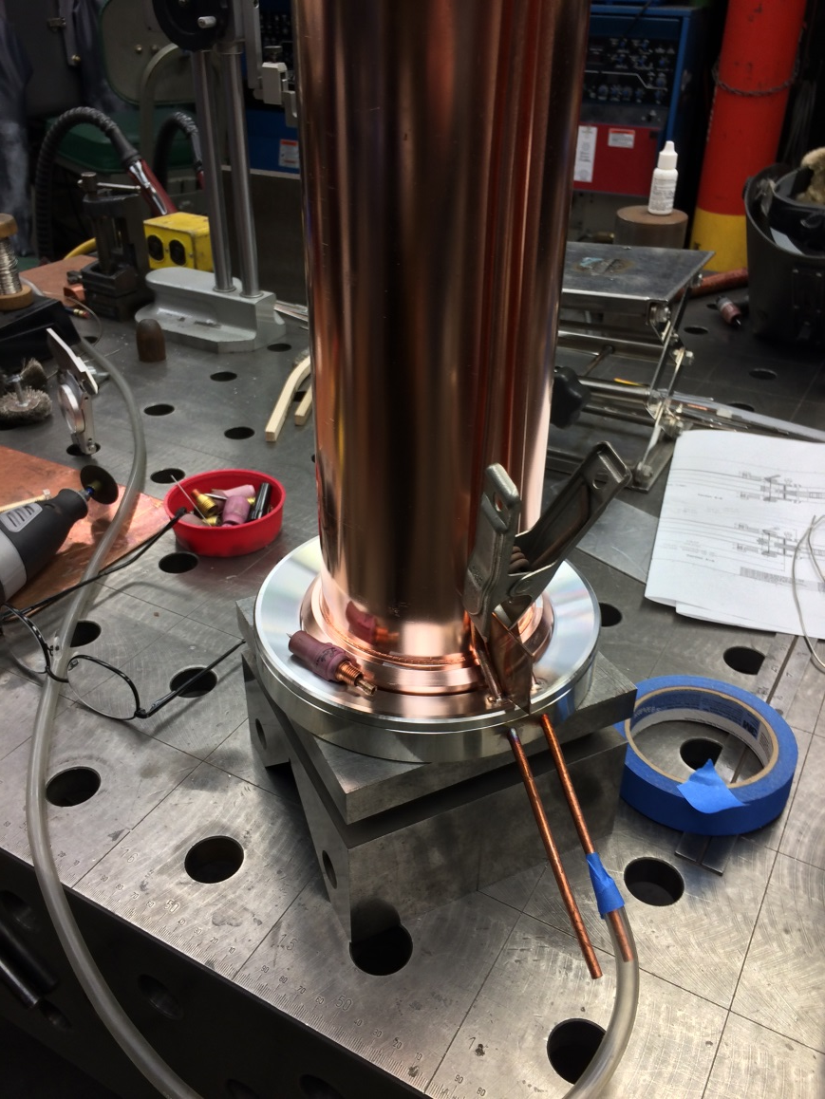
RF Couplers
All welds on the first two RF couplers are complete, one is vacuum tight, the other is in repair for minor vacuum leaks
Will begin assembly immediately after 2nd coupler is leak tight
Ship two fully assembled couplers (minus cooling line fixtures) to FNAL MTA – do these go to RAL as spares when MTA testing is finished?
Continuing with the welding and assembly of the remaining 4 couplers
What will be done with the current RF couplers at the MTA?

Slide 5
Clean room preparation
New curtains
Ordered, waiting on arrival
Linoleum flooring
Ordered, waiting on arrival
Ceiling work
Additional ceiling filtration units in-hand
Will begin installation next week
Changing tent
Bids out, will purchase and install

Slide 6
Assembly preparation work
Waiting on equipment from FNAL
Items should arrive next week
Cleanroom item procurement
Underway
Measured the two MICE cavities for tuner arm machining
Tuner arms being machined to nominal dimension; shimmed into place during assembly
Fabricating shims
Water feedthrough welds on cavity
Starting this process

Slide 7
Summary
Actuators
Completed 12 + 2 spares
RF couplers
2 for FNAL MTA near complete
Next 4 for MICE underway
Clean room prep
Underway
Assembly prep
Tuner arm machining
Feedthrough welding
Staging

