Slide 1
Review of Electrical Safety 2015
Heath Garrison, NREL
Heath.Garrison@nrel.gov
303-384-7408
July 18, 2016

Slide 2
Introduction
The number of reported electrical safety events has shown a slight decreaseover the year.

Slide 3
Why should we be Concerned?
Electrical hazards cause more than 300 deaths and 4,000 injuries in the workplace each year. Electrical accidents rank sixth among all causes of work-related deaths in the United States.
Construction trades and installation, maintenance, and repair professionals were the top two groups with the most fatal electrical injuries from 2003 to 2007 (BLS data).
The greatest number of nonfatal electrical injuries occurred in the construction industry, followed by the manufacturing industry. During the five-year period, 42 percent of victims in the construction industry suffered electrical shock injuries and 58 percent were treated fro electrical burns.
DOE has had only one electrical fatality in the past seven years.

Slide 4
The Data Set
The data set included 146 ORPS reports that were reported during CY-2015 and coded for electrical safety issues. They account for 15 percent of all ORPS reports.

Slide 5
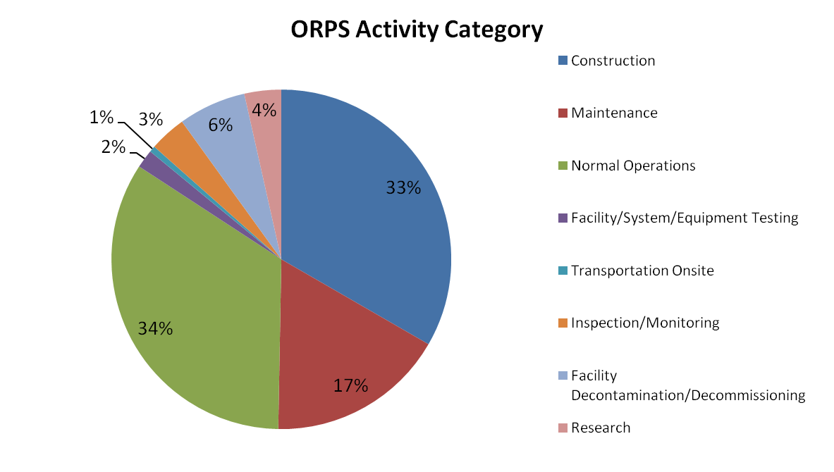
What were the Work Activities?
Construction and Maintenance accounted for half of the reported electrical safety events.

Slide 6
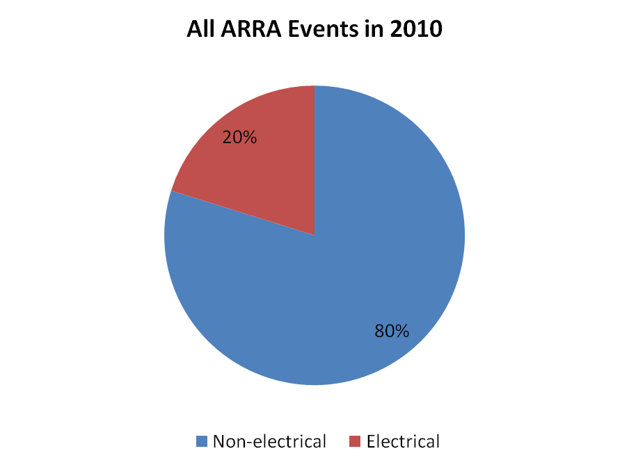
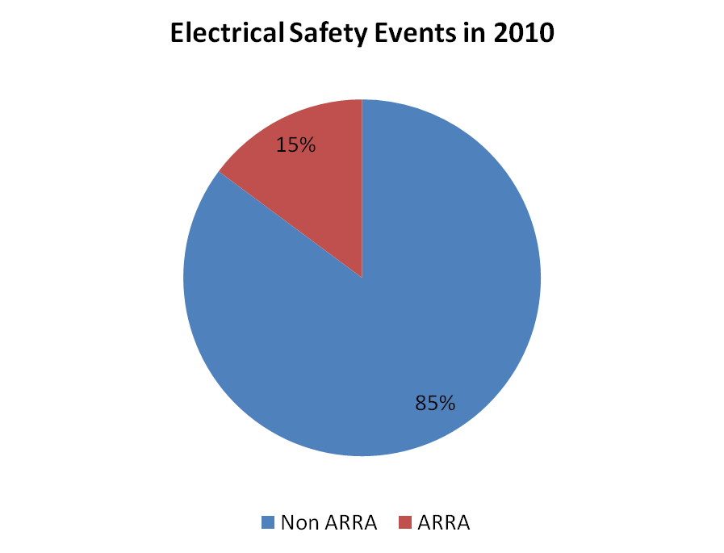
Was ARRA Work Involved?
Nine percent of all ORPS reports in 2010 were reported under ARRA work. The following charts show the distribution of ARRA reports for electrical events.

Slide 7
What Offices were Involved?

Slide 8
How do Worker Types Compare?
The following charts show a comparison of Electrical Workers versus Non-Electrical Workers.

Slide 9
Who were the Workers?
Electrical Workers – 40%
Non-Electrical Workers: 27%
Electrical Subcontractors: 23%
Non-Electrical Subcontractors: 9%

Slide 10
Event Outcomes

Slide 11
Electrical Shock Events
There were 37 shocks in CY-2015. The average over the past seven years is 31 shocks per year. Two of these events resulted in significant injury and received high electrical severity scores. Both events involved site employed electrical workers.

Slide 12
Electrical Shock Events
(Continued)
High Severity Event
High Severity Event

Slide 13
Electrical Intrusion Events
The overall trend of electrical intrusions for the year was favorable.
Notes:
Excavation increased but vehicle intrusion and penetration/cutting events decreased.

Slide 14
Hazards Recognition
During the year, workers recognized potential hazardous conditions 74 percent of the time.

Slide 15
Hazardous Energy Control and Job Planning
The seven-year average is 54 LOTO events and 30 job planning events per year. The trend in LOTO events and issues with job planning increased over the year. CY-2015 LOTO and job planning events are above average totaling 57 and 37 events, respectively.

Slide 16
Electrical Severity
The Electrical Severity Index increased dramatically in CY-2015 due to two high scoring events; one of which obtained one of the highest severity scores ever recorded throughout the DOE complex at 42,000.

Slide 17
Electrical Severity
(Continued)
Notes:
Last Extreme ES was in September 2009 at Savannah River when an electrician received burn injuries while troubleshooting energized electrical equipment.

Slide 18
ORPS Cause Codes
Three cause codes were majority of codes entered in the CY-2015 electrical event reports
Management Problems (105 entries)
Management Methods
Management policy guidance/expectation not well-defined, understood or enforced
Management direction created insufficient awareness of the impact of actions on safety/reliability
Work Organization & Planning
Job scoping did not identify special circumstances and/or conditions
Inadequate work package preparation
Human Performance Problems (83 entries)
Skill Based Errors
Check of work was LTA
Incorrect performance due to mental lapse
Knowledge Based Error
Attention was given to wrong issues
Incorrect assumption that a correlation exists between two or more facts
Communication Problems (46 entries)
Written Communication Content
Incomplete/situation not covered
Ambiguous instructions/requirements
Verbal Communication
Communication between work groups
Shift communications

Slide 19
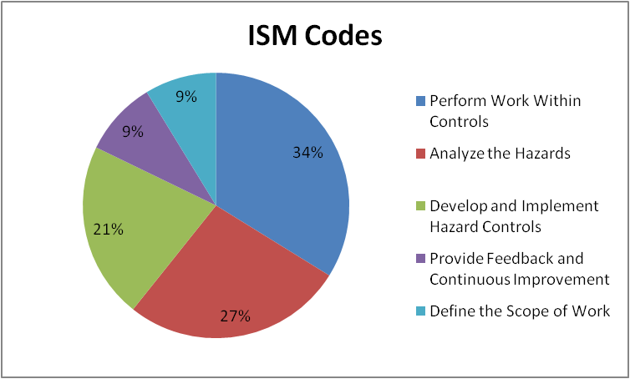
Integrated Safety Management
The distribution of ISM codes for electrical safety events are almost identical to the distribution for all 1,287 ORPS reports for CY 2010.

Slide 20
Work Management Issues
Supervisors – failed to adequately supervise the workforce and to ensure that management expectations were well-defined, understood and enforced.
Work Organization and Planning – work package preparation, job scoping, and job planning were less than adequate.
Work Control Documents – contained incomplete or ambiguous instructions or requirements.
Communications – between work groups and between shift workers was less than adequate.
Workers – failed to check work, follow procedures, or remain focused on the task at hand.

Slide 21
Improving Areas
We have seen improvements in the following areas:
Hazards Recognition
Electrical Intrusion Events
This is not good for us. In years past there were several more areas of improvement.

Slide 22
Thanks for Support
Our contact information:
Kelli Urban
NREL – Electrical Safety Officer Administrative Support and Scheduling
303-275-3292
Heath Garrison
NREL – Electrical Safety Officer Field Manager / AHJ
303-384-7408

Slide 23
QUESTIONS

