Slide 1
Lithium Ion Battery Safety
Lloyd Gordon, Nicole Graham
07/18/2016

Slide 2
Intended Audience
Electrical AHJ – Should be aware of the hazards of R&D use of LiIon batteries, errors that will lead to failure, and steps to assure safety.
Users - Should be aware of potential risks, counterfeit items, increased regulations, and proper disposal in order to effectively use the product and prevent hazards such as fires.

Slide 3
Battery Applications
The primary use of batteries is for:
  portable equipment
  uninterruptible power supplies, large and small
Batteries are also used in the laboratory to:
  bias or power instrumentation, coils, etc. in an isolated state
  provide large dc currents for relatively short times
Notes:
99% of all battery use at the lab is in the top two.
Remember that every room at the lab has a UPS for emergency lighting.

Slide 4
Technical Terms - Parameters and Units
Parameter | Symbol | Unit | Symbol
Voltage | V | Volt | V
Current | I | Ampere | A
Time | t | second | s
Power | P | Watt | W
Energy | E | Joule | J
Charge | Q | Coulomb | C
Length | l | meter | m
Capacity |  | Ampere-hour | A-hr
p = pico = x10⁻¹² | k = kilo = x10³
n = nano = x10⁻⁹ | M = mega = x10⁶
μ = micro = x10⁻⁶ | G = giga = x10⁹
m = milli = x10⁻³ | T = tera = x10¹²
Notes:
Skim through top ones, but focus on C, charge, and Capacity. Show them the equation.
Definition of current I = Q/t
Multiply through by t
I x t = Q
1 Amp x 1 second = 1 coulomb
Thus, capacity is the total charge in the battery.

Slide 5
Definitions 1
Cell - a single self-contained electrochemical system capable of delivering electrical power and comprising an anode, a cathode, electrolyte, separator, and containing structures.
Anode - the electrode in an electrochemical cell where oxidation takes place. It is the negative electrode of a primary cell.
Cathode - the electrode in an electrochemical cell where reduction takes place. It is the positive electrode of a primary cell.
Electrolyte - a conducting medium in which the flow of electric current takes place by migration of ions.
Separator - porous, nonconductive material interposed between the electrodes of a cell to prevent internal short circuits.
Battery - a single cell or several cells connected in series or parallel.
Battery Bank - several batteries connected in series or parallel.
Notes:
Hit Cell, Battery, and battery bank.
Briefly mention the four key components inside the case:
Anode, cathode, electrolyte, separator.
The electrolyte may be liquid, gelatin, or solid

Slide 6
Definitions 2
Primary battery - a non rechargeable battery
Secondary battery - a rechargeable battery
Capacity - the total number of ampere-hours that can be withdrawn from a fully charged cell or battery under specified conditions of discharge.
Overcharge - electrical charge or process in which more charge is supplied to a battery than is required to convert the electrodes to the fully charged state.
Overvoltage - difference between the operating voltage of a cell on charge or discharge and the open-circuit voltage of the cell, both at the same state of charge.
Polarization - departure of the voltage of an electrode or of a battery from its equilibrium value.
Reversal - process in which discharge current is forced through a cell after its capacity has been exhausted.
Notes:
Focus on primary and secondary
Do not go over the others, just for information.

Slide 7
Definition 5
Battery Explosion - an energetic event resulting in a battery coming apart in two or more pieces
Venting - a release of pressure, sometimes with flame, but battery stays together
Notes:
Very briefly, these are from UL standard for Lithium Ion Batteries.

Slide 8
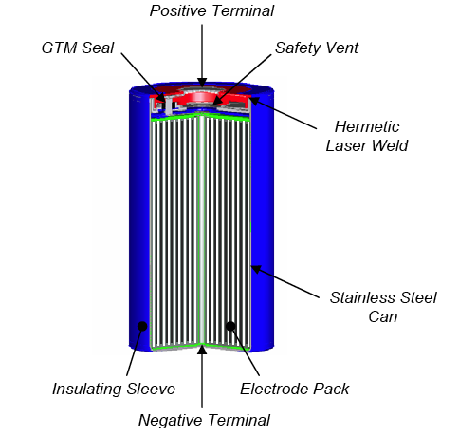
Li-Ion battery construction
Notes:
Explain construction with hands.
Copper foil strip with carbon powder
Aluminum foil with Cobalt oxide powder
Two layers of separator (four layers total)
Liquid organic polymer electrolyte.
All rolled up, put in stainless steel can

Slide 9
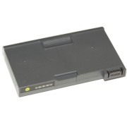

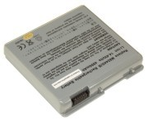
Laptop Lithium-Ion Batteries
Notes:
Protected by embedded cryptocode. Can NOT be counterfeited.

Slide 10
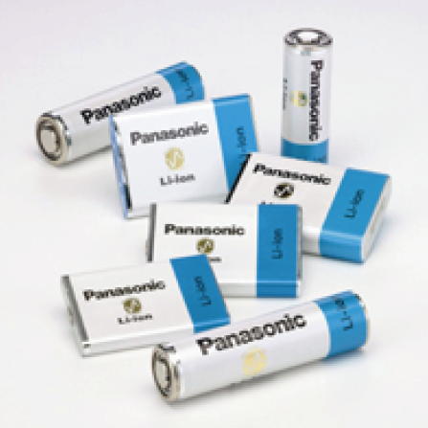
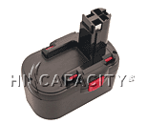
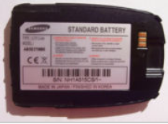
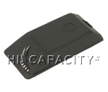
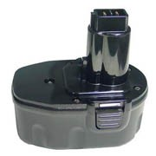
Lithium-Ion and Lithium-Polymer Batteries
Notes:
There have been 18 injuries to the hands and face in U.S. from counterfeit cell phone batteries. Buy from manufacturer, phone company or reputable distributor.
Do not buy highly discounted, or off of the web from discount company.
Power tools and portable medical emergency equipment (e.g., AEDs) use Lithium Polymer, because they can deliver higher currents and withstand higher temperatures.

Slide 11
Types of Lithium Ion Batteries
Lithium Ion (MgCo)
LiIion Polymer
LiIon Nanophosphate
Etc.

Slide 12
Danger - Thermal runaway
High rates of discharge
Short circuits
Charging and reversals
Chemical reactions
Ion depletion

Slide 13
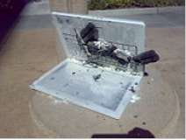
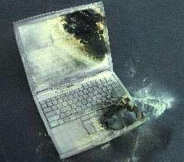
Example of Li-ion Battery damage to laptops

Slide 14
Prevalence in everyday life
Laptops
Cellphones
Electrical vehicles
Electronic cigarettes
Hoverboards, etc.

Slide 15
Lithium-ion technology
Li ions are transported
  to/from carbon anode
  to/from LiCoO₂ cathode
  through a liquid organic electrolyte (flammable)
  electrodes are held apart by a porous separator
During normal use, in a healthy state, there is no metallic lithium
Lithium-ion batteries are fragile and can have violent failure modes
With proper care and protection, Li-ion battery technology is SAFE
Over 2 billion Li-ion batteries produced annually
The fastest growing, and highest energy density battery technology

Slide 16
Characteristics of the Lithium-ion cell
Full charge voltage - 4.2 V
“nominal” voltage - 3.6 V
Rated in AmpHours (Ah)
Charge and discharge measured in “C”
  1 C is the current that discharges the battery in 1 hour
  for a 5.2 Ah cell, 1 C = 5.2 A, 2 C = 10.4 A, 0.5 C = 2.6 A
The most common Lithium-ion technology
  Cobalt Lithium-ion
  Used for laptops, cell phones, cameras

Slide 17
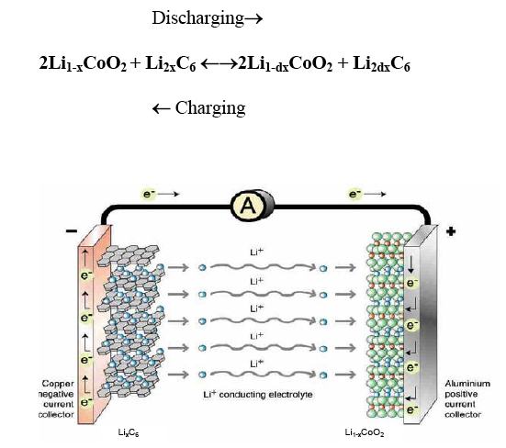
Lithium-ion cycle

Slide 18
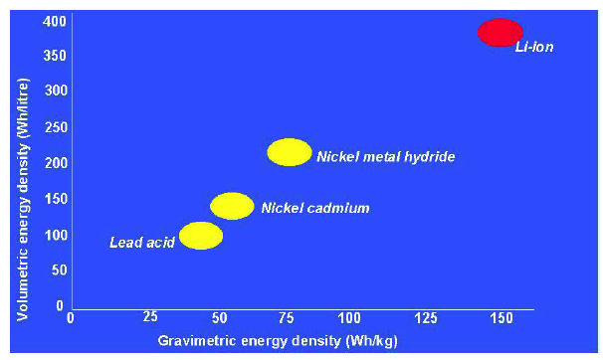
Energy Density Comparison Chart

Slide 19
Lithium Batteries vs.
Lithium Ion Batteries
Lithium batteries, or primary batteries, are single use and incapable of recharge.
Lithium ion (Li-ion) batteries, or secondary batteries, are rechargeable and used world-wide.
Both contain highly flammable electrolytes

Slide 20
Li-ion Safety
Several mechanisms of abuse can cause metallization of the lithium ions (lithium ions bond together into a metallic form)
Several mechanisms of abuse can cause thermal runaway, leading to:
  further metallization of lithium
  reduction of cathode creating oxygen
  boiling of electrolyte
Failure mode can be catastrophic
  Once the metallized lithium melts, a violent, energetic chemical reaction occurs, with high temperatures and potentially high pressures

Slide 21
Protection of Li-ion batteries
To prevent hazardous failure, and to maintain safe use, the following protections must be employed
  protection against overcharge (V < 4.3 V)
  protection against undercharge (V > 2.5 V)
  protection against over charging ( less than 1 C in)
  protection against over discharging (less than 1 C out)
  protection against over temperature
  protection against over pressure
Each cell in a battery pack must be protected
Series configurations are the most susceptible to failure

Slide 22
Incidents at LANL
August 6th, 2007: Lithium Ion Battery Explosion on LANL R&D equipment, DAF at NTS
2010, Lithium Ion Battery explosion
January 6th, 2007: Electronic Cigarette Incident

Slide 23
Lithium Ion Battery Accident on
LANL R&D equipment
Improperly matched charger to series of 5 lithium ion batteries
Lithium metallization over 3 months
Battery explosion at 11 pm, no one present

Slide 24
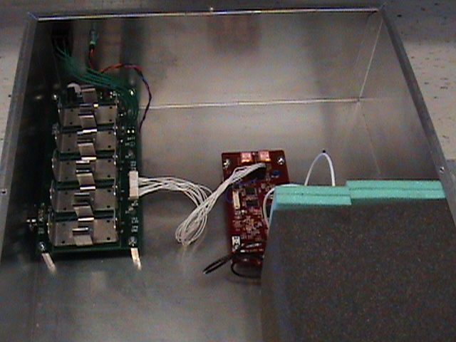
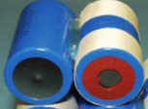

(1) Inside of Test Equipment prior to Event

Slide 25
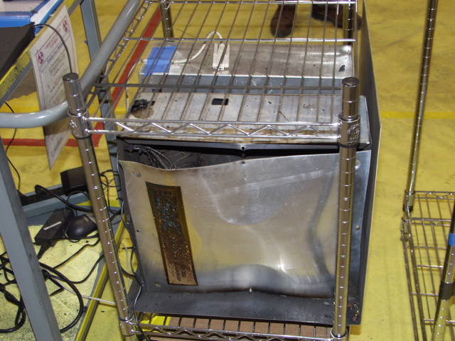
(2) Showing cover plate blown open

Slide 26
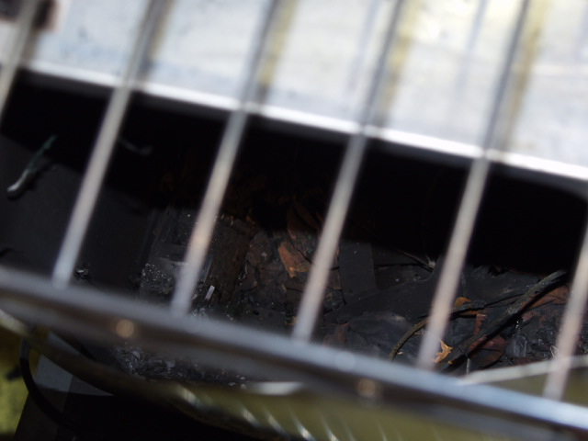
(3) View inside, showing charred remains

Slide 27
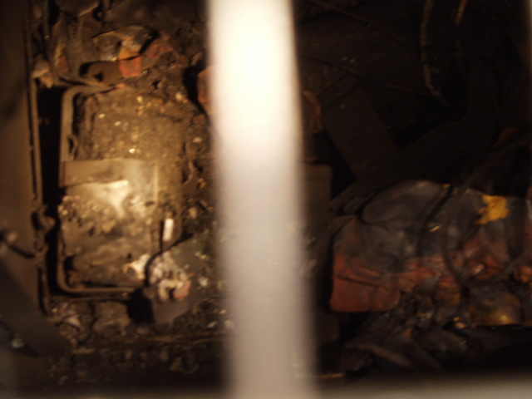
(4) Inside, showing one remaining battery in clip

Slide 28
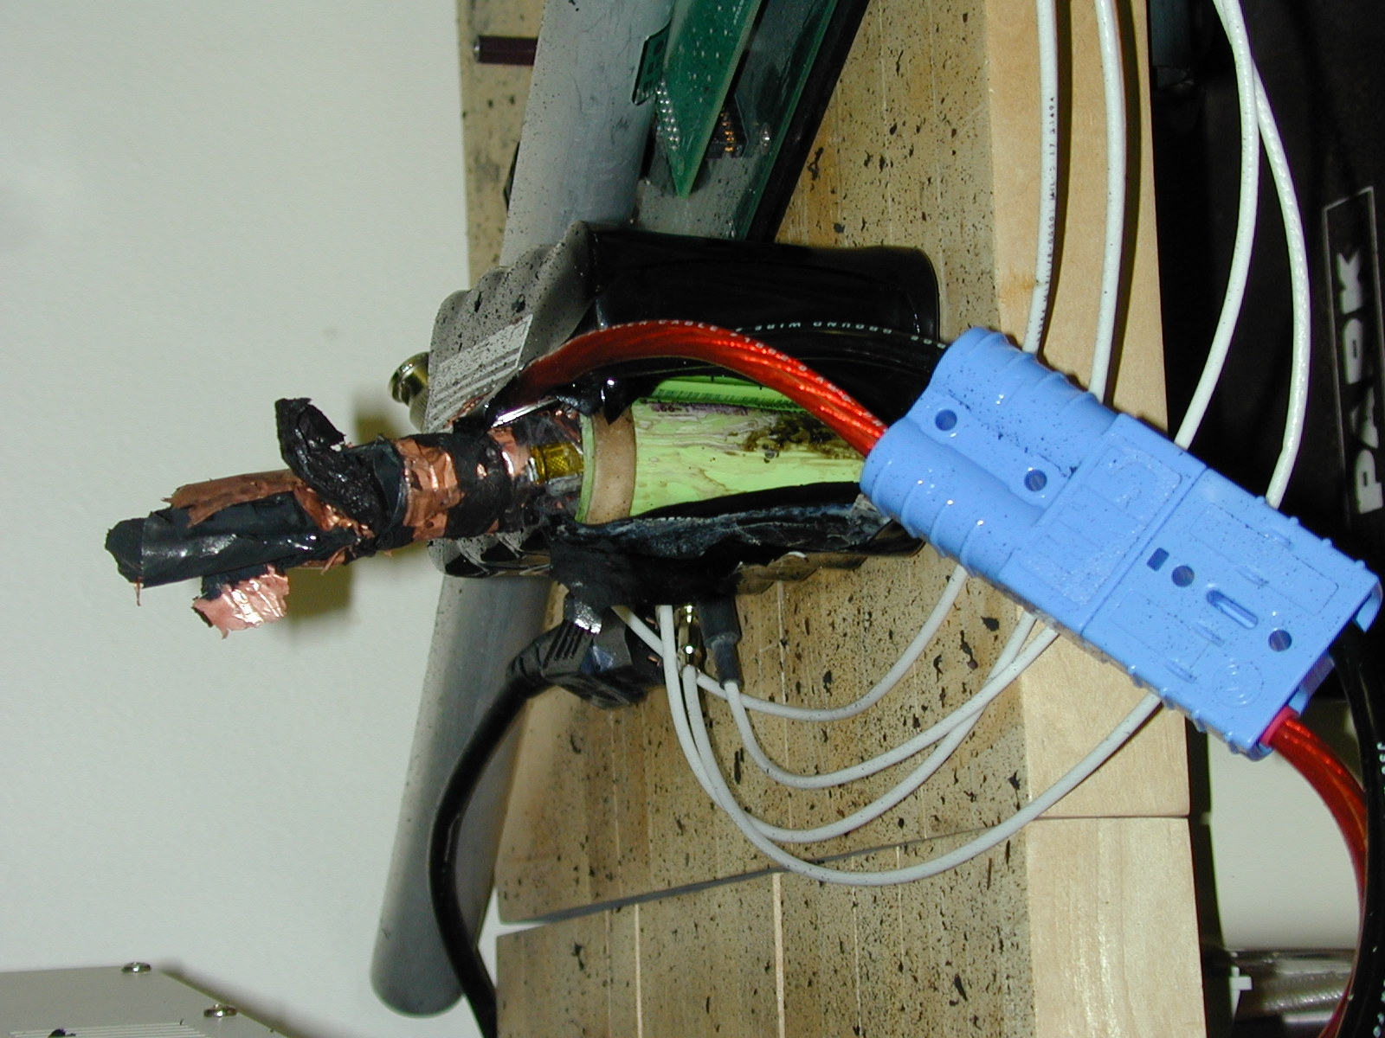
(2) Lithium Ion Phosphate battery explosion on January 21, 2010

Slide 29
Electronic Cigarette Incident
An employee’s electronic cigarette contained two lithium ion batteries. One battery ignited.
Batteries had been purchased from Ebay and had no protective circuitry.
No injuries or LANL policies violated

Slide 30
Summary of Facts from Lithium-Ion Battery failure January 6, 2016
Facts
  A worker had personal electronics at work (electronic cigarette, four batteries, and charger)
  The cigarette uses two LiIon batteries, in series
  While taking the used pair of batteries out of a holder, in preparation for recharging, one battery began to heat and vent, with flame
  The worker dropped the battery onto the floor
  The battery spun around, spewing sparks, “flame” and smoke
  Coworkers put out the “fire” with a class ABC fire extinguisher
  There was no injury to any personnel, no damage to the facility.
  The fire extinguisher products triggered the facility smoke detector
  The worker had purchased the LiIon batteries from Ebay
Note: the words “flame” and “fire” are not classical heat induced combustion, in the normal use of the words, but a rapid exothermic reaction between Lithium metal and oxygen and/or water. No heat source is required to start this reaction once water or oxygen reaches lithium metal. This is known as a alkali metal fire or reaction. The primary byproduct of this reaction is hydrogen, which then rapidly burns in the presence of oxygen.

Slide 31
Analysis of Incident
  The Lithium Ion batteries, purchased from Ebay did NOT have protective circuitry, which is required of all LiIon batteries to prevent the plating out of lithium metal, which is normally only in Ion form (non metallic) in a healthy LiIon battery.
  The charger seemed to be built safely to prevent overcharging.
  The cigarette had been modified by the worker to produce more power in the vaporization of the material, from 15 W to 150 W
  The battery load (the electronic cigarette) caused the LiIon batteries to over discharge (dropping below 2.5 V per cell) causing the lithium to plate on the electrodes in metal form.
  After repeated over discharging, and the plating of sufficient lithium metal, one battery went into thermal runaway, where it began to heat, which caused more heat, and ultimately caused the electrolyte (a liquid polymer) to decompose creating some oxygen and water products.
  Once the water/oxygen reached the lithium, the lithium reaction started.

Slide 32

Vented Lithium Ion battery

Slide 33

Closeup of battery

Slide 34
Conclusions
Lithium Ion battery fires have recently received additional press due to new products coming out, that are not being built to existing lithium ion battery safety standards. Many injuries and fires have been reported, including from electronic cigarettes. This includes products such as hover boards and electronic cigarettes.
The combination of purchasing cheap or possibly even counterfeit LiIon batteries without protective circuitry, plus modification of the product by the user, caused damage to the batteries, leading to the fire.
The worker did not violate any existing laboratory policy or requirement.

Slide 35
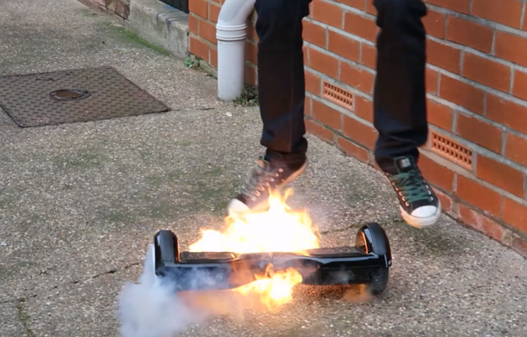
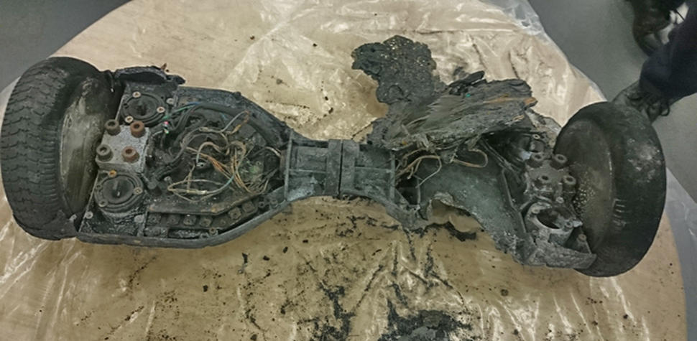
Lithium Ion Batteries Nationwide
Lithium ion battery fires have recently received additional press due to new products that have caused many reported injuries and fires, including hover boards.
http://www.bbc.com/news/technology-36727652

Slide 36
Recent Actions
Airlines have banned all LiIon mobility “toys” from air travel, carry on and checked
Amazon has offered to refund for all hoverboard purchases
Consumer Product Safety Commission is conducting an investigation
Lawsuits
Major recall

Slide 37
Regulations for Lithium Ion
Batteries
Despite numerous recalls on lithium ion battery products due to fire hazard, the Consumer Product Safety Commission (CPSC) currently has no regulations, mandatory standards, or bans on lithium ion batteries.

Slide 38
Regulations for Lithium Ion
Batteries
Amazon complies with the following regulations when shipping lithium batteries:
U.S. Department of Transportation
United States Postal Service
IATA's Dangerous Goods Regulations (DGR)
IATA's Lithium Batteries Guidance
ICAO's Technical Instructions for the Safe Transport of Dangerous Goods by Air

Slide 39
Regulations for Lithium Ion
Batteries
Federal Aviation Agency (FAA) regulations:
  Spare lithium ion and lithium metal batteries must be carried in carry-on baggage
  2 grams of lithium per battery and 100 Wh limit
  Batteries for further sale or distribution are prohibited
  With airline approval up to 2 larger lithium ion batteries (101-160 Wh) may be carried on board.

Slide 40
Regulations for Lithium Ion
Batteries
According to USA today more than 30 universities now ban hover boards on campus due to fire hazard, including:
  University of New Mexico
  Purdue University
  Vanderbilt University
  University of Massachusetts Amherst

Slide 41
Recommendations - Design
Li-ion batteries (individual cells) and battery packs (multiple cells connected together) should be properly protected for
  under voltage
  over voltage
  excess charging rate
  excess discharging rate
  over temperature
  over pressure
Design, installation, protection, maintenance, and use of Li-ion batteries in equipment should be well-documented, and a rigorous design review should be conducted prior to release for use.

Slide 42
Recommended Actions
Understand general lithium ion battery safety
Know how to identify a counterfeit battery
Know what to do in case of a lithium ion battery fire
Understand lithium ion battery disposal at LANL

Slide 43
1. Understand General Lithium Ion
Battery Safety
Store batteries at room temperature
Do not expose batteries to high temperatures such as could be achieved in a parked car in the sun
Use a charger designed for the battery or device
When feasible, do not leave a battery charging unattended
Store batteries separately from anything hazardous, such as explosives, combustibles, or any other highly flammable material
Avoid over-charging, over discharging, or shorting
Watch for signs of failure such as discoloration or swelling
Dispose of the battery before the expiration date or when the battery is no longer functioning properly

Slide 44
2. Know How to Identify a Counterfeit Battery
Compare your batteries with pictures on listed website
Buy your batteries from a reputable source
Measure and weigh the batteries, compare to spec sheet
Look for unusual wear and tear like burns, rust, or excessive scratches

Slide 45
3. Know What To Do In Case of a
Lithium Ion Battery Fire
For Lithium (primary, non- rechargeable) batteries: Use Class D extinguishing agent with copper powder. DO NOT use water
For Lithium-Ion (secondary, rechargeable) batteries: Use an ABC dry chemical fire extinguisher or water hose

Slide 46
3. Know What To Do In Case of a
Lithium Ion Battery Fire
In case of contact with electrolyte, gases, or combustion byproducts from a lithium battery or lithium ion battery release:
Immediately flush eyes with a direct stream of water for at least 15 minutes and seek immediate attention
Flush skin with cool water or shower for at least 15 minutes and seek medical attention if necessary
Move to fresh air and monitor breathing and circulation. Take appropriate first aid or CPR actions as necessary and seek immediate medical attention

Slide 47
4. Understand Lithium Ion Battery
Disposal
If you anticipated generating batteries for recycling, contact your Waste Management Coordinator
Ensure there is no radioactive or chemical contamination
Remove batteries from consumer products
Batteries and battery packs may be disassembled to individual batteries or cells, as long as the battery cell remains intact and closed
Store batteries that have become waste in a universal waste area
Label the container with the words “Universal Waste Battery” and the date that the battery became waste

Slide 48
Conclusions - Lithium Ion Batteries
Li-ion batteries are a safe technology if certain precautions in design and use are followed.
If such precautions are not taken, Li-ion batteries can fail dramatically causing equipment damage, fire and possible personal harm.

Slide 49
Q&A

