Slide 1
EFCOG Working Group #3
Safe Conduct of Subcontracted Electrical Work and 851 Compliance Best Practices
POC - Jeff Williams
Notes:
Content Slide Notes
“UNCLASSIFIED” marking of slides is not a security requirement and may be deleted from the Slide Master (View › Master › Slide Master). In general, slides should be marked “UNCLASSIFIED” if there is potential for confusion or misinterpretation of something that could be deemed classified. For guidance on marking slides containing classified and unclassified controlled information, see the Protecting Information Web site at http://int.lanl.gov/security/protectinfo/.

Slide 2
The Dream Team
John Anderson – Fermi
Steven Baca – LANL
Mauricio Burgos – ANL
Anthony Cuaron – LANL
Brian Gutierrez – SNL
John Knox – INL
David Mertz – Fermi
Craig Schumann – DOE-CH
Jim Watson – LLNL
Marion Wilde – SNL
Jeff Williams – NNSA-Los Alamos

Slide 3
Last Year – Team 3
Group 3 was tasked with improvement of the operations involving medium voltage and subcontractors.
The driver – Three serious incidents in 2014 involved medium voltage systems at DOE sites.
This group worked to develop tools and processes that would reduce the likelihood of a recurrence.
In some cases, failures in system and process directly contributed to the accident. The team focused on this connection and ways to improve work control processes.

Slide 4
Issues from last year still top the list
Effective subcontract management in the DOE complex has a lot of moving parts
Senior management and other stakeholders do not have the tools to efficiently manage subcontracted work
Players, scope, requirements and expectations constantly change

Slide 5
Scope Change for 2016
Discussions and interactions over the past year indicate that issues are not limited to medium voltage work.
Subcontracted electrical work under 851 WSHP flow down is particularly challenging – period.
Three keys to improve performance of subcontracted electrical work:
Drive continuous code & standard updates complex-wide
Identify and capitalize on best practices
Develop universally applicable tools for efficiency

Slide 6
Current training
“Electrical Safety Program: Electrical Crafts at LANL” 10997
4 hour course
Covers some elements of LANL Electrical Safety Program
Required for:
Electricians/Apprentices
Facility Engineers
Linemen & Utility Engineers (no one is in this curricula)
Nonelectrician Crafts: Energized
Non-energized Maintenance Coordinators

Slide 7
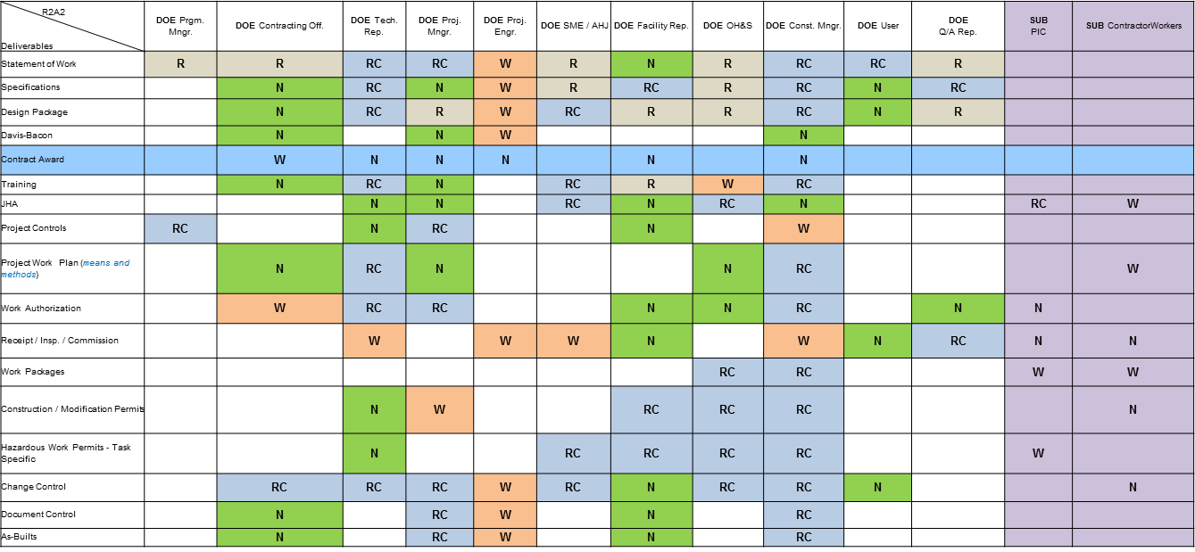
Framework from last year
Responsibilities Matrix (R²A²)

Slide 8
Vision
All DOE sites are implementing either the latest versions of NEC and 70E, or one revision back
Web based tool(s) available for use by all M&O and subcontract work providers
Implement and build on best practices already in place.
Streamline 851 compliance for consistently high performance
Establish a basis for continuous improvement and a model for other 851/WSHP segments

Slide 9
Message to Senior DOE and M&O Leaders
This approach will simultaneously achieve:
Reduced 851 compliance risk
Ensure implementation of electrical safety requirements only as they apply to the work being contracted
Clarify and simplify execution of subcontracted electrical work
Improvement in electrical safety metrics across DOE
This approach will NOT:
Require adoption of non-applicable requirements
Require costly changes to existing site M&O processes
Require lengthy implementation or training

Slide 10
Synergy
This effort to develop web based resources will be interacting with other ongoing improvement efforts
Revision of the DOE Electrical Safety Handbook
Development of Tools & Techniques to support ESO’s and work planners at LANL develop and implement effective work control documents.

Slide 11
Discussion
Please speak up with any suggestions for Group 3 to help achieve the objectives presented
If any come to mind this week regarding Group 3 efforts, please don’t hesitate to bring them to us.

