Slide 1
DC Systems Working Group
EFCOG ESTG
Fermi National Laboratory
July 18-22, 2016

Slide 2
DC - History
On the EFCOG ESTG website
See DC Working Group 20140714e.PPTX for:
DC Arc Flash WG Phase I – 10/2010
DC Systems WG Phase II – 10/2012
DC Systems WG Phase III – 7/2014
See DC Working Group 20150713d1.PPTX for:
DC Systems WG Phase IV – 7/2015

Slide 3
Advertised Agenda
This working group continues efforts from last year to quantify the degree of hazard posed by DC sources, especially where it differs from AC system hazards, and safe work procedures for DC systems, such as battery and photovoltaic systems, where de-energization methods are not obvious or practical. It provides input to standards-making bodies where justified.

Slide 4
Detailed Agenda
Prepare EFCOG Best Practices from 2015 ESW
Battery Risk Assessment Flowchart
DC Arc Hazard Evaluation Spreadsheets (verified)
Excel calculator based on Doan’s NFPA 70E 2012
Two Excel calculators based on Ammerman by INL and LLNL
High Energy Ground Stick Standard for Pulsed Power Applications, from LBNL.
New issues concerning ground faulting in large PV systems that require 2x voltage protection for workers
New DC Arc Hazard calculations for PV systems that correct the 4x underreporting of IE for workers.

Slide 5
DC Arc Flash WG 2016 Members new members this year
Stan Berry, Gary Dreifuerst, Adam Green, Timothy Kuneli, Adam Martinez, Peter McNutt, Lynn Ribaud, Melkie A. Tega, Justin Tokash, Kyle Carr, Thomas Floyd, Martin Iedema, Eugene Ormond, Jason Sempsrott, Gedeon Teame, Michael Utes, Kyle Roberts, Perry Plotkin
Facilities-ANL, DOE, FNAL, LANL, LBNL, LLNL, Navy, NREL, NSTec, PNNL, SNL

Slide 6
Battery Flow Chart is Ready for BP publishing
See next slide
Photovoltaic (PV) Spreadsheet
Arc-flash calculation will be added as an additional tab to the Doan spreadsheet final (BP) submittal
Worked out technical aspects of the AF calculation
Additional BP that warns of possible doubling of value of worker esposure to voltage appearing across PV isolation switches and its impacts on equipment and PPE
Target date this Winter EFCOG ESTG meeting.

Slide 7
Battery Risk Assessment Flowchart 70E 2015 for Worker
START
Electrical
Other Hazards to Consider
Thermal (>3kW)
Chemical (electrolyte)
Gas (explosion)
Pressure (case rupture)
Weight (lifting, rigging)
MIN PPE REQ:
Safety Glasses, No Metal/Jewelry, Insulated Tools
No exposed circuits
N
<100V
N
Can it be segmented <100V
Y
Y
Y
Y
<1.2 cal/cm²
N
No SHOCK or ARC FLASH Rated PPE REQ
SHOCK PPE REQ, no ARC FLASH Rated PPE REQ
SHOCK and ARC FLASH Rated PPE REQ

Slide 8
DC Arc Hazard Evaluation Spreadsheets
Excel calculator based on Doan’s NFPA 70E 2012
Two Excel calculators based on Ammerman by INL and LLNL
WG found spreadsheets to be reasonable but we find technical & questionable procedural details that we wish to return to authors for clarification and/or revision.
WG also proposes to produce a best-practices version to submit to EFCOG ESTG.
Target date this Winter EFCOG ESTG meeting.

Slide 9
Excel calculator based on Doan’s NFPA 70E

Slide 10
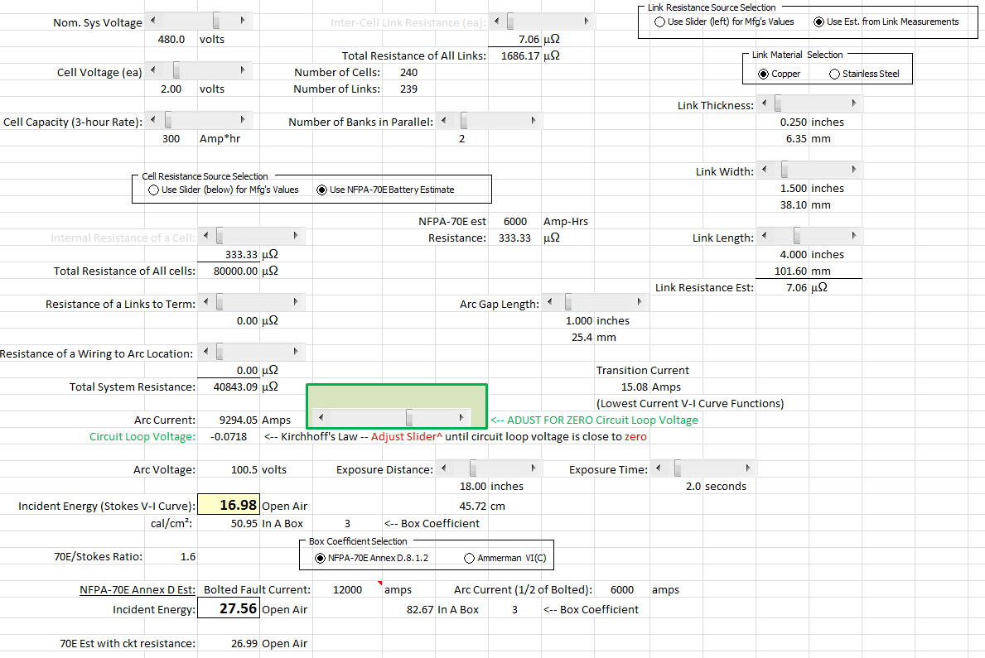
INL Excel calculator based on NFPA 70E Annex Stokes, Oppenlander and Ammerman papers

Slide 11
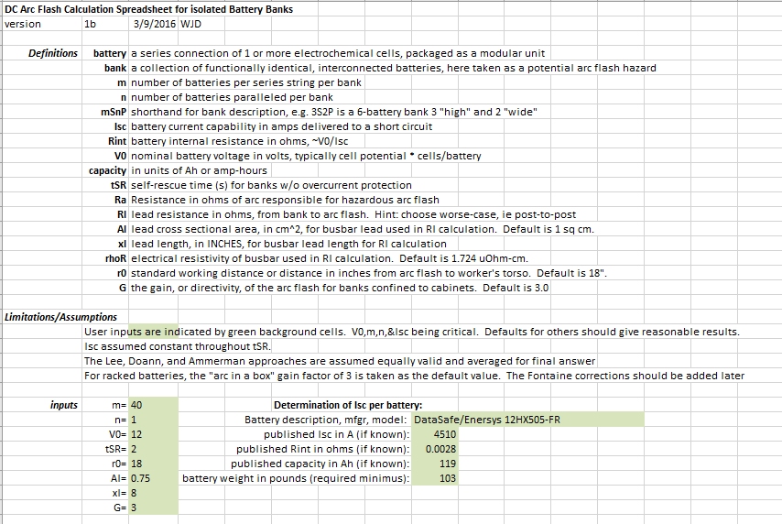
LLNL Excel calculator based on NFPA 70E Annex Stokes, Oppenlander and Ammerman papers, page 1

Slide 12
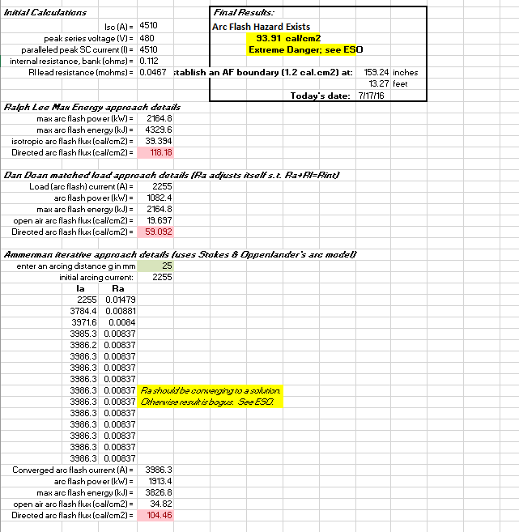
LLNL Excel calculator based on NFPA 70E Annex Stokes, Oppenlander and Ammerman papers, page 2

Slide 13
Ground Hook (Stick) Safety July 2016 Update
Reviewed LBNL Ground Hook Safety documents. Recommended as draft for sites that have no requirements in place. (This is a design/assembly consideration document, not how to handle sticks document).

Slide 14
Ground Hook (Stick) Safety
Reviewed ISA High Energy Discharge Stick Standard for Pulsed Power Applications.
Recommend simpler calculations for user friendliness.
Sites should be able to provide proof that calculations have been completed, even if vendor completed calcs. Sites shall have independent verification of calculations as this is a safety system.

Slide 15
Ground Hook (Stick) Safety
Recommend Draft ISA Standard be reviewed by EFCOG ESTG participants and feedback be provided.
Verified ASTM F711 has mechanical and electrical testing intervals of two years as applicable. (Up to each site as some sites feel these are not being used as live line tools).

Slide 16
Where are Utility DC systems going?
Increased by 20% since 2015 to reach 2 GW

Slide 17
Where is the NEC going for Energy?
Existing code structure
690 Solar Photovoltaic (PV) Systems
692 Fuel Cell Systems
694 Wind Electric Systems
705 Interconnected Electric Power Production Sources
708 Critical Operations Power Systems
New for 2017 proposed

Slide 18
PV Systems DC Arc Flash calcs, p1
Eduardo Enrique, “DC Arc Flash Calculations for Solar Farms”, 2013 1st IEEE Conference on Technologies for Sustainability
The methods in 70E2015 Annex D.5 use the maximum power method which can underestimate the incident energy by as much as 3x.
In Enrique’s survey of Utility-grade PV Modules, he found that the arcing voltage is max power voltage and that the same holds true for the current. Both values are on the panel’s nameplate.

Slide 19
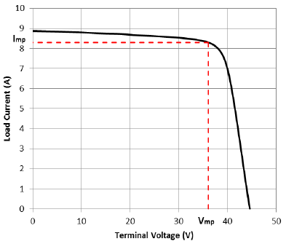
PV Systems DC Arc Flash calcs, p2
Ratio of Electrical Characteristics for Utility-Grade PV Modules
VI for 300W PV
Isc-pv
Voc-pv

Slide 20
PV Systems DC Arc Flash calcs, p3
For the standard example in his paper, the IEpv/IEmax was 3.24, when the temperature compensation factor (raises the PV output voltage for cold temperatures) was included the factor was 3.94. That is basically 4x the 70E method for calculating AF PPE.

Slide 21
QUESTIONS?

