Slide 1
CMS HL-LHC Upgrades
Vivian O’Dell
Fermilab PAC
19 January 2016

Slide 2
Disclaimer
This talk is much too short to show the entire U. S. CMS contributions to the HL-LHC Upgrades
I will focus on highlights of the Fermilab contributions and the status of planning / funding for the upgrade project

Slide 3
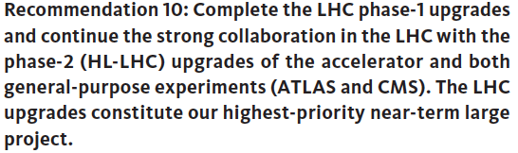
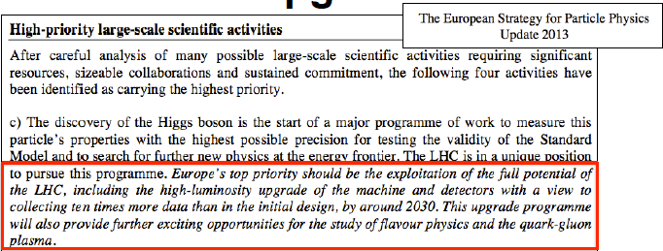
LHC Upgrades: High Priority from P5 and ESG!
US HEP community (P5) report June 2014

Slide 4
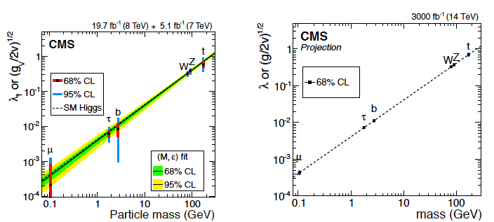
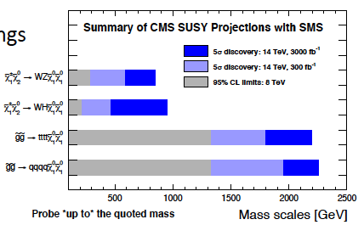
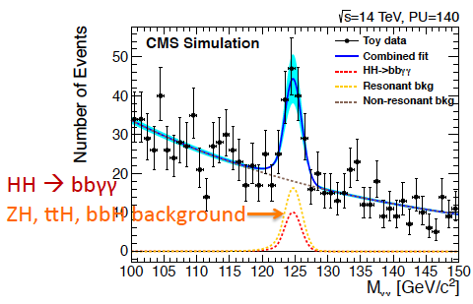
Physics Reach at HL-LHC
2-10% on Higgs couplings
  (currently up to 30%!)
Evidence of di-Higgs production
Access to small cross section SUSY processes
Several other SM rare processes and BSM physics predictions
… and increased mass range

Slide 5
Requirements for the upgrades
HL-LHC enables a broad physics program: all physics objects – detectors – remain equally important
Enhanced role of forward region, particularly to study VBF/VBS processes
  And extremely challenging given the high instantaneous luminosity / pile up conditions
Maintain low momentum / energy thresholds in event selection
  Stresses trigger system – need more trigger information at Level 1 to survive
The full CMS upgrade is described in the CMS Technical Proposal
  CERN-LHCC-2015-010 https://cds.cern.ch/record/2020886

Slide 6
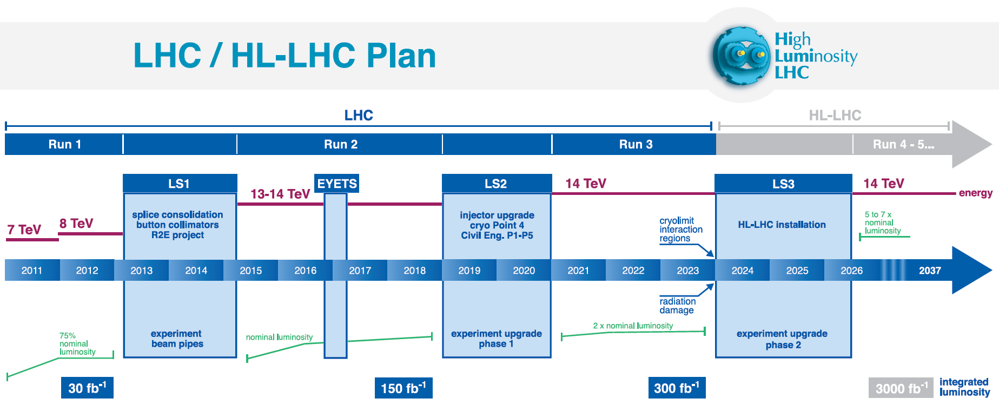
LHC Upgrades: Timeline towards HL-LHC
Shutdowns
Run I
0.75 10³⁴ cm⁻²s⁻¹
50 ns bunch
high pile up ∼40
Run II
1.5 10³⁴ cm⁻²s⁻¹
25 ns bunch
pile up ∼40
Run III
1.7-2.2 10³⁴ cm⁻²s⁻¹
25 ns bunch
pile up ∼60
Run IV
~5(7.5!) 10³⁴ cm⁻²s⁻¹
25 ns bunch
pile up ∼140 - 200

Slide 7
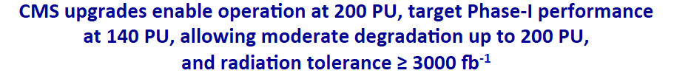
LHC Upgrades: Timeline towards HL-LHC
Shutdowns
HL-LHC Upgrades: Installed during LS3
(CY 2024 – mid 2026)

Slide 8
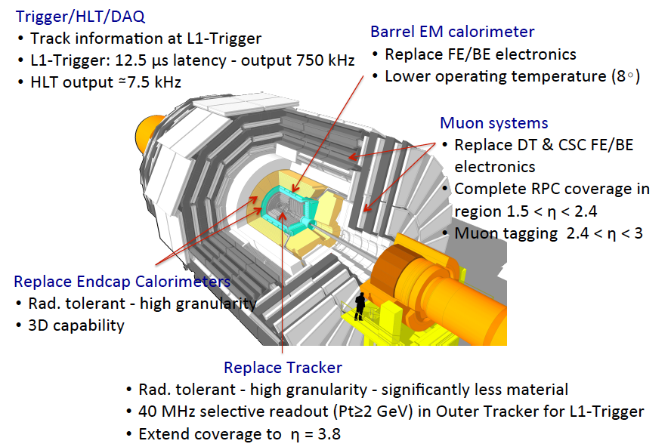


CMS Upgrades for HL-LHC: Summary

Slide 9
U. S. CMS HL-LHC Upgrade Organization
U. S. CMS HL-LHC Upgrade Project Organization
402.01 HL-LHC CMS Detector Upgrade Project
Project Office
Project Manager: V. O’Dell
Deputy PM: A. Ryd
CMS HL-LHC liaison: J. Spalding
ESH&Q Coordinator: G. Snow
Project Controls: W. Freeman
Project Finance: J. Teng
Risk Manager: L. Taylor
Project Electronics Engineer TBN
Project Mechanical Engineer TBN
DOE scope
NSF scope
Areas where Fermilab is a major partner
DOE or NSF scope (TBD)
402.07 DAQ
L2 Manager: TBN
402.02 Tracker
L2 Manager: K. Ecklund
L2 Manager: C. Hill
402.03 Barrel Cal.
L2 Manager: C. Jessop
402.04 Endcap Cal.
L2 Manager: J. Mans
402.05 Endcap Muons
L2 Manager: A. Safonov
402.06 Trigger
L2 Manager: J. Berryhill
402.02.03 FPIX
L3 Manager:
A. Dominguez
402.03.03 ECAL
L3 Manager:
B. Hirosky
402.04.03 Sensors/Modules
L3 Managers:
N. Akchurin, M. Paulini
402.05.03 CSC
L3 Managers:
D. Wood, A. Korytov
402.06.03 Cal Trig
L3 Manager:
W. Smith
402.02.04 OT
L3 Manager:
G. Bolla
402.02.04 HCAL
L3 Manager:
A. Belloni
402.04.04 Cassettes
L3 Manager: J. Strait
402.05.04 GEM
L3 Manager: D. Salzberg
402.06.04 Muon Trig
L3 Manager:
D. Acosta
402.04.05 BH Active
L3 Manager: TBN
402.02.05 TT
L3 Manager:
P. Wittich
402.06.05 Track Correlator Trig
L3 Manager:
R. Cavanaugh
402.04.06 Electronics and Services
L3 Manager: M. Klute

Slide 10
CMS HL-LHC upgrades
Project schedules / profiles

Slide 11
CMS HL-LHC upgrades
For the DOE, the following (approximate) dates for funding
  CD0: January, 2016 (i.e. imminently)
  CD1: end of CY2016
  CD2: early CY2018
  CD3a: mid-CY2018 (allows buying long lead-time items)
  CD3: late CY2018 / early CY2019
For the NSF, we (along with US ATLAS) will be pursuing a new (for HEP) form of funding
  The total we are proposing is $150M, split evenly between USCMS / USATLAS
  This has to go through the NSF MREFC panel and the National Science Board
    Note, we have gotten the first go-ahead to proceed to “Conceptual Design Review” which will be held mid-March
    Preliminary Design Review / Final Design Review will be in late 2017 / late 2019 respectively
  The earliest we can expect project construction funding is in FY2020

Slide 12
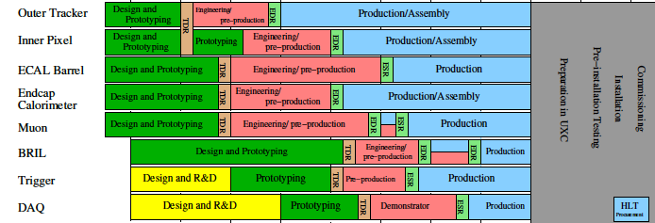
CMS HL-LHC upgrade schedule
CD0
CD1
PDR
CD2
CD3A
CD3
FDR
CD4
CDR
Physics
LS 2
Physics
LS 3
FY15
FY20
FY21
FY22
FY23
FY25
FY24
FY18
FY19
FY17
FY16
NSF review steps
DOE review steps

Slide 13
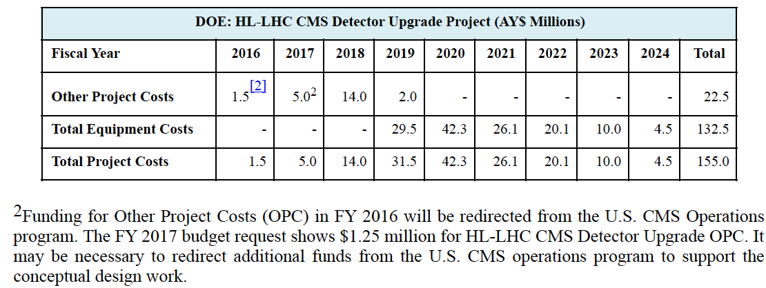
CMS HL-LHC upgrades – DOE profile
Note that for 2016 / 2017 money is assumed to be redirected from the Operations Program for the DOE scope of the upgrades
  (Unfortunately the Ops program doesn’t have $5M in 2017 to redirect)
  However, we are getting ~ $3M in 2016, and assume ~$3M in 2017 – so the total is ~$6M (vs. $6.5M).

Slide 14
CMS HL-LHC upgrades – NSF profile
NSF is proposal driven – they don’t give us a profile
For R&D, pre-FDR stage, we are assuming a redirection of about $1M / year from the operations program through 2020
We will be asking for a supplement to this from NSF directly after the CDR in mid-March
  Possibly get some supplement in 2017
  Expect ~ $7M in supplemental funding from 2017-2019
NSF projects carefully selected to be:
hosted at Universities
later in the project schedule

Slide 15
CMS HL-LHC upgrades
Some Highlights of Fermilab Activities on Upgrades

Slide 16
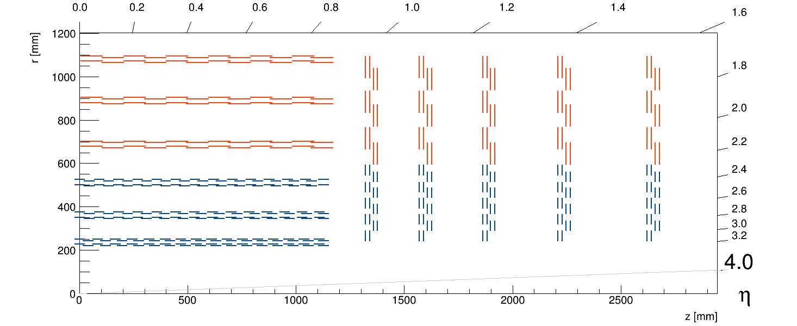
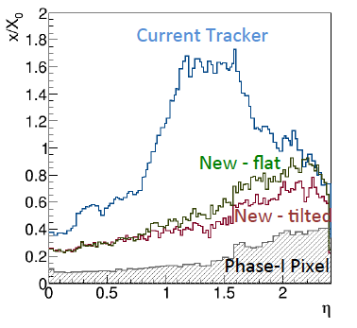
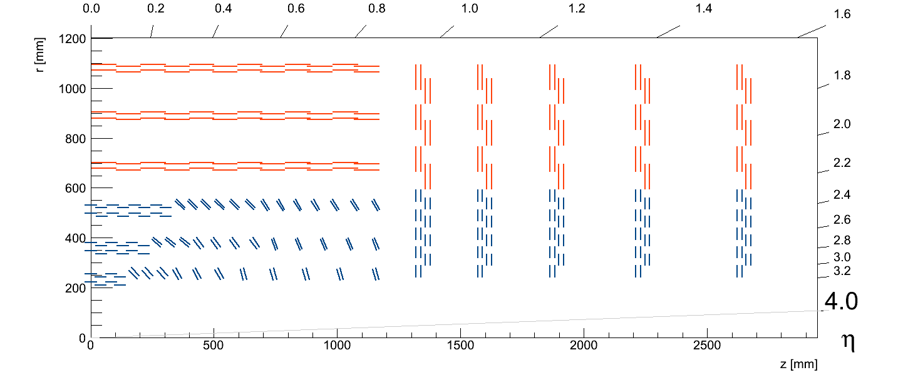
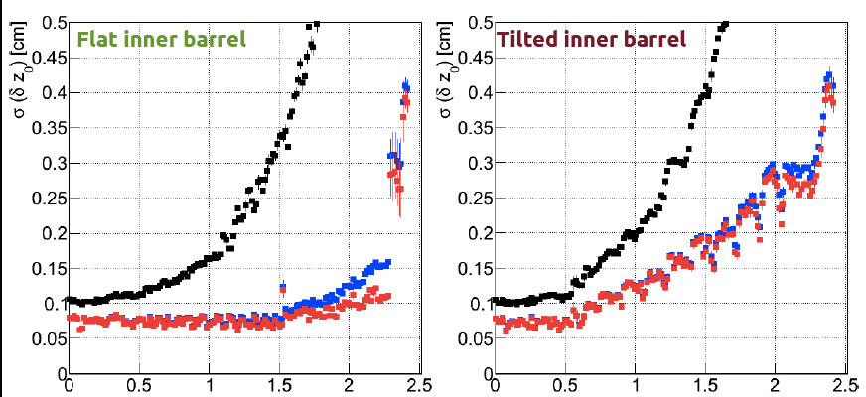
Outer Tracker – overview of the upgrade
TB2S
TEDD
TBPS
TB2S
TEDD
TBPS
Less material, equal or better tracking performance
Less modules / cost saving
Slightly degraded z0 resolution for L1 tracks
Flat TBPS
Tilted TBPS
L1 tracks (no pixel)
Z-resolution

Slide 17
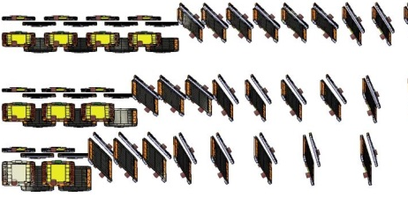
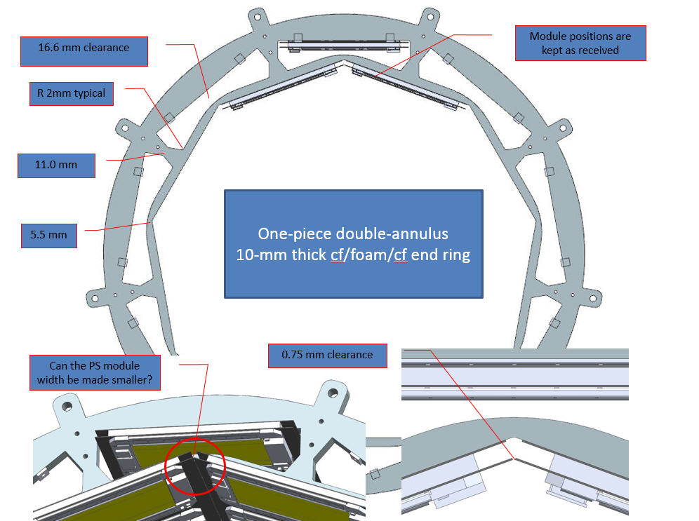
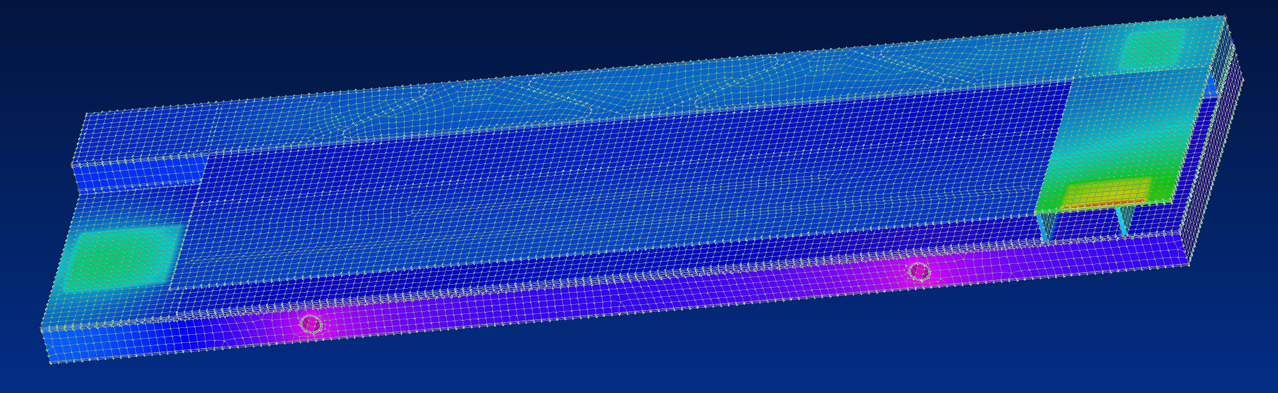
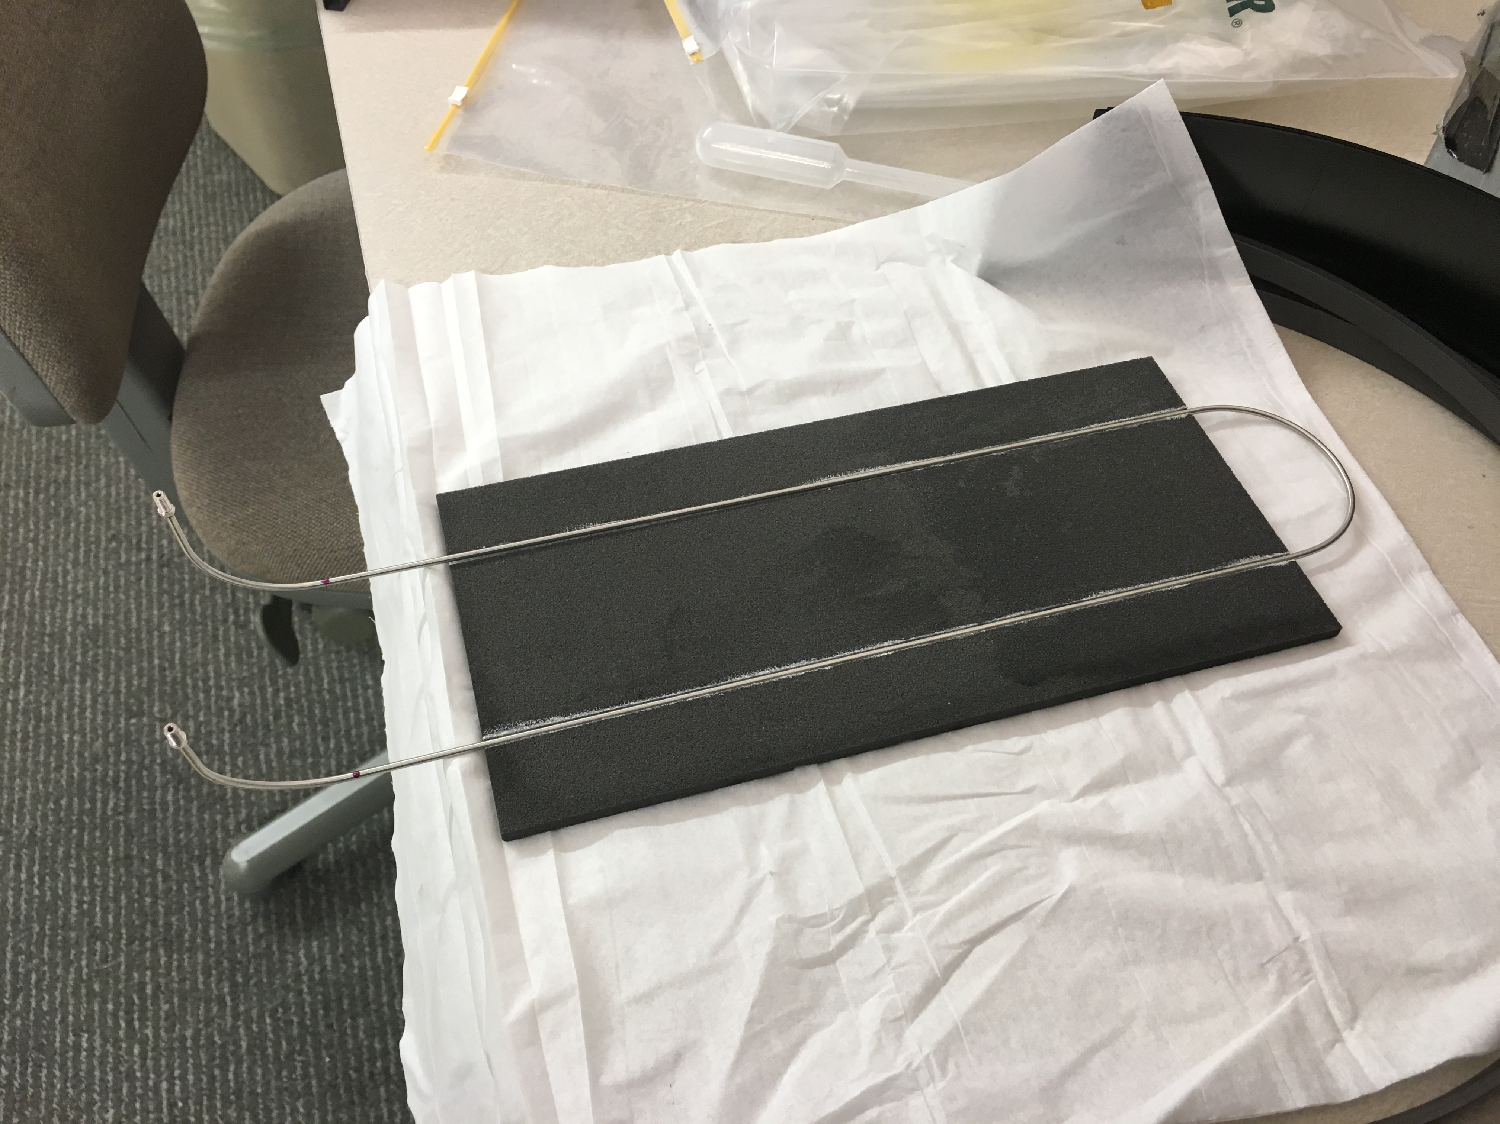
HL-LHC Upgrades: Tracker
FNAL is responsible for the design and fabrication of the short barrel section of the outer tracker
  Support design and fabrication
  Thermal modeling
  Cooling tests
  Work to understand coupling to small Co₂ cooling pipe

Slide 18
HL-LHC Upgrades: Tracker
FNAL will be a major module fabrication center for CMS HL-LHC upgrades
Modules produced for thermal testing using dummy silicon
Produced carbon fiber and polyimide parts
Ramp up effort after FPIX production
Fabrication of 8” sensor wafers with US vendor (CMS and SBIR funded) – first 8” wafers for HEP!

Slide 19
Track Finder at Level 1 Trigger (Track Trigger)
U. S. CMS is leading two approaches to the Track Trigger
  Pure FPGA “tracklet” led by Cornell (NSF)
  Custom ASIC + FPGA (~CDF) led by FNAL (DOE)
Both groups leading to demonstrator end of CY16 – decision early 2017
  (this will also determine if the track trigger will go into NSF or DOE scope)

Slide 20
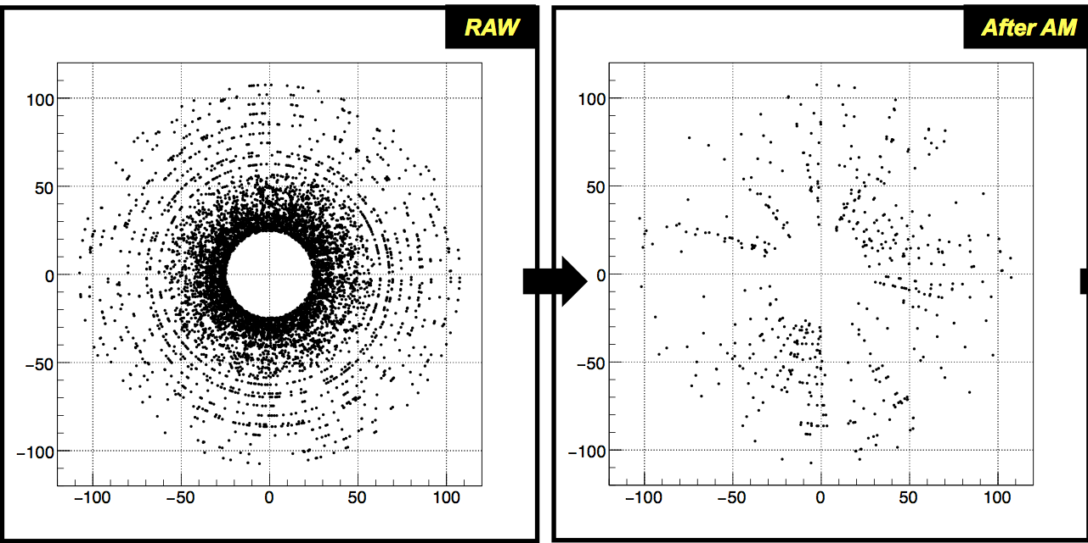
Track Finder at Level 1 Trigger (Track Trigger)
Before and after AM stage:Associative Memory for CMS case at HL-LHC
~100M patterns, or ~2M pattern per trigger tower, or few x 100K per chip
Roads found
PU200+4Top event simulation (endcap)
A factor of > 10 reduction of occupancy, and more importantly, stubs/hits are organized in roads (“hits of interest”),making the track fitting task inside FPGA much easier.

Slide 21
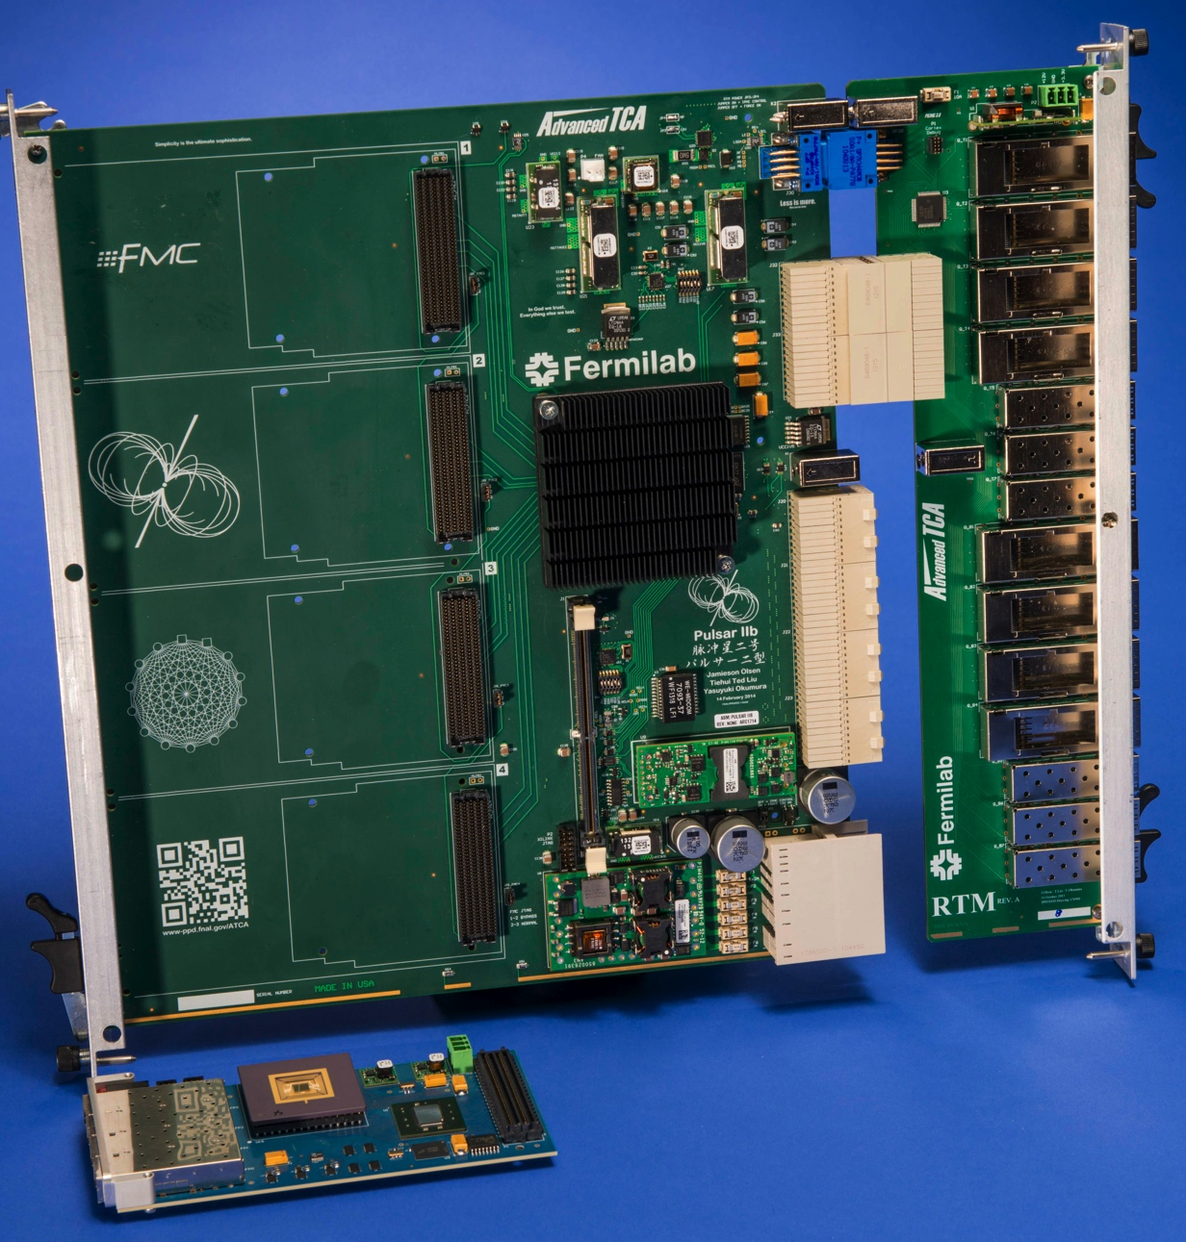
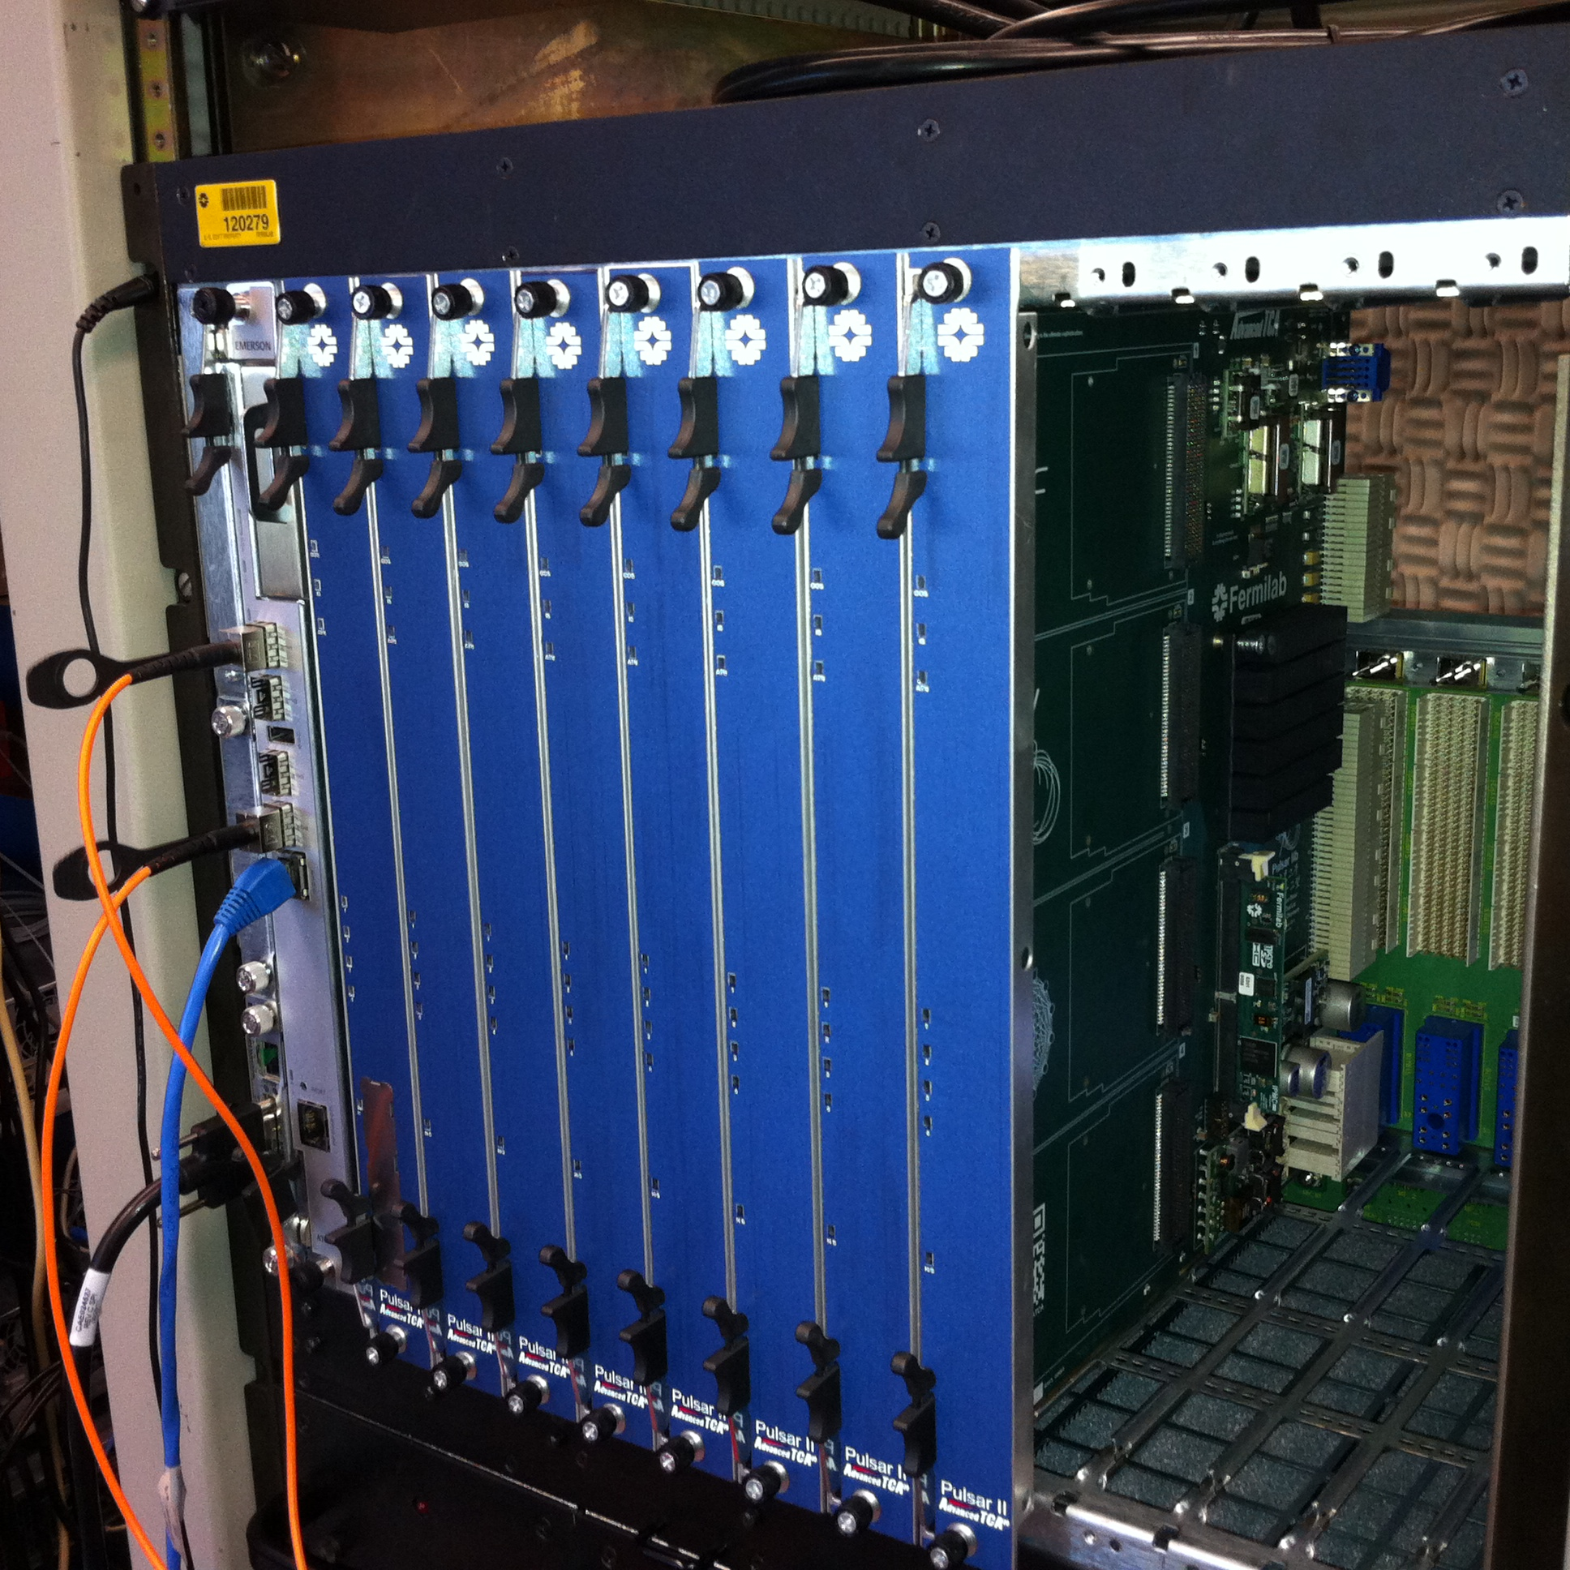
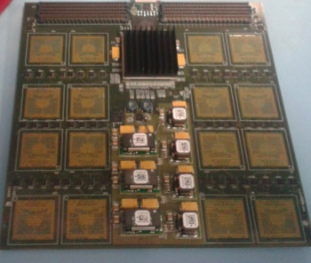
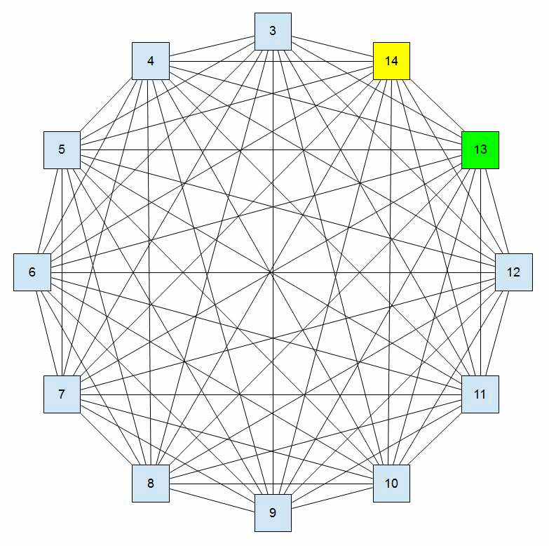
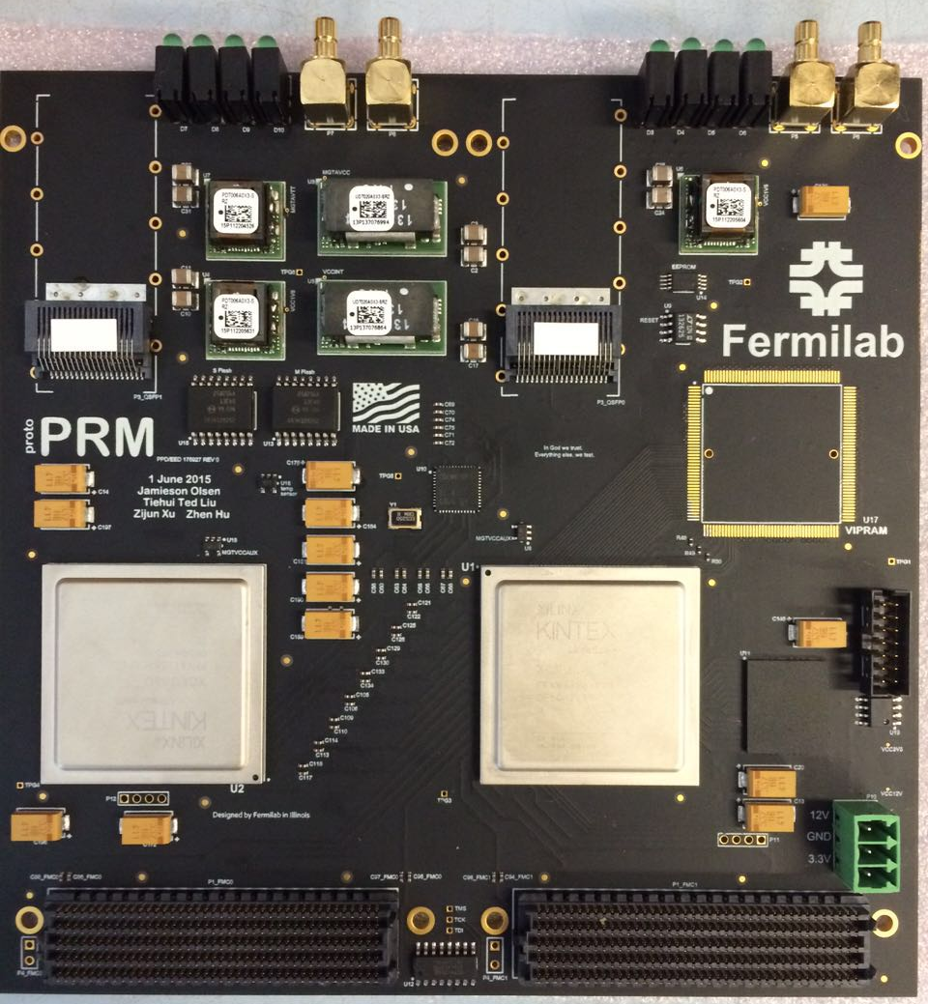
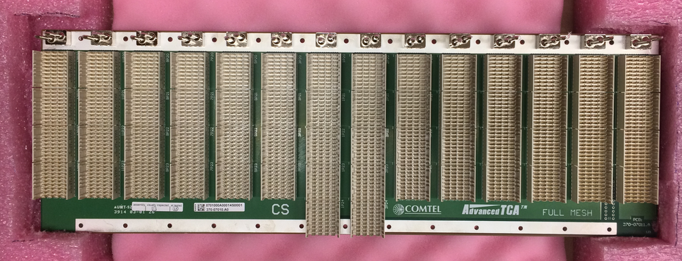
Hardware developed for Track Trigger demonstrator
INFN PRM
Summary / Conclusions
Kintex-7 FPGA based
Vertex-7
With AMchip05 (2k).
AMchip06 (128k) submitted
FNAL PRM
Pulsar 2b ATCA
http://www-ppd.fnal.gov/EEDOffice-w/Projects/ATCA/
New commercial 100G/40G+
full-mesh backplane fully evaluated
with Pulsar 2b and performance
good for demo needs
Major hardware
developments done
UltraScale FPGA based
One FPGA will act as AM for initial demo

Slide 22
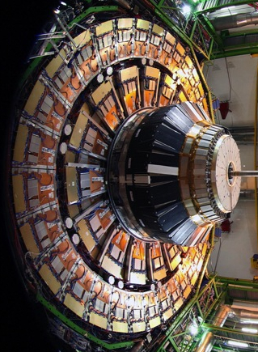
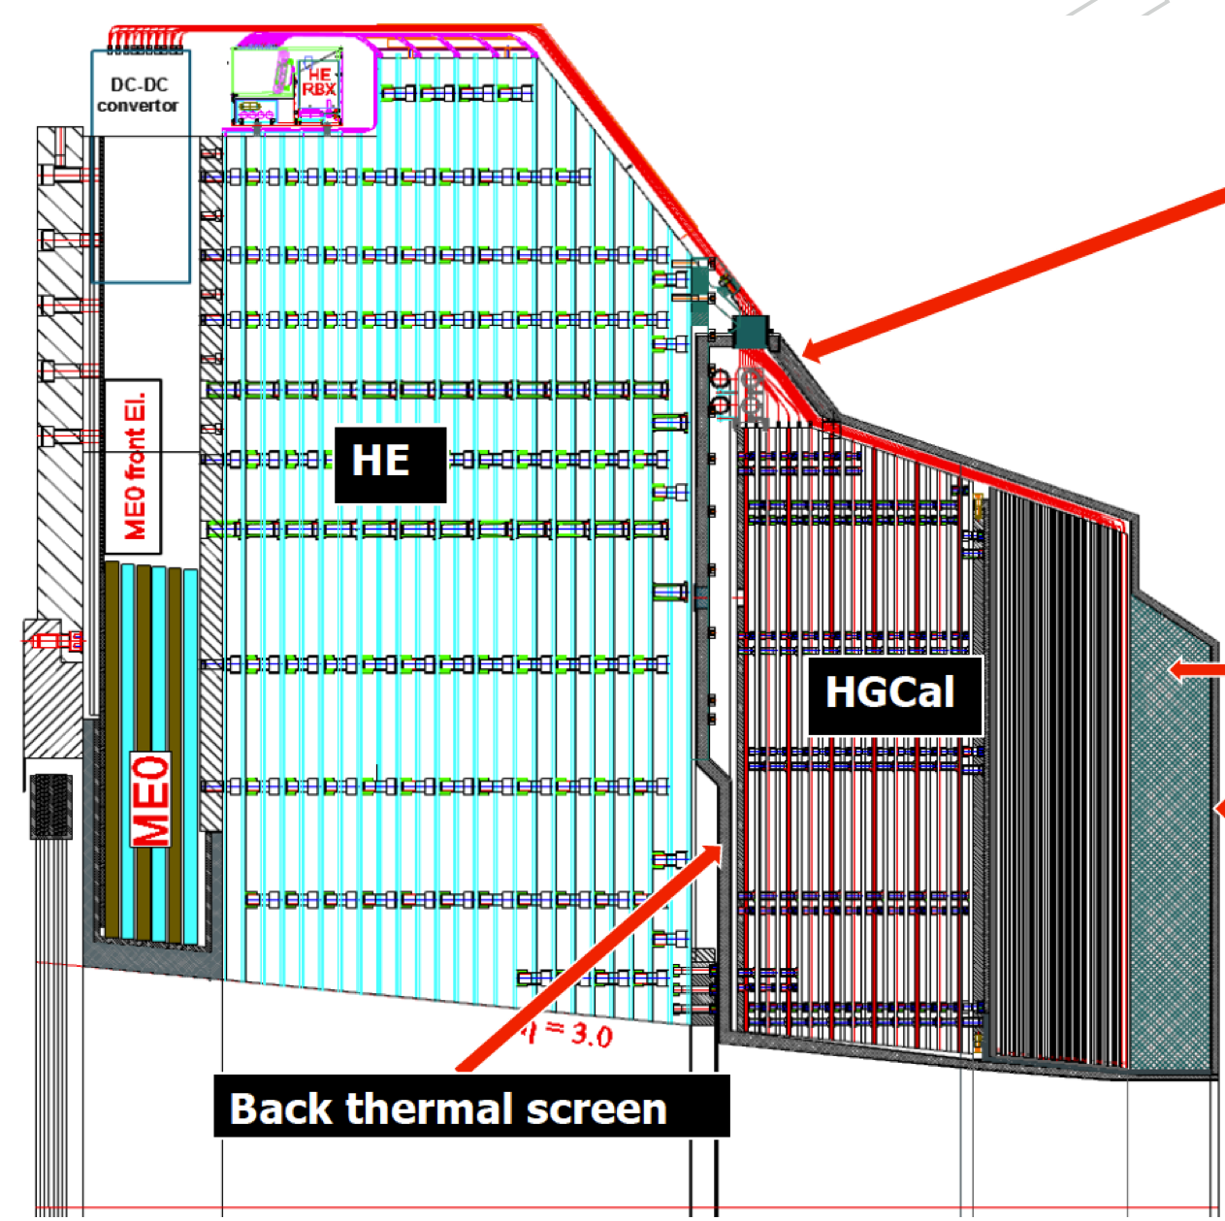

High Granularity Endcap Calorimeter
HGCAL
FH
EE
BH
neutron
moderator
Front thermal screen
CMS HL-LHC Upgrade Endcap
Current Detector Endcap
Presenter | Presentation Title
22

Slide 23
High Granularity Endcap Calorimeter
Silicon/tungsten electromagnetic calorimeter (EE)
  28 layers with varying X₀ thickness (average 1.0)
Silicon/brass hadron calorimeter (FH)
  12 sampling layers separated by 0.3 λ
Scintillator/brass hadron calorimeter (BH)
  12 sampling layers
HGCAL
FH
EE
BH
neutron
moderator
Front thermal screen
23

Slide 24
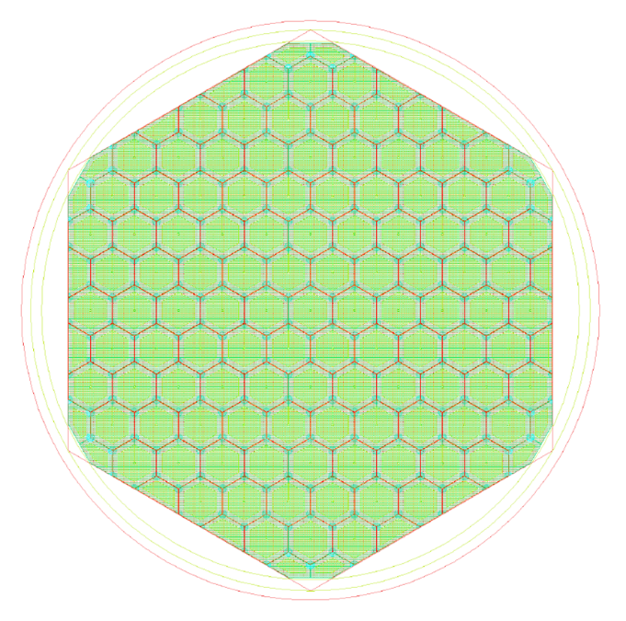
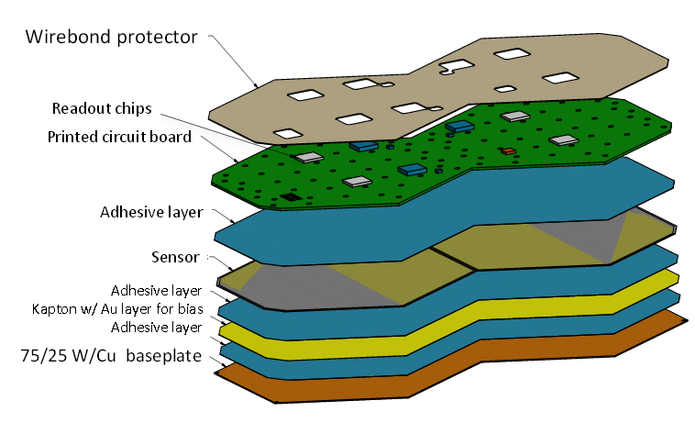
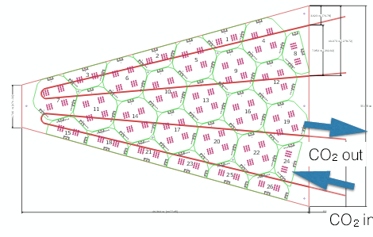
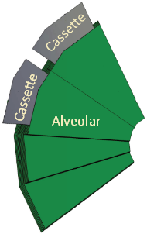
Sensors, Modules and Cassettes
Silicon Sensor
Module with sensor readout
128 and 256 readout channels
Modules mounted on cassettes
Integration of cooling and services
Cassettes inserted in the absorber structure
Final assembly at CERN
Fermilab will be a casette assembly site

Slide 25
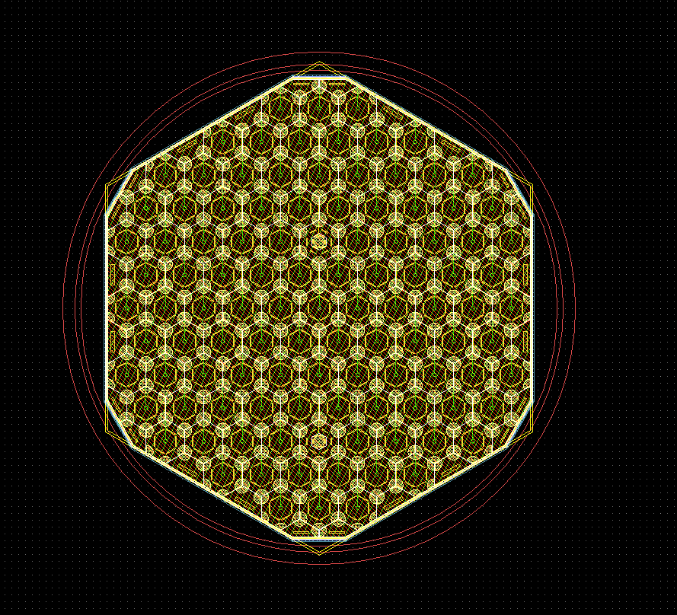
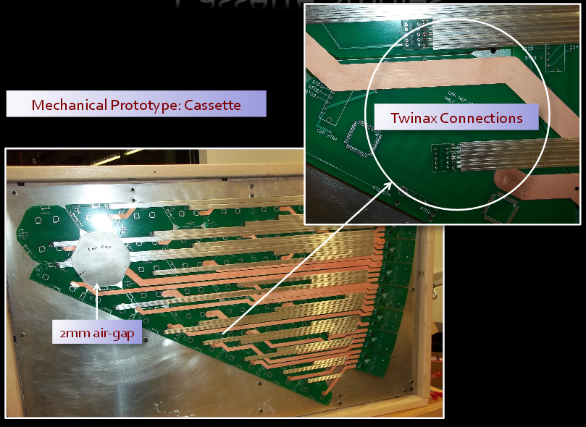
High Granularity Endcap Calorimeter
FNAL designed the HGC test beam sensors.
Designed a probe card and established test stand for sensor testing
Designed and fabricated the mechanical support
Designed the readout and DAQ electronics
“Pogo pin” test card

Slide 26
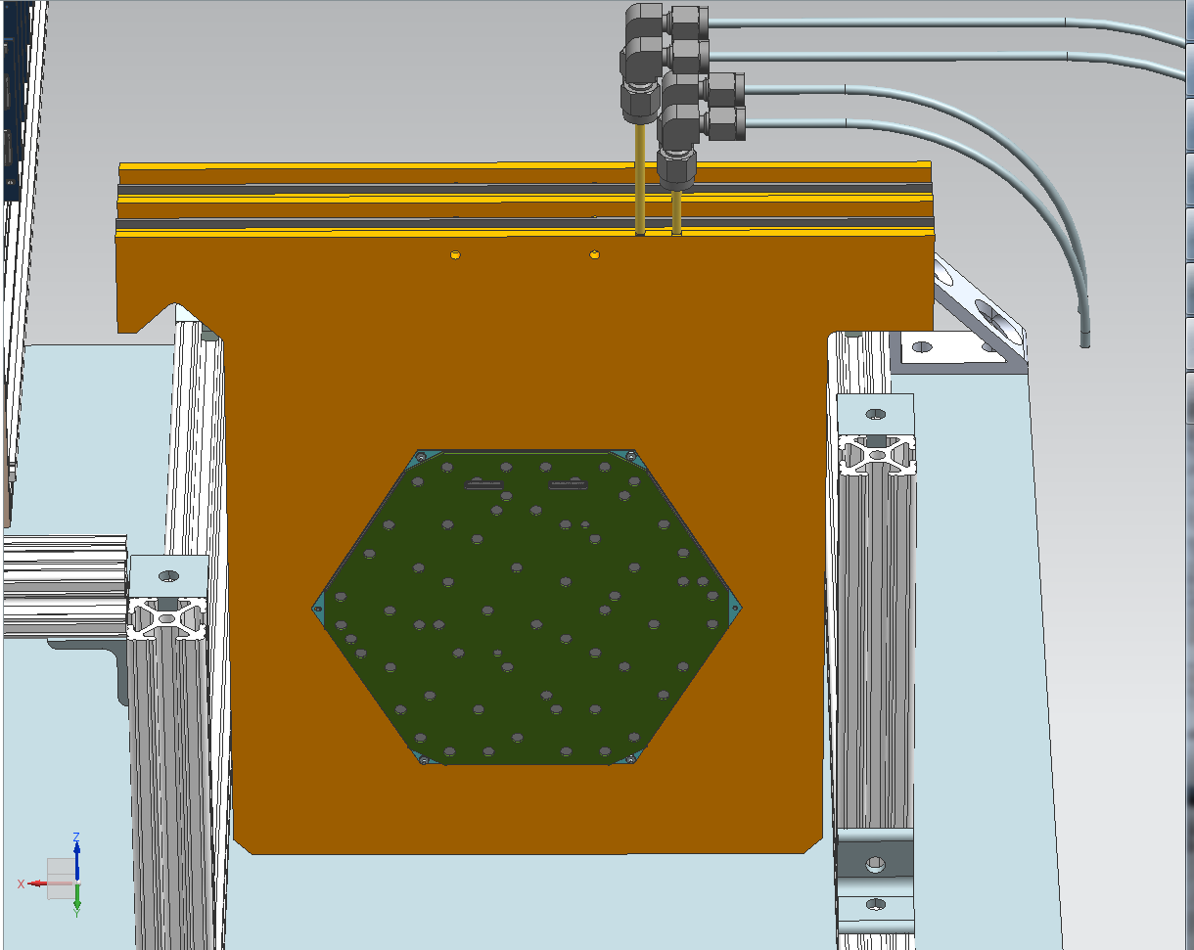
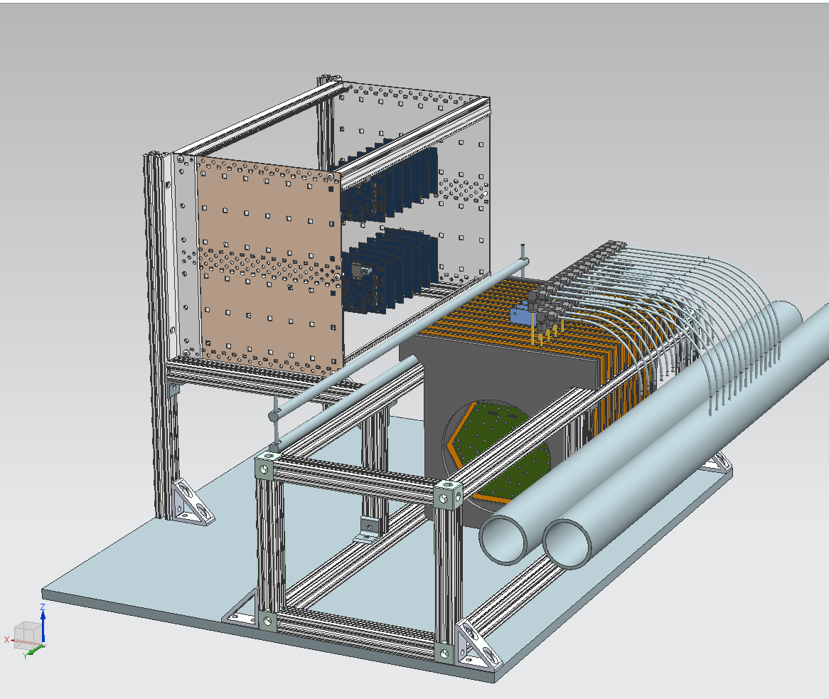
HGC in Fermilab Test Beam (March 2016)
Electronics Crate for carrier cards with FMC-IO, and 2 ZedBoards
Cooling water manifold
Testbeam prototype double module “cassettes”
Hanging File Design

Slide 27
CMS HL-LHC upgrades
Summary / Conclusions

Slide 28
Fermilab support of HL-LHC Upgrades
No money yet from the Funding Agencies specifically for HL-LHC Upgrades
  We are supported by the CMS Operations Program (thanks Lothar!), but the Operations program is also very stressed
  We hope to be able to pay for ourselves starting ~2018, according to the Funding Agency schedule
  However, even before we get any “real” money, we have to go through serious NSF / DOE reviews (e.g. CDR / CD-1) as well as make progress on R&D!
Fermilab is supporting the project through:
  Project management support, espeically from Chief Project Officer (thanks Mike!)
  We really appreciate the support, but we’ll need more in terms of project schedulers (i.e. P6), engineering for R&D, etc., and hope we rely on the lab to get us through these lean years!

Slide 29
CMS HL-LHC upgrades
backup

Slide 30
CMS Phase 1 Upgrade Project – Barreling along
Hadron Calorimeter
Forward Front End
In Post-production Burn-in
Installation Dec 2016
Endcap/Barrel Front End
Successful Testbeam, Production Ensues
Installation Dec 2016/Jan 2019
Forward Pixel
Components
In Production
Feeds A&T
Assembly & Testing
Ramping Up
Installation Dec 2016
L1 Trigger
Muon Trigger
Installed, commisioning
→ Operations in 2016
Calorimeter Trigger
Installed, ~commisioned
→ Operations in 2016
Back End Readout
Installed, ~commisioned
→ Operations in 2016
Pilot System
Installed, ~commisioned
→ Operations in 2016
Successful DOE/NSF Review Oct 2015
Upshot: Challenging Schedule! Keep up the hard work.

Slide 31
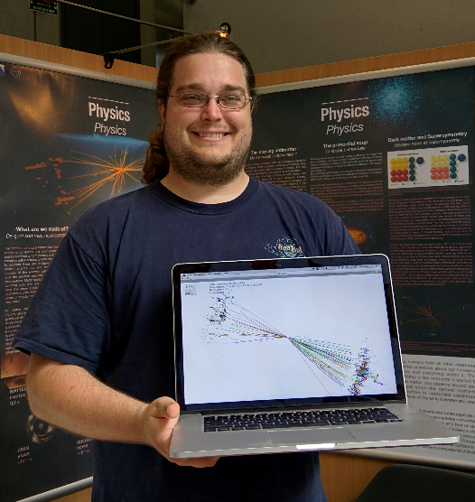
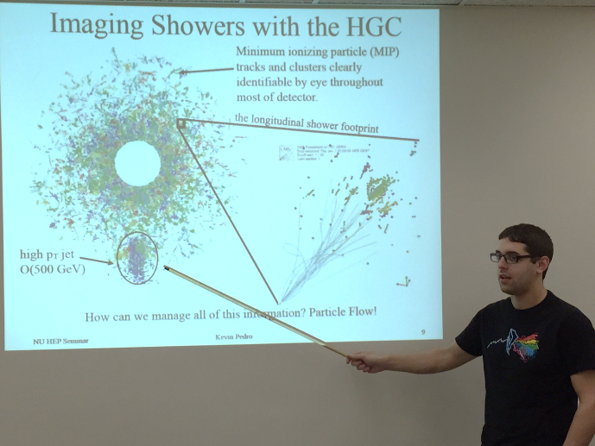
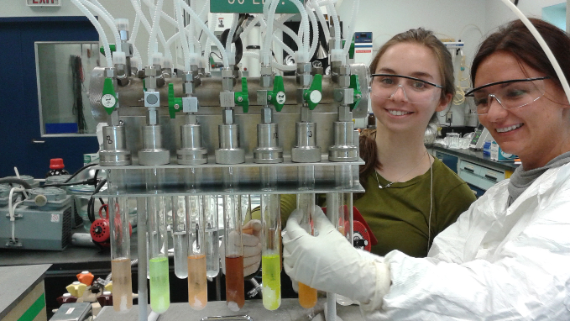
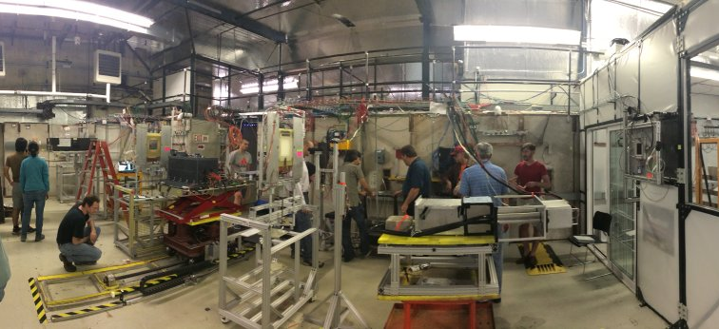
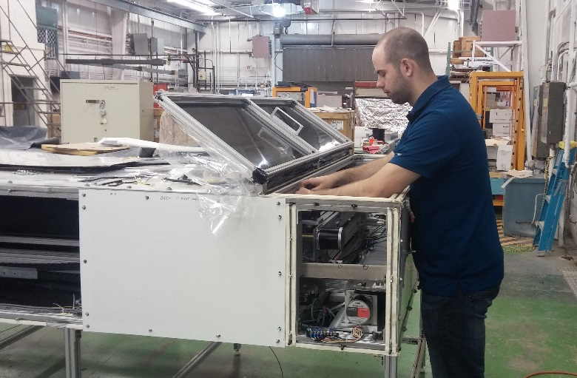
Fermilab RAs, Summer Students, and University partners
Reconstruction using PFlow
Development of rad hard scintillator
Revamping the scintillator scanner
Fast timing at the test beam facility

Slide 32
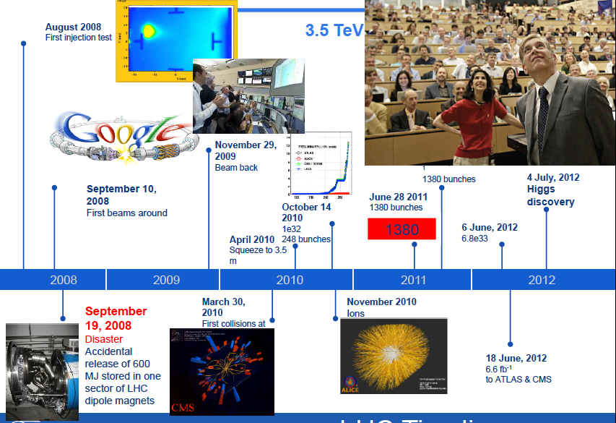
LHC past: In a Nutshell

