Slide 1
Short Baseline Neutrino Program (SBN)
Gina Rameika, Neutrino Division Head
January 2016 PAC
19 January 2016

Slide 2
Outline
PAC Charge Questions
Scope of this talk
SBN Progress in 2015
December 2015 Director’s Review
  Executive Summary and Highlights
  Concerns and Recommendations
  Program Response to Recommendations
Resource Planning for 2016, 2017, and beyond
SBN in context with the Fermilab Neutrino Program

Slide 3
Charge to this PAC
i) We ask the PAC to advise on whether the SBN Program is ready for Stage 2 approval. Note that it is intended that a proposal to upgrade the BNB beamline will be considered at a later date.
ii) Given the results from the Directors Review in December, does the PAC believe that, for Stage 2 approval, there is an adequate understanding of the resources required to execute the program? With the present understanding of the resources required, is the SBN program consistent with the P5 recommendations?
iii) Is adequate progress being made towards coordinating plans for analysis across all three SBN experiments?
iv) Does the progress to date on MicroBooNE give confidence that this experiment will fulfill its role in the SBN program?

Slide 4
Charge to this PAC
i) We ask the PAC to advise on whether the SBN Program is ready for Stage 2 approval. Note that it is intended that a proposal to upgrade the BNB beamline will be considered at a later date.
ii) Given the results from the Directors Review in December, does the PAC believe that, for Stage 2 approval, there is an adequate understanding of the resources required to execute the program? With the present understanding of the resources required, is the SBN program consistent with the P5 recommendations?
iii) Is adequate progress being made towards coordinating plans for analysis across all three SBN experiments? – Next talk
iv) Does the progress to date on MicroBooNE give confidence that this experiment will fulfill its role in the SBN program? – Last talk

Slide 5
Scope of this talk
This talk will cover :
  Progress on Detector Hall Infrastructure
  Status of ICARUS refurbishment
  SBND Detector Design status
  Plans for mitigation of cosmogenic backgrounds
  Analysis of resources needed, including discussion of in-kind contributions
This talk will not cover
  MicroBooNE, except for discussion of the resources needed for cosmogenic background mitigation
  LAr reconstruction efforts and progress
  Post-construction phase collaboration organization

Slide 6
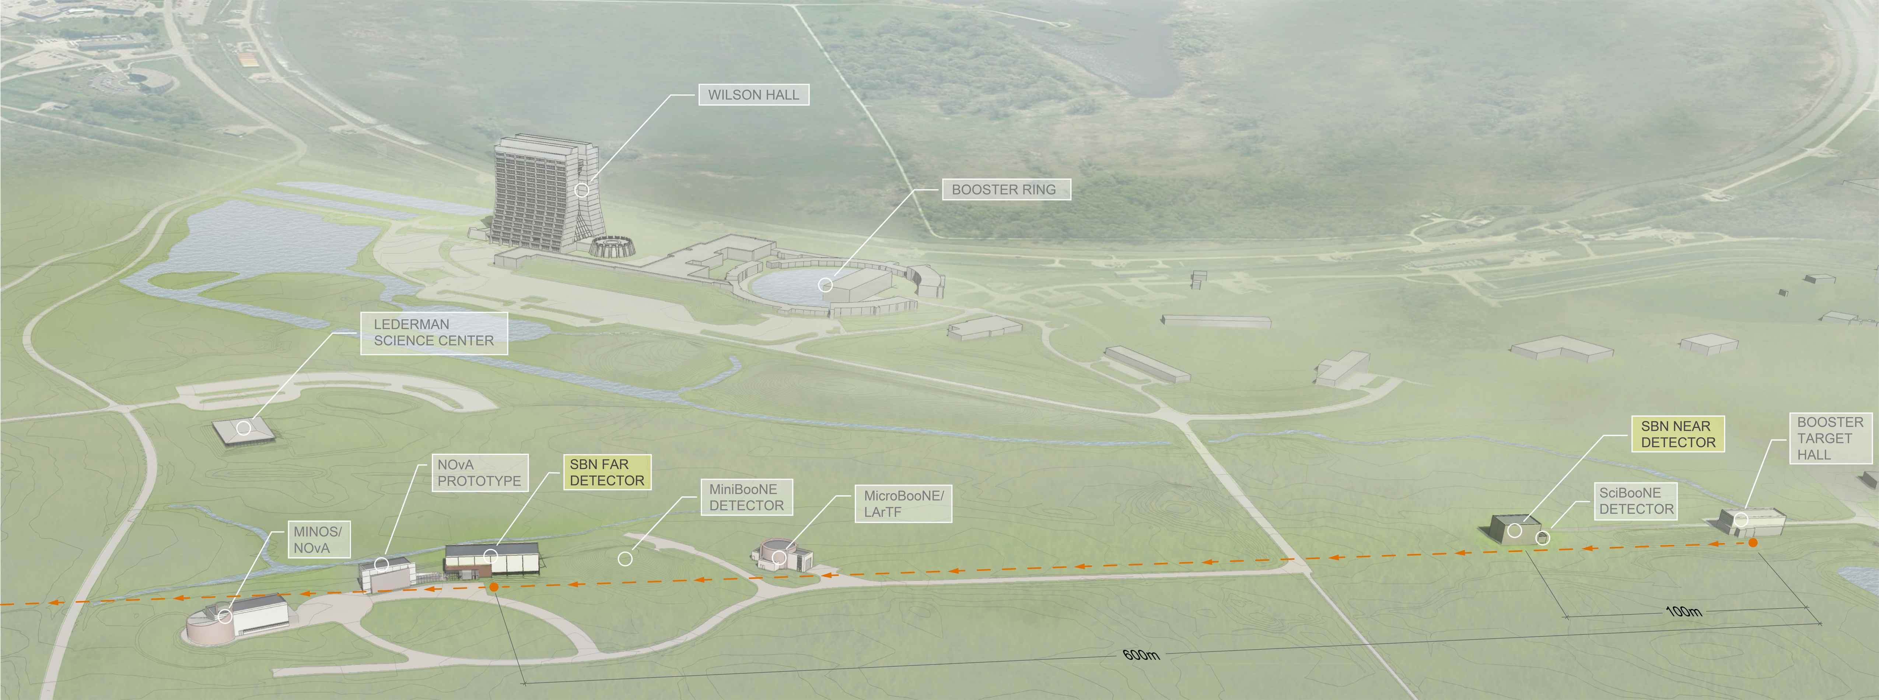
SBN Program – Three detectors
ICARUS
Fewer ν_{μ} ?
More ν_{e}?
MicroBooNE
Fewer ν_{μ} ?
More ν_{e}?
SBND
ν_{μ}
~1% ν_{e}
Produce
ν_{μ}
~1% ν_{e}
110m
470m
600m

Slide 7
SBN Science Goals
Directly follow up on the MiniBooNE neutrino anomaly by utilizing the LArTPC technology to determine the composition of the observed excess as electrons or photons (MicroBooNE during Phase I)
Apply the advantages of the LArTPC technology and multiple detectors at different baselines to the question of high-Δm² sterile neutrino oscillations for the first time, testing current allowed oscillation parameters at ≥5σ (Phase II)
Study ν-Argon interaction physics using millions of events from both the Booster and Main Injector neutrino beams at Fermilab
Further develop the LArTPC technology toward the aim of applying it at very large scales for long-baseline physics in DUNE

Slide 8
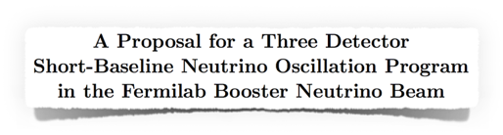
The SBN Proposal
Returned to the January 2015 PAC meeting with an updated proposal:
Submitted jointly by ICARUS, MicroBooNE and SBND (LAr1-ND)
http://sbn-docdb.fnal.gov:8080/cgi-bin/ShowDocument?docid=269
Part I: SBN Physics Program
Part II: Near Detector Conceptual Design
Part III: T600 Design and Refurbishing
Part IV: Infrastructure and Civil Construction
Part V: Booster Neutrino Beam
Part VI: Coordination and Schedule
Program Conceptual Design Report
Stage 1 Approval in February 2015
Goal: Operations with beam by 2018

Slide 9
SBN Work Breakdown

Slide 10
SBN Work Breakdown

Slide 11
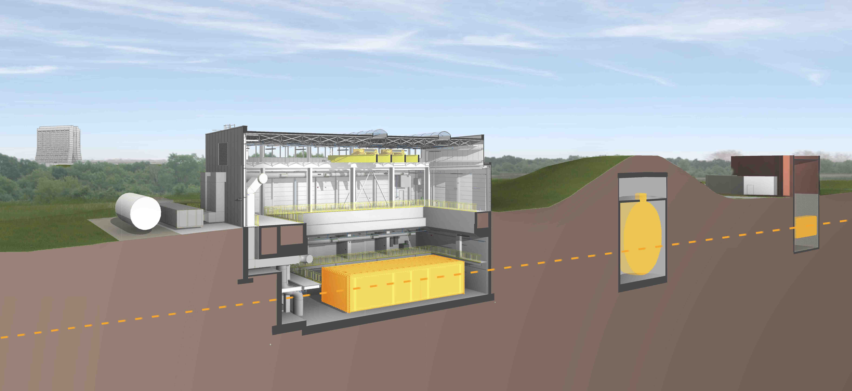
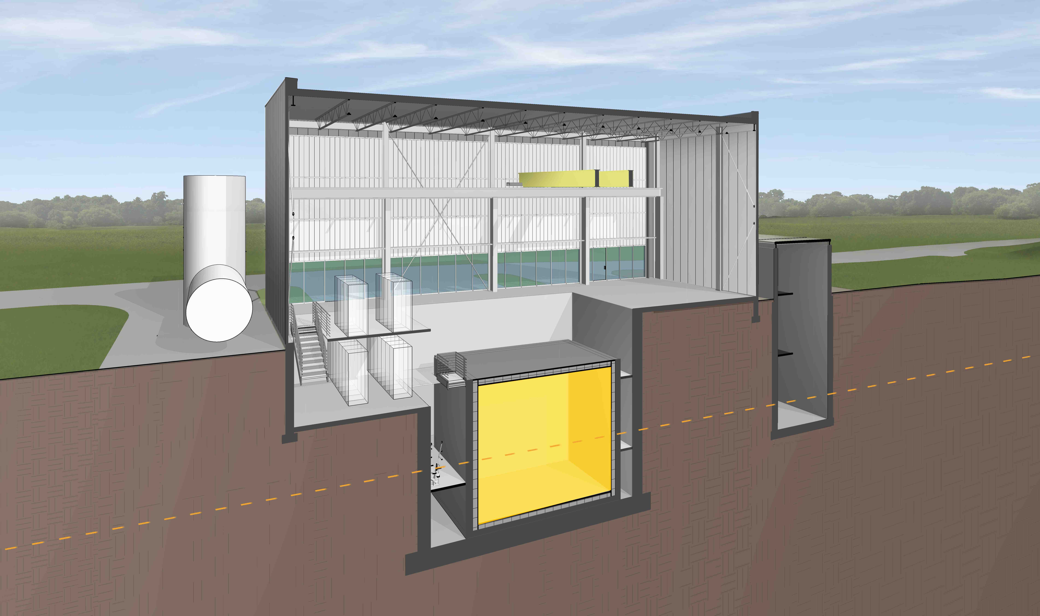
SBN Program – Three detectors
Detector | Distance from BNB Target | Active LAr Mass
SBND | 110 m | 112 ton
MicroBooNE | 470 m | 87 ton
ICARUS | 600 m | 476 ton
MiniBooNE
MicroBooNE(operating)
ν
SBND
(new)
ν
Icarus – T600
(relocated)

Slide 12
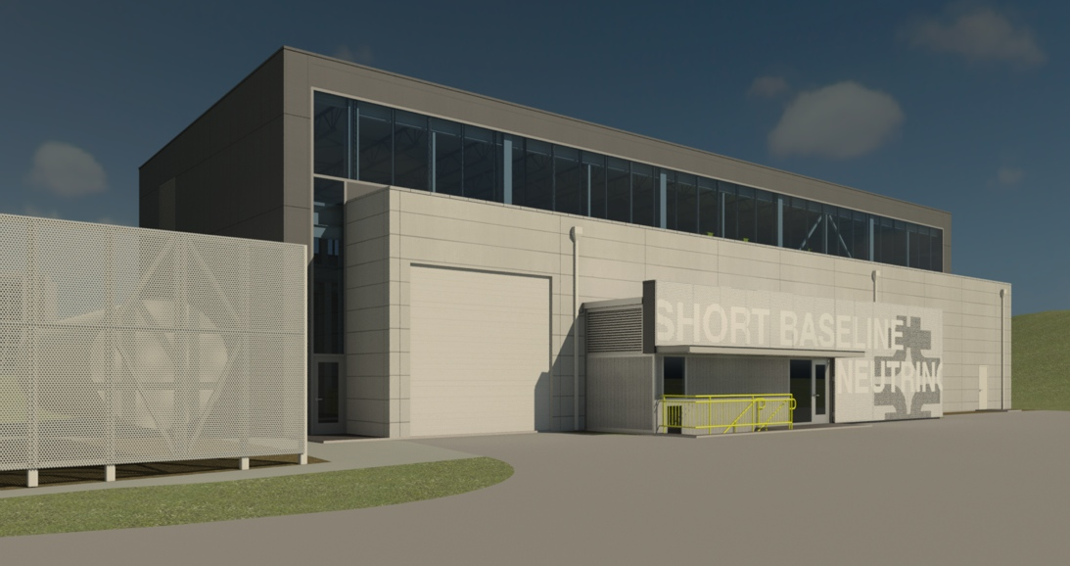
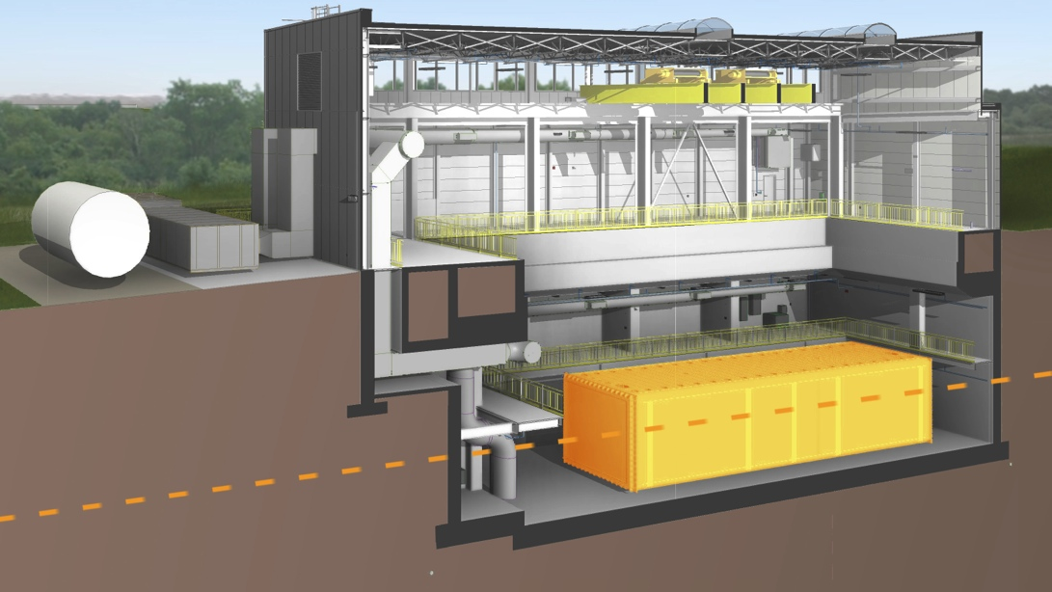
Far Detector Building
Close cooperation between ICARUS, CERN and Fermilab on design requirements and review.
Designed for 3m concrete overburden over detector to mitigate cosmogenic backgrounds for near surface operation
Milestones:
  Aug 2014 Start preliminary design
  Mar 2015 Design complete
  April 2015 Construction contract bidding
  July 2015 Construction Start
  Sept 2015 Excavation complete
  Jan 2016 Concrete complete
  June 2016 Building envelope complete
  Oct 2016 Beneficial Occupancy
ν
T600

Slide 13
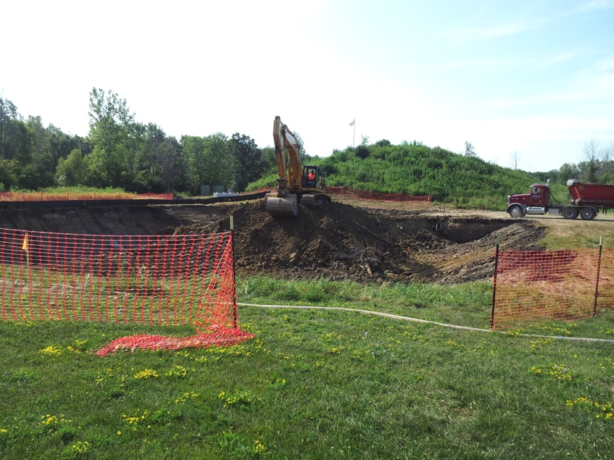
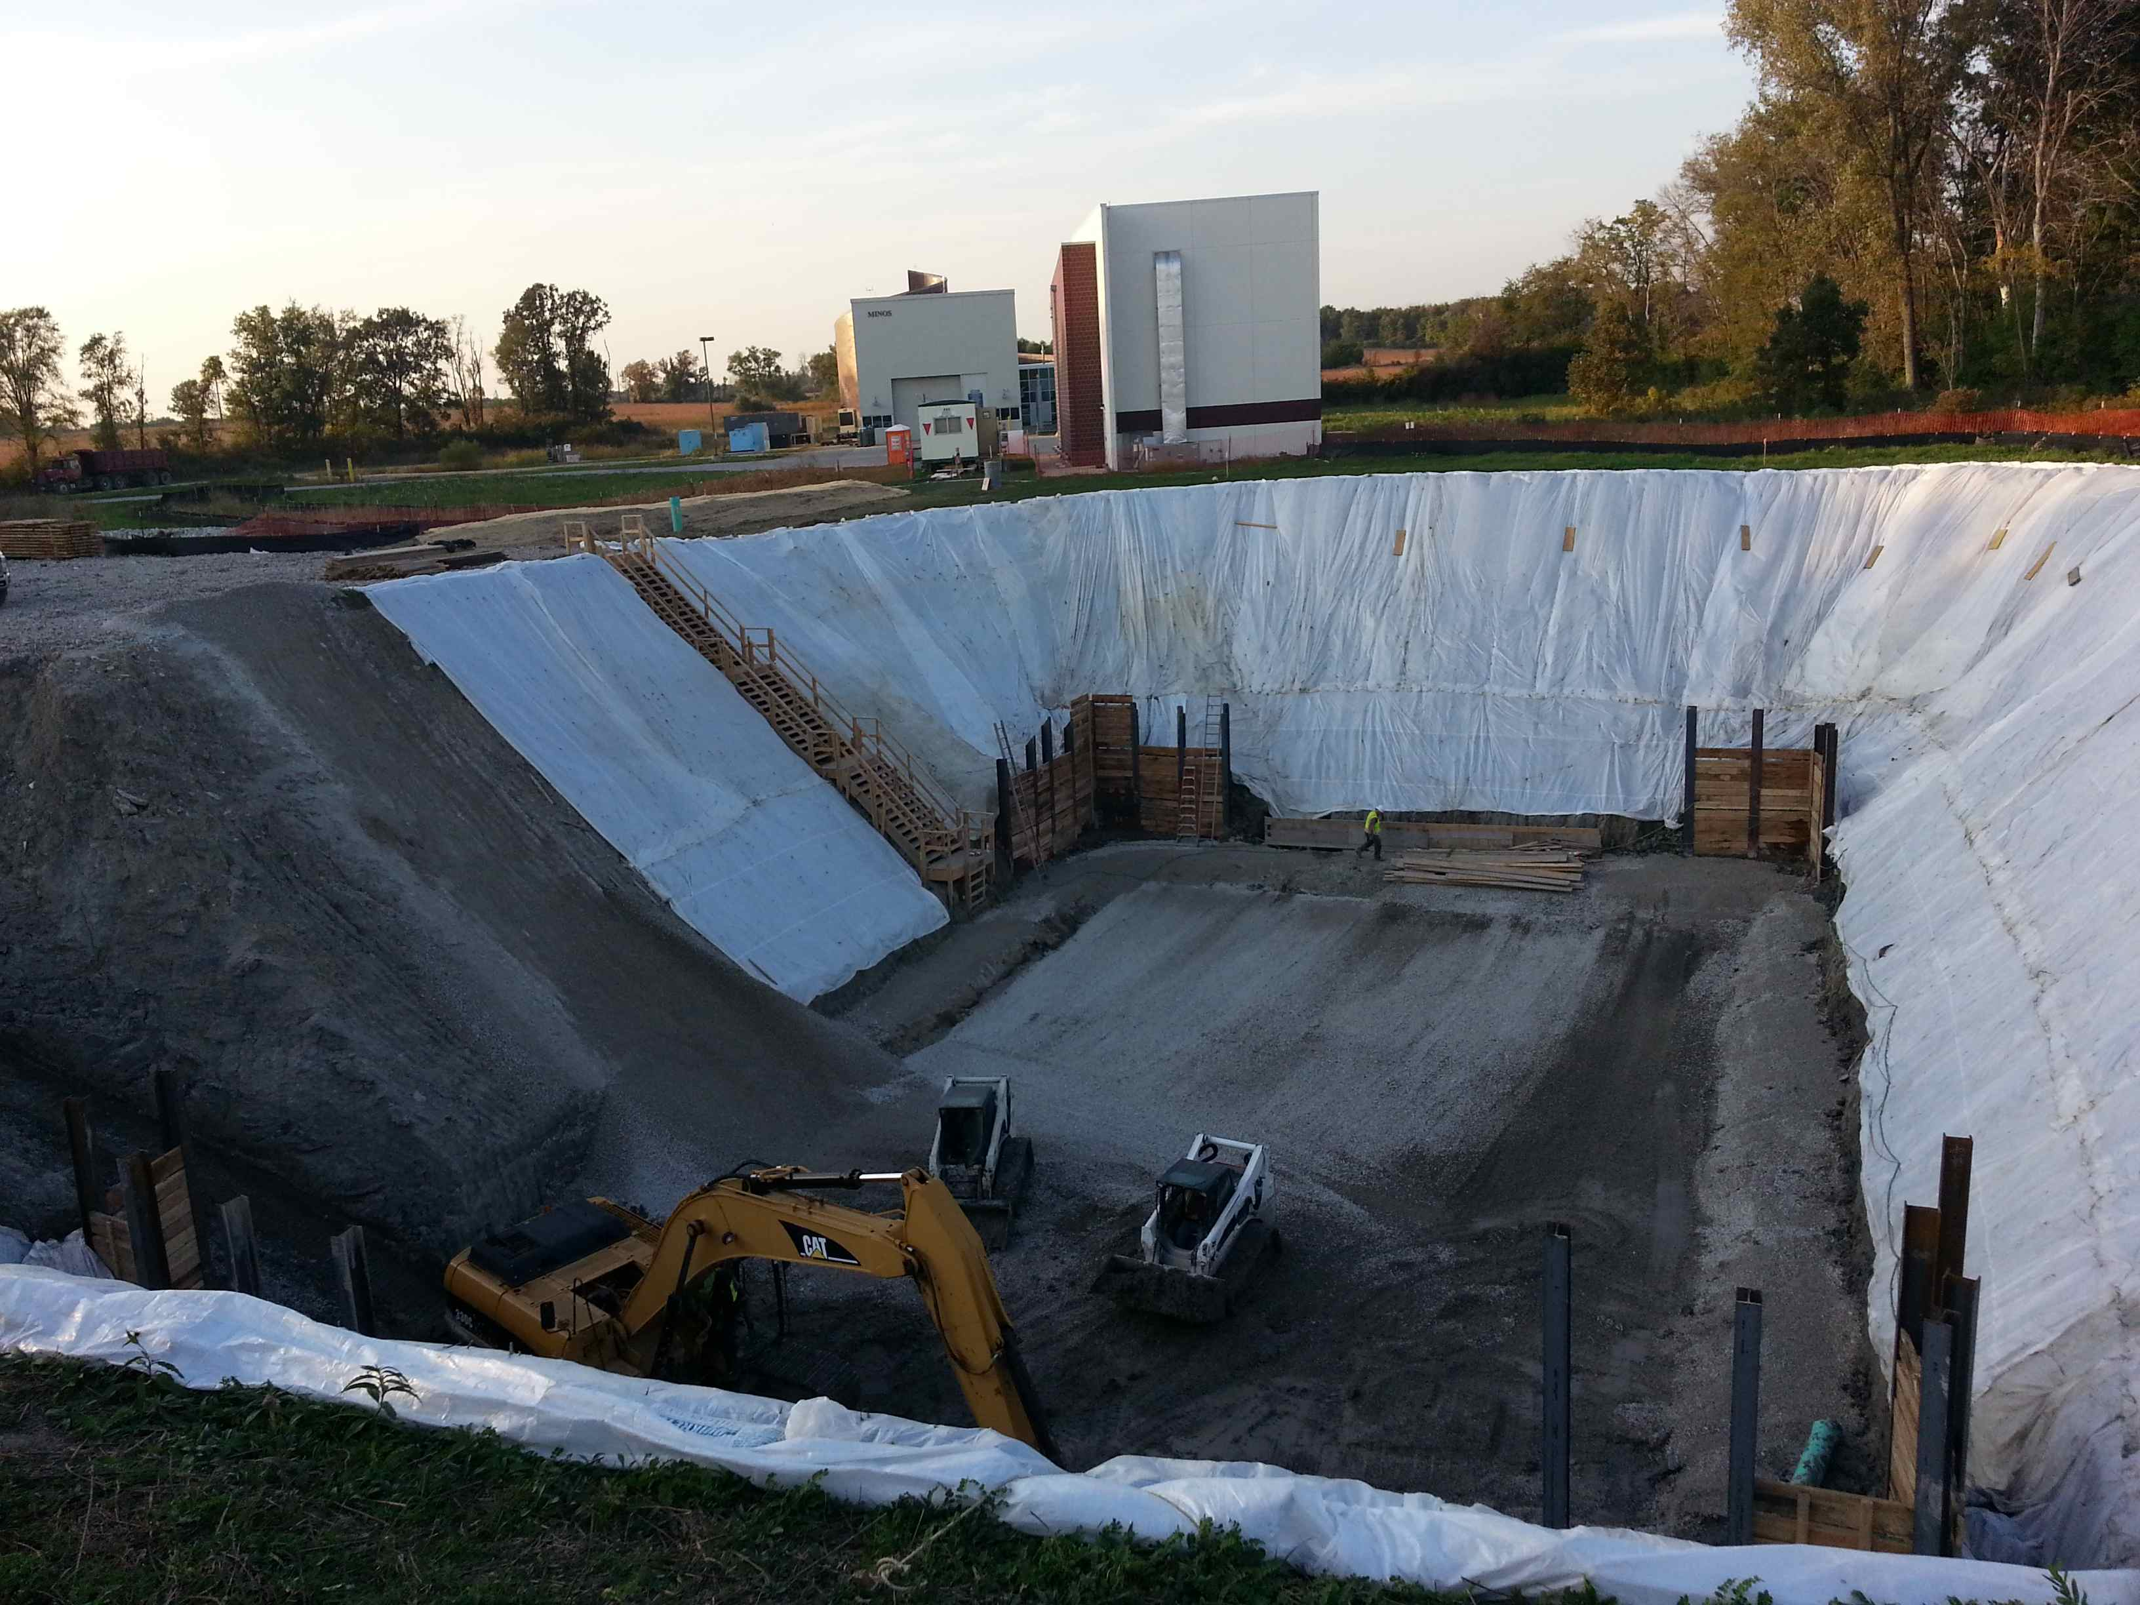
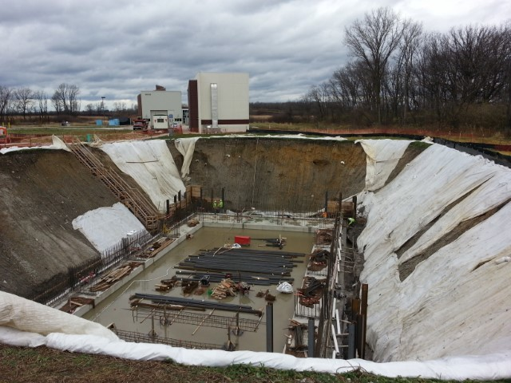
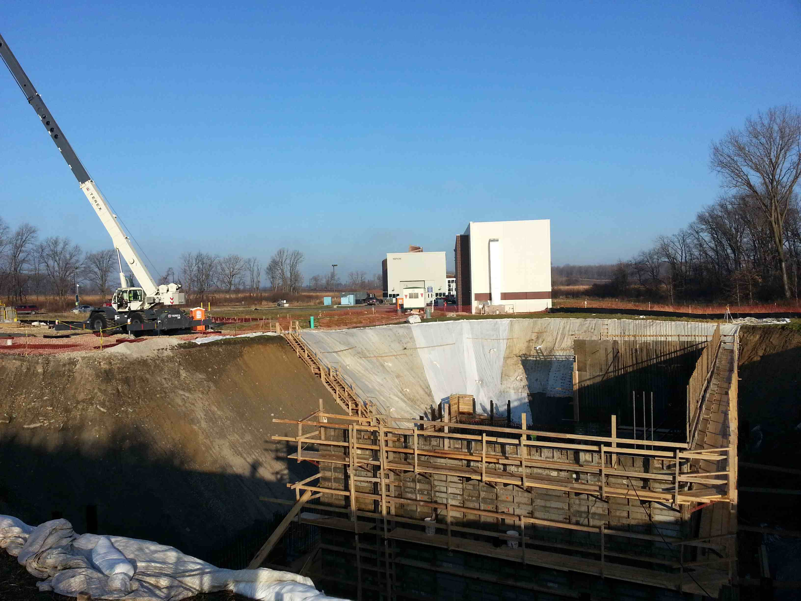
Far Detector Building Progress
Aug 13: view south
Oct 7: view north
Nov 17: view north
Dec 9: view north

Slide 14
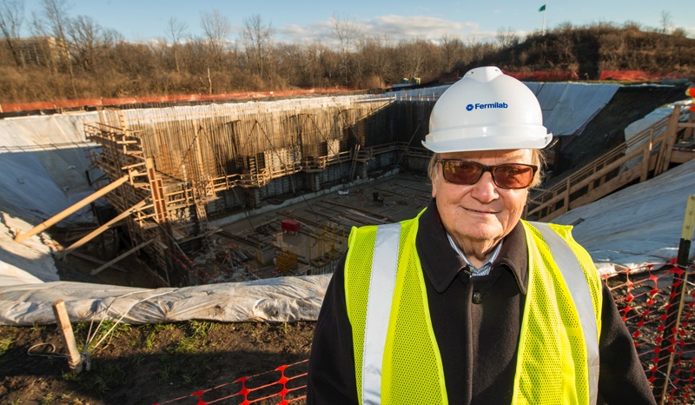
Making Carlo Smile

Slide 15
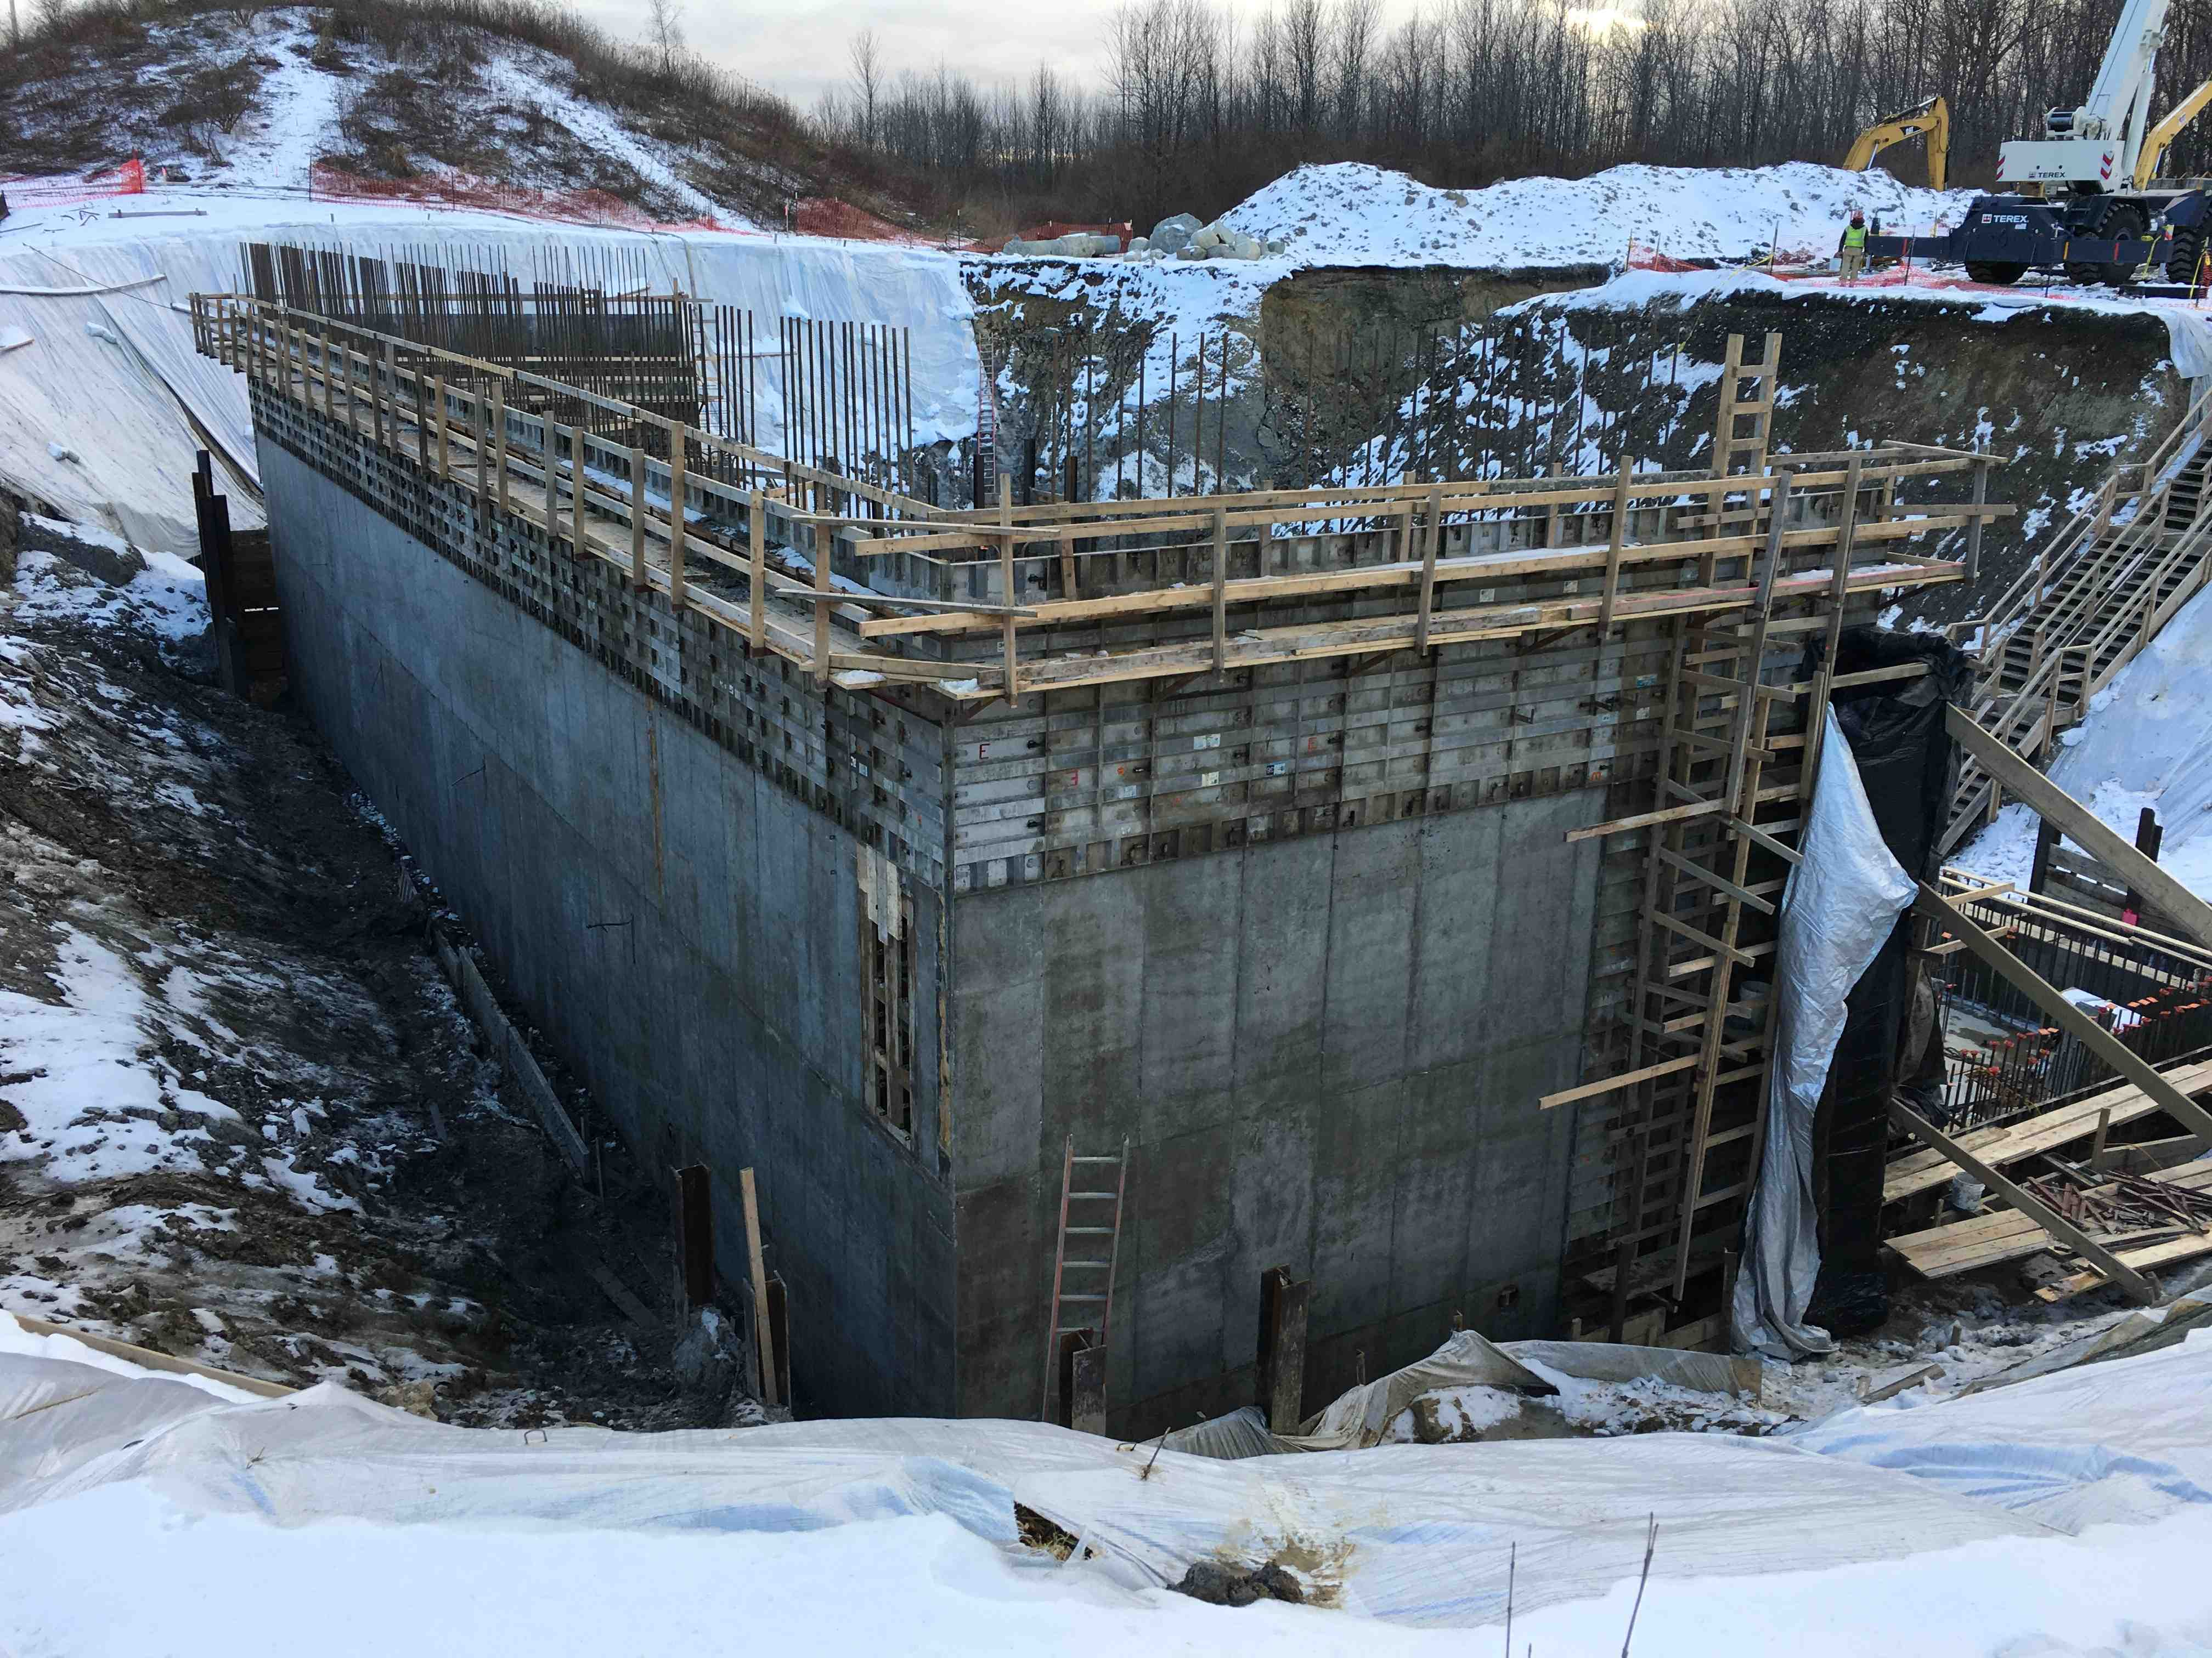
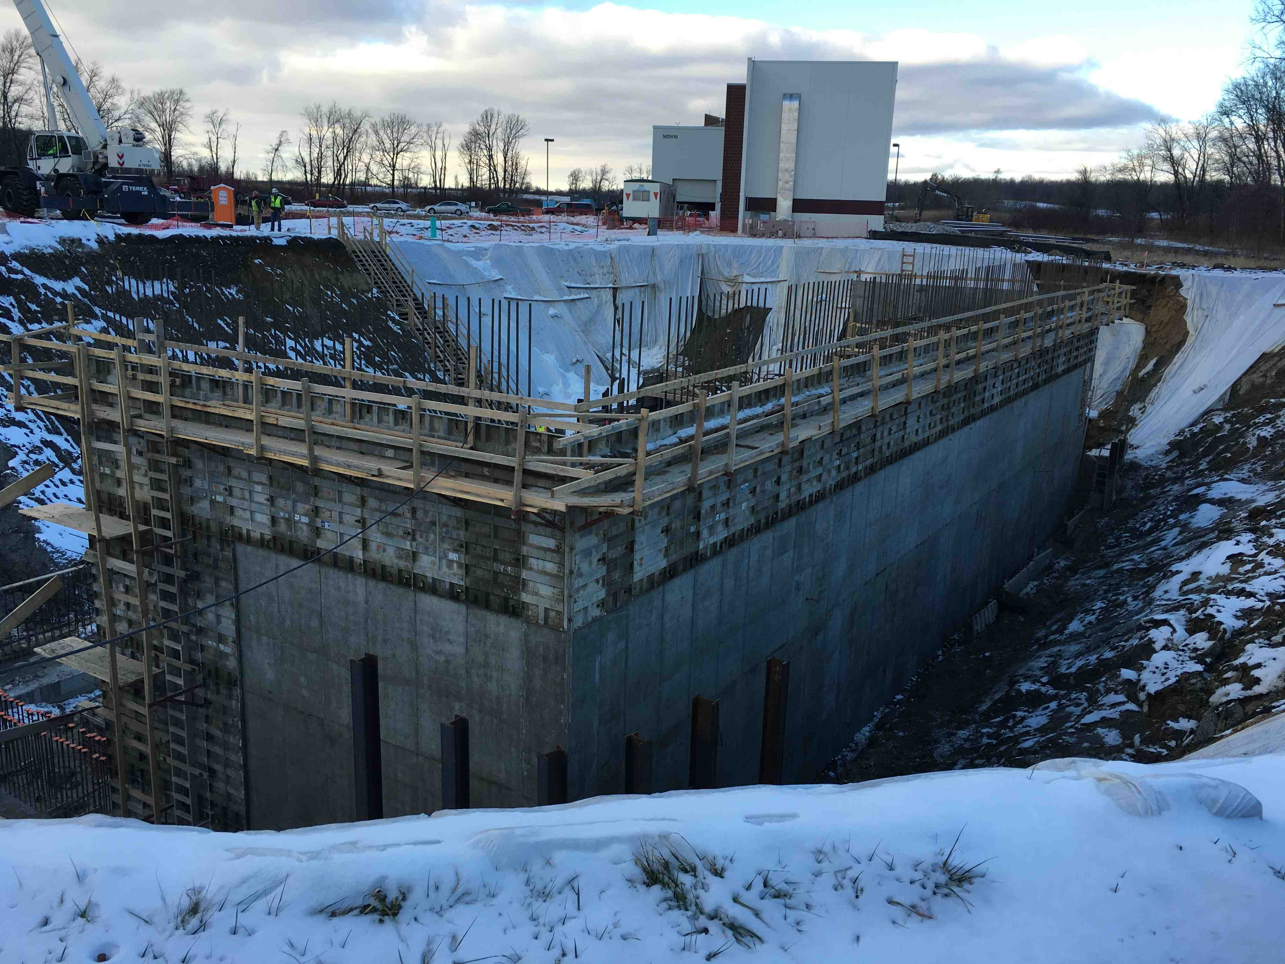
January Progress
Site visit can be arranged
for tomorrow morning
if PAC members desire

Slide 16
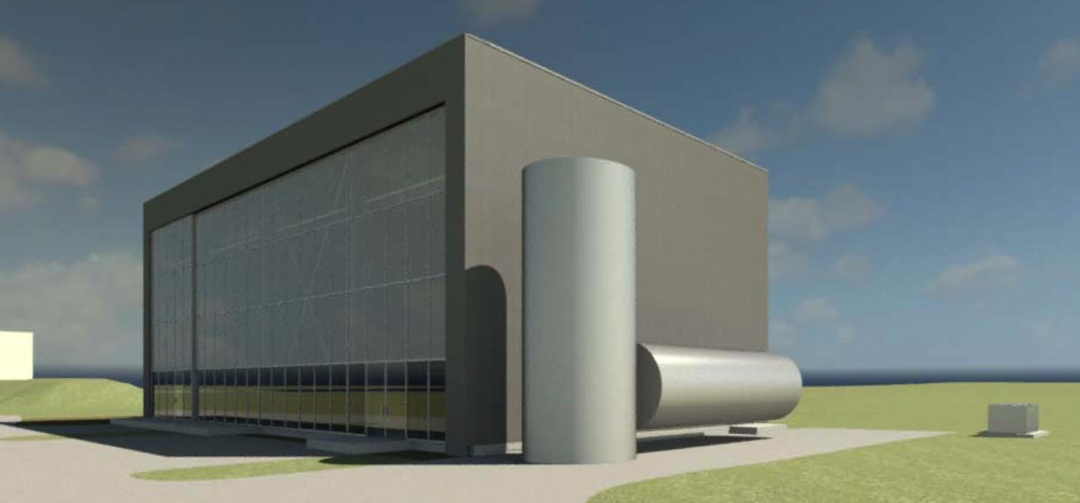
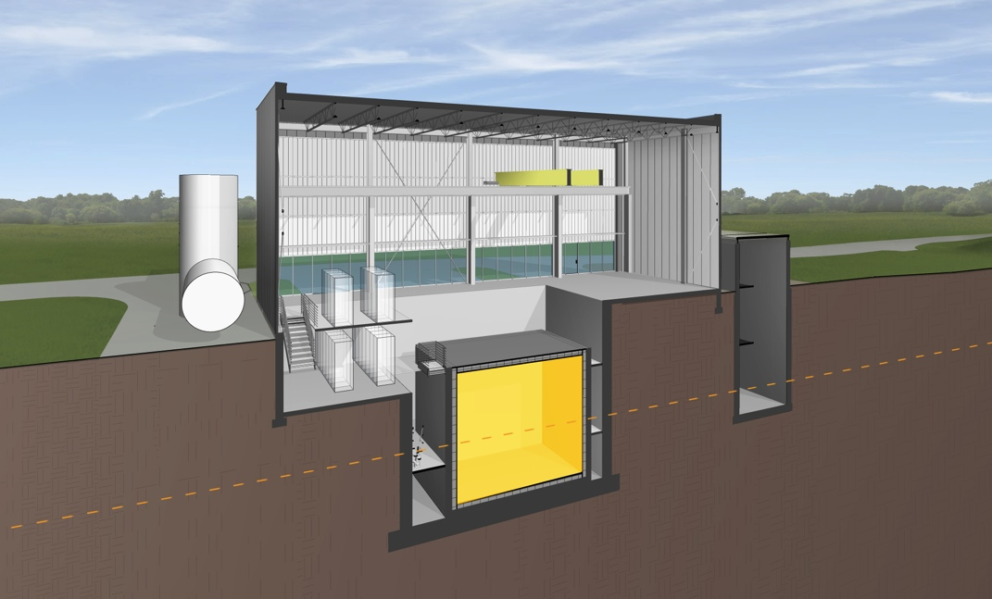
Near Detector Building
Designed for 3m concrete overburden inside building to mitigate cosmogenic backgrounds for near surface operation
Milestones:
  Jan 2015 Design start
  May 2015 60% Design complete
  July 2015 Final design review
  Aug 2015 Design complete
  Oct 2015 Bidding complete
  Jan 2016 Notice to proceed
  Feb 2016 Construction start
  Nov 2016 Beneficial Occupancy

Slide 17
Scope of ICARUS Work at CERN (WA104)
TPC refurbishing in progress:
  New cryostats
  Flatten cathodes
  Replace internal TPC cabling
  New HV decoupling boards
  New 8” PMTs (90 per wire plane)
  Upgrade TPC readout electronics
Rebuild cryogenic system
In planning stage (some may be DOE scope):
  Cosmic Ray Tagger system
  DAQ System
First TPC Module in CERN Cleanroom

Slide 18
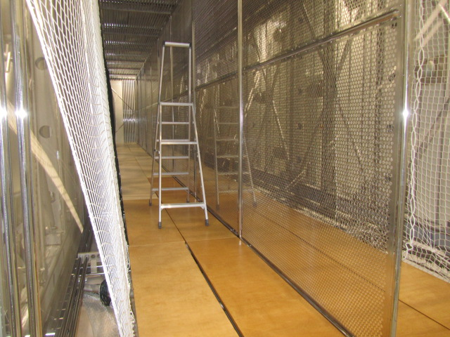
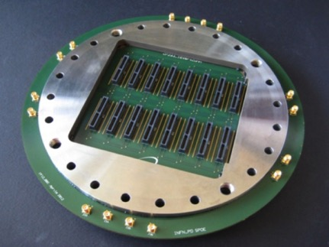
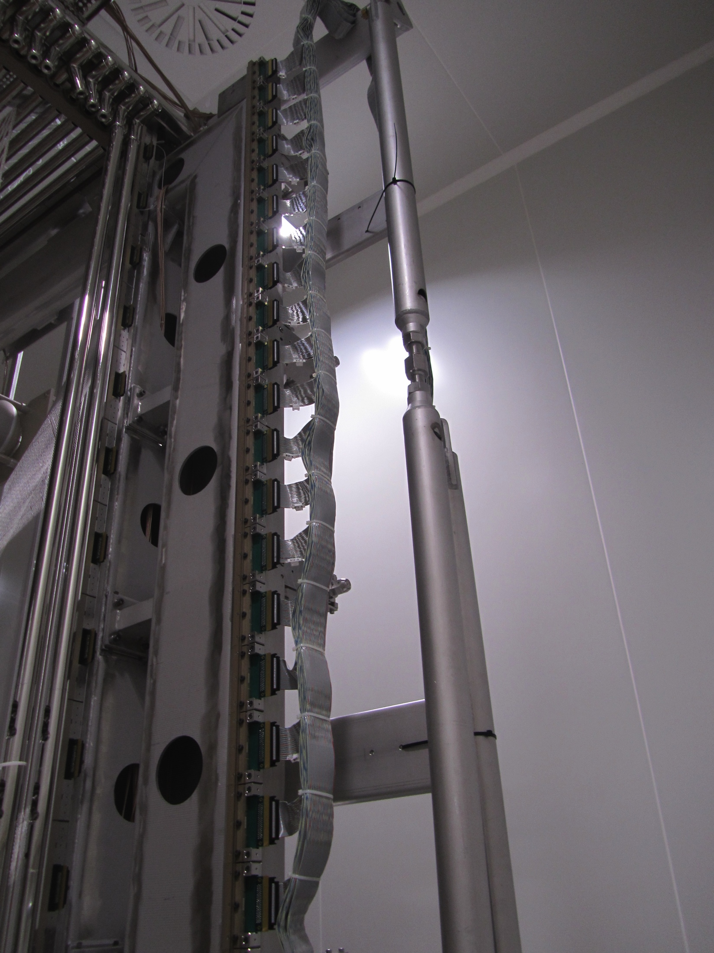
ICARUS Progress
New flange
(to accommodate
old cable modularity)
Cathode panels after flattening and electro-polishing
First cables bundle

Slide 19
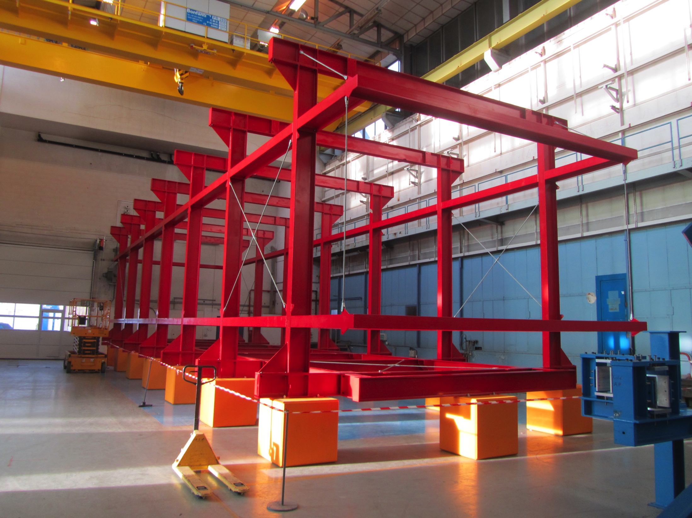
New Cryostat Construction
Assembly tooling
Passive insulation same as other
cryostats

Slide 20
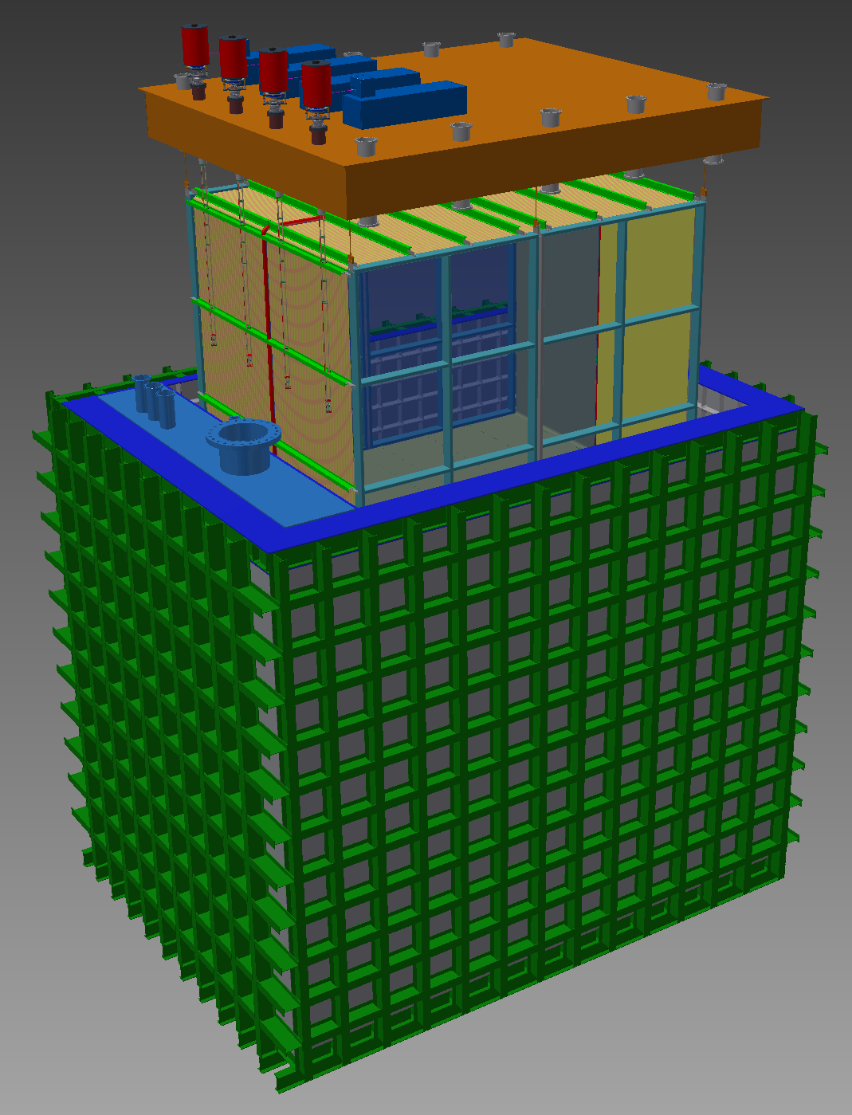
SBND Detector
Completely new detector incorporating experience from ICARUS, MicroBooNE, LBNE 35 ton
Coordinate with DUNE on designs
Scope of work:
  TPC design and construction
  PMT (8”) system
  Laser Calibration system
  Cosmic Ray Tagger
  Cold TPC readout electronics
  DAQ (and electronics infra)
  Membrane cryostat
  Integration and Installation
Plate A: TPC support and detector feedthroughs
TPC
SS Inner Membrane
Plate B: Cryogenic Services
Foam Insulation (60cm)
Steel outer cryostat and support structure

Slide 21
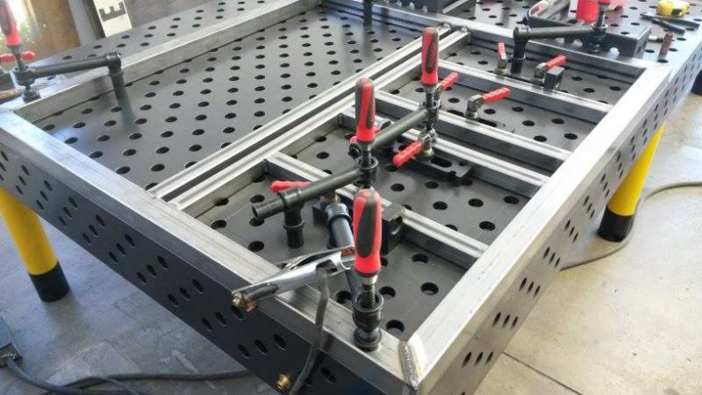
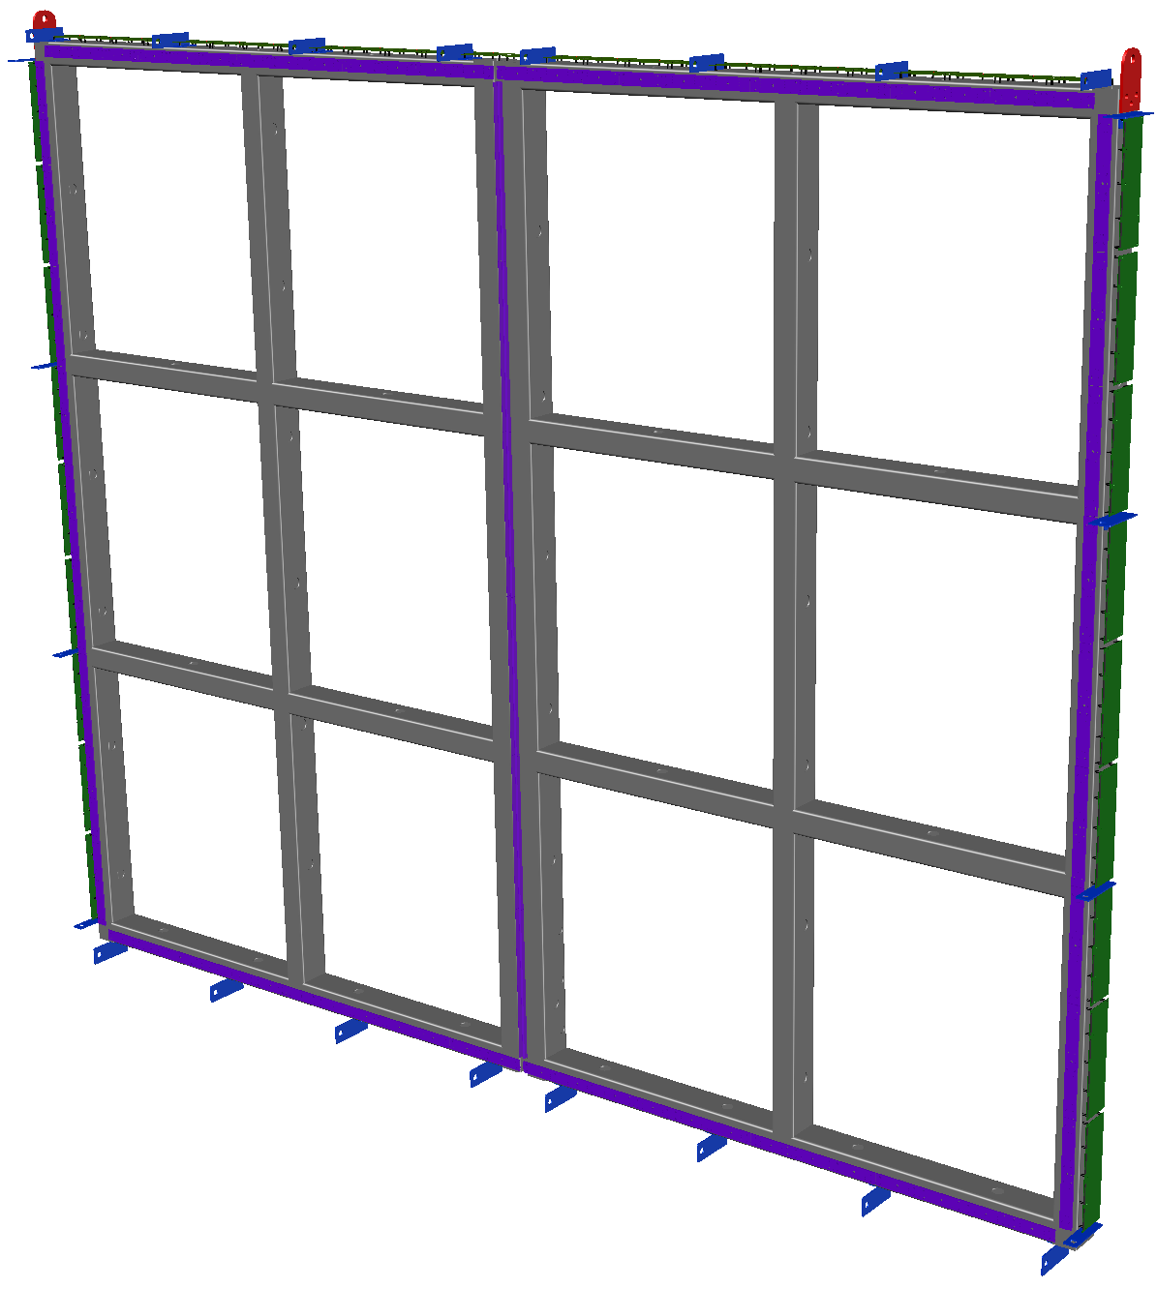
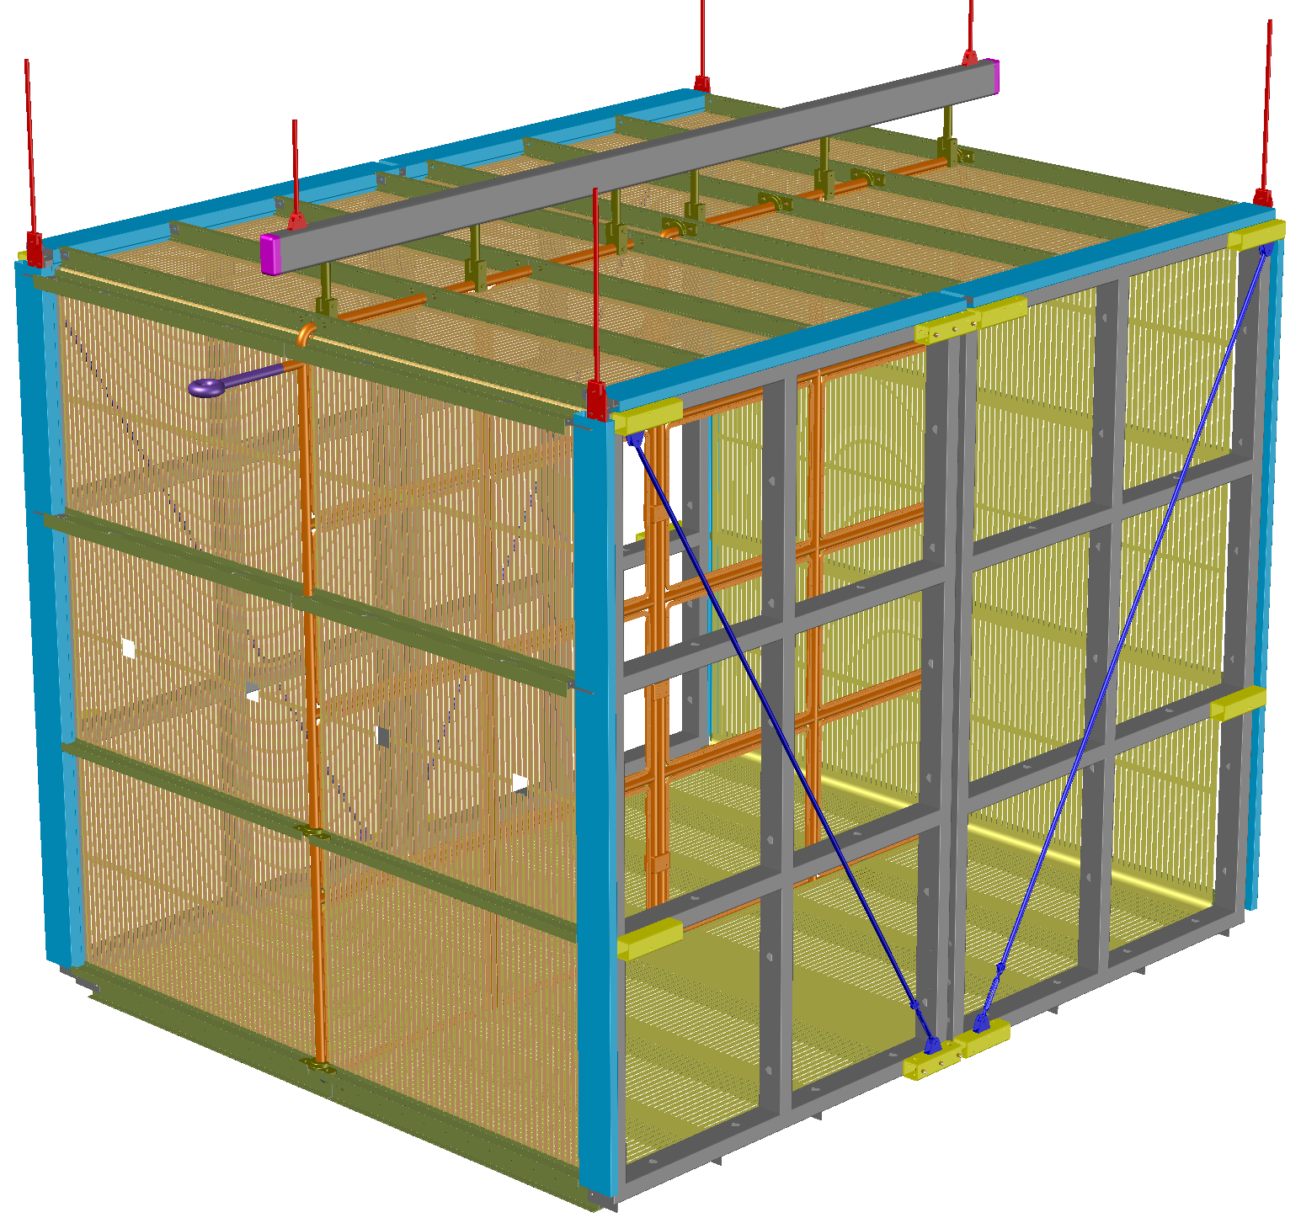
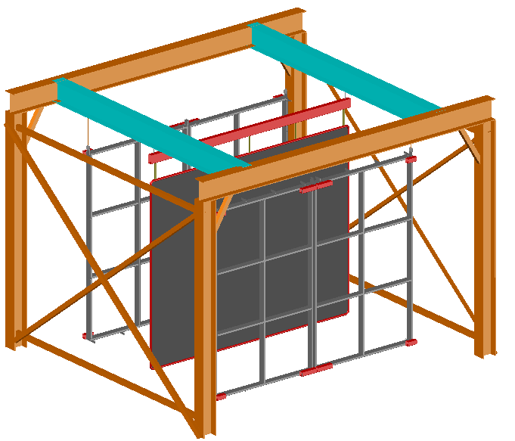
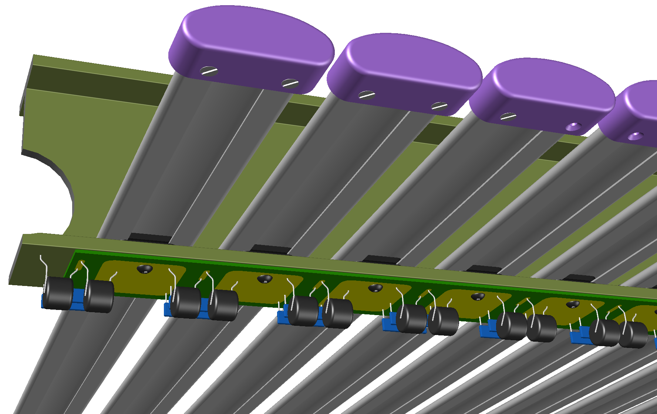
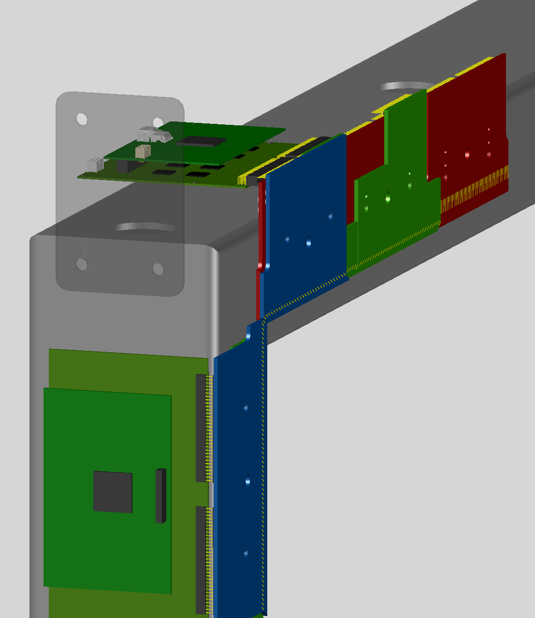
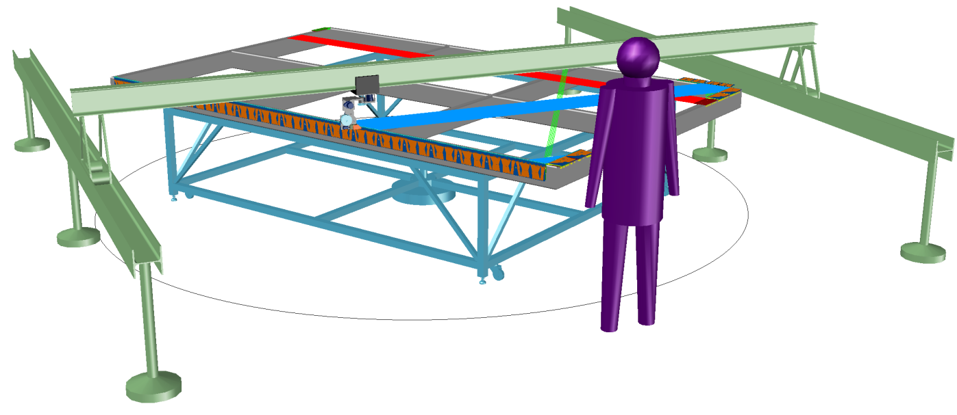
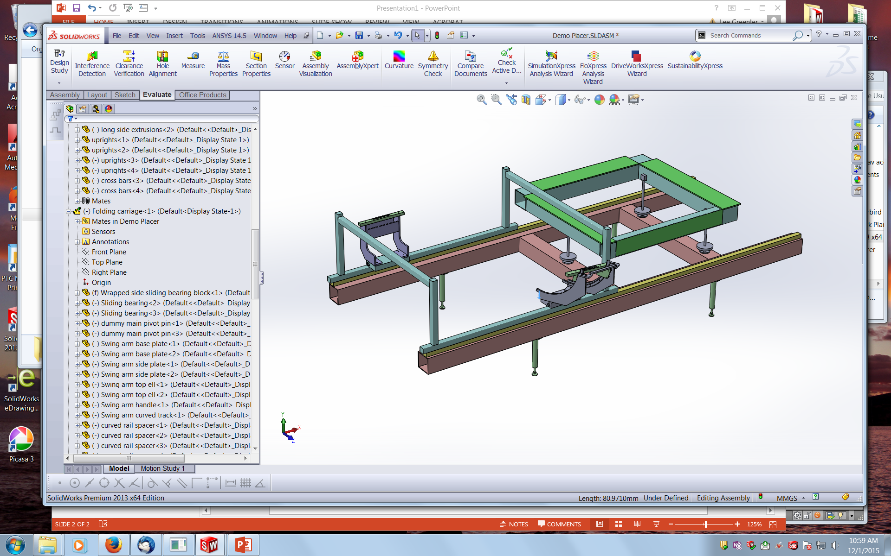
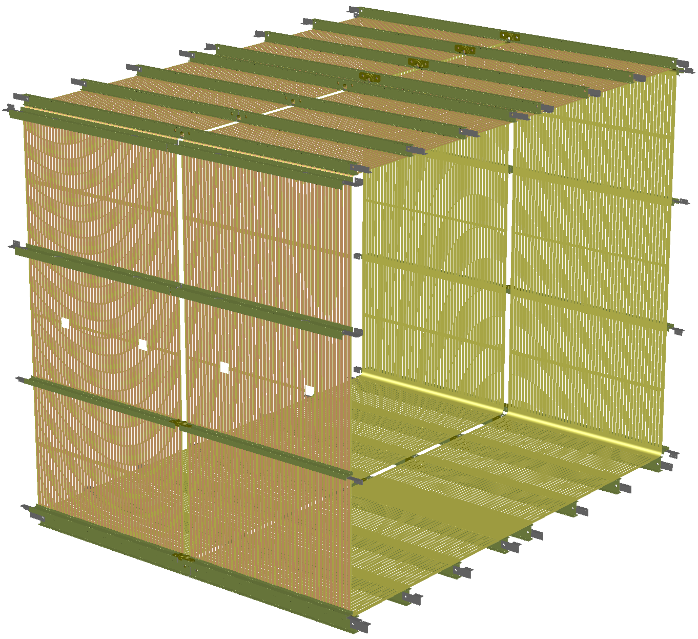
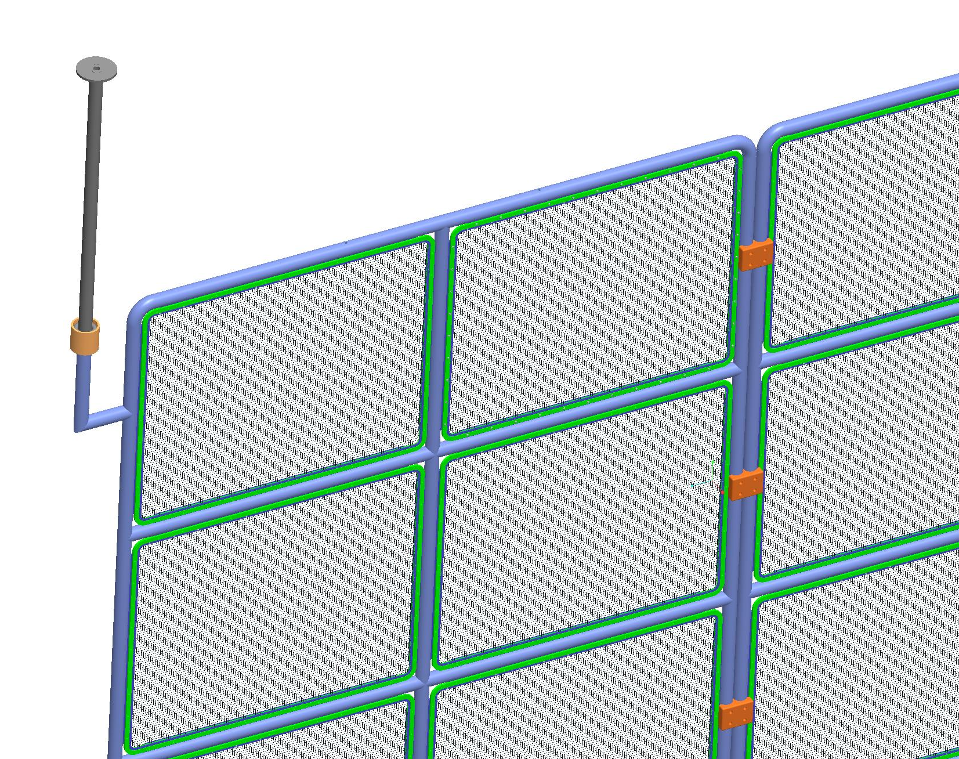
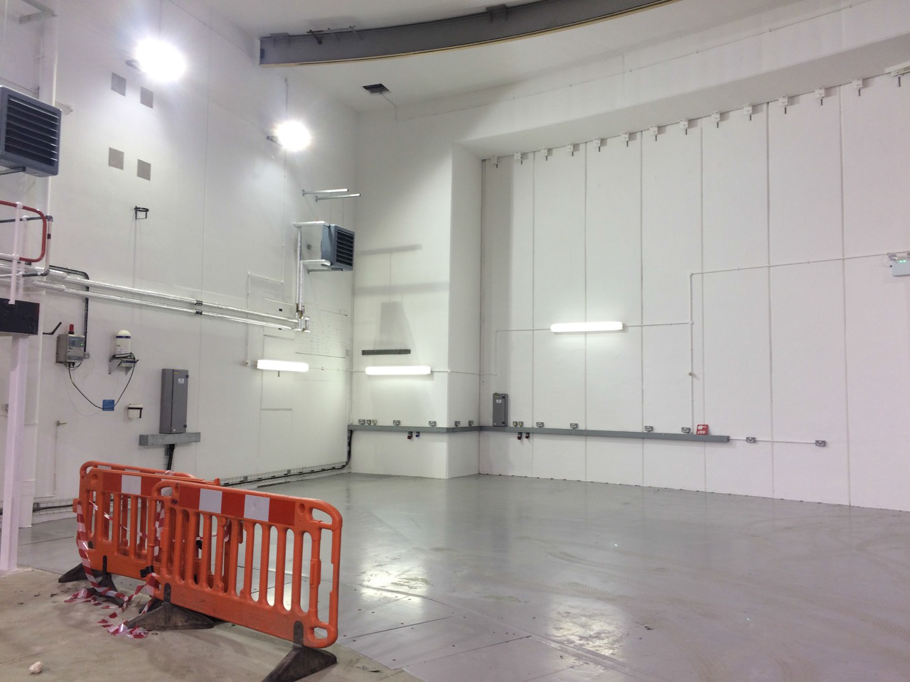
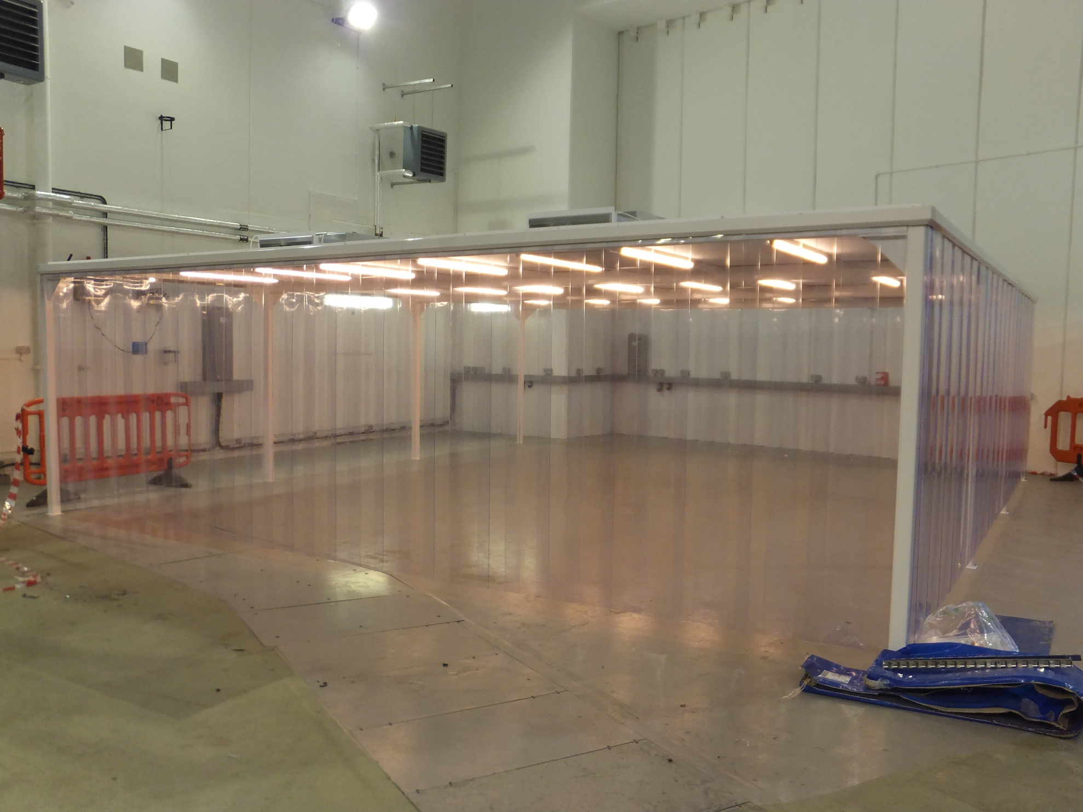
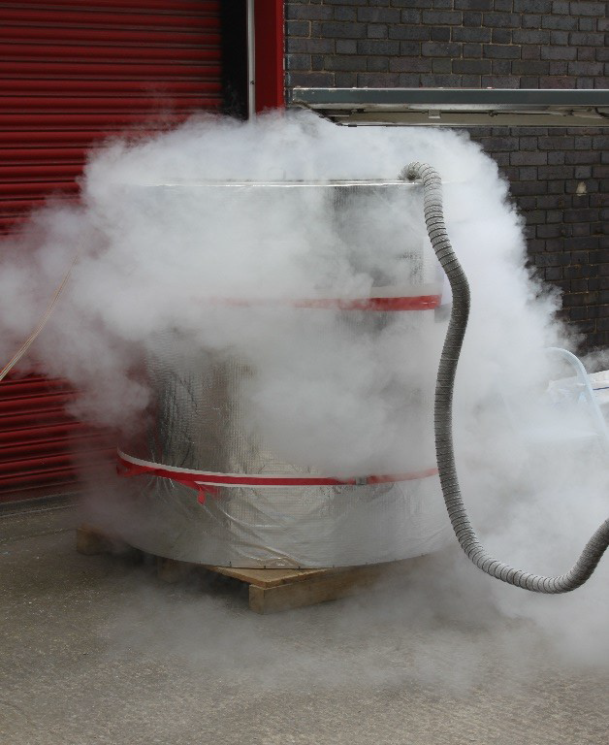
TPC Participating Institutions
TPC Assembly
-Chicago/FNAL
APA Frames - Sheffield
Geometry boards - Yale/BNL
Wire Winding -Manchester/Syracuse/Yale
Field Cages–Yale/BNL
HV feed-through–Yale/UCL
CPA -Liverpool
Cold Test - Lancaster

Slide 22
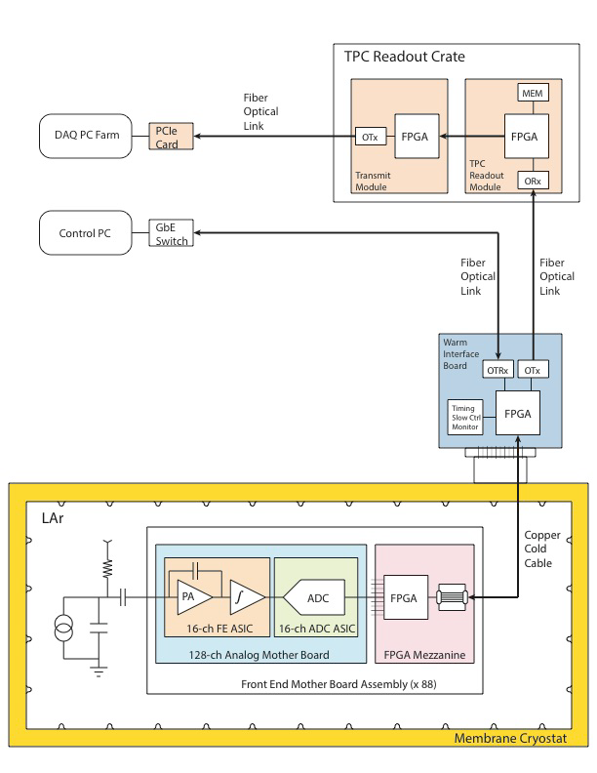
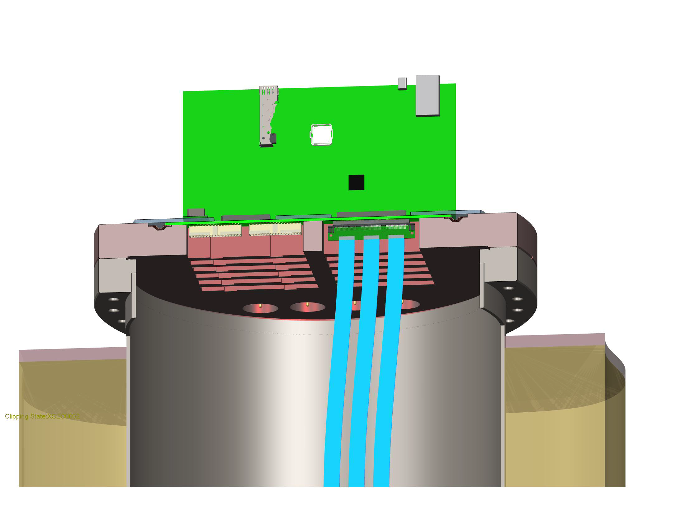
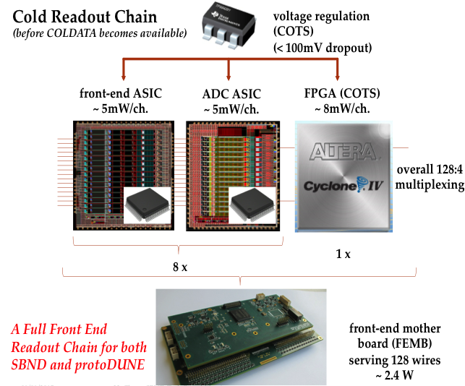
TPC Electronics Components
Warm, inside DAQ rack
Cold, on TPC inside cryostat

Slide 23
Scope of Cryogenics Systems
Rebuild ICARUS cryogenic system
New SBND cryogenic system
Joint CERN-Fermilab responsibility
Worked partitioning:
  Internal : inside the cryostat
    ICARUS – CERN-INFN scope
    SBND – Fermilab scope
  Proximity : Argon circulation & filtering
    SBND & ICARUS - CERN scope
  External : Nitrogen & Argon delivery
    SBND & ICARUS - Fermilab scope
  Controls – Fermilab scope
Process Flow Diagrams

Slide 24
Far Detector Timeline
ICARUS Module 1 & Cold Vessel
Phase I: Construct & Install
Phase II: Operations
Module 2 & CV
Warm Vessel Design & Fabrication
Ship
Ship
Cryogenics Design and Fabrication
Building Construction
Install Warm Vessel
Install Cold Vessel
Cryogenics Installation
Not all activities shown: e.g. CRT
Commission
Operate
Operate
Overburden
4Q 2015
Timeline – Calendar year
1Q 2016
2Q 2016
3Q 2016
4Q 2016
1Q 2017
2Q 2017
3Q 2017
4Q 2017
1Q 2018
2Q 2018
3Q 2018
4Q 2018

Slide 25
Near Detector Timeline
Phase I: Construct & Install
Phase II: Operations
TPC Design and Fabrication (PMT Procurement)
TPC Assembly
TPC Electronics Design and Fabrication
Cryostat Design & Fabrication
Cryogenics Design and Fabrication
Building Construction
Cryostat Installation
Detector Installation
Cryogenics Installation
Commission
Not all activities shown
Cold Commission
Overburden
4Q 2015
Timeline – Calendar year
1Q 2016
2Q 2016
3Q 2016
4Q 2016
1Q 2017
2Q 2017
3Q 2017
4Q 2017
1Q 2018
2Q 2018
3Q 2018
4Q 2018

Slide 26
December 2015 Director’s Progress Review
Design and Scope. Have performance requirements been defined that meet the goals of the SBN program? Have independent design reviews been conducted? Based on the design reviews, are the designs sound and likely to meet the performance requirements? Do the designs capture the entire scope and are they adequately defined? Have the partnering agencies/organizations (e.g. CERN, DOE, INFN, NSF, SNSF, and STFC) identified and agreed to their respective scope?
Cost and Schedule. Are the DOE cost and schedule estimates credible and realistic? Is the proposed DOE spending profile consistent with the projected available budget? Has adequate scope and schedule contingency been identified?
Management. Have sufficient management plan documents been developed? Are coordinated management teams in place? Is there a credible plan for interface control? Are the projected resources sufficient to complete design, construction, and installation and are these resources likely to be available when needed? Are critical procurements sufficiently understood and coordinated across the organizations involved?
Environment, Safety, and Health. Is ES&H being appropriately addressed? Are the required environmental approvals, permits, and safety approvals on track to meet the schedule?

Slide 27
Review Committee
Chairperson : Jim Strait, FNAL
Project Management
Dan Green, FNAL Emeritus*
Jim Strait, FNAL
Cost and Schedule
Rich Marcum, FNAL*
Bill Freeman, FNAL
ESH&Q
David Mertz, FNAL*
* Lead
Facilities and Infrastructure
Jim Grudzinski, ANL*
Mark Messier, IN University
Brian Rebel, FNAL
Bill Soyars, FNAL
Detectors
Mayly Sanchez, Iowa State*
Bruce Baller, FNAL
Melynda Brooks, LANL
Gary Drake, ANL
Luca Grandi, Univ of Chicago
Booster Neutrino Beam Upgrade
Chris Polly, FNAL*

Slide 28
Executive Summary and Highlights
Program – not a DOE 413 project
  Significant funding from non-DOE sources
  More like the “campaigns” on some recent AD activities (i.e. PIP)
  Pros and cons to this approach
  Internally motivated review process important to keep all assessed of progress and issues
Committee found the Program “well conceived, well managed and is proceeding satisfactorily toward timely completion and installation of the two detectors”
Significant challenges include :
  Three independent collaborations (though significant overlap)
  SBND is a completely new detector (though design base on experience from ICARUS, MicroBooNE and 35 ton)
    Working schedule is very aggressive
  Planning for ICARUS installation is just starting
  Funding plan for the ICARUS CRT is not yet in place

Slide 29
Major Concerns and Recommendations
General (recurring through different areas)
  More attention needed on documenting interfaces and establishing control over changes
Infrastructure
  Need to formalize agreements on installation and commissioning of the ICARUS detector
Detectors
  A formal final design review should be carried out prior to beginning construction of SBND
Cost & Schedule
  Funding profile doesn’t match well with work plan; current schedule runs into a funding limitation in FY17
  Overall “contingency” not included in the plan; available reserve appears to be at ~10%, well below the level expected in project at this stage
  Schedules are very aggressive
Management
  Need to finalize a plan to get the CRT funded and built in a timely way
  Get agreements (MOU, WPAs) in place and signed

Slide 30
Program Response to Recommendations
Total of 25 recommendations
Program managers have assembled all into the standard format used by projects
  Assigned
  Status
  Date tracking
Key/critical actions
  Interface control documents
  Installation coordination
  Continue design reviews before commencing fabrication
  Finalize plans for cosmic background mitigation

Slide 31
Resources to Execute the Program
Funding Plans
  Two sources for DOE funded items :
    Re-programmed KA25 in FY15, 16, 17, 18 : total $10M fully loaded
    ND Detector Operations in FY16 - ? : ~$3M/yr fully loaded
Manpower Availability
  Very limited in FY15 (predominantly program office)
  Design and engineering added in FY16; good progress
  Ramp up for infrastructure and installation starts in FY17
Contingency
  Will translate into schedule slip and funding into FY19
  Need to prioritize tasks; far detector installation and commissioning critical to the success of the science program
Partner Agreements
  Dependent on SBND cryostat and proximity cryogenics being delivered by CERN

Slide 32
SBN Work Breakdown - Funding Source
FNAL
FNAL
STFC-NSF
FNAL-CERN-INFN
LANL
FNAL-CERN-INFN
Bern-FNAL
TBD
BNL-Columbia
FNAL
CERN-INFN
WA104
CERN-FNAL

Slide 33
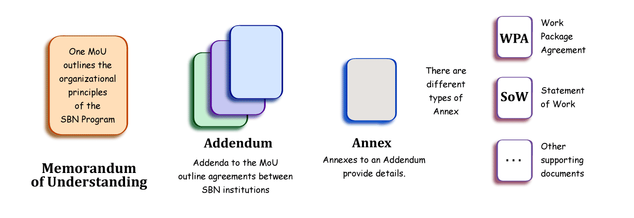
Proposed SBN Program Agreement Structure
Draft MOU ready for review
Drafts of first Addenda and Annexes ready for review
  Bi-lateral covering design, construction and installation
  Later: multilateral for operations and multilateral for physics
Work Package Agreements drafted for cryogenics activities, SBND cryostat, several components of SBND
Fermilab Sharepoint page for SBN agreements:
https://web.fnal.gov/collaboration/sbn/_layouts/15/start.aspx#/SitePages/SBN_Agreements.aspx

Slide 34
SBN Program Office
Program Coordinator – Peter Wilson
Deputy Coordinator – Catherine James
Program Mechanical Engineers
  SBND integration – Joseph Howell (PPD)
  ICARUS integration – Andy Stefanik
Program Electrical Coordinator – Linda Bagby
Logistics Coordinator – Michael Dinnon
ES&H Coordinator – Angela Aparicio
CERN-INFN-Fermilab Safety Coordination:
  Fermilab POC – Min Jeong Kim
  CERN POC – Olga Beltramello (CERN-PH)
Project Controls – Richard Krull
Financial Officer – Molly Anderson
Administrative Support – Etta Johnson
SBND TC – Ting Miao
ICARUS TC – Claudio Montanari
Infrastructure TC – Catherine James
Support realization of the SBN detectors and infrastructure at Fermilab
  Work with program Technical Coordinators
Ensure that detectors and infrastructure are compliant with Fermilab/DOE ES&H standards
Assist in quality assurance planning
Plan and oversee DOE funded components of the program
Consists primarily of members of the Fermilab Neutrino Division

Slide 35
Cosmogenic Background
SBN Detectors are on the surface

Slide 36
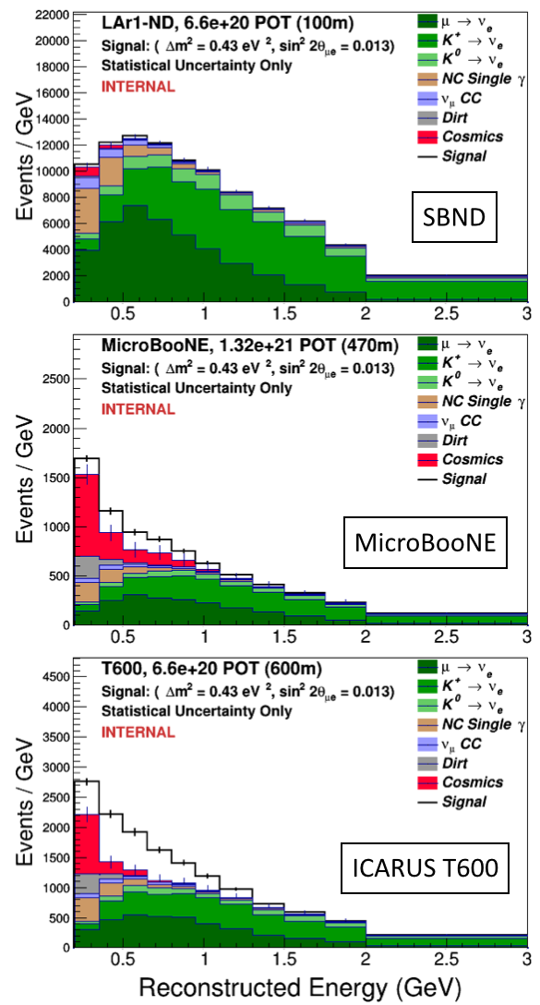
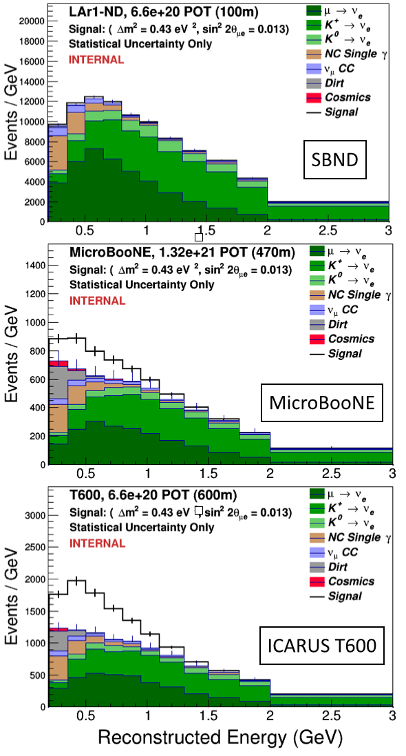
Cosmogenic Backgrounds
External cosmic ray tracker (CRT) systems
can be employed to identify contaminated beam spills
Off-beam triggers can be used to measure cosmic backgrounds to high precision – so negligible systematic uncertainties

Slide 37
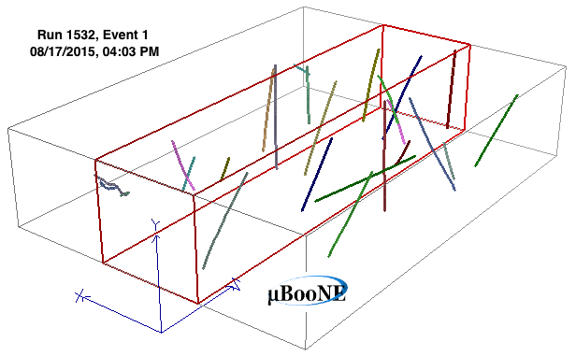
Cosmogenic Backgrounds
The problem: 1000x longer charge drift time than the beam spill time!
  1.6 μs beam spill vs. 1-2 ms TPC drift time
MicroBooNE cosmic data with 3D reconstruction!
Detector | Neutrino interaction every N spills | Cosmic muon in beam spill time every N spills
SBND | 20 | 250
MicroBooNE | 600 | 200
ICARUS-T300 | 350 | 100

Slide 38
Detector Overburden
Cosmic backgrounds in proposal assumed 3m of concrete overburden over both near and far detectors
  Buildings designed to accommodate but not included in GPPs
Scope for both detectors:
  40” thick (1.01m) of new bridging concrete blocks
  72” (1.78m) thick of recovered concrete shield blocks
  Includes installation of blocks
  Included in plan for DOE deliverables in FY18
Additional shielding needed for LArTF
  1st layer needs to be custom and requested asap
  Need for 2nd layer under study

Slide 39
Preliminary Cost Estimate for ICARUS CRT

Slide 40
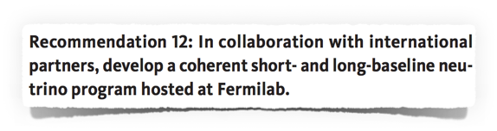
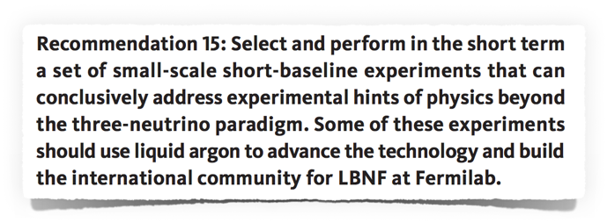
P5 Recommendations
May, 2014

Slide 41
Coordination of Common Solutions
SBN cryogenics will share designs where applicable
SBND working with ICARUS on PMT-based photon detection system
  Take advantage of experience and facilities set up at CERN
Cosmic Ray Task force started to address common needs
SBN – DUNE coordination:
  SBND and DUNE actively planning common Cold Electronics design and testing plan
  SBND pursuing light guide photon detection system as R&D toward DUNE
  Started common DAQ planning with DUNE (November workshop)

Slide 42
Status Summary
Buildings progressing well: construction completion fall 2016
ICARUS progressing well:
  First T300 refurbishing will complete early 2016, second in mid-2016
  Delivery of new PMTs started
  Cryostat fabrication underway
  New TPC electronics to fabrication contract early in 2016
SBND designs nearing final stages
  TPC in final design and preparing for fabrication
  Redesigned cold ASICs nearing prototype fabrication submission
  Cryostat nearly ready for contracts
  Preliminary integration and installation plan nearly complete

