Slide 1
Future SDN-HPON Control Plane Architecture and Protocols for
On-Demand Terabit End-to-End
Extreme-Scale Science Applications
S. J. Ben Yoo
Alberto Castro Casales, and Roberto Proietti
University of California, Davis
sbyoo@ucdavis.edu
http://sierra.ece.ucdavis.edu
Unfunded Collaboration Partners:
Esnet, Infinera Corporation, Verizon
DOE ASCR Network Research Kick-Off Meeting
Fermilab, February 17-18, 2016

Slide 2
Driving Needs for Intelligent Optical
Network Infrastructure
Big Data (Data-intensive science) on Demand
Extreme-Scale Computing
Support Network Complexities and Scalability
Software Defined Elastic Optical Networking for
End-to-End Terabit/sec Data Movements on Demand
Dynamic Assignment of Large Bandwidth On-Demand
Service Automation
Application Aware & Impairment Aware Adaptive Networking
High-Availability and Optimized Operation
Programmability
Virtualized Resource Control
Interoperability and Vendor Neutrality
End-to-End Principle with Intra-domain and Inter-domain Optimization

Slide 3
Project Objectives
Investigate Software Defined Elastic Optical Networking (SD-EON) through involving:
  Control plane
  Protocols
  Management plane
  Experimental testbed studies
In order to address the following key networking challenges:
  To support high-degrees of end-to-end performance across heterogeneous multi-domain networks for Big Data on-demand
  To design new protocols and control planes for SD-EON that effectively handle heterogeneous multi-domain ASes with heterogeneous technologies and multi-controllers
  To realize SD-EON that offer backward compatibility and interoperability with legacy technologies for seamless upgrades from today’s networks to future networks, and to test this through realistic testbed with Big Data science applications and systems.

Slide 4
Project Tasks and Timelines
Task 1. Multi-domain Software-Defined Elastic Optical Network (SD-EON) Architecture Studies
Task 2. Algorithm Development for Multi-domain Intelligence
Task 3. Multi-domain SD-EON Testbed Studies with Interoperability
Task 4. Interoperability, backward-compatibility testbed studies with Infinera, Esnet, and Verizon involving Big Data
 |  | Q1 | Q2 | Q3 | Q4 | Q5 | Q6 | Q7 | Q8 | Q9 | Q10 | Q11 | Q12 | Team | Collaborator
Task 1 | T1.1 |  |  |  |  |  |  |  |  |  |  |  |  | UC Davis
 | T1.2 |  |  |  |  |  |  |  |  |  |  |  |  | UC Davis
 | T1.3 |  |  |  |  |  |  |  |  |  |  |  |  | UC Davis
 | Milestones |  |  | 1.1 |  |  | 1.2 |  |  |  |  |  | 1.3 | UC Davis
Task 2 | T2.1 |  |  |  |  |  |  |  |  |  |  |  |  | UC Davis
 | T2.2 |  |  |  |  |  |  |  |  |  |  |  |  | UC Davis
 | T2.3 |  |  |  |  |  |  |  |  |  |  |  |  | UC Davis
 | Milestones |  |  | 2.1 |  |  | 2.2 |  |  |  | 2.3 |  |  | UC Davis
Task 3 | T3.1 |  |  |  |  |  |  |  |  |  |  |  |  | UC Davis | ESnet
 | T3.2 |  |  |  |  |  |  |  |  |  |  |  |  | UC Davis | Esnet
 | Milestones |  |  |  |  |  | 3.1 |  |  |  |  | 3.2 |  | UC Davis
Task 4 | T4.1 |  |  |  |  |  |  |  |  |  |  |  |  | UC Davis | Infinera, Esnet
 | T4.2 |  |  |  |  |  |  |  |  |  |  |  |  | UC Davis | Infinera, Esnet
 | Milestones |  |  |  |  |  |  | 4.1 |  |  |  |  | 4.2 | UC Davis

Slide 5
Software Defined Networking => Cognitive/Knowledge Plane Optical Networking
Separation of Control Plane and Data Plane
Separation of Forwarding functions and Routing functions
Virtualization of Lower Layer Functions
Observe
Act
Analyze
McKeown et al.

Slide 6
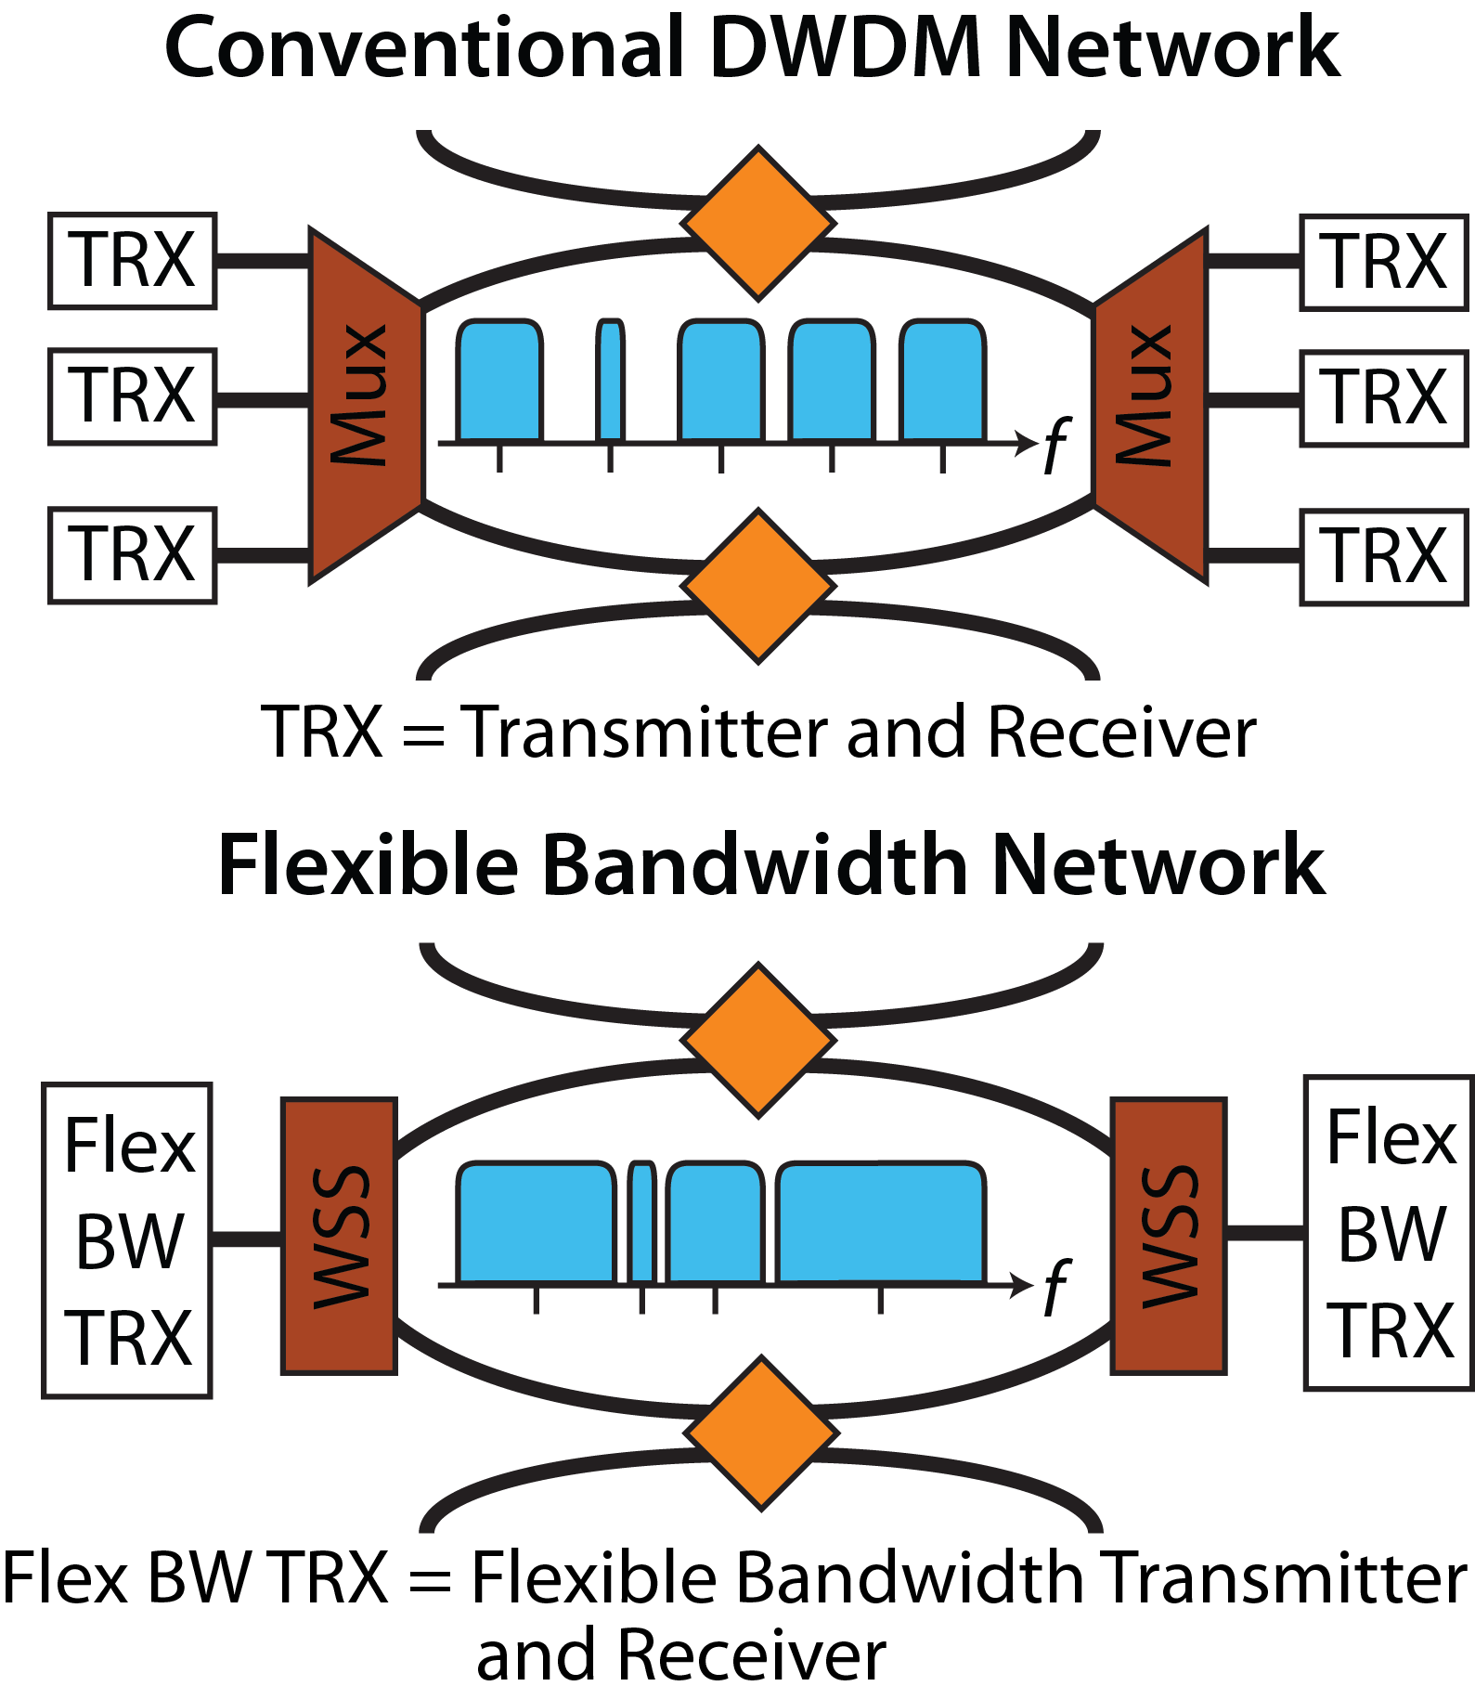
Transitioning from DWDM Networking to Elastic Optical (Flex Grid) Networking
Limited achievable spectral efficiency due to spectral guard bands
  Single channel bandwidths limited by frequency grid spacing
  Sub-wavelength and super- wavelength channels difficult
  Stranded bandwidth problem
Spectral efficiency no longer limited by network architecture
Arbitrary channel bandwidth capable
Arbitrary modulation format capable
Capable of sub-wavelength and super-wavelength channels

Slide 7
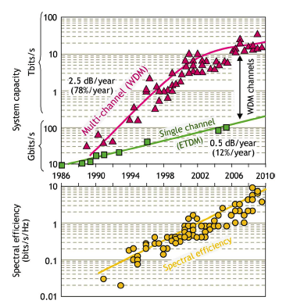
Advanced Modulation Formats for High Spectral Efficiency
1 bit/symbol
2 bits/symbol
3 bits/symbol
4 bits/symbol
5 bits/symbol
6 bits/symbol
BPSK
2-ASK/2-PSK
4-ASK/2-PSK
16-QAM
4b
32-QAM
5b
64-QAM
6b
1a
2a
3a
OOK
4-QAM or QPSK
8-PSK
2-ASK/8-PSK
1b
2b
3c
4d
2-ASK/4-PSK
4-ASK/4-PSK
3d
4e
The more information bits the modulation format contains, the more SNR and energy it requires
From: Essiambre, Alcatel-Lucent “Capacity Limit of Fiber-Optic Communications,” OFC 2009, also JLT 2010

Slide 8
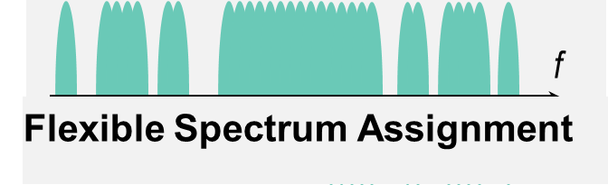
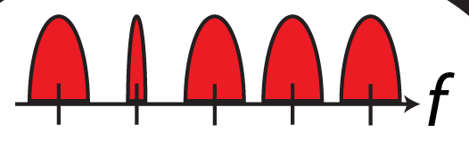
Software-Defined Elastic Optical Networking
PCE
PCE
PCE
Data Centers Business Access
Flex band Add/Drop
Residential
Access
Metropolitan
Access
Flex Bandwidth Add/Drop
Flex bandwidth
Add/Drop
Flex band Trx/Rcv
Metropolitan
Access
Long-haul
Flex band Trx/Rcv
Rigid Frequency Grid
Notes:
Single domain vs multiple domain

Slide 9
Software-Defined Elastic Optical Networking
PCE
PCE
efficient use of spectrum (~30% savings)
flexible capacity per flow
adaptive modulation format on each flow
accommodate super-channel capacity
> terabit bandwidth on-demand
big data transfer with optimized resource management.
QoS & Impairment-aware adaptive SDN
Multi-domain SDN with interoperability
Interoperability and backward-compatibility
Successful Demos of SDN-EON testbed trials
network operators and system vendors in pursuit.
PCE
Data Centers Business Access
Flex band Add/Drop
Residential
Access
Metropolitan
Access
Flex Bandwidth Add/Drop
Flex bandwidth
Add/Drop
Flex band Trx/Rcv
Metropolitan
Access
Long-haul
Flex band Trx/Rcv
Rigid Frequency Grid
Notes:
Single domain vs multiple domain

Slide 10
Key Approaches to Elastic Optical Networking
Routing Modulation Spectrum Assignment (RMSA) with Defragmentation in Temporal, Spectral, and Spatial Domains
QoS-Aware & Impairment-Aware Networking
Automatic & Adaptive Operation of Networks
Use Supervisory Channel & Optical Performance Monitoring for EON with Observe-Analyze-Act
Interoperability and backward-compatibility for Seamless Upgrades
SDN with Virtualized Resource Control
Support of Big Data transfer upon demand with efficient resource management.
Multi-domain SDN with brokers
SDN-EON Testbed Studies

Slide 11
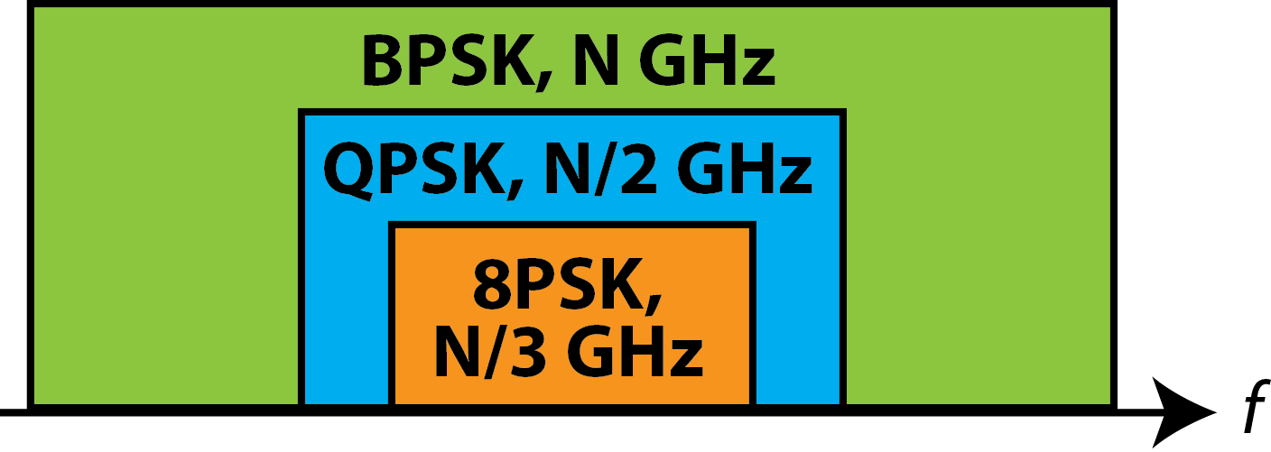
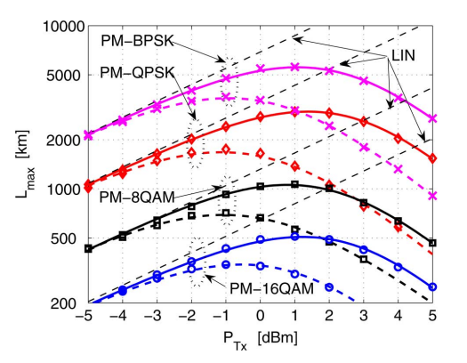
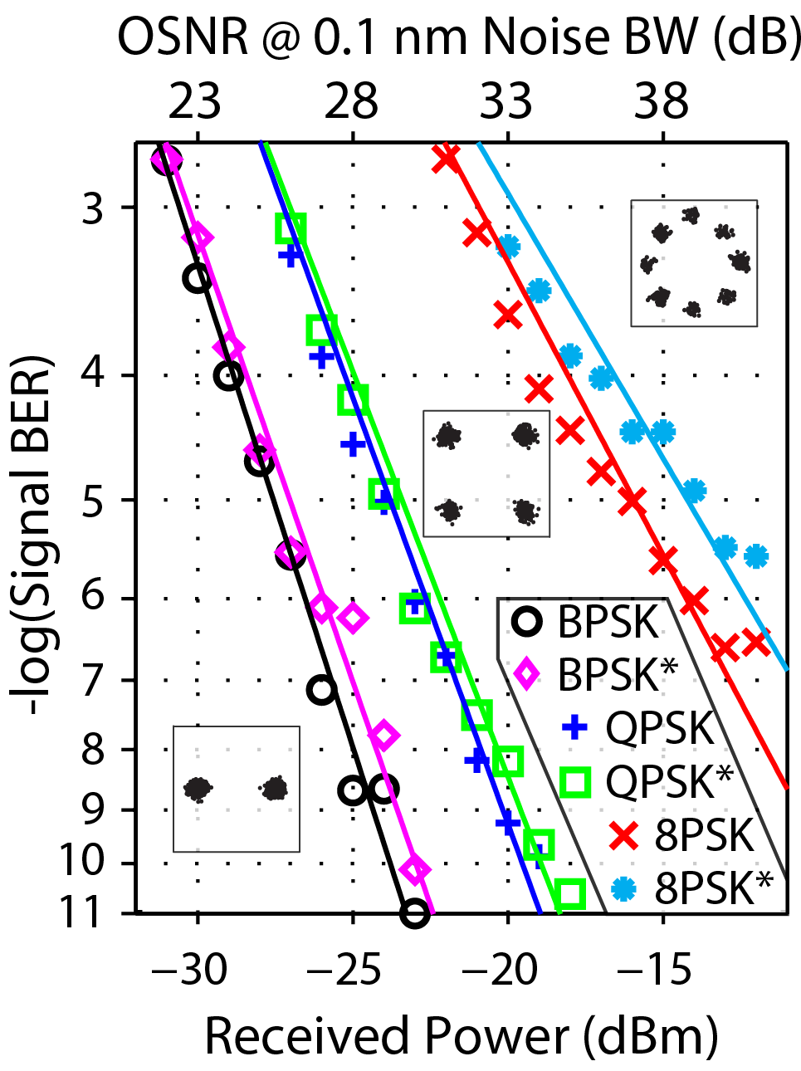
Adaptive Routing, Modulation Format, Spectrum Assignment in Dynamic Elastic Optical Networks
f_{C}
[1] Bosco et al. ‘’On the Performance of Nyquist-WDM Terabit Superchannels Based on PM-BPSK, PM-QPSK, PM-8QAM or PM-16QAM Subcarriers,” JOURNAL OF LIGHTWAVE TECHNOLOGY, Vol. 29, No. 1, January 1, 2011

Slide 12
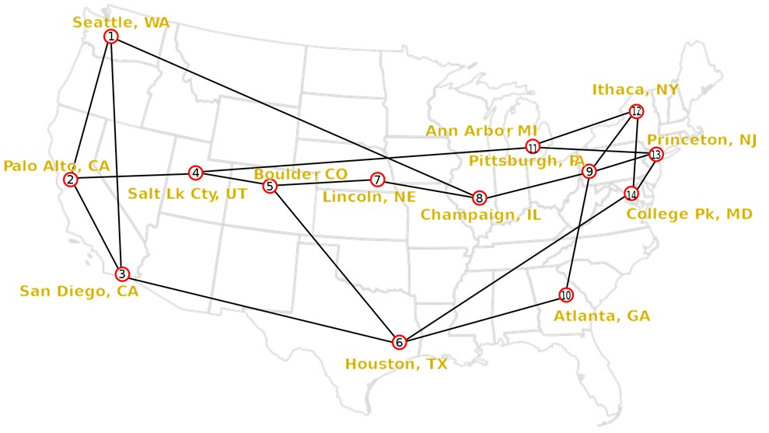
RMSA in EON Example
A
L1
New Request:
Link 2&3, 100GHz
100/12.5=8 (slots)
L5
B
L2
C
L3
L4
E
D
BCD
BCD
BCD
AC
AC
Spectrum
(subcarriers)
DE
ABD
BAC
BAC
"Dynamic On-demand Defragmentation in Flexible Bandwidth Elastic Optical Networks" by Yawei Yin, Ke Wen, David J. Geisler, Ruiting Liu, and S. J. B. Yoo, in Optics Express, Vol. 20, No. 2, pp. 1798-1804, January, 2012.
CD
BC
Links
L1
L2
L3
L4
L5

Slide 13
Designing Fragmentation-Aware RSMA
Connection: A → E
First-fit rule: in continuous available slots, always take the lowest available ones
Calculate the # of continuous spectral slots a new connection will “cut”
B
C
cut: 2
A
cut: 0
F
Path: ABCE
Path: ABDE
D
E
Path: ADE
Path: ABCFE
cut: 0

Slide 14
Designing Misalignment-Aware RSMA
First-fit rule: in continuous available slots, always take the lowest available ones
Calculate the # of misalignment increase when a path and slot is chosen.
Connection: A → E
Route 1
B
C
M+4
A
M+3
F
Link: ABCE
Link: ABDE
D
E
Link: ADE
Link: ABCFE
M+5

Slide 15
Fragmentated Network Resources and Hitless Defragmentation
Comparison of hop-tuning, MbB, and sweeping
Notes:
Fig. 1. Spectrum diagram (a) before defragmentation, (b) after sweeping defragmentation, and (c) after complete defragmentation using the proposed method.

Slide 16
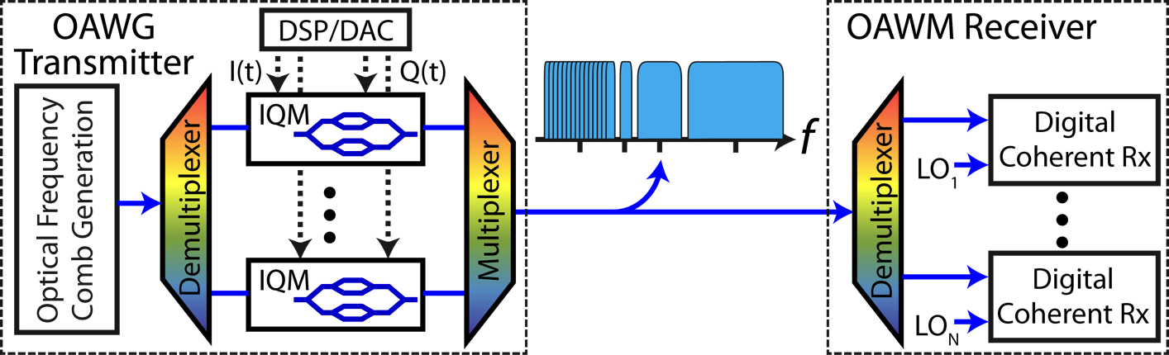
Performance Monitoring Configuration 1: Electrical Supervisory Channel & Flexible Bandwidth Transceivers
Supervisory Channel added and demodulated electrically at the client layer.
Pros: low penalty from adding supervisory channel
Cons: performance monitoring only at the receivers
Supervisory Ch. Signal
Supervisory Ch. Signal
Notes:
Need to cover
-OAWG/OAWM as flexible bandwidth transmission system
-Here we did static OAWG

Slide 17
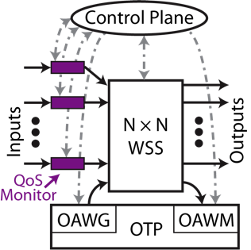
Performance Monitoring Configuration 2: Optical Supervisory Channel & Flexible Bandwidth Transceivers
Supervisory Channel added and demodulated optically at the transport layer
Pros: performance monitoring at any intermediate node
Cons: moderate penalty from adding supervisory channel
TO OTHER NODES
MZM
SMF
QoT monitor
x N
TX
RX
Low-speed OOK
Supervisory Ch. Signal
Intermediate Node
MZM: Mach Zehnder modulator
Notes:
Need to cover
-OAWG/OAWM as flexible bandwidth transmission system
-Here we did static OAWG

Slide 18
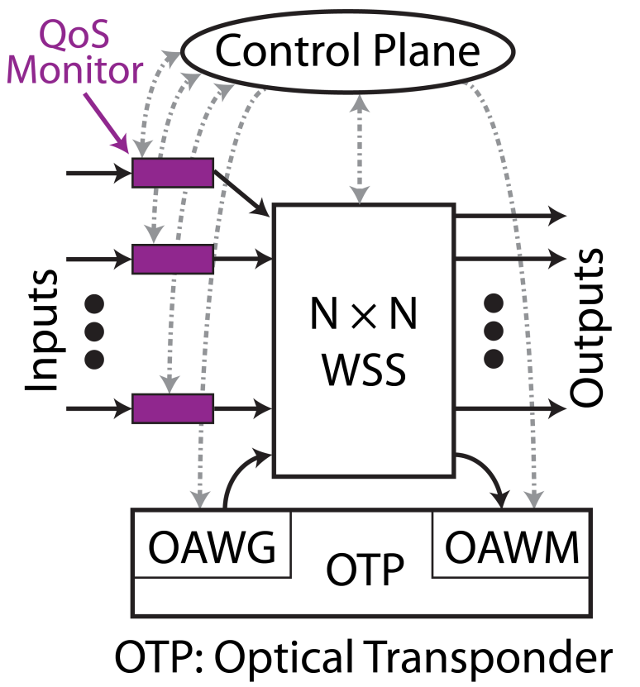
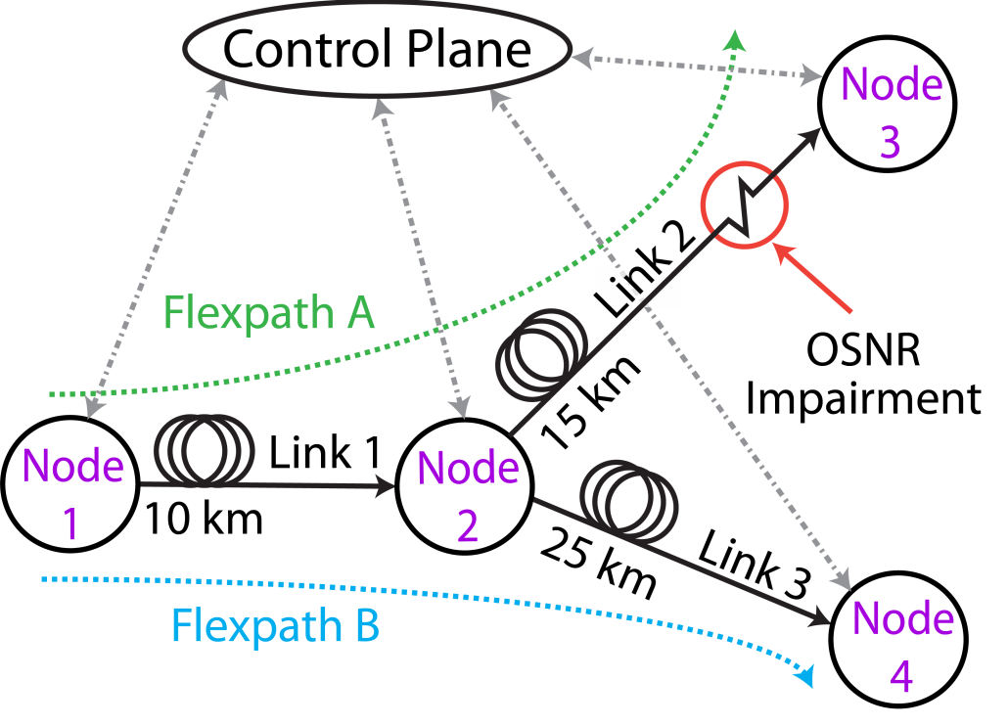
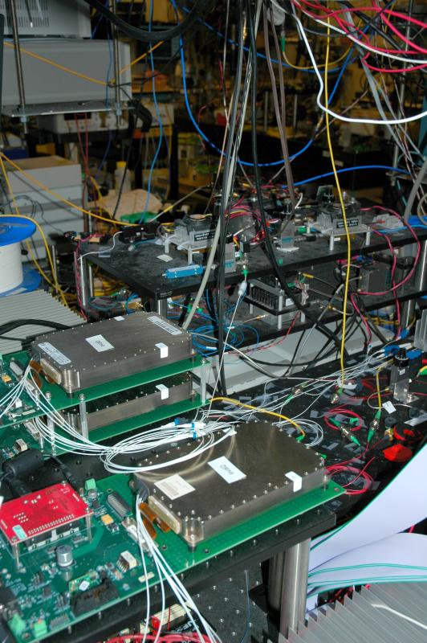
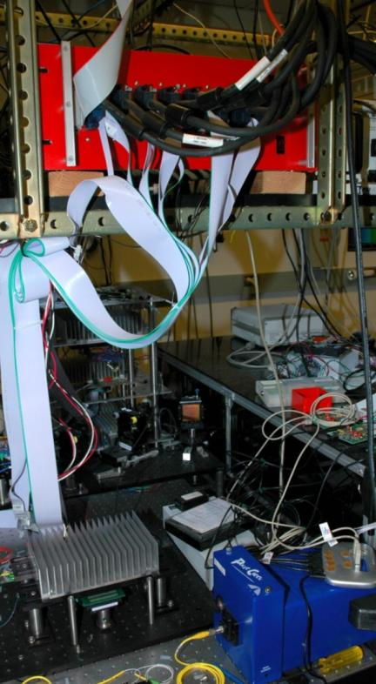
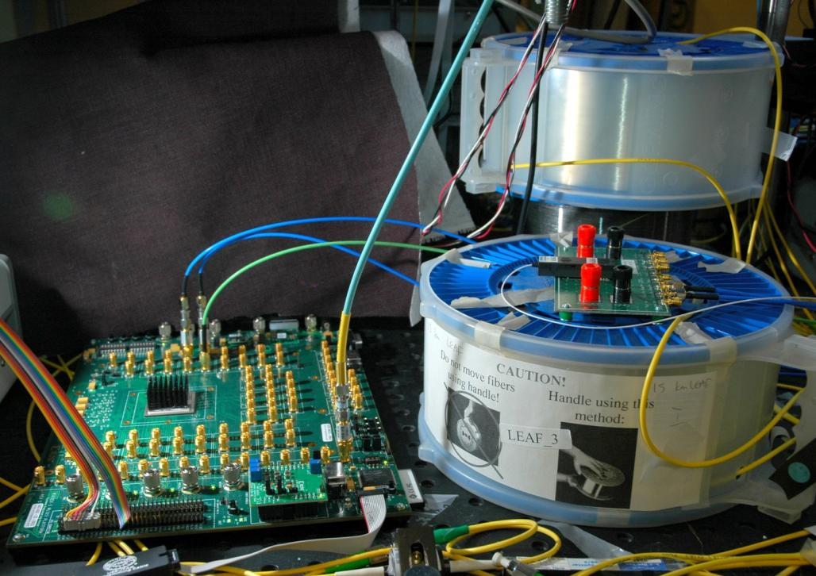
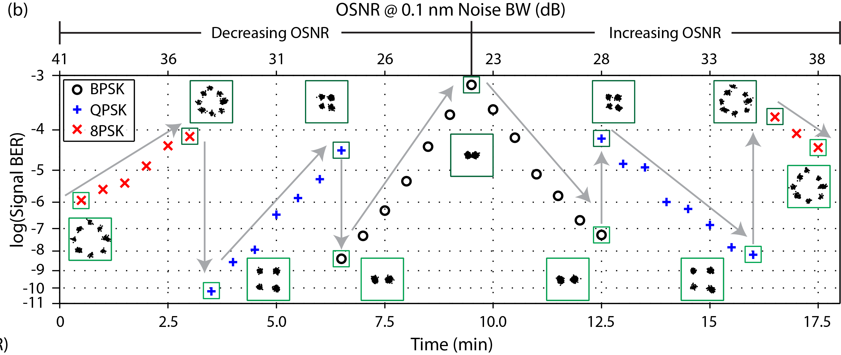
Software-Defined Elastic Optical Network Testbed with Real-Time Adaptive Control Plane
Real-time, dynamic reconfiguration based on performance monitoring in supervisory channel
Comb Generation
1.25 Gb/s Receiver
WSS Units
Virtex 5
FPGA
LEAF Spool
OAWG Control
Circuits
OAWG Device

Slide 19
Software-defined multi-domain elastic optical networks
Software-defined elastic optical networks (SD-EONs), the integration of software-defined networking and EONs, enable dynamic end-to-end connection provisioning and offer service providers the flexibility to customize their infrastructure dynamically according to application requirements
Scalability is the main objective and the most important challenge of the control plane design for future large–scale multi-domain networks
è Development of distributed control schemes that are able to dynamically and efficiently provide end-to-end transparent lightpaths in multi-domain SD-EONs is necessary

Slide 20
Distributed control plane for dynamic multi-domain SD-EONs
Domain controller B
B1
B3
Domain controller A
(for Domain A)
Domain B
Domain controller D
src
Inter-domain link
B2
A1
Domain controller C
D1
D2
A2
C1
Domain D
Intra-domain link
D3
C3
D4
dest
Domain A
A3
A4
Domain C
C2
Each domain:
Elastic optical network (i.e. Openflow/SDN control based)
Domain controller can dynamically control/configure the domain
A domain does not know routing/configuration information of others (sharing information between domains is limited)
Efficient distributed dynamic control algorithms are necessary to provide end-to-end lightpath connections dynamically

Slide 21
Distributed control plane for dynamic multi-domain SD EONs
We propose:
Spectral fragmentation-aware RMSA
  Distributed routing algorithm to search for path candidates
  Using the spectrum cutting factor, which is the number of spectrum bands cut by a slot, to assign slots for the path
Flexible multiple reservation scheme
  2 reservation types:
    Active reservation: Spectrum and resources are reserved and can not be accessible/used by other requests
    Passive reservation: Spectrum and resources are tentatively reserved and can be occupied/reserved by other request → to improve the spectrum/resource utilization efficiency
    Notes: passive reservation needs to be activated before the path can be used
  Destination domain simultaneously makes one active reservation and up to K passive reservations for a request

Slide 22
Distributed dynamic RMSA algorithms for multi-domain EONs
Signaling process:
Check domain state and Forward signaling
MSA: Decide the route, select mod. format and assign spec. slots
PATH REQ
Notes:
PATH REQ (slots, dis, frag.)
Dialing & Waiting time
PATH REQ (slots, dis, frag.)
PATH REQ
RMSA functions are mainly performed at the dest. domain controller
Sharing information between neighbor domains:
Data rate requested
Avai. Spec. slots of each domain
2) Total distance
PATH REQ (slots, dis, frag.)
PATH RESV
Active RESV
Passive RESV
PATH SETUP
Tentatively reserve k other path candidates
Passive RESV
Tentatively reserve the path @ the assigned spec. slots
Release if no need
Otherwise, activate
REL (or ACT if the main path setup is failed)
Domain controller A
(for Domain A)
Domain controller B
Domain controller C
src
B1
Inter-domain link
B2
Domain B
B3
B4
A1
A2
C1
C2
Domain A
Domain C
Tentative path
Intra-domain link
A3
A4
C3
C4
dest
Main path

Slide 23
Distributed control plane for dynamic multi-domain SD EONs
Domain controller B
1. REQUEST
2. REQUEST
Domain controller D
Domain controller A
src
Path #1
Domain B
2. REQUEST
0. REQ
1. REQUEST
Domain A
Domain controller C
Domain C
100
200
S_{A}
F_{A}
500
S_{C}
F_{C}
Path #0
dest
0
x
0
+1
1
Occupied slot
0
+1
+1
2
0
x
0
x
Free slot
0
+1
+1
2
0
+1
+1
+1
3
0
0
D_{A}=0
D_{C}=D_{A}+100+200+500 =800

Slide 24
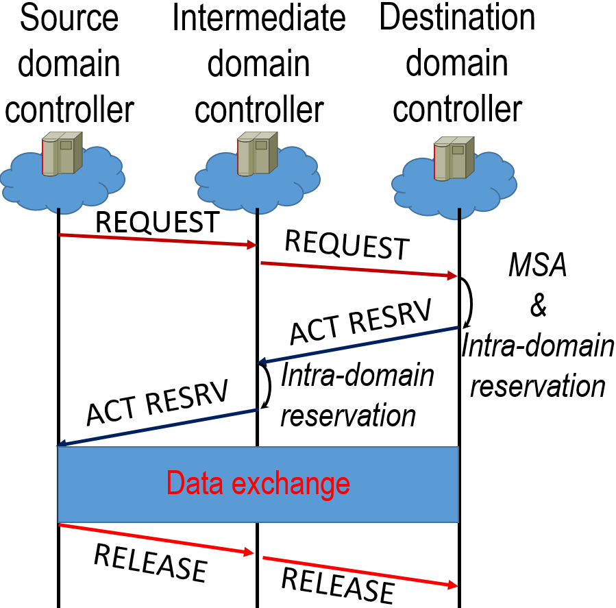
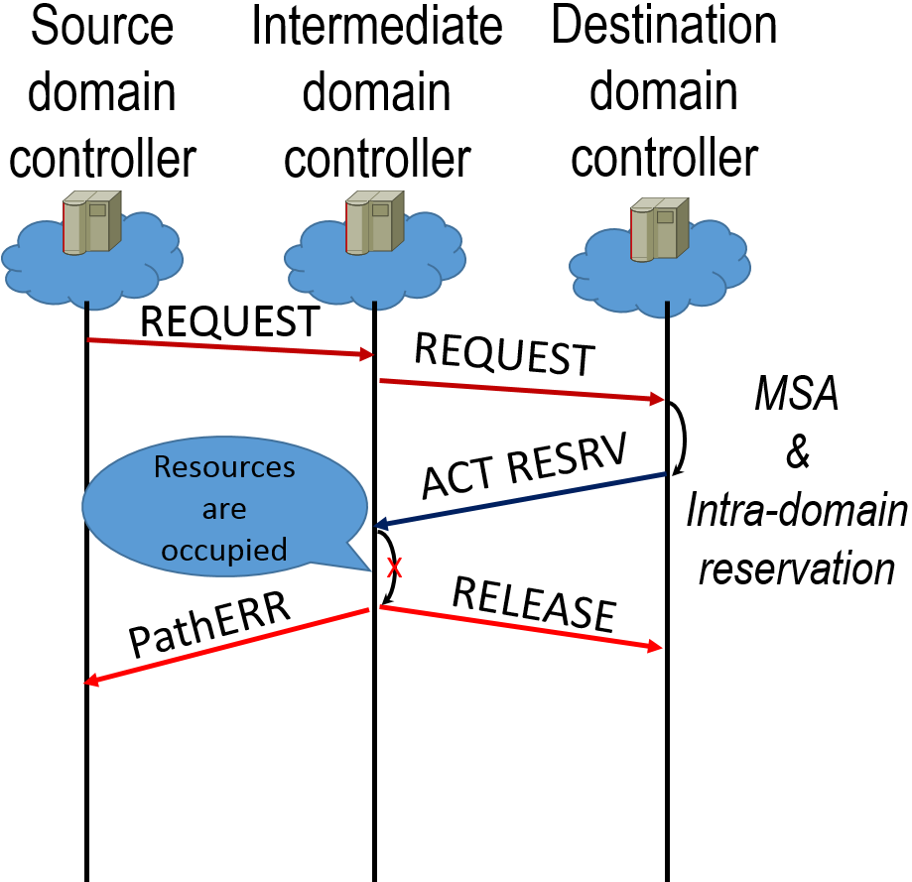
Signaling process
Type of messages Required fields
1) REQUEST = Path request message dst, distance, spec. mask, frag. factor
2) ACT RESRV = Active reservation message mod. format, spec. slots requested
3) PASS RESRV = Passive reservation message mod. format, spec. slots requested
4) RELEASE = Release message spec. slots used
5) PathERR = Path setup error indicator
6) ACTIVATE = Passive path activation message mod. Format, spec. slots requested
7) ACK = Reservation acknowledgement
Main path:

Slide 25
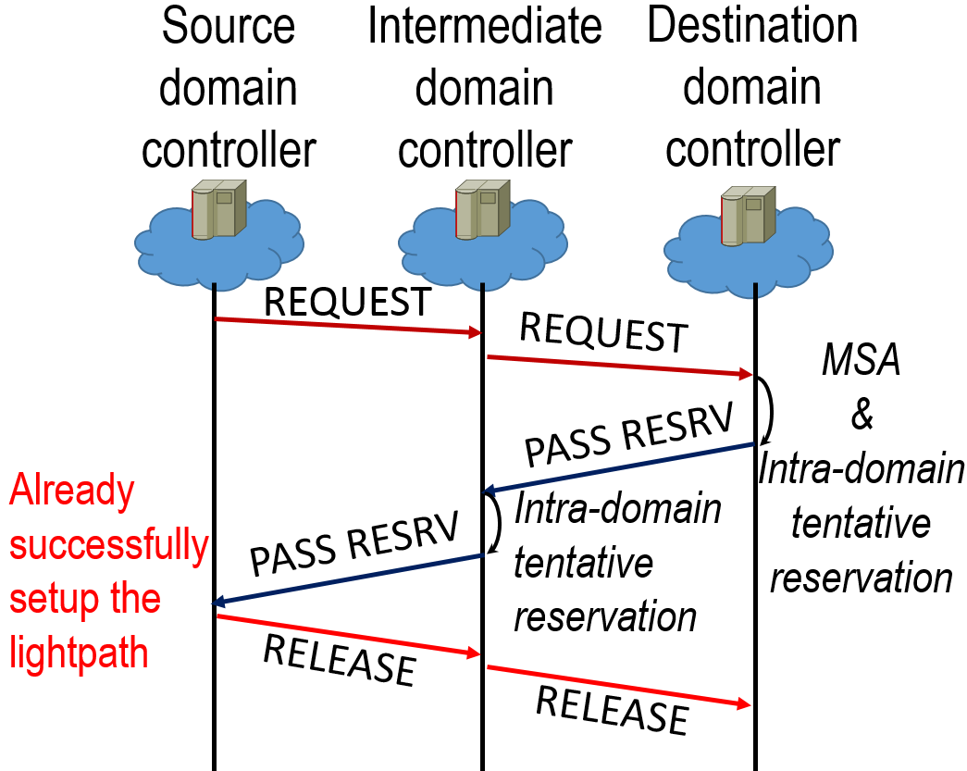
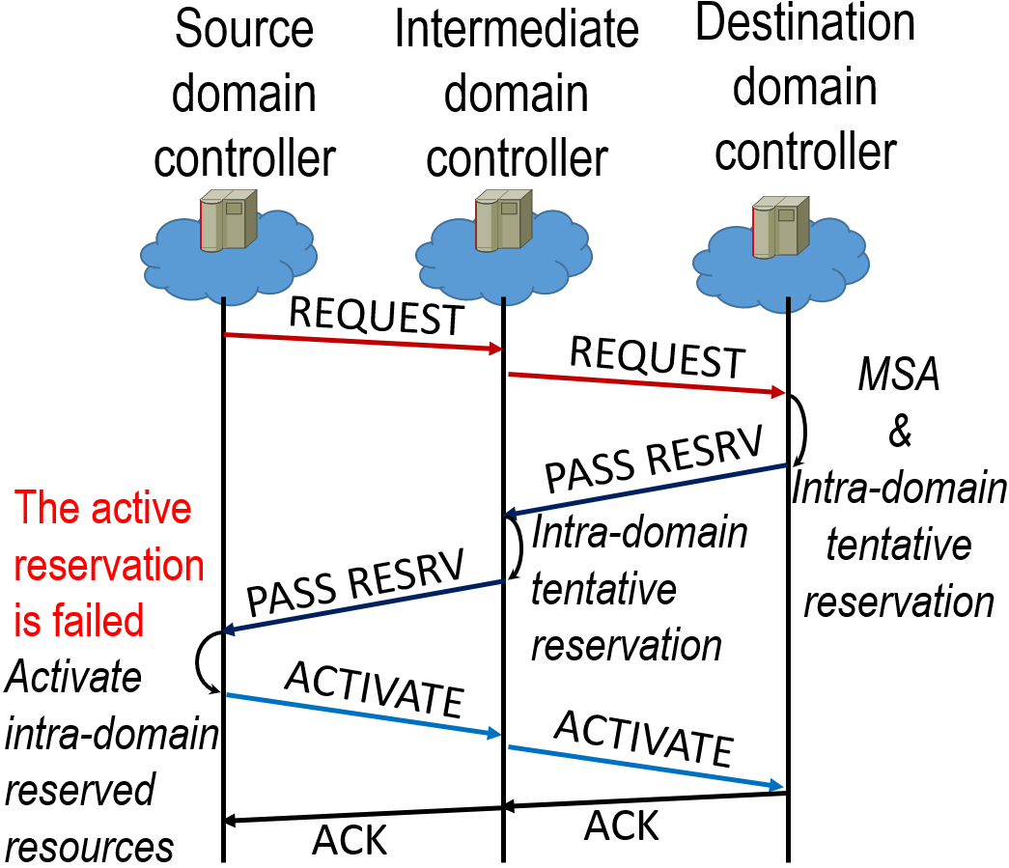
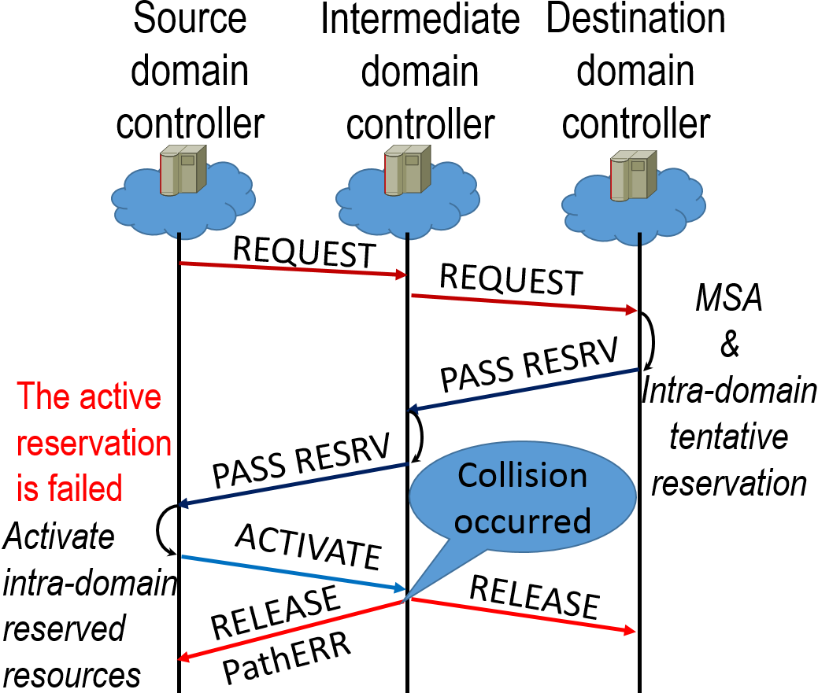
Signaling process
Other alternative paths:

Slide 26
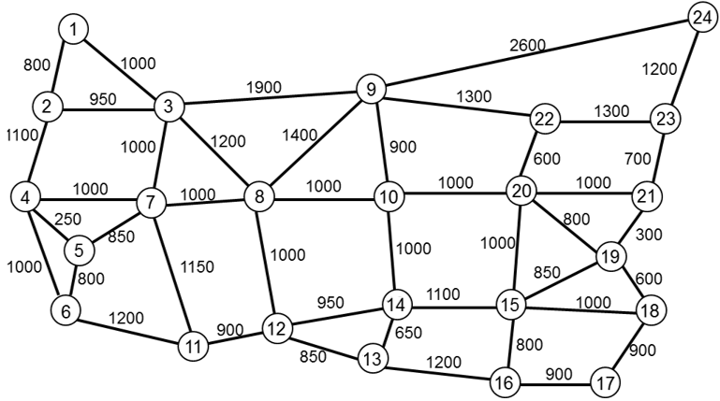
Numerical experiments (1/3)
Simulation parameters:
Fiber capacity: 125 spectrum slots
Data rates: 10 Gb/s, 40 Gb/s and 100 Gb/s
Number of passive reservations per request: K
Request arrival: Poisson distribution
Connection holding time (MHT): negative exponential distribution
Domain 1
Domain 7
Domain 6
Domain 3
Domain 2
Domain 4
Domain 5

Slide 27
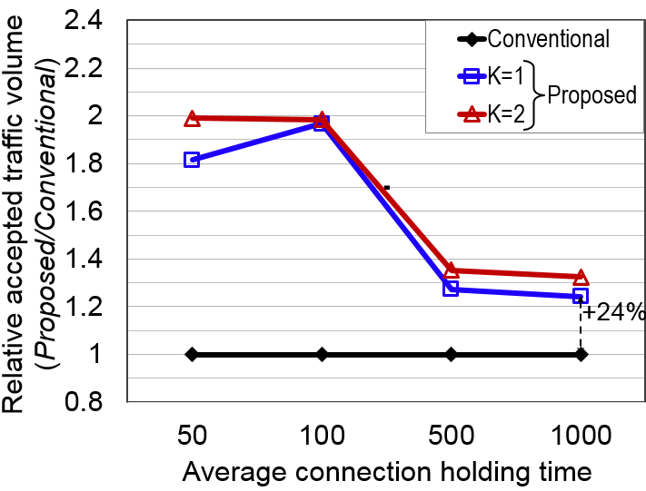
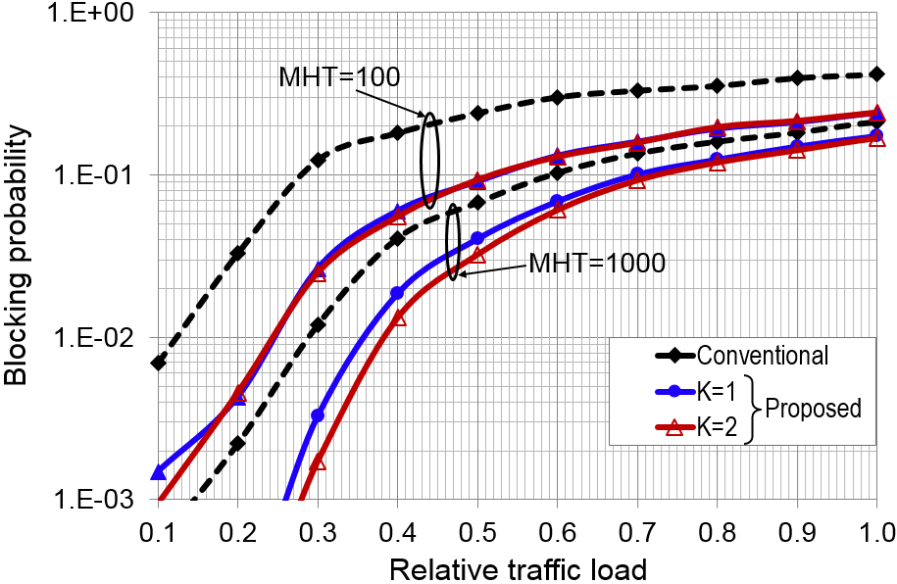
Numerical experiments (2/3)
Blocking probability
Relative accepted traffic volume
The results prove that the proposed solution outperforms the conventional GMPLS/PCE scheme. Our proposed solution significantly reduces the call loss probability; up to 40% (52%) smaller blocking probability can be obtained with K=1 (K=2) when the relative traffic load is 0.5 and MHT=1000
The proposed solution can accommodate at least 24% more traffic volume than does the conventional one. Performance of the proposed solution is improved as greater K is applied however, using larger K (more passive reservations per connection request) will increase signaling overhead.

Slide 28
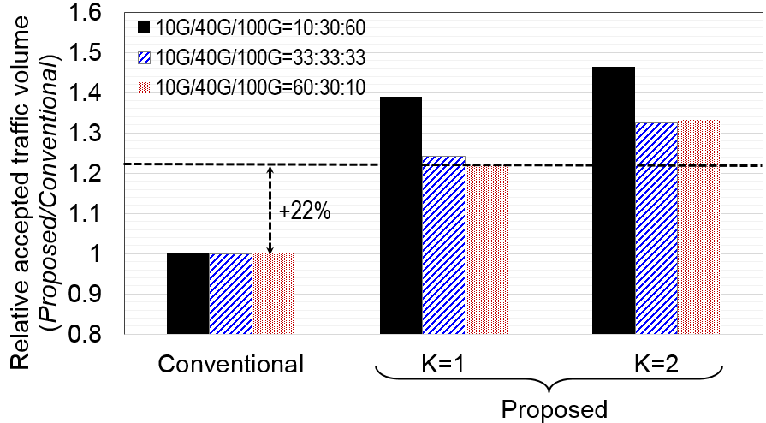
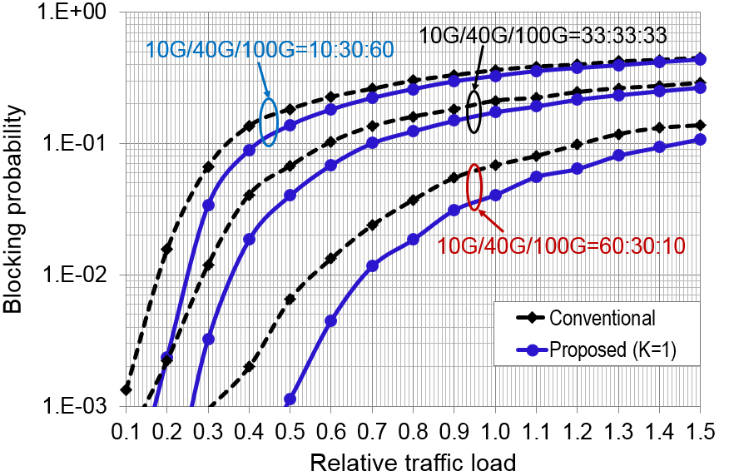
Numerical experiments (3/3)
Blocking probability under different traffic data rate patterns
Relative accepted traffic volume at 1% blocking ratio
Due to reduced requirements on network resources (fewer spectrum slots) of lower data rate requests, both the proposed and the conventional schemes provide lower blocking probability when the low data rate request portion is increased.
It was also verified that our proposed solution always offers better performance than does the conventional scheme; i.e. at the blocking ratio of 1%, even with K=1, more than 22% additional traffic volume can be accepted by using the proposed scheme.

Slide 29
Centralized + Distributed Control & Management
(from 1997 Optical Label Switching SJBYoo)
Brain: Interelement Control (out-of-band DCC)
  Slow but elaborate
  Performance monitoring based on labels
  Anomaly detection
  Overall view of network (topology)
  Listens and instructs the Reflex
Reflex: Distributed Control (in-band DWDM, Label based)
  Rapid and reflex-like
  Packet forwarding
  Anomaly detection
  Communicates with the Brain
DCC
WDM
Network
Control and
Management
PCE

Slide 30
Conventional Software-Defined Networks
Management Plane
Control Plane
Domain

Slide 31
Proposed Software-Defined Hierarchical Cognitive Networks for a single domain

Slide 32
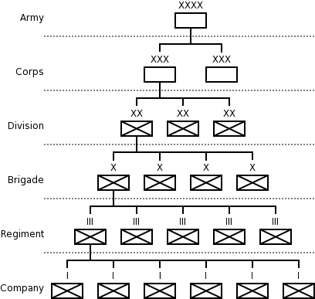
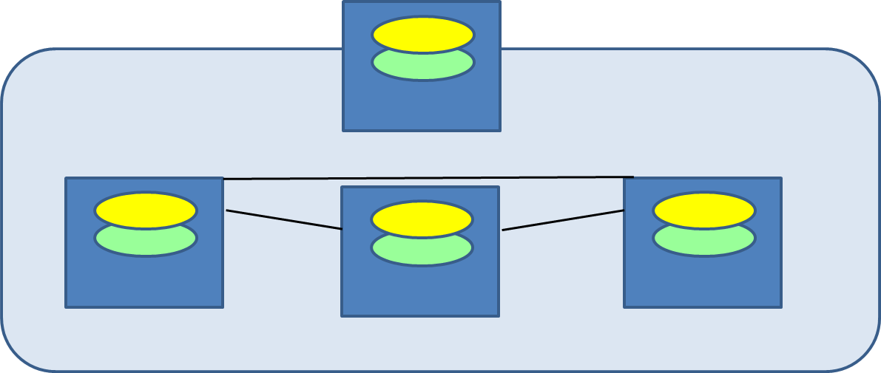
Proposed Software-Defined Hierarchical Cognitive Networks for an Autonomous System
Autonomous System (AS)
Autonomy
Policy
Security

Slide 33
What happens at the highest hierarchy of the Internet ?
Three Models for Multi-domain Heterogeneous Networking
Hierarchical --- (e.g. H-PCE, orchestrator, Federation, SDX, OSCAR)
Peer-to-Peer --- (e.g. BGP, IDP)
Brokered --- (e.g. ORCA)
Notes:
Recently emerging software defined networking (SDN) [1] has brought a centralized control plane to improve manageability of networks, however, it faces difficulties in scalability in extending it to multiple administrative domains. Hierarchical multi-domain SDNs assume another control plane at higher hierarchy to control lower hierarchy control planes in multiple SDNs. Examples are the SDN orchestrator [2, 3] and the Hierarchical Path Computation Element (H-PCE ) architecture [4], but they unduly limit the autonomy of Autonomous Systems (ASes). The recently adopted IETF’s Path Computation Element Computation Protocol (PCEP) with PCE can support multi-domain networks but it fails to achieve coordinated resource management and end-to-end QoS across multi-domain networks. The challenges we face are becoming more serious as modern networks are increasingly becoming more heterogeneous in their nature, and as heterogeneous applications are demanding more advanced end-to-end performance.
The challenges we face today are to support
Scalability in multi-domain, multi-AS networking,
Assurance for end-to-end QoS performance across multi-domain heterogeneous networks,
Assurance for autonomy and security across multi-domain heterogeneous networks, and
Service protection and restoration across multi-domains.
The substantial complexity of inter-domain networking in the Internet comes from the need to support flexible policies while scaling to a large number of ASes. While some of the problems may appear to stem from foundational or fundamental issues [5], most of the solutions were based on the premises of distributed control plane or hierarchical centralized control plane, which reaped limited success as we survey below. The proposed project seeks new solutions based on market-driven multiple broker agents that can combine the benefits from both centralized and distributed solutions.
Border Gateway Protocol (BGP) [6] [7] [8]
BGP provides each domain means for obtaining and propagating the reachability information from neighboring domains and means for defining the routes to other domains. In order to distribute reachability information, different domain border routers disseminate the addresses of all the routers they can reach. When a border router receives this information, it passes it to all the routers in its domain. In addition to routing anomalies [9] and security issues, other shortcomings are the inability to convey useful Traffic Engineering (TE) information, no support for end-to-end QoS, slow convergence and chattiness.
Optical BGP (OBGP)
OBGP [10, 11] provides end-to-end optical circuit (lightpath) across multiple domains by utilizing the interdomain properties of BGP. As in BGP, OBGP takes distributed approach and sets up necessary lightpaths by applying routing and wavelength assignment (RWA) across multiple domains. The OBGP routing model centered on the exchange of reachability information, and later Yannuzzi et al. proposed a combined intra-domain and inter-domain routing model [12] and OBGP+ [13] by including aggregated Path-State Information (PSI). OBGP and their subsequent versions suffered similar problems as BGP.
Peer-to-Peer CHORD and INS-Twine
Peer-to-Peer solutions have been widely discussed for supporting large-scale networking. In particular, CHORD [14] and INS-Twine have distinguished features including simplicity, provable correctness, and provable performance, compared with other P2P lookup protocols. However, due to the lack of network and location related information, the peer-to-peer approaches could not guarantee finding optimal paths calculated from the source to the destination, which is a serious shortcoming in multi-domain networking.
ChoiceNet [15-17] and Incentive-Compatible Routing [18]
ChoiceNet [15-17] system is based on three tightly coupled principles in that it aims to (1) Encourage Alternatives: encourage alternatives to allow users to choose among a range of services, (2) Vote With Your Wallet: let users vote with their wallets to reward superior and innovative services, and (3) Know What Happened: provide the mechanisms to stay informed on available alternatives and their performance. However, ChoiceNet has considered only a single domain networking so far. Similarly, incentive-compatible inter-domain routing [18] also seeks to optimize the use of network bandwidth by routing packets along lowest-cost paths and to do so with a truthful mechanism that can be computed in polynomial time. These approaches rewards lower cost solutions, however, they can still suffer from inter-domain routing anomaly despite following Gao-Rexford conditions [19] for global stability.
Attribute Based Networking
An attribute-based network [20] [21] [22] [23] [24] [25, 26] [27-31] is an application-level overlay consisting of client nodes and router nodes connected by communication links. As ASes (and networks) federate, the differing administrative units must enforce their own access policies as well as the policies they agreed to during the federation. Access control policies may rely on many factors such as user, point of origin, priority, type of content, and so forth. This also affects networking decisions such as priority of traffic, data being communicated among real-time sensors, or intended for real-time analysis and response, clearly must have a higher priority than other network traffic. An attribute is a data pair consisting of an attribute name and an attribute value. The name is any agreed-to identifier; the value is any quantity (including qualitative strings) providing a quantification or qualification of that attribute. The attribute may be associated with data, metadata, or a resource such as a router or infrastructure server. The infrastructure systems managing the network receive data and commands and examine their associated attributes. They then apply an attribute-based access control policy to determine how to handle the commands and data. Thus, attribute-based networking is essentially a form of policy-based routing, with the attributes being the key elements in the policy rules that the network follows. However, although there has been impressive progress, the attribute-based networking has not been applied to multi-domain cases. The proposed project will exploit labels and achieve attribute-based networking across multi-domain networks.
SDN Orchestrator and OSCARS
The controller of control planes in software-defined networking, known as a SDN Orchestrator [2], is capable of requesting object models from each of the controlling software element it is responsible for managing. Thus, each controlling software element can produce a self-describing object model with which the Orchestrator can use to manipulate it. Due to its flexibility and programmability, the SDN Orchestrator is a promising solution for future multi-domain networks, but it also has limitations in capabilities due to the fact that it is a purely centralized solution with a single point of failure. Similarly, OSCARS (On-Demand Secure Circuits and Advance Reservation System) [32], which centrally manages and automates the network functions based on user-specified requirements across multi-domain networks, suffer similar limitations as SDN Orchestrators.
Path Computation Element (PCE) and Hierarchical PCE (H-PCE)
IETF has standardized the PCE architecture and PCE Communication Protocol (PCEP). A PCE is an entity (component, application or network node) that is capable of computing a network path or route based on a network graph (TED) and applying computational constraints. Further, IETF has standardized the backwards recursive path computation (BRPC) [33, 34] to support an end-to-end inter-domain path computation. The destination domain PCE computes a virtual shortest path tree (VSPT) from the domain ingress nodes to the destination node, and then sends the computed VSPT to the upstream PCE to compute its own VSPT. The PCEP is a feature-complete protocol and used for communications among collaborating PCEs. However, the BRPC suffers from the fact that the domain sequence is unknown, that the navigating a mesh of domains may be overly complicated, and that it may not select the best path in many cases. To address this problem, the H-PCE architecture places one or more parent PCEs on top of all child PCEs in each domain. The parent PCE is capable of deciding the domain sequence and of offloading the intra-domain path computation to each child PCE to complete an end-to-end inter-domain path computation. However, H-PCE unduly limits the autonomy of the ASes since a child PCE from one AS needs to follow instructions from parent PCEs from other ASes. The proposed project exploits market-driven multiple broker agents instead of the hierarchical PCE to achieve scalable and optimal networking across multiple domains with end-to-end QoS.
rewrite this part with specific references.

Slide 34
Market-Driven Brokers
Brokers are not superiors and will respect the autonomy of ASes
Each AS will choose to (or not choose to) negotiate with a broker based on their needs and interests
Each AS may negotiate a SLA and provide info (gateways, abstracted topology, anticipated traffic, QoS/QoT, etc) in exchange for a reward (fees, advertisement, etc)
Brokers will provide better end-to-end inter-domain performance (e.g. traffic-engineering, higher throughput, lower latency, better SNR, lower energy fees, etc) by using inter-domain RMSA and other tools.
Brokers can broker deals but will not dictate the deals
Market-driven competition drives brokers to innovate and provide better services

Slide 35
Market-Driven Incentives
Incentives for ASes
Incentives for Brokers
(Rewards)
  Better end-to-end inter-domain performance without compromising autonomy, e.g.
    Better abstracted view of the global networks—traffic engineering
    Higher throughput, lower latency, lower energy consumption, higher QoS/QoT
    Virtual Federation with brokered ASes
    Resilient interdomain networking against disasters and security attacks
  Better reputations for better services from brokers
  Fees
  Advertisement
  More inter-domain resources
  High reputations
  More in-depth information from ASes
  Better social networking with other Brokers

Slide 36
Possible Market-Driven Evolutions
Many brokers may compete in the same regional and functional specialties for better services
Some brokers may expand regional and functional specialties
A number of brokers may form an alliance across heterogeneous regions and functional specialties
Some brokers may become extinct
ASes may choose to subscribe to many brokers depending on their needs and available resources
Based on positive experience and trust, ASes may choose to provide more information to Broker(s)
Some ASes may get left out by brokers and may need to resort to BGP or to proxy ASes.

Slide 37
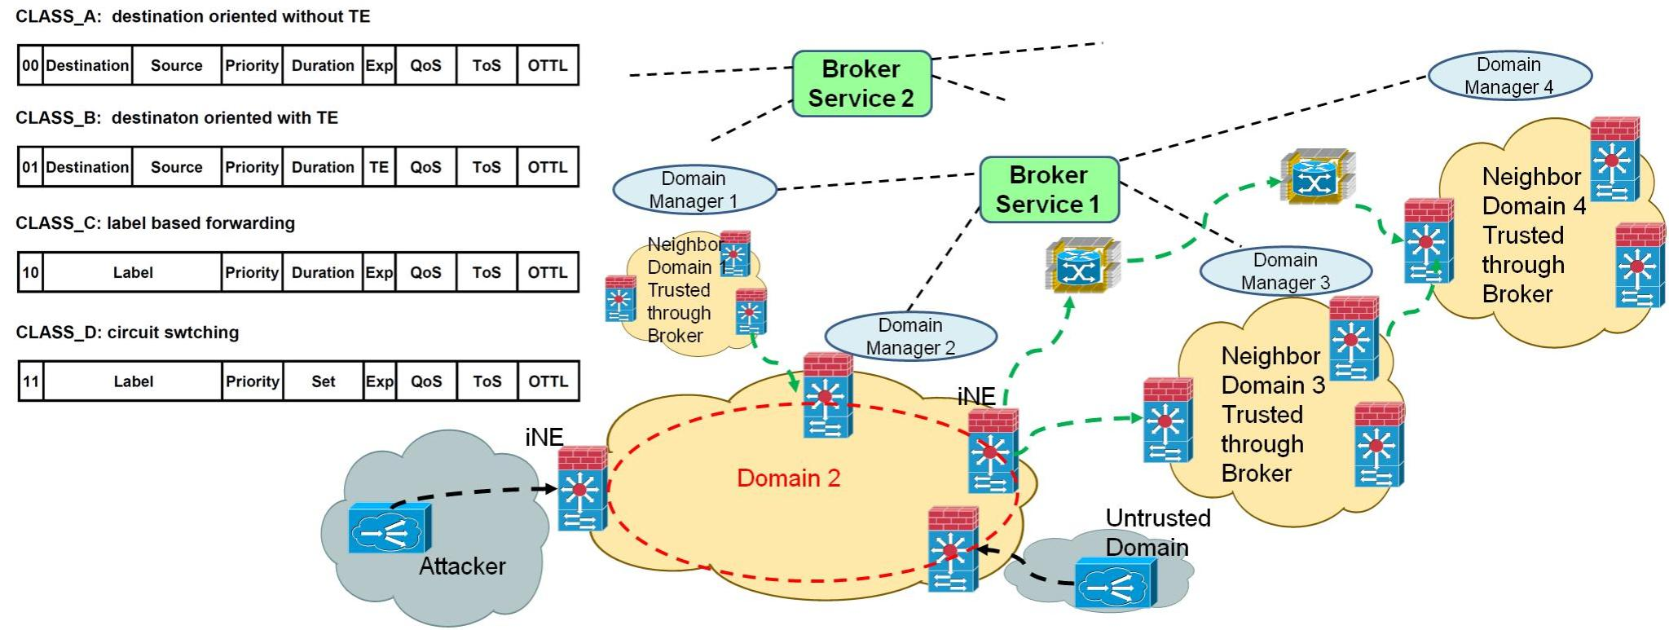
Multi-Domain Cognitive Networks
Scalable Intelligence
VPN set up based on Market-driven Community of Interest
Adaptive and Rapidly Reconfigurable
Fast yet reasonable actions (observe-anaylize-act cycle)

Slide 38
Experimental Multi-Domain SD-EON
  Elastic optical networking (EON) is a promising technique for future metro/core optical networks
    To control EONs, Software-defined Networking (SDN) is proposed as promising control plane architecture
  Multi-AS networking architectures are relevant to real operational scenarios to enhance:
    Network scalability
    Service reach
  How to support a multi-AS with multiple operators’ SD-EON?
    Operators advertise partial information regarding the topology and connectivity of its AS

Slide 39


Experimental Multi-Domain SD-EON
Broker
Multi-domain
planning tool
OpenFlow Controller
OpenFlow Controller
ABNO
Domain 1
intra-domain link
Domain 3
Domain 2
inter-domain link

Slide 40
Workflow 1: Domain Advertisement
Broker
Planning Tool
ABNO
GetDomain
1
DomainInfo
2
Update Topology
3
ACK
4

Slide 41
Domain Advertisement
Domain 100
10.0.1.1
10.0.2.1
Domain 200
7
1,5,6
1
10.0.2.4
9
5,8
3
10.0.1.2
2
10.0.2.2
4
3,7,8
10.0.2.3
1,2,6
6
Inter-Domain Links
5
10.0.3.1
Frequency slice
Link | 8 | 7 | 6 | 5 | 4 | 3 | 2 | 1 | Spectrum
1.1 – 2.1 |  |  |  |  |  |  |  |  | 0xCE
1.2 – 2.2 |  |  |  |  |  |  |  |  | 0x6F
2.3 – 3.1 |  |  |  |  |  |  |  |  | 0xDC
2.4 – 3.1 |  |  |  |  |  |  |  |  | 0x3B
Domain 300
Used Frequency Slice (1)
Available Frequency Slice (0)

Slide 42
Workflow 2: Path Provisioning
SDN-C
Broker
Planning Tool
ABNO
New
Request
5
Abstracted intra-domain
connectivity
6
Get Intra-Domain Conn.
Abstract Topology
7
8
Path Comp. Req.
Path Comp. Rep.
9
Path
Computation
10
Test Cap. Req.
Test Domain Capability
Test Cap. Rep.
11
12
Path Comp. Req.
Path Comp. Rep.
13
14
Path Set-up
Path Set-up
Path
Set-up
OK / KO
15
16

Slide 43
Path Provisioning
Abstracted intra-domain connectivity
src
10.0.1.3
Domain 100
95
10.0.2.1
1,3,6
10.0.1.1
Domain 200
5,7
7
1,5,6
1
1,4
2,4
10.0.2.4
9
2,3,8
10.0.1.2
5,8
2
3
1,3,6
10.0.2.2
4
3,7,8
10.0.2.3
1,2,6
6
Inter-Domain Links
Intra-Domain Links
5
10.0.3.1
Frequency slice
Frequency slice
Link | 8 | 7 | 6 | 5 | 4 | 3 | 2 | 1 | Spectrum
1.1 – 2.1 |  |  |  |  |  |  |  |  | 0xCE
1.2 – 2.2 |  |  |  |  |  |  |  |  | 0x6F
2.3 – 3.1 |  |  |  |  |  |  |  |  | 0xDC
2.4 – 3.1 |  |  |  |  |  |  |  |  | 0x3B
Link | 8 | 7 | 6 | 5 | 4 | 3 | 2 | 1 | Spectrum
1.3 – 1.1 |  |  |  |  |  |  |  |  | 0xDA
1.3 – 1.2 |  |  |  |  |  |  |  |  | 0xAF
2.1 – 2.3 |  |  |  |  |  |  |  |  | 0xF5
2.1 – 2.4 |  |  |  |  |  |  |  |  | 0xF6
2.2 – 2.3 |  |  |  |  |  |  |  |  | 0xDA
2.2 – 2.4 |  |  |  |  |  |  |  |  | 0x79
3.1 – 3.2 |  |  |  |  |  |  |  |  | 0xDE
1,6
tgt
10.0.3.2
84
Domain 300
Used Frequency Slice (1)
Available Frequency Slice (0)

Slide 44
Path Provisioning
Capability request
Candidate Path
src
10.0.1.3
Domain 100
95
10.0.2.1
Defragment to release
Slice # 1 or #6
1,3,6
10.0.1.1
Domain 200
5,7
7
1,5,6
1
1,4
2,4
10.0.2.4
9
2,3,8
10.0.1.2
5,8
2
3
1,3,6
10.0.2.2
4
3,7,8
10.0.2.3
1,2,6
6
Inter-Domain Links
Intra-Domain Links
5
10.0.3.1
Frequency slice
Frequency slice
Link | 8 | 7 | 6 | 5 | 4 | 3 | 2 | 1 | Spectrum
1.1 – 2.1 |  |  |  |  |  |  |  |  | 0xCE
1.2 – 2.2 |  |  |  |  |  |  |  |  | 0x6F
2.3 – 3.1 |  |  |  |  |  |  |  |  | 0xDC
2.4 – 3.1 |  |  |  |  |  |  |  |  | 0x3B
Link | 8 | 7 | 6 | 5 | 4 | 3 | 2 | 1 | Spectrum
1.3 – 1.1 |  |  |  |  |  |  |  |  | 0xDA
1.3 – 1.2 |  |  |  |  |  |  |  |  | 0xAF
2.1 – 2.3 |  |  |  |  |  |  |  |  | 0xF5
2.1 – 2.4 |  |  |  |  |  |  |  |  | 0xF6
2.2 – 2.3 |  |  |  |  |  |  |  |  | 0xDA
2.2 – 2.4 |  |  |  |  |  |  |  |  | 0x79
3.1 – 3.2 |  |  |  |  |  |  |  |  | 0xDE
1,6
tgt
10.0.3.2
84
Domain 300
Used Frequency Slice (1)
Available Frequency Slice (0)

Slide 45
Path Provisioning
Capability request
Candidate Path
src
10.0.1.3
Domain 100
95
10.0.2.1
Slice #1
can be released
1,3,6
10.0.1.1
Domain 200
5,7
7
1,5,6
1
1,4
1,2,4
10.0.2.4
9
2,3,8
10.0.1.2
5,8
2
3
1,3,6
10.0.2.2
4
3,7,8
10.0.2.3
1,2,6
6
Inter-Domain Links
Intra-Domain Links
5
10.0.3.1
Frequency slice
Frequency slice
Link | 8 | 7 | 6 | 5 | 4 | 3 | 2 | 1 | Spectrum
1.1 – 2.1 |  |  |  |  |  |  |  |  | 0xCE
1.2 – 2.2 |  |  |  |  |  |  |  |  | 0x6F
2.3 – 3.1 |  |  |  |  |  |  |  |  | 0xDC
2.4 – 3.1 |  |  |  |  |  |  |  |  | 0x3B
Link | 8 | 7 | 6 | 5 | 4 | 3 | 2 | 1 | Spectrum
1.3 – 1.1 |  |  |  |  |  |  |  |  | 0xDA
1.3 – 1.2 |  |  |  |  |  |  |  |  | 0xAF
2.1 – 2.3 |  |  |  |  |  |  |  |  | 0xF5
2.1 – 2.4 |  |  |  |  |  |  |  |  | 0xF6
2.2 – 2.3 |  |  |  |  |  |  |  |  | 0xDA
2.2 – 2.4 |  |  |  |  |  |  |  |  | 0x79
3.1 – 3.2 |  |  |  |  |  |  |  |  | 0xDE
1,6
tgt
10.0.3.2
84
Domain 300
Used Frequency Slice (1)
Available Frequency Slice (0)

Slide 46
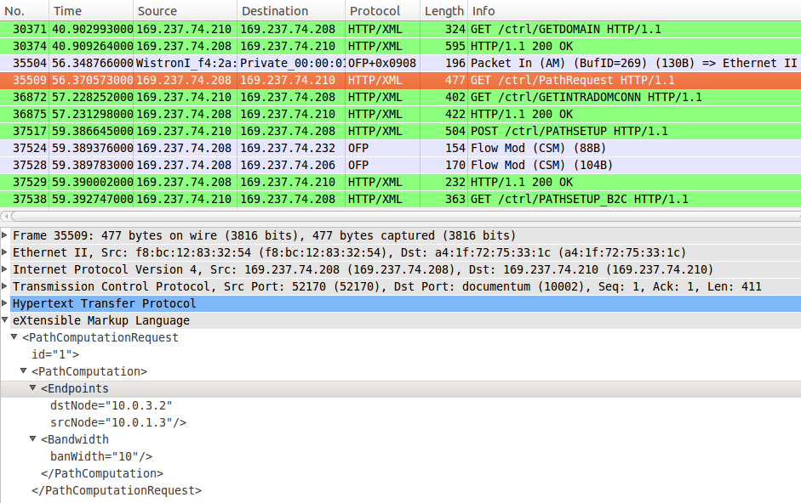
Multi-Domain SD-EON Experimental Results
Broker capture
Detail of selected XML messages
UCD OF controller capture

Slide 47
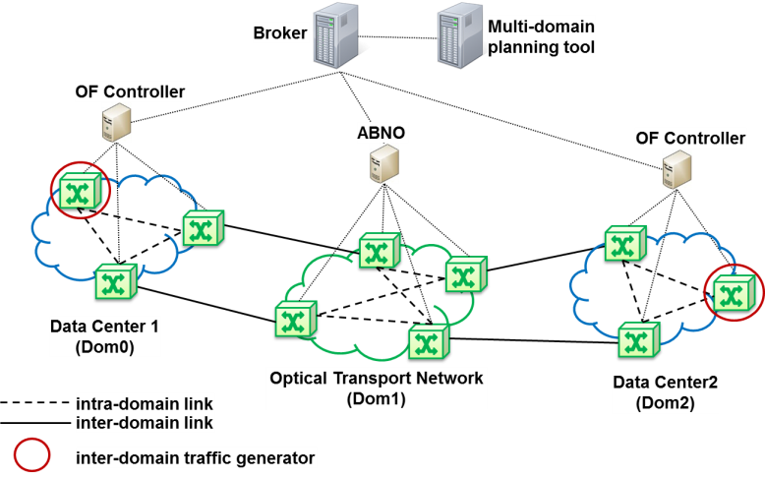
Simulation results
Inter-domain provisioning performance
Offered Load InterDom | %Pb w/o Inter |  | %Pb w/ Inter |  | %Pb Inter w/ Intra
 | Dom0 / Dom2 | Dom1 | Dom0 / Dom2 | Dom1
10 | 0.15 | 0.13 | 0.20 | 0.13 | 4.21
20 | 0.15 | 0.13 | 0.33 | 0.16 | 8.57
30 | 0.15 | 0.13 | 0.52 | 0.19 | 14.43
40 | 0.15 | 0.13 | 0.71 | 0.23 | 20.09
50 | 0.15 | 0.13 | 0.93 | 0.26 | 26.48
Offered Load (Erlangs)

Slide 48
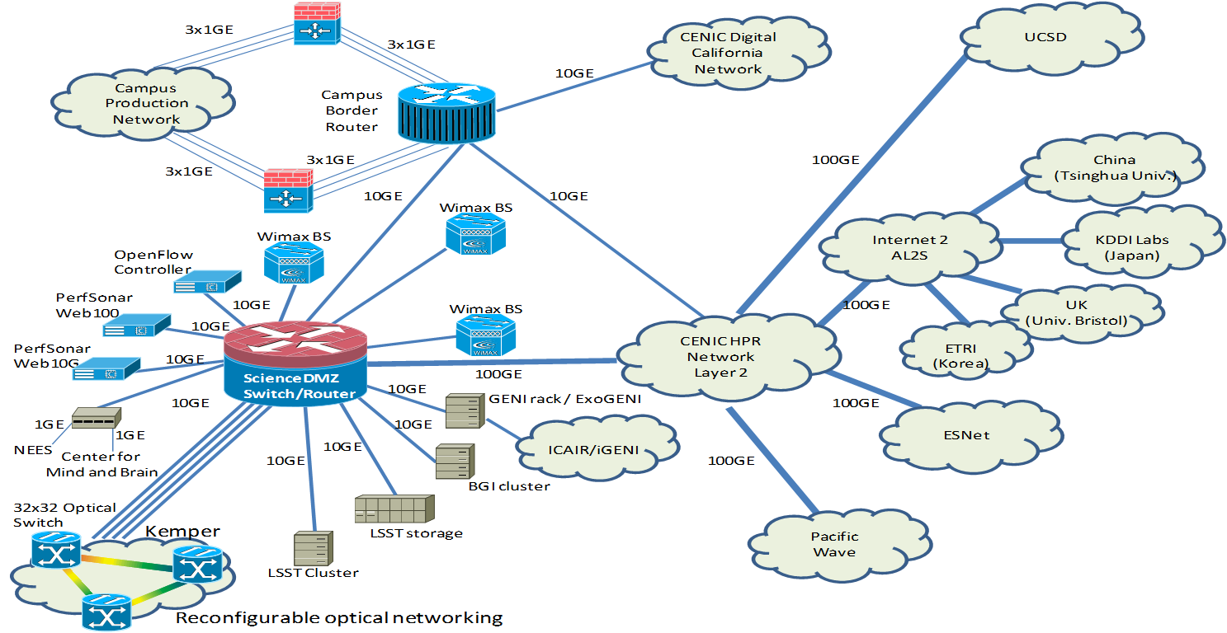
SDN experiments across UC Davis- CENIC (COTN)-ESnet
UC Davis Campus Network and its Connectivity

Slide 49
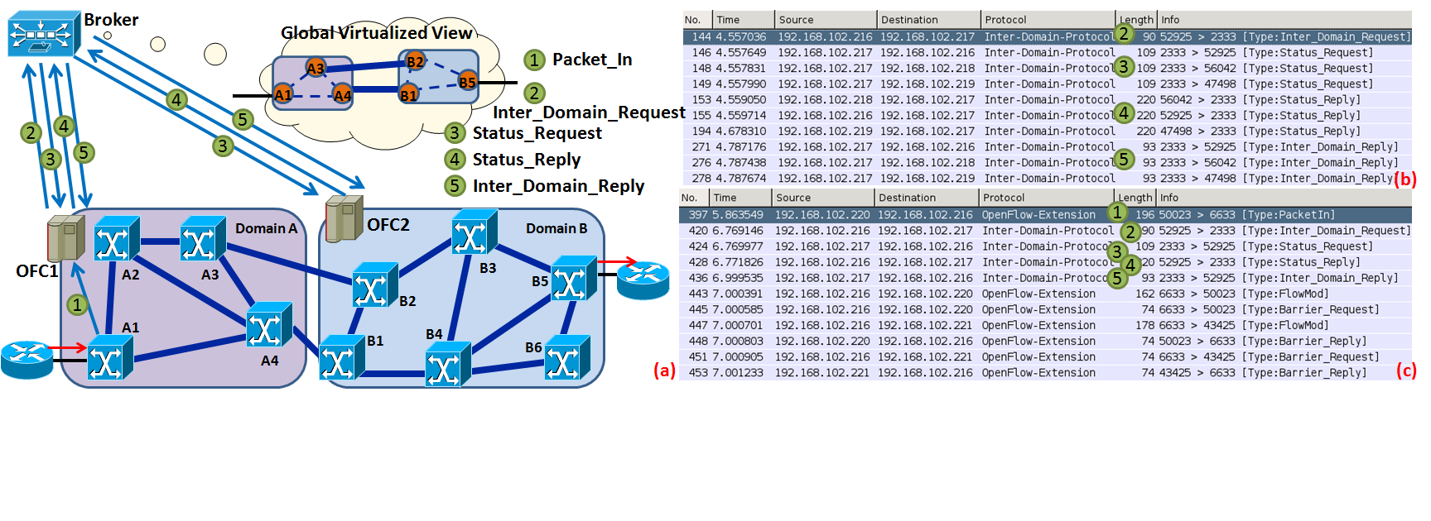
Broker-based Multi-domain Software-Defined Heterogeneous Optical Networks
Broker-based OF control plane for multi-domain networks
Wireshark capture of the broker 1 for dynamic path provisioning from UC Davis to COTN to ESNet
Wireshark capture of the OFC1 for dynamic path provisioning from UC Davis to COTN to ESNet

Slide 50
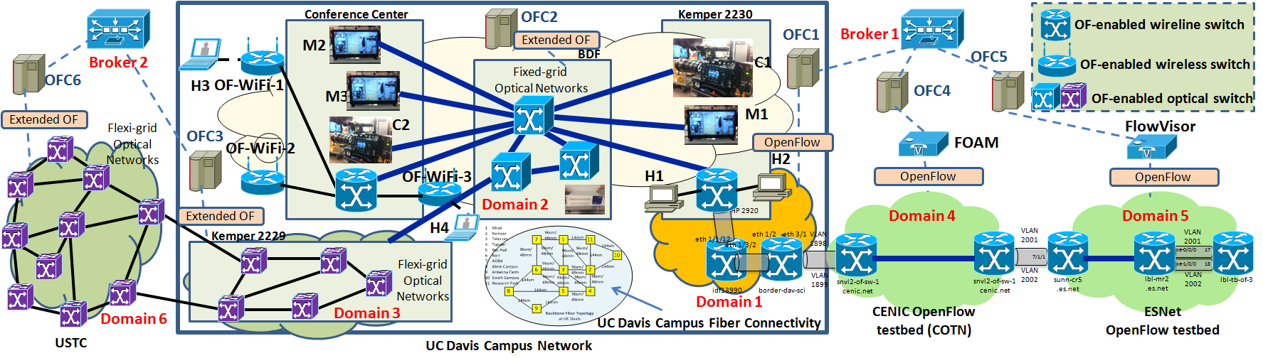
Market-Driven Broker-based OpenFlow control plane for Multi-Domain Heterogeneous networks

Slide 51
UC Davis Campus Research Network and its Connectivity
UC Davis - ESNet – COTN Optical SDN demo @GENI
COTN

Slide 52

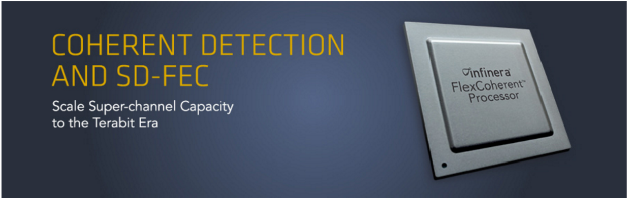
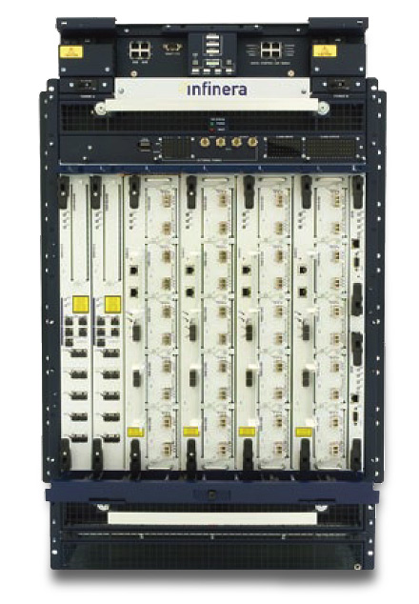
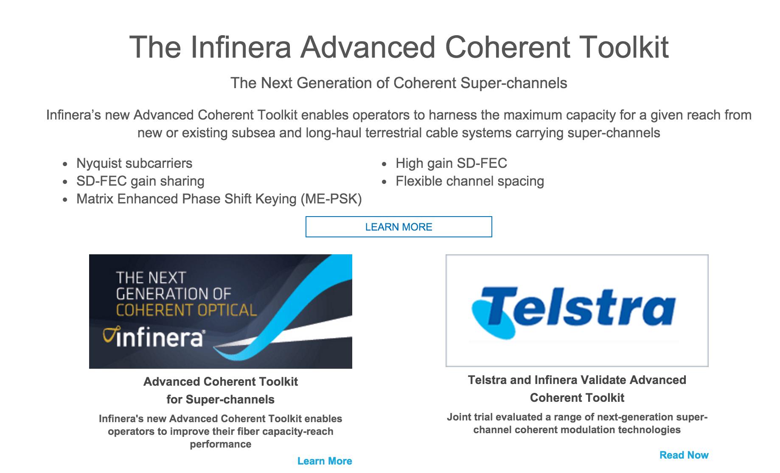

Slide 53
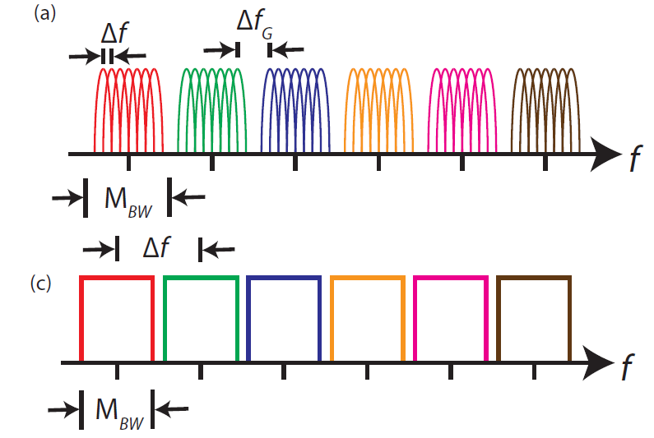
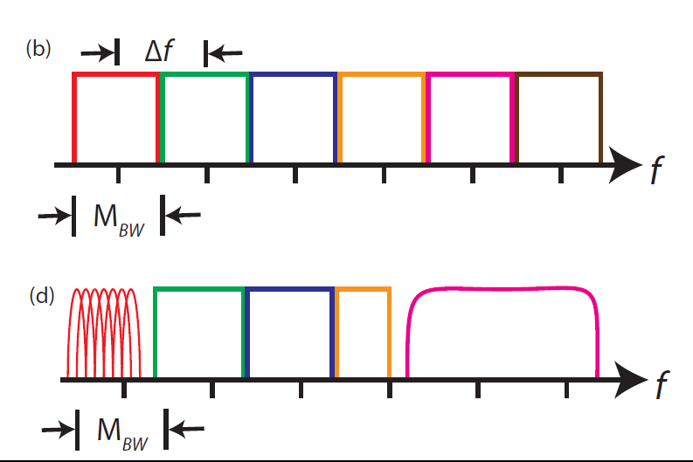
CO-OFDM generates many low speed subcarriers using an inverse fast Fourier Transform (iFFT) to ensure orthogonality.
Nyquist-WDM combines many independently generated channels together with a minimum guard band.
CoWDM operates by combining many orthogonal subcarriers together to form a seemingly random waveform.
OAWG operates over a continuous, gapless spectrum enabling the generation of any combination of single-carrier or multicarrier waveforms.
Gerstel, Jinno, Lord, Yoo, IEEE Com Mag 2012
∆f : subcarrier frequency spacing, ∆f_{G} : frequency spacing between CO-OFDM bands. M_{BW} : modulator bandwidth

Slide 54
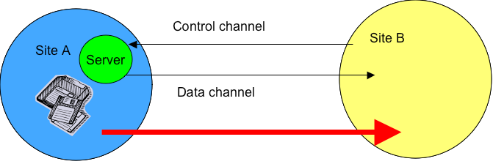
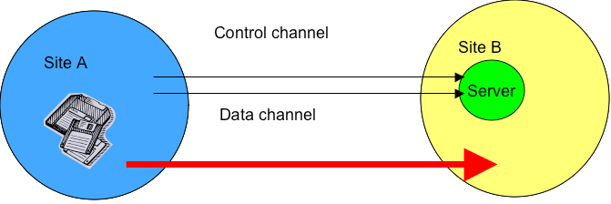
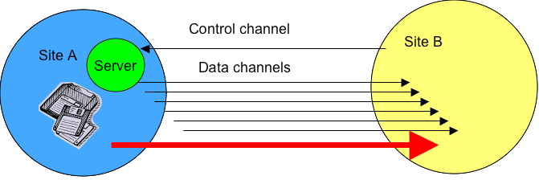
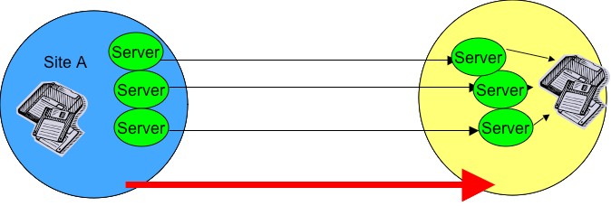
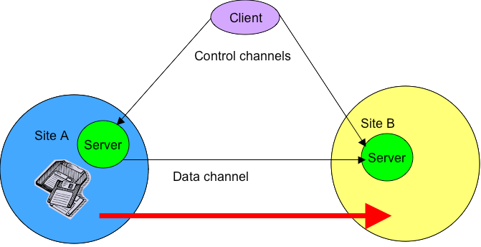
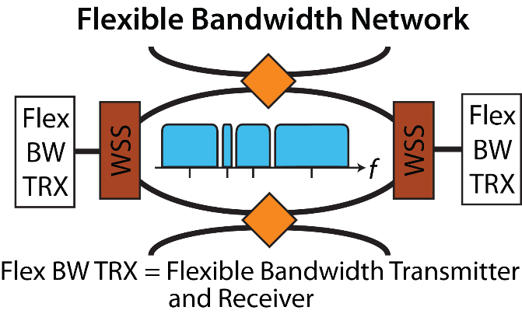
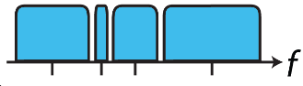
Grid FTP vs. Elastic Grid FTP
Basic Grid FTP transfer
Grid FTP with server on destination node
Grid FTP transfer on Parallel Channels
Striped Grid FTP transfer
Elastic Grid FTP
Elastic Grid FTP
Elastic Pipe
Elastic Hose
Elastic Hose

Slide 55
Flex-grid Node and S-BVT
Deg.1
Deg.2
WXC
WXC
Deg.4
Deg.3
WXC
WXC
Flex WSS
Flex WSS
Add
Drop
S-BVTs
Client Network
Flow Processing
100G
20G
10Gb/s
100Gb/s
400Gb/s
200G
Router
40G
S-BVTs
Sliceable Bandwidth Variable Transponder (S-BVT)

Slide 56
Project Plans and Milestones - Task 1
Multi-domain Software-Defined Elastic Optical Network (SD-EON) Architecture Studies: conduct architecture studies for multi-domain SD-EONs with combined features of centralized and distributed control planes, and design multi-domain networking protocols w/ emphasis on backward compatibility & interoperability.
Milestones
  1.1. Complete the architecture design for Software-Defined Elastic Optical Networks with backward compatibilities and interoperability with legacy networks, and complete Southbound APIs that extend OpenFlow
  1.2. Complete broker agent architecture design and define protocols for inter-domain SDN networking services
  1.3. Complete performance studies of the proposed inter-domain SDN architecture with distributed signaling
Deliverables
  Year 1 Report : backward compatibility and interoperability approaches.
  Year 2 Report : the broker-based architecture definition.
  Year 3 Final Report: the distributed signaling protocol and the inter-domain architecture.

Slide 57
Project Plans and Milestones - Task 2
Algorithm Development for Multi-domain Intelligence:
  Investigate EON algorithms for resource allocation, network restoration and fault-tolerance with constraints dictated by the heterogeneity in data traffic, physical layer, security and resources available in multiple domains
Milestones
  2.1. Complete algorithm design for fragmentation-aware routing, modulation format and spectrum allocation (RMSA) for mixed traffic (i.e. IP, Grid-FTP) and heterogeneous file sizes
  2.2. Extend 2.1. to multi-domain scenarios
  2.3. Complete simulation studies and performance analysis
Deliverables
  Year 2 Report : problem formulation and algorithms for single and multi-domain RMSA
  Year 3 Final Report : simulation studies and performance analysis results

Slide 58
Project Plans and Milestones - Task 3
Multi-domain SD-EON Testbed Studies with Interoperability: conduct control plane and data plane testbed experiments of multidomain heterogeneous networks, leveraging our collaboration with ESnet, CENIC, and Verizon
Milestones
  3.1. Complete multi-domain broker-based control plane experiment across UC Davis, ESnet, CENIC, Internet2, and Europe
  3.2. Repeat experiment in 3.1. with distributed SDN control scheme
Deliverables
  Year1 report: multi-domain broker-based testbed results
  Year2 report: results on distributed SDN control plane testbed

Slide 59
Project Plans and Milestones - Task 4
Interoperability, backward-compatibility testbed studies with Infinera and ESnet involving Big Data: conduct compatibility and interoperability control and data plane testbed experiments leveraging our collaboration with Infinera and ESnet
Milestones
  4.1. Backward compatibility and interoperability data plane experiments (legacy WDM + Flex-grid) using Infinera data plane and control plane technologies across UC Davis and Esnet
  4.2. Application study: End-to-End GRID_FTP + IP traffic demo across multiple domains (ESnet + UC Davis)
Deliverables
  Year3 final report : results on compatibility and interoperability
  Year3 final report : results on Application study

