Slide 1
SDN-SF: Software Defined Network Science Flows
Raj Kettimuthu, Ian Foster, Eun-Sung Jung
Argonne National Laboratory

Slide 2

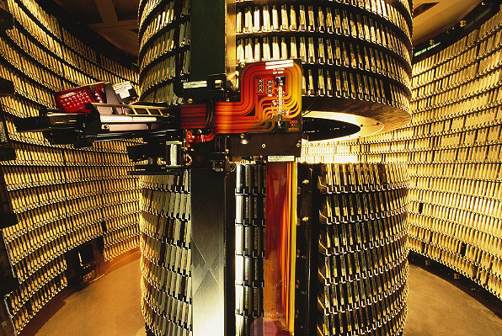
Science Workflows
Experimental/Observational/
Computational Facility
Remote Facility
Supercomputer
Analysis
Local cluster
network
Analysis
Storage
Data Acquisition
Replication/
Distribution
Archival
Replication/
Distribution
Notes:
Fast CCD generates ~128 - 400 MB/s and written to local storage first
Slow CCD generates ~ 4-12 MB/S and can be written to Parallel Storage Directly

Slide 3


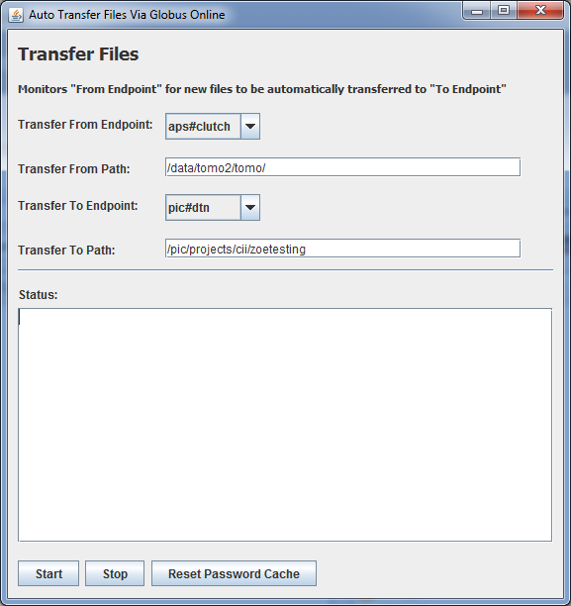
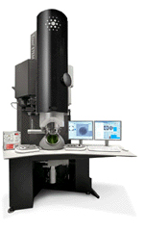
Example
cii.velo.pnnl.gov
ssh
Visus Converter
PNNL
Remote Desktop
ciiwin.pnl.gov
PIC Lustre FS
/pic/projects/cii
Custom Analysis Apps
IDL
AmeriCT
Biofilm Viewer
Visus
dtn.pnl.gov
APS
ANL Instrument Node
Notes:
PNNL scientists generate terabytes of data from APS. But they need to analyze using tools/visualizations/processes they have installed and customized at PNNL. Need near-real time processing on current sample in order to make decisions that affect same or subsequent samples. Need to decide what to change before sample quality degrades due to electron beam. Previously would only be able to reconstruct a handful of image slices because they had to move data around using a thumb drive and run code on their laptop. Would need to bring a hard drive with them to transfer all the data after the experiment was done and then ship home.

Slide 4
Network Reservation
Network Reservation
Service
IP:PORT
Destination
Src, Dst, Start, End, Bw
AUTH
PASV
AUTH
Network Reservation
Service
Client
Connect IP:PORT
PORT <IP:PORT>
AUTH
PORT <IP:PORT>
Src, Dst, Src-port,
Dst-port,Start, End, Bw
Source

Slide 5
Advanced Reservation
Network Reservation
Service
IP:PORT
Destination
Token
Src, Dst, Start, End, Bw
PASV
Client
Connect IP:PORT:Token
IP:PORT:Token
Source

Slide 6
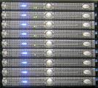
Wide-area File Transfer
Wide Area Network
Data Transfer Node
Data Transfer Node
Parallel
Storage
Parallel
Storage
.
Site 1
Site 2
Compute Cluster
Compute Cluster
Notes:
Most of these transfers we discussed are from a parallel storage system at one site to a parallel storage system at another site.

Slide 7
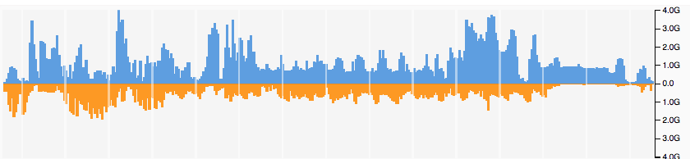
Adaptive QoS
BW unused by QoS flows are given to other QoS flows in priority order if those flows can use it.
Flows, whose current assigned BW is below QoS BW, are considered first.
BW increased/decreased incrementally through dynamic meter table changes.

Slide 8
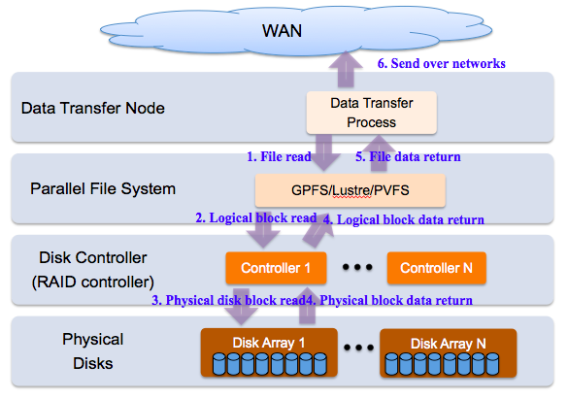
Disk-to-Disk Transfers
Notes:
Dedicated data transfer nodes (DTNs) exist for high-performance data transfer among science facilities. Parallel file systems are widely adopted at major science facilities. Deep I/O path despite direct I/o. A long I/O path has a high latency and increases the unpredictability and fluctuation of data transfer throughput. Shared parallel file systems (PFS). The maximum aggregate throughput of PFS is done through a large number of nodes. A small number of DTNs may not be able to achieve the full throughput.

Slide 9
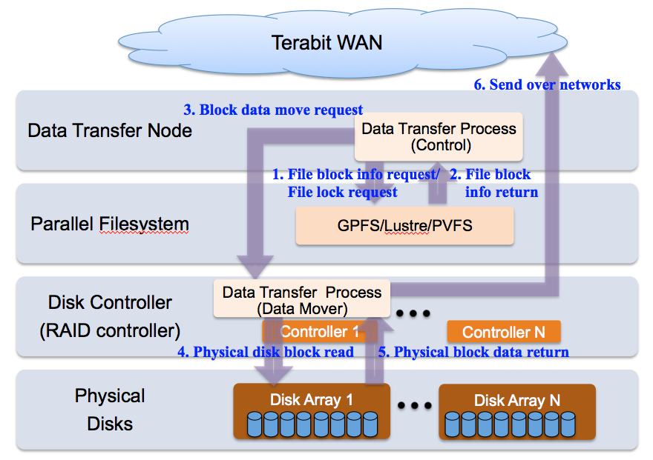
Data Transfer Process in Disk Controller

Slide 10
Questions

