Slide 1
SDN-SF: Software Defined Network Science Flows
ORNL FWP No. ERKJ302
Oak Ridge National Laboratory (Lead): Nagi Rao
Argonne National Laboratory: Raj Kettimuthu
Brookhaven National Laboratory: Dantong Yu
Los Alamos National Laboratory: Brad Settlemyer
PI Meeting
February 17-18, 2016
Fermi National Laboratory

Slide 2
Outline
Project Description
SDF-SF Overview
  SDN for Science Flows
  DOE Science Scenarios
Solution Technology Ingredients
  SDN Technologies:
    Controllers and north bound software
    Application integration and APIs
  Pilot Testbed
    Experimentation and Analysis
    Phased deployment strategy
ORNL Preliminary Results
  dpctl and ODL for Path Switching
  Lustre WAN Transfers
  Impulse Response Method
Individual Presentations from ANL, BNL and LANL

Slide 3
SDN-SF: Software Defined Network Science Flows
ORNL FWP No. ERKJ302
Project Overview:
Overall Goal:
  Develop SDN/SDI technologies to support DOE science application across sites over wide-area networks
Duration: FY16-FY18
Collaboration: Four National Laboratories
    ORNL (Lead): Nagi Rao, Satya Sen, Susan Hicks, Qiang Liu (post-doc)
    ANL: Raj Kettimuthu, Ian Foster
    BNL: Dantong Yu, Dimitri Katramatos
    LANL: Brad Settlemyer
  No-Cost Collaborations
    ESnet: Inder Monga, Chin Guok
    Cisco Systems: Steven Carter
    Ciena: someone in place of Jim Archuleta
  https://sites.google.com/site/sdnsfproject/

Slide 4
A simple generic path provisioning illustration
end site
end site
host
end-to-end
application
host
SDN-SF trigger
SDN-SF
trigger
application
server
application
client
path provisioning
border
router
border
router
Objective: Technologies to setup in software complex end-to-end flows in support of science applications with emphasis on end sites

Slide 5
Three Target Science Scenarios
High-Performance DTN Transfers
  Setup site DTN-border dedicated connections – on-demand/scheduled
  SDNs extended to include IO and file systems
HPC-Remote Dynamic Memory Flows
between codes running on HPC systems to remote user/analysis sites
  Application triggers while code is running
  inform user, present rendering, initiate analysis
  establish control path to steer computation
  SDN extended to include multi-core nodes and interconnects
3. Remote Complex Flows for Science instruments
- SDNs extended to include science instruments – APS and NSLS

Slide 6
site control-plane
v
v
site control-plane
extended SDN
controller
flow
orchestrator
long-haul
SDX
extended
SDN
controller
north
bound
south
bound
NIC
LAN
switch
router
LAN
switch
NIC
router
host
NIC
node 1
HPC system
HBA
HBA
HBAs
HBA
HBA
HBA
FCAs
NIC
cross-connect
switch
node N
HBA
HBA
HBAs
storage/file
computing extension
SDN - networking
storage extension

Slide 7
SDN for DTN Transfers: DTN to border routers
SDN
controller
north
bound
SDN
controller
DTN
DTN
long-haul network
application
south
bound
application
TCP
TCP
IP
IP
LAN
switch
LAN
switch
NIC
router
router
NIC
OS
OS
I/O stack
long-haul
SDX
I/O stack
local-area network
local-area network
HBA
HBA
FCAs
HBA
HBA
HBA
FCAs
Collaboration with ESnet
disk
array
disk
array

Slide 8
Complex Host-to-Host Memory/IO Flows
NIC
LAN
switch
router
LAN
switch
NIC
router
host
NIC
NIC
host 1
HBA
HBA
FCAs
NIC
HBA
HBA
HBA
FCAs
host 2
storage
switch
HBA
HBA
FCAs
SDN
controller
storage
controller
disks
SDN
controller
disks

Slide 9
Host-to-Host Memory Transfers: HPC systems to remote sites
SDN
controller
SDN
controller
long-haul
SDX
northbound
southbound
NIC
LAN
switch
router
LAN
switch
NIC
router
host
NIC
host 1
HBA
HBA
FCAs
HBA
HBA
HBA
FCAs
NIC
cross-connect
switch
host 2
HBA
HBA
FCAs
remote site
HPC system

Slide 10
Proposed User Tools
Science User Tools : SDN-SF suite
    Application API
    IO-File and storage modules
    Instrument modules
SDN Tools
  Northbound APIs
  Orchestrator modules
Pilot Testbed Tools
  Dual-purpose: development and performance testing
  Path for gradual integration into site networks
  Would like to discuss collaboration with other projects

Slide 11
Orchestrator Modules: Setup and Coordinate Flows
NIC
LAN
switch
router
LAN
switch
NIC
router
host
host 1
NIC
Application
HBA
HBA
HBA
API
FCAs
SDN
controller
flow
request
SDN
controller
disks
service
module
remote
module
To WAN service
To remote site orchestrator
orchestrator
flow initiation site

Slide 12
SDN-SF site orchestrator modules
Local services
network
service
instrument
service
compute
service
remote
flow
service
advanced
scheduler
on-demand
provision
Openflow
custom
Curl, CLI
Local device control
Modules of orchestrator stack

Slide 13
Orchestrator modules: build and deployment
  Global git repository:
  All software modules are kept together as single git repository
    replicated and readily available to all participants organizations
    supports coordinate software development – simple push of ready codes
  Specific Scenarios: may require a subset of orchestrator modules
    specific modules for a scenario will be selected
    not all modules may be needed in a given scenario

Slide 14
Hosting of Orchestrator Software Builds:
  Global git repository:
  Maintained by ANL and backup at ORNL
    project version – all codes: mature and under development
    public version – used for public release of mature codes
  Replicated at all participant institutions
    each institution
      maintains its own development branch
      pushes mature codes to global git repository

Slide 15
Deliverables: Orchestrator Modules - Year 1
ANL:
  instrument service modules for APS (v.1)
  local device control modules for APS (v.1)
BNL:
  instrument service modules for NSLS (v.1)
  device control modules for NSLS (v.1)
  remote flow service module for SDX (v.1);
LANL:
  compute service modules for IO system (v.1)
  custom device control modules for IO system (v.1)
ORNL:
  local network service module (v.1);
  remote flow service module for OpenFlow (v.1);
  control modules for OpenFlow (v.1);
  on-demand provisioning modules for OpenFlow (v.1)

Slide 16
SDN-SF site orchestrator modules – Year 1 starts
Local services
network
service
instrument
service
compute
service
remote
flow
service
ORNL
ANL, BNL
ORNL, LANL
BNL. ORNL
advanced
scheduler
on-demand
provision
ORNL
Openflow
custom
Curl, CLI
ORNL
ANL, BNL. LANL
Local device control

Slide 17
Deliverables: Orchestrator Modules Starting in Year 2
All Year 1 modules will be refined and released as version 2.0
ANL:
  remote flow instrument service for APS (v.1)
  on-demand provisioning modules for APS (v.1)
BNL:
  remote flow instrument service module for NSLS (v.1)
  on-demand provisioning modules for NSLS (v.1)
LANL:
  compute service modules for file system (v.1)
  custom device control modules for file system (v.1)
  on-demand provisioning modules for IO (v.1)
ORNL:
  remote flow service module for custom control (v.1);
  advanced scheduler module for OpenFlow(v.1)

Slide 18
SDN-SF site orchestrator modules – Year 2 starts
Local services
network
service
instrument
service
compute
service
remote
flow
service
ORNL, LANL
ALL
advanced
scheduler
on-demand
provision
ORNL
ALL
Openflow
custom
Curl, CLI
LANL, ORNL
Local device control

Slide 19
Deliverables: Orchestrator Modules - Year 3
ANL:
  remote flow instrument service for APS (v.2)
  advanced scheduler module for APS (v.1)
BNL:
  remote flow instrument service module for NSLS (v.2)
  advanced scheduler module for NSLS (v.1)
LANL:
  advance schedule modules for IO and file system (v.1)
  combined custom device control modules for IO and file system (v.1)
ORNL:
  remote flow service module for custom control (v.2);
  on-demand provisioning module for OpenFlow and custom control (v.3)
  advanced scheduler module for OpenFlow and custom control (v.2)

Slide 20
ANL
BNL
site control-plane
v
v
site control-plane
BNL
extended SDN
controller
flow
orchestrator
long-haul
SDX
extended
SDN
controller
ORNL
ORNL
north
bound
south
bound
NIC
LAN
switch
router
LAN
switch
NIC
router
host
NIC
node 1
HPC system
ORNL
HBA
HBA
HBAs
HBA
HBA
HBA
FCAs
NIC
cross-connect
switch
node N
LANL
HBA
HBA
HBAs
storage/file
computing extension
SDN - networking
storage extension

Slide 21
Pilot Testbed
Multiple Sites:
  DOE: ORNL, ANL, LANL, Esnet
  Basic configuration to be
    developed at ORNL
    replicated at ANL, BNL and LANL
Emulation ORNL testbed
ANUEs can emulate multi-site configurations
initially, to identify site equipment and configuration
later, augment Pilot with emulated connections to BNL, LBL,
leveraged from DOD project – in use for more than year

Slide 22
Testbed Configuration
BNL - NSLS
SDN-SF
rack
ANL - APS
SDN-SF
rack
SDN-SF
rack
Esnet
OSCARS
SDX
ORNL – N/W
2*100 Gbps
Ciena SDN
SDN-SF
rack
Atlanta
loopback
LANL – IO/File

Slide 23
data plane
science
instrument
control plane
SDN-SF server
File/disk
system
orchestrator
function plane
storage
switch
SDN
controller
SDX
controller
compute server
LAN
switch
OpenFlow
switch
router
router
SDN-SF rack
long-haul network
science facility site
Proposed Basic Site Configuration: SDN-SF rack

Slide 24
ORNL SDN Current Testbed
controller
host
linux
workstation
linux
workstation
controller
host
ANUE OC192
emulator
linux
workstation
OpenFlow
switch
OpenFlow
switch
linux
workstation
ANUE 10GigE
emulator
server/client
host
server/client
host
long-haul connection emulation
two OpenFlow switches
Cisco
3064
HP
5406zl

Slide 25
Remote controller performance tests: Cisco 3064 performance app + REST interface + odl controller
feynman 1
odl
feynman 3
odl app
Emulated long-haul path: 0-800ms rtt
Cisco
3064
ANUE
OC192
e300
10GE-OC192
feynman 4
Cisco
3064
ANUE
OC192
odl
app
feynman 2
odl
feynman 3
feynman 4
iperf TCP
iperf
TCP

Slide 26
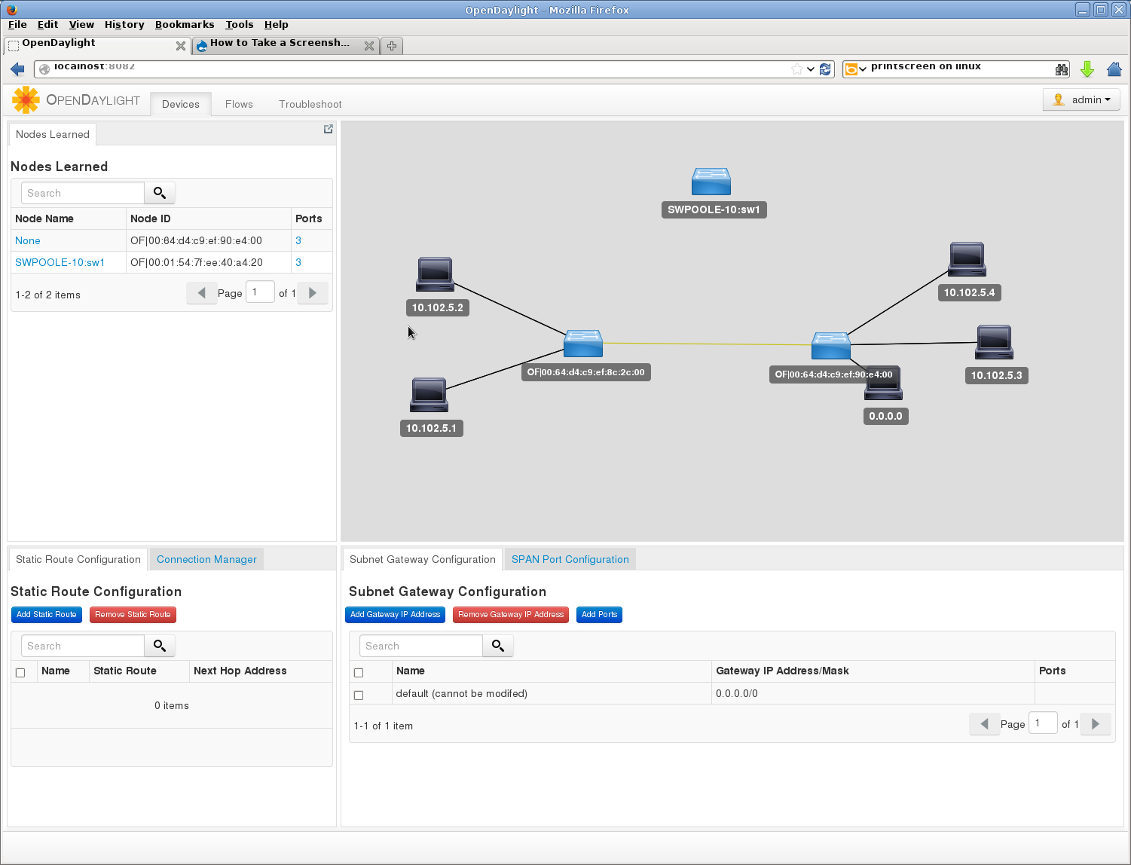
OpenDaylight – Hydrogen
Currently testing: Lithium and Floodlight

Slide 27
Emulation Testbed Configuration
SDN-SF
rack
ANL - APS
ANUE
BNL - NSLS
SDN-SF
rack
ANUE
ANUE
SDN-SF
rack
ORNL – N/W
ANUE
2*100G
2*100 Gbps
Ciena SDN
SDN-SF
rack
Atlanta
loopback
LANL – IO/File

Slide 28
Testbed – Leveraged from DOD-ESSC
SDN components
  1.1 Switches: Cisco 3064, HP 5604zl, Cumulus linux qunata
  1.2 Controllers: Opendaylight, dpct
  1.3 Northbound codes: python, curl
Host systems
  2.1 Multi-core, multi-socket, multi-bus
  2.2 Suites of 10/40G NICs
Storage: Disks and File Systems
  3.1 ORNL storage; ANL
  3.2 File systems: Lustre at ORNL and GPFS at ANL
Network Connections
  4.1 LAN10/40G Ethernet, all-optical switching, IB (QDR, FDR)
  4.2 Long-Haul
    ORNL-ANL 100G connections
    ESnet and ANI network connections
    ORNL ANUE Emulators
    10/40G IB WAN accelerators

Slide 29
Outline
Project Description
SDF-SF Overview
  SDN for Science Flows
  DOE Science Scenarios
Solution Technology Ingredients
  SDN Technologies:
    Controllers and north bound software
    Application integration and APIs
  Pilot Testbed
    Experimentation and Analysis
    Phased deployment strategy
ORNL Preliminary Results
  dpctl and ODL for Path Switching
  Lustre WAN Transfers
  Impulse Response Method
Individual Presentations from ANL, BNL and LANL

Slide 30
dpctl controller
feynman 1
10GigE
HP
5406zl
perf
api
dpctl app
openflow
perf-app: bash script with dpctl api calls
monitors connection latency
if latency exceeds threshold, uses api to install flows to restore path
Advantages: i) small code easier to analyze and authenticate
ii) promising for science flows – few high-performance flows
iii) one openflow connection to secure – easier to justify to sites
Publication:
N. S. V. Rao, Performance Comparison of SDN Solutions for Switching Dedicated Long-Haul Connections, The International Symposium on Advances in Software Defined Networking and Network Functions Virtualization, February 21 - 25, 2016 - Lisbon, Portugal.

Slide 31
Performance app + REST interface + odl controller
feynman 1
odl
http server
http
feynman 3
openflow
REST
interface
HP
5406zl
perf
app
10GigE
perf-app: bash script with python REST api calls
monitors connection latency
if latency exceeds threshold, uses REST api to send flows to odl http server
odl on remote server installs flows onto the switch
Disadvantages: i) complicated code: bash, python, REST, http – hard to analyze
ii) need to secure http connection and webserver inside odl

Slide 32
Configuration A: Controller performance tests: HP 5406zl dpctl – custom controller+app
feynman 1
dpctl app
dpctl
app
HP
5406zl
default path
e300
10GE-OC192
ANUE
OC192
feynman 2
dpctl app
HP
5406zl
Simulated degraded path:
  long-haul emulation: latency 30 ms
dpctl
app
feynman 1
feynman 2
iperf TCP
iperf
TCP
TCP throughput dynamics:
indirect measurement app+controller+switch performance

Slide 33
Configuration C: Remote controller performance tests: HP 5406zl performance app + REST interface + odl controller
feynman 1
odl
feynman 3
odl app
Simulated degraded path:
  long-haul emulation: latency 30 ms
HP
5406zl
loop back
e300
10GE-OC192
ANUE
OC192
feynman 4
HP
5406zl
odl
app
feynman 2
odl
feynman 3
feynman 4
iperf TCP
iperf
TCP
remote-odl

Slide 34
Configuration E: Remote controller performance tests: Cisco 3064 performance app + REST interface + odl controller
feynman 1
odl
feynman 3
odl app
Simulated degraded path:
  long-haul emulation: latency 30 ms
Cisco
3064
ANUE
OC192
e300
10GE-OC192
feynman 4
Cisco
3064
ANUE
OC192
odl
app
feynman 2
odl
feynman 3
feynman 4
iperf TCP
iperf
TCP
remote-odl

Slide 35
Controller Test Summary:
Test Configurations:
iperf tcp between hosts: 10Gbps on default
identical data connection configurations
degraded path: long-haul emulation ANUE OC192
Controller Performance Testing:
periodically degrade current path externally
hp: dpctl-switch to longer path
hp, cisco: ANUE latency increase
controller-app detects longer rtt and swaps to standby path
performance measured: how quickly TCP peak performance is restored
Overall Conclusions:
dpctl controller responds fastest overall
- same performance when each path switch realized with 100 flow entries
odl is slower to respond – typically lags 0-5 seconds behind in recovery
Science flows handled effectively using light-weight dpctl controllers will be identified through performance tests

Slide 36
SDN for WAN File transfers: Need in-situ optimization
Initial Measurements:
network profile: 0-366 ms rtt – 10 streams with 0.25GB buffers
disk profile: higher than 10 Gbps using 8 threads and 165MB bugger
end-to-end throughput: using xdd
Lustre:
default IO: 4 threads/streams with 8MB request : 7.5Gbps peak
direct IO: 10 threads: 9.6 Gbps peak
xfs: 9 threads with 8MB request size: 9.9Gbps peak
Conclusion and Plans:
File IO systems need different setting and parameters per SDN-SF basis
- currently mostly done manually by experts
SDN-SF Approach:
generate in-situ profiles
iperf with multiple network congestion control modules
xddprof: for file IO systems
xdd: for transfers
orchestrator chooses appropriate number of flows and request size based:
end site file IO systems
long-haul connections
Science flows handled effectively using in-situ profiles integrated into SDN-SF modules

Slide 37
end-to-end flow
xdd thread : io+tcp
xdd io thread :
file system
read
buffer
write
file system
TCP
buffer
read
buffer
TCP
buffer
write
tcp stream
network
capacity
LAN
switch
router
LAN
switch
NIC
NIC
router
host
host 1
NIC
host
HBA
HBA
HBA
FCAs
HBA
HBA
HBA
FCAs
Lustre file system
Lustre file system
disks
disks

Slide 38
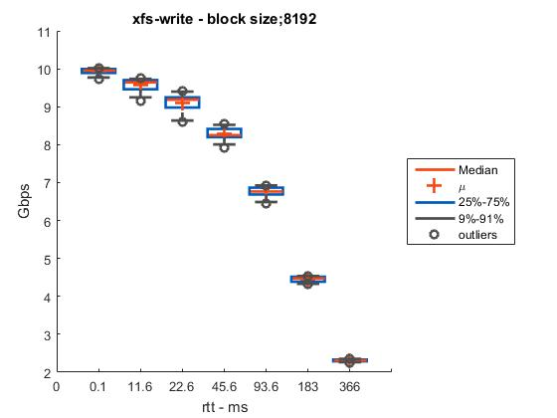
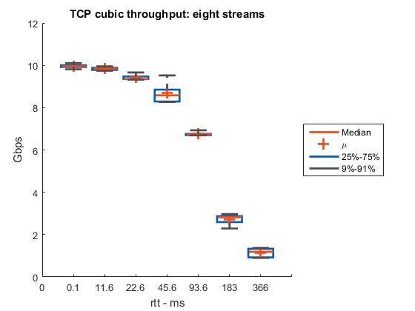
xfs file WAN transfers
Configuration: default IO
SSD connected to PCI bus: > 30Gbps IO thtoughput
network connections: 0-366 ms rtt
Throughput limited by TCP
SDN-SF orchestration module:
for default IO, chooses 8 streams for xfs transfers
- can be improved for higher rtt using direct IO for xdd

Slide 39
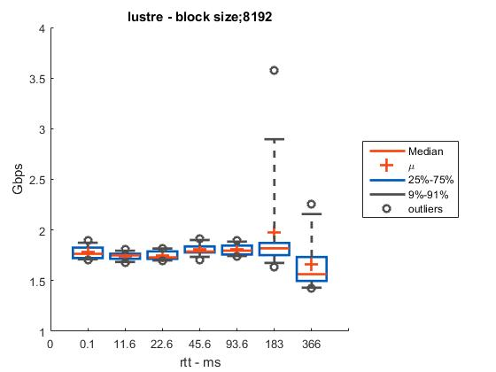
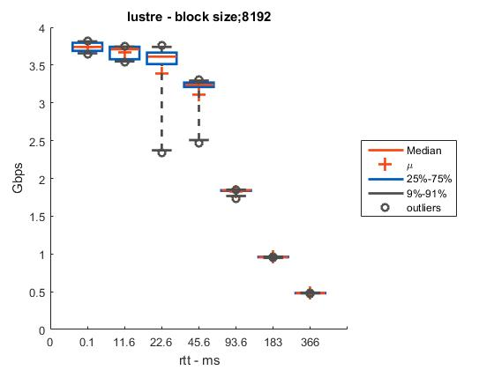
Lustre file WAN transfers
Configuration: default IO on write side
Lustre mounted over IB LAN: 8 osts
network connections: 0-366 ms rtt
8 streams
low throughput
1 stream

Slide 40
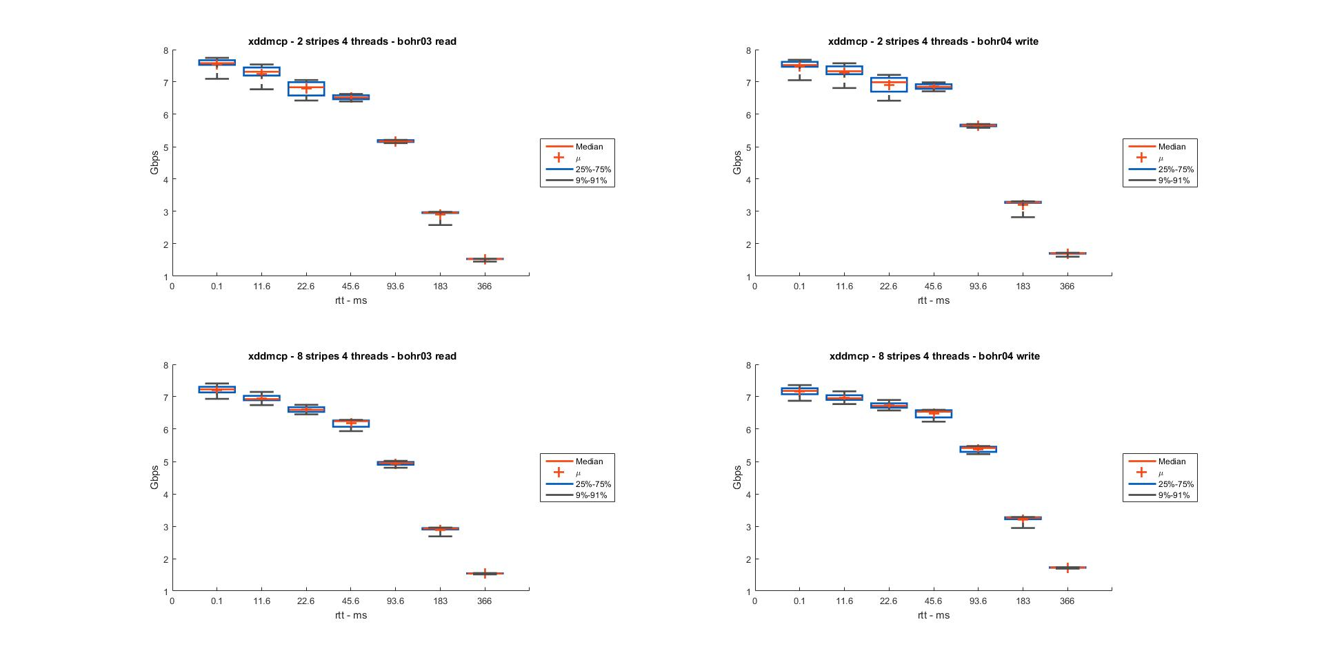
Lustre file WAN transfers: Default IO on write
Peak Throughput: 4 threads and 2 Lustre stripes
SDN/SDT extended to File IO systems can automate selection of transfer parameters: using lpaths for lustre (LANL task)

Slide 41
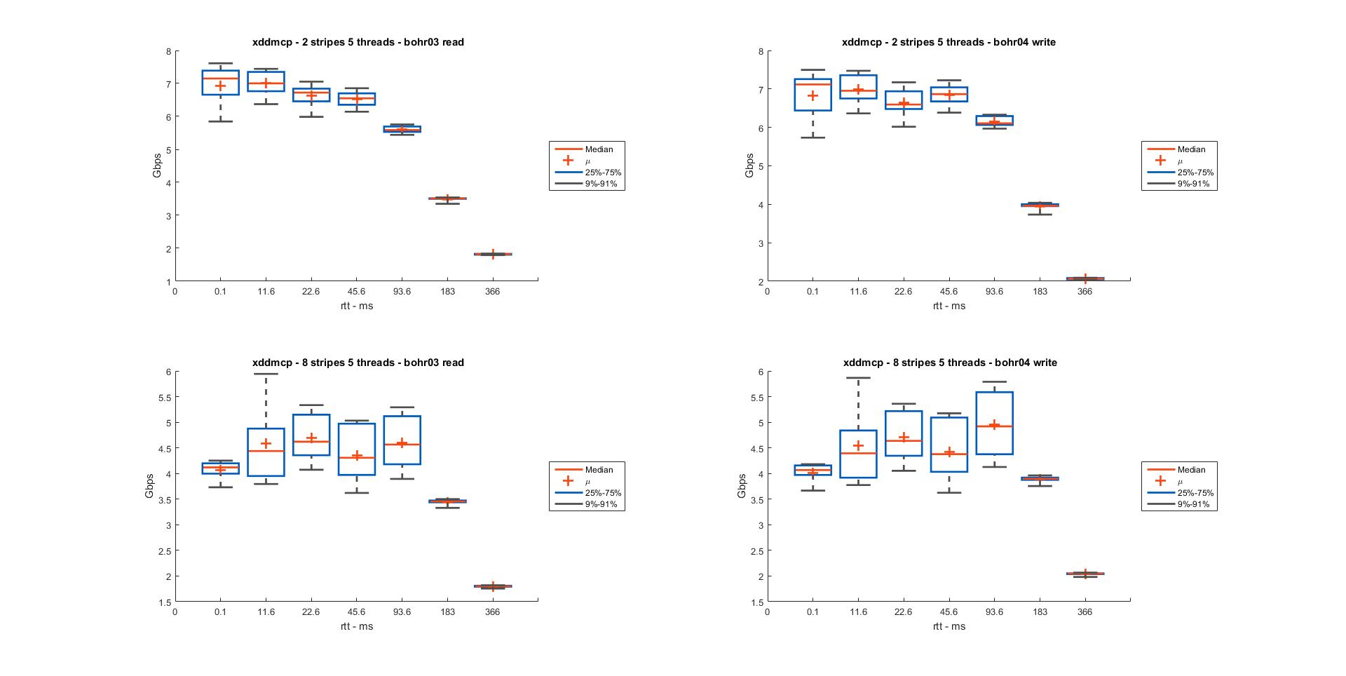
Lustre file WAN transfers: Default IO on write
Low throughput: 5 threads with 8 Lustre stripes
- usual expectation: more stipes yield higher throughput
SDN/SDT extended to File IO systems can automate selection of transfer parameters – simple adhoc rules are not sufficient

Slide 42
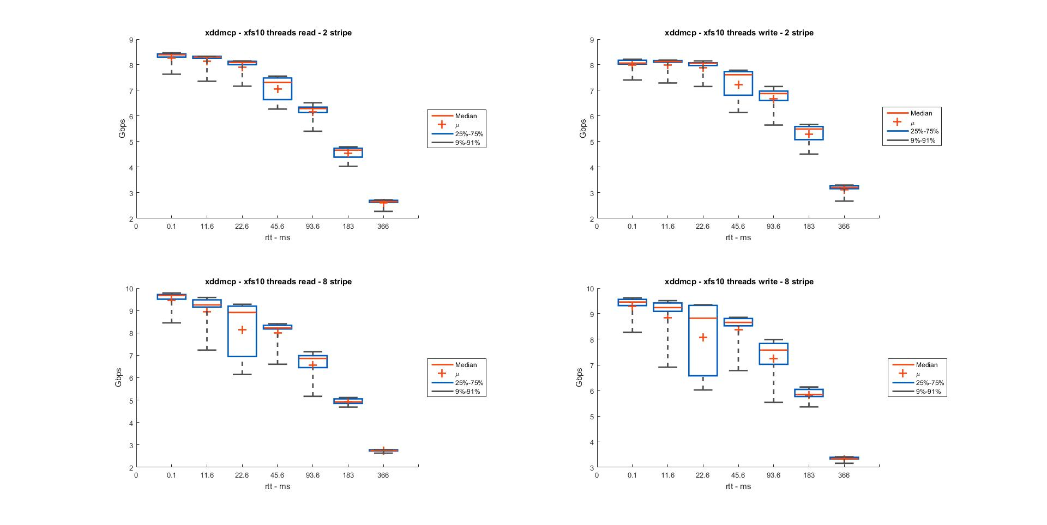
Lustre file WAN transfers: Direct IO on read and write
Highest throughput: 10 threads with 8 Lustre stripes: 9.6Gbps
- usual expectation: more stipes yield higher throughput - works for direct IO
SDN/SDT extended to File IO systems can automate selection of transfer parameters – simple adhoc rules are not sufficient

Slide 43
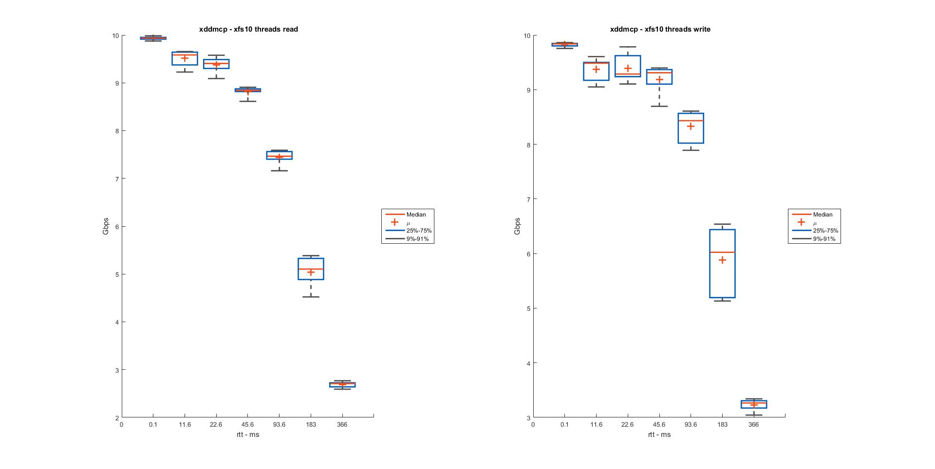
xfs file WAN transfers: Direct IO
Configuration: Direct IO
SSD connected to PCI bus: > 30Gbps IO thtoughput
network connections: 0-366 ms rtt
Throughput limited by TCP
SDN-SF orchestration module:
Chooses 10 streams and direct IO for xfs transfers using xdd

Slide 44
Impulse Response Test:
To Assess Controller Responsiveness
Host-Host TCP Throughput: Peak performance depends on:
    hosts, switches, controller, controller-app, data path
Controller Impulse Response Test: for controllers
two different controllers: opendaylight and custom-dpctl periodically degrade current data connection - impulse input
measure TCP degradation and recovery: output impulse
- narrowness of output impulse: quickness of controller response
Input: Impulse train of path disruptions:
Impulse Response: Defined as peak minus measured TCP throughput
Output Characterizations:
  desired response: small dip in TCP throughput for each disruption
  ideal output is also an impulse train:
  - narrower impulses indicate quicker TCP recovery
path disruptions: input impulse:
iperf TCP
iperf
TCP
impulse response
Developed to address “yet another SDN controller or device” phenomenon

Slide 45
Example Trace:
path switch
input
impulse train
TCP throughput loss
TCP throughput
latency increase
rtt

Slide 46
Five Test Configurations:
test configuration | controller | path degradation | switch vendor
A | dpctl | path switch | HP 5064zl
B | ODL local | path switch | HP 5064zl
C | ODL | path switch | HP 5064zl
D | ODL | rtt extension | HP 5064zl
E | ODL | rtt extension | Cisco 3064
controllers
switches
Path Degradations: introduced externally
Path switch: current path is switched to longer path using dpctl
Rtt extension: increase rtt of current path on ANUE using curl script
Controller performance comparison: A and C
Switch performance comparison: D and E
Solution performance comparison: A and E
For Official Use Only

Slide 47
Path Degradation Method 1: Path switching using dpctl
Configurations A, B, C
linux
dpctl switch
periodically switches default path to longer path
linux
workstation
OpenFlow
switch
default path
OpenFlow
switch
linux
workstation
server/client
host
server/client
host
ANUE OC192
emulator

Slide 48
Path Degradation Method 2: Extend rtt of current path using CURL script
Configurations D and E
linux
CURL script
periodically degrades rtt of current path
ANUE OC192
emulator
linux
workstation
OpenFlow
switch
OpenFlow
switch
linux
workstation
ANUE 10GigE
emulator
server/client
host
server/client
host
long-haul connection emulation

Slide 49
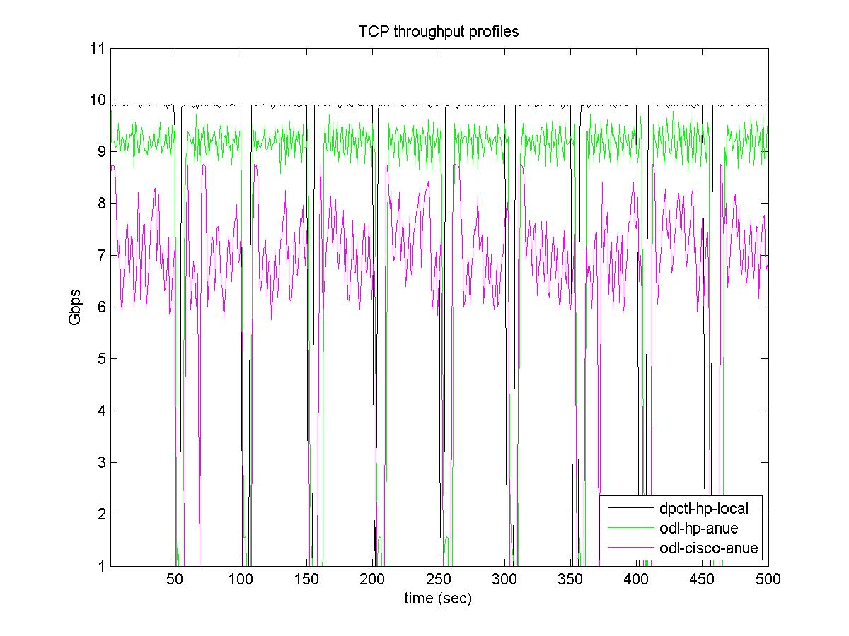
TCP Throughput Traces:
A: dpctl - HP
D: ODL - HP
E: ODL - Cisco
For Official Use Only

Slide 50
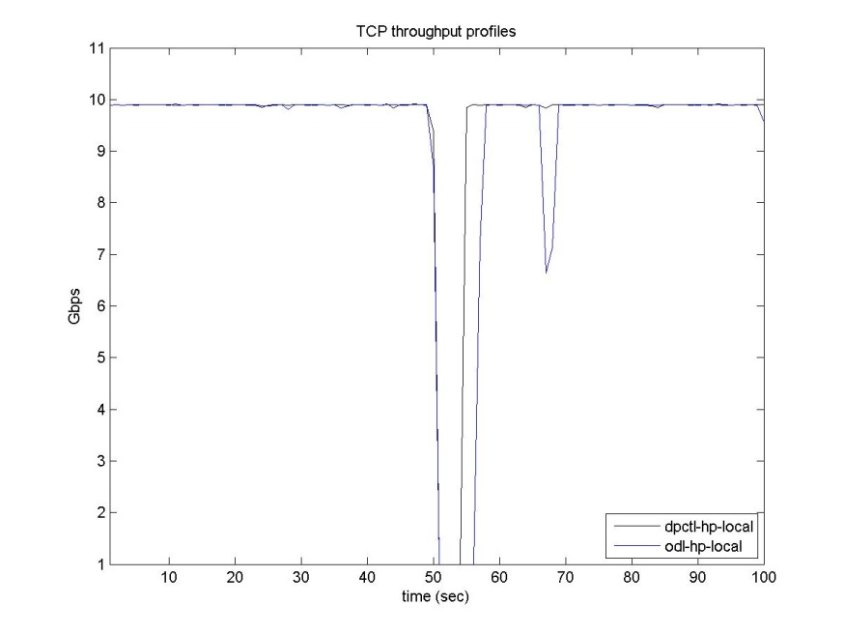
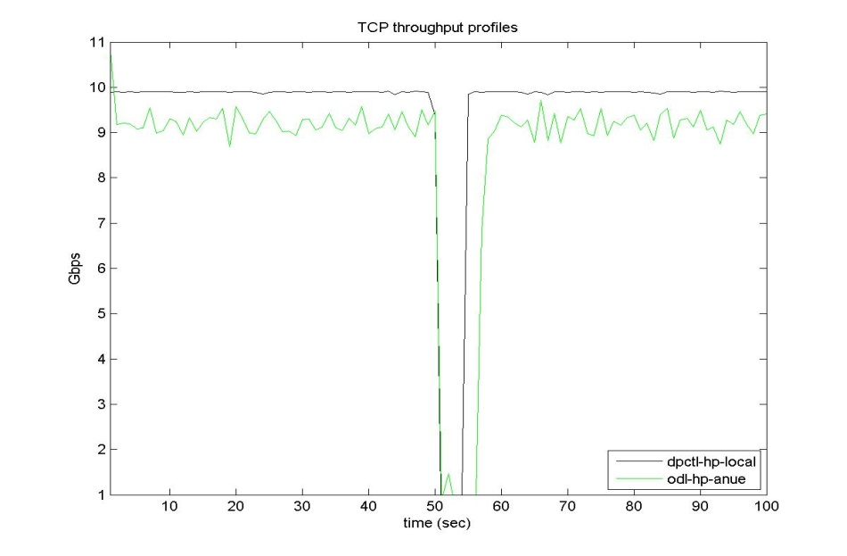
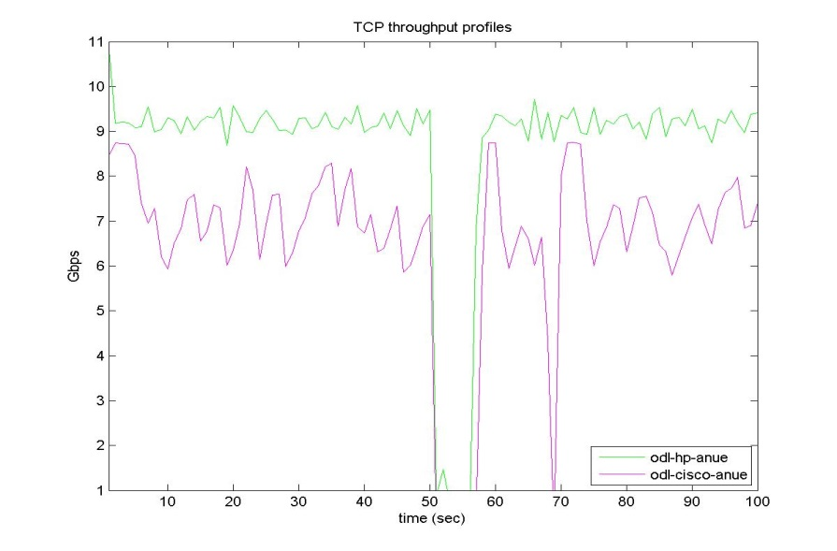
Closer Look at Throughput Recovery: Controllers and Switches
A: dpctl - HP
B: ODL- HP
Loopback throughput recovery:
Controller Performance:
dpctl is few seconds quicker
For Official Use Only
A: dpctl - HP
D: ODL - HP
E: ODL - Cisco
Throughput recovery with switches: slower than over direct connection

Slide 51
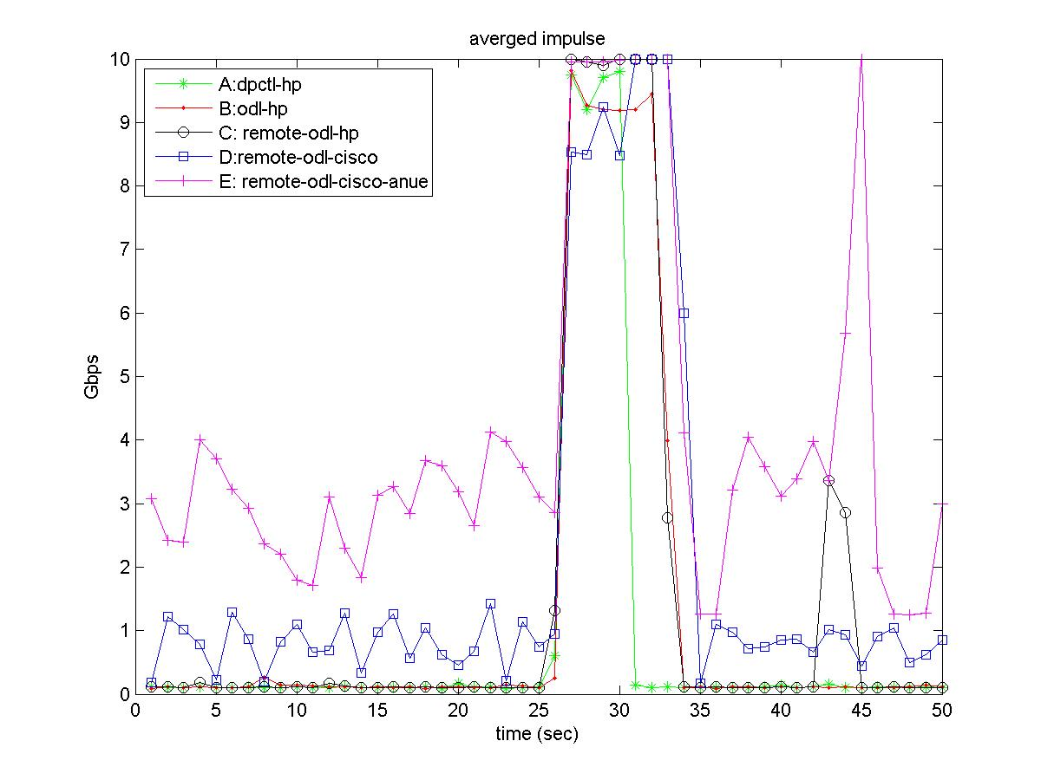
Impulse response:
A: dpctl - HP
B: ODL – HP local
controllers gap
B: ODL – HP remote
Loopback throughput recovery
switch gap
D: ODL - HP
E: ODL - cisco
throughput recovery with switches
TCP throughput:
Unrealized throughput:
Impulse Response:
to ith degradation

Slide 52
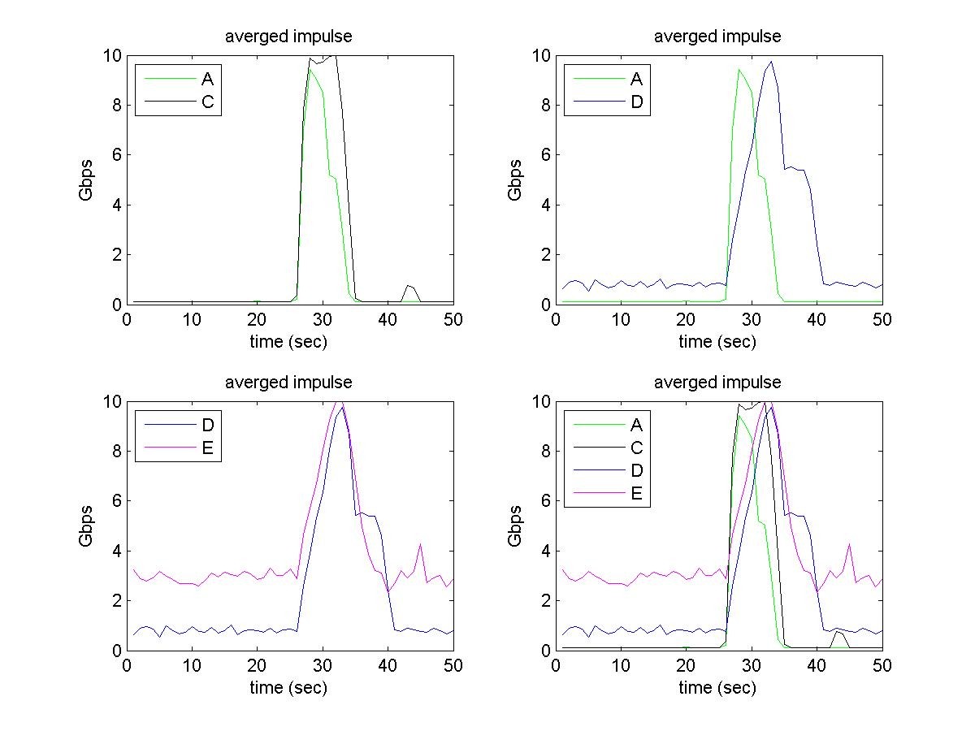
Impulse response mean:
N=10, T=50sec
Impulse response:
Response regression:
Response mean:

Slide 53
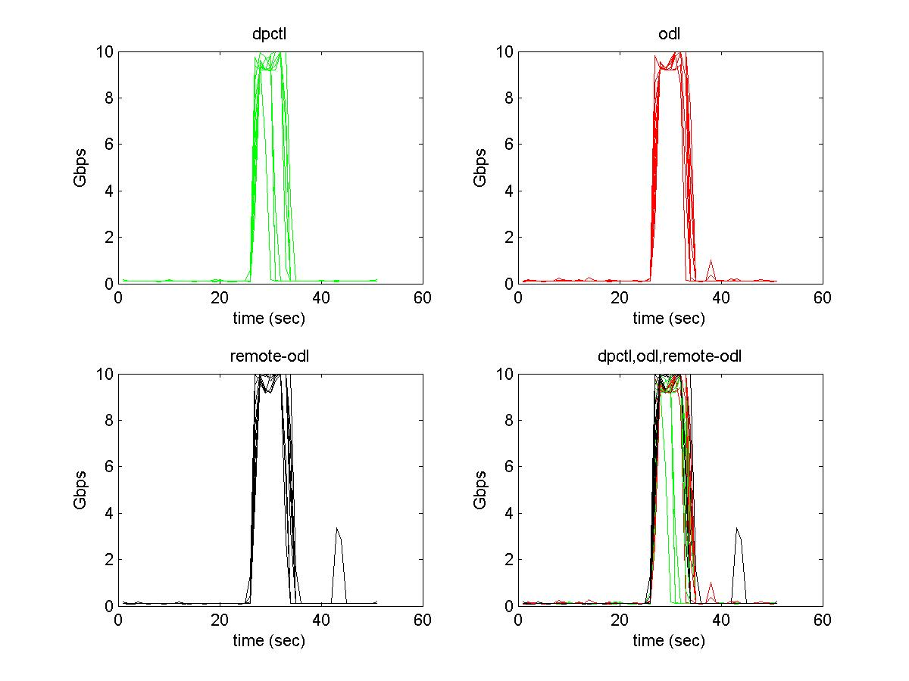
dpctl, odl, remote-odl controllers: impulse responses
10 path disruptions
Response pulses
overlaid in time
dpctl controller:
response pulses are narrower
start around same time
end earlier

Slide 54
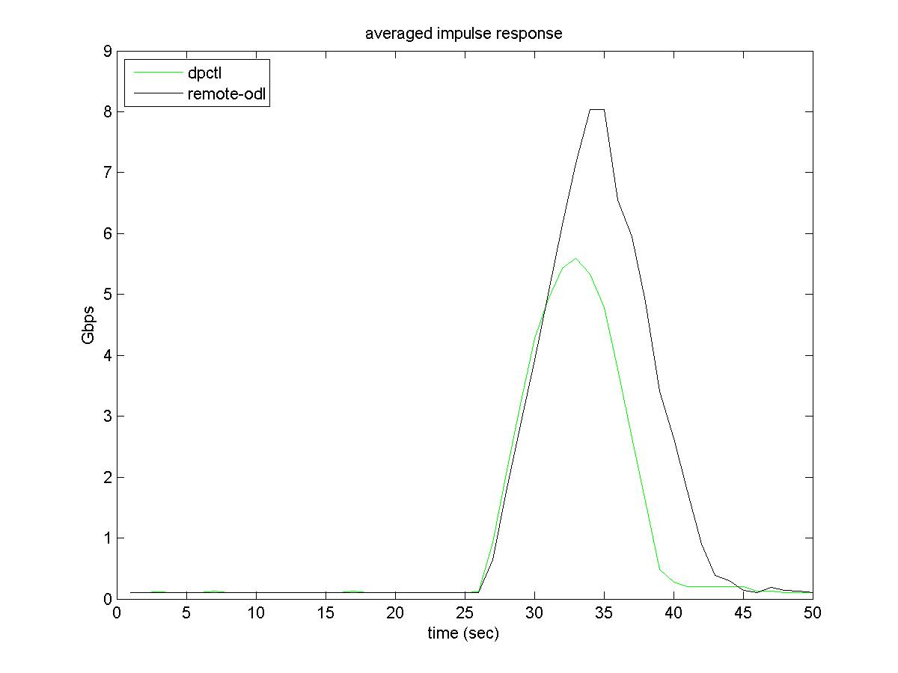
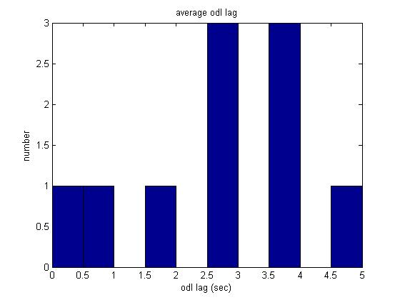
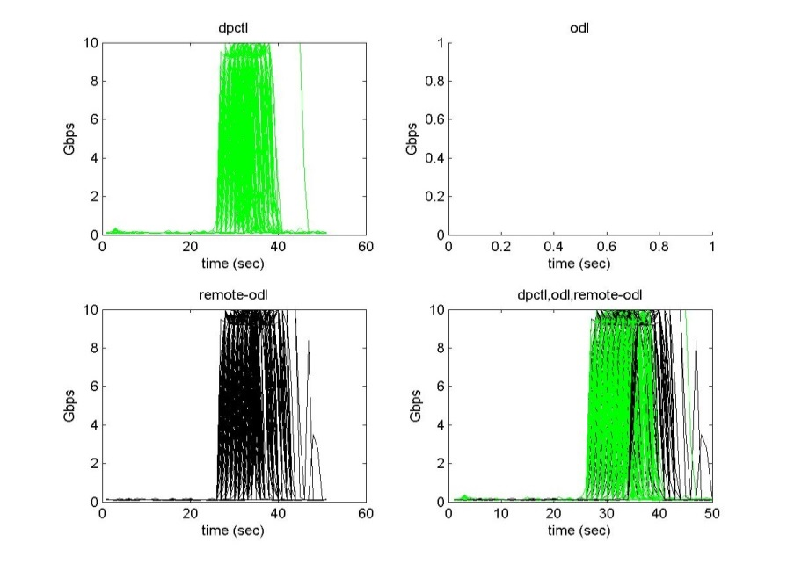
Response means of dpctl and ODL controllers: A and C
100 path disruptions
remote-odl controllers
lag histogram
lag:
0-5 sec
100 impulse
responses
Remote-odl controller: output pulses:
start same time
lag in trailing edge up to 5sec

Slide 55
Statistical Analysis:
Generic impulse regression estimate:
for estimator function g
Estimator f is composed of :
degradation function
recovery function
Expected error of estimator f
Empirical error of estimator f

Slide 56
Response mean is a good approximation of impulse regression:
Statistical Justification
Best expected estimator:
Best empirical estimator:
Response mean is a best empirical estimator:
Using Vapnik-Chervonenkis theory, we have
Response mean approaches best expected estimator with more measurements

Slide 57
Conclusions
Presented SDN-SF Project Overview
Technical Areas: End systems and sites:
  instruments, storage and IO, computing nodes
  site LANs up to border
DOE wide effort:
  Joint between ANL, BNL, LANL and ORNL
  Collaboration with Esnet for WAN
Very interested in collaborations: Technical areas, deployments and testing
Major challenges to Overall SDN/SDI areas
Technologies are in flux: too much turn over
  – flaky software with limited documentation and testing
  very limited performance testing
  too much push from vendors
Concern about security and vulnerabilities: Sites are unsure about deployments
ODL website – new ones published
Cumulus Linux – recent hacks
  Sites are need to be sure before deploying them
Useful compehensive SDN reference: Kreutz et al, Proceedings of IEEE 2015

Slide 58
Thank You

