Slide 1
SDN-SF: Software Defined Network Science Flows
Dantong Yu
Dimitrios Katramatos
Brookhaven National Laboratory

Slide 2
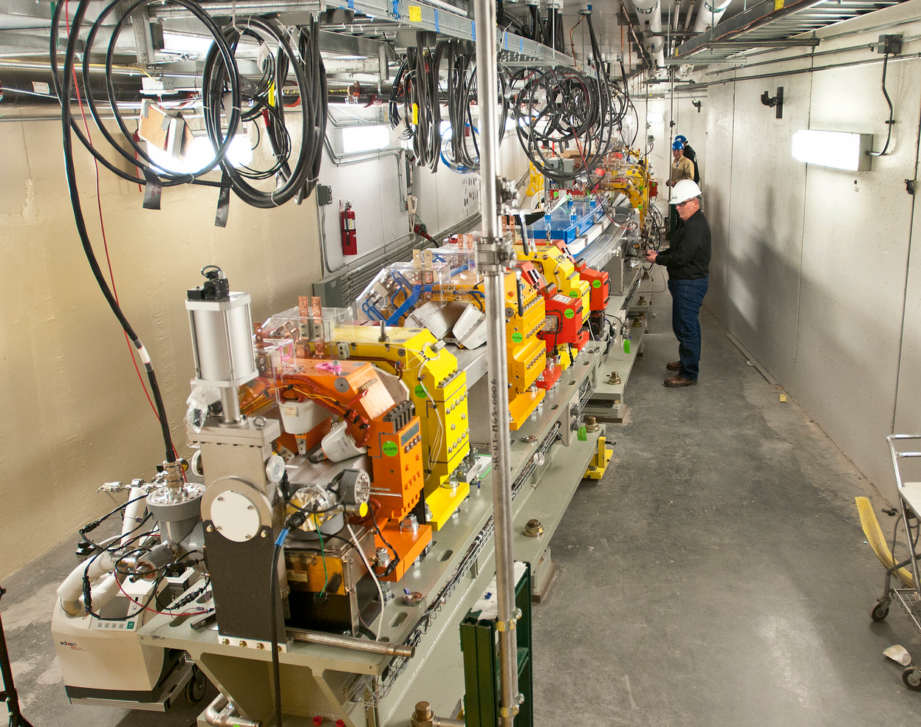
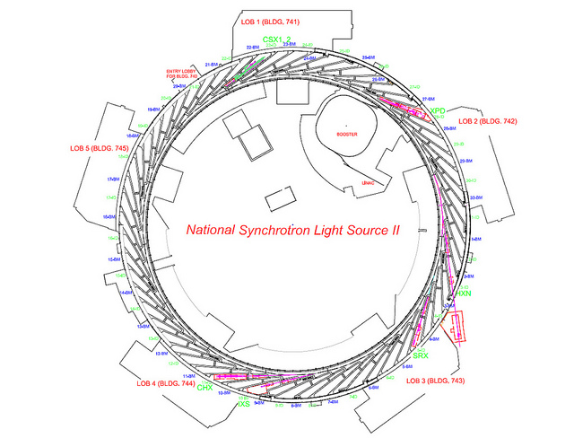
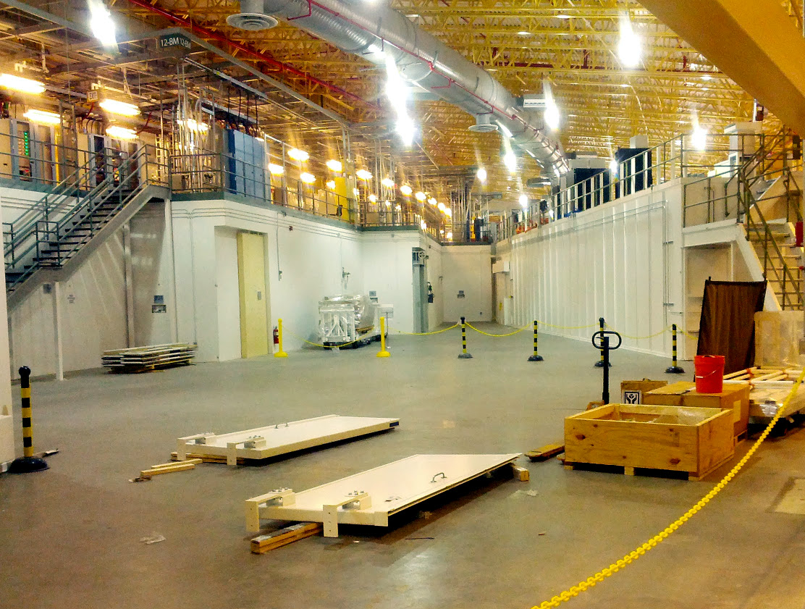
Motivation Use Case
NSLS-II
$912M
791 m circumference
58 beam ports
3 GeV, 500 mA
Each x-ray beam is ~10¹³ ph/s

Slide 3

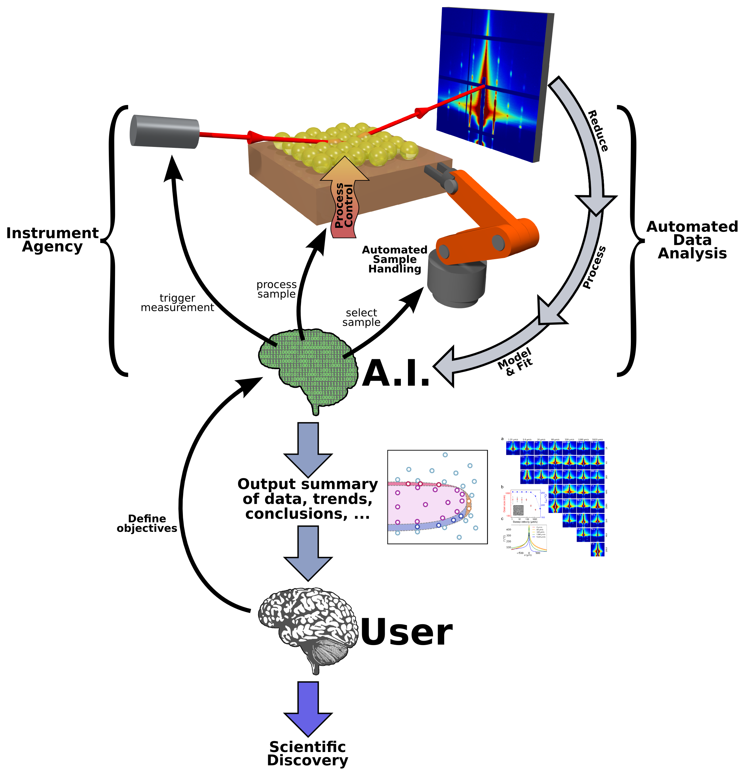
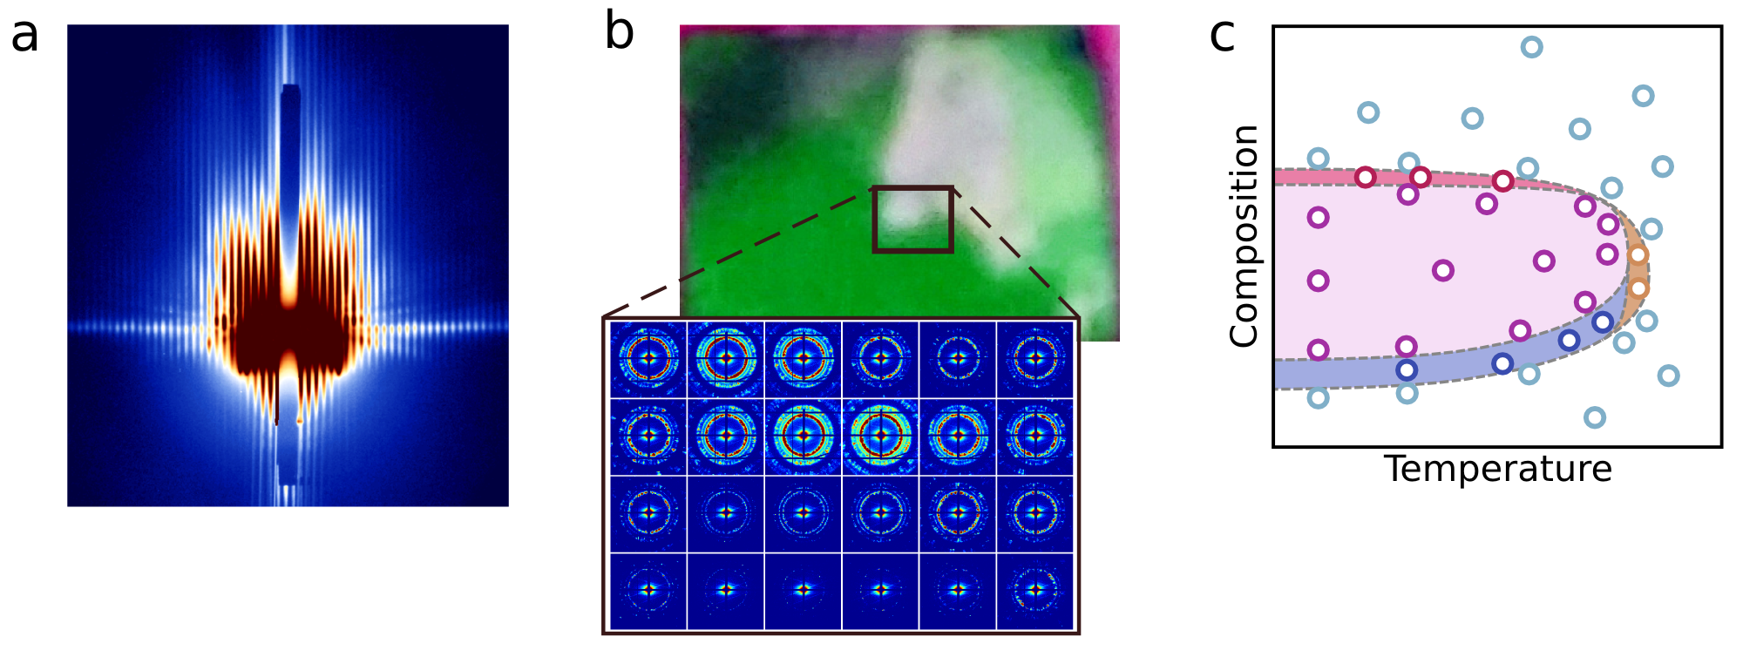
Motivation
Modern scientific experiments generate massive amounts of data
NSLS-II beamlines study materials from many perspectives: Complex, multi-component, hierarchical materials, Diffraction, scattering, coherence experiments, Structure & dynamics across many scales
X-ray scattering generates various ‘images’ that can be analyzed using machine-learning
Complex data infrastructure consumes scientists’ precious time, distracting from deep scientific questions
SDN promises a predictable network substrate to support data streaming from experimental facility to on-site data center and remote user home institution.

Slide 5
SDN-SF (with OSCARS/IDC)
Network provisioning with dedicated virtual paths
2
SDN-SF/OpenFLow
1
3
SDN-SF/OpenFLow
OSCARS/SENOS services
WAN

Slide 6
Data Transfer Tool Integration
Integration of SDN-SF with data transfer tools
Application
1
2
Network-Aware
Data Transfer Tool
Network-Aware
Data Transfer Tool
control flow
3
4
SDN-SF/OpenFlow
SDN-SF/OpenFlow
5
IDC (OSCARS/SENOS)
data flow
WAN

Slide 7
User Case Analysis
BES facilities
  Remote Data Analysis
  Experimental Data need to be moved to computing sites for reconstruction/analysis and experiment steering decision (more demanding), i.e., LCLS ➔ NERSC ➔ LCLS
  Network is a key component of BES infrastructure
  SDN-SF will enable data sharing among BES facilities.

Slide 8
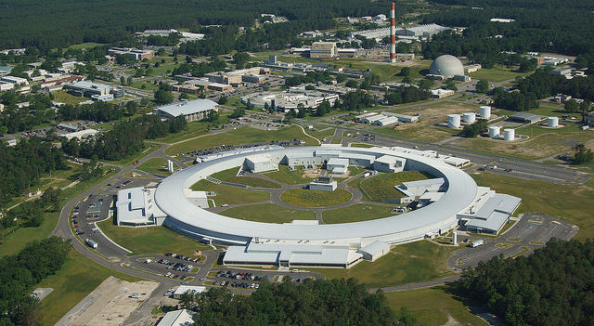
Potential Distributed Workflow can be supported by SDN-SF
ORNL
ANL
LBNL (NERSC)
ESnet
BNL

Slide 9
BNL Research Tasks:
Test, Evaluate and integrate Long-Haul Network with ESNet/SENSE (ENOS).
  Application agnostic Multi-domain circuit stitching LAN⬄WAN⬄LAN.
  Free applications from manipulating and directly controlling, steering network traffic, and dedicating these tasks to network routers.
Work within the project and across project to test and evaluate OpenSM/OpenFLow-enabled Software Defined Storage Area Network (SD-SAN) with iSCSI (tgtr)

Slide 10
BNL Testbed for SDN-SF
ESnet
2x100G
BNL perimeter
2x100G
SDMZ network
10G
dynamic circuit capable
legacy testbed
4x40G
qtr1
2x10G
sdmz-sw
10G
10G
SDN-sw
8x1G
netmaster
2x10G
1G
mgt
1G
netdtn
1G
qtr2
mgt
1G
mgt
mgt

Slide 11
BNL 3-year plans (Y1)
Establish dedicated OpenFlow-capable testbed
Focus on on-demand long-haul network configuration
  Development: Orchestrator interface to WAN controller and peering orchestrator
    Initially interfacing module for OSCARS based on known APIs and prior experience
    Closely follow/collaborate with ESnet’s ENOS effort
  Deployment: Deploy OpenFlow/ODL in local testbed infrastructure

Slide 12
BNL 3-year plans (Y2)
Focus on advanced reservations
Study NSLS-II-specific workflow requirements
Design/implement application specific API and communication module to accommodate data streams from experiment to computing site(s)
Continue development of interfaces with ESNet/WAN depending of progress of related projects (ENOS/OSCARS)

Slide 13
BNL 3-year plans (Y3)
Deployment of software stack (NSLS-II workflow software/orchestrator/controller) in our OpenFlow testbed
Testing transferring experiment data from Science DMZ to our testbed facilities/other facilities

