Slide 1
Discussion slides
Dual-Phase ProtoDune
25/2/2016

Slide 2
General requirements and architecture

Slide 3
Double phase liquid argon TPC
6x6x6 m3 active volume
Event size: drift window of
7680 channels x 10000 samples = 146.8 MB
X and Y charge collection strips
3.125 mm pitch, 3 m long
7680 readout channels
Segmented anode
In gas phase with double-phase amplification
3 m
E=0.5 kV/cm
Drift coordinate
6 m = 4 ms
sampling 2.5 MHz
(400 ns), 12 bits
10000 samples
per drift window
LAr volume
Drift
dE/dx → ionization
Prompt UV
light
6 m
6 m
Cathode
Photomultipliers
3

Slide 4
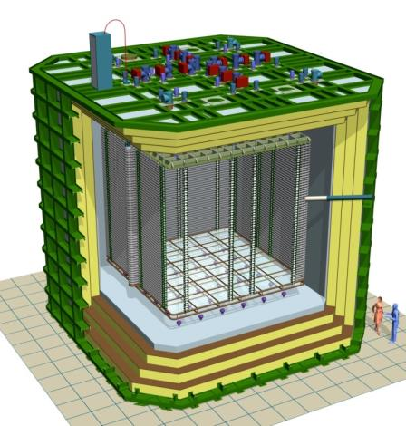
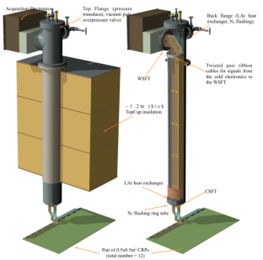
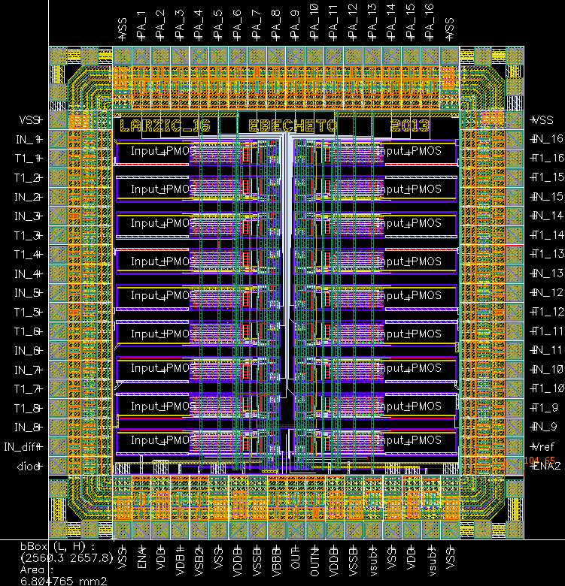
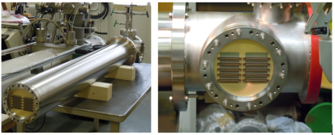
Accessible cold front-end electronics and uTCA DAQ system
Full accessibility provided by the double-phase charge readout at the top of the detector
Digital electronics at warm on the tank deck:
Architecture based on uTCA standard
1 crate/signal chimney, 640 channels/crate
→ 12 uTCA crates, 10 AMC cards/crate, 64 ch/card
Cryogenic ASIC amplifiers (CMOS 0.35um) 16ch externally accessible:
Working at 110K at the bottom of the signal chimneys
Cards fixed to a plug accessible from outside
→Short cables capacitance, low noise at low T
Warm
ASICs 16 ch.
(CMOS 0.35 um)
uTCA crate
Cold
CRP
Signal chimney
4

Slide 5
Dual phase ProtoDUNE detector characteristics:
- Two views with 3.125 mm pitch → 7680 channels
Long drift 4 us → 10000 samples at 2.5 MHz
High S/N~100
All electronics at warm, accessible
Costs minimization, massive use of commercial large bandwidth standards in telecommunication industry, uTCA, Ethernet networks, massive computing
Easy to follow technological evolution, benefit of costs reduction and increase of performance in the long term perspective
Non-zero suppressed data flow handled up to computing farm back-end which is taking care of final part of event building, data filtering, online processing for data quality, purity, gain analysis, local buffer of data and data formatting for transfer to EOS storage in files of a few GBs
Signal lossless compression benefits by high S/N ratio, developed an optimized version of Huffman code reducing data volume by at least a factor 10
Timing and trigger distribution scheme based on White Rabbit (became commercial hardware too); thought since the beginning for a beam application (handles beam window signals, beam trigger counters, external trigger counters for cosmics) → Components of the timing chain purchased and uTCA slave card for signal distributions on crates backplane developed

Slide 6
FE based on microTCA standard and 10 Gbit/s ethernet
→ 120 uTCA digitization boards under production for the 6x6X6 since the end of last year, will be available this summer
Light readout fully integrated in charge readout uTCA scheme and with different operation modes in-spill out-spill
Back-end actually based on two commercial Bittware cards (already purchased) with x8 10 Gbit links with high computing power and event building capabilities. Each card performs event building for ½ of the detector charge readout, one card deals with light signals too
Online storage and computing facility is an important part of the system, a possible implementation has been designed and costed with DELL, it will be implemented on a smaller scale for the 3x1x1 by September 2016
20 Gbit/s data link foreseen for data transfer to computing division

Slide 7
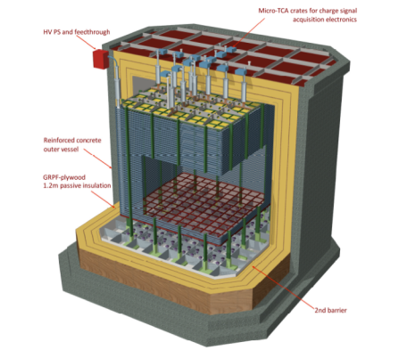
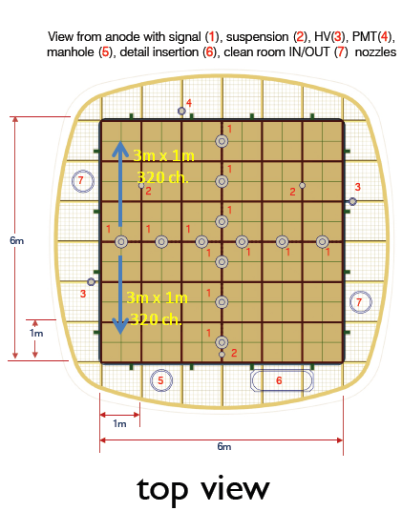
uTCA charge readout architecture
uTCA crates
640 channels/chimney
1 uTCA crate/chimney, 10 Gb/s link
10 AMC digitization boards per uTCA crate, 64 readout channels per AMC board
→ 12 uTCA crates for charge readout + 1 uTCA crate for light readout
Readout in groups of 640 channels/chimney
7

Slide 8
DAQ timing-trigger integration
Meinberg GPS
Time
White Rabbit GrandMaster
switch
WR slave MCH mezzanine
WR Clock + time + triggers
CC 1
CC 2
CC 6
CC 7
CC 12
PMC
Light readout
Charge readout
Digitized data
WR Clock + time + triggers
Data processing PC 1
Data processing PC 2
Trigger PC
6 10 GbE links + 2 spares
7 10 GbE links + 1 spares
WR slave trigger board
Beam window
NIM signal every 20 s
Time
Cosmics counters
Bittware card 1
Bittware card 2
Beam Trigger counter
NIM signal ~ a few 100 Hz
8
8

Slide 9
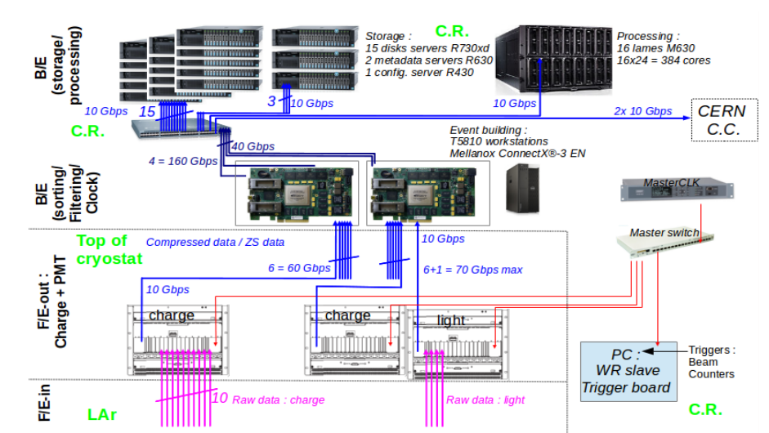
C.R. stands for Counting Room

Slide 10
Front-end electronics

Slide 11
uTCA charge readout architecture
uTCA crates
640 channels/chimney
1 uTCA crate/chimney, 10 Gb/s link
10 AMC digitization boards per uTCA crate, 64 readout channels per AMC board, memory buffer 12228 samples/channel
→ 12 uTCA crates for charge readout + 1 uTCA crate for light readout
Readout in groups of 640 channels/chimney
11

Slide 12
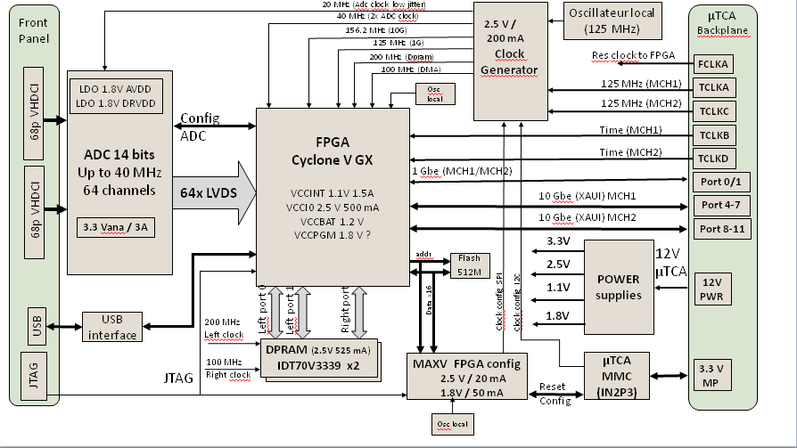
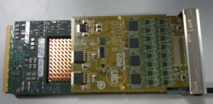
Prototype of the 64 channels AMC digitization card (2.5-25 MHz, 12 bits, 2V, AD5297) hosted on Bittware S4AM, 10 GbE output on uTCA backplane

Slide 13
Typical event signature for ground surface Liquid Ar TPC operation
drift
The « belt conveyor » effect
+- 4 ms around the beam trigger time
t=beam trigger - 2 ms
t=beam trigger → reconstructed event
drift
t=beam trigger
t=beam trigger + 2 ms
reconstructed event
13

Slide 14
During spills it is needed a continuous digitization of the light in the +-4 ms around the trigger time (the light signal is instantaneous and keeps memory of the real arrival time of the cosmics)
→ Sampling can be coarse up to 400 ns just to correlate to charge readout
→ Sum 16 samples at 40MHz to get an effective 2.5 MHz sampling like for the charge readout
The LRO card has to know spill/out of spill
Out of spill it can define self-triggering light triggers when “n” PMTs are over a certain threshold and transmit its
time-stamp over the WR

Slide 15
DAQ timing-trigger integration
Meinberg GPS
Time
White Rabbit GrandMaster
switch
WR slave MCH mezzanine
WR Clock + time + triggers
CC 1
CC 2
CC 6
CC 7
CC 12
PMC
Light readout
Charge readout
Digitized data
WR Clock + time + triggers
Data processing PC 1
Data processing PC 2
Trigger PC
6 10 GbE links + 2 spares
7 10 GbE links + 1 spares
WR slave trigger board
Beam window
NIM signal every 20 s
Time
Cosmics counters
Bittware card 1
Bittware card 2
Beam Trigger counter
NIM signal ~ a few 100 Hz
15
15

Slide 16
Back-end

Slide 17
DAQ timing-trigger integration
Meinberg GPS
Time
White Rabbit GrandMaster
switch
WR slave MCH mezzanine
WR Clock + time + triggers
CC 1
CC 2
CC 6
CC 7
CC 12
PMC
Light readout
Charge readout
Digitized data
WR Clock + time + triggers
Data processing PC 1
Data processing PC 2
Trigger PC
6 10 GbE links + 2 spares
7 10 GbE links + 1 spares
WR slave trigger board
Beam window
NIM signal every 20 s
Time
Cosmics counters
Bittware card 1
Bittware card 2
Beam Trigger counter
NIM signal ~ a few 100 Hz
17
17

Slide 18
8 10 Gbit links, high computing power in FPGA,
OPENCL programming, event building

Slide 20
C.R. stands for Counting Room

Slide 21
Trigger and timing

Slide 22
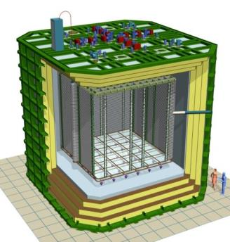
DAQ timing-trigger integration
uTCA crate of LRO
x12 Charge readout WR links
Trigger counter
Cosmic muon
Start of spill signal (cable)
External trigger plane
for cosmics
Light
Crate with NIM logic
PMTs
for light readout
PC with WR time stamping card
Time stamps:
Beam trigger
Start of spill
External cosmic trigger
Calibration pulses
Light readout WR link
WR switch
(optical links 1 Gbps)
Beam triggers from SPS
Tertiary beam line ~100Hz

Slide 23
White Rabbit developed for the synchronization of CERN accelerators chain offers sub-ns synchronization over ~10 km distance, based on PTP + synchronous ethernet scheme previously developed in 2008 (http://arxiv.org/abs/0906.2325)
White Rabbit chains can be now set up with commercial components:
Network based on Grand Master switch
Time tagging cards for external triggers
Slave nodes in piggy back configuration to interface to uTCA
Transmission of synchronization and trigger data over the WR network + clock
Slave uTCA nodes propagate clock + sync + trigger planes on the uTCA backplane so that the FE digitization cards are aligned in sampling, know absolute time and can compare it with the one of transmitted triggers
FE knows spill time and off spill time and can set up different operation modes
Trigger timestamps may be created by beam counters, cosmic counters, light readout system in uTCA

Slide 24
DAQ timing-trigger integration
Meinberg GPS
Time
White Rabbit GrandMaster
switch
WR slave MCH mezzanine
WR Clock + time + triggers
CC 1
CC 2
CC 6
CC 7
CC 12
PMC
Light readout
Charge readout
Digitized data
WR Clock + time + triggers
Data processing PC 1
Data processing PC 2
Trigger PC
6 10 GbE links + 2 spares
7 10 GbE links + 1 spares
WR slave trigger board
Beam window
NIM signal every 20 s
Time
Cosmics counters
Bittware card 1
Bittware card 2
Beam Trigger counter
NIM signal ~ a few 100 Hz
24
24

Slide 26
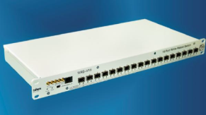
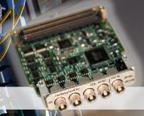
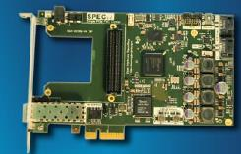
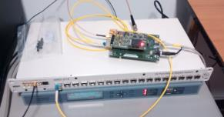
Commercial components for the WR network:
WR Grand Master Switch WRS-3/18
18 SFP fiber cages, 1GbE
Supports connections up to 10 km distance
Connected to Meimberg GPS as time source
PC time-tagging trigger board
SPEC carrier board+ Fine Delay FMC
Can time-stamp with 1ns accuracy beam trigger signals or external large area scintillator counters → Trigger time-stamps data are transmitted over the WR network to the microTCA MCH
WR-LEN (White rabbit Light Embedded Node) → WR slave node cards basis of WA105 development for a MCH WR uTCA mezzanine
FMC Fine Delay 1 ns 4 channels
SPEC FMC PCIe carrier V4
Test-bench with Meimberg + switch
+ slave node
26

Slide 27
Online storage and processing

Slide 28
Data size
Data are expected to be taken without zero skipping and exploiting loss-less compression and the system has been designed to support up to 100 Hz of beam triggers without zero-skipping and no compression
7680 channels, 10k samples in a drift windows of 4ms→ 146.8MB/events, No zero skipping
Beam rate: 100Hz
Data flow= 14.3 GB/s
Light readout does not change in a significant way this picture (<0.5 GB/s)
Integrated local DAQ bandwidth on the “20 GB/s scale”
1 day of data ~ 1000TB (no zero skipping, no compression) (assuming 50% beam duty cycle + contingency)
Huffman lossless compression can reduce the non-zero-skipped charge readout data volume by at least a factor 10 (S/N for double phase ~100:1, small noise fluctuations in absolute ADC counts)

Slide 29
Online storage and processing
Online storage
The B/E boards are hosted into Event Building Workstations transferring the data at
40 Gbps to the local storage/processing system (two links per WS)
A standard 10/40 Gbps switch is used to interconnect all these elements and to send the data to be permanently stored to the CERN EOS/CASTOR system.
The online storage/processing system fulfills the CERN requirements of a few days equivalent data storage local buffer for the experiment DAQ system.
The online processing/storage system includes 15 disks servers (Object Storage Servers – OSS, DELL R730xd for the reference design) for a total capacity of the order of 1 PB, 2 redundant MetaData Servers (MDS, DELL R630), 1 configuration server (DELL R430) and 1 processing farm (DELL M1000e with 16 M630 blades leading to 384 cores).
Final system software configuration under evaluation with data writing/access tests at the CCIN2P3 (LYON computing center), first application of a reduced scale system on 3x1x1
Software for data transfer at CERN based on IT standards EOS/CASTOR scripts

Slide 30
Typical event signature for ground surface Liquid Ar TPC operation
For each beam trigger we can have on average 70 cosmics overlapped on the
drift window after the trigger (these cosmics may have interacted with the detector in the
4 ms before the trigger and in the 4 ms after the trigger → chopped tracks, “belt conveyor” effect
Example of cosmics only event
(in one of the views)

Slide 31
DAQ timing-trigger integration
Meinberg GPS
Time
White Rabbit GrandMaster
switch
WR slave MCH mezzanine
WR Clock + time + triggers
CC 1
CC 2
CC 6
CC 7
CC 12
PMC
Light readout
Charge readout
Digitized data
WR Clock + time + triggers
Data processing PC 1
Data processing PC 2
Trigger PC
6 10 GbE links + 2 spares
7 10 GbE links + 1 spares
WR slave trigger board
Beam window
NIM signal every 20 s
Time
Cosmics counters
Bittware card 1
Bittware card 2
Beam Trigger counter
NIM signal ~ a few 100 Hz
31
31

Slide 32
C.R. stands for Counting Room

Slide 35
Offline

Slide 36
Offline and computing model:
MC production and code management actually centralized at CCIN2P3 in Lyon
Massive MC production expected at CCIN2P3 and possible other centers
6x6x6 data production at CERN and Fermilab
Software based on QSCAN (simulation/reconstruction); fast execution and easily adaptable for detector performance analysis, online monitoring and analysis :
Framework dealing with all the aspects of the detector simulation and reconstruction going from: geometry description, interface to MC transport codes like Geant3 and 4 via VMC, events generators like Genie, detector response and electronics simulation for both single and dual-phase, simulated and real events reconstruction and event display. Interface to the raw and simulated data formats for various detector setups going from several R&D prototypes to WA105 3x1x1 and 6x6x6 and the 20 and 50 kton detectors considered in the LAGUNA-LBNO design study. Allowing to understand the performance of the detectors under construction like the 3x1X1 and 6x6x6 by also comparing to the result obtained in the last 10 years with different prototypes.
3x1x1 simulation analysis and monitoring with QSCAN (September 2016)
Developing QSCAN for 6x6x6; needed for detector optimization analysis and online analysis/monitoring

Slide 37
Total data volume
WA105 TDR: 175 M triggers, to be refined once the beam simulation will be available
If totally stored in non-zero-skipped, lossless compression format
(assuming Huffman, factor 10 compression: 15MB/event) → 2.4 PB
(+ cosmic runs and technical tests)
Following discussions we had with the IT people at CERN this total data volume of 2.4 PB does not present any technical problem on the CERN and Fermilab storage facilities scale
Requested link from online-storage to CERN computing division at 20 Gbps, compatible with 100 Hz non-zero-skipped, Huffman compressed (factor 10) data flow
Existing fast link between CERN and FNAL

