Slide 1
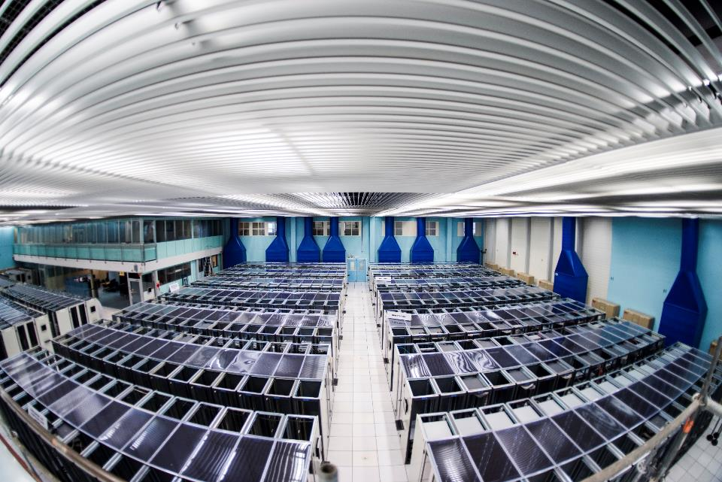
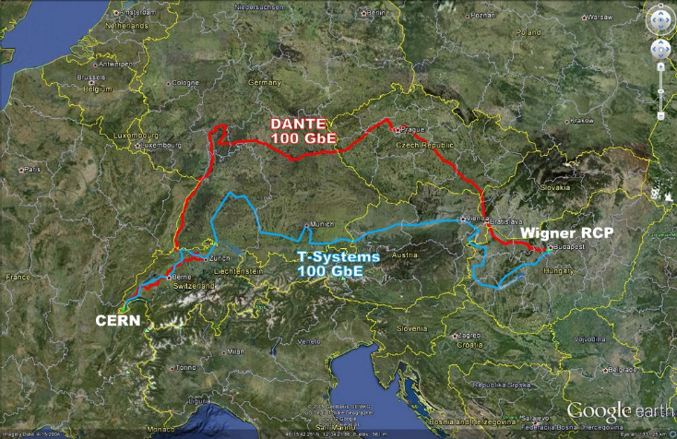
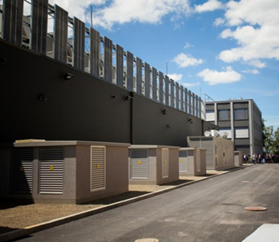
CERN Computer Centre
Meyrin centre limited in power (3.8 MW) and space.
No new building on site, but rather
remote extension via a tendering process
Wigner centre in Budapest, Hungary
Tier-0 (CERN):
Data recording
Initial data reconstruction
Data distribution
Tier-1 (12 centres + Russia):
Permanent storage
Re-processing
Analysis
WLCG
~ 160 sites, 35 countries
300000 cores
200 PB of storage
2 Million jobs/day
10 Gbps links
Split across two physical sites
Managed as one centre, not federated
Same IP address range,
transparent access to processing
and data, some optimization for locality
Tier-2 (~140 centres):
Simulation
End-user analysis

Slide 2
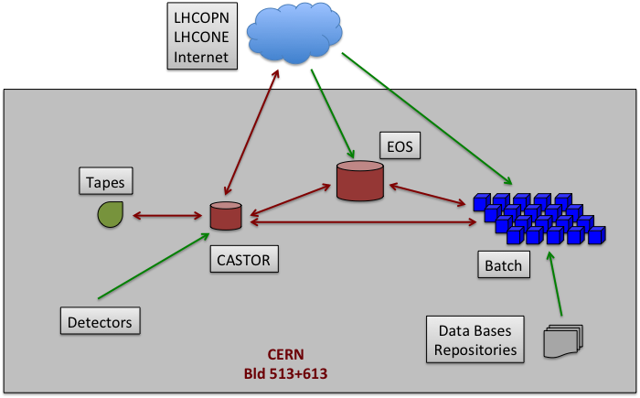
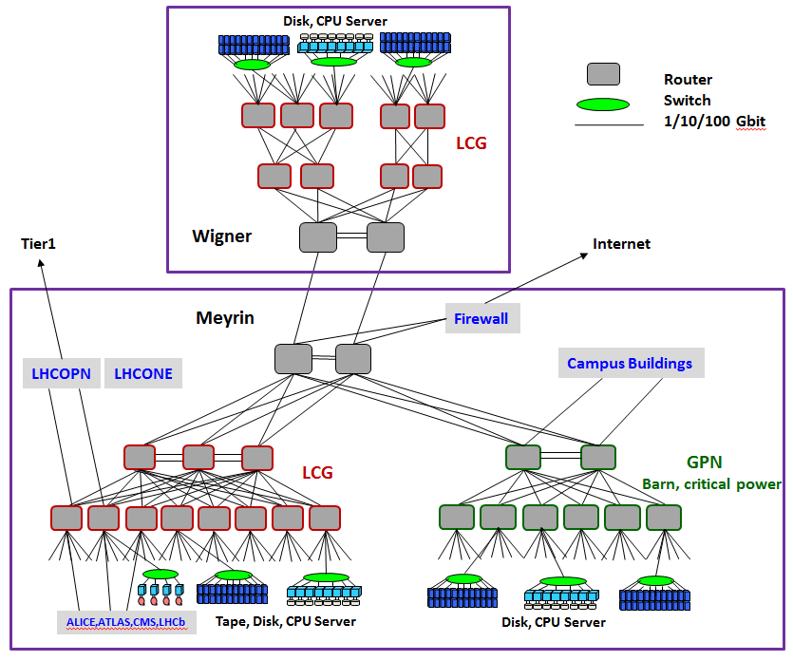
Basic Architecture and Tools
200 PB tape archive with 10 PB disk cache (Castor)
100 PB disk-only storage for processing and analysis (EOS)
7000 server virtualized processing farm (160000 cores)
(LSF batch and openstack compute)
Hierarchical Ethernet network infrastructure
https://meter.cern.ch/public/_plugin/kibana/#/dashboard/elasticsearch/Overview:%20Data%20Centre

Slide 3
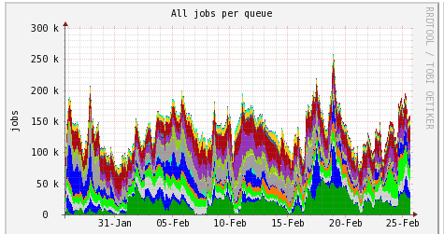
The CERN computer centre supports the 4 LHC experiments plus 50 other experiments/groups
(fixed-target, test beams, AD, Isolde, Theory, beams, etc. ) with 40000 registered users, 1500 very active users
450000 batch jobs per day
Internal CERN IO traffic [Gbytes/s],
Much higher throughput possible

Slide 4
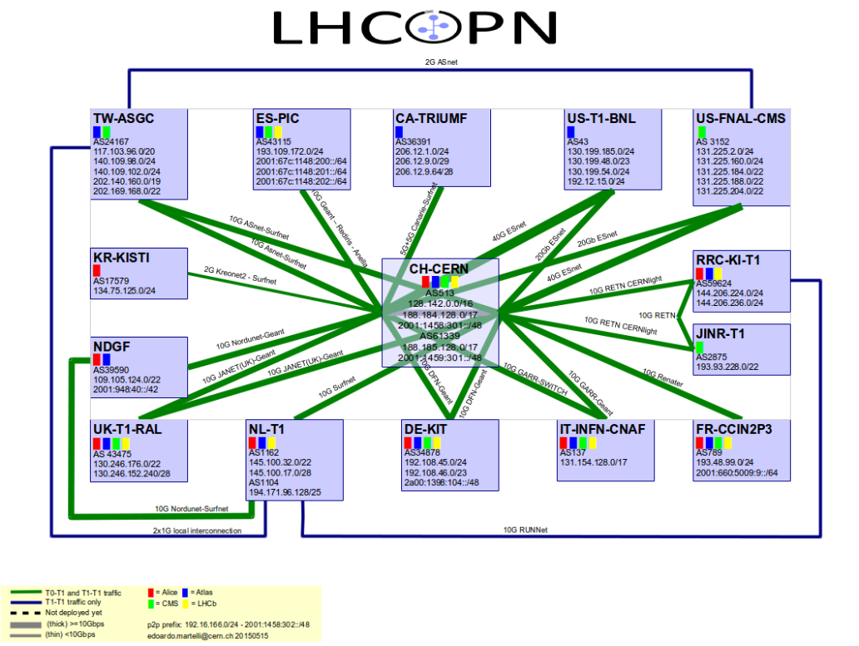
WAN Connectivity
LHC Optical Private Network
A collaborative effort
Layer3 (IP) : designed, built and operated by
the Tier0-Tier1s community
Layer1-2 (transmission) : links provided by
Research and Education network providers:
Asnet, ASGCnet, Canarie, DFN, Esnet, GARR,
Geant, JANET, Kreonet, Nordunet, Rediris,
Renater, Surfnet, SWITCH, TWAREN, USLHCnet
Plus 100 Gbit links to GEANT and ESNET

Slide 5
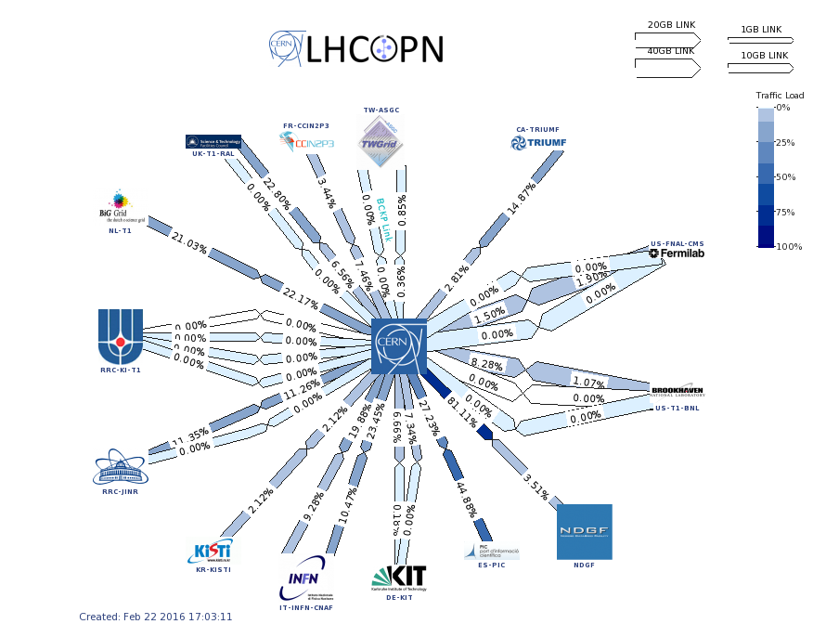
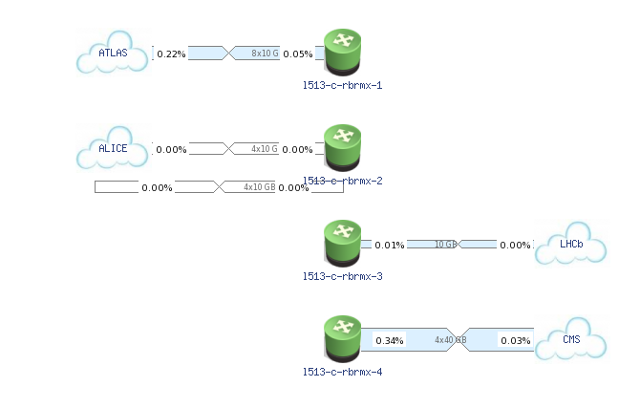
Internal links to the 4 LHC experiment
From 10 to 160 Gbits/s
Average traffic during data taking
is about 1 Gbyte/s per experiment

Slide 6
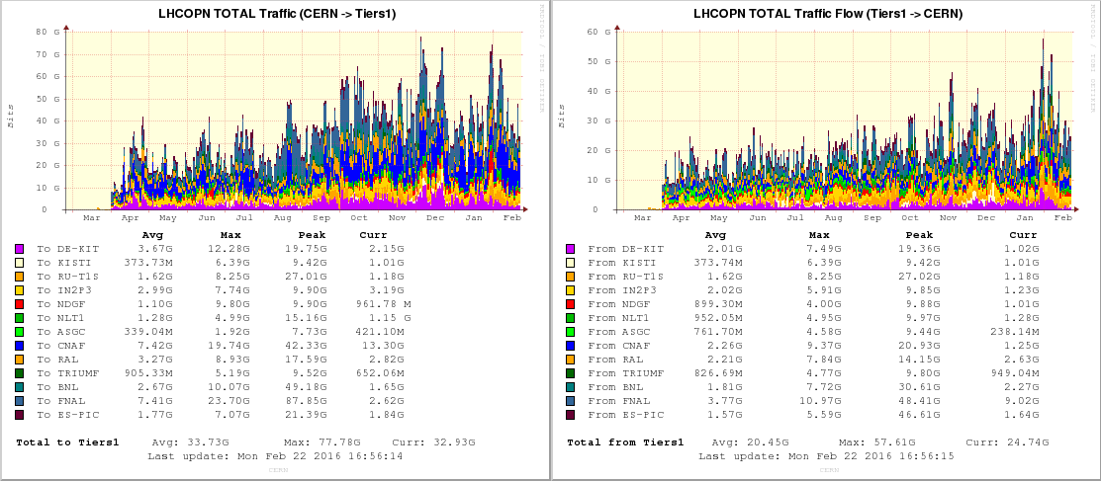
34 Gbit/s average aggregate LHC experiment traffic from CERN with 80 Gbit/s

Slide 7
There are currently no computing resources foreseen for ProtoDUNE and WA105, besides
some small amounts of processing and space capacity to get people going.
Prerequisite for the resource discussion would be a computing model or
at least a sketch of a computing model.
This is then used as the starting point for any resource calculations, the associated equipment planning
and the cost estimates.

Slide 8
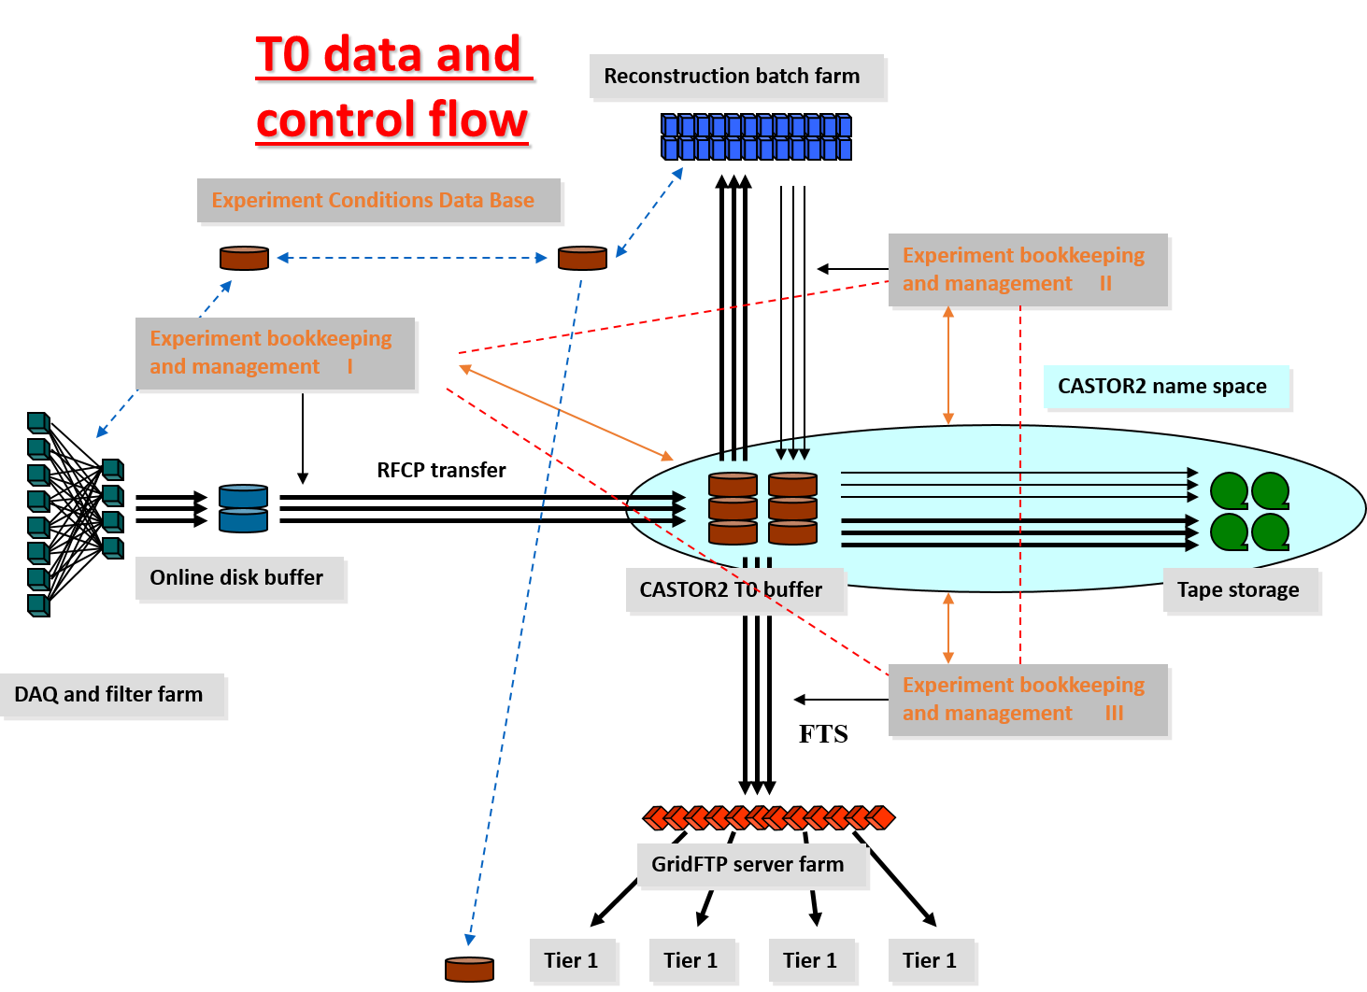
Computing Model
Establish basic parameter values:
Event size, trigger rates, derived data sizes, meta-data size,
event processing times, compression factors,
beam time,……
Derived parameters:
Network data rates, storage data rates and types,
processing capacities, storage capacities,……..
e.g. 20 Gbit/s Central-Data-Recording
Average? Sustained ? Peak ? Headroom ? per experiment ?
Concurrent ? Double for backlog ?
There are thresholds /step-functions, lead-time for expansion,
e.g. 2 Gbit is ‘background’ activity
20 Gbit requires dedicated fibre layout
Example data+meta-data
flow diagram
Architecture:
Data flow architecture
Meta-data flow architecture
Processing scheme, orchestration
Bookkeeping infrastructure
Data and meta-data formats
Interplay of data and meta-data
during data processing
…………….
Considerations: Online+offline, ‘holistic’ view, TCO,
Choices and consequences, software and hardware interplay

Slide 9
Tentative next steps:
User and experiment registration at CERN
Appointing a computing coordinator, IT contact person from the experiment
Integration into IT infrastructure (support chain, day-to-day problems reporting line, monthly Experiment-IT meeting, etc.)
Prepare a first 2-3 page computing model layout
Prepare based on the computing model a 2-3 page resource and cost model for the next 3 years
Start to build-up the resources and infrastructure
High level IT contact is Bernd Panzer-Steindel (panzer@mail.cern.ch)
Consultancy, architecture, resources and cost

