Slide 1
SNS Cryogenic Test Facility Kinney Vacuum Pump Commissioning and Operation at 2K
Presented at the
Cryogenics Workshop 2016
Brian DeGraff
SCL Systems Cryogenic Engineer
Research Accelerator Division, ORNL
October 27, 2016

Slide 2
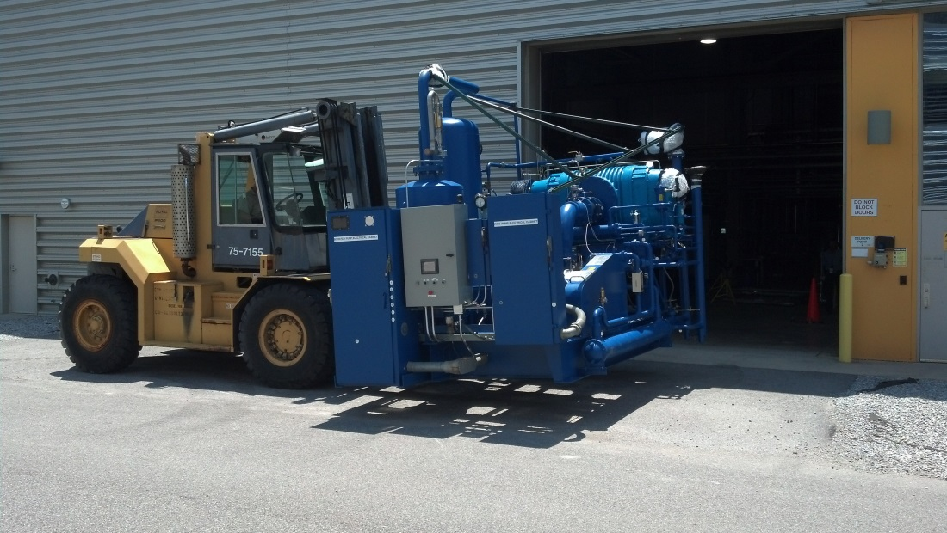
Outline
System Description
Skid Design
Skid History
Commissioning Period #1
Commissioning Period #2
Current Operations
Summary
Kinney Vacuum Pump Delivery to SNS – 2013

Slide 3
System Description
SNS began operation in 2006:
  23 cryomodules cooled to 2.1K by a Central Helium Liquefier (CHL)
  81 SRF Niobium cavities that accelerate an H⁻ beam to a design energy of 1 GeV
  Operation of the cryogenic system and cryomodule operation is the responsibility of the Superconducting LINAC (SCL) Systems group
In 2013, the Cryogenic Test Facility (CTF) was commissioned to decouple testing from main CHL:
  Cryomodule testing in the Radio Frequency Test Facility (RFTF) cave
  Dressed cavity testing in the Horizontal Test Apparatus (HTA)
  Dressed or bare cavity testing in the Vertical Test Apparatus (VTA)
  All testing in support of a robust R&D program:
    Medium-beta (MB) cavity prototyping towards spare MB cryomodule
    Plasma processing
    Proton Power Upgrade (PPU) support

Slide 4
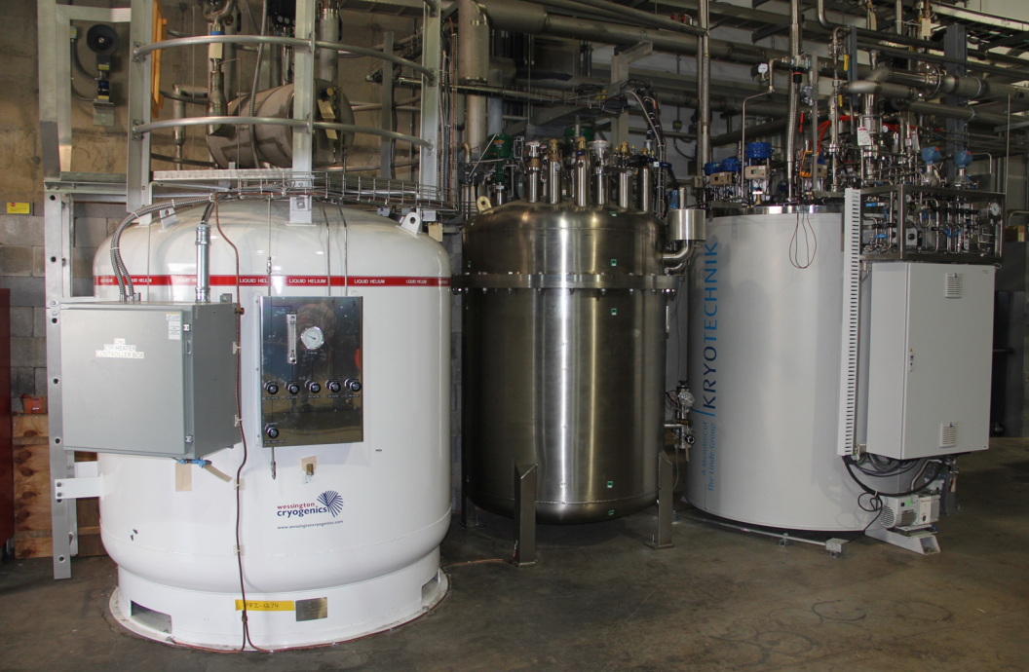
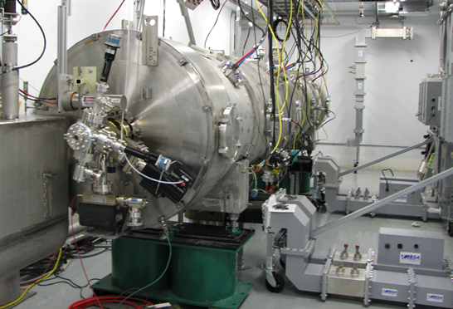
System Description
The CTF system is designed to support either 4.5K or 2K testing of cavities:
  Linde 4K cold box
  Kaiser compressor (80 g/s)
  Distribution box
  Main liquid helium dewar
  Fill station fixed dewar and filling stand
  Cryogenic transfer line to RFTF
  Oil removal skid
  Kinney vacuum pump
CTF Dewar, Distribution Box & 4K Cold Box
CM Testing in RFTF Test Cave

Slide 5
System Description
CTF Block Flow Diagram –

Slide 6
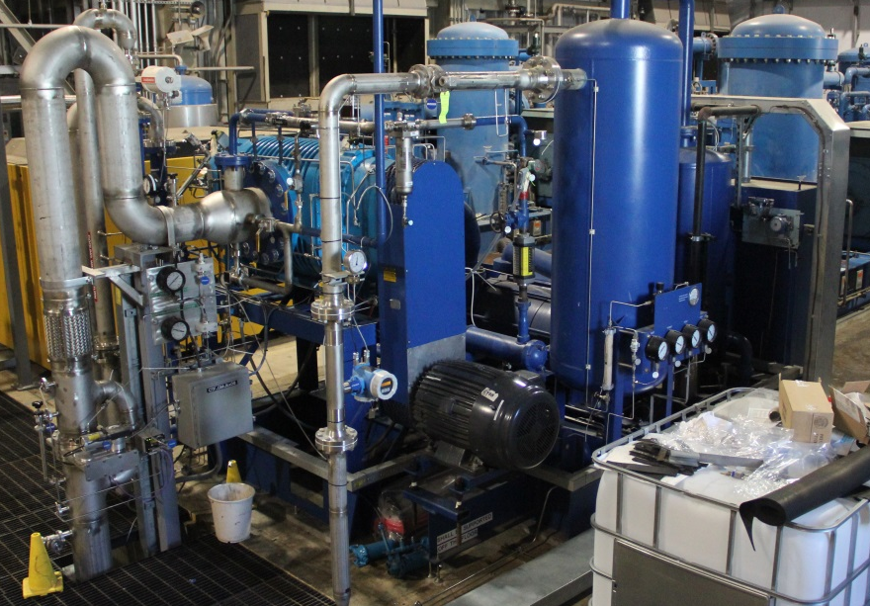
Skid Design
What is the “Kinney” pump?
  Two stage helium vacuum skid originally assembled by Kinney/Tuthill Vacuum
  Refurbished with complete controls package by Fermilab in 2012
    Custom Fermilab programmed PLC
    Staggered hardwire & analog trip settings
  First stage roots blower
    KMBD-9400
  Second stage liquid ring pump
    KLRC-2100
  Guard helium circuits
  Dynamic shaft seals
  Oil pump for primary oil circuit
  Bulk oil separation on skid
  ICW cooling for oil and process circuits
SNS Kinney Pump

Slide 7
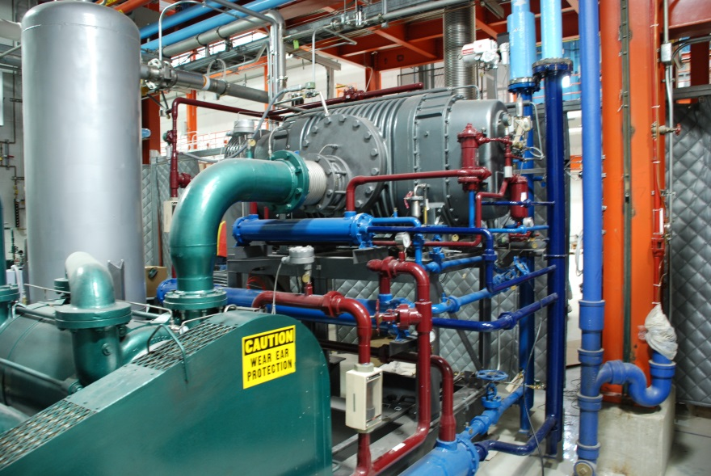
Skid History
Skids originally designed in 1993
  Never were operated
Fermilab improved the operation of this style skid:
  MDB Kinney skid started in 2006
  NML Kinney skid started in 2009
  CMTF Kinney skid started in 2016
  Helium guard circuits added (all)
  Controls and hardware upgrades (all)
SNS acquired skids from JLAB
  Sent to Fermilab in 2012 for similar hardware and controls upgrades
  Received back from Fermilab in 2013
  Piping and integration into CTF system complete in 2014
NML Kinney Pump – Fermilab

Slide 8
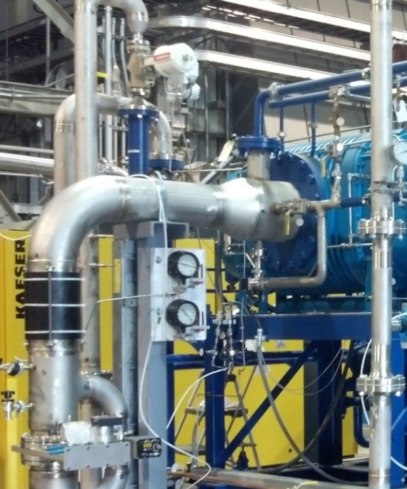
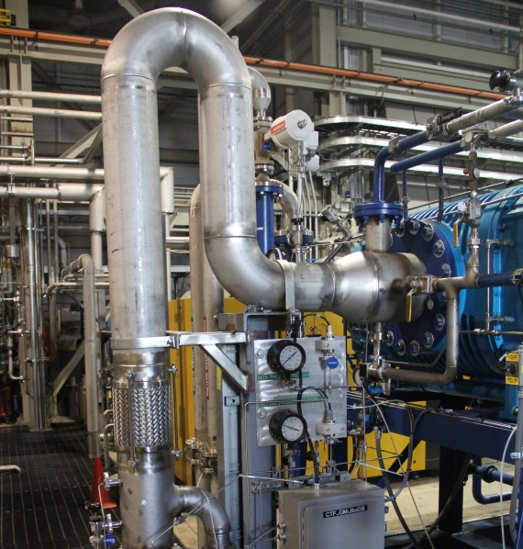
Commissioning Period #1
Several issues appeared during the first commissioning period
Oil migration into suction line during initial hour of operation
  Original design of suction line was horizontal leading away from pump before turning down to the valve assembly
  Initial operation was conducted with all three valves closed
  Continuous oil level dropping was indication of improper operation
  Oil was discovered collecting on inlet valves
  Piping modification to “U” bend corrected this issue
Original Inlet Piping
Modified “U” Bend Inlet

Slide 9
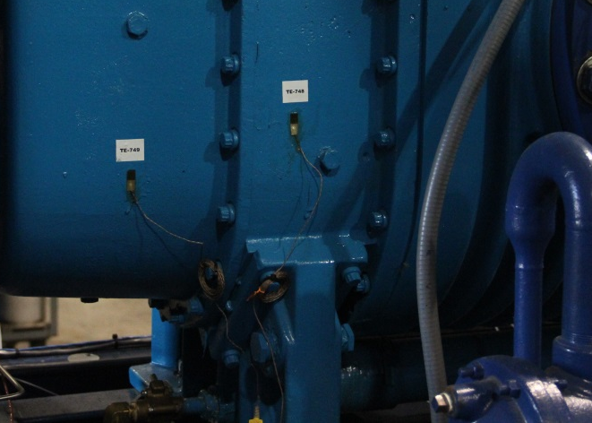
Commissioning Period #1
Excessive vibrations after about 16 hours of operation
  During startup of blower, vibration was nominal (~0.15 in-s)
  Quickly increased with operating time until eventual skid trip (0.9 in-s)
  Changes to inlet piping supports did not reduce vibrations
Further analysis revealed that the drive end bearing was not being cooled by the blower oil circuit
  Capillary spray nozzle was plugged for drive bearing
  Bearing failure possible source of vibration
  Suspected flake of 3M epoxy from oil circuit blocked flow
    Connections sealants changed to Loctite #567 at Tuthill’s recommendation
  Overheating caused damage to bearing
    New thermometry added to monitor the temperature of the blower housing (trip if T > 190F)
Blower Housing Thermometry

Slide 10
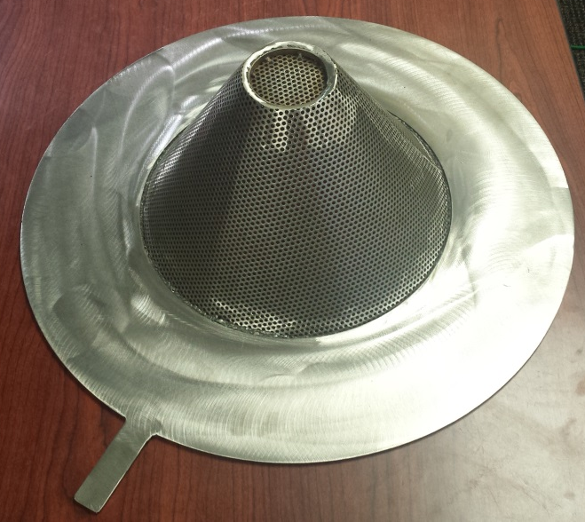
Commissioning Period #1
Seizing of blower lobes
  Unable to rotate shaft by hand
  Required blower shipment back to and repair by Tuthill
  Disassembly did not reveal a cause for seizing
  Assumed that small particulate is culprit
    Possibly from poor cleanup after inlet piping modification
Inlet screen added to blower suction
  Hole size = 1/8”
  “Witches Hat” design retains 80% pumping surface area
  Sized limited by oil injection line in suction header
  Designed to catch large particles
Inlet Screen

Slide 11
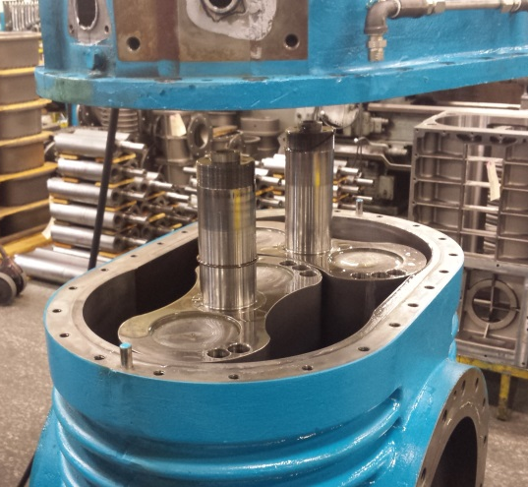
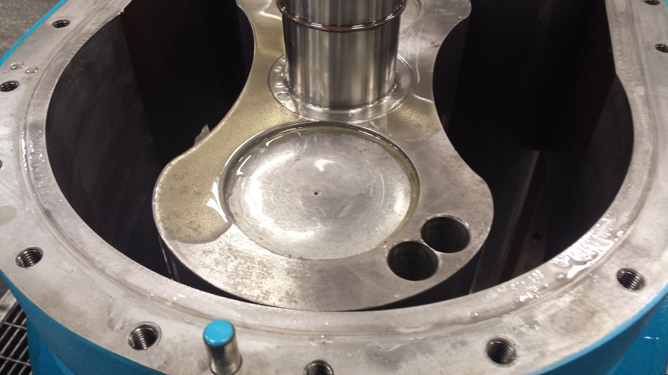
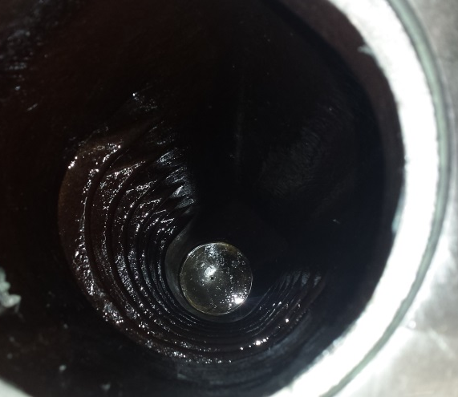
Commissioning Period #2
Return to SNS and recommissioning of Kinney skid:
  Initial skid performance during VTA cavity test huge success
  Skid remained off for about 1 week after testing
    Upon restart, skid “shook the building”
    Within a few seconds skid trip at vibration > 0.9 in-s
  Again blower shipped back to Tuthill for investigation and repair
    Discovered that plugs in the lobes had “weep” holes
    Lobes were full of liquid oil due to process oil injection
Lobe Oil Investigation At Tuthill

Slide 12
Current Operations
Welch plugs replaced with same style but without weep holes and blower returned to SNS
  Proper configuration of helium pumping with oil injection
  Atypical for most other pumping applications
After last repair conducted on Kinney blower by Tuthill:
  Review of entire Kinney skid and operating sequences was conducted by Tuthill engineers
  Report made several useful suggestions but found no additional potential failure modes to address
    Decrease oil injection rate into liquid ring pump
    Limit blower “wind milling” to time periods less than 2 hours
      Wind milling is free spinning of blower due to flow during liquid ring only periods of operation
    Recommended blower oil inject rate is 3 GPM per 1000 cfm
    Oil level in liquid ring pump should be at shaft centerline on startup

Slide 13
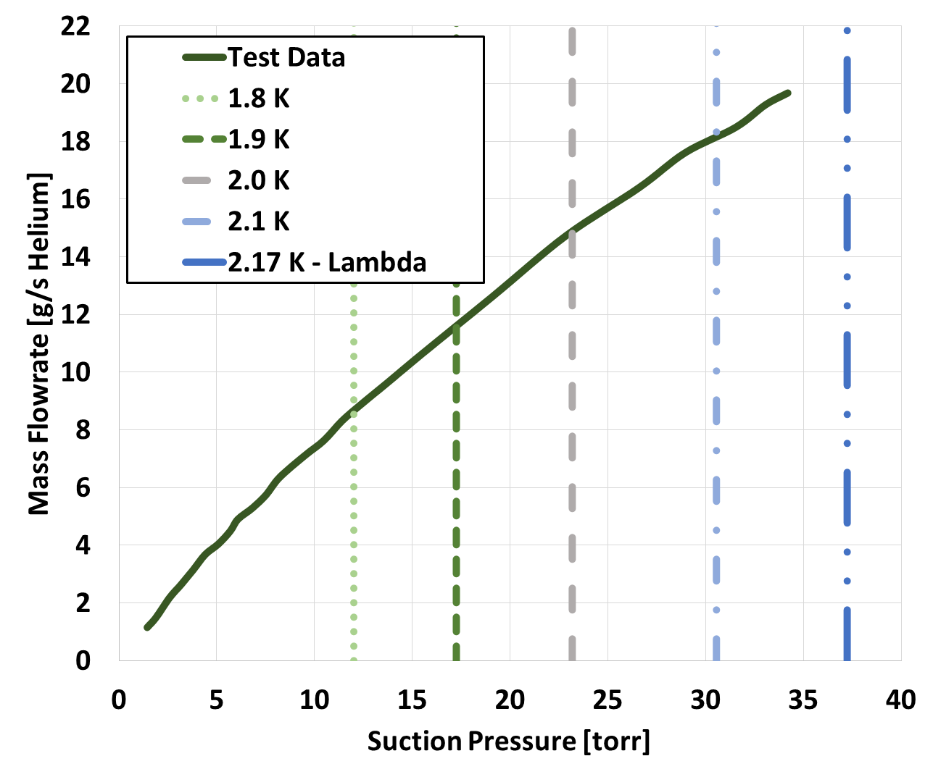
Current Operations
Kinney Flow Capacity Curve –
  Testing data obtained using side bypass control valve
  Higher flowrate requires increase in oil injection to 15 GPM
  Flowmeter calibration change allows operation at flows > 20 g/s
  Administrative limit during operation keeps suction pressure below 40 torr

Slide 14
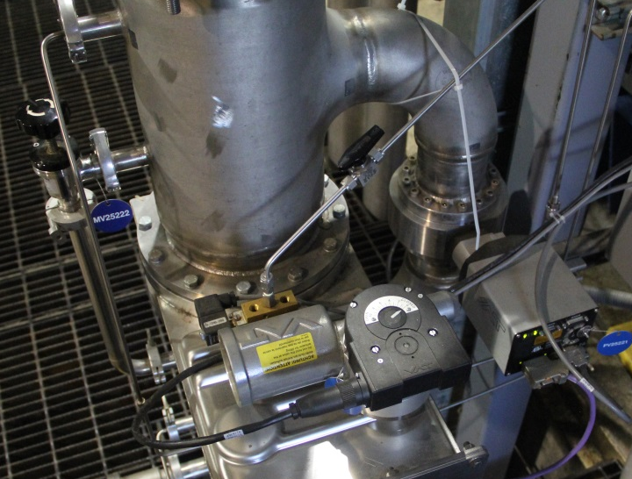
Current Operations
VTA pump down procedure is well established
  Starting point with VTA full of saturated liquid helium at 1.1 atm
  Kinney liquid ring pump is started with skid isolated from VTA
  1” MDC hand valve at skid inlet is throttled open until ~18 g/s pumping
  Continue iterating until about 0.7 atm, then flow control is transitioned to 4” position controlled VAT valve, again maintaining ~18 g/s
  At 0.1 atm, VTA pressure regulating valve closes, dropping skid inlet pressure
  While pumping, blower is started
  VTA pressure valve begins regulating to achieve operating pressure of 0.042 atm
Parallel Skid Inlet Valves

Slide 15
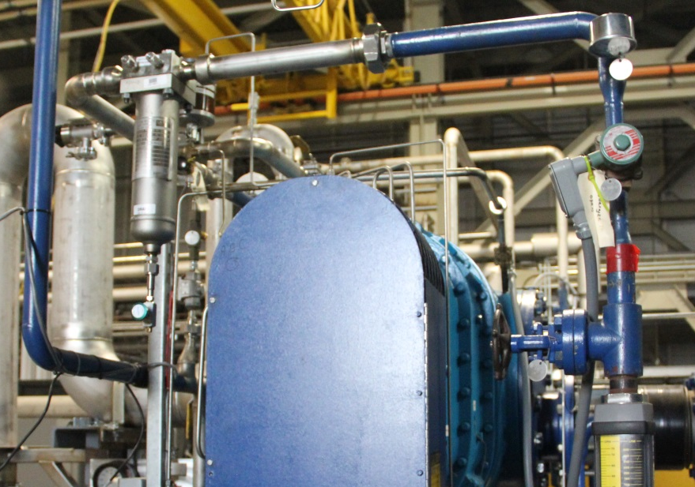
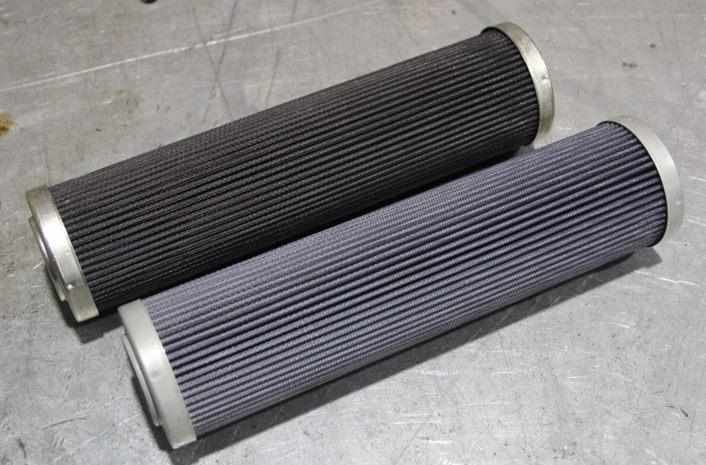
Current Operations
Oil filter on blower oil injection line is recent addition
  Similar to the “witches hat”
  Approximately 20% of oil pump flow is injected into blower
    Eventually cleans entire skid
  Protects the blower lobes from particulates
  Initial 5 micron filter plugged injection line within minutes with black particulates
  Several 100 micron filters used to clean up system
  Current operation on 2nd 25 micron filter appears sustainable
    Future oil sampling to determine contamination source
New Blower Oil Injection Filter Housing
Observed Contamination on Filter Elements

Slide 16
Future Improvements
Soft starter installation for liquid ring pump
  Currently design is in-progress
  Will require some changes to skid startup sequence
Design and fabrication of a new belt cover for the liquid ring pump to provide more air circulation without compromising personnel safety
  Belt guard currently has a fan pulling air through the enclosure
  Design is complete and new guard should be delivered next month
Integration with SNS EPICS controls architecture
  Ethernet communication is established
  ICS personnel are in the commissioning stage

Slide 17
Summary
After 3 years of difficult commissioning, SNS now has a reliable vacuum pump capable of providing 2K liquid helium for testing in the RFTF VTA & Test Cave
Lessons learned from the commissioning have been received and implemented to improve skid operations
Capacity of skid has been measured and is sufficient to support the needs of the SRF program at SNS
Recent oil contamination investigation has yielded interesting results, with more analysis coming
Future improvements will hopefully contribute to successful Kinney operations for many years

Slide 18
THANKS!
QUESTIONS?

