Slide 1
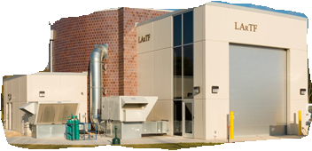
MicroBooNE Experience: Operations of the cryogenic system for the Fermilab MicroBooNE Liquid Argon Neutrino detector
M. Zuckerbrot, M. Geynisman, J. Kilmer, B. Norris, R. Sanders, M. Sarychev, F. Schwartz, J. Tillman
Workshop on Cryogenic Operations
Fermilab, 25-27 October 2016

Slide 2
Presentation Outline
Cryogenic Requirements
System Overview
Stages of Commissioning
Piston Purge
Gas Recirculation
Cooldown
Filling
Initial Liquid Purification
Operations
Overview and Notes
Summary
LarTF

Slide 3
Cryogenic Requirements
Additional Requirements:
Reach purity requirements without cryostat evacuation
< 20 K dT on the TPC during cooldown
Level and pressure stability
Sampling for contaminants
Electrical isolation of cryogenic components from cryostat
LarTF

Slide 4
System Overview
Recirculation/Cooldown System
Fluitron gas compressor, 3 pass heat exchanger, Mole. Sieve
Purification System
Cryostat: ASME cylindrical pressure vessel (30 psig)
LAr pumps: Barber Nichols
Condensers: 10 kW capacity
Filtration Skids: Copper (O2) and molecular sieve (H2O)
Can be activated and regenerated in place using hot Ar and Ar/H2 mix
11,000 gallon liquid Nitrogen dewar: Coolant
500 Gallon LAr Dewar: Supplies makeup gas, actuators, purges, etc…
Gas analyzers: O2, N2, and H2O
Multiple sample points: LAr pump discharge, post-filters, cryostat ullage/chimneys, 500 gallon dewar, etc…
LarTF

Slide 5
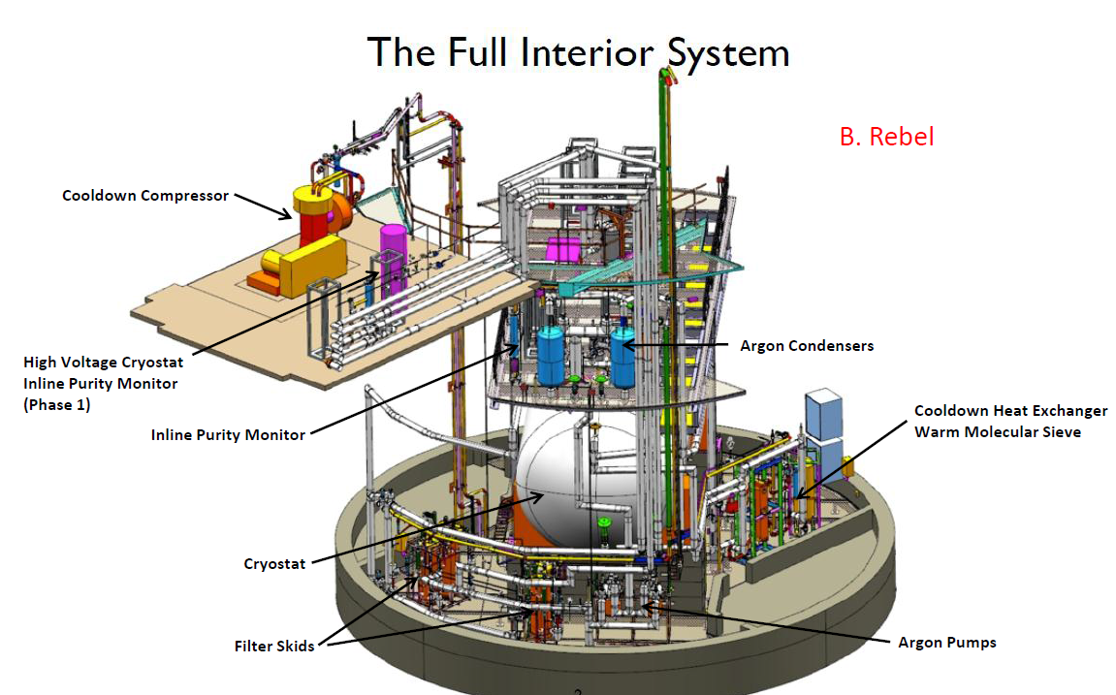
System Overview
LarTF

Slide 6
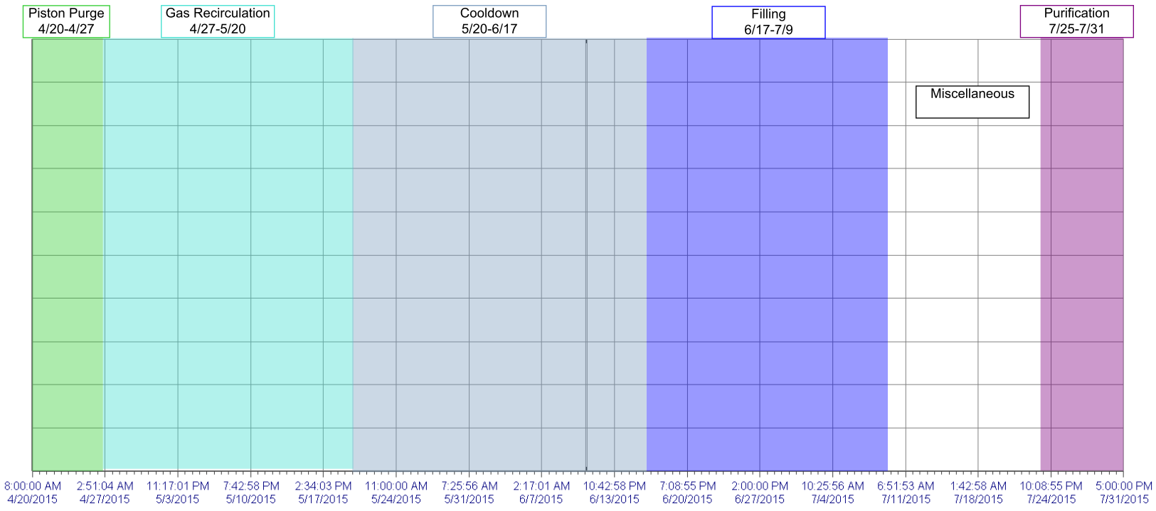
Stages of Commissioning
Commissioning Timeline
LarTF

Slide 7
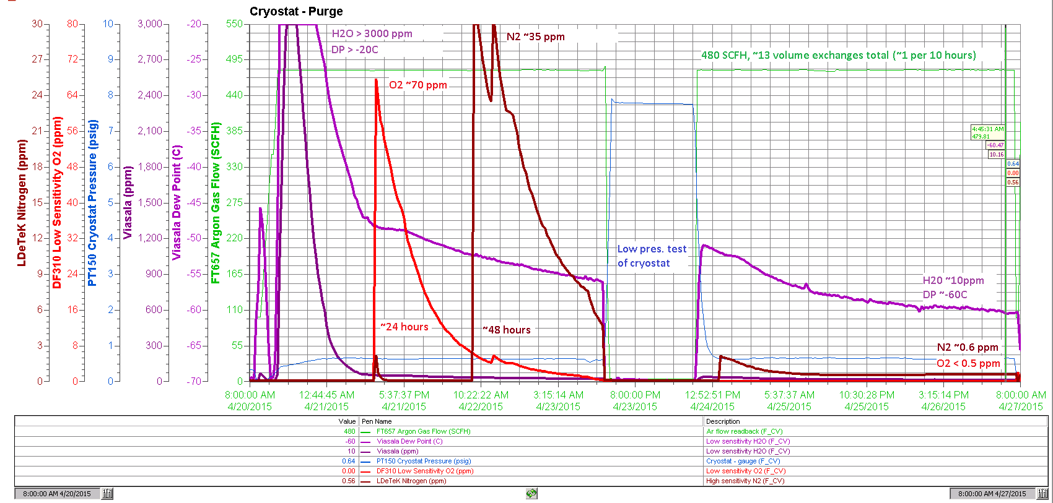
Stages of Commissioning
Piston Purge
~13 volume exchanges, < 10 ppm H2O, < 1 ppm N2, < 1 ppm O2
LarTF

Slide 8
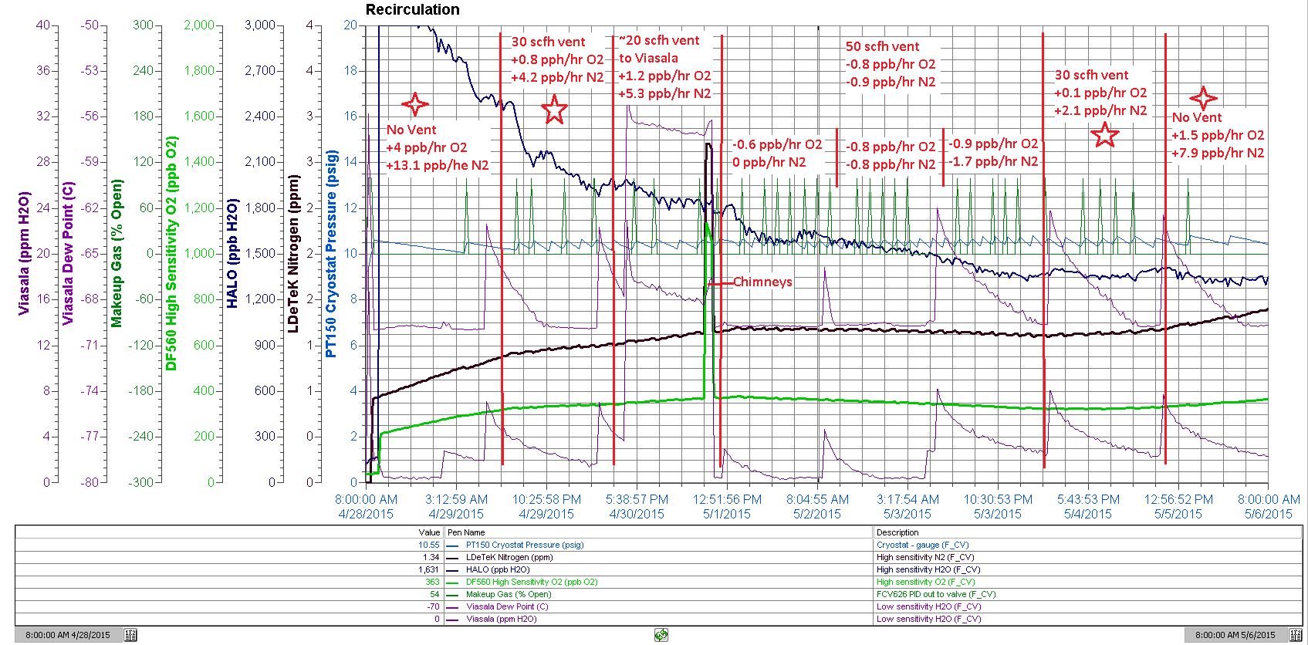
Stages of Commissioning
Gas Recirculation
With no O2/N2 filtration, contaminants increase due to outgassing, controlled by venting through chimneys
LarTF

Slide 9
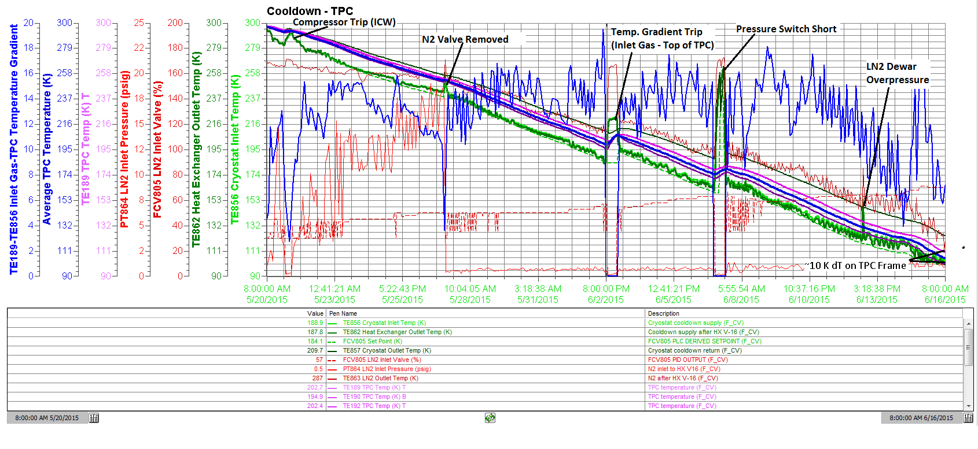
Stages of Commissioning
Cooldown
Temps. and system trips shown, maintained < 20 K dT
LarTF

Slide 10
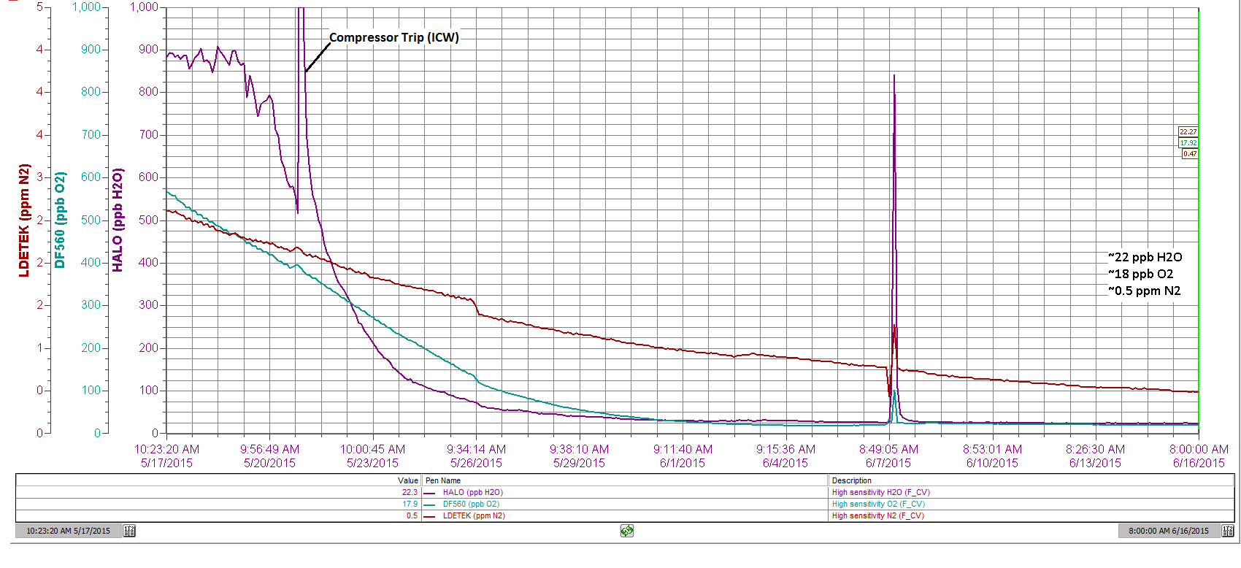
Stages of Commissioning
Cooldown
Contamination during cooldown process shown
-Outgassing decreases with temperature
-Venting from chimneys and replacing with cleaner gas
LarTF

Slide 11
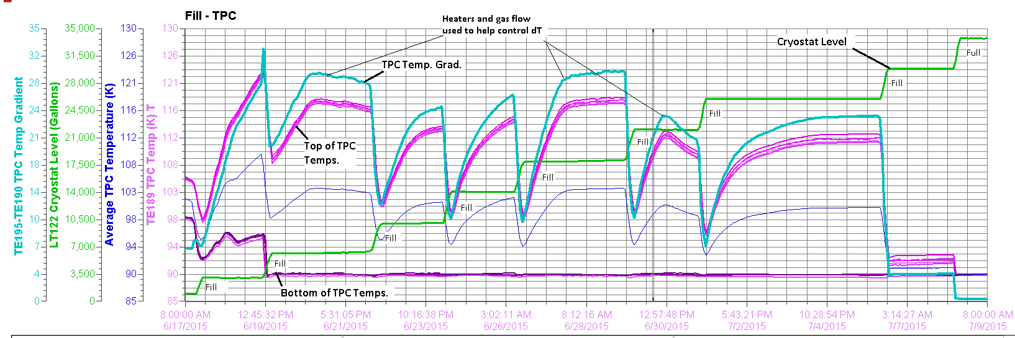
Stages of Commissioning
Filling
Contractual issues: Vendors hesitant to sign contract due to tight N2 requirements and aggressive schedule
Temperature gradients: Form when the liquid level is low
Controlled with shell heaters and bottom-up gas flow to increase convection in the ullage
LarTF

Slide 12
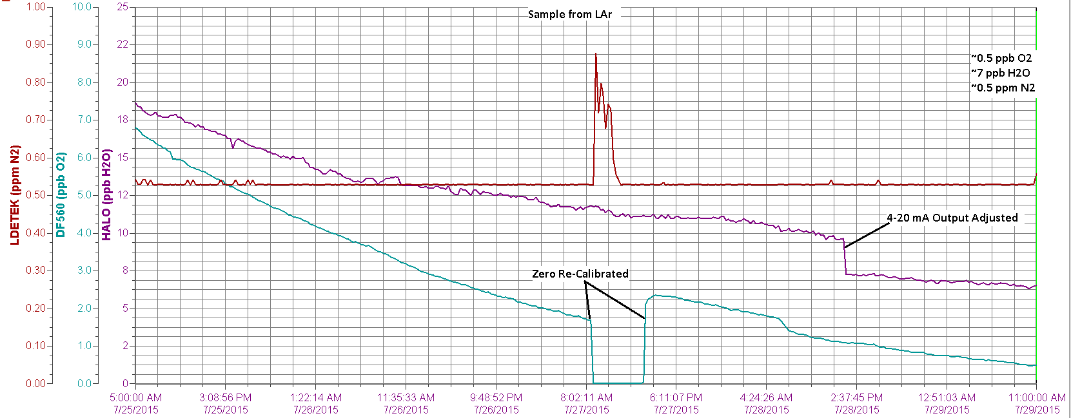
Stages of Commissioning
Purification
Did not fill through filters, started with commercial argon
LAr purified to acceptable levels within a week
LarTF

Slide 13
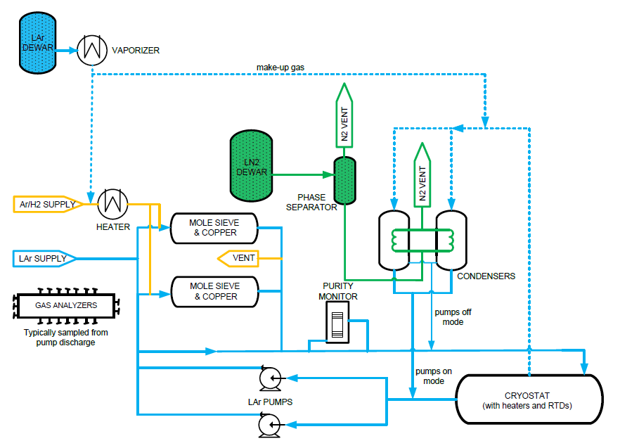
Operations
Overview of Normal Operating System
Spare LAr pump, condenser, and filter skid
Makeup argon from
utility dewar ~3 weeks
Inline PM inactive
No active purge on
chimney ports
Pressure control via
LN2 control valve on
condenser coil inlet
O2, N2 sampled at
LAr pump discharge;
H2O from ullage
LarTF

Slide 14
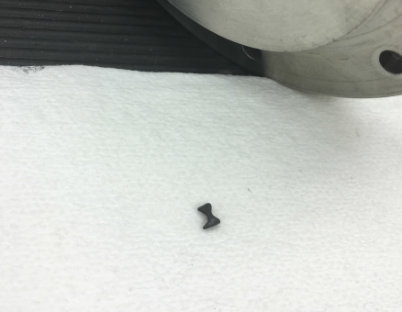
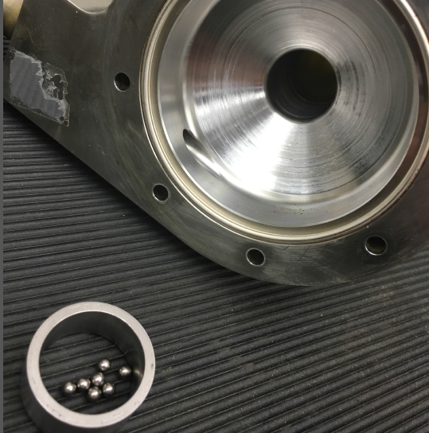
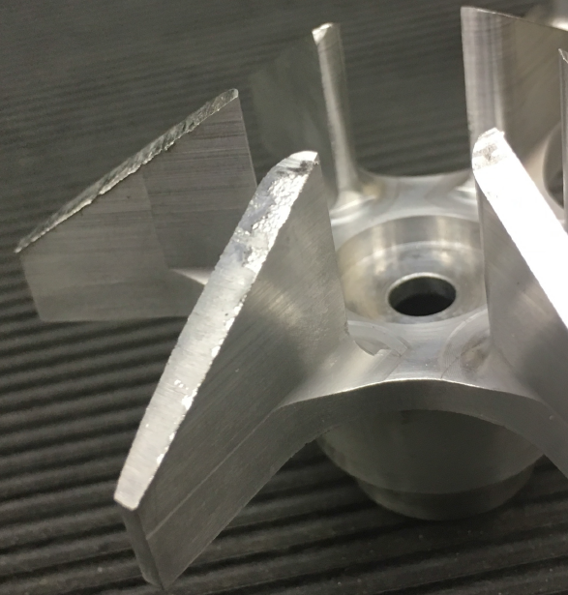
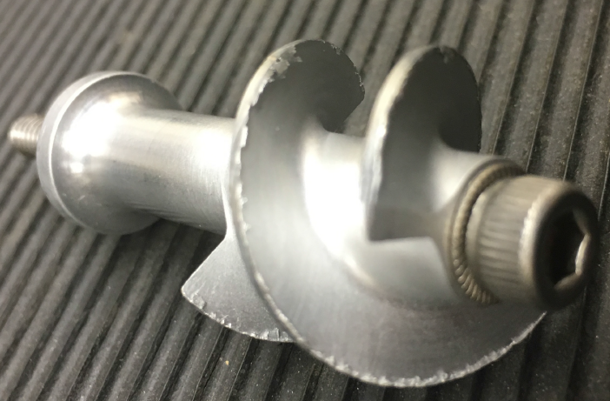
Operations
Barber Nichols LAr Pumps
Startup: Difficult to start without first bypassing the filters then slowly cooling them, likely amplified by downstream throttle valve
LAr Pump Bearing Failure
Detected audibly
Lower cold bearing (cage)
~6000 hours of operation
Possible cause: Prior failure of
discharge pressure transmitter
caused pump to ramp up/down
for several hours
Likely caused cavitation and
shortened bearing life
LarTF

Slide 15
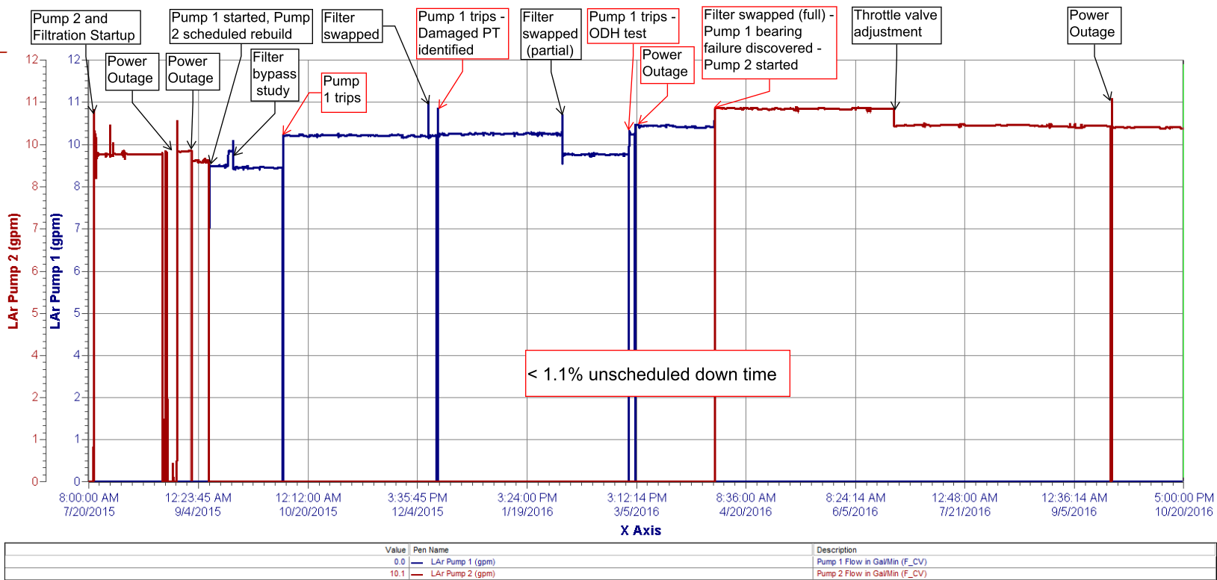
Summary
Electron Lifetime: Analysis is ongoing - 9 ms or greater
System Reliability: > 98.9% up time
LarTF

Slide 16
Questions?
LarTF

