Slide 2

Vibration monitoring of the rotating machines of the CERN cryogenic systems
7th International Workshop on Cryogenics Operations,
October 25-27, 2016
Fermi National Accelerator Laboratory, USA
O. Pirotte
Cryogenics Group
Technology Department
CERN

Slide 3
Content
    Introduction
    Cold/hot spares strategy
    Vibration monitoring and analysis
    Set up of vibration monitoring at CERN
    Examples of vibration monitoring and analysis
    Dashboards and statistics
    Summary

Slide 4
CERN accelerator complex
Geneva’s airport
Test areas
Central services
Standby
T level | Installed capacity | # of plants
80 K | 5.2 MW | 14
4.5 K | 164 kW | 24
20 K | 60 W | 2
1.8 K | 19.7 kW | 12
300 mK | 350 mW | 1
LHC accelerator
LHC detectors
Other detectors
Other acceler.

Slide 5
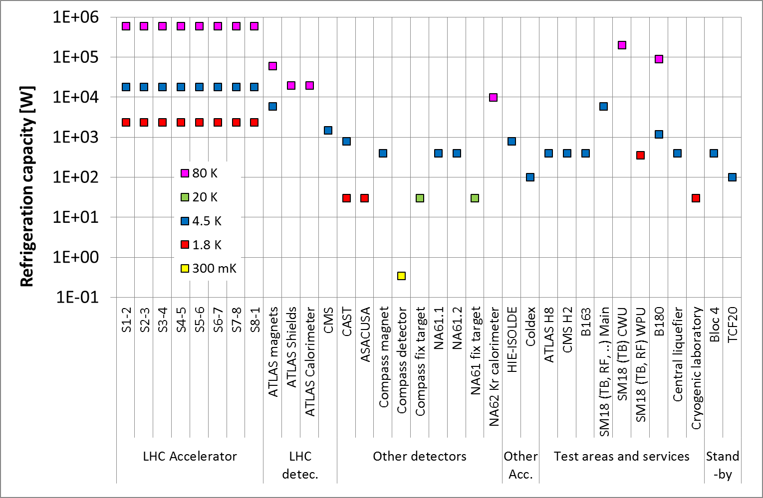
Inventory of cryogenic installations at CERN (34)
23 cryogenic installations are part of the core infrastructure running 24/7/365 for the CERN physics reasearch program where availability & reliability are essential

Slide 6
INTRODUCTION
  In case of breakdown of rotating machinery severe downtime can be induced : couple of days for the exchange of a motor / compressor / turbine / …
  -> Strategy is needed to ensure availability and reliability of rotating machinery :
    Redundant equipment, cold and hot spares
    Preventive maintenance : exchange or revision of components based on integrated running hours
    Predictive maintenance : anticipate issues and possible interventions to correct problems

Slide 7
INTRODUCTION
  Inventory of rotating machinery and main critical components in cryogenic plants :
  At cryogenic temperature :
    Turbines in refrigerators
    Cold compressors / Pumps
  At room temperature :
    Motor-compressor systems (screw and piston type)
    Motor-pump systems (oil or vacuum)
CERN, Cryo-Ops 2014
-> 0 % downtime
-> Process control, cabling & electronic
issues (active magnetic bearing)
most critical
At CERN
-> 88 compressors
-> 60 oil pumps + 6 Roots
    Powerful systems, generating large vibrations
      -> increased wear
      -> increased risks and collateral damages : leaks, pollution (He , environment)
    High costs in case of breakdown
    Long downtime
    Experience of severe breakdowns during LHC run 1 (see Cryo-ops 2014)

Slide 8
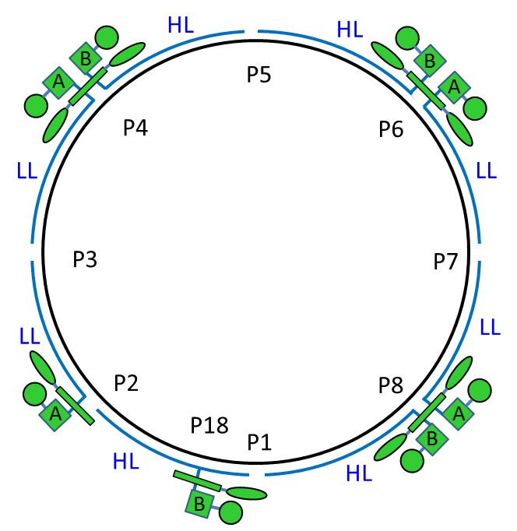
LHC cryogenic warm compressors layout
HPb
HPa
HPa
HPb
MPb
MPa
MPa
MPb
LPb
LPa
LPa
LPb
S1-2
S2-3
S3-4
S4-5
P18
P2
P4
HPb
HPa
HPa
HPb
MPb
MPa
MPa
MPb
LPb
LPa
LPa
LPb
S5-6
S6-7
S7-8
S8-1
P6
P8
9 types of compressors:
2 Aerzen types (536aM & 536aH)
- 7 Stal types (S73_LP, S73_HP, S75, S87, S89, S93_LP & S93_HP)
Aerzen
Stal
8 cryo plants
5 cryo islands
(HP/ LP)
(HP/ LP)
Available
spares
(2016)

Slide 9
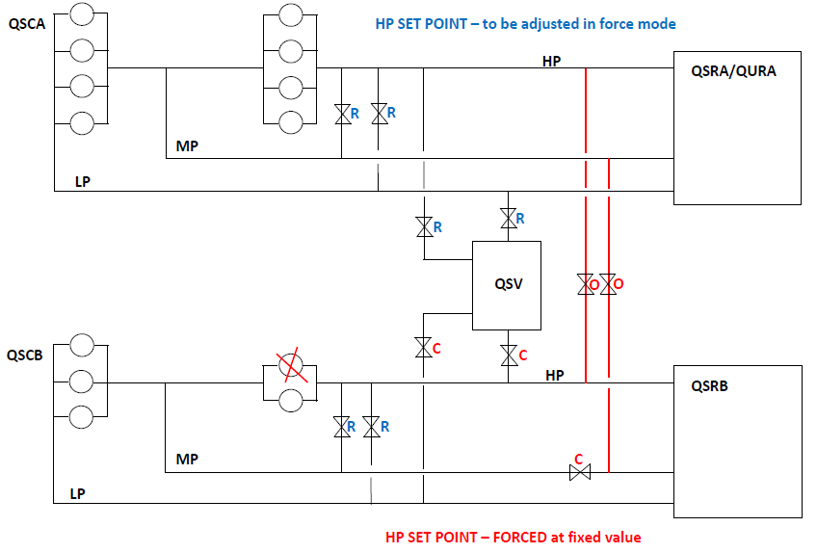
LHC “Hot spare” solution
Screen from 2 sectors is connected to this refrigerator
TU1,2,3 stopped
TU4 flow
Configuration without one HP compressor. Similar configuration can be applied for LP stage compressors and in such case LP and MP bypasses between the cryo plants will be open.

Slide 10
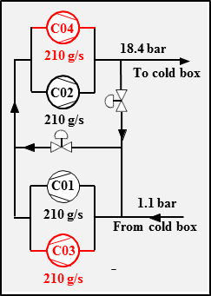
ATLAS & CMS “Hot spare” solution
Upgrade of ATLAS and CMS compressor stations during first long shutdown (LS1) period of LHC (2013-2014)
ATLAS : exchange of C2 compressor to ensure a mininimum of 400 g/s with three boosters, and new C6 compressor
CMS: new hot spare compressors

Slide 11
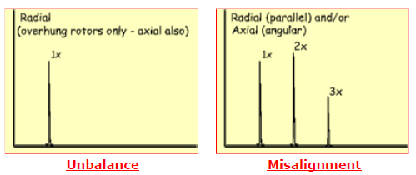
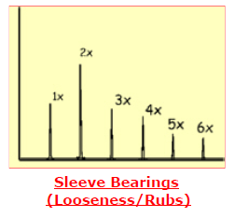
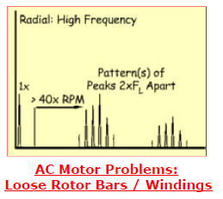
Vibration monitoring and analyis
  Vibration measurement techniques have been developed for rotating machinery since 1950's
  In the 1980’s, Portable Data Collectors (PDC) were introduced, combined with condition monitoring software
  Since then, there is a continuous enhancement of these products and their capabilities in parallel with development in electronics for hardware and software
  It is now possible to anticipate issues and to diagnose many problems for rotating machinery :
    Unbalance ,
    Misalignment, soft foot,
    Bearing faults,
    Structural looseness or resonance,
    Belt drive faults,
    Gear faults,
    Electrical motor faults (rotor bars, eccentricity rotor/stator)
    Hunting Tooth Frequency (FHT), …
  A set of specialized standards is available : ISO, VDI, API

Slide 12
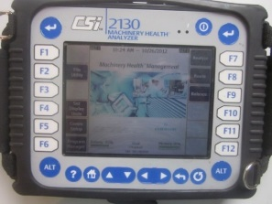
Predictive maintenance and compressor
station at CERN
Before 2007
2013 - 2016
Occasional use of vibration meters to check components (compressor, pipework, valve, …)
Condition based maintenance for screw compressors, roots and oil pumps and the associated electrical motors
2011 - 2012
Investigations with a vibration expert
2008 - 2011
Measurements of only global acceleration/behavior of the motor-compressor systems (1 measurement point, 0-1000 Hz)
2012 - 2014
Set up of a predictive maintenance plan based on vibration monitoring
2007 2008 2009 2010 2011 2012 2013 2014 2015 2016
2007 : purchase of a first PDC (Emerson™ CSI 2130) in view of LHC run (numerous CPs, higher vibrations)
Dec-2009
QSCB-8-CP3
Roller bearing
(failure)
VMY536aH
Feb-2011
QSCA-2-M08
Journal bearing
(failure)
Dec-2011
QSCB-8-CP6
Plain bearing
(wear)
VMY536aH
Nov-2012
QSCA-8-M08
Journal bearing
(wear)
Dec-2010
QSCB-4-CP6
Roller bearing
(breakdown)
VMY536aH
Jun-2011
QSCB-8-CP7
Roller bearing
(breakdown)
VMY536aH
Feb-2012
QSCB-4-CP7
Damaged rotor
VMY536aH
Jun-2014
ANRS
Roller bearing
(breakdown)
Kaeser

Slide 13
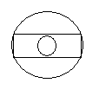
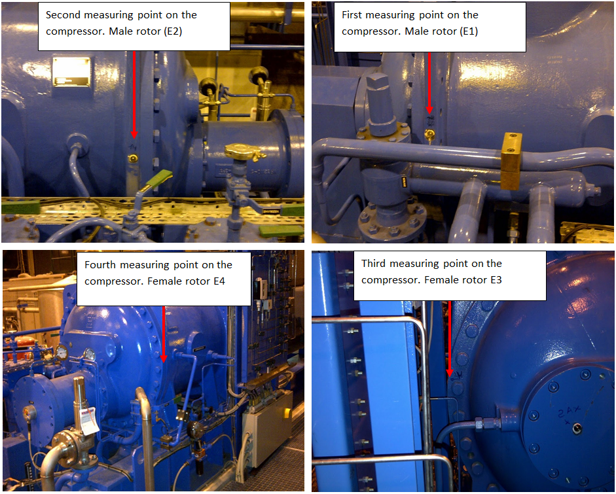
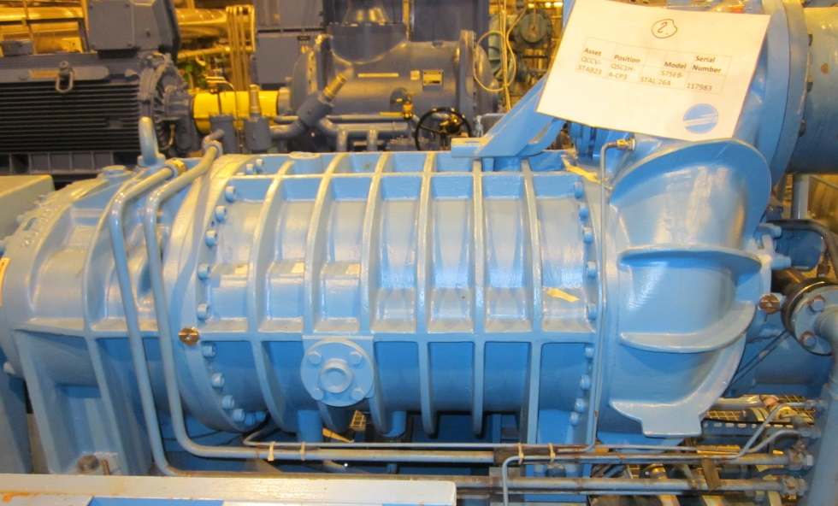
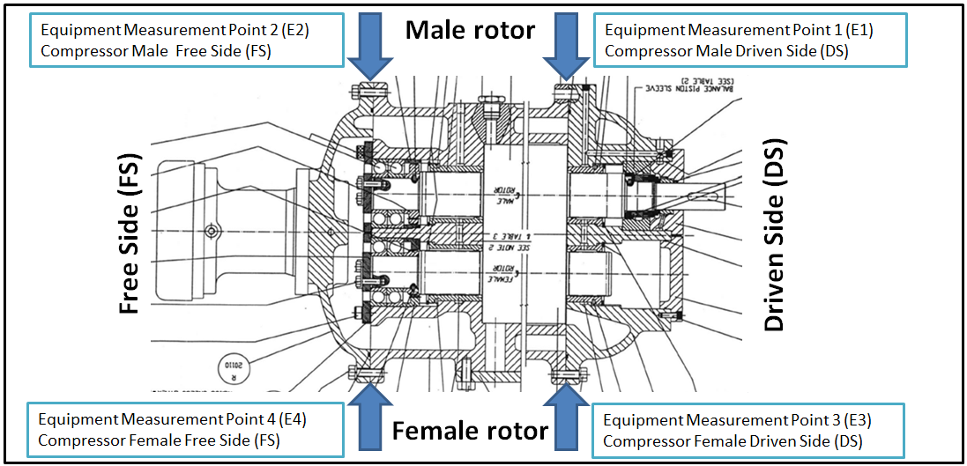
Measurement points for a compressor system
Tri-Axis Sensor
Fixed coded pin
Notes:
Database setup, for every system :
Inventory of all characteristics to configure the condition monitoring software and its database (kinematic chain, geometry, bearing data, …)
Monitoring program : selection of all the measurement points and their characteristics (freq. ranges, resolution, …)
Define the alarm thresholds for the various faults
Define the measurement intervals
Define and configure routes in the PDC
Equip each systems with fixed coded pins to avoid measurement errors

Slide 14
Vibration analysis
Vibration analysis
Wear
Roller / plain / journal bearing
Weakness
Unbalance
(1 x n)
Rotor bars (motor)
Alignment
(2 x n)
Asymetric magnetic field (2 x f.net)
Skid (resonance, Looseness)
Problems which may evolve more or less rapidly
Problems which, if corrected, will improve the system
Avoid breakdown
Higher reliability and availability, lower wear and maintenance costs
…
…

Slide 15
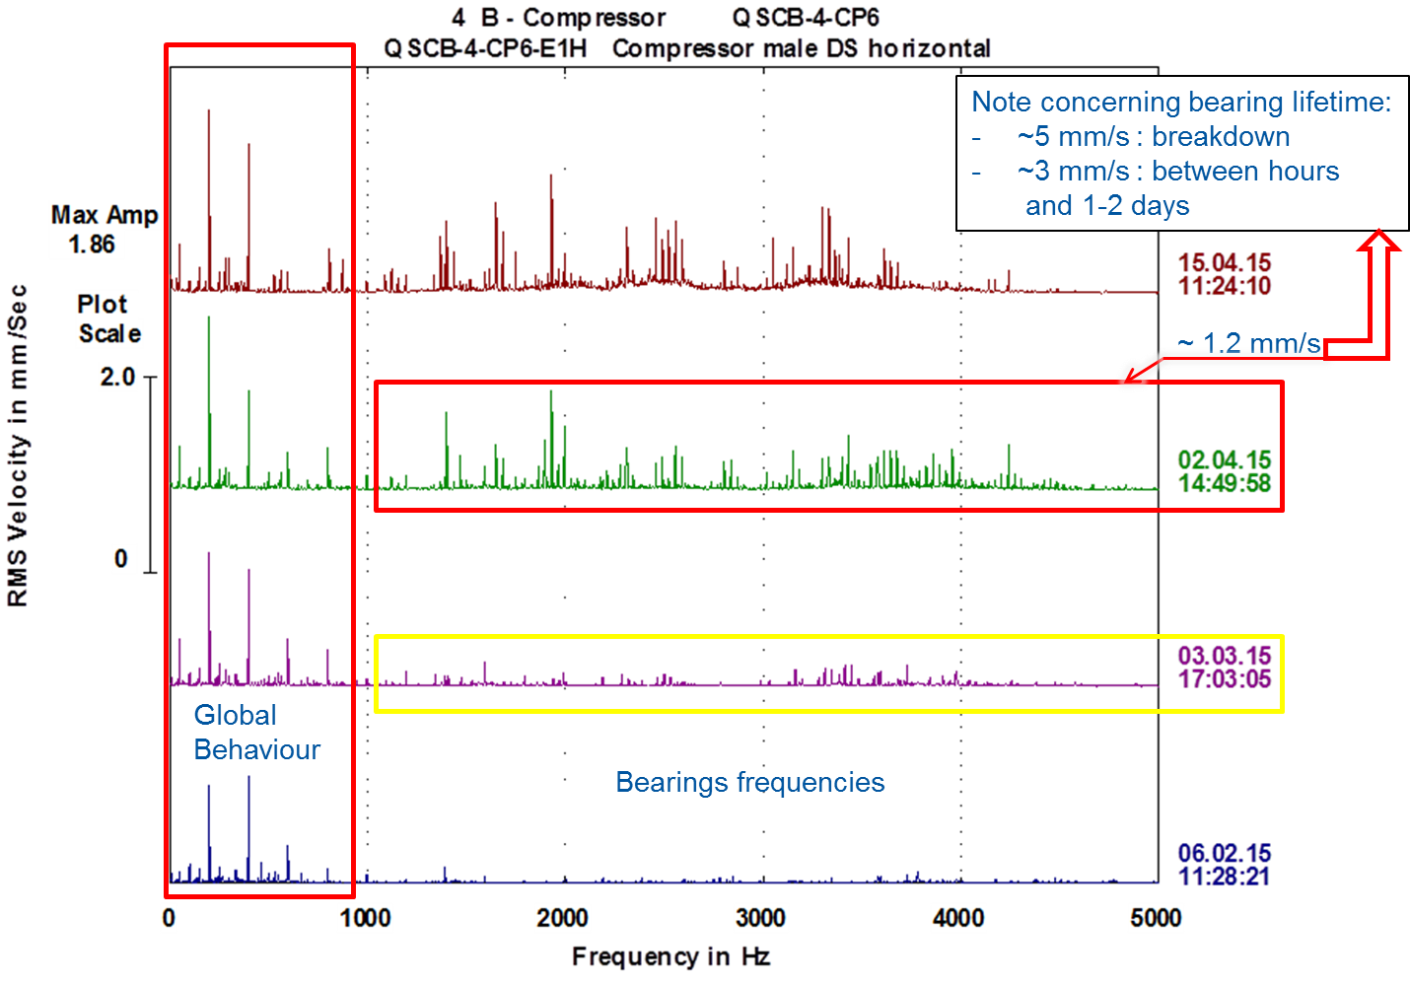
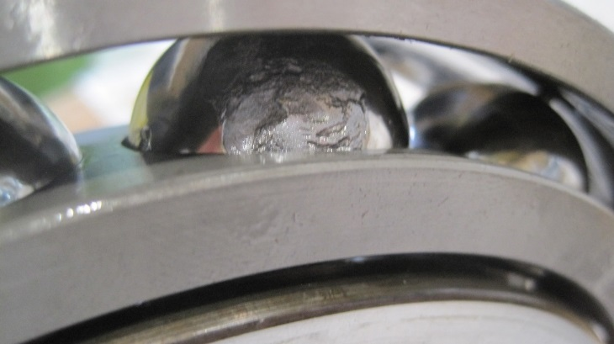
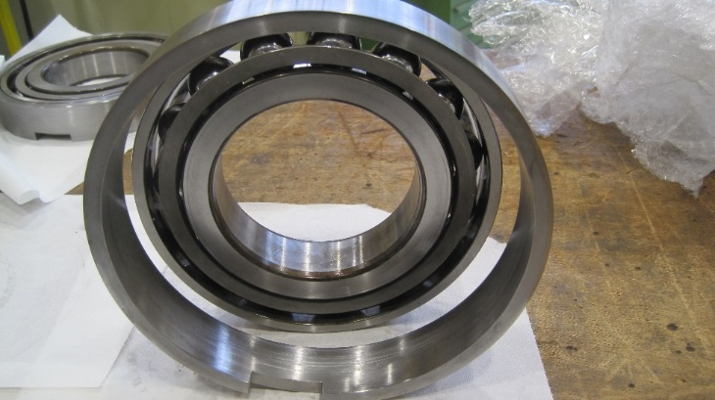
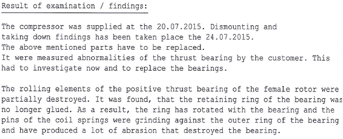
Example 1 : roller bearing QSCB-4-CP6 (VMY536aH, April 2015)
(Compressor major overhauled 2 years ago!)
Assembly error during major overhauling
(Aerzen’s expertise 29 July 2015)

Slide 16
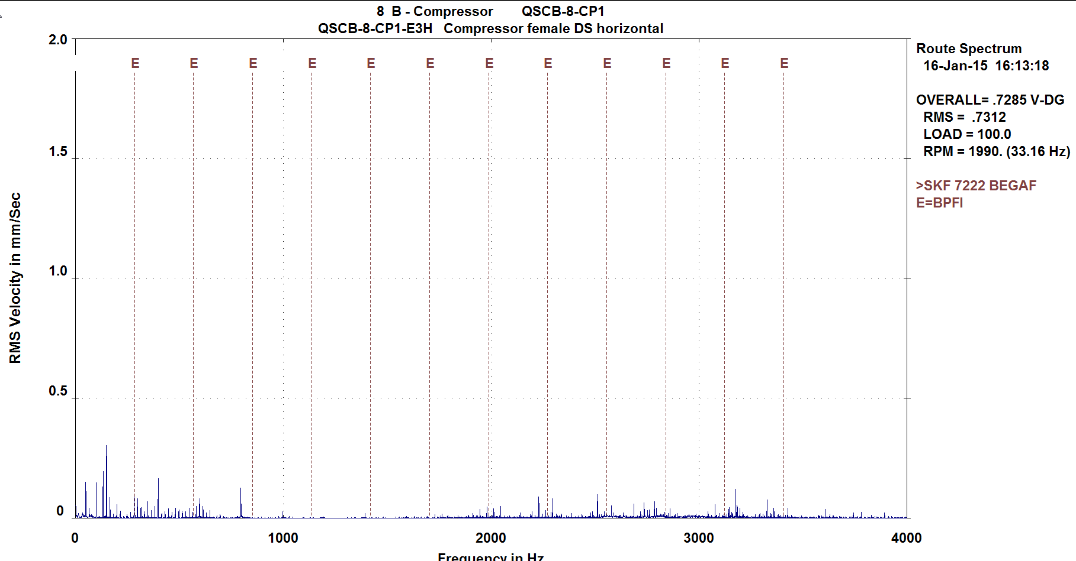
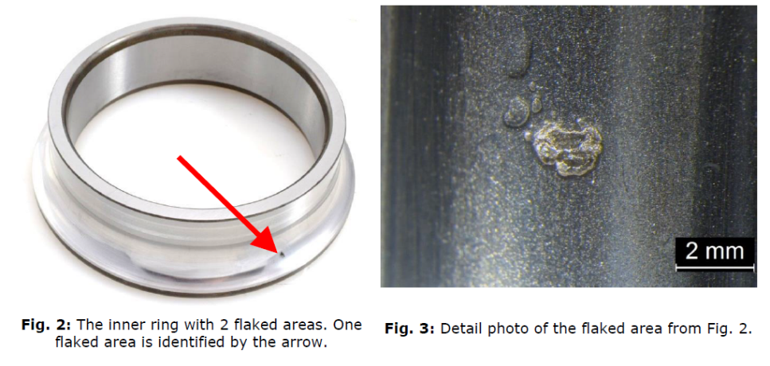
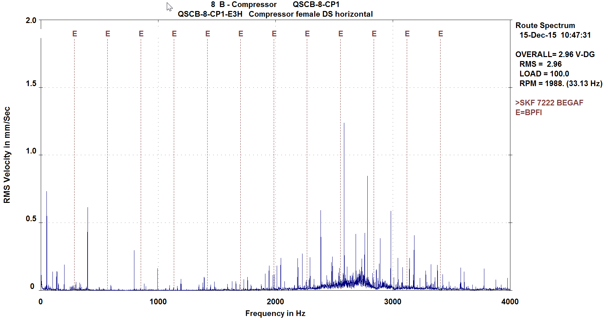
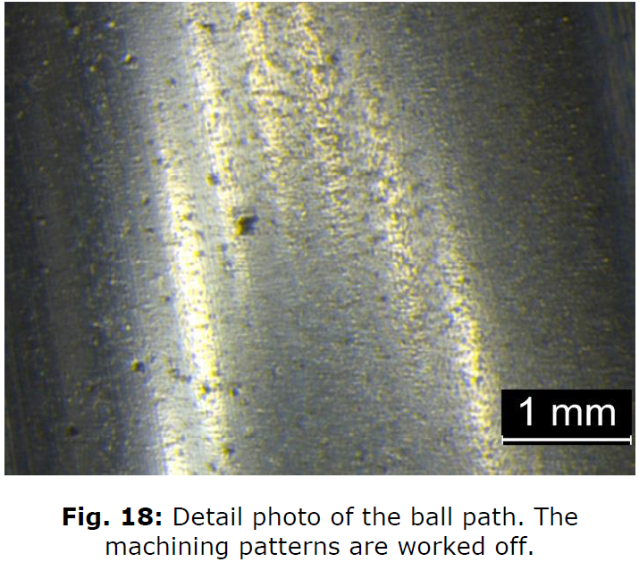
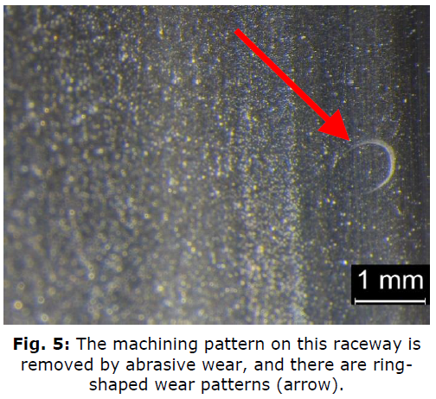
Example 2 : roller bearing QSCB-8-CP1 (VMY536aM, 2015)
SKF report (bearing after 1 year)
The inner ring shows two small flaking areas, a large number of overrolled indentations caused by soft and large, but also hard micro-particles, as well as abrasive removal of the machining pattern in the ball path. A large number of wear marks are visible which are either round or have the shape of circle segments, with surface distress on the bottom and which were overrolled in operation (Figs. 2 to 13). In addition to one flaked are, the machining pattern was worn off due to vibration with the bearing stationary.
Jan-2015 : First indication of bearing issue
~1 year
Only one spare and concern with other CP of the same type
Jan-2016 : Exchange of the compressor during end of year shutdown

Slide 17
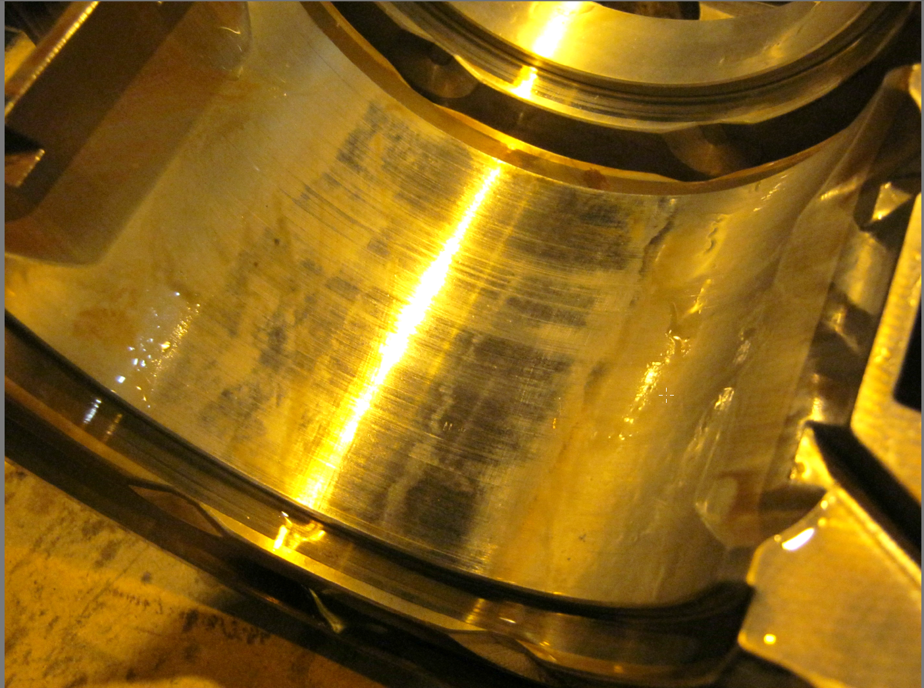
Example 3 : journal bearing QSCA-8-M08 (2012)
Detection of a faulty journal bearing in a motor (August 2012) :
  « Internal play in the journal bearing is increasing slowly but continuously over last few months »
-> Replacement of the bearing during a technical stop in November 2012

Slide 18
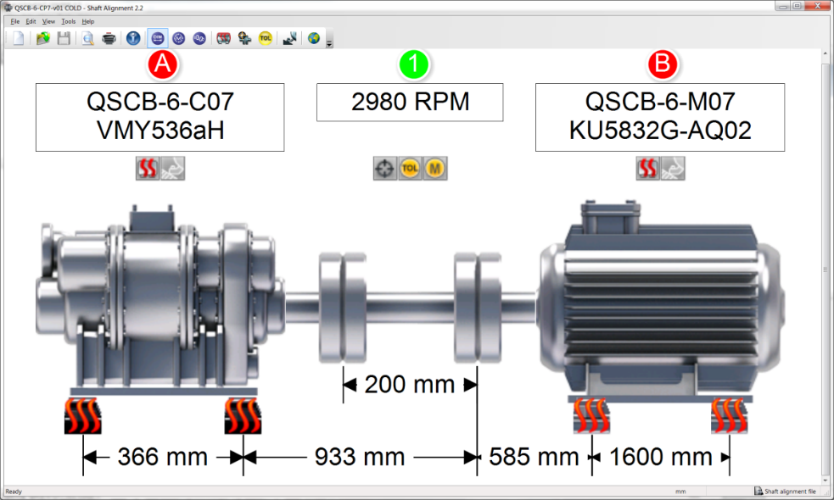
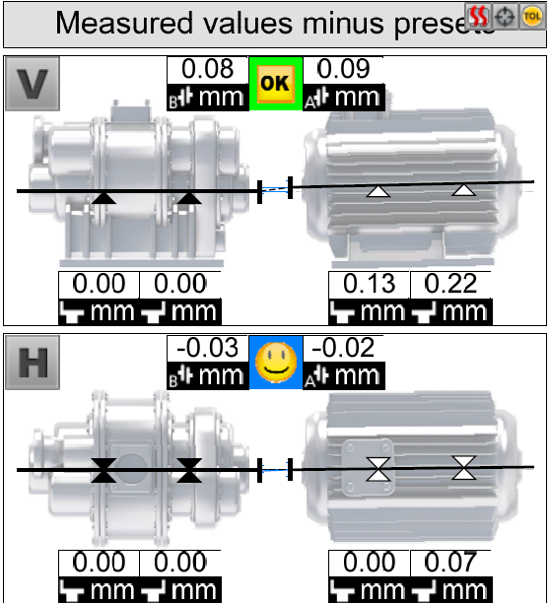
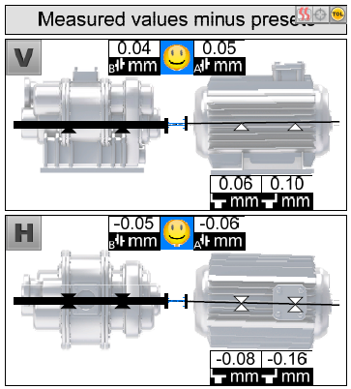
Example 4 : vibration analysis & alignment practice
During the set up of the vibration monitoring, many problems of misalignment were reported
Investigation wrt alignment practice. Findings :
  Configuration errors in the database (geometry, length,…)
  Faulty soft foot check
  Thermal growth not taken into account
  Dynamic tolerances not well taken into account
Laser shaft alignment system : OPTALIGN®
Geometry of the system
Alignment at "cold"
Verification at "warm"
-> Complete review of the alignment procedure and QAP

Slide 19
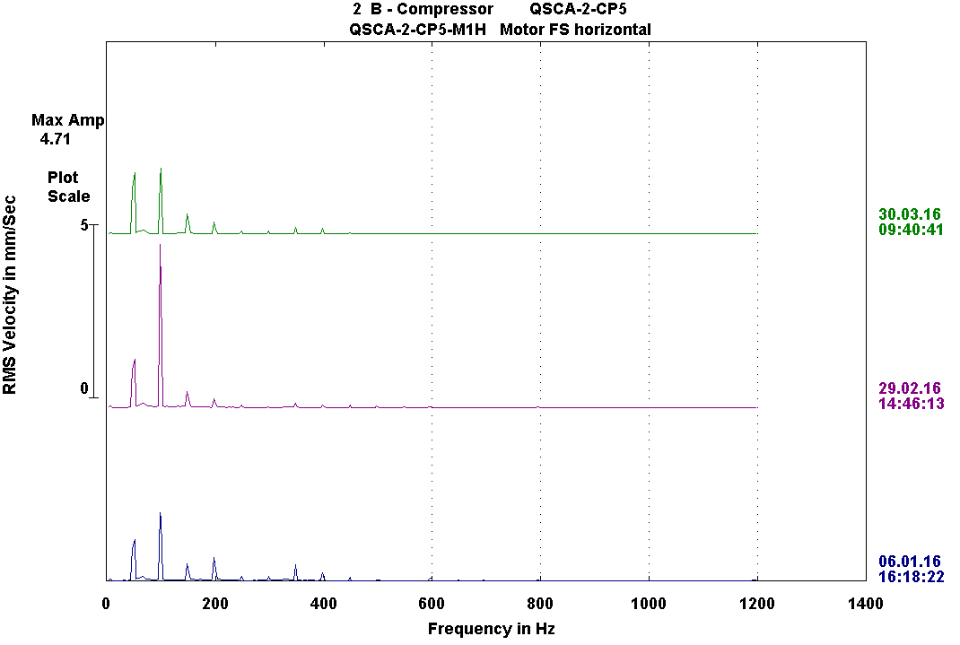
Example 5 : maintenance practice & Quality Control
Alignment issue found on compressor QSCA-2-CP5 (Feb-2016)
Investigations -> alignment during Jan-2016
Thermal growth not taken into account during alignment process
Balancing issue found on motor QSCA-4-M0A (Feb-2016)
Investigations -> there was an exchange of shaft seal during Jan-2016
Bad remounting of coupling (unsymmetrical mounting of the conical clamping ring)
After correct alignment, and
thermal growth taken into account
1xn before shaft seal intervention
Alignment problem
Before alignment
1xn after shaft seal intervention
Vibration analysis contributes valuably and efficiently to QC
Correct alignment improves bearing and seal life, and reliability of rotary machinery

Slide 20
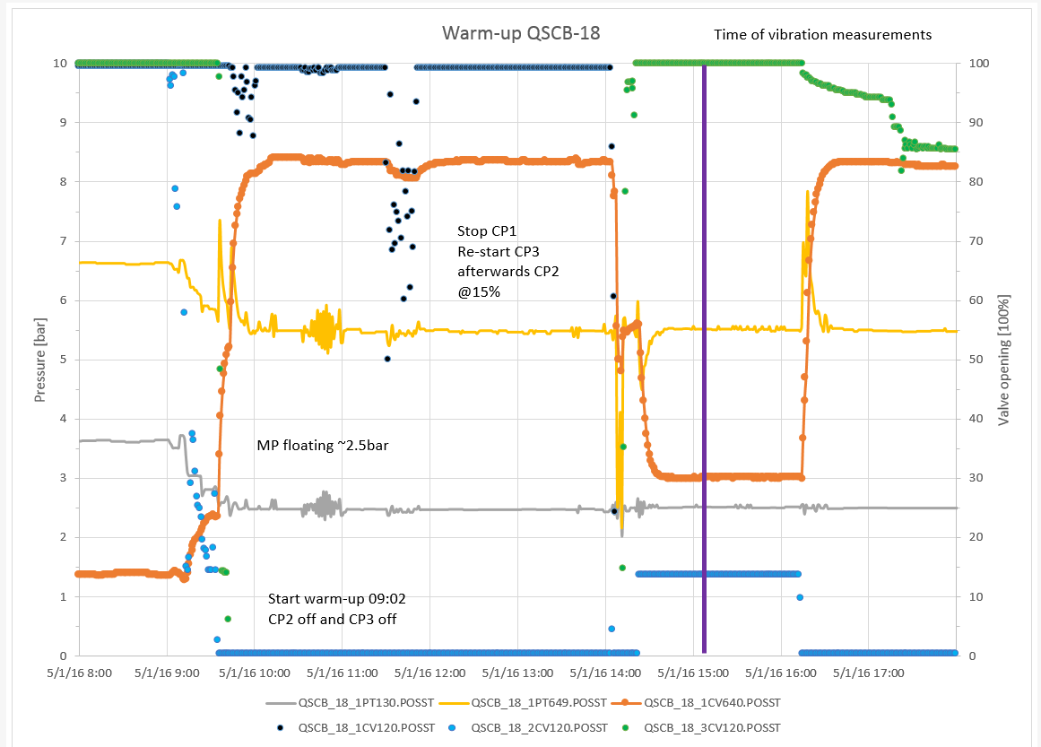
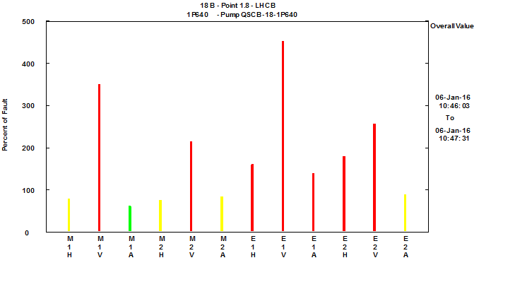
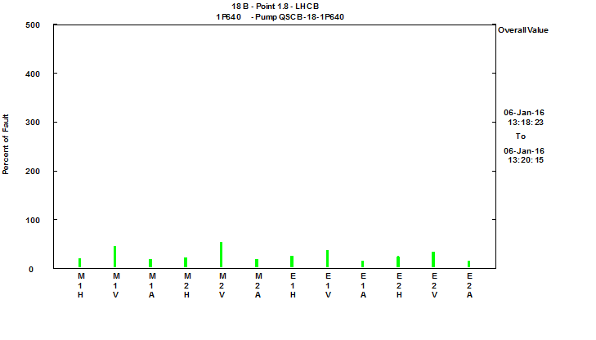
Example 6 : Operation practice (Jan-2016)
During a vibration measurement, very high vibrations are recorded for the oil pump QSCB-18-2P640 (motor & pump) : cavitation
Motor
Pump
Vib. level of pump QSCB-18-2P640
Heavy impacts
Investigation of the operation process
Vibration measurement
Slide valve @ 13%
Vibration analysis contributes valuably to operation practice
Comparing vibration behavior at different pump suction pressure
MP @ 2.5 bar
MP @ 3.5 bar

Slide 21
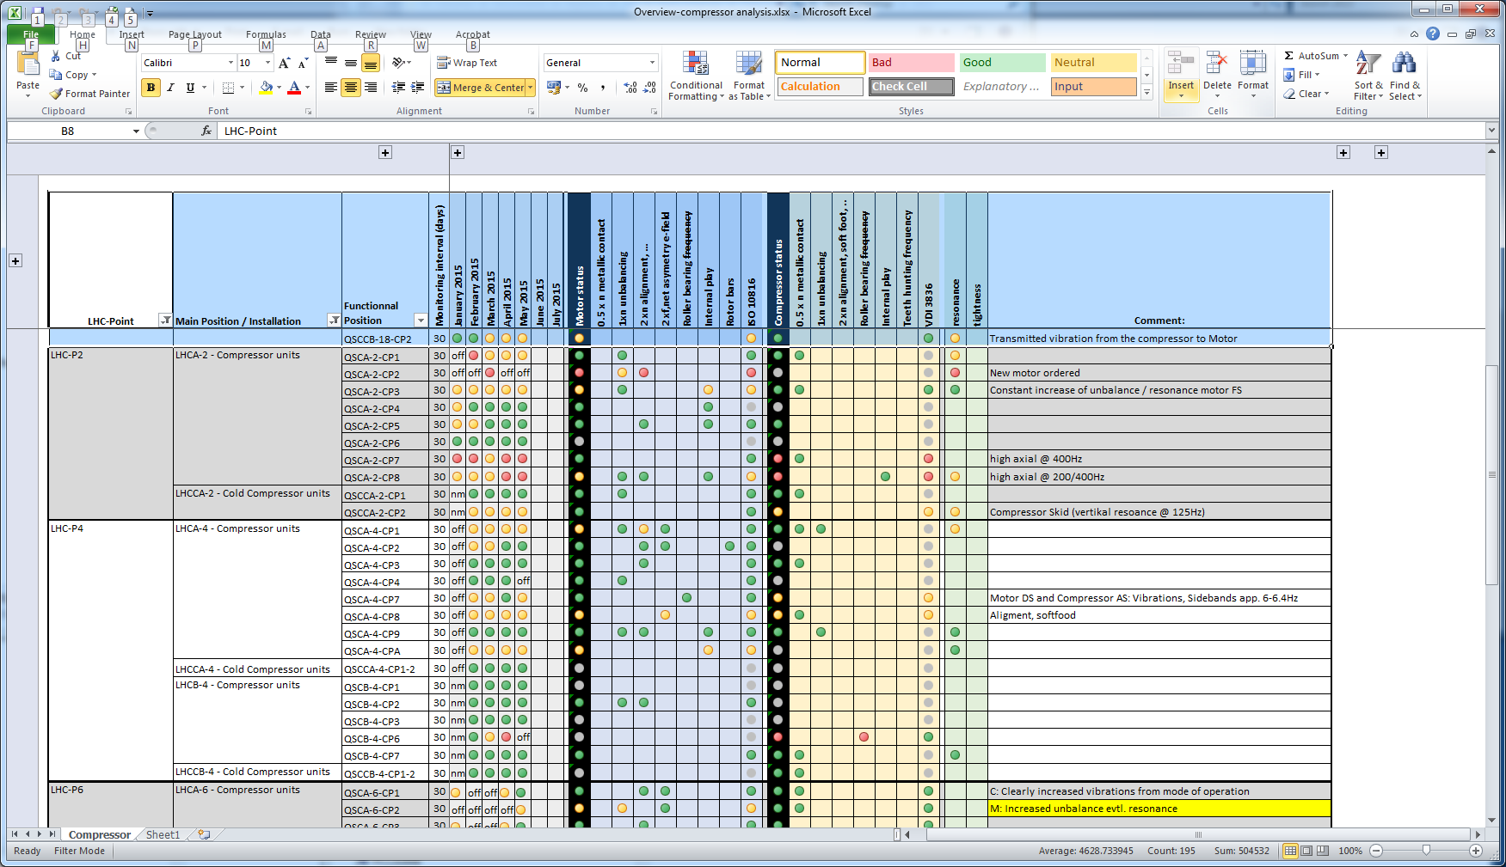
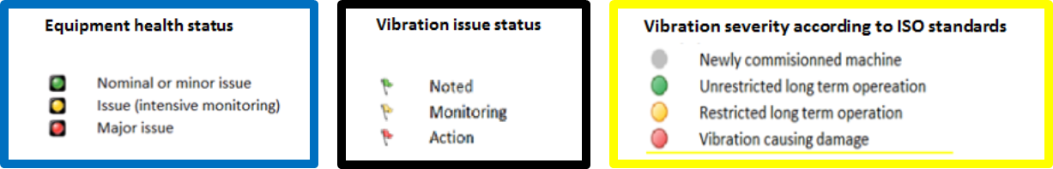
Vibration monitoring : detailed dashboards
Motor status
Compressor status
Skid

Slide 22
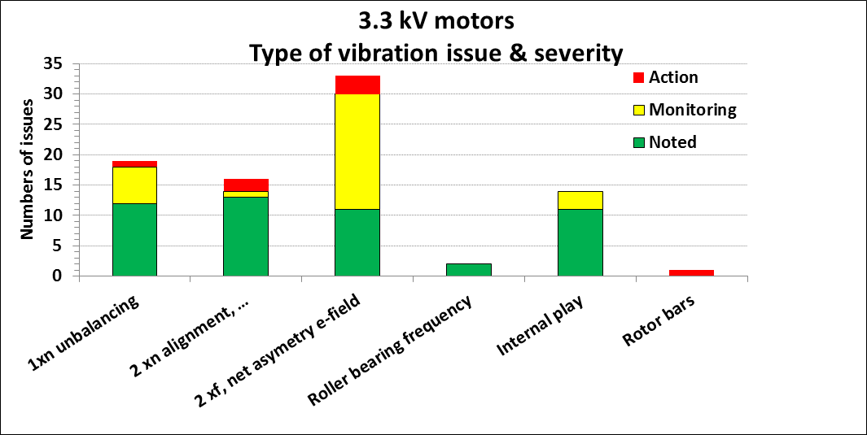
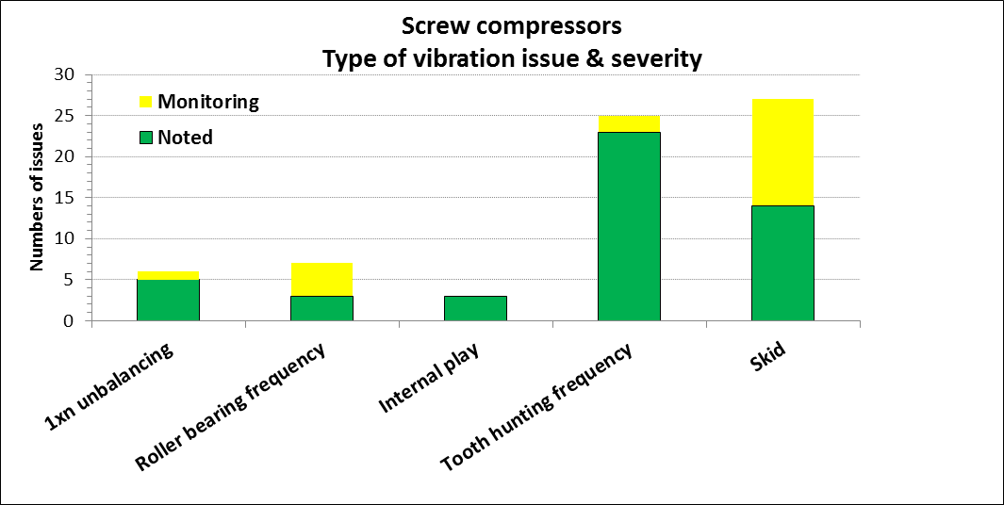
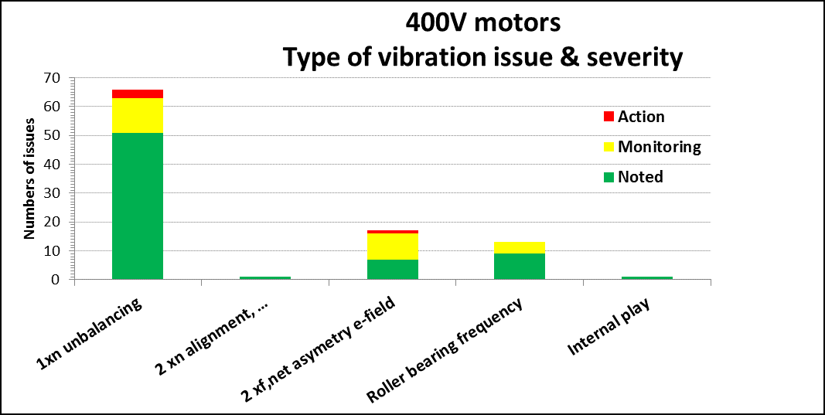
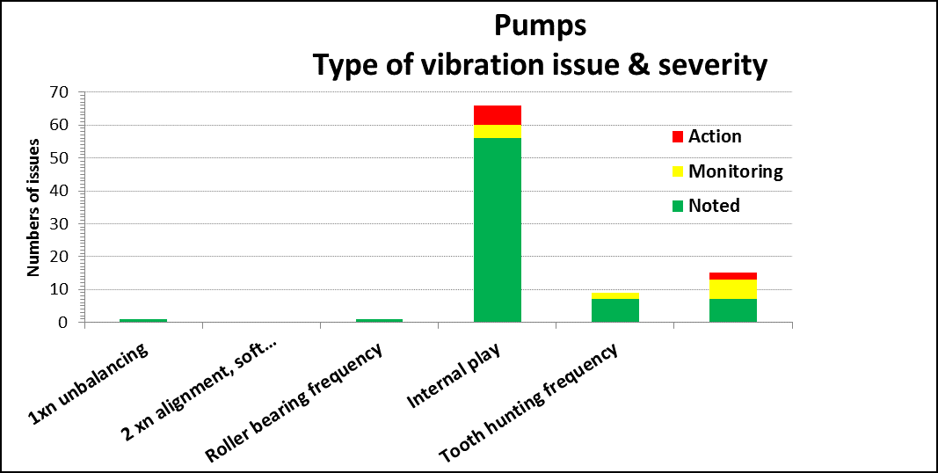
Vibration monitoring : dashboards & statistics

Slide 23
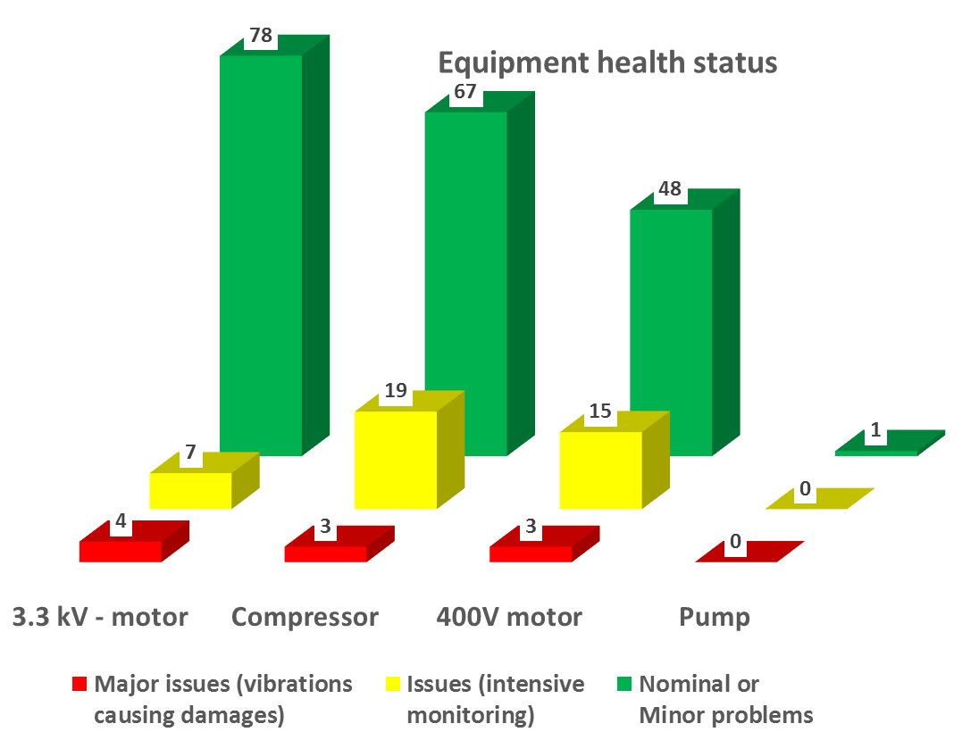
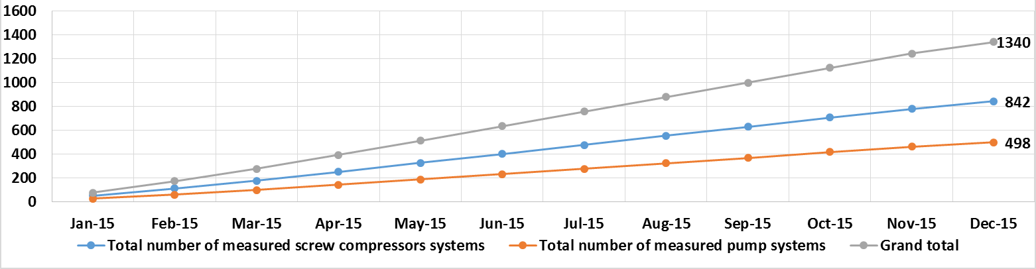
Vibration monitoring : dashboards & statistics

Slide 24
SUMMARY
  Vibration monitoring of rotary machinery is the first brick of the predictive maintenance plan for CERN cryogenic plants
  It is a complementary and an essential tool to cold/hot spares strategy and preventive maintenance : it allows to anticipate issues and program interventions during technical stops, to prioritize the issues, and in case of urgency to switch to a hot spare configuration or to stop before the destruction of the machine
  Vibration monitoring has allowed to revise major overhauling intervals and reduce preventive maintenance costs. Nevertheless major overhauling can not be skipped (slide valves, plain bearing,…)
  Vibration analysis is a powerful tool for the QC. It was shown that it contributes to improve efficiently the maintenance and operation practices
  Vibration monitoring increases the confidence in the equipment health status and increases the availability and reliability of the cryogenic plants
  Next steps :
  Incorporate oil analysis
  Monitoring of plain bearings
  Investigate online monitoring
Thank you for your attention

Slide 25
Additional slides

Slide 26
Example : Rotor bars in motor (QSCA-4-M02, 2015-2016)
Sep/2015: Detection of a problem with rotor bars in motor QSCA-4-M02 (Alert: high vibration due to an asymmetry in the magnetic field)
Mar/2016 : Constant fault threshold
-> Replacement of the motor during the technical stop of May 2016
March 2015 -> March 2016

Slide 27
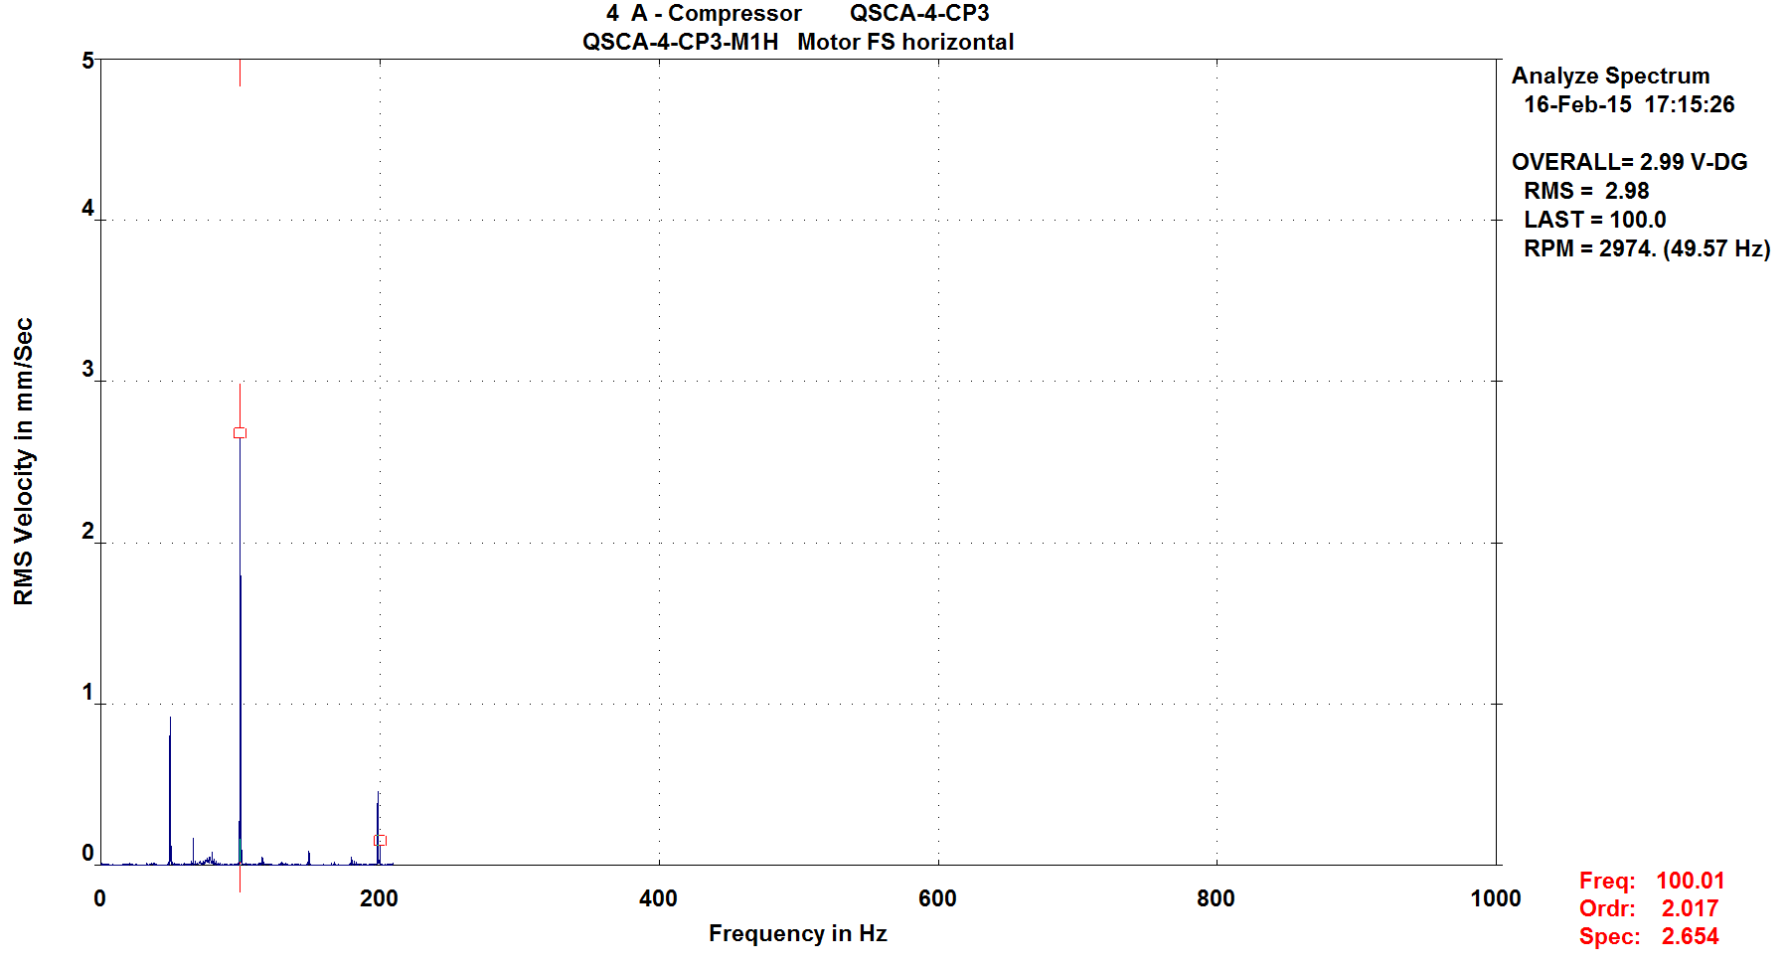
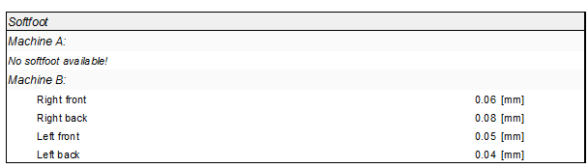
Example : maintenance practice & Quality Control
Alignment issue found on compressor QSCA-2-CP5 (Feb-2016)
Investigations -> alignment during Jan-2016
Thermal growth not taken into account during alignment process
Soft foot issue detected for QSCA-4-CP3 (Feb-2015)
Investigations -> alignment during Jan-2015
In alignment report, one foot was found out of tolerance
After correct alignment, and
thermal growth taken into account
Soft foot issue
Alignment problem
Before alignment
Extract from alignment report in the DB
Vibration analysis contributes valuably and efficiently to QC
Correct alignment improves bearing and seal life, and reliability of the CS
> max 0.06

Slide 28
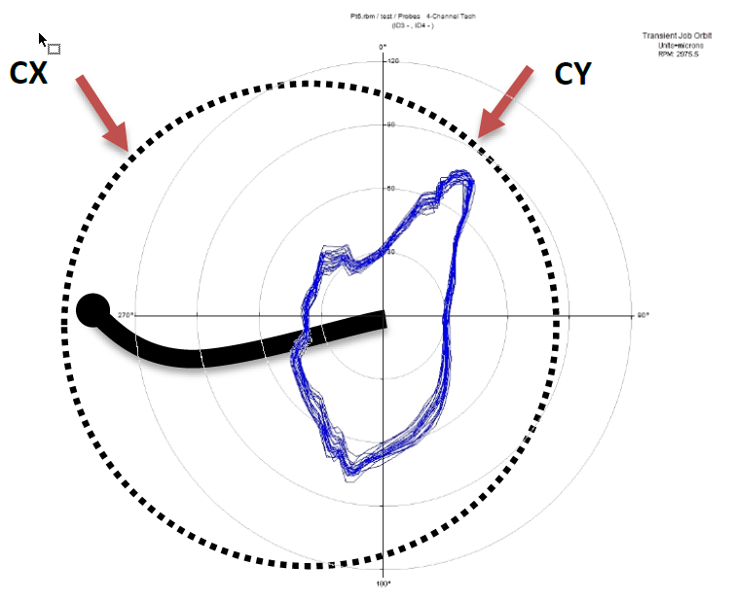
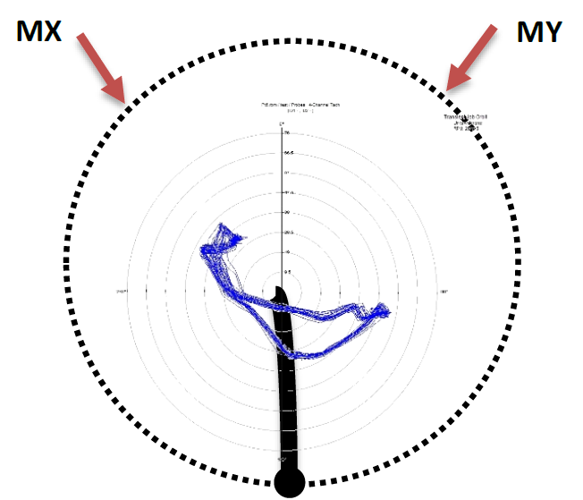
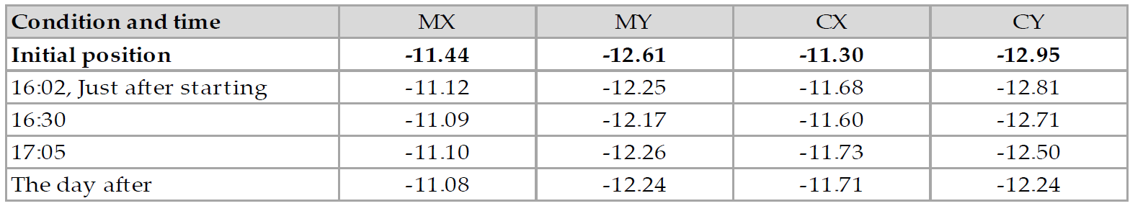
Vibration measurement : displacement probes
Despite big progress with the alignment practice, vibration analysis was continuously reporting an alignment problem for one type of compressor system (Stal S87/S89)
Noncontact displacement sensors were used to measure the displacement and shaft vibration
Results for shaft centerline
and for dynamic measurements
Motor shaft moves ~57 μm up and 4 μm to the left
No influence of the thermal growth
Compressor shaft moves horizontally 110 μm to the right
Big influence of thermal growth : 90 μm
Unfiltered orbit of compressor (green) and motor (blue)
Motor bearing heavily preloaded in MY

Slide 29
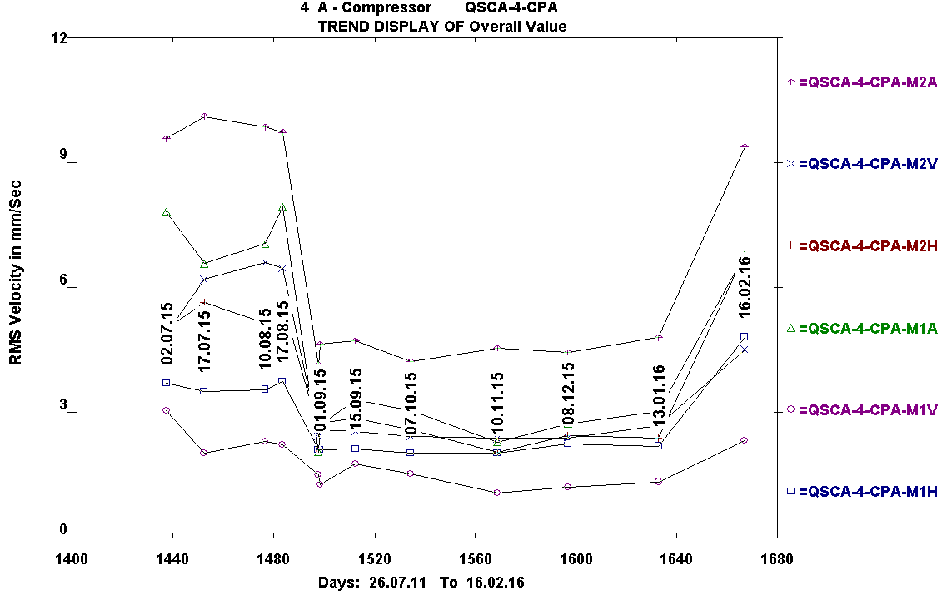
Example : Unbalancing after shaft seal intervention
Balancing issue found on motor QSCA-4-M0A (Feb-2016)
Investigations -> there was an exchange of shaft seal during Jan-2016
Bad remounting of coupling (unsymmetrical mounting of the conical clamping ring)
1xn after shaft seal intervention
1xn before shaft seal intervention
After shaft seal intervention, increase of motor overall values
1xn after re-balancing intervention

Slide 30
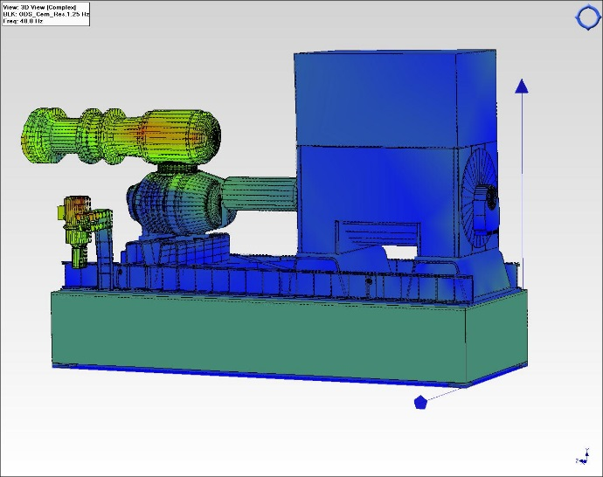
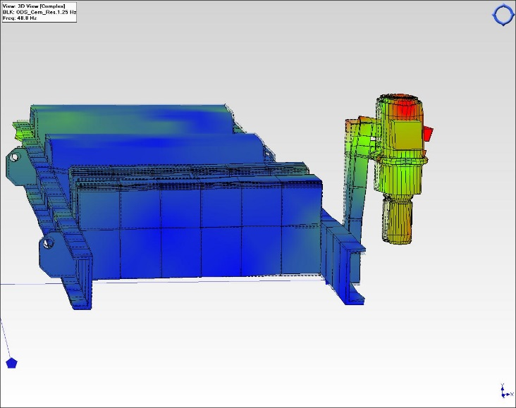
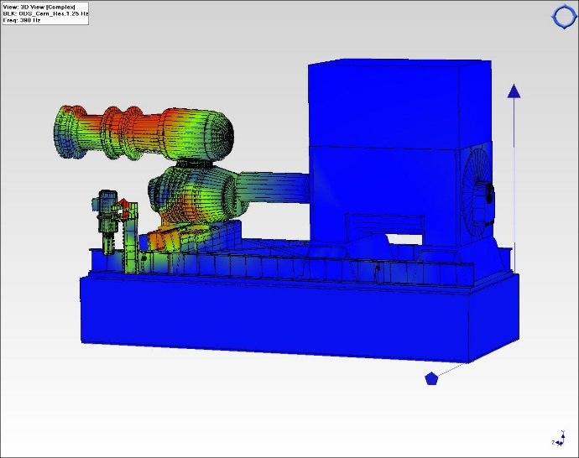
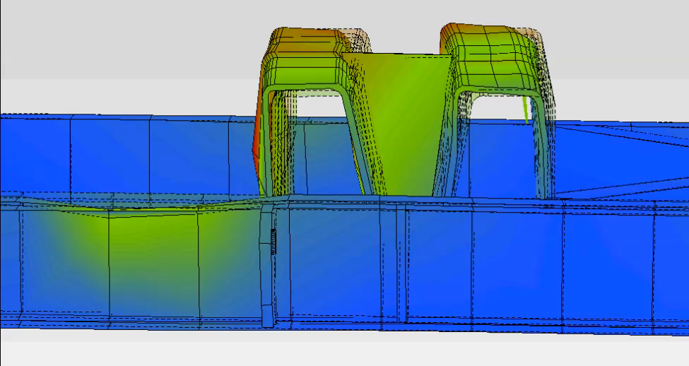
Example of Operation Deflection Shape measurement
A set of high stage compressors (Stal S93) was presenting very high vibration level (global). High sensitivity wrt operation conditions (MP/HP ratio)
Can we improve the system and its dynamic behavior ? -> ODS measurement
Excessive vibration of oil pump and support beam
Outcome:
Oil pump has been installed on a separate frame
Frame and pipework support need to be re-inforced (stiffness & fixations)
Deflection @ 49 hz
Deflection @ 49 Hz – Oil pump
Excessive deformation of the support frame
Deflection @ 398 hz
Deflection @ 199 Hz – frame

Slide 31
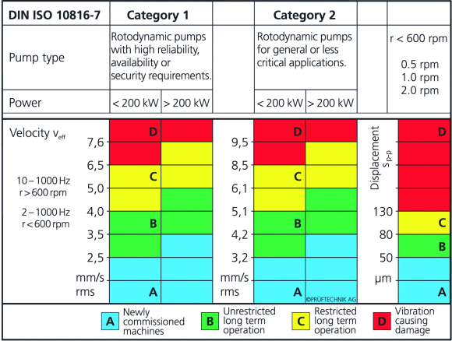
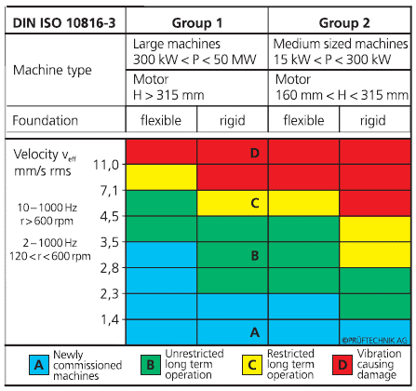
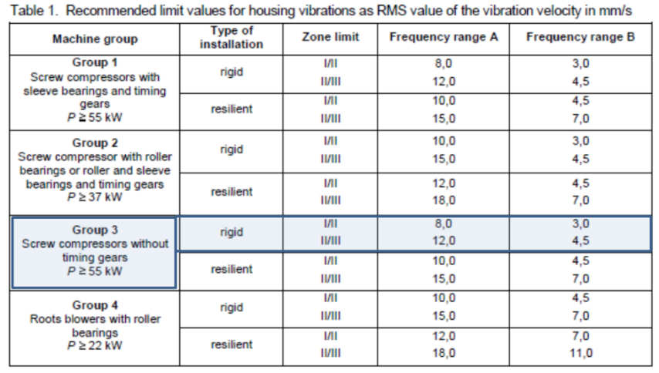
Condition Based Maintenance for CS
  A set of specialized standards is available : ISO, VDI, API
ISO 18816-7 for pump
ISO 18816-3 for electrical motor
VDI 3836 for screw compressor

Slide 32


Vibration analysis
AMS suite – Machinery Health Manager

Slide 33


Preventive maintenance (Cryo-Ops 2014)
Major overhauling periods have been revised according to criticality criteria wrt process, redundancy, cost, available spare, and predictive maintenance plan
Screw compressors major overhauling
Manufacturer | Recommendation | CERN preventive plan
Aerzen | 20'000 h | 40'000 h
Stal | 40'000 h
Kaeser | 40'000 h
Mycom | 20'000 h
Howden | 4 years of operation
Motors major overhauling
Type | Voltage | Power | CERN preventive plan
Ball bearings | 3.3 kV | - | 30'000 h
Journal bearings |  |  | 40'000 h
Ball bearings (oil pumps) | 400 V | > 10 kW | 30'000 h
 |  | ≤ 10 kW | Replacement (new)
Pumps major overhauling
Manufacturer | Recommendation | CERN preventive plan
IMO | 16'000 h | 24'000 h
Stal | 5'000 h | 24'000 h
Desmi | 8'000 h | 8'000 h
Kral | 40'000 h | 40'000 h
Mayekawa | 40'000 h | 40'000 h
Allweiller | 16'000 h | 40'000 h
Leybold | 20'000 h | 40'000 h

Slide 34

Vibrations

Slide 35

Set up of vibration measurements
  Database setup, for every system :
  Inventory of all characteristics to configure the condition monitoring software and its database (kinematic chain, geometry, bearing data, …)
  Monitoring program : selection of all the measurement points and their characteristics (freq. ranges, resolution, …)
  Define and configure routes in the PDC
  Equip each systems with fixed coded
  pins to avoid measurement errors
  Define the alarm thresholds for the various
  faults
  Define the measurement intervals

